Slide 1


Public Health 101 Series
Introduction to Public Health
Surveillance
Instructor name
Title
Organization
Note: This slide set is in the public domain and may be customized as needed by the user for informational or educational purposes. Permission from the Centers for Disease Control and Prevention is not required, but citation of the source is appreciated.
Center for Surveillance, Epidemiology, and Laboratory Services
Division of Scientific Education and Professional Development
Notes:
<WELCOME participants to the Introduction to Public Health Surveillance course and provide your background.>
GO to next slide.

Slide 2
Course Topics
Introduction to Public Health Surveillance
A Public Health Approach
What is Public Health Surveillance?
Public Health Surveillance Role and Uses
Public Health Surveillance Legal Basis
Public Health Surveillance Types and
Attributes
Public Health Surveillance Process
2
Notes:
SAY:
Today we will discuss the basics of surveillance and its role and use in public health. We will review the legal basis, types, attributes, and the process for conducting surveillance. Finally, we will apply what we have learned by examining some cases where surveillance was used to resolve a public health problem.
GO to next slide.

Slide 3
Learning Objectives
By the end of this session, you will be able to
define public health surveillance
describe the goal of public health surveillance
describe the uses of a public health surveillance system
recognize the legal basis for public health surveillance in the United States
compare active and passive public health surveillance
identify sources of data commonly used for public health surveillance
describe the public health surveillance process
Notes:
SAY:
After completing this course, you will be able to
<READ the objectives from the slide.>
GO to next slide.

Slide 4

Topic 1
A Public Health Approach
Notes:
GO to next slide.

Slide 5


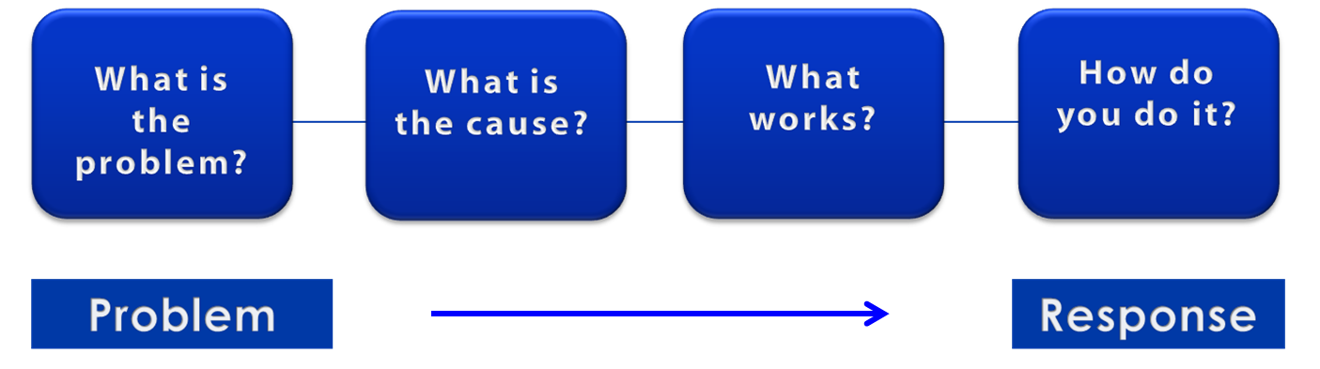
A Public Health Approach
Risk Factor Identification
Intervention
Evaluation
Surveillance
Implementation
5
Notes:
SAY:
Let’s talk about public health in a broader context. Public health problems are diverse and can include infectious diseases, chronic diseases, emergencies, injuries, environmental health problems, as well as other health threats.
Regardless of the topic, we take the same approach to a public health problem by following four general steps.
<CLICK for first arrow to appear.>
First, we ask “What is the problem?”
In public health, we identify the problem by using surveillance systems to monitor health events and behaviors occurring among a population.
After we’ve identified the problem, the next question is, “What is the cause of the problem?”
<CLICK to advance animation; first arrow will disappear, and second arrow will appear above Risk Factor Identification box.>
For example, are there factors that might make certain populations more susceptible to disease, such as something in the environment or certain behaviors that people are practicing?
<CLICK to advance animation; second arrow will disappear, and third arrow will appear above Intervention Evaluation box.>
After we’ve identified the risk factors related to the problem, we ask, “What intervention works to address the problem?”
We look at what has worked in the past in addressing this same problem and if a proposed intervention makes sense with our affected population.
<CLICK to advance animation; third arrow will disappear, and fourth arrow will appear above Implementation box.>
In the last step, we ask, “How can we implement the intervention? Given the resources we have and what we know about the affected population, will this work?”
As we go through this course, you will see different examples of this public health approach at work.
GO to next slide.

Slide 6
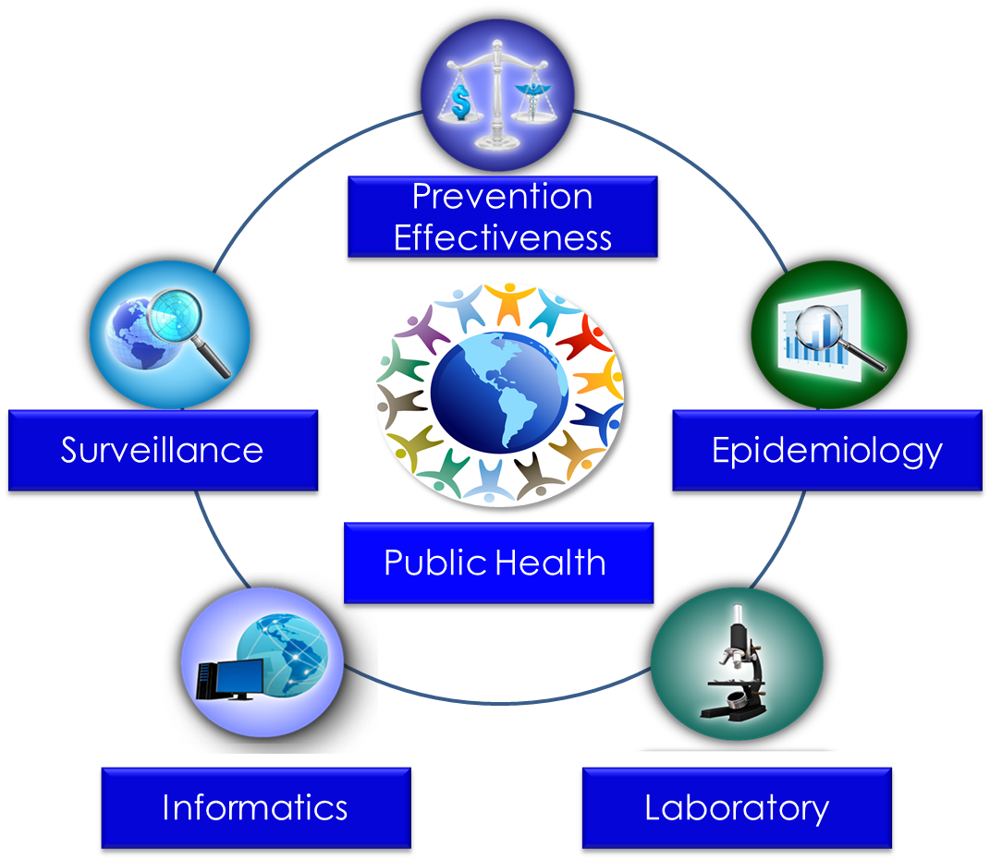
Public Health Core Sciences
Notes:
SAY:
To implement the public health approach, practitioners use and apply scientific methods. These methods come from a series of core sciences that provide the foundation.
These sciences include Public Health Surveillance, which we use to monitor a public health situation.
Epidemiology enables us to determine where diseases originate, how or why they move through populations, and how we can prevent them.
Public Health Laboratories support public health by performing tests to confirm disease diagnoses. Laboratories also support public health by conducting research and training.
As we continue to move from the use of paper documents to electronic health records, Public Health Informatics continues to increase in importance. Informatics deals with the methods for collecting, compiling, and presenting health information. It enables us to use electronic data effectively when addressing a public health situation.
Prevention Effectiveness is closely linked to public health policy. Prevention effectiveness studies provide important economic information for decision makers to help them choose the best option available.
Together, these five core sciences can help us protect and promote the public’s health by giving public health practitioners the answers they need. Public health is better able to respond to the situation by using contributions from each of these sciences. One science alone cannot answer the questions and provide a solution; it is the application of these core sciences together.
<OPTIONAL, IF TIME PERMITS, SAY>
For example, let’s look at the public health challenge of influenza. Public health surveillance can monitor when and where cases of influenza occur each year. Professionals can use the science of epidemiology to understand why different populations choose to get vaccinated against influenza. They can use the science of informatics to receive and analyze electronic information from health care institutions (e.g., doctors’ offices and hospitals) to determine whether persons who get influenza go to see a doctor and whether they get well or die. Public health practitioners can use laboratory science to determine whether persons with fever and cough have influenza or a different infection, and they can use prevention effectiveness to show that influenza vaccination campaigns that might cost $200,000 can prevent $1 million in medical costs, lost wages, and other costs.
GO to next slide.

Slide 7
Topic 2
What is Public Health Surveillance?
7
Notes:
ASK:
When you hear the term public health surveillance, what do you think of? What comes to mind?
<ELICIT responses from the participants.>
GO to next slide.

Slide 8
Public Health Surveillance Defined
The ongoing, systematic collection, analysis, and interpretation of health-related data essential to planning, implementation, and evaluation of public health practice, closely integrated with the timely dissemination of these data to those responsible for prevention and control
Adapted from: Thacker SB, Birkhead GS. Surveillance. In: Gregg, MB, ed. Field epidemiology. Oxford, England: Oxford University Press; 2008.
Notes:
SAY:
The term surveillance comes from a French word meaning “to watch over.”
<READ the definition on the slide.>
GO to next slide.

Slide 9
Public Health Surveillance Keywords
systematic
ongoing
collection
analysis
interpretation
dissemination
health-related data
linked to public health practice
Notes:
SAY:
Let’s break down the definition and examine the key words. Surveillance is
<CLICK for each of the following terms to appear as you say them.>
the systematic,
ongoing,
collection,
analysis,
interpretation, and
dissemination of
health-related data.
It is closely linked to public health practice.
<If time permits, PROVIDE more detail about what is meant by each term.>
GO to next slide.

Slide 10
Goal of Public Health Surveillance
Provide information that can be used for health action by public health personnel, government leaders, and the public to guide public health policy and programs
Smith PF, Hadler JL, Stanbury M, et al. Blueprint version 2.0: updating public health surveillance for the 21st century. J Public Health Manag Pract 2013;19:231–9.
Notes:
SAY:
What is the goal of public health surveillance?
<READ the slide.>
GO to next slide.

Slide 11


Knowledge Check
Public Health Surveillance is the ________, __________ collection, analysis, and interpretation of health-related data.
A. systemic, short-term
B. ongoing, systemic
C. ongoing, systematic
D. methodical, ongoing
Notes:
SAY:
Let’s do a quick knowledge check.
ASK:
What is public health surveillance?
<ELICIT answers from the participants.>
<CLICK for correct answer to appear.>
SAY:
The correct answer is C, the ongoing, systematic collection, analysis, and interpretation of health-related data.
GO to next slide.

Slide 12
Knowledge Check
What is the goal of public health surveillance?
A. To give public health personnel policies to regulate
B. To provide information to be used for public
health action
C. To guide Congress in enacting public health laws
D. To keep the public aware of new diseases
Notes:
<READ the question.>
<ELICIT answers from the participants.>
<CLICK for correct answer to appear.>
SAY:
The correct answer is B, to provide information to be used for public health action.
GO to next slide.

Slide 13
Topic 3
Public Health Surveillance
Role and Uses
13
Notes:
GO to next slide.

Slide 14
  Uses of Public Health Surveillance
Identify patients and their contacts for treatment and intervention
Detect epidemics, health problems, changes in health behaviors
Estimate magnitude and scope of health problems
Measure trends and characterize disease
Monitor changes in infectious and environmental agents
Assess effectiveness of programs and control measures
Develop hypotheses and stimulate research
Notes:
SAY:
Now that we’ve defined public health surveillance, let’s discuss its role and uses in public health.
Here are some specific ways public health surveillance can be used.
<READ the bullets on the slide.>
GO to next slide.

Slide 15
  Public Health Headlines
Whooping Cough Kills Five in California;
State Declares an Epidemic
New CDC Report Shows Adult Obesity Growing or Holding Steady in All States
Increase Seen in Deaths from
Pneumonia and Flu
Number of Rare E. Coli Cases
In U.S. Rose Last Year
Percentage of New Yorkers Lighting Up
is Down to 14%
Notes:
SAY:
Let’s take a look at a few newsworthy headlines that highlight epidemics that have occurred in the past.
<CHOOSE a participant to read the headlines.>
SAY:
How do we know an epidemic is occurring? How do we know the percentage of New Yorkers lighting up is decreasing or that obesity rates might be increasing or holding steady?
<ELICIT answers from the participants.>
SAY:
Public health surveillance provides the answers to questions such as these.
GO to next slide.

Slide 16

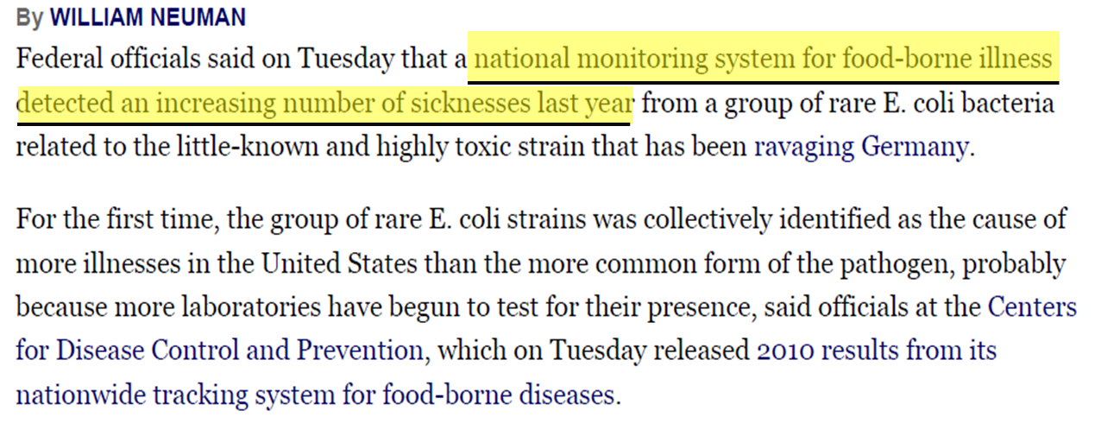
Number of Rare E. Coli Cases
In U.S. Rose Last Year
Neuman W. Number of Rare E. Coli Cases In U.S. Rose Last Year. The New York Times. June 7, 2011. http://www.nytimes.com. Accessed July 8, 2014.
Notes:
SAY:
Now, let’s examine part of the article, “Number of rare E. coli cases in U.S. rose last year.”
Notice that these results came from a national monitoring system for foodborne illness.
ASK:
Which surveillance uses can you link to this article?
<ELICIT answers from the participants.>
Possible Answer
Measure trends in a particular disease.
<Instructor Note: Give additional explanatory notes for each of these answers as was done in the previous slide, if time permits.>
GO to next slide.

Slide 17
Knowledge Check
Identify the surveillance uses that can be linked to
the New York Times E. coli article.
  Measure trends of a particular disease
  Estimate the magnitude of the problem
  Monitor changes in infectious and environmental
  agents
  Assess effectiveness of programs and control
  measures
  All of the above
Notes:
<READ the question.>
<ELICIT answers from the participants.>
<CLICK for correct answer to appear.>
SAY:
The correct answer is E, all of the above.
GO to next slide.

Slide 18

Topic 4
Public Health Surveillance
Legal Basis
18
Notes:
GO to next slide.

Slide 19
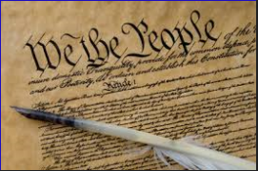

Legal Authority for Conducting
Public Health Surveillance
States have authority based on
the U.S. Constitution
  General welfare clause
  Interstate commerce clause
CDC responds when
  disease or condition has interstate implications
  invited by a state
Notes:
SAY:
We’ve learned about the role and use of surveillance. Now, let’s take a look at its legal basis.
In the previous New York Times article, data related to a person’s illness or behaviors were collected as part of surveillance efforts. You might have asked yourself, “How can public health officials conduct surveillance without a person’s permission?” or “How do public health authorities decide if they have the right to conduct surveillance in a particular circumstance?”
Legal authority for states to conduct public health surveillance is based on the U.S. Constitution in two specific clauses — general welfare and interstate commerce.
The federal government is charged with promoting the general welfare of the people, and it has authority over interstate commerce. CDC can respond when a disease has interstate implications because of the commerce clause. Otherwise, CDC typically must be invited by a state to conduct surveillance or investigations within its borders.
GO to next slide.

Slide 20
State-Based Notifiable Disease
Surveillance Systems
Mandated by state law or regulation
Health care providers, hospitals, and laboratories are required to report cases to the local health department (LHD)
The LHD is usually responsible for case investigation and action
The LHD forwards the disease report to the state health department
The state health department assists the LHD as needed
Notes:
SAY:
State-based notifiable disease surveillance systems, also called reportable disease systems, are mandated by law or regulation and specify not only who must report, but also the list of diseases to report, how to report, and when.
In certain states, laws or regulations also allow the state health officer to mandate reporting of specific diseases or conditions.
Most commonly, physicians, laboratories, hospitals, clinics, and in certain instances, school nurses and public health professionals are required to report cases to the local health department. The local health department is usually responsible for the case investigation and any resulting actions.
After the local health department receives a report and, in many cases, verifies that it meets the case definition, they then send the report to the state health department. The state health department can also assist the local health department as needed.
GO to next slide.

Slide 21
Knowledge Check
The purpose and legal basis for public health surveillance is granted by which U.S. document?
  Bill of Rights
  Declaration of Independence
  U.S. Constitution
  1812 Treaty of Public Health
Notes:
<READ the question.>
<ELICIT answers from the participants.>
<CLICK for correct answer to appear.>
SAY:
The correct answer is C, the U.S. Constitution.
GO to next slide.

Slide 22
Knowledge Check
CDC must be invited by a state before conducting public health surveillance.
  True
  False
Notes:
<READ the question.>
<ELICIT answers from the participants.>
<CLICK for correct answer to appear.>
The correct answer is A, true.
GO to next slide.

Slide 23
Topic 5
Public Health Surveillance
Types and Attributes
23
Notes:
GO to next slide.

Slide 24
Types of Public Health Surveillance
Passive Surveillance
Active Surveillance
Diseases are reported
by health care providers
Simple and inexpensive
Limited by incompleteness
of reporting and variability
of quality
Health agencies contact health providers seeking reports
Ensures more complete reporting of conditions
Used in conjunction
with specific epidemiologic investigation
Notes:
SAY:
Let’s look at the two primary types of public health surveillance, passive and active.
Most routine notifiable disease surveillance relies on passive reporting. In passive surveillance, the physician, laboratory, or other health care provider (i.e., the reporter) takes the initiative in submitting the report by following the list of reportable diseases in that state; the health department or health agency waits for reports to be submitted by others. This is the most common type of surveillance; it is simple and inexpensive, but it is also limited by variability of quality and incompleteness in reporting.
Active systems involve regular outreach to potential reporters to stimulate the reporting of specific diseases or injuries. Active surveillance can validate the representativeness of passive reports, ensure more complete reporting of conditions, or be used in conjunction with specific epidemiologic investigations. Active systems are often used for brief periods for discrete purposes, such as during outbreak investigations, or special time-limited events, or for diseases of special interest (e.g., SARS).
GO to next slide.

Slide 25
Other Types of Public Health Surveillance
Sentinel Surveillance
  Reporting of health events by health professionals who are selected to represent a geographic area or a specific reporting group
  Can be active or passive
Syndromic Surveillance
  Focuses on one or more symptoms rather than a physician-diagnosed or laboratory-confirmed disease
Notes:
SAY:
Another type of surveillance is sentinel surveillance.
<READ the definition of Sentinel Surveillance.>
SAY:
Syndromic surveillance focuses on the signs and symptoms of an illness rather than physician-diagnosed or laboratory-confirmed illnesses. The case definition for a syndrome is never as specific as for a disease. Therefore, follow-up is always necessary to verify if an outbreak is actually occurring. Syndromic surveillance is the preferred method for bioterrorism. An advantage of this method is that reporting does not need to wait for a diagnosis to be made, which can add time and delay the reporting process. Because of this time-saving aspect, syndromic surveillance has been used as a method of early detection to improve situational awareness, especially in the context of bioterrorism. The term syndromic surveillance has also been loosely applied to surveillance of school and work absenteeism, calls to 9-1-1, and over-the-counter medications, where for example, a sharp increase in sales of antidiarrheal medications in a community can indicate an outbreak of gastroenteritis.
GO to next slide.

Slide 26
Surveillance System Attributes
Attribute | Question It Answers
Usefulness | How useful is the system in accomplishing its objectives?
Data quality | How reliable are the available data? How complete and accurate are data fields in the reports received by the system?
Timeliness | How quickly are reports received?
Flexibility | How quickly can the system adapt to changes?
Simplicity | How easy is the system’s operation?
Notes:
SAY:
Ten key attributes should be considered when determining if a surveillance system will be effective. This slide depicts the first five attributes of an effective surveillance system.
The first attribute to consider is usefulness. How useful is the system in accomplishing its objectives?
Data quality examines how reliable the data are. How complete and accurate are the data fields in the reports received by the system?
The next attribute is timeliness. How quickly are reports received? Timeliness might be important for certain conditions, but less important for others. You might need to report one disease immediately to implement contact-avoidance and prevention measures. With other conditions, such as obesity, a longer delay in reporting is acceptable.
Flexibility considers how quickly the system can adapt to changes.
And
Simplicity considers whether the system is easy to operate.
GO to next slide.

Slide 27
Surveillance System Attributes
Attribute | Question It Answers
Stability | Does the surveillance system work well? Does it break down often?
Sensitivity | How well does it capture the intended cases?
Predictive value positive | How many of the reported cases meet the case definition?
Representativeness | How good is the system at representing the population under surveillance?
Acceptability | How easy is the system’s operation?
Notes:
SAY:
Stability is the next attribute. Does the surveillance system work well, or does it break down often?
Sensitivity considers how well the system captures the intended cases. Does it capture 60% of the cases or 80%? If you have a system that only captures 60% but 80% is needed, it might not be effective enough for that condition or situation.
The next attribute is predictive value positive. How many of the reported cases are true cases that meet the criteria for what we are calling a case — that is, how many reported cases actually meet the case definition?
Representativeness considers how well the system represents the population under consideration. Does it identify events only among certain groups, or does it accurately capture events across the whole target population?
The final attribute is acceptability. How willing are the system users to actively participate in the surveillance efforts and to report their data?
Under real-world conditions, we need to balance the attributes of the surveillance system to accomplish the objectives. For example, sensitivity and predictive value positive typically have an inverse association. The more sensitive the system, the lower your predictive value positive. Therefore, you might have to decide whether you rather have a more sensitive system or a higher predictive value positive to accomplish your goal.
GO to next slide.

Slide 28
Knowledge Check
The New York State Department of Health contacts the health providers in District A every Friday to obtain the number of patients examined with Influenza. What type of surveillance is this?
  Passive
  Active
Notes:
<READ the question.>
<ELICIT answers from the participants.>
<CLICK for correct answer to appear.>
SAY:
The correct answer is B, active.
GO to next slide.

Slide 29
Topic 6
Public Health Surveillance Process
29
Notes:
SAY:
Many other decisions have to be made after you decide to place an illness or injury under public health surveillance, including decisions about collection, analysis, interpretation, dissemination, and action, all of which require long-term planning.
Next, we will discuss each one.
GO to next slide.

Slide 30
Surveillance Process
Data Collection
Before collecting data, decide
on the overarching goal
of the system
Data Analysis
Data Interpretation
Data Dissemination
Link to Action
Notes:
SAY:
Five steps must be completed during the decision-making process, including data collection, analysis, interpretation, dissemination, and follow-up action.
Let’s begin by looking at data collection. Before collecting data, you must decide what the overarching goal of the system is and what specific objectives might be required for meeting that goal.
Possible questions to ask might include,
What will we monitor?
Who will collect the data, and how will it be collected?
Who is the target population?
Where do we implement the system?
Will the system be active or passive?
How will the data be transmitted to the person performing the analysis?
GO to next slide.

Slide 31
Data Sources for Public Health Surveillance
Reported diseases or syndromes
Electronic health records (e.g., hospital discharge data)
Vital records (e.g., birth and death certificates)
Registries (e.g., cancer, immunization)
Surveys (e.g., National Health and Nutrition Examination Survey [NHANES])
Notes:
SAY:
Surveillance relies on a variety of data sources to monitor different conditions and situations. You might already be familiar with some of the data sources listed on the slide. What are some other data sources used in public health surveillance?
Possible Answers
Administrative data systems (e.g., billing records)
Laboratory surveillance (e.g., PulseNet)
Environmental, vector, or animal surveillance (e.g., mosquito trapping for West Nile virus)
Other (e.g., pharmacy, laws and policies, or 9-1-1 calls)
GO to next slide.

Slide 32
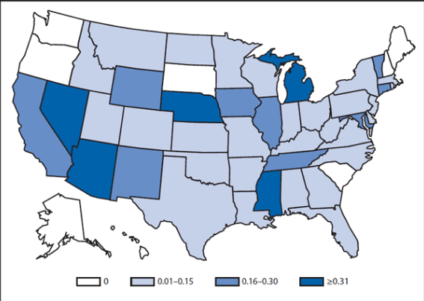
Nationally Notifiable Disease
Surveillance System (NNDSS)
Many diseases on a state list are also nationally
notifiable
Notes:
SAY:
The nationally notifiable disease surveillance system is a collaboration between CDC and the Council of State and Territorial Epidemiologists, or CSTE. Many of the diseases on a state list are also nationally notifiable, but the reporting by the state is voluntary.
Each state determines which diseases and conditions are reportable in their jurisdiction, and they decide which ones from the list of nationally notifiable diseases or conditions they will report for their state. CDC and CSTE collaborate closely on the national list. It is revised yearly and therefore varies somewhat from year to year. States typically fully cooperate with national disease reporting because CDC publishes the provisional data weekly in the Morbidity and Mortality Weekly Report, or MMWR, and the final data annually in the MMWR Annual Summary of Notifiable Diseases. MMWR displays the data in complex tables and in maps, such as the one displayed on this slide. This allows each state to know how their population’s health compares with other states.
<DISTRIBUTE Georgia’s notifiable disease reporting list.>
ASK:
What do you notice on this form?
<ELICIT answers from the participants.>
SAY:
You might have noted four items on this form.
1. Most of the conditions are infectious conditions. These are diseases that are passed from person to person or from animal or insect to person.
2. Georgia has four different reporting timeframes: immediately, 7 days, 1 month, and 6 months.
<CITE two examples from each timeframe.>
3. Who is required to report is specified. This is in the top block <INDICATE> and includes physicians, laboratories, or other health care providers.
4. The fourth and final item you might have noticed is that the form states that any “cluster of illnesses” is to be reported. In Georgia, the state health department then determines if that cluster is unusual. Health departments want to know about disease clusters. For example, before 1999, West Nile virus had not occurred in the U.S. Therefore, in 1998, West Nile virus was not on Georgia’s list. Health departments have been able to capture new or reemerging diseases when clusters are reported, as was the case with West Nile virus.
GO to next slide.

Slide 33

Internationally Notifiable Diseases
Reporting to WHO is required for cases of
Smallpox
Poliomyelitis (wild type)
Human influenza caused by any new subtype
Severe acute respiratory syndrome (SARS)
Notes:
SAY:
The World Health Organization, or W-H-O, is a United Nations agency that coordinates international health activities and helps governments improve health services.
Reporting to WHO is required for
smallpox,
poliomyelitis, or polio, (wild type)
human influenza (flu) caused by any new subtype, and
severe acute respiratory syndrome, or SARS.
GO to next slide.

Slide 34
Surveillance Data Analysis
Data Collection
  Who will analyze the data?
  What methodology will they use?
  How often will they analyze the data?
Data Analysis
Data Interpretation
Data Dissemination
Link to Action
Notes:
SAY:
Next we will look at the data analysis step.
During this step, we must determine
Who will analyze the data?
What methodology will they use?
and
How often will the data be analyzed? Daily, weekly, monthly, or some other timeframe?
Surveillance data analysis usually includes descriptive information consisting of time, place, and person. However, other analytic methods are often used.
Let’s look at a few examples.
GO to next slide.

Slide 35
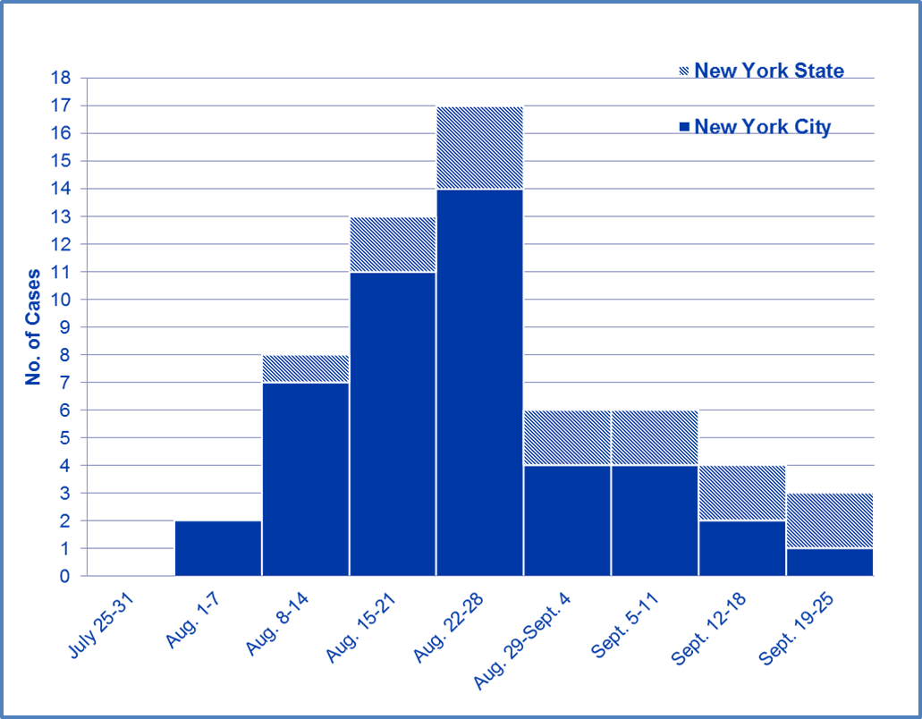
Patients Hospitalized with West Nile
Virus Infection, by Week, New York, 1999
Week of illness onset
  Nash D, Mostashari F, Fine A, et al. Outbreak of West Nile virus infection in the New York City area in 1999.
  N Engl J Med. 2001;344:1807–14.
Notes:
SAY:
Analysis by time can be by the minute, days, months, years, or other specific ranges of time. This graph demonstrates an example of data analysis by week for West Nile virus infection in New York State and New York City.
ASK:
When was the peak?
Where were the majority of cases occurring, the state or the city?
<ELICIT answers from the participants.>
SAY:
Hospitalizations peaked during August 22–28.
<CLICK to advance animation. Yellow bar for week of August 22–28 will appear.>
The numbers held steady for the next 2 weeks, then began to decline in New York City but remained steady in New York State, as indicated by the striped blocks.
<CLICK to advance animation. Yellow bar will appear on the 2-week data for New York State.>
The majority of the cases overall are occurring in New York City, as indicated by the solid blocks.
GO to next slide.

Slide 36
Surveillance Data Analysis by Place
Laboratory-Confirmed WNV Human Cases — August–September 1999
Map Courtesy of the New York City Department of Health and Mental Hygiene
Notes:
SAY:
Data analysis by place is the usual method used to examine reports either by where the case was reported or, ideally, by where the illnesses occurred. Data analysis by location allows prevention resources to be directed to where the exposure occurred.
This map is an example of laboratory-confirmed West Nile virus cases among humans for August and September 1999, when the virus first emerged in the New York City area. Each red dot represents a human case.
ASK:
What patterns can you see on this chart?
<ELICIT answers from the participants.>
SAY:
Cases are scattered throughout the area, but a cluster of cases is located in the North Queens area, as indicated by the arrow.
GO to next slide.

Slide 37
Data Analysis by Person
Do you notice any patterns in the rates?
Demographics for Persons Hospitalized for WNV and Population Rates of Infection
Characteristic | No. of Patients (%) | Population at Risk | Rate of Infection per Million Population
Age (years)
0–19 | 2 (3) | 2,324,081 | 0.9
20–29 | 1 (2) | 1,553,981 | 0.6
30–39 | 3 (5) | 1,549,111 | 1.9
40–49 | 1 (2) | 1,177,190 | 0.8
50–59 | 9 (15) | 867,331 | 10.4
60–69 | 12 (22) | 814,838 | 16.0
70–79 | 18 (31) | 534,785 | 33.7
≥80 | 12 (20) | 281,054 | 42.7
Age category (years)
≥50 | 52 (88) | 2,498,008 | 20.8
<50 | 7 (12) | 6,604,363 | 1.1
Sex
Male | 31 (53) | 4,289,988 | 7.2
Female | 28 (47) | 4,812,383 | 5.8
Race
White | 41 (69) | 5,983,901 | 6.9
Nonwhite | 9 (15) | 3,118,470 | 2.9
Unknown | 9 (15) | -- | --
Borough or county of residence
New York City
Brooklyn (Kings) | 3 (5) | 2,300,664 | 1.3
Bronx | 9 (15) | 1,203,789 | 7.5
Manhattan | 1 (2) | 1,487,536 | 0.7
Queens | 32 (54) | 1,951,599 | 16.4
Staten Island (Richmond) | 0 | 379,999 | 0.0
New York State
Nassau | 6 (10) | 1,287,348 | 4.7
Westchester | 8 (14) | 847,866 | 9.1
Nash D, Mostashari F, Fine A, et al. Outbreak of West Nile virus infection in the New York City area in 1999. N Engl J Med. 2001;344:1807–14.
Notes:
<Instructor Note: Walk the participants through the table columns and rows to orient them to the data.>
SAY:
Here is an example of data analysis by person. This table displays the demographics for persons hospitalized for West Nile virus and the population rates of infection for a selected period.
ASK:
What patterns within the rates, if any, do you notice?
<ELICIT responses from the participants.>
<CLICK to advance animation.>
SAY:
You can see that those persons aged 70 years and older have the highest rates of infection.
<CLICK to advance animation.>
You can also see that the cases among males and females were approximately equal, 31 versus 28. However, the rate of infection is slightly higher among males than among females, 7.2 per million versus 5.8 per million.
GO to next slide.

Slide 38
Surveillance Data Interpretation
Data
Collection
Data interpretation is closely coupled with data analysis
Data Analysis
Data
Interpretation
Data
Dissemination
Link to Action
Notes:
SAY:
The next step in the surveillance process is data interpretation, which is closely coupled with data analysis. By identifying the person, place, and time, you can more easily determine how and why the health event happened.
GO to next slide.

Slide 39
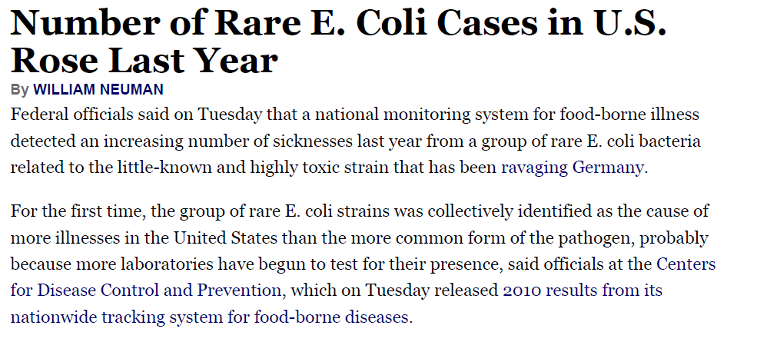
What Can Account for an
Apparent Increase in Cases?
Number of Rare E. Coli Cases
In U.S. Rose Last Year
Neuman, W. Rare E. Coli Cases Rose In the U.S. Last Year. New York Times June 7, 2011. http://www.nytimes.com. Accessed July 9, 2014.
Notes:
SAY:
Suppose that your analysis identifies an apparent increase in reported cases of a disease under surveillance.
ASK:
What can account for an apparent increase in cases of a particular disease or condition?
<ELICIT answers from the participants.>
SAY:
Possible reasons include
increased access to health care,
a change in reporting procedures or surveillance system, or
a change in case definition.
But the reason why the number of sicknesses increased last year from the previous year in this scenario is because more laboratories have begun to test for the presence of E. coli.
GO to next slide.

Slide 40
Data Dissemination
Data Collection
Health agency newsletters, bulletins, or alerts
Surveillance summaries and reports
Medical and epidemiologic journal articles
Press releases and social media
Data Analysis
Data Interpretation
Data Dissemination
Link to Action
Notes:
SAY:
Data dissemination describes how to distribute information to those who need to know.
Methods of distribution include
health agency newsletters, bulletins, or alerts;
surveillance summaries and reports;
medical and epidemiologic journal articles; and
press releases and social media.
Let’s look at the target audience for each of these dissemination methods.
GO to next slide.

Slide 41
Data Dissemination Target Audiences
Public health practitioners
Clinicians and other health care providers
Policy and other decision makers
Community organizations
The general public
Notes:
SAY:
Target audiences can include
public health practitioners,
clinicians and other health care providers,
policy and other decision makers,
community organizations, and
the general public.
Providing feedback to those who report the data is crucial because it improves the acceptability of the surveillance system, and data reporters are more likely to cooperate if they know their efforts are being tabulated, analyzed, and used.
GO to next slide.

Slide 42
Surveillance Link to Action
Data Collection
Public health surveillance should always have a
link to action
Data Analysis
Data
Interpretation
Data
Dissemination
Link to Action
Notes:
SAY:
Link to action is the final and a required step in the public health surveillance process because, without action, the collected data serve no real purpose.
GO to next slide.

Slide 43
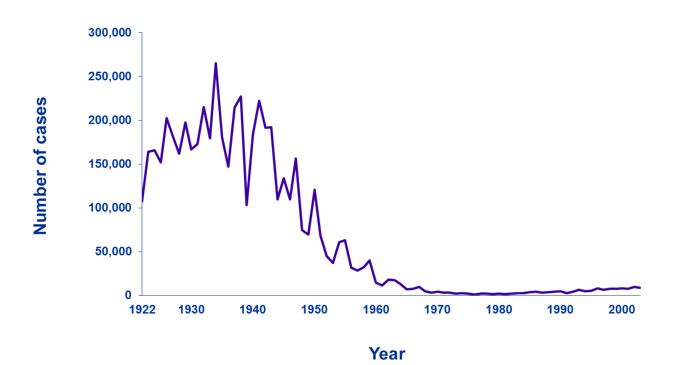
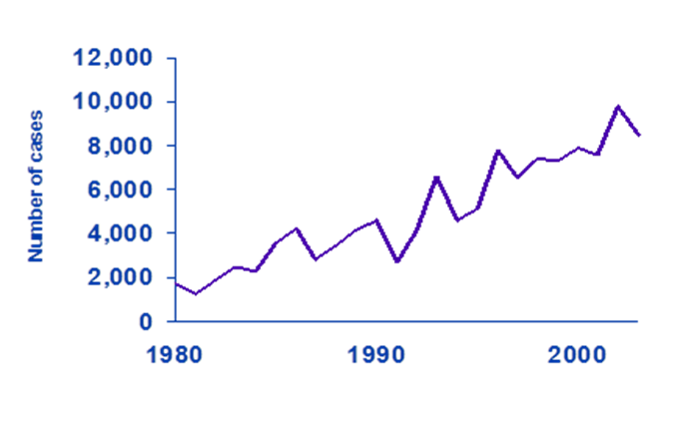
Link to Action
Monitor trends and patterns in disease, risk factors, and agents
Pertussis (Whooping Cough) Cases, by Year — United States, 1922–2000
Source: Centers for Disease Control and Prevention (CDC). National Notifiable Diseases Surveillance System and Supplemental Pertussis Surveillance System and 1922-1949, passive reports to the US Public Health Service. Atlanta, GA: US Department of Health and Human Services, CDC. Available at: http://www.cdc.gov/pertussis/images/incidence-graph.jpg.
Notes:
SAY:
This graph displays the number of cases of pertussis, or whooping cough, in the U.S. from 1922 through 2000.
ASK:
What do you see?
<ELICIT answers from the participants.>
SAY:
The rate has declined substantially over time.
Let’s look at the years 1980 through 2000.
<CLICK for box to highlight years 1980–2000.>
<ELICIT answers from the participants.>
SAY:
Let’s look closer.
<CLICK to advance animation; secondary graph will appear.>
SAY:
The inset graph clearly indicates that pertussis is actually on the increase again.
ASK:
What action would you take on the basis of this information?
<ELICIT answers from the participants.>
SAY:
The investigation revealed that weakening immunity to pertussis after primary vaccination was part of the reason for the increase. Consequently, new vaccination recommendations stated that adults should receive a booster vaccination.
GO to next slide.

Slide 44
Knowledge Check
Choose the option that is NOT a part of the public health surveillance process.
  Data dissemination
  Data storage
  Link to action
  Data collection
Notes:
<READ the question.>
<ELICIT answers from the participants.>
<CLICK for correct answer to appear.>
SAY:
The correct answer is B, data storage.
GO to next slide.

Slide 45
Knowledge Check
In data interpretation, by identifying the ___________,
________, and _____________, you can more easily determine how and why the health event occurred.
  disease, risk, occurrence
  person, protocol, risk
  person, place, time
  risk, protocol, disease
Notes:
<READ the question.>
<ELICIT answers from the participants.>
<CLICK for correct answer to appear.>
SAY:
The correct answer is C, person, place, time.
GO to next slide.

Slide 46
Knowledge Check
Choose the option that is NOT a source of data used for public health surveillance.
  Administrative data systems
  Vital records
  Newspaper articles
  Disease notifications
Notes:
<READ the question.>
<ELICIT answers from the participants.>
<CLICK for correct answer to appear.>
SAY:
The correct answer is C, newspaper articles.
GO to next slide.

Slide 47
Public Health Surveillance-Based Action
Describe the burden of or potential for disease
Monitor trends and patterns in disease, risk factors, and agents
Detect sudden changes in disease occurrence and distribution
Provide data for programs, policies, and priorities
Evaluate prevention and control efforts
Notes:
SAY:
Finally, let’s identify the steps of surveillance-based action.
Public health surveillance-based action includes the following five steps:
Describe the burden of or potential for disease;
Monitor trends and patterns in disease, risk factors, and agents;
Detect sudden changes in disease occurrence and distribution;
Provide data for programs, policies, and priorities; and
Evaluate prevention and control efforts.
<IF TIME PERMITS, bonus slides are available at the end of the module. Ask participants for input as to which example of surveillance-based action they would like to see Describe, Monitor, Detect, Provide, or Evaluate, then choose the appropriate slide to show as an example.>
GO to next slide.

Slide 48
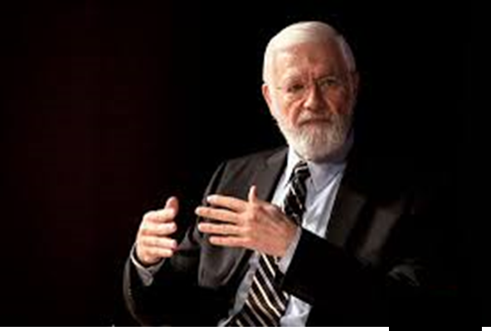
“The reason for collecting, analyzing, and disseminating information on a disease is to control that disease. Collection and analysis should not be allowed to consume resources if action does not follow.”
—William Foege, 1976
Photo: Kay Hinton, Emory University
Foege WH, Hogan RC, Newton LH. Surveillance projects for selected diseases. Int J Epidemiol 1976;5:29–37.
Notes:
SAY:
In the words of Bill Foege, former CDC Director and a person who played a substantial role in the global smallpox eradication,
<READ the quotation on the slide.>
GO to next slide.

Slide 49
Course Summary
During this session, you learned to
define public health surveillance
describe the goal of public health surveillance
describe the uses of public health surveillance system
recognize the legal basis for public health surveillance
in the United States
compare active and passive public health surveillance
identify sources of data commonly used for public health surveillance
describe the public health surveillance process
Notes:
SAY:
During this session, you learned to
<READ the objectives from the slide.>
GO to next slide.

Slide 50
QUESTIONS?
Notes:
GO to next slide.

Slide 51
Resources and Additional Reading
Smith PF, Hadler JL, Stanbury M, et al. Blueprint version 2.0: updating public health surveillance for the 21st century. J Public Health Manag Pract 2013;19:231–9.
Centers for Disease Control and Prevention. CDC’s vision for public health surveillance in the 21st century. Morb Mortal Wkly Rep 2012;61(Suppl, July 27, 2012):1–40.
Centers for Disease Control and Prevention (CDC). Principles of epidemiology in public health practice [Self-Study Course]. 3rd ed. Atlanta, GA: US Department of Health and Human Services, CDC; 2006. http://www.cdc.gov/osels/scientific_edu/ss1978/SS1978.pdf.
Lee LM, Teutsch SM, Thacker SB, St. Louis M, Eds. Principles and practice of public health surveillance. 3rd ed. Oxford, England: Oxford University Press; 2010.
Thacker SB, Birkhead GS. Surveillance. In: Gregg, MB, ed. Field epidemiology. Oxford, England: Oxford University Press; 2008.
Langmuir AD. The surveillance of communicable diseases of national importance. New Engl J Med 1963;258:182–92.
Foege WH, Hogan RC, Newton LH. Surveillance projects for selected diseases. Int J Epidemiol 1976;5:29–37.
Notes:
SAY:
The information from today’s class is based on these resources; I encourage you to take a look at them.
GO to next slide.

Slide 52
Resources and Additional Reading
Centers for Disease Control and Prevention. Updated guidelines for evaluating public health surveillance systems: recommendations from the Guidelines Working Group. MMWR Recommend Rep 2001;50(No. RR-13).
Centers for Disease Control and Prevention (CDC). Surveillance resource center. Atlanta, GA: US Department of Health and Human Services, CDC; 2013. http://www.cdc.gov/surveillancepractice/.
Nash D, Mostashari F, Fine A, et al. Outbreak of West Nile virus infection in the New York City area in 1999. N Engl J Med. 2001;344:1807–14.
Török TJ, Tauxe RV, Wise RP, et al. A large community outbreak of salmonellosis caused by intentional contamination of restaurant salad bars. JAMA 1997;278:389–95.
Kim M, Berger D, Matte T. Diabetes in New York City: public health burden and disparities. New York: New York City Department of Health and Mental Hygiene; 2006. http://www.nyc.gov/html/doh/downloads/pdf/epi/diabetes_chart_book.pdf.
Swerdlow DL, Woodruff BA, Brady RC, et al. A waterborne outbreak in Missouri of Escherichia coli O157:H7 associated with bloody diarrhea and death. Ann Intern Med 1992;117:812–9.
Notes:
GO to next slide.

Slide 53
BONUS SLIDES
Notes:
<Instructor Note>
The following are bonus slides. You should solicit class input as to which example of surveillance-based action they want to see (Describe, Detect, Provide, or Evaluate).
Choose the appropriate slide to show as an example.
GO to next slide.

Slide 54
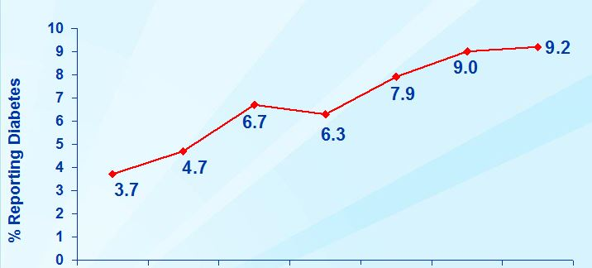
Link to Action
Provide data for programs, policies, and priorities
% Reporting diabetes
1994–95
1996–97
1998–99
2000–01
2002
2003
2004
Year
Kim M, Berger D, Matte T. Diabetes in New York City: public health burden and disparities. New York: New York City Department of
Health and Mental Hygiene; 2006. http://www.nyc.gov/html/doh/downloads/pdf/epi/diabetes_chart_book.pdf.
Notes:
SAY:
This graph depicts adults with self-reported diabetes in New York City from 1994 through 2004.
ASK:
What can you infer about diabetes from this graph?
<ELICIT answers from the participants.>
SAY:
Diabetes has been increasing steadily. In fact, prevalence — the percentage of adults reporting diabetes — increased more than 250% from 1994 through 2004.
The link to action was as follows:
In 2005, the New York City Department of Health Commissioner proposed that all clinical laboratories be required to submit electronic reports, with identifiers of the patient and doctor and specific blood test values to the city health department. In other words, they added diabetes to the New York City Department of Health notifiable disease list required of laboratories. The health department then used this information to monitor patterns and trends, direct diabetes control resources, and provide feedback to physicians about their patients.
The New York City Board of Health adopted the requirement, creating the first population-based registry of diabetes in the nation.
In June 2012, on the basis of surveillance data documenting continued increases in obesity and diabetes among city residents, the mayor proposed a ban on supersized sodas and sugary drinks, which are major contributors to obesity and diabetes.
GO to next slide.

Slide 55
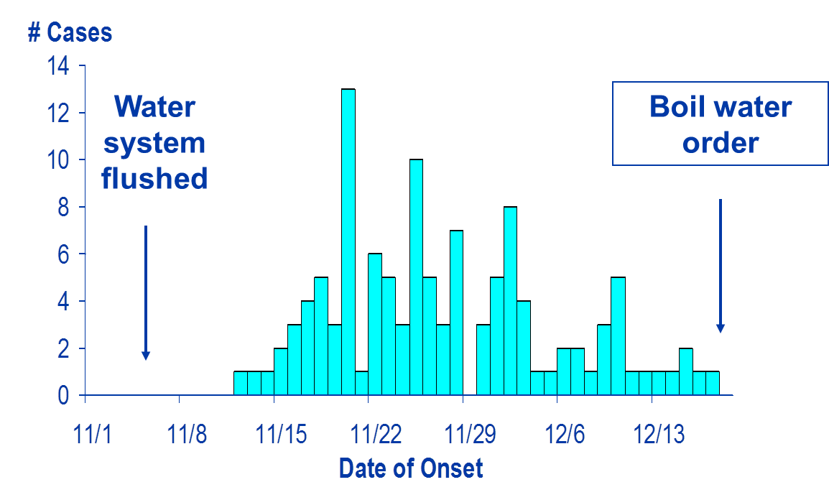
Link to Action
Evaluate prevention and control efforts
Boil-water
order
Water
system flushed
No. of cases
Date of onset
Swerdlow DL, Woodruff BA, Brady RC, et al. A waterborne outbreak in Missouri of Escherichia coli O157:H7 associated with bloody
diarrhea and death. Ann Intern Med 1992;117:812–9.
Notes:
SAY:
This is an epidemic curve of diarrheal illness in Missouri. An outbreak occurred just before November 15, after the water system was flushed during the first week of November. The action in this outbreak was a boil-water order issued by the health department on December 18.
Continued surveillance was required to determine if the intervention was effective. However, cases continued despite the boil-water order. The health department further investigated and determined that residents were forgetting to boil their water. They either did not believe that the water needed to be boiled, nor did they realize that ice should be made using boiled water. Consequently, the public health officials concluded that the boil-water order was not enough to stop the outbreak.
GO to next slide.

Slide 56
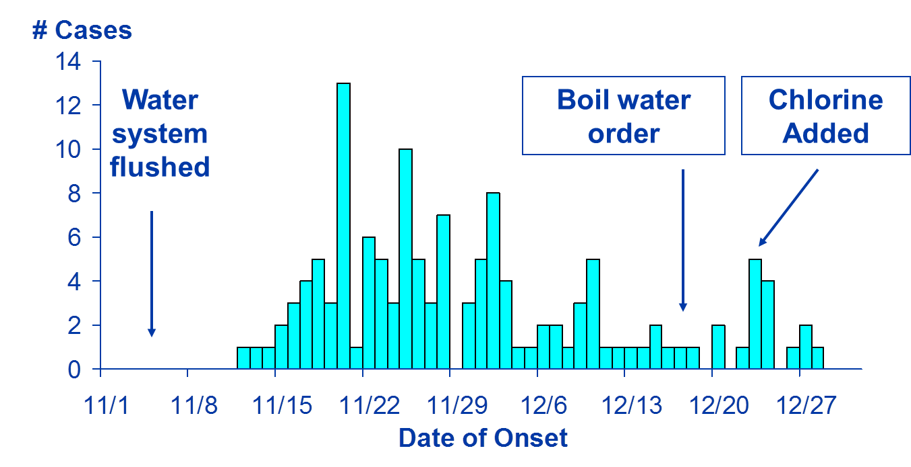
Link to Action
Evaluate prevention and control efforts (continued)
Boil-water
order
Chlorine added
Water
system flushed
No. of cases
Date of onset
Swerdlow DL, Woodruff BA, Brady RC, et al. A waterborne outbreak in Missouri of Escherichia coli O157:H7 associated with bloody
diarrhea and death. Ann Intern Med 1992;117:812–9.
Notes:
SAY:
The health officials then started chlorinating the water supply on December 23. After that, cases declined; ultimately, the outbreak was interrupted.
GO to next slide.

Slide 57
Disclaimers
Links provided in this course to nonfederal organizations are provided solely as a service to our users. These links do not constitute an endorsement of these organizations nor their programs by the Centers for Disease Control and Prevention (CDC) or the federal government, and none should be inferred. CDC is not responsible for the content contained at these sites.
Use of trade names and commercial sources is for identification only and does not imply endorsement by the Division of Scientific Education and Professional Development, Center for Surveillance, Epidemiology, and Laboratory Services, Centers for Disease Control and Prevention, the Public Health Service, or the U.S. Department of Health and Human Services.
The findings and conclusions in this course are those of the authors and do not necessarily represent the official position of the Centers for Disease Control and Prevention.
Notes:
GO to next slide.

Slide 58
For more information, please contact the Centers for Disease Control and Prevention
1600 Clifton Road NE, Atlanta, GA 30333
Telephone: 1-800-CDC-INFO (232-4636)/TTY: 1-888-232-6348
Visit: http://www.cdc.gov | Contact CDC at: 1-800-CDC-INFO or http://www.cdc.gov/info
The findings and conclusions in this course are those of the authors and do not necessarily represent the official position of the Centers for Disease Control and Prevention.
Center for Surveillance, Epidemiology, and Laboratory Services
Division of Scientific Education and Professional Development

