Slide 1

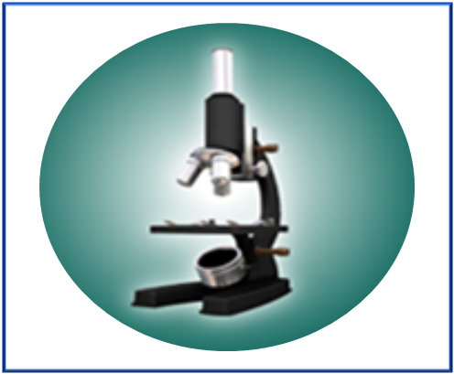

Public Health 101 Series
Introduction to Public
Health Laboratories
Instructor name
Title
Organization
Note: This slide set is in the public domain and may be customized as needed by the user for informational or educational purposes. Permission from the Centers for Disease Control and Prevention is not required, but citation of the source is appreciated.
Notes:
<WELCOME participants to the public health laboratories course and provide your background.>
GO to next slide.

Slide 2
Course Topics
Introduction to Public Health Laboratories
A Public Health Approach
What Are Public Health Laboratories?
Core Functions of State Public Health Laboratories
Public Health Laboratory Infrastructure
Laboratory Safety
Using Results To Affect Public Health
2
Notes:
SAY:
Today we will discuss the following topics that will help you understand some basic aspects of public health laboratories.
<READ each topic on the slide.>
GO to next slide.

Slide 3
Learning Objectives
After this course, you will be able to
  describe the role of public health laboratories
  summarize the core functions of state public health laboratories
  describe the parts that are common to all public health laboratory system infrastructures
  recognize the need for different laboratory levels and safety practices
  explain the necessity for communicating with a laboratory when collecting and submitting samples for testing
  describe how laboratory results are used to affect public health
Notes:
SAY:
After today’s session, you will be able to
<READ the objectives on the slide.>
GO to next slide.

Slide 4

Topic 1
A Public Health Approach
4
Notes:
Topic 1
A Public Health Approach
SAY:
First, we will learn about the public health approach and how it relates to public health core sciences.
GO to next slide.

Slide 5
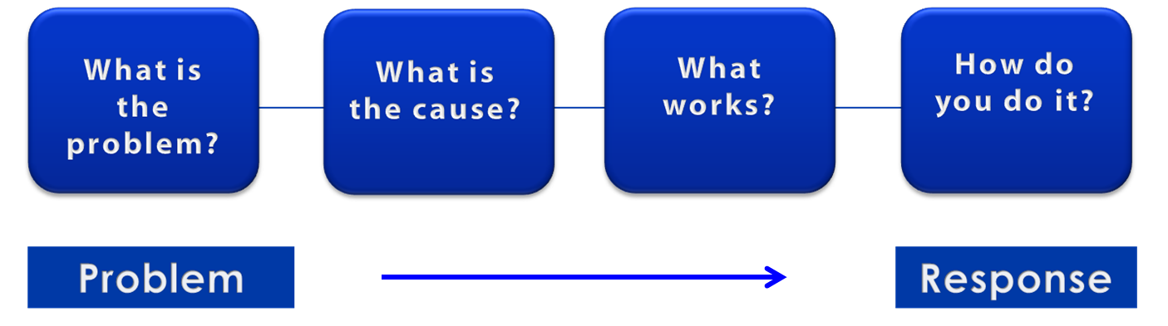
A Public Health Approach
Risk Factor Identification
Intervention
Evaluation
Surveillance
Implementation
Notes:
SAY:
Let’s talk about public health in a broader context. Public health problems are diverse and can include infectious diseases, chronic diseases, emergencies, injuries, environmental health problems, or other health threats.
Regardless of the topic, we take the same approach to a public health problem by following four general steps.
<CLICK for first arrow to appear.>
First, we ask “What is the problem?”
In public health, we identify the problem by using surveillance systems to monitor health events and behaviors occurring among a population.
After we’ve identified the problem, the next question is, “What is the cause of the problem?”
<CLICK to advance animation; first arrow will disappear, and second arrow will appear above Risk Factor Identification box.>
For example, are there factors that might make certain populations more susceptible to disease, such as something in the environment or certain behaviors that people are practicing?
<CLICK to advance animation; second arrow will disappear, and third arrow will appear above Intervention Evaluation box.>
After we’ve identified the risk factors related to the problem, we ask, “What intervention works to address the problem?”
We look at what has worked in the past in addressing this same problem and if a proposed intervention makes sense with our affected population.
<CLICK to advance animation; third arrow will disappear, and fourth arrow will appear above Implementation box.>
In the last step, we ask, “How can we implement the intervention? Given the resources we have and what we know about the affected population, will this work?”
As we go through this course, you will see different examples of this public health approach at work.
GO to next slide.

Slide 6
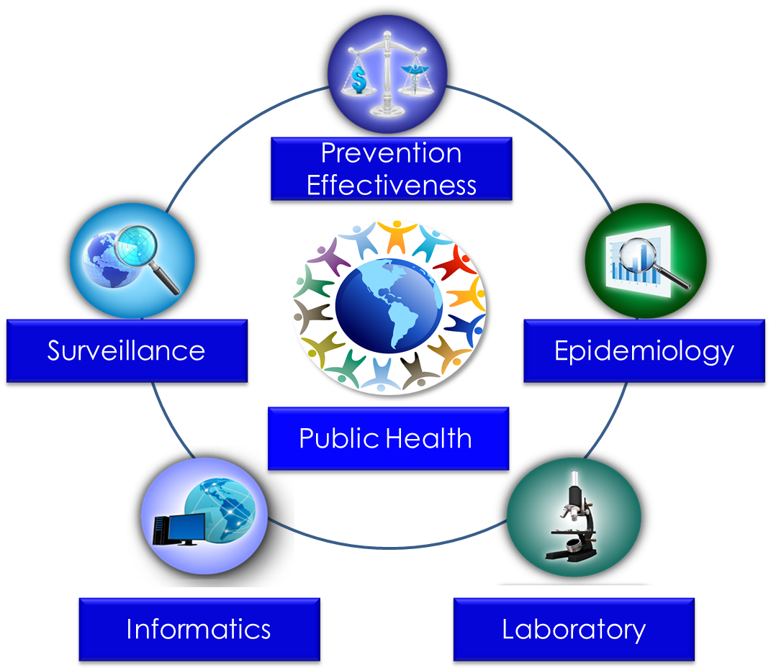
Public Health Core Sciences
Notes:
SAY:
To implement the public health approach, practitioners use and apply scientific methods. These methods come from a series of core sciences that provide the foundation.
These sciences include Public Health Surveillance, which we use to monitor a public health situation.
Epidemiology enables us to determine where diseases originate, how or why they move through populations, and how we can prevent them.
Public Health Laboratories support public health by performing tests to confirm disease diagnoses. Laboratories also support public health by conducting research and training.
As we continue to move from the use of paper documents to electronic health records, Public Health Informatics continues to increase in importance. Informatics deals with the methods for collecting, compiling, and presenting health information. It enables us to use electronic data effectively when addressing a public health situation.
Prevention Effectiveness is closely linked to public health policy. Prevention effectiveness studies provide important economic information for decision makers to help them choose the best option available.
Together, these five core sciences can help us protect and promote the public’s health by giving public health practitioners the answers they need. Public health is better able to respond to the situation by using contributions from each of these sciences. One science alone cannot answer the questions and provide a solution; it is the application of these core sciences together.
<OPTIONAL, IF YOU HAVE TIME, SAY>
For example, let’s look at the public health challenge of influenza. Public health surveillance can monitor when and where cases of influenza occur each year. Professionals can use the science of epidemiology to understand why different populations choose to get vaccinated against influenza. They can use the science of informatics to receive and analyze electronic information from health care institutions (e.g., doctors’ offices and hospitals) to determine whether persons who get influenza go to see a doctor and whether they get well or die. Public health practitioners can use laboratory science to determine whether persons with fever and cough have influenza or a different infection, and they can use prevention effectiveness to show that influenza vaccination campaigns that might cost $200,000 can prevent $1 million in medical costs, lost wages, and other costs.
GO to next slide.

Slide 7
Topic 2
What Are Public Health Laboratories?
7
Notes:
Topic 2
What are Public Health Laboratories?
SAY:
Now we are going to find out what public health laboratories are and what type of services they provide.
GO to next slide.

Slide 8
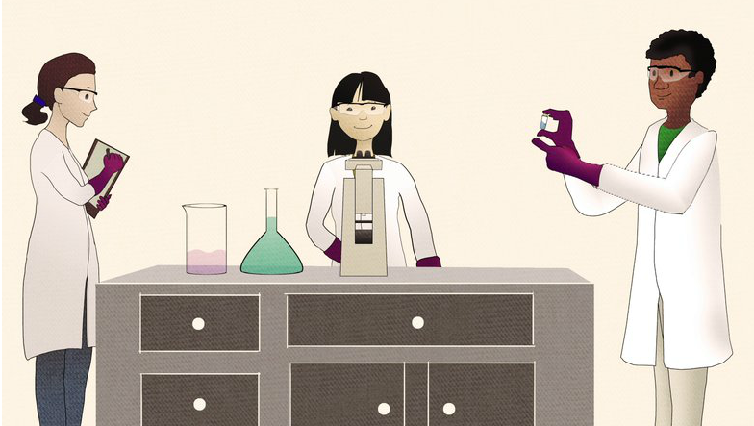
What Is a Public Health Laboratory?
Video available at: http://vimeo.com/52548635
Notes:
<Instructor Note: If Internet access is available, show the video clip at http://vimeo.com/52548635 (approximately 1 minute in length). If Internet access is not available, GO to next slide.>
SAY:
Now, let’s watch a brief video that provides an overall description of what a public health laboratory, or PHL is.
<CLICK the image to view the video “What is a public health laboratory?” (it is hyperlinked) or copy and paste the URL into a web browser.>
<ASK the following question after viewing the video.>
After watching this video, how would you now describe public health laboratories?
<BRIEFLY discuss participant feedback.>
GO to next slide.

Slide 9

Public Health Laboratories
Working in collaboration with other arms of the nation’s public health
system, PHLs provide
clinical diagnostic testing
disease surveillance
advanced skills in laboratory practice
Photo: James Gathany, CDC
Notes:
SAY:
PHLs serve as a first line of defense to protect the public against diseases and other health hazards. Working in collaboration with other arms of the nation’s public health system, PHLs provide
clinical diagnostic testing,
disease surveillance, and
advanced skills in laboratory practice.
GO to next slide.

Slide 10

The Goal of Public Health Laboratories
The goal of public health laboratories is to protect and improve public health by
testing samples
providing expertise
communicating scientific information
Notes:
SAY:
The goal of public health laboratories is to protect and improve public health by
testing samples,
providing expertise, and
communicating scientific information.
PHLs support identification and confirmation of illness during outbreaks; they conduct research for future responses to public health situations; and they provide information that can be used to generate policies and procedures related to public health.
GO to next slide.

Slide 11
Clinical Laboratories
versus Public Health Laboratories
Clinical Laboratories — Individual Health | Public Health Laboratories — Population Health
Diagnostic testing Some reference testing Medical management | Some diagnostic testing Reference testing Surveillance and monitoring Emergency response support Applied research Workforce development and training
Notes:
SAY:
You probably understand the concept of a laboratory, but you might be thinking more about the role laboratories play in clinical laboratory testing. For example, when you go to your doctor’s office for an examination, you might need some routine tests performed, such as cholesterol screening or a blood test. These types of tests are usually performed in clinical laboratories, where the focus is on the individual patient. Clinical laboratories are often privately owned and operated.
By comparison, PHLs focus on diseases and the health status of population groups by performing limited diagnostic testing, reference testing, disease surveillance, and emergency response support. They also perform applied research by using the practical application of science, and they provide training for laboratory personnel.
GO to next slide.

Slide 12
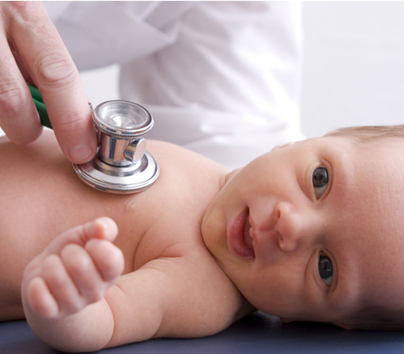
Newborn Screening
Newborn screening is an example of one of the many functions that a public health laboratory performs
Notes:
SAY:
PHLs provide many public health functions, such as screening all newborn babies for different diseases and conditions.
In August 2013, the nation celebrated the 50th anniversary of the first newborn screening tests. These tests were developed to detect conditions among infants immediately after birth because certain conditions, such as metabolic disorders, can result in serious illness or death. The testing panel has expanded substantially since the first tests were administered.
Although newborn screenings vary among public health laboratories, a common test is for hypothyroidism. This condition occurs when the thyroid gland does not produce adequate amounts of the thyroid hormone to meet the body’s needs. Hypothyroidism can affect an infant’s growth rate and cause brain damage. However, if it is identified through a newborn screening test, the infant can be treated with medication.
GO to next slide.

Slide 13


Knowledge Check
Which of the following are activities and services performed by public health laboratories? (Select
all that apply)
Conducting blood tests as part of the ongoing management of a patient’s disease
Testing samples collected during a disease outbreak
Providing screening for all newborns
Training public health laboratory personnel
Notes:
SAY:
Let’s do a quick knowledge check based on what you’ve learned so far.
<READ the knowledge check question and wait for participant responses.>
<CLICK for the correct answers to appear.>
The correct answers are B, testing samples collected during a disease outbreak; C, providing screening for all newborns; and D, training public health laboratory personnel.
These are all examples of activities and services that PHLs provide. Answer A relates to a clinical laboratory that likely performs tests that are part of the medical management of an individual patient with a chronic or ongoing disease.
GO to next slide.

Slide 14
Knowledge Check
Which of the following is the best example of what public health laboratories do as opposed to clinical laboratories?
Cholesterol screening
Diagnostic testing
Routine blood testing
Disease surveillance
Notes:
<READ the knowledge check question and wait for participant responses.>
<CLICK for the correct answer to appear.>
The correct answer is D, disease surveillance.
GO to next slide.

Slide 15

Topic 3
Core Functions of State
Public Health Laboratories
Photo: James Gathany, CDC
15
Notes:
Topic 3
Core Functions of State Public Health Laboratories
SAY:
Now that we have covered what PHLs are, let‘s learn about the core functions of state public health laboratories.
GO to next slide.

Slide 16
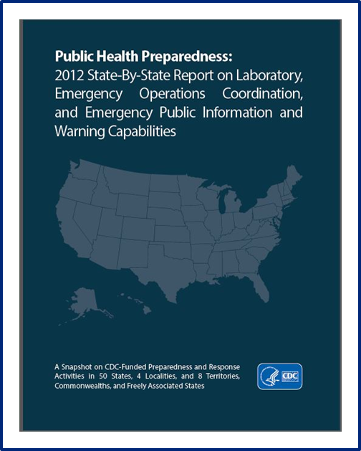
Core Functions of State
Public Health Laboratories
Eleven core functions have
been established by the Association of Public Health Laboratories, or APHL, to provide a basis for assessing and improving the quality of laboratory activities being conducted
Photo: CDC
16
Notes:
SAY:
The Association of Public Health Laboratories, or APHL, has established 11 core functions that provide a basis for assessing and improving the quality of laboratory activities being conducted by PHLs. The list demonstrates the variety of functions that are performed by state PHLs or laboratories at the local, regional, and national level within a broader PHL system.
Let’s take a closer look at these core functions.
GO to next slide.

Slide 17
Core Functions of State
Public Health Laboratories
Core Functions 1–3
1. Disease prevention, control, and surveillance
2. Integrated data management
3. Reference and specialized testing
Association of Public Health Laboratories (APHL). About public health labs. Silver Spring, MD: APHL; [undated].
17
Notes:
SAY:
The first function is disease prevention, control, and surveillance. It includes the ability to provide accurate and precise results in a timely manner and serves as the center of expertise. It also provides specialized testing and population surveillance. Reflecting back on the newborn screening example, this function is used for early detection of congenital disorders among newborns.
Integrated data management includes the gathering and sharing of scientific information that supports public health programs, serving the needs of the state. An example would include the ability to capture data to detect trends and analyze outbreaks by reviewing the data to detect increases in a specific strain of flu.
State public health laboratories serve as the primary reference laboratory for specialized testing. For example, this might include testing for rare but extremely serious diseases, such as those caused by anthrax, plague, or other agents of bioterrorism. Certain kinds of tests can be highly complex. They might require special equipment, personnel with specialized training, or exceptional safety practices. Not every clinical laboratory can or should have the ability to run these kinds of tests.
GO to next slide.

Slide 18
Core Functions of State
Public Health Laboratories (continued)
Core Functions 4–6
4. Environmental health and protection
5. Food safety
6. Laboratory improvement and regulation
Association of Public Health Laboratories (APHL). About public health labs. Silver Spring, MD: APHL; [undated].
18
Notes:
SAY:
Environmental health and protection refers to the ability to conduct analysis and provide services related to environmental samples, such as the testing performed after the 2011 oil spill in the Gulf of Mexico resulting from an oil rig explosion. Laboratories might also test for toxic chemical, radiologic, or microbiologic contaminants in air, water, and soil, or for contaminants resulting from hazardous waste.
State public health laboratories are also expected to test and analyze specimens related to food safety. This includes samples from persons, food, or beverages during foodborne illness outbreaks to detect the responsible pathogen. Items such as beef, milk, and ice cream are routinely tested for safety.
The state public health laboratory takes a leadership role in laboratory regulations by coordinating and promoting quality-assurance programs. They also oversee licensure, accreditation, and laboratory certification. State PHLs inspect many of the clinical and private laboratories to ensure that they are in compliance with federal and state regulations regarding testing of clinical samples. This is crucial for ensuring that test results are accurate.
GO to next slide.

Slide 19
Core Functions of State
Public Health Laboratories (continued)
Core Functions 7–9
7. Policy development
8. Public health preparedness and response
9. Public health–related research
Association of Public Health Laboratories (APHL). About public health labs. Silver Spring, MD: APHL; [undated].
19
Notes:
SAY:
State PHLs are charged with providing both scientific and managerial leadership in the development of state and federal public health policies and standards of practice. This generates scientific evidence on which to base public health practice, standards, and laws.
PHLs also play a key role in emergency preparedness and response by responding to requests for rapid testing, timely notification, and secure messaging of results associated with acts of biologic or chemical terrorism and other high-priority pubic health emergencies. An example of this is the response to the anthrax-tainted letters that were sent through the U.S. postal mail in October 2001. The clinical laboratory sent the suspicious isolate to Florida’s state PHL, where the identification was quickly confirmed, resulting in an immediate national response.
Next is public health-related research. This function can be performed by all PHLs. PHLs are an essential collaborator for research into new ways to identify diseases, new drugs to fight diseases, and new vaccines to prevent diseases. Many PHLs work with partners to validate new methods before they are implemented in other PHLs.
GO to next slide.

Slide 20
Core Functions of State
Public Health Laboratories (continued)
Core Functions 10–11
10. Training and education
11. Partnerships and communication
Association of Public Health Laboratories (APHL). About public health labs. Silver Spring, MD: APHL; [undated].
20
Notes:
SAY:
State PHLs also serve as resources for training and education and are expected to be skilled in the latest procedures and equipment. For example, a state PHL might be the first to receive a newly developed piece of equipment, and they might bring in technicians from other laboratories to teach them how to use the equipment.
Developing and strengthening partnerships between state, county, city, organization, academia, and private industries is also a core PHL function. Here, PHLs participate in strategic policy planning and work on maintaining strong communication channels among different types of public health personnel. These laboratories link to national networks and help support the coordination of public health activities.
ASK:
Thinking back to the newborn screening test we discussed earlier, what PHL functions do you think apply to those tests?
<ELICIT responses from the participants.>
Possible Answers
1. Disease prevention, control, and surveillance; and
2. reference and specialized testing.
SAY:
Let’s look at each of these functions in a little more detail as well as at some examples of how each function might be used.
GO to next slide.

Slide 21
Knowledge Check
Newborn screenings vary among public health laboratories; however, they all test for which condition?
Diabetes
Leukemia
Jaundice
Hypothyroidism
21
Notes:
SAY:
Let’s do another quick knowledge check.
<READ the knowledge check question and wait for participant responses.>
<CLICK for the correct answer to appear.>
The correct answer is D, hypothyroidism.
GO to next slide.

Slide 22
Knowledge Check
Eleven core functions have been established by the Association of Public Health Laboratories, or APHL,
to provide a basis for _________ and _________ the quality of laboratory activities being conducted
assessing, maintaining
assessing, improving
maintaining, standardizing
Improving, standardizing
Notes:
<READ the knowledge check question and wait for participant responses.>
<CLICK for correct answer to appear.>
The correct answer is B, assessing and improving.
GO to next slide.

Slide 23

Topic 4
Public Health Laboratory
Infrastructure
23
Notes:
Topic 4
Public Health Laboratory Infrastructure
SAY:
Now that we know more about the core functions that state PHLs perform, let’s discuss laboratory infrastructure in public health.
GO to next slide.

Slide 24
PHL System Infrastructure
Environmental
laboratories
Federal public health
laboratories
Physician
laboratories
State PHL
Local public health departments
and laboratories
Clinical
laboratories
Notes:
SAY:
PHL systems are an interwoven network of federal, state, and local laboratories that work in collaboration with private laboratories, such as clinical and physician laboratories. In addition, state and city public health departments were at the forefront of establishing the first PHLs, whereas federal laboratories were not established until 1946. Because the basis of public health authority rests with the states, the state PHL is considered the central focus of the PHL system.
Each state or territory's laboratory infrastructure varies on the basis of available resources, needs, and governance in that jurisdiction. PHLs serve many agencies and perform diverse functions; therefore, their structure is often based on the availability of resources and the laboratories’ functions in the case of an incident or situation.
Although this graphic depicts some of the key components of the infrastructure, each PHL system varies and might include additional components or stakeholders, such as first-responders and epidemiologists. In certain situations, environmental laboratories operate under the federal government, but the state public health laboratory is part of the state’s health department.
GO to next slide.

Slide 25
PHL System Infrastructure (continued)
Environmental
laboratories
Federal public health
laboratories
State PHL
Physician
laboratories
Local public health departments
and laboratories
Clinical
laboratories
Notes:
SAY:
Some of the key components of state PHLs include
environmental laboratories,
physician laboratories,
clinical laboratories,
local public health departments and laboratories, and
federal public health laboratories.
The public health laboratory infrastructure varies across jurisdictions because of differences in funding, grants, associations with universities, and state government affiliations. Communication and interactivity is vital within the infrastructure because it can affect how quickly and accurately public health situations are addressed. For example, a physician laboratory might refer a particular specimen to a clinical reference laboratory, and then that laboratory might refer it to the state laboratory. Public health surveillance systems and PHLs depend on the referral and reporting by physician and clinical laboratories.
In certain situations, laboratories share their resources across jurisdictions to better fulfill the essential functions. Alternatively, a PHL might need to work with multiple laboratories to diagnose and implement new diagnostic practices.
GO to next slide.

Slide 26
PHL System Infrastructure (continued)
Perform tests on behalf
of the jurisdiction
States and Territories
Becomes involved when additional assistance is needed
Federal
Focuses on testing samples of air, food, soil, water, and zoonotic-related illnesses
Environmental
Identifies initial cases associated with an outbreak
Private (physician
or clinical)
Notes:
SAY:
Let’s take a closer look at the PHL system infrastructure.
States and Territories: Every state and territory has a PHL. These centralized public health laboratories perform tests on behalf of their jurisdiction and are often part of the state health department or another department within the state. They assist in regulating laboratories within the state by developing new policies and methods for detecting and combating disease. Many states also have local or regional laboratories that support public health activities. State PHLs and some local or regional laboratories might have the ability to conduct testing unavailable elsewhere.
Federal: Federal PHLs become involved when additional assistance is needed or a widespread public health threat occurs. CDC, the U.S. Army Medical Research Institute of Infectious Diseases, and the Food and Drug Administration are examples of federal agencies operating PHLs. Federal PHLs perform specialized testing that state and local PHLs are unable to perform, such as identifying certain chemical, toxin, radiologic, and biologic substances. They also have responsibility for follow-up on a larger scale. For example, in the case of a widespread chemical spill, not only would the local and state PHLs and environmental protection personnel respond, but the U.S. Environmental Protection Agency might be called in to assist with the cleanup and testing. CDC might become involved by assisting with the epidemiologic investigation and with testing specimens from those persons who were exposed to the chemical. Federal PHLs might also help develop new methodologies that can be passed down to state PHLs for further testing, research, and implementation.
Environmental: Other laboratories within the system might include environmental laboratories that focus on testing samples for air, food, soil, water, and zoonotic-related (zoonotic meaning a disease that normally exits in animals but that can infect humans) illnesses. As mentioned previously, they might operate within or under a different organization than the local or state health department.
Private (Clinical or Physician): Although privately operated, clinical or physician laboratories are often used to identify initial cases associated with an outbreak. In reporting systems and networks, these laboratories refer results and information up the chain to state laboratories.
GO to next slide.

Slide 27
Knowledge Check
Which laboratory serves as the center of the public health laboratory system infrastructure?
Local public health laboratories
State public health laboratories
Federal laboratories
Private clinical laboratories
Notes:
<READ the knowledge check question and wait for participant responses.>
<CLICK for the correct answer to appear.
The correct answer is B, state public health laboratories.
GO to next slide.

Slide 28
Knowledge Check
In the event of a salmonellosis outbreak, what role might a federal laboratory perform?
Collect specimens required for testing
Send specimens to clinical laboratories for confirmation of initial findings
Confirm cases through testing
Provide guidelines and recommendations for
testing Salmonella bacteria
Notes:
<READ the knowledge check question and wait for participant responses.>
<CLICK for correct answer to appear.>
The correct answer is D, provide guidelines and recommendations for testing Salmonella bacteria.
GO to next slide.

Slide 29
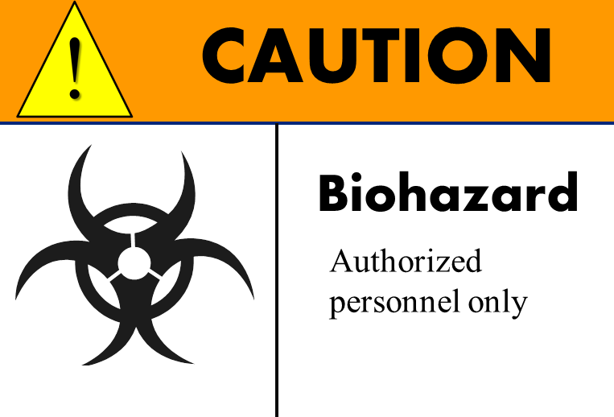
Topic 5
Laboratory Safety
29
Notes:
Topic 5
Laboratory Safety
SAY:
Now that you have been introduced to the PHL infrastructure, let’s take a look at an another important aspect, laboratory safety.
GO to next slide.

Slide 30
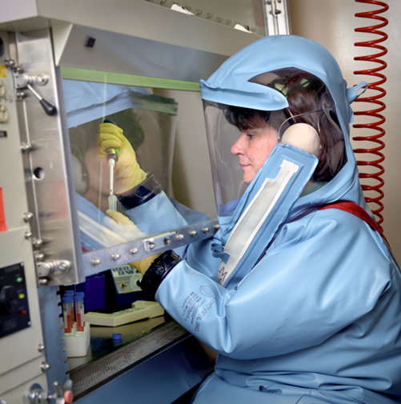
Laboratory Safety Overview
Each laboratory must have key safety principles and procedures in place that minimize the risk
for contamination and exposure to the pathogens being tested
30
Notes:
SAY:
Each laboratory must have key safety principles and procedures in place that minimize the risk to laboratory personnel and others for contamination and exposure to the pathogens being tested. Specimen-submittal protocols are crucial because each laboratory has its own safety procedures in place for collecting, shipping, labeling, and performing tests. As the risk associated with a sample increases, the level, equipment, and personal protective equipment needed also increases.
GO to next slide.

Slide 31
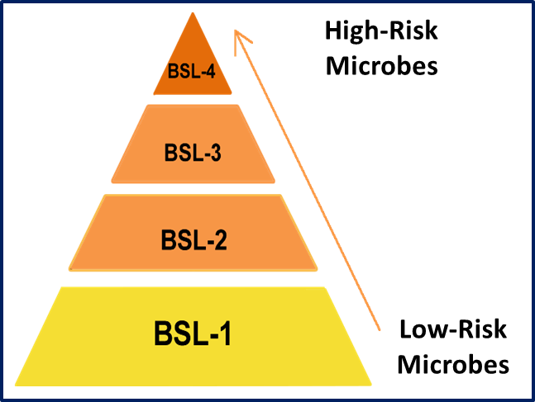
Laboratory Biosafety Levels
In biologic laboratories, one of four biosafety levels are assigned, with Level 1 being the lowest risk and Level 4 the highest
31
Notes:
SAY:
In biologic laboratories, one of four biosafety levels is assigned, with Level 1 being the lowest risk and Level 4 the highest. Level selection depends on different factors, including how the organisms spread among persons (for example, by air, water, or person-to-person contact). As the risks associated with the microbe increases, the assigned level increases.
For example, a virus that spreads by air can spread easily from person to person and requires complicated handling in the laboratory. If a vaccine or effective treatment does not exist, a high biosafety level is required. However, an organism that does not cause severe disease only requires a low biosafety level. Each laboratory must display signs notifying personnel of the applicable biosafety level that represents how the agent should be handled.
Each biosafety level has its own specific containment controls, safety equipment, and required facility construction. Different types of specialized controls and equipment are used to provide barriers between the microbe and the laboratory practitioner, ranging from disposable gloves and face shields to complex biosafety cabinets.
GO to next slide.

Slide 32
Laboratory Safety Governance
Federal Entities
Occupational Safety and Health Administration (OSHA)
Clinical Laboratory Improvements Amendments (CLIA)
U.S. Department of Agriculture (USDA)
U.S. Department of Justice (DOJ)
U.S. Environmental Protection Agency (EPA)
Food and Drug Administration (FDA)
Centers for Disease Control and Prevention (CDC)
National Institutes of Health (NIH)
32
Notes:
SAY:
Overall laboratory safety is governed by local, state, and federal regulations administered by different agencies.
OSHA, or the Occupational Safety and Health Administration, has published extensive guidance for minimizing risks and making laboratories safer. OSHA standards provide rules that protect workers from chemical hazards as well as biologic, physical, and safety hazards.
Other federal entities issue guidelines and regulations for programmatic testing, such as the Clinical Laboratory Improvement Amendments, or CLIA, which are federal regulatory standards that apply to all clinical laboratory safety practices. USDA, DOJ, EPA, FDA, CDC, and NIH all have additional guidelines and regulations in place regarding how testing and laboratory practice must be conducted.
GO to next slide.

Slide 33
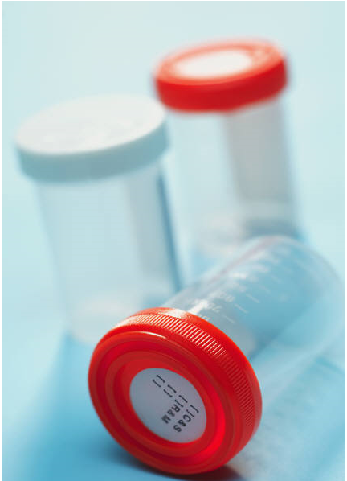
Laboratory Safety Considerations
What type of samples to collect
What method(s) to use to collect the samples
How to store the samples
Which laboratory can receive and test the samples
How to pack, label, and ship the samples
Notes:
SAY:
Safe specimen handling and shipment is a crucial part of laboratory practice. All PHLs have specific specimen collection manuals that must be provided to users. Quality standards govern laboratories in terms of specimen collection and shipping. Incorrect collection and shipping can result in the laboratory being unable to perform the requested test or cause it to provide invalid results. Because specifications, collection methods, and shipping procedures are based on the qualifications of the receiving laboratory and the type of specimens being collected, entities submitting samples for testing need to know the correct protocol to follow.
Before sample collection, those entities should know
what type of samples to collect;
what methods to use for collecting the samples;
how to store the samples before shipment;
which laboratory can receive and test the samples; and
how to pack, label, and ship the samples.
Packing and shipping techniques might include refrigeration, such as using dry ice.
The importance of correct packaging and shipping cannot be overstated. For example, anthrax samples that are incorrectly packaged and shipped will be rejected because that places laboratory personnel at high risk for infection. This will delay the public health response and impede crucial public health interventions.
GO to next slide.

Slide 34
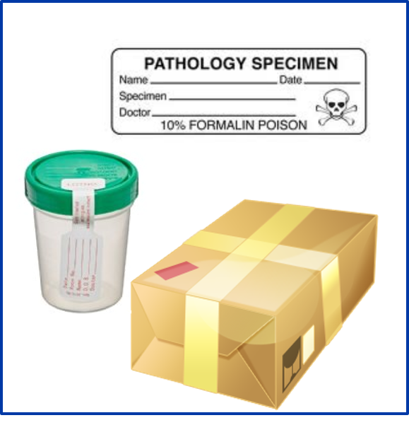
Shipping Samples
Before shipping samples,
determine if the specimen is appropriate for the designated PHL
identify correct packing and shipping techniques
ensure specimens have correct documentation and labels
Notes:
SAY:
Laboratories are required by regulation to inform and monitor the quality of specimen labeling and shipping.
Before shipping samples, staff should
determine if the specimen is appropriate for the designated PHL;
identify the correct packing and shipping techniques; and
ensure the specimens have correct documentation and labels.
After the laboratory completes the testing, test results are delivered by telephone, U.S. postal mail, express mail delivery service, or e-mail, depending on the laboratory and the urgency of the needed test results.
GO to next slide.

Slide 35
Knowledge Check
True or false?
Safety principles and practices are the same for all laboratories.
True
False
Notes:
<READ the knowledge check question and wait for participant responses.>
<CLICK for correct answer to appear.>
The correct answer is B, false.
GO to next slide.

Slide 36
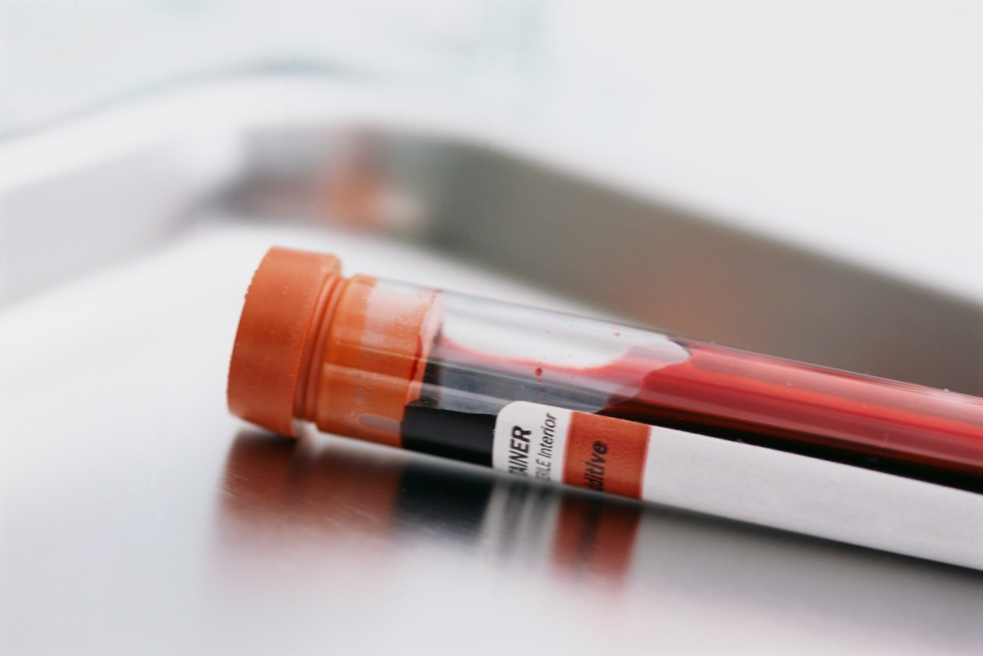
Topic 6
Using Results To Affect
Public Health
Notes:
Topic 6
Using Results To Affect Public Health
SAY:
Now that you know more about laboratory safety, we will take a closer look at how laboratory data are used in public health.
GO to next slide.

Slide 37

Electronic Laboratory Reporting (ELR)
Laboratory Response Network (LRN)
Food Emergency Response Network (FERN)
PulseNet
Notes:
SAY:
As noted earlier in the course, communication and collaboration within the public health infrastructure is essential. Electronic laboratory reporting, or ELR, uses automated systems for rapid reporting to health authorities, which can help them quickly identify trends and alert other public health professionals. These reports are used for surveillance and disease intervention and have many benefits, including improved timeliness, reduction of manual data-entry errors, and reports that are more complete.
Examples of ELRs include the following:
The Laboratory Response Network, or LRN, focuses on bioterrorism and chemical terrorism response.
The Food Emergency Response Network, or FERN, integrates the nation's food-testing laboratories at the local, state, and federal levels into a network that is able to respond to emergencies involving biologic, chemical, or radiologic contamination of food.
PulseNet is a national network of public health and food regulatory agency laboratories maintained by CDC. PulseNet facilitates early identification of common-source outbreaks by comparing the individual DNA fingerprints from certain bacteria identified by PHLs and determining if bacteria with matching fingerprints might be associated with a foodborne outbreak. Communication within this network can help food regulatory agencies.
GO to next slide.

Slide 38
Using PHL Results
After public health data from ELRs are collected and disseminated, data are used to
monitor trends and detect changes,
identify or confirm an outbreak,
provide guidance and immediate action,
guide public policy,
determine disease history,
prioritize resource allocation,
provide a baseline for epidemiologic research, and
identify environmental hazard and exposures
Notes:
SAY:
After the public health data from the ELR are collected and disseminated, they can be used to monitor trends and detect changes. For example, increased resistance to antibiotics can be identified, or syndromic surveillance can be used to enhance laboratory and informatics data analysis.
Data can be used to identify or confirm an outbreak. For example, laboratories perform seasonal testing for West Nile virus, a virus carried by mosquitos. Testing is conducted on human specimens and mosquito pools to confirm that an outbreak is occurring or is likely to occur.
After laboratory confirmation that a disease is occurring in a community, the public health authorities can take immediate action by issuing guidance and control measures. In the West Nile virus example, authorities might conduct prevention activities, such as communitywide insecticide spraying to eliminate mosquitoes or broadcasting prevention messages to the public.
Laboratory data are also helpful in evaluating and creating policy. Again in the case of West Nile virus, one potential policy change might be to require seasonal community-based mosquito control programs as a matter of course instead of waiting for the illness to occur each year.
PHLs are also used in determining disease history. For example, West Nile virus was first found in the West Nile District of Uganda in 1937, but it did not appear in North America until 1999, when it was identified in laboratory specimens from both humans and horses.
Laboratory data can be used to prioritize resource allocation, including funding or personnel. Laboratory results from mosquitoes infected with West Nile virus allows focusing of mosquito control efforts to specific geographic areas rather than throughout an entire city, state, or region.
Laboratory data can provide a base for epidemiologic research. This can help guide long-term resource allocation to prevent future West Nile virus outbreaks in a specific region, for example.
The data can also help identify environmental hazards and exposures. An example would be laboratory data that indicate if environmental hazards were created as a result of the communitywide insecticide spraying to prevent West Nile virus cases.
GO to next slide.

Slide 39
Knowledge Check
Which of the following describe how public health laboratory data are used to affect public health?
Guide public policy
Determine disease history
Detect changes
All of the above
Notes:
<READ the knowledge check question and wait for participant responses.>
<CLICK for correct answer to appear.>
The correct answer is D, all of the above.
GO to next slide.

Slide 40
Course Summary
During this course, you learned to
  describe the role of public health laboratories
  summarize the core functions of state public health laboratories
  describe the parts that are common to all public health laboratory system infrastructures
  recognize the need for different laboratory levels and safety practices
  explain the necessity for communicating with a laboratory when collecting and submitting samples for testing
  describe how laboratory results are used to affect public health
Notes:
SAY:
Now that you have completed this course, you should be able to
<READ the objectives listed on the slide.>
GO to next slide.

Slide 41
Resources and Additional Reading
Centers for Disease Control and Prevention. Core functions and capabilities of state public health laboratories. MMWR Recommend Rep 2002;51(No. RR 14). http://www.cdc.gov/mmwr/PDF/rr/rr5114.pdf.
Centers for Disease Control and Prevention (CDC). Multistate outbreak of listeriosis linked to whole cantaloupes from Jensen Farms, Colorado. Atlanta, GA: US Department of Health and Human Services, CDC; 2012. http://www.cdc.gov/listeria/outbreaks/cantaloupes-jensen-farms/index.html.
Centers for Disease Control and Prevention (CDC). Recognizing the biosafety levels [Online training module]. Atlanta, GA: US Department of Health and Human Services, CDC; 2012. http://www.cdc.gov/learning/quick_learns.html.
Association of Public Health Laboratories (APHL). About public health labs. Silver Spring, MD: APHL; [undated]. http://www.aphl.org/aboutaphl/aboutphls/pages/default.aspx.
Centers for Disease Control and Prevention (CDC). West Nile virus. Atlanta, GA: US Department of Health and Human Services, CDC; 2012. http://www.cdc.gov/westnile/index.html.
Notes:
GO to next slide.

Slide 42
Disclaimers
Links provided in this course to nonfederal organizations are provided solely as a service to our users. These links do not constitute an endorsement of these organizations nor their programs by the Centers for Disease Control and Prevention (CDC) or the federal government, and none should be inferred. CDC is not responsible for the content contained at these sites.
Use of trade names and commercial sources is for identification only and does not imply endorsement by the Division of Scientific Education and Professional Development, Center for Surveillance, Epidemiology, and Laboratory Services, Centers for Disease Control and Prevention, the Public Health Service, or the U.S. Department of Health and Human Services.
The findings and conclusions in this course are those of the authors and do not necessarily represent the official position of the Centers for Disease Control and Prevention.
42
Notes:
GO to next slide.

Slide 43
For more information, please contact the Centers for Disease Control and Prevention
1600 Clifton Road, NE, Atlanta, GA 30333
Telephone: 1-800-CDC-INFO (232-4636)/TTY: 1-888-232-6348
Visit: http://www.cdc.gov | Contact CDC at: 1-800-CDC-INFO or http://www.cdc.gov/info
The findings and conclusions in this course are those of the authors and do not necessarily represent the official position of the Centers for Disease Control and Prevention.
Center for Surveillance, Epidemiology, and Laboratory Services
Division of Scientific Education and Professional Development

Slide 44
Course Activity
(if time permits)
Notes:
GO to next slide.

Slide 45
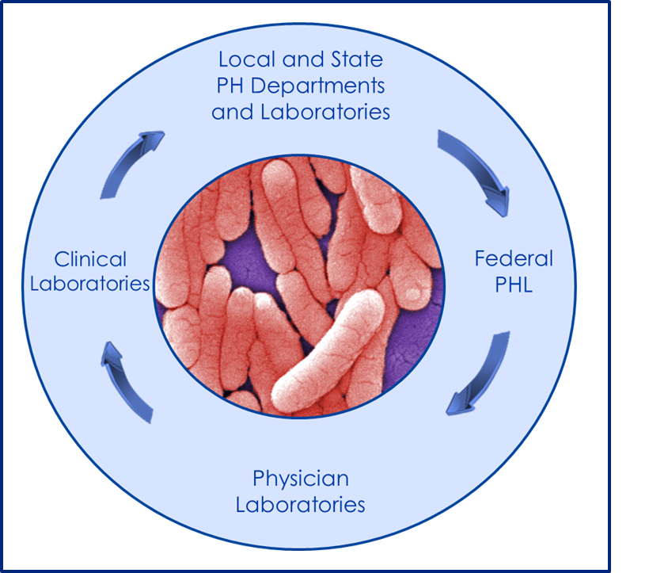
Salmonellosis Outbreak
Photograph: Janice Haney Carr
Notes:
SAY:
Here is an example of how laboratories might be used in the event of a foodborne illness outbreak.
Salmonellosis is an infection that is caused by the bacteria Salmonella and that is commonly referred to as food poisoning. Salmonella can cause severe diarrhea, fever, and cramping, and in some instances, can spread from the intestines to the bloodstream. It can be transmitted by eating contaminated foods, such as beef, poultry, milk, or eggs.
An estimated 1.2 million cases occur annually in the United States. Approximately 42,000 cases are laboratory-confirmed. Those instances typically are reported to both the state and then to CDC. Confirmed salmonellosis cases are reported by PHLs to the state, and the data are entered into the National Notifiable Disease Surveillance System (NNDSS) and FoodNet, both of which help track trends associated with the infection.
After all the information is collected, laboratories provide information back to the public health community so that the information can be used to guide treatment, measure trends, and determine what public health response is needed to prevent any additional cases or future outbreaks.
ASK:
In the event of a salmonellosis outbreak, what role does each of the laboratories depicted on the slide play?
<Instructor Note: If time permits, break into four groups. Have each group decide on a type of laboratory they will represent. Each group should appoint one person to present to the class. (NOTE: Although this can be a linear process, it can also be cyclical and might not follow the route depicted on the slide.)>
Possible Answers
Federal Laboratories: CDC’s and FDA’s laboratories provide guidelines and recommendations for testing of Salmonella bacteria. CDC and FDA conduct training for the PHL personnel so that they are ready to test the specimens and have the equipment and other supplies needed.
Physician or Hospital Laboratories: Physician or hospital laboratories collect the specimens needed for testing, and they might be the first to notice a trend or commonality among persons reporting signs and symptoms.
Clinical Laboratories: Physicians might not send results or notify hospitals, but they might send their specimens to the clinical reference laboratory for confirmation of their initial findings.
State Laboratories: Because salmonellosis is considered a notifiable disease and confirmed cases should be reported to the state, clinical reference laboratories or physician and hospital laboratories should report their findings to the state health department as specified by their state (each state varies in the diseases they require to be reported). The state public health laboratories can then confirm cases through testing by using guidelines and recommendations as provided by the federal public health laboratories.

