Slide 1



Public Health 101 Series
Introduction to Public
Health Informatics
Instructor name
Title
Organization
Note: This slide set is in the public domain and may be customized as needed by the user for informational or educational purposes. Permission from the Centers for Disease Control and Prevention is not required, but citation of the source is appreciated.
Notes:
<WELCOME participants to the Introduction to Public Health Informatics course and provide your background.>
GO to next slide.

Slide 2
Course Topics
Introduction to Public
Health Informatics
1. A Public Health Approach
2. Public Health Informatics Definition, Components, and Functions
3. Creating a Public Health Information System
4. At the Intersection of the Informatician, the Public Health Official, and the Information Technologist
Notes:
SAY:
During this course, we will discuss
<READ the topics listed on the slide.>
GO to next slide.

Slide 3
Learning Objectives
After this course, you will be able to
explain the importance of informatics to the public health mission
describe the role of the informatician in public health practice
differentiate between public health informatics and information technology
Notes:
SAY:
After completing this course, you will be able to
<READ the bullets listed on the slide.>
GO to next slide.

Slide 4

Topic 1
A Public Health Approach
Notes:
Topic 1
A Public Health Approach
GO to next slide.

Slide 5
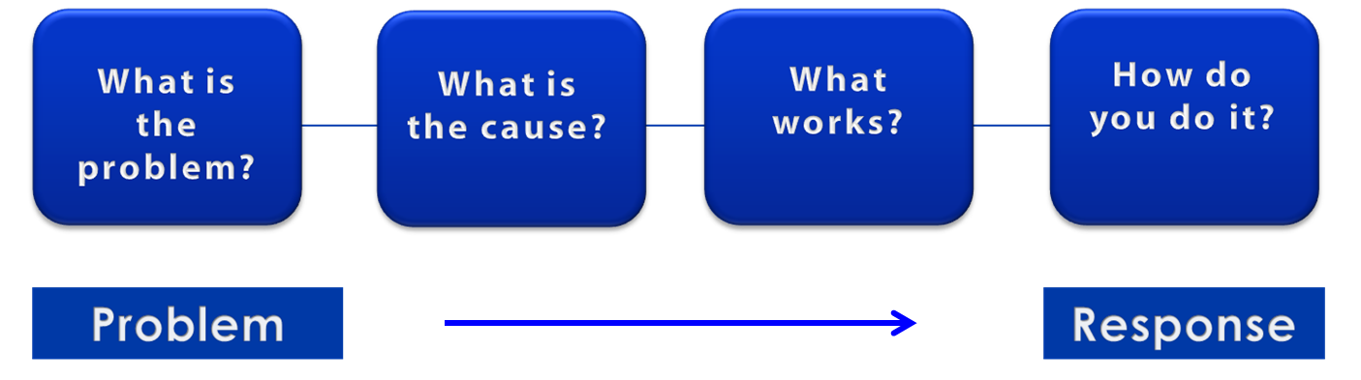
A Public Health Approach
Risk Factor Identification
Intervention
Evaluation
Surveillance
Implementation
Notes:
SAY:
Let’s talk about public health in a broader context. Public health problems are diverse and can include infectious diseases, chronic diseases, emergencies, injuries, environmental health problems, and a host of other health threats.
Regardless of the topic, we take the same approach to a public health problem by following four general steps.
First, we ask “What is the problem?”
<CLICK for first arrow to appear.>
In public health we identify the problem by using surveillance systems to monitor health events and behaviors occurring among a population.
After we’ve identified the problem, the next question is, “What is the cause of the problem?”
<CLICK to advance animation; first arrow will disappear, and second arrow will appear above Risk Factor box.>
For example, are there factors that might make certain populations more susceptible to disease, such as something in the environment or certain behaviors that people are practicing?
<CLICK to advance animation; second arrow will disappear, and third arrow will appear above Intervention Evaluation box.>
After we’ve identified the risk factors related to the problem, we ask, “What intervention works to address the problem?”
We look at what has worked in the past in addressing this same problem and if a proposed intervention makes sense with our affected population.
<CLICK to advance animation; third arrow will disappear, and fourth arrow will appear above Implementation box.>
In the last step, we ask, “How can we implement the intervention? Given the resources we have and what we know about the affected population, will this work?”
As we go through this course, you will see different examples of this public health approach at work.
GO to next slide.

Slide 6
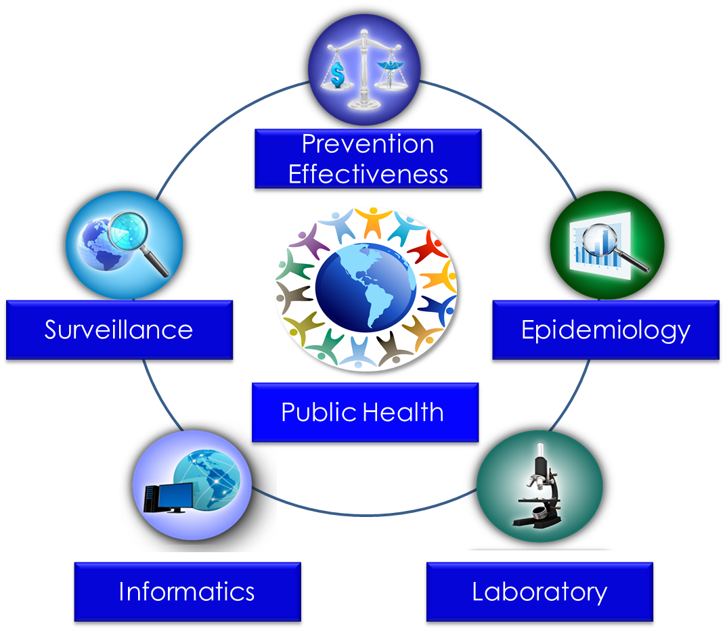
Public Health Core Sciences
Notes:
SAY:
To implement the public health approach, practitioners use and apply scientific methods. These methods come from a series of core sciences that provide the foundation.
These sciences include Public Health Surveillance, which we use to monitor a public health situation.
Epidemiology enables us to determine where diseases originate, how or why they move through populations, and how we can prevent them.
Public Health Laboratories support public health by performing tests to confirm disease diagnoses. Laboratories also support public health by conducting research and training.
As we continue to move from the use of paper documents to electronic health records, Public Health Informatics continues to increase in importance. Informatics deals with the methods for collecting, compiling, and presenting health information. It enables us to use electronic data effectively when addressing a public health situation.
Prevention Effectiveness is closely linked to public health policy. Prevention effectiveness studies provide important economic information for decision makers to help them choose the best option available.
Together, these five core sciences can help us protect and promote the public’s health by giving public health practitioners the answers they need. Public health is better able to respond to the situation by using contributions from each of these sciences. One science alone cannot answer the questions and provide a solution; it is the application of these core sciences together.
<OPTIONAL, IF TIME PERMITS, SAY>
For example, let’s look at the public health challenge of influenza. Public health surveillance can monitor when and where cases of influenza occur each year. Professionals can use the science of epidemiology to understand why different populations choose to get vaccinated against influenza. They can use the science of informatics to receive and analyze electronic information from health care institutions (e.g., doctors’ offices and hospitals) to determine whether persons who get influenza go to see a doctor and whether they get well or die. Public health practitioners can use laboratory science to determine whether persons with fever and cough have influenza or a different infection, and they can use prevention effectiveness to show that influenza vaccination campaigns that might cost $200,000 can prevent $1 million in medical costs, lost wages, and other costs.
GO to next slide.

Slide 7
Topic 2
Public Health Informatics Definition, Components, and Functions
Notes:
Topic 2
Public Health Informatics Definition, Components, and Functions
GO to next slide.

Slide 8

The Public Health Mission
CDC provides crucial scientific information that protects our nation against dangerous and costly health threats
Notes:
SAY:
Public health focuses on groups of persons, rather than individual persons. At the core of public health lies the principle of social justice, providing persons the right to be healthy and to live in conditions that support their health and wellbeing.
CDC increases the health security of our nation. As the nation’s health protection agency, CDC saves lives and protects people from health threats. To accomplish our mission, CDC provides crucial scientific information that protects our nation against expensive and dangerous health threats. When threats do arise, CDC responds.
GO to next slide.

Slide 9
Public Health Informatics — Defined
Public health informatics is the systematic application of information, computer science, and technology to public health practice, research, and learning
Yasnoff WA, O’Carroll PW, Koo D, Linkins RW, Kilbourne EM. Public health informatics: improving and transforming public health in the information age. J Public Health Manag Pract 2000;6:67–75.
Riegelman R, ed. Public health 101: healthy people—healthy populations. Sudbury, MA: Jones & Bartlett Learning; 2010: 40.
Notes:
SAY:
The health information that CDC provides is known as informatics. It is problem-based and uses computer science, technology, and applied information methods that bring data together in a format that aids analysis.
Informatics blends three essential knowledge and skillsets, including
knowledge of public health practice and its foundation principles as they relate to health systems, laboratories, hospitals, surveillance systems, and epidemiology;
knowledge of the functional capabilities and limitations of current and emerging information technology; and
a keen ability to envision, realize, and implement technology solutions to public health challenges.
Public health professionals use informatics daily, regardless of their official job title, to
improve population health in daily practice,
further our knowledge through public health practice, and
broaden the public health knowledge base through learning.
GO to next slide.

Slide 10






Building Your Dream Home
Electrician
Brick Layer
Framer
Plumber
Painter
Notes:
SAY:
To help you understand the difference and overlap between informatics, information technology, and other public health professions, such as epidemiology and surveillance, we will use the familiar metaphor of building a house.
Constructing a house requires different specialists, including brick layers, electricians, roofers, plumbers, painters, and others. If you are building your dream home, would you meet individually with each of these specialists to discuss functional space and design options, or would you meet with one person who knows about all of the design aspects?
An electrician is excellent at installing wires and light fixtures, and a plumber is an expert at installing pipes and bathroom and kitchen fixtures. But when it comes to translating your living requirements, conditions, and design preferences to be used by the electricians, plumbers, brick layers, and others, you need a person who is capable of understanding and envisioning your idea of the whole dream house.
In addition to understanding your aspirations, that person must also have knowledge and experience in
each home-building profession,
local building codes, and
licensing and occupancy policies and regulations.
That person is the developer or architect.
GO to next slide.

Slide 11






Building Your Public Health
Information System
Programmer
Web Designer
Database
Administrator
Security Specialist
Network Administrator
11
Notes:
SAY:
The dream home scenario is a mirror image of the process of building a public health information system.
First, replace the developer or architect with the public health informatician. This profession combines the knowledge and expertise in public health practice with information technology, data policies and regulations, and standards required to build a public health information system.
Next, compare building a dream home with plans to automate a public health function.
Finally, replace the electricians, plumbers, brick layers, roofers, and framers with
programmers,
database administrators,
web designers,
security specialists, and
network administrators.
GO to next slide.

Slide 12


Knowledge Check
A tuberculosis outbreak has occurred in 10 states across the country. To increase knowledge of the health threat, CDC uses computer science, technology, and applied information methods that will inform the nation’s population about important _________________.
research
health information
security measures
Notes:
<READ the knowledge check question and wait for participant responses.>
<CLICK for the correct answer to appear.>
The correct answer is B, health information.
GO to next slide.

Slide 13
Knowledge Check
Informatics uses public health knowledge to
broaden the public health knowledge base through learning
improve population health in daily practice
further knowledge in public health research
all of the above
Notes:
<READ the knowledge check question and wait for participant responses.>
<CLICK for the correct answer to appear.>
The correct answer is D, all of the above.
GO to next slide.

Slide 14

Topic 3
Creating a Public Health
Information System
Notes:
Topic 3
Creating a Public Health Information System.
GO to next slide.

Slide 15




The Informatician
Understands ideas
Envisions innovative
scenarios
Understands capabilities, opportunities, and limitations
Security
Data Standards
Policy
Notes:
SAY:
An informatician’s key responsibilities is to accomplish the public health mission. He or she is knowledgeable about security, data standards, and additional policies that influence the design and operation of the health information system.
Additionally, the informatician
understands ideas;
envisions innovative scenarios for automating the public health function; and
understands the capabilities, opportunities, and limitations of
programmers,
database developers,
web designers, and
the available/emerging hardware and software tools necessary for developing feasible implementation plans and specifications.
Informaticians who possess broad knowledge and expertise of both public health and information technology are involved in creating public health information systems. Such systems ensure the production, analysis, dissemination, and use of reliable, timely information regarding health determinants, health system performance, and health status.
GO to next slide.

Slide 16
Creating a Public Health Information System
Creating a Public Health Information System | Public health official | Informatician | Information technology professional
Step 1 — Vision and System Planning
Envision solutions, opportunities, and application of information technology in public health
Step 2 — Health Data Standards and Integration
Define and design health data standards and transformation (e.g., HL7, ICD, SNOMED) and health domain integration (e.g., ELR, EHR, CMS, HIE, surveillance, demographics, social media)
Design and implement databases, tables, columns, data formats, and keys for linking tables and data to support defined health data standards and integration
Step 3 — Data Privacy and Security
Define and implement health data privacy and HIPAA regulations
Implement and enforce data, systems, and communication security
Step 4 — Systems Design and Implementation
Define and design methods for public health functions, data elements, data flow, case definitions, and message mapping
Implement information technology for defined functions, data elements, data flow, and case definitions
Step 5 — Visualization, Analysis, and Reporting of Health Data
Broad knowledge of public health practice, proficiency in information technology, and capacity for innovation
Expertise in health data standards, database design, and data linking and integration across health systems
Expertise in relational/SQL databases and unstructured data design and management
Knowledge of health data privacy
Understanding information technology security functions
Expertise in health systems and data interoperability
Expertise in managing information technology systems development
Expertise in public health practice, business intelligence, decision making, and use of analytic software
CMS = Centers for Medicare and Medicaid Services; EHR = electronic health record; ELR = electronic laboratory record; HIE = health information exchange; HIPAA = Health Insurance Portability and Accountability Act; HL7 = Health Level 7; ICD = International Classification of Diseases; SNOMED = Systematized Nomenclature of Human Medicine; SQL = structured query language.
Notes:
<Briefly WALK participants through the chart.>
SAY:
Public health information systems are public, private, and voluntary entities that contribute to the delivery of essential public health services within a health jurisdiction (e.g., county, city, state, tribal reservation, or region). This concept ensures that all entities’ contributions to the health and wellbeing of the community or state are recognized in assessing the provision of public health services.
As you have learned, informatics uses computer science, technology, and applied information methods. Therefore, informaticians must work side by side with other public health officials and information technology professionals to build the most accurate public health information systems.
The table you see here illustrates the contributions of each expertise required to create a system. The five-step process involves
vision and system planning;
health data standards and integration;
data privacy and security;
systems design and implementation; and
visualization, analysis, and reporting of health data.
Next, we’ll examine each step in more detail.
GO to next slide.

Slide 17



Step 1 — Vision and System Planning
Hardware
Software
Communication
Technology
Notes:
SAY:
Step one, vision and system planning, is the most distinct. It is the ability to envision what and how the different hardware, software, and communication technologies can be successfully applied to solve a problem or improve public health practice.
After a vision for a public health information system has been established, translating the vision into a blueprint or design proposal that users, such as public health practitioners and technology programmers, can understand and endorse follows. The design proposal is converted into functional, data, and workflow requirements that information technology professionals can use to develop
computer programs,
linked data sets or tables,
communication tools, and
security instruments.
The conversion is usually accomplished by
defining the data needed by the system,
defining the security and privacy rules throughout the system lifecycle,
defining and designing the software system architecture, and
visualizing, analyzing, and reporting health data.
GO to next slide.

Slide 18

Step 2 — Health Data Standards
and Integration
Health data standards and integration are required when defining the data.
Centers for Disease Control and Prevention (CDC). Meaningful use—introduction. Atlanta, GA: US Department of Health and Human Services, CDC; 2012. http://www.cdc.gov/ehrmeaningfuluse/introduction.html.
Notes:
SAY:
The second step involves health data standards and integration, but this step first requires defining the data.
Data sources, transfer methods (collection and extraction), and health coding standards — such as Health Level 7, International Classification of Disease codes, the Systematized Nomenclature of Human Medicine, or SNOMED, and Logical Observation Identifiers, Names, and Codes, or LOINC — are identified and must be employed to ensure data quality, integration, and the requirements of meaningful data usage.
The term meaningful use is defined as the use of electronic health record, or EHR, technology in a manner that benefits the patient (for example, electronic prescribing of medications); ensures that the EHR technology enables electronic exchange of health information to improve the quality of the patient’s care; and enables the provider to submit to the Secretary of the U.S. Department of Health and Human Services information on quality of care and other measures.
The concept of meaningful use rests on the five pillars of health outcome policy priorities, including
improving quality, safety, efficiency, and reducing health disparities;
engaging patients and families in their health decisions;
improving care coordination;
improving population and public health; and
ensuring adequate privacy and security protection for personal health information.
GO to next slide.

Slide 19

Step 3 — Data Privacy and Security
Data privacy and security must be identified, prescribed, and implemented throughout the data lifecycle.
Notes:
SAY:
Step 3 involves data privacy and security. Relevant health and federal information, security and privacy policies, and regulations must be identified, prescribed, and implemented throughout the data lifecycle.
The data lifecycle is a six-phase process used to design information systems that result in action and to identify what is necessary to turn data into information that will make a public health impact.
GO to next slide.

Slide 20

Step 4 — Systems Design
and Implementation
Define or design methods for public health functions, data elements, data flow, case definitions, and message mapping
Implement information technology for defined public health functions, data elements, data flow, case definition, and similar needs
Notes:
SAY:
During Step 4, software system architecture is defined and designed.
This process involves
logical steps and workflow;
processing functions and methods;
technology use, including mobile device versus a desktop computer, Internet access versus client-server, in-house versus commercial applications; and
user interface or experience requirements.
Specialists, such as programmers, database administrators, security specialists, and web designers, use the system design architecture, data specifications, and security requirements to develop, deploy, and operate the target system.
GO to next slide.

Slide 21

Step 5 — Visualization, Analysis,
and Reporting of Health Data
Visualization and implementation of the required analysis, reporting, and meaningful use of the data collected and managed by the system.
Notes:
SAY:
The final, yet ongoing, step involves visualizing and implementing the required analysis, reporting, and meaningful use of the data collected and managed by the system.
Step 5 requires understanding public health and the elements of information technology that can support data-related needs, which involves using
dashboards to monitor high-level events or outcomes,
core statistical or management reports, and
data extraction and dissemination when required.
Now, let’s look at how informatics can be used in a format for easy analysis.
GO to next slide.

Slide 22

Informatics in Action — CDC’s FluView
A clear-cut way to share national influenza data was needed by
the public health community,
clinicians,
scientists, and
the general public
Notes:
SAY:
Let’s look at an actual situation. Improved communication about national influenza occurrences was needed by
the public health community,
clinicians,
scientists, and
the general public.
The information to be shared needed to include laboratory data about the virus strains, as well as information about doctor visits for influenza-like illnesses. However, the supporting data needed for such broad communication were stored in different computer systems and formats.
The challenge involved finding a clear-cut process to bring all of the data together so that it could be easily understood by both subject-matter experts and the general public.
GO to next slide.

Slide 23
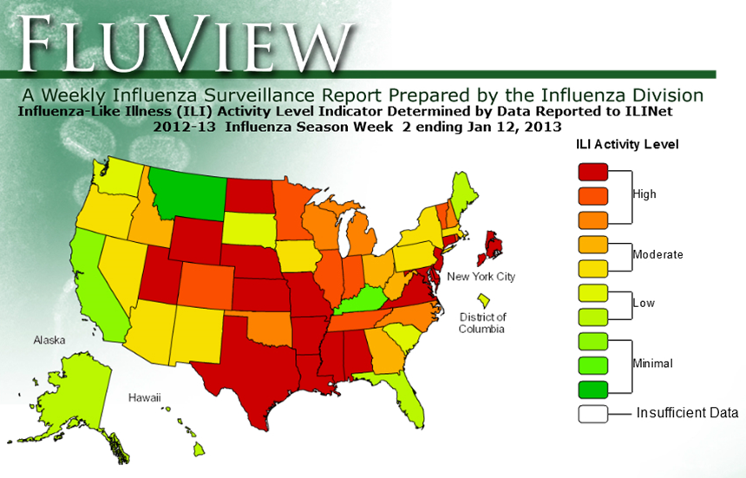
Informatics in Action — FluView
Centers for Disease Control and Prevention (CDC). FluView. Atlanta, GA: US Department of Health and Human Services,
CDC; 2013. http://gis.cdc.gov/grasp/fluview/main.html.
Notes:
SAY:
The resulting communication system is known to the public as FluView, a weekly surveillance report prepared by CDC’s Influenza Division. It is a visual graphic that displays a range of data illustrating the activity levels for each state. FluView was created by experts in computer science, technology, and applied information methods and is now used to share complex health information in an easy-to-understand manner.
CDC’s monitoring system collects the required data and displays the weekly surveillance report that guides public health practice, research, and learning.
FluView is the result of how informatics
brings data together,
combines the data into a useful format for analysis, and
displays the data in an interactive and dynamic manner.
GO to next slide.

Slide 24
Knowledge Check
On the basis of what you have learned about creating a public health information system, which of the following does an informatician consider first when identifying technologies to use for sharing national malaria data?
Health data standards and integration
Vision and systems planning
System design and implementation
Notes:
<READ the knowledge check question and wait for participant responses.>
<CLICK for the correct answer to appear.>
The correct answer is B, vision and systems planning.
GO to next slide.

Slide 25
Knowledge Check
Informatics is used to create a program such as CDC’s FluView. Which of the following three disciplines must work together to visually represent the data in an effective method?
Computer science, epidemiology, and public health
B.
Technology, computer science, and applied information methods
C.
Technology, surveillance systems, and epidemiology
Notes:
<READ the knowledge check question and wait for participant responses.>
<CLICK for the correct answers to appear.>
The correct answers is B, technology, computer science, and applied information methods.
GO to next slide.

Slide 26
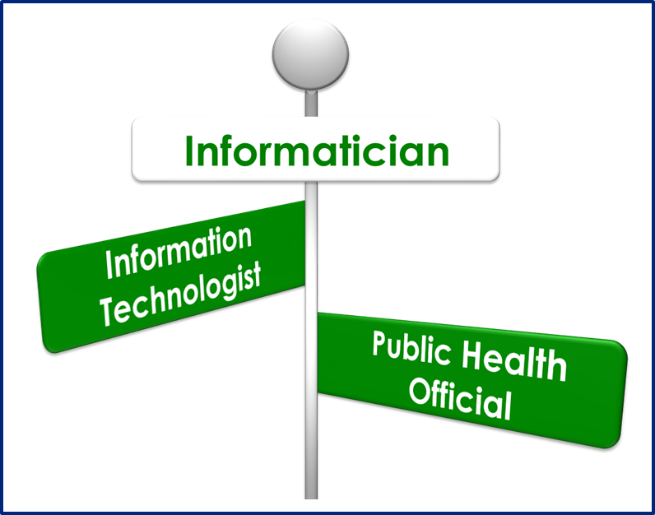
Topic 4
At the Intersection
of the Informatician,
the Public Health Official,
and the Information Technologist
Notes:
Topic 3
At the Intersection of the Informatician, the Public Health Official, and the Information Technologist
GO to next slide.

Slide 27
Common Knowledge and Skills
Creating a Public Health Information System | Public health official | Informatician | Information technology professional
Step 1 — Vision and System Planning
Envision solutions, opportunities, and application of information technology in public health
Step 2 — Health Data Standards and Integration
Define and design health data standards and transformation (e.g., HL7, ICD, SNOMED) and health domain integration (e.g., ELR, EHR, CMS, HIE, surveillance, demographics, social media)
Design and implement databases, tables, columns, data formats, and keys for linking tables and data to support defined health data standards and integration
Step 3 — Data Privacy and Security
Define and implement health data privacy and HIPAA regulations
Implement and enforce data, systems, and communication security
Step 4 — Systems Design and Implementation
Define and design methods for public health functions, data elements, data flow, case definitions, and message mapping
Implement information technology for defined functions, data elements, data flow, and case definitions
Step 5 — Visualization, Analysis, and Reporting of Health Data
Broad knowledge of public health practice, proficiency in information technology, and capacity for innovation
Expertise in health data standards, database design, and data linking and integration across health systems
Expertise in relational/SQL databases and unstructured data design and management
Knowledge of health data privacy
Understanding information technology security functions
Expertise in health systems and data interoperability
Expertise in managing information technology systems development
Expertise in public health practice, business intelligence, decision making, and use of analytic software
CMS = Centers for Medicare and Medicaid Services; EHR = electronic health record; ELR = electronic laboratory record; HIE = health information exchange; HIPAA = Health Insurance Portability and Accountability Act; HL7 = Health Level 7; ICD = International Classification of Diseases; SNOMED = Systematized Nomenclature of Human Medicine; SQL = structured query language.
Notes:
SAY:
Let’s refer back to the chart that details how to create a public health information system.
<ALLOW participants time to retrieve the handout of the chart.>
We’ll now take a look at how the common knowledge and skills of the informatician, the public health official, and the information technologist intersect.
<DIRECT participants to the right side of the chart where public health, informatics, and information technology columns are displayed.>
Notice that the informatician shares common knowledge and skills with both professions and often acts as a translator or a bridge between public health program staff and information technology specialists.
GO to next slide.

Slide 28
Step 4 — Creating a Public Health Information System
Creating a Public Health Information System | Public health official | Informatician | Information technology professional
Step 4 — Systems Design and Implementation
Define and design methods for public health functions, data elements, data flow, case definition, and message mapping
Implement information technology for defined public health functions, data elements, data flow, and case definition
Step 4 – Systems Design and Implementation
Expertise in health systems and data interoperability
Expertise in managing information technology systems development
Notes:
SAY:
The informatician brings expertise to the table to communicate what is needed to both the public health customer and the system. Therefore, all three professionals must collaborate to attain a public health goal.
For example, let’s look at Step 4, Systems Design and Implementation.
Notice that the informatician has a broad knowledge of defining or designing methods for public health functions, data elements, data flow, case definition, and message mapping. The public health official has knowledge of the process and can therefore offer skills in defining and designing the necessary methods to attain the goal.
However, the public health official has no knowledge of implementing information technology for defined public health functions, data elements, data flow, and case definition. The informatician has limited knowledge in this area and therefore relies heavily on the information technology professional’s expertise in managing systems development.
GO to next slide.

Slide 29


Combined Disciplines — The Informatician and the Information Technologist
Notes:
SAY:
Although the informatician shares knowledge with public health officials, they work more closely with information technologists to accomplish public health goals.
When collaborating, the informatician applies knowledge of health problems and information needs, while the information technologist applies knowledge of systems and design.
As we learned earlier, informaticians possess a broad knowledge of
security,
data standards,
the White House Office of Management and Budget regulations regarding use of federal funds, and
other policies that influence system design and operation.
Information technology professionals are knowledgeable about
technology standards,
servers,
communication networks,
programming languages, and
system design architecture.
GO to next slide.

Slide 30
The Role of the Informatician
in Public Health
Plans, designs, and defines functional requirements for public health information systems
Evaluates the application and impact of information systems in support of health goals
Serves as a liaison between multidisciplinary teams
Uses data standards to support interoperability of data between systems
Ensures confidentiality, security, and integrity standards
Is knowledgeable about health data standards, sources, and meaningful use of health data
Centers for Disease Control and Prevention (CDC). Public health informatics competencies. Atlanta, GA: US Department of Health and Human Services, CDC; 2009. http://www.cdc.gov/informaticscompetencies/.
Notes:
SAY:
Although informaticians employ many different disciplines in their practice, their key responsibility is to understand how systems can best support the translation of data into useful public health information.
Although not an exhaustive list, the informatician
<READ the bullets on the slide.>
GO to next slide.

Slide 31
The Role of the Information Technologist
in Public Health
Plans technology projects and milestones, develops software, and maintains and operates systems
Evaluates the performance and availability of information systems
Designs, implements, and administers database architecture, privacy, security, and backup procedures
Centers for Disease Control and Prevention (CDC). Public health informatics competencies. Atlanta, GA: US Department of Health and Human Services, CDC; 2009. http://www.cdc.gov/informaticscompetencies/.
Notes:
SAY:
Information technology professionals specialize in the study or use of systems (especially computers and telecommunications) for storing, retrieving, and sending information.
They are knowledgeable about technology standards, servers, and communication networks, and they are skilled extensively in programming languages and systems design architecture.
When working with the public health informatician, information technology professionals use data specifications to develop programs, such as
data entry forms and
data coding or transformation tools.
They also design tables and columns to define the keys or index columns to retrieve, sort, and integrate the data across tables. The information technologist, therefore,
<READ the bullets on the slide.>
By combining the two disciplines, an information solution can be developed that will have an impact in solving different public health challenges.
GO to next slide.

Slide 32

Knowledge Check
One of the United Nations’ Millennium Development Goals is to substantially reduce infant mortality worldwide. A system has been developed that will display the data and track the progress of attaining this goal.
Which of the following professionals works with health data standards and sources and ensures the integrity and security of the standards?
The information technologist
The informatician
Notes:
<READ the knowledge check question and wait for participant responses.>
<CLICK for the correct answer to appear.>
The correct answer is B, the informatician.
SAY:
Informatics serves as a bridge between the two professions because it shares common knowledge and skillsets with both.
GO to next slide.

Slide 33
Knowledge Check
Which of the following is NOT a function of a public health informatician?
Uses data standards to support interoperability of data between systems
Ensures confidentiality, security, and integrity standards
Designs, implements, and administers database architecture, privacy, security, and backup procedures
Is knowledgeable about health data standards, sources, and meaningful use of health data
Notes:
<READ the knowledge check question and wait for participant responses.>
<CLICK for the correct answer to appear.>
The correct answer is C, designs, implements, and administers database architecture, privacy, security, and backup procedures. These functions are the responsibility of an information technologist.
GO to next slide.

Slide 34
Learning Objectives
During this course, you learned to
explain the importance of informatics to the public health mission
describe the role of the Informatician in public health practice
differentiate between public health informatics and information technology
Notes:
SAY:
Now that you have completed this course, you have learned to
<READ the bullets on the slide.>
GO to next slide.

Slide 35
QUESTIONS?
Notes:
GO to next slide.

Slide 36
Resources and Additional Reading
  Yasnoff WA, O’Carroll PW, Koo D, Linkins RW, Kilbourne EM. Public health informatics: improving and transforming public health in the information age. J Public Health Manag Pract 2000;6:67–75.
  Riegelman R, ed. Public health 101: healthy people—healthy populations. Sudbury, MA: Jones & Bartlett Learning; 2010: 40.
  Centers for Disease Control and Prevention (CDC). Public health approach. Atlanta, GA: US Department of Health and Human Services, CDC; 2008. http://www.cdc.gov/
  ViolencePrevention/overview/publichealthapproach.html.
  Taylor RS. Value-added processes in the information life cycle. J Am Soc Inf Sci 1982:33:341–6. http://asis.org/Publications/JASIS/Best_Jasist/1982Taylor.pdf.
  Centers for Disease Control and Prevention (CDC). Public health informatics competencies. Atlanta, GA: US Department of Health and Human Services, CDC; 2009. http://www.cdc.gov/informaticscompetencies/.
  Centers for Disease Control and Prevention (CDC). FluView. Atlanta, GA: US Department of Health and Human Services, CDC; 2013. http://gis.cdc.gov/grasp/fluview/main.html.
  Environmental Protection Agency (EPA). Data standards. Washington, DC: EPA; 2013. https://iaspub.epa.gov/sor_internet/registry/datastds/home/whatisadatastandard/.
  Centers for Disease Control and Prevention (CDC). Youth violence: state statistics; Texas. Atlanta, GA: US Department of Health and Human Services, CDC; 2011. http://www.cdc.gov/ViolencePrevention/youthviolence/stats_at-a_glance/TX.html.
Notes:
SAY:
The information from this course is based on these resources; I encourage you to take a look at them.
GO to next slide.

Slide 37
Disclaimers
Links provided in this course to nonfederal organizations are provided solely as a service to our users. These links do not constitute an endorsement of these organizations nor their programs by the Centers for Disease Control and Prevention (CDC) or the federal government, and none should be inferred. CDC is not responsible for the content contained at these sites.
Use of trade names and commercial sources is for identification only and does not imply endorsement by the Division of Scientific Education and Professional Development, Center for Surveillance, Epidemiology, and Laboratory Services, Centers for Disease Control and Prevention, the Public Health Service, or the U.S. Department of Health and Human Services.
The findings and conclusions in this course are those of the authors and do not necessarily represent the official position of the Centers for Disease Control and Prevention.
Notes:
GO to next slide.

Slide 38
For more information, please contact the Centers for Disease Control and Prevention
1600 Clifton Road, NE, Atlanta, GA 30333
Telephone: 1-800-CDC-INFO (232-4636)/TTY: 1-888-232-6348
Visit: http://www.cdc.gov | Contact CDC at: 1-800-CDC-INFO or http://www.cdc.gov/info
The findings and conclusions in this course are those of the authors and do not necessarily represent the official position of the Centers for Disease Control and Prevention.
Center for Surveillance, Epidemiology, and Laboratory Services
Division of Scientific Education and Professional Development

