Slide 1



Public Health 101 Series
Introduction to Prevention Effectiveness
Instructor name
Title
Organization
Note: This slide set is in the public domain and may be customized as needed by the user for informational or educational purposes. Permission from the Centers for Disease Control and Prevention is not required, but citation of the source is appreciated.
Notes:
<WELCOME learners to the Introduction to Prevention Effectiveness course and provide your background.>
GO to next slide.

Slide 2
Course Topics
Introduction to Prevention
Effectiveness
A Public Health Approach
What Is Prevention Effectiveness?
Prevention Effectiveness Study Design
Economic Costs
Types of Economic Evaluations
Notes:
SAY:
Today we are discussing several interrelated topics that, taken together, provide an overview of prevention effectiveness. These are our course topics for today.
<READ each topic on the slide.>
GO to next slide.

Slide 3
Learning Objectives
After completing this course, you will be able to
define prevention effectiveness
describe the key components of prevention effectiveness studies
identify basic economic evaluation methods used in prevention effectiveness studies
identify data used in the most common types of economic evaluation methods
Notes:
SAY:
After this course, you will be able to
<READ each objective on the slide.>
GO to next slide.

Slide 4

Topic 1
A Public Health Approach
Notes:
Topic 1
A Public Health Approach
GO to next slide.

Slide 5


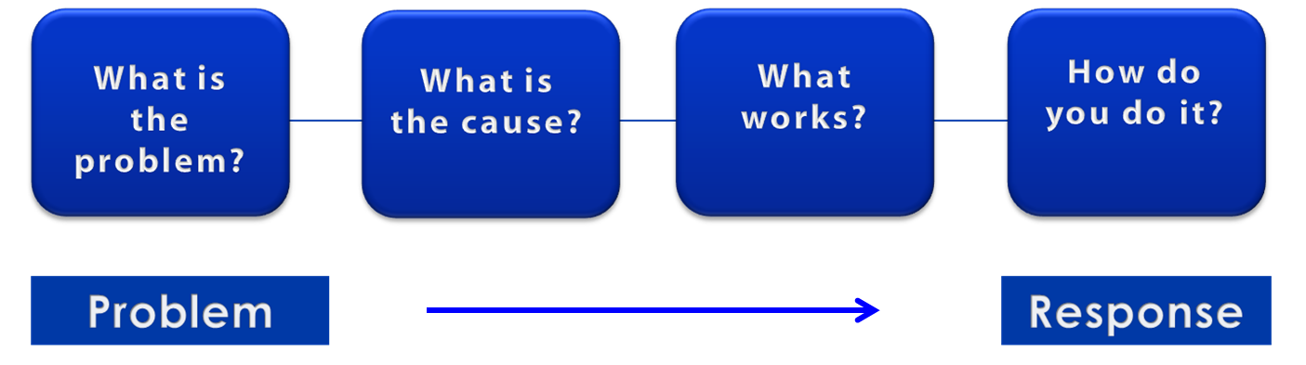
A Public Health Approach
Risk Factor Identification
Intervention
Evaluation
Surveillance
Implementation
5
Notes:
SAY:
Let’s talk about public health in a broader context. Public health problems are diverse and can include infectious diseases, chronic diseases, emergencies, injuries, environmental health problems, as well as other health threats.
Regardless of the topic, we take the same approach to a public health problem by following four general steps.
<CLICK for first arrow to appear.>
First, we ask “What is the problem?”
In public health, we identify the problem by using surveillance systems to monitor health events and behaviors occurring among a population.
After we’ve identified the problem, the next question is, “What is the cause of the problem?”
<CLICK to advance animation; first arrow will disappear, and second arrow will appear above Risk Factor Identification box.>
For example, are there factors that might make certain populations more susceptible to disease, such as something in the environment or certain behaviors that people are practicing?
<CLICK to advance animation; second arrow will disappear, and third arrow will appear above Intervention Evaluation box.>
Once we’ve identified the risk factors related to the problem, we ask, “What intervention works to address the problem?”
We look at what has worked in the past in addressing this same problem and if a proposed intervention makes sense with our affected population.
<CLICK to advance animation; third arrow will disappear, and fourth arrow will appear above Implementation box.>
In the last step, we ask, “How can we implement the intervention? Given the resources we have and what we know about the affected population, will this work?”
As we go through this course, you will see different examples of this public health approach at work.
GO to next slide.

Slide 6
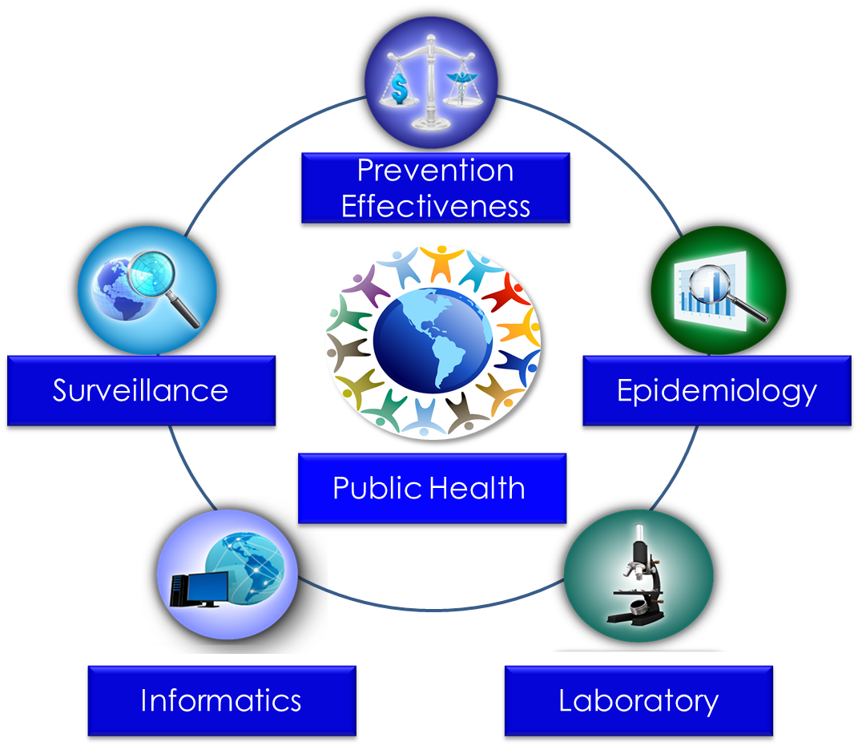
Public Health Core Sciences
Notes:
SAY:
To implement the public health approach, practitioners use and apply scientific methods. These methods come from a series of core sciences that provide the foundation.
These sciences include Public Health Surveillance, which we use to monitor a public health situation.
Epidemiology enables us to determine where diseases originate, how or why they move through populations, and how we can prevent them.
Public Health Laboratories support public health by performing tests to confirm disease diagnoses. Laboratories also support public health by conducting research and training.
As we continue to move from the use of paper documents to electronic health records, Public Health Informatics continues to increase in importance. Informatics deals with the methods for collecting, compiling, and presenting health information. It enables us to use electronic data effectively when addressing a public health situation.
Prevention Effectiveness is closely linked to public health policy. Prevention effectiveness studies provide important economic information for decision makers to help them choose the best option available.
Together, these five core sciences can help us protect and promote the public’s health by giving public health practitioners the answers they need. Public health is better able to respond to the situation by using contributions from each of these sciences. One science alone cannot answer the questions and provide a solution; it is the application of these core sciences together.
<OPTIONAL, IF YOU HAVE TIME, SAY>
For example, let’s look at the public health problem of influenza. Public health surveillance can monitor when and where cases of influenza occur each year. Professionals can use the science of epidemiology to understand why different populations choose to get vaccinated against influenza. They can use the science of informatics to receive and analyze electronic information from health care institutions (e.g., doctors’ offices and hospitals) to determine whether persons who get influenza go to see a doctor and whether they get well or die. Public health practitioners can use laboratory science to determine whether persons with fever and cough have influenza or a different infection, and they can use prevention effectiveness to show that influenza vaccination campaigns that might cost $200,000 can prevent $1 million in medical costs, lost wages, and other costs.
GO to next slide.

Slide 7
Topic 2
What Is Prevention Effectiveness?
Notes:
Topic 2
What is Prevention Effectiveness?
SAY:
Now, let’s take a look at what prevention effectiveness is. We will also take a look at
prevention effectiveness functions,
the strategy life cycle, and
what prompts a prevention effectiveness study.
GO to next slide.

Slide 8

Prevention Effectiveness Defined
Prevention effectiveness is the systematic assessment of the impact of public health policies, programs, and practices on health outcomes by determining their effectiveness, safety, and costs.
Haddix AC, Teutsch SM, Corso PS. Prevention effectiveness: a guide to decision analysis and economic evaluation, 2nd ed. New York, NY: Oxford University Press; 2002.
Notes:
SAY:
What is prevention effectiveness?
<READ the definition on the slide.>
SAY:
It is closely linked to policy and provides decision makers with crucial information that is necessary in allocating resources around programmatic priorities.
GO to next slide.

Slide 9
What Prevention Effectiveness Does
Assesses
the impact
of prevention policies, programs, and practices
Evaluates
the allocation
of health care resources
Provides decision makers
with information
for action
Centers for Disease Control and Prevention (CDC). What is prevention effectiveness? Atlanta, GA: US Department of Health and Human Services, CDC; 2010. http://www.cdc.gov/PEF/WhatIs.html.
Haddix AC, Teutsch SM, Corso PS, eds. Prevention effectiveness: a guide to decision analysis and economic evaluation. 2nd ed. Oxford, England: Oxford University Press; 2002: 1.
Notes:
SAY:
Prevention effectiveness is useful for many reasons, including
assessing the impact of prevention policies, programs, and practices on public health outcomes by determining their effectiveness, safety, and costs;
evaluating allocation of health care resources by asking
— what interventions?
— who pays?
— who benefits?; and
providing decision makers with such information as comparisons between options, what might happen if a given option is chosen, or how best to allocate resources.
GO to next slide.

Slide 10


Prevention Effectiveness in Developing and Implementing Prevention Strategies
Basic
Research
Applied
Research
Community
Demonstrations
Implementation
Is prevention
plausible?
Can prevention work (efficacy)?
Does
prevention
work (effectiveness)?
Is it continuing
to work?
Prevention Effectiveness
Adapted from: Haddix AC, Teutsch SM, Corso PS, eds. Prevention effectiveness: a guide to decision analysis and economic evaluation. 2nd ed. Oxford, England: Oxford University Press; 2002: 2.
Notes:
SAY:
Now, let’s take a look at the prevention effectiveness strategy life cycle.
The graphic you see details the process of developing and implementing a prevention strategy. The arrows indicate the steps of a prevention strategy, and the steps represent the questions that need to be answered.
We’ll begin with the first step.
<READ the first step.>
Basic Research
Is prevention plausible?
Risk factors and their impact are identified through basic research. After the results are known, potential interventions can be developed. At this point, a determination is made regarding prevention plausibility.
<READ the second step.>
Applied Research
Can prevention work?
Applied research, such as randomized controlled trials, is conducted in this step. This type of research can demonstrate the degree to which an intervention works under ideal conditions, with carefully selected populations, and in many cases, with optimal resources. This stage will help determine if the intervention is efficacious, meaning if it will work.
<READ the third step.>
Community Demonstrations
Does prevention work?
Next, how well these strategies work in real-world conditions, such as community settings, is determined.
<READ the fourth step.>
Implementation
Is it continuing to work?
Lastly, assuming that the first three questions have been answered, the implementation of the strategy is assessed. Is it working according to plan?
GO to next slide.

Slide 11


Knowledge Check
Prevention effectiveness includes which of the following? (Select all that apply.)
Examining costs and benefits
Providing funding for an intervention
Evaluating allocation of health care resources
Assessing the impact of different policies,
programs, and practices
Notes:
SAY:
Let’s review what we have learned about prevention effectiveness so far through a knowledge check.
<READ the knowledge check question and elicit participant responses.>
<CLICK for correct answers to appear.>
The correct answers are A, C, and D, examining costs and benefits, evaluating the allocation of health care resources, and assessing the impact of different policies, programs, and practices.
SAY:
Prevention effectiveness provides information that helps decision makers consider different policies, programs, and practices. Prevention effectiveness does not provide the funding.
GO to next slide.

Slide 12
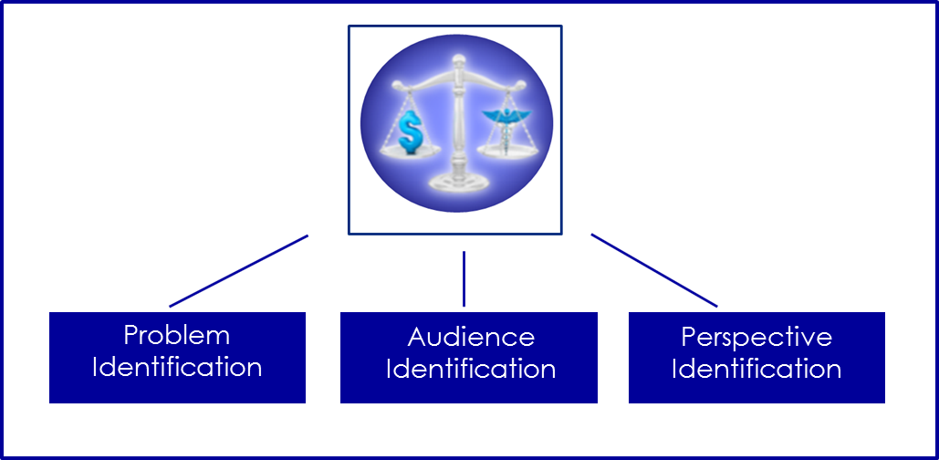
Topic 3
Prevention Effectiveness
Study Design
Notes:
Topic 3
Prevention Effectiveness Study Design
SAY:
Now, let’s turn our focus to the three types of prevention effectiveness study designs.
GO to next slide.

Slide 13
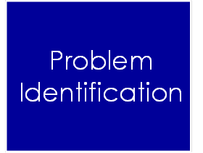
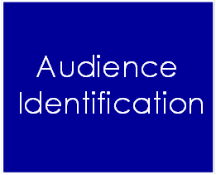
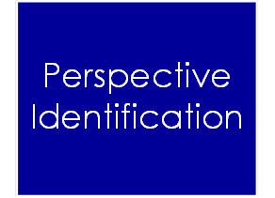
Prevention Effectiveness
Design Approaches
Notes:
SAY:
Prevention effectiveness analysis attempts to determine what will happen with a given policy, compared with not having that policy. Prevention effectiveness studies seek to directly link the intervention with the health outcome.
The study should be framed correctly by using three specific study design approaches that include
problem identification,
audience identification, and
perspective identification.
GO to next slide.

Slide 14

Problem Identification
Any health-related situation in which a policy solution or management decision can be applied
Haddix AC, Teutsch SM, Corso PS, eds. Prevention effectiveness: a guide to decision analysis and economic evaluation. 2nd ed. Oxford, England: Oxford University Press; 2002.
Centers for Disease Control and Prevention (CDC). Framing an economic evaluation [self-study course]. Atlanta, GA: US Department of Health and Human Services, CDC; [undated]. http://www.cdc.gov/owcd/eet/framing3/1.html.
Notes:
SAY:
Let’s take a look at the first study element, problem identification.
In this study element, the problem is any health-related situation in which a policy solution or management decision can be applied. Defining the problem is the most crucial step and can be the most difficult part of any prevention effectiveness study.
Public health surveillance monitors health trends to find early signs of outbreaks and epidemics and also characterizes the nature of public health problems. Estimating the cost of an HIV/AIDS surveillance system is an example of defining a problem statement. In this case, the problem is how widespread HIV/AIDS is in the United States.
In this study, cost and outcome data were lacking in the scientific literature. Initially, much time was spent trying to define what constitutes HIV/AIDS surveillance in the US when all of the state, local, public, private, and federal efforts regarding HIV/AIDS were taken into consideration. However, after a definition of a surveillance system was identified, moving forward in the study was much more straight forward.
GO to next slide.

Slide 15

Audience Identification
Policy and program decision makers
Health care organizations
Researchers
Clinical workers
The general public
The media
Haddix AC, Teutsch SM, Corso PS, eds. Prevention effectiveness: a guide to decision analysis and economic evaluation. 2nd ed. Oxford, England: Oxford University Press; 2002.
Centers for Disease Control. A framework for assessing the effectiveness of disease and injury prevention. MMWR Recommend Report 1992;41(No. RR-3).
Notes:
SAY:
The next study design element is audience identification.
A prevention effectiveness study might have different target audiences.
Public health professionals and policymakers at the national, state, and local levels make judgments concerning public health priorities, select prevention strategies, and allocate resources.
Health care practitioners, insurance companies, and Medicaid/Medicare administrators make decisions about clinical strategies for delivering preventive services. Study results must be presented in a way that the intended audience can understand, especially for those who are neither economic nor public health experts.
The primary audience is not the only consumer of the study. A study intended for policymakers, for example, might be used for further research, or as a basis for a media campaign to inform consumers.
GO to next slide.

Slide 16
Perspective Identification
Cost item | Patient | Physician | Payer (e.g., insurance, Medicaid) | Society
Physician time |  |  |  | 
Medication |  |  |  | 
Administration |  |  |  | 
Patient travel |  |  |  | 
Time off from work |  |  |  | 
Notes:
SAY:
The final study design approach is perspective identification.
Perspective is the voice of the study through whose lens the study is being viewed.
Each prevention effectiveness study is conducted from a specific perspective that involves
who pays,
who benefits, and
what is paid.
Let’s take a look at an example.
The checkmarks in this table indicate which cost item from the column at the left is important to each person on the chart: the patient, physician, payer, or society.
A patient with some form of insurance usually pays a small fee, or “copay,” for services received. However, the biggest cost for many patients is time. Although time is important, so is the cost of medication. This might not be a concern to a patient with insurance, but for the uninsured, drug or treatment costs can be prohibitive.
The physician is probably concerned about how much time he or she spends with each patient because of the office administrative costs (overhead and staff salaries).
The payer (usually the insurance company) is certainly looking at the cost of medications as well as that company’s administrative costs.
Society considers all of the perspectives. Prevention effectiveness analyses typically take the societal perspective.
The audience of the study is the end-user, and the study is often looking at factors from that perspective.
GO to next slide.

Slide 17
Knowledge Check
Fill in the blanks with the correct answers.
What are the three prevention effectiveness study design approaches?
1.
2.
3.
Problem identification
Audience identification
Perspective identification
Notes:
<READ the knowledge check question and elicit participant responses.>
<CLICK for answers to appear.>
The correct answers are problem identification, audience identification, and perspective identification.
<NOTE that answers are in no specific order.>
SAY:
Study designs identify the problem, audience, and perspective.
GO to next slide.

Slide 18
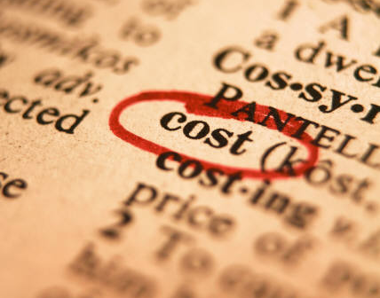
Topic 4
Economic Costs
Notes:
Topic 4
Economic Costs
SAY:
Cost is a component in most prevention effectiveness studies, particularly economic evaluations.
GO to next slide.

Slide 19

Prevention Effectiveness Costs
Direct
Indirect
Intangible
Opportunity
Notes:
SAY:
Cost considerations are an important aspect of a prevention effectiveness study and the main quantitative variable that can be used in the analysis. Categorizing costs can be performed in many different ways that are sometimes simple, but others are not so apparent at first glance.
The main types of costs include
direct,
indirect,
intangible, and
opportunity costs.
Let’s begin with direct costs.
GO to next slide.

Slide 20

Direct Costs
Medications
Medical devices
Computer software and equipment
Research and development
Inpatient care
Haddix AC, Teutsch SM, Corso PS, eds. Prevention effectiveness: a guide to decision analysis and economic evaluation. 2nd ed. Oxford, England: Oxford University Press; 2002.
Centers for Disease Control. A framework for assessing the effectiveness of disease and injury prevention. MMWR Recommend Report 1992;41(No. RR-3).
Notes:
SAY:
Direct costs can be medical and nonmedical, such as medications or fees associated with receiving a flu shot.
Other examples of direct medical costs include
medical devices,
computer software and equipment,
research and development, and
in-patient care.
<DISCUSS a few of the bullet points, as appropriate.>
GO to next slide.

Slide 21

Indirect Costs
Change in productivity
Costs of absenteeism
Foregone leisure time
Time spent caring for the patient
Haddix AC, Teutsch SM, Corso PS, eds. Prevention effectiveness: a guide to decision analysis and economic evaluation. 2nd ed. Oxford, England: Oxford University Press; 2002.
Centers for Disease Control. A framework for assessing the effectiveness of disease and injury prevention. MMWR Recommend Report 1992;41(No. RR-3).
Notes:
SAY:
Next, indirect costs include time or productivity. For example, if a patient is not working because of a scheduled appointment at the doctor’s office, time and productivity are lost at the job.
Additional examples of indirect costs include
changes in productivity resulting from a change in health status,
costs of absenteeism,
foregone leisure time, and
time spent by family and friends caring for the patient.
<DISCUSS a few of the bullet points, as appropriate.>
GO to next slide.

Slide 22

Intangible Costs
Physical pain and suffering
Emotional anxiety
Social stigmatization
Haddix AC, Teutsch SM, Corso PS, eds. Prevention effectiveness: a guide to decision analysis and economic evaluation. 2nd ed. Oxford, England: Oxford University Press; 2002.
Notes:
SAY:
Intangible costs are the third type of cost. These costs are often difficult to measure with a monetary value, yet they affect decision making. They include what the patient perceives as a risk. This might be physical pain, such as from a vaccination, anxiety about a medical procedure, or social stigmatization, which might occur after a disease or health condition is diagnosed.
<DISCUSS a few of the bullet points, as appropriate.>
GO to next slide.

Slide 23

Opportunity Costs
Monetary and nonmonetary
Costs and charges
Notes:
SAY:
The final economic costs are referred to as opportunity costs. Because resources are limited, not all interventions can be implemented. The cost of a prevention strategy must reflect what might be gained by alternative strategies. They can be monetary or nonmonetary, such as time and productivity losses for employees and employers during a flu outbreak or worker injuries and health and safety hazards.
Another way of thinking about opportunity costs is to consider what opportunities might be lost now or in the future by choosing a particular intervention strategy.
Differentiating between costs and charges is important. Costs are the resources used for a selected opportunity. For example, if we put resources toward a cholesterol screening program, we cannot use those resources elsewhere. In contrast, the charge for a product or service does not always represent the true cost. For example, to encourage cholesterol screening, a clinic might only charge $5, but that charge likely does not cover all of the costs associated with the screening, such as the staff needed to conduct the screening and the costs of screening supplies.
GO to next slide.

Slide 24

Knowledge Check
Choose the best answer from the choices below.
Prevention effectiveness costs are important to a study because they are often the main quantitative variable for use in
prevention
analysis
identification
effectiveness
Notes:
<READ the knowledge check question and elicit participant responses.>
<CLICK for correct answer to appear.>
The correct answer is B, analysis.
GO to next slide.

Slide 25

Topic 5
Types of Economic
Evaluations
Notes:
Topic 5
Types of Economic Evaluations
SAY:
Let’s now take a look at the different prevention effectiveness analytic methods.
GO to next slide.

Slide 26

Types of Economic Evaluations
The choice of economic evaluations used is dependent on
audience
study question
data
Notes:
SAY:
Now that we’ve covered the types of costs examined in a prevention effectiveness study, let’s compare the types of economic evaluations.
The methods used depend on the audience, the study question, and the available data. In some economic studies, more than one method is used to answer specific questions.
Now, let’s explore the main economic evaluation methods used.
Economic evaluations of a prevention effectiveness study involve four common methods,
cost analysis,
cost-effectiveness analysis,
cost-utility analysis, and
cost-benefit analysis.
These methods use many different sources of data. They consider the costs, benefits, and disadvantages of different program and policy options.
GO to next slide.

Slide 27
Comparison of Economic Evaluation Methods
Method | Data inputs used | Outcome value desired
Cost analysis | Costs | Total program or intervention cost (typically reported as cost per patient or cost per service rendered)
Cost-effectiveness | Net cost of intervention versus intervention effectiveness | Dollars per life saved because of an intervention
Cost-utility | Quality‐adjusted life years (QALYs) | Number of life years saved, adjusted to account for loss of quality
Cost-benefit | Money | Net costs or savings of an intervention
Notes:
SAY:
Here is a brief overview of each method.
A cost analysis identifies the total cost for a program or intervention. It is typically reported as the cost per patient or cost per services rendered.
A cost-effectiveness study is used to estimate the dollars per life saved. Cost-effectiveness measures dollars expended per health outcome attained. For example, if certain types of diseases are prevented, lives are saved. This is the most common method.
A cost-utility study looks at outcomes measured in quality-adjusted life years, or QALYs, or years of healthy life, YHL. A standard formula is used to determine QALYs. For example, 1 year of perfect health = 1 QALY, but if the quality of health is reduced during that year (for example, being bedridden), the QALY is proportionally reduced.
A cost-benefit method converts health outcomes into dollars on the basis of willingness to pay for the health outcomes, and the results are provided as net costs or net savings. This method considers costs and benefits across a time continuum. A cost-benefit analysis allows the investigator to evaluate a health intervention against a nonhealth intervention. For example, if a policymaker has $100,000 to spend and has multiple health-related and nonhealth–related options, a cost-benefit analysis can assist by providing data to use in deciding where to spend the dollars for the best possible results.
GO to next slide.

Slide 28

Cost Analysis
Considers program or intervention costs and cost of illness
Achieves cost minimization for the program under consideration
Notes:
SAY:
A cost analysis estimates the total costs of a program or intervention with the goal of identifying the least costly method for obtaining a certain level or output.
Many think cost analysis is the only economic analysis conducted in prevention effectiveness. In reality, it is most useful as a first step when a policymaker is deciding, “What am I getting in return for investing in a given public health project or service?” An example is performing a cost analysis of a program or intervention to observe the changes in average costs over time that occur as a program matures.
The first year of a new program is likely to have substantial start-up costs, yet examining the average costs over time can provide a more valid representation of the program’s total costs.
GO to next slide.

Slide 29

Cost-Effectiveness Analysis
Compares interventions for the same disease or condition among a common population
Grosse SD. Presentation to the Canadian Pediatric Endocrine Group 2011 Scientific Meeting, Toronto, Ontario, February 12, 2011.
Notes:
SAY:
Cost-effectiveness analysis is used when comparing the net cost of an intervention to its effectiveness. This method, which is the most common economic analysis in public health, is useful when comparing one or more interventions for the same disease or condition among a common population. A cost-effectiveness analysis is not designed to compare different health conditions, and it does not address quality of life.
When you hear the phrases “dollars per life saved” or “dollars per illness averted,” reference is being made to a cost-effectiveness analysis.
In public health prevention effectiveness, the term “cost-effective” has two distinct technical meanings. If an intervention is determined to be cost-saving, the choice is easy. The cost of the intervention is less than that of the alternative.
If we say that the intervention is cost-effective, the cost is higher than the alternative, but that cost is worthwhile. Policymakers must decide how much we are willing to pay per death or illness averted. To be able to make such decisions, they must have the data related to the health outcomes.
GO to next slide.

Slide 30

Cost-Utility Analysis
Considers quality-adjusted life years
Compares interventions for same disease or injury
Notes:
SAY:
A cost-utility analysis is a method that estimates the cost-effectiveness of an intervention. It is useful when comparing utility among a well-defined population, assuming the utility is the same among different interventions. This analysis also combines multiple outcomes into one QALY, or quality-adjusted life year.
GO to next slide.

Slide 31

Cost-Benefit Analysis
Evaluates multiple options
Compares different options among sectors
Centers for Disease Control and Prevention (CDC). Cost-benefit analysis [self-study course]. Atlanta, GA: US Department of Health and Human Services, CDC; [undated]. ttp://www.cdc.gov/owcd/EET/CBA/Fixed/1.html.
Notes:
SAY:
Finally, a cost-benefit analysis is used when a policymaker requests a single dollar amount to
evaluate multiple options, or
compare different options among sectors.
An intervention option is effective if benefits are greater than costs. The challenge of assigning a monetary value to health outcomes, such as a human life, is difficult and controversial.
GO to next slide.

Slide 32
Knowledge Check
Choose the correct answer from the choices below.
Selecting the best economic evaluation method is dependent on the audience, the study question, and the ________________.
data
cost
policy
application
Notes:
<READ the knowledge check question and elicit participant responses.>
<CLICK for correct answer to appear.>
The correct answer is A, data.
GO to next slide.

Slide 33
Knowledge Check
Match the data used with each method of analysis
Cost-utility analysis
Cost-effectiveness analysis
Cost-benefit analysis
Cost analysis
A. Cost-utility analysis
1. Quality-adjusted life years
D. Cost analysis
2. Cost
C. Cost-benefit analysis
3. Money
B. Cost-effectiveness analysis
4. Net cost of intervention versus
intervention’s effectiveness
Notes:
<READ the first knowledge check question and ELICIT participant responses.>
<CLICK for answer to appear.>
The correct answer is A, cost-utility analysis.
<READ the second knowledge check question and ELICIT participant responses.>
<CLICK for answer to appear.>
The correct answer is D, cost analysis.
<READ the third knowledge check question and ELICIT participant responses.>
<CLICK for answer to appear.>
The correct answer is C, cost-benefit analysis.
<READ the fourth knowledge check question and ELICIT participant responses.>
<CLICK for answer to appear.>
The correct answer is B, cost-effectiveness analysis.
GO to next slide.

Slide 34
Course Summary
During this course, you learned to
define prevention effectiveness
describe the key components of prevention effectiveness studies
identify basic economic evaluation methods used in prevention effectiveness studies
identify data used in the most common types of economic evaluation methods
Notes:
SAY:
Let’s review the learning objectives for this course.
<READ the objectives listed on the slide.>
GO to next slide.

Slide 35
QUESTIONS?
Notes:
GO to next slide.

Slide 36
Acknowledgments
Ricardo Basurto-Davila, PhD, MSc, Los Angeles County Department of Public Health, California
Paul Farnham, PhD, National Center for HIV/AIDS, Viral Hepatitis, STD, and TB Prevention, Centers for Disease Control and Prevention, Atlanta, Georgia
Martin Meltzer, PhD, MS, National Center for Emerging and Zoonotic Infectious Diseases
Notes:
GO to next slide.

Slide 37
Resources and Additional Reading
Haddix AC, Teutsch SM, Corso PS, eds. Prevention effectiveness: a guide to decision analysis and economic evaluation. 2nd ed. Oxford, England: Oxford University Press; 2002.
Prosser LA, Bridges CB, Uyeki TM, et al. Health benefits, risks, and cost-effectiveness of influenza vaccination of children. Emerg Infect Dis 2006;12:1548–58.
Centers for Disease Control. A framework for assessing the effectiveness of disease and injury prevention. MMWR Recommend Report 1992;41(No. RR-3).
Centers for Disease Control and Prevention (CDC). What is prevention effectiveness? Atlanta, GA: US Department of Health and Human Services, CDC; 2010. http://www.cdc.gov/PEF/WhatIs.html.
Centers for Disease Control and Prevention (CDC). Framing an economic evaluation [self-study course]. Atlanta, GA: US Department of Health and Human Services, CDC; [undated]. http://www.cdc.gov/owcd/eet/framing3/1.html.
Meltzer MI, Cox NJ, Fukuda K. The economic impact of pandemic influenza in the United States: priorities for intervention. Emerg Infect Dis 1999;5:659–71.
Grosse SD. Presentation to the Canadian Pediatric Endocrine Group 2011 Scientific Meeting, Toronto, Ontario, February 12, 2011.
Centers for Disease Control and Prevention (CDC). Cost-benefit analysis [self-study course]. Atlanta, GA: US Department of Health and Human Services, CDC; [undated]. ttp://www.cdc.gov/owcd/EET/CBA/Fixed/1.html.
Wagner TH, Engelstad LP, McPhee SJ, Pasick RJ. The costs of an outreach intervention for low-income women with abnormal Pap smears. Prev Chronic Dis. 2007;4:A11. Epub Dec 15, 2006.
Centers for Disease Control and Prevention (CDC). Cervical cancer statistics. Atlanta, GA: US Department of Health and Human Services, CDC; 2012. http://www.cdc.gov/cancer/cervical/statistics/.
Notes:
SAY:
The information from this course is based on these resources; I encourage you to take a look at them after this course.
GO to next slide.

Slide 38
Resources and Additional Reading
Drummond MF, Sculpher MJ, Torrance GW, O’Brien B, Stoddart GL. Methods for the economic evaluation of health care programmes. 3rd ed. Oxford, England: Oxford University Press; 2005.
Gold MR, Siegal JE, Russell LB, Weinstein MC, eds. Cost-effectiveness in health and medicine. Oxford, England: Oxford University Press;1996.
Patrick DL, Erickson P. Health status and health policy: quality of life in health care evaluation and resource allocation. Oxford, England: Oxford University Press; 1993.
Meltzer MI, Teutsch SM. Setting priorities for health needs, managing resources. In: Stroup DF, Teutsch SM, eds. Statistics in public health: quantitative approaches to public health problems. Oxford, England: Oxford University Press; 1998.
Lichtenstein AH. New York City trans fat ban: improving the default option when purchasing foods prepared outside of the home. Ann Intern Med 2012;157:144–5.
Messonnier M. Economics and public health at CDC. MMWR Suppl 2006;55(Suppl 2):17–9.
O’Brien BJ, Helyland D, Richardson WS, Levine M, Drummond MF. Users’ guides to the medical literature. XIII. How to use an article on economic analysis of clinical practice. B. What are the results and will they help me in caring for my patients? JAMA 1997;277:1802–6.
Stewart KJ. The challenge of cost-effective decision making. Fam Pract Manage 1996;July/August:16–7.
Meltzer MI, Cox NJ, Fukuda K. The economic impact of pandemic influenza in the United States: priorities for intervention. Emerg Infect Dis 1999;5:659–71.
Notes:
GO to next slide.

Slide 39
Disclaimers
Links provided in this course to nonfederal organizations are provided solely as a service to our users. These links do not constitute an endorsement of these organizations nor their programs by the Centers for Disease Control and Prevention (CDC) or the federal government, and none should be inferred. CDC is not responsible for the content contained at these sites.
Use of trade names and commercial sources is for identification only and does not imply endorsement by the Division of Scientific Education and Professional Development, Center for Surveillance, Epidemiology, and Laboratory Services, Centers for Disease Control and Prevention, the Public Health Service, or the U.S. Department of Health and Human Services.
The findings and conclusions in this course are those of the authors and do not necessarily represent the official position of the Centers for Disease Control and Prevention.
Notes:
GO to next slide.

Slide 40
For more information, please contact Centers for Disease Control and Prevention
1600 Clifton Road NE, Atlanta, GA 30333
Telephone: 1-800-CDC-INFO (232-4636)/TTY: 1-888-232-6348
Visit: http://www.cdc.gov | Contact CDC at: 1-800-CDC-INFO or http://www.cdc.gov/info
The findings and conclusions in this course are those of the authors and do not necessarily represent the official position of the Centers for Disease Control and Prevention.
Center for Surveillance, Epidemiology, and Laboratory Services
Division of Scientific Education and Professional Development

