Slide 1

Know the risks:
Youth and E-cigarettes
Notes:
Today we are going to talk about e-cigarettes.

Slide 2

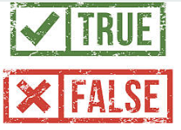
Quiz
Some
e-cigarettes
are safe for youth.
Notes:
First, let’s get a sense about what you know about e-cigarettes or vapes.
True or False – Some e-cigarettes are safe for youth.

Slide 3
Quiz (1)
Some
e-cigarettes
are safe for youth.
Notes:
FALSE. All e-cigarettes or vapes are unsafe for youth. We’ll talk about why today.

Slide 4
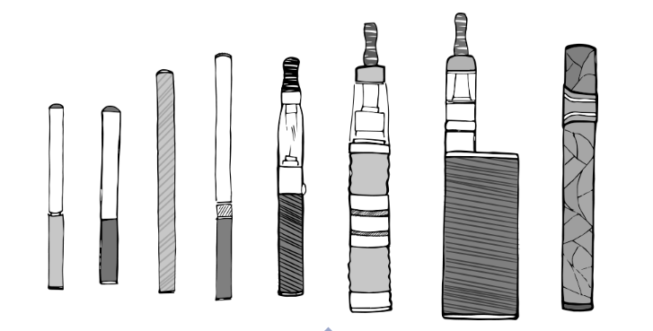

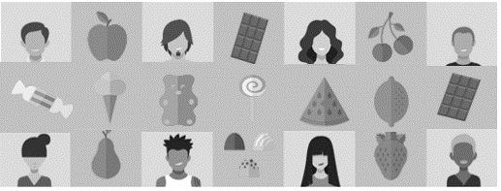

Topics 1
1
What Are
E-cigarettes?
2
2.
What Are The Health Risks?
3
What Leads
To E-cigarette Use?
4
What Can You Do About It?
Notes:
Today’s presentation will cover 4 main topics.
First, we’ll talk about what e-cigarettes or vapes are.
Next, we’ll talk about why they are dangerous to youth.
Then, we’ll look at the factors that lead to youth e-cigarette use in the first place.
Finally, we’ll talk about what you can do to address the urgent public health issue of youth e-cigarette use.
Let’s start with, What is an e-cigarette or vape?

Slide 5
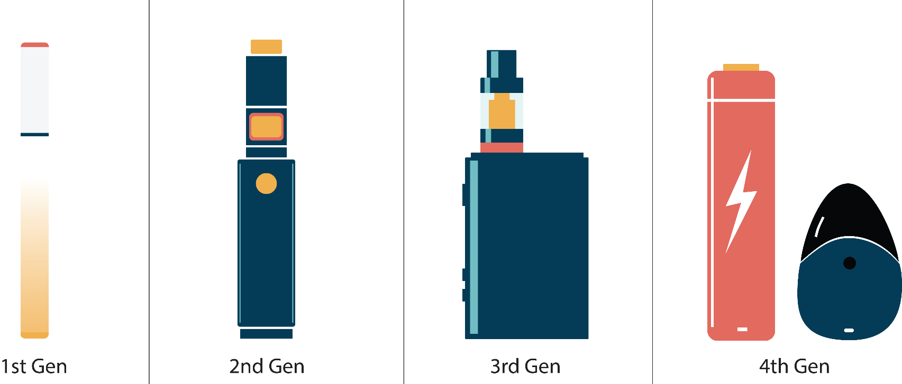
NO MATTER WHAT YOU CALL IT, IT’S AN E-CIGARETTE
Notes:
E-cigarettes are known by many different names. You’ve probably heard them called “vapes,” “vape pens”, “e-cigs” or just “JUUL.” There are also newer products on the market, such as “Elf Bar.” So, no matter what you call it, it’s an e-cigarette.
For more information on different types of e-cigarettes read this guide: E-Cigarette, or Vaping, Products Visual Dictionary (cdc.gov).

Slide 6
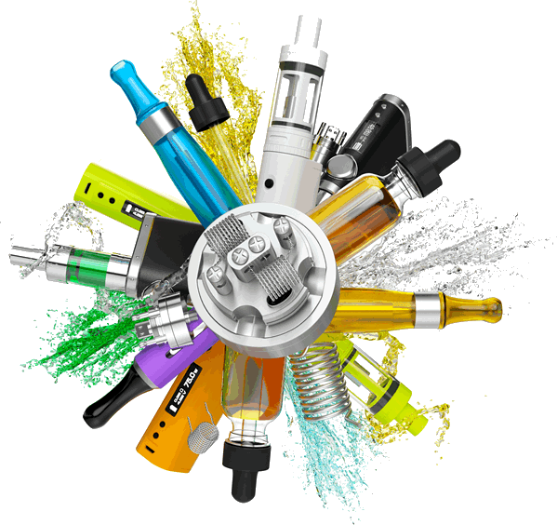
E-CIGARETTES COME IN MANY DIFFERENT SHAPES
E-cigarettes are devices that heat a liquid into an aerosol that the user inhales.
Notes:
E-cigarettes are devices that heat liquids containing nicotine or other drugs, such as marijuana, into an aerosol that the user inhales. E-Cigarette Use Among Youth and Young Adults: A Report of the Surgeon General (cdc.gov)
An aerosol is a suspension of fine solid or liquid particles in gas. Aerosol Definition & Meaning - Merriam-Webster
E-cigarettes come in lots of different shapes.
Some e-cigarettes look like regular tobacco products, such as cigarettes. But in recent years, we’ve seen e-cigarettes that look like other things, including USB flash drives, pens, and other everyday items. Puff Bar, Vuse, JUUL, and SMOK are examples of common e-cigarettes shaped like USB flash drives.
In 2022, the most common type of device used by middle and high school students was disposable e-cigarettes. Notes from the Field: E-cigarette Use Among Middle and High School Students — United States, 2022 | MMWR (cdc.gov)
But regardless of what you call it, these are all e-cigarettes and none of them are safe for young people to use.

Slide 7
Quiz .
E-cigarettes create a harmless water vapor.
Notes:
Let’s do another knowledge check: True or False: E-cigarettes create a harmless water vapor.

Slide 8
Quiz . .
E-cigarettes create a harmless water vapor.
E-cigarettes create a harmless water vapor
Notes:
The answer is FALSE.
E-cigarettes allow the user to exhale clouds that are not “harmless water vapor.” The tobacco industry prefers the term “vapor” because this implies it is harmless. But it is not harmless.
E-cigarettes create an aerosol that can be harmful to your health. Examples of aerosols include cleaning products and cooking sprays.
As a reminder, an aerosol is a suspension of fine solid or liquid particles in gas. Aerosol Definition & Meaning - Merriam-Webster.

Slide 9
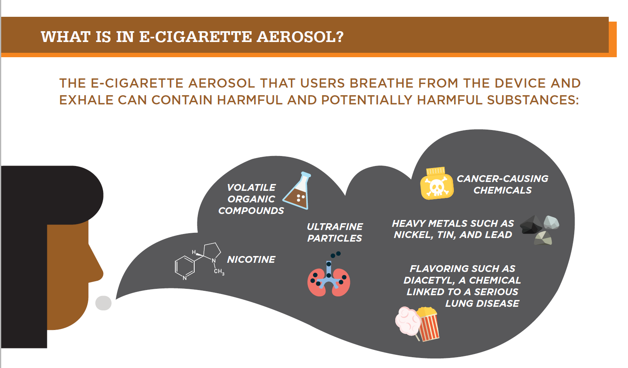
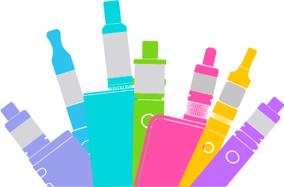
E-cigarettes Make Aerosol, Not Vapor
Source: Quick Facts on the Risks of E-cigarettes for Kids, Teens, and Young Adults | CDC
Notes:
Besides nicotine, e-cigarette aerosol can contain cancer-causing chemicals, heavy metals, and ultrafine particles that can be inhaled deeply into the lungs and harm your body.
And even though e-cigarette aerosol generally contains fewer harmful chemicals than regular cigarettes, it does not mean it is safe. This applies to both people using e-cigarettes, as well as people who may be exposed to secondhand aerosol from other people using e-cigarettes.
By the way, those flavorings in e-cigarettes are not safe either. The gut can handle a lot more than the lungs and flavorings in e-liquids or pods is not safe when inhaled.
Scientists are still working to understand more fully the health effects of e-cigarette content when they are heated and turned into an aerosol.

Slide 10
QUIZ,
Most
e-cigarettes contain nicotine.
Notes:
Ok, thinking about what is in an e-cigarette, let’s check to see what you already know.
True or False - Most e-cigarettes contain nicotine.

Slide 11
Quiz . .
Most
e-cigarettes contain nicotine.
Notes:
This is TRUE. According to the CDC, e-cigarettes usually contain nicotine, which is the addictive drug in regular cigarettes and other tobacco products. That is especially important to understand because nicotine is highly addictive and can harm the adolescent brain, which continues to develop until about 25 years old.
We’ll talk more about that now.

Slide 12
Topics 2
1
What Are
E-cigarettes?
2
What Are The Health Risks?
3
What Leads
To E-cigarette Use?
4
What Can You Do About It?
Notes:
So now we know what e-cigarettes are and that they contain nicotine. So what? Why does this matter?

Slide 13
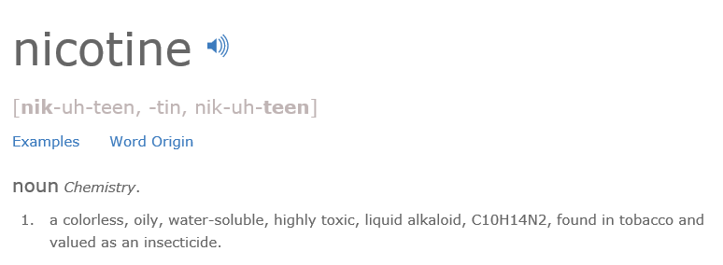
WHAT IS NICOTINE?
Source: www.dictionary.com
Notes:
Here you will see the dictionary definition of nicotine. We don’t expect you to know what all of these things are, but it’s important to have a basic understanding of what nicotine is before you can understand why using an e-cigarette is risky.
Nicotine is a drug found in tobacco plants.
Also, you should know that nicotine is the drug found in tobacco products that makes them addictive. That means that once someone uses it, their body will continue to want more.
Some immediate effects of nicotine include an increased heart rate, altering brain chemistry, increased stress, and it affects all parts of the body when inhaled.

Slide 14
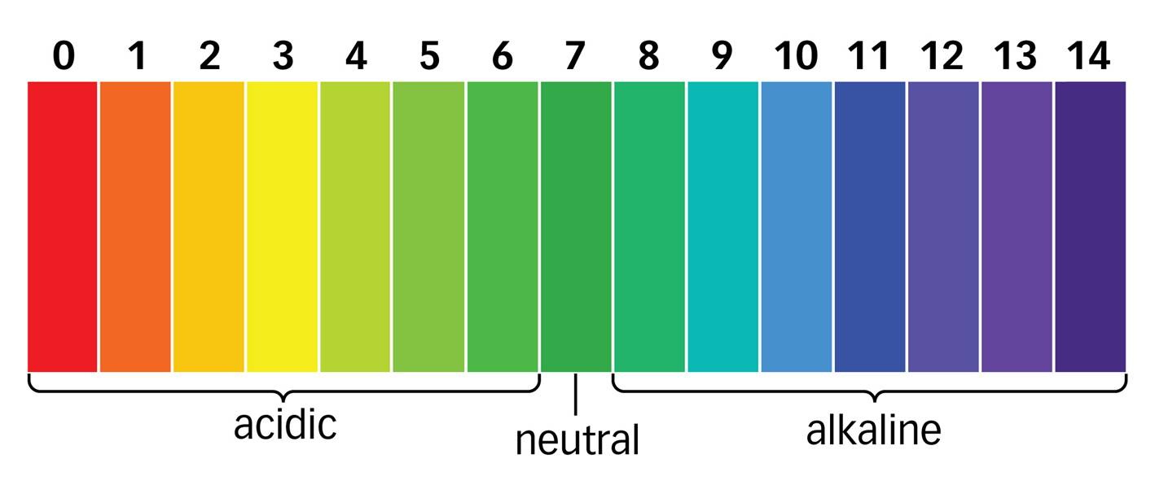

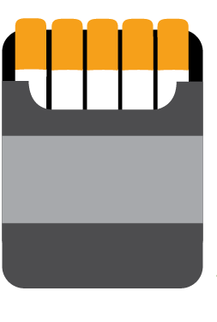
Nicotine Comes In Different Types
pH Scale
00
Free- Base Nicotine
Nicotine Salts
Notes:
We’ve told you what nicotine is, but did you know there are different types of nicotine?
The pH scale measures how acidic or basicity (alkalinity) a solution is.
An acidic solution has a high concentration of hydrogen ions (H+), greater than that of pure water. Examples of acidic items include lemons, soda, and batteries. A basic solution has a low H+ concentration, less than that of pure water. Examples of basic or alkaline solutions include baking soda, toothpaste, and eggs.
So why are we showing you this? Well, pH matters when it comes to how harsh feeling nicotine is on one’s body, particularly one’s throat when nicotine is being inhaled.
Most nicotine in cigarettes and some e-cigarettes is what we call free-base nicotine, which means it’s an alkaline on the pH scale. Since free-base nicotine is an alkaline, it has a harsh feeling on your throat.
Nicotine salts are considered an acid and are less harsh feeling on your throat. This is of particular concern for young people because it allows for nicotine to be used more easily, which increases the likelihood of trying an e-cigarette and getting hooked.
Another type of nicotine is synthetic nicotine, which is made in a lab rather than derived from the tobacco plant. Examples of e-cigarettes that are made with synthetic nicotine include Puff Bar and Elf Bar.
It does not matter if the nicotine comes from tobacco plants or made in the lab: nicotine is addictive and can harm the developing brain.

Slide 15
Quiz .
Nicotine harms brain development.
Notes:
Now that we’ve learned about the risks of nicotine, let’s talk about why that matters for your health.
In this section, we’ll talk about a variety of risks from e-cigarette use.
Let’s start with the brain.
Let’s check in again – True or False: Nicotine harms brain development.

Slide 16
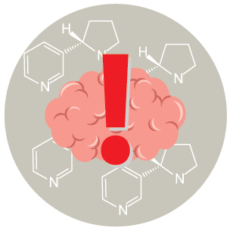
Quiz .. .
Nicotine harms brain development.
Notes:
The answer is TRUE.
Remember, e-cigarettes usually contain nicotine, which is highly addictive and can harm brain development.

Slide 17
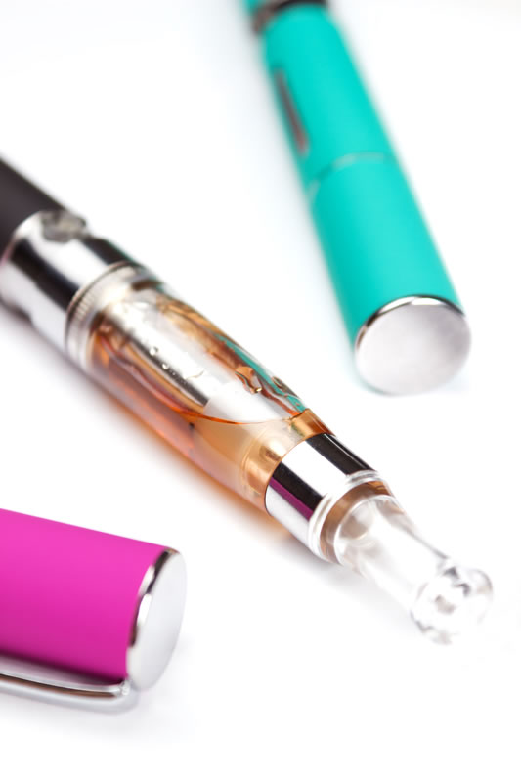
HOW DOES NICOTINE IN E-CIGARETTES IMPACT THE BRAIN?.
Youth who use nicotine can harm the parts of the brain that control attention, learning, mood, and impulse control.
Source: Quick Facts on the Risks of E-cigarettes for Kids, Teens, and Young Adults | CDC
Notes:
Important growth is happening in your brains and will continue to happen until you are about 25 years old. The brain is the last organ in the human body to develop fully. Exposing the brain to nicotine, while it’s in this important developmental phase, can cause addiction and harm the brain.
Why? Think about it like this, each time a new memory is created or a new skill is learned, stronger connections – or synapses – are built between brain cells. Nicotine changes the way these connections, or synapses, are formed, which can harm the parts of the brain that control attention and learning.
For youth, any exposure to nicotine is unsafe. Putting nicotine in the body is dangerously addictive, and it can also prime the brain for addiction to other tobacco products, or other drugs, like cocaine.

Slide 18

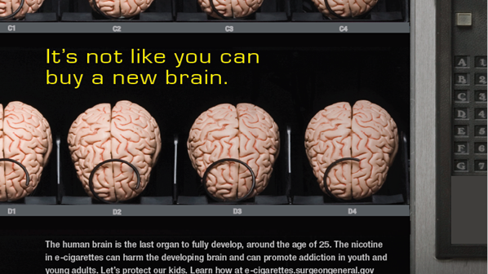
Nicotine Use Can Lead to Addiction
Food and Drug Administration’s My Vaping Mistake: How It Became an Addiction
Notes:
Let’s talk about addiction.
Youth are especially sensitive to nicotine’s addictive effects because their brains are still developing, and this makes it easier to get hooked. The use of nicotine can rewire a youth’s brain to become more easily addicted to other drugs.
Nicotine is quickly absorbed into the body and goes directly to the brain. Nicotine activates areas of the brain that makes a person feel satisfied and happy.
Nicotine addiction can look different from person to person. Some signs of nicotine addiction include:
Cravings, or feeling the need to use tobacco.
Going out of the way to get tobacco.
Feeling anxious or irritable if you want to use tobacco but can’t because you are in school.
Continuing to use tobacco because you find it hard to stop.
As a reminder, e-cigarettes usually contain nicotine.
Nicotine & Addiction | Smokefree Teen
Video from the Food and Drug Administration’s (FDA) My Vaping Mistake: How it became an addiction(https://www.youtube.com/watch?v=jpKMWFaptwE)

Slide 19

Nicotine Addiction Affects Your Mental Health
Food and Drug Administration’s The Real Cost Campaign: My Vaping Mistake: How It Affected My Mental Health
Notes:
When a person is dependent on (or addicted to) nicotine and stops using it, their body and brain have to get used to not having nicotine. This can result in temporary symptoms of nicotine withdrawal.
Nicotine withdrawal symptoms include irritability, restlessness, feeling anxious or depressed, trouble sleeping, problems concentrating, and craving nicotine. People may keep using tobacco products to help relieve these symptoms.
Youth may turn to vaping to try to deal with stress or anxiety, creating a cycle of nicotine dependence. But nicotine addiction can be a source of stress.
What may start as social experimentation can become an addiction.
The most common reason U.S. middle and high school students give for trying an e-cigarette is “a friend used them.”
The most common reason youth give for continuing to use e-cigarettes is “I am feeling anxious, stressed, or depressed.”
Youth e-cigarette and cigarette use have been associated with mental health symptoms such as depression.
Quick Facts on the Risks of E-cigarettes for Kids, Teens, and Young Adults | CDC
Food and Drug Administration’s (FDA) The Real Cost Campaign: My Vaping Mistake: How It Affected My Mental Health https://youtu.be/RRgJY4HKiK8

Slide 20


BEHAVIOR RISKS
Youth who use e-cigarettes may be more likely to smoke regular cigarettes in the future.
U.S. Department of Health and Human Services. E-Cigarette Use Among Youth and Young Adults. A Report of the Surgeon General. Atlanta, GA: U.S. Department of Health and Human Services, Centers for Disease Control and Prevention, National Center for Chronic Disease Prevention and Health Promotion, Office on Smoking and Health, 2016.
Notes:
Another risk in using e-cigarettes is that many youth who use them are more likely to go on to smoke cigarettes, even if they think they never will.
Use of two or more tobacco products is common among middle and high school youth. Many young people who use e-cigarettes also smoke cigarettes.
The best thing to do to protect your health is to ensure your not using any tobacco product at all. No matter how it’s delivered – whether it be an e-cigarette or a cigarette - nicotine is harmful to your health.
Quick Facts on the Risks of E-cigarettes for Kids, Teens, and Young Adults | CDC

Slide 21
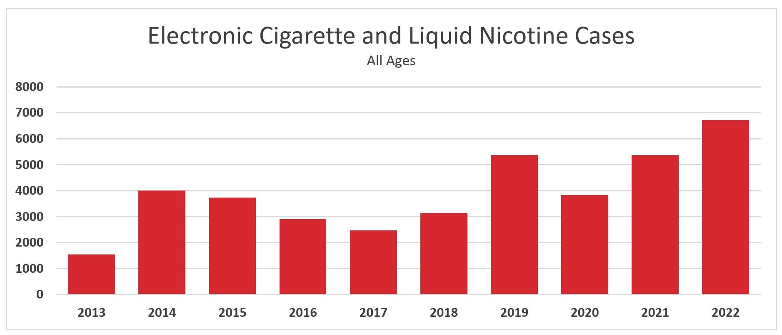
E-cigarette Poisonings
Source: American Association of Poison Control Centers
Notes:
And if that isn’t scary enough, children and adults have been poisoned by swallowing, breathing, or absorbing e-cigarette liquid through their skin or eyes.
Just look at the increase in calls to poison control centers across the country where people call for help when they’ve been exposed to poisons or other harmful things. In 2021, over 5,000 calls came from e-cigarettes devices and liquid nicotine. In 2022, poison control centers received more than 6,700 calls.

Slide 22



ne PoisNoning and pets
Nicotine Poisoning and pets
Notes:
Pets can also experience nicotine poisoning by drinking nicotine refill liquid, chewing on e-cigarette nicotine refill canisters, or chewing on the devices themselves.
Signs of nicotine poisoning in pets include the following: vomiting, unsteadiness, drooling, tiredness, fast heart rate, shaking, weakness, seizures, and death.
Be Smoke-free and Help Your Pets Live Longer, Healthier Lives | FDA

Slide 23


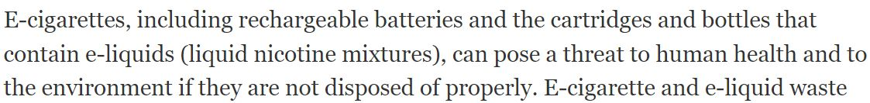
E-cigarettes and the environment
Notes:
Not only are e-cigarettes not safe for youth, they pose a significant environmental threat.
E-cigarette waste introduce plastic, nicotine salts, heavy metals, lead, mercury, and flammable lithium-ion batteries into waterways, soil, and to wildlife.
E-cigarette waste is not biodegradable and when left on the streets, eventually break down into microplastics and chemicals that flow into the storm drains to pollute waterways and wildlife.
Let’s watch the Truth Initiative’s® ad, Trash Talking Trash, on the impact e-cigarettes have on the environment. Trash Talking Trash | truth (thetruth.com)
Resources:
Truth Initiative®: E-Cigarette-Waste-Report-FINAL-042821.pdf (truthinitiative.org)
Public Health Law Center: Commerical-Tobacco-Health-and-the-Environment.pdf (publichealthlawcenter.org)
Food and Drug Administration: Tips for Safe Disposal of E-Cigarettes and Nicotine Waste (hhs.gov)

Slide 24
Topics 3
1
What Are
E-cigarettes?
2
What Are The Health Risks?
3
What Leads
To E-cigarette Use?
4
What Can You Do About It?
Notes:
So what leads to e-cigarette use among youth?

Slide 25




Most U.S. Youth Are Exposed to E-Cigarette
Advertising, NYTS 2021
E-CIGARETTE ADVERTISING:
70.3% OF MIDDLE AND HIGH SCHOOL STUDENTS
RETAIL STORES
TELEVISION, STREAMING SERVICES, OR MOVIES
58.7%
14.37 MILLION
21.7%
5.24 MILLION
INTERNET
NEWSPAPER OR MAGAZINES
36.0%
8.97 MILLION
28.7%
3.50 MILLION
Source: Gentzke AS, Wang TW, Cornelius M, et al. Tobacco Product Use and Associated Factors Among Middle and High School Students — National Youth Tobacco Survey, United States, 2021. MMWR Surveill Summ 2022;71(No. SS-5):1–29.​
Notes:
Youth are exposed to e-cigarette advertising.
And these messages come in many different forms, whether it’s store signs, television ads, movies, the Internet, social media ads, magazines with cool images, or newspapers….it’s all around you.
And big tobacco is one of the main contributors. They spent $8.2 billion in the year 2019 on marketing their products. Costs and Expenditures (cdc.gov)
E-cigarette ads reach nearly 4 in 5 middle and high school students, and youth exposure to these ads has increased in recent years.
E-cigarette companies are targeting young people and making a lot of money off it.
Here are a few examples of how they are doing it.
E-cigarette marketing ads are using themes including sexual content, independence, rebellion, and celebrity figures to appeal to youth and young adults.

Slide 26

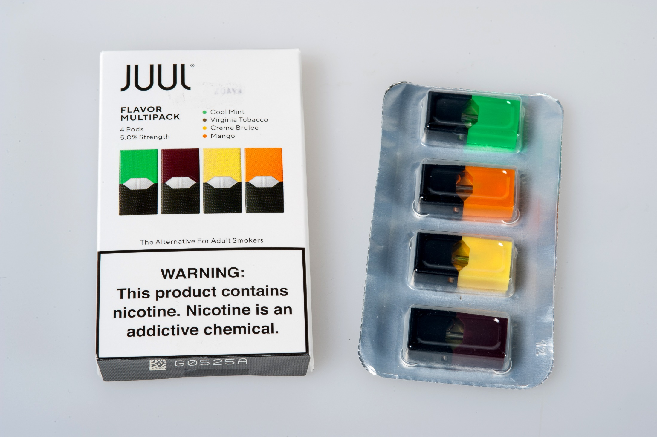
USE OF FLAVORS IS PROMINENT AMONG YOUTH
About 8 out of 10
middle and high school students who currently use e-cigarettes use a
FLAVORED product
Cooper M, Park-Lee E, Ren C, Cornelius M, Jamal A, Cullen KA. Notes from the Field: E-cigarette Use Among Middle and High School Students — United States, 2022. MMWR Morb Mortal Wkly Rep 2022;71:1283–1285. DOI: http://dx.doi.org/10.15585/mmwr.mm7140a3
Notes:
In addition to advertising, we also know that flavors influence youth use.
Most youth who use e-cigarettes are doing so because of the appeal of flavors. And very few of them don’t use flavors.
Among youth who currently used e-cigarettes in 2022, 84.9% used flavored e-cigarettes including 85.5% of high school and 81.5% of middle school users. Overall, the most commonly used flavor types were fruit; candy, desserts, or other sweets; mint; and menthol.

Slide 27
Quiz ..
The tobacco industry can sell any type or flavor of e-cigarettes they wish.
Notes:
Let’s do another knowledge check: True or False: The tobacco industry is in the e-cigarette game.

Slide 28
Quiz .
The Food and Drug Administration regulates all tobacco products.
Notes:
The answer is False.
The Food and Drug Administration (FDA) has the authority to regulate all tobacco products, including e-cigarettes. As of May 2023, the FDA has authorized 23 tobacco-flavored e-cigarette products and devices, which are the only e-cigarettes that currently may be lawfully sold or distributed in the U.S.
FDA Denies Marketing of 250+ Flavored and Tobacco-Flavored E-Liquids | FDA

Slide 29

Age to buy e-cigarettes
Notes:
In order to purchase e-cigarettes, you must be 21 years old. It is illegal for retailers to sell any tobacco products to anyone under 21.
Tobacco 21 | FDA

Slide 30
Topics 4
1
What Are
E-cigarettes?
2
What Are The Health Risks?
3
What Leads
To E-cigarette Use?
4
What Can You Do About It?
Notes:
So, finally, what can you do about the problem of e-cigarettes?

Slide 31
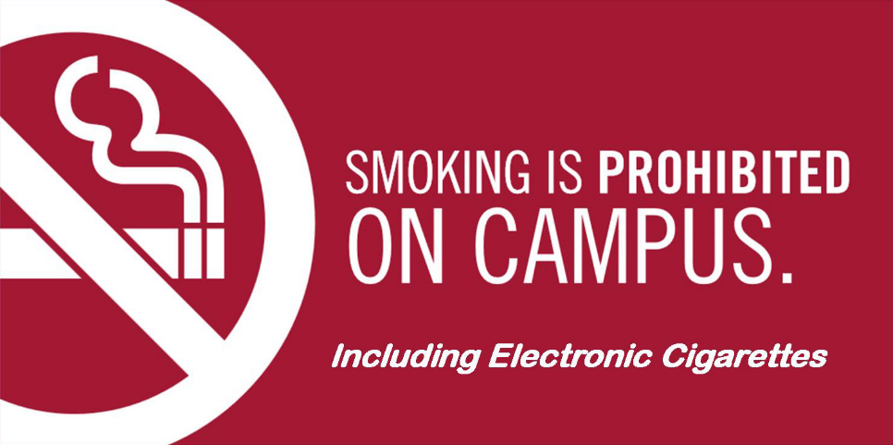
HELP YOUR SCHOOL GO TOBACCo FREE
Notes:
Does your school have a tobacco-free policy that does not allow any tobacco products, including e-cigarettes, on school grounds? If not, engage friends and teachers in discussions about the risks of all forms of tobacco use, including e-cigarettes to ensure students and staff have a safe learning and work environment.
For free communication materials visit: Media Campaign Resource Center (MCRC) Campaign: Protecting Young People from E-cigarettes (cdc.gov).

Slide 32

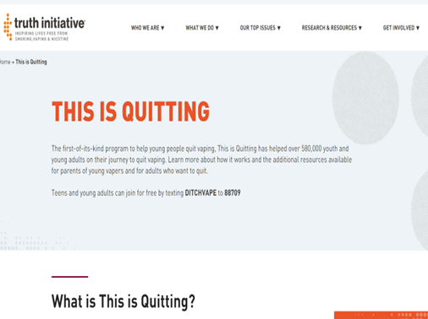
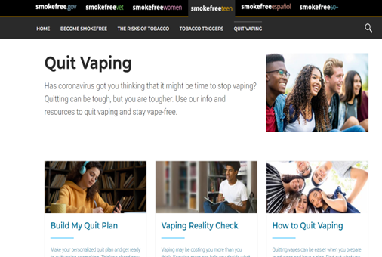
Free Quitting Resources
Food and Drug Administration’s The Real Cost: My Vaping Mistake: How It Impacted My Sports Performance
Truth Initiative® This Is Quitting
Quit Vaping | Smokefree Teen
Notes:
If you or someone you know is struggling to quit using e-cigarettes, free resources are available. Visit Quit Vaping | Smokefree Teen or This is Quitting (truthinitiative.org) to learn more. You can always talk with your doctor.
Video link: My Vaping Mistake: How it impacted my sports performance | AwesomenessTV - YouTube

Slide 33

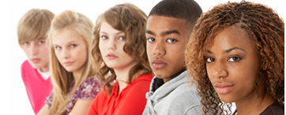
Most Important Takeaway
There is no safe tobacco product, including e-cigarettes.
Notes:
Don’t forget the most important takeaway from this presentation.
There is no safe tobacco product, including e-cigarettes.

