Slide 1


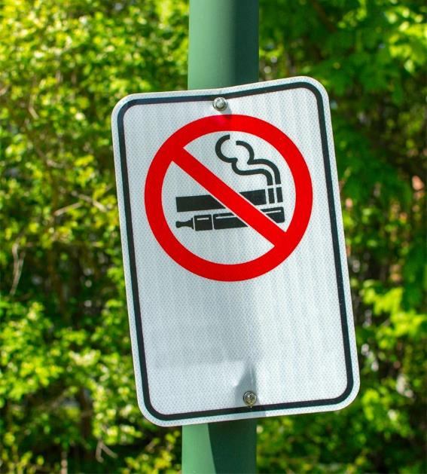


KNOW THE RISKS: A Parent’s Guide to E-Cigarettes and Youth
Office on Smoking and Health

Slide 2

KNOW THE RISKS: A Parent’s Guide to E-Cigarettes and Youth
Office on Smoking and Health
What Are E-Cigarettes?
1
What Are the Health Risks?
2
What Leads to E-Cigarette Use?
3
What Can You Do About It?
4

Slide 3

What are E-Cigarettes?
E-cigarettes are devices that heat a liquid into an aerosol that the user inhales.
Notes:
E-cigarettes sometimes called “e-cigs,” “vapes,” and “electronic nicotine delivery systems (ENDS),” are battery operated devices that heat a liquid to produce an inhaled aerosol. The liquid in e-cigarettes usually contains nicotine as well as flavorings and other chemicals. Some e-cigarettes can also be used to deliver THC (a psychoactive chemical found in cannabis) or other drugs.
E-cigarettes come in a variety of shapes and sizes. Some e-cigarettes look like USB flash drives or regular cigarettes.
In 2022, the most common type of device used by middle and high school students was disposable e-cigarettes. Notes from the Field: E-cigarette Use Among Middle and High School Students — United States, 2022 | MMWR (cdc.gov)
Tobacco use is NOT safe for young people.
NOTE: The definition of aerosol is a suspension of fine solid or liquid particles in gas. Aerosol Definition & Meaning - Merriam-Webster It is not water vapor. Examples of aerosols include cleaning products and cooking sprays.

Slide 4
.
What Are E-Cigarettes?
1
What Are the Health Risks?
2
What Leads to E-Cigarette Use?
3
What Can You Do About It?
4

Slide 5


E-Cigarettes Are the Most Commonly Used Tobacco Product Among U.S. Youth
E-cigarettes are the most common tobacco product currently used (use on 1 or more days in the past 30 days) by 2.55 million students, or almost 1 in 10 of America’s middle school and high school students.
Slightly more than 4 in 10 reported frequent use (use on 20 or more days in the past 30 days)
Slightly more than 1 in 4 reported daily use.
Source: Cooper M, Park-Lee E, Ren C, et al. Notes from the Field: E-Cigarette Use Among Middle and High School Students — National Youth Tobacco Survey, United States, 2022. MMWR Morb Mortal Wkly Rep 2022;71:1283–1285.
Notes:
CDC and the Food and Drug Administration (FDA) analyzed data from the 2022 National Youth Tobacco Survey (NYTS) to estimate current (past 30-day) use of eight tobacco products among U.S. middle (grades 6–8) and high school (grades 9–12) students.
Since 2014, e-cigarettes have been the most commonly used tobacco product among U.S. youth.
In 2022, e-cigarettes continue to be the most common tobacco product.
Over 2.5 million students currently used (past 30-day) e-cigarettes in 2022, including 2.14 million high school students.
Among both middle and high school students who currently used e-cigarettes, the most commonly used device type was disposables, followed by prefilled or refillable pods or cartridges and tanks or mod systems.
The most commonly reported “usual brand” was Puff Bar, followed by Vuse, JUUL, SMOK, NJOY, Hyde, and blu. Approximately one fifth of current e-cigarette users reported “some other brand” as their usual brand.

Slide 6


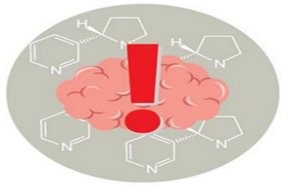
Nicotine Poses Unique Dangers to Young People
Nicotine can harm brain development, which continues until about age 25.
Nicotine can harm the parts of the brain that control attention, learning, mood, and impulse control.
Nicotine is a highly addictive drug.
Nicotine can prime the brain for addiction to other drugs.
Notes:
Nicotine exposure during adolescence can harm the developing brain—which continues to develop until about age 25.
Using nicotine in adolescence can harm the parts of the brain that control attention, learning, mood, and impulse control.
Using nicotine in adolescence may also increase risk for future addiction to other drugs.

Slide 7

Nicotine Addiction Is a
Source of Stress
When a person is dependent on nicotine and stops using it, their body and brain must readjust to not having nicotine.
Youth may turn to vaping to try to deal with stress or anxiety, creating a cycle of nicotine dependence.
Nicotine withdrawal symptoms include irritability, restlessness, feeling anxious or depressed, trouble sleeping, problems concentrating, and craving nicotine.
People, especially youth, may keep using tobacco products to help relieve these symptoms.
Notes:
When a person is dependent on nicotine and stops using it, their body and brain must readjust to not having nicotine.
Youth may turn to vaping to try to deal with stress or anxiety, creating a cycle of nicotine dependence.
Nicotine withdrawal symptoms include irritability, restlessness, feeling anxious or depressed, trouble sleeping, problems concentrating, and craving nicotine.
People, especially youth, may keep using tobacco products to help relieve these symptoms.

Slide 8
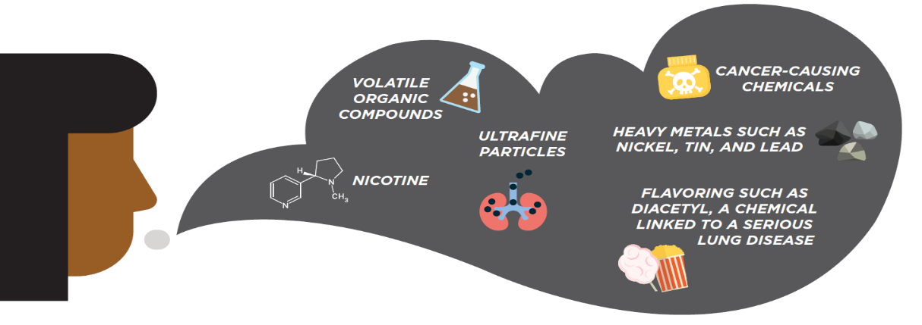
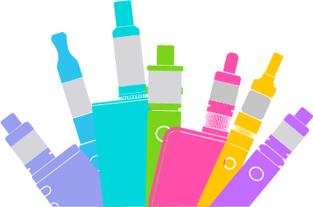
E-Cigarette Aerosol is Not Harmless
Notes:
Besides nicotine, e-cigarette aerosol can contain cancer-causing chemicals, heavy metals, and ultrafine particles that can be inhaled deeply into the lungs and harm your body. Again, it is not harmless and it is not water vapor.
And even though e-cigarette aerosol generally contains fewer harmful chemicals than regular cigarettes, safer doesn’t mean safe. This applies to both people using e-cigarettes, as well as people who may be exposed to secondhand aerosol from other people using e-cigarettes.
By the way, those flavorings in e-cigarettes aren’t necessarily safe either. The gut can handle a lot more than the lungs and flavorings in e-liquids or pods may not be safe when inhaled.
Scientists are still working to understand more fully the health effects and harmful doses of e-cigarette content when they are heated and turned into an aerosol.

Slide 9
What Leads to E-Cigarette Use?
What Are E-Cigarettes?
1
What Are the Health Risks?
2
What Leads to E-Cigarette Use?
3
What Can You Do About It?
4

Slide 10
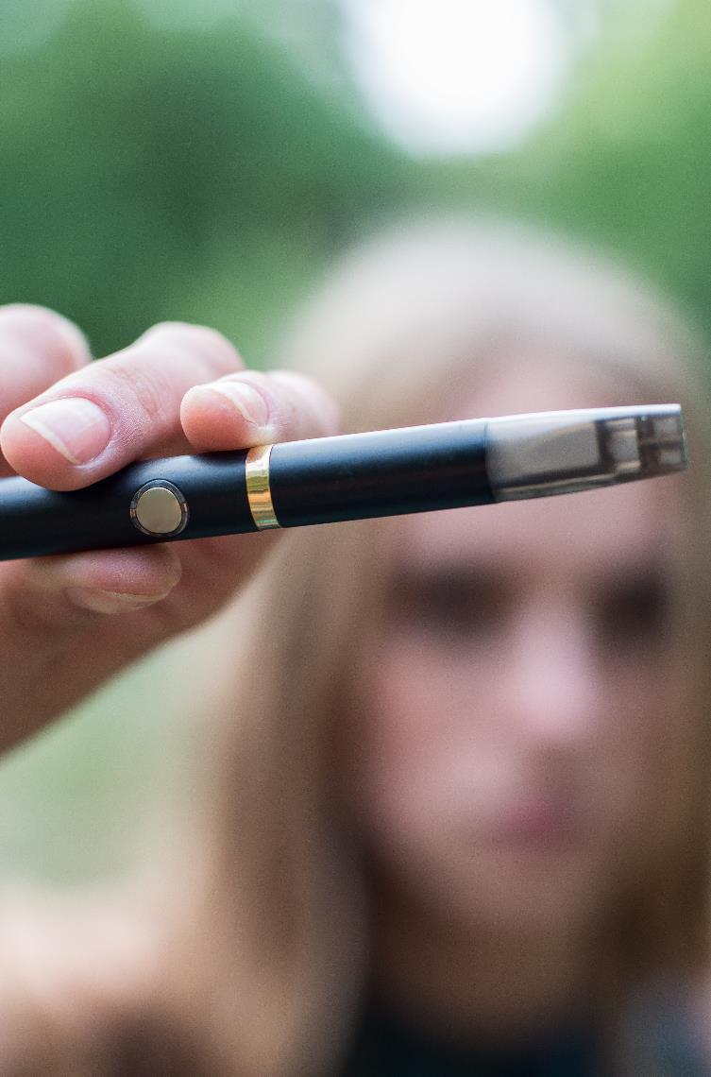
Youth Reasons for Ever Trying an E-Cigarette, NYTS, 2021
* Restricted to the top 4 reasons listed for combined middle and high school students, NYTS 2021
,Source: Gentzke AS, Wang TW, Cornelius M, et al. Tobacco Product Use and Associated Factors Among Middle and High School Students — National Youth Tobacco Survey United States, 2021. MMWR Surveill Summ 2022;71(No. SS-5):1–29.​
Notes:
Youth trying an e-cigarette means the first use of the product.

Slide 11

Youth Reasons for Current E-Cigarette Use, NYTS, 2021
* Restricted to the top 4 reasons listed for combined middle and high school students, NYTS 2021
Source: Gentzke AS, Wang TW, Cornelius M, et al. Tobacco Product Use and Associated Factors Among Middle and High School Students — National Youth Tobacco Survey, United States, 2021. MMWR Surveill Summ 2022;71(No. SS-5):1–29.​
Notes:
Current use of e-cigarettes was defined as use on ≥1 day during the past 30 days.

Slide 12





Most U.S. Youth Are Exposed to E-Cigarette
Advertising, NYTS 2021
ALL TOBACCO PRODUCT ADVERTISING
E-CIGARETTE ADVERTISING:
70.3% OF MIDDLE AND HIGH SCHOOL STUDENTS
3 in 4
RETAIL STORES
TELEVISION, STREAMING SERVICES, OR MOVIES
58.7%
14.37 MILLION
21.7%
5.24 MILLION
US MIDDLE AND HIGH SCHOOL STUDENTS (75.7%, 19.21 MILLION)
INTERNET
NEWSPAPER OR MAGAZINES
36.0%
8.97 MILLION
28.7%
3.50 MILLION
Source: Gentzke AS, Wang TW, Cornelius M, et al. Tobacco Product Use and Associated Factors Among Middle and High School Students — National Youth Tobacco Survey, United States, 2021. MMWR Surveill Summ 2022;71(No. SS-5):1–29.​
Notes:
Youth exposure to e-cigarettes is increasing.
One of the main reasons is advertising.
Overall, 3 in 4 US middle and high school students see tobacco product advertising.
And these messages come in many different forms, whether it’s store signs, television ads, movies, the Internet, social media ads, magazines with cool images, or newspapers….it’s all around you.
And big tobacco is one of the main contributors. They spent $8.2 billion in the year 2019 on marketing their products.
E-cigarette ads reach nearly 4 in 5 middle and high school students, and tobacco product advertising reach 3 in 4 middle and high school students.
Here are a few examples of how they are doing it.
E-cigarette marketing ads are using themes including sexual content, independence, rebellion, and celebrity figures to appeal to youth and young adults.

Slide 13

Tobacco Use Impacts People and Communities Differently
Certain communities are targeted by tobacco industry marketing
This includes the geographic distribution of tobacco retail outlets and price promotions
The tobacco industry develops novel tobacco products that appeal to youth, including flavored tobacco products and “stealth” products
There is unequal implementation of policies we know work to reduce youth use: tobacco price increases, smokefree indoor air laws, and flavor restrictions
Source: American Academy of Pediatrics. Youth Tobacco Cessation: Considerations for Clinicians (page 4). Accessed August 8,2021. https://downloads.aap.org/AAP/PDF/AAP_Youth_Tobacco_Cessation_Considerations_for_Clinicians.pdf
Notes:
Targeted marketing by the tobacco industry – In 2019, the tobacco companies spent about $22.5 a day marketing their products. The tobacco companies specifically advertise and market their products to specific populations. (Tobacco Industry Marketing | CDC)
Youth and young adults
Tobacco ads make smoking appear to be appealing, which can increase adolescents’ desire to smoke.
Women
Marketing toward women is dominated by themes of social desirability, empowerment, and independence, which are conveyed by advertisements featuring slim, attractive, and athletic models.;
Racial and minority populations
Hispanic and American Indians/Alaska Natives, African American communities
African American communities is targeted with advertisements and promotion for menthol cigarettes.
Asian Americans
LGBTQ+ communities (Unfair and Unjust Practices Harm LGBTQ+ People and Drive Health Disparities | CDC)
Geographic distribution of tobacco retail outlets and promotions – The number of retailers selling tobacco products varies widely depending on community characteristics with more retailers in areas with lower incomes and greater proportions of African-American residents. (Inequalities in tobacco outlet density by race, ethnicity and socioeconomic status, 2012, USA: results from the ASPiRE Study | Journal of Epidemiology & Community Health (bmj.com)).
Industry development of novel tobacco products that appeal to youth, including flavored tobacco products and “stealth” products – E-cigarettes in youth–appealing flavors are being sold in retailers. Several of the e-cigarettes most popular with youth resemble USB flash drives and can be relatively odorless. E-cigarettes can be “stealth” products and disguised as backpacks, smartwatches, sweatshirts, fidget spinners, or hand-held gaming devices to avoid detection or be seen by others. How to Spot Stealth and Disposable E-Cigarettes | Parents | Vaping Prevention Resources | HHS.gov
There are policies that we know work and have known that they work for decades, but they have not been implemented in all communities. This includes increasing the price of tobacco products, smokefree indoor air laws, and prohibiting the sale of flavored products.

Slide 14
What Can You Do About It?
What Are E-Cigarettes?
1
What Are the Health Risks?
2
What Leads to E-Cigarette Use?
3
What Can You Do About It?
4

Slide 15
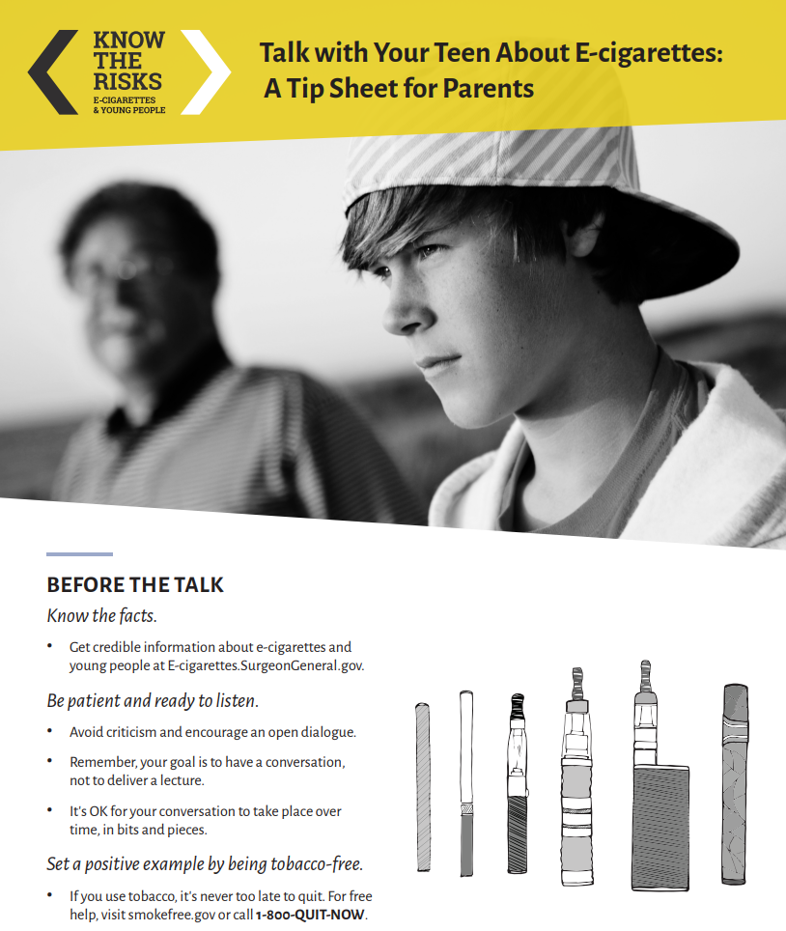
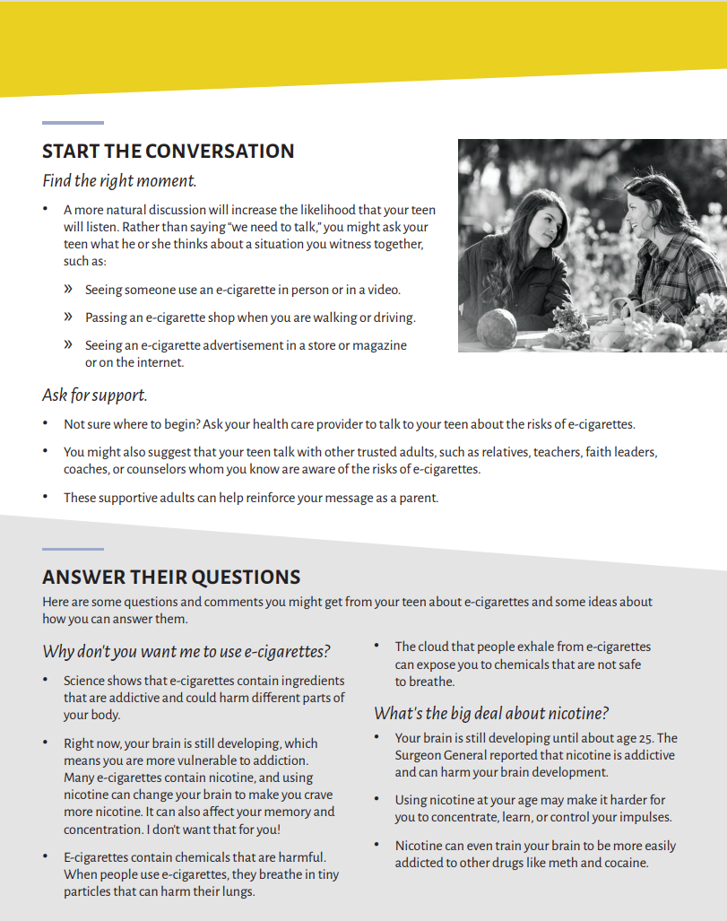
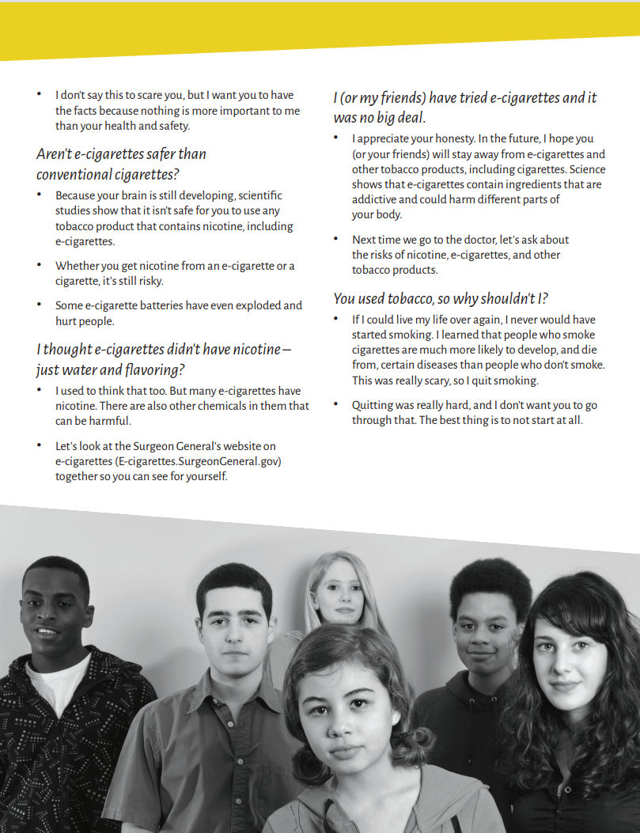
Talk with Your Teen
Talk with Your Teen About E-cigarettes: A Tip Sheet for Parents (surgeongeneral.gov)
Notes:
It is never too late to talk with your teen about e-cigarettes.
Educate yourself about e-cigarettes before discussing them with your teen and learn helpful ways to approach the conversation.
Recognize the warning signs of nicotine addiction in youth and find e-cigarette quit resources tailored to teens.
Keep the conversation going.
The Surgeon General’s website contains additional tools and resources for parents regarding youth use of e-cigarettes. These resources can be found at https://e-cigarettes.surgeongeneral.gov/resources.html.

Slide 16




Resources to Help Youth Quit
Quitlines― Trained Counselors
Resources to Help Youth Quit
Resources to help youth Quit: Quitline trained counselors
Texting Programs
Web-Based Resources
Smartphone Apps
1-800-QUIT-NOW
1-800 Dejélo-Ya (Spanish)
1-800-838-8917
(Mandarin + Cantonese)
1-800-566-5564 (Korean)
1-800-778-8440 (Vietnamese)
1-855-5AI-QUIT
SmokefreeTXT for Teens
SmokefreeTXT
DipfreeTXT
SmokefreeTXT en Español
This is Quitting (Truth)
My Life, My Quit
QuitSTART
Smokefree Teen
Smokefree en Espanol
Smokefree.gov
My Life, My Quit
American Indian Commercial
Tobacco Program
NOT for Me
Source: Behavioral Cessation Supports for Youth and Young Adults, AAP. Accessed August 18, 2021. https://teen.smokefree.gov/. Image Source: Become A Smokefree Teen website.
Notes:
Most youth want to quit using e-cigarettes. There are resources to help them quit.

Slide 17



Be Tobacco Free!
Notes:
1) Ensure your child’s school has a tobacco-free grounds policy. 2) Set a positive example. If you smoke or vape, consider quitting. 3) Establish a tobacco-free home. Don’t allow anyone to smoke or vape in your house or car.

Slide 18
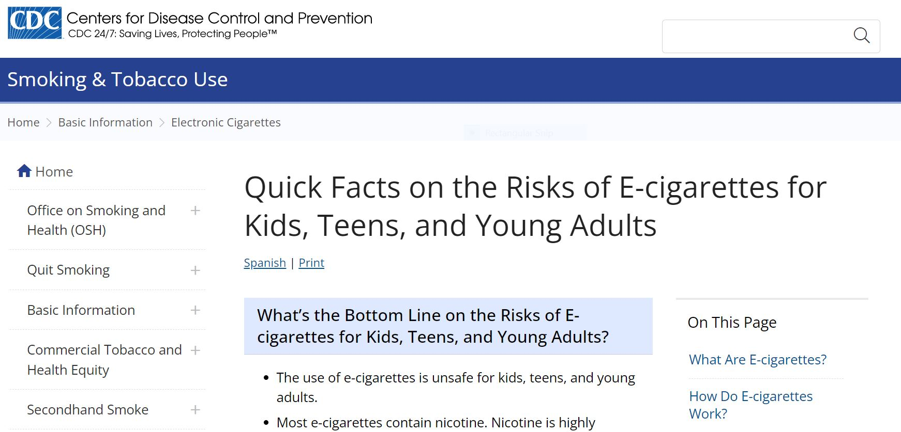
Know the Risks
For additional information, please visit: Quick Facts on the Risks of E-cigarettes for Kids, Teens, and Young Adults | CDC

