Slide 1
Tuberculosis (TB) in the United States
1993–2022*
Division of Tuberculosis Elimination
National Tuberculosis Surveillance System
*Data updated as of July 8, 2023
Notes:
Tuberculosis in the United States—National Tuberculosis Surveillance System, Highlights from 2022. This slide set was prepared by the Division of Tuberculosis Elimination, National Center for HIV, Viral Hepatitis, STD, and TB Prevention (NCHHSTP), Centers for Disease Control and Prevention (CDC), U.S. Department of Health and Human Services (HHS). It provides recent trends and highlights of data collected through the National Tuberculosis Surveillance System (NTSS) for 2022.
Since 1953, through the cooperation of state and local health departments, CDC has collected information on newly reported cases of tuberculosis (TB) disease in the United States. Each individual TB case report (Report of Verified Case of Tuberculosis, or RVCT) is submitted electronically to CDC. The data for this slide set are based on TB case reports for 1993–2022 received by CDC as of July 8, 2023. All case counts and rates for years 1993–2021 have been updated, and data from 2022 have been added.

Slide 2
Progress Towards TB Elimination, United States, 1982–2022
26,673 TB cases in 1992
Incidence rate: 10.4 per 100,000
8,331 TB cases in 2022
Incidence rate: 2.5 per 100,000
Notes:
This graph shows the annual number of TB cases in the United States for each year during 1982–2022, and the TB elimination threshold goal of <1 case per 1,000,000 (1 million) population, which is approximately 330 cases per year for the current U.S. population. In 1992, 26,673 cases were reported in the United States, with an incidence rate of 10.4 cases per 100,000 population. TB cases and incidence rates have declined substantially since 1992, but the annual rate of decline has been inadequate to achieve TB elimination goals.
In 2022, 8,331 cases were reported, with an incidence rate of 2.5 cases per 100,000, representing a 5.9% increase in case count and 5.5% increase in incidence rate compared with 2021.
After declining substantially in 2020, TB cases rose in 2021 and 2022 but remain 6.3% lower compared with 2019. TB cases appear to be gradually returning to prepandemic levels, but concerns about pandemic-related disruptions to public health persist.

Slide 3
TB Cases and Incidence Rates, United States, 1993–2022
8,331 TB cases in 2022
Incidence rate: 2.5 per 100,000
Notes:
During 2022, the United States reported 8,331 TB cases, an incidence rate of 2.5 cases per 100,000 persons. Except for 2015, the U.S. TB case count and incidence rate declined every year during 1993 to 2020. Since the sharp decline in 2020 associated with the COVID-19 pandemic, the annual incidence rate has increased every year, with a 5.5% increase from 2021 to 2022.

Slide 4
TB Incidence Rates and Annual Percent Change in Rate,
United States, 2010–2022
*Annual percent change in rate based on unrounded data
Notes:
The top graph shows incidence rates (cases per 100,000 persons) since 2010. The bottom graph shows annual percentage change in incidence rate, with any value >0 representing an increase from the previous year and any value <0 representing a decrease from the previous year.
The incidence rate increased by 5.5% from 2021 (2.4 cases per 100,000) to 2022 (2.5 cases per 100,000) but remains 7.7% lower compared with 2019. TB incidence appears to be gradually returning to prepandemic levels, but concerns about pandemic-related disruptions to public health persist.

Slide 5
TB-Related Deaths* and Mortality Rates, United States, 1993–2021
602 TB-related deaths in 2021
Mortality rate: 0.2 per 100,000
*National Vital Statistics System Underlying Cause of Death (based on deaths reported through 2021)
Notes:
The National Vital Statistics System (NVSS) reported 602 TB-related deaths (0.2 deaths per 100,000 persons) where TB was the underlying cause of death for 2021, the most recent year for which data are available. This represents a 0.3% increase in deaths and a 0.2% increase in the mortality rate compared with 2020.
It is important to note that under current NVSS guidance, deaths caused by TB among persons with comorbid HIV infections are classified with HIV as the underlying cause of death, not TB, and are not included here.
National Vital Statistics System accessed from CDC WONDER as of July 12, 2023: https://wonder.cdc.gov/

Slide 6
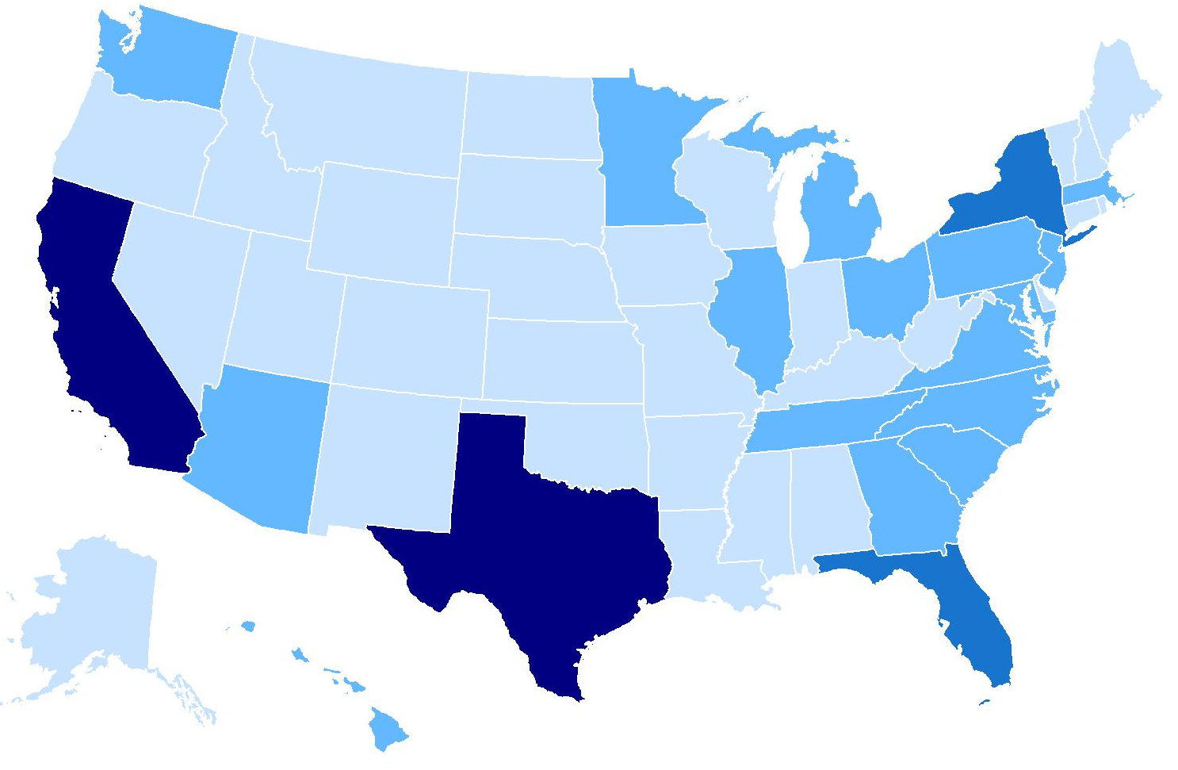
TB Cases by Reporting Area, United States, 2022
New York*
9%
California 22%
Florida
6%
Number of TB cases
≤99
Texas
13%
100–299
300–999
≥1000
* Includes New York City
Notes:
Among U.S. states, half (50.4%) of TB cases continue to be reported from 4 states: California (22.2%, n=1,848), Texas (13.2%, n=1,098), New York state (including New York City, 8.6%, n=714) and Florida (6.4%, n=535). These states are also the most populous states in the United States, but only represent about a third of the total U.S. population.
Note: ranges were determined based on the Jenks Natural Breaks method, then rounded to the nearest 100.

Slide 7
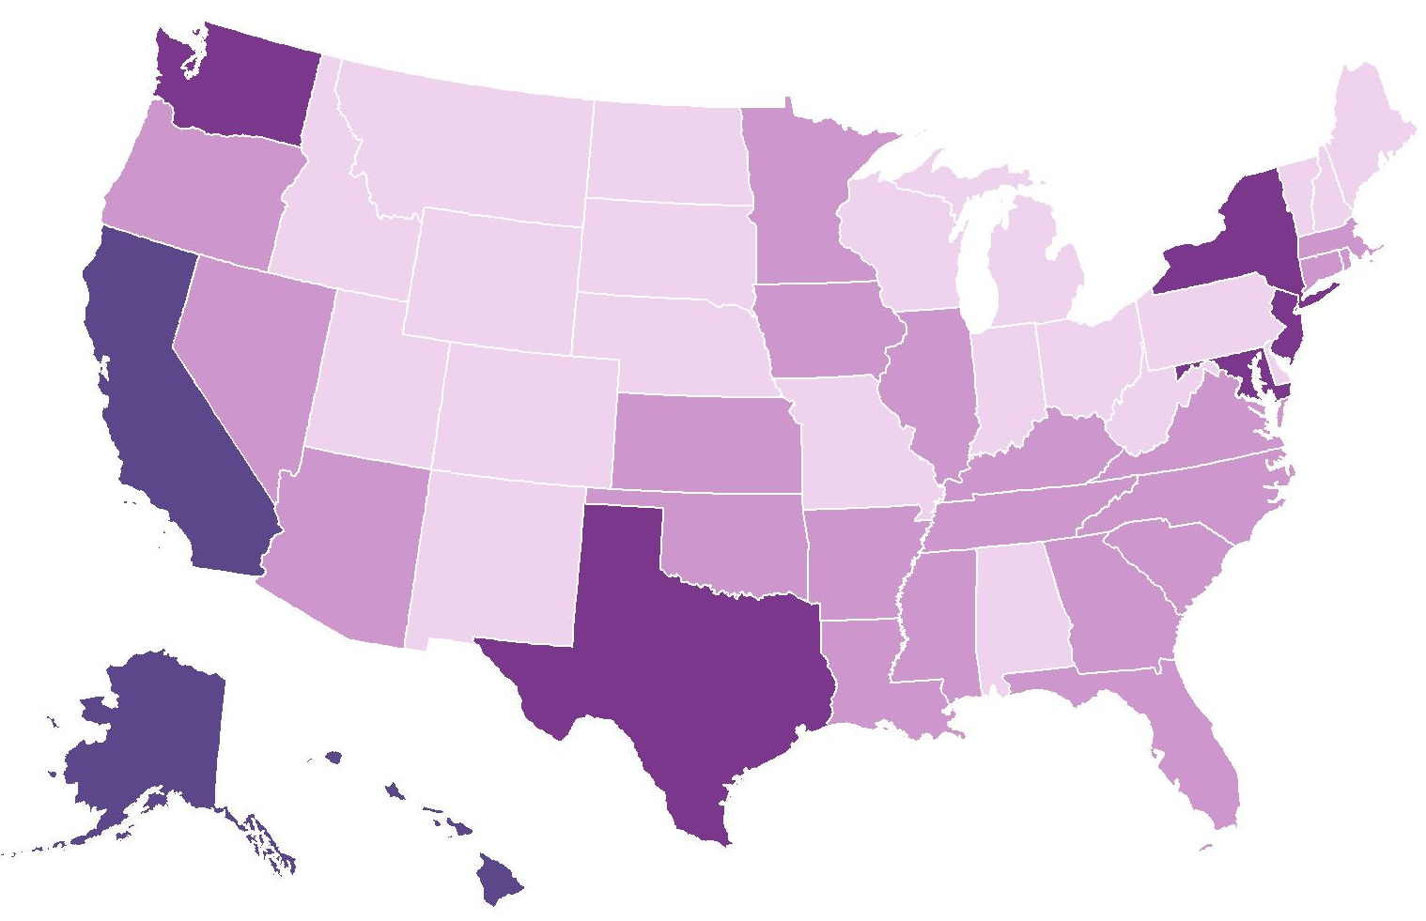
TB Incidence Rates* by Reporting Area, United States, 2022
Washington
3.2
New York
3.6†
New Jersey
3.1
California
4.7
Maryland
2.5
Alaska
13.0
Incidence rate
Hawaii
7.0
<1.5
1.5–<2.5
Texas
3.7
2.5–<4.5
*Cases per 100,000 persons
†Includes New York City
≥4.5
Notes:
Eight states had incidence rates higher than the national rate of 2.5 cases per 100,000 persons in 2022. Alaska had the highest rate (13.0), followed by Hawaii (7.0), California (4.7), Texas (3.7), New York (including New York City, 3.6), Washington (3.2), New Jersey (3.1), and Maryland (2.5). These reporting areas also had incidence rates greater than the national rate in 2021.
Note: New York City, which is a distinct reporting area, had an incidence rate of 6.4 cases per 100,000 persons. When New York City is analyzed separately, the remainder of New York state has an incidence rate of 1.6 cases per 100,000 persons.

Slide 8
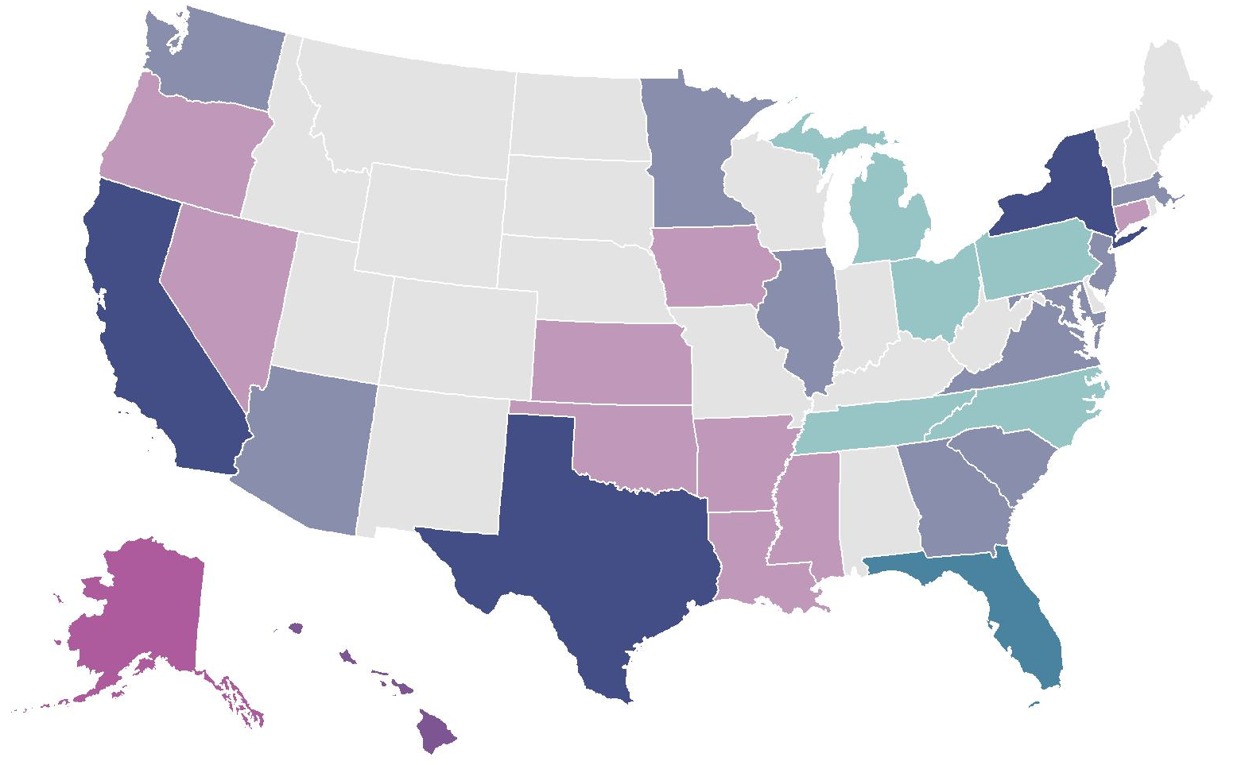
TB Cases and Incidence Rates*
by Reporting Area, United States, 2022
100–499
≤99
≥500
≥3.4
1.7–<3.4
<1.7
Incidence rate*
Case count
*Cases per 100,000 persons
Notes:
This map shows each state shaded based on two scales, one representing TB case counts and one representing incidence rates, overlaid. Case counts reflect the overall burden of testing, treating, and preventing TB in each jurisdiction, but the incidence provides a clearer picture of epidemiologic risk by jurisdiction. The lighter shades represent low values and darker shades represent higher values on each measure.
States with low case count and low incidence rate are shown in light grey, such as Maine and Idaho. (n=20)
States with low case count but medium incidence rate, such as Nevada, are shown in light pink. (n=10)
States with low case count but high incidence rate, such as Alaska, are shown in magenta. (n=1)
States with a medium case count but low incidence rate are shown in light teal, such as Ohio. (n=5)
States with medium case count and medium incidence rate are shown in light indigo (the middle of the color key), such as Georgia and Washington. (n=10)
Hawaii was the only state with medium case count and high incidence rate, shown in purple. (n=1)
None of the states had a high case count but low incidence rate, so turquoise is not found on the map.
Florida was the only state with high case count and medium incidence rate, shown in teal. (n=1)
States with high case count and high incidence rate are shown in dark indigo, such as California, Texas, and New York. (n=3)

Slide 9
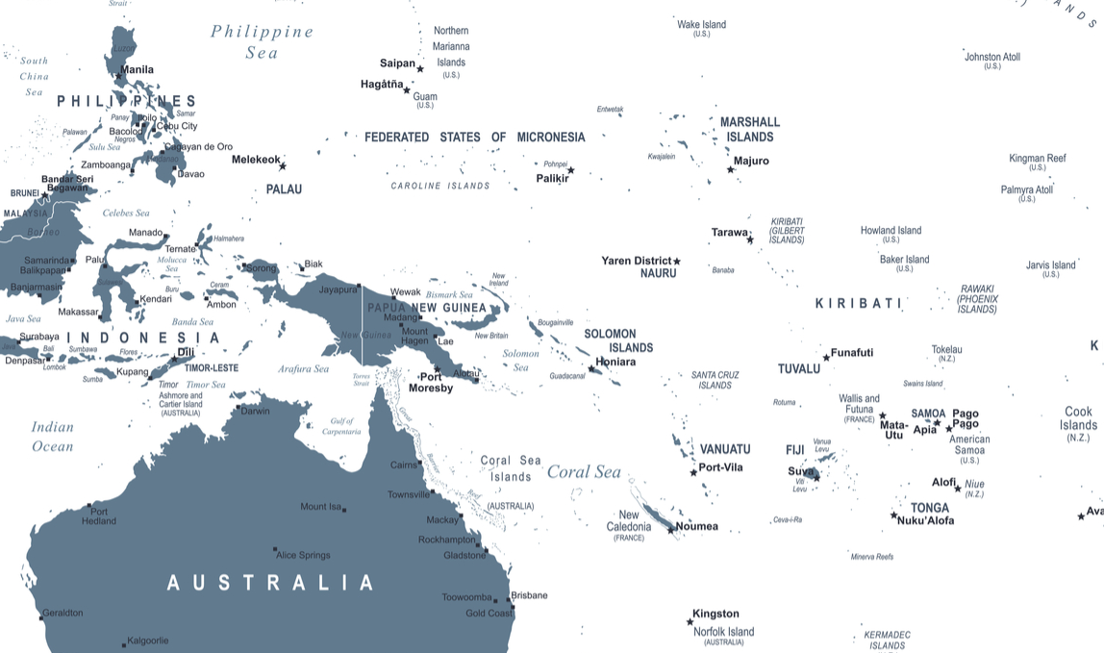
TB Incidence Rates* by U.S.-Affiliated Pacific Islands, 2022
Northern Mariana Islands
44.7
Guam
34.9
Republic of Marshall Islands
252.1
Republic of Palau
38.8
Federated States of Micronesia
45.1
American Samoa
Data not available†
*Cases per 100,000 persons
†American Samoa data not submitted for 2022
Notes:
Among the U.S.-Affiliated Pacific Islands, incidence rates (cases per 100,000 persons) ranged from 34.9 (Guam, n=59) to 252.1 (Republic of the Marshall Islands, n=106).

Slide 10
TB Cases and Incidence Rates by Origin of Birth,*
United States, 1993–2022
*Persons born in the United States, certain U.S. territories, or elsewhere to at least one U.S. citizen parent are categorized as U.S.-born. All other persons are categorized as non-U.S.–born.
Notes:
The distribution of the origin of birth for persons with TB remained similar in 2022 to previous years. Most reported TB cases occurred among non-U.S.–born persons (n=6,148, 73.8%), 2,142 (25.7%) cases occurred among U.S.-born persons, and 41 (0.5%) cases were reported with an unknown origin of birth. The percentage of cases among non-U.S.–born persons has gradually increased over time in the past decade, from 62.6% in 2011 to 73.8% in 2022. Compared with 2021, the incidence rate in 2022 among non-U.S.–born persons increased to 13.0 cases per 100,000 persons, while the rate for U.S.-born persons remained similar at 0.8 cases per 100,000.

Slide 11
TB Incidence Rates by Origin of Birth,* United States, 2011–2022
4% increase from 2021 to 2022
2% decrease from 2021 to 2022
*Persons born in the United States, certain U.S. territories, or elsewhere to at least one U.S. citizen parent are categorized as U.S.-born. All other persons are categorized as non-U.S.–born.
Notes:
Incidence rates for U.S.-born persons are shown in the left figure in purple, and incidence rates for non-U.S.–born persons are shown on the right figure in blue. Note that the scale of the y-axes for these figures are different.
Among both U.S.-born and non-U.S.–born persons, TB incidence rates declined during 2011 to 2020 and increased in 2021. In 2022, the incidence rate among non-U.S.–born persons increased by 4.0% from 12.5 cases per 100,000 persons to 13.0 cases per 100,000 persons, but the incidence rate among U.S.-born persons was 0.8 cases for 100,000 population both years, decreasing by 1.8% from 2021 to 2022 when using unrounded numbers.

Slide 12
TB Incidence Rates and Percentages by Origin of Birth,*
United States, 2022 (N=8,331)
Origin of birth unknown, <1%
U.S.-born, 26%
(Rate: 0.8 per 100,000)
$$–$$
Non-U.S.–born 74%
(Rate: 13.0 per 100,000)
*Persons born in the United States, certain U.S. territories, or elsewhere to at least one U.S. citizen parent are categorized as U.S.-born. All other persons are categorized as non-U.S.–born.
Notes:
In 2022, 6,148 (73.8%) cases occurred among non-U.S.–born persons and 2,142 (25.7%) cases among U.S.-born persons. The TB incidence rate among non-U.S.–born persons of 13.0 per 100,000 persons was 17 times the rate of 0.8 per 100,000 among U.S.-born persons (using unrounded rates).

Slide 13
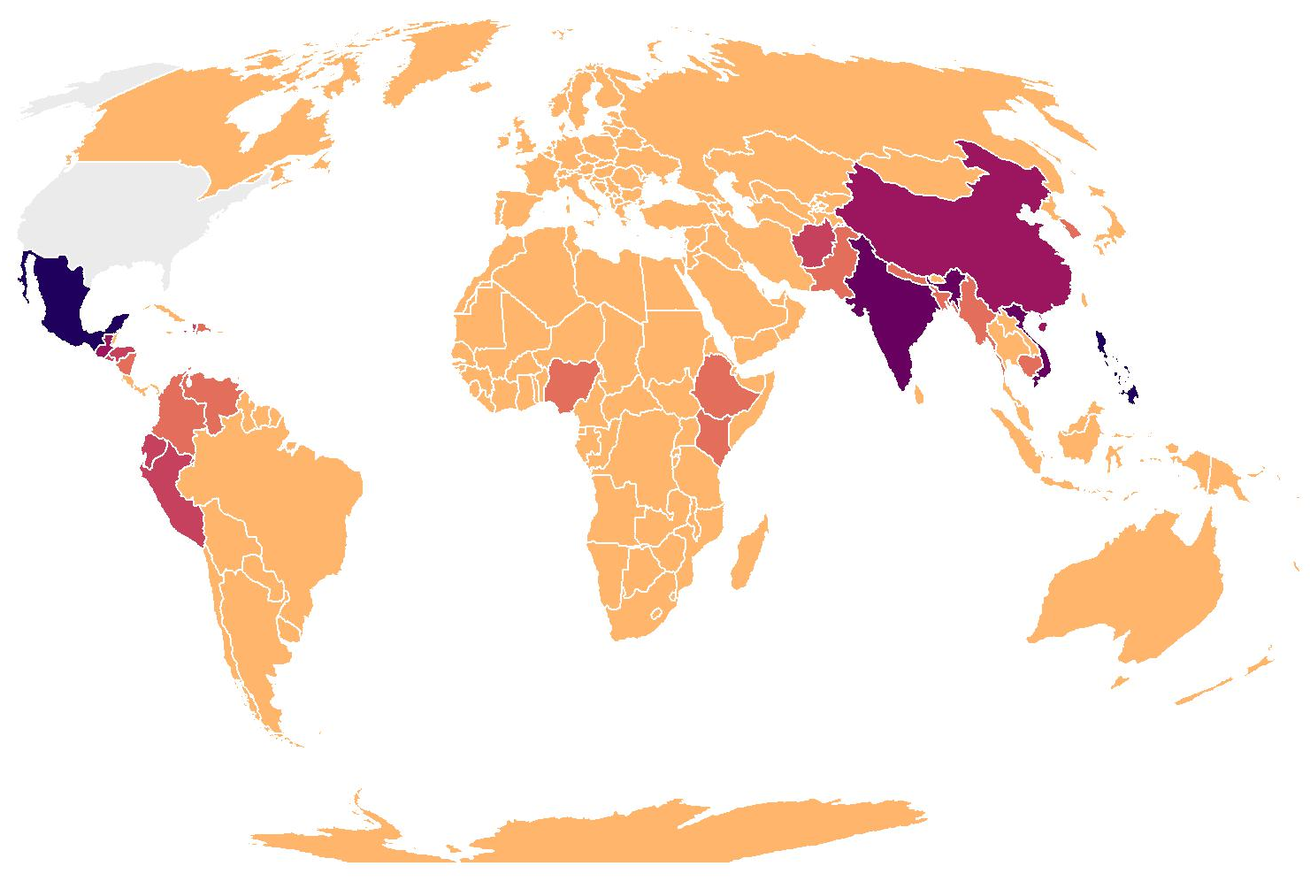

TB Cases by Countries of Birth Among Non-U.S.–Born* Persons with TB, United States, 2022 (N=6,148)
China
6%
Philippines
11%
Mexico
19%
Vietnam
8%
India
9%
N/A
0 - 49
50 - 99
100 - 249
250 - 399
400 - 599
600 +
*Persons born in the United States, certain U.S. territories, or elsewhere to at least one U.S. citizen parent are categorized as U.S.-born. All other persons are categorized as non-U.S.–born.
Notes:
In 2022, five countries of birth accounted for 53% of U.S. TB cases among non-U.S.–born persons.
The most common countries of birth among non-U.S.–born persons with TB disease remained similar to previous years, with Mexico (18.9%) as the most frequently reported country of birth, followed by the Philippines (10.9%), India (8.8%), Vietnam (8.2%), and China (6.0%). These countries also have large populations that live in the United States.

Slide 14
Percentage of TB Cases Among Non-U.S.–Born* Persons by Years Since Initial Arrival in the United States at Diagnosis,† 2022 (N=6,148)
*Persons born in the United States, certain U.S. territories, or elsewhere to at least one U.S. citizen parent are categorized as U.S.-born. All other persons are categorized as non-U.S.–born.
†The number of years since initial arrival in the United States at diagnosis was unknown or missing for 7% of non-U.S.–born persons. These persons were included in the denominator when percentages were calculated.
Notes:
This slide shows the percentage of TB cases among the non-U.S.–born by number of years since initial arrival in the United States at diagnosis. In 2022, 30.6% of non-U.S.–born persons with TB were diagnosed within 5 years of arrival in the United States, with more than half of those occurring within the first year after arrival. Over one-third (34.6%) were diagnosed after being in the United States for at least 20 years.

Slide 15
TB Cases by Race/Ethnicity,* United States, 2011–2022
Multiple Race
Native Hawaiian or Other Pacific Islander
American Indian or Alaska Native
White
Black or African American
Hispanic or Latino
Asian
*Persons who identified as Hispanic or Latino were categorized as "Hispanic," regardless of self-reported race. Persons who did not identify as Hispanic or Latino were categorized by self-reported race; if more than one race was reported, the person was categorized as "Multiple race."
Notes:
This graph shows overall TB case counts in the past decade by race/ethnicity. With the exception of a slight increase from 2014 (n=9,381) to 2015 (n=9,538), the overall number of TB cases decreased during 2011 through 2020. The number of cases subsequently increased in 2021 (n=7,870) and 2022 (n=8,331) compared with 2020 (n=7,171).
Compared with 2021, the number of cases in 2022 decreased among Black or African American persons (2021: 1,416; 2022: 1,317) and White persons (2021: 885; 2022: 850). The case count in all other race/ethnicity groups increased from 2021 to 2022. The largest increase was seen in Hispanic or Latino persons (2021: 2,405; 2022: 2,824), followed by Native Hawaiian or Other Pacific Islanders (2021: 115; 2022: 155), Asian persons (2021: 2,829; 2022: 2,855), and American Indian or Alaska Native persons (2021: 87; 2022: 112).

Slide 16
Percentage of TB Cases by Race/Ethnicity,* United States, 2011–2022
Multiple Race
Native Hawaiian or Other Pacific Islander
American Indian or Alaska Native
White
Black or African American
Hispanic or Latino
Asian
*Persons who identified as Hispanic or Latino were categorized as "Hispanic," regardless of self-reported race. Persons who did not identify as Hispanic or Latino were categorized by self-reported race; if more than one race was reported, the person was categorized as "Multiple race."
Notes:
This 100% stacked bar chart shows percentage distributions over time by race/ethnicity. Despite the decline in overall number of TB cases in 2020 and the subsequent increases in 2021 and 2022, the distribution of race/ethnicity among persons with TB disease has been relatively consistent since 2011.

Slide 17
Percentage of TB Cases by Race/Ethnicity,*
United States, 2022 (N=8,331)
*Persons who identified as Hispanic or Latino were categorized as "Hispanic," regardless of self-reported race. Persons who did not identify as Hispanic or Latino were categorized by self-reported race; if more than one race was reported, the person was categorized as "Multiple race."
Notes:
This bar chart shows the percentage of TB cases by race/ethnicity for 2022. Non-Hispanic Asian persons were the most common race/ethnicity group among all cases (34.3%), followed by Hispanic or Latino persons (33.9%), non-Hispanic Black or African American persons (15.8%), and non-Hispanic White persons (10.2%). All other race groups (American Indian or Alaska Native persons, Native Hawaiian or Other Pacific Islander persons, non-Hispanic persons who identify with more than one race, and those with unknown or missing race/ethnicity information) each represented 1–2% of cases.

Slide 18
TB Incidence Rates by Race/Ethnicity,* United States, 2011–2022
Native Hawaiian or Other Pacific Islander
Asian
American Indian or Alaska Native
Hispanic or Latino
Black or African American
Multiple Race
White
*Persons who identified as Hispanic or Latino were categorized as "Hispanic," regardless of self-reported race. Persons who did not identify as Hispanic or Latino were categorized by self-reported race; if more than one race was reported, the person was categorized as "Multiple race."
Notes:
TB incidence rates (cases per 100,000 persons) vary by race/ethnicity groups. In 2022, Native Hawaiian or Other Pacific Islander persons had the highest rate (24.4), followed by Asian persons (14.1). Rates among American Indian or Alaska Native persons and Hispanic or Latino persons were 4.6 and 4.4, respectively. Persons who identify with more than one race (1.2) and White persons (0.4) had the lowest rates in 2022. The rate for Black or African American persons decreased from 3.4 in 2021 to 3.1 in 2022. Based on unrounded numbers, rates increased in 2022 compared with 2021 for American Indian or Alaska Native persons, Native Hawaiian or Other Pacific Islander persons, and for Hispanic or Latino persons.

Slide 19
TB Cases Among U.S.-Born* Persons by Race/Ethnicity,†
United States, 2011–2022
Multiple Race
Native Hawaiian or Other Pacific Islander
American Indian or Alaska Native
White
Black or African American
Hispanic or Latino
Asian
*Persons born in the United States, certain U.S. territories, or elsewhere to at least one U.S. citizen parent are categorized as U.S.-born. All other persons are categorized as non-U.S.–born.
†Persons who identified as Hispanic or Latino were categorized as "Hispanic," regardless of self-reported race. Persons who did not identify as Hispanic or Latino were categorized by self-reported race; if more than one race was reported, the person was categorized as "Multiple race."
Notes:
The number of TB cases reported among U.S.-born persons decreased during 2011 (n=3,914) to 2020 (n=2,009), increased during 2021 (n=2,177), and then decreased in 2022 (n=2,142).
Compared with 2011, the percentage of cases among White persons (2011: 33.4%; 2022: 26.3%) and Black or African American persons (2011: 39.1%; 2022: 31.4%) in 2022 have decreased. All other race/ethnicity groups have increased in percentages during 2011 to 2022. The largest increases in percentages were seen among Hispanic or Latino persons (2011: 19.5%; 2022: 25.0%) and Asian persons (2011: 3.3%; 2022: 6.8%).
In 2022, Black or African American persons (n=673) and White persons (n=564) had the greatest number of TB cases among U.S.-born persons.

Slide 20
TB Incidence Rates Among U.S.-Born* Persons by Race/Ethnicity,† United States, 2011–2022
Native Hawaiian or
Other Pacific Islander
American Indian or
Alaska Native
Black or African American
Asian
Hispanic or Latino
White
Multiple Race
*Persons born in the United States, certain U.S. territories, or elsewhere to at least one U.S. citizen parent are categorized as U.S.-born. All other persons are categorized as non-U.S.–born.
†Persons who identified as Hispanic or Latino were categorized as "Hispanic," regardless of self-reported race. Persons who did not identify as Hispanic or Latino were categorized by self-reported race; if more than one race was reported, the person was categorized as "Multiple race."
Notes:
For approximately a decade, the highest TB incidence rates (cases per 100,000 persons) among U.S.-born persons have occurred among Native Hawaiian or Other Pacific Islander persons and American Indian or Alaska Native persons. That pattern continued in 2022 with incidence rates of 6.3 among Native Hawaiian or Other Pacific Islander persons and 4.5 among American Indian or Alaska Native persons. The rates among Native Hawaiian or Other Pacific Islander persons and American Indian or Alaska Native persons have greater year-to-year variability than all other groups because of low case counts and smaller population sizes.
Incidence rates among U.S.-born persons have declined or remained relatively steady over time among Black or African American persons, Hispanic or Latino persons, Asian persons, White persons, and persons of multiple races. However, the incidence rate among U.S.-born Asian persons increased from 1.2 in 2020 to 1.4 in 2021 and 1.8 in 2022. White persons and persons who identify with more than one race continue to have the lowest rates among all race groups.

Slide 21
TB Cases Among Non-U.S.–Born* Persons by Race/Ethnicity,†
United States, 2011–2022
Multiple Race
Native Hawaiian or Other Pacific Islander
American Indian or Alaska Native
White
Black or African American
Hispanic or Latino
Asian
*Persons born in the United States, certain U.S. territories, or elsewhere to at least one U.S. citizen parent are categorized as U.S.-born. All other persons are categorized as non-U.S.–born.
†Persons who identified as Hispanic or Latino were categorized as "Hispanic," regardless of self-reported race. Persons who did not identify as Hispanic or Latino were categorized by self-reported race; if more than one race was reported, the person was categorized as "Multiple race."
Notes:
The number of TB cases reported among non-U.S.–born persons increased from 2021 (n=5,629) to 2022 (n=6,148). Over 80% of non-U.S.–born cases occurred among Asian persons (n=2,704) and Hispanic or Latino persons (n=2,268). Since 2011, the distribution of the number of TB cases by race/ethnicity among non-U.S.–born persons has been relatively consistent.

Slide 22
TB Incidence Rates Among Non-U.S.–Born* Persons by Race/Ethnicity,† United States, 2011–2022
Multiple Race
Native Hawaiian or Other Pacific Islander
Asian
Black or African American
Hispanic or Latino
White
*Persons born in the United States, certain U.S. territories, or elsewhere to at least one U.S. citizen parent are categorized as U.S.-born. All other persons are categorized as non-U.S.–born.
†Persons who identified as Hispanic or Latino were categorized as "Hispanic," regardless of self-reported race. Persons who did not identify as Hispanic or Latino were categorized by self-reported race; if more than one race was reported, the person was categorized as "Multiple race."
Notes:
In 2022, among non-U.S.–born persons, persons who identify with more than one race had the highest incidence rate (31.2 cases per 100,000 persons), followed by Native Hawaiian or Other Pacific Islander persons (27.8) and Asian persons (22.7). The rates among Native Hawaiian or Other Pacific Islander persons and persons who identify with more than one race have greater year-to-year variability than all other groups because of low case counts and smaller populations. White persons have the lowest incidence rates among all race/ethnicity groups of non-U.S.–born persons.

Slide 23
TB Incidence Rates Among Non-U.S.–Born and U.S.-Born* Persons by Race/Ethnicity,† United States, 2011–2022
Non-U.S.–born§
U.S.–born
*Persons born in the United States, certain U.S. territories, or elsewhere to at least one U.S. citizen parent are categorized as U.S.-born. All other persons are categorized as non-U.S.–born.
†Persons who identified as Hispanic or Latino were categorized as "Hispanic," regardless of self-reported race. Persons who did not identify as Hispanic or Latino were categorized by self-reported race; if more than one race was reported, the person was categorized as "Multiple race."
§Non-U.S-born American Indian/Alaska Native are not displayed because some years have zero cases, which cannot be displayed in a log-scale graph.
Notes:
These figures show TB incidence rates by race/ethnicity among non-U.S.–born persons and U.S.-born persons, separately on the log scale. Non-U.S.–born American Indian or Alaska Native persons did not have any reported TB cases in years 2014, 2016, 2020, and 2022; therefore, their data are not presented in the non-U.S.–born graph since zeros cannot be displayed on the log scale.
For all race/ethnicity groups, incidence rates are higher among non-U.S.–born persons compared with U.S.-born persons.
Compared with 2021, TB incidence rates in 2022 remained steady or increased for all race/ethnicity groups for both U.S.-born and non-U.S.–born persons, except among non-U.S.–born Asian persons (2021: 23.7; 2022: 22.7), non-U.S.–born Black or African American persons (2021: 15.3; 2022: 14.0), and U.S.-born Black or African American persons (2021: 2.0; 2022: 1.9).

Slide 24
Percentage* of TB Cases by Origin† and Race/Ethnicity,§
United States, 2022
Non-U.S.–born persons
(N=6,148)
U.S.-born persons
(N=2,142)
Asian
Hispanic or Latino
Black or
African American
White
Native Hawaiian or
Other Pacific Islander
Multiple Race
0%
American Indian or
Alaska Native
*Percentages are rounded.
†Persons born in the United States, certain U.S. territories, or elsewhere to at least one U.S. citizen parent are categorized as U.S.-born. All other persons are categorized as non-U.S.–born.
§Persons who identified as Hispanic or Latino were categorized as "Hispanic," regardless of self-reported race. Persons who did not identify as Hispanic or Latino were categorized by self-reported race; if more than one race was reported, the person was categorized as "Multiple race.”
Notes:
The distribution of race/ethnicity among persons with TB disease continued to differ markedly by origin of birth in 2022. Approximately half of the TB cases reported among non-U.S.–born persons occurred among Asian persons (44.0%), followed by Hispanic or Latino persons (36.9%), Black or African American persons (10.4%), and White persons (4.6%). Among U.S.-born persons with TB disease, Black or African American persons represented the largest percentage of cases (31.4%), followed by White persons (26.3%), Hispanic or Latino persons (25.0%), and Asian persons (6.8%).

Slide 25
TB Incidence Rates* by Origin† and Race/Ethnicity,§
United States, 2022
Non-U.S.–born persons
(N=6,148)
U.S.-born persons
(N=2,142)
Asian
Asian
Hispanic or Latino
Black or
African American
White
Native Hawaiian or
Other Pacific Islander
Multiple Race
American Indian or Alaska Native
*Cases per 100,000 persons
†Persons born in the United States, certain U.S. territories, or elsewhere to at least one U.S. citizen parent are categorized as U.S.-born. All other persons are categorized as non-U.S.–born.
§Persons who identified as Hispanic or Latino were categorized as "Hispanic," regardless of self-reported race. Persons who did not identify as Hispanic or Latino were categorized by self-reported race; if more than one race was reported, the person was categorized as "Multiple race."
Notes:
This slide shows TB incidence rates (cases per 100,000 persons) by race/ethnicity among non-U.S.–born persons compared with U.S.-born persons in 2022. Among non-U.S.–born persons with TB disease, persons who identify with more than one race had the highest incidence rate (31.2) followed by Native Hawaiian or Other Pacific Islander persons (27.8), Asian persons (22.7), Black or African American persons (14.0), Hispanic or Latino persons (10.4), and White persons (3.5).
Among U.S.-born persons with TB disease, Native Hawaiian or Other Pacific Islander persons had the highest incidence rate (6.3), followed by American Indian or Alaska Native persons (4.5), Black or African American persons (1.9), Asian persons (1.8), and Hispanic or Latino persons (1.3). White persons and persons who identify with more than one race had the lowest rates (0.3).

Slide 26
TB Cases by Age Group, United States, 1993–2022
Notes:
The distribution of TB cases by age group in 2022 remained similar to past years with most cases occurring among persons aged 25 to 44 years (29.4%), followed closely by persons 45 to 64 years old (29.1%) and persons 65 years or older (27.0%). In contrast, only 14.5% of reported TB cases occurred among children and young adults less than 25 years.

Slide 27
TB Cases by Age Group, United States, 2022 (N=8,331)
Notes:
This bar chart shows the percentage of TB cases by age group for 2022. The largest percentage of TB cases occurred among persons 25 to 44 years old (29.4%), followed by persons 45 to 64 years old (29.1%), persons 65 years old or greater (27.0%), and persons 15 to 24 years old (10.1%). Less than 5% of all TB cases occurred among persons 0 to 14 years old.

Slide 28
TB Incidence Rates by Age Group, United States, 1993–2022
Notes:
This graph displays the TB incidence rates (cases per 100,000 persons) by age group on a log scale. Incidence rates are higher among adults than children less than 15 years old. Among persons 15 years and older, the incidence rates increase with age. In 2022, persons 65 years or older had the highest TB incidence rate (3.9), and children aged 5 to 14 years had the lowest rate (0.4). Incidence rates either remained steady or increased in 2022 compared with 2021 for all age groups.

Slide 29
TB Cases Among U.S.-Born* Persons by Age Group,
United States, 1994–2022
*Persons born in the United States, certain U.S. territories, or elsewhere to at least one U.S. citizen parent are categorized as U.S.-born. All other persons are categorized as non-U.S.–born.
Notes:
This graph shows the number of cases among U.S.-born persons by age group per year from 1994 to 2022. Among U.S.-born persons, all age groups less than 25 years experienced an increase in cases in 2022 compared with 2021, and all age groups greater than or equal to 25 years experienced a decrease in cases in 2022 compared with 2021.

Slide 30
TB Incidence Rates* Among U.S.-Born† Persons by Age Group,
United States, 1994–2022
*Population Source: U.S. Census Bureau, Current Population Survey Basic Monthly: https://data.census.gov/mdat/
†Persons born in the United States, certain U.S. territories, or elsewhere to at least one U.S. citizen parent are categorized as U.S.-born. All other persons are categorized as non-U.S.–born.
Notes:
This graph displays the TB incidence rates (cases per 100,000 persons) among U.S.-born persons, by age group, on a log scale. Since 1994, each age group among U.S.-born persons has experienced a decrease of at least 68% in incidence rate, with the 65 years or older age group experiencing the biggest decline at more than 92% (1994: 14.2; 2022: 1.0). Incidence rates were steady or increased in 2022 compared with 2021 for all age groups less than 25 years with the 0 to 4 years age group experiencing the largest increase at 20.0%. All age groups greater than or equal to 25 years experienced a decrease in incidence in 2022 compared with 2021.

Slide 31
TB Cases Among Non-U.S.–Born* Persons by
Age Group, United States, 1994–2022
*Persons born in the United States, certain U.S. territories, or elsewhere to at least one U.S. citizen parent are categorized as U.S.-born. All other persons are categorized as non-U.S.–born.
Notes:
The distribution of TB cases by age group among non-U.S.–born persons remained relatively steady from 2021 to 2022; the number of cases increased from 2021 to 2022 for all age groups.

Slide 32
TB Incidence Rates* Among Non-U.S.–Born† Persons by
Age Group, United States, 1994–2022
*Population Source: U.S. Census Bureau, Current Population Survey Basic Monthly: https://data.census.gov/mdat/
†Persons born in the United States, certain U.S. territories, or elsewhere to at least one U.S. citizen parent are categorized as U.S.-born. All other persons are categorized as non-U.S.–born.
Notes:
This graph displays the TB incidence rates (cases per 100,000 persons) among non-U.S.–born persons, by age group, on a log scale. From 1994 through 2022, each age group among non-U.S.–born persons has experienced a 50% or greater decline in incidence rate, with the 5 to 14 years age group experiencing the biggest decline at more than 83% (1994: 18.4; 2022: 3.2). Compared with 2021, the incidence rate for 2022 increased by 265% for non-U.S.–born persons aged 0 to 4 years from 3.2 to 11.8, by 15% for persons aged 15 to 24 years from 14.2 to 16.3, and by 8% for persons aged 25 to 44 years from 10.6 to 11.4. For all other age groups among non-U.S.–born persons, incidence rates either decreased or remained steady from 2021 to 2022.

Slide 33
Percentage of TB Cases by Sex and Age Group, United States, 2022
Males (N=5,157)
Age group
Females (N=3,144)
0–4 years (N=201)
5–14 years (N=163)
15–24 years (N=845)
25–44 years (N=2,449)
45–64 years (N=2,421)
≥65 years (N=2,252)
Notes:
Males continued to represent the majority (61.9%) of persons with TB disease overall. The percentage was greater for males compared with females for all age groups except for children 5 to 14 years old (males: 46%; females: 54%).

Slide 34
Pediatric* TB Cases by Origin of Birth,† United States, 1993–2022
*Children less than 15 years old
†Persons born in the United States, certain U.S. territories, or elsewhere to at least one U.S. citizen parent are categorized as U.S.-born. All other persons are categorized as non-U.S.–born.
Notes:
In contrast to overall U.S. TB cases, for which over two-thirds of cases were among non-U.S.–born persons, only 82 (22.5%) of 364 cases in children less than 15 years old occurred among non-U.S.–born persons in 2022. The percentage of non-U.S.–born persons among pediatric cases has fluctuated between 20% and 30% since 1993.

Slide 35
Pediatric TB Incidence Rates* by Origin of Birth,†
United States, 1994–2022
*Population Source: U.S. Census Bureau, Current Population Survey Basic Monthly: https://data.census.gov/mdat/
†Persons born in the United States, certain U.S. territories, or elsewhere to at least one U.S. citizen parent are categorized as U.S.-born. All other persons are categorized as non-U.S.–born.
Notes:
In 2022, the majority (77.5%) of children less than 15 years old with TB disease were U.S.-born, however, the incidence rate (cases per 100,000 persons) was higher among non-U.S.–born children compared with U.S.-born children. For children aged 0 to 4 years old, the incidence rate among non-U.S.–born children (11.8) was 12 times the rate among U.S.-born children (1.0). For children aged 5 to 14 years, the incidence rate among non-U.S.–born children (3.2) was more than 11 times the rate among U.S.-born children (0.3).

Slide 36
Percentage of TB Cases by Site of Disease, United States, 2022
*Persons might have more than one extrapulmonary site of disease.
Notes:
The vast majority of TB cases had pulmonary TB only (70.4%), 18.8% had extrapulmonary TB only, and 10.6% had both pulmonary and extrapulmonary TB.
There were a total of 2,765 extrapulmonary sites of disease. Among these, lymphatic (26.1%,) and pleural (22.1%) sites of disease were the most common, followed by bone and joint (9.4%), peritoneal (6.3%), meningeal (5.8%), genitourinary (4.2%), and laryngeal (1.1%).
“Other” includes all other extrapulmonary sites of disease (e.g., ocular, hepatic).

Slide 37
Percentage of TB Cases* by Initial Drug Regimen,
United States, 1993–2022
HRZE†
Other 4+ drug regimen§
*Persons alive at diagnosis with initial drug regimen information.
†H, isoniazid; R, rifampin; Z, pyrazinamide; E, ethambutol.
§A drug regimen with at least four drugs, other than HRZE.
Notes:
Since 2002, the percentage of patients started on the standard initial four-drug regimen of isoniazid, rifampin, pyrazinamide, and ethambutol has remained above 80%. In some situations, including known or suspected drug resistance or a clinical contraindication to the standard initial therapy, a different four-drug regimen could be clinically appropriate. The percentage of patients on an initial drug regimen of four or more drugs other than the standard four-drug regimen has increased from 4.3% in 2002 to 13.0% in 2022. Use of initial regimens with fewer than four drugs has represented <7% of reported cases in the past decade.

Slide 38
Percentage of TB Cases* by Initial Drug Regimen,
United States, 2022 (N=8,045)
Other 4+ drug regimen†, 13%
*Persons alive at diagnosis with initial drug regimen information.
† A drug regimen with at least four drugs, other than HRZE.
§ H, isoniazid; R, rifampin; Z, pyrazinamide; E, ethambutol.
Notes:
Of the 8,045 TB patients diagnosed in 2022 who prescribed TB therapy, 81.1% started on isoniazid, rifampin, pyrazinamide, and ethambutol (HRZE), 13.0% started on a 4-drug regimen other than HRZE, and 6.0% started on a regimen of less than four drugs, including persons who were not prescribed any drugs.

Slide 39
Percentage of TB Cases by Method of Treatment Administration,* United States, 1993–2020†
DOT§ only
DOT and SAT§
*Persons on an initial drug therapy with at least one drug.
†Most recent year for which data are complete.
§DOT=directly observed therapy; SAT=self-administered therapy.
Notes:
The percentage of persons with TB disease receiving at least a portion of their medication by directly observed therapy (DOT) has risen from 35.4% in 1993 to 92.4% in 2020, the most recent year with data available.

Slide 40
Percentage of TB Cases* by Method of Treatment Administration, United States, 2020† (N=6,907)
*Persons on an initial drug therapy with at least one drug.
†Most recent year for which data are complete.
Notes:
During 2020, the most recent year for which treatment completion data are available, 61.5% of patients were administered treatment exclusively by directly observed therapy (DOT), 5.8% solely by self-administered therapy (SAT), and 31.0% by a combination of DOT and SAT.

Slide 41
Percentage of TB Cases* by Completion of TB Therapy,
United States, 1993–2020†
National Goal:§
95%
*Persons alive at diagnosis who started TB therapy and for whom therapy <1 year was indicated.
†Most recent year for which data are complete.
§National goal: for 95% of patients with newly diagnosed TB disease for whom ≤12 months of treatment is indicated to complete treatment within 12 months.
Notes:
The national goal for treatment completion is for 95% of patients for whom ≤12 months of treatment is indicated to complete treatment within 12 months. Although the percentage of eligible patients completing therapy within 1 year has risen from 63.4% in 1993 to 89.0% in 2020, the nation is still short of the 95% goal, and the percentage has been relatively level since 2009.

Slide 42
TB Cases Resistant to Isoniazid* by Origin of Birth,†
United States, 1993–2022
*Persons with isolates resistant to at least isoniazid among persons with isolates tested with at least isoniazid and rifampin.
†Persons born in the United States, certain U.S. territories, or elsewhere to at least one U.S. citizen parent are categorized as U.S.-born. All other persons are categorized as non-U.S.–born.
Notes:
The number of TB cases resistant to isoniazid has decreased by 65.5% from 1,534 in 1993 to 528 in 2022. In 2022, 525 isoniazid-resistant TB cases were reported among persons with a known origin of birth. The number of isoniazid-resistant TB cases decreased from 2021 to 2022 among both non-U.S.–born (2021: 448; 2022: 439) and U.S.-born persons (2021: 88; 2022: 86).

Slide 43
Number and Percentage of Multidrug-Resistant (MDR)* TB Cases† by History of TB, United States, 1993–2022
*Persons with isolates resistant to at least isoniazid and rifampin among persons with isolates tested with at least isoniazid and rifampin
†Excludes persons with unknown origin of birth
Notes:
Since 1996, the percentage of all multidrug-resistant (MDR) cases occurring among persons with no previous history of TB disease (i.e., primary MDR TB) has remained below 1.5%. The overall MDR case count was 87 in 2022 compared with 78 in 2021.

Slide 44
Percentage of HIV Coinfection by Age Among Persons with TB,* United States, 2011–2022
*Persons alive at diagnosis with HIV test results
Notes:
Coinfection with HIV is a major risk factor for progression of latent TB infection to TB disease. Among 8,076 persons who were alive at TB diagnosis in 2022, HIV status was known for 89.5% (n=7,232). Among the persons with TB and a known HIV status, the percentage of HIV coinfection has decreased from 7.5% in 2011 to 4.3% in 2022 for all ages, from 10.9% in 2011 to 7.2% in 2022 for persons aged 25 to 44 years, and from 9.7% in 2011 to 5.3% in 2022 for persons aged 45 to 64 years old.

Slide 45
Percentage of Selected Risk Factors Among Persons with TB by Origin of Birth,* United States, 2022
*Persons born in the United States, certain U.S. territories, or elsewhere to at least one U.S. citizen parent are categorized as U.S.-born. All other persons are categorized as non-U.S.–born.
Notes:
Among all reported risk factors for TB disease, diabetes mellitus (24.3%) was the most commonly reported factor by all persons with TB, followed by non-HIV immunosuppression (9.5%), TNF-α inhibitors (1.0%), and post-organ transplantation (0.7%). Diabetes mellitus was more common among non-U.S.–born persons (26.9%), compared with U.S.-born persons (17.1%).

Slide 46
Percentage of Social and Behavioral Risk Factors Among Persons
Aged ≥15 Years with TB, United States, 2022
Excess alcohol use*
Noninjecting drug use*
Experiencing homelessness*
Residing in long-term care facility†
Injecting drug use*
*Within past 12 months prior to TB diagnosis
†At the time of TB diagnosis
Notes:
Among persons who had risk factor information available and were at least 15 years of age, the most common social risk factor reported was excess alcohol use (9.1%) in the past 12 months, followed by noninjecting drug use (7.2%), experiencing homelessness (5.0%), and injecting drug use (1.0%). At the time of TB diagnosis, 1.8% reported residing in a long-term care facility. Persons residing in congregate settings are at higher risk of being infected with TB than the general population.

Slide 47
Percentage of TB Cases by Status and Cause of Death, United States, 2020*
Dead at diagnosis
(N=208)
Died after diagnosis
(N=637)†
TB cause of death
TB not cause
of death
Unknown cause of death
*Most recent year for which data are complete
†Six deaths were related to TB therapy.
Notes:
In 2020, the most recent year for which complete data are available, 845 (11.8%) deaths were reported. Of the 845 deaths reported, 208 (24.6%) were dead at the time of TB diagnosis and 637 (75.4%) died after diagnosis (i.e., during treatment). TB was reported as the cause of death for 28.8% (n=60) of persons who were dead at diagnosis and 40.7% (n=259) of persons who died after diagnosis. Six deaths were related to TB therapy. The percentage who died among persons with TB disease has remained consistent with previous years.

Slide 48
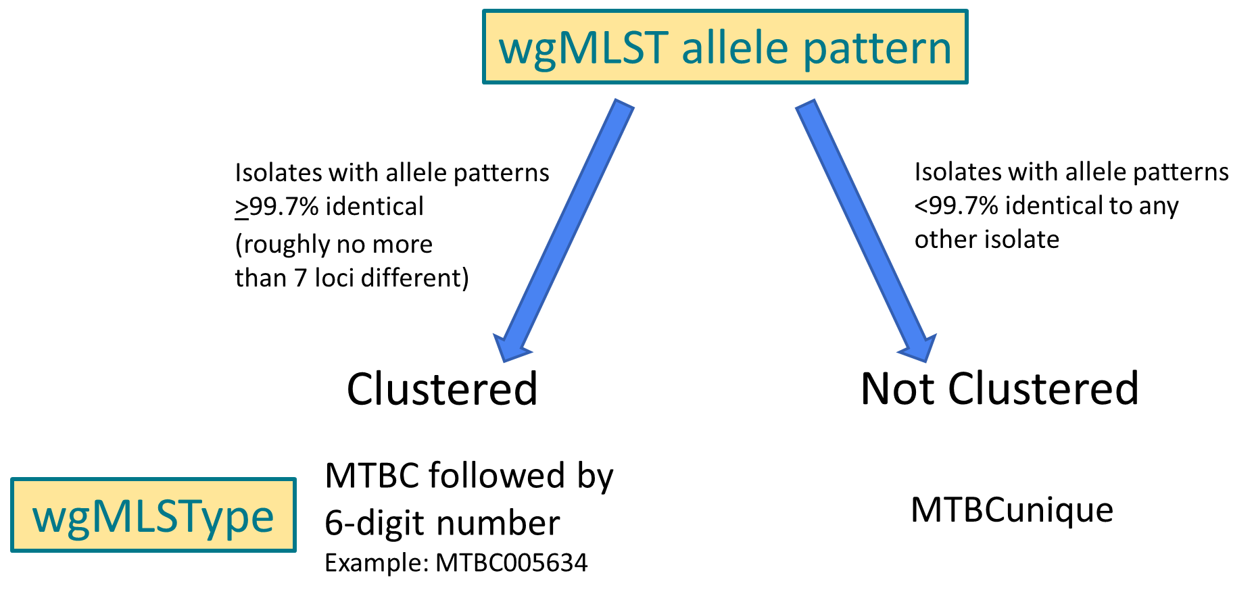
Definitions for TB Genotyping in the United States
wgMLST, whole-genome multilocus sequence typing.
More information on WGS is available at https://www.cdc.gov/tb/programs/genotyping/genome-sequencing.htm.
Notes:
This slide depicts the assignment of wgMLSType. Isolates with whole genome sequencing based allele patterns that are ≥99.7% identical are assigned a numbered whole-genome multilocus sequence type or wgMLSType. Isolates with allele patterns <99.7% identical are assigned a wgMLSType of “MTBCunique.” An isolate designated as MTBCunique might be assigned to a numbered wgMLSType if it matches one or more isolates’ allele pattern by ≥99.7% in the future.
More information on WGS is available at https://www.cdc.gov/tb/programs/genotyping/genome-sequencing.htm.

Slide 49
Number of County-based TB Genotype Clusters* by Cluster Size, United States, 2020–2022
* Clusters have two or more cases with matching whole-genome multilocus sequence type (wgMLSType) within a county during the specified 3-year time period.
Notes:
This slide shows the number of county-based TB genotype clusters by the size of the clusters. A genotype cluster has two or more cases with matching wgMLSType within a county during the specified 3-year time period. During 2020 to 2022, there were 675 two-case clusters, 139 three-case clusters, 64 four-case clusters, 36 five-case clusters, 17 six-case clusters, 9 seven-case clusters, 13 eight-case clusters, 7 nine-case clusters, and 27 clusters with 10 or more TB cases. The total number of clusters during 2019 to 2021 (n=1,241) declined during 2020 to 2022 (n=987). The number of clusters with 6 or more cases was comparable for 2019 to 2021 (n=74) and 2020 to 2022 (n=73).

Slide 50
TB Genotype Clusters by TB GIMS* Alert Levels,† United States, 2020–2022 (N=987)
* TB GIMS=Tuberculosis Genotyping Information Management System
† Alert levels are based on a log-likelihood ratio (LLR), which calculates the geographical concentration of a genotype in a county compared to the rest of the country during a 3-year period. TB GIMS generates alert level notifications based on this statistic: “No alert” is indicated if LLR is between 0–<4, “medium” is for LLR of 4–<10 and “high” alert is for clusters with LLR ≥10.
Notes:
Clusters are classified into alert levels based on a log-likelihood ratio (LLR) calculation. Clusters with an LLR of 4–<10 are classified as a medium alert level, and clusters with an LLR ≥10 are classified as a high alert level. At the individual case level, clustered cases were often part of medium- (41.3%, n=1,238) or high-level alerts (24.4%, n=732). At the cluster level, 56.1% (n=554) of 987 clusters identified nationally during 2020 to 2022 were either medium- (48.2%, n=476) or high-level alerts (7.9%, n=78). 2020–2022 data were based on wgMLSType to determine clustering; the distribution of alerts has changed compared with 2019–2021 which based clustering on GENType and fewer clustered cases were in medium- (23.5%, n=836) or high-level alerts (14.8%, n=529) and 27% (n=335) of 1,241 clusters were medium- or high-level alerts.

Slide 51
Percentage of Clustered TB Cases in Alert and No Alert Genotype Clusters by Origin of Birth,* United States, 2020–2022
No alert†
(N=1,029)
Alert§
(N=1,970)
* Cases with unknown origin of birth not shown (n=14).
† No alert indicates the case was in a cluster with a log-likelihood ratio (LLR) of <4.
§ Alert indicates the case was in a cluster with an LLR of ≥4.
Notes:
A greater percentage of clustered cases in alerted clusters were U.S.-born (62.0%, n=1,218), whereas the majority of clustered cases in no alert clusters were non-U.S.–born (55.4%, n=566).

Slide 52
Percentage of Clustered TB Cases in Alerted Clusters by
Age Group, United States, 2020–2022
Notes:
Alerted clusters have a higher concentration of a genotype in the county or county equivalent than non-alerted clusters, and alerted clusters are reviewed by CDC staff for possible programmatic follow-up. The percent of clustered cases in alerted clusters is higher among younger age groups than older. Of the 106 cases that occurred among persons 0 to 4 years old and were in a cluster, 79.3% (n=84) were in a cluster that alerted, compared with 60.5% (n=225) of the 372 cases in persons 65 years or older who were in a cluster.

Slide 53
Percentage of Clustered TB Cases in Alerted Clusters by Race/Ethnicity Group,* United States, 2020–2022
*Persons who identified as Hispanic or Latino were categorized as "Hispanic," regardless of self-reported race. Persons who did not identify as Hispanic or Latino were categorized by self-reported race; if more than one race was reported, the person was categorized as "Multiple race."
Notes:
Greater percentages of clustered cases in an alerted cluster were identified among American Indian or Alaska Native persons (96.1%, n=123), Black or African American persons (76.2%, n=628), and Native Hawaiian or Other Pacific Islander persons (71.8%, n=102), compared with national average estimates (50 states and Washington, DC; 65.7%, n=1,970).

Slide 54
Percentage of Clustered TB Cases in Alerted Clusters by
Selected Risk Factors, United States, 2020–2022
Notes:
Greater percentages of clustered cases in an alert were identified among persons diagnosed while incarcerated (75%, n=123) compared with national average estimates (50 states and Washington, DC; 65.7%, n=1,970). The lowest percentages of clustered cases in an alert were among persons experiencing homelessness (64.2%, n=204) and persons living with HIV (62.7%, n=106).

Slide 55
Division of Tuberculosis Elimination
National Center for HIV, Viral Hepatitis, STD, and TB Prevention
Centers for Disease Control and Prevention
1600 Clifton Road NE
Atlanta, GA 30329
Phone: 404-639-8120
E-mail: tbinfo@cdc.gov
Internet Address: http://www.cdc.gov/tb/

