Slide 1

Introduction to Tuberculosis (TB)
December 2024
Notes:
This slide set is an introduction on the basics of tuberculosis, often referred to as TB.

Slide 2








This Slide Deck Covers the Following Topics about Tuberculosis (TB):
What is Tuberculosis (TB)?
How TB spreads
Inactive TB Infection and TB Disease
Risk Factors
TB Testing
Treatment
TB Elimination

Slide 3

What is Tuberculosis (TB)?

Slide 4

Tuberculosis (TB)
TB is spread from person to person through the air
TB is a disease caused by bacteria called Mycobacterium tuberculosis. The bacteria, or TB germs, usually attack the lungs. However, TB germs can attack any part of the body such as the kidney, spine, or brain
  Pulmonary TB is TB in the lungs
  Extrapulmonary TB is TB in places other than the lungs, such as the kidney, spine, or brain
Not everyone infected with TB germs becomes sick
Notes:
TB is an airborne disease that spreads from person to person through the air. When a person breathes in TB germs, the germs can settle in the lungs and begin to grow. From there, the germs can move through the blood to other parts of the body, like the kidney, spine, or brain. Pulmonary TB is TB in the lungs. Extrapulmonary TB is TB disease that occurs in places other than the lungs.
For more information: https://www.cdc.gov/tb/about/index.html

Slide 5

TB is the one of the World’s Top Causes of Death due to Infectious Disease
TB is not a disease of the past
Too many people in the United States still suffer from TB
10.8 million cases were reported worldwide in 2023
In 2023, there were 9,633 cases of TB disease in the United States, the highest reported since 2013.
TB is a serious disease that can cause a person to become very sick if not treated with medicine
Treatments are available to prevent and cure TB
Notes:
Tuberculosis is preventable and treatable but remains one of the world’s deadliest infectious-disease killers. After decreasing considerably in 2020, TB cases have been increasing since 2021 with 2023 reporting the highest number of cases since 2013.
For more information: https://www.cdc.gov/tb-surveillance-report-2023/index.html

Slide 6
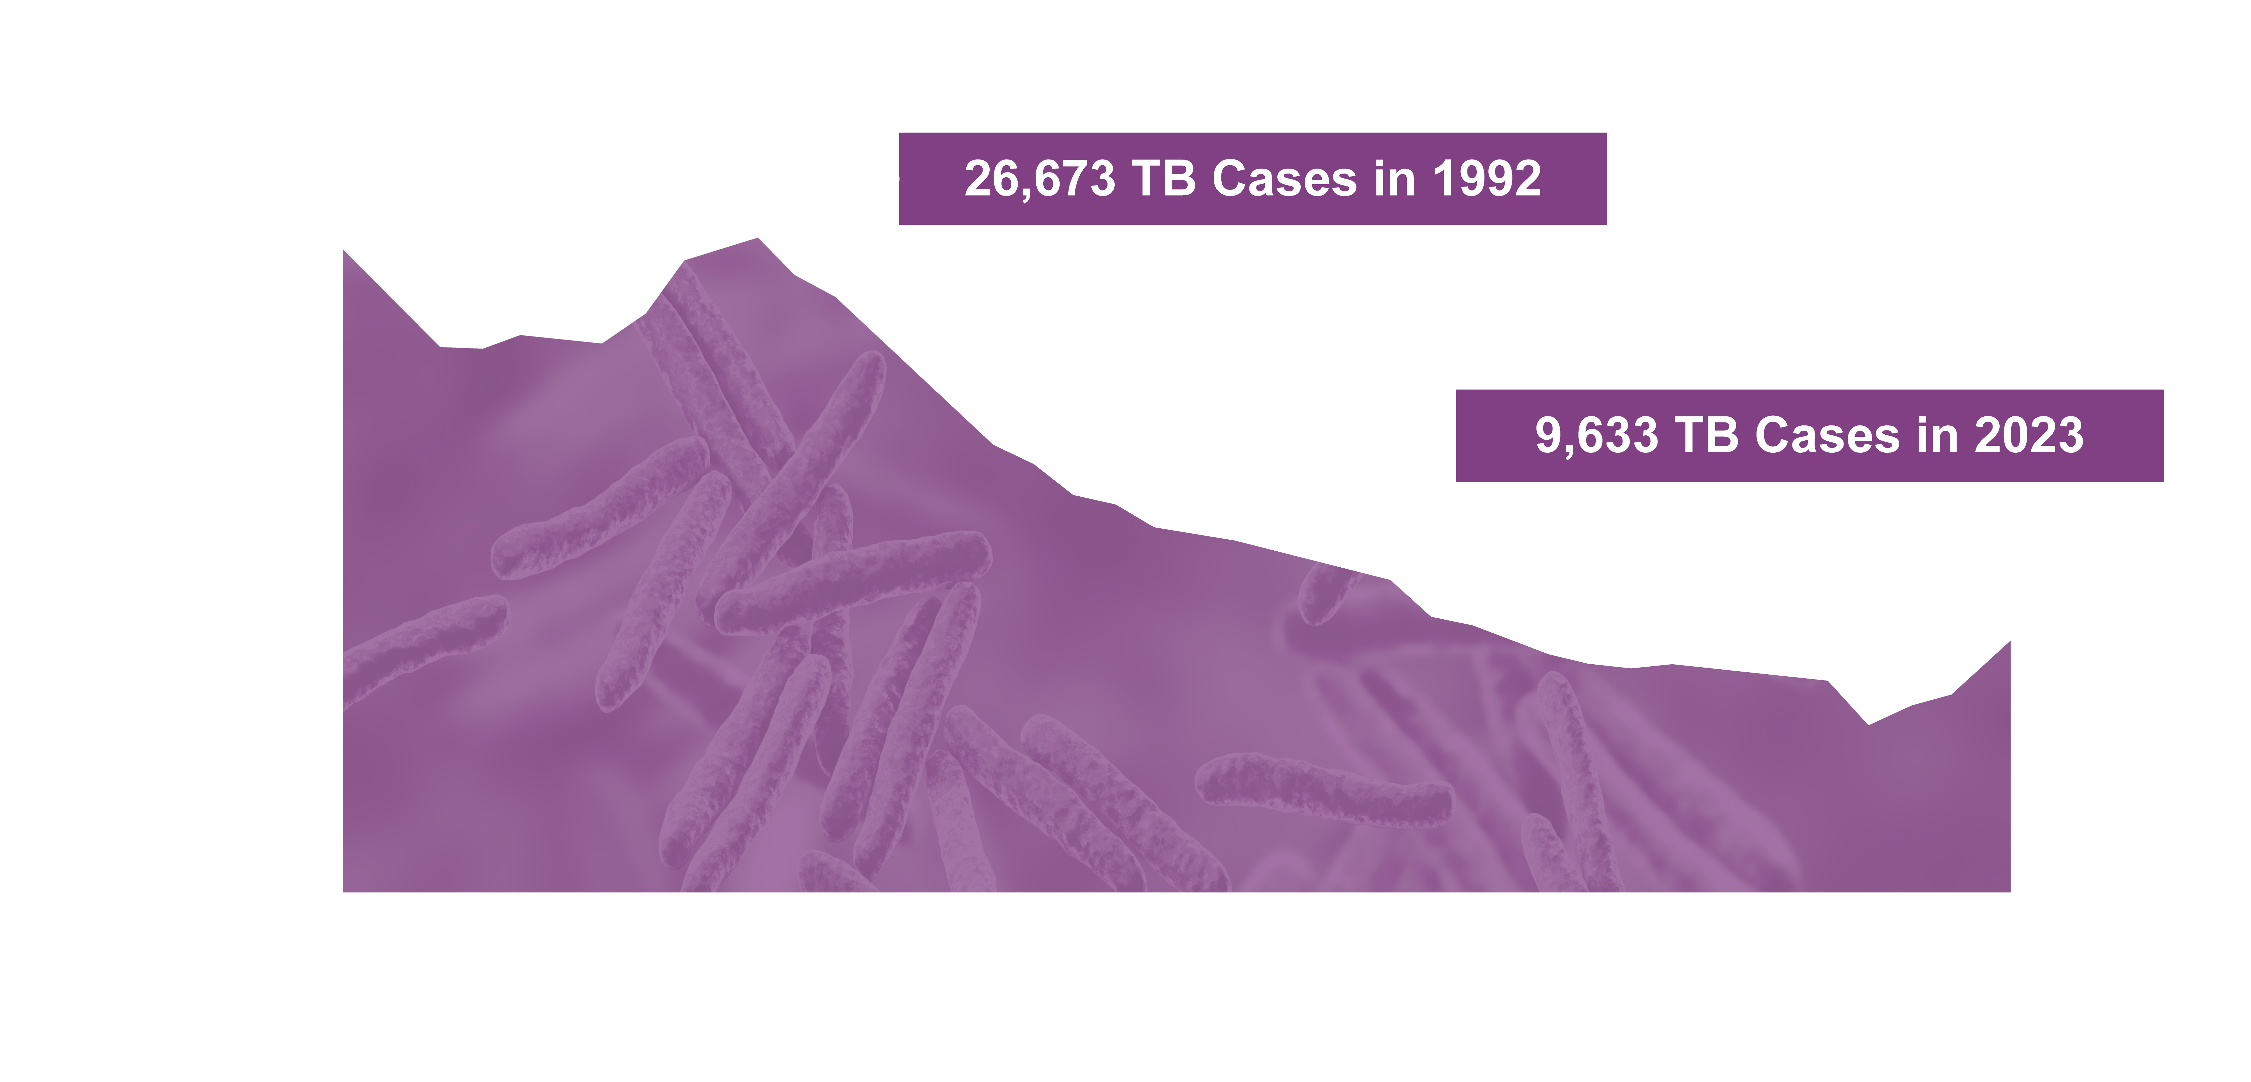
Progress Toward TB Elimination,
United States, 1982-2023
Notes:
This graph shows the number of TB cases for each year from 1983 to 2023 (the most recent year for which TB data are available). In 1992, the U.S. had the highest number of reported TB cases during this period.
2023 saw a 15.6% increase in cases compared with 2022. There were 9,633 TB cases in the United States in 2023.
To reverse recent increases in TB and reach the goal of TB elimination in the United States, enhanced strategies to diagnose and treat inactive TB and TB disease are needed. The TB elimination threshold is <1 case per 1,000,000 population, which is approximately 335 cases per year for the current U.S. population.
For more information: https://www.cdc.gov/tb-surveillance-report-2023/index.html

Slide 7



TB Impacts People from All Over the United States
https://www.cdc.gov/tb/stories/
Notes:
TB is still a life-threatening problem in this country, and it impacts people across the United States. TB knows no borders, and people in the United States are suffering from TB. Anyone can get TB. CDC has worked with the We Are TB Survivors Network and the National Tuberculosis Coalition of America to highlight the personal experiences of people who have been diagnosed with and treated for TB disease, as well as the work of TB control professionals. These stories provide insight into some of the challenges TB survivors have had to overcome regarding their diagnosis and treatment of TB.
For more information: https://www.cdc.gov/tb/stories/

Slide 8

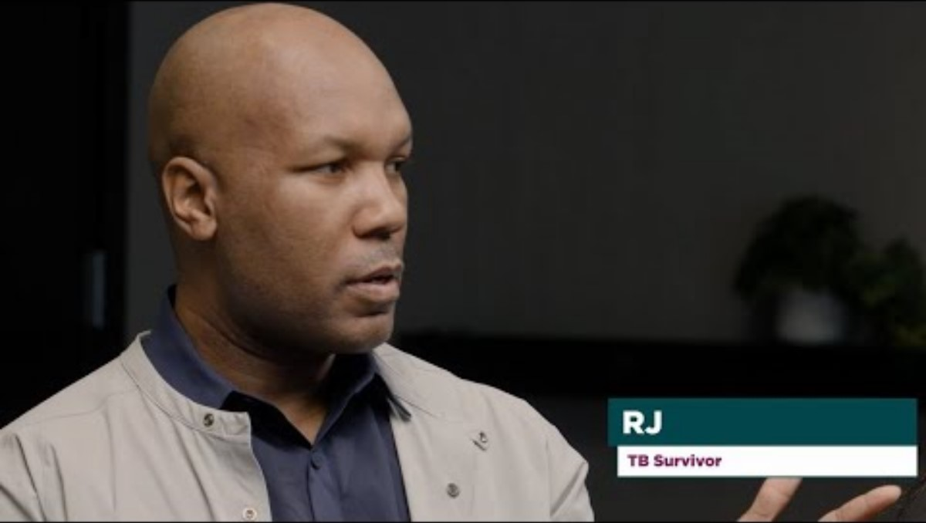
TB Survivors Share their Stories
Notes:
In this video, TB disease survivors Renee, Greg, and RJ give advice to people recently diagnosed with TB disease.
For more information: https://www.cdc.gov/tb/stories/

Slide 9

How TB Spreads

Slide 10
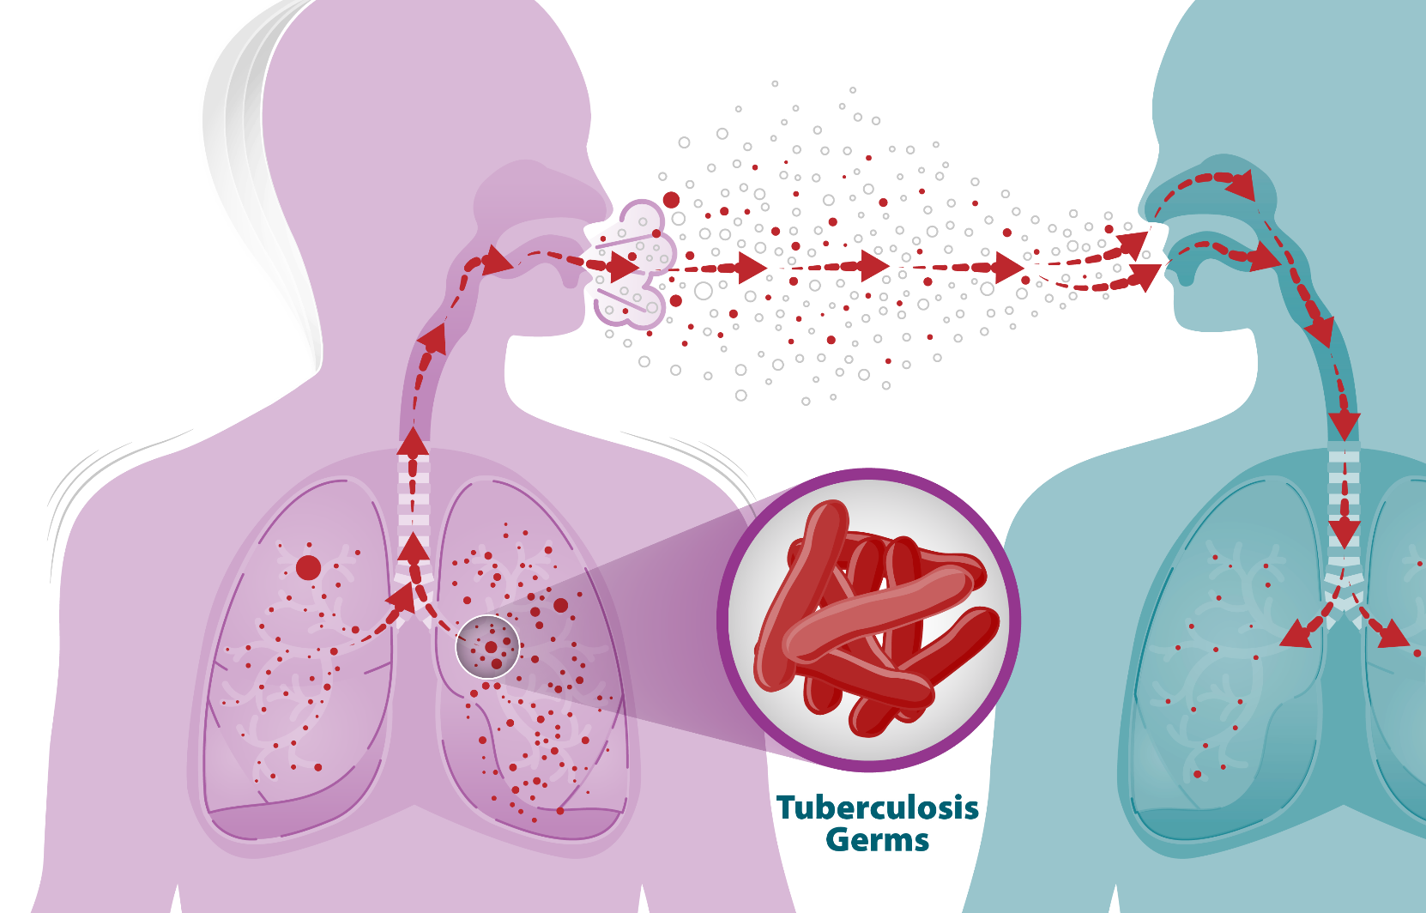
TB Spreads Through the Air
TB spreads from person to person when someone with active TB disease coughs, speaks, or sings
Notes:
This image shows how TB germs spread through the air. The TB germs are put into the air when a person with TB disease (on the left) of the lungs or throat coughs, speaks, or sings. People nearby may breathe in these germs (illustrated by the person on the right) and become infected. The person on the left has TB disease and is putting TB germs into the air. The person on the right is breathing in the TB germs into their lungs.
The best way to stop TB spread is to
Identify people who have TB.
Isolate those who are contagious.
Provide treatment as soon as possible to anyone who is contagious.
People with TB disease are most likely to spread it to people they spend time with every day, including family members, friends, coworkers, or schoolmates.
For more information: https://www.cdc.gov/tb/causes/index.html

Slide 11






TB Is NOT Spread by
Sharing toothbrushes
Saliva from kissing
Shaking someone’s hand
Touching bed linens or toilets
Sharing food, drink, or utensils
Notes:
For more information: https://www.cdc.gov/tb/causes/index.html#cdc_causes_how_it_spreads-how-it-spreads

Slide 12

Inactive TB and TB Disease

Slide 13

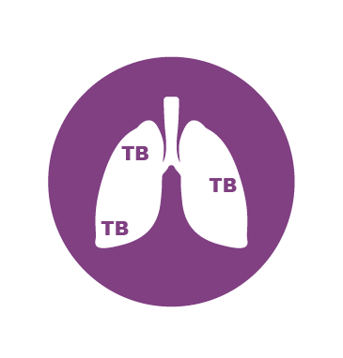
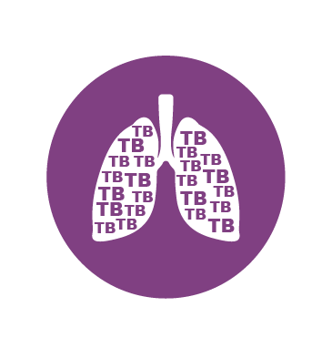
Two TB-Related Conditions
Inactive TB
People with latent TB infection or inactive TB
Do not feel sick, do not have symptoms, and cannot spread
TB germs to others
Can have inactive TB for years
Have a small amount of TB germs in their bodies that are
alive but inactive
Inactive TB can develop into TB disease
TB Disease
If TB germs become active and multiply, inactive TB can turn into TB disease
Notes:
Not everyone infected with TB germs becomes sick. As a result, two TB-related conditions exist: inactive TB (sometimes called latent TB, or LTBI) and TB disease.
TB germs can live in the body without making you sick. This is called inactive TB. People with inactive TB have TB germs in their bodies, but do not have TB disease and cannot spread the infection to other people.
TB germs become active if the immune system can’t stop them from growing. When TB germs are active (multiplying in your body), this is called TB disease.
On this slide, the lung with inactive TB (top) has a small amount of TB due to the immune system controlling the germs. The lung with TB disease (bottom) is full of TB because the immune system cannot stop the TB germs from growing and multiplying.
For more information: https://www.cdc.gov/tb/about/inactive-tuberculosis.html

Slide 14
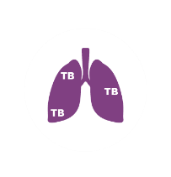
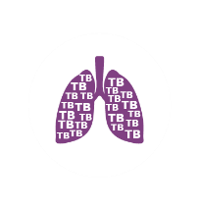
Not Everyone Who Is Infected with TB Becomes Sick
Person with Inactive TB | Person with TB Disease
Has a small amount of TB germs in their body that are alive but inactive | Has a large amount of active TB germs in their body
Cannot spread TB germs to others | May spread TB germs to others
Has no symptoms and does not feel sick, but may become sick if the germs become active in their body | Feels sick and has symptoms such as a cough, fever, and/or weight loss
Usually has a positive TB skin test or TB blood test result indicating TB infection | Usually has a positive TB skin test or TB blood test result indicating TB infection
Has a normal chest x-ray and a negative sputum smear | May have an abnormal chest x-ray, or positive sputum smear or culture
Needs treatment for inactive TB infection to prevent TB disease | Needs treatment for active TB disease
Notes:
This table compares inactive TB and TB disease.
Both inactive TB and TB disease usually result in a positive TB skin test or TB blood test.
For more information: https://www.cdc.gov/tb/about/inactive-tuberculosis.html

Slide 15

Untreated Inactive TB Can Lead to TB Disease
If the immune system can’t stop TB germs from growing,
they become active (multiplying in your body); this is called TB disease
Most people diagnosed with TB disease in the United States become sick after living with inactive TB for years
It is estimated that up to 13 million people in the United States have inactive TB
Inactive TB treatment is 90% effective in preventing the development of TB disease
Notes:
More than 80% of people who get sick with active TB disease in the United States each year get sick from untreated inactive TB.
Many people who have inactive TB never develop TB disease. Some people develop TB disease soon after becoming infected (within weeks), before their immune system can fight the TB germs. Other people may get sick years later when their immune system becomes weak for another reason.
While not everyone with inactive TB will develop TB disease, 1 in 10 people will develop TB disease over their lifetimes if not treated. The progression from inactive TB to TB disease may occur at any time, but it is most common within the first two years of infection.
For more information: https://www.cdc.gov/tb/about/inactive-tuberculosis.html

Slide 16
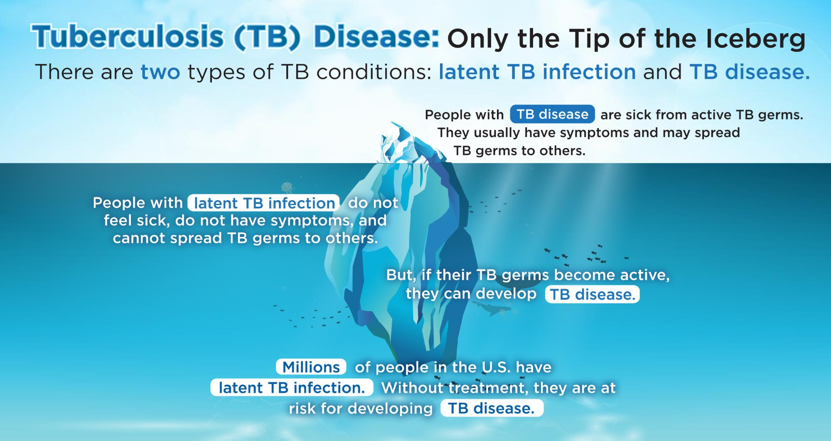
Tuberculosis (TB) Disease: Only the Tip of the Iceburg
There are two types of TB conditions: latent TB infection and TB disease.
People with TB disease are sick from active TB germs. They usually have symptoms and may spread TB germs to others.
People with latent TB infection do not feel sick, do not have symptoms, and cannot spread TB germs to others.
But, if their TB germs become active, they can develop TB disease.
Millions of people in the U.S. have latent TB infection Without treatment, they are at risk for developing TB disease.
Notes:
This graphic helps summarize TB disease and inactive TB (also called latent TB infection, or LTBI) in the United States. TB disease is just the tip of the iceberg that is visible above the water. TB disease can be seen because of the active germs in a person’s body and the symptoms they experience. People with TB disease can spread TB to others.
However, the larger part of the iceberg that is hidden underwater represents inactive TB. Like the iceberg, inactive TB can be easily hidden because TB germs are inactive and people with inactive TB germs do not feel sick. Many people with inactive TB do not know they are infected with TB. There are up to 13 million people in the U.S. with inactive TB. Without treatment for inactive TB, they could develop TB disease.

Slide 17

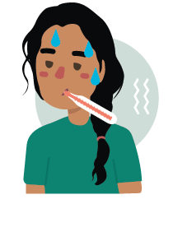






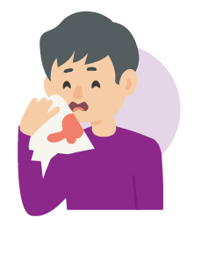
Possible TB Disease Symptoms
Night Sweats
Fever
Chills
Weakness or fatigue
No appetite
Weight loss
Cough lasting longer than
3 weeks
Coughing up blood or sputum (phlegm from inside the lungs)
Pain in
the chest
Notes:
Pulmonary TB disease develops in the lungs while extrapulmonary TB disease can develop in other parts of the body. Symptoms can vary depending on the type of TB Disease.
For more information: https://www.cdc.gov/tb/signs-symptoms/index.html

Slide 18
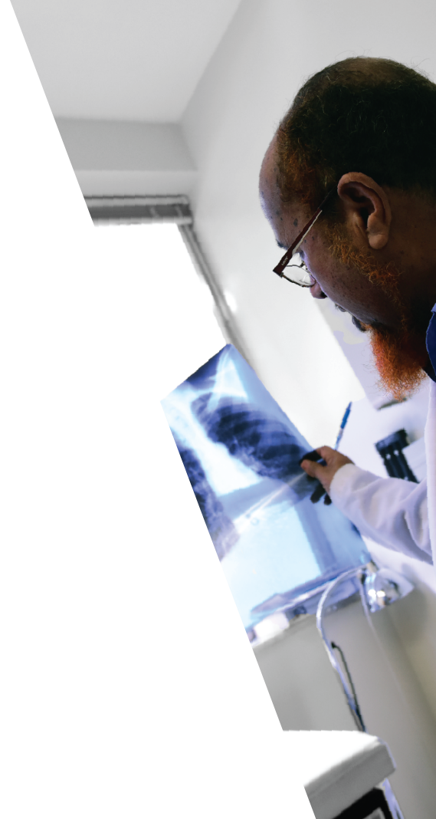


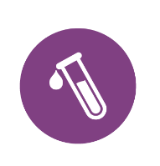

People with TB Disease Are Sick and Can Spread TB Germs
TB disease is a serious condition and can lead to death if
not treated
TB disease can almost always be treated and cured with medicine
A person with TB disease typically requires the following:
X-rays
4-6 months of medicine
Lab tests
Follow up and testing of close contacts
Notes:
People with TB disease feel sick and can spread TB germs, especially to people they spend time with every day.
A person with TB disease will require at least 4 months of medication plus X-rays, lab tests, and follow-up and testing of contacts.
TB disease is a serious condition and can lead to death if not treated. TB disease can almost always be treated and cured with medicine.
TB germs become active if the immune system can’t stop them from growing. When TB germs are active (multiplying in your body), this is called TB disease.
For more information: https://www.cdc.gov/tb/testing/index.html

Slide 19

Public Health Workers Are Responsible for Finding People Exposed to TB
A person who was exposed to someone with contagious TB disease is considered a TB contact
Persons exposed to someone with TB can include family members, roommates or housemates, close friends, coworkers, classmates, and others
People with TB disease can spread TB germs to those around them
The local health department will conduct a contact investigation by following up and testing those who have been close to someone with TB
Notes:
Conducting contact investigations is a priority for tuberculosis (TB) programs in the United States. The goals of a contact investigation are to successfully stop the spread of TB and prevent future cases and outbreaks of TB disease.
For more information, please see module 8 of the Self-Study Modules on Tuberculosis : https://www.cdc.gov/tb/hcp/education/self-study-modules-on-tuberculosis.html

Slide 20

Risk Factors

Slide 21



Who Is at Higher Risk for Becoming Infected with TB Germs?
Anyone can get TB
Some people have a higher risk of getting infected
with TB:
People who have contact with someone who has infectious TB disease
People who were born in or who frequently travel to countries where TB disease is common, including some countries in Asia, Africa, or Latin America
Health care workers and others who work or live in places at high risk for TB transmission, such as homeless shelters, jails, and nursing homes
Notes:
Others at higher risk include
Employees of high-risk congregate settings
Health care workers who serve patients with TB disease
Populations defined locally as having an increased incidence of inactive TB infection or TB disease, including medically underserved populations, low-income populations, or people who use drugs or alcohol
infants, children, and adolescents exposed to adults who are at increased risk for inactive TB infection or TB disease
For more information: https://www.cdc.gov/tb/risk-factors/index.html

Slide 22
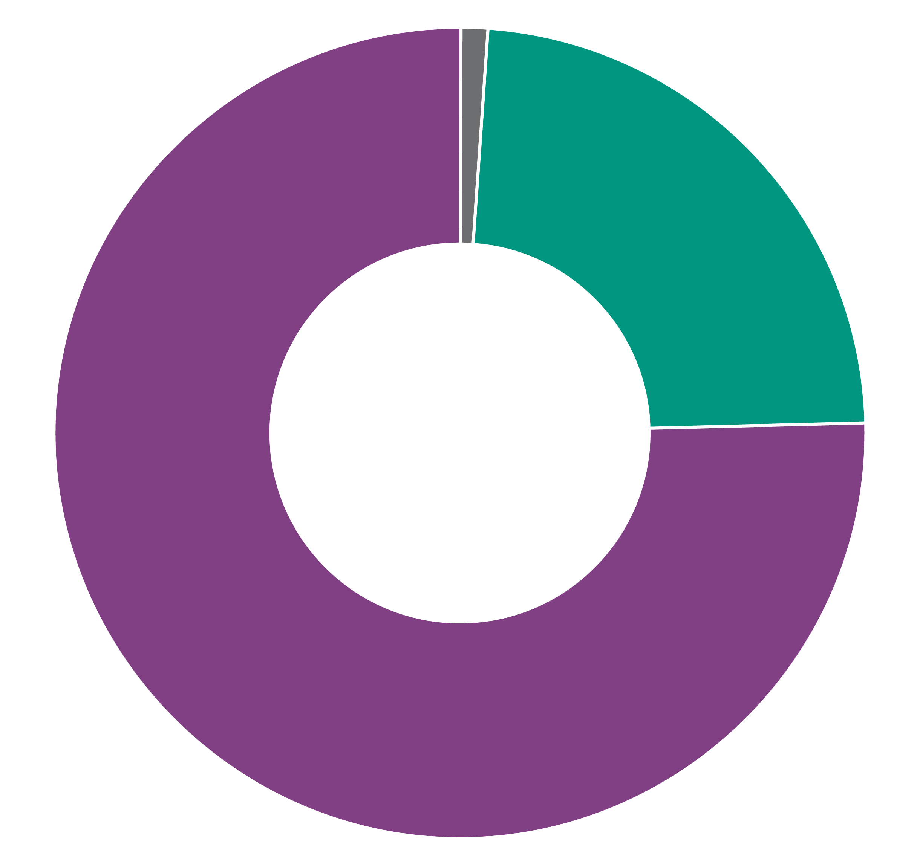
TB Incidence Rates and Percentages by Origin of Birth,* United States, 2023 (N=9,633)
U.S.-born
24%
Non-U.S.-born
Origin of birth unknown, <1%
76%
*Percentages are rounded; data from 2023
Notes:
TB disease in the United States is most common among people who were born in countries with high rates of TB.
Demographic characteristics of TB patients have remained consistent over the last several years. For example, since 2010, the majority of reported TB disease cases in the U.S. occur among non-U.S.-born persons. The data on this slide is from 2023.
For more information: https://www.cdc.gov/tb-surveillance-report-2023/index.html

Slide 23
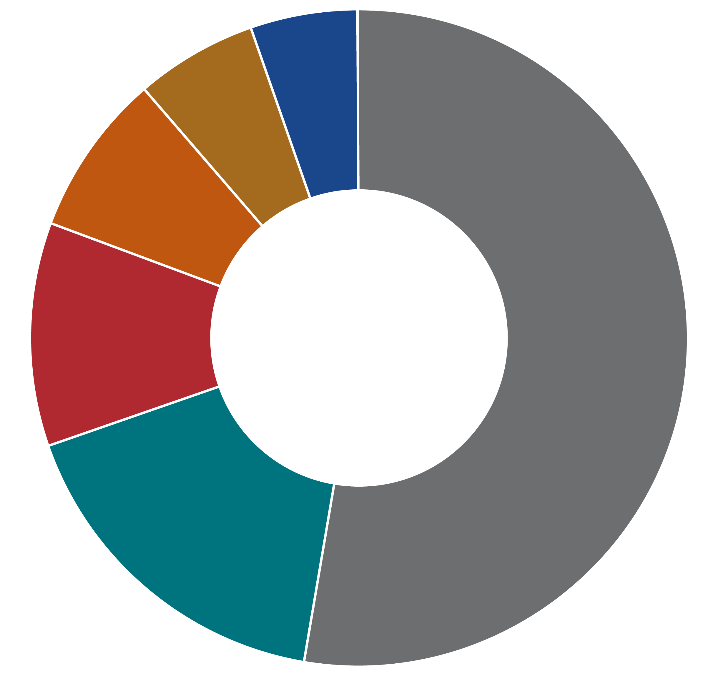
TB Cases by Countries of Birth Among Non-U.S.-Born* Persons, United States, 2023 (N=7,299)
5%
6%
Mexico
8%
Philippines
India
11%
52%
Vietnam
China
Other Countries
17%
*Percentages are rounded
Notes:
As seen on the previous slide, TB disease in the United States is most common among people who were born in countries outside the U.S., usually countries with high rates of TB.
This pie chart shows the most common countries of birth among non-U.S.-born persons with TB disease reported in the U.S.
The most common countries of birth among non-U.S.-born TB patients remained fairly consistent over the last several years. This slide shows data from 2023 with Mexico (17%) the most frequently reported country of birth, followed by the Philippines (11%), India (8%), Vietnam (6%), and China (5%). Other countries represented 52% of cases.
For more information: https://www.cdc.gov/tb-surveillance-report-2023/index.html

Slide 24
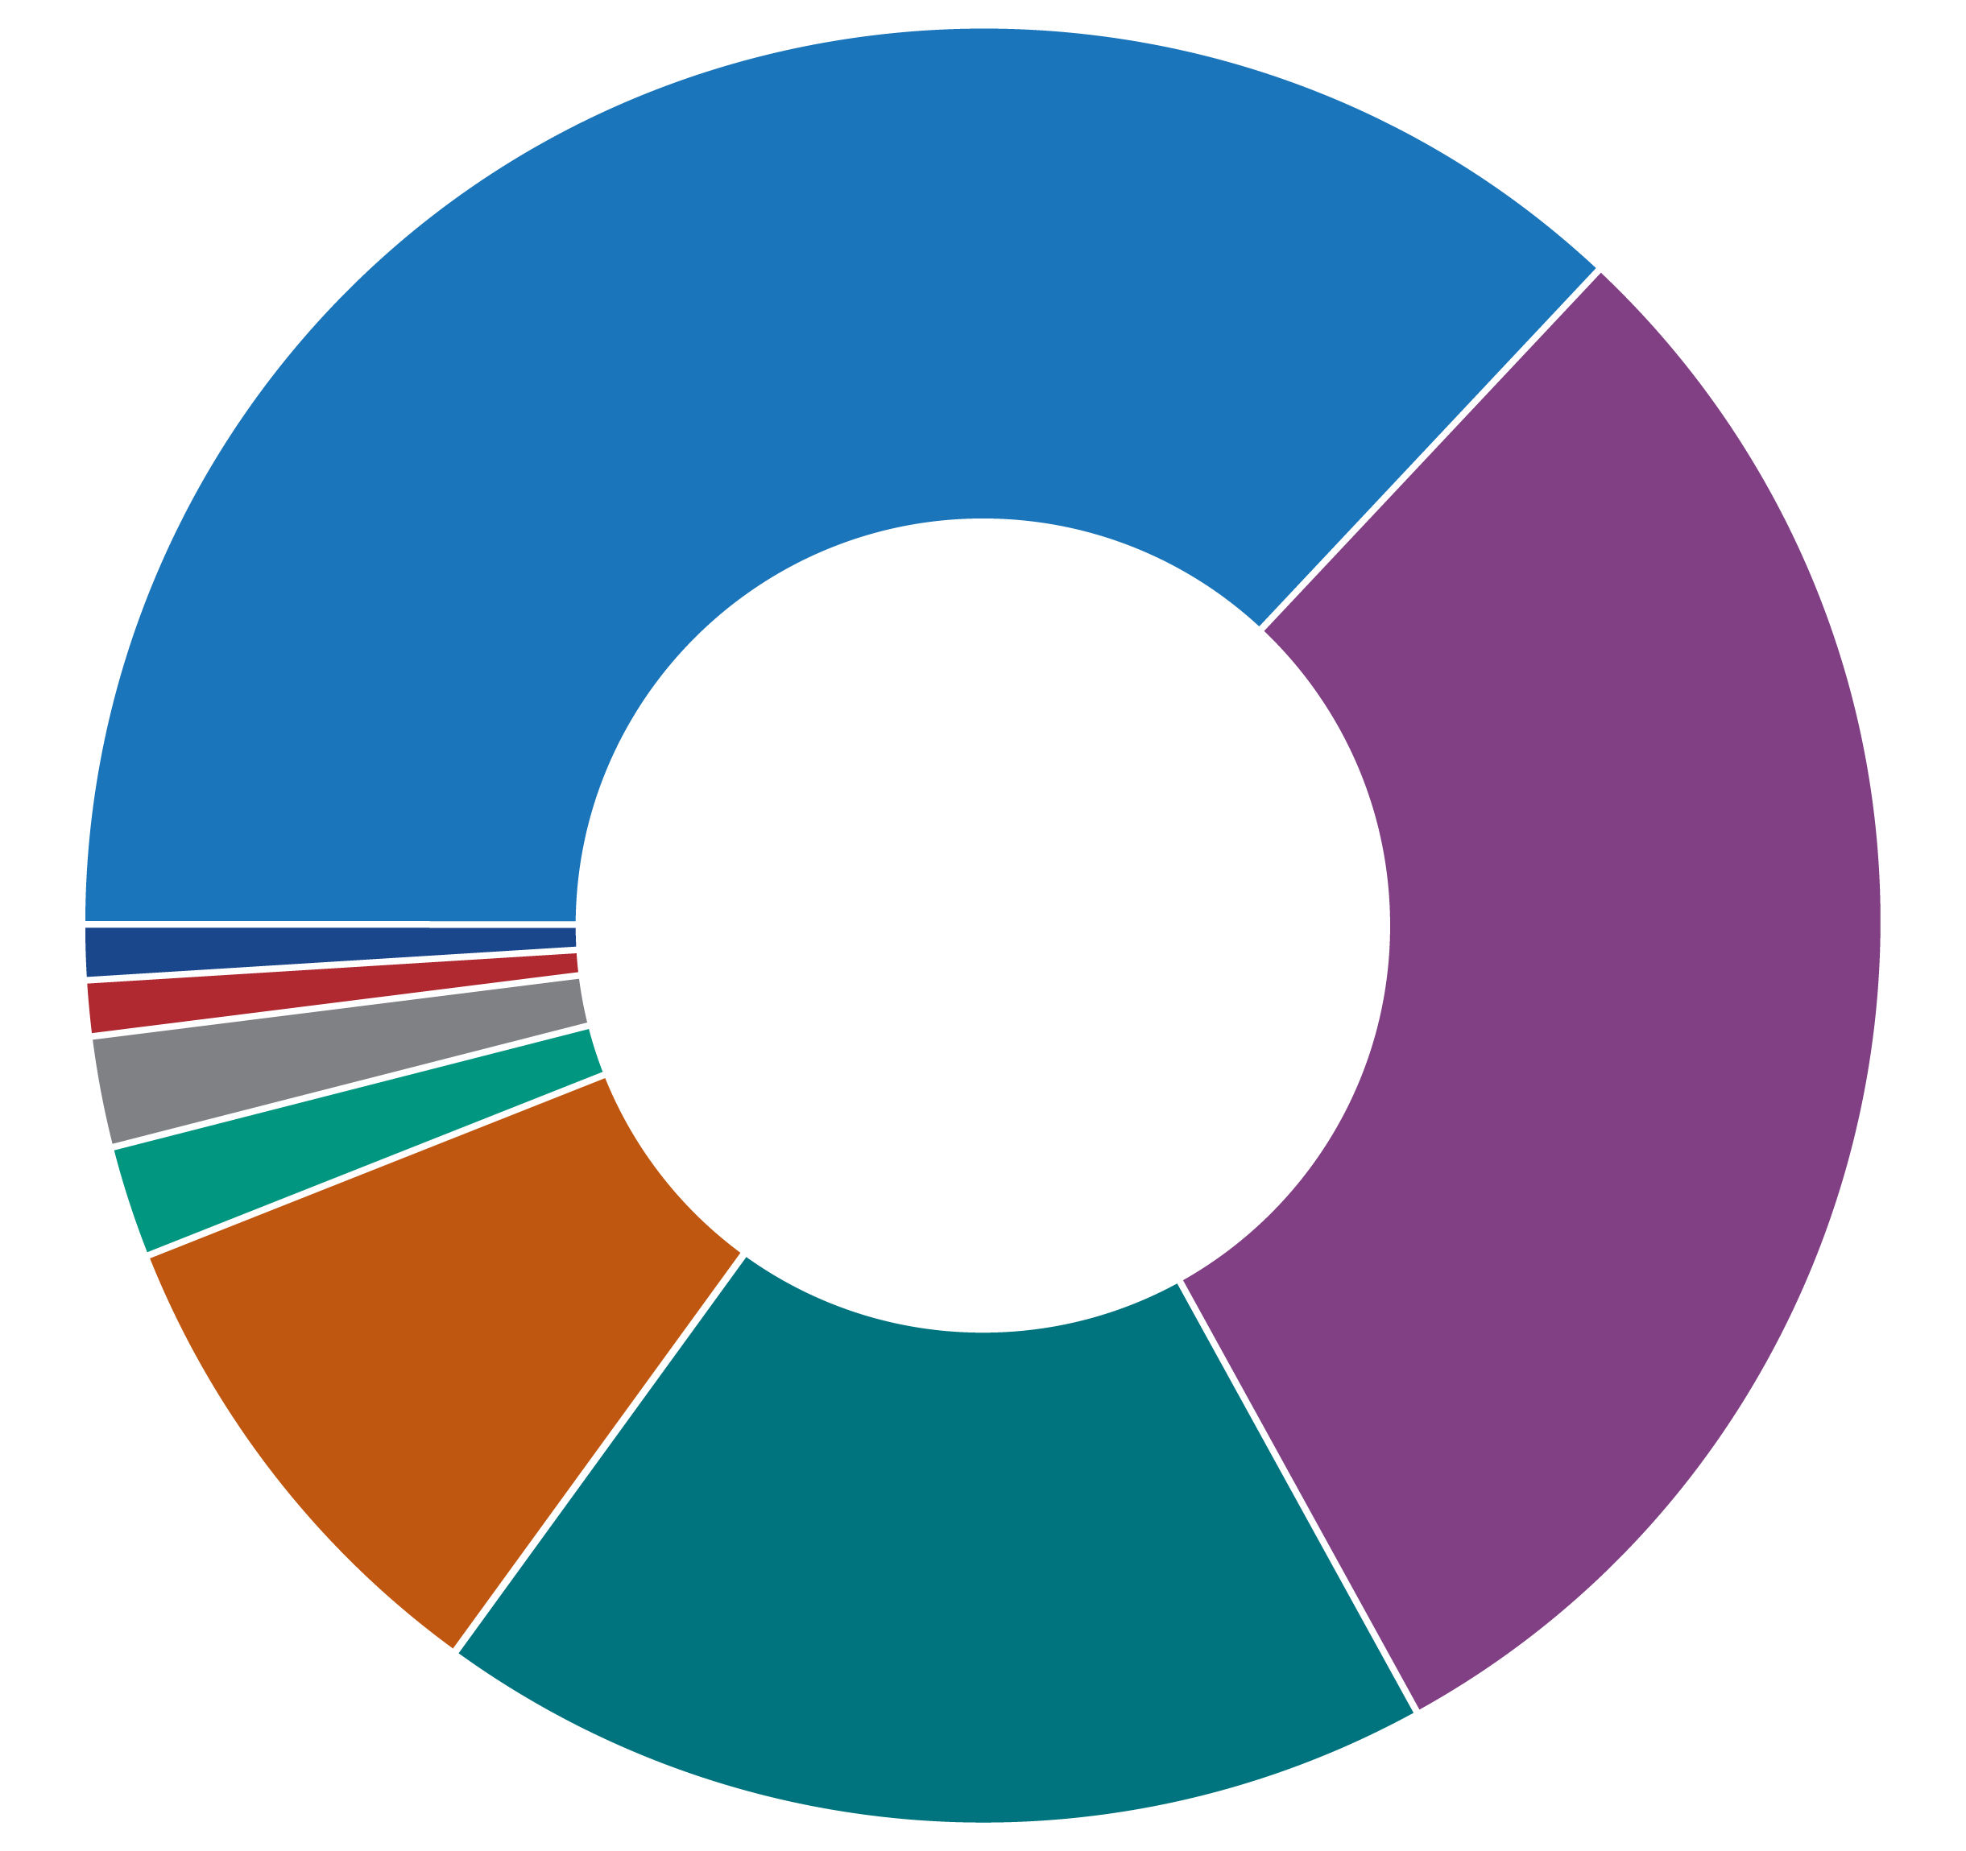
Percentage of TB Cases by Race/Ethnicity,* United States, 2023 (N=9,633)
Hispanic or Latino
37%
Asian
Black or African American
White
1%
Multiple Race
1%
30%
2%
Native Hawaiian or Other Pacific Islander
2%
American Indian or Alaska Native
9%
Other Race
18%
* All races are non-Hispanic; multiple races indicates two or more races reported for a person but does not include persons of Hispanic/Latino origin.
Notes:
In 2023 Hispanic or Latino persons (36.8%) represented the largest proportion of TB patients, followed by Non-Hispanic Asian persons (30.0%), non-Hispanic Black or African American persons (17.6%), and non-Hispanic White persons (9.3%). American Indian or Alaska Native persons, Native Hawaiian or Other Pacific Islander persons, persons who identify with more than one race, persons who identify as Other race and those with unknown or missing race/ethnicity information each represented 1–2% of patients.
For more information: https://www.cdc.gov/tb-surveillance-report-2023/index.html

Slide 25

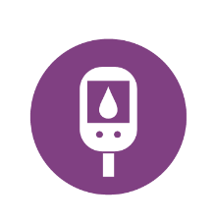


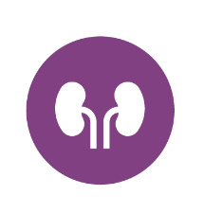

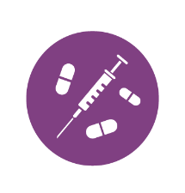
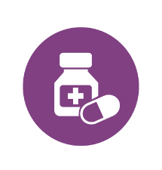


Who Is at Risk for Developing TB Disease?
People at higher risk for developing TB disease generally fall into two categories:
  Those who have been recently infected with TB germs
  Those with medical conditions that weaken the immune system, such as:
HIV infection
Diabetes
Specialized treatment for rheumatoid arthritis or Crohn’s disease
Organ transplants
Severe kidney disease
Head or neck cancer
Substance use
Medical treatments such as corticosteroids
Silicosis
Low body weight
Notes:
While not everyone with inactive TB will develop TB disease, about 1 in 10 people will develop TB disease over their lifetimes if not treated. Progression from untreated inactive TB to TB disease is estimated to account for more than 80% of U.S. TB cases.
Babies and young children are also at higher risk because they often have weak immune systems.
For more information: https://www.cdc.gov/tb/risk-factors/index.html

Slide 26

TB Testing

Slide 27
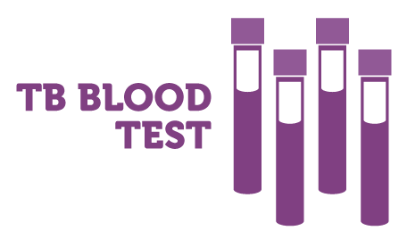
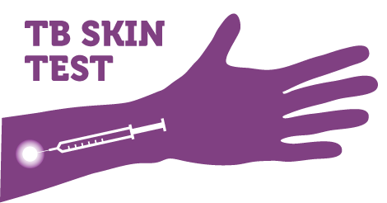



Two Types of Tests Can Be Used to Diagnose TB Infection
TB blood test or
TB skin test
OR
If either test is positive, further tests are done to confirm a diagnosis of TB disease:
  Medical examination
  Chest x-ray
Notes:
Health care providers are encouraged to use newer TB blood tests to screen for TB infection. A positive TB skin test or TB blood test only tells that a person has been infected with TB germs. It does not tell whether the person has inactive TB or has progressed to TB disease. Other tests, such as a chest x-ray and a sample of sputum, are needed to see whether the person has TB disease.
Generally, it is not recommended to test a person with both a TB skin test and a TB blood test.
For more information: https://www.cdc.gov/tb/testing/index.html

Slide 28
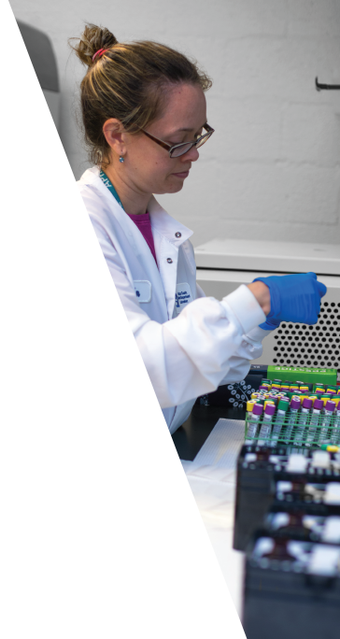

TB Blood Test
Blood is drawn and sent to a lab for analysis.
Positive blood test: A person likely has been infected with
TB germs. Additional tests are needed to determine if the person has inactive TB or TB disease.
Negative blood test: A person’s blood did not react to the test and inactive TB, or TB disease is not likely.
The TB blood test is also known as an Interferon-Gamma Release Assay (IGRA).
Notes:
Blood tests measure a person’s immune reactivity to TB germs. White blood cells from most people that have been infected with TB germs will release interferon-gamma (IFN-g) when mixed with antigens (substances that can produce an immune response) derived from TB germs.
Results for blood tests can be read as positive or negative. If the result is not a clear positive or negative, the test can be repeated.
Positive: Inactive TB likely
Negative: Inactive TB unlikely, but cannot be excluded, especially if the
Person has signs and symptoms consistent with TB disease
Person has a high risk for developing TB disease once infected with TB germs
Blood tests are the preferred test for people who have received the bacille Calmette-Guerin (BCG) vaccine. See slides 30 and 31 for more info on BCG.
For more information: https://www.cdc.gov/tb/testing/blood-test.html

Slide 29
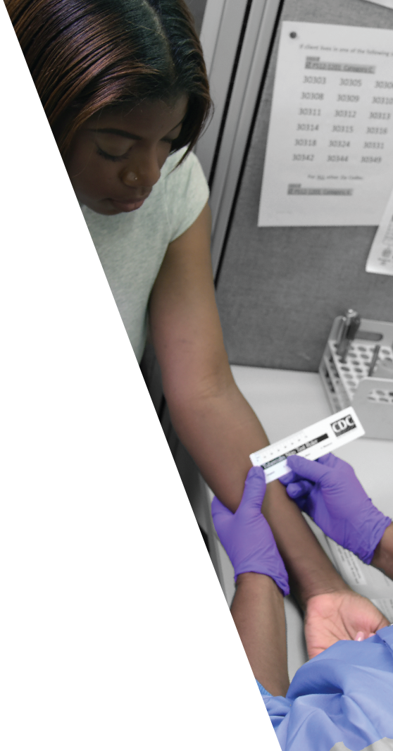
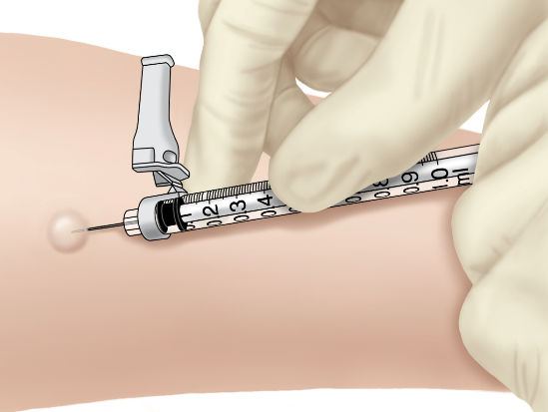
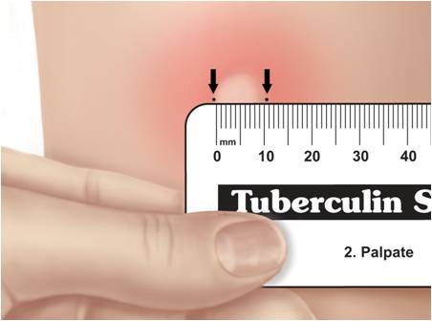
TB Skin Test
The TB skin test, also called the Mantoux tuberculin skin test (TST), requires two visits with a health care provider
On the first visit, a test is placed
On the second visit, the test is read
Notes:
The image on the left shows a TB skin test being administered into a patient’s arm. The image on the right shows the test being read by measuring the reaction at the test injection site.
A skin test is NOT a vaccine for TB disease.
A TB skin test requires two visits with a health care provider.
On the first visit, the skin test is placed by injecting a small amount of fluid (called tuberculin) into the skin on the lower part of the arm. The skin will react if there are TB germs in the body.
A person given the tuberculin skin test must return within 48–72 hours to have a trained health care worker look for a reaction on the arm. The result depends on the size of the raised, hard area where the skin reacted.
The result depends on the size of the raised, hard area or swelling.
Positive skin test: This means the person’s body is infected with TB germs. Additional tests are needed to determine if the person has inactive TB (LTBI) or TB disease.
Negative skin test: This means the person’s body did not react to the test, and that inactive TB or TB disease is not likely.
For more information: https://www.cdc.gov/tb/testing/skin-test.html

Slide 30
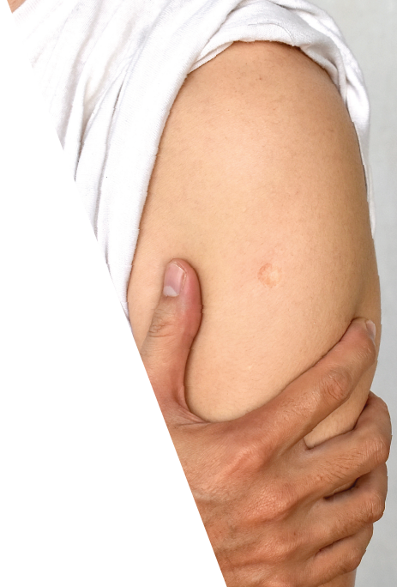
People Vaccinated with BCG
Can Still Get TB Disease
Bacille Calmette-Guérin (BCG)
Is a vaccine for TB disease
The TB vaccine is not widely used in the United States
Is often given to infants and small children in countries where TB is more common
Protects against severe forms of active TB in children
Protection from TB goes away as people get older
Notes:
BCG is a vaccine for preventing TB disease. It is a weak form of bacteria that is closely related to the germs that cause TB. This vaccine is not widely used in the United States, but it is often given to infants and small children in other countries where TB is common. BCG vaccine does not always protect people from getting TB and protection goes away as people get older.
For more information: https://www.cdc.gov/tb/vaccines/index.html

Slide 31
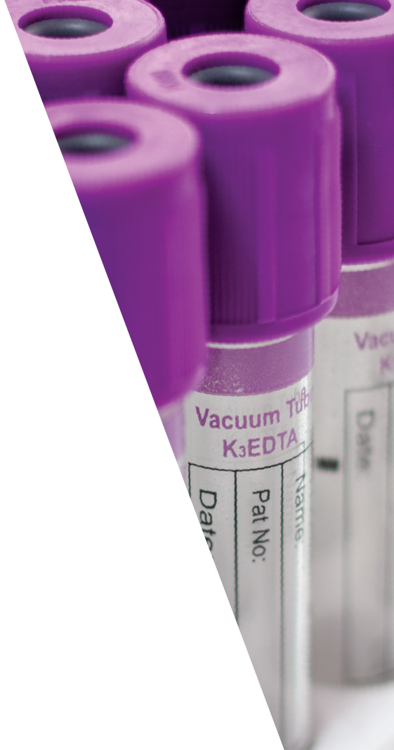
TB Blood Tests Are Preferred for People Who Have Received the TB Vaccine (BCG)
The TB vaccine (BCG) may cause a positive TB skin test
The TB vaccine does not affect TB blood tests results
TB blood tests give more accurate results in people who have received the TB vaccine
Anyone who has received the TB vaccine should receive a TB blood test instead of a TB skin test
Notes:
Many people born outside of the United States have received the TB vaccine.
The TB vaccine may cause a false-positive reaction to the TB skin test, which can complicate decisions about treatment. The presence or size of a TB skin test reaction in those who have been vaccinated with BCG does not predict whether the vaccine will provide protection against TB disease.
TB blood tests, unlike the TB skin test, are not affected by prior TB vaccination and are easier to interpret in people who have received the TB vaccine.
For more information: https://www.cdc.gov/tb/vaccines/index.html

Slide 32

Treatment

Slide 33
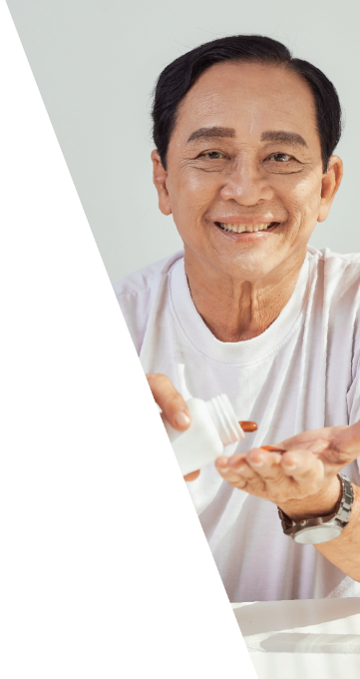
Treatment for Inactive TB Can Prevent the Development of TB Disease
People with inactive TB will not feel sick
  As long as TB germs remain in the body, they can become active, multiply, and make someone sick with TB disease
People with inactive TB
  Should take medicine to prevent the development of TB disease, even though they don’t feel sick
Notes:
People with inactive TB do not have symptoms, and they cannot spread TB germs to others. However, if inactive TB germs become active in the body and multiply, the person will go from having inactive TB to being sick with TB disease. For this reason, people with inactive TB should be treated to prevent them from developing TB disease. Treatment of inactive TB is essential to controlling TB in the United States because it substantially reduces the risk that inactive TB will progress to TB disease.
For more information: https://www.cdc.gov/tb/treatment/treatment-for-inactive-tuberculosis.html

Slide 34




Treatment for Inactive TB
Compared to treatment for TB disease, inactive TB treatment
Is shorter
Is less costly
Has fewer side effects
Notes:
Treating inactive TB is effective in preventing TB disease. There are several options for the treatment of inactive TB. There have been advances in shortening the length of inactive TB infection treatment from 6–9 months to 3–4 months. Short-course inactive TB treatments are effective, safe, and have higher completion rates than longer treatments. Shorter regimens help patients finish treatment.
For more information: https://www.cdc.gov/tb/hcp/education/latent-tb-infection-recommendations-summary.html

Slide 35
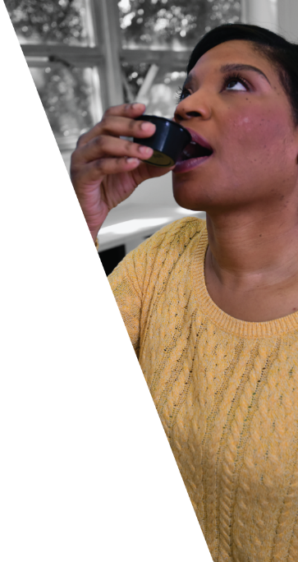
Treating TB Disease Protects Your Health and the Health of Others
People with TB disease can pass TB germs to their family, friends, and others around them if they don’t take TB medicine the right way
People with TB disease need to take several medicines when they start treatment
After taking TB medicine for several weeks, a doctor will be able to tell TB patients when they are no longer able to spread TB germs to others
  Most people take TB medicine for at least 4 months to
  be cured
Notes:
It is very important that people who have TB disease are treated, take the medicine exactly as prescribed, and finish all the medicine. If they stop taking the medicine too soon, they can become sick again; if they do not take the medicine correctly, the TB germs that are still alive may become resistant to those drugs. Resistance means that the drug can no longer kill the TB germs. Drug-resistant TB can occur when the drugs used to treat TB are misused or mismanaged. Examples of misuse or mismanagement include when
People do not complete a full course of TB treatment.
Health care providers prescribe the wrong treatment (the wrong dose or length of time).
Drugs for proper treatment are not available.
For more information: https://www.cdc.gov/tb/treatment/index.html

Slide 36

Directly Observed
Therapy (DOT)
Is the most effective strategy for ensuring that patients stay on track with their treatment
A health care worker will meet with the patient to watch them swallow each dose of the prescribed drugs
During DOT visits, the health care worker will check in with the patient to:
  answer questions
  make sure the treatment is working
  watch for side effects
Notes:
Directly observed therapy (DOT) for tuberculosis treatment involves observing a patient ingest medication, monitoring the patient for side effects, and providing support. DOT has typically been conducted in person; however, scheduling in-person DOT can present logistical challenges.
DOT can reduce the development of drug resistance, treatment failure, or relapse after the end of treatment. DOT can be given anywhere the patient and health care worker agree upon, provided the time and location are convenient and safe. It is important that the location is convenient for the patient.
For more information: https://www.cdc.gov/tb/hcp/treatment/vdot.html

Slide 37

Video Directly Observed Therapy (vDOT)
Alternative method to in-person DOT
The health care worker meets with the patient remotely using a video-enabled device to observe them taking their medication
Can be done live (synchronous) or recorded (asynchronous)
Gives patients more flexibility and autonomy as they complete their treatment
Facilitates patient monitoring outside of normal clinic hours, during an emergency, or when patients are traveling
Notes:
vDOT can assist TB programs meet the U.S. standard of care for patients undergoing tuberculosis treatment, while using resources efficiently. It facilitates patient monitoring outside of normal clinic hours, during an emergency, or when patients are traveling. vDOT allows persons undergoing TB treatment the opportunity to use video-enabled phones, tablets, or computers to remotely interact with health care workers in real time (synchronous) or through recorded videos (asynchronous).
For more information: https://www.cdc.gov/tb/hcp/treatment/vdot.html

Slide 38

TB Elimination

Slide 39



Together We Can Work Toward
TB Elimination in the United States
  Strengthen current TB programs to diagnose and treat TB disease.
  Increase efforts to identify and treat inactive TB infection.
Notes:
Current TB control measures, including early identification of TB disease, prompt and appropriate treatment for persons with TB disease, and ensuring that TB patients complete treatment, continue to be critical. Identifying and treating persons with inactive TB infection is also paramount to TB elimination. Eliminating TB in the U.S. will require this dual approach which includes strengthening existing systems to track and stop transmission of infectious TB disease and expanding efforts to address inactive TB.
The TB elimination threshold is <1 case per 1,000,000 population, which is approximately 335 cases per year for the current U.S. population.
The increase in reported cases of TB disease in 2023 highlights the need to regain the momentum lost toward the United States' goal of eliminating TB. United States continues to maintain one of the lowest TB incidence rates in the world even with the recent increase in cases.
It’s Time to End TB, meaning
It’s time to test for and treat inactive TB.
It’s time to strengthen TB education and awareness among health care providers.
It’s time to find, cure, and prevent all forms of TB in the United States and around the world.
It’s time to end stigma.
It’s time to speak up.

Slide 40
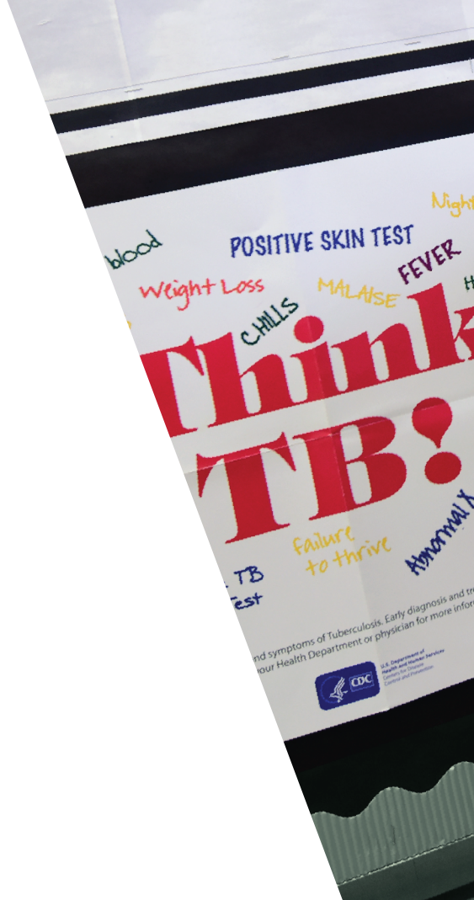
Health Care Providers and Communities Need to “Think TB!”
Protect the health and well-being of community members at higher risk for TB:
Know who is most at risk for TB
Recognize the signs and symptoms of TB
Test and treat patients who are at high risk for TB
Be aware of latest TB research and shortest treatment options
Encourage conversations about TB and how it affects the community to reduce stigma
Notes:
The key to diagnosing TB is for clinicians to “think TB” when they see a patient with signs and symptoms of TB disease. Because TB is not as common as it was years ago in the United States, many clinicians do not consider the possibility of TB when evaluating patients who have symptoms of TB. When this happens, the diagnosis of TB may be delayed or even overlooked, and the patient will remain ill and possibly infectious.
For more information: https://www.cdc.gov/tb/communication-resources/think-tb-poster.html

Slide 41


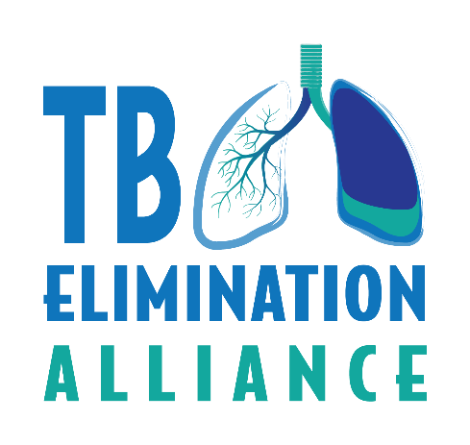

Key Partners in TB Elimination
Health care workers in doctors’ offices and hospitals, community health centers, and academic institutions
State and local health departments
Community organizations
Communities at higher risk for TB
TB survivors
Notes:
TB control and prevention is a complex undertaking that requires the collaborative efforts of a broad range of individuals, organizations, and institutions in both the public and private health sectors.
State and local health departments have the primary responsibility for preventing and controlling TB. This includes the essential role of planning, coordinating, and evaluating program activities.
Health care workers in doctors’ offices and hospitals, community health centers, and academic institutions implement TB control efforts such as testing, treating, and reporting to health departments.

Slide 42
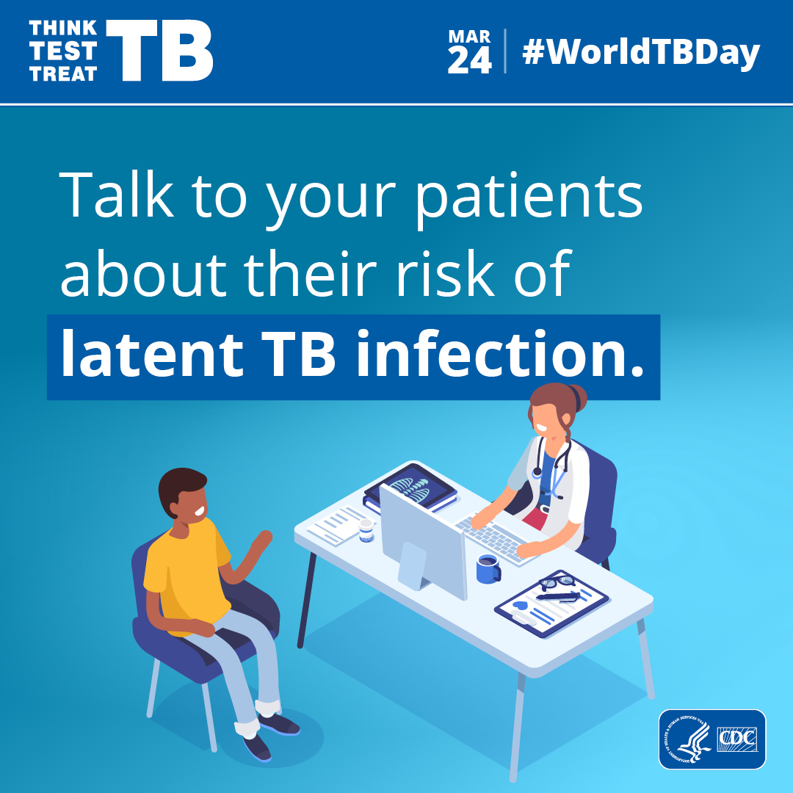
Think. Test.
Treat TB
CDC’s Think. Test. Treat TB campaign aims to reach those most at risk for inactive TB infection and their health care providers to encourage TB testing and get closer to the elimination of TB
Think. Test. Treat TB is the first national multilingual communications campaign to increase testing for inactive TB infection, a major health disparity among Asian Americans
Notes:
CDC’s Think. Test. Treat TB campaign aims to reach those most at risk for latent TB infection and their health care providers to encourage TB testing and get closer to the elimination of TB. Think. Test. Treat TB is the first national multilingual communications campaign to increase testing for inactive TB, a major health disparity among Asian Americans.
More information: https://www.cdc.gov/think-test-treat-tb/index.html

Slide 43
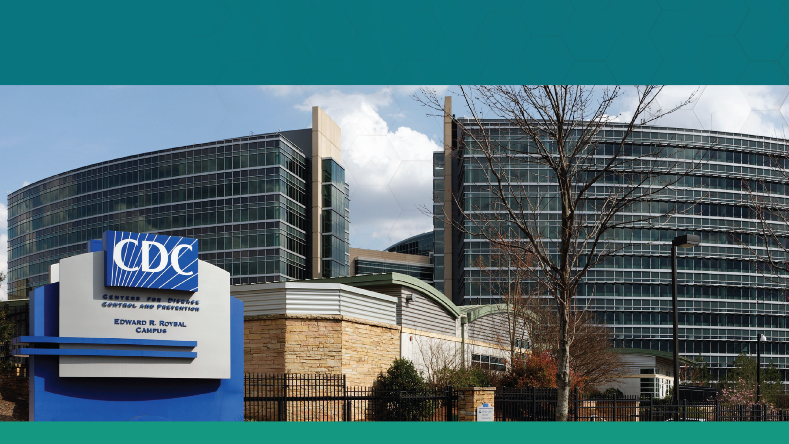






Resources
CDC TB website:
www.cdc.gov/tb/
State & Local TB Control Offices:
https://www.cdc.gov/tb/php/tb-programs/index.html
Find TB Resources:
https://findtbresources.cdc.gov
TB Centers of Excellence:
https://www.cdc.gov/tb-programs/php/about/tb-coe.html
Facebook: www.facebook.com/CDCTB/
X (formerly Twitter): www.twitter.com/cdc_tb
The findings and conclusions in this report are those of the authors and do not necessarily represent the official position of the Centers for Disease Control and Prevention.

