Slide 1
Syphilis Surveillance Supplemental Slides
2019–2023
March 2025
Notes:
This slide set was prepared by the Division of STD Prevention, National Center for HIV, Viral Hepatitis, STD, and TB Prevention (NCHHSTP), Centers for Disease Control and Prevention (CDC). Using syphilis case notification data provided to CDC through the National Notifiable Diseases Surveillance System (NNDSS), these slides display trends in selected reported behaviors among cases of primary and secondary syphilis in the United States during 2019–2023.
Data points for the figures presented in these slides as well as Technical Notes about data sources, data collection and reporting practices, and case definitions are available at https://www.cdc.gov/sti-statistics/syphilis-supplement/index.html
NOTE: This slide set is in the public domain. You may reproduce these slides without permission; however, citation as to source is appreciated.
Centers for Disease Control and Prevention. Syphilis Surveillance Supplemental Slides, 2019–2023. Atlanta: U.S. Department of Health and Human Services; 2025.
You are also free to adapt and revise these slides; however, you must remove the CDC name and logo if changes are made.

Slide 2
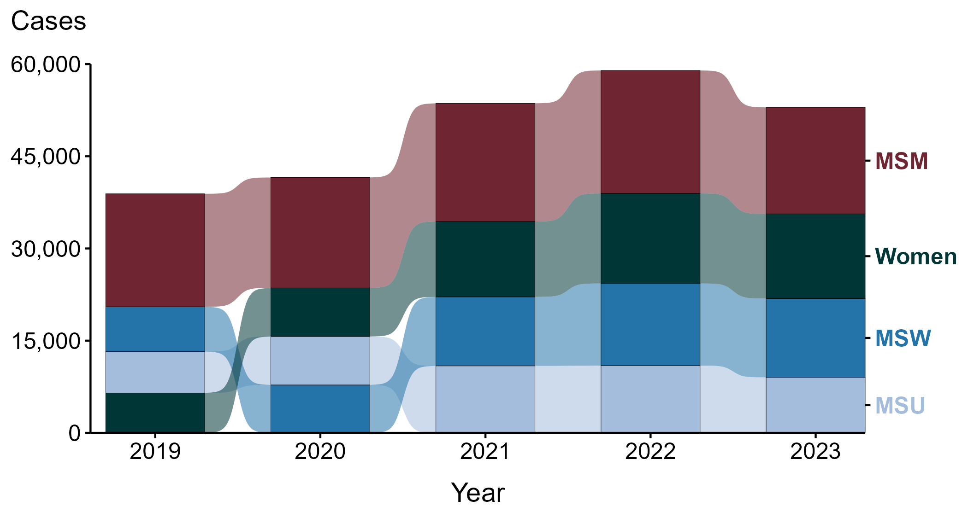
Primary and Secondary Syphilis — Reported Cases by Sex and Sex of Sex Partners, United States, 2019–2023
ACRONYMS: MSM = Men who have sex with men; MSU = Men with unknown sex of sex partners; MSW = Men who have sex with women only
NOTE: During 2019 to 2023, 0.2% of cases were reported with unknown or missing sex and were not displayed in this figure.
Notes:
In 2023, 32.7% of primary and secondary (P&S) syphilis cases were men who have sex with men (MSM), 26.0% were women, 24.2% were men who have sex with women only (MSW), and 17.0% were men with unknown sex of sex partners (MSU).
Comparing 2019 to 2023, the number of cases increased among MSU (+34.1%; 6,732 to 9,028 cases), MSW (+76.0%; 7,289 to 12,829 cases), and women (+112.0%; 6,493 to 13,763 cases) and decreased among MSM (-5.7%; 18,381 to 17,331 cases).
This report includes data from years that coincide with the COVID-19 pandemic, which introduced uncertainty and difficulty in interpreting case data. See Impact of COVID-19 on STIs (https://www.cdc.gov/sti-statistics/about/impact-of-covid-19.html) for more information.
This figure presents trends in the proportion of cases reporting one or more selected behaviors. Although rounded percentages are presented in the figure interpretive text, values used for generating the figure may be more precise. Data points for the figures presented in these slides as well as Technical Notes about data sources, data collection and reporting practices, and case definitions are available at https://www.cdc.gov/sti-statistics/syphilis-supplement/index.html.

Slide 3
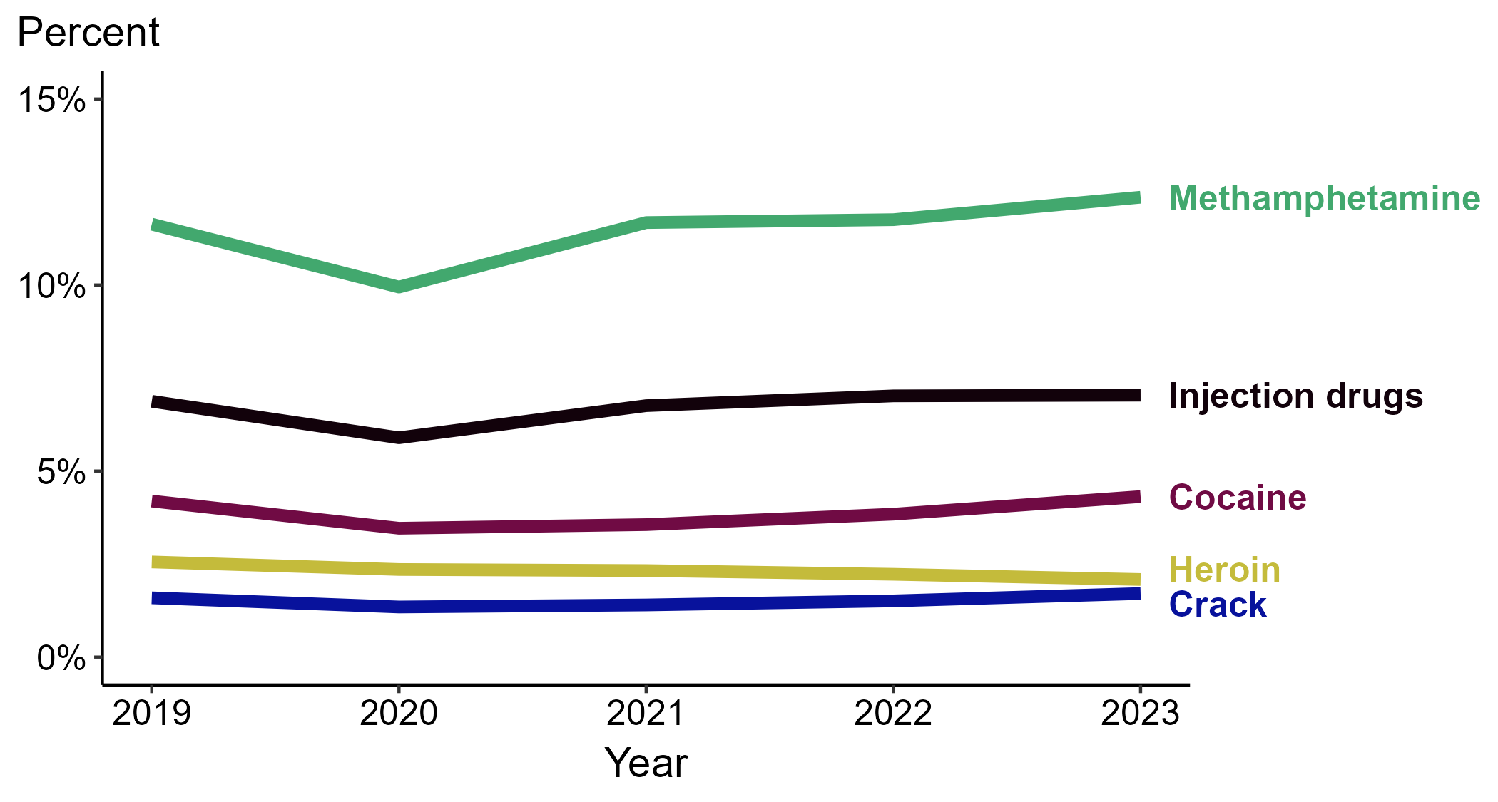
Primary and Secondary Syphilis — Percentage of Cases Reporting Selected Substance Use Behaviors*, United States, 2019–2023
*Percentage reporting injection drug use, methamphetamine use, heroin use, crack use, or cocaine use within the last 12 months calculated among cases with known data (cases with missing or unknown responses were excluded from the denominator).
Note: Substance-use categories are not mutually exclusive and display the data as they were received by CDC. “Injection drugs” is a distinctly reported category and is not substance-specific.
Notes:
Among primary and secondary (P&S) syphilis cases reported in 2023, the most frequently reported substance use behavior was methamphetamine use (12.4%), followed by injection drug use (7.0%), cocaine use (4.3%), heroin use (2.1%), and crack use (1.7%).
Comparing reported substance use behaviors for P&S syphilis cases in 2019 to 2023, the percentage remained stable for all behaviors: reported cocaine use (4.2% to 4.3%), crack use (1.6% to 1.7%), heroin use (2.6% to 2.1%), injection drug use (6.9% to 7.0%), and methamphetamine use (11.6% to 12.4%).
This report includes data from years that coincide with the COVID-19 pandemic, which introduced uncertainty and difficulty in interpreting case data. See Impact of COVID-19 on STIs (https://www.cdc.gov/sti-statistics/about/impact-of-covid-19.html) for more information.
This figure presents trends in the proportion of cases reporting one or more selected behaviors. Although rounded percentages are presented in the figure interpretive text, values used for generating the figure may be more precise. Data points for the figures presented in these slides as well as Technical Notes about data sources, data collection and reporting practices, and case definitions are available at https://www.cdc.gov/sti-statistics/syphilis-supplement/index.html.

Slide 4
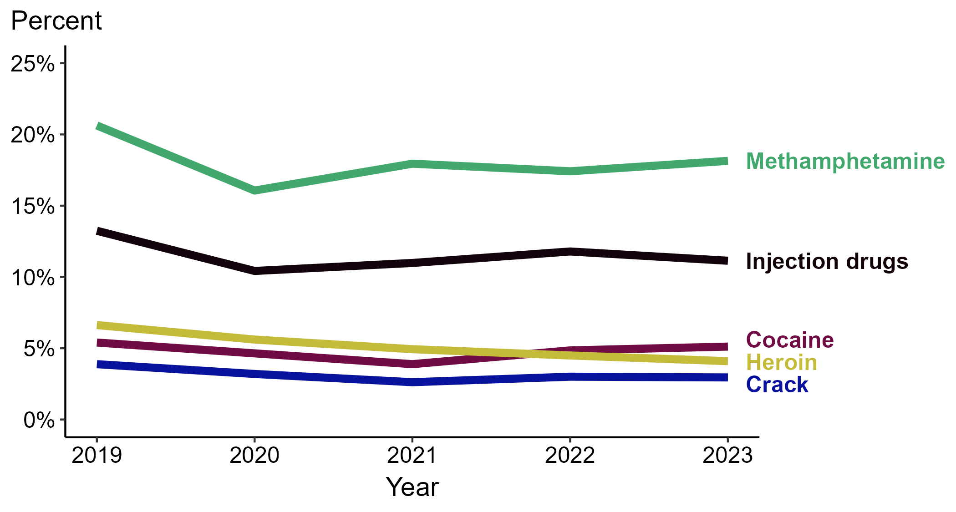
Primary and Secondary Syphilis — Percentage of Cases Reporting Selected Substance Use Behaviors* Among Women, United States, 2019–2023
*Percentage reporting injection drug use, methamphetamine use, heroin use, crack use, or cocaine use within the last 12 months calculated among cases with known data (cases with missing or unknown responses were excluded from the denominator).
Note: Substance-use categories are not mutually exclusive and display the data as they were received by CDC. “Injection drugs” is a distinctly reported category and is not substance-specific.
Notes:
Among primary and secondary (P&S) syphilis cases reported among women in 2023, the most frequently reported substance use behavior was methamphetamine use (18.1%), followed by injection drug use (11.1%), cocaine use (5.1%), heroin use (4.1%), and crack use (3.0%).
Comparing reported substance use behaviors for P&S syphilis cases among women in 2019 to 2023, the percentage remained stable for reported cocaine use (5.4% to 5.1%) and crack use (3.9% to 3.0%) and decreased for reported heroin use (6.6% to 4.1%), injection drug use (13.2% to 11.1%), and methamphetamine use (20.6% to 18.1%).
This report includes data from years that coincide with the COVID-19 pandemic, which introduced uncertainty and difficulty in interpreting case data. See Impact of COVID-19 on STIs (https://www.cdc.gov/sti-statistics/about/impact-of-covid-19.html) for more information.
This figure presents trends in the proportion of cases reporting one or more selected behaviors. Although rounded percentages are presented in the figure interpretive text, values used for generating the figure may be more precise. Data points for the figures presented in these slides as well as Technical Notes about data sources, data collection and reporting practices, and case definitions are available at https://www.cdc.gov/sti-statistics/syphilis-supplement/index.html.

Slide 5
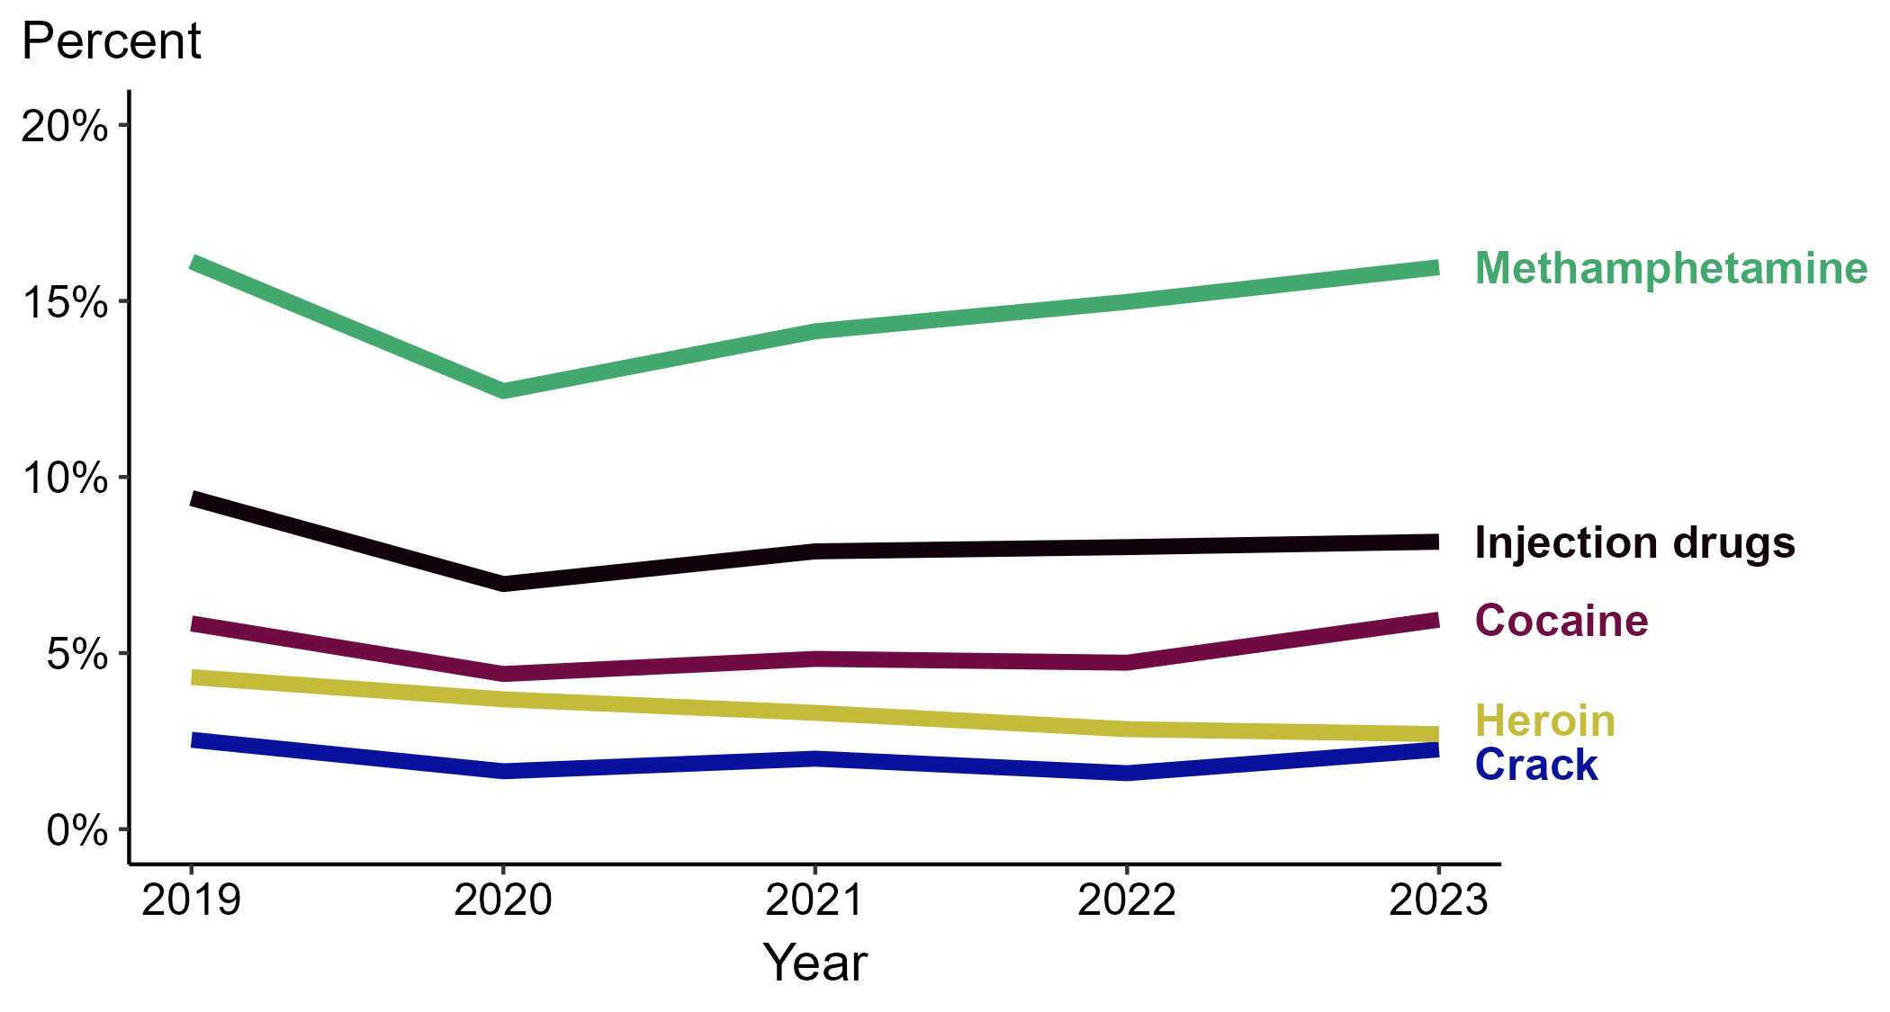
Primary and Secondary Syphilis — Percentage of Cases Reporting Selected Substance Use Behaviors* Among MSW, United States, 2019–2023
*Percentage reporting injection drug use, methamphetamine use, heroin use, crack use, or cocaine use within the last 12 months calculated among cases with known data (cases with missing or unknown responses were excluded from the denominator).
ACRONYMS: MSW = Men who have sex with women only
Note: Substance-use categories are not mutually exclusive and display the data as they were received by CDC. “Injection drugs” is a distinctly reported category and is not substance-specific.
Notes:
Among primary and secondary (P&S) syphilis cases reported among men who have sex with women only (MSW) in 2023, the most frequently reported substance use behavior was methamphetamine use (16.0%), followed by injection drug use (8.2%), cocaine use (5.9%), heroin use (2.7%), and crack use (2.3%).
Comparing reported substance use behaviors for P&S syphilis cases among MSW in 2019 to 2023, the percentage remained stable for reported cocaine use (5.8% to 5.9%), crack use (2.5% to 2.3%), and methamphetamine use (16.1% to 16.0%) and decreased for reported heroin use (4.3% to 2.7%) and injection drug use (9.4% to 8.2%).
This report includes data from years that coincide with the COVID-19 pandemic, which introduced uncertainty and difficulty in interpreting case data. See Impact of COVID-19 on STIs (https://www.cdc.gov/sti-statistics/about/impact-of-covid-19.html) for more information.
This figure presents trends in the proportion of cases reporting one or more selected behaviors. Although rounded percentages are presented in the figure interpretive text, values used for generating the figure may be more precise. Data points for the figures presented in these slides as well as Technical Notes about data sources, data collection and reporting practices, and case definitions are available at https://www.cdc.gov/sti-statistics/syphilis-supplement/index.html.

Slide 6
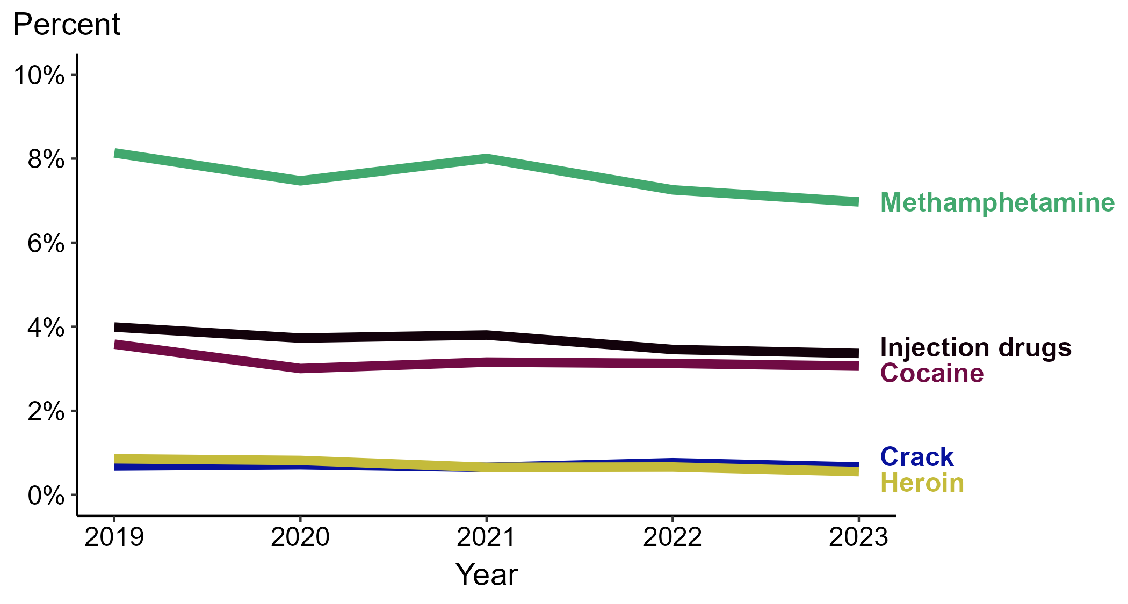
Primary and Secondary Syphilis — Percentage of Cases Reporting Selected Substance Use Behaviors* Among MSM, United States, 2019–2023
*Percentage reporting injection drug use, methamphetamine use, heroin use, crack use, or cocaine use within the last 12 months calculated among cases with known data (cases with missing or unknown responses were excluded from the denominator).
ACRONYMS: MSM = Men who have sex with men
Note: Substance-use categories are not mutually exclusive and display the data as they were received by CDC. “Injection drugs” is a distinctly reported category and is not substance-specific.
Notes:
Among primary and secondary (P&S) syphilis cases reported among men who have sex with men (MSM) in 2023, the most frequently reported substance use behavior was methamphetamine use (7.0%), followed by injection drug use (3.4%), cocaine use (3.1%), crack use (0.7%), and heroin use (0.6%).
Comparing reported substance use behaviors for P&S syphilis cases among MSM in 2019 to 2023, the percentage remained stable for reported cocaine use (3.6% to 3.1%), crack use (0.7% in both years), heroin use (0.9% to 0.6%), and injection drug use (4.0% to 3.4%) and decreased for reported methamphetamine use (8.1% to 7.0%).
This report includes data from years that coincide with the COVID-19 pandemic, which introduced uncertainty and difficulty in interpreting case data. See Impact of COVID-19 on STIs (https://www.cdc.gov/sti-statistics/about/impact-of-covid-19.html) for more information.
This figure presents trends in the proportion of cases reporting one or more selected behaviors. Although rounded percentages are presented in the figure interpretive text, values used for generating the figure may be more precise. Data points for the figures presented in these slides as well as Technical Notes about data sources, data collection and reporting practices, and case definitions are available at https://www.cdc.gov/sti-statistics/syphilis-supplement/index.html.

Slide 7
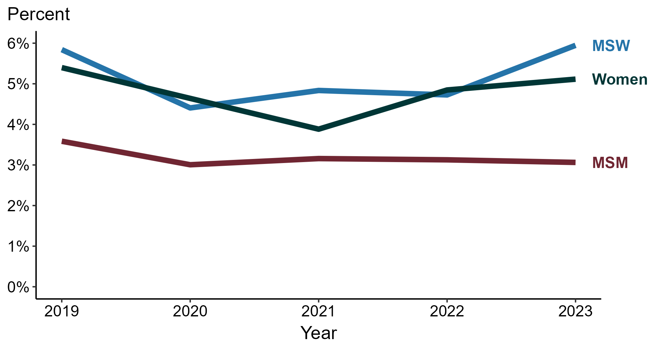
Primary and Secondary Syphilis — Percentage of Cases Reporting Cocaine Use* by Sex and Sex of Sex Partners, United States, 2019–2023
*Percentage reporting cocaine use within the last 12 months calculated among cases with known data (cases with missing or unknown responses were excluded from the denominator).
ACRONYMS: MSM = Men who have sex with men; MSW = Men who have sex with women only
Notes:
Among primary and secondary (P&S) syphilis cases reported in 2023, cocaine use was most frequently reported among men who have sex with women only (MSW; 5.9%), followed by women (5.1%) and men who have sex with men (MSM; 3.1%).
Comparing 2019 to 2023, the percentage of P&S syphilis cases that reported cocaine use remained stable among all groups: MSM (3.6% to 3.1%), MSW (5.8% to 5.9%), and women (5.4% to 5.1%).
This report includes data from years that coincide with the COVID-19 pandemic, which introduced uncertainty and difficulty in interpreting case data. See Impact of COVID-19 on STIs (https://www.cdc.gov/sti-statistics/about/impact-of-covid-19.html) for more information.
This figure presents trends in the proportion of cases reporting one or more selected behaviors. Although rounded percentages are presented in the figure interpretive text, values used for generating the figure may be more precise. Data points for the figures presented in these slides as well as Technical Notes about data sources, data collection and reporting practices, and case definitions are available at https://www.cdc.gov/sti-statistics/syphilis-supplement/index.html.

Slide 8
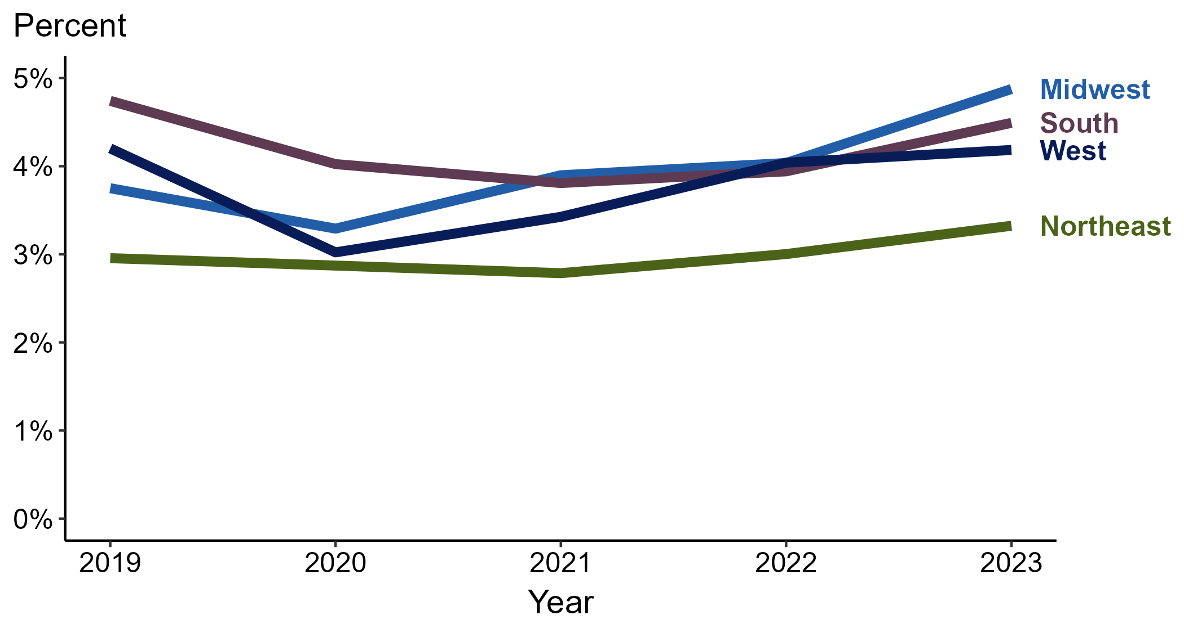
Primary and Secondary Syphilis — Percentage of Cases Reporting Cocaine Use* by Region, United States, 2019–2023
*Percentage reporting cocaine use within the last 12 months calculated among cases with known data (cases with missing or unknown responses were excluded from the denominator).
Notes:
Among primary and secondary (P&S) syphilis cases reported in 2023, cocaine use was most frequently reported in the Midwest (4.9%), followed by the South (4.5%), West (4.2%), and Northeast (3.3%).
Comparing 2019 to 2023, the percentage of P&S syphilis cases that reported cocaine use increased in the Midwest (3.8% to 4.9%) and remained stable in the Northeast (3.0% to 3.3%), South (4.7% to 4.5%), and West (4.2% in both years).
This report includes data from years that coincide with the COVID-19 pandemic, which introduced uncertainty and difficulty in interpreting case data. See Impact of COVID-19 on STIs (https://www.cdc.gov/sti-statistics/about/impact-of-covid-19.html) for more information.
This figure presents trends in the proportion of cases reporting one or more selected behaviors. Although rounded percentages are presented in the figure interpretive text, values used for generating the figure may be more precise. A map of the US Census Regions is available in the last slide of this deck. Data points for the figures presented in these slides as well as Technical Notes about data sources, data collection and reporting practices, and case definitions are available at https://www.cdc.gov/sti-statistics/syphilis-supplement/index.html.

Slide 9
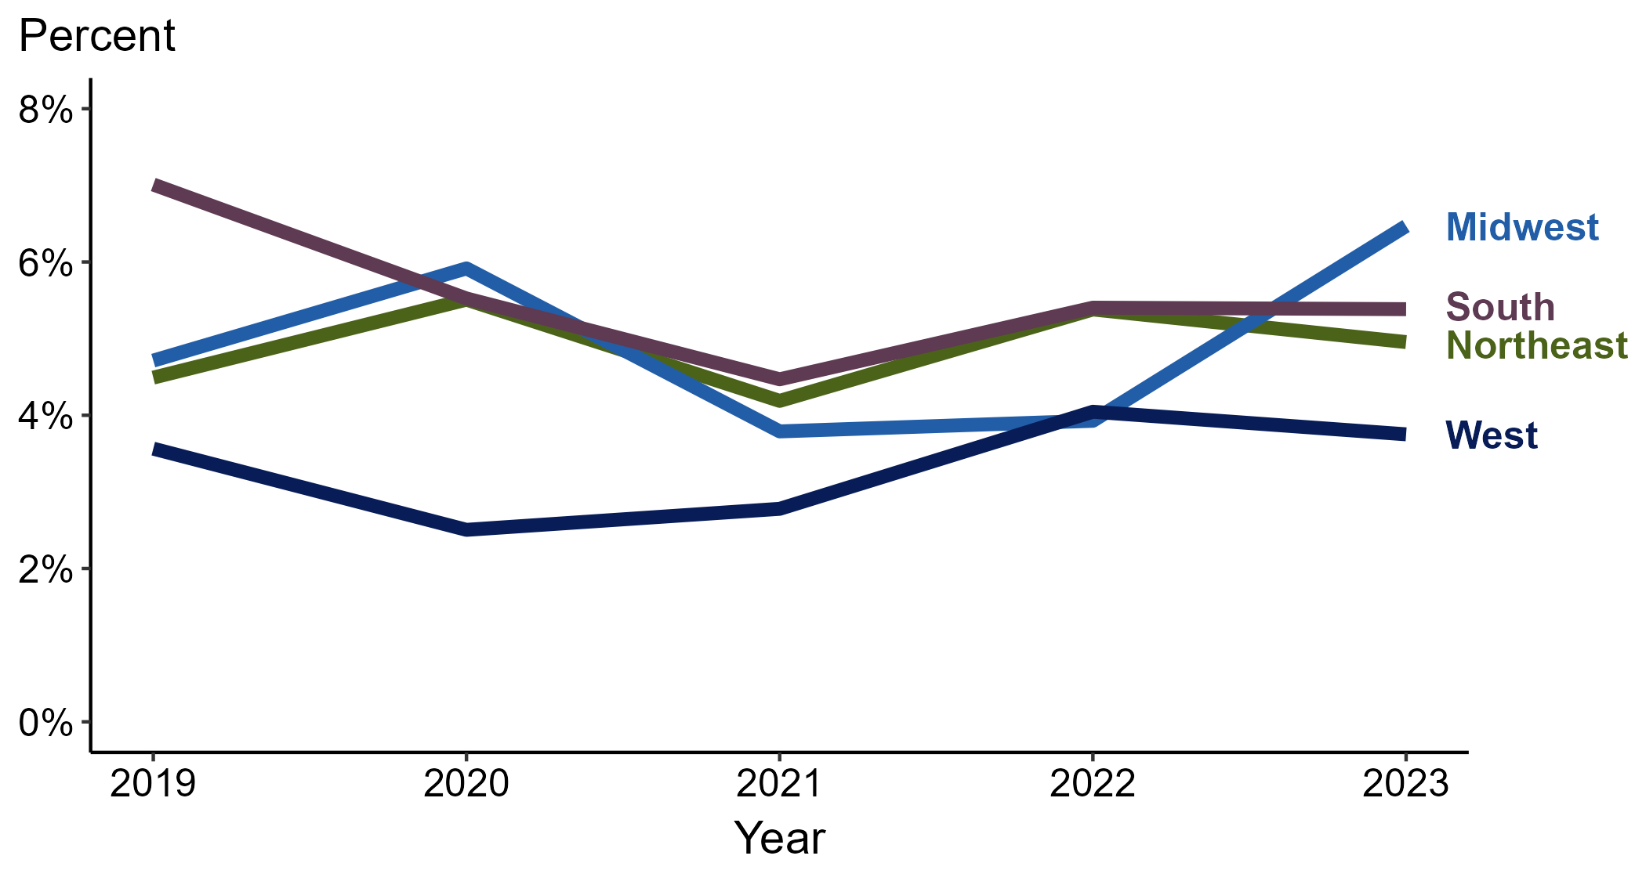
Primary and Secondary Syphilis — Percentage of Cases Reporting Cocaine Use* Among Women by Region, United States, 2019–2023
*Percentage reporting cocaine use within the last 12 months calculated among cases with known data (cases with missing or unknown responses were excluded from the denominator).
Notes:
Among primary and secondary (P&S) syphilis cases reported among women in 2023, cocaine use was most frequently reported in the Midwest (6.5%), followed by the South (5.4%), Northeast (5.0%), and West (3.8%).
Comparing 2019 to 2023, the percentage of P&S syphilis cases among women that reported cocaine use increased in the Midwest (4.7% to 6.5%), remained stable in the Northeast (4.5% to 5.0%) and West (3.6% to 3.8%), and decreased in the South (7.0% to 5.4%).
This report includes data from years that coincide with the COVID-19 pandemic, which introduced uncertainty and difficulty in interpreting case data. See Impact of COVID-19 on STIs (https://www.cdc.gov/sti-statistics/about/impact-of-covid-19.html) for more information.
This figure presents trends in the proportion of cases reporting one or more selected behaviors. Although rounded percentages are presented in the figure interpretive text, values used for generating the figure may be more precise. A map of the US Census Regions is available in the last slide of this deck. Data points for the figures presented in these slides as well as Technical Notes about data sources, data collection and reporting practices, and case definitions are available at https://www.cdc.gov/sti-statistics/syphilis-supplement/index.html.

Slide 10
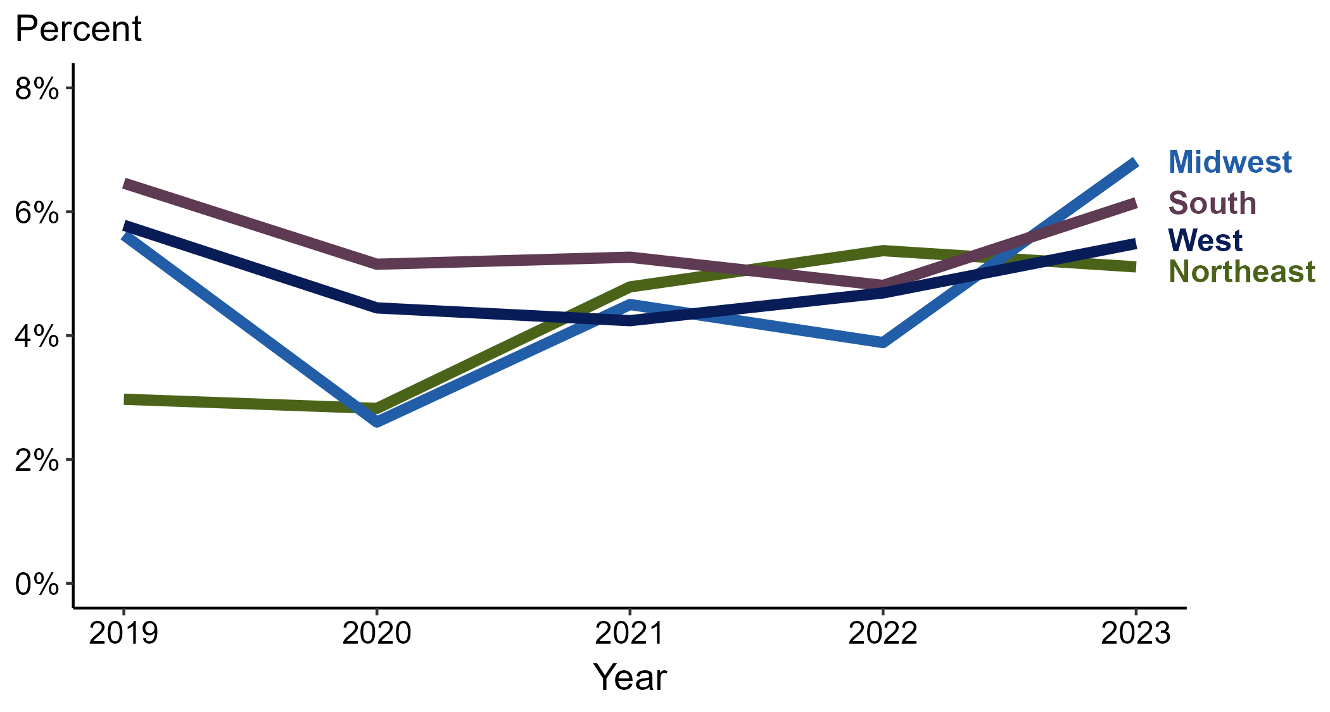
Primary and Secondary Syphilis — Percentage of Cases Reporting Cocaine Use* Among MSW by Region, United States, 2019–2023
*Percentage reporting cocaine use within the last 12 months calculated among cases with known data (cases with missing or unknown responses were excluded from the denominator).
ACRONYMS: MSW = Men who have sex with women only
Notes:
Among primary and secondary (P&S) syphilis cases reported among men who have sex with women only (MSW) in 2023, cocaine use was most frequently reported in the Midwest (6.8%), followed by the South (6.1%), West (5.5%), and Northeast (5.1%).
Comparing 2019 to 2023, the percentage of P&S syphilis cases among MSW that reported cocaine use increased in the Northeast (3.0% to 5.1%) and Midwest (5.6% to 6.8%) and remained stable in the South (6.5% to 6.1%) and West (5.8% to 5.5%).
This report includes data from years that coincide with the COVID-19 pandemic, which introduced uncertainty and difficulty in interpreting case data. See Impact of COVID-19 on STIs (https://www.cdc.gov/sti-statistics/about/impact-of-covid-19.html) for more information.
This figure presents trends in the proportion of cases reporting one or more selected behaviors. Although rounded percentages are presented in the figure interpretive text, values used for generating the figure may be more precise. A map of the US Census Regions is available in the last slide of this deck. Data points for the figures presented in these slides as well as Technical Notes about data sources, data collection and reporting practices, and case definitions are available at https://www.cdc.gov/sti-statistics/syphilis-supplement/index.html.

Slide 11
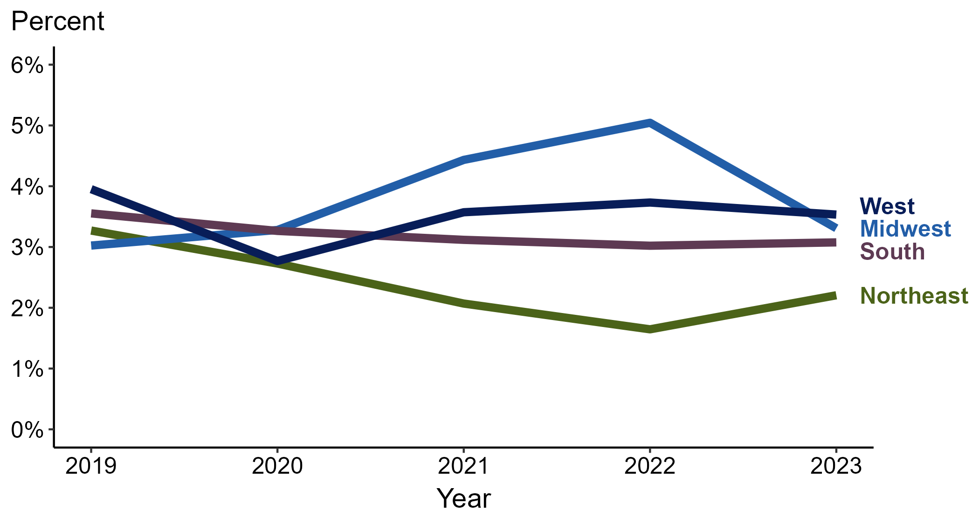
Primary and Secondary Syphilis — Percentage of Cases Reporting Cocaine Use* Among MSM by Region, United States, 2019–2023
*Percentage reporting cocaine use within the last 12 months calculated among cases with known data (cases with missing or unknown responses were excluded from the denominator).
ACRONYMS: MSM = Men who have sex with men
Notes:
Among primary and secondary (P&S) syphilis cases reported among men who have sex with men (MSM) in 2023, cocaine use was most frequently reported in the West (3.5%), followed by the Midwest (3.3%), South (3.1%), and Northeast (2.2%).
Comparing 2019 to 2023, the percentage of P&S syphilis cases among MSM that reported cocaine use remained stable in the Midwest (3.0% to 3.3%), South (3.6% to 3.1%), and West (4.0% to 3.5%) and decreased in the Northeast (3.3% to 2.2%).
This report includes data from years that coincide with the COVID-19 pandemic, which introduced uncertainty and difficulty in interpreting case data. See Impact of COVID-19 on STIs (https://www.cdc.gov/sti-statistics/about/impact-of-covid-19.html) for more information.
This figure presents trends in the proportion of cases reporting one or more selected behaviors. Although rounded percentages are presented in the figure interpretive text, values used for generating the figure may be more precise. A map of the US Census Regions is available in the last slide of this deck. Data points for the figures presented in these slides as well as Technical Notes about data sources, data collection and reporting practices, and case definitions are available at https://www.cdc.gov/sti-statistics/syphilis-supplement/index.html.

Slide 12
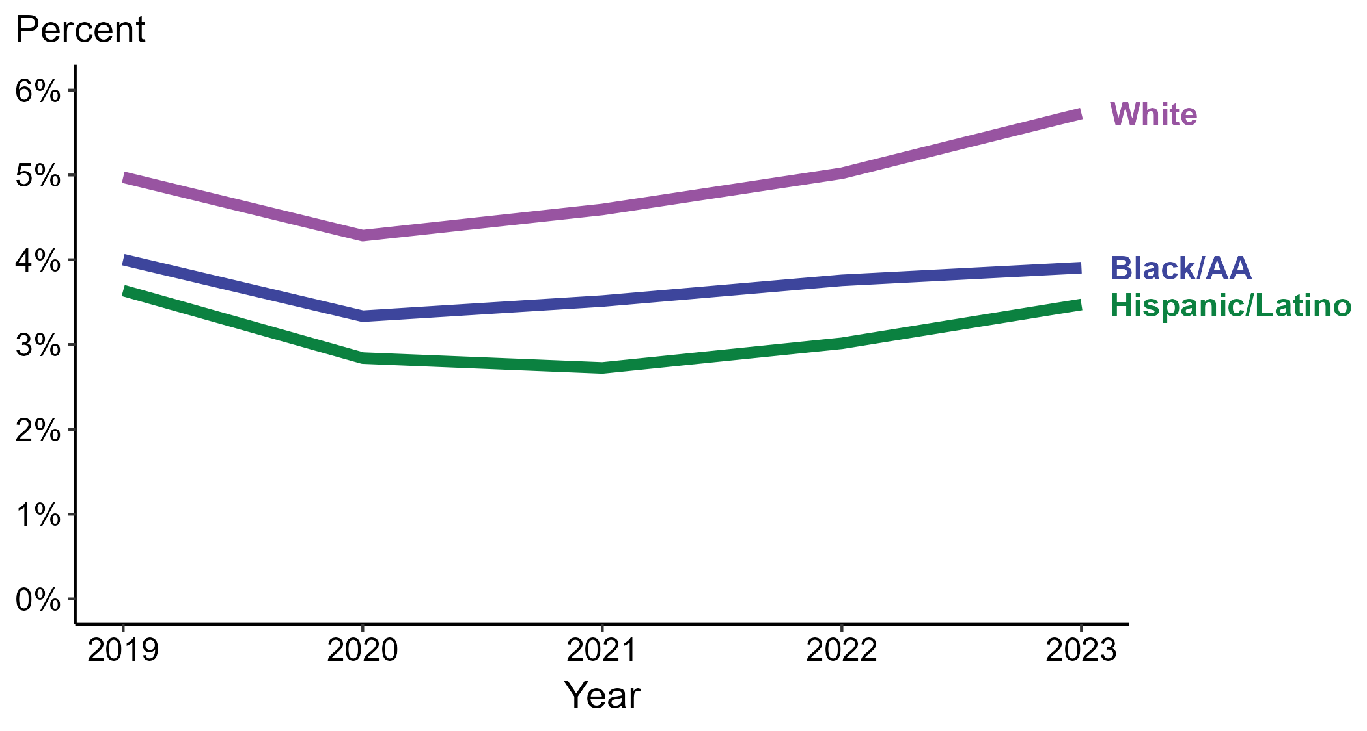
Primary and Secondary Syphilis — Percentage of Cases Reporting Cocaine Use* by Race and Hispanic Ethnicity, United States, 2019–2023
*Percentage reporting cocaine use within the last 12 months calculated among cases with known data (cases with missing or unknown responses were excluded from the denominator).
ACRONYMS: Black/AA = Black or African American
Notes:
Among primary and secondary (P&S) syphilis cases reported in 2023, cocaine use was most frequently reported among non-Hispanic White persons (5.7%), followed by non-Hispanic Black or African American persons (3.9%) and Hispanic or Latino persons (3.5%).
Comparing 2019 to 2023, the percentage of P&S syphilis cases that reported cocaine use remained stable among all categories of race and Hispanic ethnicity displayed in the figure: Hispanic or Latino persons (3.6% to 3.5%), non-Hispanic Black or African American persons (4.0% to 3.9%), and non-Hispanic White persons (5.0% to 5.7%).
Of all P&S syphilis cases reported during 2019 to 2023, 87.5% with information on cocaine use were Hispanic or Latino, non-Hispanic Black or African American, or non-Hispanic White persons. Because the vast majority of cases fall in those racial and ethnic categories, only data for those groups are displayed in the figure.
This report includes data from years that coincide with the COVID-19 pandemic, which introduced uncertainty and difficulty in interpreting case data. See Impact of COVID-19 on STIs (https://www.cdc.gov/sti-statistics/about/impact-of-covid-19.html) for more information.
This figure presents trends in the proportion of cases reporting one or more selected behaviors. Although rounded percentages are presented in the figure interpretive text, values used for generating the figure may be more precise. Data points for the figures presented in these slides as well as Technical Notes about data sources, data collection and reporting practices, and case definitions are available at https://www.cdc.gov/sti-statistics/syphilis-supplement/index.html.

Slide 13
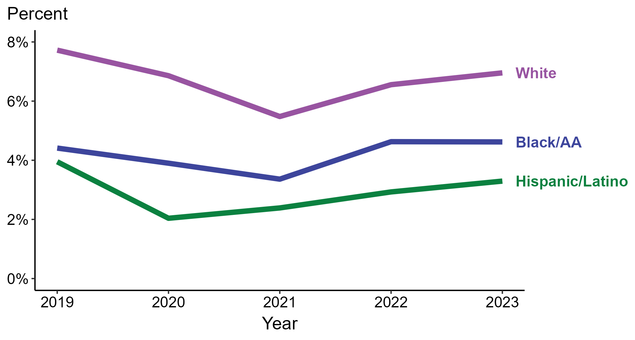
Primary and Secondary Syphilis — Percentage of Cases Reporting Cocaine Use* Among Women by Race and Hispanic Ethnicity, United States, 2019–2023
*Percentage reporting cocaine use within the last 12 months calculated among cases with known data (cases with missing or unknown responses were excluded from the denominator).
ACRONYMS: Black/AA = Black or African American
Notes:
Among primary and secondary (P&S) syphilis cases reported among women in 2023, cocaine use was most frequently reported among non-Hispanic White women (7.0%), followed by non-Hispanic Black or African American women (4.6%) and Hispanic or Latino women (3.3%).
Comparing 2019 to 2023, the percentage of P&S syphilis cases among women that reported cocaine use remained stable among all categories of race and Hispanic ethnicity displayed in the figure: Hispanic or Latino women (3.9% to 3.3%), non-Hispanic Black or African American women (4.4% to 4.6%), and non-Hispanic White women (7.7% to 7.0%).
Of all P&S syphilis cases reported among women during 2019 to 2023, 87.1% with information on cocaine use were Hispanic or Latino, non-Hispanic Black or African American, or non-Hispanic White women. Because the vast majority of cases fall in those racial and ethnic categories, only data for those groups are displayed in the figure.
This report includes data from years that coincide with the COVID-19 pandemic, which introduced uncertainty and difficulty in interpreting case data. See Impact of COVID-19 on STIs (https://www.cdc.gov/sti-statistics/about/impact-of-covid-19.html) for more information.
This figure presents trends in the proportion of cases reporting one or more selected behaviors. Although rounded percentages are presented in the figure interpretive text, values used for generating the figure may be more precise. Data points for the figures presented in these slides as well as Technical Notes about data sources, data collection and reporting practices, and case definitions are available at https://www.cdc.gov/sti-statistics/syphilis-supplement/index.html.

Slide 14
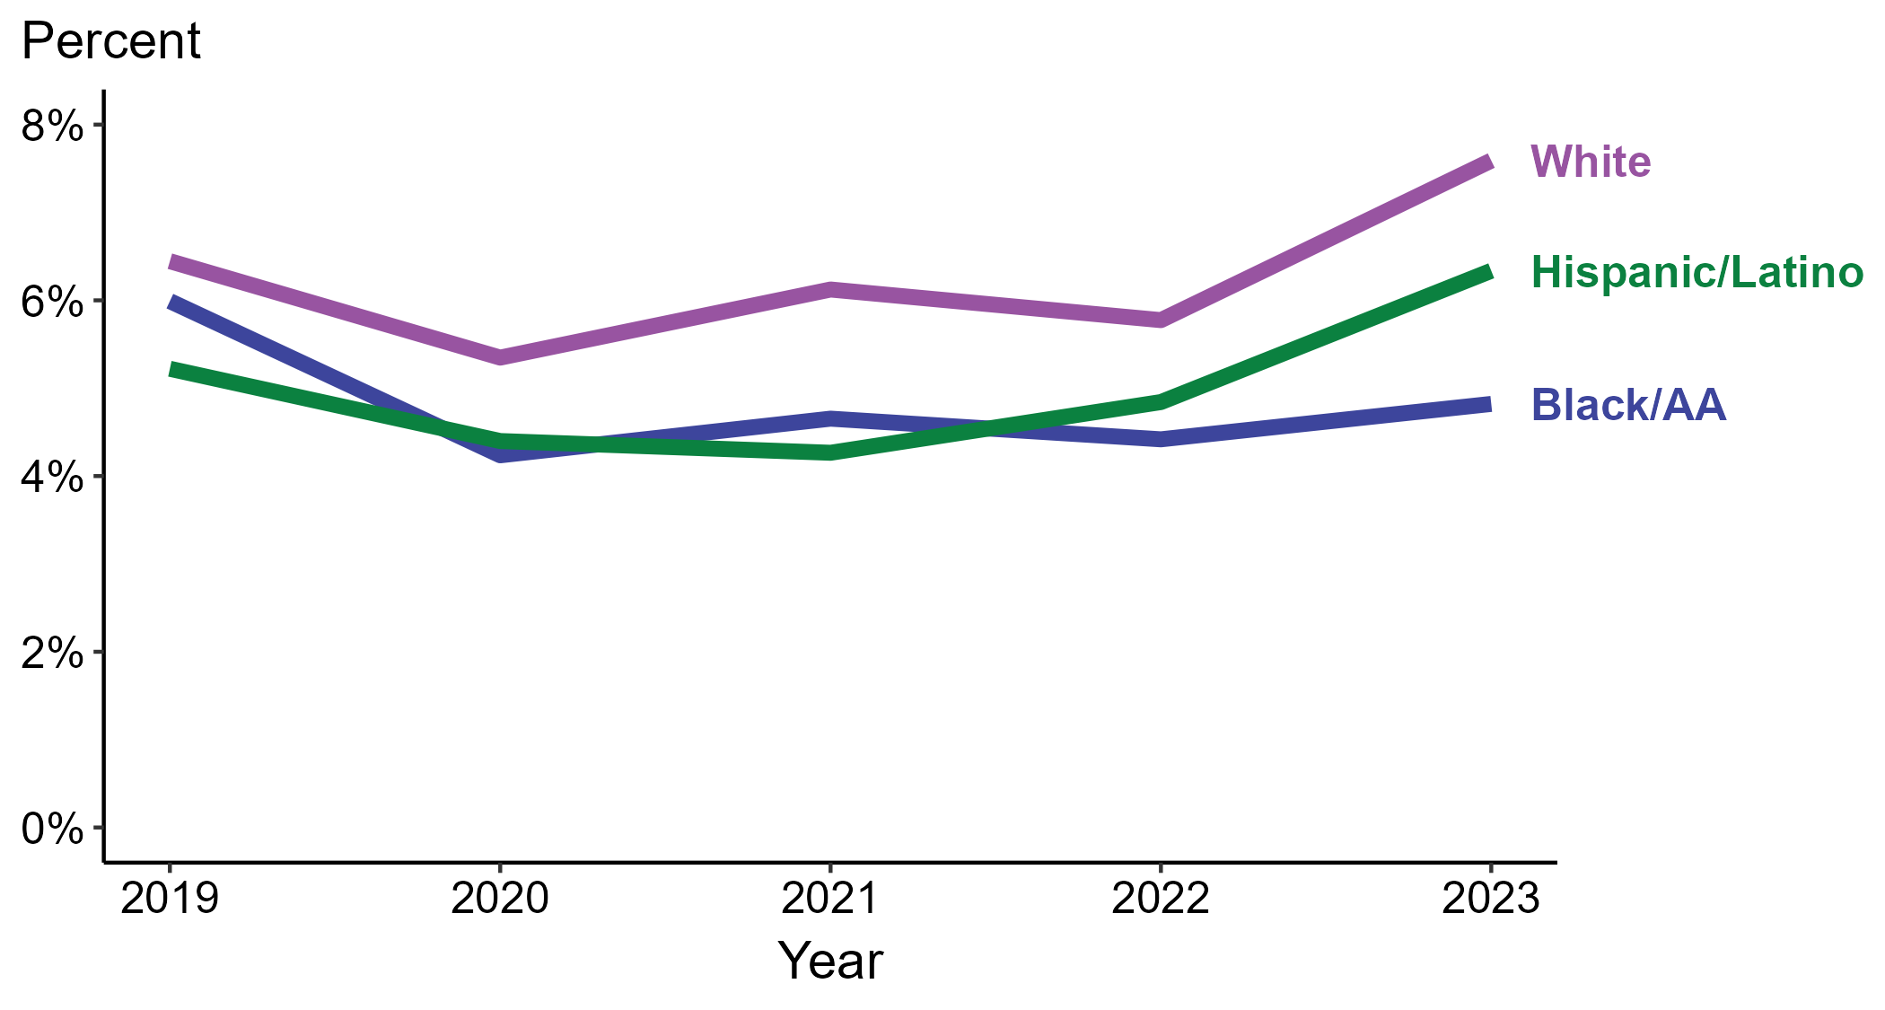
Primary and Secondary Syphilis — Percentage of Cases Reporting Cocaine Use* Among MSW by Race and Hispanic Ethnicity, United States, 2019–2023
*Percentage reporting cocaine use within the last 12 months calculated among cases with known data (cases with missing or unknown responses were excluded from the denominator).
ACRONYMS: Black/AA = Black or African American; MSW = Men who have sex with women only
Notes:
Among primary and secondary (P&S) syphilis cases reported among men who have sex with women only (MSW) in 2023, cocaine use was most frequently reported among non-Hispanic White MSW (7.6%), followed by Hispanic or Latino MSW (6.3%) and non-Hispanic Black or African American MSW (4.8%).
Comparing 2019 to 2023, the percentage of P&S syphilis cases among MSW that reported cocaine use increased among Hispanic or Latino MSW (5.2% to 6.3%) and non-Hispanic White MSW (6.4% to 7.6%) and decreased among non-Hispanic Black or African American MSW (6.0% to 4.8%).
Of all P&S syphilis cases reported among MSW during 2019 to 2023, 88.8% with information on cocaine use were Hispanic or Latino, non-Hispanic Black or African American, or non-Hispanic White MSW. Because the vast majority of cases fall in those racial and ethnic categories, only data for those groups are displayed in the figure.
This report includes data from years that coincide with the COVID-19 pandemic, which introduced uncertainty and difficulty in interpreting case data. See Impact of COVID-19 on STIs (https://www.cdc.gov/sti-statistics/about/impact-of-covid-19.html) for more information.
This figure presents trends in the proportion of cases reporting one or more selected behaviors. Although rounded percentages are presented in the figure interpretive text, values used for generating the figure may be more precise. Data points for the figures presented in these slides as well as Technical Notes about data sources, data collection and reporting practices, and case definitions are available at https://www.cdc.gov/sti-statistics/syphilis-supplement/index.html.

Slide 15
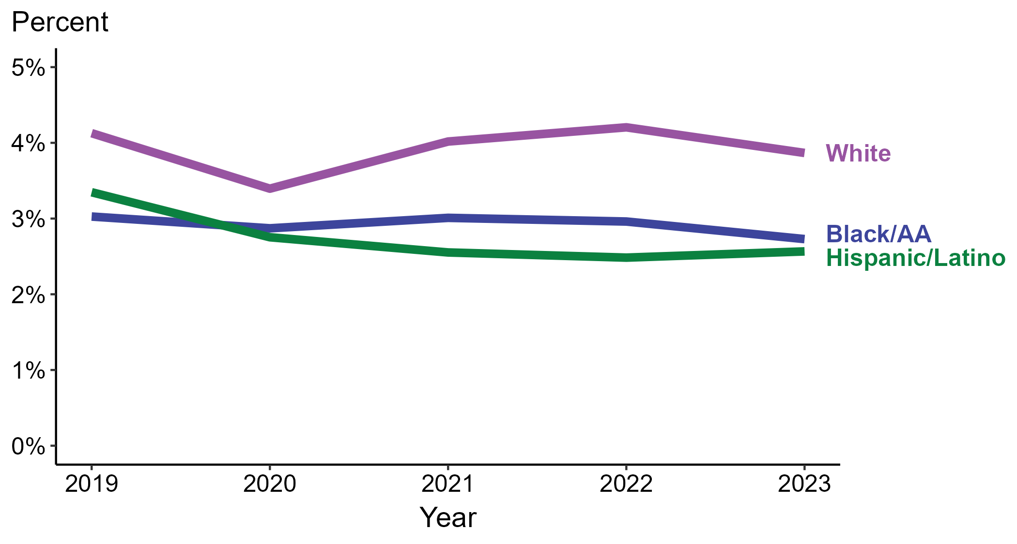
Primary and Secondary Syphilis — Percentage of Cases Reporting Cocaine Use* Among MSM by Race and Hispanic Ethnicity, United States, 2019–2023
*Percentage reporting cocaine use within the last 12 months calculated among cases with known data (cases with missing or unknown responses were excluded from the denominator).
ACRONYMS: Black/AA = Black or African American; MSM = Men who have sex with men
Notes:
Among primary and secondary (P&S) syphilis cases reported among men who have sex with men (MSM) in 2023, cocaine use was most frequently reported among non-Hispanic White MSM (3.9%), followed by non-Hispanic Black or African American MSM (2.7%) and Hispanic or Latino MSM (2.6%).
Comparing 2019 to 2023, the percentage of P&S syphilis cases among MSM that reported cocaine use remained stable among all categories of race and Hispanic ethnicity displayed in the figure: Hispanic or Latino MSM (3.3% to 2.6%), non-Hispanic Black or African American MSM (3.0% to 2.7%), and non-Hispanic White MSM (4.1% to 3.9%).
Of all P&S syphilis cases reported among MSM during 2019 to 2023, 87.7% with information on cocaine use were Hispanic or Latino, non-Hispanic Black or African American, or non-Hispanic White MSM. Because the vast majority of cases fall in those racial and ethnic categories, only data for those groups are displayed in the figure.
This report includes data from years that coincide with the COVID-19 pandemic, which introduced uncertainty and difficulty in interpreting case data. See Impact of COVID-19 on STIs (https://www.cdc.gov/sti-statistics/about/impact-of-covid-19.html) for more information.
This figure presents trends in the proportion of cases reporting one or more selected behaviors. Although rounded percentages are presented in the figure interpretive text, values used for generating the figure may be more precise. Data points for the figures presented in these slides as well as Technical Notes about data sources, data collection and reporting practices, and case definitions are available at https://www.cdc.gov/sti-statistics/syphilis-supplement/index.html.

Slide 16
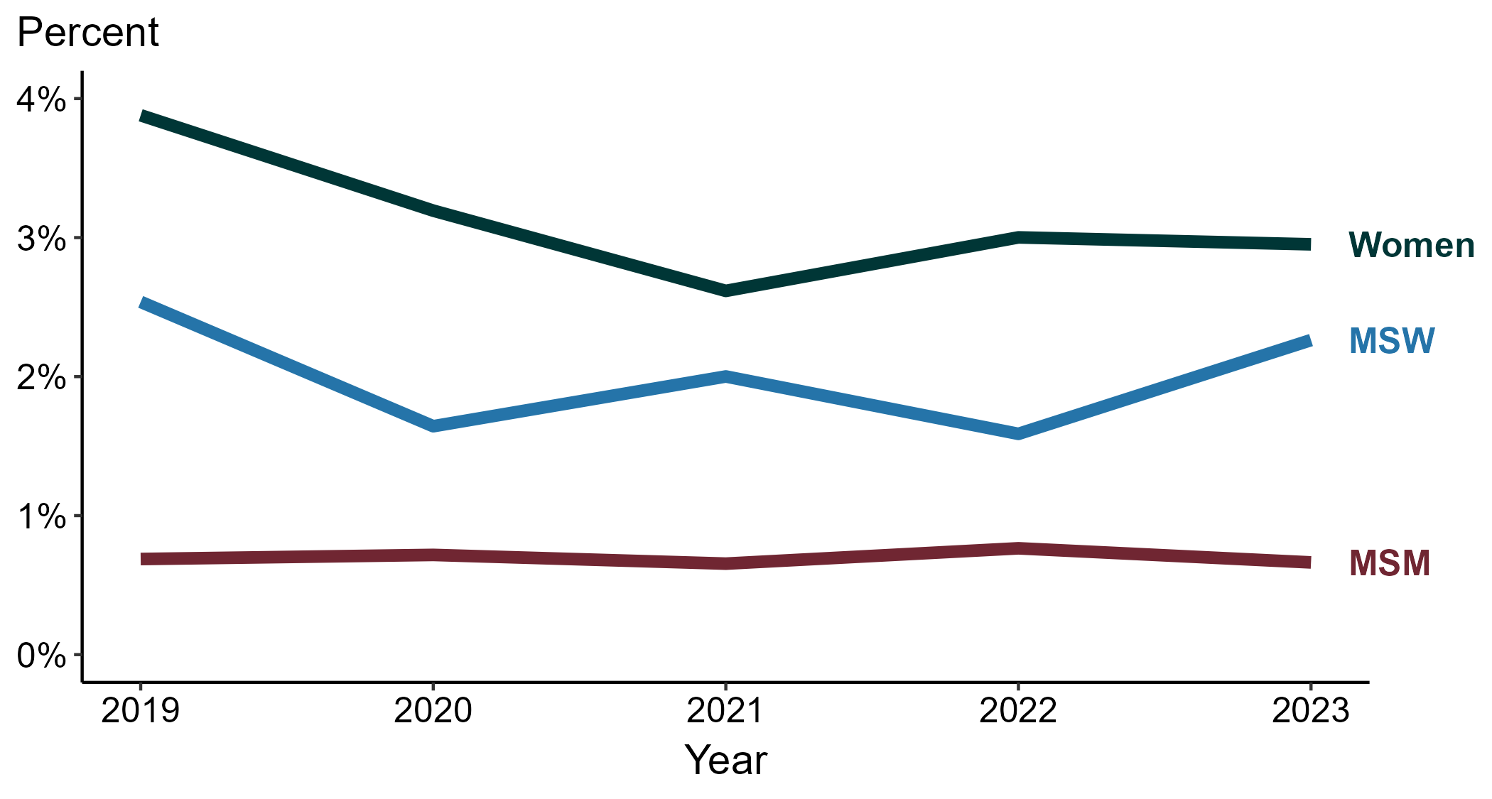
Primary and Secondary Syphilis — Percentage of Cases Reporting Crack Use* by Sex and Sex of Sex Partners, United States, 2019–2023
*Percentage reporting crack use within the last 12 months calculated among cases with known data (cases with missing or unknown responses were excluded from the denominator).
ACRONYMS: MSM = Men who have sex with men; MSW = Men who have sex with women only
Notes:
Among primary and secondary (P&S) syphilis cases reported in 2023, crack use was most frequently reported among women (3.0%), followed by men who have sex with women only (MSW; 2.3%) and men who have sex with men (MSM; 0.7%).
Comparing 2019 to 2023, the percentage of P&S syphilis cases that reported crack use remained stable among all groups: MSM (0.7% in both years), MSW (2.5% to 2.3%), and women (3.9% to 3.0%).
This report includes data from years that coincide with the COVID-19 pandemic, which introduced uncertainty and difficulty in interpreting case data. See Impact of COVID-19 on STIs (https://www.cdc.gov/sti-statistics/about/impact-of-covid-19.html) for more information.
This figure presents trends in the proportion of cases reporting one or more selected behaviors. Although rounded percentages are presented in the figure interpretive text, values used for generating the figure may be more precise. Data points for the figures presented in these slides as well as Technical Notes about data sources, data collection and reporting practices, and case definitions are available at https://www.cdc.gov/sti-statistics/syphilis-supplement/index.html.

Slide 17
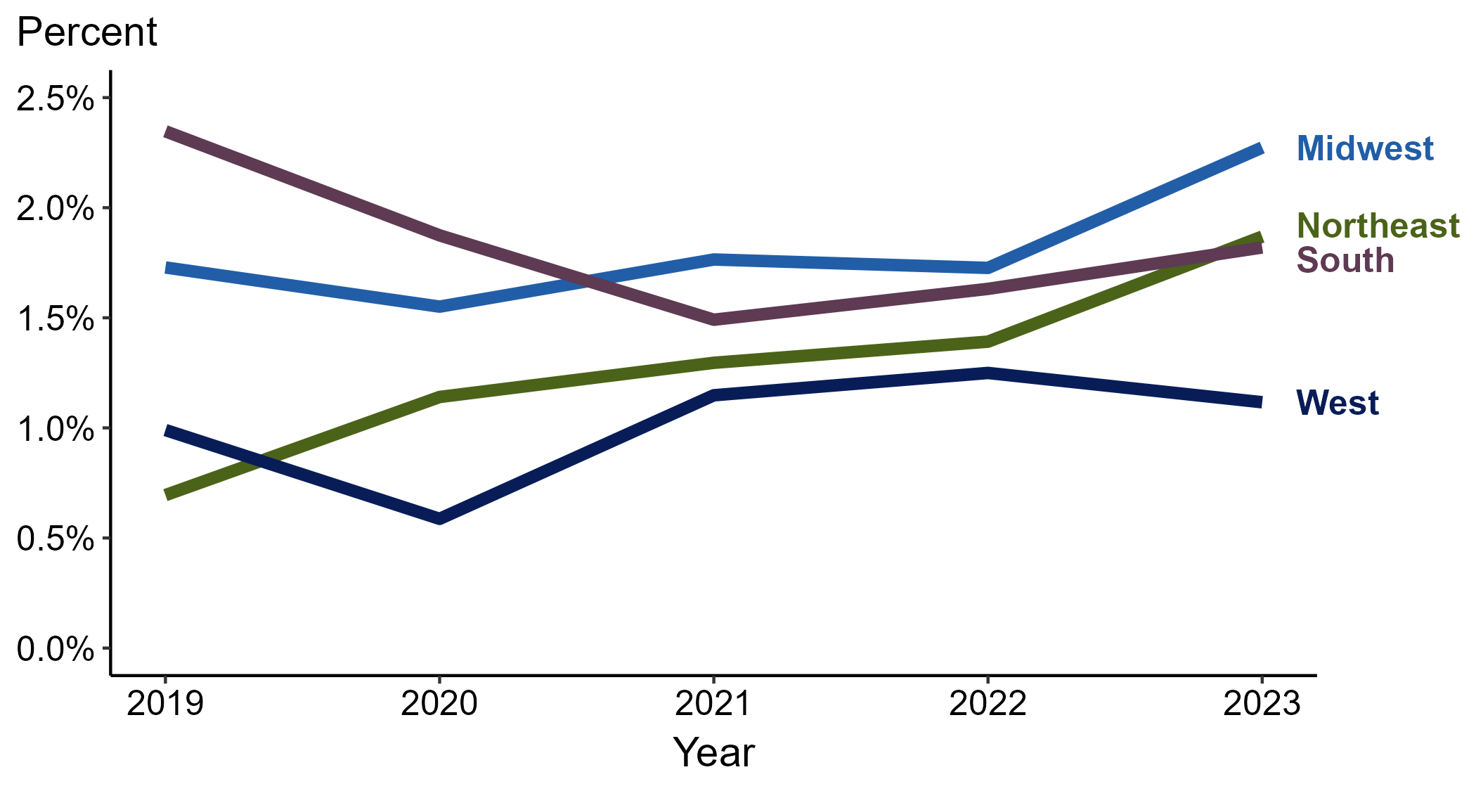
Primary and Secondary Syphilis — Percentage of Cases Reporting Crack Use* by Region, United States, 2019–2023
*Percentage reporting crack use within the last 12 months calculated among cases with known data (cases with missing or unknown responses were excluded from the denominator).
Notes:
Among primary and secondary (P&S) syphilis cases reported in 2023, crack use was most frequently reported in the Midwest (2.3%), followed by the Northeast (1.9%), South (1.8%), and West (1.1%).
Comparing 2019 to 2023, the percentage of P&S syphilis cases that reported crack use increased in the Northeast (0.7% to 1.9%) and remained stable in the Midwest (1.7% to 2.3%), South (2.3% to 1.8%), and West (1.0% to 1.1%).
This report includes data from years that coincide with the COVID-19 pandemic, which introduced uncertainty and difficulty in interpreting case data. See Impact of COVID-19 on STIs (https://www.cdc.gov/sti-statistics/about/impact-of-covid-19.html) for more information.
This figure presents trends in the proportion of cases reporting one or more selected behaviors. Although rounded percentages are presented in the figure interpretive text, values used for generating the figure may be more precise. A map of the US Census Regions is available in the last slide of this deck. Data points for the figures presented in these slides as well as Technical Notes about data sources, data collection and reporting practices, and case definitions are available at https://www.cdc.gov/sti-statistics/syphilis-supplement/index.html.

Slide 18
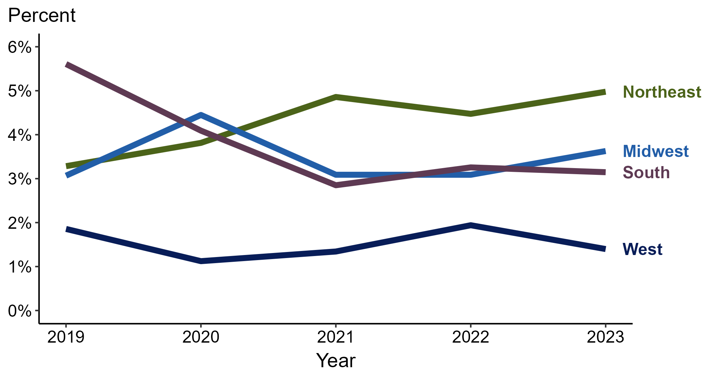
Primary and Secondary Syphilis — Percentage of Cases Reporting Crack Use* Among Women by Region, United States, 2019–2023
*Percentage reporting crack use within the last 12 months calculated among cases with known data (cases with missing or unknown responses were excluded from the denominator).
Notes:
Among primary and secondary (P&S) syphilis cases reported among women in 2023, crack use was most frequently reported in the Northeast (5.0%), followed by the Midwest (3.6%), South (3.1%), and West (1.4%).
Comparing 2019 to 2023, the percentage of P&S syphilis cases among women that reported crack use increased in the Northeast (3.3% to 5.0%), remained stable in the Midwest (3.1% to 3.6%) and West (1.9% to 1.4%), and decreased in the South (5.6% to 3.1%).
This report includes data from years that coincide with the COVID-19 pandemic, which introduced uncertainty and difficulty in interpreting case data. See Impact of COVID-19 on STIs (https://www.cdc.gov/sti-statistics/about/impact-of-covid-19.html) for more information.
This figure presents trends in the proportion of cases reporting one or more selected behaviors. Although rounded percentages are presented in the figure interpretive text, values used for generating the figure may be more precise. A map of the US Census Regions is available in the last slide of this deck. Data points for the figures presented in these slides as well as Technical Notes about data sources, data collection and reporting practices, and case definitions are available at https://www.cdc.gov/sti-statistics/syphilis-supplement/index.html.

Slide 19
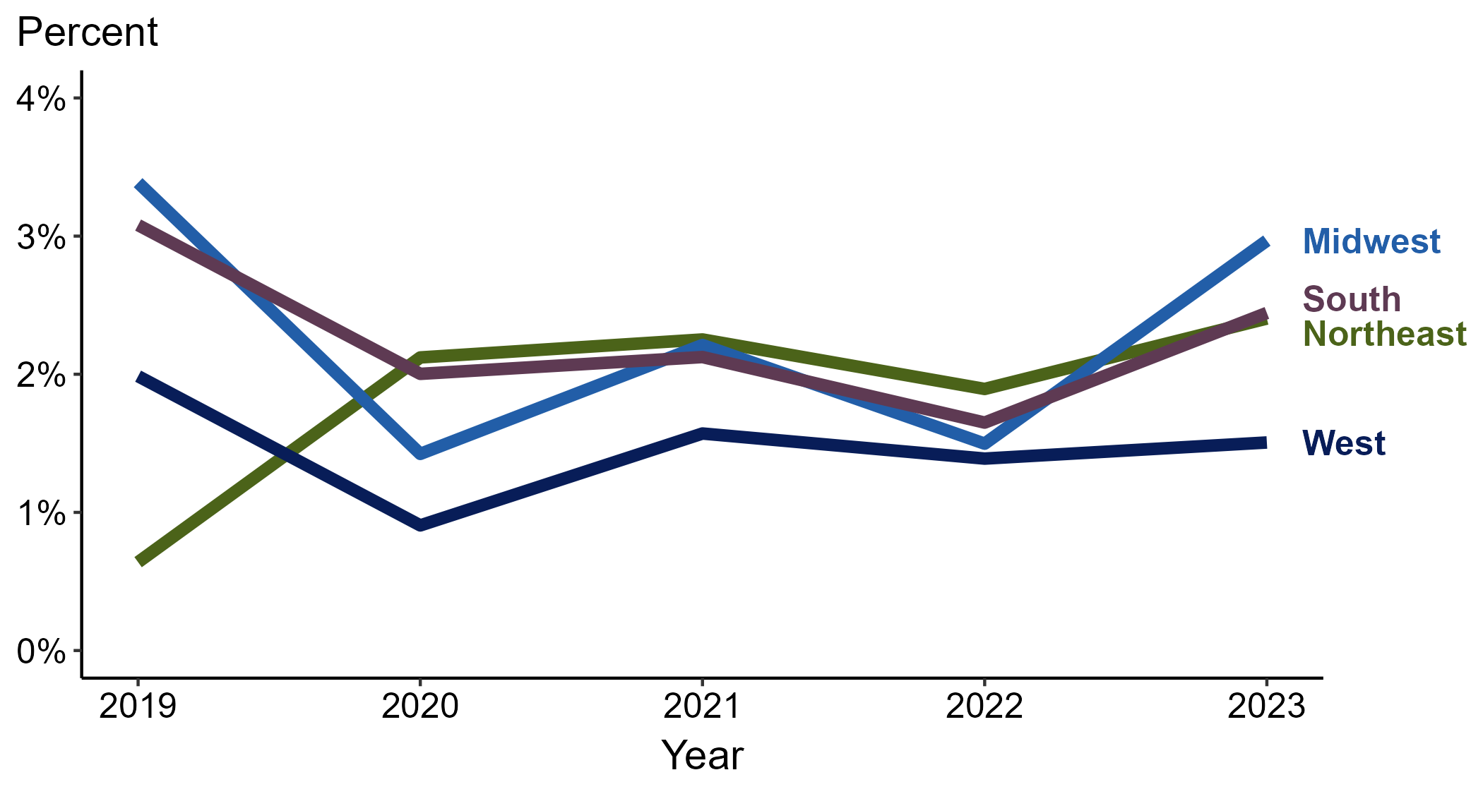
Primary and Secondary Syphilis — Percentage of Cases Reporting Crack Use* Among MSW by Region, United States, 2019–2023
*Percentage reporting crack use within the last 12 months calculated among cases with known data (cases with missing or unknown responses were excluded from the denominator).
ACRONYMS: MSW = Men who have sex with women only
Notes:
Among primary and secondary (P&S) syphilis cases reported among men who have sex with women only (MSW) in 2023, crack use was most frequently reported in the Midwest (3.0%), followed by the Northeast and South (2.4% in each region) and West (1.5%).
Comparing 2019 to 2023, the percentage of P&S syphilis cases among MSW that reported crack use increased in the Northeast (0.6% to 2.4%) and remained stable in the Midwest (3.4% to 3.0%), South (3.1% to 2.4%), and West (2.0% to 1.5%).
This report includes data from years that coincide with the COVID-19 pandemic, which introduced uncertainty and difficulty in interpreting case data. See Impact of COVID-19 on STIs (https://www.cdc.gov/sti-statistics/about/impact-of-covid-19.html) for more information.
This figure presents trends in the proportion of cases reporting one or more selected behaviors. Although rounded percentages are presented in the figure interpretive text, values used for generating the figure may be more precise. A map of the US Census Regions is available in the last slide of this deck. Data points for the figures presented in these slides as well as Technical Notes about data sources, data collection and reporting practices, and case definitions are available at https://www.cdc.gov/sti-statistics/syphilis-supplement/index.html.

Slide 20
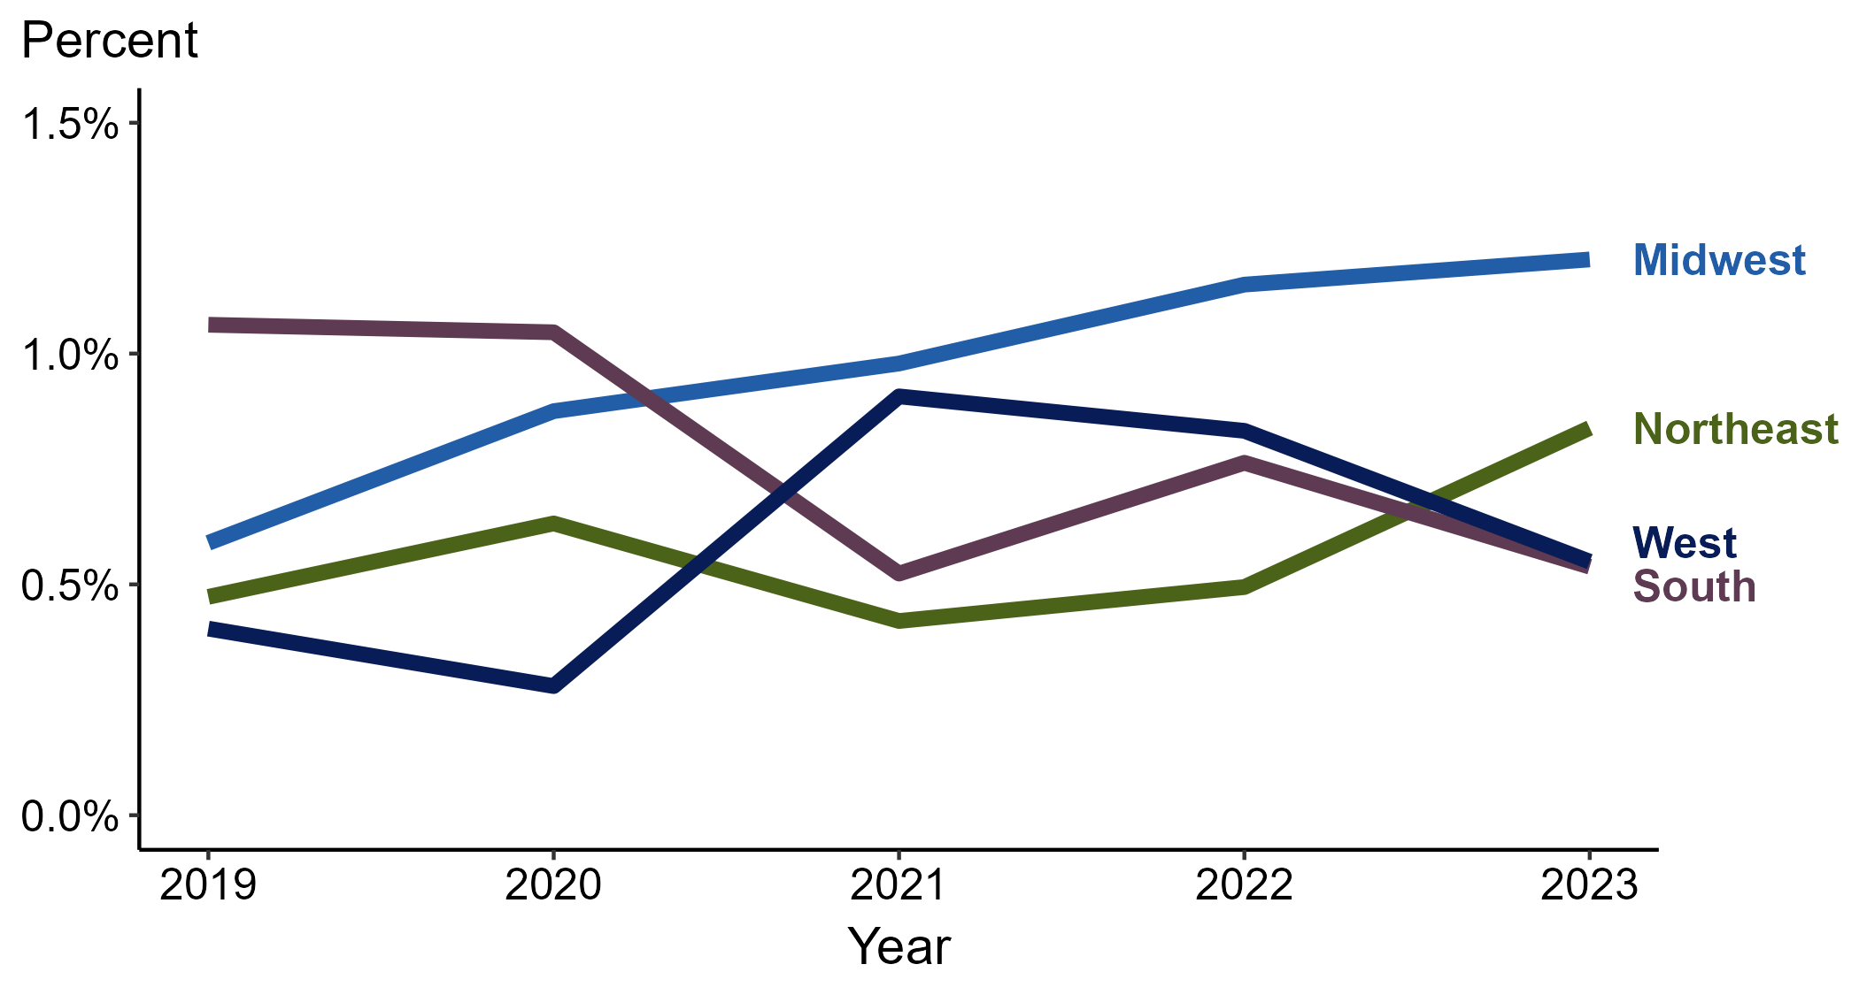
Primary and Secondary Syphilis — Percentage of Cases Reporting Crack Use* Among MSM by Region, United States, 2019–2023
*Percentage reporting crack use within the last 12 months calculated among cases with known data (cases with missing or unknown responses were excluded from the denominator).
ACRONYMS: MSM = Men who have sex with men
Notes:
Among primary and secondary (P&S) syphilis cases reported among men who have sex with men (MSM) in 2023, crack use was most frequently reported in the Midwest (1.2%), followed by the Northeast (0.8%) and South and West (0.5% in each region).
Comparing 2019 to 2023, the percentage of P&S syphilis cases among MSM that reported crack use remained stable in the Northeast (0.5% to 0.8%), Midwest (0.6% to 1.2%), South (1.1% to 0.5%), and West (0.4% to 0.5%).
This report includes data from years that coincide with the COVID-19 pandemic, which introduced uncertainty and difficulty in interpreting case data. See Impact of COVID-19 on STIs (https://www.cdc.gov/sti-statistics/about/impact-of-covid-19.html) for more information.
This figure presents trends in the proportion of cases reporting one or more selected behaviors. Although rounded percentages are presented in the figure interpretive text, values used for generating the figure may be more precise. A map of the US Census Regions is available in the last slide of this deck. Data points for the figures presented in these slides as well as Technical Notes about data sources, data collection and reporting practices, and case definitions are available at https://www.cdc.gov/sti-statistics/syphilis-supplement/index.html.

Slide 21
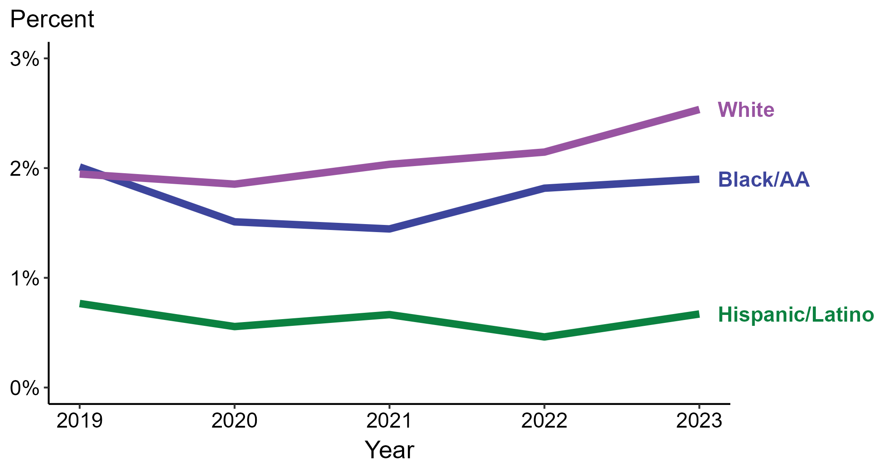
Primary and Secondary Syphilis — Percentage of Cases Reporting Crack Use* by Race and Hispanic Ethnicity, United States, 2019–2023
*Percentage reporting crack use within the last 12 months calculated among cases with known data (cases with missing or unknown responses were excluded from the denominator).
ACRONYMS: Black/AA = Black or African American
Notes:
Among primary and secondary (P&S) syphilis cases reported in 2023, crack use was most frequently reported among non-Hispanic White persons (2.5%), followed by non-Hispanic Black or African American persons (1.9%) and Hispanic or Latino persons (0.7%).
Comparing 2019 to 2023, the percentage of P&S syphilis cases that reported crack use remained stable among all categories of race and Hispanic ethnicity displayed in the figure: Hispanic or Latino persons (0.8% to 0.7%), non-Hispanic Black or African American persons (2.0% to 1.9%), and non-Hispanic White persons (1.9% to 2.5%).
Of all P&S syphilis cases reported during 2019 to 2023, 87.5% with information on crack use were Hispanic or Latino, non-Hispanic Black or African American, or non-Hispanic White persons. Because the vast majority of cases fall in those racial and ethnic categories, only data for those groups are displayed in the figure.
This report includes data from years that coincide with the COVID-19 pandemic, which introduced uncertainty and difficulty in interpreting case data. See Impact of COVID-19 on STIs (https://www.cdc.gov/sti-statistics/about/impact-of-covid-19.html) for more information.
This figure presents trends in the proportion of cases reporting one or more selected behaviors. Although rounded percentages are presented in the figure interpretive text, values used for generating the figure may be more precise. Data points for the figures presented in these slides as well as Technical Notes about data sources, data collection and reporting practices, and case definitions are available at https://www.cdc.gov/sti-statistics/syphilis-supplement/index.html.

Slide 22
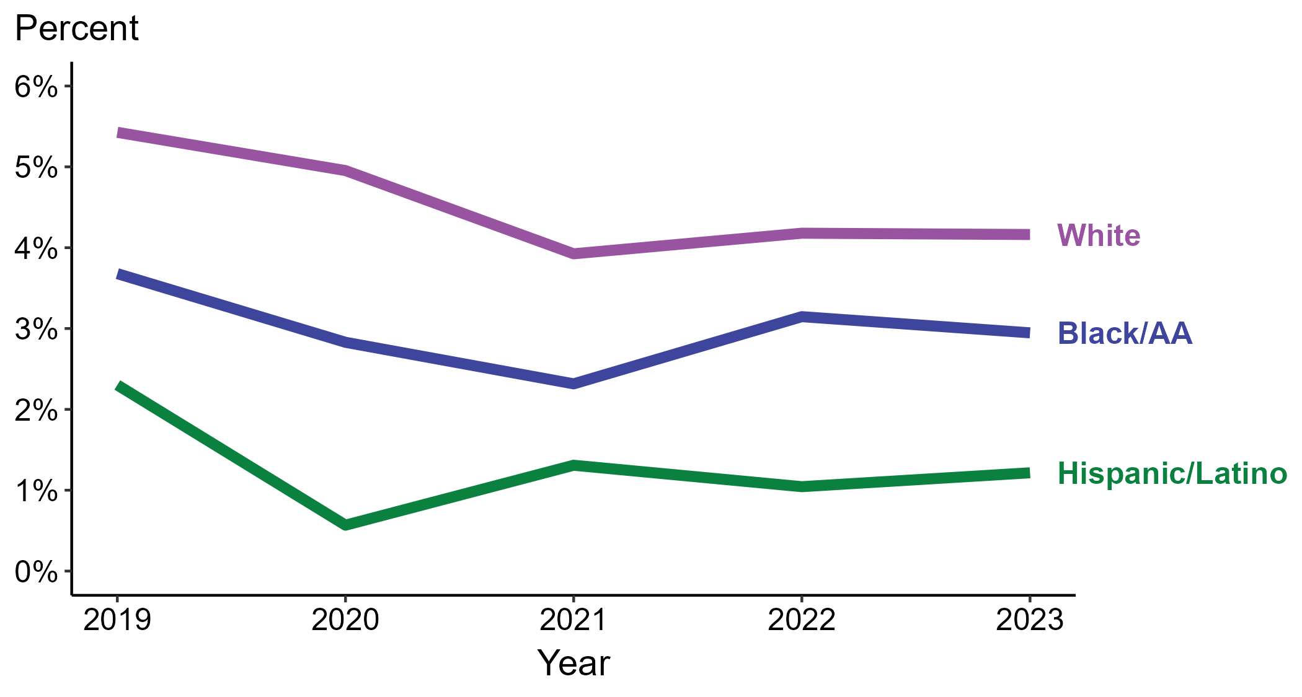
Primary and Secondary Syphilis — Percentage of Cases Reporting Crack Use* Among Women by Race and Hispanic Ethnicity, United States, 2019–2023
*Percentage reporting crack use within the last 12 months calculated among cases with known data (cases with missing or unknown responses were excluded from the denominator).
ACRONYMS: Black/AA = Black or African American
Notes:
Among primary and secondary (P&S) syphilis cases reported among women in 2023, crack use was most frequently reported among non-Hispanic White women (4.2%), followed by non-Hispanic Black or African American women (2.9%) and Hispanic or Latino women (1.2%).
Comparing 2019 to 2023, the percentage of P&S syphilis cases among women that reported crack use remained stable among non-Hispanic Black or African American women (3.7% to 2.9%) and decreased among Hispanic or Latino women (2.3% to 1.2%) and non-Hispanic White women (5.4% to 4.2%).
Of all P&S syphilis cases reported among women during 2019 to 2023, 87.2% with information on crack use were Hispanic or Latino, non-Hispanic Black or African American, or non-Hispanic White women. Because the vast majority of cases fall in those racial and ethnic categories, only data for those groups are displayed in the figure.
This report includes data from years that coincide with the COVID-19 pandemic, which introduced uncertainty and difficulty in interpreting case data. See Impact of COVID-19 on STIs (https://www.cdc.gov/sti-statistics/about/impact-of-covid-19.html) for more information.
This figure presents trends in the proportion of cases reporting one or more selected behaviors. Although rounded percentages are presented in the figure interpretive text, values used for generating the figure may be more precise. Data points for the figures presented in these slides as well as Technical Notes about data sources, data collection and reporting practices, and case definitions are available at https://www.cdc.gov/sti-statistics/syphilis-supplement/index.html.

Slide 23
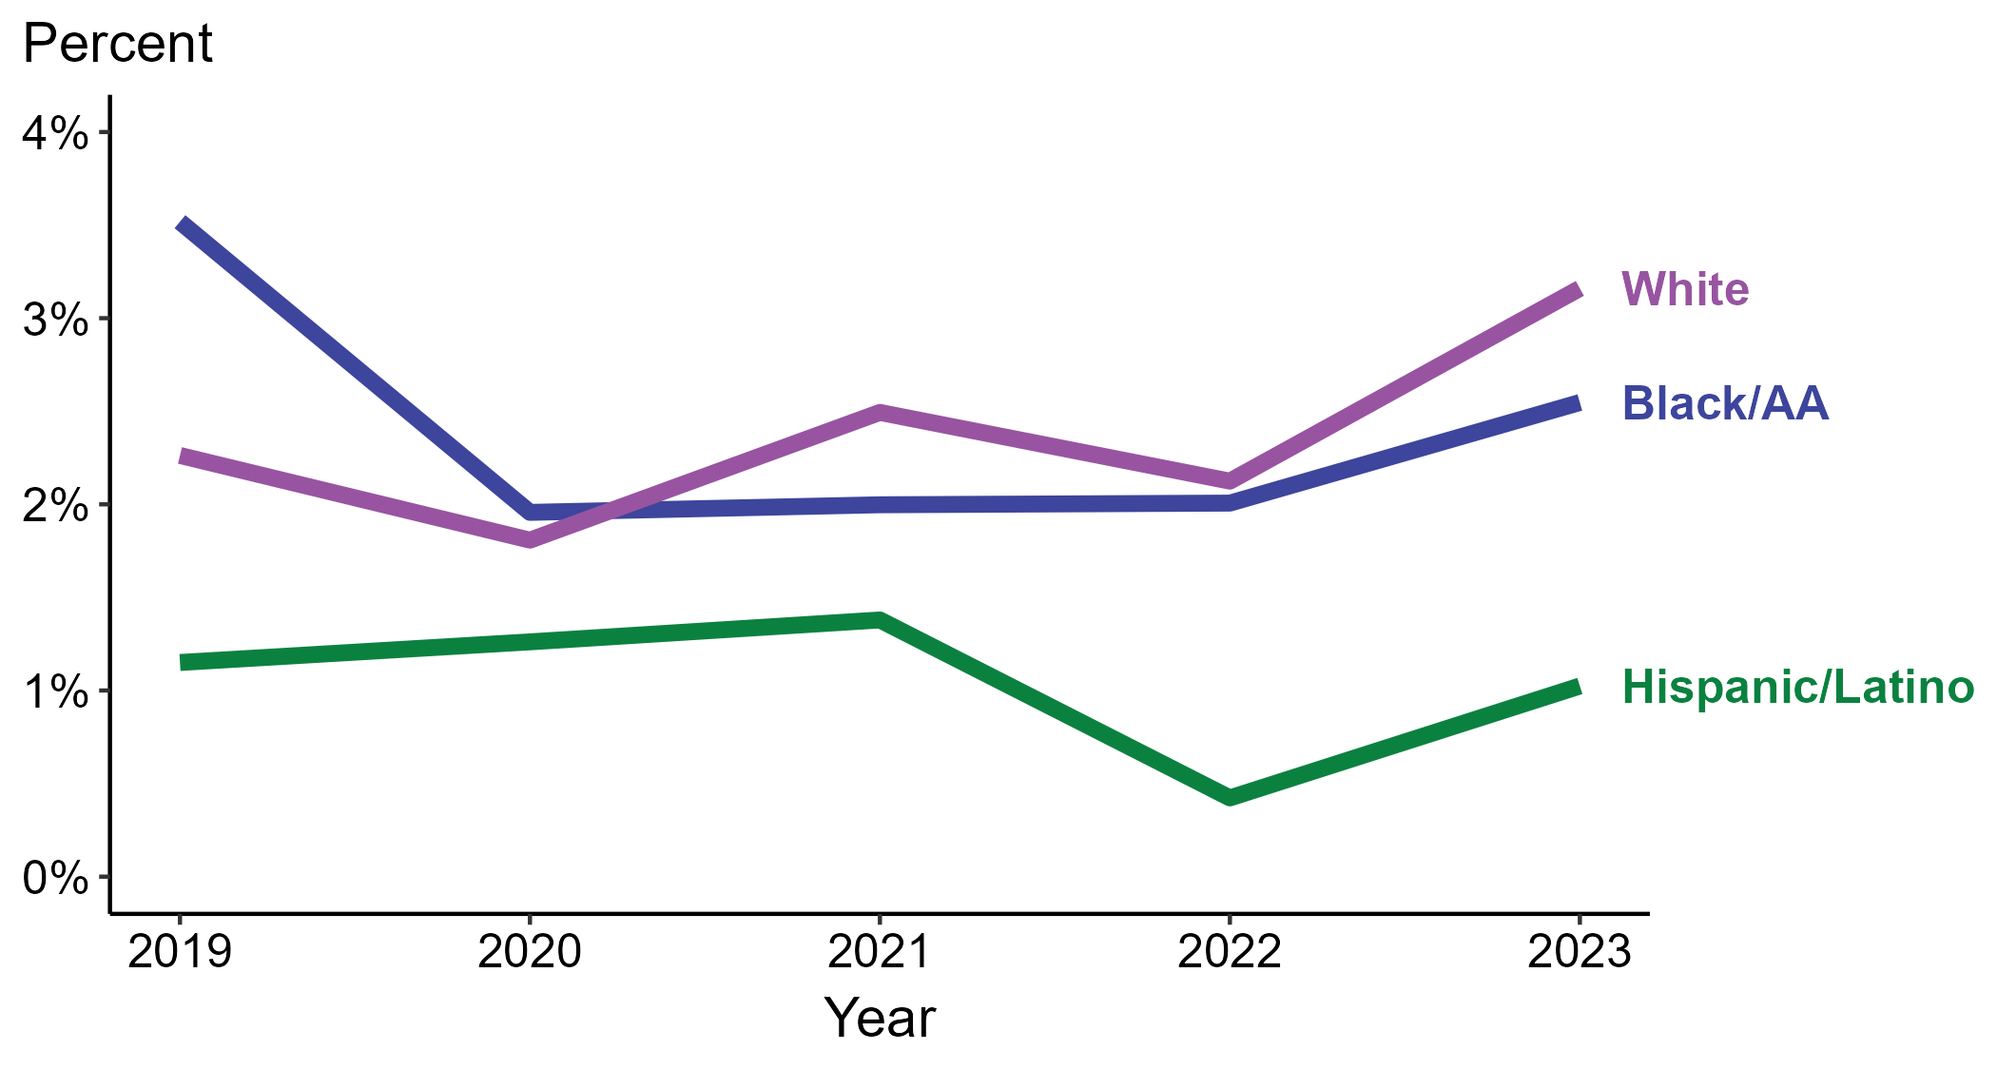
Primary and Secondary Syphilis — Percentage of Cases Reporting Crack Use* Among MSW by Race and Hispanic Ethnicity, United States, 2019–2023
*Percentage reporting crack use within the last 12 months calculated among cases with known data (cases with missing or unknown responses were excluded from the denominator).
ACRONYMS: Black/AA = Black or African American; MSW = Men who have sex with women only
Notes:
Among primary and secondary (P&S) syphilis cases reported among men who have sex with women only (MSW) in 2023, crack use was most frequently reported among non-Hispanic White MSW (3.2%), followed by non-Hispanic Black or African American MSW (2.5%) and Hispanic or Latino MSW (1.0%).
Comparing 2019 to 2023, the percentage of P&S syphilis cases among MSW that reported crack use remained stable among Hispanic or Latino MSW (1.2% to 1.0%) and non-Hispanic White MSW (2.3% to 3.2%) and decreased among non-Hispanic Black or African American MSW (3.5% to 2.5%).
Of all P&S syphilis cases reported among MSW during 2019 to 2023, 88.8% with information on crack use were Hispanic or Latino, non-Hispanic Black or African American, or non-Hispanic White MSW. Because the vast majority of cases fall in those racial and ethnic categories, only data for those groups are displayed in the figure.
This report includes data from years that coincide with the COVID-19 pandemic, which introduced uncertainty and difficulty in interpreting case data. See Impact of COVID-19 on STIs (https://www.cdc.gov/sti-statistics/about/impact-of-covid-19.html) for more information.
This figure presents trends in the proportion of cases reporting one or more selected behaviors. Although rounded percentages are presented in the figure interpretive text, values used for generating the figure may be more precise. Data points for the figures presented in these slides as well as Technical Notes about data sources, data collection and reporting practices, and case definitions are available at https://www.cdc.gov/sti-statistics/syphilis-supplement/index.html.

Slide 24
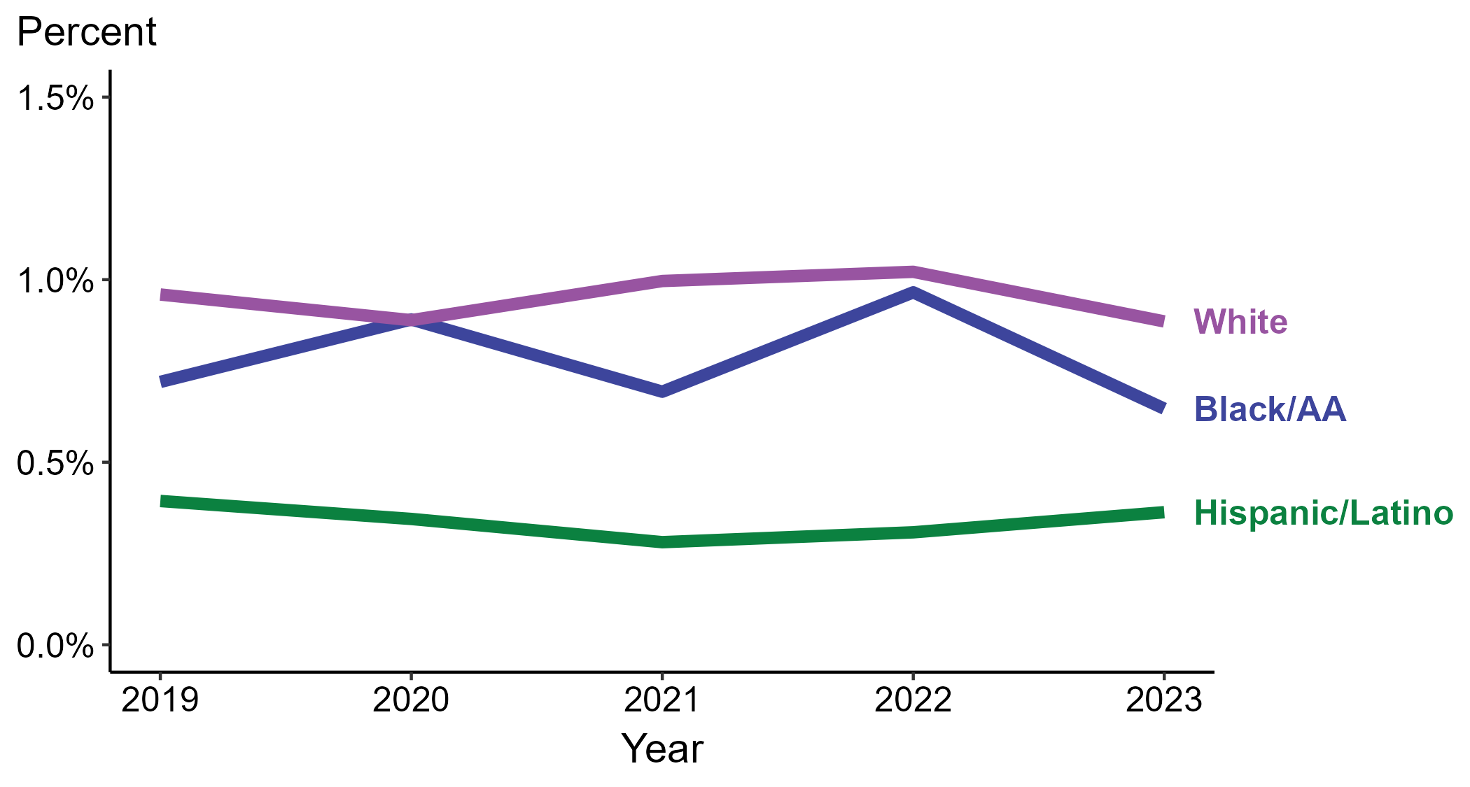
Primary and Secondary Syphilis — Percentage of Cases Reporting Crack Use* Among MSM by Race and Hispanic Ethnicity, United States, 2019–2023
*Percentage reporting crack use within the last 12 months calculated among cases with known data (cases with missing or unknown responses were excluded from the denominator).
ACRONYMS: Black/AA = Black or African American; MSM = Men who have sex with men
Notes:
Among primary and secondary (P&S) syphilis cases reported among men who have sex with men (MSM) in 2023, crack use was most frequently reported among non-Hispanic White MSM (0.9%), followed by non-Hispanic Black or African American MSM (0.6%) and Hispanic or Latino MSM (0.4%).
Comparing 2019 to 2023, the percentage of P&S syphilis cases among MSM that reported crack use remained stable among all categories of race and Hispanic ethnicity displayed in the figure: Hispanic or Latino MSM (0.4% in both years), non-Hispanic Black or African American MSM (0.7% to 0.6%), and non-Hispanic White MSM (1.0% to 0.9%).
Of all P&S syphilis cases reported among MSM during 2019 to 2023, 87.7% with information on crack use were Hispanic or Latino, non-Hispanic Black or African American, or non-Hispanic White MSM. Because the vast majority of cases fall in those racial and ethnic categories, only data for those groups are displayed in the figure.
This report includes data from years that coincide with the COVID-19 pandemic, which introduced uncertainty and difficulty in interpreting case data. See Impact of COVID-19 on STIs (https://www.cdc.gov/sti-statistics/about/impact-of-covid-19.html) for more information.
This figure presents trends in the proportion of cases reporting one or more selected behaviors. Although rounded percentages are presented in the figure interpretive text, values used for generating the figure may be more precise. Data points for the figures presented in these slides as well as Technical Notes about data sources, data collection and reporting practices, and case definitions are available at https://www.cdc.gov/sti-statistics/syphilis-supplement/index.html.

Slide 25
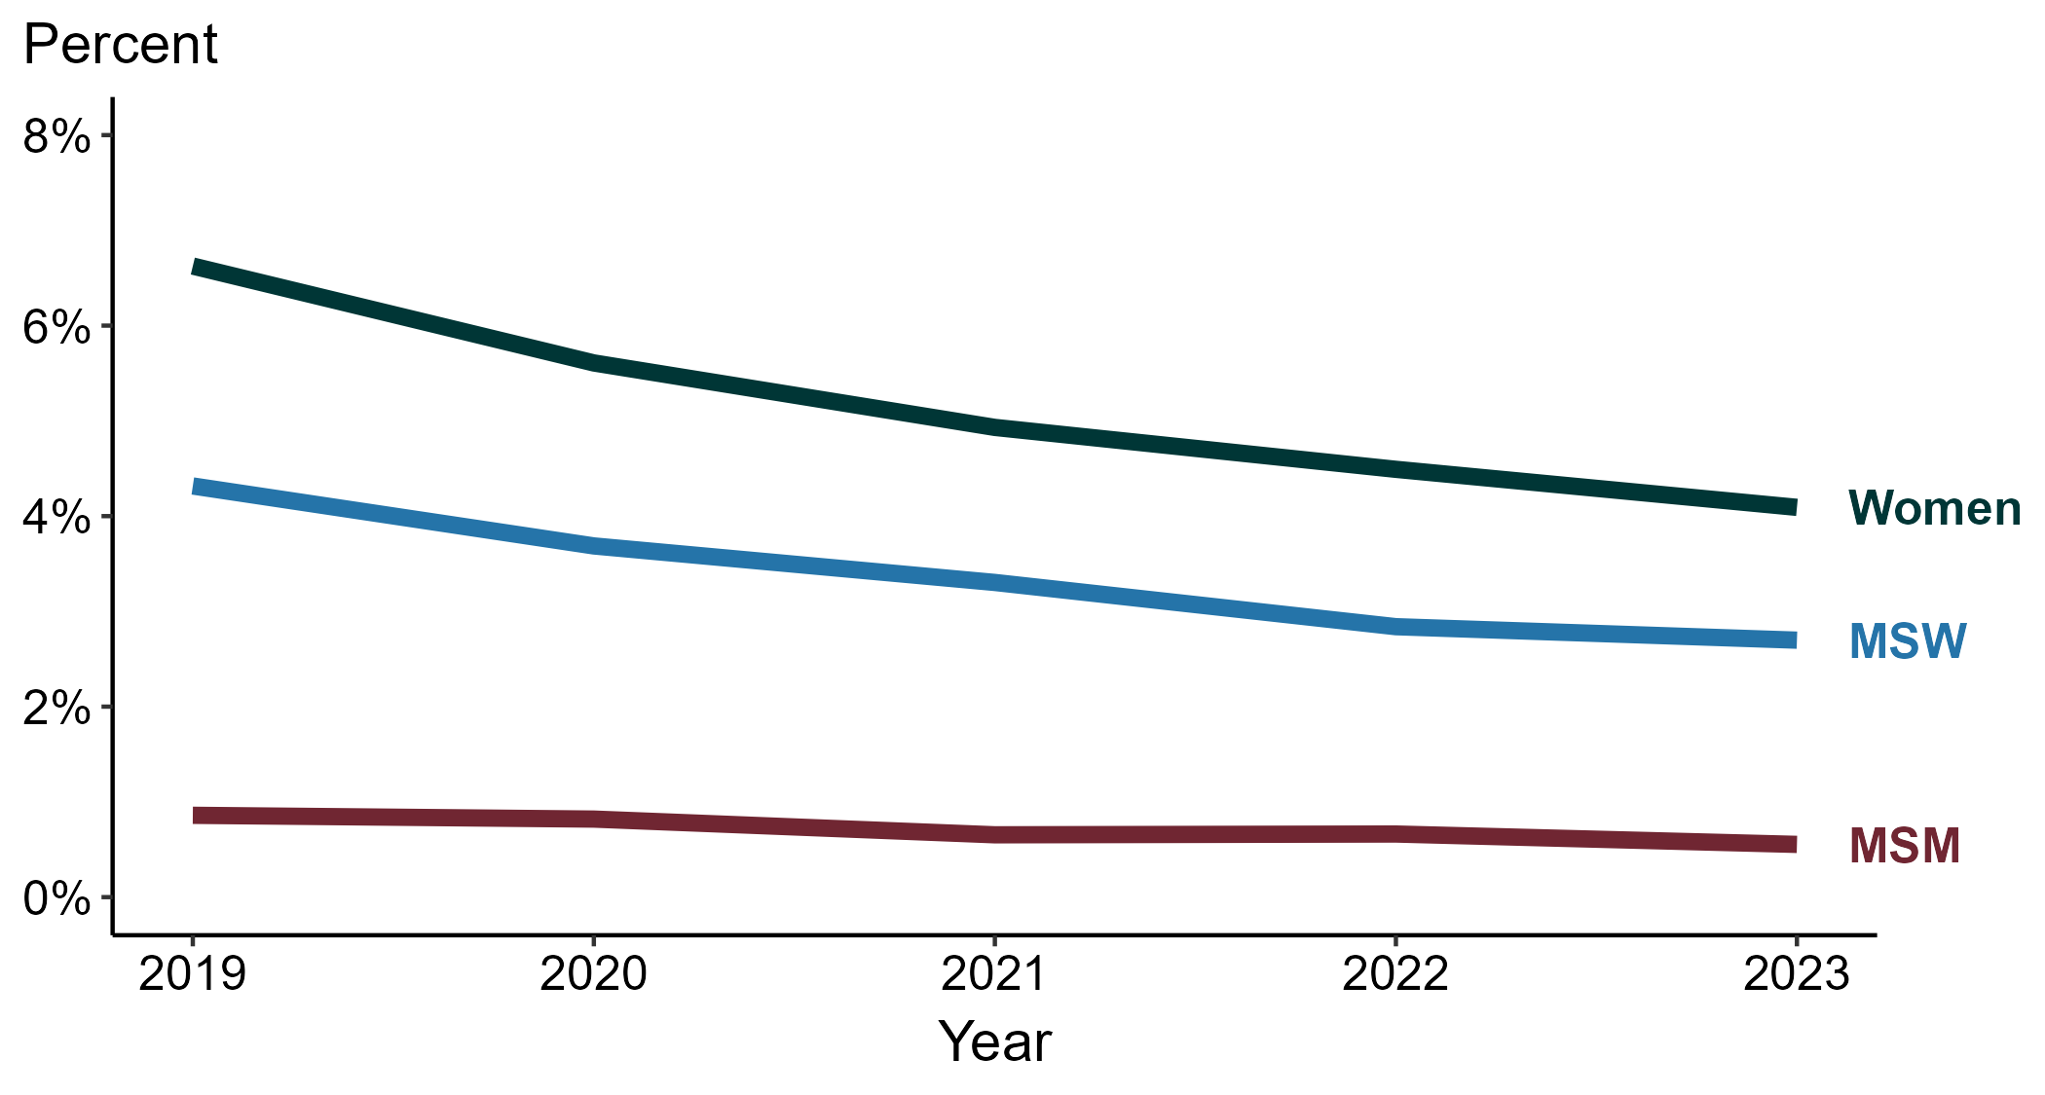
Primary and Secondary Syphilis — Percentage of Cases Reporting Heroin Use* by Sex and Sex of Sex Partners, United States, 2019–2023
*Percentage reporting heroin use within the last 12 months calculated among cases with known data (cases with missing or unknown responses were excluded from the denominator).
ACRONYMS: MSM = Men who have sex with men; MSW = Men who have sex with women only
Notes:
Among primary and secondary (P&S) syphilis cases reported in 2023, heroin use was most frequently reported among women (4.1%), followed by men who have sex with women only (MSW; 2.7%) and men who have sex with men (MSM; 0.6%).
Comparing 2019 to 2023, the percentage of P&S syphilis cases that reported heroin use remained stable among MSM (0.9% to 0.6%) and decreased among MSW (4.3% to 2.7%) and women (6.6% to 4.1%).
This report includes data from years that coincide with the COVID-19 pandemic, which introduced uncertainty and difficulty in interpreting case data. See Impact of COVID-19 on STIs (https://www.cdc.gov/sti-statistics/about/impact-of-covid-19.html) for more information.
This figure presents trends in the proportion of cases reporting one or more selected behaviors. Although rounded percentages are presented in the figure interpretive text, values used for generating the figure may be more precise. Data points for the figures presented in these slides as well as Technical Notes about data sources, data collection and reporting practices, and case definitions are available at https://www.cdc.gov/sti-statistics/syphilis-supplement/index.html.

Slide 26
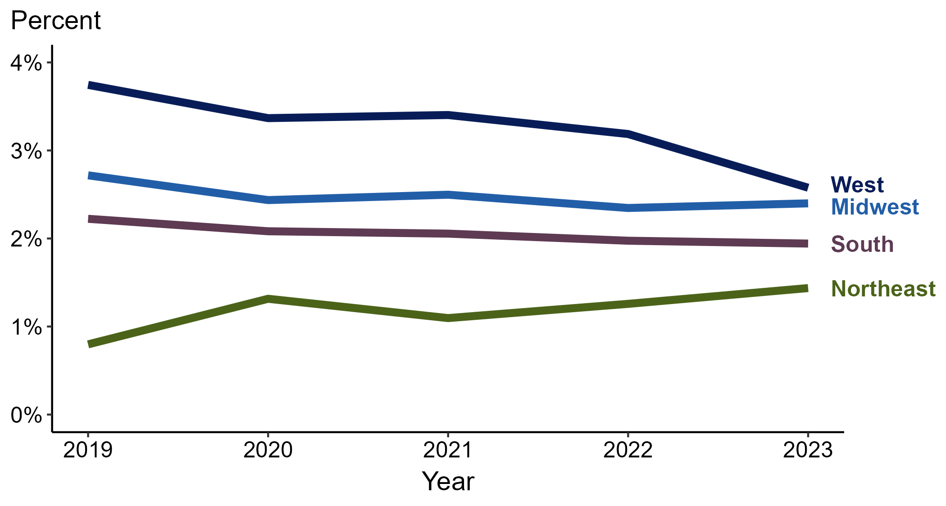
Primary and Secondary Syphilis — Percentage of Cases Reporting Heroin Use* by Region, United States, 2019–2023
*Percentage reporting heroin use within the last 12 months calculated among cases with known data (cases with missing or unknown responses were excluded from the denominator).
Notes:
Among primary and secondary (P&S) syphilis cases reported in 2023, heroin use was most frequently reported in the West (2.6%), followed by the Midwest (2.4%), South (1.9%), and Northeast (1.4%).
Comparing 2019 to 2023, the percentage of P&S syphilis cases that reported heroin use remained stable in the Northeast (0.8% to 1.4%), Midwest (2.7% to 2.4%), and South (2.2% to 1.9%) and decreased in the West (3.7% to 2.6%).
This report includes data from years that coincide with the COVID-19 pandemic, which introduced uncertainty and difficulty in interpreting case data. See Impact of COVID-19 on STIs (https://www.cdc.gov/sti-statistics/about/impact-of-covid-19.html) for more information.
This figure presents trends in the proportion of cases reporting one or more selected behaviors. Although rounded percentages are presented in the figure interpretive text, values used for generating the figure may be more precise. A map of the US Census Regions is available in the last slide of this deck. Data points for the figures presented in these slides as well as Technical Notes about data sources, data collection and reporting practices, and case definitions are available at https://www.cdc.gov/sti-statistics/syphilis-supplement/index.html.

Slide 27
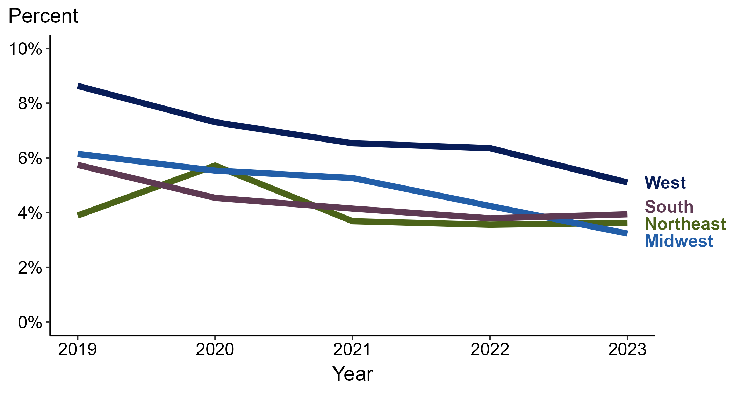
Primary and Secondary Syphilis — Percentage of Cases Reporting Heroin Use* Among Women by Region, United States, 2019–2023
*Percentage reporting heroin use within the last 12 months calculated among cases with known data (cases with missing or unknown responses were excluded from the denominator).
Notes:
Among primary and secondary (P&S) syphilis cases reported among women in 2023, heroin use was most frequently reported in the West (5.1%), followed by the South (3.9%), Northeast (3.6%), and Midwest (3.2%).
Comparing 2019 to 2023, the percentage of P&S syphilis cases among women that reported heroin use remained stable in the Northeast (3.9% to 3.6%) and decreased in the Midwest (6.1% to 3.2%), South (5.7% to 3.9%), and West (8.6% to 5.1%).
This report includes data from years that coincide with the COVID-19 pandemic, which introduced uncertainty and difficulty in interpreting case data. See Impact of COVID-19 on STIs (https://www.cdc.gov/sti-statistics/about/impact-of-covid-19.html) for more information.
This figure presents trends in the proportion of cases reporting one or more selected behaviors. Although rounded percentages are presented in the figure interpretive text, values used for generating the figure may be more precise. A map of the US Census Regions is available in the last slide of this deck. Data points for the figures presented in these slides as well as Technical Notes about data sources, data collection and reporting practices, and case definitions are available at https://www.cdc.gov/sti-statistics/syphilis-supplement/index.html.

Slide 28
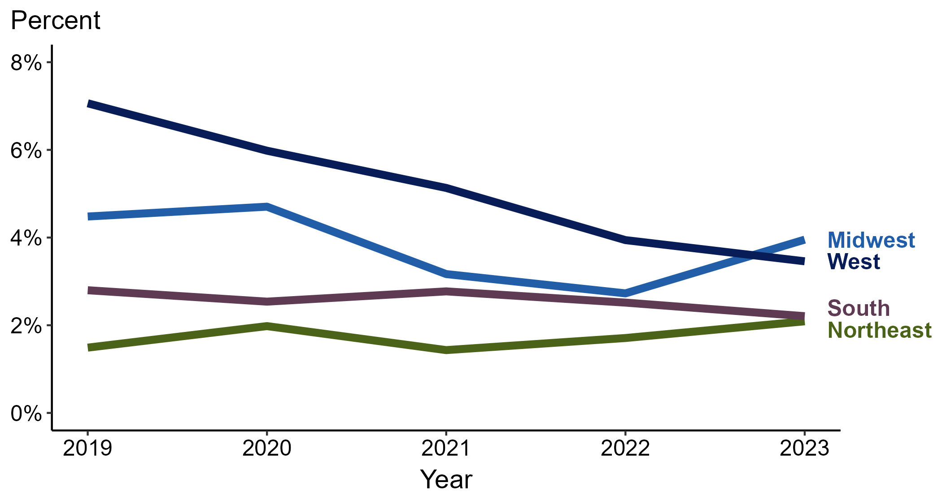
Primary and Secondary Syphilis — Percentage of Cases Reporting Heroin Use* Among MSW by Region, United States, 2019–2023
*Percentage reporting heroin use within the last 12 months calculated among cases with known data (cases with missing or unknown responses were excluded from the denominator).
ACRONYMS: MSW = Men who have sex with women only
Notes:
Among primary and secondary (P&S) syphilis cases reported among men who have sex with women only (MSW) in 2023, heroin use was most frequently reported in the Midwest (4.0%), followed by the West (3.5%), South (2.2%), and Northeast (2.1%).
Comparing 2019 to 2023, the percentage of P&S syphilis cases among MSW that reported heroin use remained stable in the Northeast (1.5% to 2.1%), Midwest (4.5% to 4.0%), and South (2.8% to 2.2%) and decreased in the West (7.1% to 3.5%).
This report includes data from years that coincide with the COVID-19 pandemic, which introduced uncertainty and difficulty in interpreting case data. See Impact of COVID-19 on STIs (https://www.cdc.gov/sti-statistics/about/impact-of-covid-19.html) for more information.
This figure presents trends in the proportion of cases reporting one or more selected behaviors. Although rounded percentages are presented in the figure interpretive text, values used for generating the figure may be more precise. A map of the US Census Regions is available in the last slide of this deck. Data points for the figures presented in these slides as well as Technical Notes about data sources, data collection and reporting practices, and case definitions are available at https://www.cdc.gov/sti-statistics/syphilis-supplement/index.html.

Slide 29
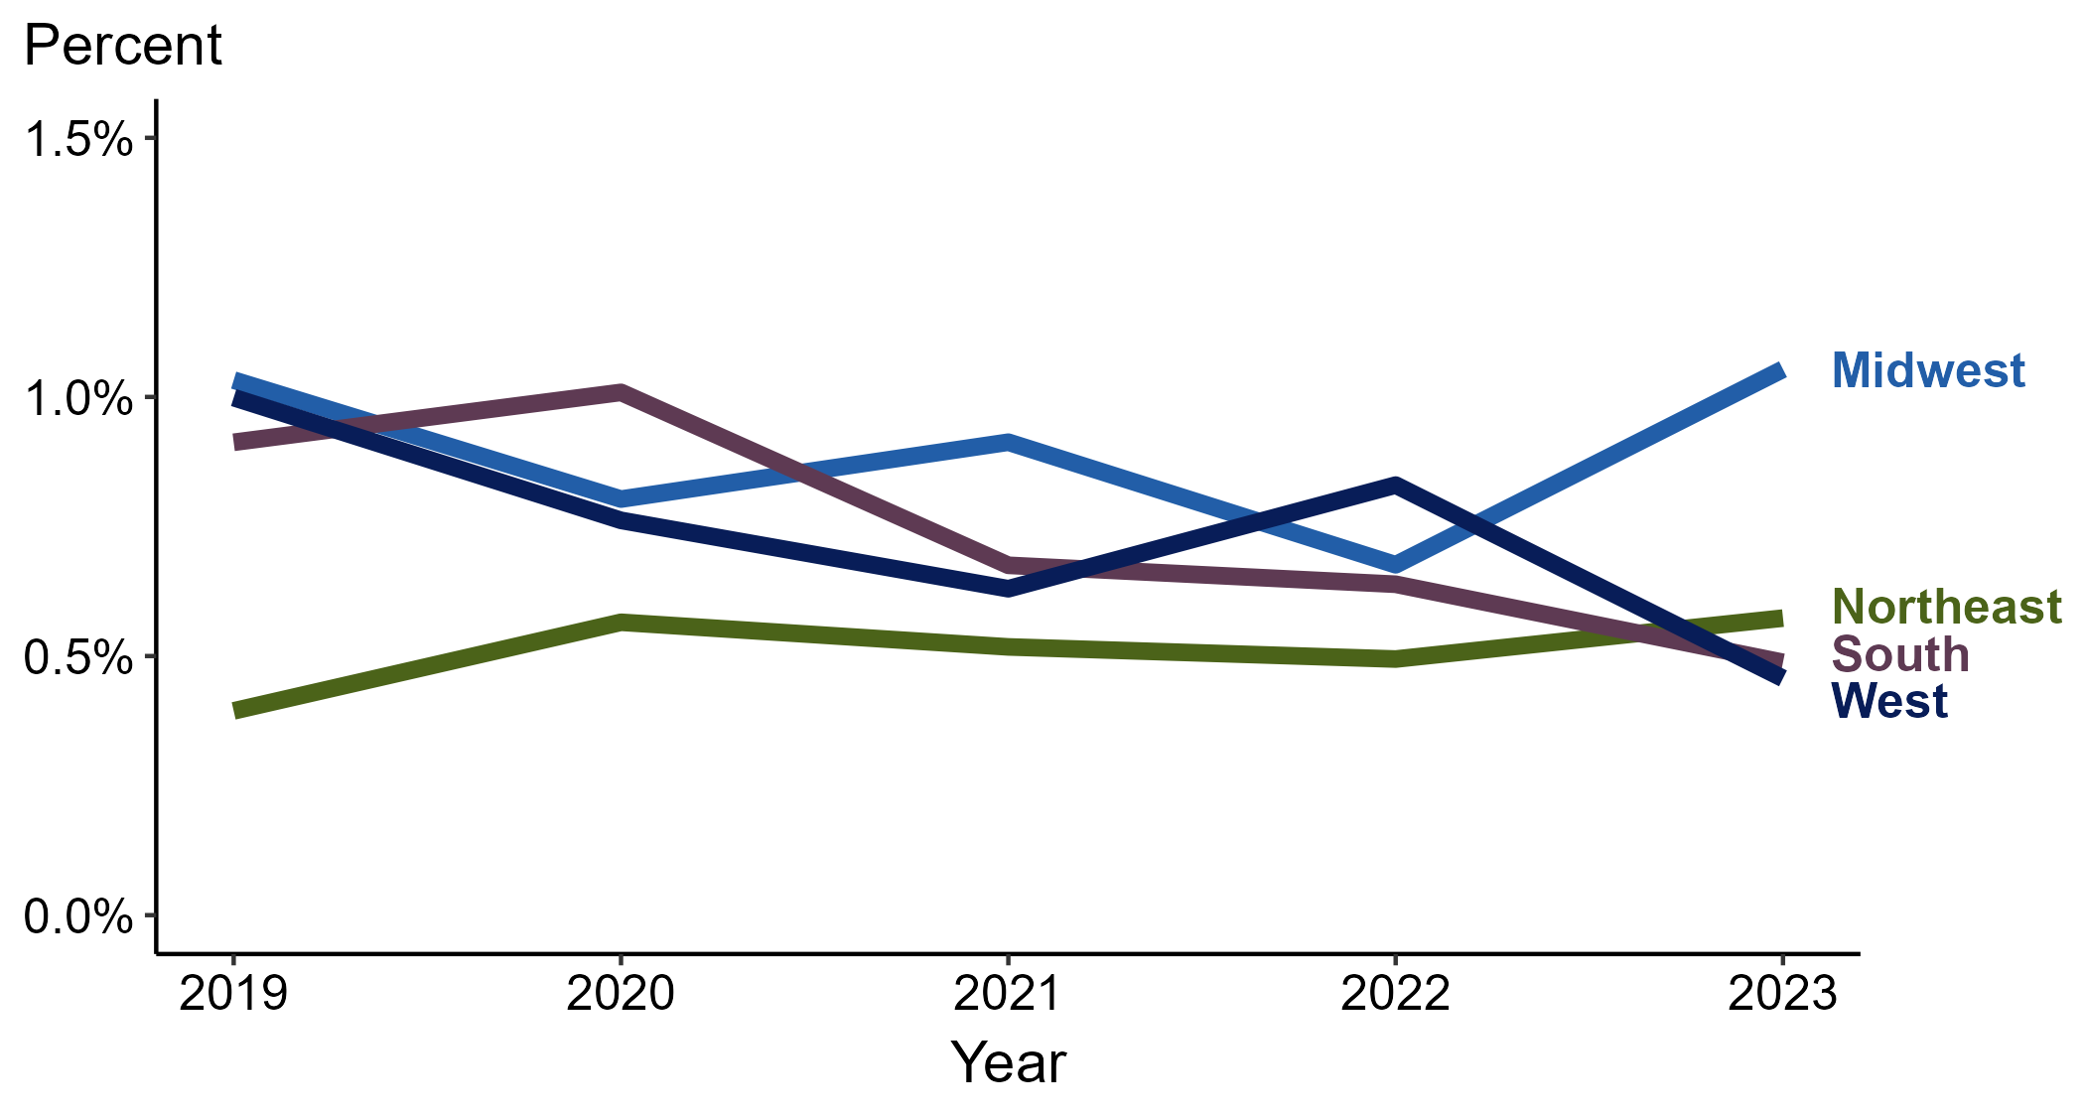
Primary and Secondary Syphilis — Percentage of Cases Reporting Heroin Use* Among MSM by Region, United States, 2019–2023
*Percentage reporting heroin use within the last 12 months calculated among cases with known data (cases with missing or unknown responses were excluded from the denominator).
ACRONYMS: MSM = Men who have sex with men
Notes:
Among primary and secondary (P&S) syphilis cases reported among men who have sex with men (MSM) in 2023, heroin use was most frequently reported in the Midwest (1.1%), followed by the Northeast (0.6%) and West and South (0.5% in each region).
Comparing 2019 to 2023, the percentage of P&S syphilis cases among MSM that reported heroin use remained stable in the Northeast (0.4% to 0.6%), Midwest (1.0% to 1.1%), South (0.9% to 0.5%), and West (1.0% to 0.5%).
This report includes data from years that coincide with the COVID-19 pandemic, which introduced uncertainty and difficulty in interpreting case data. See Impact of COVID-19 on STIs (https://www.cdc.gov/sti-statistics/about/impact-of-covid-19.html) for more information.
This figure presents trends in the proportion of cases reporting one or more selected behaviors. Although rounded percentages are presented in the figure interpretive text, values used for generating the figure may be more precise. A map of the US Census Regions is available in the last slide of this deck. Data points for the figures presented in these slides as well as Technical Notes about data sources, data collection and reporting practices, and case definitions are available at https://www.cdc.gov/sti-statistics/syphilis-supplement/index.html.

Slide 30
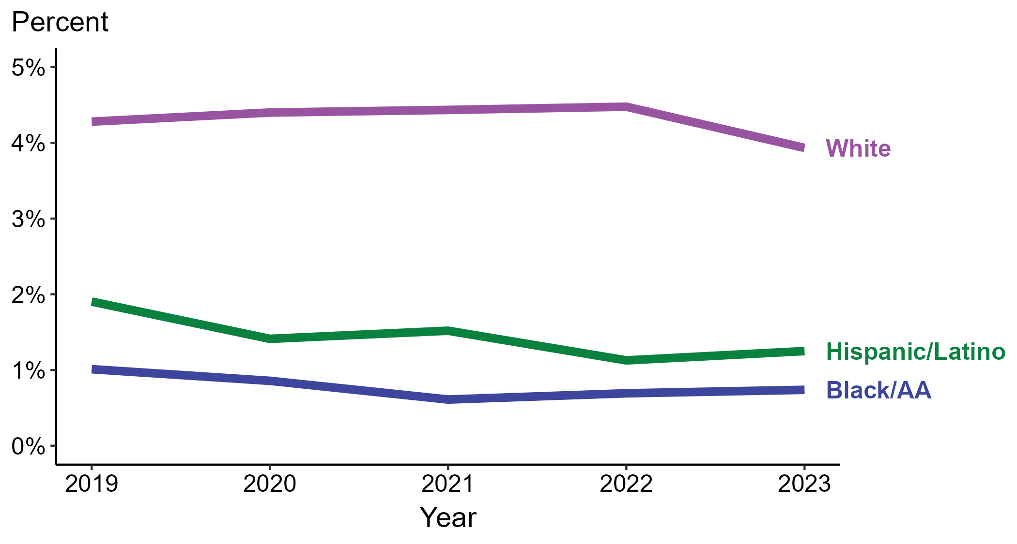
Primary and Secondary Syphilis — Percentage of Cases Reporting Heroin Use* by Race and Hispanic Ethnicity, United States, 2019–2023
*Percentage reporting heroin use within the last 12 months calculated among cases with known data (cases with missing or unknown responses were excluded from the denominator).
ACRONYMS: Black/AA = Black or African American
Notes:
Among primary and secondary (P&S) syphilis cases reported in 2023, heroin use was most frequently reported among non-Hispanic White persons (3.9%), followed by Hispanic or Latino persons (1.2%) and non-Hispanic Black or African American persons (0.7%).
Comparing 2019 to 2023, the percentage of P&S syphilis cases that reported heroin use remained stable among all categories of race and Hispanic ethnicity displayed in the figure: Hispanic or Latino persons (1.9% to 1.2%), non-Hispanic Black or African American persons (1.0% to 0.7%), and non-Hispanic White persons (4.3% to 3.9%).
Of all P&S syphilis cases reported during 2019 to 2023, 87.5% with information on heroin use were Hispanic or Latino, non-Hispanic Black or African American, or non-Hispanic White persons. Because the vast majority of cases fall in those racial and ethnic categories, only data for those groups are displayed in the figure.
This report includes data from years that coincide with the COVID-19 pandemic, which introduced uncertainty and difficulty in interpreting case data. See Impact of COVID-19 on STIs (https://www.cdc.gov/sti-statistics/about/impact-of-covid-19.html) for more information.
This figure presents trends in the proportion of cases reporting one or more selected behaviors. Although rounded percentages are presented in the figure interpretive text, values used for generating the figure may be more precise. Data points for the figures presented in these slides as well as Technical Notes about data sources, data collection and reporting practices, and case definitions are available at https://www.cdc.gov/sti-statistics/syphilis-supplement/index.html.

Slide 31
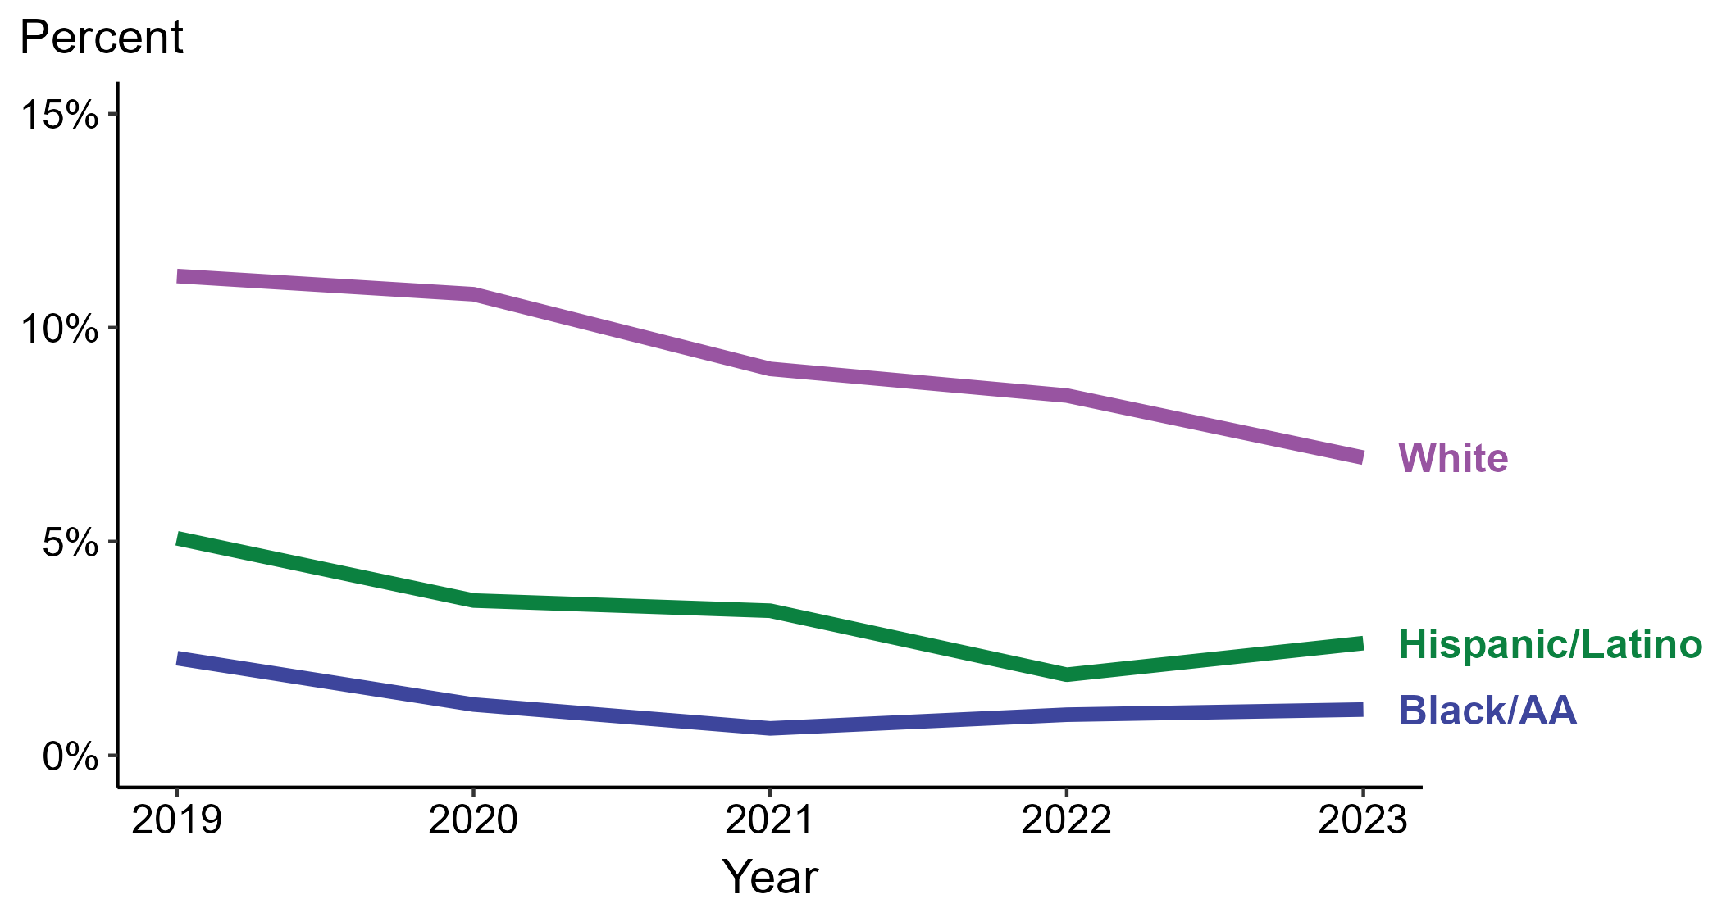
Primary and Secondary Syphilis — Percentage of Cases Reporting Heroin Use* Among Women by Race and Hispanic Ethnicity, United States, 2019–2023
*Percentage reporting heroin use within the last 12 months calculated among cases with known data (cases with missing or unknown responses were excluded from the denominator).
ACRONYMS: Black/AA = Black or African American
Notes:
Among primary and secondary (P&S) syphilis cases reported among women in 2023, heroin use was most frequently reported among non-Hispanic White women (7.0%), followed by Hispanic or Latino women (2.6%) and non-Hispanic Black or African American women (1.1%).
Comparing 2019 to 2023, the percentage of P&S syphilis cases among women that reported heroin use decreased among all categories of race and Hispanic ethnicity displayed in the figure: Hispanic or Latino women (5.1% to 2.6%), non-Hispanic Black or African American women (2.3% to 1.1%), and non-Hispanic White women (11.2% to 7.0%).
Of all P&S syphilis cases reported among women during 2019 to 2023, 87.1% with information on heroin use were Hispanic or Latino, non-Hispanic Black or African American, or non-Hispanic White women. Because the vast majority of cases fall in those racial and ethnic categories, only data for those groups are displayed in the figure.
This report includes data from years that coincide with the COVID-19 pandemic, which introduced uncertainty and difficulty in interpreting case data. See Impact of COVID-19 on STIs (https://www.cdc.gov/sti-statistics/about/impact-of-covid-19.html) for more information.
This figure presents trends in the proportion of cases reporting one or more selected behaviors. Although rounded percentages are presented in the figure interpretive text, values used for generating the figure may be more precise. Data points for the figures presented in these slides as well as Technical Notes about data sources, data collection and reporting practices, and case definitions are available at https://www.cdc.gov/sti-statistics/syphilis-supplement/index.html.

Slide 32
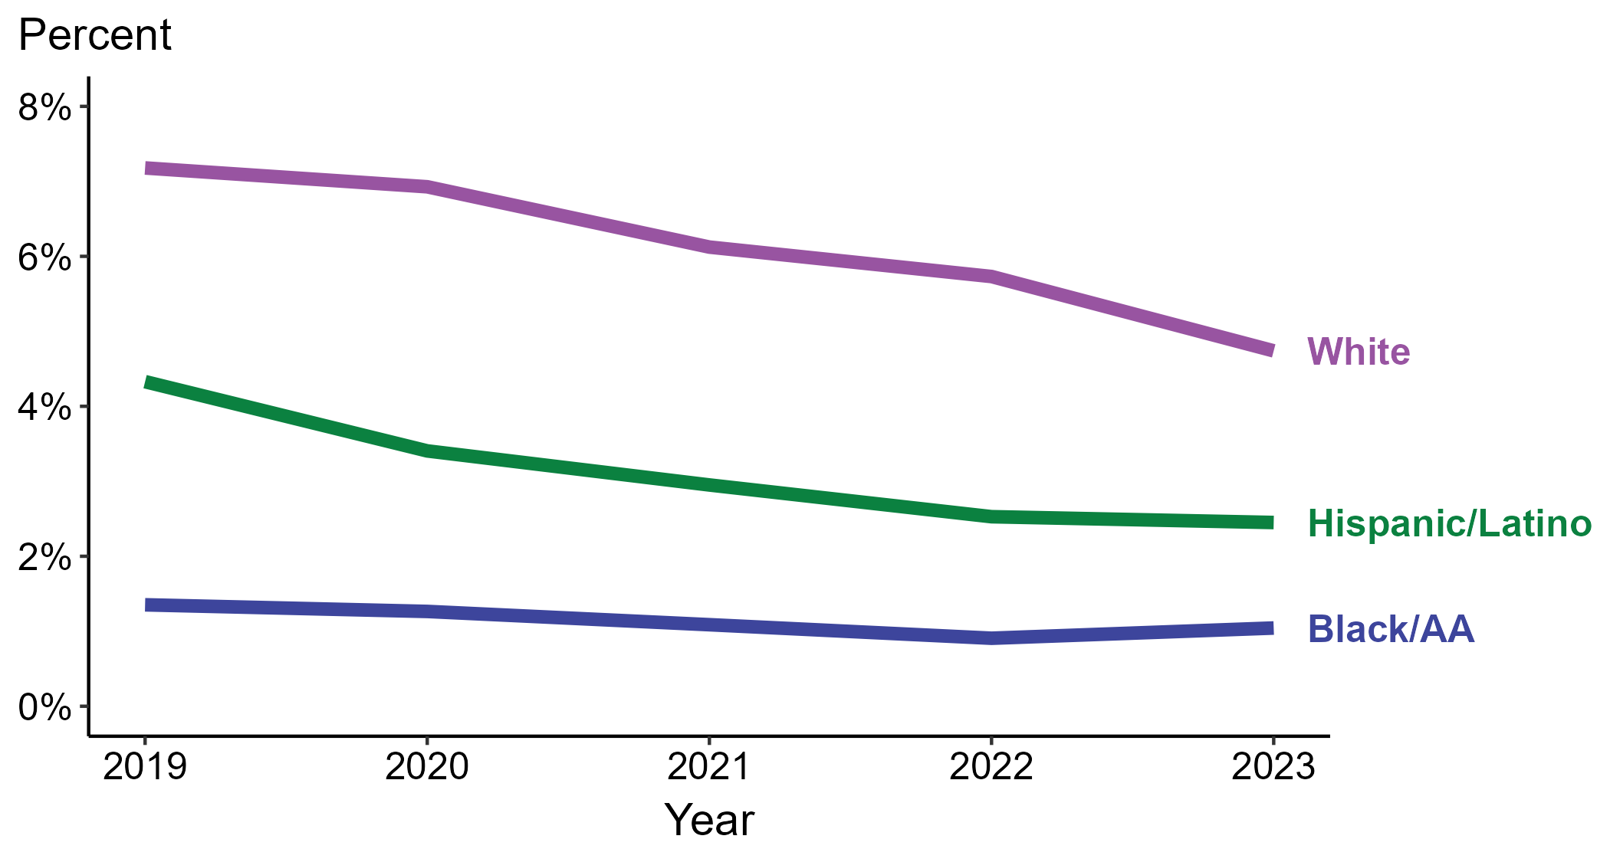
Primary and Secondary Syphilis — Percentage of Cases Reporting Heroin Use* Among MSW by Race and Hispanic Ethnicity, United States, 2019–2023
*Percentage reporting heroin use within the last 12 months calculated among cases with known data (cases with missing or unknown responses were excluded from the denominator).
ACRONYMS: Black/AA = Black or African American; MSW = Men who have sex with women only
Notes:
Among primary and secondary (P&S) syphilis cases reported among men who have sex with women only (MSW) in 2023, heroin use was most frequently reported among non-Hispanic White MSW (4.7%), followed by Hispanic or Latino MSW (2.5%) and non-Hispanic Black or African American MSW (1.0%).
Comparing 2019 to 2023, the percentage of P&S syphilis cases among MSW that reported heroin use remained stable among non-Hispanic Black or African American MSW (1.4% to 1.0%) and decreased among Hispanic or Latino MSW (4.3% to 2.5%) and non-Hispanic White MSW (7.2% to 4.7%).
Of all P&S syphilis cases reported among MSW during 2019 to 2023, 88.8% with information on heroin use were Hispanic or Latino, non-Hispanic Black or African American, or non-Hispanic White MSW. Because the vast majority of cases fall in those racial and ethnic categories, only data for those groups are displayed in the figure.
This report includes data from years that coincide with the COVID-19 pandemic, which introduced uncertainty and difficulty in interpreting case data. See Impact of COVID-19 on STIs (https://www.cdc.gov/sti-statistics/about/impact-of-covid-19.html) for more information.
This figure presents trends in the proportion of cases reporting one or more selected behaviors. Although rounded percentages are presented in the figure interpretive text, values used for generating the figure may be more precise. Data points for the figures presented in these slides as well as Technical Notes about data sources, data collection and reporting practices, and case definitions are available at https://www.cdc.gov/sti-statistics/syphilis-supplement/index.html.

Slide 33
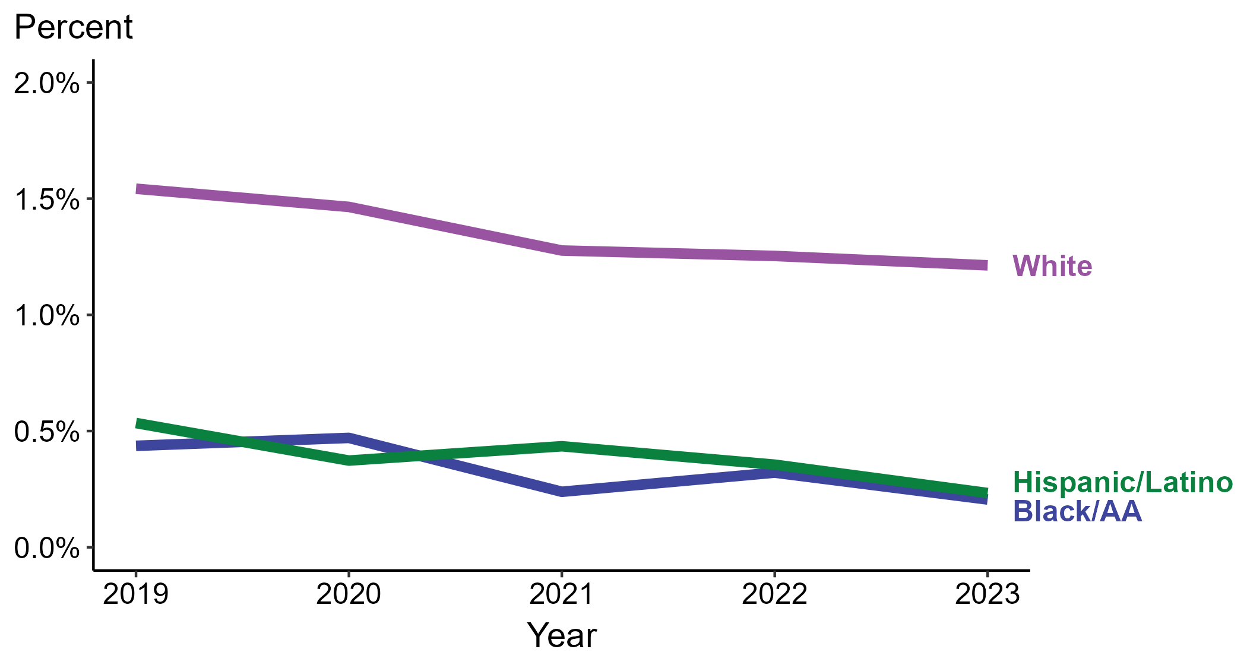
Primary and Secondary Syphilis — Percentage of Cases Reporting Heroin Use* Among MSM by Race and Hispanic Ethnicity, United States, 2019–2023
*Percentage reporting heroin use within the last 12 months calculated among cases with known data (cases with missing or unknown responses were excluded from the denominator).
ACRONYMS: Black/AA = Black or African American; MSM = Men who have sex with men
Notes:
Among primary and secondary (P&S) syphilis cases reported among men who have sex with men (MSM) in 2023, heroin use was most frequently reported among non-Hispanic White MSM (1.2%), followed by non-Hispanic Black or African American MSM and Hispanic or Latino MSM (0.2% among all two groups).
Comparing 2019 to 2023, the percentage of P&S syphilis cases among MSM that reported heroin use remained stable among all categories of race and Hispanic ethnicity displayed in the figure: Hispanic or Latino MSM (0.5% to 0.2%), non-Hispanic Black or African American MSM (0.4% to 0.2%), and non-Hispanic White MSM (1.5% to 1.2%).
Of all P&S syphilis cases reported among MSM during 2019 to 2023, 87.7% with information on heroin use were Hispanic or Latino, non-Hispanic Black or African American, or non-Hispanic White MSM. Because the vast majority of cases fall in those racial and ethnic categories, only data for those groups are displayed in the figure.
This report includes data from years that coincide with the COVID-19 pandemic, which introduced uncertainty and difficulty in interpreting case data. See Impact of COVID-19 on STIs (https://www.cdc.gov/sti-statistics/about/impact-of-covid-19.html) for more information.
This figure presents trends in the proportion of cases reporting one or more selected behaviors. Although rounded percentages are presented in the figure interpretive text, values used for generating the figure may be more precise. Data points for the figures presented in these slides as well as Technical Notes about data sources, data collection and reporting practices, and case definitions are available at https://www.cdc.gov/sti-statistics/syphilis-supplement/index.html.

Slide 34
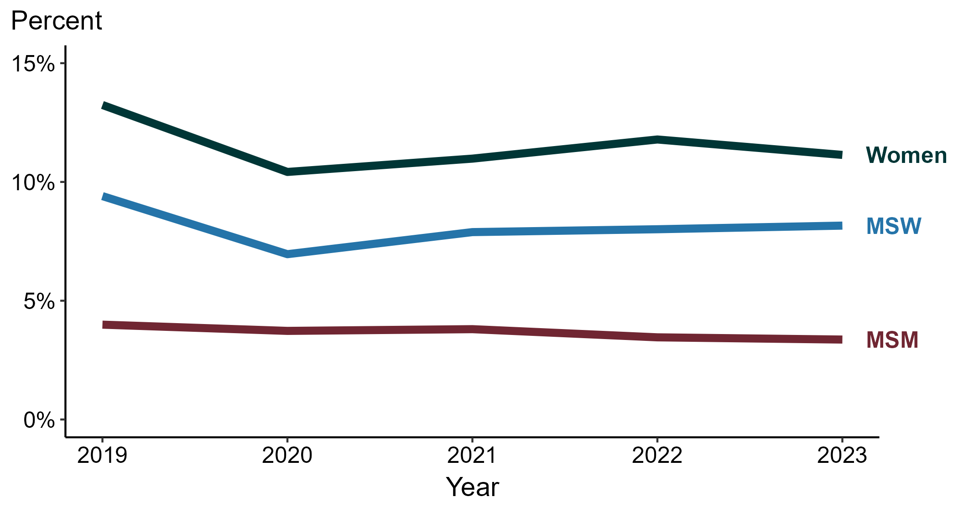
Primary and Secondary Syphilis — Percentage of Cases Reporting Injection Drug Use* by Sex and Sex of Sex Partners, United States, 2019–2023
*Percentage reporting injection drug use within the last 12 months calculated among cases with known data (cases with missing or unknown responses were excluded from the denominator).
ACRONYMS: MSM = Men who have sex with men; MSW = Men who have sex with women only
Notes:
Among primary and secondary (P&S) syphilis cases reported in 2023, injection drug use was most frequently reported among women (11.1%), followed by men who have sex with women only (MSW; 8.2%) and men who have sex with men (MSM; 3.4%).
Comparing 2019 to 2023, the percentage of P&S syphilis cases that reported injection drug use remained stable among MSM (4.0% to 3.4%) and decreased among MSW (9.4% to 8.2%) and women (13.2% to 11.1%).
This report includes data from years that coincide with the COVID-19 pandemic, which introduced uncertainty and difficulty in interpreting case data. See Impact of COVID-19 on STIs (https://www.cdc.gov/sti-statistics/about/impact-of-covid-19.html) for more information.
This figure presents trends in the proportion of cases reporting one or more selected behaviors. Although rounded percentages are presented in the figure interpretive text, values used for generating the figure may be more precise. Data points for the figures presented in these slides as well as Technical Notes about data sources, data collection and reporting practices, and case definitions are available at https://www.cdc.gov/sti-statistics/syphilis-supplement/index.html.

Slide 35
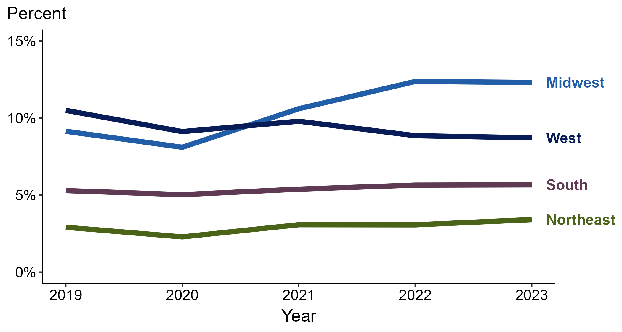
Primary and Secondary Syphilis — Percentage of Cases Reporting Injection Drug Use* by Region, United States, 2019–2023
*Percentage reporting injection drug use within the last 12 months calculated among cases with known data (cases with missing or unknown responses were excluded from the denominator).
Notes:
Among primary and secondary (P&S) syphilis cases reported in 2023, injection drug use was most frequently reported in the Midwest (12.3%), followed by the West (8.7%), South (5.7%), and Northeast (3.4%).
Comparing 2019 to 2023, the percentage of P&S syphilis cases that reported injection drug use increased in the Midwest (9.1% to 12.3%), remained stable in the Northeast (2.9% to 3.4%) and South (5.3% to 5.7%), and decreased in the West (10.5% to 8.7%).
This report includes data from years that coincide with the COVID-19 pandemic, which introduced uncertainty and difficulty in interpreting case data. See Impact of COVID-19 on STIs (https://www.cdc.gov/sti-statistics/about/impact-of-covid-19.html) for more information.
This figure presents trends in the proportion of cases reporting one or more selected behaviors. Although rounded percentages are presented in the figure interpretive text, values used for generating the figure may be more precise. A map of the US Census Regions is available in the last slide of this deck. Data points for the figures presented in these slides as well as Technical Notes about data sources, data collection and reporting practices, and case definitions are available at https://www.cdc.gov/sti-statistics/syphilis-supplement/index.html.

Slide 36
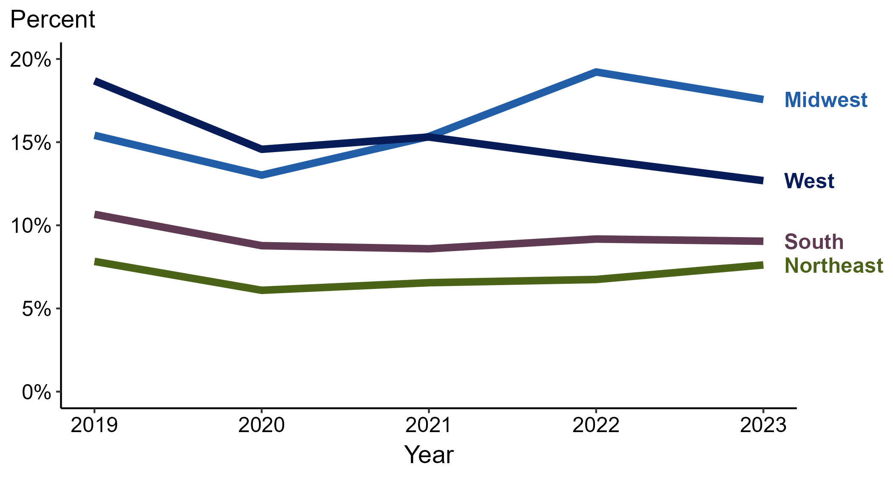
Primary and Secondary Syphilis — Percentage of Cases Reporting Injection Drug Use* Among Women by Region, United States, 2019–2023
*Percentage reporting injection drug use within the last 12 months calculated among cases with known data (cases with missing or unknown responses were excluded from the denominator).
Notes:
Among primary and secondary (P&S) syphilis cases reported among women in 2023, injection drug use was most frequently reported in the Midwest (17.6%), followed by the West (12.7%), South (9.0%), and Northeast (7.6%).
Comparing 2019 to 2023, the percentage of P&S syphilis cases among women that reported injection drug use increased in the Midwest (15.4% to 17.6%), remained stable in the Northeast (7.8% to 7.6%), and decreased in the South (10.7% to 9.0%) and West (18.7% to 12.7%).
This report includes data from years that coincide with the COVID-19 pandemic, which introduced uncertainty and difficulty in interpreting case data. See Impact of COVID-19 on STIs (https://www.cdc.gov/sti-statistics/about/impact-of-covid-19.html) for more information.
This figure presents trends in the proportion of cases reporting one or more selected behaviors. Although rounded percentages are presented in the figure interpretive text, values used for generating the figure may be more precise. A map of the US Census Regions is available in the last slide of this deck. Data points for the figures presented in these slides as well as Technical Notes about data sources, data collection and reporting practices, and case definitions are available at https://www.cdc.gov/sti-statistics/syphilis-supplement/index.html.

Slide 37
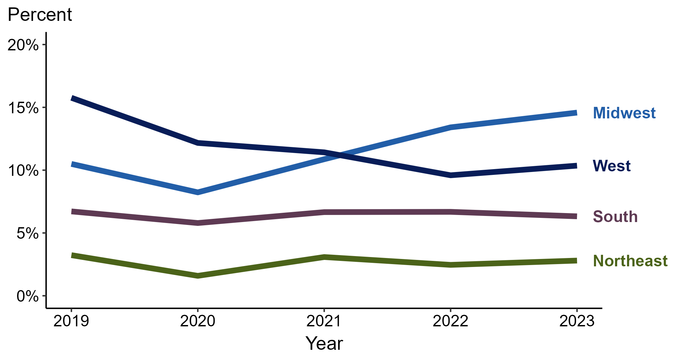
Primary and Secondary Syphilis — Percentage of Cases Reporting Injection Drug Use* Among MSW by Region, United States, 2019–2023
*Percentage reporting injection drug use within the last 12 months calculated among cases with known data (cases with missing or unknown responses were excluded from the denominator).
ACRONYMS: MSW = Men who have sex with women only
Notes:
Among primary and secondary (P&S) syphilis cases reported among men who have sex with women only (MSW) in 2023, injection drug use was most frequently reported in the Midwest (14.6%), followed by the West (10.4%), South (6.3%), and Northeast (2.8%).
Comparing 2019 to 2023, the percentage of P&S syphilis cases among MSW that reported injection drug use increased in the Midwest (10.5% to 14.6%), remained stable in the Northeast (3.2% to 2.8%) and South (6.7% to 6.3%), and decreased in the West (15.8% to 10.4%).
This report includes data from years that coincide with the COVID-19 pandemic, which introduced uncertainty and difficulty in interpreting case data. See Impact of COVID-19 on STIs (https://www.cdc.gov/sti-statistics/about/impact-of-covid-19.html) for more information.
This figure presents trends in the proportion of cases reporting one or more selected behaviors. Although rounded percentages are presented in the figure interpretive text, values used for generating the figure may be more precise. A map of the US Census Regions is available in the last slide of this deck. Data points for the figures presented in these slides as well as Technical Notes about data sources, data collection and reporting practices, and case definitions are available at https://www.cdc.gov/sti-statistics/syphilis-supplement/index.html.

Slide 38
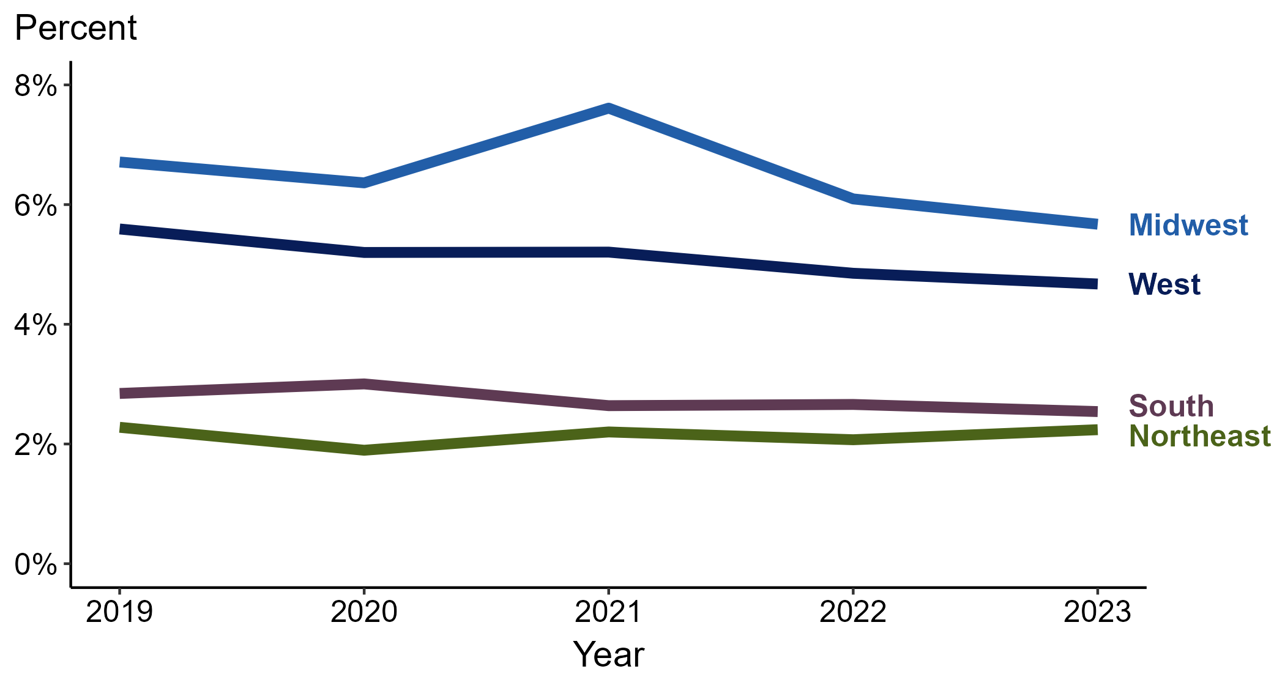
Primary and Secondary Syphilis — Percentage of Cases Reporting Injection Drug Use* Among MSM by Region, United States, 2019–2023
*Percentage reporting injection drug use within the last 12 months calculated among cases with known data (cases with missing or unknown responses were excluded from the denominator).
ACRONYMS: MSM = Men who have sex with men
Notes:
Among primary and secondary (P&S) syphilis cases reported among men who have sex with men (MSM) in 2023, injection drug use was most frequently reported in the Midwest (5.7%), followed by the West (4.7%), South (2.5%), and Northeast (2.2%).
Comparing 2019 to 2023, the percentage of P&S syphilis cases among MSM that reported injection drug use remained stable in the Northeast (2.3% to 2.2%), South (2.8% to 2.5%), and West (5.6% to 4.7%) and decreased in the Midwest (6.7% to 5.7%).
This report includes data from years that coincide with the COVID-19 pandemic, which introduced uncertainty and difficulty in interpreting case data. See Impact of COVID-19 on STIs (https://www.cdc.gov/sti-statistics/about/impact-of-covid-19.html) for more information.
This figure presents trends in the proportion of cases reporting one or more selected behaviors. Although rounded percentages are presented in the figure interpretive text, values used for generating the figure may be more precise. A map of the US Census Regions is available in the last slide of this deck. Data points for the figures presented in these slides as well as Technical Notes about data sources, data collection and reporting practices, and case definitions are available at https://www.cdc.gov/sti-statistics/syphilis-supplement/index.html.

Slide 39
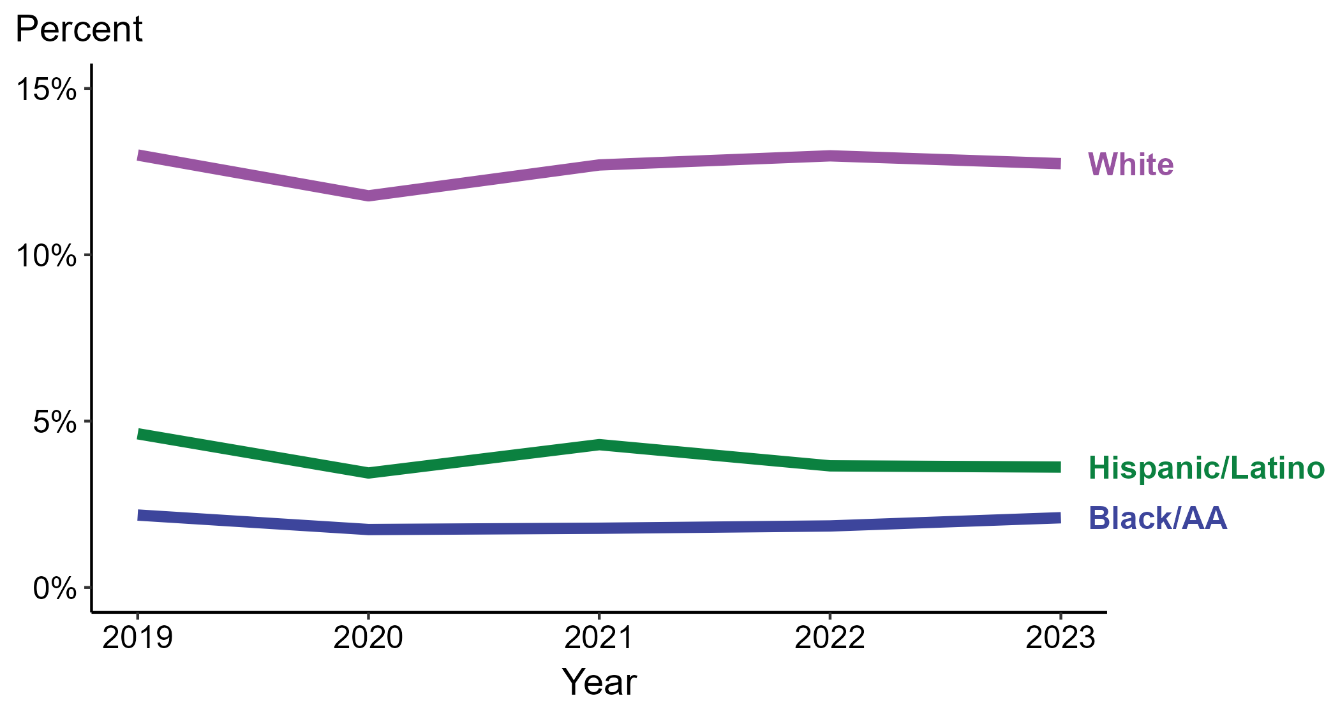
Primary and Secondary Syphilis — Percentage of Cases Reporting Injection Drug Use* by Race and Hispanic Ethnicity, United States, 2019–2023
*Percentage reporting injection drug use within the last 12 months calculated among cases with known data (cases with missing or unknown responses were excluded from the denominator).
ACRONYMS: Black/AA = Black or African American
Notes:
Among primary and secondary (P&S) syphilis cases reported in 2023, injection drug use was most frequently reported among non-Hispanic White persons (12.7%), followed by Hispanic or Latino persons (3.6%) and non-Hispanic Black or African American persons (2.1%).
Comparing 2019 to 2023, the percentage of P&S syphilis cases that reported injection drug use remained stable among all categories of race and Hispanic ethnicity displayed in the figure: Hispanic or Latino persons (4.6% to 3.6%), non-Hispanic Black or African American persons (2.2% to 2.1%), and non-Hispanic White persons (13.0% to 12.7%).
Of all P&S syphilis cases reported during 2019 to 2023, 88.8% with information on injection drug use were Hispanic or Latino, non-Hispanic Black or African American, or non-Hispanic White persons. Because the vast majority of cases fall in those racial and ethnic categories, only data for those groups are displayed in the figure.
This report includes data from years that coincide with the COVID-19 pandemic, which introduced uncertainty and difficulty in interpreting case data. See Impact of COVID-19 on STIs (https://www.cdc.gov/sti-statistics/about/impact-of-covid-19.html) for more information.
This figure presents trends in the proportion of cases reporting one or more selected behaviors. Although rounded percentages are presented in the figure interpretive text, values used for generating the figure may be more precise. Data points for the figures presented in these slides as well as Technical Notes about data sources, data collection and reporting practices, and case definitions are available at https://www.cdc.gov/sti-statistics/syphilis-supplement/index.html.

Slide 40
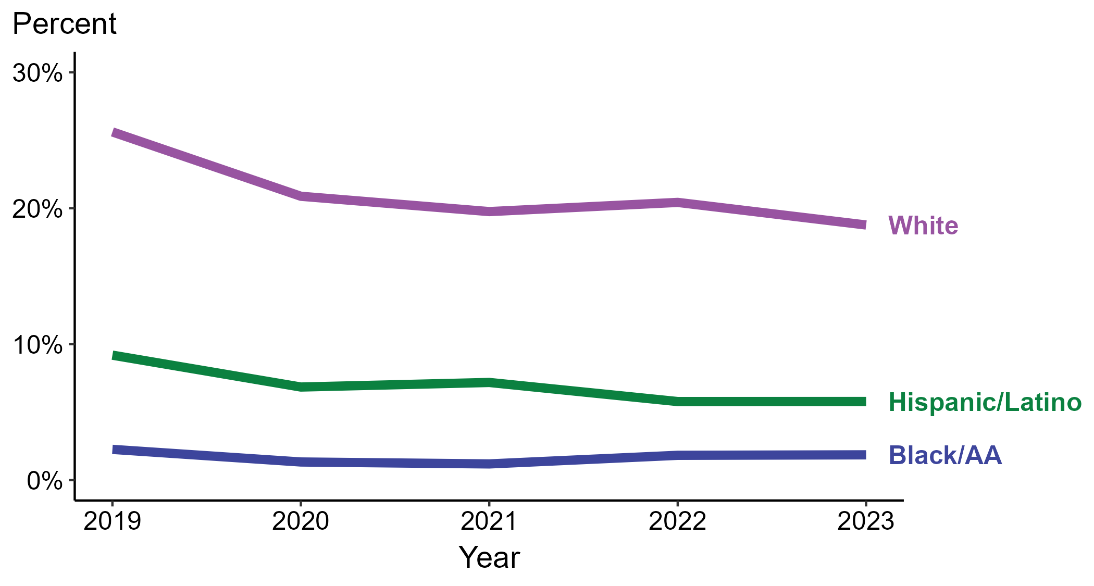
Primary and Secondary Syphilis — Percentage of Cases Reporting Injection Drug Use* Among Women by Race and Hispanic Ethnicity, United States, 2019–2023
*Percentage reporting injection drug use within the last 12 months calculated among cases with known data (cases with missing or unknown responses were excluded from the denominator).
ACRONYMS: Black/AA = Black or African American
Notes:
Among primary and secondary (P&S) syphilis cases reported among women in 2023, injection drug use was most frequently reported among non-Hispanic White women (18.8%), followed by Hispanic or Latino women (5.8%) and non-Hispanic Black or African American women (1.9%).
Comparing 2019 to 2023, the percentage of P&S syphilis cases among women that reported injection drug use remained stable among non-Hispanic Black or African American women (2.3% to 1.9%) and decreased among Hispanic or Latino women (9.2% to 5.8%) and non-Hispanic White women (25.6% to 18.8%).
Of all P&S syphilis cases reported among women during 2019 to 2023, 87.8% with information on injection drug use were Hispanic or Latino, non-Hispanic Black or African American, or non-Hispanic White women. Because the vast majority of cases fall in those racial and ethnic categories, only data for those groups are displayed in the figure.
This report includes data from years that coincide with the COVID-19 pandemic, which introduced uncertainty and difficulty in interpreting case data. See Impact of COVID-19 on STIs (https://www.cdc.gov/sti-statistics/about/impact-of-covid-19.html) for more information.
This figure presents trends in the proportion of cases reporting one or more selected behaviors. Although rounded percentages are presented in the figure interpretive text, values used for generating the figure may be more precise. Data points for the figures presented in these slides as well as Technical Notes about data sources, data collection and reporting practices, and case definitions are available at https://www.cdc.gov/sti-statistics/syphilis-supplement/index.html.

Slide 41
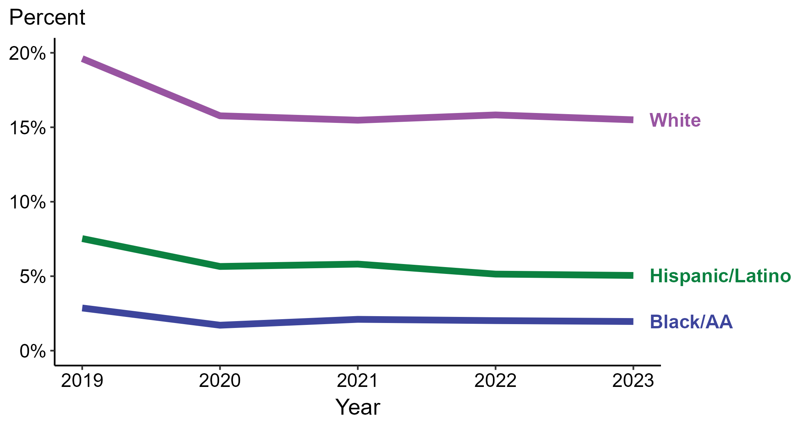
Primary and Secondary Syphilis — Percentage of Cases Reporting Injection Drug Use* Among MSW by Race and Hispanic Ethnicity, United States, 2019–2023
*Percentage reporting injection drug use within the last 12 months calculated among cases with known data (cases with missing or unknown responses were excluded from the denominator).
ACRONYMS: Black/AA = Black or African American; MSW = Men who have sex with women only
Notes:
Among primary and secondary (P&S) syphilis cases reported among men who have sex with women only (MSW) in 2023, injection drug use was most frequently reported among non-Hispanic White MSW (15.5%), followed by Hispanic or Latino MSW (5.1%) and non-Hispanic Black or African American MSW (2.0%).
Comparing 2019 to 2023, the percentage of P&S syphilis cases among MSW that reported injection drug use remained stable among non-Hispanic Black or African American MSW (2.9% to 2.0%) and decreased among Hispanic or Latino MSW (7.5% to 5.1%) and non-Hispanic White MSW (19.6% to 15.5%).
Of all P&S syphilis cases reported among MSW during 2019 to 2023, 89.2% with information on injection drug use were Hispanic or Latino, non-Hispanic Black or African American, or non-Hispanic White MSW. Because the vast majority of cases fall in those racial and ethnic categories, only data for those groups are displayed in the figure.
This report includes data from years that coincide with the COVID-19 pandemic, which introduced uncertainty and difficulty in interpreting case data. See Impact of COVID-19 on STIs (https://www.cdc.gov/sti-statistics/about/impact-of-covid-19.html) for more information.
This figure presents trends in the proportion of cases reporting one or more selected behaviors. Although rounded percentages are presented in the figure interpretive text, values used for generating the figure may be more precise. Data points for the figures presented in these slides as well as Technical Notes about data sources, data collection and reporting practices, and case definitions are available at https://www.cdc.gov/sti-statistics/syphilis-supplement/index.html.

Slide 42
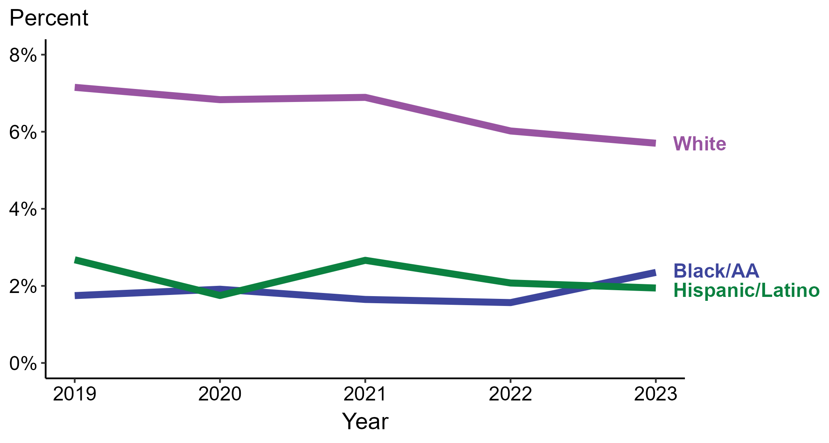
Primary and Secondary Syphilis — Percentage of Cases Reporting Injection Drug Use* Among MSM by Race and Hispanic Ethnicity, United States, 2019–2023
*Percentage reporting injection drug use within the last 12 months calculated among cases with known data (cases with missing or unknown responses were excluded from the denominator).
ACRONYMS: Black/AA = Black or African American; MSM = Men who have sex with men
Notes:
Among primary and secondary (P&S) syphilis cases reported among men who have sex with men (MSM) in 2023, injection drug use was most frequently reported among non-Hispanic White MSM (5.7%), followed by non-Hispanic Black or African American MSM (2.3%) and Hispanic or Latino MSM (1.9%).
Comparing 2019 to 2023, the percentage of P&S syphilis cases among MSM that reported injection drug use remained stable among Hispanic or Latino MSM (2.7% to 1.9%) and non-Hispanic Black or African American MSM (1.7% to 2.3%) and decreased among non-Hispanic White MSM (7.2% to 5.7%).
Of all P&S syphilis cases reported among MSM during 2019 to 2023, 89.2% with information on injection drug use were Hispanic or Latino, non-Hispanic Black or African American, or non-Hispanic White MSM. Because the vast majority of cases fall in those racial and ethnic categories, only data for those groups are displayed in the figure.
This report includes data from years that coincide with the COVID-19 pandemic, which introduced uncertainty and difficulty in interpreting case data. See Impact of COVID-19 on STIs (https://www.cdc.gov/sti-statistics/about/impact-of-covid-19.html) for more information.
This figure presents trends in the proportion of cases reporting one or more selected behaviors. Although rounded percentages are presented in the figure interpretive text, values used for generating the figure may be more precise. Data points for the figures presented in these slides as well as Technical Notes about data sources, data collection and reporting practices, and case definitions are available at https://www.cdc.gov/sti-statistics/syphilis-supplement/index.html.

Slide 43
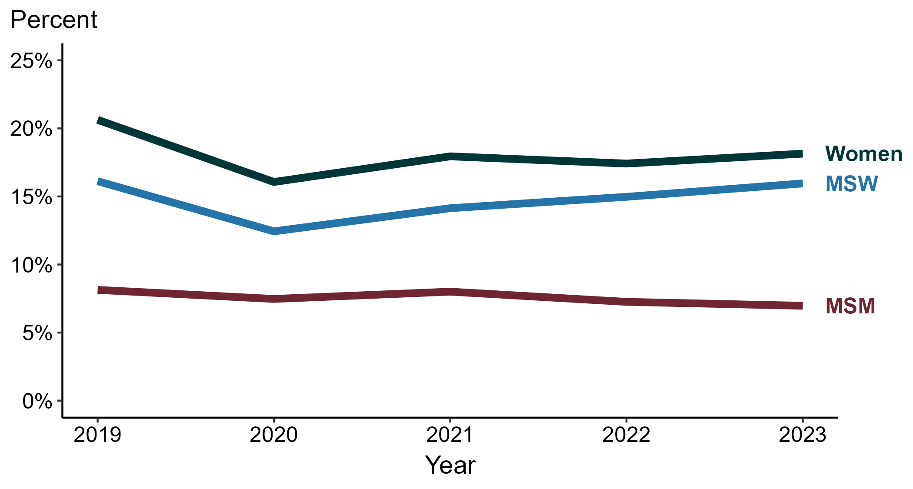
Primary and Secondary Syphilis — Percentage of Cases Reporting Methamphetamine Use* by Sex and Sex of Sex Partners, United States, 2019–2023
*Percentage reporting methamphetamine use within the last 12 months calculated among cases with known data (cases with missing or unknown responses were excluded from the denominator).
ACRONYMS: MSM = Men who have sex with men; MSW = Men who have sex with women only
Notes:
Among primary and secondary (P&S) syphilis cases reported in 2023, methamphetamine use was most frequently reported among women (18.1%), followed by men who have sex with women only (MSW; 16.0%) and men who have sex with men (MSM; 7.0%).
Comparing 2019 to 2023, the percentage of P&S syphilis cases that reported methamphetamine use remained stable among MSW (16.1% to 16.0%) and decreased among MSM (8.1% to 7.0%) and women (20.6% to 18.1%).
This report includes data from years that coincide with the COVID-19 pandemic, which introduced uncertainty and difficulty in interpreting case data. See Impact of COVID-19 on STIs (https://www.cdc.gov/sti-statistics/about/impact-of-covid-19.html) for more information.
This figure presents trends in the proportion of cases reporting one or more selected behaviors. Although rounded percentages are presented in the figure interpretive text, values used for generating the figure may be more precise. Data points for the figures presented in these slides as well as Technical Notes about data sources, data collection and reporting practices, and case definitions are available at https://www.cdc.gov/sti-statistics/syphilis-supplement/index.html.

Slide 44
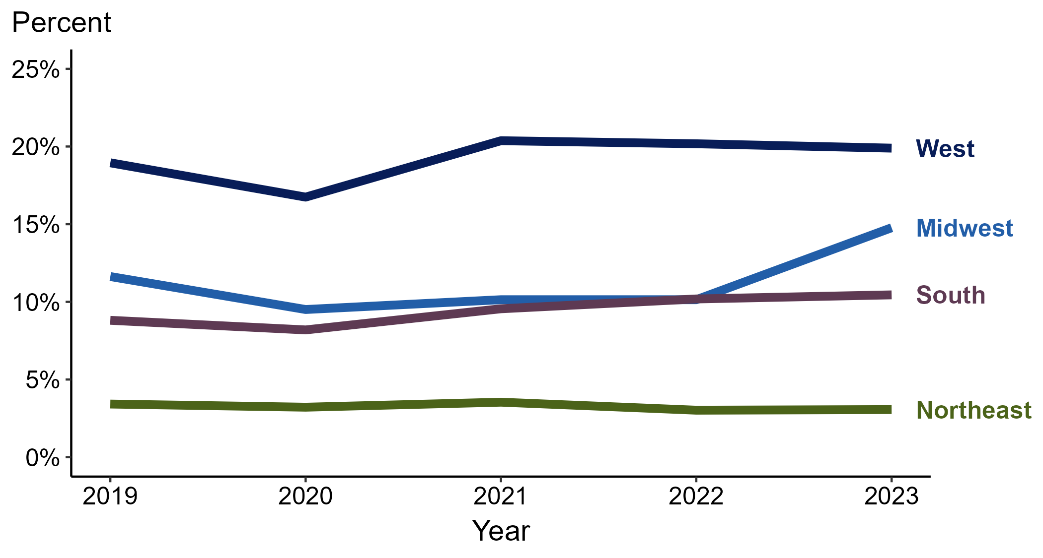
Primary and Secondary Syphilis — Percentage of Cases Reporting Methamphetamine Use* by Region, United States, 2019–2023
*Percentage reporting methamphetamine use within the last 12 months calculated among cases with known data (cases with missing or unknown responses were excluded from the denominator).
Notes:
Among primary and secondary (P&S) syphilis cases reported in 2023, methamphetamine use was most frequently reported in the West (19.9%), followed by the Midwest (14.8%), South (10.4%), and Northeast (3.1%).
Comparing 2019 to 2023, the percentage of P&S syphilis cases that reported methamphetamine use increased in the Midwest (11.6% to 14.8%) and South (8.8% to 10.4%) and remained stable in the Northeast (3.4% to 3.1%) and West (19.0% to 19.9%).
This report includes data from years that coincide with the COVID-19 pandemic, which introduced uncertainty and difficulty in interpreting case data. See Impact of COVID-19 on STIs (https://www.cdc.gov/sti-statistics/about/impact-of-covid-19.html) for more information.
This figure presents trends in the proportion of cases reporting one or more selected behaviors. Although rounded percentages are presented in the figure interpretive text, values used for generating the figure may be more precise. A map of the US Census Regions is available in the last slide of this deck. Data points for the figures presented in these slides as well as Technical Notes about data sources, data collection and reporting practices, and case definitions are available at https://www.cdc.gov/sti-statistics/syphilis-supplement/index.html.

Slide 45
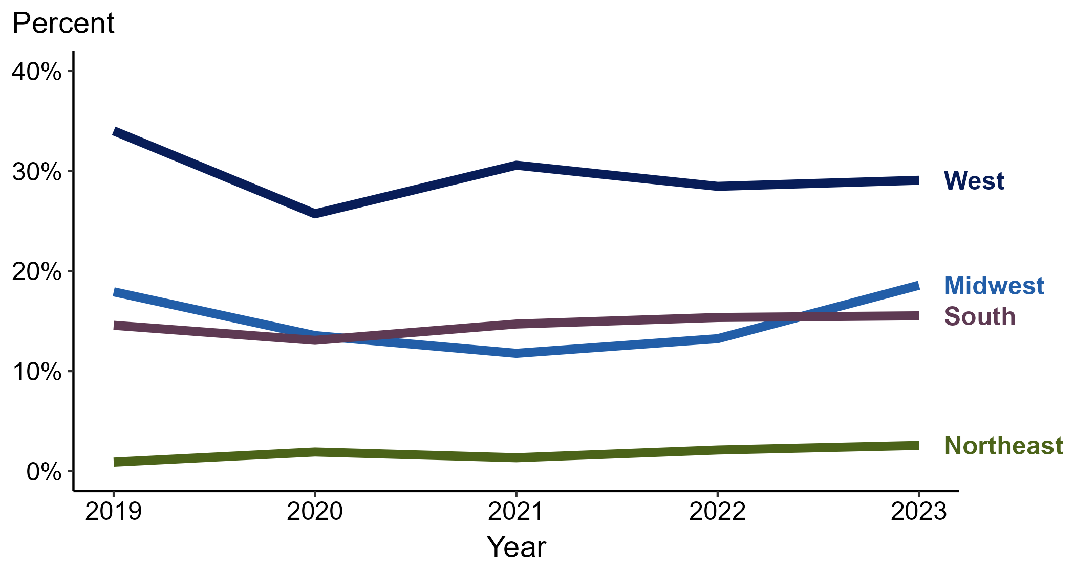
Primary and Secondary Syphilis — Percentage of Cases Reporting Methamphetamine Use* Among Women by Region, United States, 2019–2023
*Percentage reporting methamphetamine use within the last 12 months calculated among cases with known data (cases with missing or unknown responses were excluded from the denominator).
Notes:
Among primary and secondary (P&S) syphilis cases reported among women in 2023, methamphetamine use was most frequently reported in the West (29.1%), followed by the Midwest (18.6%), South (15.5%), and Northeast (2.6%).
Comparing 2019 to 2023, the percentage of P&S syphilis cases among women that reported methamphetamine use increased in the Northeast (0.9% to 2.6%), remained stable in the Midwest (17.9% to 18.6%) and South (14.6% to 15.5%), and decreased in the West (34.0% to 29.1%).
This report includes data from years that coincide with the COVID-19 pandemic, which introduced uncertainty and difficulty in interpreting case data. See Impact of COVID-19 on STIs (https://www.cdc.gov/sti-statistics/about/impact-of-covid-19.html) for more information.
This figure presents trends in the proportion of cases reporting one or more selected behaviors. Although rounded percentages are presented in the figure interpretive text, values used for generating the figure may be more precise. A map of the US Census Regions is available in the last slide of this deck. Data points for the figures presented in these slides as well as Technical Notes about data sources, data collection and reporting practices, and case definitions are available at https://www.cdc.gov/sti-statistics/syphilis-supplement/index.html.

Slide 46
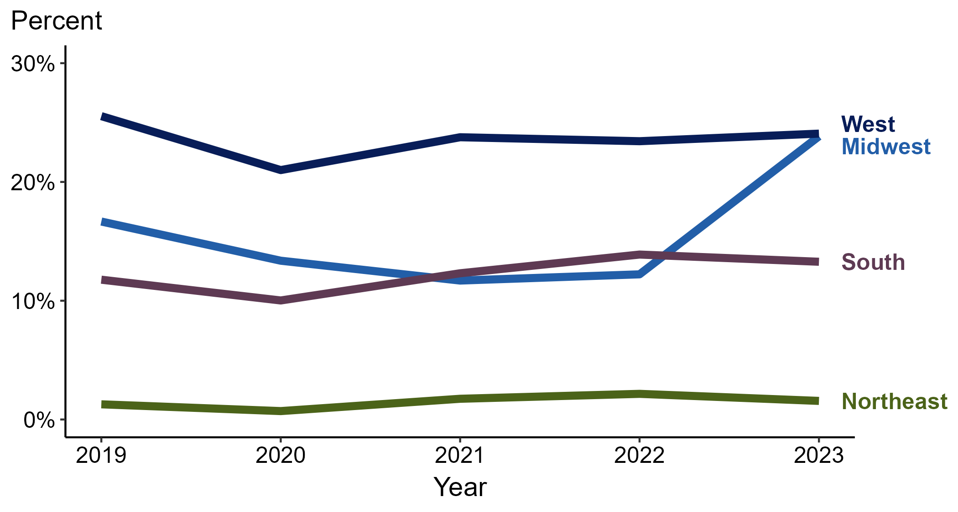
Primary and Secondary Syphilis — Percentage of Cases Reporting Methamphetamine Use* Among MSW by Region, United States, 2019–2023
*Percentage reporting methamphetamine use within the last 12 months calculated among cases with known data (cases with missing or unknown responses were excluded from the denominator).
ACRONYMS: MSW = Men who have sex with women only
Notes:
Among primary and secondary (P&S) syphilis cases reported among men who have sex with women only (MSW) in 2023, methamphetamine use was most frequently reported in the West (24.1%), followed by the Midwest (23.8%), South (13.3%), and Northeast (1.6%).
Comparing 2019 to 2023, the percentage of P&S syphilis cases among MSW that reported methamphetamine use increased in the Midwest (16.7% to 23.8%) and South (11.8% to 13.3%), remained stable in the Northeast (1.3% to 1.6%), and decreased in the West (25.5% to 24.1%).
This report includes data from years that coincide with the COVID-19 pandemic, which introduced uncertainty and difficulty in interpreting case data. See Impact of COVID-19 on STIs (https://www.cdc.gov/sti-statistics/about/impact-of-covid-19.html) for more information.
This figure presents trends in the proportion of cases reporting one or more selected behaviors. Although rounded percentages are presented in the figure interpretive text, values used for generating the figure may be more precise. A map of the US Census Regions is available in the last slide of this deck. Data points for the figures presented in these slides as well as Technical Notes about data sources, data collection and reporting practices, and case definitions are available at https://www.cdc.gov/sti-statistics/syphilis-supplement/index.html.

Slide 47
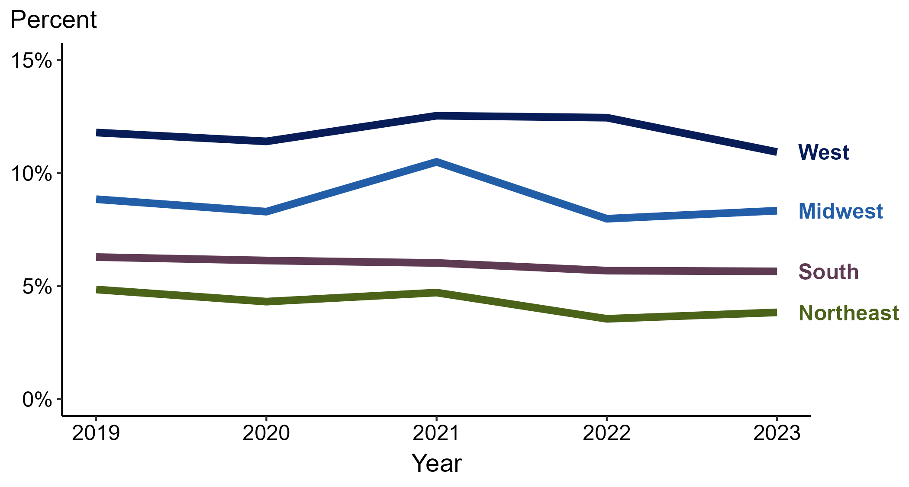
Primary and Secondary Syphilis — Percentage of Cases Reporting Methamphetamine Use* Among MSM by Region, United States, 2019–2023
*Percentage reporting methamphetamine use within the last 12 months calculated among cases with known data (cases with missing or unknown responses were excluded from the denominator).
ACRONYMS: MSM = Men who have sex with men
Notes:
Among primary and secondary (P&S) syphilis cases reported among men who have sex with men (MSM) in 2023, methamphetamine use was most frequently reported in the West (10.9%), followed by the Midwest (8.3%), South (5.6%), and Northeast (3.8%).
Comparing 2019 to 2023, the percentage of P&S syphilis cases among MSM that reported methamphetamine use remained stable in the Midwest (8.8% to 8.3%), South (6.3% to 5.6%), and West (11.8% to 10.9%) and decreased in the Northeast (4.8% to 3.8%).
This report includes data from years that coincide with the COVID-19 pandemic, which introduced uncertainty and difficulty in interpreting case data. See Impact of COVID-19 on STIs (https://www.cdc.gov/sti-statistics/about/impact-of-covid-19.html) for more information.
This figure presents trends in the proportion of cases reporting one or more selected behaviors. Although rounded percentages are presented in the figure interpretive text, values used for generating the figure may be more precise. A map of the US Census Regions is available in the last slide of this deck. Data points for the figures presented in these slides as well as Technical Notes about data sources, data collection and reporting practices, and case definitions are available at https://www.cdc.gov/sti-statistics/syphilis-supplement/index.html.

Slide 48
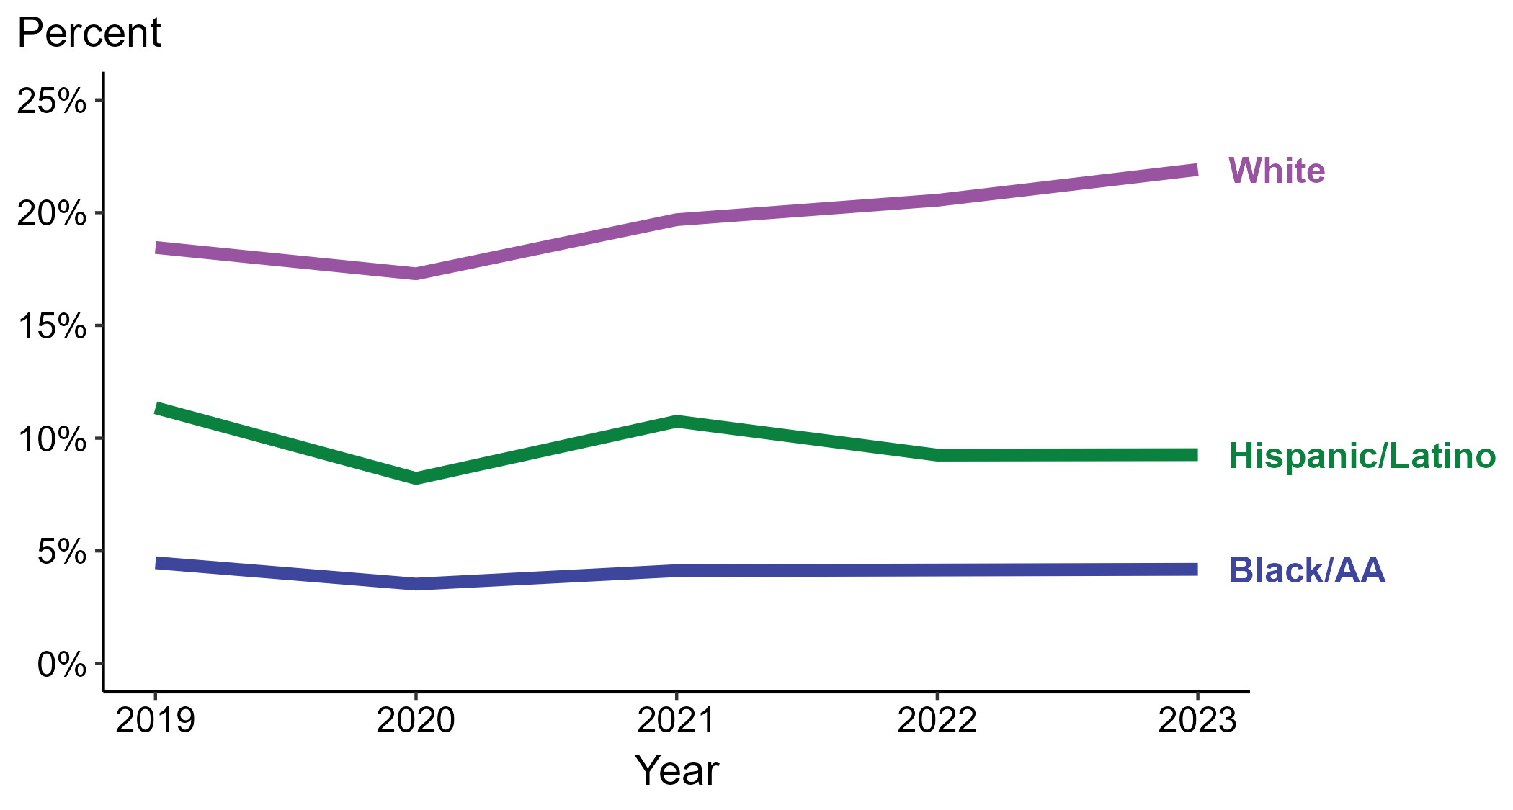
Primary and Secondary Syphilis — Percentage of Cases Reporting Methamphetamine Use* by Race and Hispanic Ethnicity, United States, 2019–2023
*Percentage reporting methamphetamine use within the last 12 months calculated among cases with known data (cases with missing or unknown responses were excluded from the denominator).
ACRONYMS: Black/AA = Black or African American
Notes:
Among primary and secondary (P&S) syphilis cases reported in 2023, methamphetamine use was most frequently reported among non-Hispanic White persons (21.9%), followed by Hispanic or Latino persons (9.3%) and non-Hispanic Black or African American persons (4.2%).
Comparing 2019 to 2023, the percentage of P&S syphilis cases that reported methamphetamine use increased among non-Hispanic White persons (18.5% to 21.9%), remained stable among non-Hispanic Black or African American persons (4.5% to 4.2%), and decreased among Hispanic or Latino persons (11.3% to 9.3%).
Of all P&S syphilis cases reported during 2019 to 2023, 87.4% with information on methamphetamine use were Hispanic or Latino, non-Hispanic Black or African American, or non-Hispanic White persons. Because the vast majority of cases fall in those racial and ethnic categories, only data for those groups are displayed in the figure.
This report includes data from years that coincide with the COVID-19 pandemic, which introduced uncertainty and difficulty in interpreting case data. See Impact of COVID-19 on STIs (https://www.cdc.gov/sti-statistics/about/impact-of-covid-19.html) for more information.
This figure presents trends in the proportion of cases reporting one or more selected behaviors. Although rounded percentages are presented in the figure interpretive text, values used for generating the figure may be more precise. Data points for the figures presented in these slides as well as Technical Notes about data sources, data collection and reporting practices, and case definitions are available at https://www.cdc.gov/sti-statistics/syphilis-supplement/index.html.

Slide 49
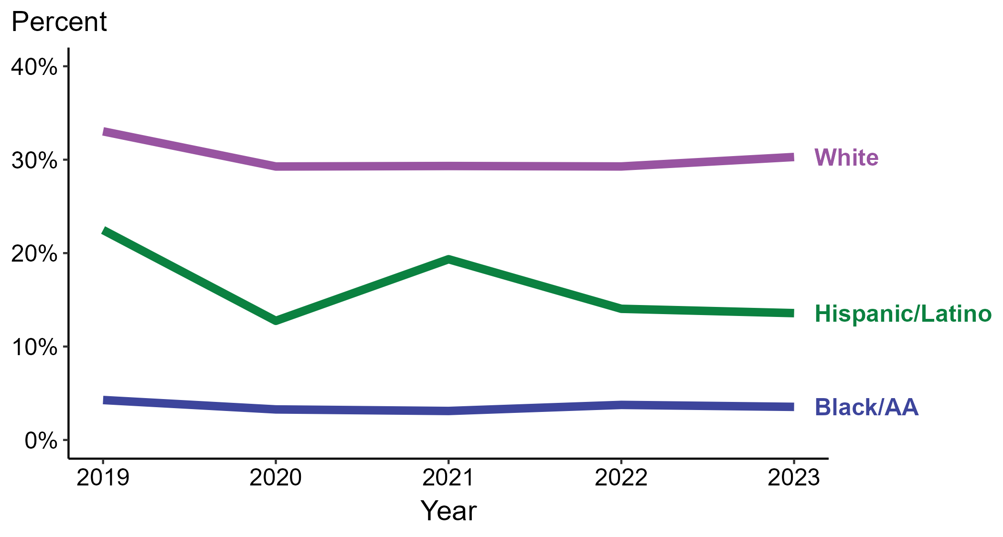
Primary and Secondary Syphilis — Percentage of Cases Reporting Methamphetamine Use* Among Women by Race and Hispanic Ethnicity, United States, 2019–2023
*Percentage reporting methamphetamine use within the last 12 months calculated among cases with known data (cases with missing or unknown responses were excluded from the denominator).
ACRONYMS: Black/AA = Black or African American
Notes:
Among primary and secondary (P&S) syphilis cases reported among women in 2023, methamphetamine use was most frequently reported among non-Hispanic White women (30.3%), followed by Hispanic or Latino women (13.6%) and non-Hispanic Black or African American women (3.5%).
Comparing 2019 to 2023, the percentage of P&S syphilis cases among women that reported methamphetamine use remained stable among non-Hispanic Black or African American women (4.3% to 3.5%) and decreased among Hispanic or Latino women (22.5% to 13.6%) and non-Hispanic White women (33.0% to 30.3%).
Of all P&S syphilis cases reported among women during 2019 to 2023, 86.9% with information on methamphetamine use were Hispanic or Latino, non-Hispanic Black or African American, or non-Hispanic White women. Because the vast majority of cases fall in those racial and ethnic categories, only data for those groups are displayed in the figure.
This report includes data from years that coincide with the COVID-19 pandemic, which introduced uncertainty and difficulty in interpreting case data. See Impact of COVID-19 on STIs (https://www.cdc.gov/sti-statistics/about/impact-of-covid-19.html) for more information.
This figure presents trends in the proportion of cases reporting one or more selected behaviors. Although rounded percentages are presented in the figure interpretive text, values used for generating the figure may be more precise. Data points for the figures presented in these slides as well as Technical Notes about data sources, data collection and reporting practices, and case definitions are available at https://www.cdc.gov/sti-statistics/syphilis-supplement/index.html.

Slide 50
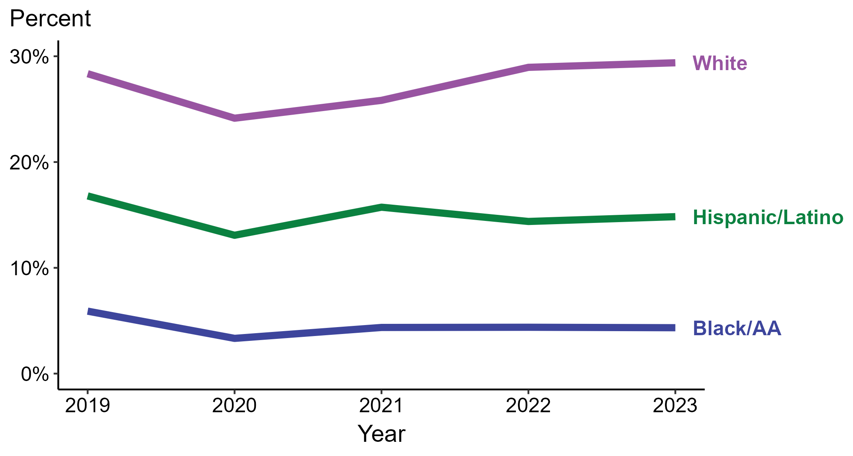
Primary and Secondary Syphilis — Percentage of Cases Reporting Methamphetamine Use* Among MSW by Race and Hispanic Ethnicity, United States, 2019–2023
*Percentage reporting methamphetamine use within the last 12 months calculated among cases with known data (cases with missing or unknown responses were excluded from the denominator).
ACRONYMS: Black/AA = Black or African American; MSW = Men who have sex with women only
Notes:
Among primary and secondary (P&S) syphilis cases reported among men who have sex with women only (MSW) in 2023, methamphetamine use was most frequently reported among non-Hispanic White MSW (29.4%), followed by Hispanic or Latino MSW (14.8%) and non-Hispanic Black or African American MSW (4.3%).
Comparing 2019 to 2023, the percentage of P&S syphilis cases among MSW that reported methamphetamine use increased among non-Hispanic White MSW (28.4% to 29.4%) and decreased among Hispanic or Latino MSW (16.8% to 14.8%) and non-Hispanic Black or African American MSW (5.9% to 4.3%).
Of all P&S syphilis cases reported among MSW during 2019 to 2023, 88.7% with information on methamphetamine use were Hispanic or Latino, non-Hispanic Black or African American, or non-Hispanic White MSW. Because the vast majority of cases fall in those racial and ethnic categories, only data for those groups are displayed in the figure.
This report includes data from years that coincide with the COVID-19 pandemic, which introduced uncertainty and difficulty in interpreting case data. See Impact of COVID-19 on STIs (https://www.cdc.gov/sti-statistics/about/impact-of-covid-19.html) for more information.
This figure presents trends in the proportion of cases reporting one or more selected behaviors. Although rounded percentages are presented in the figure interpretive text, values used for generating the figure may be more precise. Data points for the figures presented in these slides as well as Technical Notes about data sources, data collection and reporting practices, and case definitions are available at https://www.cdc.gov/sti-statistics/syphilis-supplement/index.html.

Slide 51
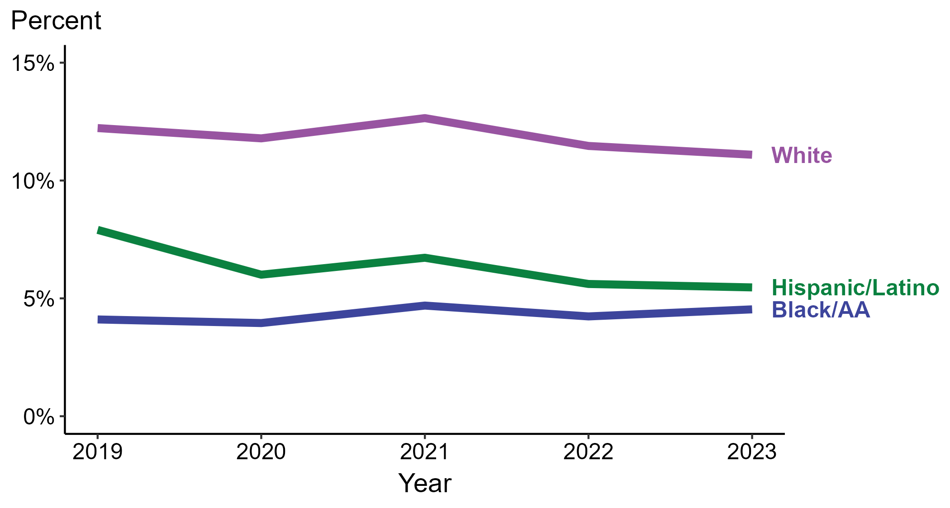
Primary and Secondary Syphilis — Percentage of Cases Reporting Methamphetamine Use* Among MSM by Race and Hispanic Ethnicity, United States, 2019–2023
*Percentage reporting methamphetamine use within the last 12 months calculated among cases with known data (cases with missing or unknown responses were excluded from the denominator).
ACRONYMS: Black/AA = Black or African American; MSM = Men who have sex with men
Notes:
Among primary and secondary (P&S) syphilis cases reported among men who have sex with men (MSM) in 2023, methamphetamine use was most frequently reported among non-Hispanic White MSM (11.1%), followed by Hispanic or Latino MSM (5.5%) and non-Hispanic Black or African American MSM (4.5%).
Comparing 2019 to 2023, the percentage of P&S syphilis cases among MSM that reported methamphetamine use remained stable among non-Hispanic Black or African American MSM (4.1% to 4.5%) and decreased among Hispanic or Latino MSM (7.9% to 5.5%) and non-Hispanic White MSM (12.2% to 11.1%).
Of all P&S syphilis cases reported among MSM during 2019 to 2023, 87.7% with information on methamphetamine use were Hispanic or Latino, non-Hispanic Black or African American, or non-Hispanic White MSM. Because the vast majority of cases fall in those racial and ethnic categories, only data for those groups are displayed in the figure.
This report includes data from years that coincide with the COVID-19 pandemic, which introduced uncertainty and difficulty in interpreting case data. See Impact of COVID-19 on STIs (https://www.cdc.gov/sti-statistics/about/impact-of-covid-19.html) for more information.
This figure presents trends in the proportion of cases reporting one or more selected behaviors. Although rounded percentages are presented in the figure interpretive text, values used for generating the figure may be more precise. Data points for the figures presented in these slides as well as Technical Notes about data sources, data collection and reporting practices, and case definitions are available at https://www.cdc.gov/sti-statistics/syphilis-supplement/index.html.

Slide 52

Primary and Secondary Syphilis — Percentage of Cases Reporting Selected Sexual Behaviors*, United States, 2019–2023
*Percentage reporting sex with PWID, sex with anonymous partners, sex while intoxicated/high on drugs, or exchange sex for drugs or money within the last 12 months calculated among cases with known data (cases with missing or unknown responses were excluded from the denominator).
ACRONYMS: PWID = Persons who inject drugs
Notes:
Among primary and secondary (P&S) syphilis cases reported in 2023, the most frequently reported sexual behavior was sex with anonymous partners (41.2%), followed by sex while intoxicated and/or high on drugs (34.8%), sex with a person who injects drugs (8.7%), and exchange sex for drugs or money (5.6%).
Comparing reported sexual behaviors for P&S syphilis cases in 2019 to 2023, the percentage remained stable for reported exchange sex for drugs or money (6.2% to 5.6%), sex while intoxicated and/or high on drugs (35.3% to 34.8%), and sex with a person who injects drugs (8.2% to 8.7%) and decreased for reported sex with anonymous partners (51.5% to 41.2%).
This report includes data from years that coincide with the COVID-19 pandemic, which introduced uncertainty and difficulty in interpreting case data. See Impact of COVID-19 on STIs (https://www.cdc.gov/sti-statistics/about/impact-of-covid-19.html) for more information.
This figure presents trends in the proportion of cases reporting one or more selected behaviors. Although rounded percentages are presented in the figure interpretive text, values used for generating the figure may be more precise. Data points for the figures presented in these slides as well as Technical Notes about data sources, data collection and reporting practices, and case definitions are available at https://www.cdc.gov/sti-statistics/syphilis-supplement/index.html.

Slide 53

Primary and Secondary Syphilis — Percentage of Cases Reporting Selected Sexual Behaviors* Among Women, United States, 2019–2023
*Percentage reporting sex with PWID, sex with anonymous partners, sex while intoxicated/high on drugs, or exchange sex for drugs or money within the last 12 months calculated among cases with known data (cases with missing or unknown responses were excluded from the denominator).
ACRONYMS: PWID = Persons who inject drugs; MSM = Men who have sex with men
Notes:
Among primary and secondary (P&S) syphilis cases reported among women in 2023, the most frequently reported sexual behaviors were sex while intoxicated and/or high on drugs (37.2%), followed by sex with anonymous partners (19.9%), sex with a person who injects drugs (12.7%), exchange sex for drugs or money (7.7%), and sex with a man who has sex with men (6.0%).
Comparing reported sexual behaviors for P&S syphilis cases among women in 2019 to 2023, the percentage increased for reported sex with a man who has sex with men (4.6% to 6.0%) and decreased for reported exchange sex for drugs or money (10.6% to 7.7%), sex while intoxicated and/or high on drugs (39.6% to 37.2%), sex with a person who injects drugs (15.2% to 12.7%), and sex with anonymous partners (24.0% to 19.9%).
This report includes data from years that coincide with the COVID-19 pandemic, which introduced uncertainty and difficulty in interpreting case data. See Impact of COVID-19 on STIs (https://www.cdc.gov/sti-statistics/about/impact-of-covid-19.html) for more information.
This figure presents trends in the proportion of cases reporting one or more selected behaviors. Although rounded percentages are presented in the figure interpretive text, values used for generating the figure may be more precise. Data points for the figures presented in these slides as well as Technical Notes about data sources, data collection and reporting practices, and case definitions are available at https://www.cdc.gov/sti-statistics/syphilis-supplement/index.html.

Slide 54

Primary and Secondary Syphilis — Percentage of Cases Reporting Selected Sexual Behaviors* Among MSW, United States, 2019–2023
*Percentage reporting sex with PWID, sex with anonymous partners, sex while intoxicated/high on drugs, or exchange sex for drugs or money within the last 12 months calculated among cases with known data (cases with missing or unknown responses were excluded from the denominator).
ACRONYMS: PWID = Persons who inject drugs; MSW = Men who have sex with women only
Notes:
Among primary and secondary (P&S) syphilis cases reported among men who have sex with women only (MSW) in 2023, the most frequently reported sexual behaviors were sex while intoxicated and/or high on drugs (41.0%), followed by sex with anonymous partners (37.1%), sex with a person who injects drugs (10.2%), and exchange sex for drugs or money (6.6%).
Comparing reported sexual behaviors for P&S syphilis cases among MSW in 2019 to 2023, the percentage decreased for all behaviors: reported exchange sex for drugs or money (9.3% to 6.6%), sex while intoxicated and/or high on drugs (44.5% to 41.0%), sex with a person who injects drugs (11.3% to 10.2%), and sex with anonymous partners (44.9% to 37.1%).
This report includes data from years that coincide with the COVID-19 pandemic, which introduced uncertainty and difficulty in interpreting case data. See Impact of COVID-19 on STIs (https://www.cdc.gov/sti-statistics/about/impact-of-covid-19.html) for more information.
This figure presents trends in the proportion of cases reporting one or more selected behaviors. Although rounded percentages are presented in the figure interpretive text, values used for generating the figure may be more precise. Data points for the figures presented in these slides as well as Technical Notes about data sources, data collection and reporting practices, and case definitions are available at https://www.cdc.gov/sti-statistics/syphilis-supplement/index.html.

Slide 55

Primary and Secondary Syphilis — Percentage of Cases Reporting Selected Sexual Behaviors* Among MSM, United States, 2019–2023
*Percentage reporting sex with PWID, sex with anonymous partners, sex while intoxicated/high on drugs, or exchange sex for drugs or money within the last 12 months calculated among cases with known data (cases with missing or unknown responses were excluded from the denominator).
ACRONYMS: PWID = Persons who inject drugs; MSM = Men who have sex with men
Notes:
Among primary and secondary (P&S) syphilis cases reported among men who have sex with men (MSM) in 2023, the most frequently reported sexual behavior was sex with anonymous partners (59.0%), followed by sex while intoxicated and/or high on drugs (29.2%), sex with a person who injects drugs (5.0%), and exchange sex for drugs or money (3.6%).
Comparing reported sexual behaviors for P&S syphilis cases among MSM in 2019 to 2023, the percentage remained stable for reported exchange sex for drugs or money (3.7% to 3.6%) and sex with a person who injects drugs (5.1% to 5.0%) and decreased for reported sex while intoxicated and/or high on drugs (31.4% to 29.2%) and sex with anonymous partners (62.7% to 59.0%).
This report includes data from years that coincide with the COVID-19 pandemic, which introduced uncertainty and difficulty in interpreting case data. See Impact of COVID-19 on STIs (https://www.cdc.gov/sti-statistics/about/impact-of-covid-19.html) for more information.
This figure presents trends in the proportion of cases reporting one or more selected behaviors. Although rounded percentages are presented in the figure interpretive text, values used for generating the figure may be more precise. Data points for the figures presented in these slides as well as Technical Notes about data sources, data collection and reporting practices, and case definitions are available at https://www.cdc.gov/sti-statistics/syphilis-supplement/index.html.

Slide 56

Primary and Secondary Syphilis — Percentage of Cases Reporting Exchange Sex for Drugs or Money* by Sex and Sex of Sex Partners, United States, 2019–2023
*Percentage reporting exchange sex for drugs or money within the last 12 months calculated among cases with known data (cases with missing or unknown responses were excluded from the denominator).
ACRONYMS: MSM = Men who have sex with men; MSW = Men who have sex with women only
Notes:
Among primary and secondary (P&S) syphilis cases reported in 2023, exchange sex for drugs or money was most frequently reported among women (7.7%), followed by men who have sex with women only (MSW; 6.6%) and men who have sex with men (MSM; 3.6%).
Comparing 2019 to 2023, the percentage of P&S syphilis cases that reported exchange sex for drugs or money remained stable among MSM (3.7% to 3.6%) and decreased among MSW (9.3% to 6.6%) and women (10.6% to 7.7%).
This report includes data from years that coincide with the COVID-19 pandemic, which introduced uncertainty and difficulty in interpreting case data. See Impact of COVID-19 on STIs (https://www.cdc.gov/sti-statistics/about/impact-of-covid-19.html) for more information.
This figure presents trends in the proportion of cases reporting one or more selected behaviors. Although rounded percentages are presented in the figure interpretive text, values used for generating the figure may be more precise. Data points for the figures presented in these slides as well as Technical Notes about data sources, data collection and reporting practices, and case definitions are available at https://www.cdc.gov/sti-statistics/syphilis-supplement/index.html.

Slide 57

Primary and Secondary Syphilis — Percentage of Cases Reporting Exchange Sex for Drugs or Money* by Region, United States, 2019–2023
*Percentage reporting exchange sex for drugs or money within the last 12 months calculated among cases with known data (cases with missing or unknown responses were excluded from the denominator).
Notes:
Among primary and secondary (P&S) syphilis cases reported in 2023, exchange sex for drugs or money was most frequently reported in the Midwest (6.2%), followed by the Northeast (6.1%), South (5.7%), and West (4.9%).
Comparing 2019 to 2023, the percentage of P&S syphilis cases that reported exchange sex for drugs or money increased in the Northeast (4.1% to 6.1%), remained stable in the Midwest (6.7% to 6.2%), and decreased in the South (6.7% to 5.7%) and West (5.9% to 4.9%).
This report includes data from years that coincide with the COVID-19 pandemic, which introduced uncertainty and difficulty in interpreting case data. See Impact of COVID-19 on STIs (https://www.cdc.gov/sti-statistics/about/impact-of-covid-19.html) for more information.
This figure presents trends in the proportion of cases reporting one or more selected behaviors. Although rounded percentages are presented in the figure interpretive text, values used for generating the figure may be more precise. A map of the US Census Regions is available in the last slide of this deck. Data points for the figures presented in these slides as well as Technical Notes about data sources, data collection and reporting practices, and case definitions are available at https://www.cdc.gov/sti-statistics/syphilis-supplement/index.html.

Slide 58

Primary and Secondary Syphilis — Percentage of Cases Reporting Exchange Sex for Drugs or Money* Among Women by Region, United States, 2019–2023
*Percentage reporting exchange sex for drugs or money within the last 12 months calculated among cases with known data (cases with missing or unknown responses were excluded from the denominator).
Notes:
Among primary and secondary (P&S) syphilis cases reported among women in 2023, exchange sex for drugs or money was most frequently reported in the Northeast (9.9%), followed by the South (7.6%), West (7.5%), and Midwest (7.3%).
Comparing 2019 to 2023, the percentage of P&S syphilis cases among women that reported exchange sex for drugs or money remained stable in the Northeast (9.6% to 9.9%) and decreased in the Midwest (10.9% to 7.3%), South (11.3% to 7.6%), and West (9.7% to 7.5%).
This report includes data from years that coincide with the COVID-19 pandemic, which introduced uncertainty and difficulty in interpreting case data. See Impact of COVID-19 on STIs (https://www.cdc.gov/sti-statistics/about/impact-of-covid-19.html) for more information.
This figure presents trends in the proportion of cases reporting one or more selected behaviors. Although rounded percentages are presented in the figure interpretive text, values used for generating the figure may be more precise. A map of the US Census Regions is available in the last slide of this deck. Data points for the figures presented in these slides as well as Technical Notes about data sources, data collection and reporting practices, and case definitions are available at https://www.cdc.gov/sti-statistics/syphilis-supplement/index.html.

Slide 59

Primary and Secondary Syphilis — Percentage of Cases Reporting Exchange Sex for Drugs or Money* Among MSW by Region, United States, 2019–2023
*Percentage reporting exchange sex for drugs or money within the last 12 months calculated among cases with known data (cases with missing or unknown responses were excluded from the denominator).
ACRONYMS: MSW = Men who have sex with women only
Notes:
Among primary and secondary (P&S) syphilis cases reported among men who have sex with women only (MSW) in 2023, exchange sex for drugs or money was most frequently reported in the Northeast (9.0%), followed by the South (6.9%), Midwest (6.6%), and West (4.6%).
Comparing 2019 to 2023, the percentage of P&S syphilis cases among MSW that reported exchange sex for drugs or money increased in the Northeast (6.2% to 9.0%) and decreased in the Midwest (10.9% to 6.6%), South (10.0% to 6.9%), and West (8.2% to 4.6%).
This report includes data from years that coincide with the COVID-19 pandemic, which introduced uncertainty and difficulty in interpreting case data. See Impact of COVID-19 on STIs (https://www.cdc.gov/sti-statistics/about/impact-of-covid-19.html) for more information.
This figure presents trends in the proportion of cases reporting one or more selected behaviors. Although rounded percentages are presented in the figure interpretive text, values used for generating the figure may be more precise. A map of the US Census Regions is available in the last slide of this deck. Data points for the figures presented in these slides as well as Technical Notes about data sources, data collection and reporting practices, and case definitions are available at https://www.cdc.gov/sti-statistics/syphilis-supplement/index.html.

Slide 60

Primary and Secondary Syphilis — Percentage of Cases Reporting Exchange Sex for Drugs or Money* Among MSM by Region, United States, 2019–2023
*Percentage reporting exchange sex for drugs or money within the last 12 months calculated among cases with known data (cases with missing or unknown responses were excluded from the denominator).
ACRONYMS: MSM = Men who have sex with men
Notes:
Among primary and secondary (P&S) syphilis cases reported among men who have sex with men (MSM) in 2023, exchange sex for drugs or money was most frequently reported in the Midwest (4.7%), followed by the West (3.7%), South (3.3%), and Northeast (2.9%).
Comparing 2019 to 2023, the percentage of P&S syphilis cases among MSM that reported exchange sex for drugs or money increased in the Midwest (3.7% to 4.7%) and remained stable in the Northeast (3.1% to 2.9%), South (3.7% to 3.3%), and West (4.0% to 3.7%).
This report includes data from years that coincide with the COVID-19 pandemic, which introduced uncertainty and difficulty in interpreting case data. See Impact of COVID-19 on STIs (https://www.cdc.gov/sti-statistics/about/impact-of-covid-19.html) for more information.
This figure presents trends in the proportion of cases reporting one or more selected behaviors. Although rounded percentages are presented in the figure interpretive text, values used for generating the figure may be more precise. A map of the US Census Regions is available in the last slide of this deck. Data points for the figures presented in these slides as well as Technical Notes about data sources, data collection and reporting practices, and case definitions are available at https://www.cdc.gov/sti-statistics/syphilis-supplement/index.html.

Slide 61

Primary and Secondary Syphilis — Percentage of Cases Reporting Exchange Sex for Drugs or Money* by Race and Hispanic Ethnicity, United States, 2019–2023
*Percentage reporting exchange sex for drugs or money within the last 12 months calculated among cases with known data (cases with missing or unknown responses were excluded from the denominator).
ACRONYMS: Black/AA = Black or African American
Notes:
Among primary and secondary (P&S) syphilis cases reported in 2023, exchange sex for drugs or money was most frequently reported among non-Hispanic White persons (7.1%), followed by non-Hispanic Black or African American persons (5.9%) and Hispanic or Latino persons (3.6%).
Comparing 2019 to 2023, the percentage of P&S syphilis cases that reported exchange sex for drugs or money remained stable among non-Hispanic Black or African American persons (6.3% to 5.9%) and non-Hispanic White persons (7.1% in both years) and decreased among Hispanic or Latino persons (5.0% to 3.6%).
Of all P&S syphilis cases reported during 2019 to 2023, 88.7% with information on exchange sex for drugs or money were Hispanic or Latino, non-Hispanic Black or African American, or non-Hispanic White persons. Because the vast majority of cases fall in those racial and ethnic categories, only data for those groups are displayed in the figure.
This report includes data from years that coincide with the COVID-19 pandemic, which introduced uncertainty and difficulty in interpreting case data. See Impact of COVID-19 on STIs (https://www.cdc.gov/sti-statistics/about/impact-of-covid-19.html) for more information.
This figure presents trends in the proportion of cases reporting one or more selected behaviors. Although rounded percentages are presented in the figure interpretive text, values used for generating the figure may be more precise. Data points for the figures presented in these slides as well as Technical Notes about data sources, data collection and reporting practices, and case definitions are available at https://www.cdc.gov/sti-statistics/syphilis-supplement/index.html.

Slide 62

Primary and Secondary Syphilis — Percentage of Cases Reporting Exchange Sex for Drugs or Money* Among Women by Race and Hispanic Ethnicity, United States, 2019–2023
*Percentage reporting exchange sex for drugs or money within the last 12 months calculated among cases with known data (cases with missing or unknown responses were excluded from the denominator).
ACRONYMS: Black/AA = Black or African American
Notes:
Among primary and secondary (P&S) syphilis cases reported among women in 2023, exchange sex for drugs or money was most frequently reported among non-Hispanic White women (10.9%), followed by non-Hispanic Black or African American women (5.5%) and Hispanic or Latino women (4.6%).
Comparing 2019 to 2023, the percentage of P&S syphilis cases among women that reported exchange sex for drugs or money decreased among all categories of race and Hispanic ethnicity displayed in the figure: Hispanic or Latino women (8.2% to 4.6%), non-Hispanic Black or African American women (7.7% to 5.5%), and non-Hispanic White women (15.6% to 10.9%).
Of all P&S syphilis cases reported among women during 2019 to 2023, 87.9% with information on exchange sex for drugs or money were Hispanic or Latino, non-Hispanic Black or African American, or non-Hispanic White women. Because the vast majority of cases fall in those racial and ethnic categories, only data for those groups are displayed in the figure.
This report includes data from years that coincide with the COVID-19 pandemic, which introduced uncertainty and difficulty in interpreting case data. See Impact of COVID-19 on STIs (https://www.cdc.gov/sti-statistics/about/impact-of-covid-19.html) for more information.
This figure presents trends in the proportion of cases reporting one or more selected behaviors. Although rounded percentages are presented in the figure interpretive text, values used for generating the figure may be more precise. Data points for the figures presented in these slides as well as Technical Notes about data sources, data collection and reporting practices, and case definitions are available at https://www.cdc.gov/sti-statistics/syphilis-supplement/index.html.

Slide 63

Primary and Secondary Syphilis — Percentage of Cases Reporting Exchange Sex for Drugs or Money* Among MSW by Race and Hispanic Ethnicity, United States, 2019–2023
*Percentage reporting exchange sex for drugs or money within the last 12 months calculated among cases with known data (cases with missing or unknown responses were excluded from the denominator).
ACRONYMS: Black/AA = Black or African American; MSW = Men who have sex with women only
Notes:
Among primary and secondary (P&S) syphilis cases reported among men who have sex with women only (MSW) in 2023, exchange sex for drugs or money was equally reported among non-Hispanic Black or African American MSW and non-Hispanic White MSW (7.3% among all two groups), followed by Hispanic or Latino MSW (5.0%).
Comparing 2019 to 2023, the percentage of P&S syphilis cases among MSW that reported exchange sex for drugs or money decreased among all categories of race and Hispanic ethnicity displayed in the figure: Hispanic or Latino MSW (9.0% to 5.0%), non-Hispanic Black or African American MSW (9.7% to 7.3%), and non-Hispanic White MSW (8.6% to 7.3%).
Of all P&S syphilis cases reported among MSW during 2019 to 2023, 89.2% with information on exchange sex for drugs or money were Hispanic or Latino, non-Hispanic Black or African American, or non-Hispanic White MSW. Because the vast majority of cases fall in those racial and ethnic categories, only data for those groups are displayed in the figure.
This report includes data from years that coincide with the COVID-19 pandemic, which introduced uncertainty and difficulty in interpreting case data. See Impact of COVID-19 on STIs (https://www.cdc.gov/sti-statistics/about/impact-of-covid-19.html) for more information.
This figure presents trends in the proportion of cases reporting one or more selected behaviors. Although rounded percentages are presented in the figure interpretive text, values used for generating the figure may be more precise. Data points for the figures presented in these slides as well as Technical Notes about data sources, data collection and reporting practices, and case definitions are available at https://www.cdc.gov/sti-statistics/syphilis-supplement/index.html.

Slide 64

Primary and Secondary Syphilis — Percentage of Cases Reporting Exchange Sex for Drugs or Money* Among MSM by Race and Hispanic Ethnicity, United States, 2019–2023
*Percentage reporting exchange sex for drugs or money within the last 12 months calculated among cases with known data (cases with missing or unknown responses were excluded from the denominator).
ACRONYMS: Black/AA = Black or African American; MSM = Men who have sex with men
Notes:
Among primary and secondary (P&S) syphilis cases reported among men who have sex with men (MSM) in 2023, exchange sex for drugs or money was most frequently reported among non-Hispanic Black or African American MSM (4.7%), followed by non-Hispanic White MSM (3.8%) and Hispanic or Latino MSM (2.6%).
Comparing 2019 to 2023, the percentage of P&S syphilis cases among MSM that reported exchange sex for drugs or money remained stable among all categories of race and Hispanic ethnicity displayed in the figure: Hispanic or Latino MSM (3.2% to 2.6%), non-Hispanic Black or African American MSM (3.9% to 4.7%), and non-Hispanic White MSM (4.2% to 3.8%).
Of all P&S syphilis cases reported among MSM during 2019 to 2023, 88.9% with information on exchange sex for drugs or money were Hispanic or Latino, non-Hispanic Black or African American, or non-Hispanic White MSM. Because the vast majority of cases fall in those racial and ethnic categories, only data for those groups are displayed in the figure.
This report includes data from years that coincide with the COVID-19 pandemic, which introduced uncertainty and difficulty in interpreting case data. See Impact of COVID-19 on STIs (https://www.cdc.gov/sti-statistics/about/impact-of-covid-19.html) for more information.
This figure presents trends in the proportion of cases reporting one or more selected behaviors. Although rounded percentages are presented in the figure interpretive text, values used for generating the figure may be more precise. Data points for the figures presented in these slides as well as Technical Notes about data sources, data collection and reporting practices, and case definitions are available at https://www.cdc.gov/sti-statistics/syphilis-supplement/index.html.

Slide 65

Primary and Secondary Syphilis — Percentage of Cases Reporting Sex with Anonymous Partners* by Sex and Sex of Sex Partners, United States, 2019–2023
*Percentage reporting sex with anonymous partners within the last 12 months calculated among cases with known data (cases with missing or unknown responses were excluded from the denominator).
ACRONYMS: MSM = Men who have sex with men; MSW = Men who have sex with women only
Notes:
Among primary and secondary (P&S) syphilis cases reported in 2023, sex with anonymous partners was most frequently reported among men who have sex with men (MSM; 59.0%), followed by men who have sex with women only (MSW; 37.1%) and women (19.9%).
Comparing 2019 to 2023, the percentage of P&S syphilis cases that reported sex with anonymous partners decreased among all groups: MSM (62.7% to 59.0%), MSW (44.9% to 37.1%), and women (24.0% to 19.9%).
This report includes data from years that coincide with the COVID-19 pandemic, which introduced uncertainty and difficulty in interpreting case data. See Impact of COVID-19 on STIs (https://www.cdc.gov/sti-statistics/about/impact-of-covid-19.html) for more information.
This figure presents trends in the proportion of cases reporting one or more selected behaviors. Although rounded percentages are presented in the figure interpretive text, values used for generating the figure may be more precise. Data points for the figures presented in these slides as well as Technical Notes about data sources, data collection and reporting practices, and case definitions are available at https://www.cdc.gov/sti-statistics/syphilis-supplement/index.html.

Slide 66

Primary and Secondary Syphilis — Percentage of Cases Reporting Sex with Anonymous Partners* by Region, United States, 2019–2023
*Percentage reporting sex with anonymous partners within the last 12 months calculated among cases with known data (cases with missing or unknown responses were excluded from the denominator).
Notes:
Among primary and secondary (P&S) syphilis cases reported in 2023, sex with anonymous partners was most frequently reported in the South (43.2%), followed by the Northeast (42.9%), West (38.4%), and Midwest (37.7%).
Comparing 2019 to 2023, the percentage of P&S syphilis cases that reported sex with anonymous partners decreased in the Northeast (51.6% to 42.9%), Midwest (50.9% to 37.7%), South (51.6% to 43.2%), and West (51.6% to 38.4%).
This report includes data from years that coincide with the COVID-19 pandemic, which introduced uncertainty and difficulty in interpreting case data. See Impact of COVID-19 on STIs (https://www.cdc.gov/sti-statistics/about/impact-of-covid-19.html) for more information.
This figure presents trends in the proportion of cases reporting one or more selected behaviors. Although rounded percentages are presented in the figure interpretive text, values used for generating the figure may be more precise. A map of the US Census Regions is available in the last slide of this deck. Data points for the figures presented in these slides as well as Technical Notes about data sources, data collection and reporting practices, and case definitions are available at https://www.cdc.gov/sti-statistics/syphilis-supplement/index.html.

Slide 67

Primary and Secondary Syphilis — Percentage of Cases Reporting Sex with Anonymous Partners* Among Women by Region, United States, 2019–2023
*Percentage reporting sex with anonymous partners within the last 12 months calculated among cases with known data (cases with missing or unknown responses were excluded from the denominator).
Notes:
Among primary and secondary (P&S) syphilis cases reported among women in 2023, sex with anonymous partners was most frequently reported in the South (22.1%), followed by the Northeast (20.5%), Midwest (18.9%), and West (15.0%).
Comparing 2019 to 2023, the percentage of P&S syphilis cases among women that reported sex with anonymous partners remained stable in the Northeast (19.7% to 20.5%) and decreased in the Midwest (22.6% to 18.9%), South (26.1% to 22.1%), and West (22.2% to 15.0%).
This report includes data from years that coincide with the COVID-19 pandemic, which introduced uncertainty and difficulty in interpreting case data. See Impact of COVID-19 on STIs (https://www.cdc.gov/sti-statistics/about/impact-of-covid-19.html) for more information.
This figure presents trends in the proportion of cases reporting one or more selected behaviors. Although rounded percentages are presented in the figure interpretive text, values used for generating the figure may be more precise. A map of the US Census Regions is available in the last slide of this deck. Data points for the figures presented in these slides as well as Technical Notes about data sources, data collection and reporting practices, and case definitions are available at https://www.cdc.gov/sti-statistics/syphilis-supplement/index.html.

Slide 68

Primary and Secondary Syphilis — Percentage of Cases Reporting Sex with Anonymous Partners* Among MSW by Region, United States, 2019–2023
*Percentage reporting sex with anonymous partners within the last 12 months calculated among cases with known data (cases with missing or unknown responses were excluded from the denominator).
ACRONYMS: MSW = Men who have sex with women only
Notes:
Among primary and secondary (P&S) syphilis cases reported among men who have sex with women only (MSW) in 2023, sex with anonymous partners was most frequently reported in the South (39.6%), followed by the Northeast (39.3%), Midwest (34.1%), and West (32.6%).
Comparing 2019 to 2023, the percentage of P&S syphilis cases among MSW that reported sex with anonymous partners decreased in the Northeast (43.5% to 39.3%), Midwest (44.2% to 34.1%), South (45.7% to 39.6%), and West (44.4% to 32.6%).
This report includes data from years that coincide with the COVID-19 pandemic, which introduced uncertainty and difficulty in interpreting case data. See Impact of COVID-19 on STIs (https://www.cdc.gov/sti-statistics/about/impact-of-covid-19.html) for more information.
This figure presents trends in the proportion of cases reporting one or more selected behaviors. Although rounded percentages are presented in the figure interpretive text, values used for generating the figure may be more precise. A map of the US Census Regions is available in the last slide of this deck. Data points for the figures presented in these slides as well as Technical Notes about data sources, data collection and reporting practices, and case definitions are available at https://www.cdc.gov/sti-statistics/syphilis-supplement/index.html.

Slide 69

Primary and Secondary Syphilis — Percentage of Cases Reporting Sex with Anonymous Partners* Among MSM by Region, United States, 2019–2023
*Percentage reporting sex with anonymous partners within the last 12 months calculated among cases with known data (cases with missing or unknown responses were excluded from the denominator).
ACRONYMS: MSM = Men who have sex with men
Notes:
Among primary and secondary (P&S) syphilis cases reported among men who have sex with men (MSM) in 2023, sex with anonymous partners was most frequently reported in the South (62.1%), followed by the Midwest (57.6%), West (56.5%), and Northeast (54.8%).
Comparing 2019 to 2023, the percentage of P&S syphilis cases among MSM that reported sex with anonymous partners decreased in the Northeast (58.0% to 54.8%), Midwest (62.5% to 57.6%), South (63.7% to 62.1%), and West (64.0% to 56.5%).
This report includes data from years that coincide with the COVID-19 pandemic, which introduced uncertainty and difficulty in interpreting case data. See Impact of COVID-19 on STIs (https://www.cdc.gov/sti-statistics/about/impact-of-covid-19.html) for more information.
This figure presents trends in the proportion of cases reporting one or more selected behaviors. Although rounded percentages are presented in the figure interpretive text, values used for generating the figure may be more precise. A map of the US Census Regions is available in the last slide of this deck. Data points for the figures presented in these slides as well as Technical Notes about data sources, data collection and reporting practices, and case definitions are available at https://www.cdc.gov/sti-statistics/syphilis-supplement/index.html.

Slide 70

Primary and Secondary Syphilis — Percentage of Cases Reporting Sex with Anonymous Partners* by Race and Hispanic Ethnicity, United States, 2019–2023
*Percentage reporting sex with anonymous partners within the last 12 months calculated among cases with known data (cases with missing or unknown responses were excluded from the denominator).
ACRONYMS: Black/AA = Black or African American
Notes:
Among primary and secondary (P&S) syphilis cases reported in 2023, sex with anonymous partners was most frequently reported among Hispanic or Latino persons (45.2%), followed by non-Hispanic White persons (41.3%) and non-Hispanic Black or African American persons (39.5%).
Comparing 2019 to 2023, the percentage of P&S syphilis cases that reported sex with anonymous partners decreased among all categories of race and Hispanic ethnicity displayed in the figure: Hispanic or Latino persons (56.0% to 45.2%), non-Hispanic Black or African American persons (46.7% to 39.5%), and non-Hispanic White persons (53.7% to 41.3%).
Of all P&S syphilis cases reported during 2019 to 2023, 88.4% with information on sex with anonymous partners were Hispanic or Latino, non-Hispanic Black or African American, or non-Hispanic White persons. Because the vast majority of cases fall in those racial and ethnic categories, only data for those groups are displayed in the figure.
This report includes data from years that coincide with the COVID-19 pandemic, which introduced uncertainty and difficulty in interpreting case data. See Impact of COVID-19 on STIs (https://www.cdc.gov/sti-statistics/about/impact-of-covid-19.html) for more information.
This figure presents trends in the proportion of cases reporting one or more selected behaviors. Although rounded percentages are presented in the figure interpretive text, values used for generating the figure may be more precise. Data points for the figures presented in these slides as well as Technical Notes about data sources, data collection and reporting practices, and case definitions are available at https://www.cdc.gov/sti-statistics/syphilis-supplement/index.html.

Slide 71

Primary and Secondary Syphilis — Percentage of Cases Reporting Sex with Anonymous Partners* Among Women by Race and Hispanic Ethnicity, United States, 2019–2023
*Percentage reporting sex with anonymous partners within the last 12 months calculated among cases with known data (cases with missing or unknown responses were excluded from the denominator).
ACRONYMS: Black/AA = Black or African American
Notes:
Among primary and secondary (P&S) syphilis cases reported among women in 2023, sex with anonymous partners was most frequently reported among non-Hispanic White women (20.7%), followed by non-Hispanic Black or African American women (20.5%) and Hispanic or Latino women (18.5%).
Comparing 2019 to 2023, the percentage of P&S syphilis cases among women that reported sex with anonymous partners remained stable among non-Hispanic Black or African American women (20.6% to 20.5%) and decreased among Hispanic or Latino women (21.5% to 18.5%) and non-Hispanic White women (28.1% to 20.7%).
Of all P&S syphilis cases reported among women during 2019 to 2023, 87.3% with information on sex with anonymous partners were Hispanic or Latino, non-Hispanic Black or African American, or non-Hispanic White women. Because the vast majority of cases fall in those racial and ethnic categories, only data for those groups are displayed in the figure.
This report includes data from years that coincide with the COVID-19 pandemic, which introduced uncertainty and difficulty in interpreting case data. See Impact of COVID-19 on STIs (https://www.cdc.gov/sti-statistics/about/impact-of-covid-19.html) for more information.
This figure presents trends in the proportion of cases reporting one or more selected behaviors. Although rounded percentages are presented in the figure interpretive text, values used for generating the figure may be more precise. Data points for the figures presented in these slides as well as Technical Notes about data sources, data collection and reporting practices, and case definitions are available at https://www.cdc.gov/sti-statistics/syphilis-supplement/index.html.

Slide 72

Primary and Secondary Syphilis — Percentage of Cases Reporting Sex with Anonymous Partners* Among MSW by Race and Hispanic Ethnicity, United States, 2019–2023
*Percentage reporting sex with anonymous partners within the last 12 months calculated among cases with known data (cases with missing or unknown responses were excluded from the denominator).
ACRONYMS: Black/AA = Black or African American; MSW = Men who have sex with women only
Notes:
Among primary and secondary (P&S) syphilis cases reported among men who have sex with women only (MSW) in 2023, sex with anonymous partners was most frequently reported among non-Hispanic Black or African American MSW (39.3%), followed by Hispanic or Latino MSW (39.0%) and non-Hispanic White MSW (34.5%).
Comparing 2019 to 2023, the percentage of P&S syphilis cases among MSW that reported sex with anonymous partners decreased among all categories of race and Hispanic ethnicity displayed in the figure: Hispanic or Latino MSW (48.2% to 39.0%), non-Hispanic Black or African American MSW (45.8% to 39.3%), and non-Hispanic White MSW (42.5% to 34.5%).
Of all P&S syphilis cases reported among MSW during 2019 to 2023, 88.8% with information on sex with anonymous partners were Hispanic or Latino, non-Hispanic Black or African American, or non-Hispanic White MSW. Because the vast majority of cases fall in those racial and ethnic categories, only data for those groups are displayed in the figure.
This report includes data from years that coincide with the COVID-19 pandemic, which introduced uncertainty and difficulty in interpreting case data. See Impact of COVID-19 on STIs (https://www.cdc.gov/sti-statistics/about/impact-of-covid-19.html) for more information.
This figure presents trends in the proportion of cases reporting one or more selected behaviors. Although rounded percentages are presented in the figure interpretive text, values used for generating the figure may be more precise. Data points for the figures presented in these slides as well as Technical Notes about data sources, data collection and reporting practices, and case definitions are available at https://www.cdc.gov/sti-statistics/syphilis-supplement/index.html.

Slide 73

Primary and Secondary Syphilis — Percentage of Cases Reporting Sex with Anonymous Partners* Among MSM by Race and Hispanic Ethnicity, United States, 2019–2023
*Percentage reporting sex with anonymous partners within the last 12 months calculated among cases with known data (cases with missing or unknown responses were excluded from the denominator).
ACRONYMS: Black/AA = Black or African American; MSM = Men who have sex with men
Notes:
Among primary and secondary (P&S) syphilis cases reported among men who have sex with men (MSM) in 2023, sex with anonymous partners was most frequently reported among non-Hispanic White MSM (63.5%), followed by Hispanic or Latino MSM (59.0%) and non-Hispanic Black or African American MSM (54.3%).
Comparing 2019 to 2023, the percentage of P&S syphilis cases among MSM that reported sex with anonymous partners decreased among all categories of race and Hispanic ethnicity displayed in the figure: Hispanic or Latino MSM (66.3% to 59.0%), non-Hispanic Black or African American MSM (56.6% to 54.3%), and non-Hispanic White MSM (65.6% to 63.5%).
Of all P&S syphilis cases reported among MSM during 2019 to 2023, 88.8% with information on sex with anonymous partners were Hispanic or Latino, non-Hispanic Black or African American, or non-Hispanic White MSM. Because the vast majority of cases fall in those racial and ethnic categories, only data for those groups are displayed in the figure.
This report includes data from years that coincide with the COVID-19 pandemic, which introduced uncertainty and difficulty in interpreting case data. See Impact of COVID-19 on STIs (https://www.cdc.gov/sti-statistics/about/impact-of-covid-19.html) for more information.
This figure presents trends in the proportion of cases reporting one or more selected behaviors. Although rounded percentages are presented in the figure interpretive text, values used for generating the figure may be more precise. Data points for the figures presented in these slides as well as Technical Notes about data sources, data collection and reporting practices, and case definitions are available at https://www.cdc.gov/sti-statistics/syphilis-supplement/index.html.

Slide 74

Primary and Secondary Syphilis — Percentage of Cases Reporting Sex while Intoxicated/High on Drugs* by Sex and Sex of Sex Partners, United States, 2019–2023
*Percentage reporting sex while intoxicated/high on drugs within the last 12 months calculated among cases with known data (cases with missing or unknown responses were excluded from the denominator).
ACRONYMS: MSM = Men who have sex with men; MSW = Men who have sex with women only
Notes:
Among primary and secondary (P&S) syphilis cases reported in 2023, sex while intoxicated and/or high on drugs was most frequently reported among men who have sex with women only (MSW; 41.0%), followed by women (37.2%) and men who have sex with men (MSM; 29.2%).
Comparing 2019 to 2023, the percentage of P&S syphilis cases that reported sex while intoxicated and/or high on drugs decreased among all groups: MSM (31.4% to 29.2%), MSW (44.5% to 41.0%), and women (39.6% to 37.2%).
This report includes data from years that coincide with the COVID-19 pandemic, which introduced uncertainty and difficulty in interpreting case data. See Impact of COVID-19 on STIs (https://www.cdc.gov/sti-statistics/about/impact-of-covid-19.html) for more information.
This figure presents trends in the proportion of cases reporting one or more selected behaviors. Although rounded percentages are presented in the figure interpretive text, values used for generating the figure may be more precise. Data points for the figures presented in these slides as well as Technical Notes about data sources, data collection and reporting practices, and case definitions are available at https://www.cdc.gov/sti-statistics/syphilis-supplement/index.html.

Slide 75

Primary and Secondary Syphilis — Percentage of Cases Reporting Sex while Intoxicated/High on Drugs* by Region, United States, 2019–2023
*Percentage reporting sex while intoxicated/high on drugs within the last 12 months calculated among cases with known data (cases with missing or unknown responses were excluded from the denominator).
Notes:
Among primary and secondary (P&S) syphilis cases reported in 2023, sex while intoxicated and/or high on drugs was most frequently reported in the Midwest (44.7%), followed by the South (34.2%), West (33.7%), and Northeast (24.9%).
Comparing 2019 to 2023, the percentage of P&S syphilis cases that reported sex while intoxicated and/or high on drugs remained stable in the Midwest (44.6% to 44.7%) and West (33.0% to 33.7%) and decreased in the Northeast (29.0% to 24.9%) and South (35.8% to 34.2%).
This report includes data from years that coincide with the COVID-19 pandemic, which introduced uncertainty and difficulty in interpreting case data. See Impact of COVID-19 on STIs (https://www.cdc.gov/sti-statistics/about/impact-of-covid-19.html) for more information.
This figure presents trends in the proportion of cases reporting one or more selected behaviors. Although rounded percentages are presented in the figure interpretive text, values used for generating the figure may be more precise. Data points for the figures presented in these slides as well as Technical Notes about data sources, data collection and reporting practices, and case definitions are available at https://www.cdc.gov/sti-statistics/syphilis-supplement/index.html.

Slide 76

Primary and Secondary Syphilis — Percentage of Cases Reporting Sex while Intoxicated/High on Drugs* Among Women by Region, United States, 2019–2023
*Percentage reporting sex while intoxicated/high on drugs within the last 12 months calculated among cases with known data (cases with missing or unknown responses were excluded from the denominator).
Notes:
Among primary and secondary (P&S) syphilis cases reported among women in 2023, sex while intoxicated and/or high on drugs was most frequently reported in the Midwest (45.9%), followed by the West (38.2%), South (35.6%), and Northeast (25.9%).
Comparing 2019 to 2023, the percentage of P&S syphilis cases among women that reported sex while intoxicated and/or high on drugs decreased in the Northeast (29.6% to 25.9%), Midwest (46.9% to 45.9%), South (37.6% to 35.6%), and West (41.8% to 38.2%).
This report includes data from years that coincide with the COVID-19 pandemic, which introduced uncertainty and difficulty in interpreting case data. See Impact of COVID-19 on STIs (https://www.cdc.gov/sti-statistics/about/impact-of-covid-19.html) for more information.
This figure presents trends in the proportion of cases reporting one or more selected behaviors. Although rounded percentages are presented in the figure interpretive text, values used for generating the figure may be more precise. A map of the US Census Regions is available in the last slide of this deck. Data points for the figures presented in these slides as well as Technical Notes about data sources, data collection and reporting practices, and case definitions are available at https://www.cdc.gov/sti-statistics/syphilis-supplement/index.html.

Slide 77

Primary and Secondary Syphilis — Percentage of Cases Reporting Sex while Intoxicated/High on Drugs* Among MSW by Region, United States, 2019–2023
*Percentage reporting sex while intoxicated/high on drugs within the last 12 months calculated among cases with known data (cases with missing or unknown responses were excluded from the denominator).
ACRONYMS: MSW = Men who have sex with women only
Notes:
Among primary and secondary (P&S) syphilis cases reported among men who have sex with women only (MSW) in 2023, sex while intoxicated and/or high on drugs was most frequently reported in the Midwest (48.7%), followed by the West (42.9%), South (40.0%), and Northeast (29.5%).
Comparing 2019 to 2023, the percentage of P&S syphilis cases among MSW that reported sex while intoxicated and/or high on drugs decreased in the Northeast (36.0% to 29.5%), Midwest (52.3% to 48.7%), South (42.8% to 40.0%), and West (45.6% to 42.9%).
This report includes data from years that coincide with the COVID-19 pandemic, which introduced uncertainty and difficulty in interpreting case data. See Impact of COVID-19 on STIs (https://www.cdc.gov/sti-statistics/about/impact-of-covid-19.html) for more information.
This figure presents trends in the proportion of cases reporting one or more selected behaviors. Although rounded percentages are presented in the figure interpretive text, values used for generating the figure may be more precise. A map of the US Census Regions is available in the last slide of this deck. Data points for the figures presented in these slides as well as Technical Notes about data sources, data collection and reporting practices, and case definitions are available at https://www.cdc.gov/sti-statistics/syphilis-supplement/index.html.

Slide 78

Primary and Secondary Syphilis — Percentage of Cases Reporting Sex while Intoxicated/High on Drugs* Among MSM by Region, United States, 2019–2023
*Percentage reporting sex while intoxicated/high on drugs within the last 12 months calculated among cases with known data (cases with missing or unknown responses were excluded from the denominator).
ACRONYMS: MSM = Men who have sex with men
Notes:
Among primary and secondary (P&S) syphilis cases reported among men who have sex with men (MSM) in 2023, sex while intoxicated and/or high on drugs was most frequently reported in the Midwest (40.4%), followed by the South (29.2%), West (26.6%), and Northeast (21.7%).
Comparing 2019 to 2023, the percentage of P&S syphilis cases among MSM that reported sex while intoxicated and/or high on drugs remained stable in the Midwest (41.1% to 40.4%) and West (27.0% to 26.6%) and decreased in the Northeast (28.1% to 21.7%) and South (32.6% to 29.2%).
This report includes data from years that coincide with the COVID-19 pandemic, which introduced uncertainty and difficulty in interpreting case data. See Impact of COVID-19 on STIs (https://www.cdc.gov/sti-statistics/about/impact-of-covid-19.html) for more information.
This figure presents trends in the proportion of cases reporting one or more selected behaviors. Although rounded percentages are presented in the figure interpretive text, values used for generating the figure may be more precise. A map of the US Census Regions is available in the last slide of this deck. Data points for the figures presented in these slides as well as Technical Notes about data sources, data collection and reporting practices, and case definitions are available at https://www.cdc.gov/sti-statistics/syphilis-supplement/index.html.

Slide 79

Primary and Secondary Syphilis — Percentage of Cases Reporting Sex while Intoxicated/High on Drugs* by Race and Hispanic Ethnicity, United States, 2019–2023
*Percentage reporting sex while intoxicated/high on drugs within the last 12 months calculated among cases with known data (cases with missing or unknown responses were excluded from the denominator).
ACRONYMS: Black/AA = Black or African American
Notes:
Among primary and secondary (P&S) syphilis cases reported in 2023, sex while intoxicated and/or high on drugs was most frequently reported among non-Hispanic White persons (40.4%), followed by non-Hispanic Black or African American persons (34.4%) and Hispanic or Latino persons (27.4%).
Comparing 2019 to 2023, the percentage of P&S syphilis cases that reported sex while intoxicated and/or high on drugs increased among non-Hispanic White persons (39.0% to 40.4%) and decreased among Hispanic or Latino persons (30.5% to 27.4%) and non-Hispanic Black or African American persons (35.7% to 34.4%).
Of all P&S syphilis cases reported during 2019 to 2023, 88.5% with information on sex while intoxicated and/or high on drugs were Hispanic or Latino, non-Hispanic Black or African American, or non-Hispanic White persons. Because the vast majority of cases fall in those racial and ethnic categories, only data for those groups are displayed in the figure.
This report includes data from years that coincide with the COVID-19 pandemic, which introduced uncertainty and difficulty in interpreting case data. See Impact of COVID-19 on STIs (https://www.cdc.gov/sti-statistics/about/impact-of-covid-19.html) for more information.
This figure presents trends in the proportion of cases reporting one or more selected behaviors. Although rounded percentages are presented in the figure interpretive text, values used for generating the figure may be more precise. Data points for the figures presented in these slides as well as Technical Notes about data sources, data collection and reporting practices, and case definitions are available at https://www.cdc.gov/sti-statistics/syphilis-supplement/index.html.

Slide 80

Primary and Secondary Syphilis — Percentage of Cases Reporting Sex while Intoxicated/High on Drugs* Among Women by Race and Hispanic Ethnicity, United States, 2019–2023
*Percentage reporting sex while intoxicated/high on drugs within the last 12 months calculated among cases with known data (cases with missing or unknown responses were excluded from the denominator).
ACRONYMS: Black/AA = Black or African American
Notes:
Among primary and secondary (P&S) syphilis cases reported among women in 2023, sex while intoxicated and/or high on drugs was most frequently reported among non-Hispanic White women (46.7%), followed by non-Hispanic Black or African American women (29.4%) and Hispanic or Latino women (26.9%).
Comparing 2019 to 2023, the percentage of P&S syphilis cases among women that reported sex while intoxicated and/or high on drugs remained stable among non-Hispanic Black or African American women (29.6% to 29.4%) and decreased among Hispanic or Latino women (35.3% to 26.9%) and non-Hispanic White women (51.3% to 46.7%).
Of all P&S syphilis cases reported among women during 2019 to 2023, 87.8% with information on sex while intoxicated and/or high on drugs were Hispanic or Latino, non-Hispanic Black or African American, or non-Hispanic White women. Because the vast majority of cases fall in those racial and ethnic categories, only data for those groups are displayed in the figure.
This report includes data from years that coincide with the COVID-19 pandemic, which introduced uncertainty and difficulty in interpreting case data. See Impact of COVID-19 on STIs (https://www.cdc.gov/sti-statistics/about/impact-of-covid-19.html) for more information.
This figure presents trends in the proportion of cases reporting one or more selected behaviors. Although rounded percentages are presented in the figure interpretive text, values used for generating the figure may be more precise. Data points for the figures presented in these slides as well as Technical Notes about data sources, data collection and reporting practices, and case definitions are available at https://www.cdc.gov/sti-statistics/syphilis-supplement/index.html.

Slide 81

Primary and Secondary Syphilis — Percentage of Cases Reporting Sex while Intoxicated/High on Drugs* Among MSW by Race and Hispanic Ethnicity, United States, 2019–2023
*Percentage reporting sex while intoxicated/high on drugs within the last 12 months calculated among cases with known data (cases with missing or unknown responses were excluded from the denominator).
ACRONYMS: Black/AA = Black or African American; MSW = Men who have sex with women only
Notes:
Among primary and secondary (P&S) syphilis cases reported among men who have sex with women only (MSW) in 2023, sex while intoxicated and/or high on drugs was most frequently reported among non-Hispanic White MSW (46.9%), followed by non-Hispanic Black or African American MSW (38.6%) and Hispanic or Latino MSW (36.9%).
Comparing 2019 to 2023, the percentage of P&S syphilis cases among MSW that reported sex while intoxicated and/or high on drugs decreased among all categories of race and Hispanic ethnicity displayed in the figure: Hispanic or Latino MSW (39.2% to 36.9%), non-Hispanic Black or African American MSW (43.3% to 38.6%), and non-Hispanic White MSW (50.3% to 46.9%).
Of all P&S syphilis cases reported among MSW during 2019 to 2023, 89.2% with information on sex while intoxicated and/or high on drugs were Hispanic or Latino, non-Hispanic Black or African American, or non-Hispanic White MSW. Because the vast majority of cases fall in those racial and ethnic categories, only data for those groups are displayed in the figure.
This report includes data from years that coincide with the COVID-19 pandemic, which introduced uncertainty and difficulty in interpreting case data. See Impact of COVID-19 on STIs (https://www.cdc.gov/sti-statistics/about/impact-of-covid-19.html) for more information.
This figure presents trends in the proportion of cases reporting one or more selected behaviors. Although rounded percentages are presented in the figure interpretive text, values used for generating the figure may be more precise. Data points for the figures presented in these slides as well as Technical Notes about data sources, data collection and reporting practices, and case definitions are available at https://www.cdc.gov/sti-statistics/syphilis-supplement/index.html.

Slide 82

Primary and Secondary Syphilis — Percentage of Cases Reporting Sex while Intoxicated/High on Drugs* Among MSM by Race and Hispanic Ethnicity, United States, 2019–2023
*Percentage reporting sex while intoxicated/high on drugs within the last 12 months calculated among cases with known data (cases with missing or unknown responses were excluded from the denominator).
ACRONYMS: Black/AA = Black or African American; MSM = Men who have sex with men
Notes:
Among primary and secondary (P&S) syphilis cases reported among men who have sex with men (MSM) in 2023, sex while intoxicated and/or high on drugs was most frequently reported among non-Hispanic Black or African American MSM (34.4%), followed by non-Hispanic White MSM (31.5%) and Hispanic or Latino MSM (23.2%).
Comparing 2019 to 2023, the percentage of P&S syphilis cases among MSM that reported sex while intoxicated and/or high on drugs remained stable among non-Hispanic Black or African American MSM (34.1% to 34.4%) and decreased among Hispanic or Latino MSM (27.5% to 23.2%) and non-Hispanic White MSM (33.2% to 31.5%).
Of all P&S syphilis cases reported among MSM during 2019 to 2023, 88.7% with information on sex while intoxicated and/or high on drugs were Hispanic or Latino, non-Hispanic Black or African American, or non-Hispanic White MSM. Because the vast majority of cases fall in those racial and ethnic categories, only data for those groups are displayed in the figure.
This report includes data from years that coincide with the COVID-19 pandemic, which introduced uncertainty and difficulty in interpreting case data. See Impact of COVID-19 on STIs (https://www.cdc.gov/sti-statistics/about/impact-of-covid-19.html) for more information.
This figure presents trends in the proportion of cases reporting one or more selected behaviors. Although rounded percentages are presented in the figure interpretive text, values used for generating the figure may be more precise. Data points for the figures presented in these slides as well as Technical Notes about data sources, data collection and reporting practices, and case definitions are available at https://www.cdc.gov/sti-statistics/syphilis-supplement/index.html.

Slide 83

Primary and Secondary Syphilis — Percentage of Cases Reporting Sex with PWID* by Sex and Sex of Sex Partners, United States, 2019–2023
*Percentage reporting sex with PWID within the last 12 months calculated among cases with known data (cases with missing or unknown responses were excluded from the denominator).
ACRONYMS: PWID = Persons who inject drugs; MSM = Men who have sex with men; MSW = Men who have sex with women only
Notes:
Among primary and secondary (P&S) syphilis cases reported in 2023, sex with a person who injects drugs was most frequently reported among women (12.7%), followed by men who have sex with women only (MSW; 10.2%) and men who have sex with men (MSM; 5.0%).
Comparing 2019 to 2023, the percentage of P&S syphilis cases that reported sex with a person who injects drugs remained stable among MSM (5.1% to 5.0%) and decreased among MSW (11.3% to 10.2%) and women (15.2% to 12.7%).
This report includes data from years that coincide with the COVID-19 pandemic, which introduced uncertainty and difficulty in interpreting case data. See Impact of COVID-19 on STIs (https://www.cdc.gov/sti-statistics/about/impact-of-covid-19.html) for more information.
This figure presents trends in the proportion of cases reporting one or more selected behaviors. Although rounded percentages are presented in the figure interpretive text, values used for generating the figure may be more precise. Data points for the figures presented in these slides as well as Technical Notes about data sources, data collection and reporting practices, and case definitions are available at https://www.cdc.gov/sti-statistics/syphilis-supplement/index.html.

Slide 84

Primary and Secondary Syphilis — Percentage of Cases Reporting Sex with PWID* by Region, United States, 2019–2023
*Percentage reporting sex with PWID within the last 12 months calculated among cases with known data (cases with missing or unknown responses were excluded from the denominator).
ACRONYMS: PWID = Persons who inject drugs
Notes:
Among primary and secondary (P&S) syphilis cases reported in 2023, sex with a person who injects drugs was most frequently reported in the Midwest (13.7%), followed by the West (9.7%), South (7.4%), and Northeast (5.7%).
Comparing 2019 to 2023, the percentage of P&S syphilis cases that reported sex with a person who injects drugs increased in the Northeast (4.1% to 5.7%) and Midwest (10.2% to 13.7%), remained stable in the South (7.2% to 7.4%), and decreased in the West (11.3% to 9.7%).
This report includes data from years that coincide with the COVID-19 pandemic, which introduced uncertainty and difficulty in interpreting case data. See Impact of COVID-19 on STIs (https://www.cdc.gov/sti-statistics/about/impact-of-covid-19.html) for more information.
This figure presents trends in the proportion of cases reporting one or more selected behaviors. Although rounded percentages are presented in the figure interpretive text, values used for generating the figure may be more precise. A map of the US Census Regions is available in the last slide of this deck. Data points for the figures presented in these slides as well as Technical Notes about data sources, data collection and reporting practices, and case definitions are available at https://www.cdc.gov/sti-statistics/syphilis-supplement/index.html.

Slide 85

Primary and Secondary Syphilis — Percentage of Cases Reporting Sex with PWID* Among Women by Region, United States, 2019–2023
*Percentage reporting sex with PWID within the last 12 months calculated among cases with known data (cases with missing or unknown responses were excluded from the denominator).
ACRONYMS: PWID = Persons who inject drugs
Notes:
Among primary and secondary (P&S) syphilis cases reported among women in 2023, sex with a person who injects drugs was most frequently reported in the Midwest (17.6%), followed by the West (14.3%), South (11.1%), and Northeast (8.9%).
Comparing 2019 to 2023, the percentage of P&S syphilis cases among women that reported sex with a person who injects drugs remained stable in the Northeast (9.0% to 8.9%) and South (11.8% to 11.1%) and decreased in the Midwest (18.9% to 17.6%) and West (21.5% to 14.3%).
This report includes data from years that coincide with the COVID-19 pandemic, which introduced uncertainty and difficulty in interpreting case data. See Impact of COVID-19 on STIs (https://www.cdc.gov/sti-statistics/about/impact-of-covid-19.html) for more information.
This figure presents trends in the proportion of cases reporting one or more selected behaviors. Although rounded percentages are presented in the figure interpretive text, values used for generating the figure may be more precise. A map of the US Census Regions is available in the last slide of this deck. Data points for the figures presented in these slides as well as Technical Notes about data sources, data collection and reporting practices, and case definitions are available at https://www.cdc.gov/sti-statistics/syphilis-supplement/index.html.

Slide 86

Primary and Secondary Syphilis — Percentage of Cases Reporting Sex with PWID* Among MSW by Region, United States, 2019–2023
*Percentage reporting sex with PWID within the last 12 months calculated among cases with known data (cases with missing or unknown responses were excluded from the denominator).
ACRONYMS: PWID = Persons who inject drugs; MSW = Men who have sex with women only
Notes:
Among primary and secondary (P&S) syphilis cases reported among men who have sex with women only (MSW) in 2023, sex with a person who injects drugs was most frequently reported in the Midwest (17.2%), followed by the West (11.3%), South (8.2%), and Northeast (6.3%).
Comparing 2019 to 2023, the percentage of P&S syphilis cases among MSW that reported sex with a person who injects drugs increased in the Northeast (4.3% to 6.3%) and Midwest (13.5% to 17.2%) and decreased in the South (9.5% to 8.2%) and West (15.9% to 11.3%).
This report includes data from years that coincide with the COVID-19 pandemic, which introduced uncertainty and difficulty in interpreting case data. See Impact of COVID-19 on STIs (https://www.cdc.gov/sti-statistics/about/impact-of-covid-19.html) for more information.
This figure presents trends in the proportion of cases reporting one or more selected behaviors. Although rounded percentages are presented in the figure interpretive text, values used for generating the figure may be more precise. A map of the US Census Regions is available in the last slide of this deck. Data points for the figures presented in these slides as well as Technical Notes about data sources, data collection and reporting practices, and case definitions are available at https://www.cdc.gov/sti-statistics/syphilis-supplement/index.html.

Slide 87

Primary and Secondary Syphilis — Percentage of Cases Reporting Sex with PWID* Among MSM by Region, United States, 2019–2023
*Percentage reporting sex with PWID within the last 12 months calculated among cases with known data (cases with missing or unknown responses were excluded from the denominator).
ACRONYMS: PWID = Persons who inject drugs; MSM = Men who have sex with men
Notes:
Among primary and secondary (P&S) syphilis cases reported among men who have sex with men (MSM) in 2023, sex with a person who injects drugs was most frequently reported in the Midwest (7.1%), followed by the West (6.4%), Northeast (4.2%), and South (4.0%).
Comparing 2019 to 2023, the percentage of P&S syphilis cases among MSM that reported sex with a person who injects drugs remained stable in the Northeast (3.5% to 4.2%), Midwest (6.3% to 7.1%), South (4.6% to 4.0%), and West (6.2% to 6.4%).
This report includes data from years that coincide with the COVID-19 pandemic, which introduced uncertainty and difficulty in interpreting case data. See Impact of COVID-19 on STIs (https://www.cdc.gov/sti-statistics/about/impact-of-covid-19.html) for more information.
This figure presents trends in the proportion of cases reporting one or more selected behaviors. Although rounded percentages are presented in the figure interpretive text, values used for generating the figure may be more precise. A map of the US Census Regions is available in the last slide of this deck. Data points for the figures presented in these slides as well as Technical Notes about data sources, data collection and reporting practices, and case definitions are available at https://www.cdc.gov/sti-statistics/syphilis-supplement/index.html.

Slide 88

Primary and Secondary Syphilis — Percentage of Cases Reporting Sex with PWID* by Race and Hispanic Ethnicity, United States, 2019–2023
*Percentage reporting sex with PWID within the last 12 months calculated among cases with known data (cases with missing or unknown responses were excluded from the denominator).
ACRONYMS: Black/AA = Black or African American; PWID = Persons who inject drugs
Notes:
Among primary and secondary (P&S) syphilis cases reported in 2023, sex with a person who injects drugs was most frequently reported among non-Hispanic White persons (15.2%), followed by Hispanic or Latino persons (4.8%) and non-Hispanic Black or African American persons (3.6%).
Comparing 2019 to 2023, the percentage of P&S syphilis cases that reported sex with a person who injects drugs remained stable among non-Hispanic Black or African American persons (3.6% in both years) and non-Hispanic White persons (14.4% to 15.2%) and decreased among Hispanic or Latino persons (6.4% to 4.8%).
Of all P&S syphilis cases reported during 2019 to 2023, 89.1% with information on sex with a person who injects drugs were Hispanic or Latino, non-Hispanic Black or African American, or non-Hispanic White persons. Because the vast majority of cases fall in those racial and ethnic categories, only data for those groups are displayed in the figure.
This report includes data from years that coincide with the COVID-19 pandemic, which introduced uncertainty and difficulty in interpreting case data. See Impact of COVID-19 on STIs (https://www.cdc.gov/sti-statistics/about/impact-of-covid-19.html) for more information.
This figure presents trends in the proportion of cases reporting one or more selected behaviors. Although rounded percentages are presented in the figure interpretive text, values used for generating the figure may be more precise. Data points for the figures presented in these slides as well as Technical Notes about data sources, data collection and reporting practices, and case definitions are available at https://www.cdc.gov/sti-statistics/syphilis-supplement/index.html.

Slide 89

Primary and Secondary Syphilis — Percentage of Cases Reporting Sex with PWID* Among Women by Race and Hispanic Ethnicity, United States, 2019–2023
*Percentage reporting sex with PWID within the last 12 months calculated among cases with known data (cases with missing or unknown responses were excluded from the denominator).
ACRONYMS: Black/AA = Black or African American; PWID = Persons who inject drugs
Notes:
Among primary and secondary (P&S) syphilis cases reported among women in 2023, sex with a person who injects drugs was most frequently reported among non-Hispanic White women (21.8%), followed by Hispanic or Latino women (6.9%) and non-Hispanic Black or African American women (2.5%).
Comparing 2019 to 2023, the percentage of P&S syphilis cases among women that reported sex with a person who injects drugs remained stable among non-Hispanic Black or African American women (3.0% to 2.5%) and decreased among Hispanic or Latino women (12.4% to 6.9%) and non-Hispanic White women (28.8% to 21.8%).
Of all P&S syphilis cases reported among women during 2019 to 2023, 88.3% with information on sex with a person who injects drugs were Hispanic or Latino, non-Hispanic Black or African American, or non-Hispanic White women. Because the vast majority of cases fall in those racial and ethnic categories, only data for those groups are displayed in the figure.
This report includes data from years that coincide with the COVID-19 pandemic, which introduced uncertainty and difficulty in interpreting case data. See Impact of COVID-19 on STIs (https://www.cdc.gov/sti-statistics/about/impact-of-covid-19.html) for more information.
This figure presents trends in the proportion of cases reporting one or more selected behaviors. Although rounded percentages are presented in the figure interpretive text, values used for generating the figure may be more precise. Data points for the figures presented in these slides as well as Technical Notes about data sources, data collection and reporting practices, and case definitions are available at https://www.cdc.gov/sti-statistics/syphilis-supplement/index.html.

Slide 90

Primary and Secondary Syphilis — Percentage of Cases Reporting Sex with PWID* Among MSW by Race and Hispanic Ethnicity, United States, 2019–2023
*Percentage reporting sex with PWID within the last 12 months calculated among cases with known data (cases with missing or unknown responses were excluded from the denominator).
ACRONYMS: Black/AA = Black or African American; PWID = Persons who inject drugs; MSW = Men who have sex with women only
Notes:
Among primary and secondary (P&S) syphilis cases reported among men who have sex with women only (MSW) in 2023, sex with a person who injects drugs was most frequently reported among non-Hispanic White MSW (18.4%), followed by Hispanic or Latino MSW (6.6%) and non-Hispanic Black or African American MSW (4.3%).
Comparing 2019 to 2023, the percentage of P&S syphilis cases among MSW that reported sex with a person who injects drugs decreased among all categories of race and Hispanic ethnicity displayed in the figure: Hispanic or Latino MSW (9.1% to 6.6%), non-Hispanic Black or African American MSW (5.6% to 4.3%), and non-Hispanic White MSW (20.8% to 18.4%).
Of all P&S syphilis cases reported among MSW during 2019 to 2023, 89.5% with information on sex with a person who injects drugs were Hispanic or Latino, non-Hispanic Black or African American, or non-Hispanic White MSW. Because the vast majority of cases fall in those racial and ethnic categories, only data for those groups are displayed in the figure.
This report includes data from years that coincide with the COVID-19 pandemic, which introduced uncertainty and difficulty in interpreting case data. See Impact of COVID-19 on STIs (https://www.cdc.gov/sti-statistics/about/impact-of-covid-19.html) for more information.
This figure presents trends in the proportion of cases reporting one or more selected behaviors. Although rounded percentages are presented in the figure interpretive text, values used for generating the figure may be more precise. Data points for the figures presented in these slides as well as Technical Notes about data sources, data collection and reporting practices, and case definitions are available at https://www.cdc.gov/sti-statistics/syphilis-supplement/index.html.

Slide 91

Primary and Secondary Syphilis — Percentage of Cases Reporting Sex with PWID* Among MSM by Race and Hispanic Ethnicity, United States, 2019–2023
*Percentage reporting sex with PWID within the last 12 months calculated among cases with known data (cases with missing or unknown responses were excluded from the denominator).
ACRONYMS: Black/AA = Black or African American; PWID = Persons who inject drugs; MSM = Men who have sex with men
Notes:
Among primary and secondary (P&S) syphilis cases reported among men who have sex with men (MSM) in 2023, sex with a person who injects drugs was most frequently reported among non-Hispanic White MSM (7.9%), followed by non-Hispanic Black or African American MSM (3.8%) and Hispanic or Latino MSM (3.2%).
Comparing 2019 to 2023, the percentage of P&S syphilis cases among MSM that reported sex with a person who injects drugs increased among non-Hispanic Black or African American MSM (2.7% to 3.8%), remained stable among non-Hispanic White MSM (8.1% to 7.9%), and decreased among Hispanic or Latino MSM (4.4% to 3.2%).
Of all P&S syphilis cases reported among MSM during 2019 to 2023, 89.5% with information on sex with a person who injects drugs were Hispanic or Latino, non-Hispanic Black or African American, or non-Hispanic White MSM. Because the vast majority of cases fall in those racial and ethnic categories, only data for those groups are displayed in the figure.
This report includes data from years that coincide with the COVID-19 pandemic, which introduced uncertainty and difficulty in interpreting case data. See Impact of COVID-19 on STIs (https://www.cdc.gov/sti-statistics/about/impact-of-covid-19.html) for more information.
This figure presents trends in the proportion of cases reporting one or more selected behaviors. Although rounded percentages are presented in the figure interpretive text, values used for generating the figure may be more precise. Data points for the figures presented in these slides as well as Technical Notes about data sources, data collection and reporting practices, and case definitions are available at https://www.cdc.gov/sti-statistics/syphilis-supplement/index.html.

Slide 92

Primary and Secondary Syphilis — Percentage of Cases Reporting Sex with MSM* Among Women, United States, 2019–2023
*Percentage reporting sex with MSM within the last 12 months calculated among cases with known data (cases with missing or unknown responses were excluded from the denominator).
ACRONYMS: MSM = Men who have sex with men
Notes:
Among primary and secondary (P&S) syphilis cases reported among women in 2023, 6.0% reported sex with a man who has sex with men.
Comparing P&S syphilis cases among women in 2019 to 2023, the percentage that reported sex with a man who has sex with men increased (4.6% to 6.0%).
This report includes data from years that coincide with the COVID-19 pandemic, which introduced uncertainty and difficulty in interpreting case data. See Impact of COVID-19 on STIs (https://www.cdc.gov/sti-statistics/about/impact-of-covid-19.html) for more information.
This figure presents trends in the proportion of cases reporting one or more selected behaviors. Although rounded percentages are presented in the figure interpretive text, values used for generating the figure may be more precise. Data points for the figures presented in these slides as well as Technical Notes about data sources, data collection and reporting practices, and case definitions are available at https://www.cdc.gov/sti-statistics/syphilis-supplement/index.html.

Slide 93

Primary and Secondary Syphilis — Percentage of Cases Reporting Sex with MSM* Among Women by Region, United States, 2019–2023
*Percentage reporting sex with MSM within the last 12 months calculated among cases with known data (cases with missing or unknown responses were excluded from the denominator).
ACRONYMS: MSM = Men who have sex with men
Notes:
Among primary and secondary (P&S) syphilis cases reported among women in 2023, sex with a man who has sex with men was most frequently reported in the South (7.1%), followed by the West (5.4%), Midwest (4.3%), and Northeast (3.5%).
Comparing 2019 to 2023, the percentage of P&S syphilis cases among women that reported sex with a man who has sex with men increased in the South (4.8% to 7.1%), remained stable in the Midwest (4.0% to 4.3%) and West (4.5% to 5.4%), and decreased in the Northeast (4.5% to 3.5%).
This report includes data from years that coincide with the COVID-19 pandemic, which introduced uncertainty and difficulty in interpreting case data. See Impact of COVID-19 on STIs (https://www.cdc.gov/sti-statistics/about/impact-of-covid-19.html) for more information.
This figure presents trends in the proportion of cases reporting one or more selected behaviors. Although rounded percentages are presented in the figure interpretive text, values used for generating the figure may be more precise. A map of the US Census Regions is available in the last slide of this deck. Data points for the figures presented in these slides as well as Technical Notes about data sources, data collection and reporting practices, and case definitions are available at https://www.cdc.gov/sti-statistics/syphilis-supplement/index.html.

Slide 94

Primary and Secondary Syphilis — Percentage of Cases Reporting Sex with MSM* Among Women by Race and Hispanic Ethnicity, United States, 2019–2023
*Percentage reporting sex with MSM within the last 12 months calculated among cases with known data (cases with missing or unknown responses were excluded from the denominator).
ACRONYMS: Black/AA = Black or African American; MSM = Men who have sex with men
Notes:
Among primary and secondary (P&S) syphilis cases reported among women in 2023, sex with a man who has sex with men was most frequently reported among Hispanic or Latino women (7.8%), followed by non-Hispanic White women (7.1%) and non-Hispanic Black or African American women (4.0%).
Comparing 2019 to 2023, the percentage of P&S syphilis cases among women that reported sex with a man who has sex with men increased among Hispanic or Latino women (3.7% to 7.8%) and remained stable among non-Hispanic Black or African American women (3.2% to 4.0%) and non-Hispanic White women (6.2% to 7.1%).
Of all P&S syphilis cases reported among women during 2019 to 2023, 87.8% with information on sex with a man who has sex with men were Hispanic or Latino, non-Hispanic Black or African American, or non-Hispanic White women. Because the vast majority of cases fall in those racial and ethnic categories, only data for those groups are displayed in the figure.
This report includes data from years that coincide with the COVID-19 pandemic, which introduced uncertainty and difficulty in interpreting case data. See Impact of COVID-19 on STIs (https://www.cdc.gov/sti-statistics/about/impact-of-covid-19.html) for more information.
This figure presents trends in the proportion of cases reporting one or more selected behaviors. Although rounded percentages are presented in the figure interpretive text, values used for generating the figure may be more precise. Data points for the figures presented in these slides as well as Technical Notes about data sources, data collection and reporting practices, and case definitions are available at https://www.cdc.gov/sti-statistics/syphilis-supplement/index.html.

Slide 95

Primary and Secondary Syphilis — Percentage of Cases Reporting Incarceration* by Sex and Sex of Sex Partners, United States, 2019–2023
*Percentage reporting being incarcerated within the last 12 months calculated among cases with known data (cases with missing or unknown responses were excluded from the denominator).
ACRONYMS: MSM = Men who have sex with men; MSW = Men who have sex with women only
Notes:
Among primary and secondary (P&S) syphilis cases reported in 2023, being incarcerated in the past 12 months was most frequently reported among men who have sex with women only (MSW; 24.2%), followed by women (18.6%) and men who have sex with men (MSM; 5.4%).
Comparing 2019 to 2023, the percentage of P&S syphilis cases that reported being incarcerated in the past 12 months remained stable among MSM (4.8% to 5.4%) and women (19.3% to 18.6%) and decreased among MSW (25.4% to 24.2%).
This report includes data from years that coincide with the COVID-19 pandemic, which introduced uncertainty and difficulty in interpreting case data. See Impact of COVID-19 on STIs (https://www.cdc.gov/sti-statistics/about/impact-of-covid-19.html) for more information.
This figure presents trends in the proportion of cases reporting one or more selected behaviors. Although rounded percentages are presented in the figure interpretive text, values used for generating the figure may be more precise. Data points for the figures presented in these slides as well as Technical Notes about data sources, data collection and reporting practices, and case definitions are available at https://www.cdc.gov/sti-statistics/syphilis-supplement/index.html.

Slide 96

Primary and Secondary Syphilis — Percentage of Cases Reporting Incarceration* by Region, United States, 2019–2023
*Percentage reporting being incarcerated within the last 12 months calculated among cases with known data (cases with missing or unknown responses were excluded from the denominator).
Notes:
Among primary and secondary (P&S) syphilis cases reported in 2023, being incarcerated in the past 12 months was most frequently reported in the Midwest (19.0%), followed by the West (17.9%), South (15.2%), and Northeast (7.3%).
Comparing 2019 to 2023, the percentage of P&S syphilis cases that reported being incarcerated in the past 12 months increased in the Northeast (5.3% to 7.3%), Midwest (11.2% to 19.0%), and South (11.9% to 15.2%) and remained stable in the West (17.8% to 17.9%).
This report includes data from years that coincide with the COVID-19 pandemic, which introduced uncertainty and difficulty in interpreting case data. See Impact of COVID-19 on STIs (https://www.cdc.gov/sti-statistics/about/impact-of-covid-19.html) for more information.
This figure presents trends in the proportion of cases reporting one or more selected behaviors. Although rounded percentages are presented in the figure interpretive text, values used for generating the figure may be more precise. A map of the US Census Regions is available in the last slide of this deck. Data points for the figures presented in these slides as well as Technical Notes about data sources, data collection and reporting practices, and case definitions are available at https://www.cdc.gov/sti-statistics/syphilis-supplement/index.html.

Slide 97

Primary and Secondary Syphilis — Percentage of Cases Reporting Incarceration* Among Women by Region, United States, 2019–2023
*Percentage reporting being incarcerated within the last 12 months calculated among cases with known data (cases with missing or unknown responses were excluded from the denominator).
Notes:
Among primary and secondary (P&S) syphilis cases reported among women in 2023, being incarcerated in the past 12 months was most frequently reported in the West (22.9%), followed by the Midwest (21.5%), South (17.5%), and Northeast (10.2%).
Comparing 2019 to 2023, the percentage of P&S syphilis cases among women that reported being incarcerated in the past 12 months increased in the Midwest (16.4% to 21.5%), remained stable in the South (16.8% to 17.5%), and decreased in the Northeast (11.2% to 10.2%) and West (27.2% to 22.9%).
This report includes data from years that coincide with the COVID-19 pandemic, which introduced uncertainty and difficulty in interpreting case data. See Impact of COVID-19 on STIs (https://www.cdc.gov/sti-statistics/about/impact-of-covid-19.html) for more information.
This figure presents trends in the proportion of cases reporting one or more selected behaviors. Although rounded percentages are presented in the figure interpretive text, values used for generating the figure may be more precise. A map of the US Census Regions is available in the last slide of this deck. Data points for the figures presented in these slides as well as Technical Notes about data sources, data collection and reporting practices, and case definitions are available at https://www.cdc.gov/sti-statistics/syphilis-supplement/index.html.

Slide 98

Primary and Secondary Syphilis — Percentage of Cases Reporting Incarceration* Among MSW by Region, United States, 2019–2023
*Percentage reporting being incarcerated within the last 12 months calculated among cases with known data (cases with missing or unknown responses were excluded from the denominator).
ACRONYMS: MSW = Men who have sex with women only
Notes:
Among primary and secondary (P&S) syphilis cases reported among men who have sex with women only (MSW) in 2023, being incarcerated in the past 12 months was most frequently reported in the Midwest (29.7%), followed by the West (27.0%), South (23.9%), and Northeast (12.3%).
Comparing 2019 to 2023, the percentage of P&S syphilis cases among MSW that reported being incarcerated in the past 12 months increased in the Midwest (21.3% to 29.7%), remained stable in the South (23.1% to 23.9%), and decreased in the Northeast (16.0% to 12.3%) and West (35.0% to 27.0%).
This report includes data from years that coincide with the COVID-19 pandemic, which introduced uncertainty and difficulty in interpreting case data. See Impact of COVID-19 on STIs (https://www.cdc.gov/sti-statistics/about/impact-of-covid-19.html) for more information.
This figure presents trends in the proportion of cases reporting one or more selected behaviors. Although rounded percentages are presented in the figure interpretive text, values used for generating the figure may be more precise. A map of the US Census Regions is available in the last slide of this deck. Data points for the figures presented in these slides as well as Technical Notes about data sources, data collection and reporting practices, and case definitions are available at https://www.cdc.gov/sti-statistics/syphilis-supplement/index.html.

Slide 99

Primary and Secondary Syphilis — Percentage of Cases Reporting Incarceration* Among MSM by Region, United States, 2019–2023
*Percentage reporting being incarcerated within the last 12 months calculated among cases with known data (cases with missing or unknown responses were excluded from the denominator).
ACRONYMS: MSM = Men who have sex with men
Notes:
Among primary and secondary (P&S) syphilis cases reported among men who have sex with men (MSM) in 2023, being incarcerated in the past 12 months was most frequently reported in the Midwest (6.5%), followed by the South (5.9%), West (5.0%), and Northeast (2.8%).
Comparing 2019 to 2023, the percentage of P&S syphilis cases among MSM that reported being incarcerated in the past 12 months increased in the Midwest (5.1% to 6.5%) and remained stable in the Northeast (2.3% to 2.8%), South (5.0% to 5.9%), and West (5.9% to 5.0%).
This report includes data from years that coincide with the COVID-19 pandemic, which introduced uncertainty and difficulty in interpreting case data. See Impact of COVID-19 on STIs (https://www.cdc.gov/sti-statistics/about/impact-of-covid-19.html) for more information.
This figure presents trends in the proportion of cases reporting one or more selected behaviors. Although rounded percentages are presented in the figure interpretive text, values used for generating the figure may be more precise. A map of the US Census Regions is available in the last slide of this deck. Data points for the figures presented in these slides as well as Technical Notes about data sources, data collection and reporting practices, and case definitions are available at https://www.cdc.gov/sti-statistics/syphilis-supplement/index.html.

Slide 100

Primary and Secondary Syphilis — Percentage of Cases Reporting Incarceration* by Race and Hispanic Ethnicity, United States, 2019–2023
*Percentage reporting being incarcerated within the last 12 months calculated among cases with known data (cases with missing or unknown responses were excluded from the denominator).
ACRONYMS: Black/AA = Black or African American
Notes:
Among primary and secondary (P&S) syphilis cases reported in 2023, being incarcerated in the past 12 months was most frequently reported among non-Hispanic White persons (19.9%), followed by non-Hispanic Black or African American persons (12.5%) and Hispanic or Latino persons (10.6%).
Comparing 2019 to 2023, the percentage of P&S syphilis cases that reported being incarcerated in the past 12 months increased among non-Hispanic Black or African American persons (10.9% to 12.5%) and non-Hispanic White persons (14.9% to 19.9%) and remained stable among Hispanic or Latino persons (11.3% to 10.6%).
Of all P&S syphilis cases reported during 2019 to 2023, 88.7% with information on being incarcerated in the past 12 months were Hispanic or Latino, non-Hispanic Black or African American, or non-Hispanic White persons. Because the vast majority of cases fall in those racial and ethnic categories, only data for those groups are displayed in the figure.
This report includes data from years that coincide with the COVID-19 pandemic, which introduced uncertainty and difficulty in interpreting case data. See Impact of COVID-19 on STIs (https://www.cdc.gov/sti-statistics/about/impact-of-covid-19.html) for more information.
This figure presents trends in the proportion of cases reporting one or more selected behaviors. Although rounded percentages are presented in the figure interpretive text, values used for generating the figure may be more precise. Data points for the figures presented in these slides as well as Technical Notes about data sources, data collection and reporting practices, and case definitions are available at https://www.cdc.gov/sti-statistics/syphilis-supplement/index.html.

Slide 101

Primary and Secondary Syphilis — Percentage of Cases Reporting Incarceration* Among Women by Race and Hispanic Ethnicity, United States, 2019–2023
*Percentage reporting being incarcerated within the last 12 months calculated among cases with known data (cases with missing or unknown responses were excluded from the denominator).
ACRONYMS: Black/AA = Black or African American
Notes:
Among primary and secondary (P&S) syphilis cases reported among women in 2023, being incarcerated in the past 12 months was most frequently reported among non-Hispanic White women (26.5%), followed by Hispanic or Latino women (14.2%) and non-Hispanic Black or African American women (8.6%).
Comparing 2019 to 2023, the percentage of P&S syphilis cases among women that reported being incarcerated in the past 12 months remained stable among non-Hispanic Black or African American women (9.5% to 8.6%) and decreased among Hispanic or Latino women (21.2% to 14.2%) and non-Hispanic White women (28.0% to 26.5%).
Of all P&S syphilis cases reported among women during 2019 to 2023, 87.8% with information on being incarcerated in the past 12 months were Hispanic or Latino, non-Hispanic Black or African American, or non-Hispanic White women. Because the vast majority of cases fall in those racial and ethnic categories, only data for those groups are displayed in the figure.
This report includes data from years that coincide with the COVID-19 pandemic, which introduced uncertainty and difficulty in interpreting case data. See Impact of COVID-19 on STIs (https://www.cdc.gov/sti-statistics/about/impact-of-covid-19.html) for more information.
This figure presents trends in the proportion of cases reporting one or more selected behaviors. Although rounded percentages are presented in the figure interpretive text, values used for generating the figure may be more precise. Data points for the figures presented in these slides as well as Technical Notes about data sources, data collection and reporting practices, and case definitions are available at https://www.cdc.gov/sti-statistics/syphilis-supplement/index.html.

Slide 102

Primary and Secondary Syphilis — Percentage of Cases Reporting Incarceration* Among MSW by Race and Hispanic Ethnicity, United States, 2019–2023
*Percentage reporting being incarcerated within the last 12 months calculated among cases with known data (cases with missing or unknown responses were excluded from the denominator).
ACRONYMS: Black/AA = Black or African American; MSW = Men who have sex with women only
Notes:
Among primary and secondary (P&S) syphilis cases reported among men who have sex with women only (MSW) in 2023, being incarcerated in the past 12 months was most frequently reported among non-Hispanic White MSW (30.3%), followed by Hispanic or Latino MSW (19.7%) and non-Hispanic Black or African American MSW (19.6%).
Comparing 2019 to 2023, the percentage of P&S syphilis cases among MSW that reported being incarcerated in the past 12 months remained stable among non-Hispanic Black or African American MSW (20.2% to 19.6%) and decreased among Hispanic or Latino MSW (25.7% to 19.7%) and non-Hispanic White MSW (31.8% to 30.3%).
Of all P&S syphilis cases reported among MSW during 2019 to 2023, 89.2% with information on being incarcerated in the past 12 months were Hispanic or Latino, non-Hispanic Black or African American, or non-Hispanic White MSW. Because the vast majority of cases fall in those racial and ethnic categories, only data for those groups are displayed in the figure.
This report includes data from years that coincide with the COVID-19 pandemic, which introduced uncertainty and difficulty in interpreting case data. See Impact of COVID-19 on STIs (https://www.cdc.gov/sti-statistics/about/impact-of-covid-19.html) for more information.
This figure presents trends in the proportion of cases reporting one or more selected behaviors. Although rounded percentages are presented in the figure interpretive text, values used for generating the figure may be more precise. Data points for the figures presented in these slides as well as Technical Notes about data sources, data collection and reporting practices, and case definitions are available at https://www.cdc.gov/sti-statistics/syphilis-supplement/index.html.

Slide 103

Primary and Secondary Syphilis — Percentage of Cases Reporting Incarceration* Among MSM by Race and Hispanic Ethnicity, United States, 2019–2023
*Percentage reporting being incarcerated within the last 12 months calculated among cases with known data (cases with missing or unknown responses were excluded from the denominator).
ACRONYMS: Black/AA = Black or African American; MSM = Men who have sex with men
Notes:
Among primary and secondary (P&S) syphilis cases reported among men who have sex with men (MSM) in 2023, being incarcerated in the past 12 months was most frequently reported among non-Hispanic Black or African American MSM (6.9%), followed by non-Hispanic White MSM (6.0%) and Hispanic or Latino MSM (3.5%).
Comparing 2019 to 2023, the percentage of P&S syphilis cases among MSM that reported being incarcerated in the past 12 months increased among non-Hispanic Black or African American MSM (5.8% to 6.9%) and remained stable among Hispanic or Latino MSM (3.6% to 3.5%) and non-Hispanic White MSM (5.1% to 6.0%).
Of all P&S syphilis cases reported among MSM during 2019 to 2023, 89.1% with information on being incarcerated in the past 12 months were Hispanic or Latino, non-Hispanic Black or African American, or non-Hispanic White MSM. Because the vast majority of cases fall in those racial and ethnic categories, only data for those groups are displayed in the figure.
This report includes data from years that coincide with the COVID-19 pandemic, which introduced uncertainty and difficulty in interpreting case data. See Impact of COVID-19 on STIs (https://www.cdc.gov/sti-statistics/about/impact-of-covid-19.html) for more information.
This figure presents trends in the proportion of cases reporting one or more selected behaviors. Although rounded percentages are presented in the figure interpretive text, values used for generating the figure may be more precise. Data points for the figures presented in these slides as well as Technical Notes about data sources, data collection and reporting practices, and case definitions are available at https://www.cdc.gov/sti-statistics/syphilis-supplement/index.html.

Slide 104

Reference Map of US Census Regions
Notes:
More information on US census designated areas is available at https://www.census.gov/programs-surveys/economic-census/guidance-geographies/levels.html#par_textimage_34.

