Slide 1
Sexually Transmitted Infections
Surveillance 2023
Sexual and Gender Minorities
Notes:
This slide set was prepared by the Division of STD Prevention, National Center for HIV, Viral Hepatitis, STD, and TB Prevention (NCHHSTP), Centers for Disease Control and Prevention (CDC). These slides display trends for STIs in the United States through 2023. Data presented include case notifications provided to CDC through the National Notifiable Diseases Surveillance System (NNDSS) and data collected through projects and programs that monitor STIs in various settings, including the STI Surveillance Network (SSuN).
For more information on data sources, data collection and reporting practices, and case definitions, please see the Technical Notes, available at https://www.cdc.gov/sti-statistics/annual/technical-notes.html.
All data points for figures presented in these slides are available at https://www.cdc.gov/sti-statistics/media/files/2024/08/data.zip.
NOTE: This slide set is in the public domain. You may reproduce these slides without permission; however, citation as to source is appreciated.
Centers for Disease Control and Prevention. Sexually Transmitted Infections Surveillance 2023. Atlanta: U.S. Department of Health and Human Services; 2024.
You are also free to adapt and revise these slides; however, you must remove the CDC name and logo if changes are made.

Slide 2
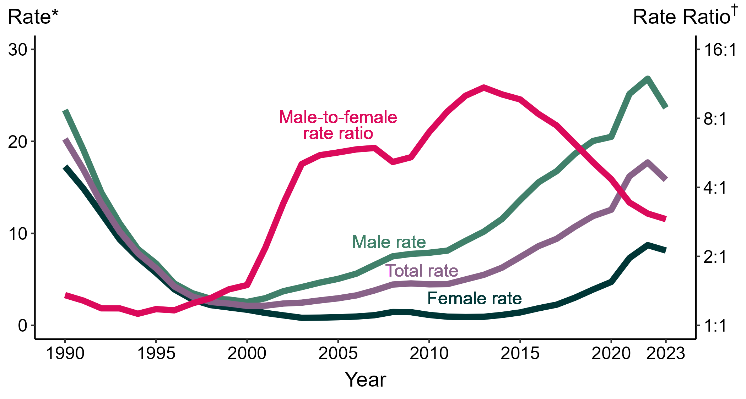
Primary and Secondary Syphilis — Rates of Reported Cases by Sex and Male-to-Female Rate Ratios, by Year, United States, 1990–2023
* Per 100,000
† Log scale
Notes:
Although the male-to-female rate ratio for primary and secondary syphilis increased from 1990 to 2013, the rate ratio has declined in recent years due to the increasing rate of syphilis among women. During 2019 to 2023, the rate of primary and secondary syphilis among women more than doubled (3.9 to 8.1 per 100,000).
This report includes data from years that coincide with the COVID-19 pandemic, which introduced uncertainty and difficulty in interpreting STI surveillance data. See Impact of COVID-19 on STIs (https://www.cdc.gov/sti-statistics/about/impact-of-covid-19.html) for more information.
See Technical Notes (https://www.cdc.gov/sti-statistics/annual/technical-notes.html) for information on STI case reporting formats and practices, including collected and derived variables displayed in this report. Table A (https://www.cdc.gov/sti-statistics/data-vis/table-selected-percunknown.html) provides information on unknown, missing, or invalid values of select variables.
Data for all figures are available at https://www.cdc.gov/sti-statistics/media/files/2024/08/data.zip. The file “PS Syphilis - Rates by Sex and Male-to-Female Rate Ratios (US 1990-2023).xlsx” contains the data for the figure presented on this slide.

Slide 3
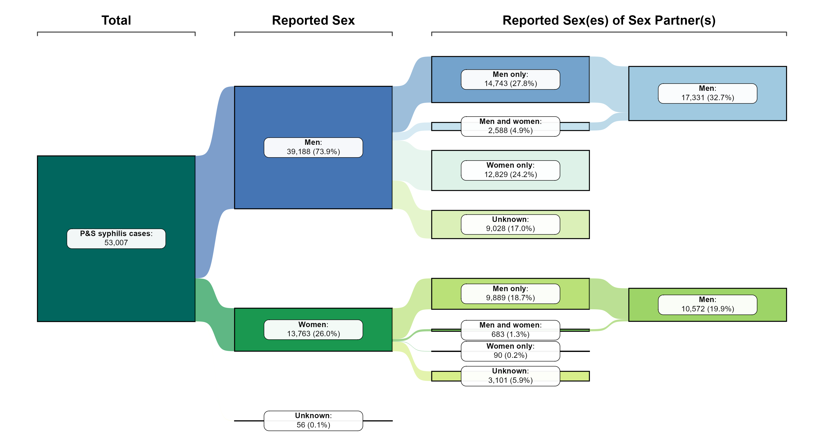
Primary and Secondary Syphilis — Distribution of Cases by Sex and Sex of Sex Partners, United States, 2023
NOTE: Percentages represent the number of primary and secondary (P&S) syphilis cases among the 53,007 total P&S syphilis cases reported in 2023.
Notes:
Of 53,007 reported primary and secondary syphilis cases in 2023, 73.9% were among men and 26.0% were among women.
By sex and sex(es) of sex partners, the largest percentage of cases (27.8%) were among men who have sex with men only.
Men who have sex with men — including men who have sex with men and women — represented 32.7% of cases overall and 44.2% of cases among men (57.5% of cases among men with known sex of sex partners).
Women who have sex with men — including women who have sex with women and men — represented 19.9% of cases overall and 76.8% of cases among women (99.2% of cases among women with known sex of sex partners).
Note that percentages in figure and text may not sum as expected due to rounding.
This report includes data from years that coincide with the COVID-19 pandemic, which introduced uncertainty and difficulty in interpreting STI surveillance data. See Impact of COVID-19 on STIs (https://www.cdc.gov/sti-statistics/about/impact-of-covid-19.html) for more information.
See Technical Notes (https://www.cdc.gov/sti-statistics/annual/technical-notes.html) for information on STI case reporting formats and practices, including collected and derived variables displayed in this report. Table A (https://www.cdc.gov/sti-statistics/data-vis/table-selected-percunknown.html) provides information on unknown, missing, or invalid values of select variables.
Data for all figures are available at https://www.cdc.gov/sti-statistics/media/files/2024/08/data.zip. The file “PS Syphilis - Distribution by Sex and Sex of Sex Partners (US 2023).xlsx” contains the data for the figure presented on this slide.

Slide 4
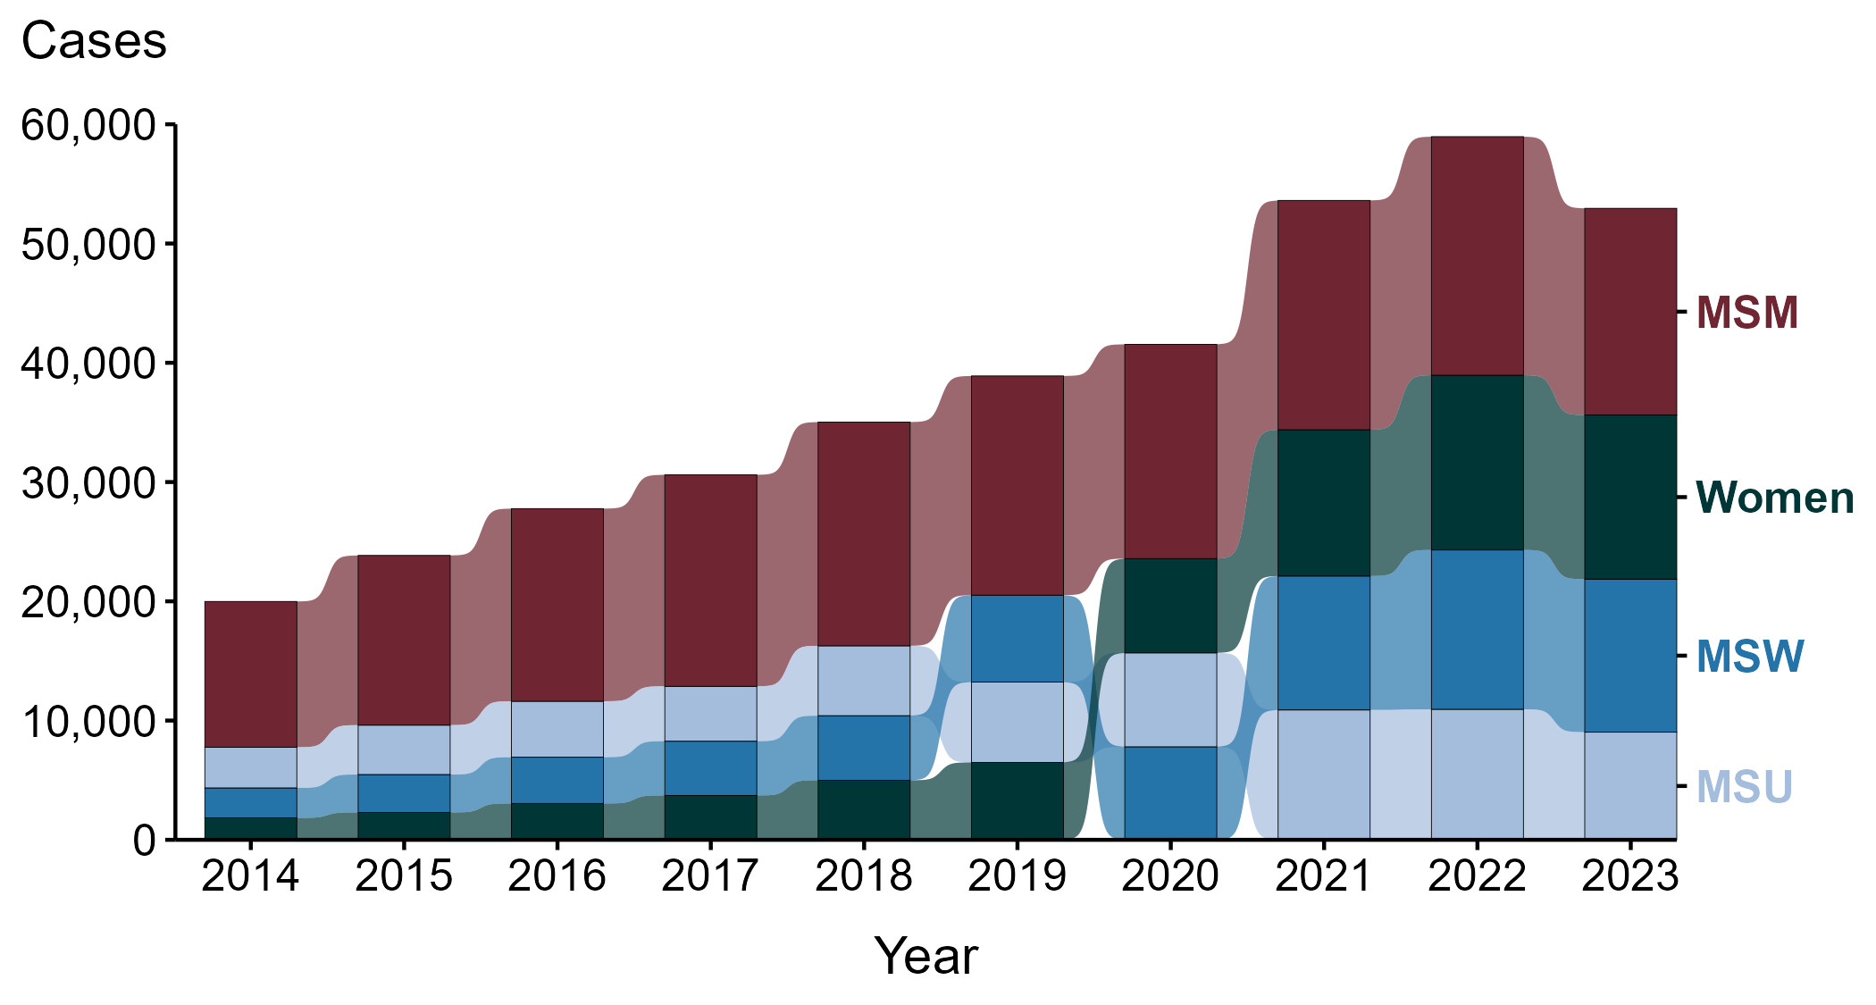
Primary and Secondary Syphilis — Reported Cases by Sex and Sex of Sex Partners and Year, United States, 2014–2023
ACRONYMS: MSM = Men who have sex with men; MSU = Men with unknown sex of sex partners; MSW = Men who have sex with women only
Notes:
During the period from 2014 to 2023, the largest percentage (44.9%) of primary and secondary syphilis cases were among men who have sex with men (MSM; 172,019 cases).
During 2022 to 2023, the number of cases among MSM decreased 13.4% (20,004 to 17,331), while the number of cases decreased 4.0% among men who have sex with women only (MSW; 13,359 to 12,829), 6.1% among women (14,652 to 13,763), and 17.5% among men with unknown sex of sex partners (MSU; 10,946 to 9,028).
During the five-year period from 2019 to 2023, the number of cases among MSM decreased 5.7% (18,381 to 17,331), while the number of cases increased 76.0% among MSW (7,289 to 12,829), 112.0% among women (6,493 to 13,763), and 34.1% among MSU (6,732 to 9,028).
During the 10-year period from 2014 to 2023, the number of cases among MSM increased 41.8% (12,226 to 17,331), while the number of cases increased 410.5% among MSW (2,513 to 12,829), 648.0% among women (1,840 to 13,763), and 165.0% among MSU (3,407 to 9,028).
This report includes data from years that coincide with the COVID-19 pandemic, which introduced uncertainty and difficulty in interpreting STI surveillance data. See Impact of COVID-19 on STIs (https://www.cdc.gov/sti-statistics/about/impact-of-covid-19.html) for more information.
See Technical Notes (https://www.cdc.gov/sti-statistics/annual/technical-notes.html) for information on STI case reporting formats and practices, including collected and derived variables displayed in this report. Table A (https://www.cdc.gov/sti-statistics/data-vis/table-selected-percunknown.html) provides information on unknown, missing, or invalid values of select variables.
Data for all figures are available at https://www.cdc.gov/sti-statistics/media/files/2024/08/data.zip. The file “PS Syphilis - Cases by Sex and Sex of Sex Partners (US 2014-2023).xlsx” contains the data for the figure presented on this slide.

Slide 5
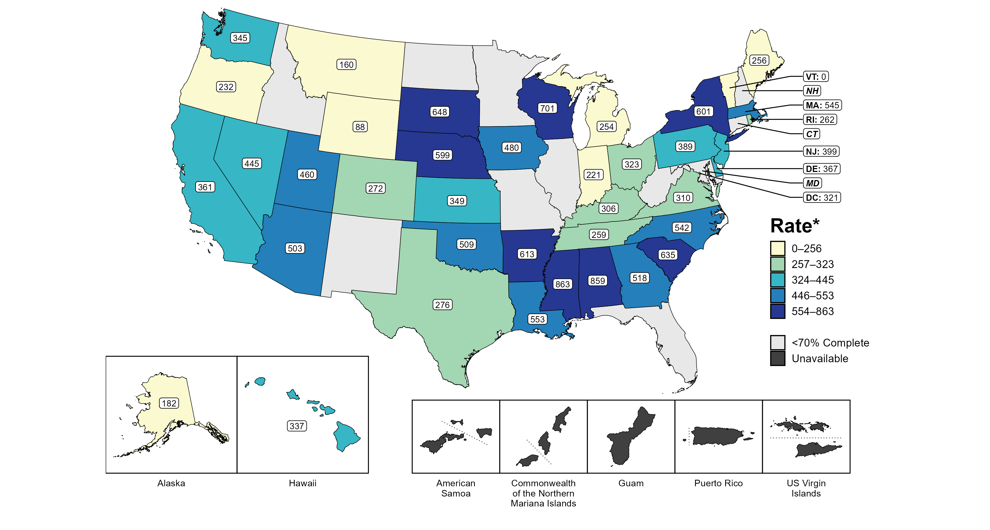
Primary and Secondary Syphilis — Estimated Rates of Reported Cases Among MSM by Jurisdiction, 39 States and the District of Columbia, 2023
* Per 100,000
ACRONYMS: MSM = Men who have sex with men
NOTE: Figure displays rates for jurisdictions reporting ≥70% completeness of sex of sex partners data for male primary and secondary syphilis cases in 2023. Population estimates for MSM in US territories are unavailable.
Notes:
In 2023, 39 states and the District of Columbia (DC) provided data to classify at least 70% of male primary and secondary syphilis cases as men who have sex with men (MSM) or men who have sex with women only. Among the states, estimated rates of primary and secondary syphilis cases in MSM ranged from 0 per 100,000 in Vermont to 863 per 100,000 in Mississippi. The estimated rate in DC was 321 per 100,000.
Tennessee transitioned STI surveillance information systems in September of 2023 which may have impacted the overall case counts. Caution should be applied in interpretation of these data.
This report includes data from years that coincide with the COVID-19 pandemic, which introduced uncertainty and difficulty in interpreting STI surveillance data. See Impact of COVID-19 on STIs (https://www.cdc.gov/sti-statistics/about/impact-of-covid-19.html) for more information.
See Technical Notes (https://www.cdc.gov/sti-statistics/annual/technical-notes.html) for information on STI case reporting formats and practices, including collected and derived variables displayed in this report. Table A (https://www.cdc.gov/sti-statistics/data-vis/table-selected-percunknown.html) provides information on unknown, missing, or invalid values of select variables.
Data for all figures are available at https://www.cdc.gov/sti-statistics/media/files/2024/08/data.zip. The file “PS Syphilis - Rates MSM by Jurisdiction (US 2023).xlsx” contains the data for the figure presented on this slide.

Slide 6
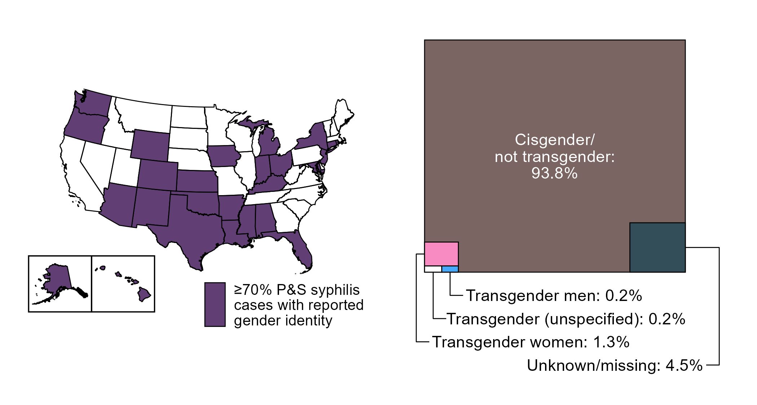
Primary and Secondary Syphilis — Distribution of Cases by Gender Identity, 26 States* and the District of Columbia, 2023
* Jurisdictions reporting gender identity for ≥70% reported primary and secondary syphilis cases in 2023; in 2023, 35 states and the District of Columbia reported on gender identity for primary and secondary syphilis cases
ACRONYMS: P&S syphilis = Primary and secondary syphilis
Notes:
Starting in 2018, jurisdictions were able to provide gender identity for reported cases of primary and secondary syphilis; however, not all jurisdictions have been able to report complete data. To minimize bias due to missing data, this figure displays data from jurisdictions with ≥70% complete information on gender identity for primary and secondary syphilis cases. As reporting of gender identity improves, case counts and distribution of cases by gender identity will become more representative of the US.
In 2023, 26 states and the District of Columbia reported gender identity for ≥70% of reported primary and secondary syphilis cases. In those areas, 30,704 total cases were reported, of which 93.8% were reported with cisgender (i.e., not transgender) identity, 4.5% were reported with missing or unknown gender identity, and 1.7% were reported with transgender identity, specifically as transgender women (1.3%), transgender men (0.2%), and unspecified transgender identity (0.2%).
This report includes data from years that coincide with the COVID-19 pandemic, which introduced uncertainty and difficulty in interpreting STI surveillance data. See Impact of COVID-19 on STIs (https://www.cdc.gov/sti-statistics/about/impact-of-covid-19.html) for more information.
See Technical Notes (https://www.cdc.gov/sti-statistics/annual/technical-notes.html) for information on STI case reporting formats and practices, including collected and derived variables displayed in this report. Table A (https://www.cdc.gov/sti-statistics/data-vis/table-selected-percunknown.html) provides information on unknown, missing, or invalid values of select variables.
Data for all figures are available at https://www.cdc.gov/sti-statistics/media/files/2024/08/data.zip. The file “PS Syphilis - Distribution by Gender Identity in Reporting Jurisdictions (US 2023).xlsx” contains the data for the figure presented on this slide.

Slide 7
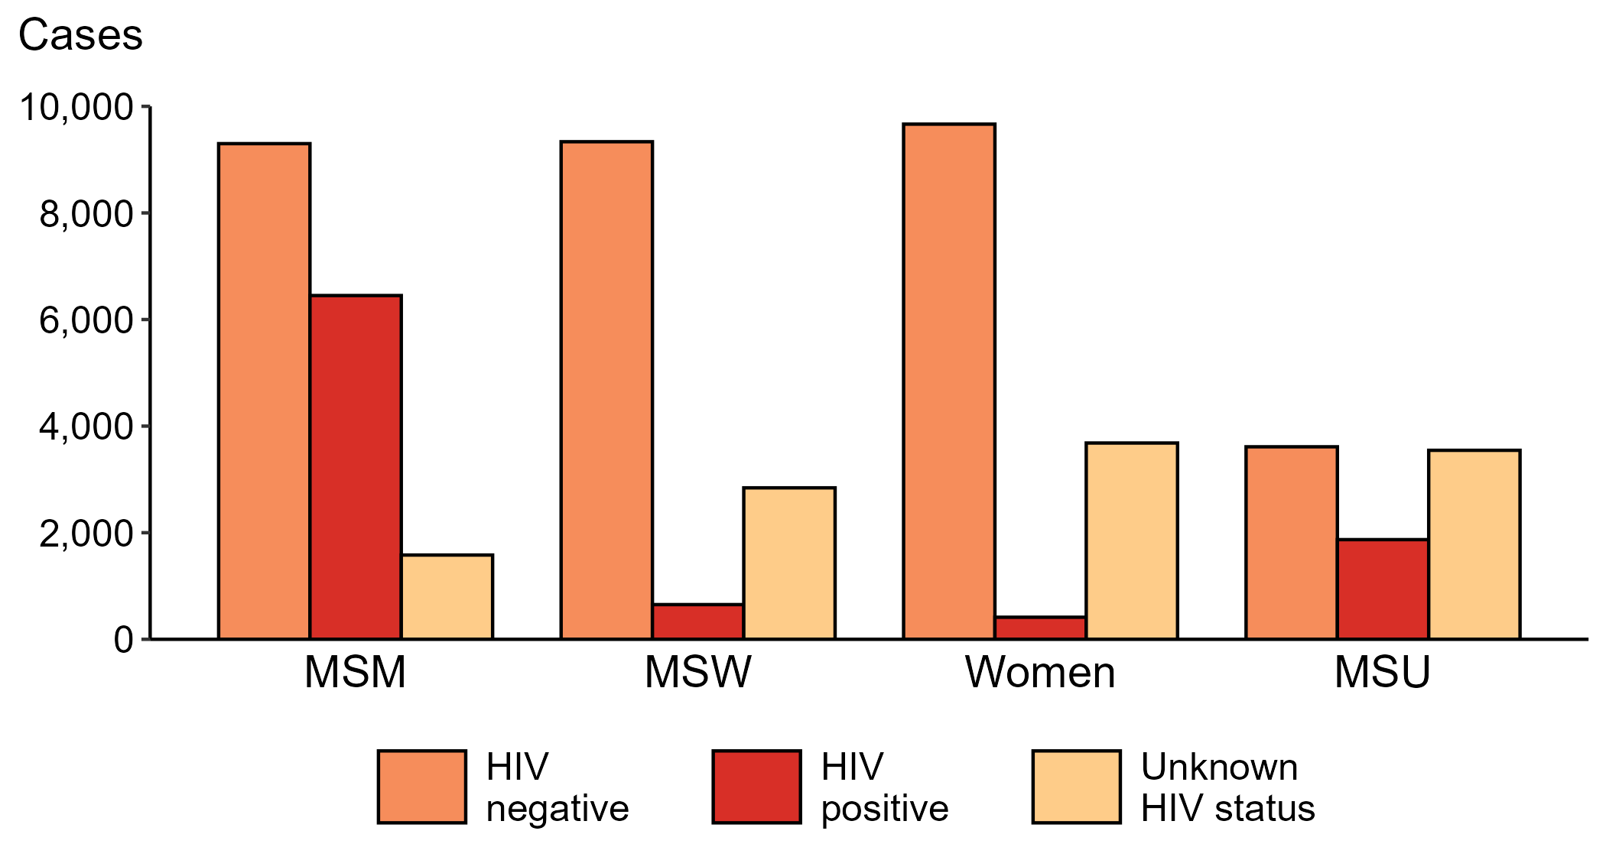
Primary and Secondary Syphilis — Reported Cases by Sex, Sex of Sex Partners, and HIV Status, United States, 2023
ACRONYMS: MSM = Men who have sex with men; MSW = Men who have sex with women only; MSU = Men with unknown sex of sex partners
Notes:
Among primary and secondary syphilis cases with reported HIV status, 41.0% of cases among men who have sex with men were HIV positive, compared with 34.1% of cases among men with unknown sex of sex partners, 6.5% of cases among men who have sex with women only, and 4.1% of cases among women.
For this figure, HIV status is categorized as reported by jurisdictions. Jurisdictions determine HIV status using multiple sources, including self-report, match with HIV registry, and available HIV test results. Cases reported with a missing or unknown status are categorized as having an unknown HIV status.
This report includes data from years that coincide with the COVID-19 pandemic, which introduced uncertainty and difficulty in interpreting STI surveillance data. See Impact of COVID-19 on STIs (https://www.cdc.gov/sti-statistics/about/impact-of-covid-19.html) for more information.
See Technical Notes (https://www.cdc.gov/sti-statistics/annual/technical-notes.html) for information on STI case reporting formats and practices, including collected and derived variables displayed in this report. Table A (https://www.cdc.gov/sti-statistics/data-vis/table-selected-percunknown.html) provides information on unknown, missing, or invalid values of select variables.
Data for all figures are available at https://www.cdc.gov/sti-statistics/media/files/2024/08/data.zip. The file “PS Syphilis - Cases by Sex Sex of Sex Partners and HIV Status (US 2023).xlsx” contains the data for the figure presented on this slide.

Slide 8
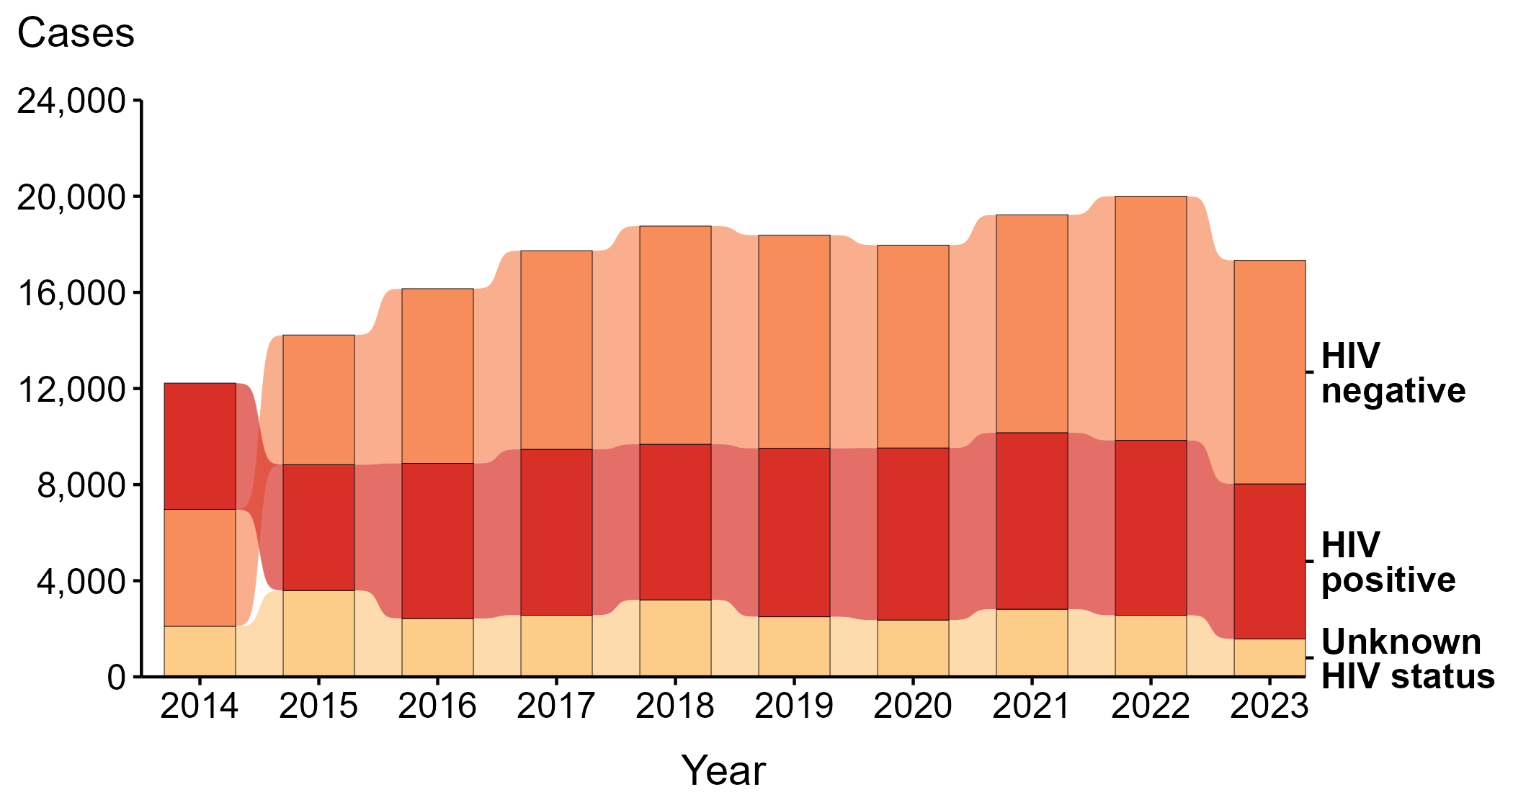
Primary and Secondary Syphilis — Reported Cases Among Men Who Have Sex with Men by HIV Status and Year, United States, 2014–2023
Notes:
During 2014 to 2023, the largest percentage (46.9%) of primary and secondary (P&S) syphilis cases among men who have sex with men (MSM) were among persons reported as HIV negative. Among only those reported as either HIV negative or HIV positive (i.e., with a known status), 55.2% were among persons reported as HIV negative.
During 2022 to 2023, the number of P&S syphilis cases among MSM who were reported as HIV negative decreased 8.5% (from 10,161 to 9,300), the number who were reported as HIV positive decreased 11.4% (from 7,281 to 6,450), and the number who were reported with unknown HIV status decreased 38.3% (from 2,562 to 1,581).
During 2014 to 2023, the number of P&S syphilis cases among MSM who were reported as HIV negative increased 91.2% (from 4,863 to 9,300), the number who were reported as HIV positive increased 22.7% (from 5,257 to 6,450), and the number who were reported with unknown HIV status decreased 24.9% (from 2,106 to 1,581).
Since 2015, the number of primary and secondary syphilis cases among MSM who are HIV negative has surpassed the number of cases among those who are HIV positive.
For this figure, HIV status is categorized as reported by jurisdictions. Jurisdictions determine HIV status using multiple sources, including self-report, match with HIV registry, and available HIV test results. Cases reported with a missing or unknown status are categorized as having an unknown HIV status.
This report includes data from years that coincide with the COVID-19 pandemic, which introduced uncertainty and difficulty in interpreting STI surveillance data. See Impact of COVID-19 on STIs (https://www.cdc.gov/sti-statistics/about/impact-of-covid-19.html) for more information.
See Technical Notes (https://www.cdc.gov/sti-statistics/annual/technical-notes.html) for information on STI case reporting formats and practices, including collected and derived variables displayed in this report. Table A (https://www.cdc.gov/sti-statistics/data-vis/table-selected-percunknown.html) provides information on unknown, missing, or invalid values of select variables.
Data for all figures are available at https://www.cdc.gov/sti-statistics/media/files/2024/08/data.zip. The file “PS Syphilis - Cases MSM by HIV Status (US 2014-2023).xlsx” contains the data for the figure presented on this slide.

Slide 9
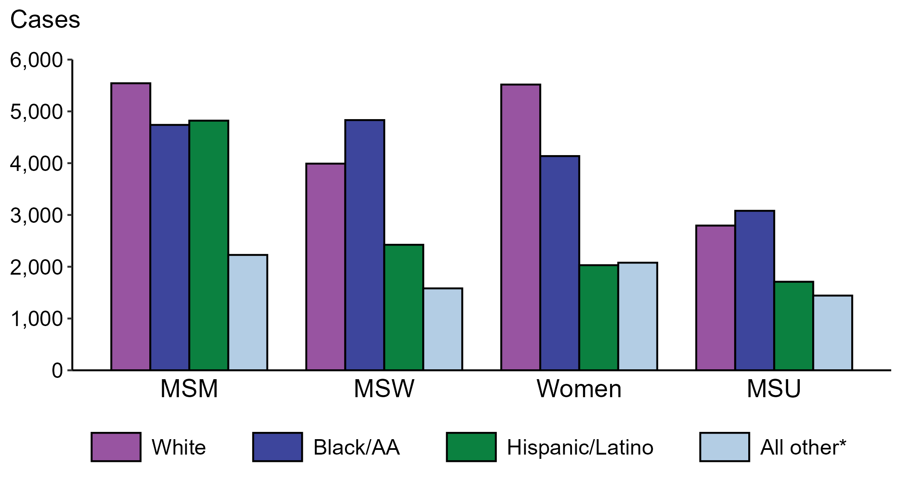
Primary and Secondary Syphilis — Reported Cases by Sex, Sex of Sex Partners, and Race/Hispanic Ethnicity, United States, 2023
* Includes persons with missing or unknown race who were not reported with Hispanic ethnicity.
ACRONYMS: MSM = Men who have sex with men; MSW = Men who have sex with women only; MSU = Men with unknown sex of sex partners
Notes:
The largest percentage of all primary and secondary (P&S) syphilis cases were reported to be men who have sex with men (MSM; 32.7%). When looking within categories of sex and sex of sex partners, P&S syphilis cases reported as non-Hispanic White were the largest percentage among women (40.1%) and MSM (32.0%). P&S syphilis cases reported as non-Hispanic Black or African American were the largest percentage among men who have sex with women only (MSW; 37.7%) and men with unknown sex of sex partners (MSU; 34.1%).
This report includes data from years that coincide with the COVID-19 pandemic, which introduced uncertainty and difficulty in interpreting STI surveillance data. See Impact of COVID-19 on STIs (https://www.cdc.gov/sti-statistics/about/impact-of-covid-19.html) for more information.
See Technical Notes (https://www.cdc.gov/sti-statistics/annual/technical-notes.html) for information on STI case reporting formats and practices, including collected and derived variables displayed in this report. Table A (https://www.cdc.gov/sti-statistics/data-vis/table-selected-percunknown.html) provides information on unknown, missing, or invalid values of select variables.
Data for all figures are available at https://www.cdc.gov/sti-statistics/media/files/2024/08/data.zip. The file “PS Syphilis - Cases by Sex Sex of Sex Partners and Race Hispanic Ethnicity (US 2023) .xlsx” contains the data for the figure presented on this slide.

Slide 10
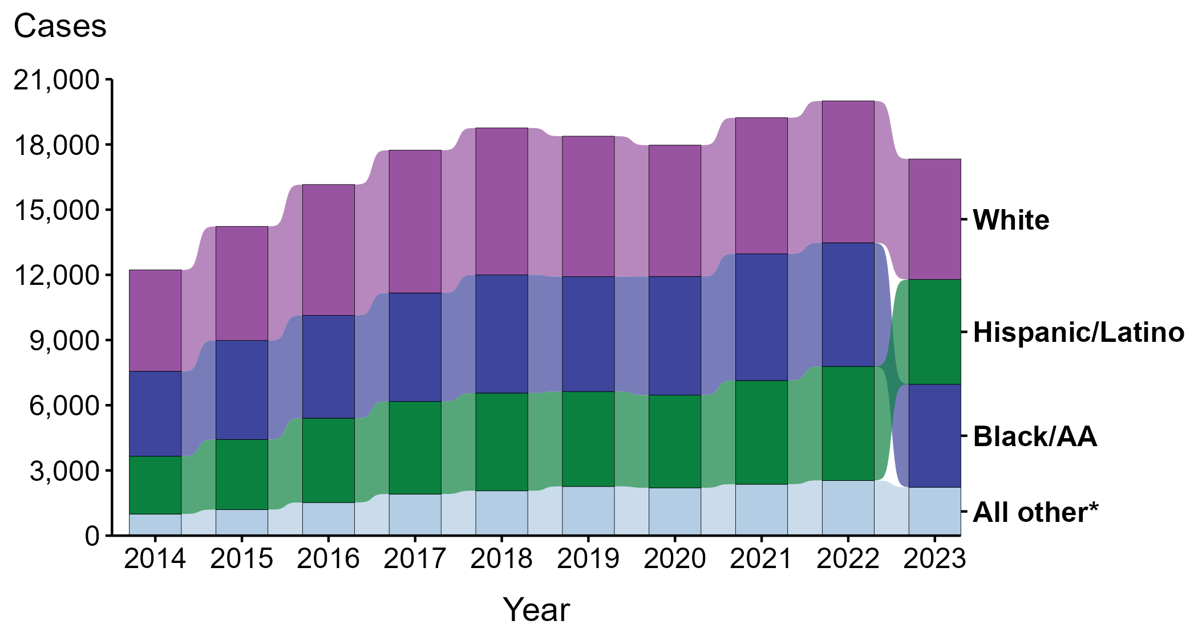
Primary and Secondary Syphilis — Reported Cases Among Men Who Have Sex with Men by Race and Hispanic Ethnicity, United States, 2014–2023
* Includes all cases not captured in the labeled race and Hispanic ethnicity categories, including those with unknown or missing race and Hispanic ethnicity. This category is intended to show the balance of primary and secondary (P&S) syphilis cases among men who have sex with men (MSM) and should not be interpreted independently.
Notes:
During 2014 to 2023, the largest percentage (34.9%) of primary and secondary (P&S) syphilis cases among men who have sex with men (MSM) were reported to be non-Hispanic White.
During 2022 to 2023, case counts decreased among non-Hispanic Black or African American MSM (16.7% decrease; 5,689 to 4,739 cases), non-Hispanic White MSM (15.1% decrease; 6,528 to 5,543 cases), and Hispanic or Latino MSM of any race(s) (8.2% decrease; 5,250 to 4,821 cases).
During 2014 to 2023, case counts increased among Hispanic or Latino MSM of any race(s) (81.2% increase; 2,660 to 4,821 cases), non-Hispanic Black or African American MSM (21.3% increase; 3,907 to 4,739 cases), and non-Hispanic White MSM (18.8% increase; 4,664 to 5,543 cases).
This report includes data from years that coincide with the COVID-19 pandemic, which introduced uncertainty and difficulty in interpreting STI surveillance data. See Impact of COVID-19 on STIs (https://www.cdc.gov/sti-statistics/about/impact-of-covid-19.html) for more information.
See Technical Notes (https://www.cdc.gov/sti-statistics/annual/technical-notes.html) for information on STI case reporting formats and practices, including collected and derived variables displayed in this report. Table A (https://www.cdc.gov/sti-statistics/data-vis/table-selected-percunknown.html) provides information on unknown, missing, or invalid values of select variables.
Data for all figures are available at https://www.cdc.gov/sti-statistics/media/files/2024/08/data.zip. The file “PS Syphilis - Cases MSM by Race Hispanic Ethnicity (US 2014-2023) .xlsx” contains the data for the figure presented on this slide.

Slide 11
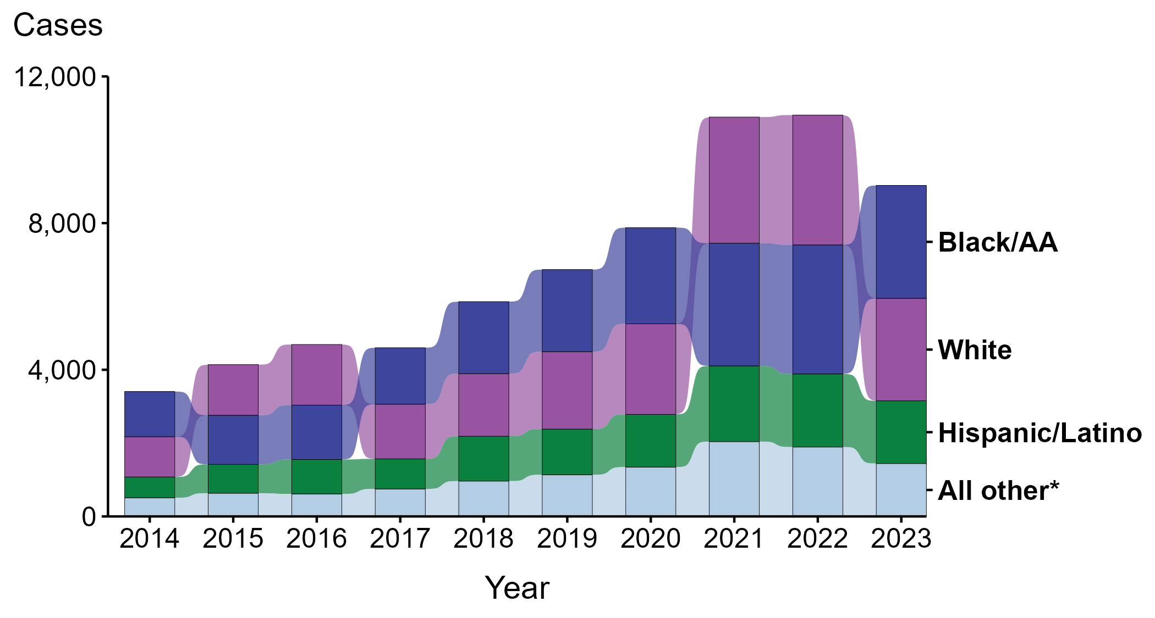
Primary and Secondary Syphilis — Reported Cases Among Men with Unknown Sex of Sex Partners by Race and Hispanic Ethnicity, United States, 2014–2023
* Includes all cases not captured in the labeled race and Hispanic ethnicity categories, including those with unknown or missing race and Hispanic ethnicity. This category is intended to show the balance of primary and secondary (P&S) syphilis cases among men with unknown sex of sex partners (MSU) and should not be interpreted independently.
Notes:
During 2014 to 2023, the largest percentage (32.8%) of primary and secondary (P&S) syphilis cases among men with unknown sex of sex partners (MSU) were reported to be non-Hispanic Black or African American.
During 2022 to 2023, case counts decreased among non-Hispanic White MSU (21.1% decrease; 3,541 to 2,795 cases), Hispanic or Latino MSU of any race(s) (14.2% decrease; 1,993 to 1,710 cases), and non-Hispanic Black or African American MSU (12.5% decrease; 3,519 to 3,080 cases).
During 2014 to 2023, case counts increased among Hispanic or Latino MSU of any race(s) (201.1% increase; 568 to 1,710 cases), non-Hispanic White MSU (154.8% increase; 1,097 to 2,795 cases), and non-Hispanic Black or African American MSU (149.8% increase; 1,233 to 3,080 cases).
This report includes data from years that coincide with the COVID-19 pandemic, which introduced uncertainty and difficulty in interpreting STI surveillance data. See Impact of COVID-19 on STIs (https://www.cdc.gov/sti-statistics/about/impact-of-covid-19.html) for more information.
See Technical Notes (https://www.cdc.gov/sti-statistics/annual/technical-notes.html) for information on STI case reporting formats and practices, including collected and derived variables displayed in this report. Table A (https://www.cdc.gov/sti-statistics/data-vis/table-selected-percunknown.html) provides information on unknown, missing, or invalid values of select variables.
Data for all figures are available at https://www.cdc.gov/sti-statistics/media/files/2024/08/data.zip. The file “PS Syphilis - Cases MSU by Race Hispanic Ethnicity (US 2014-2023) .xlsx” contains the data for the figure presented on this slide.

Slide 12
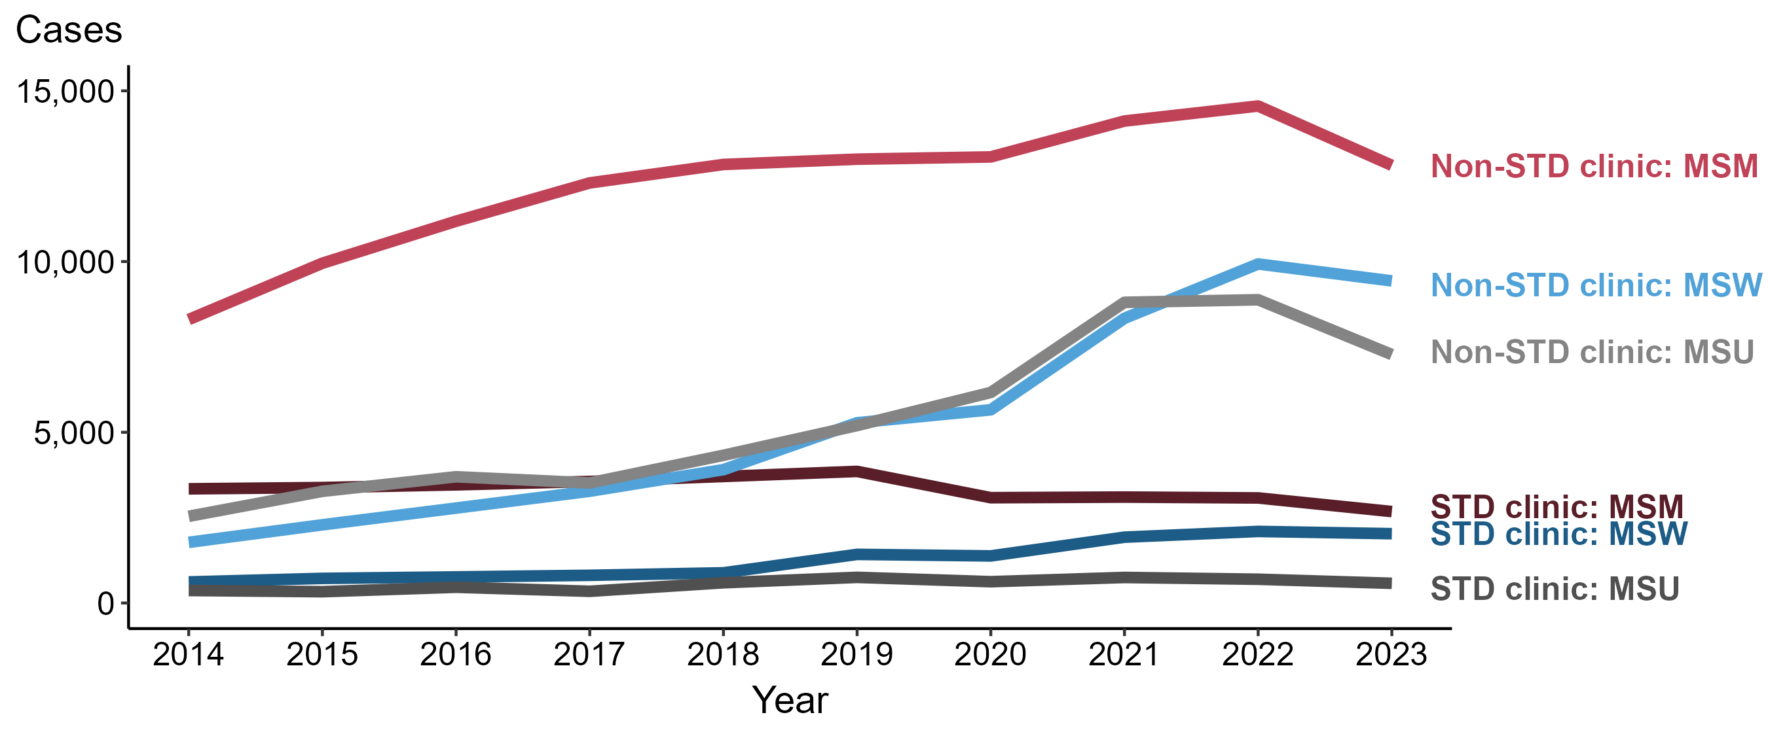
Primary and Secondary Syphilis — Reported Cases among Men by Reporting Source and Sex of Sex Partners and Year, United States, 2014–2023
ACRONYMS: MSM = Men who have sex with men; MSW = Men who have sex with women only; MSU = Men with unknown sex of sex partners
NOTE: During 2014 to 2023, the percentage of all male cases with unknown reporting source was 10.4%, from a low of 6.6% (n = 1,201) in 2014 to a high of 12.6% (n = 3,777) in 2018.
Notes:
During 2022 to 2023, the number of primary and secondary (P&S) syphilis cases reported from STD clinics decreased 13.0% among men who have sex with men (MSM; 3,077 to 2,678 cases), 3.1% among men who have sex with women only (MSW; 2,096 to 2,030 cases), and 17.1% among men with unknown sex of sex partners (MSU; 696 to 577 cases). Concurrently, the number of cases reported from non-STD clinics decreased 11.9% among MSM (14,555 to 12,817 cases), 5.0% among MSW (9,929 to 9,433 cases), and 18.1% among MSU (8,881 to 7,276 cases).
During 2014 to 2023, the number of P&S syphilis cases reported from STD clinics decreased 19.9% among MSM (3,344 to 2,678 cases), increased 229.0% among MSW (617 to 2,030 cases), and increased 57.2% among MSU (367 to 577 cases). Over the same period, the number of cases reported from non-STD clinics increased 54.4% among MSM (8,302 to 12,817 cases), 431.1% among MSW (1,776 to 9,433 cases), and 186.6% among MSU (2,539 to 7,276 cases).
This report includes data from years that coincide with the COVID-19 pandemic, which introduced uncertainty and difficulty in interpreting STI surveillance data. See Impact of COVID-19 on STIs (https://www.cdc.gov/sti-statistics/about/impact-of-covid-19.html) for more information.
See Technical Notes (https://www.cdc.gov/sti-statistics/annual/technical-notes.html) for information on STI case reporting formats and practices, including collected and derived variables displayed in this report. Table A (https://www.cdc.gov/sti-statistics/data-vis/table-selected-percunknown.html) provides information on unknown, missing, or invalid values of select variables.
Data for all figures are available at https://www.cdc.gov/sti-statistics/media/files/2024/08/data.zip. The file “PS Syphilis - Cases Men by Reporting Source and Sex of Sex Partners (US 2014-2023).xlsx” contains the data for the figure presented on this slide.

Slide 13
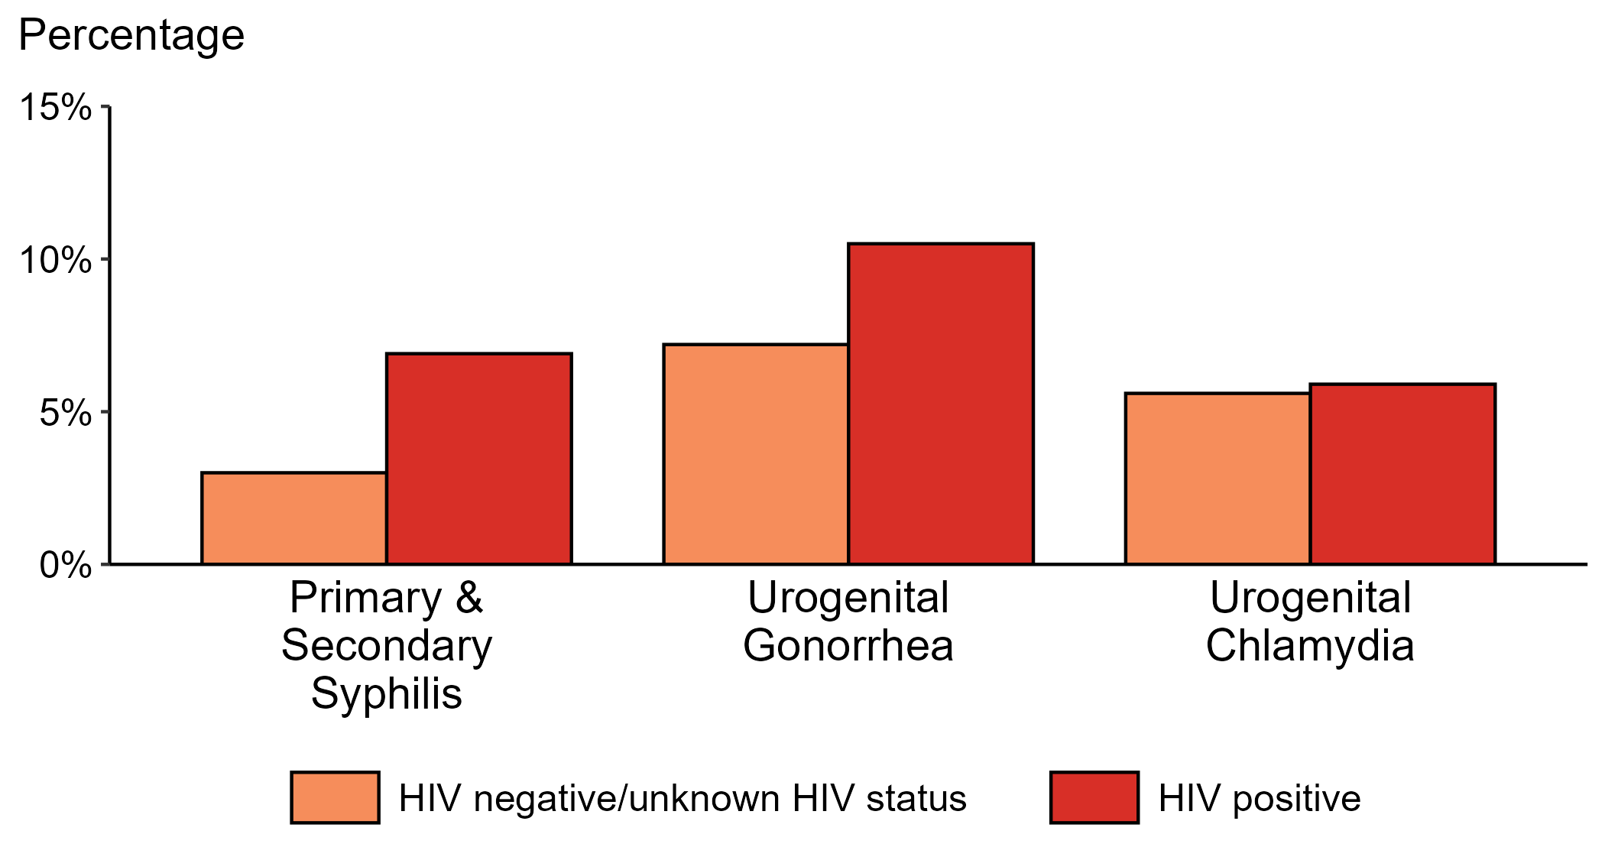
Proportion of MSM with Primary and Secondary Syphilis, Urogenital Gonorrhea, or Urogenital Chlamydia by HIV Status, STI Surveillance Network (SSuN), 2023
ACRONYMS: MSM = Gay, bisexual, and other men who have sex with men
NOTE: Results are based on data obtained from patients attending a participating STI clinic in 11 jurisdictions.
Notes:
Among gay, bisexual, and other men who have sex with men (MSM) attending participating STI clinics in the STI Surveillance Network in 2023, the portion diagnosed with primary and secondary syphilis was higher for those that were HIV positive compared with those not known to be HIV positive (6.9% versus 3.0%). The pattern was similar for urogenital gonorrhea, with the proportion of testing positive higher among HIV-positive MSM compared with MSM not known to be HIV positive (10.5% versus 7.2%); however, the proportion testing positive for urogenital chlamydia was similar (5.9% among HIV-positive MSM and 5.6% among MSM not known to be HIV positive).
For this figure, information of HIV status was ascertained from patient self-report of most recent HIV test result or from documentation in the jurisdiction’s HIV surveillance registry.
This report includes data from years that coincide with the COVID-19 pandemic, which introduced uncertainty and difficulty in interpreting STI surveillance data. See Impact of COVID-19 on STIs (https://www.cdc.gov/sti-statistics/about/impact-of-covid-19.html) for more information.
See Technical Notes (https://www.cdc.gov/sti-statistics/annual/technical-notes.html) for information on SSuN methodology. Table A (https://www.cdc.gov/sti-statistics/data-vis/table-selected-percunknown.html) provides information on unknown, missing, or invalid values of select variables.

Slide 14
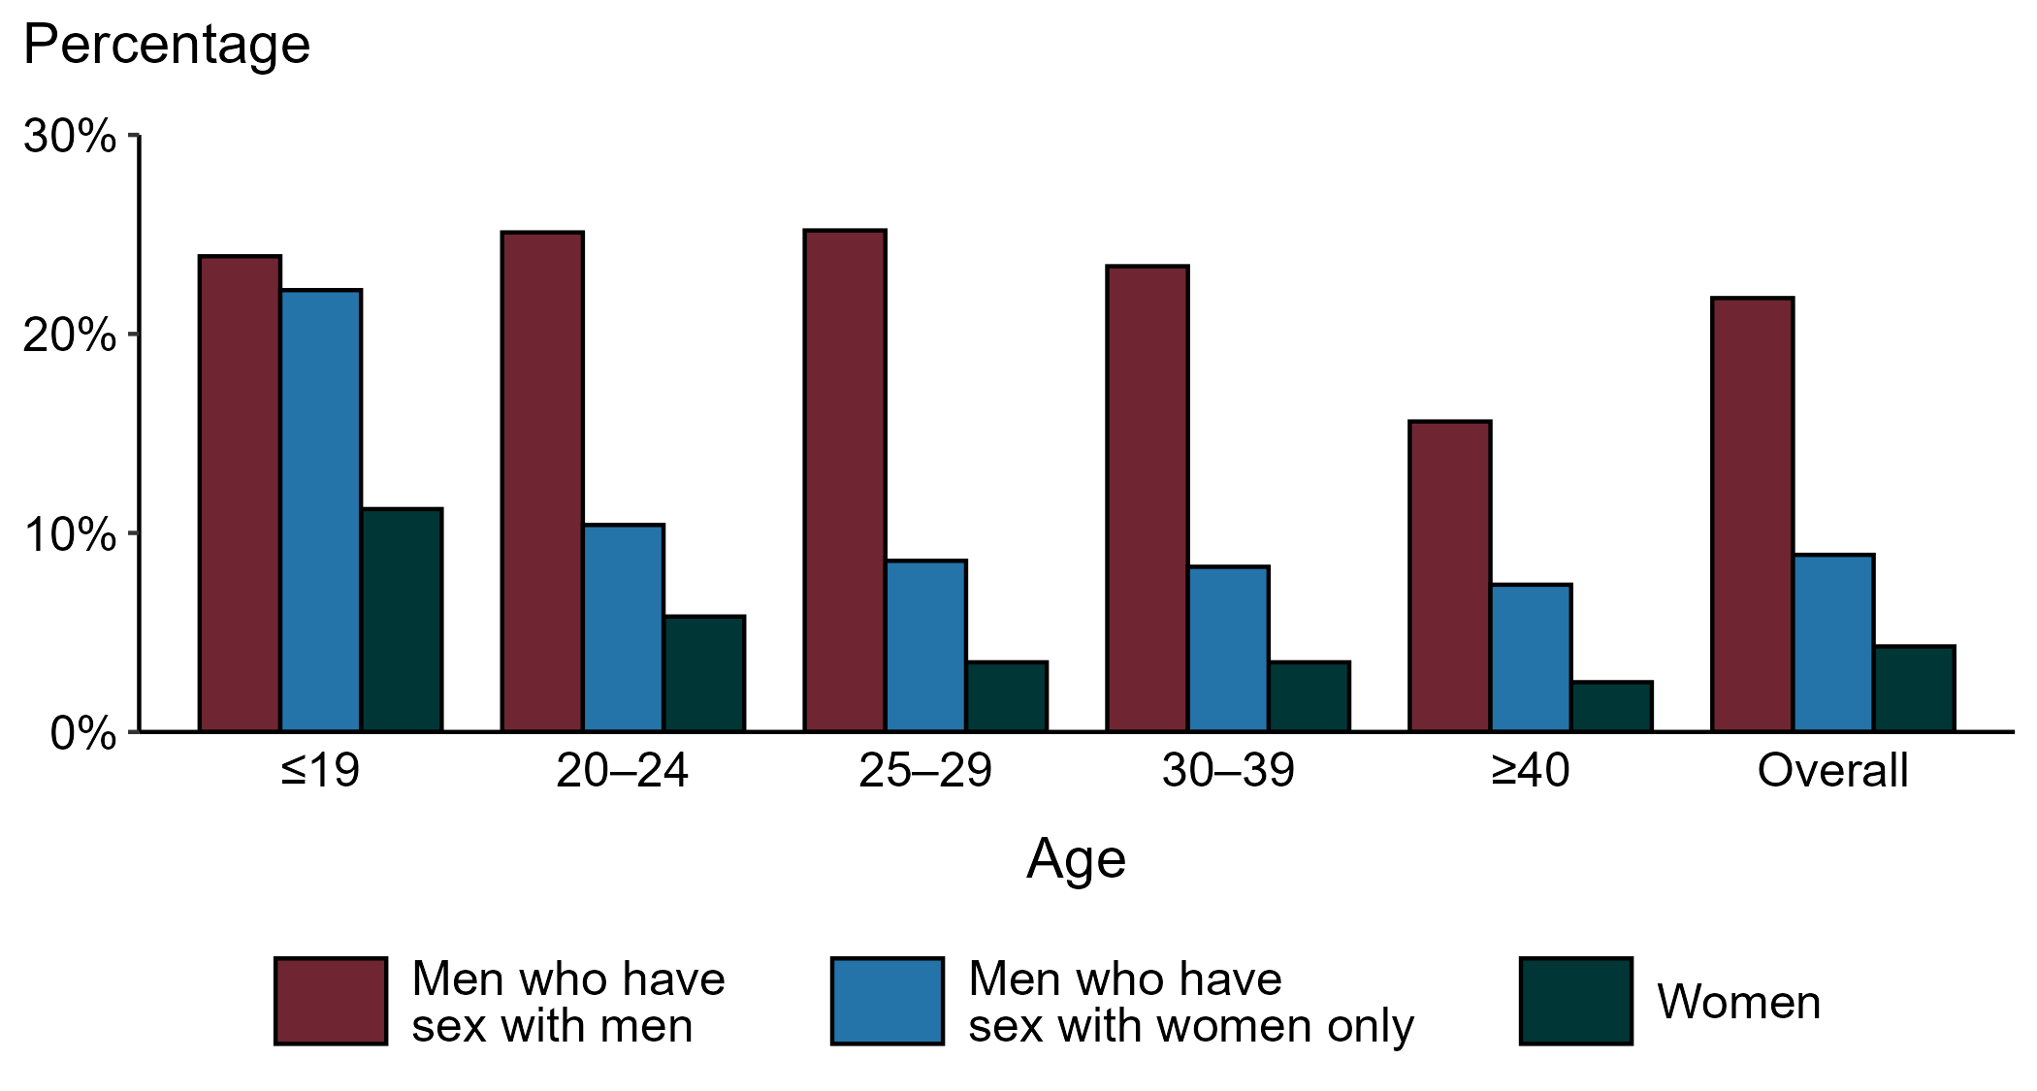
Gonorrhea — Proportion of STD Clinic Patients Testing Positive by Age Group, Sex, and Sex of Sex Partners, STI Surveillance Network (SSuN), 2023
NOTE: Results are based on 52,956 unique patients in 11 participating jurisdictions with known sex of sex partners attending SSuN STI clinics who were tested ≥1 times for gonorrhea in 2023.
Notes:
Among patients accessing care in participating STI clinics in the STI Surveillance Network (SSuN) who were tested for gonorrhea in 2023, 21.8% of gay, bisexual, and other men who have sex with men (MSM), 8.9% of men who have sex with women only (MSW), and 4.3% of women were positive. The proportion of STI clinic patients who tested positive for gonorrhea varied by sex and sex of sex partners, as well as by age group. MSM were noted to have higher proportions of testing positive in all age groups when compared to women and MSW.
This report includes data from years that coincide with the COVID-19 pandemic, which introduced uncertainty and difficulty in interpreting STI surveillance data. See Impact of COVID-19 on STIs (https://www.cdc.gov/sti-statistics/about/impact-of-covid-19.html) for more information.
See Technical Notes (https://www.cdc.gov/sti-statistics/annual/technical-notes.html) for information on SSuN methodology. Table A (https://www.cdc.gov/sti-statistics/data-vis/table-selected-percunknown.html) provides information on unknown, missing, or invalid values of select variables.

Slide 15
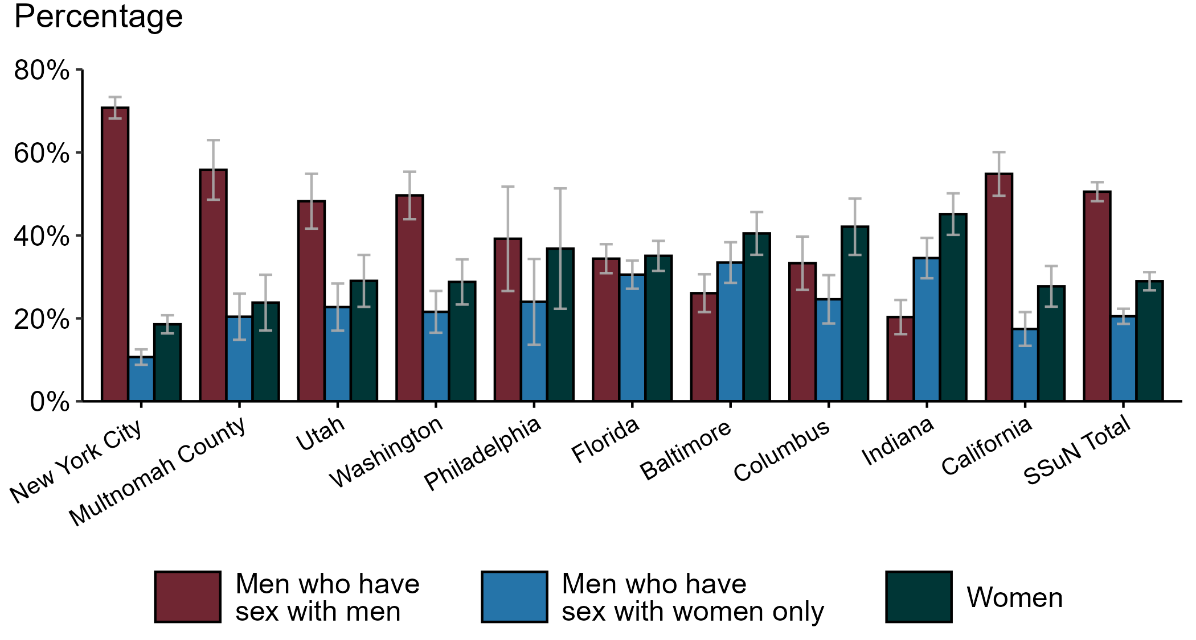
Gonorrhea — Estimated Proportion of Cases by Sex and Sex of Sex Partners and Jurisdiction, STI Surveillance Network (SSuN), 2023
NOTE: Estimate based on weighted analysis of data on sex of sex partners obtained from interviews (n=5,705) conducted among a random sample of gonorrhea cases reported to participating SSuN jurisdictions during January to December 2023. Includes ten SSuN sites reporting completed case investigations in 2023 for at least 1% of all reported cases.
Notes:
In 2023, New York City had the highest proportion of gonorrhea cases reported among gay, bisexual, and other men who have sex with men (MSM) among SSuN jurisdictions meeting the inclusion threshold, Indiana had the highest proportion of gonorrhea cases reported among women, and Indiana had the highest proportion of gonorrhea cases reported among men who have sex with women only. Overall, the proportion of gonorrhea estimated to be attributed to MSM was 50.5% in 2023.
This report includes data from years that coincide with the COVID-19 pandemic, which introduced uncertainty and difficulty in interpreting STI surveillance data. See Impact of COVID-19 on STIs (https://www.cdc.gov/sti-statistics/about/impact-of-covid-19.html) for more information.
See Technical Notes (https://www.cdc.gov/sti-statistics/annual/technical-notes.html) for information on SSuN methodology. Table A (https://www.cdc.gov/sti-statistics/data-vis/table-selected-percunknown.html) provides information on unknown, missing, or invalid values of select variables.

Slide 16
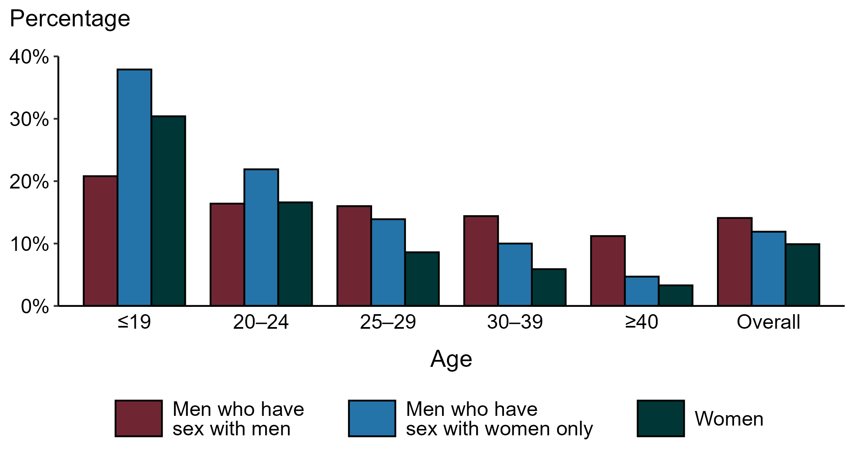
Chlamydia — Proportion of STD Clinic Patients Testing Positive by Age Group, Sex, and Sex of Sex Partners, STI Surveillance Network (SSuN), 2023
NOTE: Results are based on 50,808 unique patients in 11 participating jurisdictions with known sex of sex partners attending SSuN STI clinics who were tested ≥1 times for chlamydia in 2023.
Notes:
Among patients accessing care in participating STI clinics in the STI Surveillance Network (SSuN) who were tested for chlamydia in 2023 and had known sexual orientation or sex of sex partners, 14.1% of gay, bisexual and other men who have sex with men (MSM), 11.9% of men who have sex with women only (MSW), and 9.9% of women were found to be positive. The proportion testing positive for chlamydia varied by sex and sex of sex partners, as well as by age group. The highest proportion of patients testing positive were MSW aged 19 years and younger (37.9%).
This report includes data from years that coincide with the COVID-19 pandemic, which introduced uncertainty and difficulty in interpreting STI surveillance data. See Impact of COVID-19 on STIs (https://www.cdc.gov/sti-statistics/about/impact-of-covid-19.html) for more information.
See Technical Notes (https://www.cdc.gov/sti-statistics/annual/technical-notes.html) for information on SSuN methodology. Table A (https://www.cdc.gov/sti-statistics/data-vis/table-selected-percunknown.html) provides information on unknown, missing, or invalid values of select variables.

Slide 17
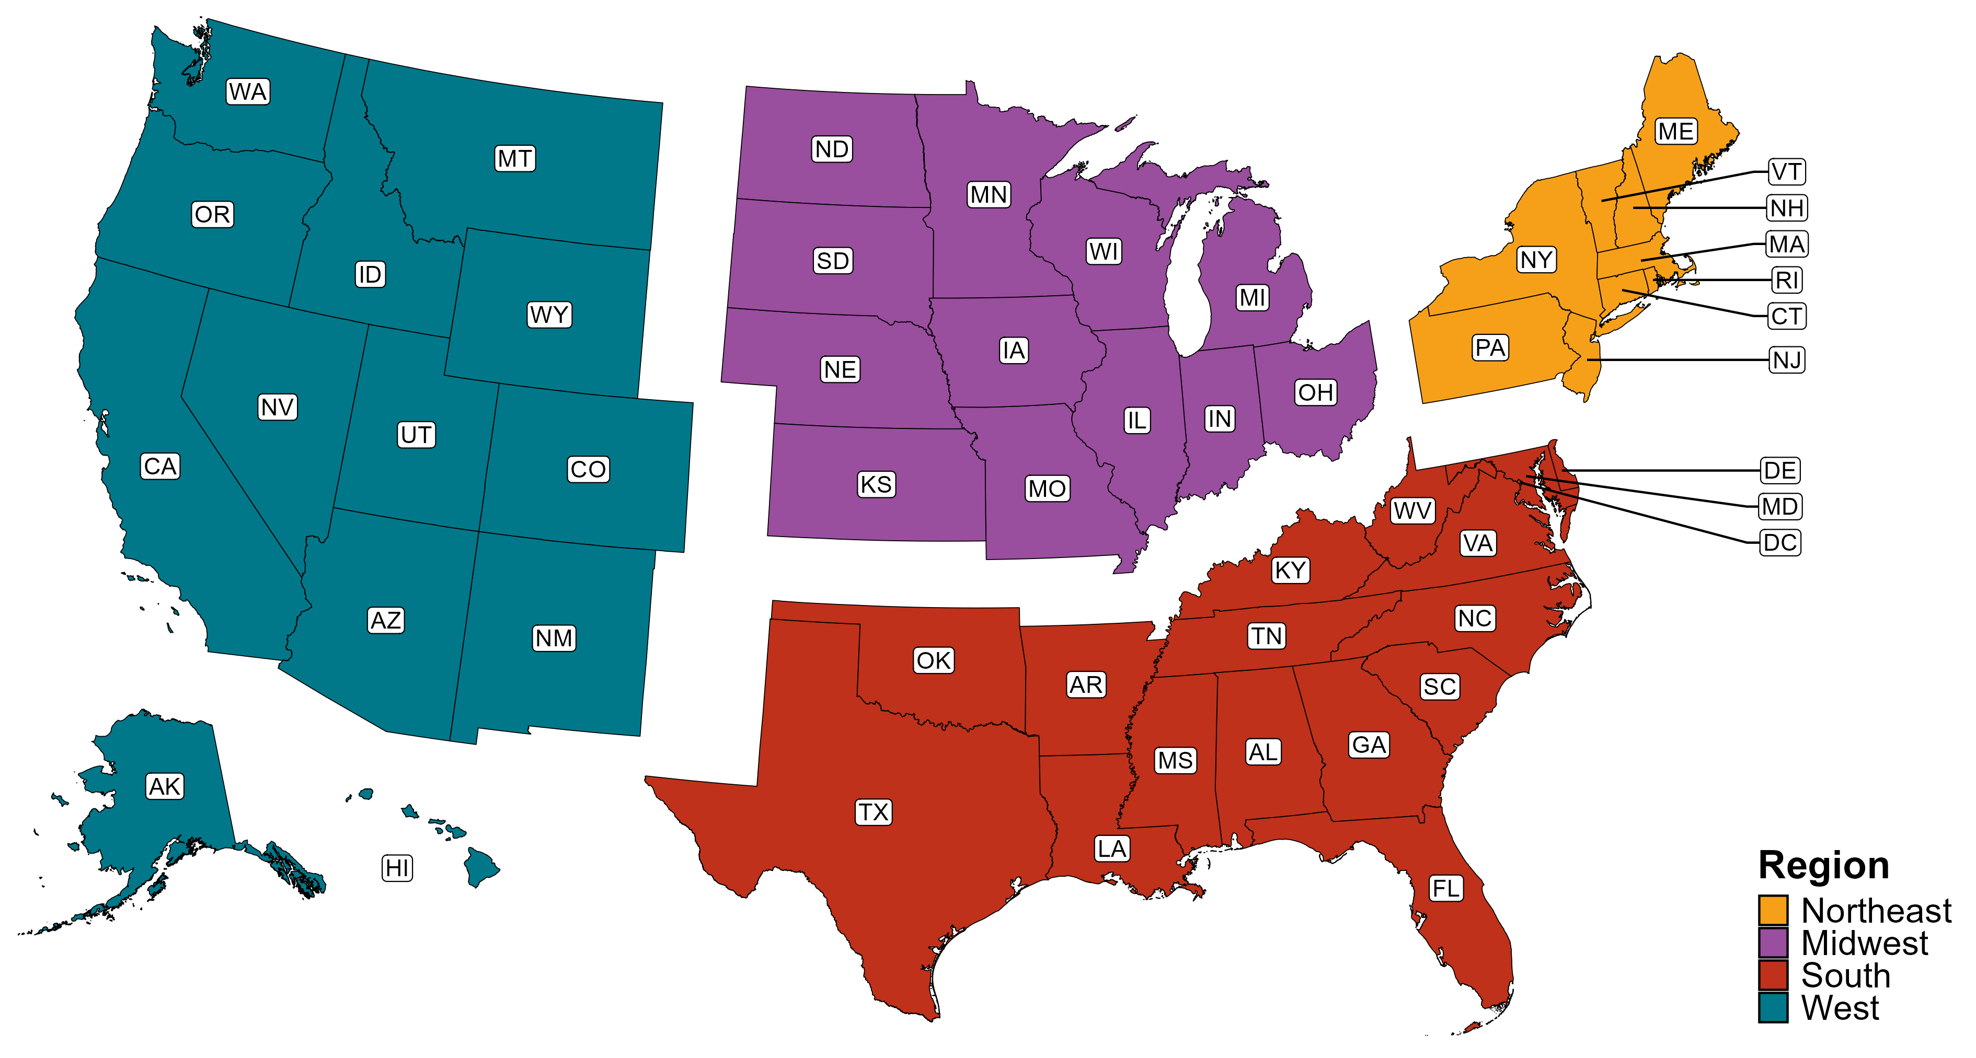
Reference Map of US Census Regions

