Slide 1
Sexually Transmitted Infections
Surveillance 2023
Chlamydia
Notes:
This slide set was prepared by the Division of STD Prevention, National Center for HIV, Viral Hepatitis, STD, and TB Prevention (NCHHSTP), Centers for Disease Control and Prevention (CDC). These slides display trends for STIs in the United States through 2023. Data presented include case notifications provided to CDC through the National Notifiable Diseases Surveillance System (NNDSS) and data collected through projects and programs that monitor STIs in various settings, including the STI Surveillance Network (SSuN).
For more information on data sources, data collection and reporting practices, and case definitions, please see the Technical Notes, available at https://www.cdc.gov/sti-statistics/annual/technical-notes.html.
All data points for figures presented in these slides are available at https://www.cdc.gov/sti-statistics/media/files/2024/11/2023-STI-Surveillance-Report-Data-Points.zip.
NOTE: This slide set is in the public domain. You may reproduce these slides without permission; however, citation as to source is appreciated.
Centers for Disease Control and Prevention. Sexually Transmitted Infections Surveillance 2023. Atlanta: U.S. Department of Health and Human Services; 2024.
You are also free to adapt and revise these slides; however, you must remove the CDC name and logo if changes are made.

Slide 2
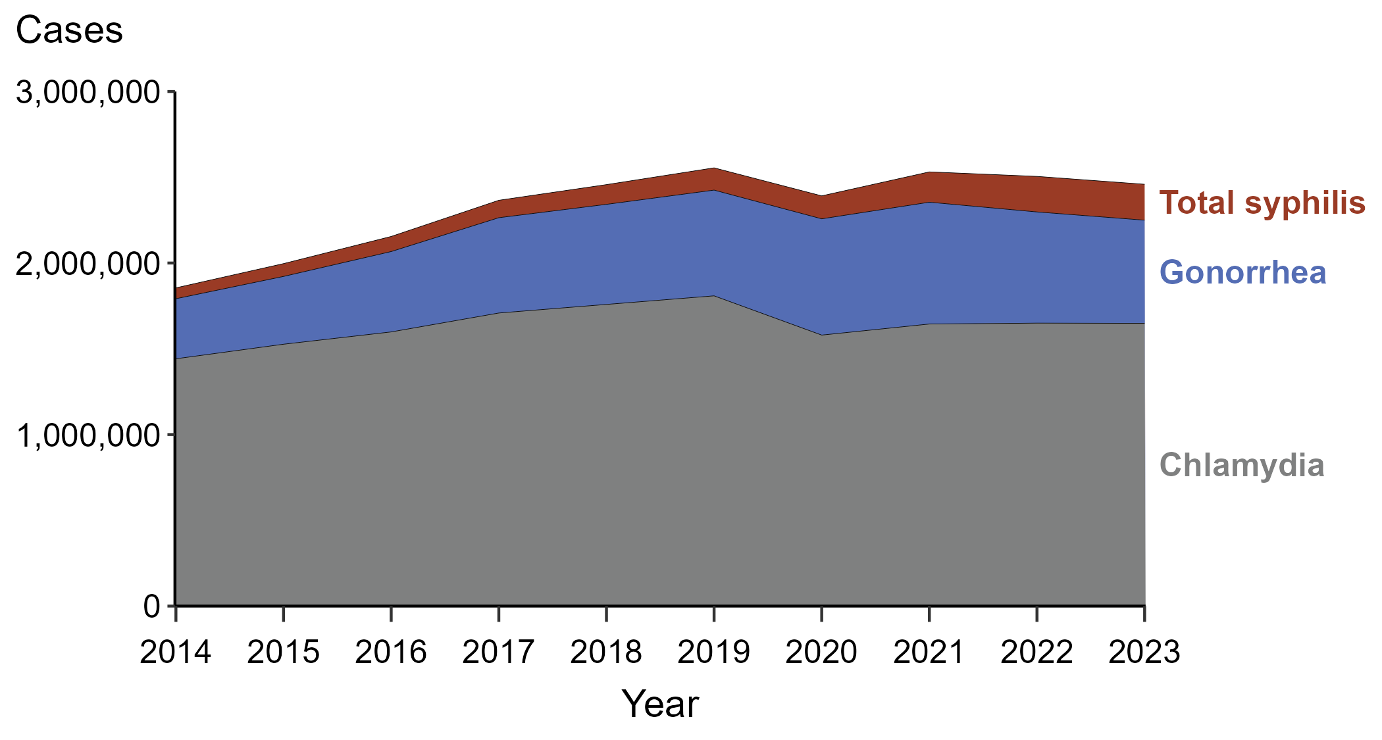
Sexually Transmitted Infections (STIs) — Reported Cases by STI and Year, United States, 2014–2023
NOTE: “Total syphilis” includes all stages of syphilis and congenital syphilis.
Notes:
In 2023, there were 2,459,140 cases of syphilis (including congenital syphilis), gonorrhea, and chlamydia reported in the United States. The over 2.4 million cases reflect a 1.8% decrease from 2022, a 3.7% decrease from 2019, and a 32.5% increase from 2014.
Case definitions are periodically revised using CSTE’s Position Statements and provide uniform criteria of nationally notifiable conditions for reporting purposes. Prior to 2018, syphilis cases identified as “early non-primary non-secondary syphilis” were classified as “early latent syphilis.” Prior to 2018, cases in the “unknown duration or late syphilis” category included cases classified as “late latent syphilis,” “latent syphilis of unknown duration,” “late syphilis with clinical manifestations,” and “neurosyphilis.” Please see the NNDSS website (https://ndc.services.cdc.gov/) for historical case definitions and for the case definitions in use for the current calendar year.
This report includes data from years that coincide with the COVID-19 pandemic, which introduced uncertainty and difficulty in interpreting STI surveillance data. See Impact of COVID-19 on STIs (https://www.cdc.gov/sti-statistics/about/impact-of-covid-19.html) for more information.
See Technical Notes (https://www.cdc.gov/sti-statistics/annual/technical-notes.html) for information on STI case reporting formats and practices, including collected and derived variables displayed in this report. Table A (https://www.cdc.gov/sti-statistics/data-vis/table-selected-percunknown.html) provides information on unknown, missing, or invalid values of select variables.
Data for all figures are available at https://www.cdc.gov/sti-statistics/media/files/2024/11/2023-STI-Surveillance-Report-Data-Points.zip. The file “STI - Cases by Year (US 2014-2023).xlsx” contains the data for the figure presented on this slide.

Slide 3
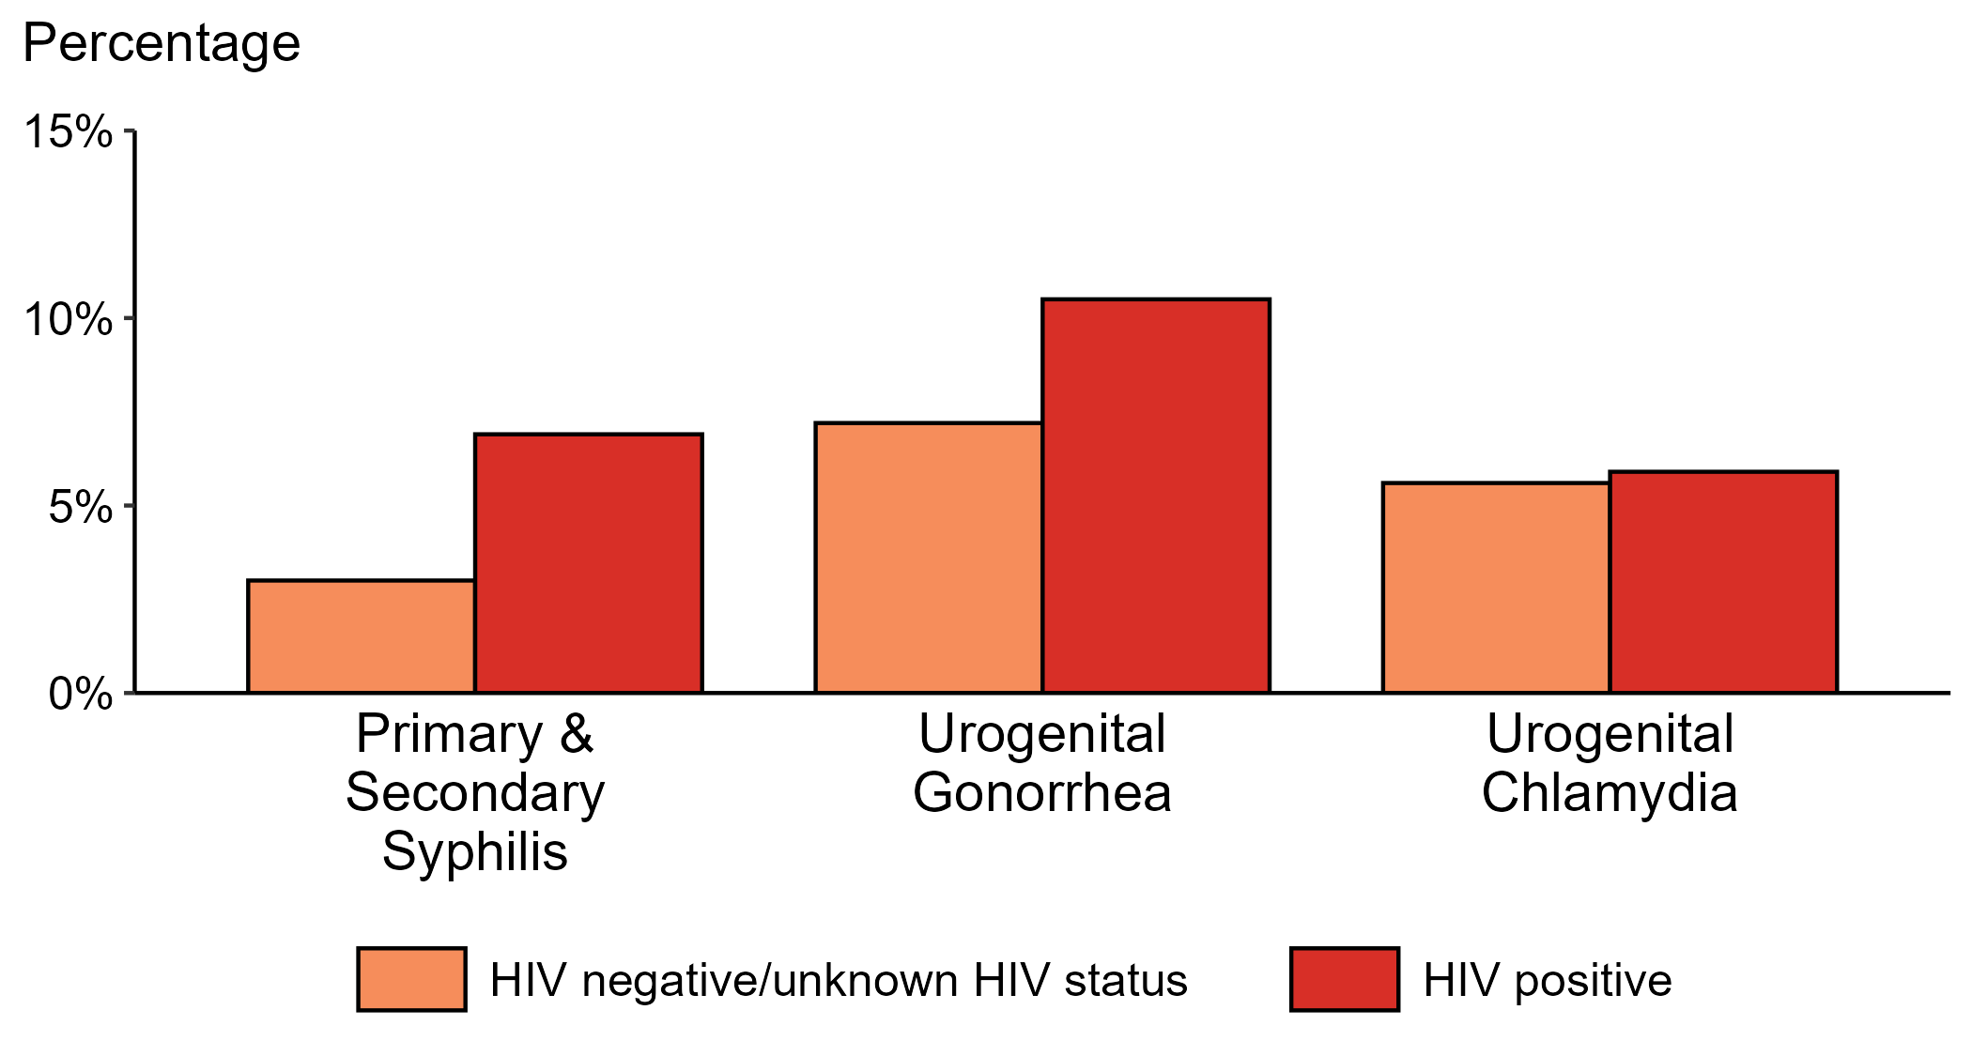
Proportion of MSM with Primary and Secondary Syphilis, Urogenital Gonorrhea, or Urogenital Chlamydia by HIV Status, STI Surveillance Network (SSuN), 2023
ACRONYMS: MSM = Gay, bisexual, and other men who have sex with men
NOTE: Results are based on data obtained from patients attending a participating STI clinic in 11 jurisdictions.
Notes:
Among gay, bisexual, and other men who have sex with men (MSM) attending participating STI clinics in the STI Surveillance Network in 2023, the portion diagnosed with primary and secondary syphilis was higher for those that were HIV positive compared with those not known to be HIV positive (6.9% versus 3.0%). The pattern was similar for urogenital gonorrhea, with the proportion of testing positive higher among HIV-positive MSM compared with MSM not known to be HIV positive (10.5% versus 7.2%); however, the proportion testing positive for urogenital chlamydia was similar (5.9% among HIV-positive MSM and 5.6% among MSM not known to be HIV positive).
For this figure, information of HIV status was ascertained from patient self-report of most recent HIV test result or from documentation in the jurisdiction’s HIV surveillance registry.
This report includes data from years that coincide with the COVID-19 pandemic, which introduced uncertainty and difficulty in interpreting STI surveillance data. See Impact of COVID-19 on STIs (https://www.cdc.gov/sti-statistics/about/impact-of-covid-19.html) for more information.
See Technical Notes (https://www.cdc.gov/sti-statistics/annual/technical-notes.html) for information on SSuN methodology. Table A (https://www.cdc.gov/sti-statistics/data-vis/table-selected-percunknown.html) provides information on unknown, missing, or invalid values of select variables.

Slide 4
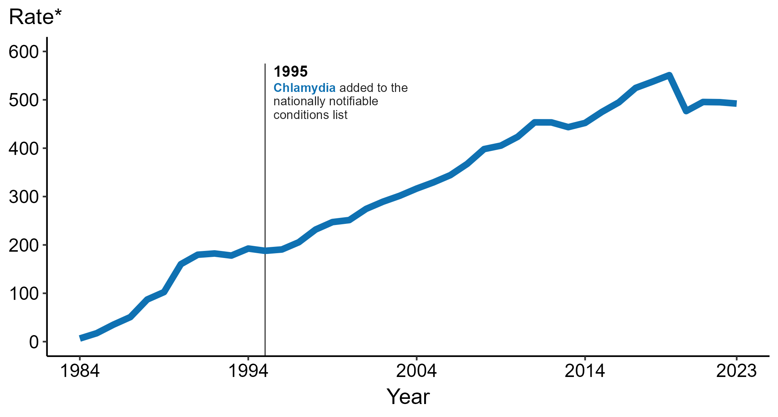
Chlamydia — Rates of Reported Cases by Year, United States, 1984–2023
* Per 100,000
Notes:
Data collection for chlamydia began in 1984 and chlamydia was made a nationally notifiable condition in 1995; however, chlamydia was not reportable in all 50 states and the District of Columbia until 2000. Steady increases in chlamydia case rates beginning in 1996 are due, in part, to improved reporting, increased screening, and the use of more sensitive diagnostic tests.
In 2023, a total of 1,648,568 cases of chlamydia were reported in the United States. During 2022 to 2023, the rate of reported chlamydia did not change substantially (<1.0% change; from 495.0 to 492.2 per 100,000).
This report includes data from years that coincide with the COVID-19 pandemic, which introduced uncertainty and difficulty in interpreting STI surveillance data. See Impact of COVID-19 on STIs (https://www.cdc.gov/sti-statistics/about/impact-of-covid-19.html) for more information.
See Technical Notes (https://www.cdc.gov/sti-statistics/annual/technical-notes.html) for information on STI case reporting formats and practices, including collected and derived variables displayed in this report. Table A (https://www.cdc.gov/sti-statistics/data-vis/table-selected-percunknown.html) provides information on unknown, missing, or invalid values of select variables.
Data for all figures are available at https://www.cdc.gov/sti-statistics/media/files/2024/11/2023-STI-Surveillance-Report-Data-Points.zip. The file “CT - Rates by Year (US 1984-2023).xlsx” contains the data for the figure presented on this slide.

Slide 5
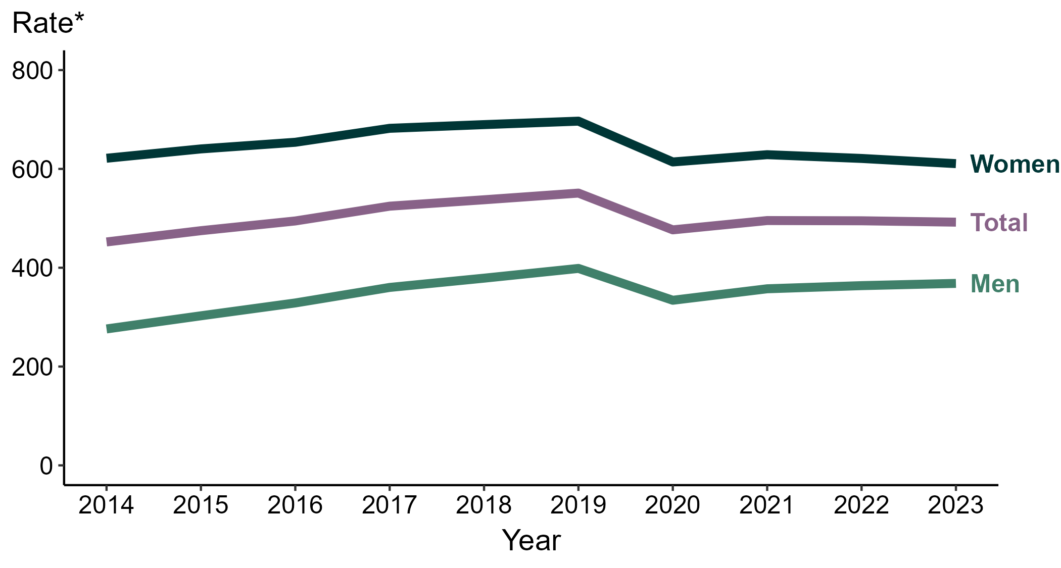
Chlamydia — Rates of Reported Cases by Sex and Year, United States, 2014–2023
* Per 100,000
Notes:
During 2022 to 2023, the rate of reported chlamydia among men increased 1.3% (from 363.7 to 368.3 per 100,000) and the rate among women decreased 1.7% (from 621.2 to 610.7 per 100,000).
During 2019 to 2023, the rate of reported chlamydia among men decreased 7.6% (from 398.6 to 368.3 per 100,000) and the rate among women decreased 12.3% (from 696.6 to 610.7 per 100,000). During 2014 to 2023, the rate among men increased 33.4% (from 276.1 to 368.3 per 100,000) and the rate among women decreased 1.8% (from 621.6 to 610.7 per 100,000).
This report includes data from years that coincide with the COVID-19 pandemic, which introduced uncertainty and difficulty in interpreting STI surveillance data. See Impact of COVID-19 on STIs (https://www.cdc.gov/sti-statistics/about/impact-of-covid-19.html) for more information.
See Technical Notes (https://www.cdc.gov/sti-statistics/annual/technical-notes.html) for information on STI case reporting formats and practices, including collected and derived variables displayed in this report. Table A (https://www.cdc.gov/sti-statistics/data-vis/table-selected-percunknown.html) provides information on unknown, missing, or invalid values of select variables.
Data for all figures are available at https://www.cdc.gov/sti-statistics/media/files/2024/11/2023-STI-Surveillance-Report-Data-Points.zip. The file “CT - Rates by Sex (US and Terr 2014-2023).xlsx” contains the data for the figure presented on this slide.

Slide 6
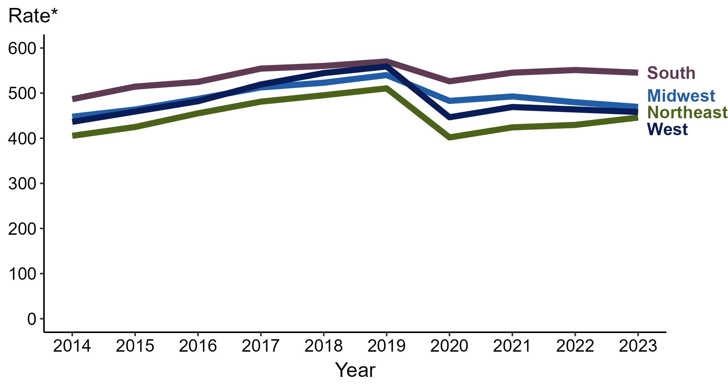
Chlamydia — Rates of Reported Cases by Region and Year, United States, 2014–2023
* Per 100,000
Notes:
In 2023, the South had the highest rate of reported chlamydia (545.3 cases per 100,000; 1.1% decrease from 2022), followed by the Midwest (469.4 cases per 100,000; 2.1% decrease from 2022), the West (458.2 cases per 100,000; 1.2% decrease from 2022), and the Northeast (445.8 cases per 100,000; 3.8% increase from 2022).
There were no substantial increases (≥1.0%) in the rate of reported cases of chlamydia in any region during the five-year period from 2019 to 2023. The South had the greatest 10-year increase in rates of reported cases of chlamydia (486.6 to 545.3 per 100,000; 12.1% increase from 2014).
This report includes data from years that coincide with the COVID-19 pandemic, which introduced uncertainty and difficulty in interpreting STI surveillance data. See Impact of COVID-19 on STIs (https://www.cdc.gov/sti-statistics/about/impact-of-covid-19.html) for more information.
See Technical Notes (https://www.cdc.gov/sti-statistics/annual/technical-notes.html) for information on STI case reporting formats and practices, including collected and derived variables displayed in this report. Table A (https://www.cdc.gov/sti-statistics/data-vis/table-selected-percunknown.html) provides information on unknown, missing, or invalid values of select variables.
Data for all figures are available at https://www.cdc.gov/sti-statistics/media/files/2024/11/2023-STI-Surveillance-Report-Data-Points.zip. The file “CT - Rates by Region (US 2014-2023).xlsx” contains the data for the figure presented on this slide.

Slide 7
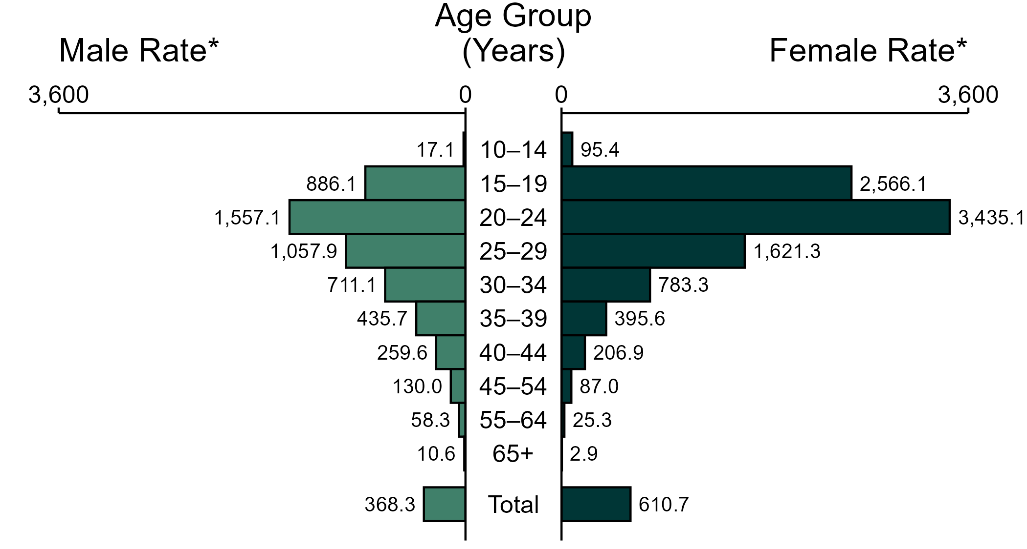
Chlamydia — Rates of Reported Cases by Age Group and Sex, United States, 2023
* Per 100,000
NOTE: In 2023, 13,417 chlamydia cases among men (2.2%) and 22,139 cases among women (2.1%) had missing or unknown age. These cases are included in the total rates.
Notes:
In 2023, the rate of reported chlamydia was higher among women (610.7 per 100,000) compared to men (368.3 per 100,000).
Among women, those aged 20 to 24 years had the highest rate of reported cases of chlamydia (3,435.1 per 100,000), followed by women aged 15 to 19 years (2,566.1 per 100,000) and women aged 25 to 29 years (1,621.3 per 100,000). Among men, those aged 20 to 24 years also had the highest rate of reported cases of chlamydia (1,557.1 per 100,000), followed by men aged 25 to 29 years (1,057.9 per 100,000) and men aged 15 to 19 years (886.1 per 100,000).
This report includes data from years that coincide with the COVID-19 pandemic, which introduced uncertainty and difficulty in interpreting STI surveillance data. See Impact of COVID-19 on STIs (https://www.cdc.gov/sti-statistics/about/impact-of-covid-19.html) for more information.
See Technical Notes (https://www.cdc.gov/sti-statistics/annual/technical-notes.html) for information on STI case reporting formats and practices, including collected and derived variables displayed in this report. Table A (https://www.cdc.gov/sti-statistics/data-vis/table-selected-percunknown.html) provides information on unknown, missing, or invalid values of select variables.
Data for all figures are available at https://www.cdc.gov/sti-statistics/media/files/2024/11/2023-STI-Surveillance-Report-Data-Points.zip. The file “CT - Rates by Age Group and Sex (US 2023).xlsx” contains the data for the figure presented on this slide.

Slide 8
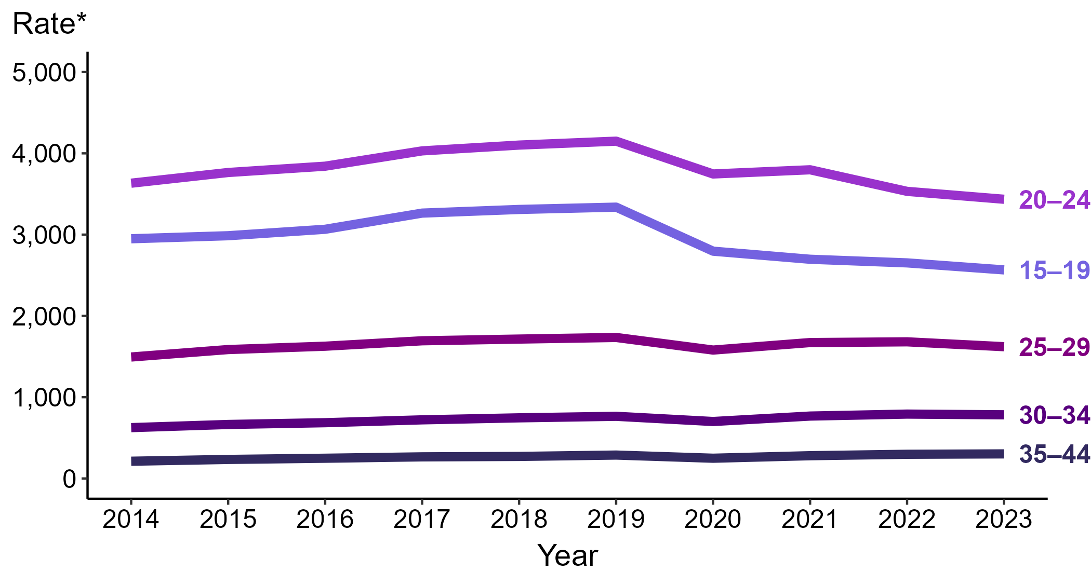
Chlamydia — Rates of Reported Cases Among Women Aged 15–44 Years by Age Group and Year, United States, 2014–2023
* Per 100,000
Notes:
Among women aged 15 to 44 years in 2023, those aged 20 to 24 years had the highest rate of reported cases of chlamydia (3,435.1 cases per 100,000; 2.8% decrease from 2022), followed by those aged 15 to 19 years (2,566.1 cases per 100,000; 3.3% decrease from 2022), those aged 25 to 29 years (1,621.3 cases per 100,000; 3.6% decrease from 2022), those aged 30 to 34 years (783.3 cases per 100,000; 1.1% decrease from 2022), and those aged 35 to 44 years (302.4 cases per 100,000; 1.6% increase from 2022).
This report includes data from years that coincide with the COVID-19 pandemic, which introduced uncertainty and difficulty in interpreting STI surveillance data. See Impact of COVID-19 on STIs (https://www.cdc.gov/sti-statistics/about/impact-of-covid-19.html) for more information.
See Technical Notes (https://www.cdc.gov/sti-statistics/annual/technical-notes.html) for information on STI case reporting formats and practices, including collected and derived variables displayed in this report. Table A (https://www.cdc.gov/sti-statistics/data-vis/table-selected-percunknown.html) provides information on unknown, missing, or invalid values of select variables.
Data for all figures are available at https://www.cdc.gov/sti-statistics/media/files/2024/11/2023-STI-Surveillance-Report-Data-Points.zip. The file “CT - Rates Women 15-44 Years by Age Group (US 2014-2023).xlsx” contains the data for the figure presented on this slide.

Slide 9
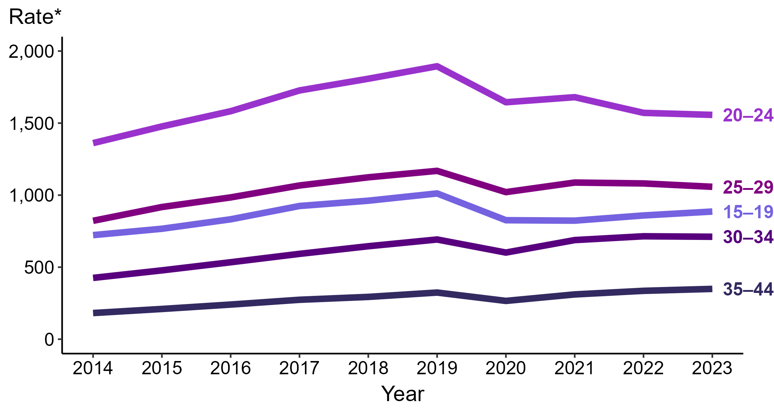
Chlamydia — Rates of Reported Cases Among Men Aged 15–44 Years by Age Group, United States, 2014–2023
* Per 100,000
Notes:
Among men aged 15 to 44 years in 2023, those aged 20 to 24 years had the highest rate of reported cases of chlamydia (1,557.1 cases per 100,000; <1.0% change from 2022), followed by those aged 25 to 29 years (1,057.9 cases per 100,000; 2.2% decrease from 2022), those aged 15 to 19 years (886.1 cases per 100,000; 3.2% increase from 2022), those aged 30 to 34 years (711.1 cases per 100,000; <1.0% change from 2022), and those aged 35 to 44 years (349.1 cases per 100,000; 4.0% increase from 2022).
This report includes data from years that coincide with the COVID-19 pandemic, which introduced uncertainty and difficulty in interpreting STI surveillance data. See Impact of COVID-19 on STIs (https://www.cdc.gov/sti-statistics/about/impact-of-covid-19.html) for more information.
See Technical Notes (https://www.cdc.gov/sti-statistics/annual/technical-notes.html) for information on STI case reporting formats and practices, including collected and derived variables displayed in this report. Table A (https://www.cdc.gov/sti-statistics/data-vis/table-selected-percunknown.html) provides information on unknown, missing, or invalid values of select variables.
Data for all figures are available at https://www.cdc.gov/sti-statistics/media/files/2024/11/2023-STI-Surveillance-Report-Data-Points.zip. The file “CT - Rates Men 15-44 Years by Age Group (US 2014-2023).xlsx” contains the data for the figure presented on this slide.

Slide 10
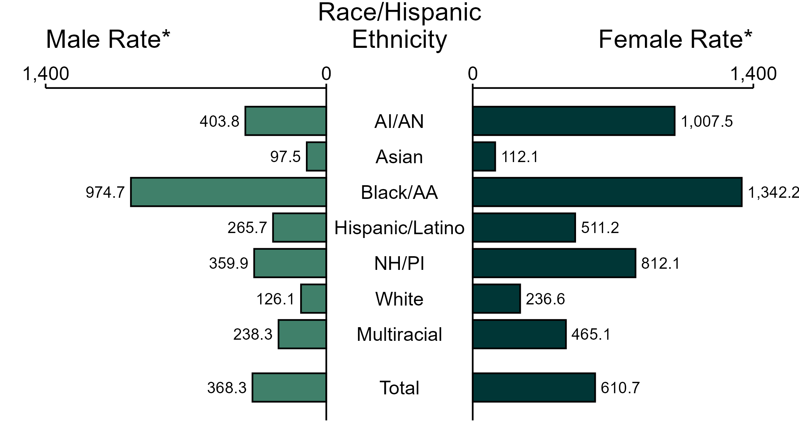
Chlamydia — Rates of Reported Cases by Race/Hispanic Ethnicity and Sex, United States, 2023
* Per 100,000
ACRONYMS: AI/AN = American Indian or Alaska Native; Black/AA = Black or African American; NH/PI = Native Hawaiian or other Pacific Islander
NOTE: In 2023, 177,355 chlamydia cases among men (29.1%) and 293,445 cases among women (28.4%) had missing, unknown, or other race and were not reported to be of Hispanic ethnicity. These cases are included in the total rates.
Notes:
In 2023, the rate of reported chlamydia was higher among women (610.7 per 100,000) compared to men (368.3 per 100,000).
Among women, non-Hispanic Black or African American women had the highest rate of reported cases of chlamydia (1,342.2 per 100,000), followed by non-Hispanic American Indian or Alaska Native women (1,007.5 per 100,000) and non-Hispanic Native Hawaiian or other Pacific Islander women (812.1 per 100,000). Among men, non-Hispanic Black or African American men also had the highest rate of reported cases of chlamydia (974.7 per 100,000), followed by non-Hispanic American Indian or Alaska Native men (403.8 per 100,000) and non-Hispanic Native Hawaiian or other Pacific Islander men (359.9 per 100,000).
Using non-Hispanic White persons as the referent category, the greatest relative disparity in rates of reported chlamydia by race and Hispanic ethnicity across both sexes was observed among non-Hispanic Black or African American men, with a rate ratio of 7.7 times that of non-Hispanic White men. Among women, the greatest relative disparity was observed among non-Hispanic Black or African American women as well, with a rate 5.7 times that of non-Hispanic White women.
This report includes data from years that coincide with the COVID-19 pandemic, which introduced uncertainty and difficulty in interpreting STI surveillance data. See Impact of COVID-19 on STIs (https://www.cdc.gov/sti-statistics/about/impact-of-covid-19.html) for more information.
See Technical Notes (https://www.cdc.gov/sti-statistics/annual/technical-notes.html) for information on STI case reporting formats and practices, including collected and derived variables displayed in this report. Table A (https://www.cdc.gov/sti-statistics/data-vis/table-selected-percunknown.html) provides information on unknown, missing, or invalid values of select variables.
Data for all figures are available at https://www.cdc.gov/sti-statistics/media/files/2024/11/2023-STI-Surveillance-Report-Data-Points.zip. The file “CT - Rates by Race Hispanic Ethnicity and Sex (US 2023).xlsx” contains the data for the figure presented on this slide.

Slide 11
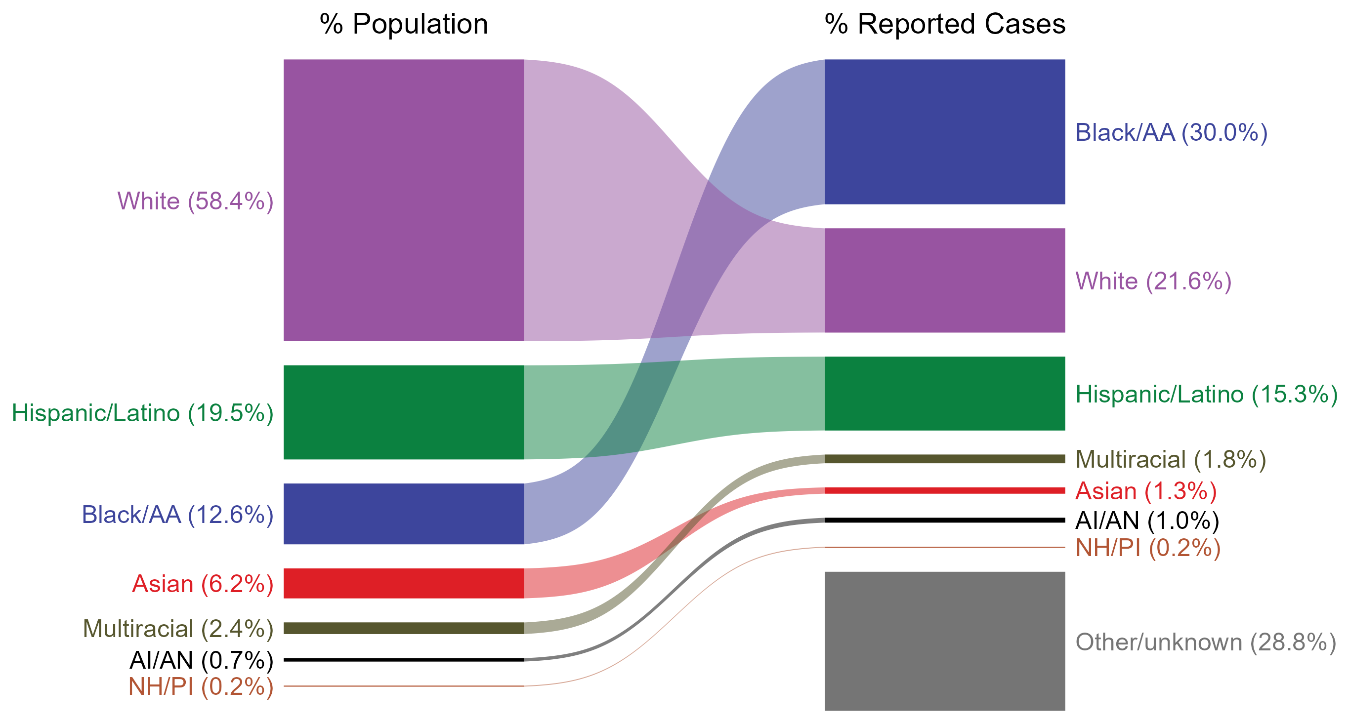
Chlamydia — Total Population and Reported Cases by Race/Hispanic Ethnicity, United States, 2023
ACRONYMS: AI/AN = American Indian or Alaska Native; Black/AA = Black or African American; NH/PI = Native Hawaiian or other Pacific Islander
NOTE: In 2023, a total of 474,218 chlamydia cases (28.8%) had missing, unknown, or other race and were not reported to be of Hispanic ethnicity. These cases are included in the “other/unknown” category.
Notes:
The percentages of chlamydia cases by race and Hispanic ethnicity were disproportionate to the percentages among the total population of the United States in 2023. The greatest absolute and relative disparities were observed among non-Hispanic Black or African American persons, who represented 30.0% of reported chlamydia cases (n = 493,754; 42.0% of chlamydia cases with reported race or Hispanic ethnicity) despite being 12.6% of the US population. This means that the burden of chlamydia among non-Hispanic Black or African American persons was 17.4% greater than — or 2.4 times — what would be expected based on their proportion of the population. Additionally, non-Hispanic American Indian or Alaska Native persons were also overrepresented among chlamydia cases relative to their proportion of the population.
This report includes data from years that coincide with the COVID-19 pandemic, which introduced uncertainty and difficulty in interpreting STI surveillance data. See Impact of COVID-19 on STIs (https://www.cdc.gov/sti-statistics/about/impact-of-covid-19.html) for more information.
See Technical Notes (https://www.cdc.gov/sti-statistics/annual/technical-notes.html) for information on STI case reporting formats and practices, including collected and derived variables displayed in this report. Table A (https://www.cdc.gov/sti-statistics/data-vis/table-selected-percunknown.html) provides information on unknown, missing, or invalid values of select variables.
Data for all figures are available at https://www.cdc.gov/sti-statistics/media/files/2024/11/2023-STI-Surveillance-Report-Data-Points.zip. The file “CT - Population and Cases by Race Hispanic Ethnicity (US 2023).xlsx” contains the data for the figure presented on this slide.

Slide 12
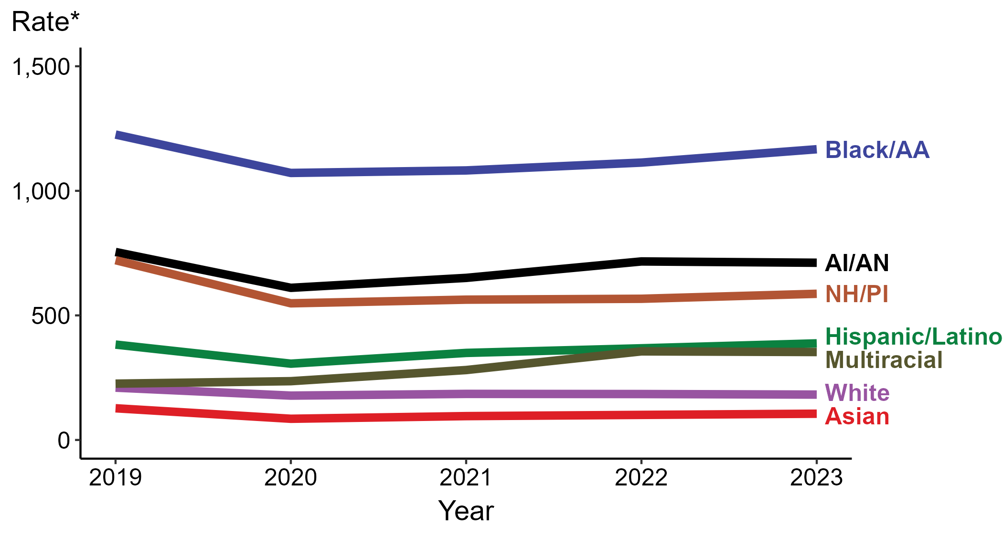
Chlamydia — Rates of Reported Cases by Race/Hispanic Ethnicity and Year, United States, 2019–2023
* Per 100,000
ACRONYMS: AI/AN = American Indian or Alaska Native; Black/AA = Black or African American; NH/PI = Native Hawaiian or other Pacific Islander
NOTE: During 2019 to 2023, the percentage of all chlamydia cases with missing, unknown, or other race and not reported to be of Hispanic ethnicity was 32.1%, from a low of 28.8% (n = 474,218) in 2023 to a high of 34.1% (n = 538,834) in 2020. These cases are not shown in this figure.
Notes:
In 2023, the highest rate of reported chlamydia cases was among non-Hispanic Black or African American persons (1,166.9 per 100,000), followed by non-Hispanic American Indian or Alaska Native persons (711.3 per 100,000).
During 2022 to 2023, the greatest increase in rate of reported chlamydia cases was among Hispanic or Latino persons of any race(s) (368.0 to 387.7 per 100,000; 5.4% increase). Non-Hispanic persons of multiple races had the greatest five-year increase in rate of reported chlamydia (226.0 to 353.0 per 100,000; 56.2% increase from 2019).
During 2022 to 2023, the only decrease in rate of reported chlamydia cases was among non-Hispanic White persons (184.3 to 182.1 per 100,000; 1.2% decrease). Non-Hispanic Native Hawaiian or other Pacific Islander persons had the greatest five-year decrease in rate of reported chlamydia (721.6 to 586.7 per 100,000; 18.7% decrease from 2019).
This report includes data from years that coincide with the COVID-19 pandemic, which introduced uncertainty and difficulty in interpreting STI surveillance data. See Impact of COVID-19 on STIs (https://www.cdc.gov/sti-statistics/about/impact-of-covid-19.html) for more information.
See Technical Notes (https://www.cdc.gov/sti-statistics/annual/technical-notes.html) for information on STI case reporting formats and practices, including collected and derived variables displayed in this report. Table A (https://www.cdc.gov/sti-statistics/data-vis/table-selected-percunknown.html) provides information on unknown, missing, or invalid values of select variables.
Data for all figures are available at https://www.cdc.gov/sti-statistics/media/files/2024/11/2023-STI-Surveillance-Report-Data-Points.zip. The file “CT - Rates by Race Hispanic Ethnicity (US 2019-2023).xlsx” contains the data for the figure presented on this slide.

Slide 13
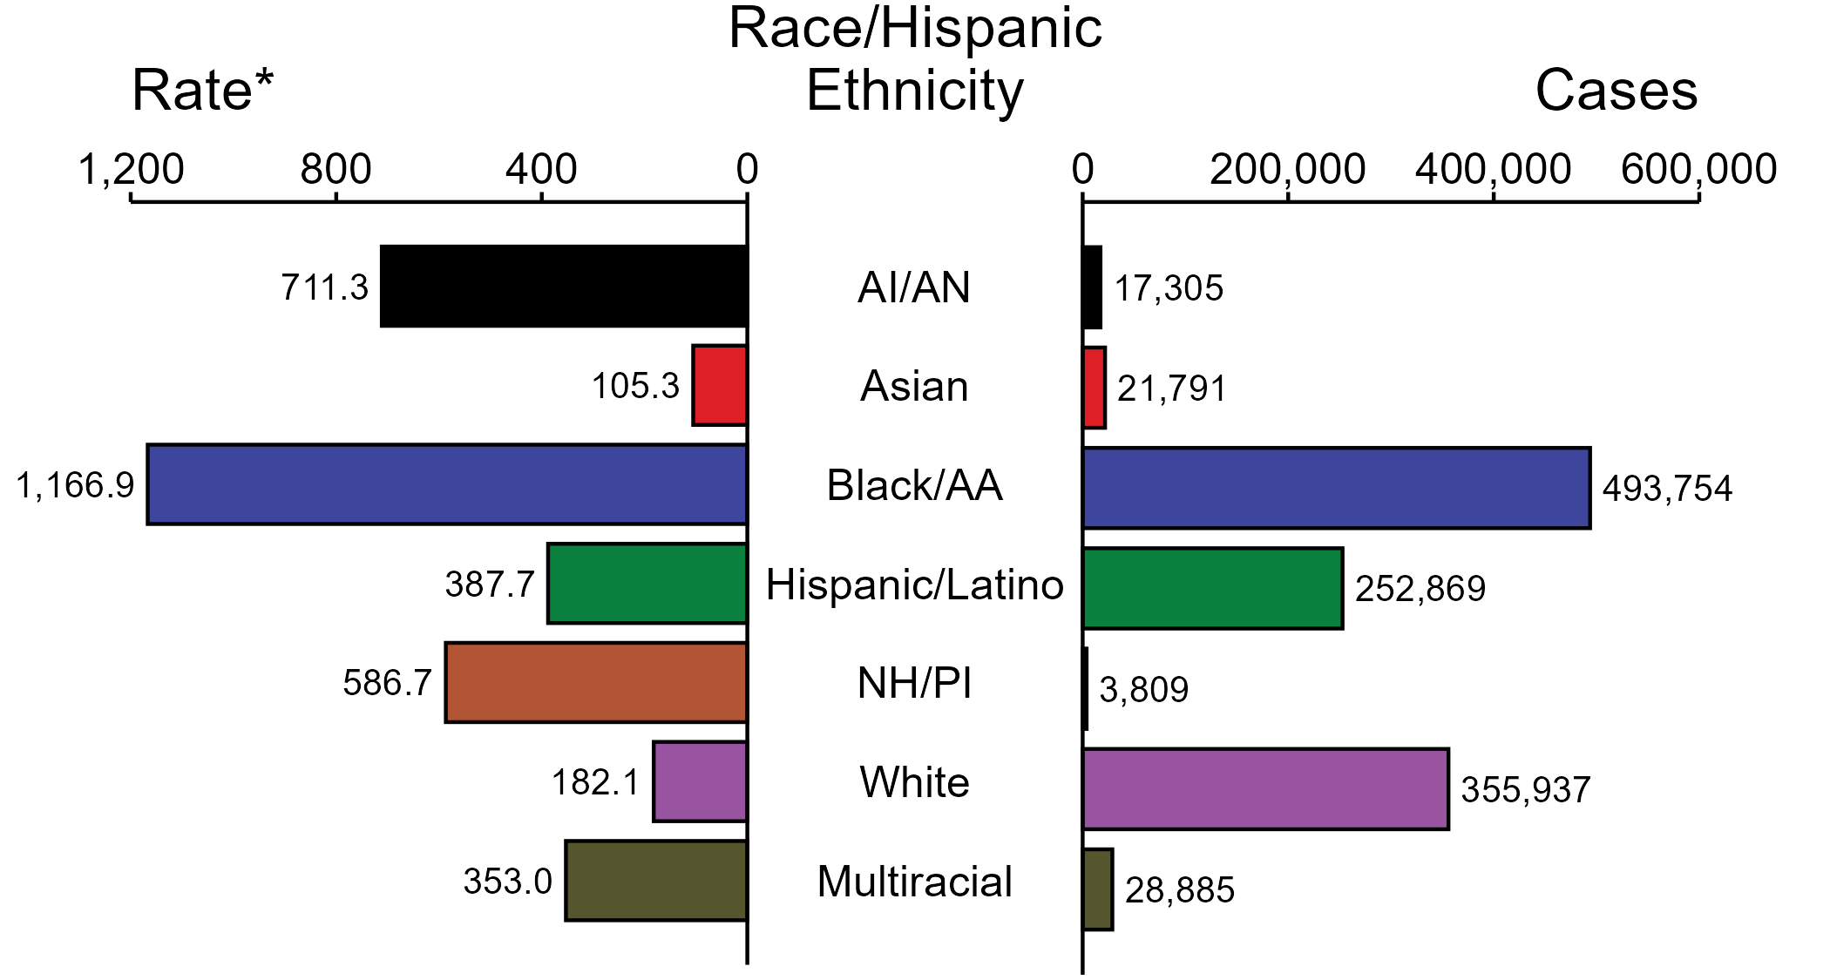
Chlamydia — Case Counts and Rates of Reported Cases by Race/Hispanic Ethnicity, United States, 2023
* Per 100,000
ACRONYMS: AI/AN = American Indian or Alaska Native; Black/AA = Black or African American; NH/PI = Native Hawaiian or other Pacific Islander
NOTE: In 2023, a total of 474,218 chlamydia cases (28.8%) had missing, unknown, or other race and were not reported to be of Hispanic ethnicity. These cases are not shown in this figure. Including these cases, there were a total of 1,648,568 cases of chlamydia reported among states and the District of Columbia for a rate of 492.2 per 100,000 persons.
Notes:
In 2023, rates of chlamydia were highest among non-Hispanic Black or African American persons (1,166.9 per 100,000), followed by non-Hispanic American Indian or Alaska Native persons (711.3 per 100,000) and non-Hispanic Native Hawaiian or other Pacific Islander persons (586.7 per 100,000). The greatest number of reported chlamydia cases was among non-Hispanic Black or African American persons (493,754 cases), followed by non-Hispanic White persons (355,937 cases) and Hispanic or Latino persons of any race(s) (252,869 cases).
This report includes data from years that coincide with the COVID-19 pandemic, which introduced uncertainty and difficulty in interpreting STI surveillance data. See Impact of COVID-19 on STIs (https://www.cdc.gov/sti-statistics/about/impact-of-covid-19.html) for more information.
See Technical Notes (https://www.cdc.gov/sti-statistics/annual/technical-notes.html) for information on STI case reporting formats and practices, including collected and derived variables displayed in this report. Table A (https://www.cdc.gov/sti-statistics/data-vis/table-selected-percunknown.html) provides information on unknown, missing, or invalid values of select variables.
Data for all figures are available at https://www.cdc.gov/sti-statistics/media/files/2024/11/2023-STI-Surveillance-Report-Data-Points.zip. The file “CT - Cases and Rates by Race Hispanic Ethnicity (US 2023).xlsx” contains the data for the figure presented on this slide.

Slide 14
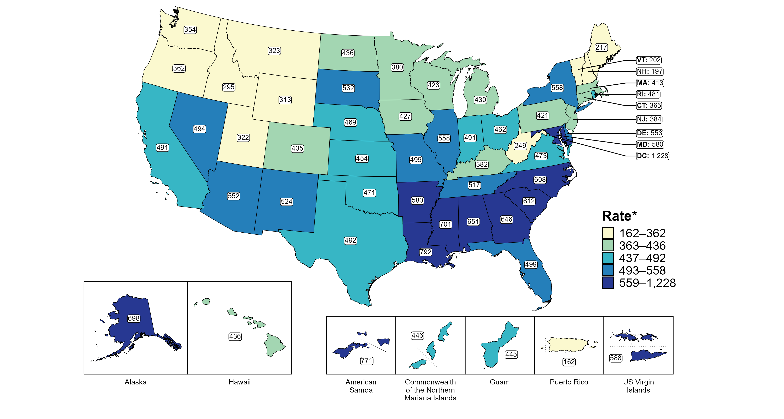
Chlamydia — Rates of Reported Cases by Jurisdiction, United States and Territories, 2023
* Per 100,000
Notes:
In 2023, rates of reported chlamydia ranged by state from 197 cases per 100,000 persons in New Hampshire to 792 cases per 100,000 persons in Louisiana. The rate of reported chlamydia in the District of Columbia was 1,228 per 100,000 persons.
Among US territories, rates of reported chlamydia ranged from 162 cases per 100,000 persons in Puerto Rico to 771 cases per 100,000 persons in American Samoa.
Tennessee transitioned STI surveillance information systems in September of 2023 which may have impacted the overall case counts. Caution should be applied in interpretation of these data.
This report includes data from years that coincide with the COVID-19 pandemic, which introduced uncertainty and difficulty in interpreting STI surveillance data. See Impact of COVID-19 on STIs (https://www.cdc.gov/sti-statistics/about/impact-of-covid-19.html) for more information.
See Technical Notes (https://www.cdc.gov/sti-statistics/annual/technical-notes.html) for information on STI case reporting formats and practices, including collected and derived variables displayed in this report. Table A (https://www.cdc.gov/sti-statistics/data-vis/table-selected-percunknown.html) provides information on unknown, missing, or invalid values of select variables.
Data for all figures are available at https://www.cdc.gov/sti-statistics/media/files/2024/11/2023-STI-Surveillance-Report-Data-Points.zip. The file “CT - Rates by Jurisdiction (US and Terr 2023).xlsx” contains the data for the figure presented on this slide.

Slide 15
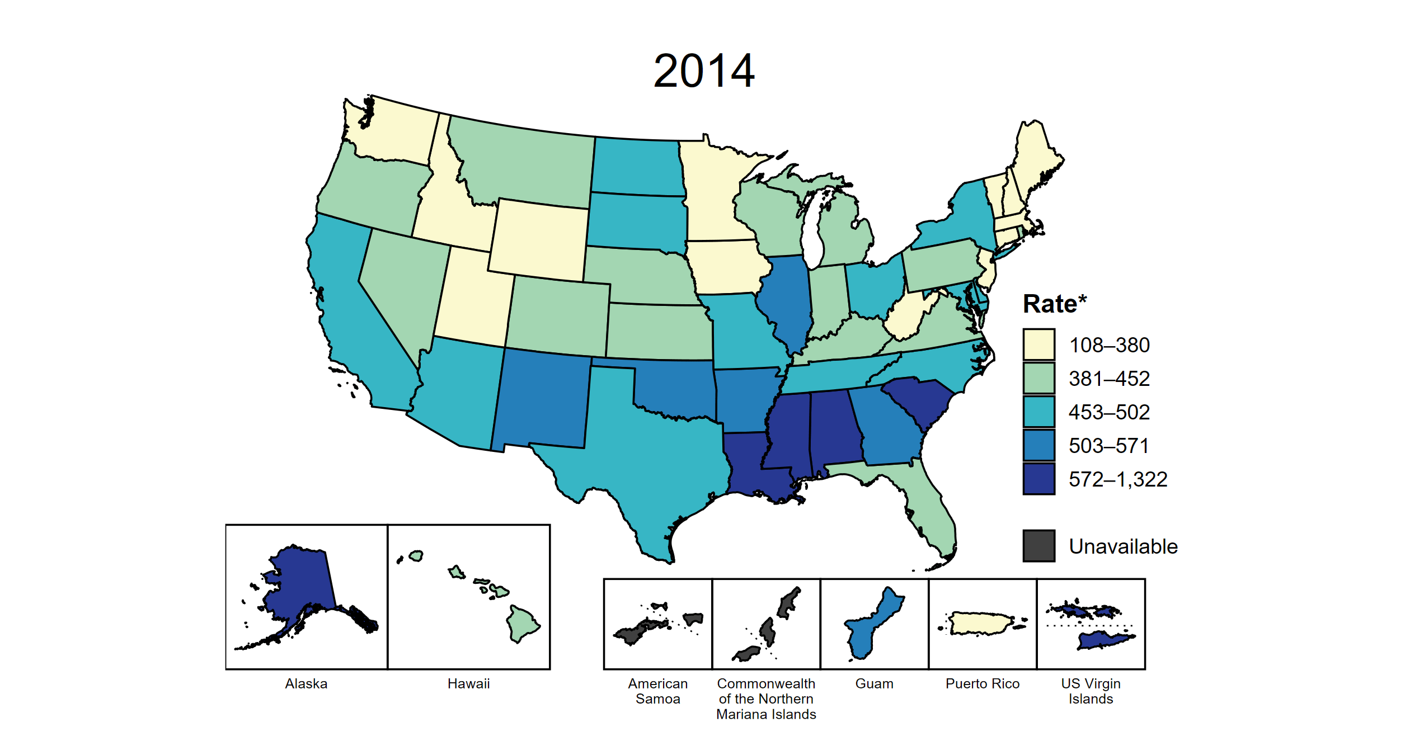
Chlamydia — Rates of Reported Cases by Jurisdiction, United States and Territories, 2014–2023
* Per 100,000
Notes:
This slide contains an animated figure that will play when the slide is in presentation mode. A static version of the figure that displays maps from the first and last years of the range is available as a separate slide.
In 2014, 10 states, the District of Columbia (DC), and two US territories (24.1% of areas with available data) had a rate of reported chlamydia greater than or equal to 503 cases per 100,000 persons. This increased to 16 states, DC, and two US territories (33.9% of areas with available data) in 2023. During 2022 to 2023, rates of reported chlamydia increased in 16 states, DC, and four territories.
American Samoa and the Commonwealth of the Northern Mariana Islands began providing data on chlamydia cases to CDC in 2018; data are not available for those areas prior to that year. In addition, data on reported chlamydia cases in 2018 are not available for the US Virgin Islands. Due to a network security incident in December 2021, the Maryland Department of Health could not finalize their 2021 STI case notification data. Data for 2021 from Maryland have been suppressed for this figure; however, they are included in national and regional case counts and rates displayed in other figures. Tennessee transitioned STI surveillance information systems in September of 2023 which may have impacted the overall case counts. Caution should be applied in interpretation of these data.
This report includes data from years that coincide with the COVID-19 pandemic, which introduced uncertainty and difficulty in interpreting STI surveillance data. See Impact of COVID-19 on STIs (https://www.cdc.gov/sti-statistics/about/impact-of-covid-19.html) for more information.
See Technical Notes (https://www.cdc.gov/sti-statistics/annual/technical-notes.html) for information on STI case reporting formats and practices, including collected and derived variables displayed in this report. Table A (https://www.cdc.gov/sti-statistics/data-vis/table-selected-percunknown.html) provides information on unknown, missing, or invalid values of select variables.
Data for all figures are available at https://www.cdc.gov/sti-statistics/media/files/2024/11/2023-STI-Surveillance-Report-Data-Points.zip. The file “CT - Rates by Jurisdiction (US and Terr 2014-2023).xlsx” contains the data for the figure presented on this slide.

Slide 16
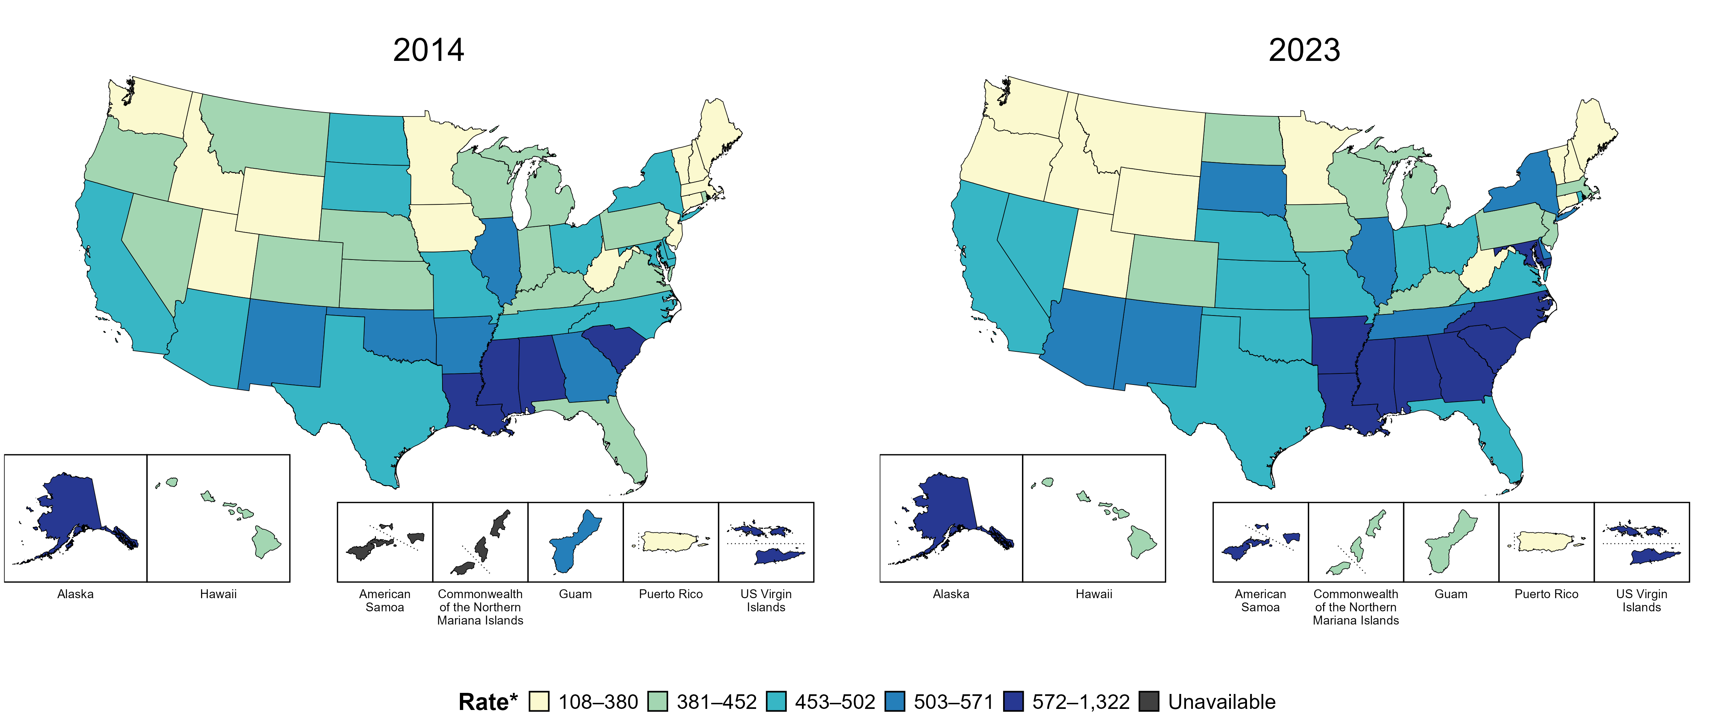
Chlamydia — Rates of Reported Cases by Jurisdiction, United States and Territories, 2014 and 2023
* Per 100,000
Notes:
In 2014, 10 states, the District of Columbia (DC), and two US territories (24.1% of areas with available data) had a rate of reported chlamydia greater than or equal to 503 cases per 100,000 persons. This increased to 16 states, DC, and two US territories (33.9% of areas with available data) in 2023.
American Samoa and the Commonwealth of the Northern Mariana Islands began providing data on chlamydia cases to CDC in 2018; data are not available for those areas prior to that year. Tennessee transitioned STI surveillance information systems in September of 2023 which may have impacted the overall case counts. Caution should be applied in interpretation of these data.
This report includes data from years that coincide with the COVID-19 pandemic, which introduced uncertainty and difficulty in interpreting STI surveillance data. See Impact of COVID-19 on STIs (https://www.cdc.gov/sti-statistics/about/impact-of-covid-19.html) for more information.
See Technical Notes (https://www.cdc.gov/sti-statistics/annual/technical-notes.html) for information on STI case reporting formats and practices, including collected and derived variables displayed in this report. Table A (https://www.cdc.gov/sti-statistics/data-vis/table-selected-percunknown.html) provides information on unknown, missing, or invalid values of select variables.
Data for all figures are available at https://www.cdc.gov/sti-statistics/media/files/2024/11/2023-STI-Surveillance-Report-Data-Points.zip. The file “CT - Rates by Jurisdiction (US and Terr 2014 and 2023).xlsx” contains the data for the figure presented on this slide.

Slide 17
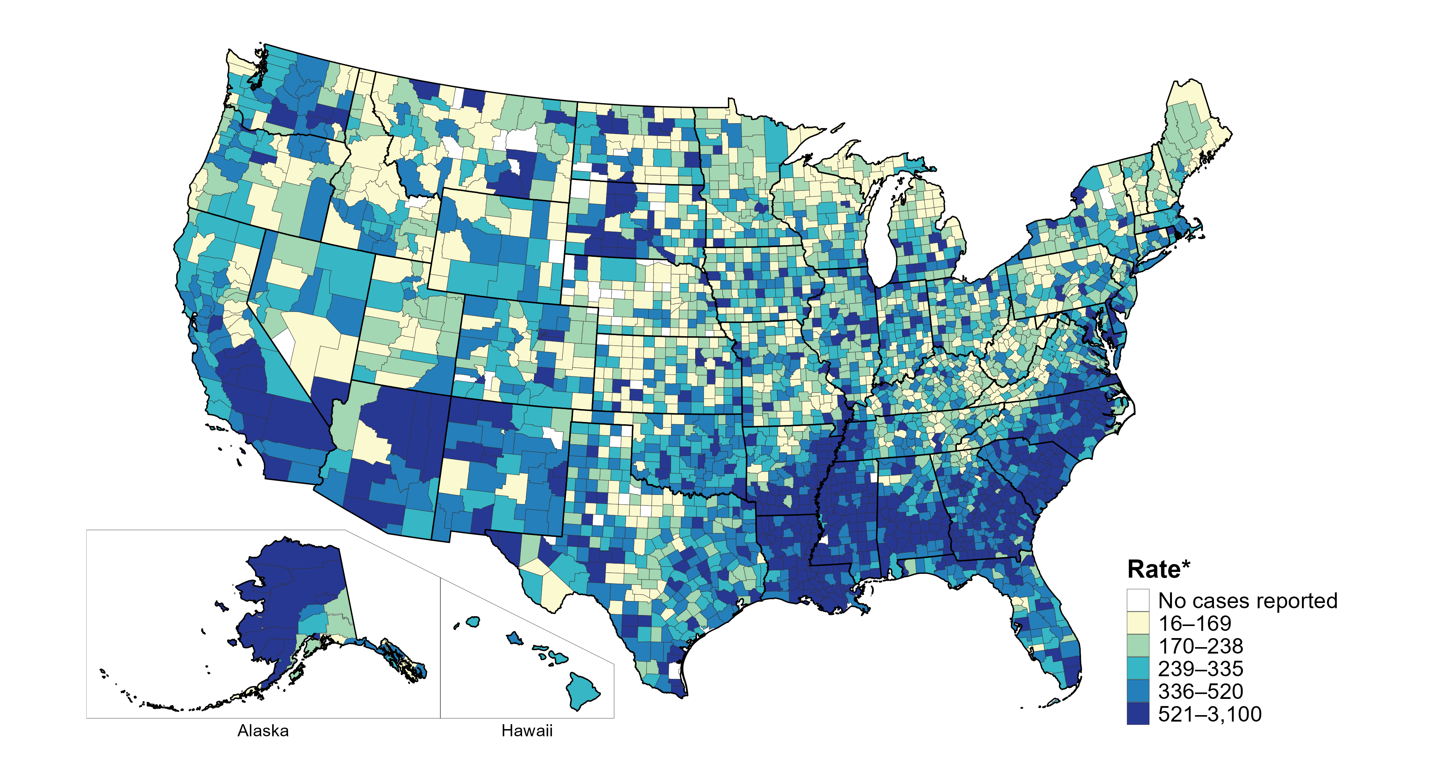
Chlamydia — Rates of Reported Cases by County, United States, 2023
* Per 100,000
Notes:
In 2023, 98.6% of all counties and county equivalents in the United States reported at least one case of chlamydia. Out of 3,144 counties and county equivalents, 92 counties or county equivalents (2.9%) reported over half of all cases of chlamydia (821,839 of 1,639,237 total cases).
Tennessee transitioned STI surveillance information systems in September of 2023 which may have impacted the overall case counts. Caution should be applied in interpretation of these data.
This report includes data from years that coincide with the COVID-19 pandemic, which introduced uncertainty and difficulty in interpreting STI surveillance data. See Impact of COVID-19 on STIs (https://www.cdc.gov/sti-statistics/about/impact-of-covid-19.html) for more information.
See Technical Notes (https://www.cdc.gov/sti-statistics/annual/technical-notes.html) for information on STI case reporting formats and practices, including collected and derived variables displayed in this report. Table A (https://www.cdc.gov/sti-statistics/data-vis/table-selected-percunknown.html) provides information on unknown, missing, or invalid values of select variables.
Data for all figures are available at https://www.cdc.gov/sti-statistics/media/files/2024/11/2023-STI-Surveillance-Report-Data-Points.zip. The file “CT - Rates by County (US 2023).xlsx” contains the data for the figure presented on this slide.

Slide 18
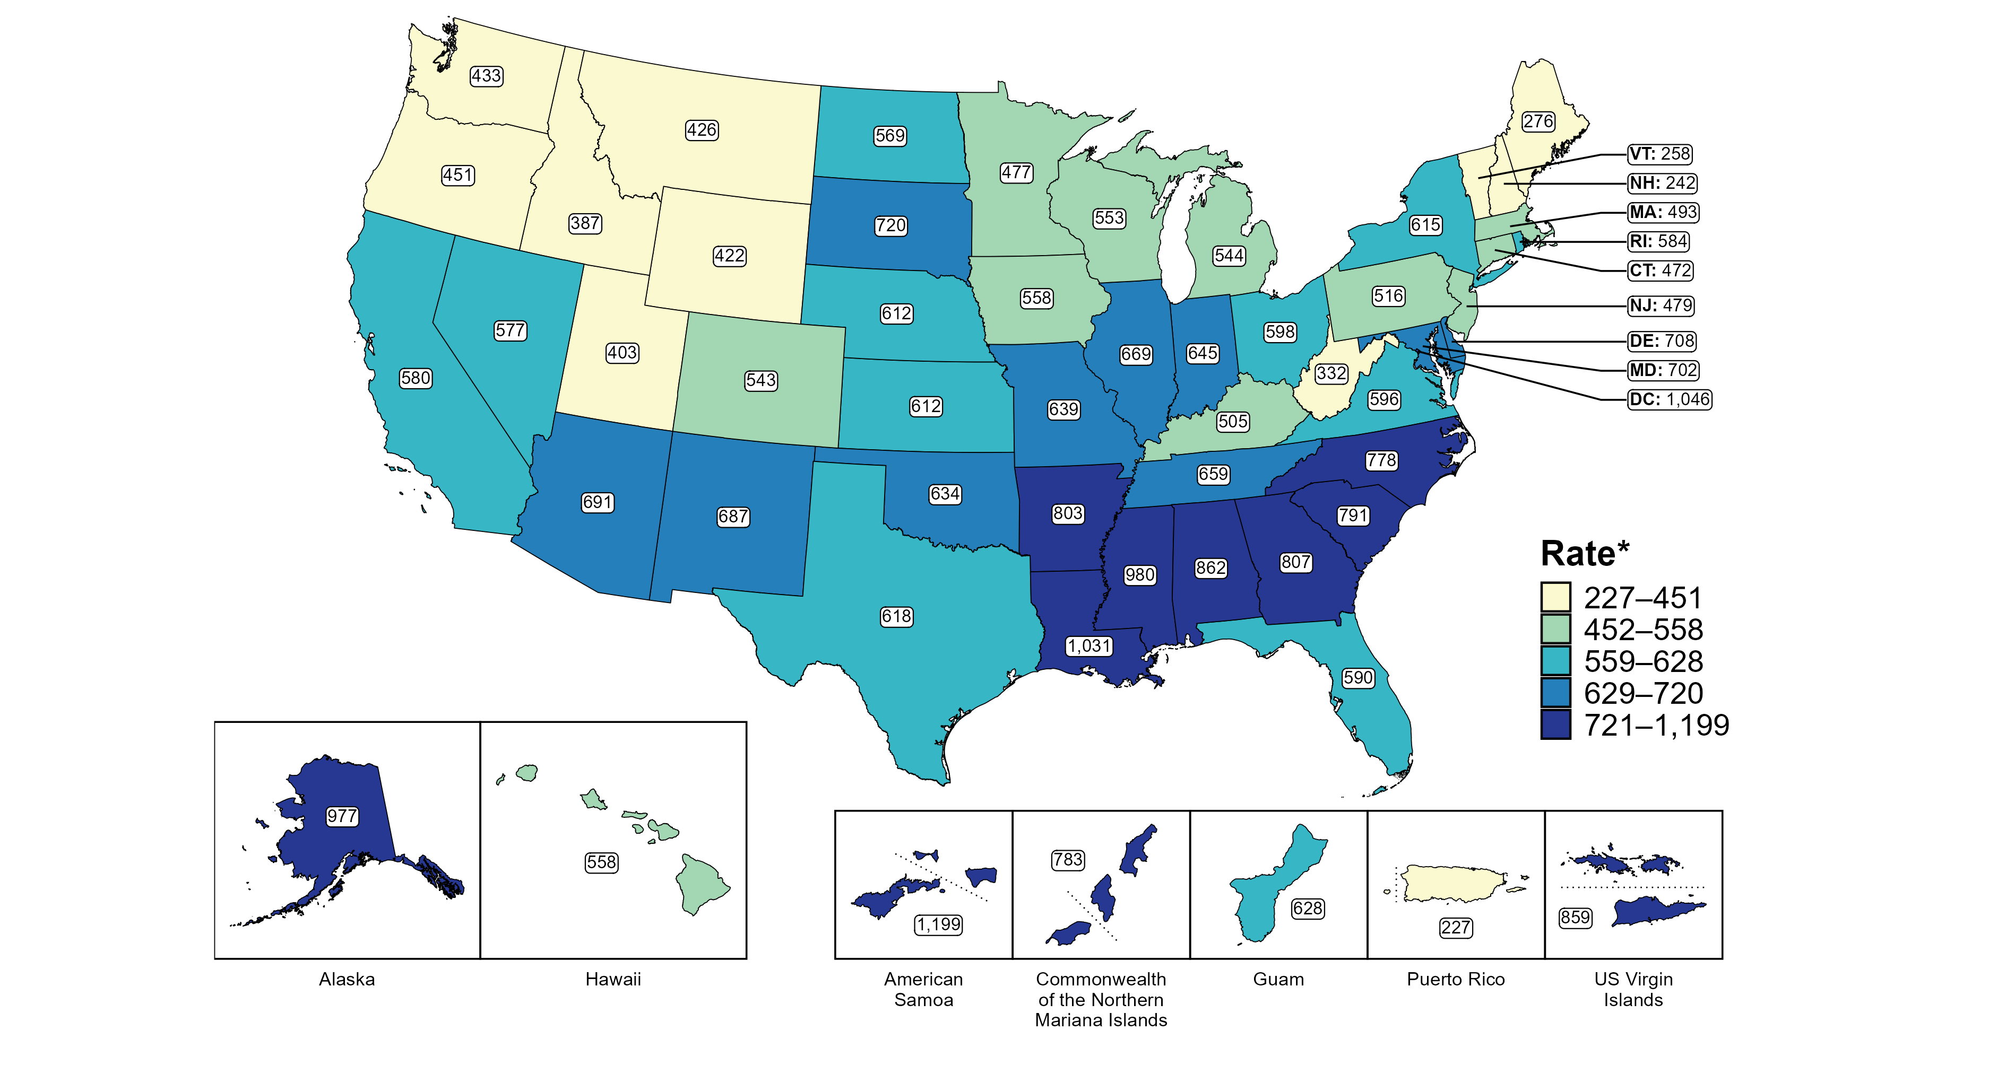
Chlamydia — Rates of Reported Cases Among Women by Jurisdiction, United States and Territories, 2023
* Per 100,000
Notes:
In 2023, rates of reported chlamydia among women ranged by state from 242 cases per 100,000 women in New Hampshire to 1,031 cases per 100,000 women in Louisiana. The rate of reported chlamydia in the District of Columbia was 1,046 per 100,000 women.
Among US territories, rates of reported chlamydia ranged from 227 cases per 100,000 women in Puerto Rico to 1,199 cases per 100,000 women in American Samoa.
Tennessee transitioned STI surveillance information systems in September of 2023 which may have impacted the overall case counts. Caution should be applied in interpretation of these data.
This report includes data from years that coincide with the COVID-19 pandemic, which introduced uncertainty and difficulty in interpreting STI surveillance data. See Impact of COVID-19 on STIs (https://www.cdc.gov/sti-statistics/about/impact-of-covid-19.html) for more information.
See Technical Notes (https://www.cdc.gov/sti-statistics/annual/technical-notes.html) for information on STI case reporting formats and practices, including collected and derived variables displayed in this report. Table A (https://www.cdc.gov/sti-statistics/data-vis/table-selected-percunknown.html) provides information on unknown, missing, or invalid values of select variables.
Data for all figures are available at https://www.cdc.gov/sti-statistics/media/files/2024/11/2023-STI-Surveillance-Report-Data-Points.zip. The file “CT - Rates Women by Jurisdiction (US and Terr 2023).xlsx” contains the data for the figure presented on this slide.

Slide 19
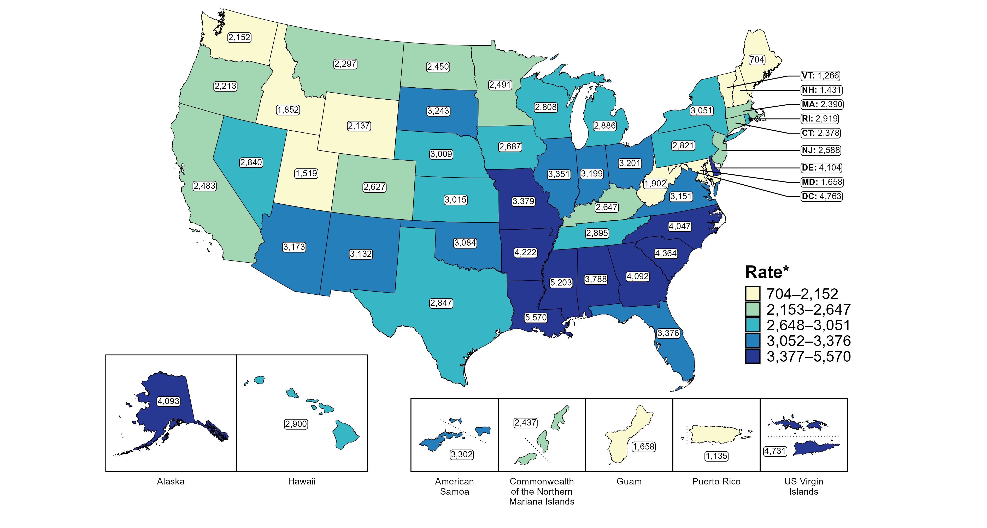
Chlamydia — Rates of Reported Cases Among Women Aged 15–24 Years by Jurisdiction, United States and Territories, 2023
* Per 100,000
Notes:
In 2023, rates of reported chlamydia among women aged 15 to 24 years ranged by state from 704 cases per 100,000 women aged 15 to 24 years in Maine to 5,570 cases per 100,000 women aged 15 to 24 years in Louisiana. The rate of reported chlamydia in the District of Columbia was 4,763 per 100,000 women aged 15 to 24 years.
Among US territories, rates of reported chlamydia ranged from 1,135 cases per 100,000 women aged 15 to 24 years in Puerto Rico to 4,731 cases per 100,000 women aged 15 to 24 years in the US Virgin Islands.
Tennessee transitioned STI surveillance information systems in September of 2023 which may have impacted the overall case counts. Caution should be applied in interpretation of these data.
This report includes data from years that coincide with the COVID-19 pandemic, which introduced uncertainty and difficulty in interpreting STI surveillance data. See Impact of COVID-19 on STIs (https://www.cdc.gov/sti-statistics/about/impact-of-covid-19.html) for more information.
See Technical Notes (https://www.cdc.gov/sti-statistics/annual/technical-notes.html) for information on STI case reporting formats and practices, including collected and derived variables displayed in this report. Table A (https://www.cdc.gov/sti-statistics/data-vis/table-selected-percunknown.html) provides information on unknown, missing, or invalid values of select variables.
Data for all figures are available at https://www.cdc.gov/sti-statistics/media/files/2024/11/2023-STI-Surveillance-Report-Data-Points.zip. The file “CT - Rates Women 15-24 Years by Jurisdiction (US and Terr 2023).xlsx” contains the data for the figure presented on this slide.

Slide 20
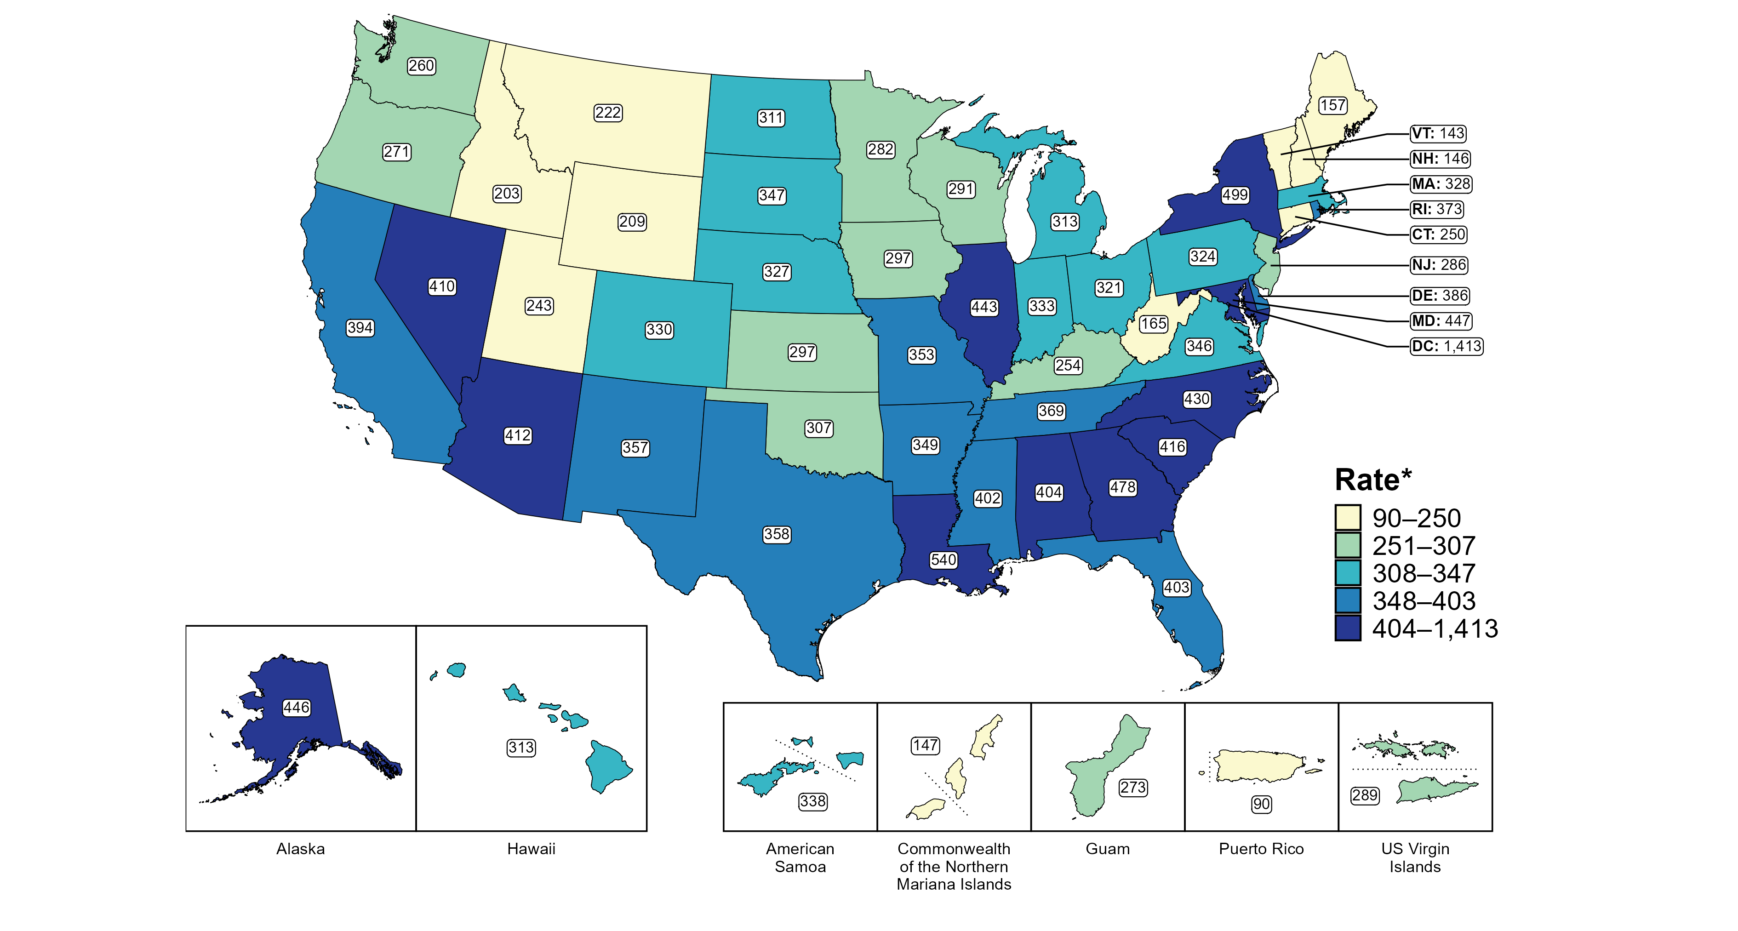
Chlamydia — Rates of Reported Cases Among Men by Jurisdiction, United States and Territories, 2023
*Per 100,000
Notes:
In 2023, rates of reported chlamydia among men ranged by state from 143 cases per 100,000 men in Vermont to 540 cases per 100,000 men in Louisiana. The rate of reported chlamydia in the District of Columbia was 1,413 per 100,000 men.
Among US territories, rates of reported chlamydia ranged from 90 cases per 100,000 men in Puerto Rico to 338 cases per 100,000 men in American Samoa.
Tennessee transitioned STI surveillance information systems in September of 2023 which may have impacted the overall case counts. Caution should be applied in interpretation of these data.
This report includes data from years that coincide with the COVID-19 pandemic, which introduced uncertainty and difficulty in interpreting STI surveillance data. See Impact of COVID-19 on STIs (https://www.cdc.gov/sti-statistics/about/impact-of-covid-19.html) for more information.
See Technical Notes (https://www.cdc.gov/sti-statistics/annual/technical-notes.html) for information on STI case reporting formats and practices, including collected and derived variables displayed in this report. Table A (https://www.cdc.gov/sti-statistics/data-vis/table-selected-percunknown.html) provides information on unknown, missing, or invalid values of select variables.
Data for all figures are available at https://www.cdc.gov/sti-statistics/media/files/2024/11/2023-STI-Surveillance-Report-Data-Points.zip. The file “CT - Rates Men by Jurisdiction (US and Terr 2023).xlsx” contains the data for the figure presented on this slide.

Slide 21
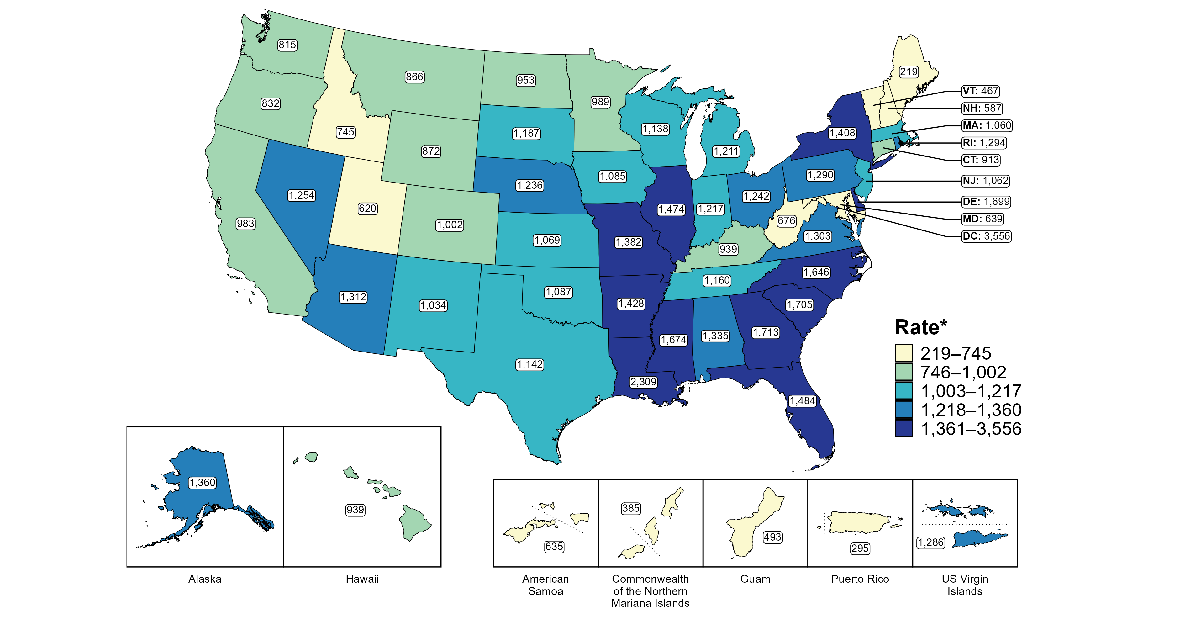
Chlamydia — Rates of Reported Cases Among Men Aged 15–24 Years by Jurisdiction, United States and Territories, 2023
* Per 100,000
Notes:
In 2023, rates of reported chlamydia among men aged 15 to 24 years ranged by state from 219 cases per 100,000 men aged 15 to 24 years in Maine to 2,309 cases per 100,000 men aged 15 to 24 years in Louisiana. The rate of reported chlamydia in the District of Columbia was 3,556 per 100,000 men aged 15 to 24 years.
Among US territories, rates of reported chlamydia ranged from 295 cases per 100,000 men aged 15 to 24 years in Puerto Rico to 1,286 cases per 100,000 men aged 15 to 24 years in the US Virgin Islands.
Tennessee transitioned STI surveillance information systems in September of 2023 which may have impacted the overall case counts. Caution should be applied in interpretation of these data.
This report includes data from years that coincide with the COVID-19 pandemic, which introduced uncertainty and difficulty in interpreting STI surveillance data. See Impact of COVID-19 on STIs (https://www.cdc.gov/sti-statistics/about/impact-of-covid-19.html) for more information.
See Technical Notes (https://www.cdc.gov/sti-statistics/annual/technical-notes.html) for information on STI case reporting formats and practices, including collected and derived variables displayed in this report. Table A (https://www.cdc.gov/sti-statistics/data-vis/table-selected-percunknown.html) provides information on unknown, missing, or invalid values of select variables.
Data for all figures are available at https://www.cdc.gov/sti-statistics/media/files/2024/11/2023-STI-Surveillance-Report-Data-Points.zip. The file “CT - Rates Men 15-24 Years by Jurisdiction (US and Terr 2023).xlsx” contains the data for the figure presented on this slide.

Slide 22
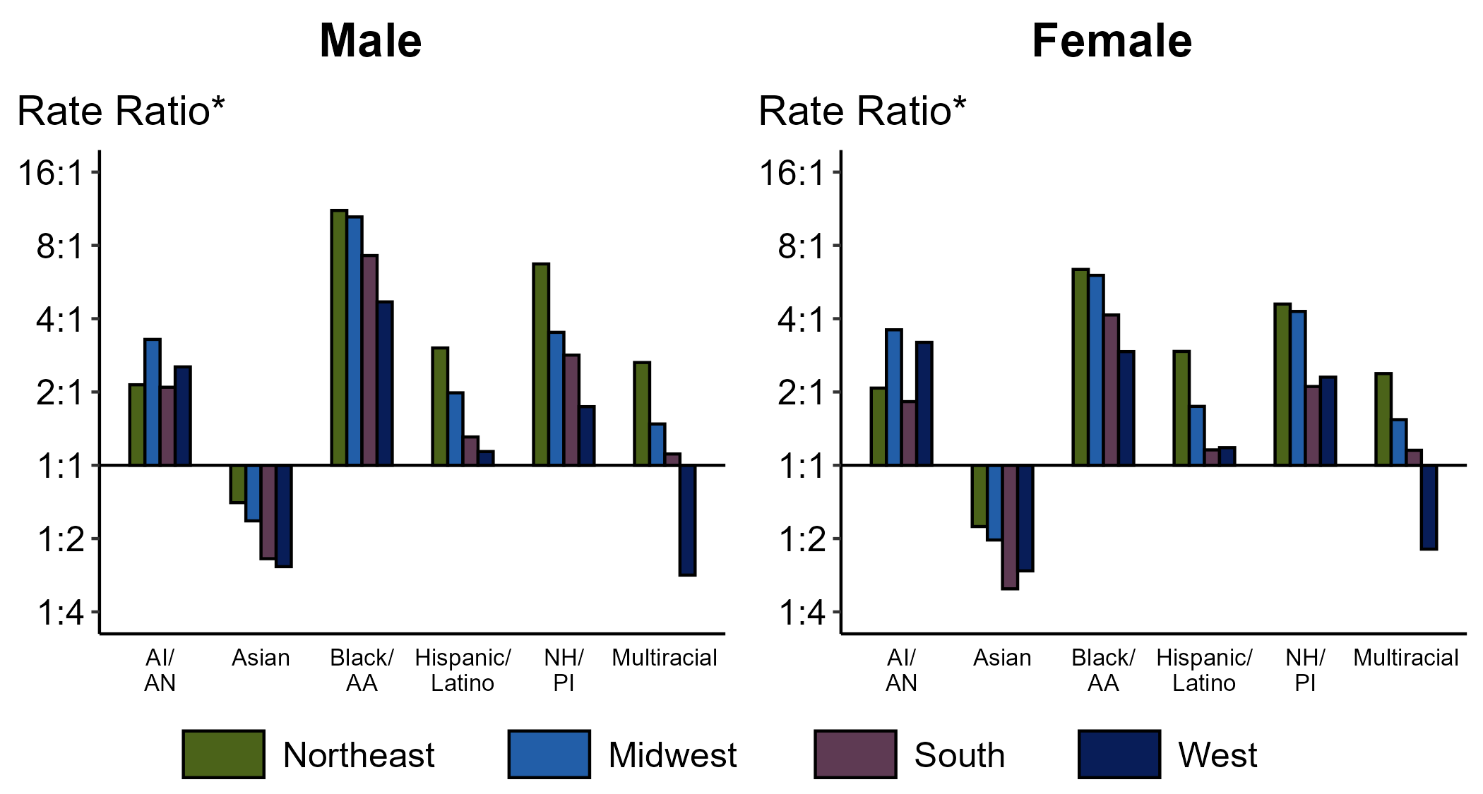
Chlamydia — Ratios of Rates of Reported Cases Among Persons Aged 15–24 Years by Sex, Race/Hispanic Ethnicity, and Region, United States, 2023
* For the rate ratios, non-Hispanic White persons are the referent population. Y-axis is log scale.
ACRONYMS: AI/AN = American Indian or Alaska Native; Black/AA = Black or African American; NH/PI = Native Hawaiian or other Pacific Islander
Notes:
Among men and women, rate ratios of rates of reported chlamydia by race/Hispanic ethnicity (using non-Hispanic White persons as the referent population) varied by region in 2023. Among men, the greatest rate ratio was in the Northeast where the rate of reported chlamydia among non-Hispanic Black or African American men was 11.1 times the rate among non-Hispanic White men. Among women, the greatest rate ratio was in the Northeast where the rate of reported chlamydia among non-Hispanic Black or African American women was 6.4 times the rate among non-Hispanic White women.
This report includes data from years that coincide with the COVID-19 pandemic, which introduced uncertainty and difficulty in interpreting STI surveillance data. See Impact of COVID-19 on STIs (https://www.cdc.gov/sti-statistics/about/impact-of-covid-19.html) for more information.
See Technical Notes (https://www.cdc.gov/sti-statistics/annual/technical-notes.html) for information on STI case reporting formats and practices, including collected and derived variables displayed in this report. Table A (https://www.cdc.gov/sti-statistics/data-vis/table-selected-percunknown.html) provides information on unknown, missing, or invalid values of select variables..
Data for all figures are available at https://www.cdc.gov/sti-statistics/media/files/2024/11/2023-STI-Surveillance-Report-Data-Points.zip. The file “CT - Ratios of Rates Persons 15-24 Years by Sex Race Hispanic Ethnicity and Region (US 2023).xlsx” contains the data for the figure presented on this slide.

Slide 23
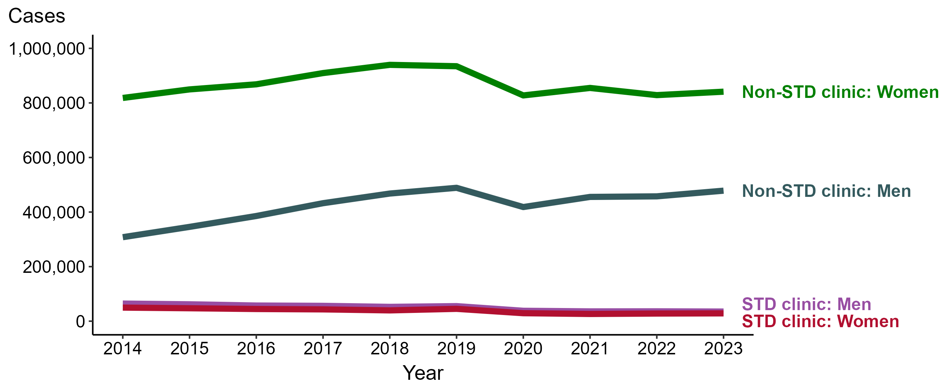
Chlamydia — Reported Cases by Reporting Source and Sex and Year, United States, 2014–2023
NOTE: During 2014 to 2023, the percentage of all cases with unknown reporting source was 15.6%, from a low of 13.9% (n = 199,982) in 2014 to a high of 17.9% (n = 295,170) in 2022.
Notes:
During 2022 to 2023, the number of chlamydia cases reported from STD clinics decreased 2.5% among men (36,135 to 35,233 cases) and increased 2.2% among women (27,930 to 28,551 cases), while the number of cases reported from non-STD clinics increased 4.5% among men (457,559 to 478,339 cases) and increased 1.5% among women (828,629 to 841,186 cases).
During 2014 to 2023, the number of chlamydia cases reported from STD clinics decreased 45.4% among men (64,479 to 35,233 cases) and decreased 42.6% among women (49,702 to 28,551 cases), while the number of cases reported from non-STD clinics increased 55.4% among men (307,841 to 478,339 cases) and increased 2.8% among women (818,242 to 841,186 cases).
This report includes data from years that coincide with the COVID-19 pandemic, which introduced uncertainty and difficulty in interpreting STI surveillance data. See Impact of COVID-19 on STIs (https://www.cdc.gov/sti-statistics/about/impact-of-covid-19.html) for more information.
See Technical Notes (https://www.cdc.gov/sti-statistics/annual/technical-notes.html) for information on STI case reporting formats and practices, including collected and derived variables displayed in this report. Table A (https://www.cdc.gov/sti-statistics/data-vis/table-selected-percunknown.html) provides information on unknown, missing, or invalid values of select variables.
Data for all figures are available at https://www.cdc.gov/sti-statistics/media/files/2024/11/2023-STI-Surveillance-Report-Data-Points.zip. The file “CT - Cases by Reporting Source and Sex (US 2014-2023).xlsx” contains the data for the figure presented on this slide.

Slide 24
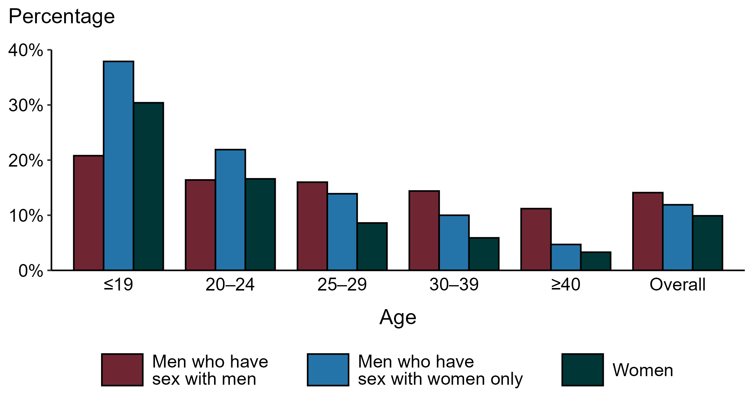
Chlamydia — Proportion of STD Clinic Patients Testing Positive by Age Group, Sex, and Sex of Sex Partners, STI Surveillance Network (SSuN), 2023
NOTE: Results are based on 50,808 unique patients in 11 participating jurisdictions with known sex of sex partners attending SSuN STI clinics who were tested ≥1 times for chlamydia in 2023.
Notes:
Among patients accessing care in participating STI clinics in the STI Surveillance Network (SSuN) who were tested for chlamydia in 2023 and had known sexual orientation or sex of sex partners, 14.1% of gay, bisexual and other men who have sex with men (MSM), 11.9% of men who have sex with women only (MSW), and 9.9% of women were found to be positive. The proportion testing positive for chlamydia varied by sex and sex of sex partners, as well as by age group. The highest proportion of patients testing positive were MSW aged 19 years and younger (37.9%).
This report includes data from years that coincide with the COVID-19 pandemic, which introduced uncertainty and difficulty in interpreting STI surveillance data. See Impact of COVID-19 on STIs (https://www.cdc.gov/sti-statistics/about/impact-of-covid-19.html) for more information.
See Technical Notes (https://www.cdc.gov/sti-statistics/annual/technical-notes.html) for information on SSuN methodology. Table A (https://www.cdc.gov/sti-statistics/data-vis/table-selected-percunknown.html) provides information on unknown, missing, or invalid values of select variables.

Slide 25
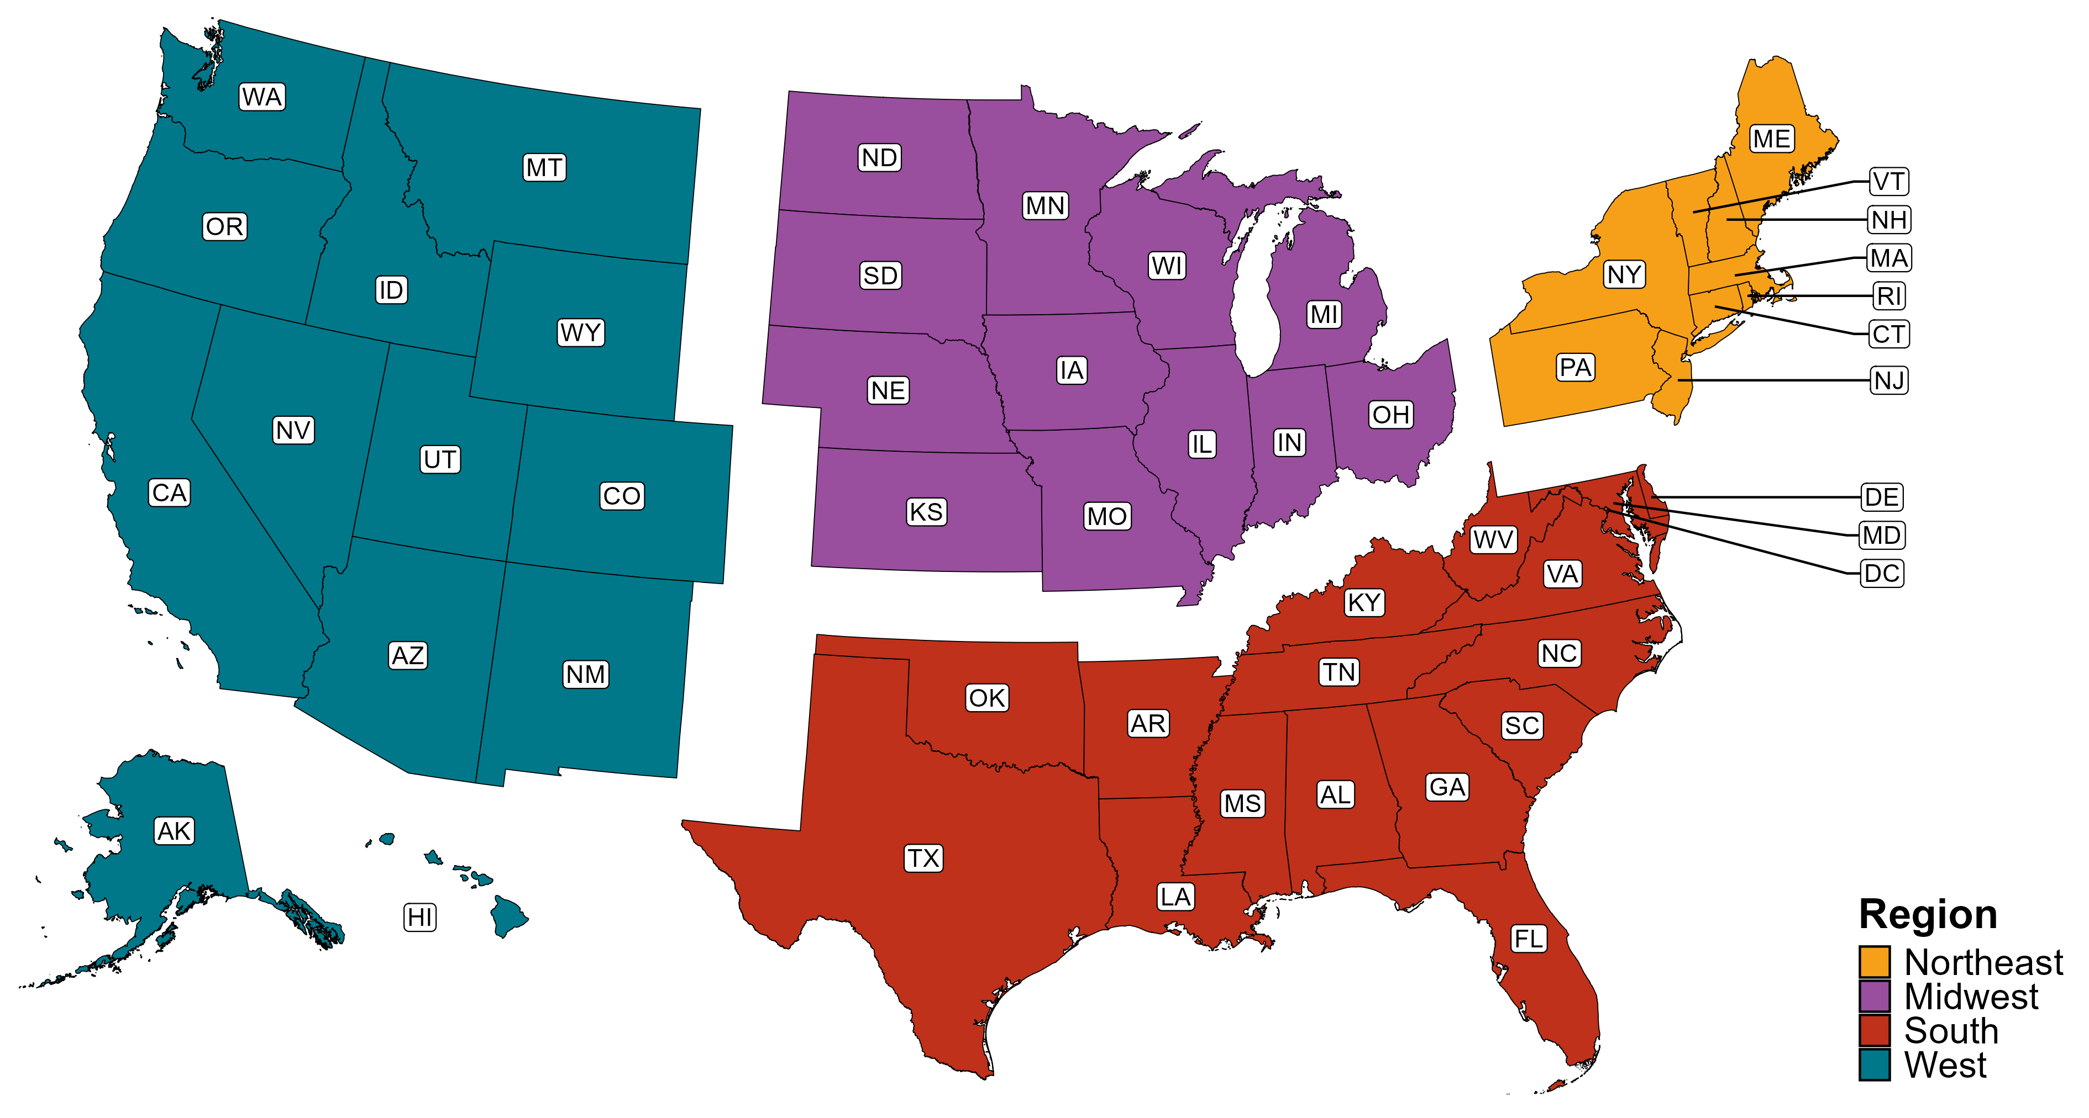
Reference Map of US Census Regions

