Slide 1
Building Clinical Strategies to STEADI Your Older Patients
Name, Title
Affiliation
Date
Disclaimer: Slide content developed by the Centers for Disease Control and Prevention

Slide 2
How to Use These Slides
Purpose: Encourage uptake of a STEADI-based fall prevention program
Target audience: Healthcare administrators
Slide order can be modified to fit your presentation
Slides 4 and 18 can be customized
Some slide notes include suggested talking points
References are listed at the end by slide

Slide 3
Presentation Overview
This presentation will highlight
The burden of falls
How we can prevent falls
Available tools and resources
Suggested steps to implement fall prevention programs

Slide 4
Your Thoughts and Experiences with Falls
How have falls among older adults (age 65+) affected you?
Have you or someone you know fallen?
What kind of life-changing events occurred because of the fall?
How could the fall have been prevented?
Notes:
Ask your audience about their experiences with falls among older adults living in the community. We define older adults as anyone aged 65 years and over.

Slide 5
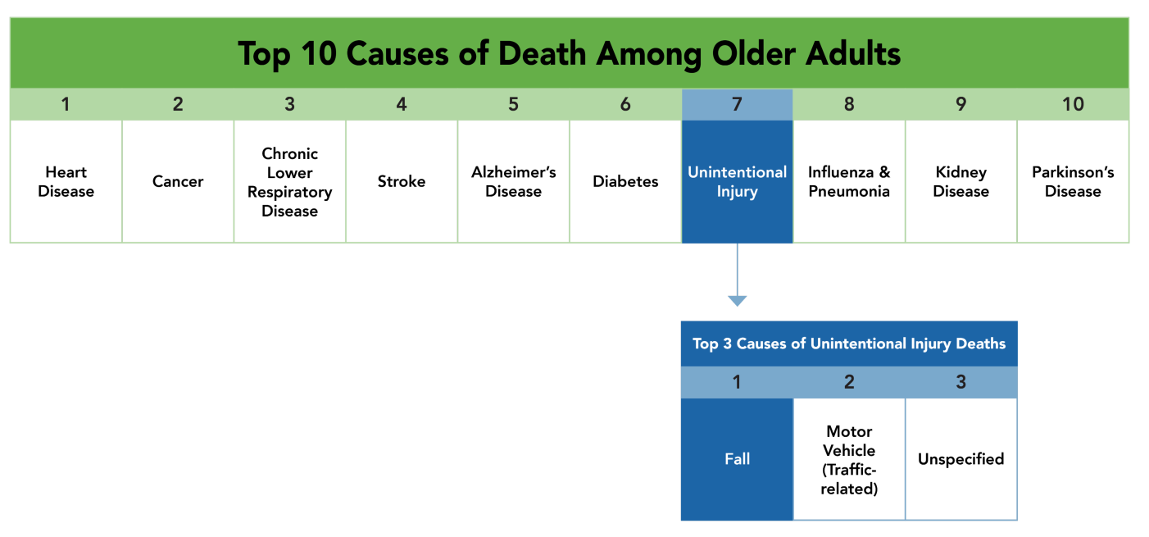
Leading Causes of Death
Data source: National Vital Statistics System
Reference: (1)
Notes:
Unintentional injuries are the 7th leading cause of death among older adults. Falls are the number one cause of those unintentional injury deaths.

Slide 6
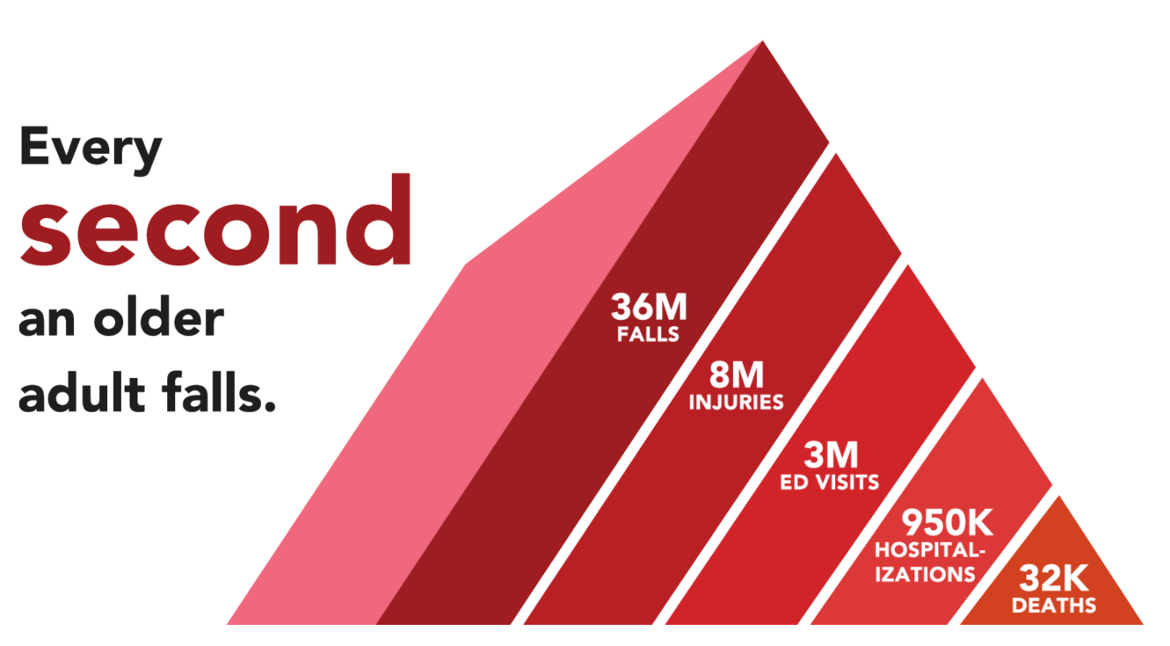
Falls Are Common
Data sources: National Vital Statistics System, National Electronic Injury Surveillance System-All Injury Program, and Behavioral Risk Factor Surveillance System.
References: (1,2)
Notes:
Every second an older adult falls. This adds up to approximately 36 million falls every year. Of those who fall, more than 8 million older adults are injured. These falls and fall injuries lead to about 3 million emergency department visits, more than 950,000 hospitalizations, and more than 32,000 deaths every year.

Slide 7
Consequences of Falls Among Older Adults
More than 95% of hip fractures are due to falls
Falls are the leading cause of traumatic brain injuries
Falls are fall injuries increase the risk of nursing home placement
Fall death rates increased about 30% between 2009 and 2018
Falls can lead to devastating outcomes
References: (3-6)
Notes:
Consequences of falls can be serious. Falls can result in debilitating injuries such as hip fractures and traumatic brain injury, loss of independence, and even deaths. Fall death rates have increased about 30% between 2009 and 2018 independent of how the population is aging.

Slide 8
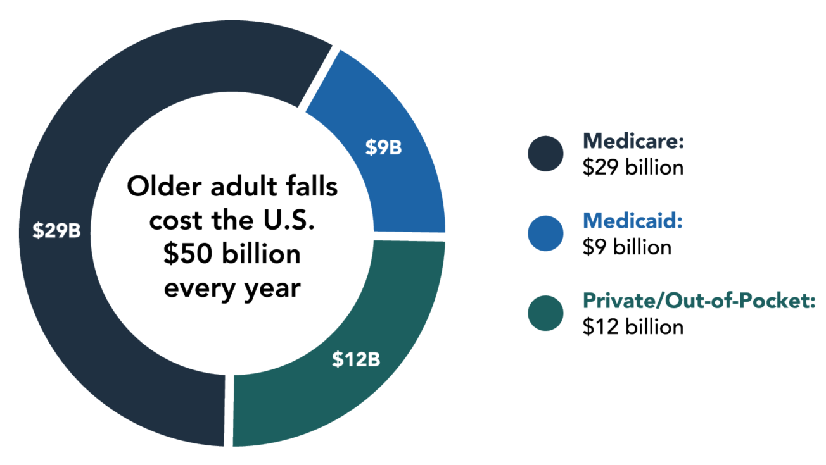
Falls Are Costly
Florence C., et al. (2018). Medical costs of fatal and nonfatal falls in older adults. Journal of the American Geriatrics Society, 66(4), 693-698.
Reference: (7)
Notes:
Falls can also be expensive. Overall in the United States, $50 billion is spent on falls every year. Programs, like Medicare and Medicaid, pay for more than 75% of these costs.

Slide 9
Falls Are Costly (Continued)
Average hospital visit for a fall costs $30,000
Fall-related injuries are a leading cause of hospital readmission
Approximate healthcare spending for falls by type of service
Type of service | Spending due to falls | Amount spent
Home health services, long-term care facilities, and other medical products | 12% | $ 29 billion
Physician, other provider | 6% | $ 11 billion
Hospital | 4% | $ 13 billion
Prescription drugs | 2% | $ 2 billion
Dental | 2% | $ 0.4 billion
References: (7-10)
Notes:
Injuries due to falls could result in hospitalizations costing an average of $30,000. Such injuries can also lead to hospital readmissions, which can further drive up the healthcare and personal expenses.
Table shows that expenses due to falls vary by type of healthcare service. The category of home health services, long-term care facilities, and other medical products (durable and nondurable) has the highest spending attributable to older adult falls. Falls accounted for about 12% of this category’s expenses, which amounts to $29 billion in spending. Similarly, falls accounted for about 6% of physician and other provider spending, 4% of hospital, 2% of prescription drugs, and 2% of dental spending.

Slide 10
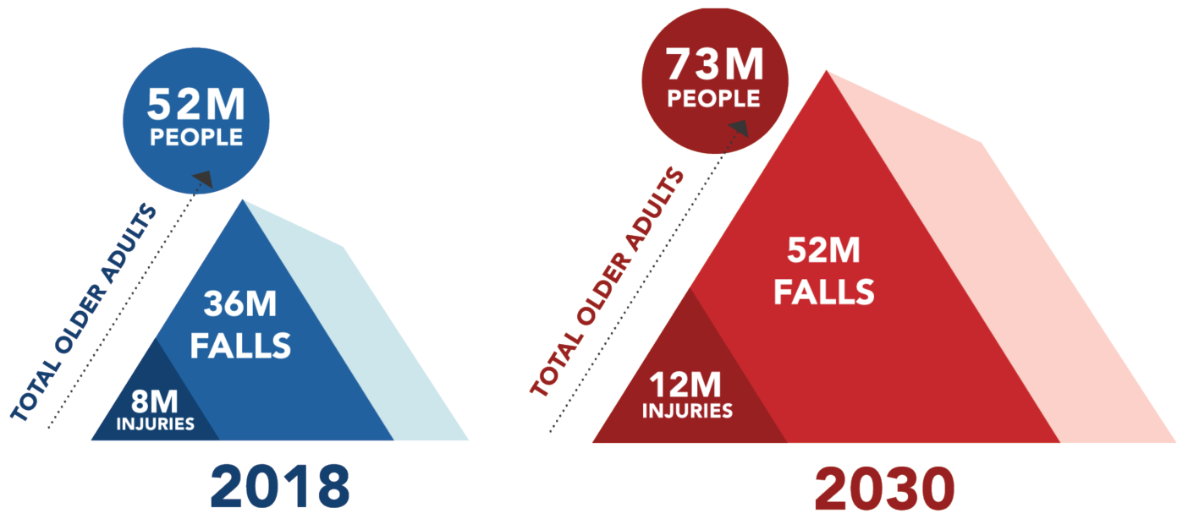
Falls are a Growing Burden
Data sources: Behavioral Risk Factor Surveillance System and United States Census Bureau
References: (2, 11)
Notes:
If more is not done to reduce fall risks, the number of falls and fall injuries will keep increasing. By 2030, 1 in 5 Americans will be aged 65 and older, and we can anticipate 52 million falls and 12 million fall injuries.

Slide 11
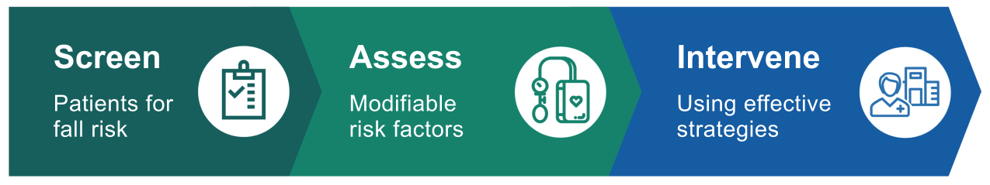
Falls Are Preventable
The Stopping Elderly Accidents, Deaths, and Injuries (STEADI) initiative was developed by the U.S. Centers for Disease Control and Prevention (CDC)
  STEADI is based on the American and British Geriatrics Societies’ Clinical Practice Guideline for Prevention of Falls in Older Persons and designed with input from healthcare providers
  STEADI offers tools and resources to help healthcare providers Screen, Assess, and Intervene to reduce fall risk.
References: (12,13)
Notes:
Healthcare providers can play an important role in reducing fall risk among older adults and preventing devastating consequences. Many risk factors for falls are modifiable such as difficulties with gait and balance or use of medications with side effects that can lead to falls. Being able to identify modifiable risk factors for falls and to intervene with appropriate evidence-based strategies can help reduce the risk of falling.
To assist healthcare providers in doing so, CDC developed a fall prevention initiative called STEADI. STEADI is based on the American and British Geriatrics Societies’ Clinical Practice Guideline for fall prevention and designed with input from healthcare providers.
STEADI provides tools and resources to manage fall risk in clinical practice. It is comprised of three components: Screen, Assess, and Intervene. Using STEADI, providers can screen older patients for fall risk, assess at-risk patient’s modifiable risk factors, and intervene to reduce the identified risks by using effective strategies.

Slide 12
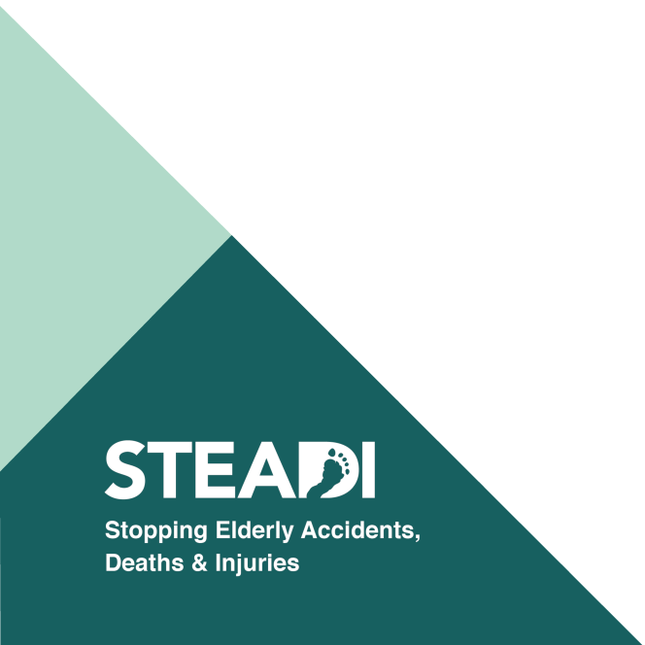
Benefits of a STEADI-based Fall Prevention Program
Use STEADI to
Reduce fall-related hospitalizations
Avert healthcare cost
Improve the lives and independence of your older patients
References: (14,15)
Notes:
Integrating STEADI into clinical practice can help reduce hospitalization due to falls, avert healthcare costs, and improve the lives and independence of your older patients.

Slide 13
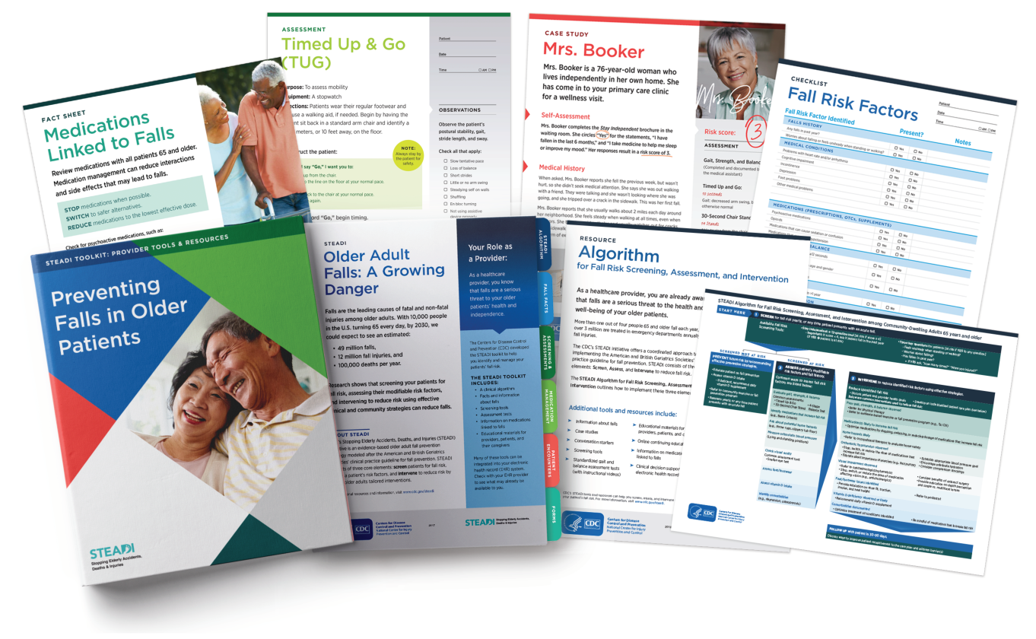
STEADI Tools & Resources: Providers
References: (13,16)
Notes:
Providers can integrate and practice fall prevention steps by utilizing STEADI’s wide array of tools and resources.
Some tools and resources for providers, include:
Clinical algorithm to show how providers can screen, assess, and intervene to reduce fall risk
Instructions on how to conduct functional assessment tests
Fact sheets with information on fall risk factors, medications associated with falls, etc.
Case studies, checklists, and online training with continuing education

Slide 14

STEADI Tools & Resources: Patients and Caregivers
References: (13,16)
Notes:
STEADI also offers educational materials for patients and caregivers with actionable fall prevention steps. These materials include:
Check for Safety: Use to identify and eliminate fall hazards in their home
Family Caregivers: Includes steps to help prevent older adult falls
Postural Hypotension: Use to teach patients how to manage their postural hypotension
What You Can Do to Prevent Falls: Use to help patients learn how to reduce their chances of falling
Stay Independent: Use checklist to determine fall risk

Slide 15
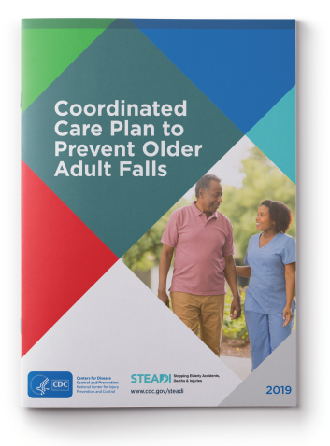
STEADI Implementation in 12 Steps
Assess readiness for practice change around fall prevention
Assess current fall prevention activities
Identify a champion and create a fall prevention team
Obtain leadership support
Determine components of the clinical fall prevention program to implement
Identify and link with community partners and resources
Reference: (17)
Notes:
There are many steps to implementing a successful fall prevention program. CDC’s Coordinated Care Plan to Prevent Older Adult Falls suggests 12 steps to facilitate the implementation process of a STEADI-based fall prevention program.

Slide 16
STEADI Implementation in 12 Steps (Continued)
Add fall prevention to the clinic workflow
Adapt health record tools (electronic or paper)
Identify primary care team members’ tasks
Train primary care team members
Develop an implementation and monitoring plan
Identify reimbursement and quality improvement opportunities
Reference: (17)
Notes:
There are many steps to implementing a successful fall prevention program. CDC’s Coordinated Care Plan to Prevent Older Adult Falls suggests 12 steps to facilitate the implementation process of a STEADI-based fall prevention program.

Slide 17
Successful Implementations
Oregon Health & Science University, Oregon
64% of patients screened for fall risk
Provided interventions for at-risk patients with modifiable risk factors, such as gait impairment and orthostatic hypotension
United Health Services Hospitals, New York
79% of patients screened for fall risk
At-risk patients with a fall prevention care plan were 40% less likely to have a fall-related hospitalization, compared to at-risk patients without a plan
References: (15,18,19)
Notes:
It is encouraging to know that STEADI has been successfully integrated in several practices. Oregon Health & Science University (OHSU) and the United Health Services Hospitals (UHS) are two of the first practices to implement STEADI in 2012. Their experience with implementation helped inform the 12 steps described in CDC’s Coordinated Care Plan to Prevent Older Adult Falls. Practices have the flexibility of using the 12 steps in a way that best fits their practice. Both OHSU and UHS developed their own strategies to implement STEADI (refer to publications). As a result, both practices saw positive practice changes such as screening older adults for fall risk. For example, before implementing STEADI, providers at UHS did not routinely screen for fall risk, but within a year of implementation they screened 79% of their older patients. STEADI implementation has also led to meaningful outcomes such as lower fall-related hospitalizations.

Slide 18
Our Fall Prevention Goals
How are we going to reduce fall risk among our older patients?
Who will be involved?
What components will the fall prevention program include?
How will we integrate STEADI into our clinical workflow?
How will we adapt our electronic health record?
How will we monitor and evaluate the program?
How will we bill for fall prevention activities?
Notes:
Now we will go over how our practice can implement a fall prevention program.
Discuss or describe your fall prevention goals using questions on the slide.
To prepare responses specific to your practice, refer to the www.cdc.gov/steadi and CDC resources such as Coordinated Care Plan to Prevent Older Adult Falls and Evaluation Guide for Older Adult Clinical Fall Prevention Programs.

Slide 19
Resources
Learn more about older adult fall prevention and STEADI resources at
www.cdc.gov/steadi

Slide 20
References
Slide 5
CDC. Web-based Injury Statistics Query and Reporting System (WISQARS) [online]. [cited 2020 July 10]. Available from URL: www.cdc.gov/injury/wisqars. Atlanta, GA: National Center for Injury Prevention and Control.
Slide 6
CDC. Web-based Injury Statistics Query and Reporting System (WISQARS) [online]. [cited 2020 July 10]. Available from URL: www.cdc.gov/injury/wisqars. Atlanta, GA: National Center for Injury Prevention and Control.
Moreland B, Kakara R, Henry A. Trends in Nonfatal Falls and Fall-Related Injuries Among Adults Aged ≥65 years—United States, 2012-2018, MMWR Morb Mortal Wkly Rep 2020;69(27):875-881. DOI; http://dx.doi.org/10.15585/mmwr.mm6927a5

Slide 21
References (Continued)
Slide 7
Parkkari J, Kannus P, Palvanen M, Natri A, Vainio J, Aho H, et al. Majority of Hip Fractures Occur as a Result of a Fall and Impact on the Greater Trochanter of the Femur: A Prespective Controlled Hip Fracture Study with 206 Consecutive Patients. Calcif Tissue Int 1999;65(3):183–7. DOI: 10.1007/s002239900679
Taylor CA, Bell JM, Breiding MJ, Xu L. Traumatic Brain Injury-Related Emergency Department Visits, Hospitalizations, and Deaths—United States, 2007 and 2013. MMWR Surveill Summ 2017;66(No. SS–9):1-15. DOI: httP://dx.doi.org/10.15585/mmwr.ss6609a1
Gill TM, Murphy TE, Gahbauer EA, Allore HG. Association of Injurious Falls With Disability Outcomes and Nursing Home Admissions in Community-Living Older Persons. Am J Epidemiol 2013;178(3):418–25. DOI: 10.1093/aje/kws554
CDC. Wide-ranging OnLine Data for Epidemiologic Research (WONDER) [online]. [cited 2020 July 10]. Available from URL: https://wonder.cdc.gov. Atlanta, GA: Centers for Disease Control and Prevention.
Slide 8
Florence CS, Bergen G, Atherly A, Burns E, Stevens J, Drake C. Medical Costs of Fatal and Nonfatal Falls in Older Adults. J Am Geriatr Soc 2018;66(4):693–8. DOI: 10.1111/jgs.15304

Slide 22
References (Continued 2)
Slide 9
Florence CS, Bergen G, Atherly A, Burns E, Stevens J, Drake C. Medical Costs of Fatal and Nonfatal Falls in Older Adults. J Am Geriatr Soc 2018;66(4):693-8. DOI: 10.1111/jgs.15304
Burns ER, Stevens JA, Lee R. The Direct Costs of Fatal and Non-fatal Falls Among Older Adults—United States. J Safety Res 2016;58:99-103. DOI:10.1016/j.jsr.2016.05.001
Bohl AA, Fishman PA, Ciol MA, Williams B, Logerfo J, Phelan EA. A Longitudinal Analysis of Total 3-Year Healthcare Costs for Older Adults Who Experience a Fall Requiring Medical Care. J Am Geriatr Soc 2010;58(5):853-60. DOI: 10.1111/j.1532-5415.2010.02816.x
Hoffman GJ, Liu H, Alexander NB, Tinetti M, Braun TM, Min LC. Posthospital Fall Injuries and 30-Day Readmissions in Adults 65 Years and Older. JAMA Netw Open 2019;2(5):e194276. DOI: 10.1001/jamanetworkopen.2019.4276
Slide 10
Moreland B, Kakara R, Henry A. Trends in Nonfatal Falls and Fall-Related Injuries Among Adults Aged ≥65 years—United States, 2012-2018, MMWR Morb Mortal Wkly Rep 2020;69(27):875–881. DOI; http://dx.doi.org/10.15585/mmwr.mm6927a5
Ortman JM, Velkoff VA, Hogan H. An Aging Nation: The Older Population in the United States, Current Population Reports, P25-1130. Washington, DC: U.S. Census Bureau. 2014.

Slide 23
References (Continued 3)
Slide 11
AGS/BGS. Summary of the Updated American Geriatrics Society/British Geriatrics Society Clinical Practice Guideline for Prevention of Falls in Older Persons. J Am Geriatr Soc 2011;59(1):148–57. DOI: 10.1111/j.1532-5415.2010.03234.x
Lee R. The CDC’s STEADI Initiative: Promoting Older Adult Health and Independence Through Fall Prevention. Am Fam Physician 2017;96(4):220–1.
Slide 12
Stevens JA, Lee R. The Potential to Reduce Falls and Avert Costs by Clinically Managing Fall Risk. Am J Prev Med 2018;55(3):290–7. DOI: 10.1016/j.amepre.2018.04.035
Johnston YA, Bergen G, Bauer M, Parker EM, Wentworth L, McFadden M, et al. Implementation of the Stopping Elderly Accidents, Deaths, and Injuries Initiative in Primary Care: An Outcome Evaluation. Gerontologist 2019;59(6):1182-91. DOI: 10.1093/geront/gny101
Slides 13 & 14
Lee R. The CDC’s STEADI Initiative: Promoting Older Adult Health and Independence Through Fall Prevention. Am Fam Physician 2017;96(4):220–1.
CDC. STEADI—Older Adult Fall Prevention [online]. [cited 2020 July 10]. Available from URL: www.cdc.gov/steadi. Atlanta, GA: National Center for Injury Prevention and Control.

Slide 24
References (Continued 4)
Slides 15 & 16
Eckstrom E, Parker EM, Shakya I, Lee R. Coordinated Care Plan to Prevent Older Adult Falls. Atlanta, GA: National Center for Injury Prevention and Control, Centers for Disease Control and Prevention 2019.
Slide 17
Johnston YA, Bergen G, Bauer M, Parker EM, Wentworth L, McFadden M, et al. Implementation of the Stopping Elderly Accidents, Deaths, and Injuries Initiative in Primary Care: An Outcome Evaluation. Gerontologist 2019;59(6):1182-91. DOI: 10.1093/geront/gny101
Casey CM, Parker EM, Winkler G, Liu X, Lambert GH, Eckstrom E. Lessons Learned From Implementing CDC’s STEADI Falls Prevention Algorithm in Primary Care. Gerontologist 2017;57(4):787–96. DOI: 10.1093/geront/gnw074
Eckstrom E, Parker EM, Lambert GH, Winkler G, Dowler D, Casey CM. Implementing STEADI in Academic Primary Care to Address Older Adult Fall Risk. Innov Aging 2017;1(2). DOI: 10.1093/geroni/igx028

