Slide 1

Recognizing Risk Using Reservoirs: A Review
Recognizing Risk Using Reservoirs
Session 3
Notes:
Facilitator Notes:
Participants log in and get settled.

Slide 2
Agenda
Welcome
Welcome and Introductions
Recognizing Risk Using Reservoirs
How Did the Germ Spread
Bringing It Together
Conclusion
Notes:
Facilitator Notes:
Welcome the group and add a greeting to the chat box.
If this session is part of an ongoing series, you may choose to say “welcome back,” “thank you for joining us again,” etc.
Announce housekeeping notes, either orally or via chat. If needed, provide additional notes specific to the platform you’re using (e.g., how to “raise your hand,” how to post questions).
Provide an overview of the agenda.
Adapt this section of the session as needed: for instance, you may choose to spend additional time on introductions if there are new faces, or if participants do not know each other.
Sample Script:
“Welcome to Project Firstline. Thank you for joining us! Before we begin, a few housekeeping notes. We’ll meet today for about 20 minutes. Please keep your videos on, to the extent possible, and keep your microphone muted when you are not contributing to the discussion. It’s great to see you all here today!
“Today, we’ll review how to recognize risks for germs to spread in healthcare. Using our knowledge about where germs live and how they are spread from those places, we’ll think through a real-world scenario of germs spreading and making someone sick. We’ll also discuss infection control actions that we can take to limit the spread of germs. We’ll have an opportunity to reflect before we wrap up for the day.”

Slide 3
Recognizing Risk Using Reservoirs

Slide 4
Recognizing Risk
Risk Recognition: Seeing the potential for a problem to happen.
  Seeing a potential problem doesn’t mean the problem will definitely happen!
  We take action to keep something bad from happening.
Reservoir: a place where germs live and thrive.
Pathway: a way for germs to be spread from their reservoir to another reservoir, or to a person to infect.
Notes:
Facilitator Notes:
Review the concept that recognizing the risk for germs to spread begins with understanding where germs live, or their “reservoirs,” and how germs are moved from their reservoirs to other places or to people, or their “pathways.”
If this session is presented as part of a series, you may choose to refer specifically to discussions from prior sessions.
Sample Script:
“When we think about ‘risk’ in infection control, we think about seeing the possibility that something bad might happen – that a germ could be spread and infect someone – and taking action to keep it from happening. As we explore the idea of recognizing risk for germs to spread in healthcare, it’s helpful to start with where we find the germs. Where do they live – what are their reservoirs? We can then think about how they get from place to place or to other people – what are their pathways?”

Slide 5
Germs in Healthcare
Reservoirs in the human body: skin, gastrointestinal (GI) system or “gut,” respiratory system, blood
Reservoirs in the healthcare environment: water and wet surfaces, dry surfaces, dirt and dust, and devices
Common pathways for germ spread in healthcare:
  Touch
  Breathing in
  Splashes or sprays
  Bypassing or breaking down the body’s natural defenses
Notes:
Facilitator Notes:
Briefly describe (or review, if this session is presented as part of a series), the common reservoirs for germs in healthcare.
Reservoirs in the human body are the skin, gastrointestinal (GI) system or “gut,” respiratory system, and blood.
Reservoirs in the healthcare environment are water and wet surfaces, dry surfaces, dirt and dust, and devices.
Additional detail regarding the reservoirs can be found on the Project Firstline website and in other Project Firstline session plans, which can be found here: https://www.cdc.gov/infectioncontrol/projectfirstline/ healthcare/training.html
Note the common pathways for germ spread in healthcare: through touch; when they’re breathed in; through splashes or sprays to the eyes, nose, or mouth, or to broken or unhealthy skin; and through clinical care tasks that bypass or break down the body’s natural defenses.
Provide examples of common tasks in healthcare that can be pathways for germs to be spread, such as procedures and surgeries that require breaking a patient’s skin.
Sample Script
“In healthcare, we think about germ reservoirs in the human body and in the healthcare environment. Reservoirs in the human body are the skin, the gastrointestinal system or ‘gut,’ the respiratory system, and blood. Reservoirs in the healthcare environment include water and wet surfaces, dry surfaces, dirt and dust, and devices.
“There are a few common pathways for germs to be spread from reservoirs in healthcare – by touch; when they’re breathed in; through splashes and sprays to the eyes, nose, or mouth, or to broken or unhealthy skin; and through things we do as part of healthcare that bypass or break down the body’s natural defenses. For instance, procedures and surgeries that require breaking a patient’s skin can allow germs from the patient’s skin to get into their body. Anything that we do that involves touch – whether it’s touching a person or things in the environment, like blood pressure cuffs or tongue depressors – can be a risk for germs to spread.”

Slide 6
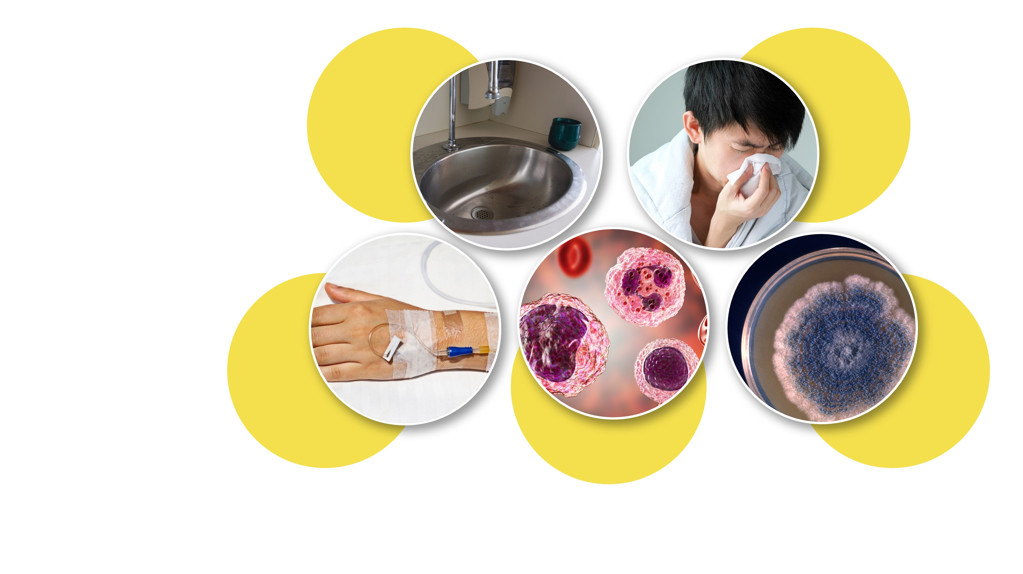
Elements of How Germs Spread and Cause Infection
Reservoirs
Person
Germ
survival
Pathways
Body’s
defenses
Notes:
Facilitator Notes:
Briefly describe (or review, if this session is presented as part of a series), the concepts of how germs spread and make people sick.
Germs need a pathway to be spread out of the reservoir where they live.
Germs need to be delivered to a person, get around their body’s defenses, and infect them.
Germs also need to survive in the environment while they spread to be able to cause an infection when they reach someone.
Infection control actions at any of these points keep the germs from causing infection.
Transition to the learning activity.
Sample Script
“There are more pieces to the puzzle of germ spread than reservoirs and pathways. Germs also need to arrive at a new person. That person could be a patient, or you or one of your colleagues! And in order to infect them, the germs need to get around the person’s natural defenses – if the person is already sick, then their immune system could be weak and not able to fight germs as well as a healthy person’s can. If their skin is broken – from having an IV inserted, for instance – germs can enter their body through that break in the skin defense. Throughout all of these elements, the germs need to survive in the environment if they’re going to make someone sick – that’s called being ‘infectious.’ The infection control actions that you take at any of these points help keep germs from spreading and causing infection. Now we’re going to use what we know about reservoirs, pathways, and how germs make people sick to discuss a scenario.”

Slide 7
How Did the Germ Spread?

Slide 8
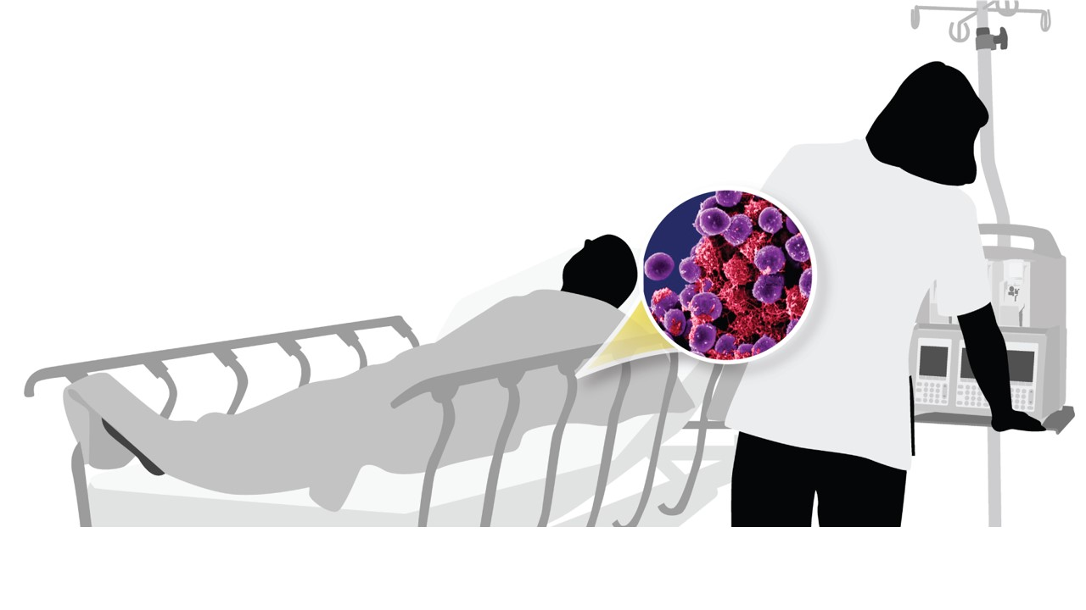
How Did the Germ Spread?
Scenario
Scenario: Staphylococcus aureus
(S. aureus) spreads to a patient.
Discussion: Recognize the reservoirs
and pathways that are risks for the germ to spread.
Notes:
Facilitator Notes:
Introduce the activity and provide instructions to the group. You will describe a brief scenario in which a germ (Staphylococcus aureus [S. aureus], or “staph”) is spread to a patient.
Divide participants into breakout groups to discuss the possible reservoirs and pathways that are risks for the germ to spread in this scenario.
Draw on the slide 9 content and sample script to provide additional background on S. aureus. Adapt the script, as needed, to suit your audience’s experience level.
Sample Script:
“I’m going to present a brief scenario in which a patient has different interactions with different healthcare workers. The outcome of the scenario is that a germ – in this case, staph – has spread to the patient. Then we’ll break into small groups to discuss the reservoirs and pathways that could have been involved in the germ spread. After we discuss in small groups, we’ll come back together to compare notes.”

Slide 9

Staphylococcus aureus (S. aureus) Basics
Commonly called “staph”
Type of germ (bacteria)
Common, most of the time does not cause any harm
Can cause serious or fatal infections
Some types are resistant to antibiotics
Anyone can get an infection, but some groups are at higher risk:
  People with chronic conditions, such as diabetes or cancer
  Patients in healthcare
From Staphylococcus aureus in Healthcare Settings | HAI | CDC
Notes:
Facilitator Notes:
This slide provides participants with background information about S. aureus. If you choose to include this slide, adapt the script for the next slides as appropriate. Audiences familiar with S. aureus may not require this foundation, in which case you can skip this slide and proceed to slide 10.
Provide a brief description of the germ, staph. Reassure participants that it’s not necessary to have in-depth knowledge of the germ for this exercise.
As appropriate for your participants and time frame, you may wish to add more detail from CDC resources: https://www.cdc.gov/hai/organisms/staph.html or https://www.cdc.gov/vitalsigns/staph/index.html
You could consider using your virtual platform’s polling feature to ask how many participants are familiar with staph, and use the results to guide your presentation of “Staph Basics.”
Sample Script:
“First, some basics about staph. It is a common bacteria – and most of the time, it doesn’t cause any harm. It can, however, cause serious or fatal infections, especially in patients in healthcare. Some types of staph are resistant to antibiotics, which means that the germs have developed the ability to defeat the drugs designed to kill them.
“Anyone can get an infection from staph, but some groups are at higher risk than others, including people with chronic conditions and patients in healthcare.”

Slide 10
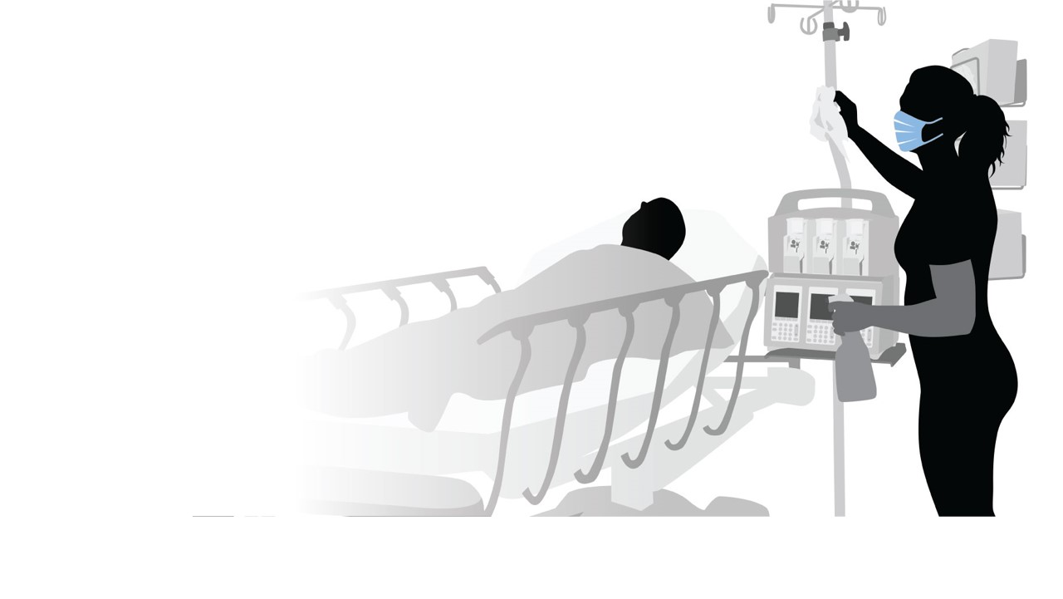
Identify how staph could be spread by touch in this scenario.
Scenario
Setting: a patient’s room with the patient in bed.
Interactions:
  A physician conducts
  a brief physical exam.
  A nurse checks the patient’s vital signs.
  An EVS technician completes a daily room cleaning.
Notes:
Facilitator Notes:
Describe the scenario, which uses S. aureus and three example healthcare worker tasks or interactions to illustrate germ spread via the “touch” pathway: a physician conducting rounds, a nurse doing a vital signs check, and an environmental services (EVS) technician completing a daily room cleaning.
Depending upon your audience, you may choose to modify the scenario as needed.
Sample Script:
“Here’s our scenario. It’s a patient room, and the patient is in the bed. First, a physician doing rounds will enter and conduct a brief physical exam. Next, a nurse will enter to check the patient’s vitals and ask a few questions about how they are feeling. Then, an EVS technician will enter to do the daily cleaning of the room, which includes greeting the patient; cleaning and disinfecting high-touch surfaces; cleaning the bathroom; and emptying the trash. At some point, staph has been spread to the patient.”

Slide 11
Recognizing Reservoirs and Pathways
Reservoirs:
Skin
Gut
Respiratory system
Blood
Water and wet surfaces
Dry surfaces
Devices
Dirt and dust
Pathways:
Touch
Breathing in
Splashes and sprays
Bypassing/breaking down
the body’s defenses
Notes:
Facilitator Notes:
Slides 11–13 provide participants with information on how S. aureus is spread in healthcare. Adapt the script as needed to suit your audience’s level of experience.
Audiences familiar with S. aureus may not require this foundation, in which case you can proceed to slide 14.
Sample Script
“For our discussion today, we’re going to focus on how staph spreads by the ‘touch’ pathway. As a reminder, these are the common reservoirs and pathways in healthcare. Before we split into groups, let’s start with the likely reservoirs for staph in this scenario.”

Slide 12
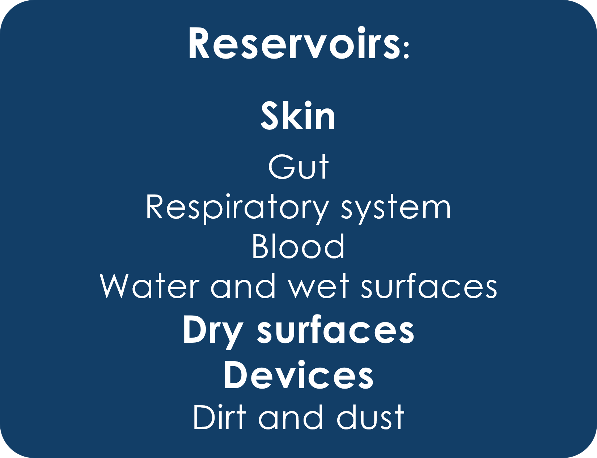
Reservoirs: S. aureus
Notes:
Facilitator Notes:
Note the reservoirs for S. aureus and how it typically spreads.
Sample Script
“Staph is found on the skin and spreads easily by touch to and from skin, dry surfaces, and devices. With that in mind, we can narrow down to our pathway.”

Slide 13
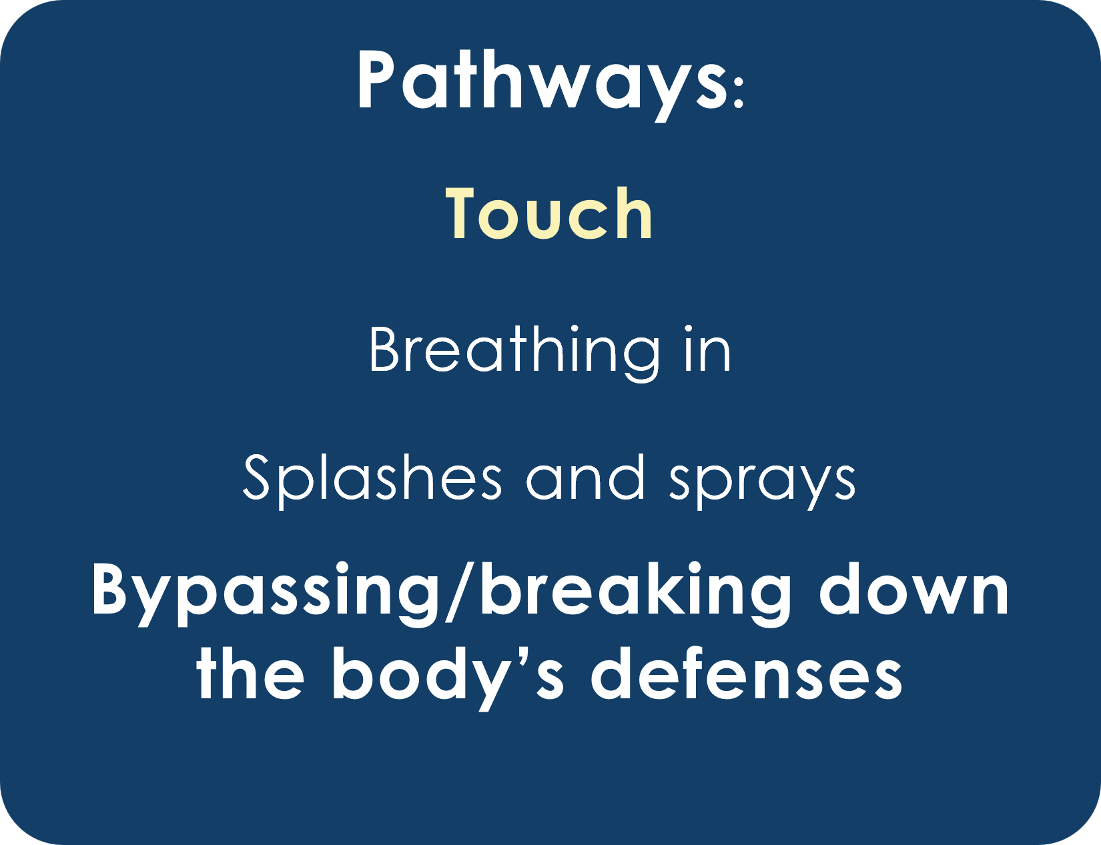
Pathways: S. aureus
Notes:
Facilitator Notes:
Explain common pathways for S. aureus.
Sample Script
“The main pathway for staph is by touch. When staph causes infections, it’s because a person’s natural defenses have been bypassed or broken down – such as through a needlestick or wound – and staph has gotten into the body’s bloodstream or tissues.
“But before staph can cause infection, it first has to be spread to the person – and that happens through touch. Keep this in mind as you think through how staph could have been spread to the patient in our scenario!”

Slide 14
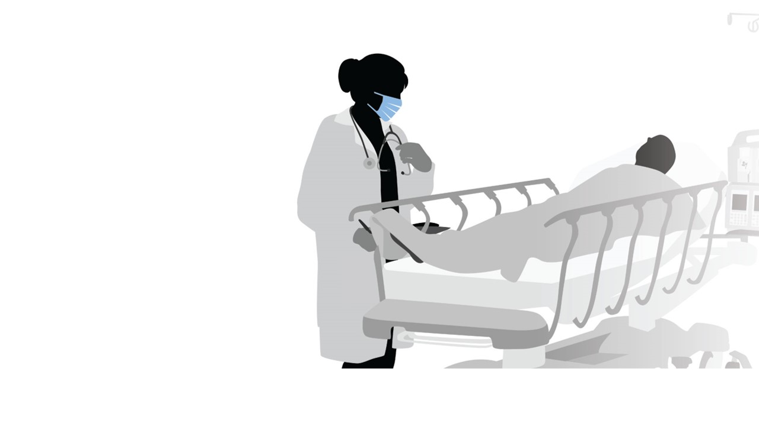
Flash Breakouts
Scenario
Identify how staph could be spread
by touch in this scenario.
Setting: a patient’s room with the patient in bed.
Interactions:
  A physician conducts a brief physical exam.
  A nurse checks the patient’s
  vital signs.
  An EVS technician completes
  the daily room cleaning.
Notes:
Facilitator Notes:
This scenario uses S. aureus to illustrate the “touch” pathway for germ spread and does not necessarily focus on how the patient might become infected. Depending upon your audience, they may incorporate clinical tasks like inserting IVs or surgery as common pathways for staph and other germs to spread in healthcare.
Describe the goals of this activity. Encourage participants to draw on their work experience as they think.
Emphasize that the activity is not designed to identify the “right” or “wrong” reservoirs and pathways, but rather to recognize risks for germ spread based on reservoirs and pathways in the scenario.
Inform participants that they will have 2 minutes to identify risks for staph to spread from reservoirs (skin, dry surfaces, devices) by the pathway of touch.
You may wish to note that the descriptions of the healthcare worker tasks and interactions are intentionally vague, so that participants can imagine details related to each interaction that could have resulted in the spread of staph.
Provide instructions, tailored to your virtual platform, for breakout groups. Inform participants how to ask for help if needed.
Ask each group to designate a person who will report to the larger group.
Sample Script:
“Now we’ll move into our flash breakout groups. You’ll have 2 minutes to think of different reservoirs and pathways for staph to have been spread in this scenario. I encourage you not to worry about being ‘right’ or ‘wrong,’ but to think broadly as you recognize the possible risks. Please identify one person who will share your group’s thoughts when we reconvene. See you soon!”

Slide 15
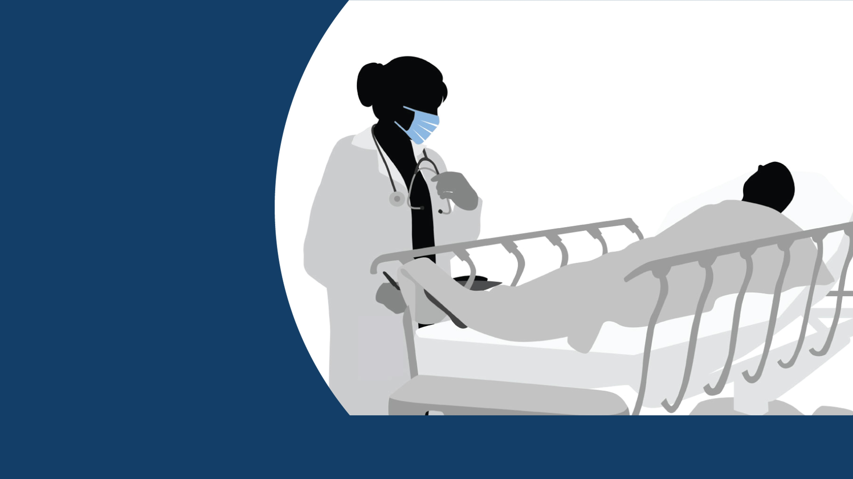
Discussion
Notes:
Facilitator Notes:
Welcome the participants back to the larger group. In turn, invite each group’s representative to report on their discussion and ideas for likely reservoirs and pathways in the spread of staph to the patient in the scenario.
You may choose to capture or summarize high-level points on a blank slide or in the chat. You might also wish to add or incorporate examples of your own, either from the examples provided in this Session Plan or from your own experience. As groups report, point out commonalities and differences in their observations.
If the groups appear to have struggled to identify likely reservoirs and pathways, you can provide prompts to stimulate discussion. For instance, you could suggest that the nurse has staph on their hand, which spreads to the patient when taking their pulse; or that there is staph on the door handle, which spreads to the EVS technician’s hand when they enter the room to clean it.
Depending upon your audience, you could consider introducing additional ideas, such as that the last patient the physician saw was colonized with staph, and the germ spread to the physician’s clothes; a device (e.g., stethoscope) that the nurse used to check the patient’s vital signs is being used on many patients and has staph growing on it; a common room (e.g., medication room, storage room) is colonized with the bacteria.
If appropriate for your audience and time frame, continue to slide 16, Challenge, which invites participants to identify infection control actions that they can use to decrease or eliminate the risks of germ spread that they identified. If you choose to include this slide, adapt the script for the next slides as appropriate. If you choose not to do this activity, proceed to slide 17 and the next section of this session, Bringing It Together.
Sample Script:
“Welcome back! Let’s hear from each other now. Will the volunteer from Group One please unmute and share some highlights from your discussion? What risks did you identify for germs to spread in this scenario, based on the possible reservoirs and pathways for staph?”
(Pause for responses.)
“Excellent. Group Two, will you please report? Did you note some similar reservoirs and pathways, or different ones?”
(Pause for additional responses.)

Slide 16
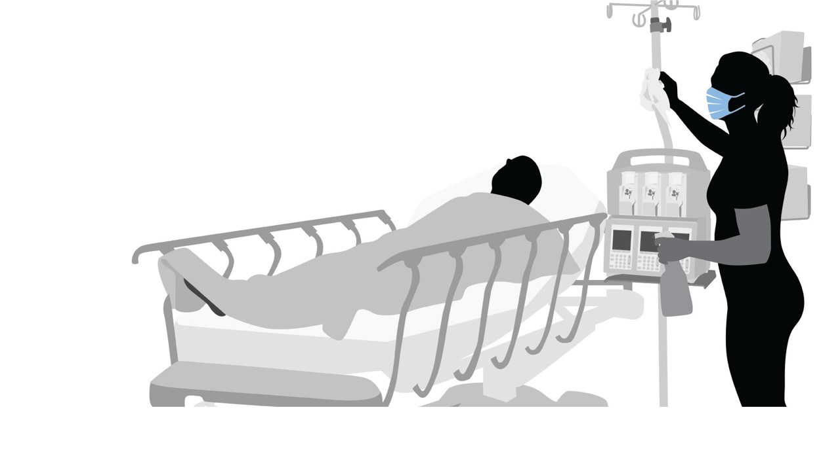
Challenge
Infection control actions
that could decrease or eliminate the risk of germ spread include:
Better hand hygiene
Cleaning and disinfection
Using gowns and gloves
Decolonization of patients
Education of staff
Notes:
Facilitator Notes:
This optional slide provides the opportunity to invite participants to identify infection control actions that they can use to decrease or eliminate the risks of germ spread that they identified. If you choose to include this slide, adapt the script for the next slides as appropriate. If you choose not to do this activity, skip this slide and proceed to slide 17.
If you captured participants’ ideas on a blank slide, you may wish to use that slide for this discussion instead of using the provided slide, which is prepopulated with likely reservoirs and pathways for the scenario.
Better hand hygiene
Cleaning and disinfection
Using gowns and gloves
Decolonization of patients
Education of staff
Sample Script:
“Now that we’ve talked through reservoirs and pathways for this scenario, let’s go one step further. You did a great job of recognizing risk for staph to spread by the touch pathway – now, what infection control actions would help stop staph from spreading in these situations? A few possibilities are listed on this slide. Would someone care to unmute and share their ideas? And please feel free to jot down your ideas in your participant booklet!”
(Acknowledge and affirm responses, as appropriate).

Slide 17
Bringing It Together

Slide 18
Reflection
Thinking about your daily work, what is one step that you can take to recognize an infection risk?
Jot down one action you can take to stop the spread of germs.
Notes:
Facilitator Notes:
Help participants connect the process of recognizing risk using reservoirs to common tasks that they do in their own work, and to actions that they can take to recognize and reduce the risk of germs spreading.
Encourage participants to make notes in their participant booklets.
Time permitting, you may wish to ask for responses in the chat or for participants to share their ideas verbally.
Sample Script:
“Now that we’ve used our knowledge about reservoirs and pathways to recognize the risk for germs to spread, let’s reflect on your work and work experiences.
“What are some of your common, everyday tasks? What is one step that you can take to recognize an infection risk at work? What is an action that you can take to keep germs from spreading? Please write down your action – or actions! – in your participant booklet.”

Slide 19
Questions
Notes:
Facilitator Notes:
Invite additional remaining questions.
If the answers are information that is already included in this session, please respond.
If the questions address content that is not covered in this session, please do not attempt to answer. Instead, take note of the questions and consult with CDC resources to follow up with answers after the session.
Sample Script:
“We covered a lot today. Does anyone have any questions still remaining, or items I can clarify about recognizing risk using reservoirs?”

Slide 20
Conclusion

Slide 21

Key Takeaways
Germs are found in certain places – called reservoirs – and need a pathway to spread to other places and people.
When you understand where germs live and how they might be moved from one place to another or to people, you can recognize the risk for it to happen.
When you recognize risks for germs to spread, you can choose the right infection control actions to keep it from happening.
Notes:
Facilitator Notes:
Thank participants for their time and review the Key Takeaways from the session.
Sample Script:
“Thank you for your time and attention today. I hope that you can take these ideas and apply them at work.”

Slide 22

How to Get Involved and Feedback
Project Firstline on CDC.gov:
https://www.cdc.gov/infection
control/projectfirstline/index.html
CDC’s Project Firstline on Facebook:
https://www.facebook.com/CDCProjectFirstline
CDC’s Project Firstline on Twitter:
https://twitter.com/CDC_Firstline
Project Firstline Inside Infection Control on YouTube:
https://www.youtube.com/playlist?list=PLvrp9iOILTQZQGtDnSDGViKDdRtIc13VX
To sign up for Project Firstline e-mails, click here: https://tools.cdc.gov/campaignproxyservice/subscriptions.aspx?topic_id=USCDC_2104
Project Firstline feedback form: https://www.cdc.gov/infectioncontrol/pdf/projectfirstline/TTK-ParticipantFeedback-508.pdf
Placeholder for partners to add their own links
Notes:
Facilitator Notes:
Share additional resources from Project Firstline and CDC.
Explain how participants can reach you by the means of your choosing, and how they can reach Project Firstline.
If this session is part of a series, you may choose to describe the themes of upcoming sessions.
Direct participants to the feedback form.
Sample Script:
“Even though we covered a lot today, there is still much more to learn. You can keep exploring these topics on your own using the resources on this slide.
“Project Firstline has a suite of products to help you learn how to recognize infection risks at work, and to learn more about where germs live in healthcare, and how germs spread. You can also follow Project Firstline on social media!
“I will stay on the line for a few minutes after our session ends and will be happy to discuss any other questions!”
(If this session is part of a series) “Next time, we will cover [insert next training topic]. Finally, please let us know how you enjoyed today’s session by completing the feedback form. Thanks again for joining us today.”

