Slide 1

How Germs Make People Sick
Recognizing Risk Using Reservoirs
Session 2
Notes:
Facilitator Notes:
Participants log in and get settled.

Slide 2
Agenda
Welcome
Welcome and Introductions
How Germs Spread and Make People Sick
How Can an Infection Occur?
Bringing It Together
Conclusion
Notes:
Facilitator Notes:
Welcome the group and add a greeting to the chat box.
If this session is part of an ongoing series, you may choose to say “welcome back,” “thank you for joining us again,” etc.
Announce housekeeping notes, either orally or via chat. If needed, provide additional notes specific to the platform you’re using (e.g., how to “raise your hand,” how to post questions).
Provide an overview of the agenda.
Adapt this section of the session as needed: for instance, you may choose to spend additional time on introductions if there are new faces, or if participants do not know each other.
Sample Script:
“Welcome to Project Firstline. Thank you for joining us! Before we begin, a few housekeeping notes. We’ll meet today for about 20 minutes. Please keep your videos on, to the extent possible, and keep your microphone muted when you are not contributing to the discussion. It’s great to see you all here today!
“Today, we’ll discuss the five elements needed for germs to spread and cause infection, and the four most common pathways for germ spread in healthcare. When you understand the elements and pathways, then the infection control actions you do every day make more sense! We’ll have an opportunity to reflect before we wrap up for the day.”

Slide 3
How Germs Spread and Make People Sick

Slide 4

How Germs Spread
Notes:
Facilitator Notes:
Remind participants that germs are everywhere, including on our bodies and in the environment. Our bodies have natural defenses to protect us from germs that could make us sick, and most of the time, those defenses work well.
Introduce the idea that five elements are needed for germs to spread and cause infection.
Transition to the How Germs Spread in Healthcare video clip and encourage participants to think about their daily work and how the five elements might be relevant to them as they are watching. Encourage them to note their thoughts in their participant booklet. If not showing video, transition to slides 6–9.
Sample Script:
“Germs are everywhere – including in and on the human body, and in the environment. Many of these germs are normal, and even keep us healthy.
“Our bodies are very good at protecting against many germs, but when patients in healthcare are weak or ill, their defenses may not work as well. Also, some germs can still cause infection in someone who’s healthy.
“In order for germs to make someone sick, five things are needed.”

Slide 5
Video:
How Germs Spread in Healthcare
Notes:
Facilitator Notes:
This slide includes a video clip that reviews key information about how germs spread and make people sick. You have two options to present this information.
Show the video clip. After the clip, transition past slides 6–9 to slide 10: How Germs Spread in Healthcare.
Encourage participants to think about how the five elements relate to their workday and their routine tasks. Invite them to make notes in their participant booklet about possibilities that they see for germs to spread.
Emphasize that these elements are not inevitable; infection control actions at any point can keep germs from spreading.
If you choose not to show the video clip, proceed past slide 5 to slides 6–9, which illustrate the elements of how germs spread and cause infection. Once you have reviewed those slides, proceed to slide 10: How Germs Spread in Healthcare.
Access the How Germs Spread in Healthcare video clip: https://www.cdc.gov/infectioncontrol/projectfirstline/videos/HowGermsSpread-LowRes.mp4
Sample Script:
“We’re going to watch a quick video clip to see these five elements in action. Keep in mind that germ spread isn’t guaranteed to happen! Infection control actions at any of the points can help keep the germs from causing infection.
“As we watch, think about how they relate to your workday and the tasks that you do. Where do you see the possibility for germs to spread? Feel free to jot your thoughts down in your participant booklet.”
(After video) “Now that we’ve talked about how germs make people sick, let’s talk about how that usually happens in healthcare.”

Slide 6
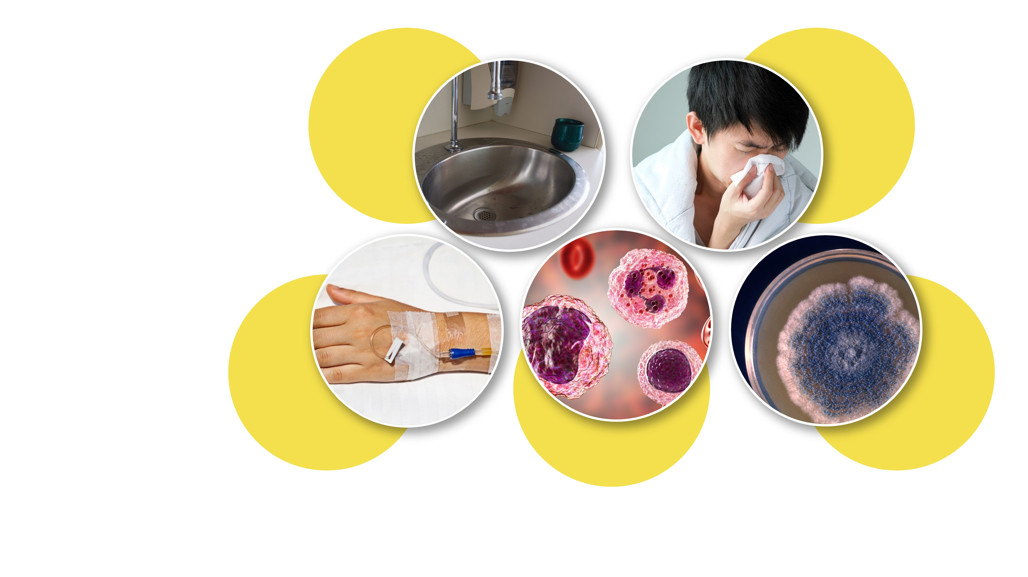
Five Elements of How Germs Spread and Cause Infection
Reservoirs
Person
Germ
survival
Pathways
Body’s
defenses
Notes:
Slides 6, 7, 8, 9, 10: Faciliator Notes (alternative to video):
If you elect not to show the video, use these slides, which describe the five elements of how germs spread and cause infection. As you advance through the slides, you may wish to use discussion points from this session’s Content Outline in the Appendix.
Encourage participants to think about how the five elements relate to their workday and their routine tasks. Invite them to make notes in their participant booklet about possibilities that they see for germs to spread.
Emphasize that these elements are not inevitable; infection control actions at any point can keep germs from spreading and prevent infections.
Sample Script (alternative to video):
“Let’s look at each of these elements in a little more detail. As we do, think about how they relate to your workday and the tasks that you do. Where do you see the possibility for germs to spread? Feel free to jot down your thoughts in your participant booklet.”
(Advance to slide 7.)

Slide 7
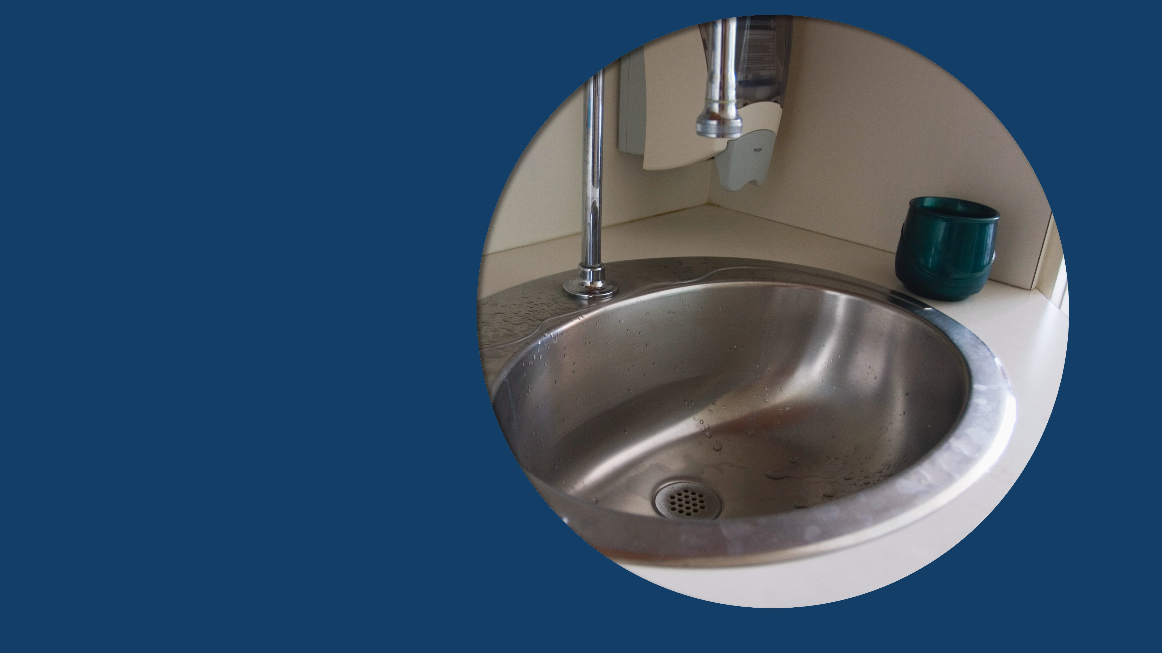
Reservoirs
Recognizing Risk Using Reservoirs | Session 2: How Germs Make People Sick
7
Notes:
Sample Script (alternative to video):
“First, germs need a place to live – we call these places ‘reservoirs.’ Essentially, they’re like habitats. Reservoirs can be in the human body – the skin; the digestive system or ‘gut’; the lungs and airway; and the blood. Reservoirs can also be in the environment: water and surfaces that have water on them; dry surfaces like countertops and bedrails; dirt and dust; and devices.”
(Advance to slide 8.)

Slide 8

Pathways
Recognizing Risk Using Reservoirs | Session 2: How Germs Make People Sick
8
Notes:
Sample Script (alternative to video):
“Second, germs need a pathway – because they typically can’t move on their own, at least not very far, germs need a way to get from where they live to another place or a person. We’ll talk more about pathways in a moment.”
(Advance to slide 9.)

Slide 9

A Person to Infect
Getting around the Body’s Defenses
Recognizing Risk Using Reservoirs | Session 2: How Germs Make People Sick
9
Notes:
Sample Script (alternative to video):
“Germs need a person to infect. That person can be a patient or you or one of your colleagues. Germs also need to get around the body’s natural defenses to make that person sick.”
(Advance to slide 10.)

Slide 10
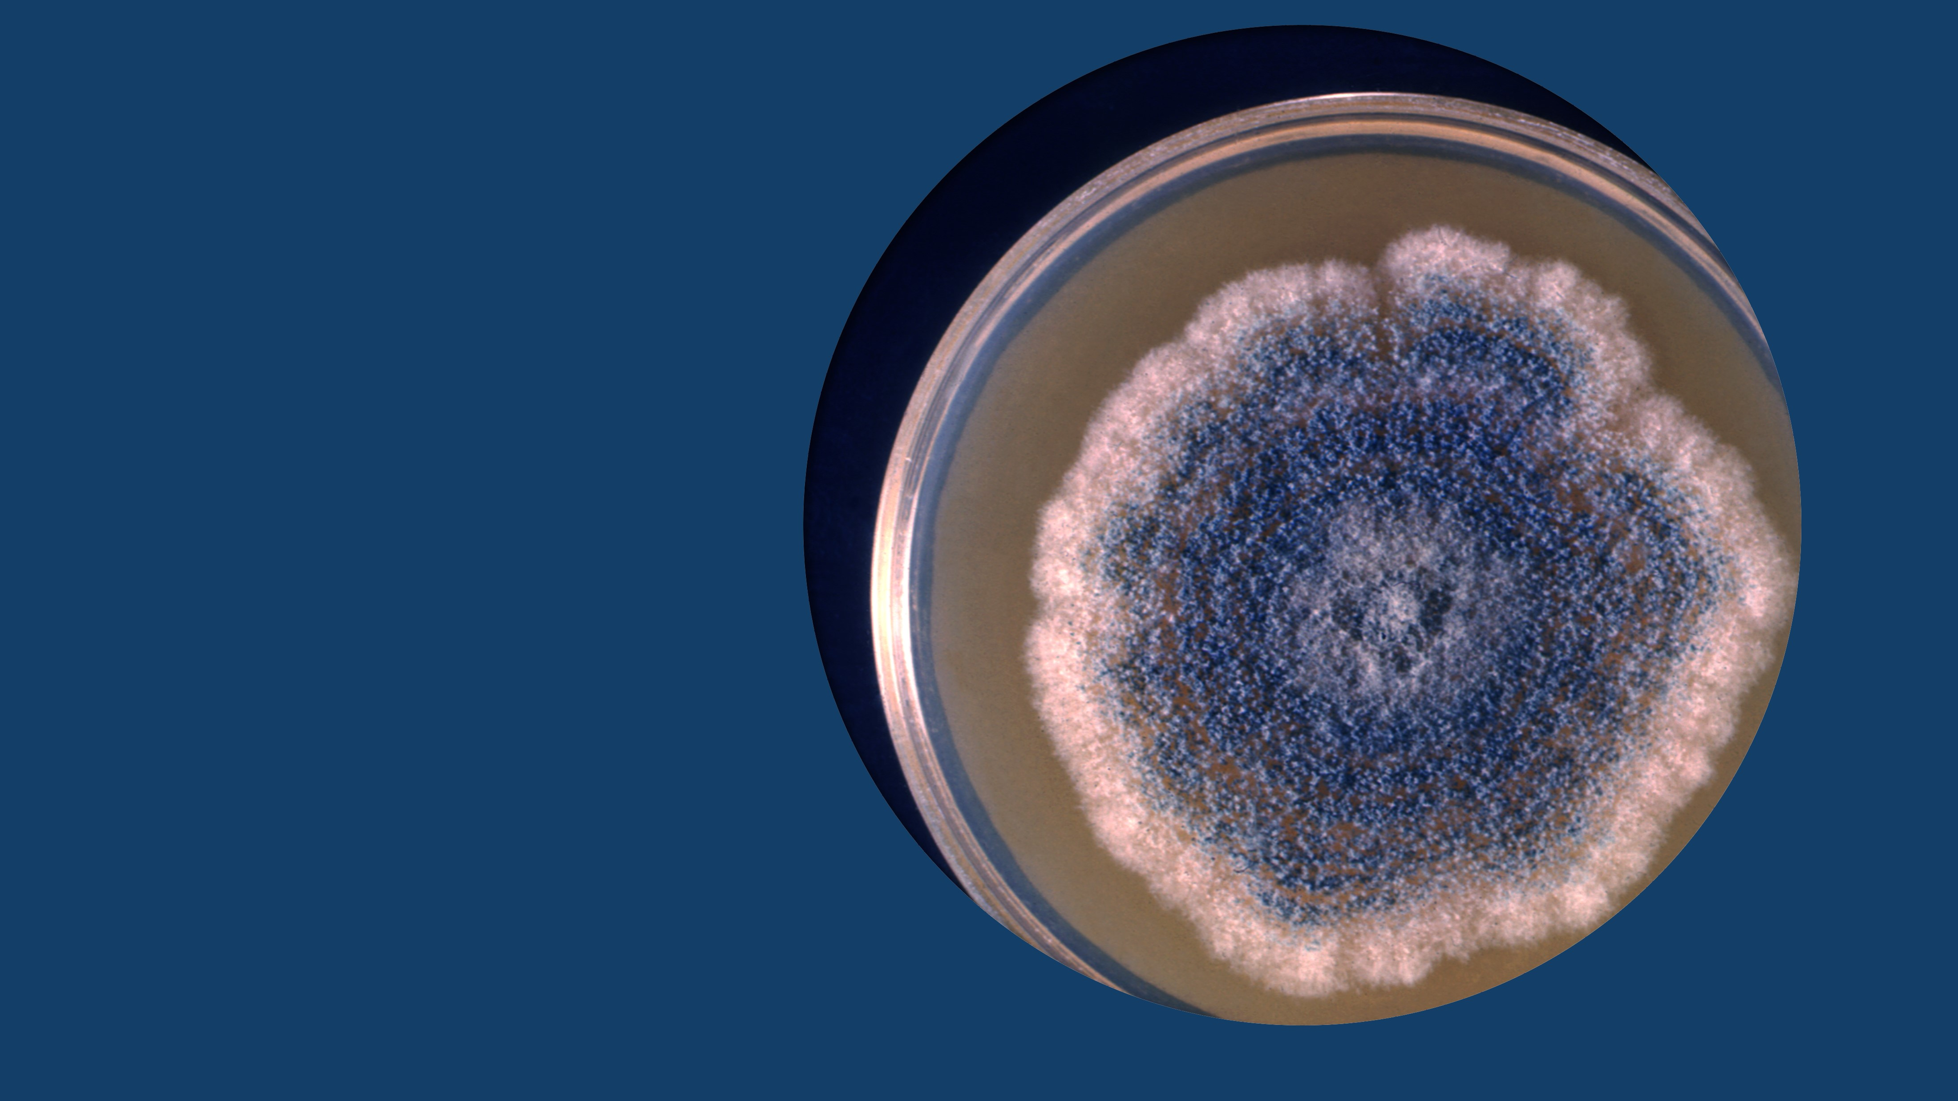
Survival
Recognizing Risk Using Reservoirs | Session 2: How Germs Make People Sick
10
Notes:
Sample Script (alternative to video):
“Finally, germs need to survive so that they’re still able to make someone sick. Keep in mind that germ spread and infections can be prevented. Acting on one or more of these five elements can keep germs from spreading and keep people from getting infected – that’s infection control.
“Now that we’ve talked about how germs spread and make people sick, let’s talk about how that usually happens in healthcare.”

Slide 11
How Germs Spread in Healthcare: Four Main Pathways
1
Through touch
2
When they’re breathed in
3
Through splashes or sprays
4
Through clinical care tasks that bypass or break down the body’s natural defenses
Notes:
Facilitator Notes:
Explain the four main pathways for germ spread in healthcare.
Sample Script:
“In most cases, there are four main pathways for germs to be spread from reservoirs in healthcare: the first is through touch. That usually involves the skin – especially the hands – but it also happens with devices, which touch different people and surfaces.
“Another pathway for germs is through breathing in. A third is through splashes or sprays of blood, body fluid, or water from a sink or other source. Germs in those splashes or sprays can get into a person’s eyes, nose, or mouth, or into a cut or a break in their skin and cause infection.
“The last common pathway for germ spread in healthcare is through clinical care tasks that bypass or break down the body’s natural defenses, like when a patient’s skin has to be broken to insert an IV. That creates a pathway for germs to enter the patient’s body.”

Slide 12
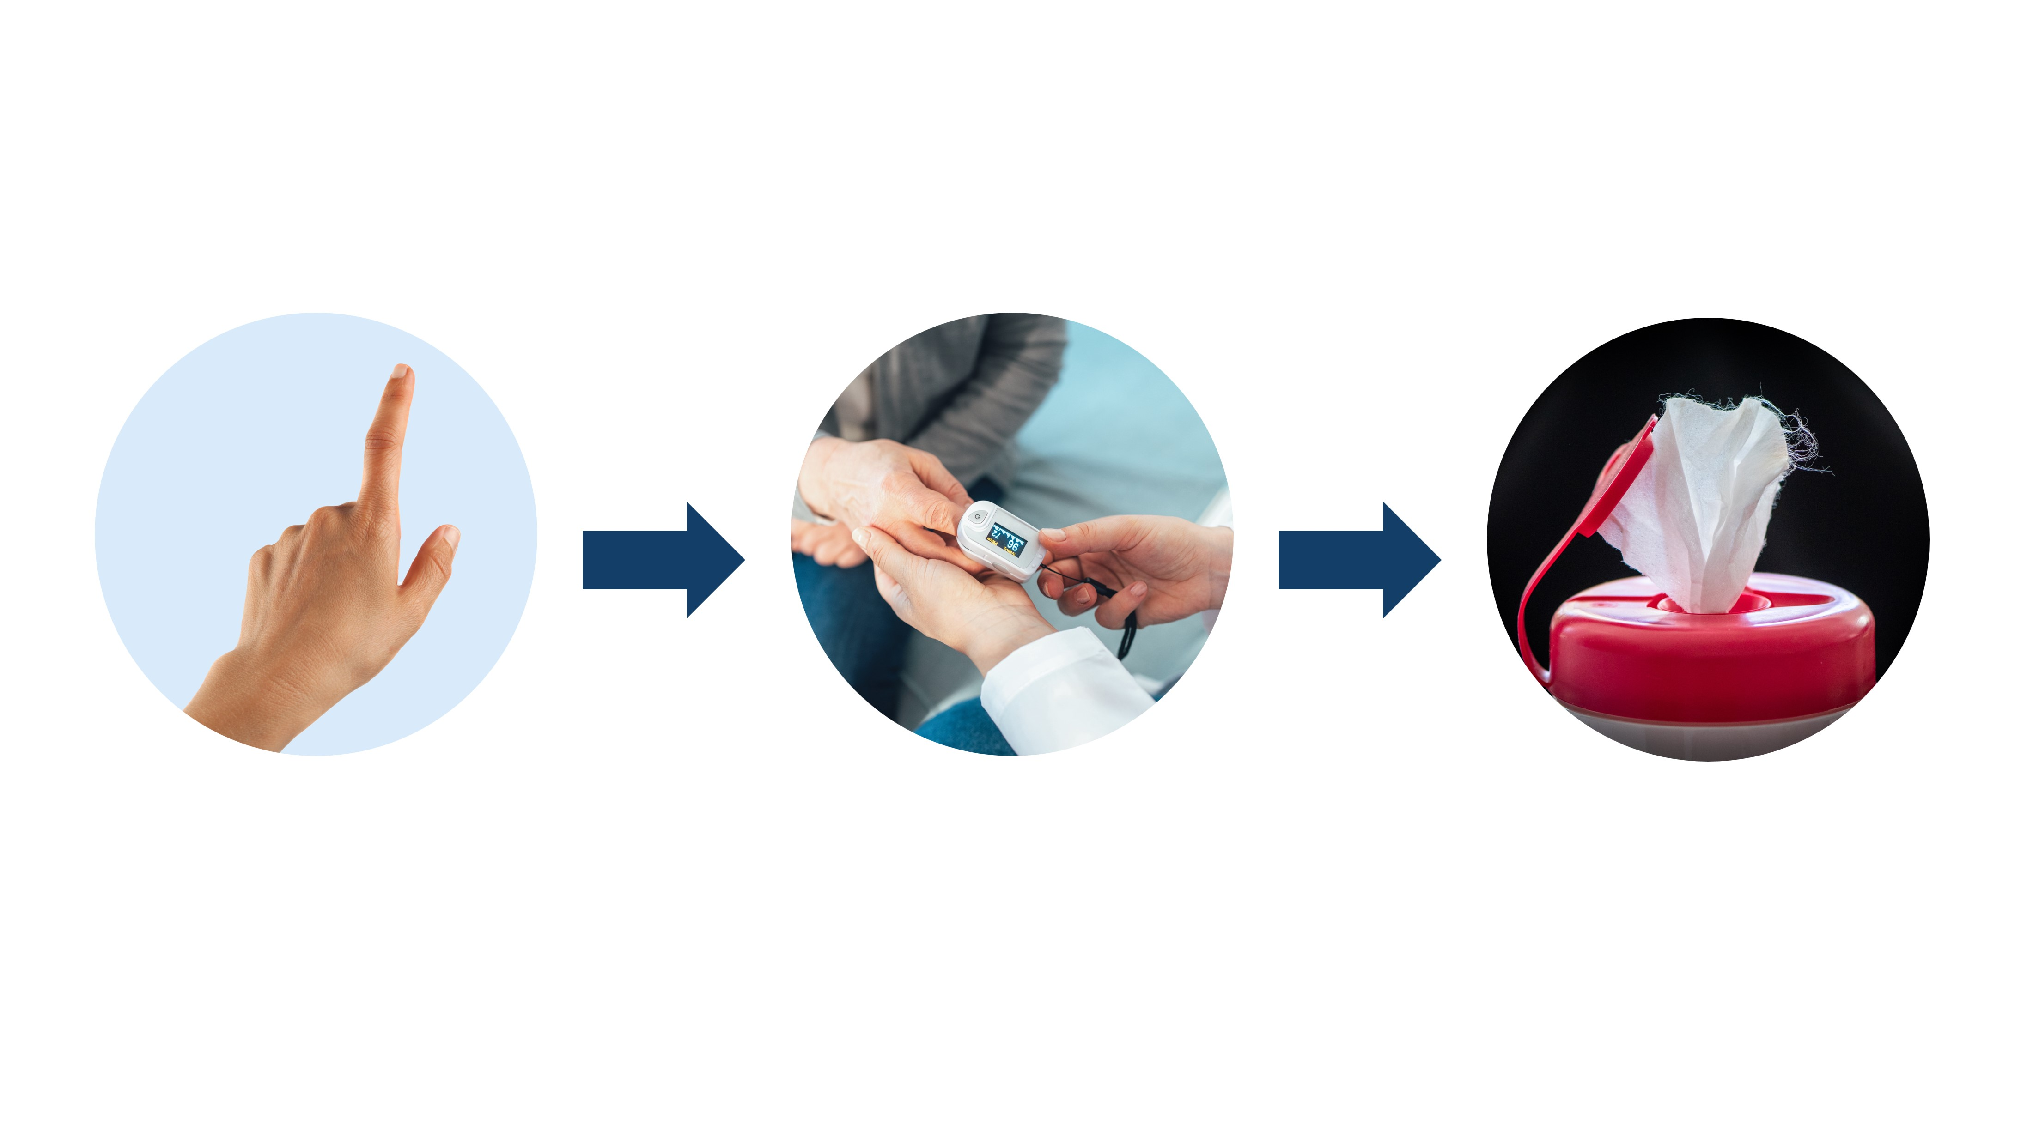
Knowing Where Germs Live and How They Spread
Helps You Recognize Risk
Reservoir
Pathway
Recognize the risks and take infection control actions
Notes:
Facilitator Notes:
Connect the elements of how germs spread and make people sick and the common pathways for germ spread in healthcare to infection control actions that stop germs from spreading.
Transition to learning activity.
Sample Script:
“Infection control actions at any one of the key points we just discussed can stop germs from spreading and causing infection. To make decisions about infection control, it’s important to think about where the germs are – which reservoir or reservoirs you are dealing with – and how the germs might get somewhere else – the pathway. Then, you can recognize the risk for germ spread to happen, and do something about it.”

Slide 13
How Can an Infection Occur?

Slide 14
Scenarios: How Can an Infection Occur?
Example scenario:
  Start with a germ and a reservoir​.
  Walk through the five elements of germ spread. ​
Create your own scenario!
Notes:
Facilitator Notes:
Explain the learning activity, which uses scenarios in which patients get infections in healthcare settings. With the first scenario, establish how an infection could occur by walking participants through possibilities for each of the five elements of how germs make people sick, beginning with a germ in a reservoir.
Explain that the emphasis should not be on the characteristics of the specific germ, but on using the framework of the five elements, the main reservoirs for germs in healthcare, and the four main pathways for germ spread in healthcare to imagine how a patient might get an infection.
The “story” that you create for how an infection occurs does not necessarily need to have exactly five steps, but should use the five elements as a guide. For instance, a germ can spread from its initial reservoir by a pathway to another reservoir (such as a surface or person), and then from there by a pathway (such as touch) to another surface or person, before arriving at a person that it infects.
Depending on your audience and if time allows, you may choose to ask a volunteer to name an infection control action that could stop the germ at a given element.
Sample Script:
“Now that we’ve talked about how germs spread and cause infection in healthcare, let’s imagine a few scenarios where it could happen. I’ll walk you through the first scenario as an example, and then you’ll have the opportunity to create your own scenario. I’ll start with the germ and the initial reservoir, and then I’ll walk through some possibilities for each of the five factors of germ spread. In the end, a patient could be infected with this germ. Of course, there are infection control actions that can keep the germ from spreading, but for now, we’re focusing on how germs spread and make people sick.
“It’s not necessary to know everything about the germ in the example to do the activity! The point is to think through the elements of how germs can be spread. Let’s get started.”

Slide 15

Strep on a Healthcare Worker’s Hand
Example Scenario
Germ:
Strep
Reservoir:
Healthcare
worker’s hand
Five
Elements:
Reservoirs
Pathways
Person
Body’s defenses
Survival
Notes:
Facilitator Notes:
Briefly summarize each of the five elements in the sample scenario.
Once you have described this first scenario, advance to the next slide, which contains the “How Germs Spread” information from the beginning of the session, tailored to illustrate this example.
Sample Script:
“Our germ is strep, and our reservoir is the skin: a healthcare worker’s hand. What is a pathway for the germ to be spread from the hand? The worker could touch the bed rail in a patient’s room without cleaning their hands first. Recall the five elements of how germs spread and cause infection: reservoirs, pathways, a person, a body's defenses, and survival.”

Slide 16
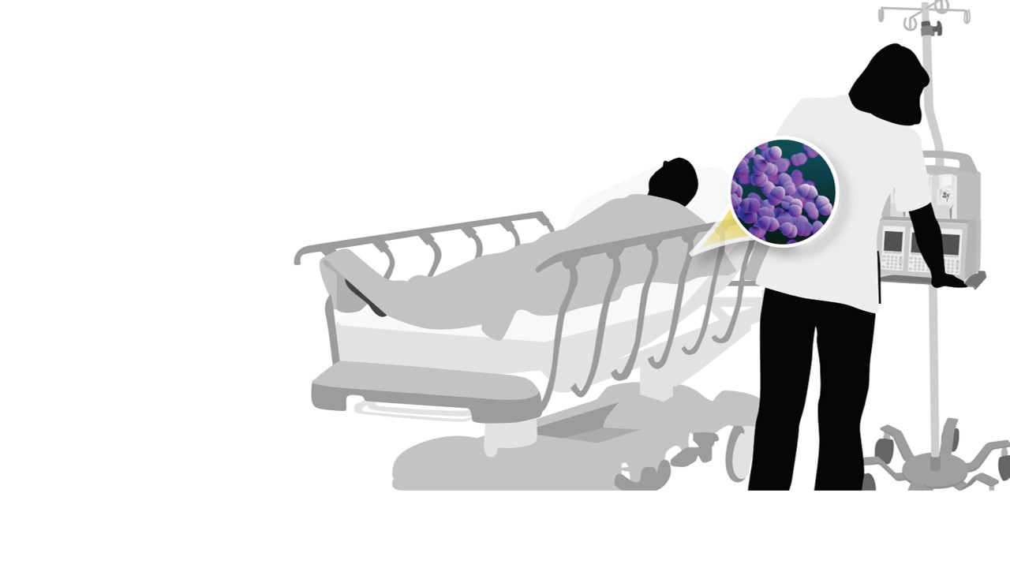
How Germs Spread and Make People Sick Example
Example Scenario
The germ is on the healthcare worker’s hands (skin)
Reservoir
The healthcare worker could touch the patient’s bed rail.
Pathway
The patient could touch the bed rail before it is cleaned and disinfected.
Person + Survival
The patient could touch their eye, bypassing the body’s defenses (skin) and delivering germs into the body.
Body’s Defenses
Notes:
Facilitator Notes:
Emphasize that the five elements that you described are not the only ways that this germ can be spread from this reservoir.
Note that the five elements are not necessarily steps that happen all in order, and that they are not inevitable. Infection control actions can keep the germ from spreading at any of the elements.
Sample Script:
"The worker could touch the bed rail in a patient’s room without cleaning their hands first.
“The germ is now on the bed rail. From there, how could it get to the patient? The patient could pick up the germ on their hand when they touch the bed rail, if it hasn’t been cleaned and disinfected first. The patient could then rub their eye, delivering the germ to their body. The germ has survived because the bed rail wasn’t cleaned and disinfected, and the patient’s natural defenses can’t fight it off. The patient now has an infection.
“Now, the way that I just outlined the five elements in this example isn’t the only way germ spread could happen. In fact, there are many ways that the elements could work in this scenario for an end result of a patient becoming infected.
“It’s also important to remember that the elements aren’t steps in an order and that it’s not inevitable that someone will get sick from a germ – infection control actions can keep germs from spreading at any point: the reservoir, pathway, the new person to infect, their body’s defenses, and the survival of the germ itself!”

Slide 17
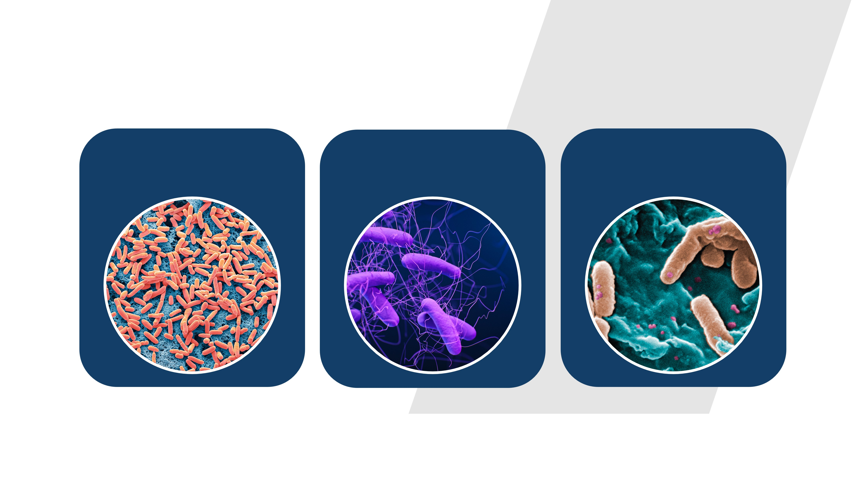
Create Your Own Scenario
E. coli in a
patient’s gut
C. difficile on a
blood pressure cuff
Pseudomonas in a
water faucet
Notes:
Facilitator Notes:
Briefly describe the three germ-and-reservoir scenarios listed on the slide: Escherichia coli (E. coli) in a patient’s gut; Clostridioides difficile (C. difficile, C. diff) on a blood pressure cuff; Pseudomonas in a water faucet.
Explain that the “story” that participants create for how an infection could occur should use the germ and the reservoir in one of the three scenarios as a starting point. The stories do not necessarily need to have exactly five steps, but should use the five elements as a guide.
Reiterate and emphasize that it is not necessary to have in-depth knowledge about the characteristics of the specific germ. Participants will use the framework of the five elements and the four main pathways for germ spread in healthcare to imagine how a patient could get an infection.
You can also point out that participants often will not know the exact germs they could be encountering in a healthcare setting.
Remind participants that they encounter these germs and situations every day. Encourage them to draw on their professional experiences as a starting point to create their stories.
Inform participants that they will have about 4 minutes to create their story.
Invite participants to note their ideas in their participant booklet.
You may choose to assign participants to one of the scenarios, such as by birth month or last name (“If you were born in January, February, March, or April, you’ll work on the first scenario,” or “If your last name begins with …”), or you can ask them to choose the scenario they’d like to work with.
Timeline, platform, and group size permitting, you might choose to divide participants into breakout rooms for group discussion.
Advance to slide 18, which reminds participants of the elements and germ-and-reservoir pairs.
Sample Script:
“Now it’s your turn. Choose one of these three scenarios: (1) E. coli in a patient’s gut; (2) C. difficile on a blood pressure cuff; or (3) Pseudomonas in a water faucet.
“In your participant booklet, make notes on a possible pathway for the germ to be spread from the reservoir, and write down how each of the five elements could contribute to a patient getting an infection. I encourage you to draw on your work experiences as you’re thinking about your ‘story,’ since these are things that you encounter and react to every day.
“And let me reassure you – it’s not necessary to know the details and characteristics of the germ in your scenario. Instead, think about the framework of the five elements and how they work to result in someone getting sick.
“One more thing: even though there are five elements, there don’t necessarily need to be five ‘steps.’ A germ could be spread from one reservoir to a person, who spreads it to another reservoir, where it’s picked up by a patient. If the germ survives all this and gets around the patient’s natural defenses, it can cause an infection.
“You’ll have about 4 minutes for this activity.”

Slide 18
Five Elements of How Germs Spread and Cause Infection
Reservoirs
Person
Germ
survival
Pathways
Body’s
defenses
Notes:
Facilitator Notes:
Point out that the five elements are provided on the slide for reference and explain how participants can ask for help.
Inform participants that you will give a “warning” when 1 minute is remaining.
Sample Script:
“I’ll leave this slide up as a reminder while you’re working. If you have any questions, please feel free to use the ‘raise your hand’ feature. I’ll give you a warning when you have about 1 minute left.”
(Give warning when 1 minute is remaining.)

Slide 19
Scenario Summaries
E. coli in a
patient’s gut
C. difficile on a
blood pressure cuff
Pseudomonas in a
water faucet
Notes:
Facilitator Notes:
Thank participants for working through the scenarios.
Invite participants to share their scenarios and describe the framework of the five elements of how germs spread and make people sick. You may choose to ask for volunteers or call on participants to speak up for each scenario. If appropriate for your audience – and if time permits – you could also consider encouraging participants to point out where an infection control action at each of the five elements could have kept the germ in each scenario from infecting the patient.
If participants need ideas or help getting started, these sample scenarios for the three germ-and-reservoir pairs could be helpful; however, please note that they are not the only ways that germs can be spread.
E. coli in a patient’s gut: After a patient goes to the bathroom, they don’t wash their hands. They use their IV pole for support as they walk back to their bed. A nurse comes to change the patient’s IV medication and moves the IV pole, which spreads the germ to the nurse’s hand. The patient in the neighboring bed calls for the nurse’s help. Without sanitizing their hands, the nurse goes to the neighbor and moves their food tray closer so they can reach it to eat, spreading the germ to the tray. That patient touches the food tray in the process of eating and gets the germ on their hand. They have a wound dressing on their hand that’s falling off, and they fix it without first cleaning their hands, spreading the germ to the inside of the dressing. The germ enters their body through the wound and infects them.
C. difficile on a blood pressure cuff: A healthcare worker uses the cuff on a patient. The germ spreads to the healthcare worker’s hand. The healthcare worker does not clean the cuff or their hands, and exits the room to move to their next patient, who is on antibiotics. The healthcare worker takes the next patient’s pulse and spreads the germ to the patient’s skin. The patient does not clean their hands and eats a snack. The germ enters their body and infects them.
Participants might identify that the C. difficile would have started in someone’s gut, and been spread to the blood pressure cuff by someone’s skin, likely their hands.
Pseudomonas in a water faucet: A healthcare worker gives a patient a soap-and-water bath. The water gets onto the patient’s IV and seeps to the head of the IV. The IV is not cleaned immediately, and the germ begins to grow. When the IV is reattached, the germ enters the patient’s body and infects them.
Sample Script:
“Thank you for thinking through the scenarios! Is anyone who took on the first scenario, E. coli in a patient’s gut, willing to unmute and briefly describe your scenario, and how the five elements come into play to result in another person becoming infected?”

Slide 20
Bringing It Together

Slide 21
Reflection
Thinking about your daily work, can you identify any of your tasks that are related to any of the five elements?
Jot down in your participant booklet two actions you can take to stop the spread of germs to you or your patients.
Notes:
Facilitator Notes:
Help participants connect their knowledge about how germs spread in healthcare to actions they can take in their daily work to help keep germs from spreading, and to protect themselves and their patients.
Encourage participants to make notes in their participant booklet.
Time permitting, you may wish to ask for responses in the chat or for participants to share their ideas verbally.
Sample Script:
“You did a great job using the five elements of how germs spread in those scenarios! Understanding how germs spread and make people sick is an important part of recognizing the risk for it to happen, and choosing infection control actions that will keep germ spread from happening – which protects your patients and yourself. Thinking about your daily work, can you identify any of your tasks that are related to any of the five elements? With that in mind, please jot down in your participant booklet two actions you can take daily to stop the spread of germs to you or to your patients.”

Slide 22
Questions
Notes:
Facilitator Notes:
Invite additional remaining questions.
If the answers are information that is already included in this session, please respond.
If the questions address content that is not covered in this session, please do not attempt to answer. Instead, take note of the questions and consult with CDC resources to follow up with answers after the session.
Sample Script:
“We covered a lot today. Does anyone have any questions still remaining, or items I can clarify about how germs spread and make people sick?”

Slide 23
Conclusion

Slide 24

Key Takeaways
Five elements for a germ to spread and cause an infection: reservoir, pathway, person to infect, getting around the body’s defenses, survival.
Infection control actions at any one of these key points stop germs from spreading and causing infection.
Main pathways for germs to spread in healthcare: touch, breathing in, splashes or sprays, bypassing or breaking down the body’s natural defenses.
Notes:
Facilitator Notes:
Thank participants for their time and review the Key Takeaways from the session.
Sample Script:
“Thank you for your time and attention today. I hope that you can take these ideas and apply them at work.”

Slide 25

How to Get Involved and Feedback
Project Firstline on CDC:
https://www.cdc.gov/infection control/projectfirstline/index.html
CDC’s Project Firstline on Facebook:
https://www.facebook.com/CDCProjectFirstline
CDC’s Project Firstline on Twitter:
https://twitter.com/CDC_Firstline
Project Firstline Inside Infection Control on YouTube:
https://www.youtube.com/playlist?list=PLvrp9iOILTQZQGtDnSDGViKDdRtIc13VX
To sign up for Project Firstline e-mails, click here: https://tools.cdc.gov/campaignproxyservice/subscriptions.aspx?topic_id=USCDC_2104
How Germs Spread in Healthcare video clip: https://www.cdc.gov/infectioncontrol/projectfirstline/videos/HowGermsSpread-LowRes.mp4
Project Firstline feedback form: https://www.cdc.gov/infectioncontrol/pdf/projectfirstline/TTK-ParticipantFeedback-508.pdf
Placeholder for partners to add their own links
Notes:
Facilitator Notes:
Share additional resources from Project Firstline and CDC.
Explain how participants can reach you, by the means of your choosing, and how they can reach Project Firstline.
If this session is part of a series, you may choose to describe the themes of upcoming sessions.
Direct participants to the feedback form.
Sample Script:
“Even though we covered a lot today, there is still much more to learn. You can keep exploring these topics on your own using the resources on this slide.
“Project Firstline has a suite of products to help you learn more about how to recognize infection risks at work, where germs live in healthcare, and how germs spread. You can also follow Project Firstline on social media!”
“I will stay on the line for a few minutes after our session ends and will be happy to discuss any other questions!”
(If this session is part of a series) “Next time, we will cover [insert next training topic]. Finally, please let us know how you enjoyed today’s session by completing the feedback form. Thanks again for joining us today.”

