Slide 1

What Does It Mean to Recognize a Risk?
Recognizing Risk Using Reservoirs
Session 1
Notes:
Facilitator Notes:
Participants log in and get settled.

Slide 2
Agenda
Welcome and Introductions
Recognizing Risk
How Healthcare Is Different
Where Is the Risk for Germs to Spread in Healthcare?
Bringing It Together
Conclusion
Recognizing Risk Using Reservoirs | Session 1: What Does It Mean to Recognize a Risk?
2
Notes:
Facilitator Notes:
Welcome the group and add a greeting to the chat box.
If this session is part of an ongoing series, you may choose to say “welcome back,” “thank you for joining us again,” etc.
Announce housekeeping notes, either orally or via chat. If needed, provide additional notes specific to the platform you’re using (e.g., how to “raise your hand,” how to post questions).
Provide an overview of the agenda.
Adapt this section of the session as needed: for instance, you may choose to spend additional time on introductions if there are new faces, or if participants do not know each other.
Sample Script:
“Welcome to Project Firstline. Thank you for joining us! Before we begin, a few housekeeping notes. We’ll meet today for about 20 minutes. Please keep your videos on, to the extent possible, and keep your microphone muted when you are not contributing to the discussion. It’s great to see you all here today!
“Today, we’ll discuss the concept of risk recognition, and how you can apply it to help prevent infections in healthcare. We’ll have an opportunity to reflect before we wrap up for the day.”

Slide 3
Recognizing Risk

Slide 4
Discussion Question:
What Is “Risk”?
Notes:
Facilitator Notes:
Open discussion by asking participants to name a recent time or event in which they saw a risk, or a possibility that something could go wrong, at home or at work, and took action as a result. Invite them to type their answers into the chat, or you may call on volunteers to unmute and share their thoughts.
Provide a non-healthcare example to stimulate ideas, such as intervening when a toddler tries to climb up on a table; slowing down when you see a dog on the side of the street as you drive by; turning the handles of pots on the stove away from the edge so the pots won’t be knocked off; or wiping up a spill so others don’t fall.
Depending upon your audience, you may wish to incorporate examples of recognizing risk and changing behaviors and actions from the COVID-19 pandemic, such as wearing a mask to the grocery store, avoiding large gatherings, or getting vaccinated.
Sample Script:
“Thinking about the question of what risk is and how you recognize it, can you think of a time when you spotted a risk at work or at home, and took action to stop something bad from happening? And how did you know it was a risk – had you seen it happen before, or was it something you were taught? Feel free to put your answers in the chat.”

Slide 5
Risk Recognition:
Seeing the potential for a problem to happen
Seeing a potential problem doesn’t mean the problem will definitely happen!
We take action to keep something bad from happening.
Notes:
Facilitator Notes:
Acknowledge responses and link them to the definition of “risk recognition” on the slide.
Note that we recognize risk all the time in our daily lives, and we act to keep bad things from happening.
Sample Script:
“Those are great examples, thank you! A simple definition of risk recognition is ‘seeing the potential for a problem to happen.’ But seeing it doesn’t mean it has to happen. You all had examples of seeing a potential problem and doing something to stop it from becoming a real problem – and that’s important. You recognize risk, and you act on it! Now, we’ll see a brief clip of these ideas in action.”

Slide 6
Video:
Healthcare Risk Recognition in Action
Notes:
Facilitator Notes:
This slide includes a video clip that reviews key points about recognizing the risk for germs to spread in healthcare. You have two options to present this information.
Show the video clip. After the clip, link the concepts of recognizing risks at home and at work with recognizing infection risks at work, and then proceed past slides 7–9 to slide 10: How Healthcare Is Different.
Depending upon your audience and time frame, you may wish to open the floor for volunteers to contribute their own examples of recognizing risk at work in healthcare, either in the chat or by unmuting and sharing aloud.
If you choose not to show the video clip, proceed past slide 6 to slides 7–9, which cover the concepts included in the clip. Once you have reviewed those slides, proceed to slide 10: How Healthcare Is Different.
Access the video here: https://www.cdc.gov/infectioncontrol/projectfirstline/videos/RiskRecognition-inAction-LowRes.mp4
Sample Script:
“Now, we’ll see a brief clip of these ideas in action.”
(Show video.)
“The concepts of recognizing risk when we’re at work in healthcare, like seeing the potential for a patient to fall down and stepping in to help, also apply to infection control. When there’s a risk for germs to spread, you do certain things – like clean your hands before giving a patient an injection, put on PPE before doing certain tasks, and clean and disinfect high-touch surfaces like door handles and light switches. Thinking further about the idea of recognizing risk, can you think of times at work when you recognized the risk for germs to spread? What have you done to stop germs from spreading before they caused problems?”
(Advance to slide 10.)

Slide 7

Example #1
Recognizing Risk Using Reservoirs | Session 1: What Does It Mean to Recognize a Risk?
7
Notes:
Slides 7, 8, 9: Facilitator Notes (alternative to video):
If you elect not to show the video clip, use these slides to link the concept of recognizing risk in daily life to the ways healthcare workers recognize risk at work and take action. Build on that idea to introduce the concept of recognizing risks for germs to spread and taking action to stop it.
Depending upon your audience and time frame, you may wish to open the floor for volunteers to contribute their own examples of recognizing risk at work in healthcare, either in the chat or by unmuting and sharing aloud. If you use these slides in instead of the video clip, adapt the script for the next slides as appropriate.
Sample Script (alternative to video):
“Our examples showed ways that we recognize risk in everyday life, and how we act to keep ourselves and others safe.”
(Advance to slide 8.)

Slide 8
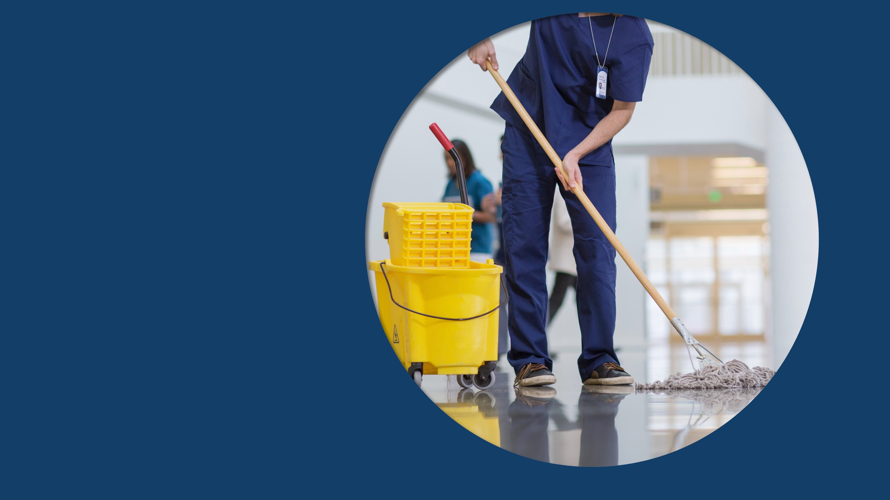
Example #2
Recognizing Risk Using Reservoirs | Session 1: What Does It Mean to Recognize a Risk?
8
Notes:
Sample Script (alternative to video):
“At work in healthcare, we do the same thing – by cleaning up spills, checking medication dosages, or stepping in to help if we see a patient who’s unsteady on their feet and could fall.”
(Advance to slide 9.)

Slide 9
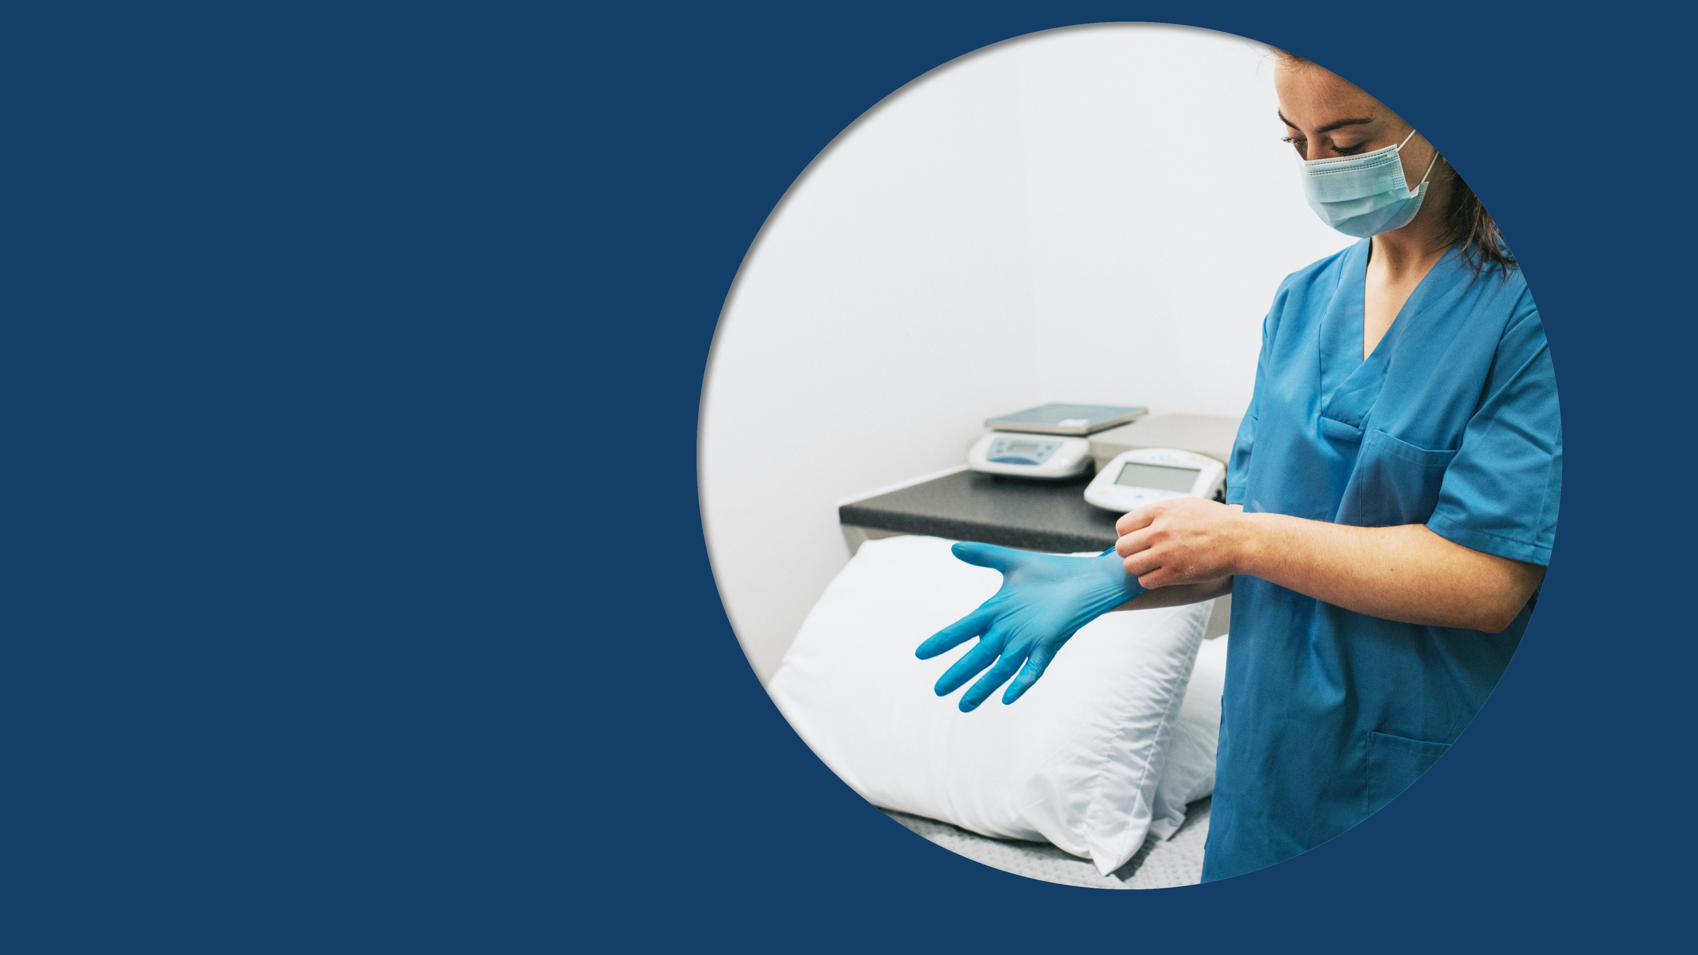
Example #3
Recognizing Risk Using Reservoirs | Session 1: What Does It Mean to Recognize a Risk?
9
Notes:
Sample Script (alternative to video):
“The same idea applies to infection control. When there’s a risk for germs to spread, you do certain things – like clean your hands before giving a patient an injection, put on PPE before doing certain tasks, and clean and disinfect high-touch surfaces like door handles and light switches. Thinking further about the idea of recognizing risk, can you think of times at work when you recognized the risk for germs to spread? What have you done to stop germs from spreading before they caused problems?”

Slide 10
How Healthcare Is Different

Slide 11

Risks of Germs in Healthcare
Higher chance patients will have an infection
Patients likely to be more vulnerable to infection
Things we do as part of care can put people at risk of infection
The work we do presents many opportunities for germs to spread
Notes:
Facilitator Notes:
Explain why risks for germs to spread in healthcare are different from risks in other places.
Emphasize that healthcare is a unique setting with different risks for germs to spread, which makes infection control especially important.
You may wish to refer to the Content Outline in the Appendix for this session for additional discussion points.
Sample Script:
“When we think about germs spreading in healthcare, it’s helpful to remember what makes healthcare a unique setting, with unique challenges and risks for infection control. We think about germs and their risks differently in healthcare than in other places, like at home or in the community.
“Why? Patients are coming in for care, so there’s a higher chance that they have an infection. Because many patients are ill and weak, they’re likely to be more vulnerable to infection, so the risks from germs spreading to them are higher. And sometimes, the things that we do as part of giving care can actually put people at risk of infection. If a patient needs an IV, their skin has to be broken. If there are germs on their skin or the needle, inserting the IV can push germs into their body.
“And, finally, the work that we do in healthcare brings opportunities for germs to spread. We usually have closer interactions with patients during care than people have in the community. We interact with many people, and we touch and share a lot of things and equipment throughout the day, which are all opportunities for germs to be spread. That’s why infection control is different in healthcare than in other places – and why it’s all the more important to recognize the risks for germs to spread throughout your workday.”

Slide 12
Where Is the Risk for Germs to Spread in Healthcare?

Slide 13
Instructions
Review photos on the following slides.
Identify infection risks in the photos.
Share your ideas.
Notes:
Facilitator Notes:
Describe the group activity. The next three slides have pictures of common scenes or situations in healthcare.
Invite participants to identify risks for germs to spread in each scene and note their observations in their participant booklets or share them in the chat or by unmuting. As observations are shared, acknowledge them and encourage additional discussion, such as by asking, “Have you recently been in a situation where you’ve seen a risk like this?”
Depending upon your audience, you could choose to ask about actions they might take to keep germs from spreading, based on the risk they’ve identified. This activity should move relatively quickly. The goal is not to name every possible risk in the scene or to name “correct” risks, but to help participants apply the idea of recognizing risk to real-world healthcare scenarios.
Sample Script:
“We’ve talked about recognizing risk in general, and about higher risks for germ spread in healthcare. Now let’s work together to identify and discuss some infection control risks. I’m going to show a slide with a picture of a common scene in healthcare. Please look at the picture and identify the risks for germs to spread. You can jot your ideas down in your participant booklet, share them in the chat, or unmute yourself and share them aloud. Ready?”

Slide 14
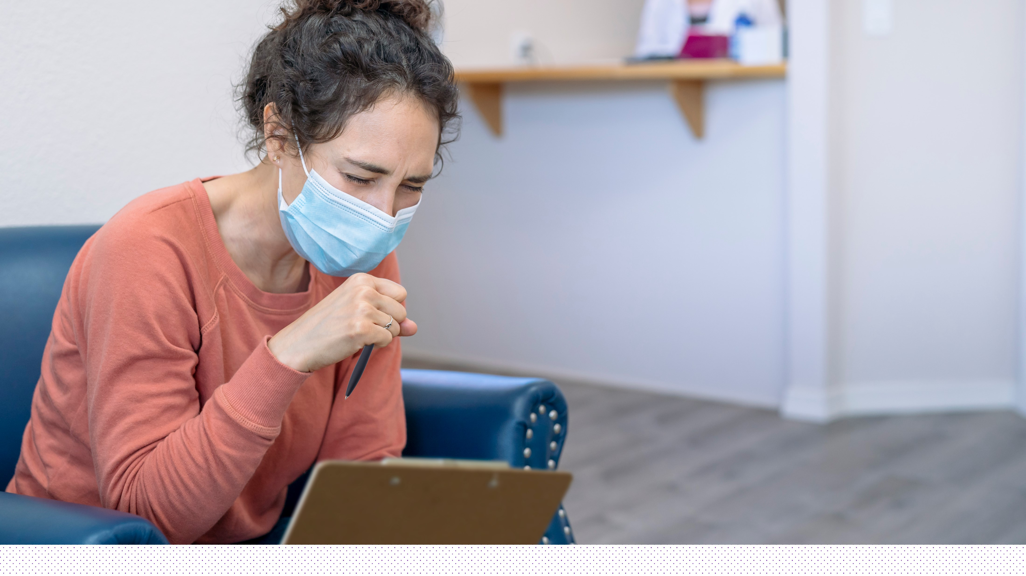
Person Coughing in Waiting Room
Notes:
Facilitator Notes:
Allow participants a few moments to look at the scene, and then open the floor to responses.
If no responses are offered, you may prompt discussion by naming a risk. Possible risks include: the patient appears to have a respiratory virus that could spread by respiratory droplets, even though they are masked; germs could spread from the patient to surfaces in the waiting room; the patient could touch surfaces in the waiting room that have germs on them and spread those germs to themself when they wipe their eyes or blow their nose.
Sample Script:
“What do you see in this scene?”
(Pause for responses.)
“Definitely, this person looks like a patient – and they look like they don’t feel very good! What risks do you see for germs to spread?”
(If no responses) “They have a mask on, but they seem to have a runny nose. What other risks do you see?”

Slide 15

Person with Burn in Waiting Room
Notes:
Facilitator Notes:.
Allow participants a few moments to look at the scene, and then open the floor to responses.
If no responses are offered, you may prompt discussion by naming a risk. Possible risks include: even though the patient looks healthy, they aren’t wearing a mask, and germs can spread from someone who doesn’t look sick; germs could be spread from the patient’s wound to surfaces in the waiting room; germs from surfaces in the waiting room could reach the patient through their wound.
Sample Script:
“Those are great ideas, thank you! Let’s look at another photo. What risks do you see here?”
(Pause for responses.)
“That’s true! Even though they don’t look sick, they should be wearing a mask to keep germs from their respiratory droplets from spreading. What else do you see?”
(Pause for additional responses.)

Slide 16
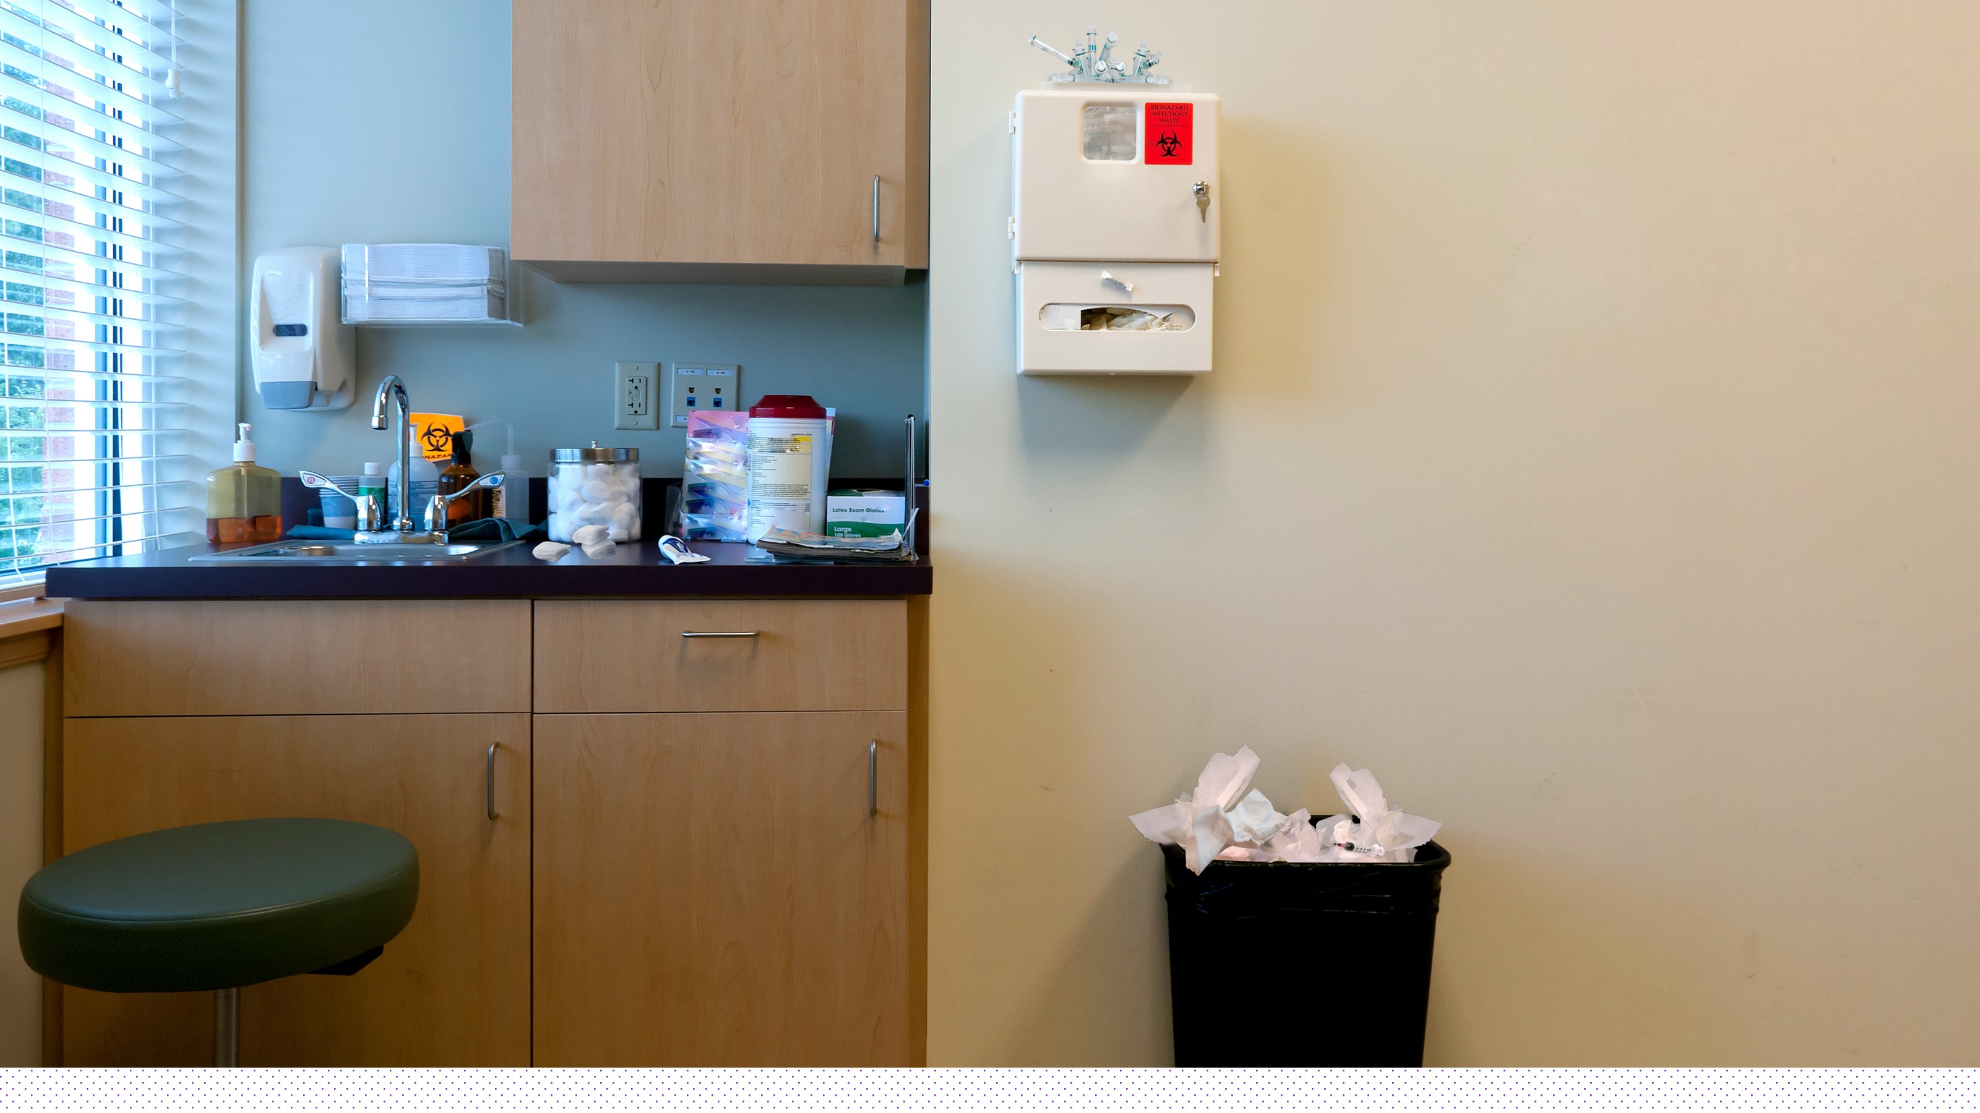
Syringe Infection Control Risk
Notes:
Facilitator Notes:
Allow participants a few moments to look at the scene, and then open the floor to responses.
If no responses are offered, you may prompt discussion by naming a risk. Possible risks include: a sharp in a regular trashcan instead of a sharps container; an overflowing trashcan, which is an infection risk if it contains items like used tissues or other items carrying germs; the supplies placed near the sink, which could get splashed with water that contains germs.
Sample Script:
“There’s no patient in this scene, but is there an infection risk?”
(Pause for responses.)
“Exactly, the uncapped needle sitting on top of the trash is a risk – someone could get stuck with it, and germs on the needle could get into their body. What other risks do you see?”

Slide 17
Bringing It Together

Slide 18
Reflection
What’s one risk for germs to spread that you might recognize in your daily work?
When you recognize that risk, what’s one thing you can do to help stop germs from spreading?
Notes:
Facilitator Notes:
Transition from the activity to give participants an opportunity to reflect and identify ways to recognize infection risks in their daily work. Encourage participants to note their ideas in their participant booklets.
You may choose to ask one or two volunteers to share their thoughts. Depending upon your audience and time frame, you could also ask how participants might take action to stop germs from spreading, based on the risk(s) they identified.
Sample Script:
“You did a great job recognizing risks! Now, as you reflect on the infection risks that we’ve talked about or identified, think about your next workday. Can you recognize one risk for germs to spread that’s part of your daily work?”
(Pause for responses.)
“Let’s go one step further. When you recognize one of these risks, what’s one thing you can do – one infection control action – to help stop germs from spreading? Please jot down your thoughts in your participant booklet. Would anyone like to unmute and share their ideas?”

Slide 19
Questions
Notes:
Facilitator Notes:
Invite additional remaining questions.
If the answers are information that is already included in this session, please respond.
If the questions address content that is not covered in this session, please do not attempt to answer. Instead, take note of the questions and consult with CDC resources to follow up with answers after the session.
Sample Script:
“We covered a lot today. Does anyone have any questions still remaining, or items I can clarify about recognizing risk for germs to spread in healthcare?”

Slide 20
Conclusion

Slide 21
Key Takeaways
Risk recognition is seeing the potential for a problem to happen.
You can help control infections in healthcare by learning to recognize the risk for germs to spread and cause infection, and not letting it happen.
Healthcare is a unique setting – we consider germs differently in healthcare than we do in other places.
Notes:
Facilitator Notes:
Thank participants for their time and review the Key Takeaways from the session.
Sample Script:
“Thank you for your time and attention today. I hope that you can take these ideas and apply them at work.”

Slide 22






How to Get Involved and Feedback
Project Firstline on CDC.gov:
https://www.cdc.gov/infection control/projectfirstline/index.html
CDC’s Project Firstline on Facebook:
https://www.facebook.com/CDCProjectFirstline
CDC’s Project Firstline on Twitter:
https://twitter.com/CDC_Firstline
Project Firstline Inside Infection Control on YouTube:
https://www.youtube.com/playlist?list=PLvrp9iOILTQZQGtDnSDGViKDdRtIc13VX
To sign up for Project Firstline e-mails, click here: https://tools.cdc.gov/campaignproxyservice/subscriptions.aspx?topic_id=USCDC_2104
Healthcare Risk Recognition in Action video clip: https://www.cdc.gov/infectioncontrol/projectfirstline/videos/RiskRecognition-inAction-LowRes.mp4
Project Firstline feedback form: https://www.cdc.gov/infectioncontrol/pdf/projectfirstline/TTK-ParticipantFeedback-508.pdf
Placeholder for partners to add their own links
Notes:
Facilitator Notes:
Share additional resources from Project Firstline and CDC.
Explain how participants can reach you, by the means of your choosing, and how they can reach Project Firstline.
If this session is part of a series, you may choose to describe the themes of upcoming sessions.
Direct participants to the feedback form.
Sample Script:
“Even though we covered a lot today, there is still much more to learn. You can keep exploring these topics on your own using the resources on this slide.
“Project Firstline has a suite of products to help you learn more about how to recognize infection risks at work, where germs live in healthcare, and how germs spread. You can also follow Project Firstline on social media!
“I will stay online for a few minutes after our session ends and will be happy to discuss any other questions!”
(If this session is part of a series) “Next time, we will cover [insert next training topic]. Finally, please let us know how you enjoyed today’s session by completing the feedback form. Thanks again for joining us today.”

