Slide 1






Physical Activity During School:
Providing Recess to All Students
Notes:
NARRATIVE:
Welcome! This presentation explains the importance of providing recess to students from kindergarten through high school. It also highlights evidence-based strategies to ensure that all students have a positive recess experience that increases physical activity and improves student behavior and learning.
NOTES FOR PRESENTER:
Middle schools and high schools might refer to recess as physical activity periods or some other term. This period should be in addition to physical education and classroom physical activity.
Presenters can personalize this presentation by adding local policy and activity references to the slides, where appropriate. Places for personalization will also be noted in the “NOTES FOR PRESENTER” section. Depending on audience interaction and questions, allow 25 to 30 minutes to present the information in this presentation.

Slide 2

Purpose
Explain how recess supports student success.
Share three new resources for recess
  Strategies for Recess in Schools
  Recess Planning in Schools: A Guide to Putting Strategies for Recess into Practice
  Recess Planning Template
Learn how to support recess in schools.
Notes:
NARRATIVE:
The main purpose of this presentation is explain the benefits of providing recess in schools and to highlight three new resources that are available to help schools develop an evidence-based recess plan for schools. These resources include CDC’s and SHAPE America’s: Strategies for Recess in Schools, Recess Planning in Schools: A Guide to Putting the Strategies for Recess into Practice, and the customizable Recess Planning Template. We also will discuss ways to build support in schools for recess.
NOTES FOR PRESENTER:
Presenters can personalize this presentation by focusing on what is happening in their schools related to recess.

Slide 3
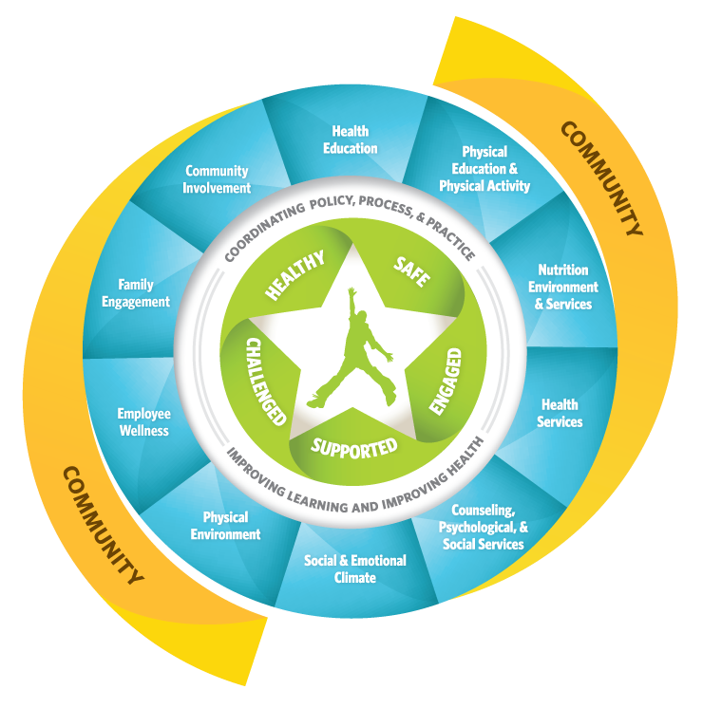
Whole School, Whole Community,
Whole Child Model
Notes:
NARRATIVE:
An important framework that guides our work in school health is the Whole School, Whole Community, Whole Child (WSCC) model. WSCC builds on CDC’s Coordinated School Health (CSH) Model and ASCD’s Whole Child Approach. It represents greater alignment of both education and public health goals.
WSCC supports opportunities for physical education and physical activity (noted by the red circle around the component for physical education and physical activity in the model). But how do schools address this component of WSCC?
NOTES FOR PRESENTER:
For more information about the WSCC model, see www.cdc.gov/healthyschools/wscc/index.htm.

Slide 4

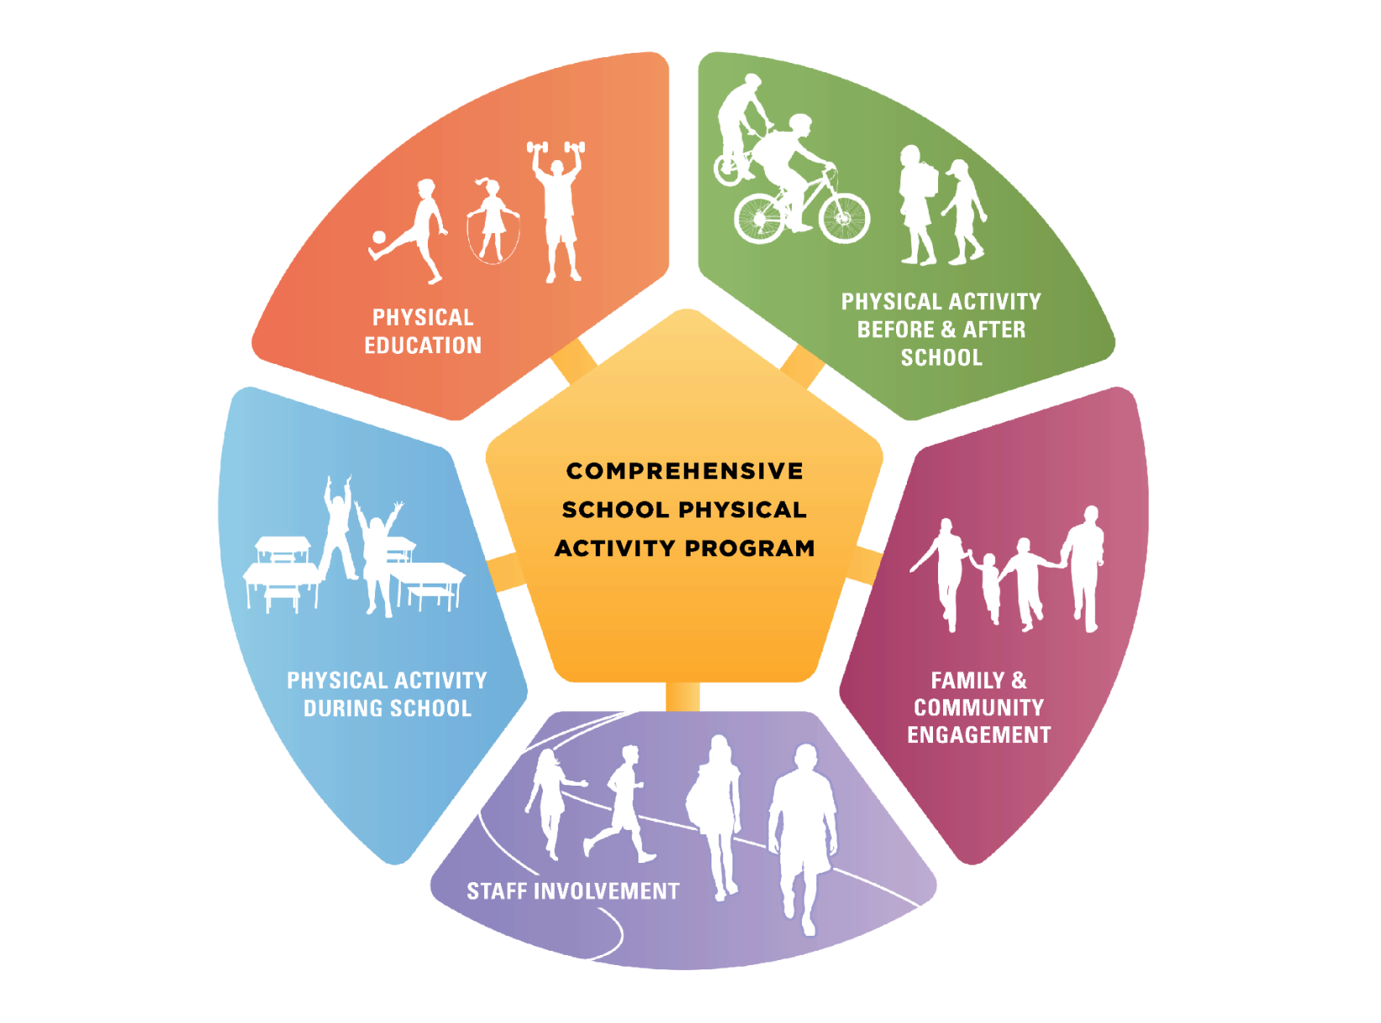
Physical Education and Physical Activity
Notes:
NARRATIVE:
This component of WSCC is defined by a Comprehensive School Physical Activity Program. The goal of a Comprehensive School Physical Activity Program is to increase physical activity opportunities before, during, and after school and to increase students’ overall physical activity and health.
There are five components in a Comprehensive School Physical Activity Program. They include physical education, physical activity during school, physical activity before and after school, staff involvement, and family and community engagement.
Within the component for physical activity during school, two types of activities are included—classroom physical activity and recess. The focus of this presentation is recess.
NOTES FOR PRESENTER:
For more information about a Comprehensive School Physical Activity Program and the five components, see www.cdc.gov/healthyschools/physicalactivity/cspap.htm.

Slide 5
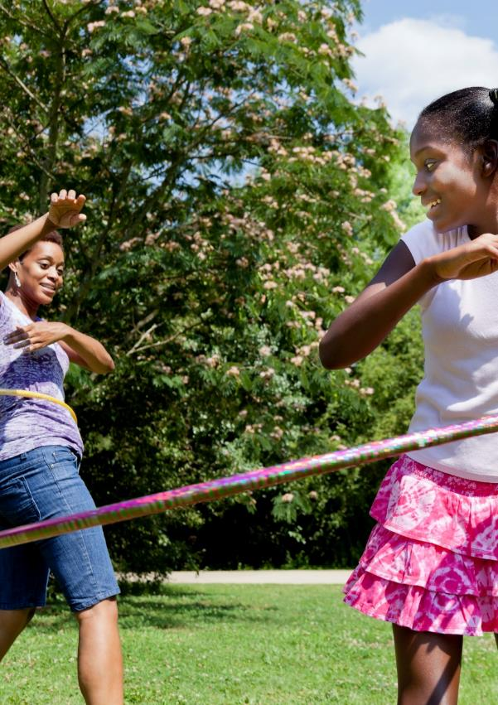
Definition of Recess
A regularly scheduled period within the school day for physical activity and play that is monitored by trained staff or volunteers.
Recess is a period of time when students are encouraged to be physically active and engaged with their peers in activities of their choice, at all grade levels, kindergarten through 12th grade.
Notes:
NARRATIVE:
CDC and SHAPE America define recess as, “A regularly scheduled period within the school day for physical activity and play that is monitored by trained staff or volunteers.”
Recess is a period of time when students are encouraged to be physically active and engaged with their peers in activities of their choice, at all grade levels, kindergarten through 12th grade.
NOTES FOR PRESENTER:
Middle and high schools may want to change the word recess to something that resonates with their student body. The goal is still to offer secondary students a period of time to be active outside of the classroom and physical education.

Slide 6
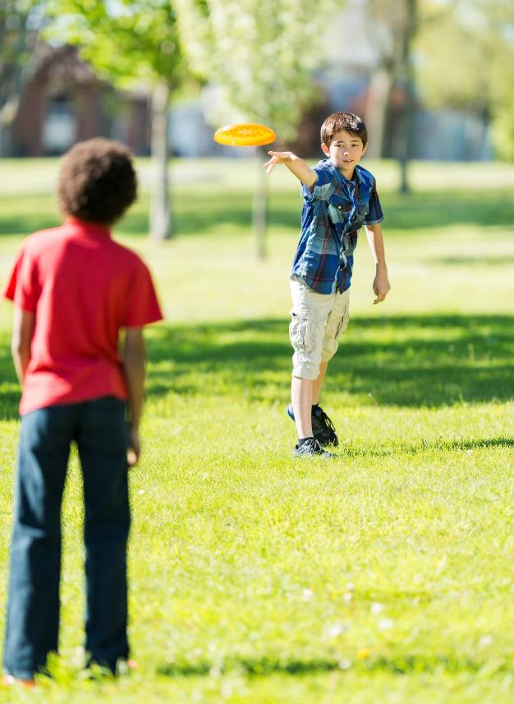
Benefits of Recess
Improves social and emotional development.
Improves memory, attention, and concentration.
Helps students stay on-task in the classroom.
Reduces disruptive behavior in the classroom.
Increases level of physical activity.
Notes:
NARRATIVE:
There are many benefits for having recess in schools. They include:
Improving students’ social and emotional development (e.g., learning how to share and negotiate).
Improving students’ memory, attention, and concentration.
Helping students stay on-task in the classroom.
Reducing disruptive behavior in the classroom.
Increasing students’ level of physical activity.
All of these benefits help improve student’s engagement in school, which leads to improved school connectedness and overall school climate.
NOTES FOR PRESENTER:
If you have examples of benefits that your school or classroom has experienced from providing recess, consider sharing them during this slide.

Slide 7

National Guidance for Recess
Provide all students K‒12 with at least 20 minutes of recess daily.
Prohibit the replacement of physical education with recess.
Provide schools and students with adequate spaces, facilities, equipment, and supplies for recess.
Ensure that spaces and facilities for recess meet or exceed recommended safety standards.
Prohibit the exclusion of students from recess for disciplinary reasons or academic performance in the classroom.
Prohibit the use of physical activity during recess as punishment.
Provide recess before lunch.
Provide staff members who lead or supervise recess with ongoing professional development.
Source: CDC and SHAPE America—Society of Health and Physical Educators. Strategies for Recess in Schools. Atlanta, GA: Centers for Disease Control and Prevention,
US Dept of Health and Human Services; 2017.
Notes:
NARRATIVE:
The following national guidance can guide state, district, and school policies for recess. This guidance encourages schools to:
Provide all students in kindergarten through 12th grade with at least 20 minutes of recess daily (or a similar daily period of physical activity).
Prohibit the replacement of physical education with recess or the use of recess to meet time requirements for physical education policies.
Provide schools and students with adequate spaces, facilities, equipment, and supplies for recess.
Ensure that spaces and facilities for recess meet or exceed recommended safety standards.
Prohibit the exclusion of students from recess for disciplinary reasons or academic performance in the classroom.
Prohibit the use of physical activity during recess as punishment.
Provide recess before lunch.
Provide staff members who lead or supervise recess with ongoing professional development.
NOTES FOR PRESENTER:
This national guidance for recess can be found on page 3 in CDC’s and SHAPE America’s Strategies for Recess in Schools, www.cdc.gov/healthyschools/physicalactivity/pdf/2016_12_16_schoolrecessstrategies_508.pdf.

Slide 8
Recess Participation
*Among elementary schools with students in that grade.
Source: CDC. Results from the School Health Policies and Practices Study 2014. Atlanta, GA. US Department of Health and Human Services; 2015.
Notes:
NARRATIVE:
CDC’s 2014 School Health Policies and Practices Study (known as SHPPS) focused on school practices. SHPPS data are nationally representative and address all three school levels (elementary, middle, and high school), except for the questions on recess, which only focus on elementary schools.
Most elementary schools across the nation had students in kindergarten through 5th grade participate in regularly scheduled recess. However, this percentage declined for students in 6th grade (for elementary schools that offered grade 6).
NOTES FOR PRESENTER:
You can replace this slide with your state, district, or school data if they are available.
For more information about the 2014 School Health Policies and Practices Study, see www.cdc.gov/healthyyouth/data/shpps/index.htm.

Slide 9

Recess: Number of Days and Minutes*
On average, schools schedule students to have recess 5 days a week.
On average, schools have students spend 27 minutes in recess each day.
YES!
Meets the national guidance for recess, but we still have schools not offering recess!
*Among elementary schools in which students participate in regularly scheduled recess.
Source: CDC. Results from the School Health Policies and Practices Study 2014. Atlanta, GA.: US Department of Health and Human Services; 2015.
Notes:
NARRATIVE:
Although US elementary schools that offer recess are meeting the national guidance for recess—that is, they are providing at least 20 minutes of daily recess—many schools are still not offering recess for every grade. In addition, schools that provide recess can improve their policies and strategies for recess to help increase physical activity, decrease behavioral issues related to recess, and improve academic achievement.
NOTES FOR PRESENTER:
You can replace this slide with your state, district, or school data if they are available.
For more information about the 2014 School Health Policies and Practices Study, see www.cdc.gov/healthyyouth/data/shpps/index.htm.

Slide 10

Recess Policy on Punishment
54% of elementary schools prohibited or actively discouraged staff from excluding students from all or part of recess as punishment for:
  Bad behavior.
  Failure to complete class work.
Source: CDC. Results from the School Health Policies and Practices Study 2014. Atlanta, GA.: U.S. Department of Health and Human Services; 2015.
`
Notes:
NARRATIVE:
Recess should not be used as punishment or withheld. However, 46% of US elementary schools exclude students from recess for bad behavior or failure to complete class work.
NOTES FOR PRESENTER:
You can replace this slide with your state, district, or school data if they are available.
For more information about the 2014 School Health Policies and Practices Study, see www.cdc.gov/healthyyouth/data/shpps/index.htm.

Slide 11
Students Can’t Go Outside for Recess
100% of elementary schools hold recess outdoors, weather permitting.
But when schools can’t let students go outside:
40% have students engage in other sedentary activities, such as board games
18% have students participate in physical activity in regular classrooms
30% have students participate in physical activity in the gym, multi-purpose room, or cafeteria
6% have students watch a DVD or video
Note: Percent in bubbles reflect the percentage of elementary schools.
Source: CDC. Results from the School Health Policies and Practices Study 2014. Atlanta, GA: US Department of Health and Human Services; 2015.
Notes:
NARRATIVE:
All elementary schools hold recess outdoors when the weather permits. When schools are unable to let students go outside, they use many different approaches, such as engaging students in sedentary activities, having recess in the gym or other school areas, having recess in classrooms, or letting students watch DVDs or videos.
Whether students are outside or inside during recess, they should be encouraged to be physically active and provided opportunities to do so.
NOTES FOR PRESENTER:
You can replace this slide with your state, district, or school data if they are available.
For more information about the 2014 School Health Policies and Practices Study, see www.cdc.gov/healthyyouth/data/shpps/index.htm.

Slide 12

Using Safety Checklist and Posting Rules
97% of elementary schools have playground facilities and equipment.
49% of elementary schools use the safety checklist and equipment guidelines published in the Public Playground Safety Handbook.
49% of elementary schools post rules for the safe use of specific types of playground equipment.
Source: CDC. Results from the School Health Policies and Practices Study 2014. Atlanta, GA. Atlanta, GA: U.S. Department of Health and Human Services; 2015.
Notes:
NARRATIVE:
Almost all US elementary schools have playground facilitates and equipment. However, less than half of these schools use a safety checklist or post rules for the safe use of specific types of playground equipment. Schools need to have rules and protocols in place to ensure the safety of students during recess.
NOTES FOR PRESENTER:
You can replace this slide with your state, district, or school data if they are available.
For more information about the 2014 School Health Policies and Practices Study, see www.cdc.gov/healthyyouth/data/shpps/index.htm.

Slide 13
Physical Activity in Middle and High Schools
Physical Activity Practice in Schools* | Middle Schools | High Schools
Have students participate in regular physical activity breaks during the school day | 64% | 27%
Have a specified time or event for schoolwide physical activity | 34% | 14%
*During the school day outside of physical education class.
Source: CDC. Results from the School Health Policies and Practices Study 2014. Atlanta, GA: U.S. Department of Health and Human Services; 2015.
Notes:
NARRATIVE:
SHPPS did not ask about recess for middle and high schools. However, two questions focused on opportunities for physical activity outside of physical education. Both middle and high schools are providing physical activity opportunities for students, with a higher percentage of these opportunity happening in high schools. However, it is not clear what types of activities are provided or how long they last.
NOTES FOR PRESENTER:
You can replace this slide with your state, district, or school data if they are available.
For more information about the 2014 School Health Policies and Practices Study, see www.cdc.gov/healthyyouth/data/shpps/index.htm.

Slide 14

Notes:
NARRATIVE:
To help strengthen recess in schools, CDC and SHAPE America collaboratively developed Strategies for Recess in Schools. This document identifies 19 evidence-based strategies for planning and providing recess in schools.
NOTES FOR PRESENTER:
For more information, see Strategies for Recess in Schools at www.cdc.gov/healthyschools/physicalactivity/pdf/2016_12_16_schoolrecessstrategies_508.pdf.

Slide 15
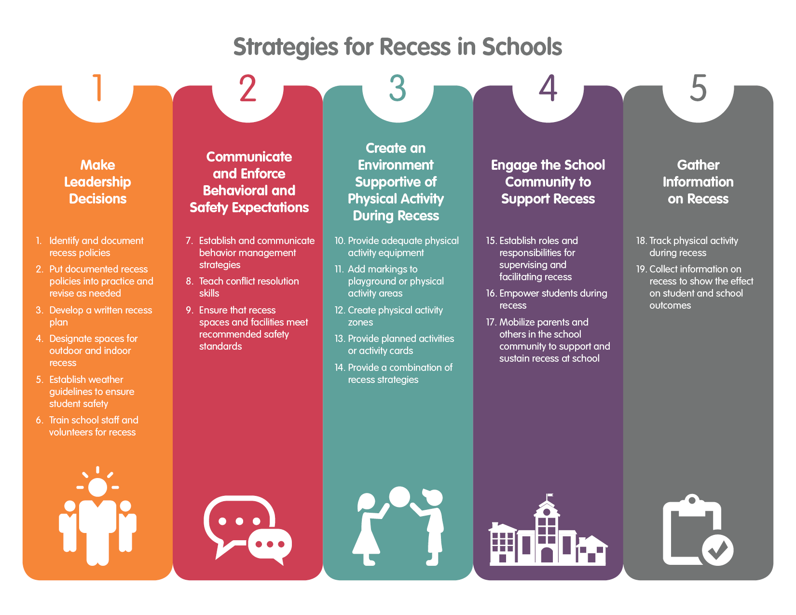
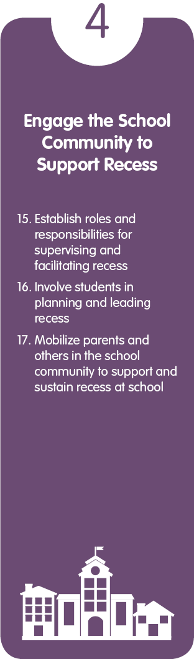
Strategies for Recess in Schools
Notes:
NARRATIVE:
The 19 strategies are organized into the following 5 categories:
Make leadership decisions
Communicate and enforce behavioral and safety expectations
Create an environment supportive of physical activity during recess
Engage the school community to support recess
Gather information on recess
NOTES FOR PRESENTER:
For more information, see Strategies for Recess in Schools at www.cdc.gov/healthyschools/physicalactivity/pdf/2016_12_16_schoolrecessstrategies_508.pdf.

Slide 16
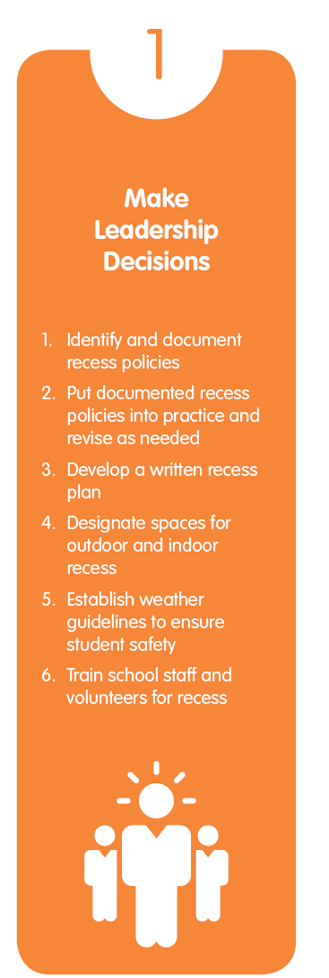
Strategies for Recess in Schools
Category 1: Make Leadership Decisions
Identify and document recess policies.
Put documented recess policies into practice and revise as needed.
Develop a written recess plan.
Designate spaces for outdoor and indoor recess.
Establish weather guidelines to ensure student safety.
Train school staff and volunteers for recess.
Notes:
NARRATIVE:
The first category of strategies is Make Leadership Decisions. This category addresses the leadership and organizational decisions that need to be made at schools about recess. These strategies include examining existing policies and practices in a school and deciding how to plan for recess and organize the recess environment. Mindful planning allows schools to provide recess in a consistent manner so that all students have a positive experience.
NOTES FOR PRESENTER:
For more information, see Strategies for Recess in Schools at www.cdc.gov/healthyschools/physicalactivity/pdf/2016_12_16_schoolrecessstrategies_508.pdf.

Slide 17
Strategies for Recess in Schools
Category 2: Communicate and Enforce Behavioral and Safety Expectations
Establish and communicate behavior management strategies.
Teach conflict resolution skills.
Ensure that recess spaces and facilities meet recommended safety standards.
Notes:
NARRATIVE:
The second category is Communicate and Enforce Behavioral and Safety Expectations. This category addresses rules, protocols, and expectations for recess to ensure that students are safe and are behaving appropriately during recess. It also focuses on the expectations for the adults who are supervising recess and how they will interact with students. Establishing school protocols that everyone understands helps to create a safe physical activity environment for all students.
NOTES FOR PRESENTER:
For more information, see Strategies for Recess in Schools at www.cdc.gov/healthyschools/physicalactivity/pdf/2016_12_16_schoolrecessstrategies_508.pdf.

Slide 18
Strategies for Recess in Schools
Category 3: Create an Environment Supportive of Physical Activity During Recess
Provide adequate physical activity equipment.
Add markings to playground or physical activity areas.
Create physical activity zones.
Provide planned activities or activity cards.
Provide a combination of recess strategies.
Notes:
NARRATIVE:
The third category is Create an Environment Supportive of Physical Activity During Recess. This category addresses what happens during the recess period. The strategies in this category have the most evidence on how to increase physical activity during recess. These strategies create an environment that invites physical activity and play and allows students to choose the physical activity of their choice. Providing options for students to self-select fosters collaboration, creativity, and fun. Recess is not meant to be prescriptive, and schools can customize what is offered according to the facilities and resources available.
NOTES FOR PRESENTER:
For more information, see Strategies for Recess in Schools at www.cdc.gov/healthyschools/physicalactivity/pdf/2016_12_16_schoolrecessstrategies_508.pdf.

Slide 19
Strategies for Recess in Schools
Category 4: Engage the School Community to Support Recess
Establish roles and responsibilities for supervising and facilitating recess.
Involve students in planning and leading recess.
Mobilize parents and others in the school community to support and sustain recess at school.
Notes:
NARRATIVE:
The third category is Engage the School Community to Support Recess. This category addresses how school staff and students can be involved in recess and help increase physical activity among students. Engaging staff to support a positive physical activity environment and encourage student leadership allows students to lead their own games in a positive way and support their peers as they model positive social skills. Supports from parents, volunteers, and others who serve the school is also needed to sustain recess at a school.
NOTES FOR PRESENTER:
For more information, see Strategies for Recess in Schools at www.cdc.gov/healthyschools/physicalactivity/pdf/2016_12_16_schoolrecessstrategies_508.pdf.

Slide 20
Strategies for Recess in Schools
Category 5: Gather Information on Recess
Track physical activity during recess.
Collect information on recess to show the effect on student and school outcomes.
Notes:
NARRATIVE:
The fifth and final category is Gather Information on Recess. This category addresses the type of information that needs to be collected to improve recess and increase physical activity and to make the case for recess. Tracking basic information about recess implementation and student engagement and satisfaction helps staff adjust program elements for maximum student success and physical activity. Information about the impact of recess allows schools to celebrate positive outcomes for students.
NOTES FOR PRESENTER:
For more information, see Strategies for Recess in Schools at www.cdc.gov/healthyschools/physicalactivity/pdf/2016_12_16_schoolrecessstrategies_508.pdf.

Slide 21

Notes:
NARRATIVE:
CDC and SHAPE America created a complementary document called Recess Planning in Schools: A Guide to Putting Strategies for Recess into Practice. This document helps schools develop a written recess plan.
NOTES FOR PRESENTER:
For more information, see Recess Planning in Schools: A Guide to Putting Strategies for Recess into Practice at www.cdc.gov/healthyschools/physicalactivity/pdf/2016_12_16_schoolrecessplanning_508.pdf.

Slide 22

Using the Planning Guide
Use questions to identify what is currently in place.
Discuss and select strategies to strengthen recess.
Document how schools will implement the strategies.
Identify relevant resources.
Notes:
NARRATIVE:
The planning guide focuses on key questions for each strategy listed and presents them in the form of fillable templates throughout the document. Schools can use these templates to discuss and answer each question. This information can then be used to create a customized recess plan. This guide also provides a list of key resources so that schools can easily access additional information during the planning process.
School can use the questions in the planning guide to document what they currently do or have for recess. They can select strategies that are feasible for their school to implement and document how they will incorporate these strategies into the current recess program.
NOTES FOR PRESENTER:
For more information, see Recess Planning in Schools: A Guide to Putting Strategies for Recess into Practice at www.cdc.gov/healthyschools/physicalactivity/pdf/2016_12_16_schoolrecessplanning_508.pdf.

Slide 23

Planning Guide Template
Document the customized school recess plan.
Identify how school will implement recess.
Communicate recess plan with school community.
Notes:
NARRATIVE:
To make it easier for schools to document their written recess plan, CDC and SHAPE America created a customizable Recess Planning Template, which is a Word document that schools can complete and modify as needed. This planning template provides fillable spaces that schools can use to document the information described in the planning guide.
NOTES FOR PRESENTER:
For more information, see Recess Planning Template
at www.cdc.gov/healthyschools/physicalactivity/pdf/2016_12_16_customizablerecessplanningtemplate.docx.

Slide 24
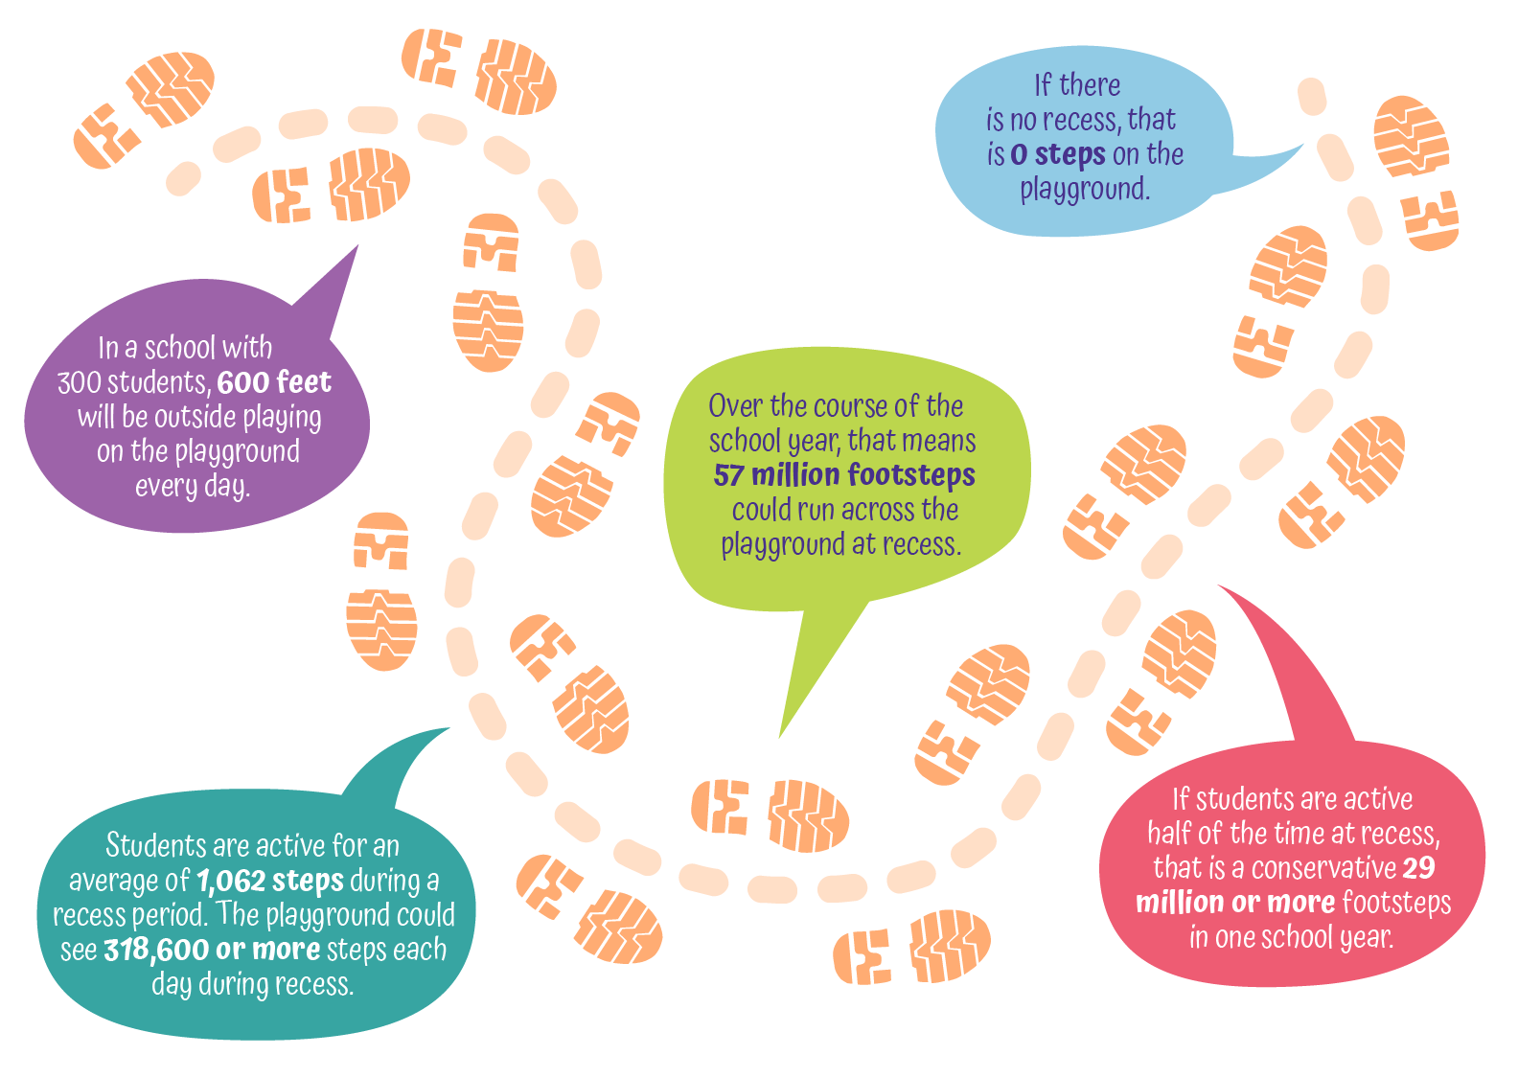
Footsteps on a Playground at Recess
Notes:
NARRATIVE:
As a final thought, here is a more tangible way to think about the impact of recess at school. In a school with 300 students, 600 feet will be outside playing on the playground every day. Data from several studies showed that students are active for an average of 1,062 steps during a recess period. That means that the school playground or combination of physical activity spaces could see 318,600 or more steps each day during recess. Over the course of the school year, that means that more than 57 million footsteps could run across the playground at recess. If students are active half of the time at recess, that is still a conservative 29 million or more footsteps in one school year.
NOTES FOR PRESENTER:
This infographic is available on CDC’s Healthy Schools website under the Physical Activity tab: www.cdc.gov/healthyschools/multimedia/infographics.htm.

Slide 25

Take Action
Educate the school community about the benefits of daily recess.
Include recess in the local school wellness policy.
Know the 19 evidence-based strategies in the Strategies for Recess in Schools.
Use the Recess Planning in Schools guide to develop a written school recess plan.
Notes:
NARRATIVE:
Here are some potential actions to promote recess in schools:
Educate the school community—principals, teachers, parents, and students—about the benefits of daily recess.
Include recess in the local school wellness policy.
Know the 19 evidence-based strategies in the Strategies for Recess in Schools.
Use the Recess Planning in Schools guide to develop a written school recess plan or strengthen the current plan.
NOTES TO PRESENTER:
Please edit these actions, as needed, so they are consistent with what is possible at your school.
For more information about recess policy, see SHAPE America’s Guide for Recess Policy at www.shapeamerica.org/advocacy/upload/Guide-for-Recess-Policy.pdf.

Slide 26

Additional Information
Notes:
NOTES TO PRESENTER:
This is an extra slide for you to use if needed.

Slide 27

Questions
Notes:
NARRATIVE:
Are there any questions?

Slide 28
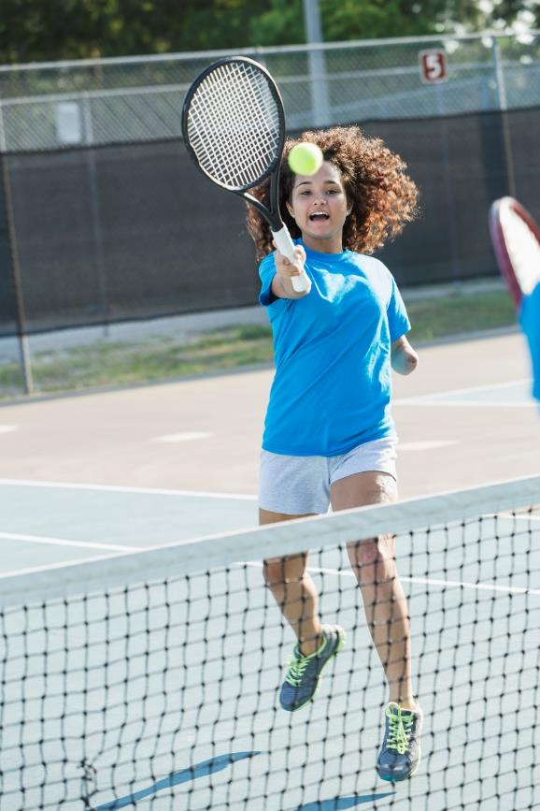
Thank You!
List speakers and contact information.
For more information, contact the Centers for Disease Control and Prevention:
Visit www.cdc.gov/healthyschools/
Contact CDC-INFO at www.cdc.gov/cdc-info
Call 1-800-CDC-INFO (232-4636); TTY: 1-888-232-6348
Notes:
NARRATIVE:
Thank you for your participation!

