Slide 1

NNDSS eSHARE July 2024 Webinar
Centers for Disease Control and Prevention
July 16, 2024
Office of Public Health Data, Surveillance, and Technology

Slide 2

Agenda
Updates on the 2023 Annual Reconciliation
Highlights from the 2024 Council of State and Territorial Epidemiologists (CSTE) Annual Conference
Questions and Answers

Slide 3
Annual Reconciliation of 2023 NNDSS Data

Slide 4
2023 Reconciliation: Roadmap to Success – July
Ongoing: Review stratification reports and line lists in MVPS Compare MVPS data to local systems
Lock conditions as data are finalized
July 16: CDC Program databases close
Send final STD YTD file and final congenital syphilis cases
July 29: Lock STD data in MVPS and lock CS with DSTDP

Slide 5
Locking Conditions Not in MVPS
If a condition is not in the list in the Lock Conditions screen, it is finalized outside of MVPS:
  COVID-19: Aggregate counts collected via Epi-Info web form.
  Mpox: Mpox case list approved in the Reconciliation module in DCIPHER.
  All others: Work directly with the condition-specific CDC program to finalize.
Please let us know if you need assistance connecting with the CDC program for a condition.

Slide 6
Reporting Exceptions for COVID-19
Reporting exceptions for COVID-19 for 2023 are reported to CDC via the Epi-Info web form.
  The Smartsheet form linked in MVPS will not be used for reporting a COVID-19 reporting exception.
If you requested a reporting exception in the Epi-Info web form, this exception will be reflected in the 2023 Annual Tables.
The reporting exception requested in the Epi-Info form will not be listed in the Reporting Exceptions screen in the MVPS Reconciliation module.
  These updates will be integrated into MVPS after the reconciliation period.
  State epidemiologists should still approve reporting exceptions if all other exceptions are correct.

Slide 7
Mpox Reconciliation Office Hours
The Poxvirus and Rabies Branch Informatics team is hosting two open office hours to provide mpox reconciliation support:
August 8, 2:00PM EST
Bring your questions!
  This is an open forum for jurisdictions to chat with representatives from mpox and NNDSS about mpox data.
Please email poxvirus@cdc.gov for the calendar invite.

Slide 8

Reconciliation Support
edx@cdc.gov
Include “Reconciliation” in the subject line

Slide 9
Agenda
Overview of 2024 CSTE Annual Conference – Becky Lampkins
Recap of Surveillance/Informatics Conference Workshop – Taylor Pinsent, Bridget Teevan
Review of Approved 2024 CSTE Position Statements - Kirtana Ramadugu
Highlights from the Surveillance/Informatics Track – Becky Lampkins
Selected CSTE S/I Subcommittee, Workgroup and Project Updates - Shaily Krishan, Becky, Taylor
2024-2025 Surveillance/Informatics, Data Modernization Priorities – Annie Fine
Q&A

Slide 10
Overview of 2024 CSTE Annual Conference - Becky Lampkins

Slide 11

2024 CSTE Annual Conference

Slide 12


Attendance and Sessions
Attendance
  2,865 Registered Attendees
  STLT Health Agencies: 72%
  Federal Agencies: 10%
  Student: 1%
  Other: 17%
Conference Workshops
  Sunday, June 9
  20 Workshops + State Epi Forum
Conference Sessions
  Mon-Wed June 10-12
  Plenary Sessions
  8 Tracks
    97 Breakout Sessions
    99 Discussion Sessions
    190 Posters
  Receptions/Networking Opportunities
  Exhibit Hall
  Position Statements
  Fun Run & Walk

Slide 13

Gold Sponsors

Slide 14

Silver Sponsors

Slide 15


Monday’s Plenary Speaker
Dr. Sharon Watkins retired from the Pennsylvania Department of Health in November 2023, having served most recently as the Director for the Bureau of Epidemiology and the State Epidemiologist. Prior to joining the department in 2015, she served as Chief for the Bureau of Epidemiology and as Director of Public Health Research for the Florida Department of Health. Dr. Watkins also served on the CSTE Executive Board from 2012 to 2021—including a term as President from 2019-2020—and was the recipient of the 2023 CSTE Pumphandle Award. Dr. Watkins is a graduate of Ohio State University where she specialized in Epidemiology, Environmental Epidemiology, and Perinatal/Maternal & Child Epidemiology.

Slide 16

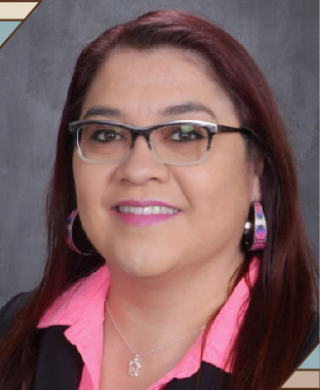

Tuesday’s Plenary Speakers
Dr. Melanie Nadeau, PhD, MPH is an enrolled citizen of the Turtle Mountain Band of Chippewa Indians, and holds an MPH in community health education and PhD in social/behavioral epidemiology from the University of Minnesota. As a community-led scholar, she has nearly two decades of experience working on research and evaluation projects within the American Indian community. Dr. Nadeau serves in multiple leadership roles, including Graduate Program Director and Assistant Professor for the Indigenous Health PhD program at the University of North Dakota.
Dr. Ruth Abaya, MD, MPH holds a combined MD/MPH degree from Northwestern University. She is an Attending Physician in the Emergency Department at Children's Hospital of Philadelphia and a Practice-based Scholar at CHOP's Center for Violence Prevention. She is also an Assistant Professor of Pediatrics at the Perelman School of Medicine at UPenn. Dr. Abaya focuses on violence prevention and leads efforts to create a registry for firearm injuries in Philadelphia. She is a fellow of the Stoneleigh Foundation and a member of the National Medical Council on Gun Violence.

Slide 17


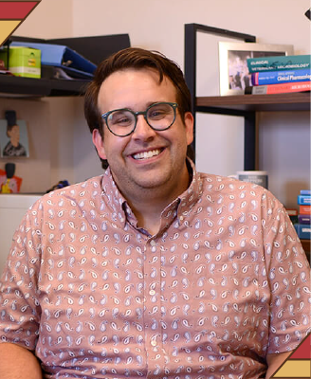
Wednesday’s Plenary Speakers
Dr. Richard Chipman is a Certified Wildlife Biologist and the National Rabies Management Coordinator for the USDA’s Animal and Plant Health Inspection Service. With a career spanning over three decades, Dr. Chipman’s expertise includes research and management of wildlife conflicts and diseases. He holds degrees from the University of Maine, University of Vermont, and University at Albany, SUNY, and has received multiple awards for his contributions to public health and wildlife management.
Dr. Stephen Cole is an Assistant Professor of Clinical Microbiology at the University of Pennsylvania School of Veterinary Medicine. With a Veterinary Medicine degree from UPenn and an MS in Microbiology, Dr. Cole’s specializes in Clinical Bacteriology, Mycology, and Infectious Diseases. His research aims to combat antibiotic-resistant bacteria in companion animals and promote antimicrobial stewardship.

Slide 18
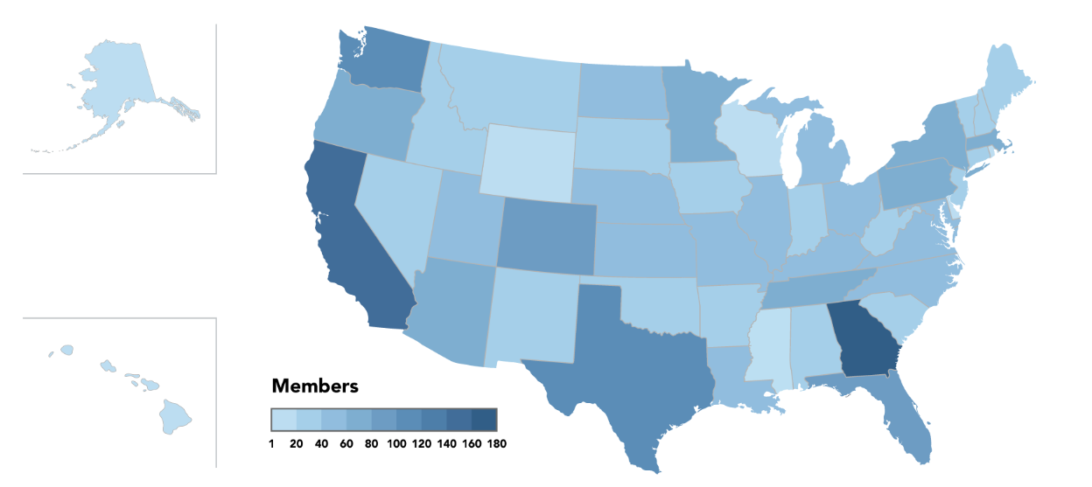
Business Meeting, Thurs 6/13/24
3585+
Roll Call of States and Territories
State of CSTE Presentation
  Financial Overview
  Programmatic Accomplishments
Presentation of Position Statements
Introduction of the 2024-25 Executive Board
Members Strong!

Slide 19
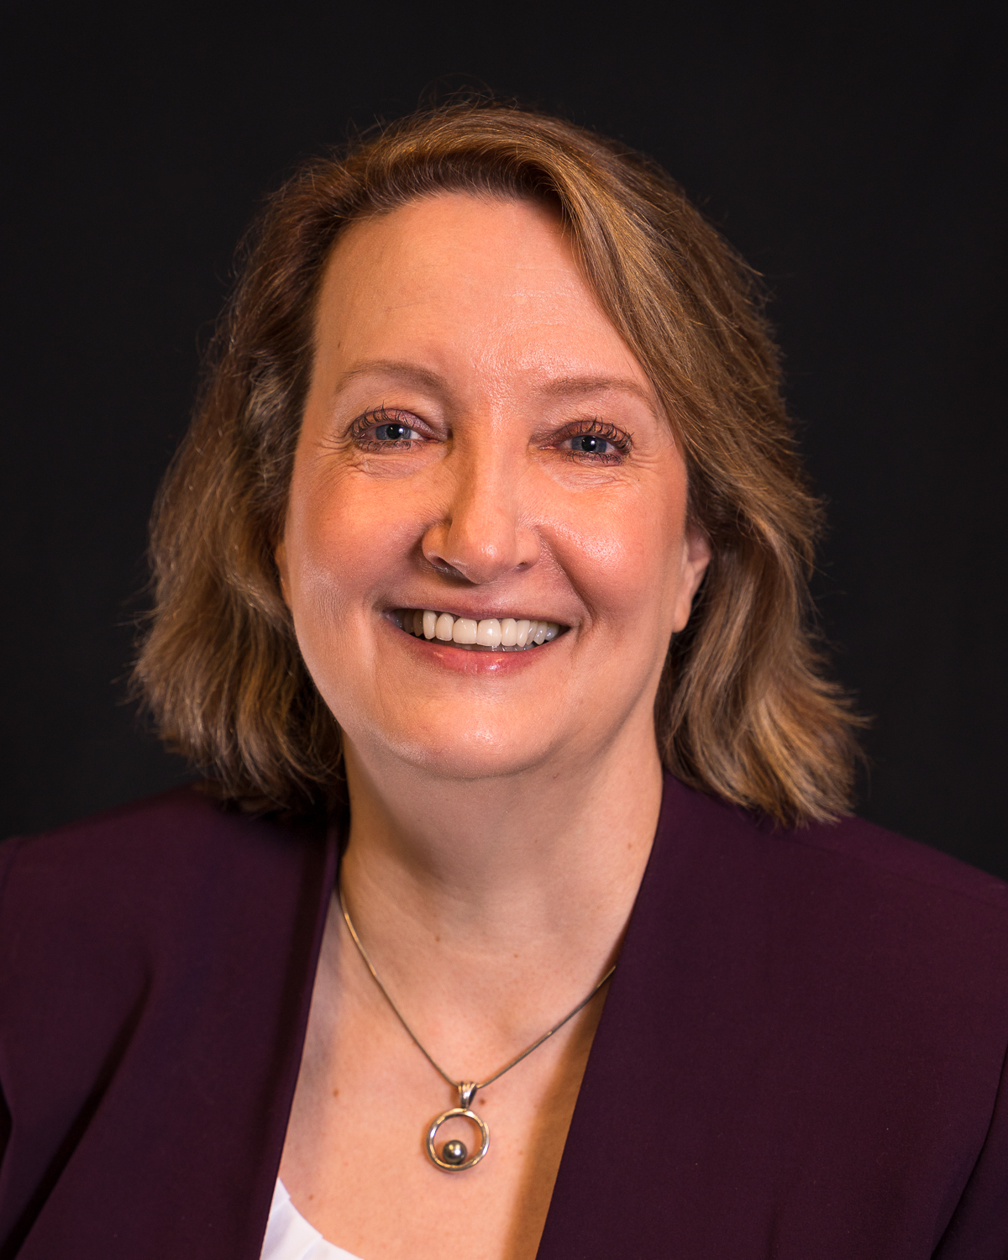


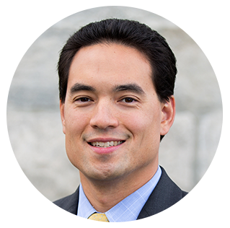
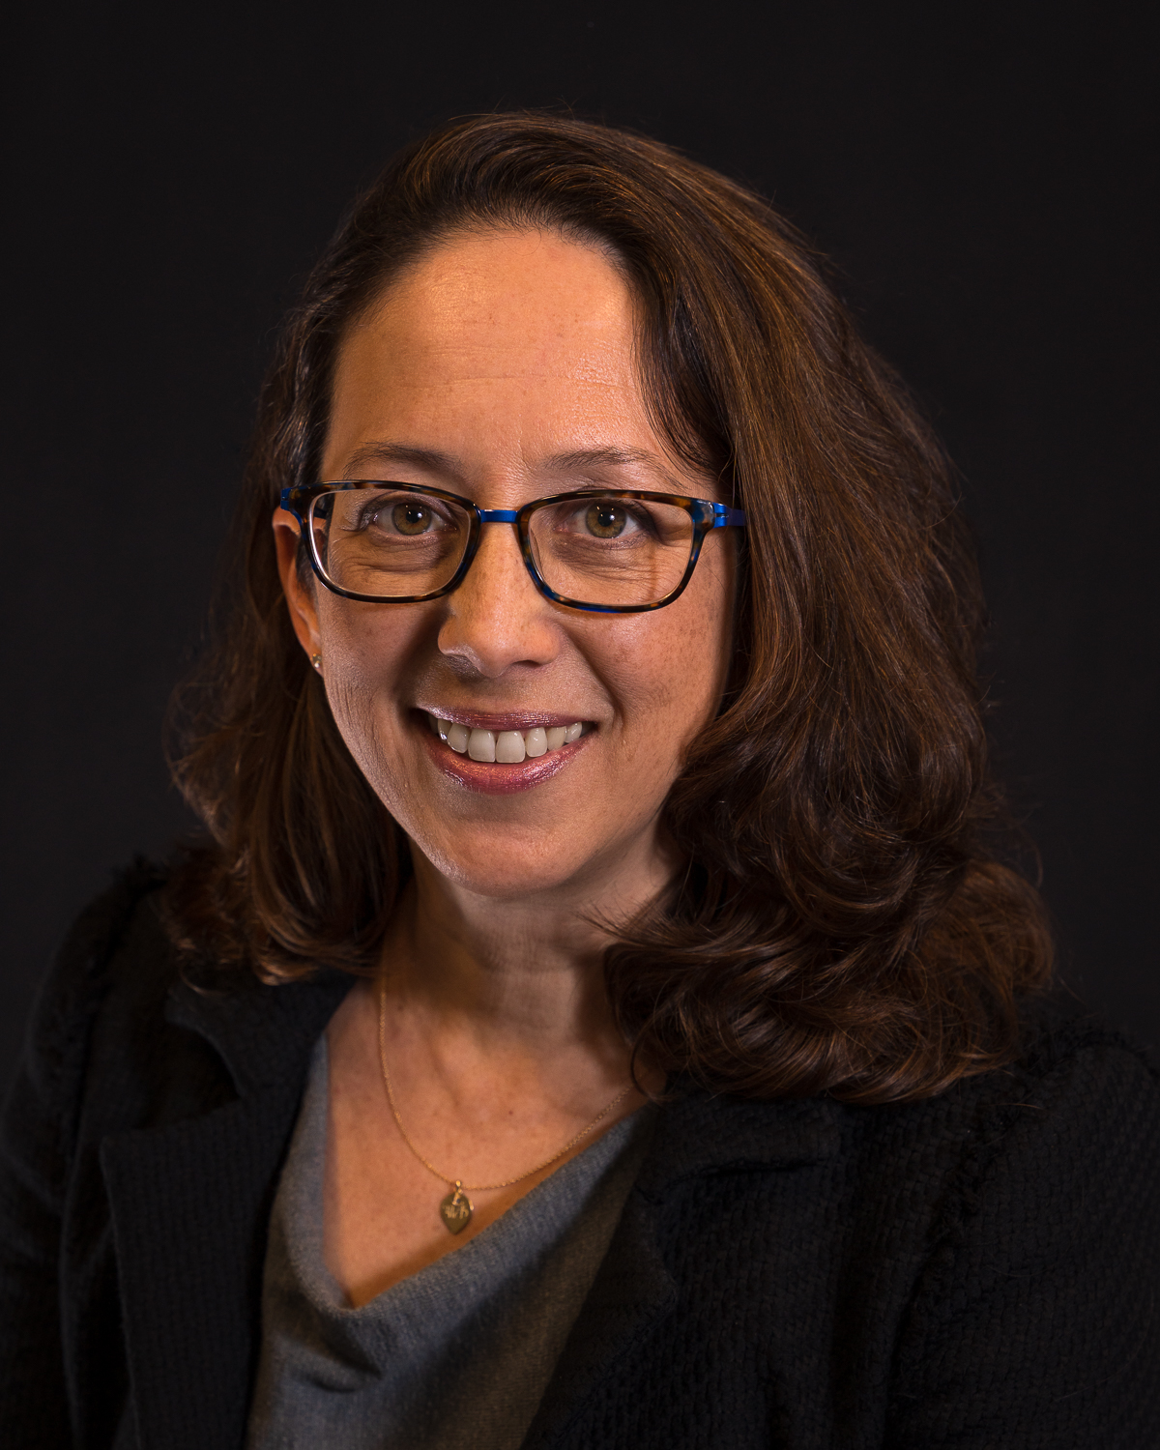
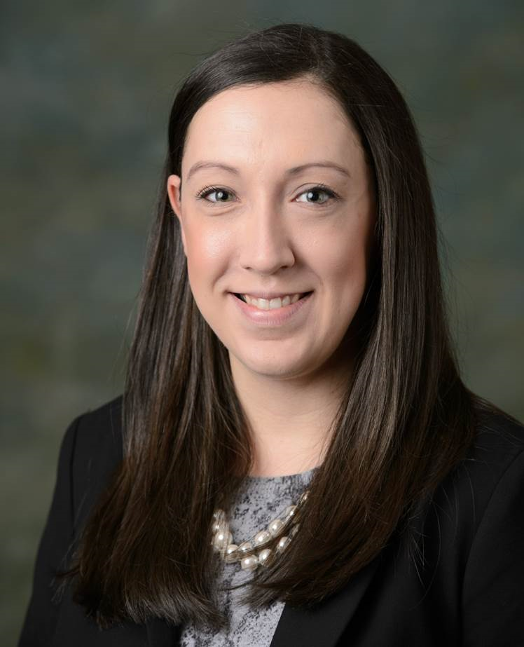

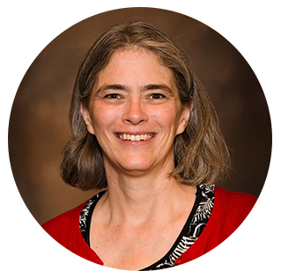


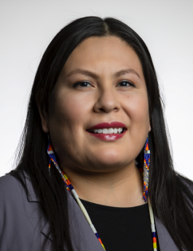
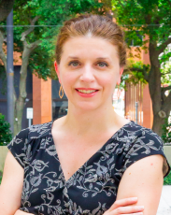
2024-25 Executive Board
Catherine Brown
President
Massachusetts
Kathy Turner
President-Elect
Idaho
Sherri Davidson
Alabama
Benjamin Chan
New Hampshire
Sarah Kemble
Hawaii
Mary-Margaret Fill
Tennessee
Officers
Members at Large
Ruth Lynfield
Secretary-Treasurer
Minnesota
Erica Pan
California
Rachelle Boulton
Utah
Sarah Lyon-Callo
Vice President
Michigan
Bah-He-Toya-Mah “Sooner” Davenport
Southern Plains Tribal Health Board
Theresa Sokol
Louisiana

Slide 20

CSTE Connect

Slide 21
Recap of S/I Conference Workshop – Taylor Pinsent & Bridget Teevan

Slide 22
2024 Surveillance/ Informatics Workshop:
Rivers of Data, Bridges of "STLT": Elevating Public Health Informatics
High Demand In-person Workshop on Sunday, June 9
  285 people registered and on waitlist
  ~208 people signed in
Pre-workshop Preparatory Virtual Session on Friday, May 17
  Presenter: Jim Collins (MI)
CSTE Connect Community for Workshop
The purpose of this workshop was informing, advising, and building relationships to support informatics initiatives.
The learning objectives for this workshop were:
  Identify and describe the motivations, key considerations, and actionable steps to advance timely and universal case notification in public health practice.
  Identify the necessary resources, workforce, and engagement required to scale up electronic case reporting (eCR) initiatives.
  Describe the infrastructure, workforce, and funding necessary to explore data exchange using Fast Healthcare Interoperability Resources (FHIR).
  Discuss the approaches taken by early adopters of the Trusted Exchange Framework and Common Agreement (TEFCA) and articulate the benefits of engagement.

Slide 23
Workshop Agenda
Rivers of Data, Bridges of “STLT”: Elevating Public Health Informatics
Time | Speaker Topic | Duration
8:30-9:00am | Welcome and Overview | 25 min
9:00-9:20am | Opening Remarks | 15 min
9:20-10:00 am | Case Notification Part 1 | 85 min
10:00-10:15 am | Break | 15 min
10:15-11:00 am | Case Notification Part 2 | 45 min
11:00 am – 12:00 pm | eCR Panel | 60 min
Time | Speaker Topic | Duration
12:00-1:30 pm | Lunch | 90 min
1:35 – 3:00 pm | Data Sharing and Exchange Panel | 85 min
3:00-3:10 pm | Break | 10 min
3:10-4:20 pm | TEFCA Panel | 70 min
4:20-4:50 pm | Small Group Networking | 30 min
4:50-5:00 pm | Close Out | 10 min

Slide 24
Opening Remarks
Opening Remarks with CDC, Dr. Angela Dunn and Q&A moderated by Megan Tompkins, CSTE
Dr. Dunn's remarks focused on the OPHDST team and their vision for the future of surveillance. Her notes provided a tone setting for the day's planned topics (MDN, eCR, FHIR, TEFCA) and highlighted CDC's commitment to moving forward in close partnership with STLTs.

Slide 25
Case Notification Panel – Minimal Data Necessary (MDN)
Learning Objective: Inform and educate on the need for Minimal Data Necessary (MDN) for case notification during early stages of emergency, key considerations for implementation, and development of a change management plan
Gillian Haney (CSTE) and Anne McIntyre (CDC) provided background on MDN.
State panelists (listed below) representing a variety of surveillance systems reflected on how they would go about implementing MDN in their jurisdiction and what support they would require from CDC. They also spoke about the value of MDN and highlighted opportunities for success.
Rachelle Boulton, MSPH, Division of Population Health Informatics Manager, Utah Department of Health and Human Services | Epitrax
Benjamin Schram, MPH, Data Modernization Director, North Dakota Department of Health and Human Services | Maven
Laura Erhart, MPH, Informatics Section Lead, Arizona Department of Health Services | Homegrown
Courtney Marshall, MPH, Informatics Epidemiologist/Informatics Lead, Kentucky Department For Public Health | NBS

Slide 26
Case Notification (MDN) Table Discussions
Workshop participants discussed the following 3 questions/prompts:
    What would you like to see from CDC to support implementation?
    What components of a change management plan would be critical for implementation of MDN plan in your jurisdiction? What are the key groups/partners to engage for success?
    Develop 3 things you can do in your jurisdiction to move this forward. Please include key considerations and identify what support is needed from CDC for success.
Key Themes/Takeaways: funding, alignment across CDC programs, documentation (data dictionary), training & education, CDC timeline, advocate & keep the momentum going!

Slide 27
Case Notification (MDN) Next Steps
Post summary of tabletop discussions and draft CDC MDN (case notification) data dictionary on CSTE Connect (in SPIS Connect space)
Follow-up presentations on CSTE S/I member calls
  7/23 S/I Steering Committee Call
  8/2 SPIS
Forming small workgroup to further consider implementation plans – will report out to SPIS

Slide 28
Electronic Case Reporting (eCR) Panel
This panel focused on the experience of expanding eCR beyond the COVID-19 use case. Panelists discussed workforce and resource requirements, strategies for engaging partners, and innovations, tools, and infrastructure being used to support eCR scale up.
Panelists:
Melanie Epstein-Corbin, MPH, Chief, CalREDIE Electronic Case Reporting (eCR) Unit, California Department of Public Health (Moderator)
Shelby Fawaz, MPH, Electronic Case Reporting Coordinator, Florida Department of Health
Sara Mader, RN, MPH, eCR Data Exchange Specialist, Wisconsin Division of Public Health
MaKenzie Hackney, MPH, eCR Supervisor, North Carolina Department of Health and Human Services
Joel Hartsell, PhD, MPH, PMP, CPMAI, eCR Lead, Association of Public Health Laboratories
Laura Conn, MPH, Data Transmission Lead, Public Health Data Transmission Branch, Detect and Monitor Division, OPHDST, CDC

Slide 29
Data Exchange Using Fast Healthcare Interoperability Resources (FHIR) Panel:
Learning Objective: Describe the infrastructure, workforce, and funding necessary to explore data exchange using Fast Healthcare Interoperability Resources (FHIR).
Panelists shared their motivation, experience and processes for getting started with FHIR, the resource requirements to support this work (including workforce and infrastructure), and 'what's next' after the pilot cases. We also provided 1-pagers to provide more details about their use case.
Panelists:
Rebecca Fisher, MPH, MA, Branch Chief, Analytics and Operations Tools, Investigate and Respond Division, OPHDST, CDC (Moderator & Panelist)
Alida Laney, MSc, Public Health Data Manager, Fairfax County Health Department
Alastair Matheson, Data Modernization Director, Public Health - Seattle & King County
Chris Baumgartner, Deputy Chief Informatics Officer, Washington State Department of Health
Sarah Solarz, MPH, MEDSS Manager and DMI Co-Lead, Minnesota Department of Health
Nathan Imihy Bean, MPP, Senior Informatics Planning Analyst, Hennepin County Public Health

Slide 30
Data Exchange Using Fast Healthcare Interoperability Resources (FHIR) Table Discussions
At tables, participants discussed the following 3 questions/prompts:
  What are your short and/or long term ‘use case’ goals with FHIR?
  What skills or tools allow for successful FHIR collaboration across jurisdictions?
  What support or resources do you need to make FHIR implementation more achievable? What federal resources are needed?

Slide 31
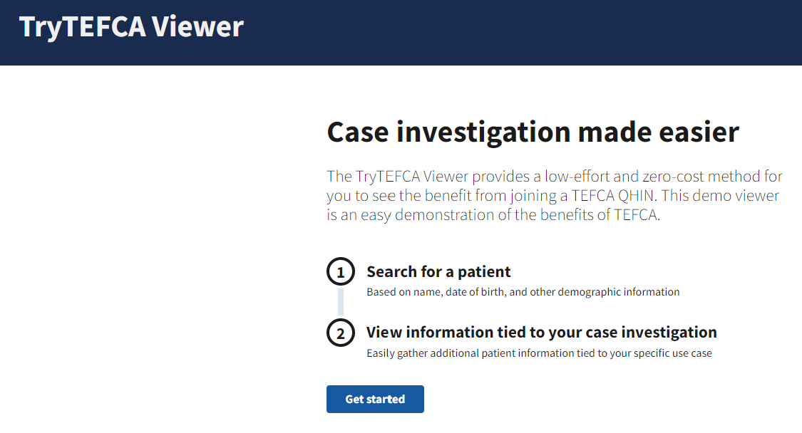
Trusted Exchange Framework and Common Agreement (TEFCA) Demo
Bill Howard (eHealth Exchange) and Dan Paseltiner (Skylight) shared the "TryTEFCA Viewer" which simulates the data a public health agency might be able to obtain through Query and Response when they are engaged with a TEFCA QHIN.
This tool contains synthetic patient data and is openly accessible
  Dibbs.cloud/tefca-viewer

Slide 32
Trusted Exchange Framework and Common Agreement (TEFCA) Early Adopters Panel
Panelists shared how they have approached TEFCA engagement so far and resources available to support getting started as well as perceived benefits to their agencies and the larger public health ecosystem
Panelists:
Megan Tompkins, MPH, Director of Data Modernization, Council of State and Territorial Epidemiologists (Moderator)
Chris Baumgartner, Deputy Chief Informatics Officer, Washington State Department of Health
Marcia Pearlowitz, MA, Data Modernization Director, Maryland Department of Health
Eliza Ramsey, MPH, CSTE Applied Public Health Informatics Fellow, Alaska Department of Health
Kate Goodin, MPH, MS, Director of Surveillance Systems and Informatics, Tennessee Department of Health
Jim Jirjis, MD, MBA, FACP, Division Director, Centers for Disease Control and Prevention

Slide 33
Thank You, Planning Committee!
Jim Collins
Joshua Clayton
Nancy Barrett
Gillian Haney
Megan Tompkins
James Muncy
Rebecca Tugan
Shaily Krishan
Rachelle Boulton
Becky Lampkins
Sara Johnston
Kate Goodin
Jim Jirjis
Heather Strosnider
Lesliann Helmus
Erin Holt Coyne
Jennifer Stewart
Laura Conn
Jordyn Easterling
Devra Barter
Shahidah Williams
Annie Fine
Anne McIntyre
Heidi Jonson
Eliza Ramsey
Laura Erhart
Benjamin Schram
Rebecca Fisher
Sarah Solarz
Nathan Imihy Bean
Ben Klekamp
Alida Laney
Tim Jenkins
Heidi Westermann
David Johnson
Chris Baumgartner
Alastair Matheson
Helen Tazelaar
Michelle Barber
Victoria Backa
Courtney Marshall
Ankur Jain
Gelilawit Tamrat
Bryant Karras
Melanie Epstein-Corbin
Sara Mader
Shelby Fawaz
Leah Eisenstein
Rebecca Berger
Karla Norsworthy
MaKenzie Hackney
Joel Hartsell
Marcia Pearlowitz
Angela Dunn
AI & Kahoot!

Slide 34
Review of Approved 2024 CSTE Position Statements – Kirtana Ramadugu

Slide 35
New Case Definitions
ID | Title | Details
24-ID-04 | Standardized Surveillance Case Definition for Acute, Congenital, and Chronic Trypanosoma cruzi Infection or Chagas Disease | Confirmed case classifications for acute and congenital Chagas Disease Confirmed, probable, and suspect case classifications for chronic Chagas Disease Does not add to NNC list
24-ID-06 | Standardized Surveillance Case Definition for Hepatitis D Virus (HDV) Infection | Laboratory criteria alone used to define confirmed and probable cases Does not add to NNC list
24-INJ-01 | Standardized Public Health Case Definition for Injuries Related to Firearms | Cases of injuries related to firearms limited to injuries from a weapon that uses a powder charge to fire a projectile Case classifications are limited only to confirmed cases Does not add to NNC list

Slide 36
Updates to Notifiable Conditions
Removals from the NNC List
ID | Title | Details
24-ID-11 | Update to the standardized surveillance case definition for SARS-CoV-2 infection, call for continued refinement of an integrated surveillance strategy in alignment with other endemic respiratory viruses, and discontinuation of national notification | Update to 22-ID-01 Recommends removal of SARS-CoV-2 infection from the NNC list

Slide 37
Updates to Notifiable Conditions
Subtypes or disease/condition categories added or removed
ID | Title | Details
24-ID-01 | Update to the Standardized Case Definition and National Notification for Anthrax | Update to 17-ID-02 Expands notifications to include cases of anthrax from all Bacillus species that produce anthrax toxin and capsule-encoding genes Provides optional subclassifications, including *new* welder’s anthrax criteria
24-ID-03 | Update to Public Health Reporting and National Notification for Brucellosis | Update to 09-ID-14 Excludes non-brucellosis causing Brucella species (e.g., former Ochronobactrum genus) from the case definition and subsequent notification

Slide 38
Updates to Notifiable Conditions
Subtypes or disease/condition categories added or removed
ID | Title | Details
24-ID-05 | Update to Public Health Reporting and National Notification for Leprosy (Hansen’s Disease) | Update to 12-ID-01 Expanded case definition to now include PNL and Leprosy caused by M. lepromatosis
24-ID-12 | Update to Public Health Reporting and National Notification of Viral Hemorrhagic Fever (VHF) Caused by Ebola or Marburg Viruses, Old World Arenaviruses (Lassa and Lujo Viruses), New World Arenaviruses (Guanarito, Machupo, Junin, Sabia, and Chapare Viruses), Rift Valley Fever Virus, or Crimean-Congo Hemorrhagic Fever Virus | Update to 21-ID-04 Adds VHF caused by Rift Valley fever virus to those VHFs notifiable to CDC

Slide 39
Updates to Notifiable Conditions
Change in data sharing/release or print criteria
ID | Title | Details
24-ID-09 | Update to Public Health Reporting and National Notification for Novel Influenza A Virus Infection | Update to 13-ID-14 Adds notification of probable cases

Slide 40
Updates to Notifiable Conditions
No changes to notifiability
ID | Title | Details
24-ID-02 | Update to Public Health Reporting and National Notification for Babesiosis | Update to 10-ID-27 No changes made to national notifiability Specifies publication in NNDSS annual tables only
24-ID-07 | Update to Public Health Reporting and National Notification for Leptospirosis | Update to 12-ID-02 No changes to notifiability
24-ID-10 | Update to Public Health Reporting and National Notification of Rubella in the United States | Update to 12-ID-09 No changes to notifiability Removes the “Unknown” case status from those to be included in case counts released to the public

Slide 41
Updates to non-Notifiable Conditions
ID | Title | Details
24-ID-08 | Update to Standardized Surveillance Case Definition for Non-pestis Yersiniosis | Update to 19-ID-03 Expands laboratory criteria and description of clinically compatible illness to allow for classification of confirmed and probable cases

Slide 42
Highlights from the Surveillance/Informatics Track - Becky Lampkins

Slide 43
Surveillance/Informatics Track Overview
21 Discussion Sessions
  Data Sharing/Exchange, Informatics Workforce/Infrastructure, Data Modernization, Communities of Practice/Workgroups, Case Surveillance
  Invited Session - OPHDST Senior Leaders – A Vision for Data Modernization
23 Breakout Sessions
  Electronic Case Reporting, Data Quality, Automation, Machine Learning, Cluster Detection Techniques, Surveillance Systems, Linking Data Sources, FHIR, Data Visualization, Syndromic Surveillance
  Presidential Priorities Session - Elevating Development of Cohesive Data Modernization Strategies for Public Health Response Across All Domains
40 Posters

Slide 44
Selected CSTE S/I Subcommittee, Workgroup and Project Updates
Becky Lampkins, Taylor Pinsent, Shaily Krishan

Slide 45

CSTE S/I Steering Committee, Subcommittees, Workgroups
S/I Steering Committee
Chair: Jim Collins (MI)
Vice Chair: Erin Holt Coyne (TN)
Electronic Laboratory and Disease Reporting (ELDRS)
Co-Chairs: Jennifer Stewart (NC) and Nancy Barrett (CT)
National ELR Workgroup
Co-chairs: Nicole Stuver (TN) and Cody McNeese (OR)
Surveillance Policy
Co-Chairs: Benjamin Schram (ND) and Josh Clayton (SD)
Data Release, Presentation, Access, Suppression, and Sharing Workgroup
Co-chairs: MaryKate Martelon (MA) and Abigail Cheney (MI)
Steering Committee
Subcommittees
Workgroups
Surveillance Practice & Implementation (SPIS)
Chair: Rachelle Boulton (UT)
Data Standardization Workgroup
Co-chairs: Molly Crockett (MA), Laura Erhart (AZ), Judie Hyun (MD)
NNDSS Evaluation Workgroup
eCR Workgroup
Co-chairs: Sara Mader (WI) and Melanie Epstein-Corbin (CA)
Data Modernization Workgroup
Co-chairs: Chris Baumgartner (WA) and Rebecca Early (VA)

Slide 46
Selected CSTE Activities: RCKMS & eCR
Reportable Conditions Knowledge Management System (RCKMS)
  Development & maintenance of Reporting specifications and Reportable Condition Trigger Codes (RCTC) for eCR
    213 conditions available in RCKMS as of July 2024
    13 new conditions (Birth Defects & Infant Disorders) will be available in RCKMS in August 2024
  RCKMS User Support
    Authoring Support Associate (ASA) team
    RCKMS Training Modules on CSTE Learn & other resources at https://www.rckms.org/
CSTE eCR Workgroup for STLT
  Co-chairs: Melanie Epstein-Corbin (CA), Sara Mader (WI)
  Support/share solutions on eCR implementation, identify PHA challenges & priorities
Community Platforms
  eCR Workgroup community in CSTE Connect
  eCR/ RCKMS Community of Practice in Basecamp
Partnership with CDC, PHAs & academic evaluation center to conduct an evaluation of eCR data quality, timeliness and completeness
Supporting HCOs/ EHR products moving to all conditions triggering & PHAs authoring all reportable conditions in RCKMS

Slide 47
Data Standardization Workgroup
CSTE workgroup formed in 2018
  Sits under CSTE’s Surveillance Practice and Implementation Subcommittee (SPIS)
  Co-Chairs: Laura Erhart (AZ), Molly Crockett (MA), Judie Hyun (MD)
Mission
  Improve data quality through the development and application of consensus definitions for core data elements for public health surveillance resulting in improved interoperability and automation for efficient case data flow and inter-jurisdictional data exchange
Objective
  Convene epidemiologists and informaticians across jurisdictions and program areas to develop recommendations for
    Defining basic ‘core’ surveillance data elements present across many conditions that are key for public health action, and,
    Standardizing common definitions and interpretations

Slide 48
Core Data: Scope for DSWG
Identify core data elements for surveillance for transmission to CDC
  For situational awareness or routine, cross-condition case surveillance
  For case-based surveillance (not syndromic, not aggregate reporting)
  Within selected data classes (e.g., hospitalization, travel history) that are used for multiple conditions
Identify common definitions, value sets/code sets, structure, and interpretation notes for those core data elements
Recommend best practices for how selected data elements are collected, structured or populated within PHA surveillance systems, if/when that will affect the interpretation of the data transmitted to CDC

Slide 49
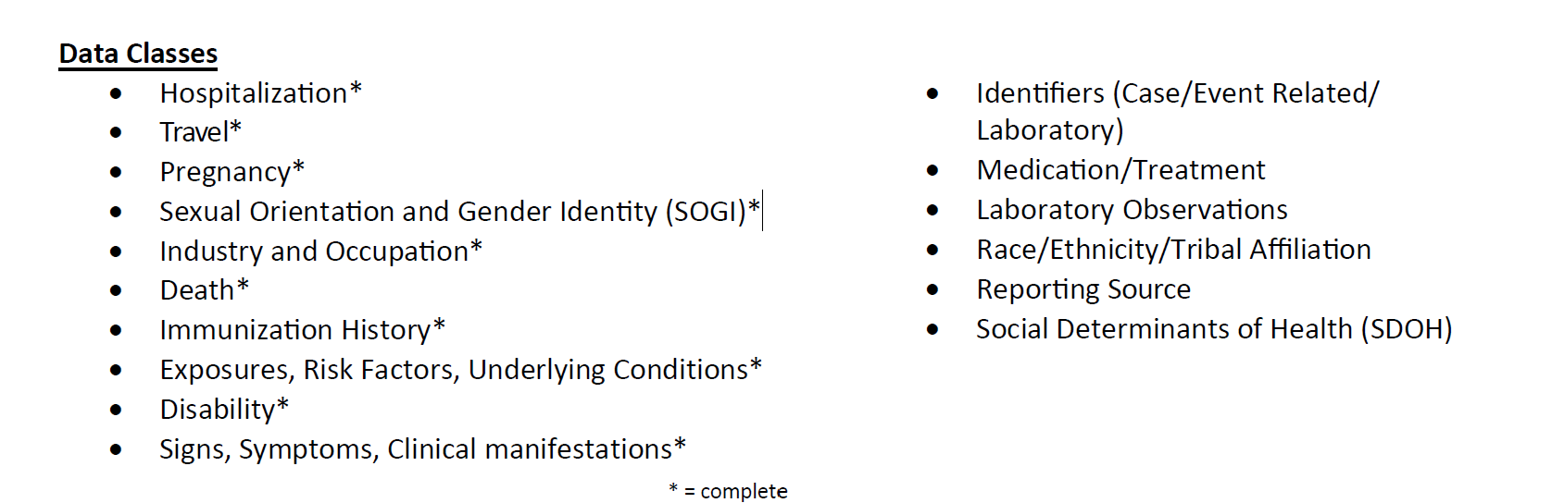
DSWG
  Issue Brief “Data Standardization: Dates of Importance to Public Health Surveillance Illness (Symptom) Onset Date, Report Dates, Laboratory-Related Dates, (Clinical) Diagnosis Date”
  Best Practices “Data Standardization: Workgroup Proposal for Standardized Case Counting Date “Proposed Calculated Case Counting Date for NNDSS Case Counting”

Slide 50
Data Privacy Training Series
CSTE Public Health Privacy and Statistical Disclosure Control Training
Course participants will have increased knowledge of the generally accepted statistical and scientific principles and methods for rendering information not individually identifiable and increased confidence in data sharing for public health action.
Course 1: Risks in Public Health- Basic Principles (2 lessons): This course is aimed as an introduction to de-identification and privacy risk assessment. If the basics covered by the first two lessons are well understood, then individuals can proceed directly to courses 2 or 3 as applicable.
Course 2: Risk Assessment and Control Guidance (7 lessons): This course is aimed at those who interact directly with data and are responsible for ensuring that they suitably balance privacy concerns with the intended purpose (i.e., public reporting, etc.). It will cover how privacy risk is assessed, the process of dataset modification to reduce re-identification risks and tokenization/encryption methodologies.
Course 3: Community Data Reporting Privacy Risk Considerations (2 lessons): This course is aimed at anyone that reports/relays epidemiological data findings to the wider community. It will provide a better understanding of the trade-offs between data equity & privacy, communication methodologies, and what future developments may change the landscape of this space.

Slide 51
DRPASS WG
Data Release Reference Document
In Scope: This document covers the release of all types of aggregate data by public health agencies to the public domain or to entities without restrictions on use of data (data requests).
Out of scope
Does not include release of individual or event level data
Does not include aggregate data to entities with data sharing or data use agreements.
Standardizing data release across all jurisdictions
Technical platforms for data sharing
Contents
Purpose & Background
Scope & Definitions
Considerations for data release policy development
  Preliminary considerations
  Review & evaluate the data
  Analysis & data privacy → Data privacy analysis
  Interpretation
  Approval process
  Dissemination / communication plan
Appendix

Slide 52
2024-2025 Surveillance/Informatics, Data Modernization Priorities – Annie Fine

Slide 53
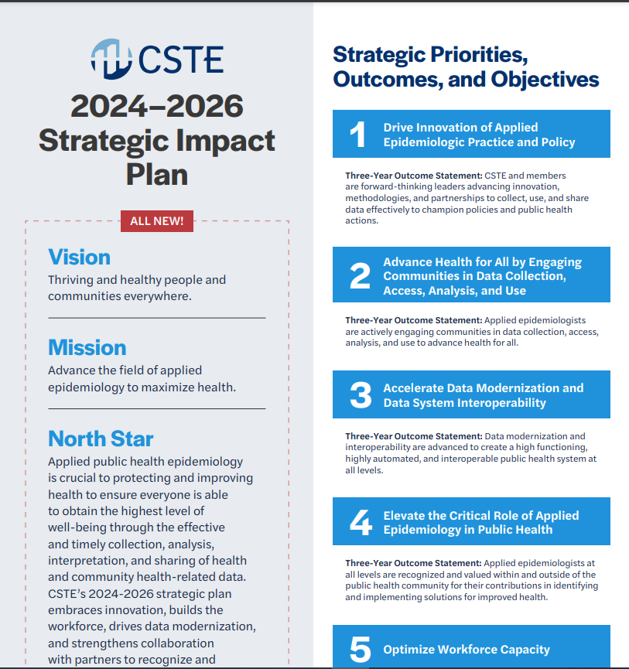
2024-2026 Strategic Impact Plan

Slide 54
CSTE Surveillance and Informatics and Data Modernization (DM) Program Priorities – 2024-2025
DM
  Advocate for sustained funding
  Support Implementation Centers
  DM workgroup
  Follow-up work from 2nd DM summit – minimum functional data capacities at STLT PHAs
  Support Public Health Data Strategy and inform 2025 PHDS
  Success stories
  Member training and communication – focus on engagement with OPHDST
  Continue expansion to non-ID programs
  TEFCA, Interoperability (EHRA and HIMSS collaboration)

Slide 55
CSTE Surveillance and Informatics and Data Modernization (DM) Program Priorities – 2024-2025
Future of national case surveillance - focus on improving national case notification policy and process
Support eCR scale up, data quality, onboarding harmonization, and evaluation
Standards work and commenting (esp HTI-2)
  Data standardization and harmonization across STLTs
  Improve public health participation and input into standards
  USCDI, USCDI+, FHIR accelerator
Data sharing policies – esp. state with local and tribal PHAs
Support building block development and scale-up

Slide 56

CSTE 2025 Annual Conference

Slide 57
CSTE Staffing Info
--- CSTE Science and Surveillance Office, Staff Contact Info ---
Annie Fine – Chief Science and Surveillance Officer, Senior Advisor to DMI – afine@cste.org
Meredith Lichtenstein Cone – Director of Scientific and Surveillance Consensus Development – mlichtenstein@cste.org
Kirtana Ramadugu – Senior Program Analyst (Scientific and Surveillance Consensus Development) – kramadugu@cste.org
Megan Tompkins – DMI Implementation Lead – mtompkins@cste.org
Bridget Teevan – Senior Program Analyst (DMI) – bteevan@cste.org
Gillian Haney – Surveillance/Informatics Director – ghaney@cste.org
Shaily Krishan – S/I Program Manager (Electronic Reporting) - skrishan@cste.org
Devra Barter – Senior Program Analyst (RCKMS/eCR) – dbarter@cste.org
Shahidah Williams – Senior Program Analyst (RCKMS/eCR, FHIR) - swilliams@cste.org
Becky Lampkins – S/I Program Manager (Surveillance Systems, Practice, Policy) - blampkins@cste.org
Jordyn Easterling – S/I Program Associate (NSSP CoP/RCKMS) – jeasterling@cste.org
James Muncy – Program Analyst III (Syndromic Surveillance/NSSP CoP) – jmuncy@cste.org
Taylor Pinsent – Senior Program Analyst (Surveillance Policy/Data Sharing) - tpinsent@cste.org
Becca Tugan – Program Analyst II (Syndromic Surveillance/NSSP CoP) - rtugan@cste.org
Meredith Eddy - Senior Program Analyst (Case Notification/Data Standardization) - meddy@cste.org

Slide 58
Q&A/Discussion

Slide 59




Thank you!
Next NNDSS eSHARE: August 20, 2024
Subscribe to
Case Surveillance News
Access NNDSS’ Technical Resource Center
Email edx@cdc.gov for technical help
Learn about case surveillance modernization

