Slide 1
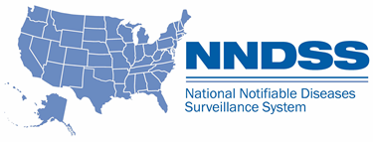
NNDSS eSHARE June 2024 Webinar
Centers for Disease Control and Prevention
June 18, 2024
Office of Public Health Data, Surveillance, and Technology

Slide 2

Agenda
Updates on the 2023 Annual Reconciliation
Overview of the Carbon Monoxide Message Mapping Guide (MMG)
Questions and Answers
2

Slide 3
Annual Reconciliation of 2023 NNDSS Data
Courtney Cook, MS
Epidemiologist
Office of Public Health Data, Surveillance, and Technology

Slide 4

2023 Reconciliation: Roadmap to Success – May/June
May 21: Reconciliation Kick-off!
Ongoing: Review stratification reports and line lists in MVPS Compare MVPS data to local systems
Lock conditions as data are finalized
June 30: Review reporting exceptions
Review retired event codes
Review and verify low incidence cases
4

Slide 5
Reminder: MVPS Help Center
The Help Center in MVPS has several tools to help guide through your routine use of MVPS and through reconciliation functions:
Annual Reconciliation Process User Guide for Jurisdictions
Reconciliation Guide for State & Territorial Epidemiologists
Monitoring Data in the MVPS Portal
Stratification Reports User Guide
MVPS Line List User Guide
Low Incidence Case Verification Process for Jurisdiction Users
MVPS User Management Job Aid

Slide 6
Mpox Reconciliation Office Hours
The Poxvirus and Rabies Branch Informatics team is hosting two open office hours to provide mpox reconciliation support:
June 25, 2:00 PM EDT
August 8, 2:00 PM EDT
Please email poxvirus@cdc.gov for the calendar invites.
6

Slide 7

Reconciliation Support
edx@cdc.gov
Include “Reconciliation” in the subject line
7

Slide 8

Implementing the Carbon Monoxide Message Mapping Guide
National Center for Environmental Health
Division of Environmental Health Science and Practice
Mackenzie Webb, MPH
Data Manager

Slide 9
Introduction to CDC’s Environmental Public Health Tracking Program

Slide 10
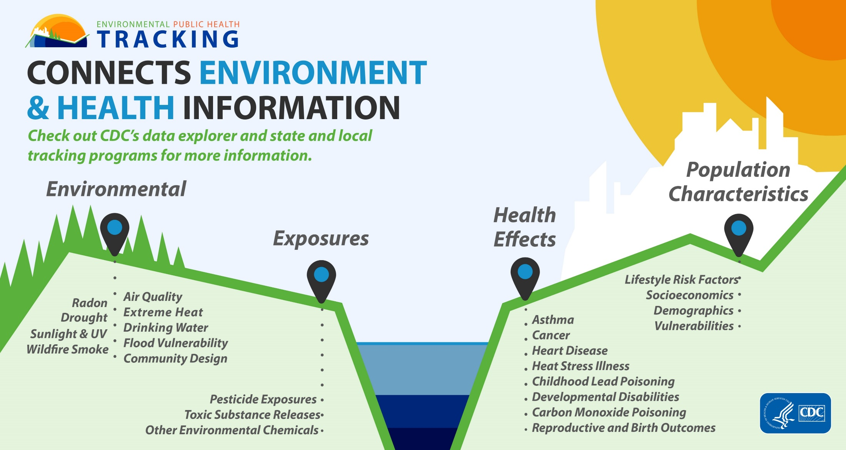
CONNECTS ENVIRONMENT & HEALTH INFORMATION

Slide 11


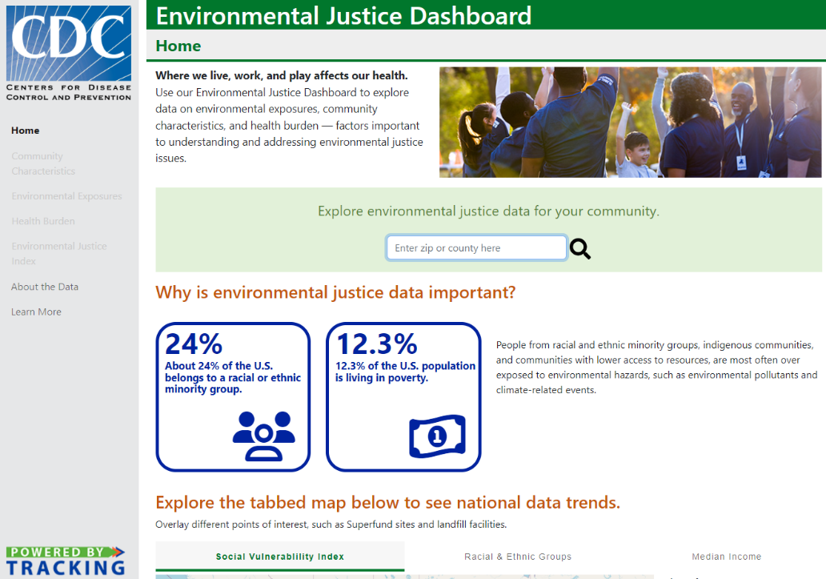

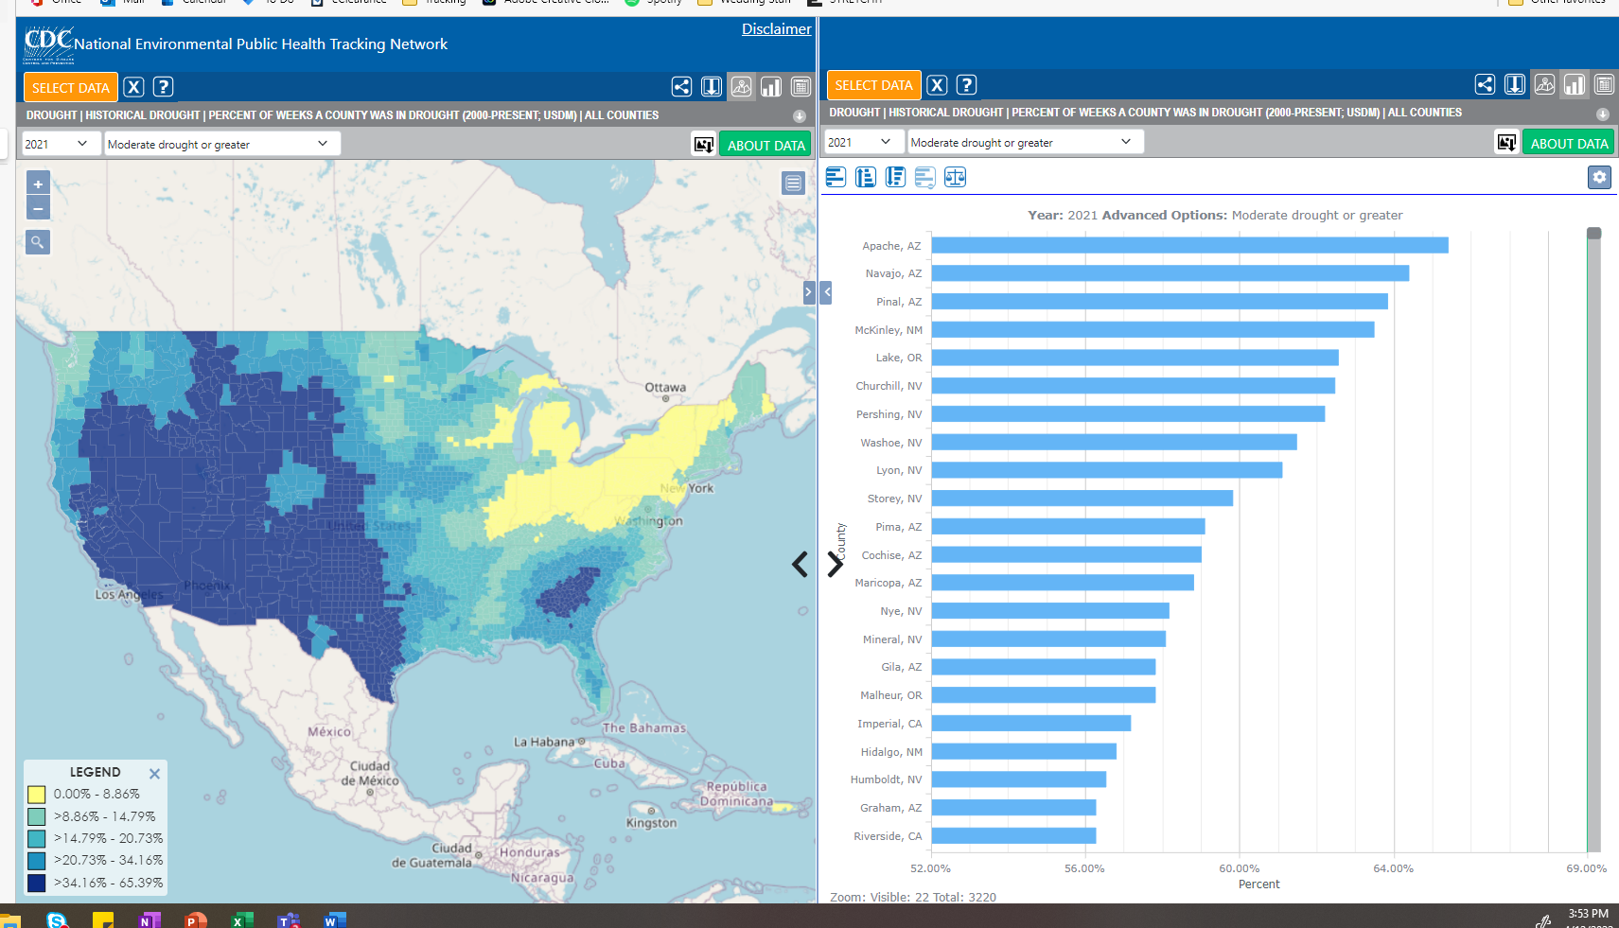

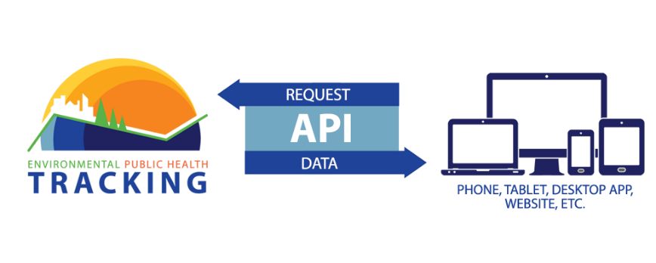

DELIVERS DATA
RELEVANT
TO YOUR NEEDS
700+ Measures
Data Visualizations
Downloadable Data
Export Images
Data Visualization Embedding
Tracking makes standardized data easier to use.
Developers can use Tracking data in their own tools and products
Interactive Data Explorer
(maps, charts, and tables)
Curated, location-specific information on a topic
Interactive
Contextual information
Dashboards
Application Program Interface (API)
11
Image source: CDC Tracking Network Data Explorer
Notes:
.

Slide 12






Help Improve Health With Data, Tools, and Expertise
Target prevention activities
Educate residents
Monitor community health
Inform city or state planning
Identify communities at risk
Inform health policies
Support epidemiologic studies
12

Slide 13
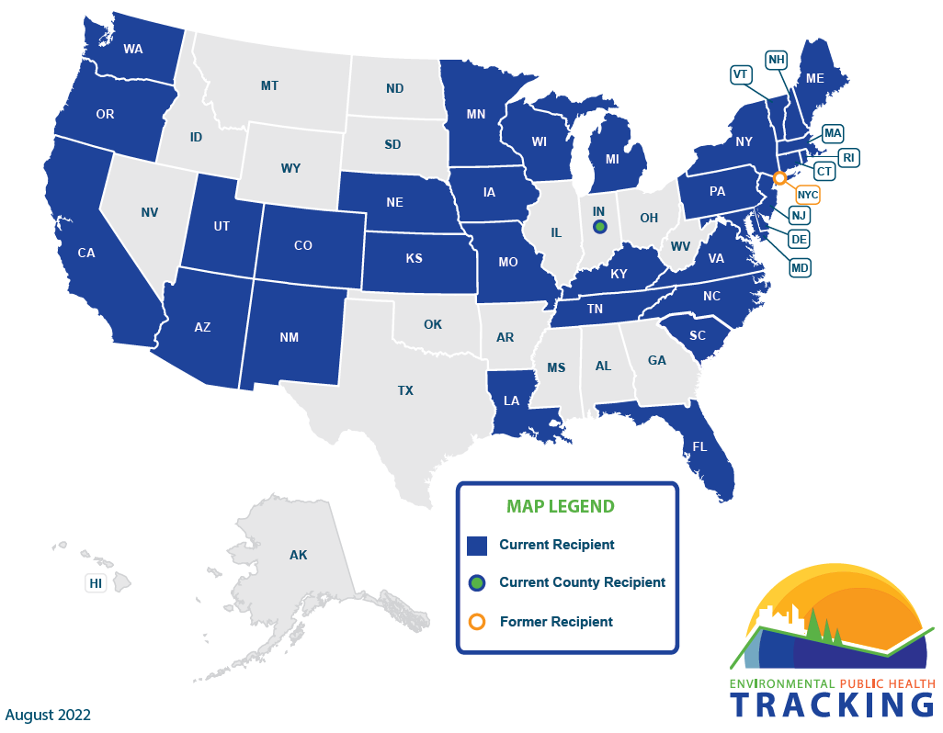
Funding Recipients: EH22-2202
13

Slide 14
Background

Slide 15
Carbon Monoxide (CO) Poisoning
CO is a colorless, odorless, nonirritating gas that is produced through the incomplete combustion of carbon-containing substances.
CO poisoning occurs from breathing air with elevated levels of CO.
CO poisoning related to power outages during natural disasters has been well documented.
Unintentional non-fire related CO poisoning death is a common and preventable cause of accidental death in the US.
15

Slide 16
CO Poisoning Surveillance Data
CO poisoning: a nationally notifiable condition since 2014.
  No active national surveillance system for CO poisoning.
Estimates and surveillance activities rely on data sources that were not primarily designed for CO poisoning surveillance.
Tracking collects and disseminates unintentional CO poisoning data.
  Mortality
  Hospitalizations
  Emergency Department Visits
16

Slide 17
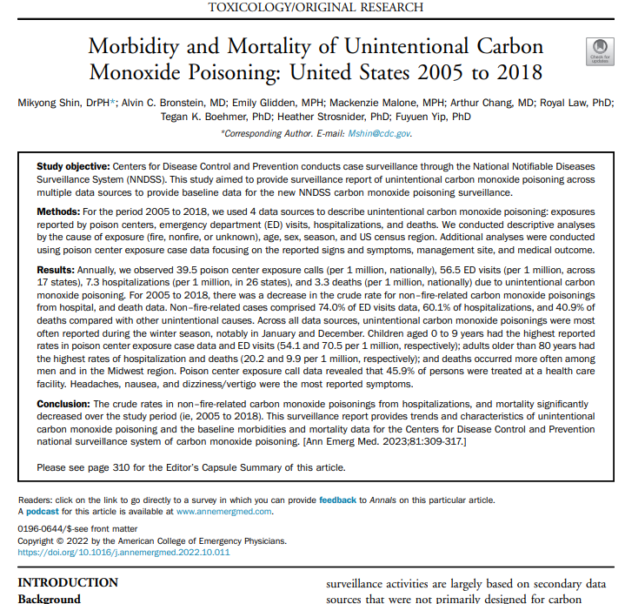
Summary of CO Surveillance Data
For the study period 2005 – 2018
  172, 489 poison center exposure cases in 50 states
  105,833 ED visits across 16 states
  19,230 hospitalizations in 26 states
  14,448 deaths in 50 states
Each data source has limitations
Link to publication

Slide 18
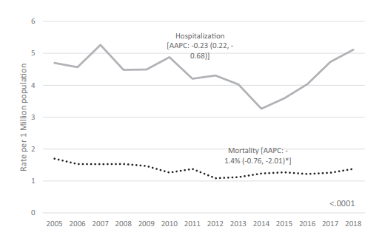
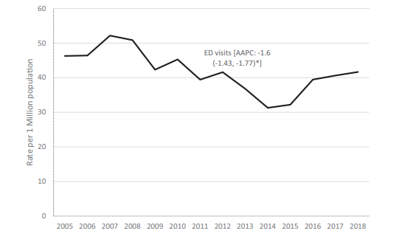
Trends of Unintentional CO Poisoning
Rates due to unintentional non-fire carbon monoxide poisoning, United States, 2005-2018.
18

Slide 19
Carbon Monoxide (CO) Poisoning MMG

Slide 20
Why Implement the CO MMG?
HL7 case notification implementation would improve the quality and volume of CO data being sent to CDC.
Improve timeliness and completeness of CO data.
Improve data transmission and consolidate data streams to reduce burden on jurisdictions in reporting cases.​
Provide standardized data elements and valid values for variables.​
Collect clinical, laboratory, epidemiologic, and exposure data.
20

Slide 21
MMG Overview
Gen V2 Data Elements
CO Data Elements
CO HL7
Message
21

Slide 22
MMG Highlights: CO Data Elements
Data Reporting Source
  Hospital (Hospital discharge),
  Emergency room (Emergency department),
  Poison control center,
  Laboratory (Laboratory report),
  Vital statistics (Death certificate),
  Provider report (clinician report),
  Medical examiner report,
  Urgent care,
  Hyperbaric facility,
  Electronic medical record,
  Workers compensation record,
  Unknown,
  Other ( )
Signs and Symptoms
  Headache,
  Dizziness/vertigo,
  Loss of consciousness,
  Nausea,
  Vomiting,
  Confusion,
  Shortness of breath,
  Chest pain,
  Other ( )
22

Slide 23
MMG Highlights: CO Data Elements
Smoking Status
  Current some day smoker
  Former smoker
  Never smoker
  Smoker, current status unknown
  Current every day smoker
  Unknown if ever smoked
Power outage event
  Yes/ No /Unknown
Extreme weather
  Yes/ No /Unknown
Intent of Exposure
  Intentional
  Unintentional
  Unknown
23

Slide 24
MMG Highlights: CO Data Elements
Incident Name (Case Outbreak Name in GenV2)
  (Text)
Event Notes
  (Text)
Carboxyhemoglobin Level
  (Numeric ---999.9 %)
Pulse CO-oximetry Measurement
  (Numeric---999.9%)
24

Slide 25





Use Cases for CO Surveillance
Understanding the health burden after a natural disaster
Identifying mass exposure events
Better understand populations at risk
Inform prevention activities and messaging
Monitor trends in CO Poisoning over time and space
25

Slide 26



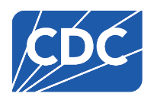
Thank you!
Contact Me:
Mackenzie Webb
yga5@cdc.gov
www.cdc.gov/ephtracking
Follow Tracking on social media.
facebook.com/CDCEPHTracking
@CDC_EPHTracking
For more information, contact CDC
1-800-CDC-INFO (232-4636)
TTY: 1-888-232-6348 www.cdc.gov
The findings and conclusions in this report are those of the authors and do not necessarily represent the official position of the Centers for Disease Control and Prevention.

Slide 27

Q & A
27

Slide 28




Thank you!
Next NNDSS eSHARE: July 16, 2024
Subscribe to
Case Surveillance News
Access NNDSS’ Technical Resource Center
Email edx@cdc.gov for technical help
Learn about case surveillance modernization

