Slide 1
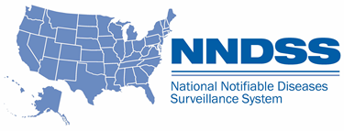
NNDSS eSHARE May 2024 Webinar
Centers for Disease Control and Prevention
May 21, 2024
Office of Public Health Data, Surveillance, and Technology

Slide 2

Agenda
NNDSS Welcome and Announcements
Overview of the Measles Message Mapping Guide (MMG)
Guidance on 2023 Annual Reconciliation
Questions and Answers
2

Slide 3
NNDSS Updates & Announcements
Hang Nguyen, MPH
Office of Public Health Data, Surveillance, and Technology

Slide 4
Multiple MMGs – Value Set Update
Units of Measure updated – now version 5
  1 value added – {Ct_value}
  PHIN VADS Case Views updated for the following MMGs:
Carbon Monoxide MMG | Measles MMG
Congenital Rubella Syndrome MMG | Mumps MMG
Congenital Syphilis MMG | Pertussis MMG
COVID-19 MMG | RIBD MMG
FDD MMG | Rubella MMG
Hepatitis MMG | STD MMG
Legionellosis MMG | Varicella MMG
Lyme and TBRD MMG
4
Units of Measure (version 5): https://phinvads.cdc.gov/vads/ViewValueSet.action?id=4FA84253-2863-4CFD-8FC7-54EF114FCC74

Slide 5
MMG pre-onboarding cohorts starting in June
Reach out to edx@cdc.gov Subject line: MMG Pre-Onboarding Cohort if your jurisdiction would like to start pre-onboarding in the next few months.
NBS Cohorts
  GenV2, STD, congenital syphilis, mumps, pertussis, varicella, HAI-MDRO, hepatitis, TB/LTBI
Non-NBS Cohorts
  STD, congenital syphilis, mumps, pertussis, varicella, Lyme/TBRD (already ongoing)
5

Slide 6
Introduction to the Measles Message Mapping Guide
May 21, 2024
Sandy Roush, MT, MPH
Adria Mathis, MSPH

Slide 7
Message Mapping Guide (MMG) Implementation for NCIRD Conditions
NCIRD provides technical and programmatic support for 23 conditions for which data is received through NNDSS
MMG data – HL7®
  8 planned to use only the Generic v2 MMG
  15 NNCs will use the Generic v2 MMG and a disease-specific MMG
NETSS
  Includes all 23 conditions for which NCIRD provides support and receives data through NNDSS
  Jurisdictions sending via NETSS will switch to Generic v2 in the future
DISEASE-SPECIFIC MMGs (HL7®)
MMG Developed:
COVID-19
Mumps
Pertussis
Varicella
H. influenzae (RIBD)
N. meningitidis (RIBD)
IPD (RIBD)
Legionellosis
Measles
Rubella
CRS
Requirement Review:
12. Diphtheria
Tetanus
Pediatric Influenza Deaths
Novel Flu A
GENERIC-V2 MMG ONLY (HL7®)
Planned to use only Generic v2:
Poliomyelitis, paralytic
Poliovirus infection, non paralytic
STSS
SARS-CoV
AFM
MIS
RSV-associated deaths
Psittacosis
FHIR® is the registered trademark of HL7 and is used with the permission of HL7.
7

Slide 8
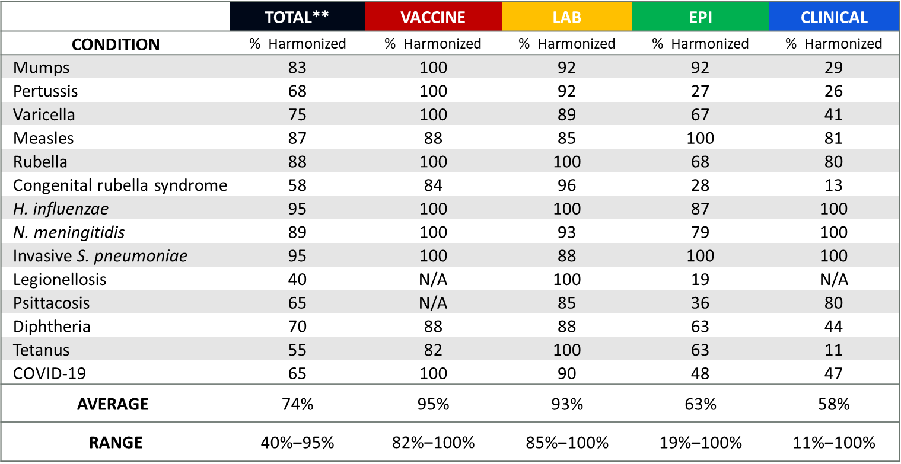
Results for Harmonization of Disease Specific MMGs by Condition*
* Data do not include Gen V2 variables.
** ”Total” column also contains variables which do not fit within the four categories on this slide (e.g., system variables)
8

Slide 9
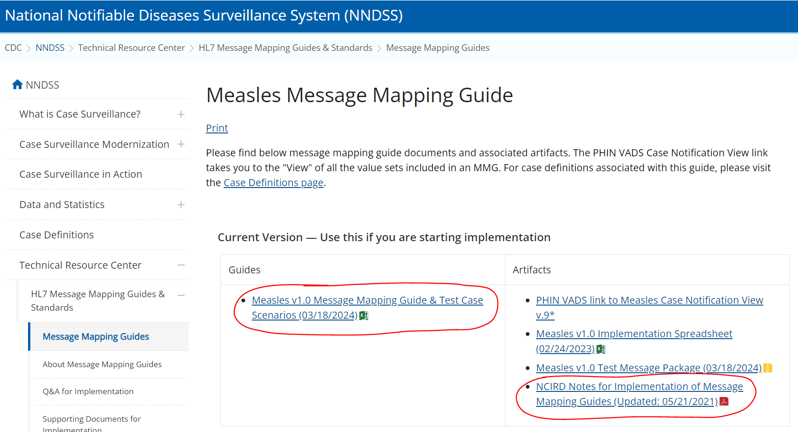
Welcome to the Measles MMG
    Message Mapping Guides (cdc.gov); NCIRD-Notes-for-Implementation-of-MMGs
9

Slide 10
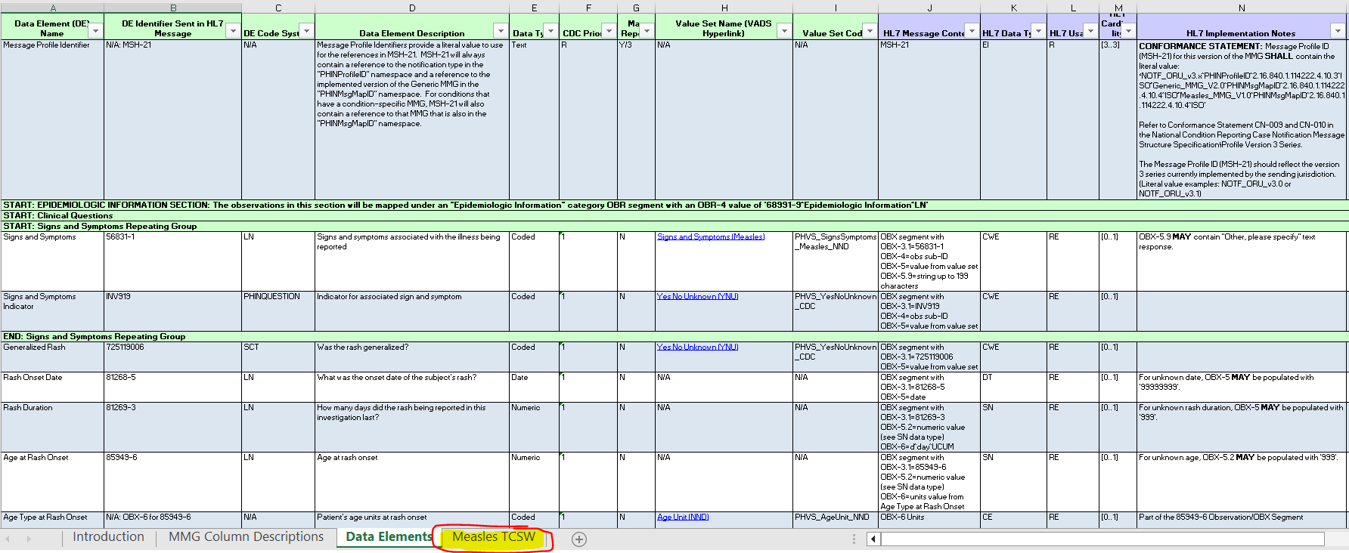
Measles MMG and TCSW
Measles Message Mapping Guide (cdc.gov)
10

Slide 11
Introduction to the Measles MMG
  The Measles MMG should be used in conjunction with the GenV2 MMG to construct a complete case notification.
  There are 68 measles-specific data elements:
          33 are divided into 6 repeating groups.
          35 are non-repeating data elements.
  Of the 68 measles-specific data elements:
        1 is required.
        41 are priority 1 (highest priority).
        14 are priority 2 (high priority).
        12 are priority 3 (low priority).
11

Slide 12
Measles MMG Repeating Groups

Slide 13
Repeating Groups
        Signs and Symptoms
              Signs and Symptoms (56831-1)
              Signs and Symptoms Indicator (INV919)
        Complications
              Type of Complication (67187-5)
              Type of Complications Indicator (INV920)
        Travel History
              International Destination(s) of Recent Travel (82764-2)
              Date of Return from Travel (TRAVEL08)
        Industry and Occupation
              Current Occupation (85658-3)
              Current Occupation Standardized (85659-1)
              Current Industry (85078-4)
              Current Industry Standardized (85657-5)
13

Slide 14
Repeating Groups, continued
Epidemiology Laboratory
          Test Type (INV290)
          Test Result (INV291)
          Test Result Quantitative (LAB628)
          Result Units (LAB115)
          Genotype Sequence (60422-3)
          Specimen Type (66746-9)
          Specimen Source (31208-2)
          Specimen Collection Date/Time (68963-8)
          Specimen Analyzed Date/Time (45375-3)
          Date Specimen Sent to CDC (85930-6)
          Performing Laboratory Type (82771-7)
          VPD Lab Message Reference Laboratory (LAB143)
          VPD Lab Message Patient Identifier (LAB598)
          VPD Lab Message Specimen Identifier (LAB125)
14

Slide 15
Repeating Groups, continued
      Vaccine History
                Vaccine Type (30956-7)
                Vaccine Administered Date (30952-6)
                Vaccine Dose Number (30973-2)
                Vaccine Manufacturer (30957-5)
                Vaccine Lot Number (30959-1)
                Vaccine Expiration Date (VAC109)
                National Drug Code (VAC153)
                Vaccination Record Identifier (VAC102)
                Vaccine Event Information Source (VAC147)
15

Slide 16
Measles MMG Non-Repeating Groups

Slide 17
Non-Repeating Data Elements
Clinical Questions
      Generalized Rash (725119006)
      Rash Onset Date (81268-5)
      Rash Duration (81269-3)
      Age at Rash Onset (85949-6)
      Age Type at Rash Onset (OBX-6 for 85949-6)
      Highest Measured Temperature (81265-1)
      Temperature Units (OBX-6 for 81265-1)
      Date of Fever Onset (81266-9)
      Chest X-ray for Pneumonia (INV923)
Interpretative Lab Questions
      Laboratory Testing Performed (LAB630)
      Laboratory Confirmed (INV164)
      Specimen Sent to CDC (82314-6)
17

Slide 18
Non-Repeating Data Elements, continued
Case Related
        Message Profile Identifier (MSH-21)
        Patient Address City (PID-11.3)
        Transmission Setting (81267-7)
        Age and Setting Verified (85700-3)
        Epi-Linked (INV217)
        US Acquired (INV516)
        Traceable to International Import (INV286)
        Length of Time in the US (DEM225)
        Length of Time in the US Units (OBX-6 for DEM225)
        Case Investigation Status Code (INV109)
        Detection Method (INV159)
        Case Patient a Healthcare Worker (223366009)
        Import Status (INV293)
        Confirmation Method (INV161)
        Confirmation Date (INV162)
18

Slide 19
Non-Repeating Data Elements, continued
Interpretive Vaccine History
      Did the Subject Ever Receive a Vaccine Against This Disease (VAC126)
      Number of Doses Received Before 1st Birthday (VAC128)
      Number of Doses Received On or After 1st Birthday (VAC129)
      Vaccination Doses Prior to Illness Onset (82745-1)
      Date of Last Dose Prior to Illness Onset (VAC142)
      Vaccinated per ACIP Recommendations (VAC148)
      Reason Not Vaccinated Per ACIP Recommendations (VAC149)
      Vaccine History Comments (VAC133)
19

Slide 20
Benefits of Harmonization
  When considering jurisdiction workload for pre-onboarding activities (e.g., mapping data elements from jurisdiction NNDSS system to MMGs):
      Among the 41 Measles MMG priority 1 data elements:
          31 (75%) are in the Mumps MMG.
          22 (53%) are in the Pertussis MMG.
          19 (46%) are in the COVID-19 MMG.
      NCIRD provides timely data validation reports and feedback to increase efficiency and
      reduce the number of days to fully implement MMGs.
  NCIRD is supportive of any individual jurisdictions’ preferences based on their needs/requirements, to onboard any disease-specific MMG in the order they prefer.
20

Slide 21
Questions?
Email: NCIRDsurvData@cdc.gov

Slide 22
Annual Reconciliation of 2023 NNDSS Data
Courtney Cook, MS
Epidemiologist
Office of Public Health Data, Surveillance, and Technology

Slide 23
Refresher: What is Annual Reconciliation?
Reconciliation is the process used to finalize case counts for the previous year.
  Collaboration between reporting jurisdictions and CDC.
  Ensures agreement in case numbers between the reporting jurisdictions and CDC NNDSS databases.
  Ensures data published in the NNDSS Annual Tables are transparent and accurate.
This process is important as it builds trust among reporting jurisdictions, CDC programs, and the public.
23

Slide 24
Reconciliation Process in MVPS
Reconciliation tasks will be completed within the Message Validation, Processing, and Provisioning System (MVPS).
These tasks include:
  Review stratification reports and line lists;
  Review reporting exceptions and any cases sent with retired event codes;
  Lock conditions as counts are finalized;
    Ability to unlock/re-lock as needed for case updates
  Approval of STD conditions by STD Manager; and
  Approval of all conditions by State/Territorial Epidemiologist.
24

Slide 25
Reconciliation of COVID-19 and Mpox
Reconciliation of 2023 coronavirus disease 2019 (COVID-19) and mpox data will follow the same process as last year:
  Final aggregate 2023 COVID-19 counts will be collected using a web form hosted on the CDC Epi InfoTM Secure Web Survey System.
    The option to add a reporting exception for COVID-19 for your jurisdiction has been added to the Epi InfoTM form.
  Finalization of 2023 mpox data will be completed within CDC’s Data Collation and Integration for Public Health Event Response (DCIPHER) platform.
    This includes NNDSS data, if submitted by your jurisdiction and validated for use within DCIPHER.
25

Slide 26
Other Conditions Reconciled Outside of MVPS
Arboviral conditions (ArboNET)
HIV
Pediatric influenza mortality
Novel influenza
Animal rabies
Tuberculosis
Varicella mortality
26

Slide 27
Key Dates from Reconciliation Calendar
May 21: Reconciliation Kick-off and eSHARE
July 16: CDC Program databases closed
Send final YTD STD file
July 29: Lock STD data
August 5: STD Manager approval
August 23: State/Territorial Epidemiologist Approvals Complete
        Approve in MVPS portal
        Sign off on mpox cases in DCIPHER
        Sign off on COVID-19 aggregate counts
27

Slide 28

2023 Reconciliation: Roadmap to Success – May/June
May 21: Reconciliation Kick-off!
Ongoing: Review stratification reports and line lists in MVPS Compare MVPS data to local systems
Lock conditions as data are finalized
June 30: Review reporting exceptions
Review retired event codes
Review and verify low incidence cases
28

Slide 29

2023 Reconciliation: Roadmap to Success – July
Ongoing: Review stratification reports and line lists in MVPS Compare MVPS data to local systems
Lock conditions as data are finalized
July 16: CDC Program databases close
Send final STD YTD file and final congenital syphilis (CS) cases
July 29: Lock STD data in MVPS and lock CS with DSTDP
29

Slide 30

2023 Reconciliation: Roadmap to Success – August
August 5: STD data verified and approved by STD Manager in MVPS
August 9: Final preparations for State/Territorial Epidemiologist approval:
        All data locked and submitted in MVPS
        COVID-19 aggregate counts prepared
        Mpox cases verified in DCIPHER
August 23: State/Territorial Epidemiologist completes approvals:
        Case data in MVPS
        Mpox cases in DCIPHER
        COVID-19 Epi-InfoTM form
30

Slide 31
Reconciliation Functions in MVPS

Slide 32
MVPS User Roles and Functions
 | Jurisdiction User | Jurisdiction Data Manager | STD Manager | State/Territorial Epidemiologist
Review stratification reports and line lists* | X | X | X | X
Lock and submit conditions*⁺ | X | X | X | X
Update user access and permissions |  | X
Approve STD conditions |  |  | X
Verify reporting exceptions and conditions sent with retired event codes |  |  |  | X
Approve final report and complete reconciliation |  |  |  | X
*Users can only view data for event codes they have permission to access.
⁺ “Show Reconciliation” option must be toggled ON to view the reconciliation module and the lock conditions page.
32

Slide 33
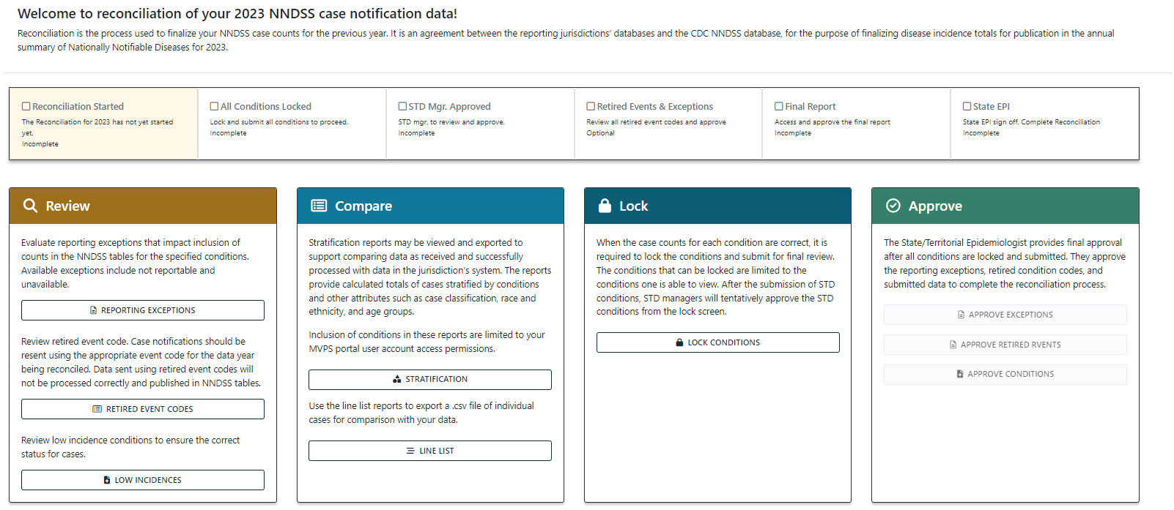
Reconciliation Module
33

Slide 34
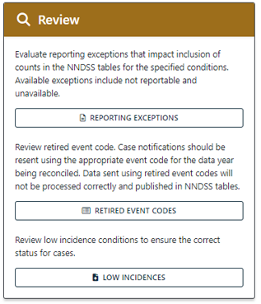
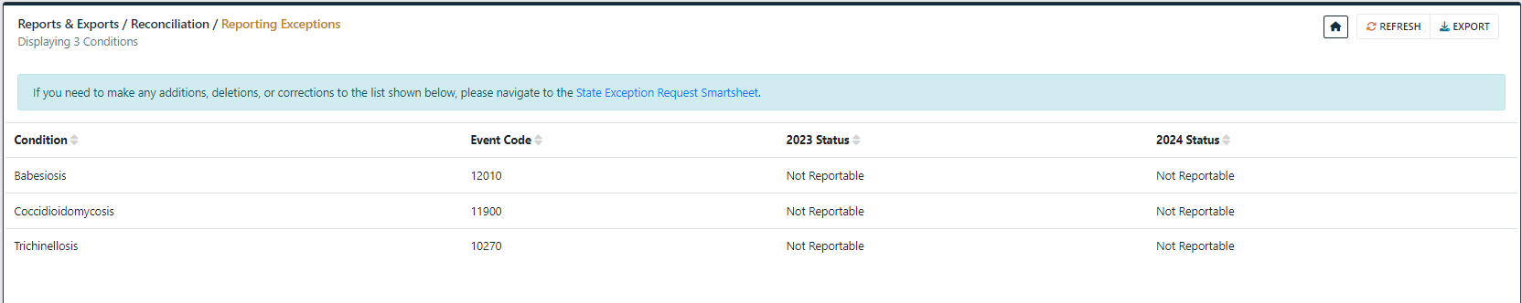
Reporting Exceptions
This screen will populate if your jurisdiction has reported any reporting exceptions for 2023 or 2024.
A link to the State Exception Request Smartsheet is provided on this screen if you need to make any changes.
34

Slide 35
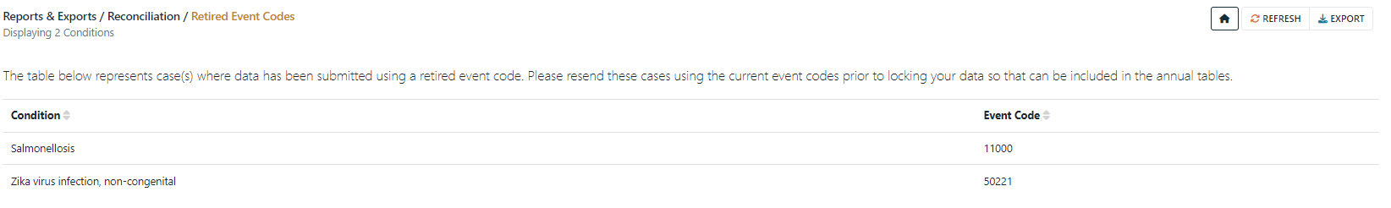
Retired Event Codes
This screen will populate if your jurisdiction has sent any cases with event codes that are retired.
Case notification updates with current event codes will need to be sent so that these cases will be counted.
35

Slide 36

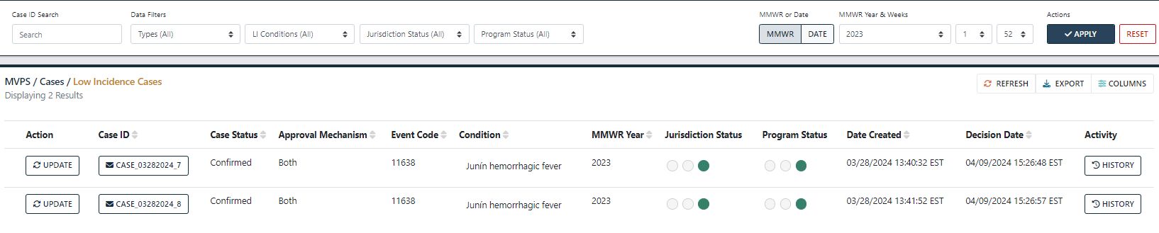
Low Incidence Conditions
This will link to the Low Incidences module (LIV) with cases requiring response.
Conditions requiring LIV response cannot be locked until the LIV process is complete.
36

Slide 37
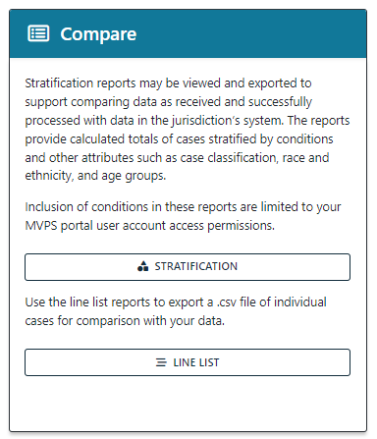
Stratification Reports and Line Lists
Stratification reports and line lists in MVPS may be used to compare data within NNDSS databases to data in local systems.
If you cannot see data for a condition while reviewing these reports, ensure your permissions include access to the event code.
  Jurisdiction Data Managers can manage and edit event code access.
37

Slide 38
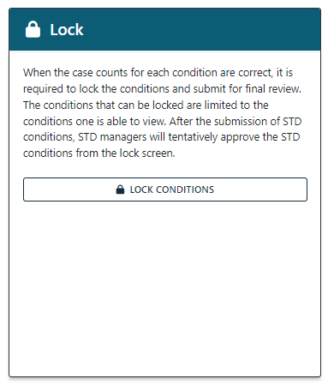
Lock, Unlock, Submit Conditions
Jurisdictions can lock conditions themselves within MVPS as case counts are verified.
Jurisdictions can also unlock conditions as needed, if updates are sent after locking.
Once conditions are locked and verified, the locked conditions must be submitted to move to the next steps in the process.
38

Slide 39

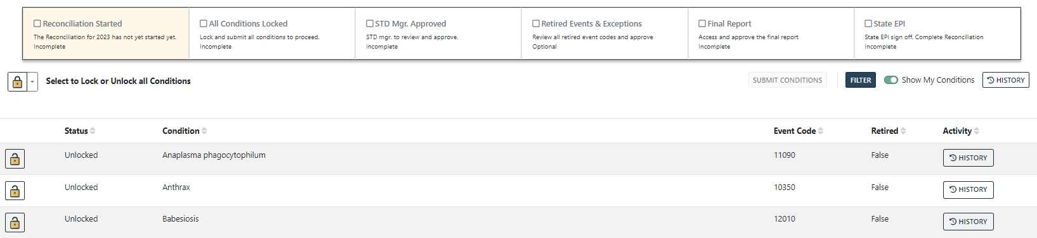
Lock, Unlock, Submit Conditions
Click the padlock icon to lock the condition.
Status bar on Lock page updated to show milestones and progression through reconciliation process.
Status will progress after locking first condition →
39

Slide 40
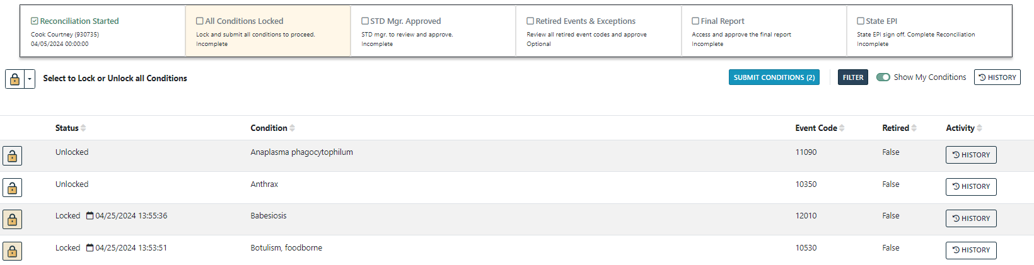
Lock, Unlock, Submit Conditions
First condition locked triggers “Reconciliation Started”.
Status bar updates with date and user that completed the task.
40

Slide 41

Lock, Unlock, Submit Conditions
Click the padlock icon to unlock the condition, if case updates for that condition need to be sent.
Once updates have been verified, click the padlock icon to re-lock.
41

Slide 42
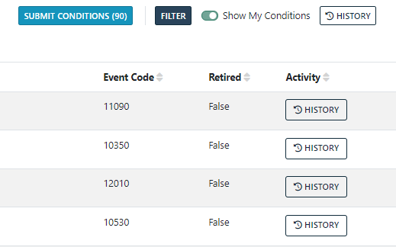
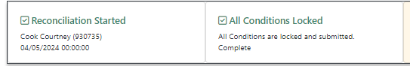
Lock, Unlock, Submit Conditions
Locked conditions must be submitted to move forward in the process.
Click Submit Conditions to do this.
In this example, we are submitting after all conditions are locked, but they do not need to be submitted all at once.
  Example: Submitting STD conditions for STD Manager approval before other conditions are locked/ready for approval.
After all conditions have been locked and submitted, the status bar will update to show this:
42

Slide 43
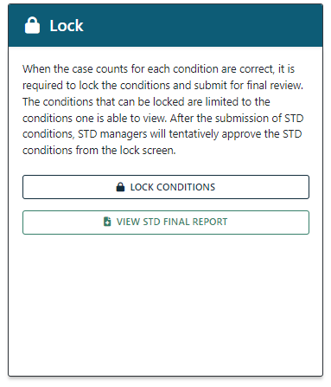
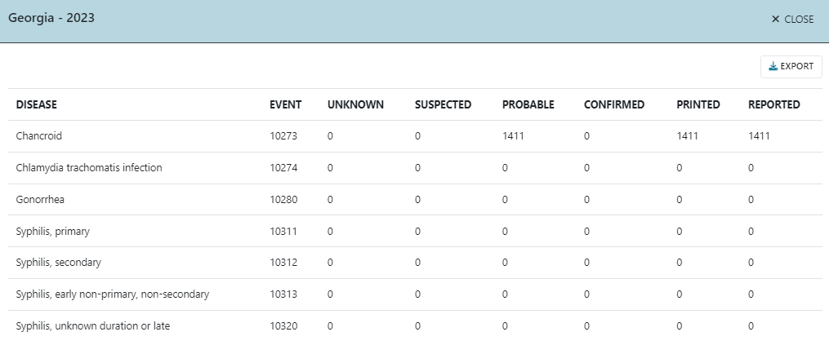
Approval: STD Manager
All STD conditions must be approved by the STD Manager before they can be approved by the State/Territorial Epidemiologist.
The STD Manager will get an email alert when all STDs have been locked/submitted.
The STD Final Report provides a quick reference of STD
condition counts for the STD Manager.
43

Slide 44
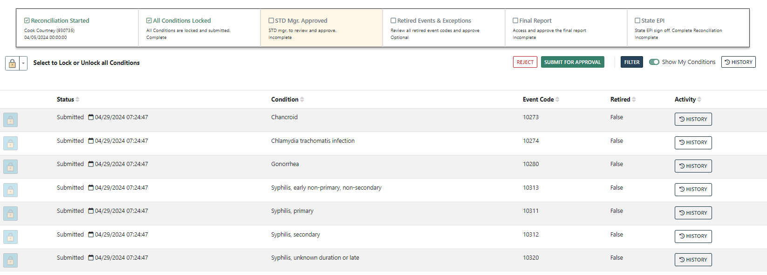
Approval: STD Manager
To approve as the STD Manager, click to the Lock Conditions screen.
Locked and submitted STD conditions will be shown.
Click Submit for Approval.
44

Slide 45
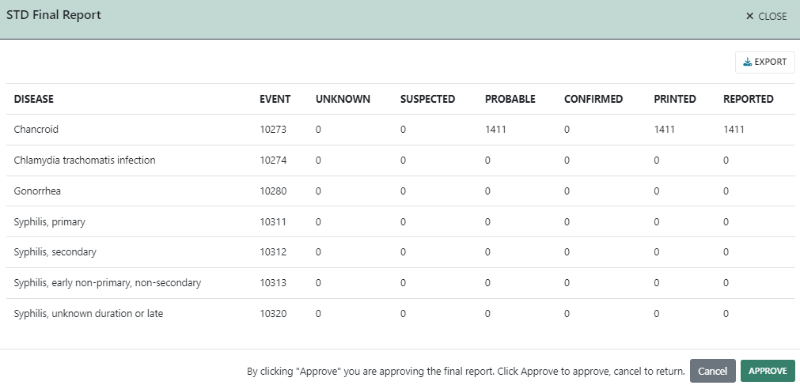
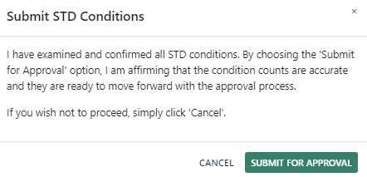
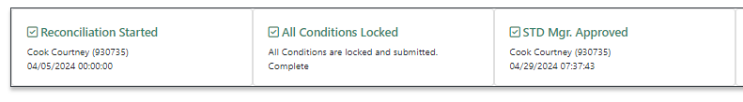
Approval: STD Manager
After clicking Submit for Approval, the STD Final Report will pop up to confirm the conditions. Click Approve to approve the final report.
In the next pop up, click Submit for Approval for final STD Manager approval.
The status bar will update after STD Manager approval.
45

Slide 46
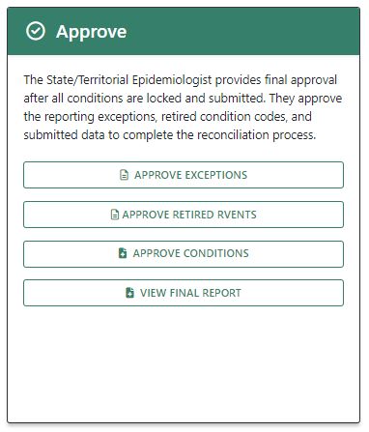
Approve: State/Territorial Epidemiologist
The State/Territorial Epidemiologist will need to review/approve:
  Reporting Exceptions
  Retired Events
  Final Report
    Available after all conditions have been locked and submitted; and STD conditions have STD Manager approval.
  Approve Conditions
46

Slide 47
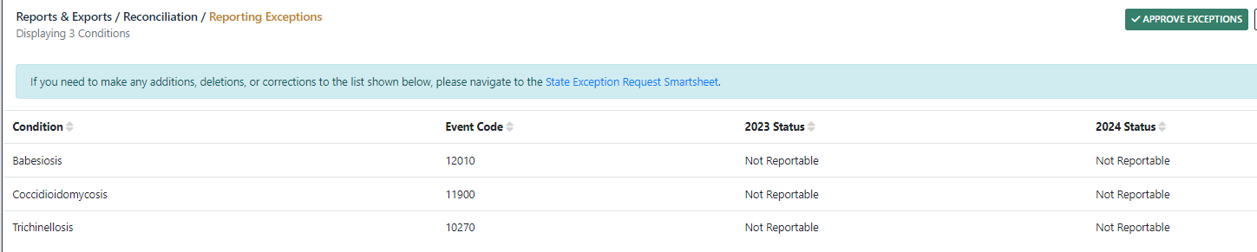
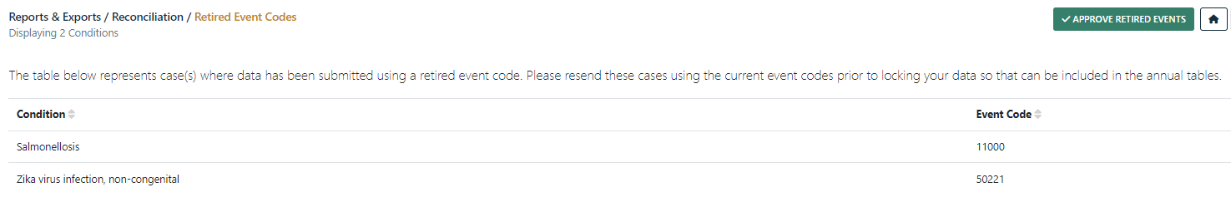
Approve: State/Territorial Epidemiologist
Clicking Approve Exceptions and Approve Retired Events will navigate to those screens, where an Approve button will now be visible.
After approving both, the status bar will update.
47

Slide 48
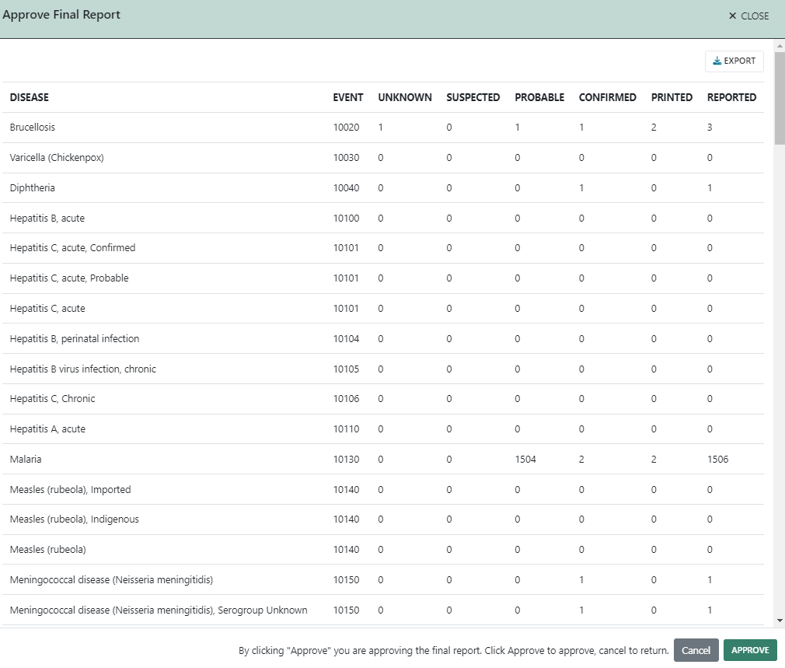
Approve: State/Territorial Epidemiologist
Clicking Approve Conditions will bring up the Lock Conditions screen with the Approve button now visible.
Click Approve once you are ready for final approval of your 2023 data. This will first bring up the final report for approval.
Click Approve to approve the report.
48

Slide 49
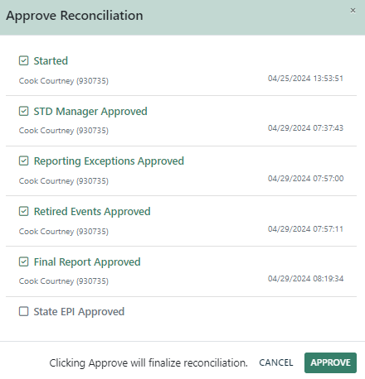
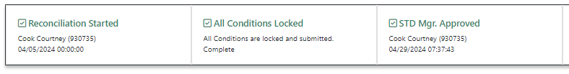
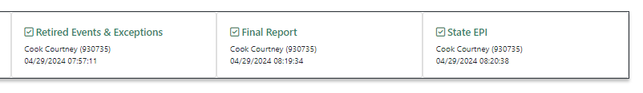
Approve: State/Territorial Epidemiologist
After approving the final report, the next pop-up reviews all reconciliation steps with a final Approve button to finish reconciliation.
The status bar will update after completing these steps:
49

Slide 50
MVPS Help: User Guides and Job Aids
The Help Center in the MVPS portal has several user guides and job aids available to assist you with the reconciliation process and with general MVPS use.
The Help Center may be found by:
  Clicking Help in the top right corner:
  Clicking Help Center in the bottom toolbar:
50

Slide 51
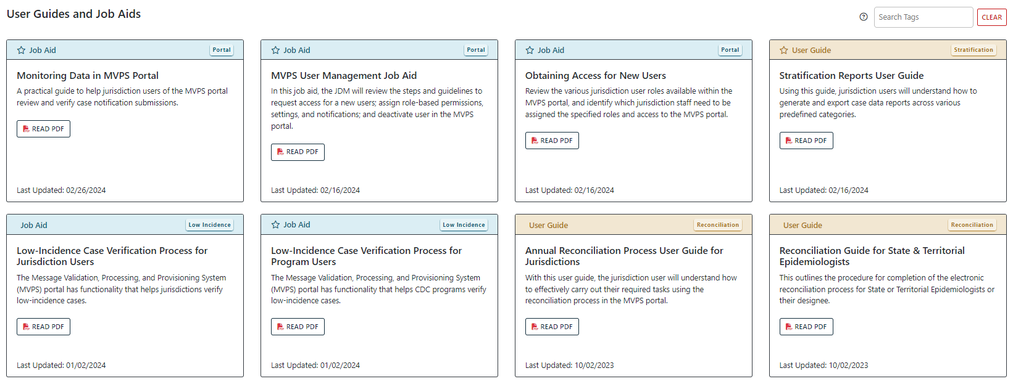
MVPS Help: User Guides and Job Aids
Two reconciliation-specific guides are available:
  General user guide walking through the full reconciliation process.
  State/Territorial Epidemiologist guide walking through tasks specific to the final approval process.
51

Slide 52
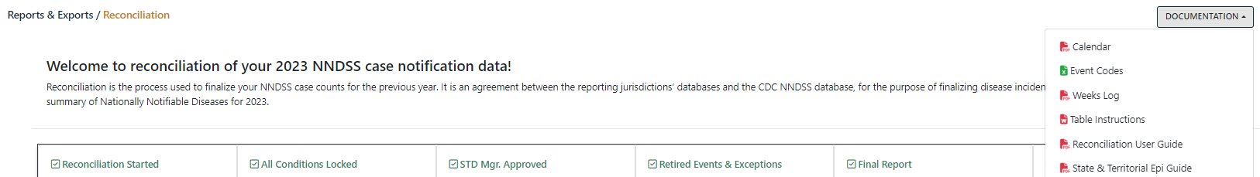
MVPS Help: User Guides and Job Aids
The reconciliation user guides are also available under Documentation in the main Reconciliation screen, along with:
  Reconciliation calendar
  Event code list
  MMWR weeks
  Table instructions
52

Slide 53
MVPS Help: User Guides and Job Aids
Additional MVPS user guides and job aids that may be useful during reconciliation:
  Monitoring Data in the MVPS Portal
  Stratification Reports User Guide
  MVPS Line List User Guide
  Low Incidence Case Verification Process for Jurisdiction Users
  MVPS User Management Job Aid
53

Slide 54

Reconciliation Support
edx@cdc.gov
Include “Reconciliation” in the subject line
54

Slide 55
Finalization of 2023 NNDSS COVID-19 Annual Data

Slide 56
Process for 2023 NNDSS COVID-19 Annual Data
Final 2023 NNDSS data for COVID-19 will not be reconciled in MVPS.
CDC will collect aggregate case counts for confirmed and probable cases.
CDC will email State/Territorial Epidemiologists a unique, jurisdiction-specific link to the Epi InfoTM web form to enter and submit counts.
  State/Territorial Epidemiologists will sign off on aggregate counts in the Epi InfoTM web form.
CDC will use these aggregate counts in the 2023 NNDSS annual tables.
56

Slide 57
COVID-19 Data for the 2023 NNDSS Annual Tables
Final 2023 COVID-19 aggregate data are needed for confirmed and probable cases among U.S. residents for the following categories:
  Total cases in jurisdiction
  Month (based on MMWR weeks)
  Age group
  Sex
  Race and Hispanic ethnicity
States send data for all categories.
U.S. territories send only total confirmed and probable cases.
Unknown or missing demographic and month data will be collected.
57

Slide 58
Combined Race and Ethnicity Categories
Race and ethnicity will be collected in a combined table but will be presented separately in the published 2023 NNDSS annual tables.
The race categories are different from race in the NETSS record layout:
  Asian and Native Hawaiian or other Pacific Islander are collected as separate categories in the Epi InfoTM web form.
If a case identifies with more than one race, only count the case under the “Other or multi-race” category.
58

Slide 59
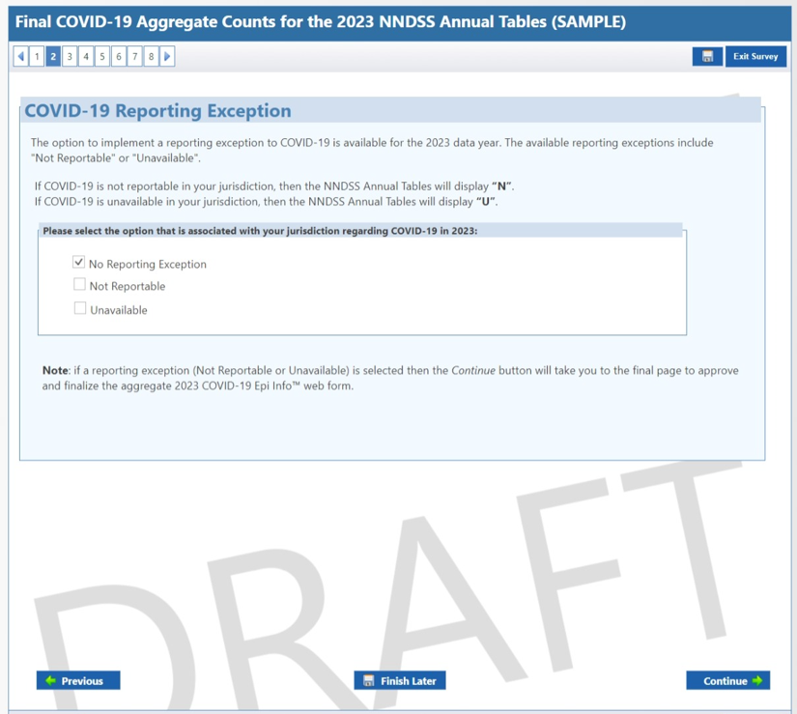
COVID-19 Reporting Exceptions
The option to add a reporting exception for your jurisdiction for 2023 NNDSS COVID-19 data is now available within the Epi InfoTM web form.
If a reporting exception is selected, the form will progress directly to the approval page and data will not need to be entered.
59

Slide 60
Epi InfoTM Web Form Guidelines
The Epi InfoTM web form may be shared with multiple people depending on who within your jurisdiction will be providing data.
  Only one person at a time should be actively in the form entering data.
  If multiple people enter data in the form at the same time, one may overwrite the changes of another.
CDC will provide an Excel worksheet with instructions to help prepare case counts for the form.
  Case counts should not be submitted using this Excel worksheet.
60

Slide 61
Epi InfoTM Web Form Guidelines
After data are entered, the State/Territorial Epidemiologist reviews, approves, and submits the final 2023 NNDSS COVID-19 data.
Do not click Submit until all data have been entered, reviewed, and approved.
If the form has been submitted prematurely, or if you have any questions regarding finalization of your 2023 NNDSS COVID-19 data:
  Email edx@cdc.gov
  Subject line “2023 Final NNDSS COVID-19 Data”
The Epi InfoTM web form should be completed, approved, and submitted by Friday, August 23.
61

Slide 62
Finalization of 2023 Mpox Annual Data

Slide 63
Process for 2023 NNDSS Mpox Annual Data
Final 2023 NNDSS mpox data for mpox will not be reconciled in MVPS.
Mpox data will be reconciled using the Mpox Data Reconciliation module in DCIPHER.
The mpox Gold Standard dataset in DCIPHER will be the source of data for the Mpox Data Reconciliation Module.
  This dataset includes data from all sources (call center, original CRF, short CRF, NNDSS, etc.) augmented together based on jurisdiction-selected augmentation priority.
The 2023 NNDSS annual tables will include total mpox cases (count of confirmed and probable cases)
63

Slide 64
Dates for Mpox Case Counts
Cases submitted via NNDSS will be counted using MMWR Week and Year from the NNDSS record.
Cases submitted via other methods will use the calculated field “Epi_Date_V3” to calculate MMWR Week and Year.
  For each unique case ID and jurisdiction case record, the earliest date from all data sources is used to populate Epi_Date_V3.
  When no other dates are available, Epi_Date_V3 defaults to the date the case was first sent to CDC.
64

Slide 65
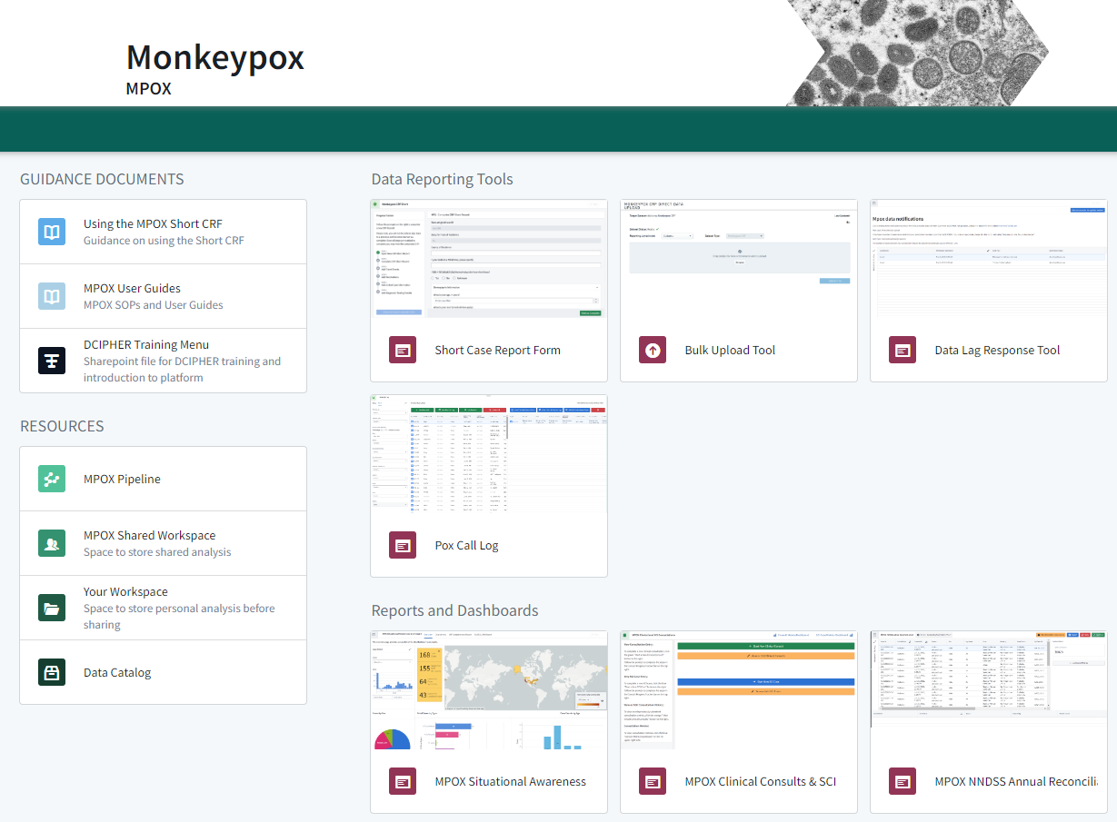
DCIPHER Mpox Reconciliation Module
65

Slide 66
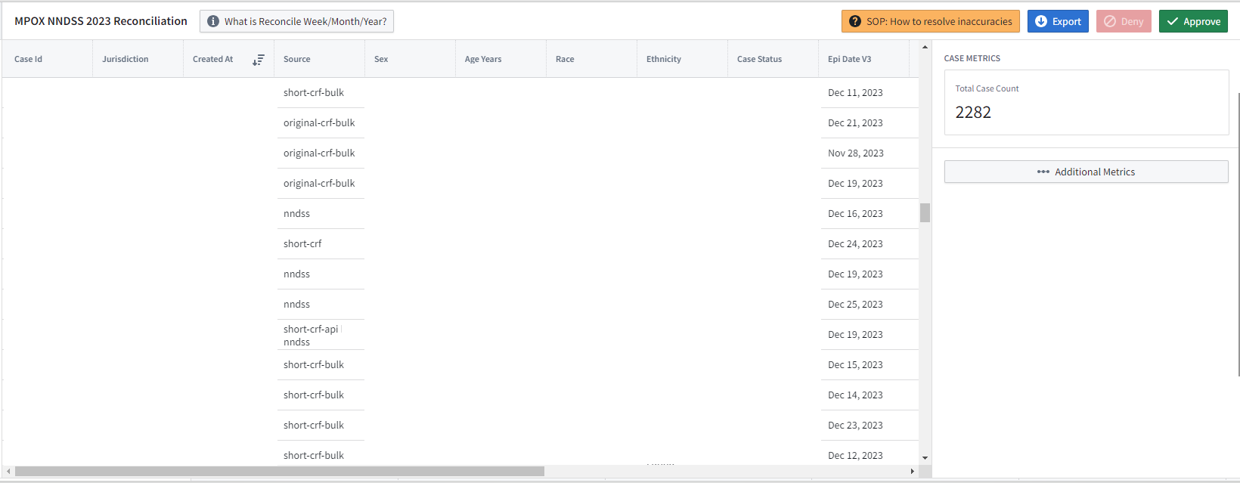
DCIPHER Mpox Reconciliation Module
2
1
3
66

Slide 67
Mpox/DCIPHER Support
poxvirus@cdc.gov
edx@cdc.gov
67

Slide 68

Q & A

Slide 69




Thank you!
Next NNDSS eSHARE: June 18, 2024
Subscribe to
Case Surveillance News
Access NNDSS’ Technical Resource Center
Email edx@cdc.gov for technical help
Learn about case surveillance modernization

