Slide 1
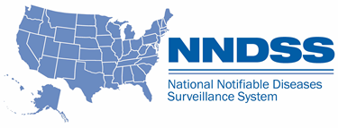
NNDSS eSHARE: April 2024 Webinar
Office of Public Health Data, Surveillance, and Technology
April 16, 2024

Slide 2

Agenda
NNDSS Welcome
Future State: Advancing Data for Public Health Action
Questions and Answers

Slide 3

Future state: Advancing Data for Public Health Action
Jen Layden, MD, PhD
Director
Office of Public Health Data, Surveillance and Technology (OPHDST)
Centers for Disease Control and Prevention (CDC)

Slide 4
Building on our history of data modernization
“Driving Public Health in the Fast Lane” report*
Start of the COVID-19
pandemic
OPHDST created
2019
2020
2021
2022
2023
First dedicated funding line for DMI to CDC FY2020
Used DMI, CARES, ARP funding to:
Expand ELR and eCR
Wastewater and HHS Protect
Vital statistics
Reduced manual processes
Cloud migration
First PHDS released
*"Driving Public Health in the Fast Lane: The Urgent Need for a 21st Century Data Superhighway." https://www.cste.org/page/DM-2021

Slide 5
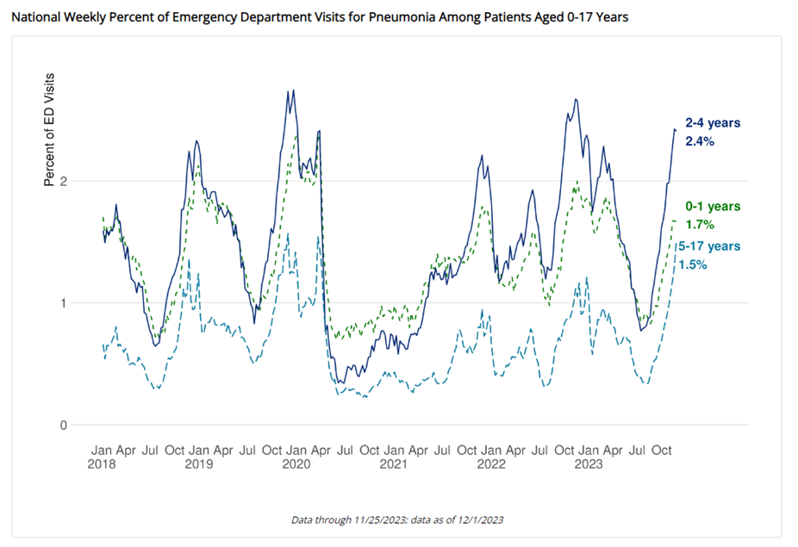
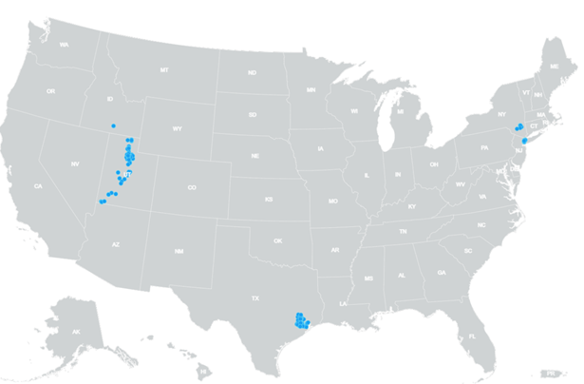
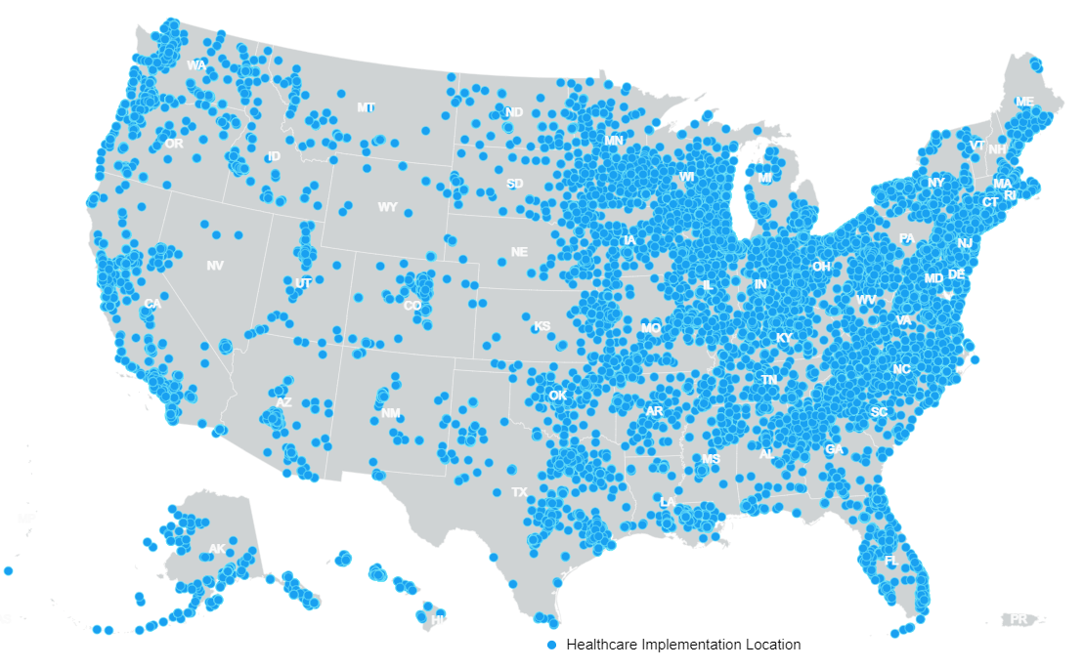
Benefits of data modernization
Expanded electronic case reporting coverage
leads to faster reporting and reduced burden
Increased syndromic data coverage to ~88% of
ED visits allows real-time threat monitoring
January 2020
March 2024
187 health care facilities
As of April 4, 2024,
over 36,100 health care facilities
Faster detection of novel cases
More complete data to detect inequities
Real-time monitoring

Slide 6

Our vision expands on modernization efforts and focuses on critical components
to advance data for public health action to equitably protect health, safety and security.

Slide 7
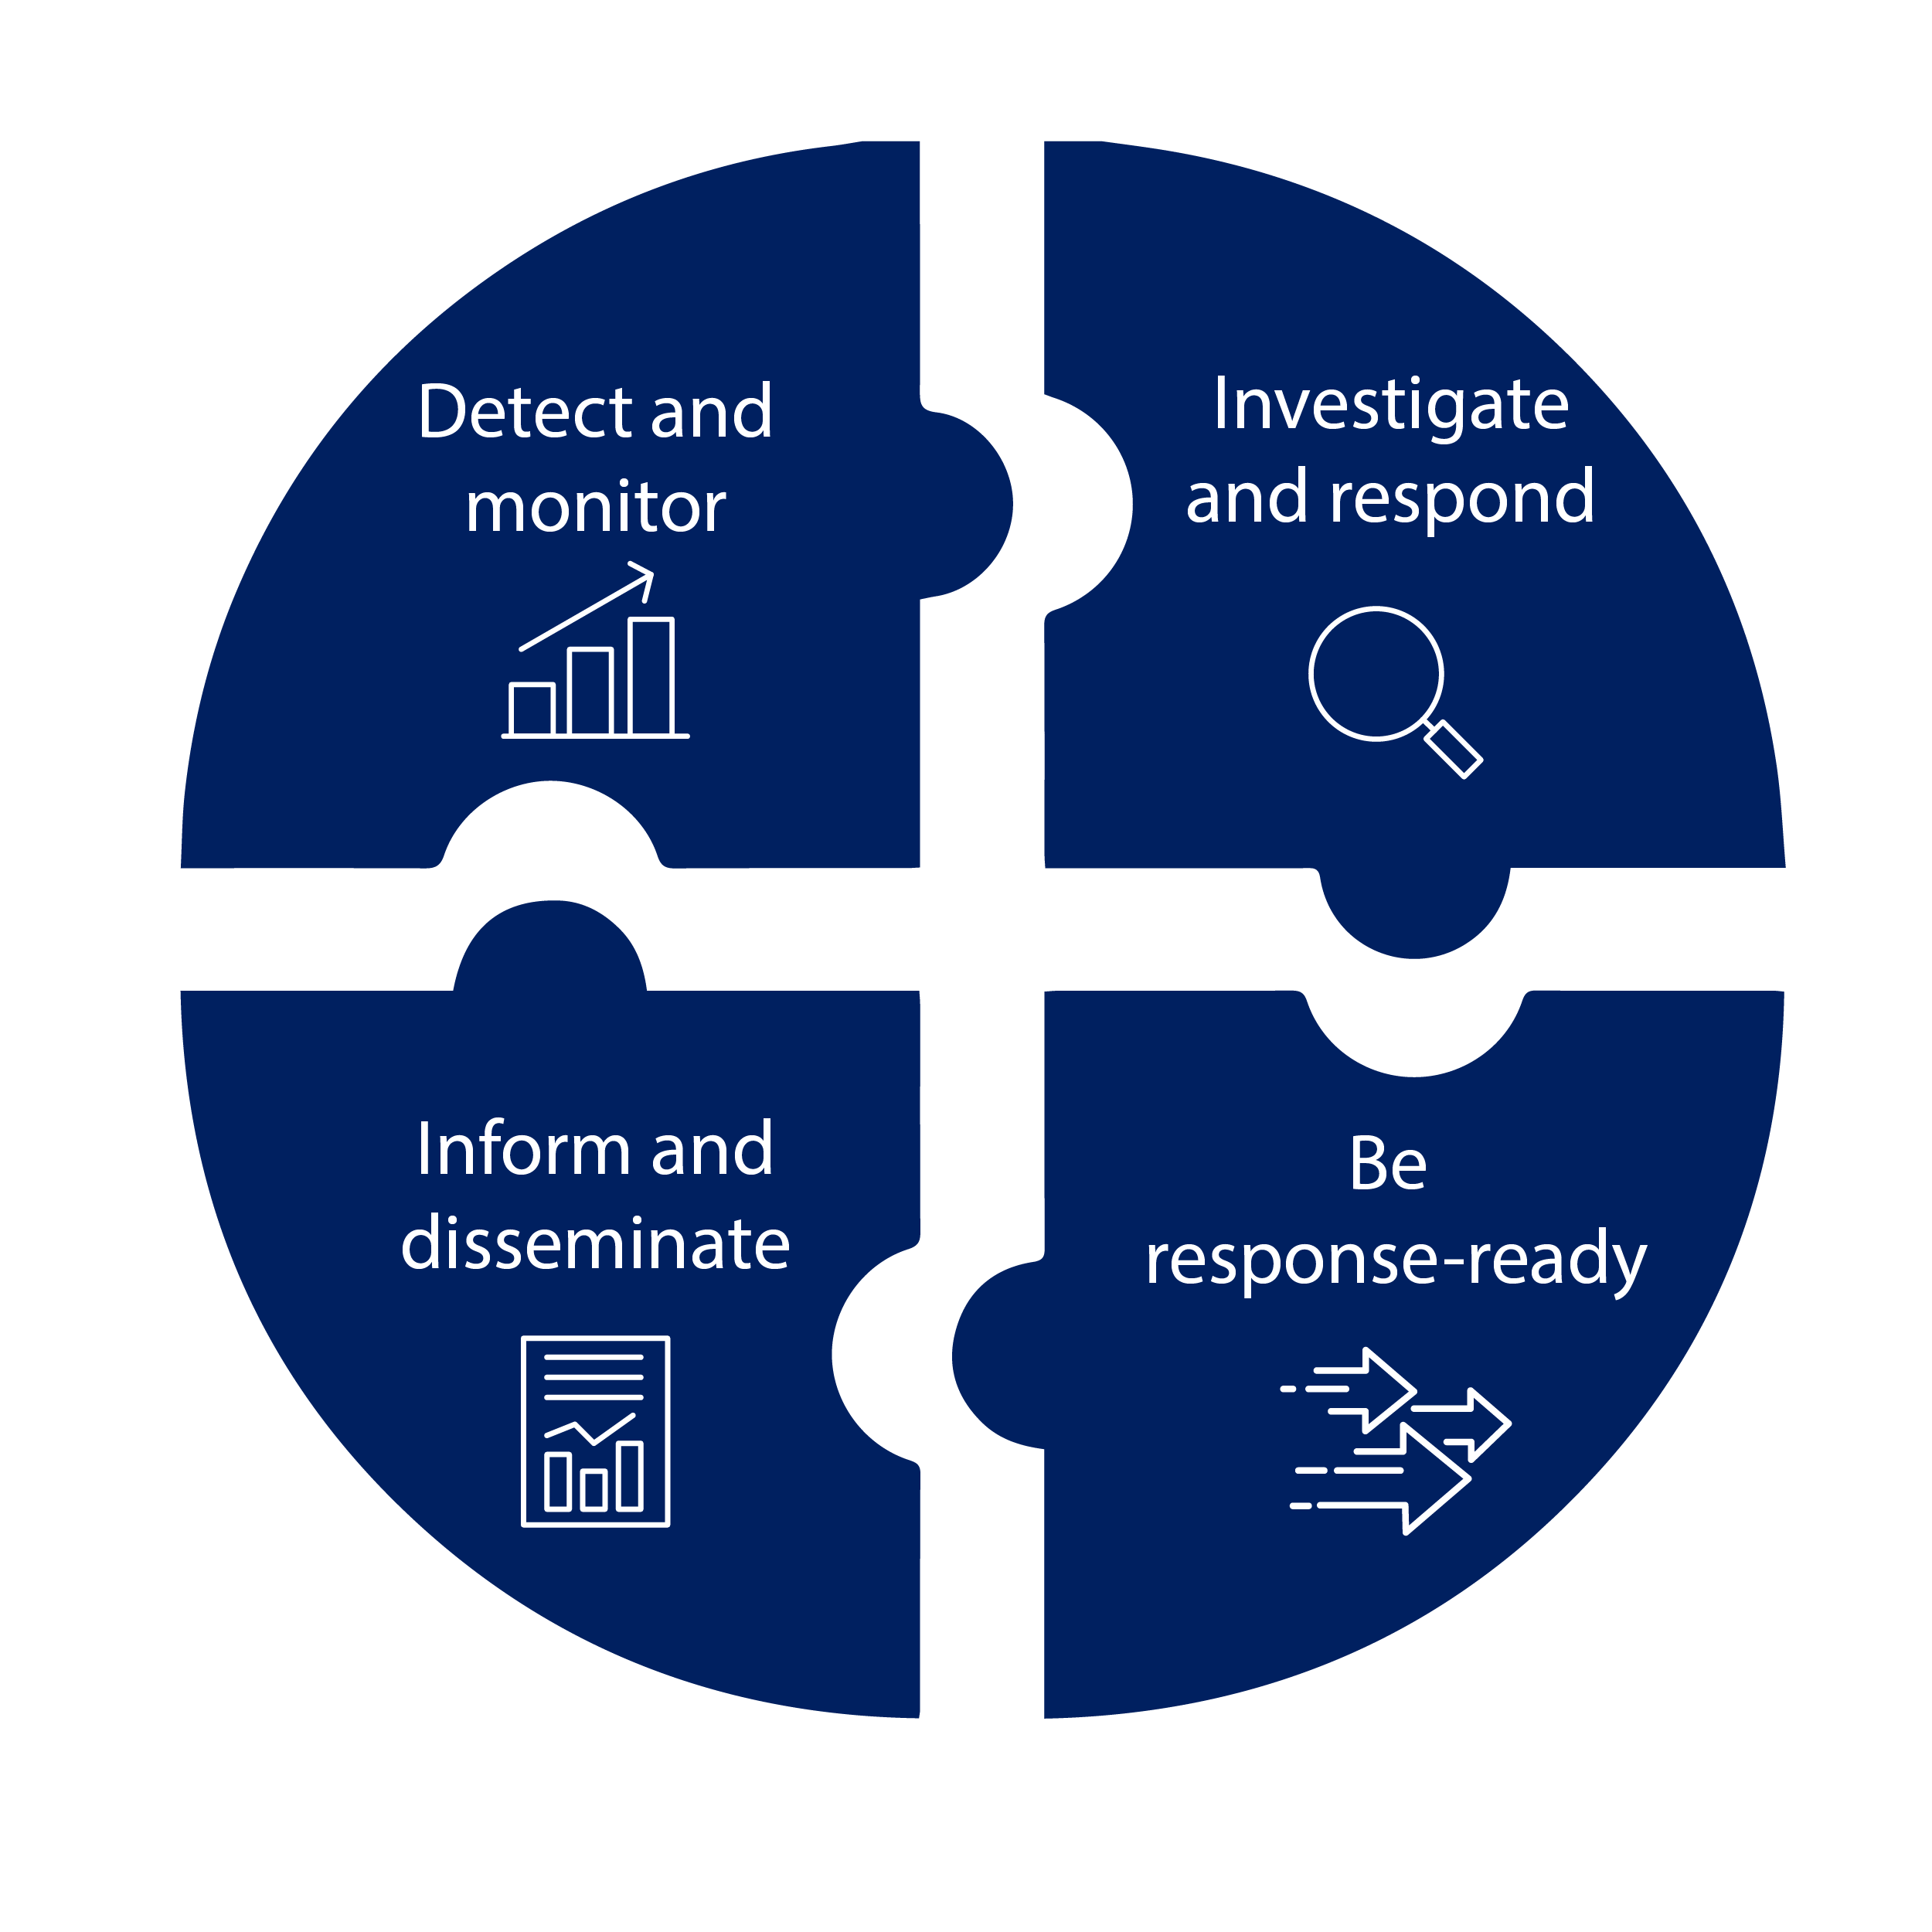
The Public Health Data Strategy (PHDS) has put us on a path to achieve our vision by outlining the data, technology, policy and administrative actions needed to exchange critical core data efficiently and securely across health care and public health.
Public Health Data Goals
1
Strengthen the core of public health data
2
  Accelerate access to analytic and automated solutions to support public health investigations and advance health equity
Core public health actions
3
Visualize and share actionable insights to inform public health action
4
Advance more open and interoperable public health data

Slide 8
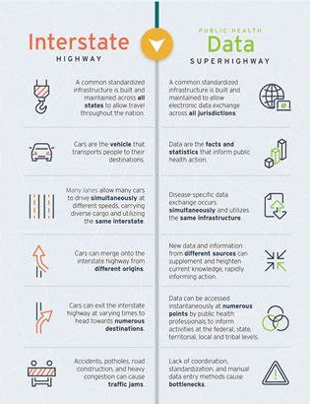
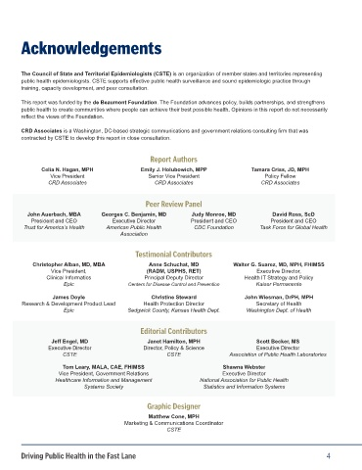




We still need to address our biggest challenges and long-standing pain points
Disconnect between public health and health IT.
Siloed systems across public health and within CDC and jurisdictions.
Manual processes, outdated technology and lagging skills.
"Driving Public Health in the Fast Lane: The Urgent Need for a 21st Century Data Superhighway." https://www.cste.org/page/DM-2021

Slide 9
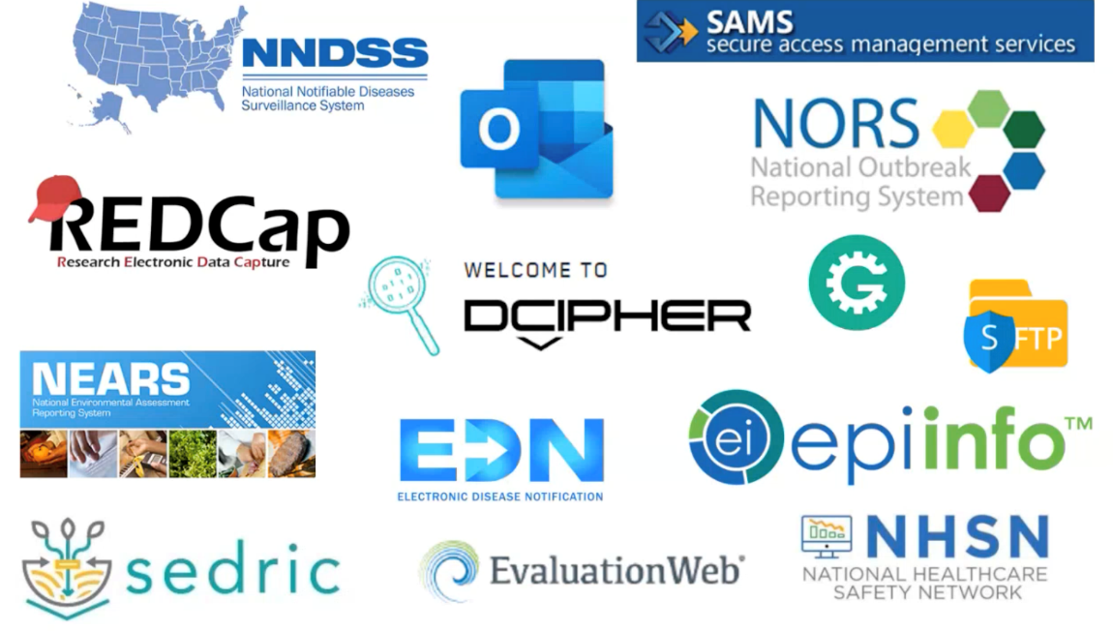
We need to continue to reduce burden for partners
Tennessee’s Public Health Department found that for 11 diseases they used at least 20 surveillance systems to send case data to the CDC.

Slide 10


Opportunities within reach
Advances in health IT connectivity, interoperability, standardization and regulation.
Multiple federal agencies supportive of and engaged in modernization efforts.
Modernized, scalable technical approaches ready to expand across public health.
CDC prioritizing moving to enterprise approach for data governance and systems.
State, Tribal, Local and Territorial (STLT) advances made during pandemic and with DMI funding.

Slide 11





Key opportunity: Advances in health IT
Public health system technical standards that align with health IT standards
Adoption of Fast Healthcare Interoperability Resource (FHIR)® for data exchange
Nationwide data standards available via EHRs (USCDI) and expanded domain specific datasets (USCDI+)
Critical actions for a robust connection
Public health joins Trusted Exchange Framework and Common Agreement (TEFCA)
Expansion of electronic Case Reporting (eCR), ELR, syndromic automated feeds

Slide 12






Key benefits: connect public health to health IT
Connected to health
information technology (health IT) investments
Higher data quality by using queries
to supplement reports
and notifications
Key Benefits
Reduce point-to-point
connections and variations
Opportunities for enhanced
automation
Near real-time data exchange
Built with sustainable, secure and
flexible principles

Slide 13



Hypothesized future: data exchange architecture
PRELIMINARY | NON-EXHAUSTIVE | FOR DISCUSSION ONLY
STLTs
Systems
Health care data
STLT collected data
Health care
Systems
Exchanges
Queries
Health care data
Core data, analytics and visualizations
Queries
Health care data
STLT collected data
CDC
Systems
Queries
Push is triggered
Pull is requested
Informational

Slide 14




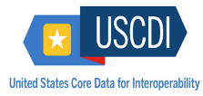
Transforming the future of data exchange
Key components to expand over 5-years to public health and health care data interoperability
Leading to:
Near real-time reporting and investigation of novel and serious health threats.
Faster detection of common public health threats and outbreaks.
Better insights into chronic disease conditions and trends.
Nationwide real-time monitoring of public health threats.
Faster sharing of information back to HC, improving clinical decision-making and patient safety.
eCR and query via TEFCA for near real-time reporting & investigations
Increase coverage of syndromic surveillance to ~100% of ED visits
2024: 75% of reportable conditions reported by eCR; 40% CAH coverage
2024: 95% ED visit coverage; continued improved visualization
~75% state & big city public health jurisdictions and CDC using TEFCA
Broad adoption of FHIR® for most core data sources and across jurisdictions
Broad adoption of USCDI and USCDI+ across public health
2024: Two public health use cases live
2024: FHIR® adoption for NVSS and health care measures
2024: USCDI/+ adoption for case and lab data

Slide 15
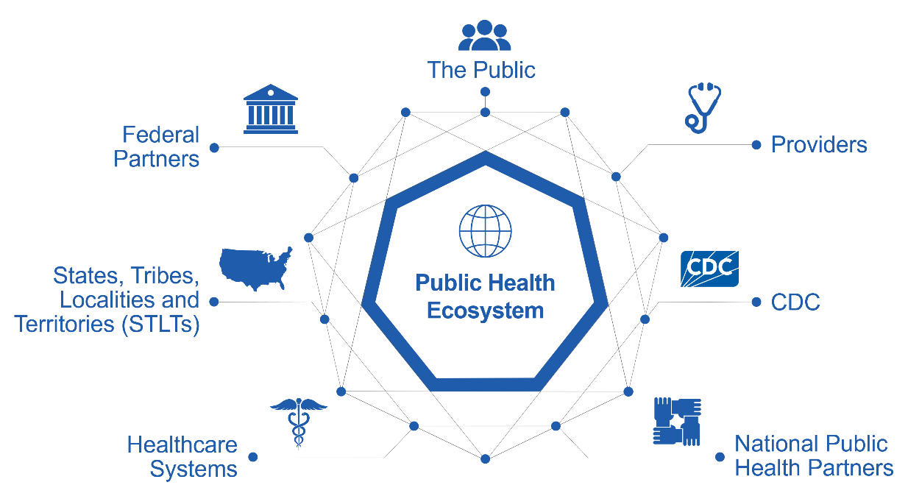
Together, we will take a 'One Public Health' approach for Advancing Data for Public Health Action

Slide 16


We will advance data for public health action to equitably protect health, safety and security.
if we…
leverage key opportunities by connecting to health IT
and we…
build capabilities to increase productivity across the PH ecosystem
and we…
design end-to-end solutions to solve public health data problems holistically

Slide 17
CDC’s approach to supporting state, local, tribal, and territorial health departments
Continued funding and technical assistance
Collaborations to design, test, and learn
Technical, policy, and logistics support through the implementation centers
Recruit, place, and support 100+ technical experts in PHAs
Maturity model and guidance documents

Slide 18

Three engagement opportunities
Connecting to TEFCA
Case Service Design (CSD)
eICR Data Evaluation
Connect public health to the health IT ecosystem
Go live with 2 STLT public health partners to exchange public health information using TEFCA Network by end of 2024. Alaska, Chicago, South Nevada, and Washington State have agreed to be the first four STLTs and we have the aggressive goal of going live with the eCR use case this summer, well before the end of the year.
Co-creating the future of case data exchange
CSD is a multi-year service design initiative focused on defining and implementing end-to-end solutions for case data exchange between healthcare; state, tribal, local, and territorial (STLT) jurisdictions; CDC; and associated partners.
Making health data more actionable and insightful for public health.
A collaboration between the CDC and local and state PHAs to make electronic case data more usable and actionable by leveraging data engineering expertise and tools developed centrally by CDC to generate insights and inform decision-making at the local, state, and federal levels.
Immediate need so we are better prepared, opportunity to test new things
Designing solutions holistically with
a focus on people and processes
Quick tests to understand potential value of EHR data for public health

Slide 19



Implementation Centers
National Partners selected to build four implementation centers
ASTHO (Association of State and Territorial Health Officials)
NNPHI (National Network of Public Health Institutes)
PHAB (Public Health Accreditation Board)
$255 million dedicated to driving public health data modernization
Three implementation centers to provide support to state, local and territorial jurisdictions
One implementation center to provide tribal support
This funding is layered on top of public health infrastructure and capacity grants and data modernization funding

Slide 20




Goals for the Implementation Centers
The purpose of this funding is to establish and coordinate efforts across four implementation centers to accelerate public health data exchange and data linkage with the intent to:
    Increase timeliness of data exchange between health care and public health for public health reporting and priority use cases.
    Improve response time to public health threat detection, prevention and/or time to intervention.
    Reduce burden on health care systems/providers and public health jurisdictions for public health data reporting and data exchange.
    Improve data quality and completeness through the identification and implementation of data linkage methods (i.e., digital ID).

Slide 21




Benefits of the Implementation Centers for STLTs
  Receive customized support based on jurisdiction-specific readiness assessment
Take advantage of the national network
that will be available through TEFCA
Benefits
  Get help adopting and using new technology and standards, including data exchange with providers, CDC, other STLTs and partners such as labs
Use the IC infrastructure to increase
their overall technical capacity to be
ready and able to seize future
opportunities
  Continued support for DMI funding, leverage what they have already implemented or moving to the next phase of data sharing
Support for critical national and local priority use cases

Slide 22
Workforce Acceleration Initiative
      The purpose of this funding is to accelerate State, Tribal, Local and Territorial (STLT) progress on Public Health Data Goals through strategic workforce placement and expansion.
Partners
CDC Foundation
Association of Public Health Laboratories
Council for State and Territorial Epidemiologists
Association of State and Territorial Health Officials
Other members of the Joint Public Health Informatics Taskforce
Program aims include:
Identify and recruit skilled technology and data experts
Establish technical competencies and proficiency standards
Develop efficient onboarding and support systems
Facilitate collaboration and knowledge sharing
Evaluate impact
Recruit, place and support technical experts in PHAs to:
Strengthen the core of public health data
Accelerate access to analytic and automated solutions
Visualize and share insights to inform public health action
Advance more open and interoperable public health data

Slide 23
The Future of Public Health Data is Now
Advancing Data for Public Health Action builds on previous modernization efforts and focuses on critical components necessary to achieve Public Health Data Strategy Milestones
  Transforming data exchange by connect public health to Health IT
  Designing end-to-end solutions that collaboratively and holistically solve data challenges
  Building capabilities that increase productivity across public health jurisdictions
We are modernizing data and systems to address longstanding pain points and to reduce the burden on partners
There are many opportunities to engage (e.g., TEFCA pilots, Case Service Design, eICR)
Implementation Centers and the Workforce Acceleration Initiative exist to support partners and help STLTs make progress on Public Health Data Strategy goals

Slide 24




Thank you!
Next NNDSS eSHARE: May 21, 2024
Subscribe to
Case Surveillance News
Access NNDSS’ Technical Resource Center
Email edx@cdc.gov for technical help
Learn about case surveillance modernization

