Slide 1

NNDSS eSHARE: March 2024 Webinar
March 19, 2024
Office of Public Health Data, Surveillance, and Technology

Slide 2

Agenda
NNDSS Welcome and Announcements
Lifting the Message Mapping Guide (MMG) Onboarding Pause
Questions and Answers
2

Slide 3
NNDSS Updates and Announcements
Keaton Hughes, MPH
Office of Public Health Data, Surveillance, and Technology

Slide 4
2024 Case Definitions Available Soon
Nationally notifiable conditions:
  Anaplasmosis
  Congenital Toxoplasmosis
  Ehrlichiosis
  Hepatitis B, acute and chronic
  Invasive Cronobacter infection among infants
  Mumps
  Nonparalytic Poliovirus
  Paralytic Poliomyelitis
  Varicella
  Zika disease
Standardized surveillance:
  Congenital Cytomegalovirus
  Toxoplasmosis and Congenital Toxoplasmosis
4

Slide 5
Updated 2024 Documents on NNDSS Website
NNDSS Event Codes & Other Surveillance Resources (landing page for the following)
CSTE Position Statement: Policy and Procedure for Timeliness of Case Notifications
Reporting Exceptions for National Notifiable Diseases (NND)
Current and Past Notifiable Conditions
2024 National Notifiable Diseases Surveillance System Event Code List (Release 1, posted on January 2, 2024)
PHIN VADS Value Set Link to the National Notifiable Diseases Surveillance System (NNDSS) 2024 Event Code List
MMWR Weeks Calendar
Notification Requirements
2024 Changes to the NNDSS and other relevant updates
5

Slide 6
New Resources available in the MVPS portal
Monitoring Data in MVPS Portal
  Guidance for reviewing and verifying case notification submissions
Stratification Reports User Guide
  Guidance generating and viewing case counts by various case data attributes
MVPS User Management Job Aid
  Details for Jurisdiction Data Managers to administer MVPS portal permissions and event code access
Obtaining Access for New Users
  Insight into what access is needed and activities associated with obtaining access
6

Slide 7
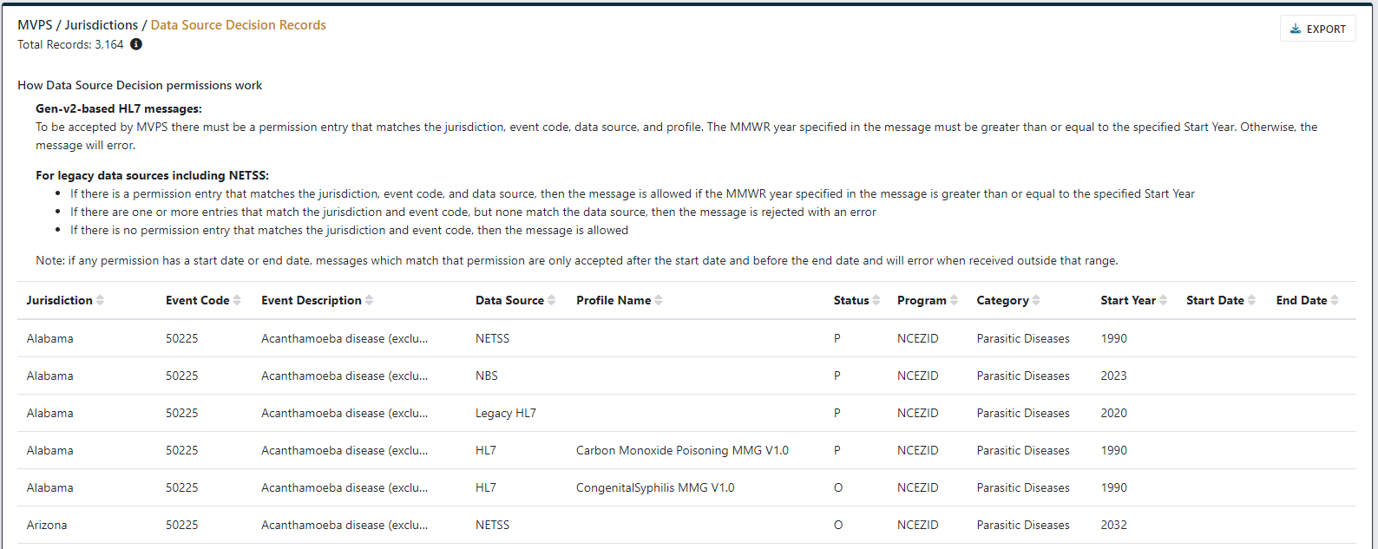
Coming Soon: Data Source Decision Insight
7

Slide 8
2023 Reconciliation Preparation
Supporting activities to prepare for 2023 reconciliation kick-off:
Begin reviewing case data internally
Use MVPS portal tools (e.g., line lists, stratification reports) to compare data
Send case notification updates accordingly
Consider updates needed to reporting exceptions
Upcoming items and projected timelines:
2023 reconciliation kick-off NNDSS eSHARE planned for May 21, 2024
Closeout and finalization of 2023 reconciliation expected to be August 23, 2024
8

Slide 9
Lifting the MMG Onboarding Pause
Hang Nguyen, MPH
Detect and Monitor Division, Public Health Data Transmission Branch
Office of Public Health, Surveillance, and Technology

Slide 10
MMG Pause: Purpose & Next Steps
Pause of MMG development and onboarding began in October 2022
  Purpose: To allow partners and CDC to focus on data standardization and create the CDC Front Door, an effort to streamline how data comes into CDC
Criteria for MMG Onboarding exceptions during pause:
  Jurisdictions allowed to continue MMG efforts:
    In latter stages of pre-onboarding MMGs: completion of system updates for MMG, creation of test messages, and filled out implementation spreadsheet & test case scenario worksheet
    Already actively onboarding an MMG with CDC
  Jurisdictions asked to pause MMG efforts:
    In early stages of pre-onboarding MMGs: planning phase or has not made any changes to their system
  GenV2 and TB/LTBI MMGs were prioritized for any jurisdictions who didn’t already onboard these guides
Listening to CDC programs’ and jurisdictions’ perspectives, NNDSS will formally end the pause on MMG Onboarding
  Date of Lift on MMG Onboarding: Wednesday, 03/20/2024
  This will resume cohorts & onboardings of published MMGs
  MMG Development will continue to be on pause
10

Slide 11



Plan: Lifting the MMG Onboarding Pause (1 of 7)
Step 1: Before Lifting the Pause
  Gauged CDC Programs’ readiness to begin MMG onboarding
  Snapshot of jurisdictions’ MMG priorities utilizing ELC HIS REDCap MMG form
  Publish specific MMGs
Step 2: Lift Pause on MMG Onboarding
  March 2024 eSHARE webinar (03/19/2024): Announce to jurisdictions about lifting the pause on MMG Onboarding
  Official “Lift” Date: 03/20/2024
  Published MMGs on NNDSS website can be adopted and onboarded by jurisdictions
Step 3: Continue Pause on MMG Development
  Official “Lift” Date: To be determined
  Consideration and inclusion of data standardization and situational awareness efforts
1
Before Lifting the Pause
2
Lift Pause: MMG Onboarding
3
Continue Pause: MMG Development
11

Slide 12
Plan: Lifting the MMG Onboarding Pause (2 of 7)
Step 1: Before Lifting the Pause
  CDC Programs’ readiness:
    Sent a link to a form to gauge programs’ capacity to onboard
    Received program confirmation jurisdictions can onboard currently posted MMGs
  Jurisdictions’ readiness:
    Utilized ELC HIS REDCap MMG form to gather jurisdictions’ MMG prioritization
    Request jurisdictions fill out their ELC HIS REDCap MMG prioritizations to aid in planning cohorts
    Gauge jurisdictions’ capacity to join cohorts and prepare for future MMG onboardings
  Publish specific MMGs
    MMGs eCleared, but not posted
    Near-final MMGs in preparation for pre-Clearance
1
Before Lifting the Pause
Lift Pause: MMG Onboarding
Continue Pause: MMG Development
12

Slide 13
Plan: Lifting the MMG Onboarding Pause (3 of 7)
Step 2: Lift Pause on MMG Onboarding
  Official “Lift” Date: 03/20/2024
  Currently published MMGs are open for onboarding:
  MMGs will be eCleared and published for onboarding:
Before Lifting the Pause
Arboviral V1.3.2* | Hepatitis V1*
Babesiosis V1.1 | Lyme/TBRD V1.0.2
Carbon Monoxide V1.0* | Malaria V1.0.2*
Congenital Syphilis V1.1* | STD V1.2*
COVID-19 V1.2 | Trichinellosis V1.0.3
FDD V1* | Tuberculosis/LTBI V3.0.3
Generic V2
2
Lift Pause: MMG Onboarding
Continue Pause: MMG Development
Congenital Rubella V1.0* | Mumps V1.0.2
HAI MDRO V1.1* | Pertussis V1.0.2
Legionellosis V1.0* | RIBD V1.1.2*
Malaria V1.1* | Rubella V1.0*
Measles V1.0* | Varicella V3.0.2*
13
* Please note: These MMGs have additional nuances shared in the next few slides.

Slide 14
Plan: Lifting the MMG Onboarding Pause (4 of 7)
Step 2: Lift Pause on MMG Onboarding (cont’d)
  NBS jurisdictions may have alternative, available versions to onboard or wait for a NBS page to be built for the following MMGs.
NBS jurisdictions can onboard these MMGs:
Arboviral V1.3.2 * | Hepatitis V1.0 *
Babesiosis V1.1 | Lyme/TBRD V1.0
Carbon Monoxide V1.0 | Malaria V1.0
Congenital Syphilis V1.0 ** | STD V1.0 **
COVID-19 V1.2 | Trichinellosis V1.0.3
Generic V2 | TB/LTBI V3.0.3
HAI MDRO V1.0.2
NBS jurisdictions can onboard these MMGs once eCleared:
HAI MDRO V1.1 | Pertussis V1.0.2
Malaria V1.1 | Varicella V3.0.2
Mumps V1.0.2
NBS jurisdictions cannot onboard yet until standard NBS packages are available, regardless of CDC onboarding status:
Congenital Rubella V1.0 | Measles V1.0
Congenital Syphilis V1.1 ** | RIBD V1.1.2 *
FDD V1.0 */** | Rubella V1.0
Hepatitis V2.0 | STD V1.2 **
Legionellosis V1.0
14
* Additional nuances for these MMGs continues in the next slide.
** Ongoing discussions with CDC programs about which versions can be onboarded.

Slide 15
Plan: Lifting the MMG Onboarding Pause (5 of 7)
Step 2: Lift Pause on MMG Onboarding (cont’d)
  MMGs with limited onboardings:
    Arboviral V1.3.2 – If jurisdictions are interested in V1.3.2, please contact edx@cdc.gov for further discussion.
    FDD V1 – MMG team and CDC programs have internal discussions about future onboardings.
    Hepatitis V1 – If jurisdictions are interested in V1.0, please contact edx@cdc.gov for further discussion.
    RIBD V1.1.2 – MMG team and CDC programs have internal discussions about future onboardings.
15

Slide 16
Plan: Lifting the MMG Onboarding Pause (6 of 7)
Step 2: Lift Pause on MMG Onboarding (cont’d)
  MMG team and APHL plan out MMG cohorts
    Cohorts: peer-to-peer opportunities for multiple jurisdictions to complete pre-onboarding activities for an MMG together
  Each cohort contains 3-12 participating jurisdictions
    Benefits: peer-to-peer learning, shared accountability, healthy competitions and encouragement, and efficient use of staffing technical assistance (TA) resources for APHL and CDC
  Jurisdictions can express interest in MMG cohorts via
    EDX mailbox (edx@cdc.gov)
    ELC HIS REDCap’s MMG form
    NBSCentral
    CDC programs
  MMG team collaborates with APHL and NBS team to organize MMG cohorts, based on jurisdictions’ MMG prioritizations and CDC programs’ availability to join cohorts
Before Lifting the Pause
2
Lift Pause: MMG Onboarding
Continue Pause: MMG Development
16

Slide 17
Plan: Lifting the MMG Onboarding Pause (7 of 7)
Step 3: Continue Pause on MMG Development
  Plan is under development
  MMG drafts will continue to be on pause:
  MMG exceptions:
  Consideration and inclusion of NNDSS data standardization and situational awareness efforts
    Progress of NNDSS data standardization: background research for 9 out of 16 data classes identified are complete, awaiting CSTE and CDC governance approval
    Progress of situational awareness efforts: NNDSS leadership and MMG team continue to have internal discussions about short-term and long-term goals
Before Lifting the Pause
Alpha-gal Syndrome V1.0 | FDD V2.0
Arboviral V2.0
Bacterial Special Pathogens (BSP) V1.0 – NNDSS Data Standardization efforts
Hepatitis V2.0 – Technology pilot
Lift Pause: MMG Onboarding
3
Continue Pause: MMG Development
17

Slide 18
Next Steps for Jurisdictions
Update ELC HIS REDCap Quarter 2 MMG Prioritizations
  Purpose: Jurisdictions’ MMG prioritizations utilized to organize potential cohorts
  Update MMG prioritizations by 03/29/2024
Other methods of notifying CDC of MMG prioritizations:
  Send email to EDX mailbox (edx@cdc.gov) with Subject Line: “Interest in MMG Cohort – [insert MMG name]”
  Contact the NBS team via NBSCentral
  Inform CDC programs of interest in MMG(s)
After potential cohorts are organized, expect APHL to reach out to confirm jurisdictions’ readiness to join MMG cohorts
18

Slide 19




Thank you!
Next NNDSS eSHARE: April 16, 2024
Subscribe to
Case Surveillance News
Access NNDSS’ Technical Resource Center
Email edx@cdc.gov for technical help
Learn about case surveillance modernization

