Slide 1

NNDSS eSHARE February Webinar
February 20, 2024
Office of Public Health Data, Surveillance, and Technology

Slide 2

Agenda
NNDSS Updates and Announcements
Case Service Design (CSD) Overview
Sharing NNDSS Power BI Reports with Jurisdictions
Questions and Answers

Slide 3
NNDSS Updates and Announcements
Hang Nguyen, MS
Office of Public Health Data, Surveillance, and Technology

Slide 4
Updated STD MMG Value Set
The PHIN Vocabulary Access and Distribution System (VADS) STD Case Notification View Version 14 for the STD MMG 1.0.4, and STD Case Notification (v1.2) Version 2 for the STD MMG version 1.2, are both now available. The changes include:
Lab Test Type (STD) (now v.9) has:
    11 values added
    63 preferred names updated
    56 concept names updated
    32 values discouraged per LOINC
    37 values deprecated
STD MMG v1.2 and v1.0.4: https://ndc.services.cdc.gov/mmgpage/std-message-mapping-guide/
STD PHIN VADS Case Notification View (version 14 for MMG v1.0.4): https://phinvads.cdc.gov/vads/ViewView.action?id=9409090F-64B1-EE11-81D2-005056ABE2F0
STD PHIN VADS Case Notification View (version 2 for MMG v1.2):https://phinvads.cdc.gov/vads/ViewView.action?id=286671AE-64B1-EE11-81D2-005056ABE2F0
PHIN VADS Lab Test Type (STD) value set (version 9):https://phinvads.cdc.gov/vads/ViewValueSet.action?oid=2.16.840.1.114222.4.11.7550
4

Slide 5
Updated Congenital Syphilis (CS) MMG Value Set
The PHIN Vocabulary Access and Distribution System (VADS) CS Case Notification View Version 11 for the CS MMG version 1.0.3, and CS Case Notification (v1.1) Version 2 for the CS MMG version 1.1.2, are both now available. The changes include:
Test Type (Syphilis) (now v.7) has:
    2 values added
    15 preferred names updated
    12 concept names updated
    10 values deprecated
CS MMG v1.1.2 and v1.0.3: https://ndc.services.cdc.gov/mmgpage/congenital-syphilis-message-mapping-guide/
CS PHIN VADS Case Notification View (version 11 for MMG v1.0.3):https://phinvads.cdc.gov/vads/ViewView.action?id=0BB70750-6DB1-EE11-81D2-005056ABE2F0
CS PHIN VADS Case Notification View (version 2 for MMG v1.1.2):https://phinvads.cdc.gov/vads/ViewView.action?id=C32A200F-6DB1-EE11-81D2-005056ABE2F0
PHIN VADS Test Type (Syphilis) value set (version 7):https://phinvads.cdc.gov/vads/ViewValueSet.action?oid=2.16.840.1.114222.4.11.7549
5

Slide 6
Case Service Design (CSD)
JT Williams, Human-Centered Design Team
Office of Public Health Data, Surveillance, and Technology

Slide 7
Case Service Design
CSD is a multi-year service design initiative to define and implement end-to-end solutions to meet public health needs for case data exchange between state, tribal, local, and territorial (STLT) jurisdictions, healthcare, public health partners, and the CDC.
Using human-centered design methods, OPHDST will bring together perspectives across public health to co-create flexible solutions for case data exchange.
These solutions will enable public health practitioners, health care providers, and the public easier access to the right public health data for the right public health action.
This work will define the future state for case data exchange and inform the evolution of the Public Health Data Strategy by using a multidisciplinary team of experts in public health, human-centered design (HCD), product strategy, and data science and engineering.

Slide 8



What is Service Design?
Service design improves the experiences of both the user and employee by designing, aligning, and optimizing an organization’s operations to better support customer journeys.*
People
Anyone who creates or uses the service, as well as individuals who may be indirectly affected by the service.
Ex.
Public Health Workers
Healthcare Workers
Technologists
Citizens
Policy Makers
Processes
These are any workflows, procedures, or rituals performed by either the employee or the user throughout a service.
Ex.
Requesting/Reporting Data
Developing Action Plans
Delivering Guidance
Governance
Measuring Success
Technology (or Props)
This component refers to the artifacts (often digital) that are needed to perform the service successfully.
Ex.
Applications
Systems
Platforms
Forms/Records
*https://www.nngroup.com/articles/service-design-101/

Slide 9
Putting People First
We will embed the people involved in case data exchange in the design process.
Co-creators across public health include state, tribal, local, and territorial (STLT) health departments, CDC programs, healthcare, and partner organizations.
Internal co-creators will include Center, Institute, and Office (CIO) senior leaders, CDC program leaders and subject matter experts, and OPHDST division leadership and staff.
External co-creators will include STLT surveillance and informatics professionals, as well as healthcare providers, system administrators and technologists.

Slide 10





Defining the end-to-end
Current state illustrative only
Event Onset
Detect + Monitor
Investigate + Respond
Inform + Disseminate
Patient is sick and
seeks care
Information is received, action is taken
Provider treats patient
Information is received, action is taken
Local PH receives data
Epi investigates
PH action is taken
Information is shared
State PH receives report
Epi investigates
PH action is taken
Information is shared
CDC receives case notification
Epi investigates
PH action is taken
Information is shared
Other Federal agencies are notified (FDA, USDA, etc.)

Slide 11
4 Scenarios across 4 Use Cases (hypothesized)
data dimensions are hypothesized
SCENARIO 1
SCENARIO 2
SCENARIO 3
SCENARIO 4
Detect signals or trends
Respond to
an emergent outbreak
Routinely
exchange case data
Conduct enhanced
and routine work
Data Quality
Data Quality
Data Quality
Data Quality
Timeliness
low
high
Timeliness
low
high
Timeliness
low
high
Timeliness
low
high
Quantity
of Data Elements
slow
fast
Quantity
of Data Elements
slow
fast
Quantity
of Data Elements
slow
fast
Quantity
of Data Elements
slow
fast
Population Sample
Size
low
high
Population Sample
Size
low
high
Population Sample
Size
low
high
Population Sample
Size
low
high
low
high
low
high
low
high
low
high
Congenital Syphilis (NCHHSTP)
Salmonella (NCEZID)
MIS-C (NCIRD)
?????

Slide 12
Phased Approach
By mapping out the current state of data exchange across select use cases, we will get a holistic view of the people processes and technology needed across the lifecycle of a case.
This will help us design a future state and define flexible data solutions that meet the needs of STLTs, healthcare, and the CDC.
present
Q4 2024
Q4 2024
Q2 2025
Phase I: 4 Differentiated Use Cases
Design and implement future services that facilitate effective data exchange for infectious disease with a focus on emergent threats.
Phase II: 4 Differentiated Use Cases
Design and implement future services that facilitate effective data exchange across all notifiable diseases, including non-infectious diseases.

Slide 13



Hypothesized Future State: Data exchange architecture
STLTs
2
3
Push is triggered
1
Pull is requested
ex. initial case data, lab
3
4
Confirmed
Informational
2
Healthcare
Exchange
ex. confirmed case data
2
3
ex. core data
1
ex. patient query
ex. case, lab, ADT, bed
ex. initial case, lab, ADT*, bed**
1
1
Detect signals or trends
ex. patient query
2
Respond to an emergent threat
ex. confirmed case data**
1
2
CDC
3
Routinely exchange case data
ex. patient query**
2
4
Conduct enhanced
and routine work¹
3
4
1
2
*Admissions, Discharge, and Transfer data
**CDC receives de-identified data

Slide 14
From current to future state
Long term:
Get modernized tech
running smoothly,
innovate and evolve
Value Create
Continuously Improve
Optimize
Keep it working
Near Term:
Modernize, get out
of technical debt,
fix what isn’t working
Stabilize
Fix what’s broken
Organize
Understand what’s what
NOW
NEAR
LATER

Slide 15
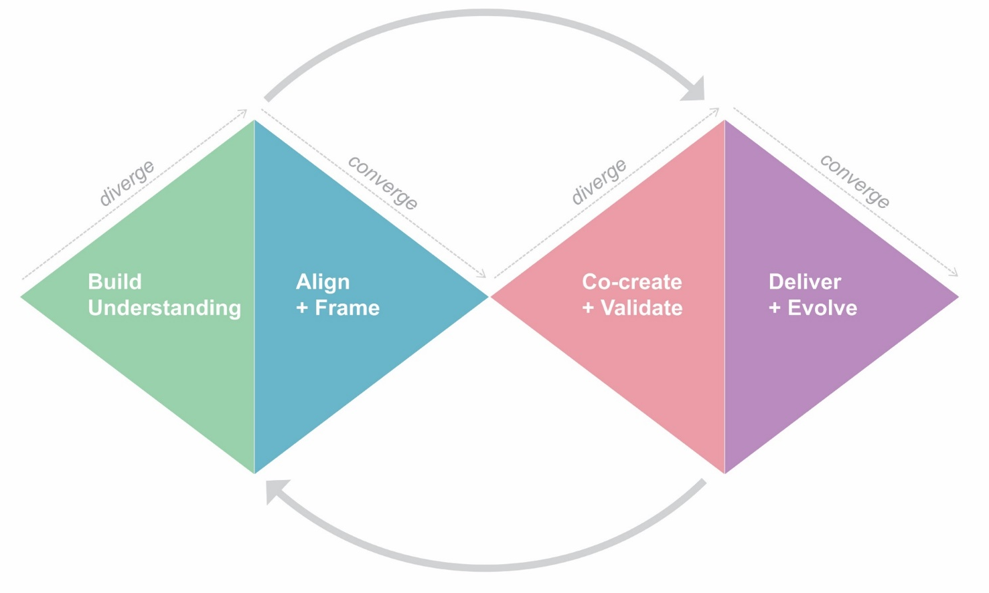

Four-Stage Framework
Build Understanding
Gather needs and insights
Understand the current state
Immerse collaborators in practitioner needs
Align + Frame
Frame problem to solve
Identify areas for improvement
Align collaborators on mission/vision for future state
Co-create + Validate
Co-create future experience
Validate strategic roadmap
Design detailed service blueprints
Deliver + Evolve
Prioritize products and features
Deliver product briefs to implementation teams
Continuously evolve products/services

Slide 16
One Public Health Vision
States
Territories
Localities
Tribes
CDC
National Public Health Partners
The Public
Using a human-centered design approach we will engage co-creators from across public health to align on a common vision and future state for case data exchange.
We are planning to do this through:
Internal interviews with program practitioners
External interviews with jurisdiction practitioners
Focus groups with health systems and providers
Ongoing feedback with national public health partners and federal partners
A series of in-person workshops where select
public health practitioners within each group can co-create the future state together
Federal Partners
Providers
Healthcare
Systems

Slide 17
OPHDST Values STLT Expertise
STLT leaders and practitioners are essential partners
in defining solutions that meet the needs of everyone.
CDC needs STLTs’ input and expertise to design and test services, processes, and solutions.
By working together, we can ensure there is transparency and visibility into the tech being built so that it meets practitioner needs.
The CSD Core team will reach out in the coming months for input as we help the CDC and our public health partners define the future state of case data exchange.

Slide 18








2024 Design Deliverables
Articulated problem statement that aligns all parties on the problem to solve
An aligned vision statement that is aspirational and helps us define our future state
High-level future
state map that defines the end-to-end experience we want to achieve
Strategic roadmap that defines the milestones over the coming years
Service blueprints that
define people, processes, and technology needed to implement the future state
Product Briefs needed to begin piloting and scaling solutions
Measurement strategy that defines clear metrics for internal teams
Insights and learnings to help evolve the Public Health Data Strategy

Slide 19
Upcoming milestones
February
March
April
May
June
July
Finish Program data collection
Recruit for STLT data collection
STLT data collection
+ current state
STLT data collection
+ current state
Co-create
future state with PH partners
Define 3-5 year strategy with PH partners
Begin E2E
Service Design

Slide 20
Questions
Questions?

Slide 21
Sharing NNDSS Power BI reports with jurisdictions
Michelle Lin, PhD, MSPH
Office of Public Health Data, Surveillance, and Technology

Slide 22
Public Health Data Strategy
Goal 3: Visualize and share insights to inform public health action
3.2 Data and visualizations available within 2–3 days (from 5–90+ days) for CDC programs and STLTs* since time of receiving case data at CDC for at least 1 nationally notifiable condition (i.e., viral hepatitis)
Success Metric: dashboards can be easily accessed and used for data analytics and to improve data quality.
Two dashboards are ready for STLT* users
22
*STLT: State, Tribal, Local and Territorial health departments

Slide 23
Topics
Two Power BI reports/dashboards to share with jurisdictions
  NNDSS* Analytics Dashboard
  NNDSS Data Element Completeness Dashboard
  *NNDSS: National Notifiable Diseases Surveillance System
23

Slide 24
Background
NNDSS Analytics for all conditions in MVPS*
  Case counts and rates
  By demographic characteristics and geographic areas
  Excluded: COVID-19, HIV, congenital syphilis, arboviral diseases, and Tuberculosis (TB)**
NNDSS Data Element Completeness
  Focused on HL7® Generic Version 2 (Gen V2) data
  Table view, time series view, CDC program view, MMG*** view
  Excluded: HIV, congenital syphilis, arboviral diseases, and TB
* Message Validation, Processing, and Provisioning System.
** The data on HIV, congenital syphilis, arboviral diseases, and TB are sent to CDC programs separately, so the line-level data are not available in MVPS. For COVID, data are partially sent to MVPS and we have developed a dedicated dashboard for COVID-19 only due to its high volume.
***Message Mapping Guide.
24

Slide 25
Purpose
Provide tools to improve data element completeness
Monitor case trends by comparing each jurisdiction’s data and regional/national data
Observe data between jurisdictions and CDC’s database
Produce quick case counts with stratifications
Supplement regularly published statistics on CDC’s website
Troubleshoot data transmission issues
Easy to use interface
  Reduce need for users to write code
  Used to support 2 emergency responses: COVID-19 and Mpox
25

Slide 26
Methods
Analytics: cases received from all formats; updated daily
Completeness: HL7® Gen V2 views; updated monthly
Access control
  Row-level security is set up for each jurisdiction user
Jurisdiction users log in Power BI Tenant via SAMS*
Quick start guides available on NNDSS Partners Site
*Secure Access Management Services
26

Slide 27
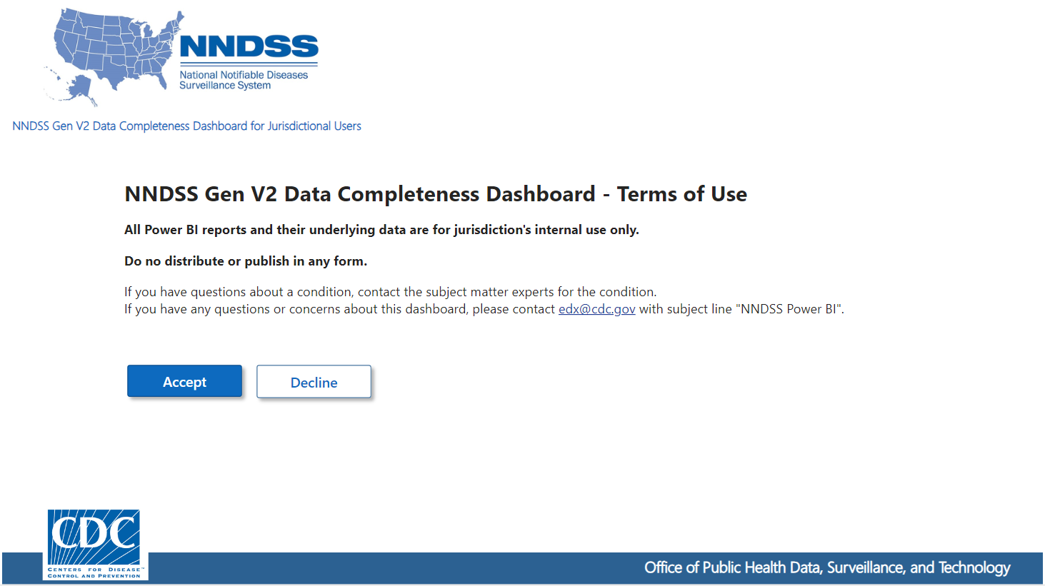
Slide 8
27

Slide 28
Dashboard #1
NNDSS Analytics

Slide 29
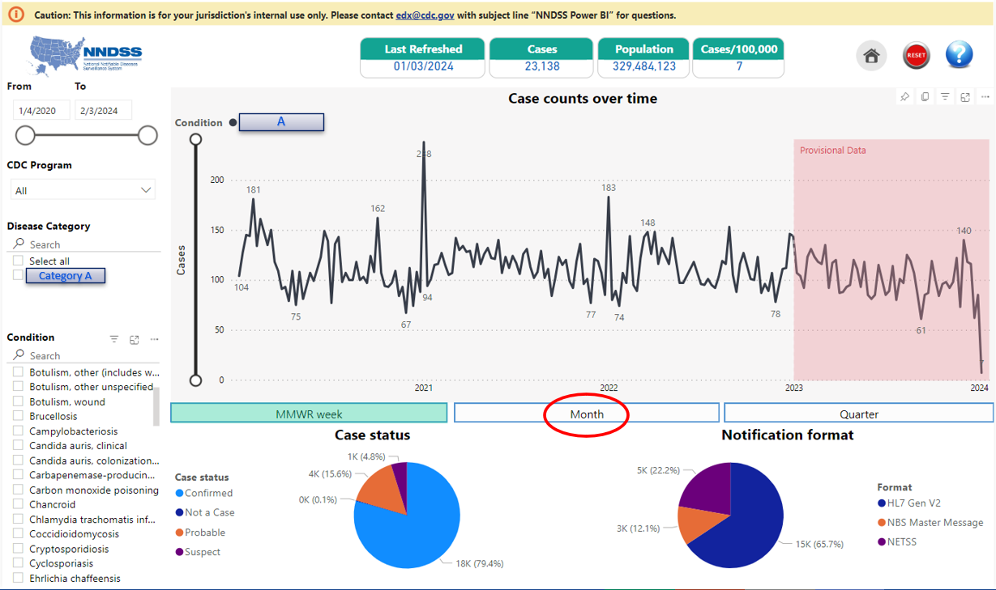
Slide 9
A
Category A
29

Slide 30
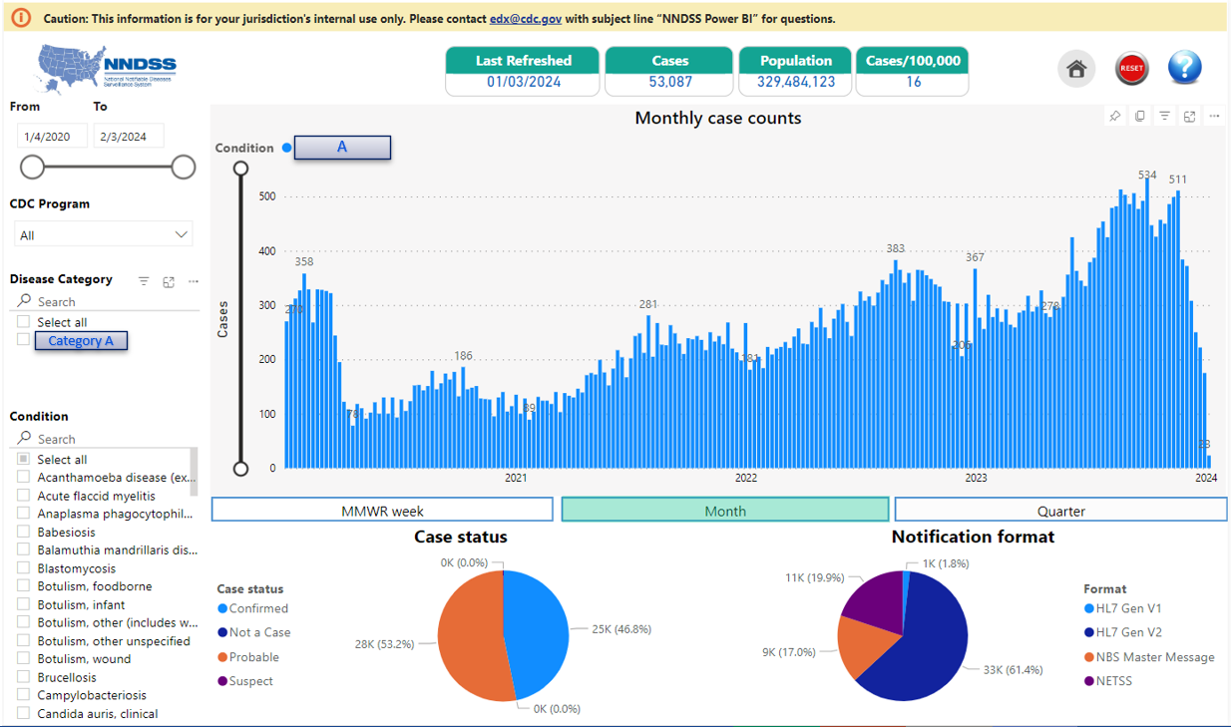
Slide 10
A
Category A
30

Slide 31
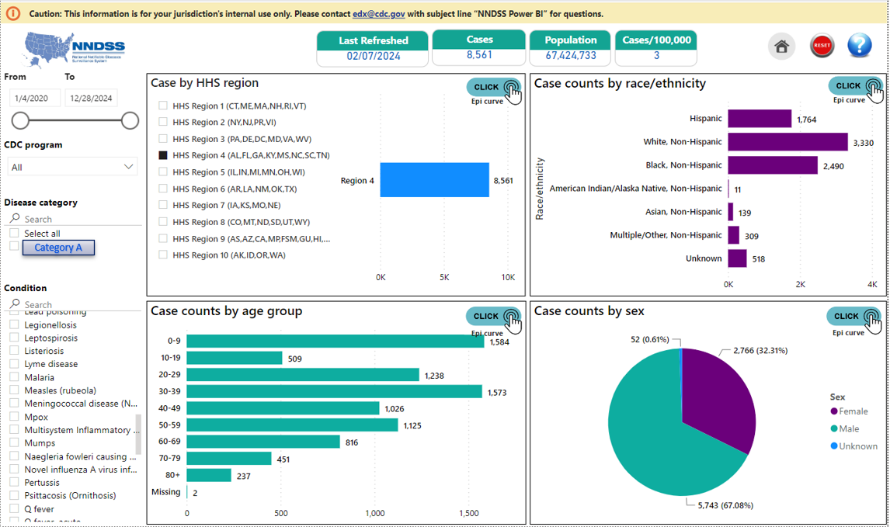
Slide 11
Category A
31

Slide 32
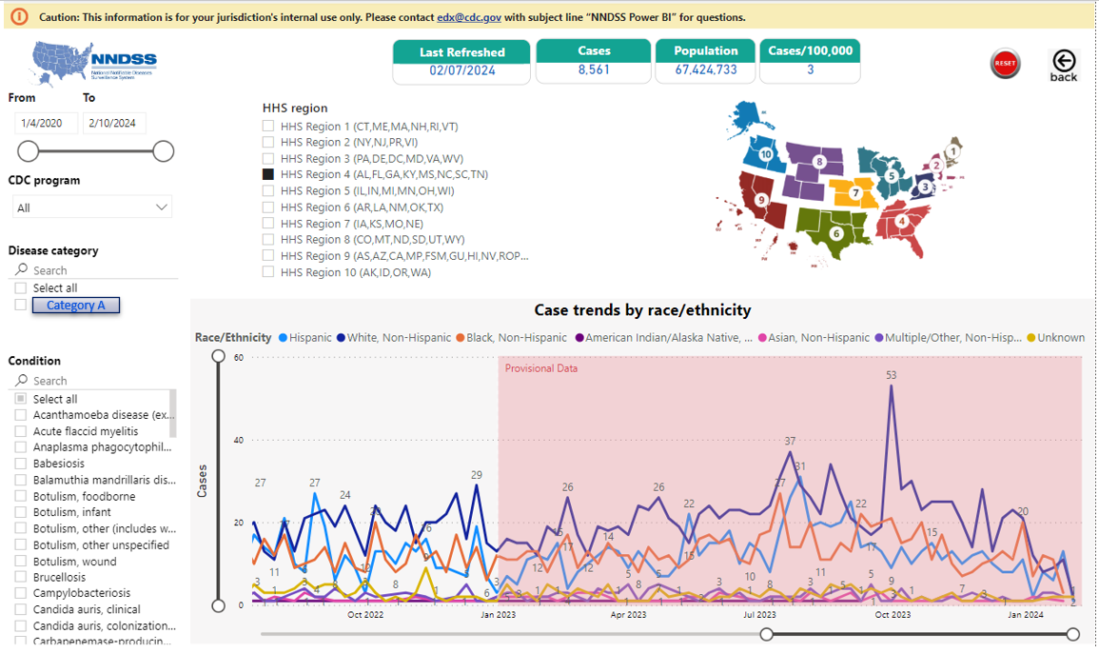
Slide 12
Category A
32

Slide 33
Slide 13
Category A
33

Slide 34
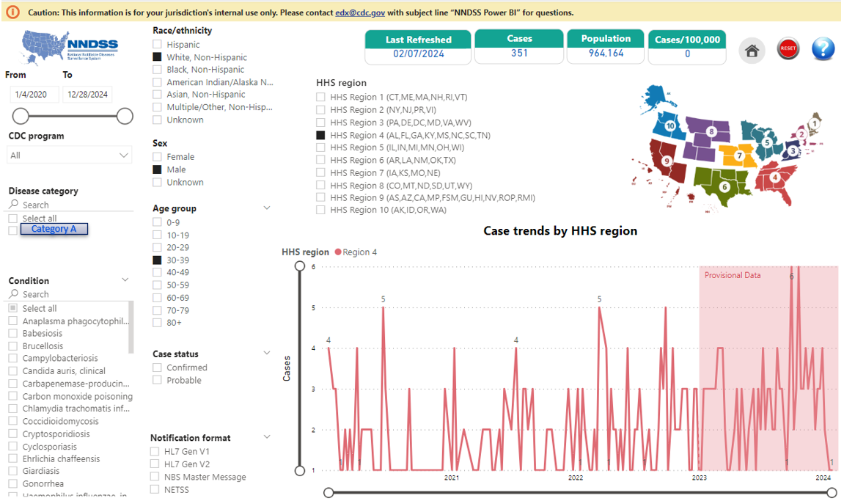
Slide 14
Category A
34
Notes:
Region level.

Slide 35
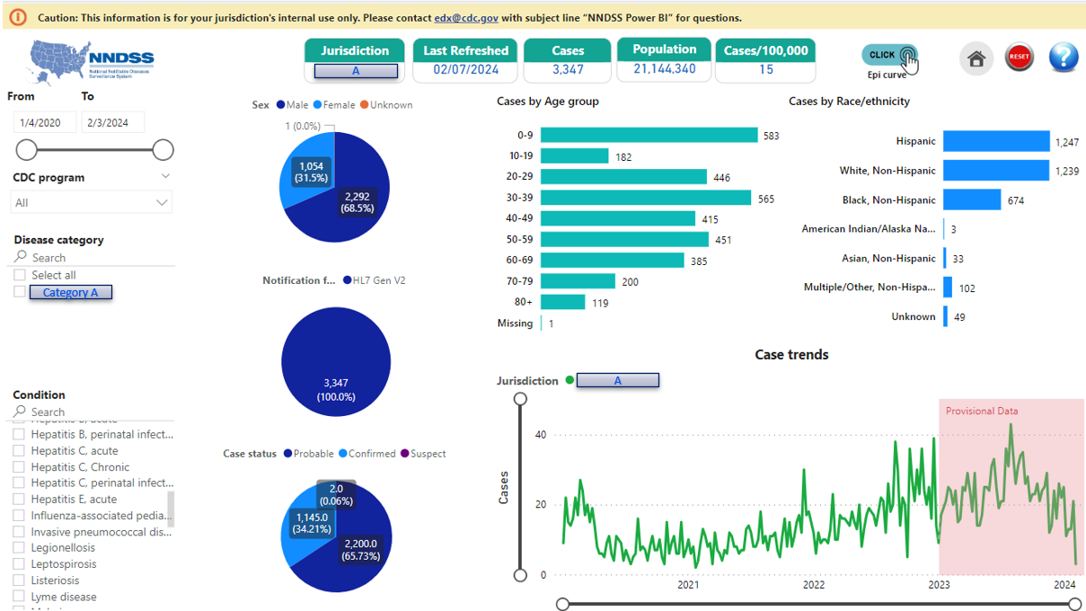
Slide 15
A
Category A
A

Slide 36
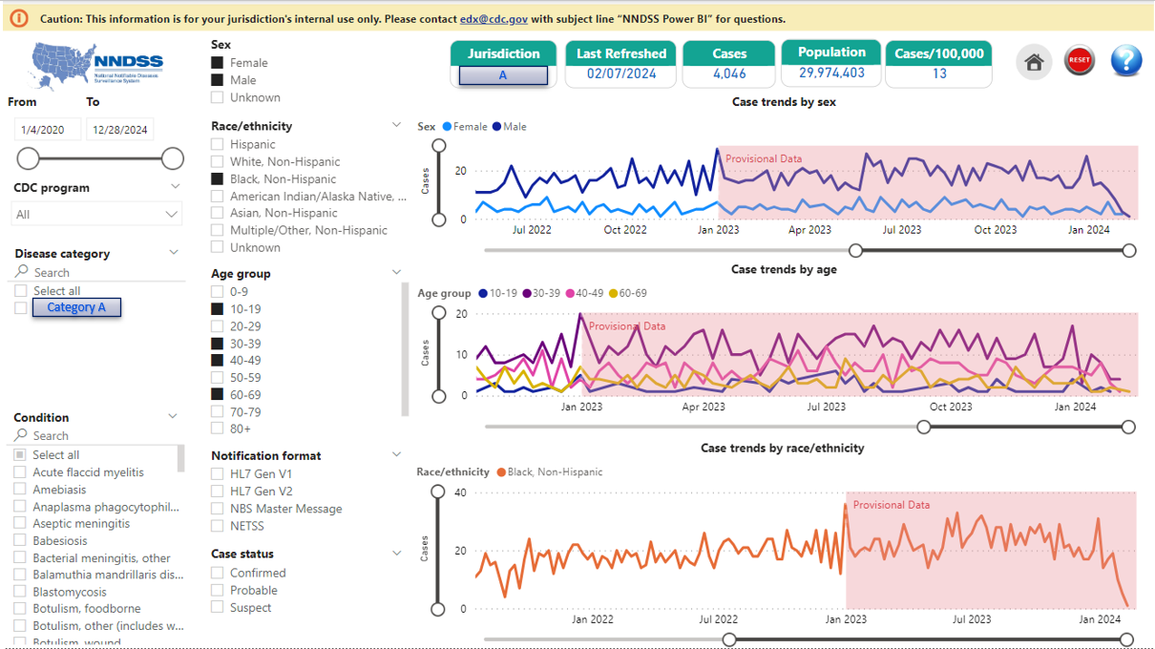
Slide 16
A
Category A

Slide 37
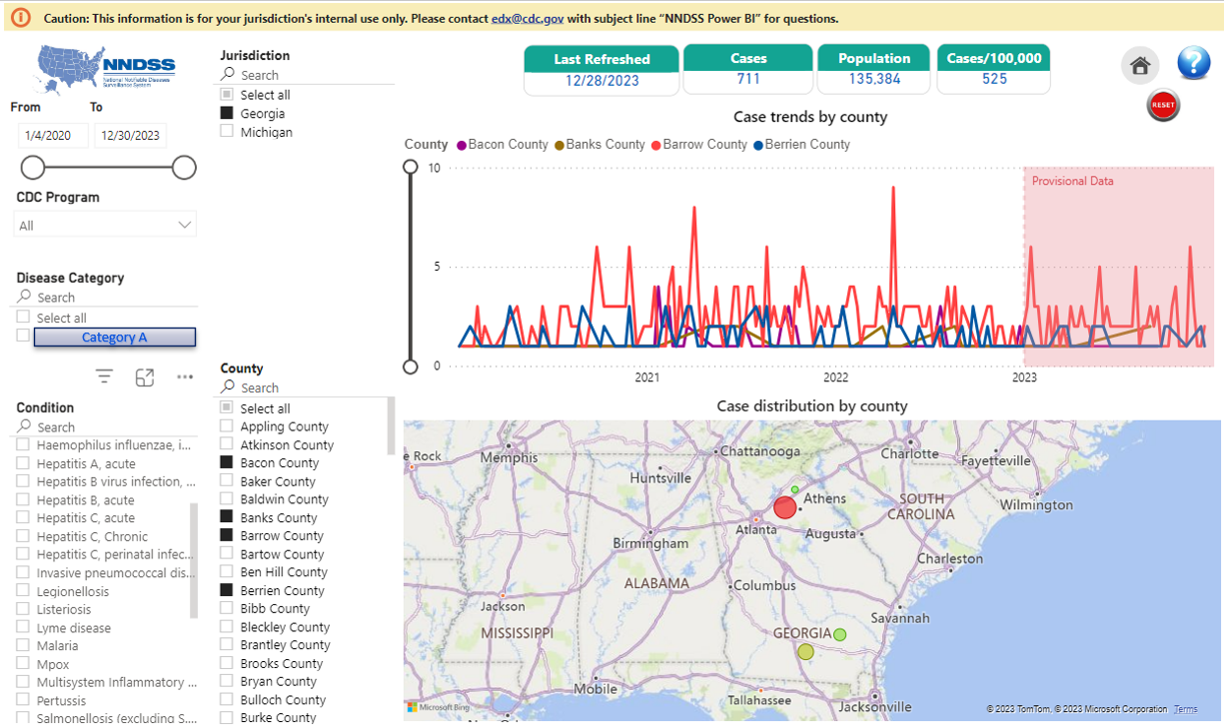
Slide 17
Category A
37

Slide 38
Dashboard #2
NNDSS Data Element Completeness (Gen V2)

Slide 39
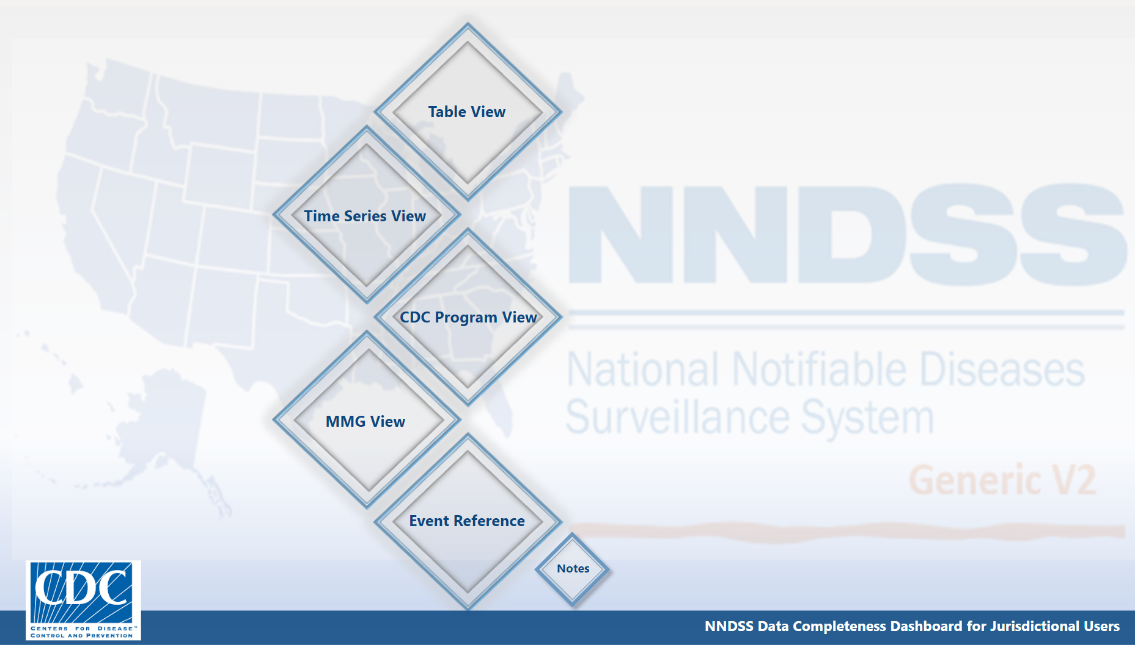
Data Element Completeness Homepage

Slide 40
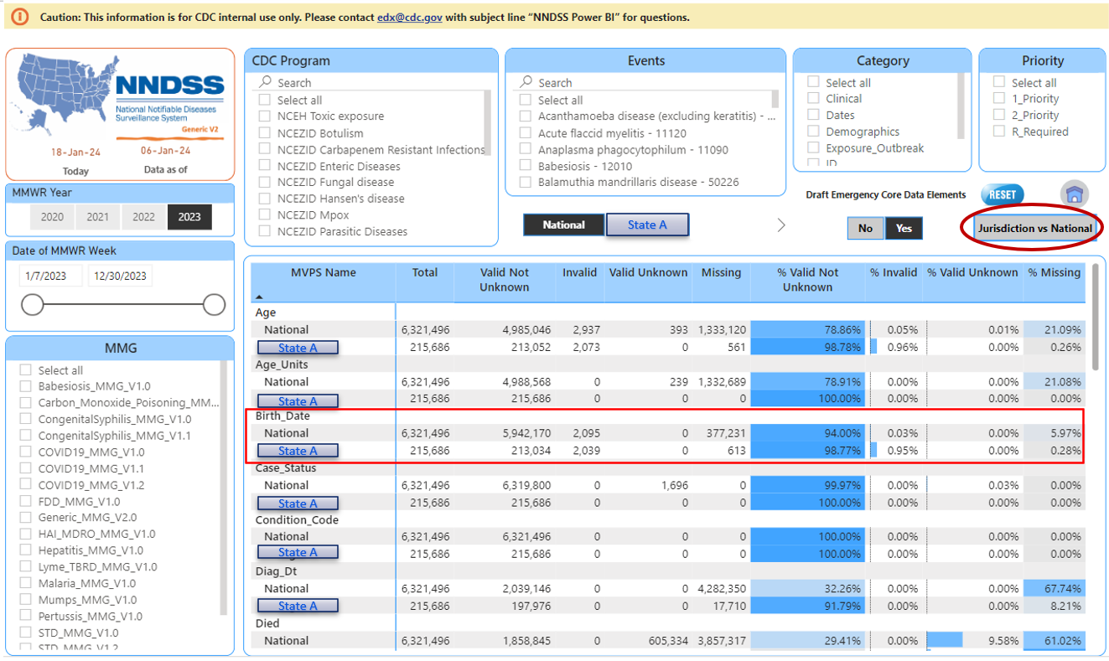
Table View
State A
State A
State A
State A
State A
State A
State A
40

Slide 41
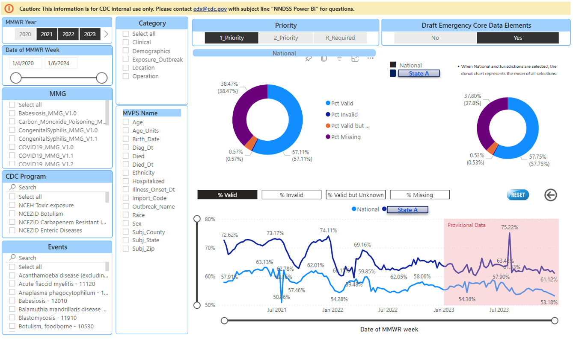
Comparison
State A
State A
41

Slide 42
Homepage

Slide 43
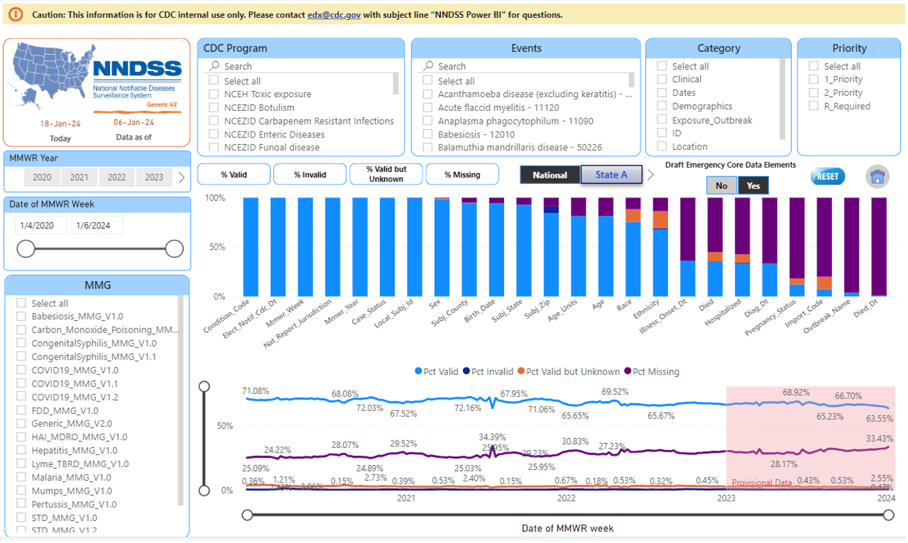
Time Series View
State A
43

Slide 44
Homepage again

Slide 45
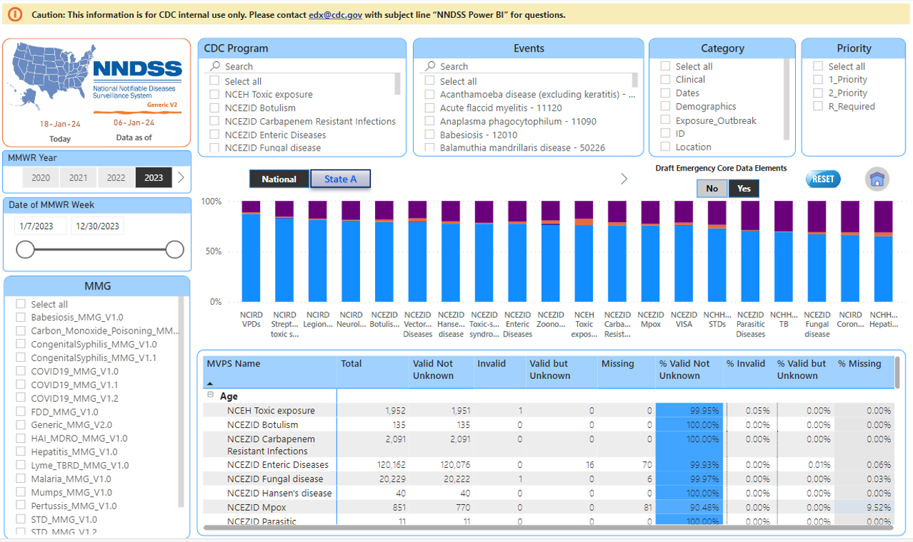
Program View
State A
45

Slide 46
Back to homepage

Slide 47
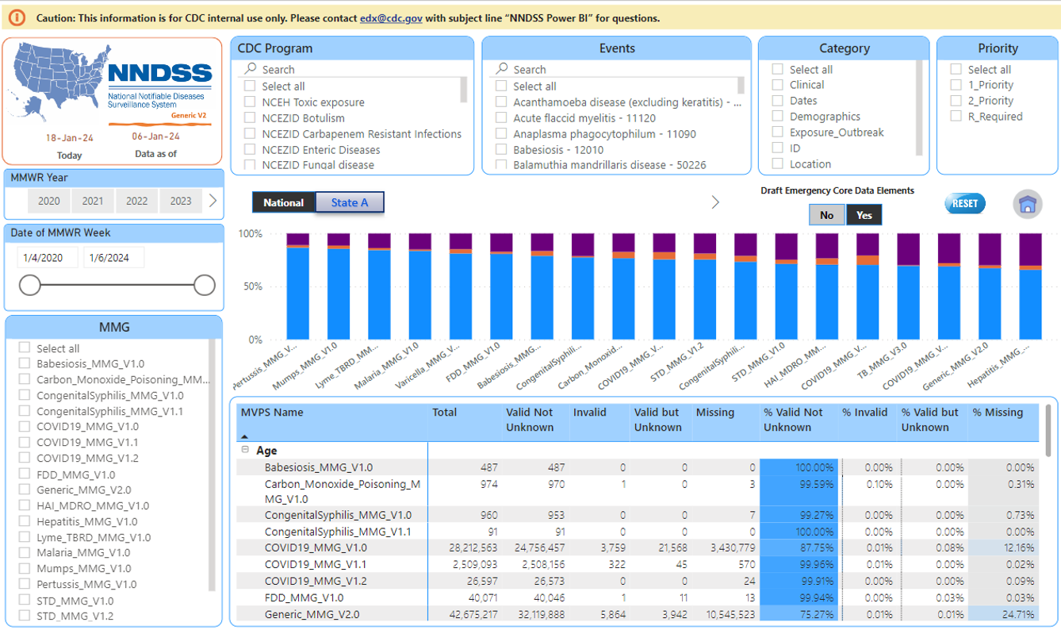
MMG View
State A
47

Slide 48
Homepage again another time

Slide 49
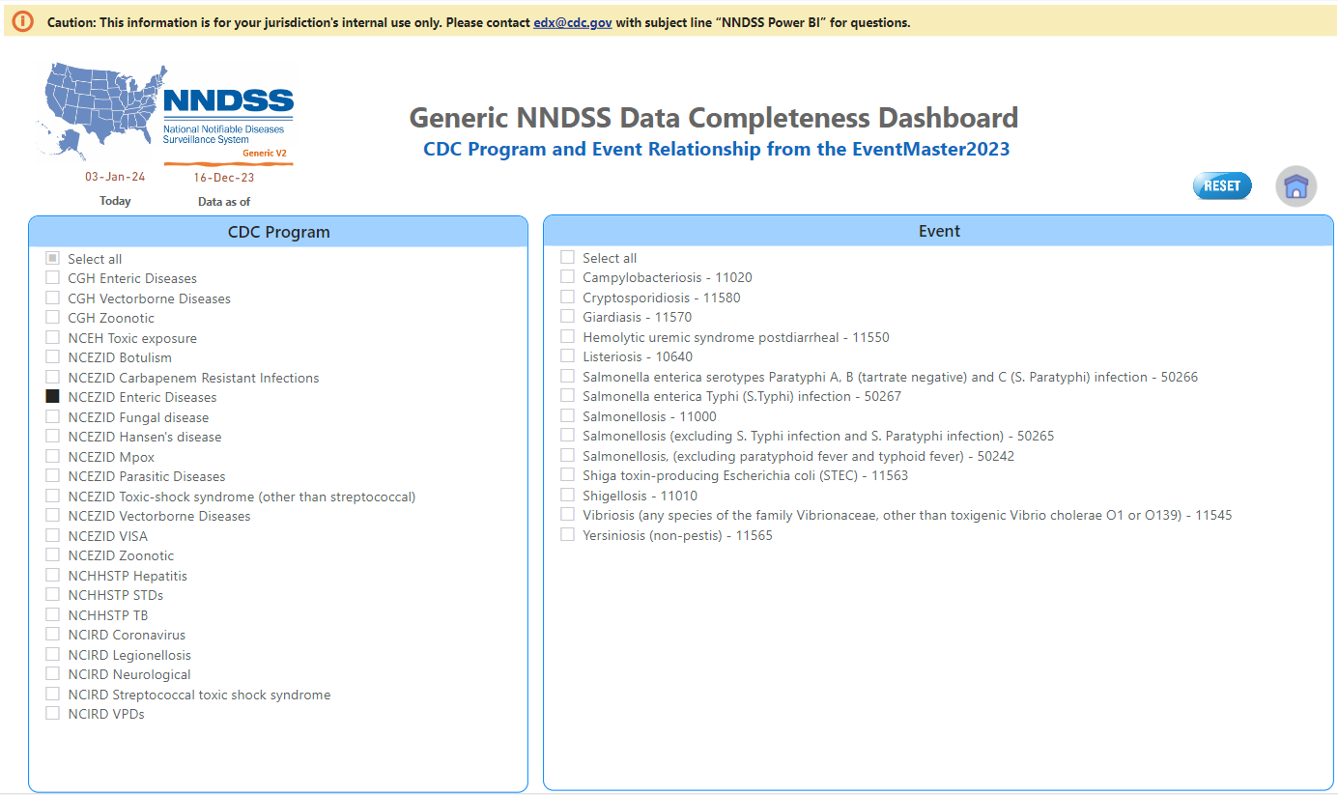
Reference table
49

Slide 50
Back to homepage again

Slide 51
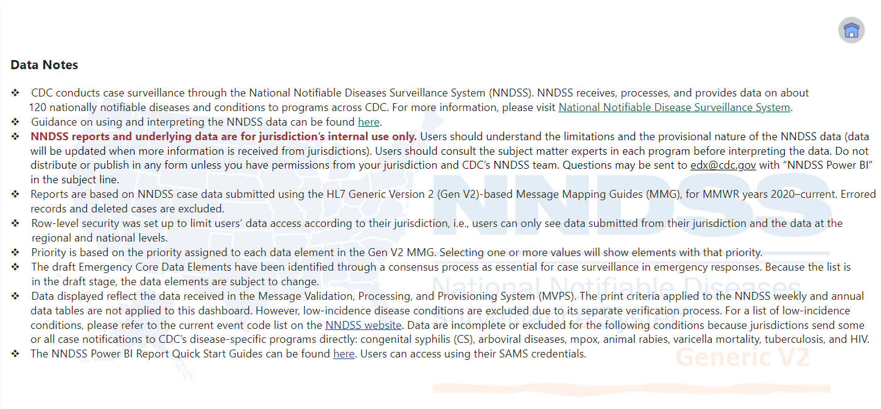
Notes page
51

Slide 52
Limitations
MVPS data only
  Data submitted directly to CDC programs are not included
Core data elements only
  Disease/condition-specific data elements are not included
Provisional data
Print criteria are not applied
Low incidence cases are not included
52

Slide 53
Summary
Sharing two Power BI reports/dashboards with jurisdictions
  NNDSS Analytics Dashboard
  NNDSS Data Element Completeness Dashboard (Gen V2 only)
53

Slide 54
Next steps
To request access, contact edx@cdc.gov with subject “NNDSS Power BI Access”
  Only users who are granted data access to their jurisdiction’s surveillance system should request access to these reports.
  In the email, please include the user’s name, jurisdiction name, work email address, which report you would like to access, and whether you currently have data access to your jurisdiction’s reportable disease surveillance system.
Questions or concerns? Email edx@cdc.gov with subject “NNDSS Power BI”
Future communications
  Case Surveillance News in March
  Office hours in March
  CSTE annual conference
54

Slide 55
Acknowledgements
Lynda Rowe
Jennifer Adjemian
Lisa Bastin
Anne McIntyre
Aaron Harris
Danielle Tack
Sara Johnston
Yusheng Zhai
Roseanne English
Paul McMurray
Claire Xu
Chris Watts
Keaton Hughes
Jonathan Zhong
55

Slide 56

Q & A

Slide 57




Thank you!
Next NNDSS eSHARE: March 19, 2024
Subscribe to
Case Surveillance News
Access NNDSS’ Technical Resource Center
Email edx@cdc.gov for technical help
Learn about case surveillance modernization

