Slide 1

NNDSS eSHARE October Webinar
October 17, 2023
Office of Public Health Data, Surveillance, and Technology

Slide 2

Agenda
NNDSS Updates and Announcements
Refresher: NNDSS Message Mapping Guide (MMG) Onboarding Process
Questions and Answers
2

Slide 3
NNDSS Updates and Announcements
Hang Nguyen, MPH
Office of Public Health Data, Surveillance, and Technology

Slide 4
Updated COVID-19 MMG
Value Set Updates
Version 16 is the most up-to-date version of the PHIN VADS COVID-19 Case Notification View. Changes include:
  6 values added to Vaccine Type (NND) (now v.13)
COVID-19 MMG v1.2: https://ndc.services.cdc.gov/mmgpage/covid-19-message-mapping-guide/
COVID-19 PHIN VADS Case Notification View (version 16): https://phinvads.cdc.gov/vads/ViewView.action?id=DD81C00A-4C69-EE11-81CE-005056ABE2F0
PHIN VADS Vaccine Type (NND) value set (version 13): https://phinvads.cdc.gov/vads/ViewValueSet.action?id=75012BE2-682B-43C5-8DD0-90FAE42640E2

Slide 5
Refresher: NNDSS MMG Onboarding Process
Hang Nguyen, MPH
Office of Public Health Data, Surveillance, and Technology

Slide 6
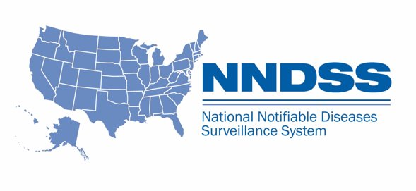
National Notifiable Diseases Surveillance System (NNDSS)
Collaboration between state, territorial, local, & tribal (STLT) jurisdictions; Council of State and Territorial Epidemiologists (CSTE); Association of Public Health Laboratories (APHL); and CDC.
About 120 nationally notifiable diseases and conditions are received by CDC, including infectious diseases, bioterrorism agents, sexually transmitted diseases, and noninfectious conditions.
Nearly 2.7 million cases are reported through NNDSS each year.
About 60 local, state, and territorial jurisdictions, consisting of about 3,000 public health departments, submit de-identified data to CDC.
6

Slide 7
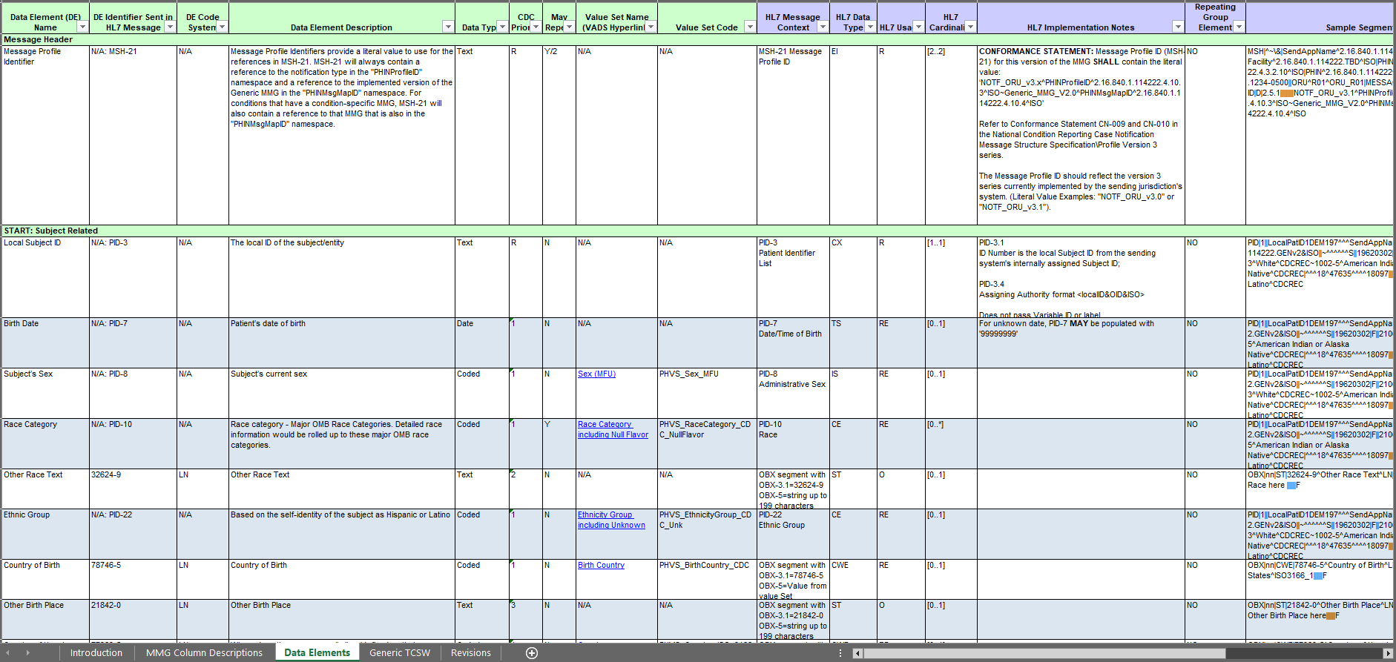
What is a Message Mapping Guide (MMG)?
Packages data from jurisdiction’s surveillance system into an HL7® case notification for CDC.
  Describes data content needed for HL7 case notification of national notifiable diseases or conditions.
  Includes description of each data element and attributes associated with each data element.
Improves collection, transmission, and analysis of data needed at the national level for public health surveillance.
  Provides opportunity to update data requested for a disease or condition when the epidemiology has changed over time.
(GenV2)
FHIR® is the registered trademark of Health Level Seven International and the use does not constitute endorsement by HL7.
The Flame Design mark is the registered trademark of Health Level Seven International and the use does not constitute endorsement by HL7.
7

Slide 8
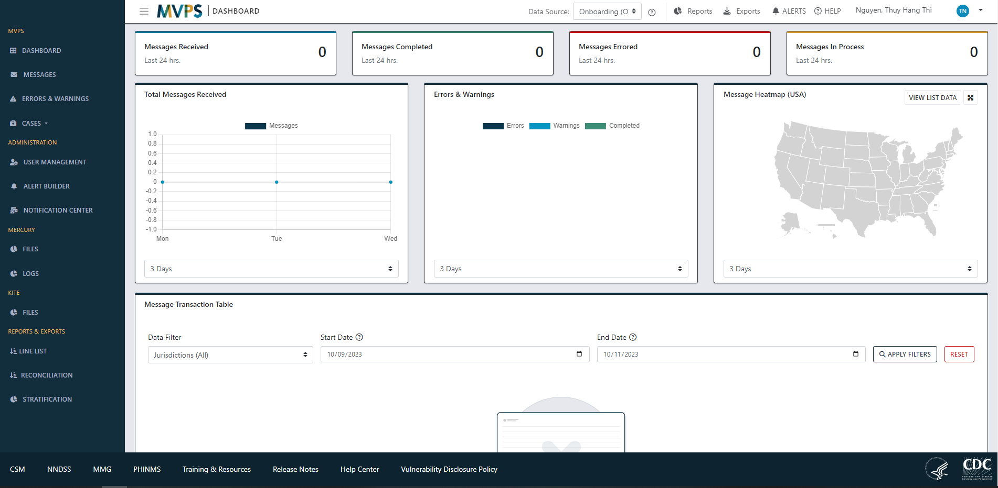
Message Validation, Processing, and Provisioning System (MVPS)
Software used to receive NNDSS data from jurisdictions.
  Validates and processes data.
  Provisions data to CDC programs for national surveillance efforts.
MVPS Onboarding & Production Portals:
  Jurisdictions view their submitted data and identify data quality issues.
8

Slide 9






NNDSS MMG Onboarding Terminology
Broadly used to include:
Discussing/Planning to adopt an MMG
MMG pre-onboarding activities
Onboarding MMG with CDC
Term: “Onboarding”
Jurisdictions
Term:
“Pre-Onboarding”
Discussing/Planning to adopt an MMG
MMG pre-onboarding activities
Term:
“MMG Implementation”
Term:
“Onboarding”
Onboarding MMG with CDC
CDC
9

Slide 10
MMG Implementation Overview
MMG Implementation Process
PRE-ONBOARDING
ONBOARDING:
3 Stages
ROUTINE NOTIFICATIONS
10

Slide 11
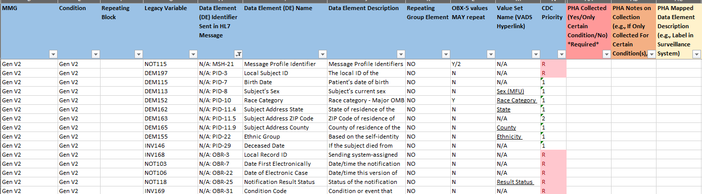
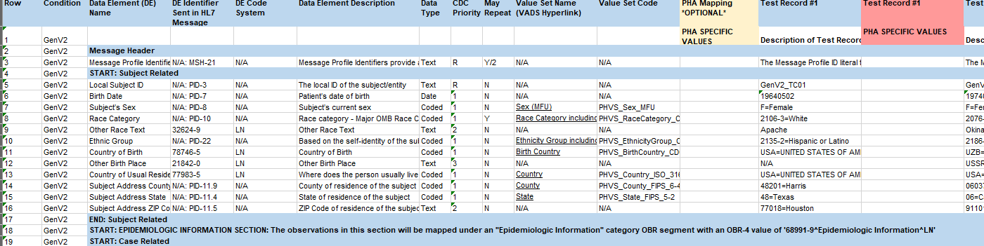
Pre-Onboarding:
Pre-onboarding Activities:
  Readiness Assessment – Assess technical infrastructure, test environment, transport, expertise, & resources; identify your team; and gather technical documents.
  Gap Analysis – Work with jurisdiction programs, compare MMG data elements against data in jurisdiction’s surveillance system. Utilize the implementation spreadsheet (IS). Provide IS to CDC program(s) for review and feedback prior to making updates to the system.
  Message Creation – Create data extract of MMG data elements, enter test cases into test environment and fill in the test case scenario worksheet (TCSW).
  Routine Creation for Transport – Develop transport route to send HL7 messages to CDC.
  Message Validation – Utilize METS tool to validate individual test messages.
(IS)
(TCSW)
11

Slide 12
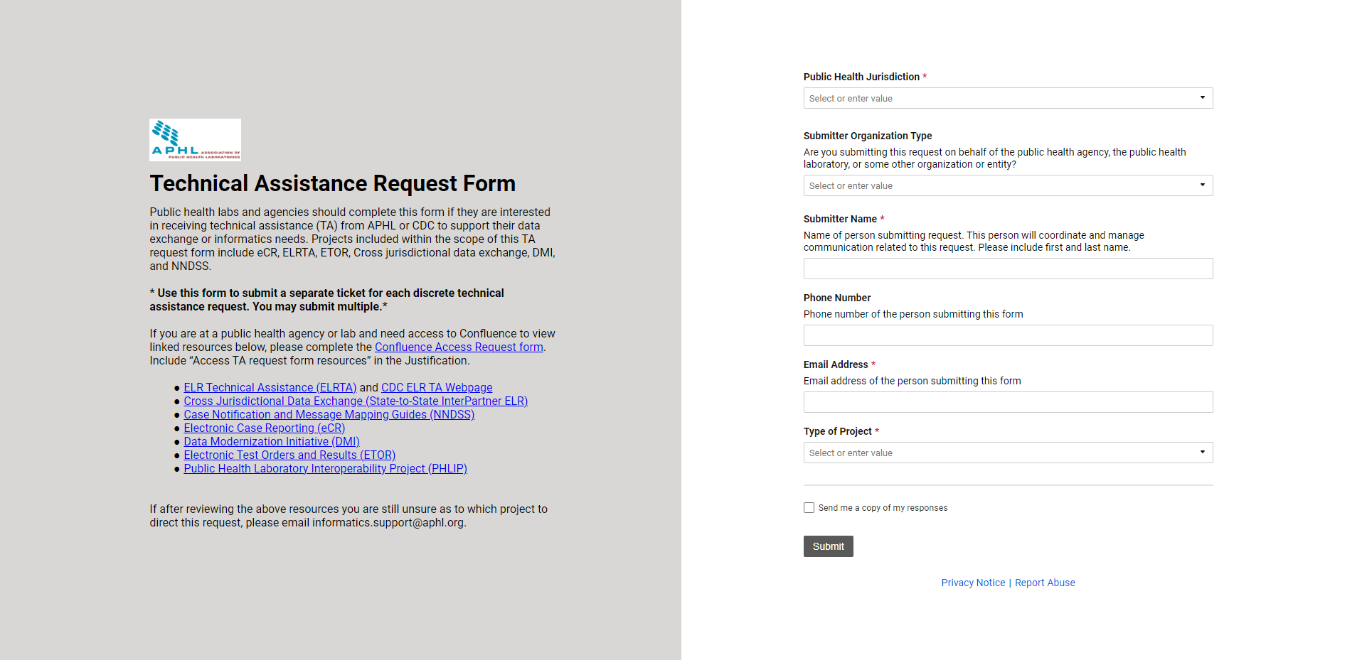
Pre-Onboarding (cont.):
Technical Assistance:
  APHL Cohorts and/or individual technical assistance.
    APHL reviews, validates, and provides feedback of test messages and artifacts.
Submit Onboarding package.
  Test case scenario worksheet (TCSW) & implementation spreadsheet (IS).
12

Slide 13

Onboarding Initiation:
Scenario 1: Jurisdiction utilizes APHL technical assistance during pre-onboarding, there will be a warm handoff from APHL to CDC.
Scenario 2: Jurisdiction independently pre-onboards the MMG, sends package to edx@cdc.gov with Subject: “[Jurisdiction name]: [MMG name] Onboarding Package”.
  Example: “MI: GenV2 MMG Onboarding Package”
  APHL still reviews, validates, and provides feedback of test messages and artifacts. Warm handoff from APHL to CDC.
CDC reviews onboarding package.
Onboarding kick-off call scheduled.
13

Slide 14
High-Level NNDSS Onboarding Overview
Jurisdiction Test Environment
MVPS Secure Onboarding Environment
Stage 1
Test Messages
Stage 2
Limited Production Messages
Jurisdiction Production Environment
MVPS Production Environment
Stage 3
Year-To-Date (YTD) Production Messages
14

Slide 15
High-Level NNDSS Onboarding Overview
Jurisdiction Test Environment
MVPS Secure Onboarding Environment
Stage 1
Test Messages
Stage 2
Limited Production Messages
Jurisdiction Production Environment
MVPS Production Environment
Stage 3
YTD Production Messages
15

Slide 16
Stage 1: Test Messages
Limited Production Messages
Year-to-Date
Pre-Onboarding
Test Messages
Routine Notification
Submit test messages to CDC’s MVPS Onboarding environment.
  CDC compares test messages with TCSW & IS, content & structural issues, and provide feedback.
Correct the messages and update system based on CDC feedback. Resubmit updated test messages to the MVPS Onboarding environment.
  CDC reviews corrected messages to confirm they are correct.
If no additional issues, jurisdiction will be approved to move forward to the Limited Production stage.
16

Slide 17
High-Level NNDSS Onboarding Overview
Jurisdiction Test Environment
MVPS Secure Onboarding Environment
Stage 1
Test Messages
Stage 2
Limited Production Messages
Jurisdiction Production Environment
MVPS Production Environment
Stage 3
YTD Production Messages
17

Slide 18
Stage 2: Limited Production
Limited Production Messages
Year-to-Date
Pre-Onboarding
Test Messages
Routine Notification
Submit limited production messages to CDC’s MVPS Onboarding environment.
  CDC reviews and validates messages. CDC provides feedback to jurisdiction.
Review CDC feedback, adjust mapping, and update system to resolve issue(s). Submit updated, corrected messages to the MVPS Onboarding environment.
  CDC reviews messages to confirm the messages are correct.
CDC approves limited production messages and jurisdiction moves forward to the Cutover to Production stage.
CDC schedules a Cutover to Production call with jurisdiction.
18

Slide 19
High-Level NNDSS Onboarding Overview
Jurisdiction Test Environment
MVPS Secure Onboarding Environment
Stage 1
Test Messages
Stage 2
Limited Production Messages
Jurisdiction Production Environment
MVPS Production Environment
Stage 3
YTD Production Messages
19

Slide 20
Stage 3: Year-to-Date (YTD)
Limited Production Messages
Year-to-Date
Pre-Onboarding
Test Messages
Routine Notification
Compile and submit production HL7 YTD messages to CDC’s MVPS Production environment.
  Depending on MMG, expect potential discussions about submitting legacy YTD.
CDC will complete the following:
  Verify case counts.
  Check errors & major warnings and provide feedback.
Jurisdiction will review & correct identified issues, then submit corrected messages.
  CDC reviews corrected messages to confirm if they are correct.
CDC approves YTD messages. Onboarding complete!
  Official approval email sent out to jurisdiction.
Note: CDC considers jurisdiction as “in production” for an MMG when HL7 messages, using the appropriate MMG header, are received in the MVPS Production environment.
20

Slide 21

Routine Notification
Limited Production Messages
Year-to-Date
Pre-Onboarding
Test Messages
Routine Notification
Best Practices & Next Steps:
  Submit messages as close to real-time as possible (e.g., daily or multiple times a day).
  Once case meets case definition, send a message to CDC. If there are any updates to the case, submit updated message.
  Monitor regularly for value set updates. CDC may update value sets at any time.
  Check the MVPS production portal daily to ensure submitted messages were received and errors are corrected.
If any issues with MVPS or METS are found, contact edx@cdc.gov.
21

Slide 22

Q & A
22

Slide 23




Next eSHARE
Thank you!
Next NNDSS eSHARE: December 12, 2023
Subscribe to
Case Surveillance News
Access NNDSS’ Technical Resource Center
Email edx@cdc.gov for technical help
Learn about case surveillance modernization

Slide 24
Appendix

Slide 25
Helpful Links
HL7 Message Mapping Guide Implementation Process | CDC
  Guidance on the three phases of MMG implementation: Pre-onboarding, Onboarding, and Routine Notification.
Technical Assistance Request Form (smartsheet.com)
  Fill out form to request technical assistance.
NBS Central (cdcnbscentral.com)
  This is for NBS jurisdictions. Submit a ticket for guidance from the NBS team.
METS - Message Evaluation and Testing Service | CDC
  Validation tool for individual test messages.
For any additional questions related to MMGs and Onboarding, email edx@cdc.gov.
25

