Slide 1

NNDSS eSHARE August Webinar
August 22, 2023
Office of Public Health Data, Surveillance, and Technology

Slide 2

Agenda
NNDSS Updates and Announcements
Jurisdiction Panel: Building Blocks for the Data Modernization Initiative
  Virginia and Los Angeles County
Questions and Answers

Slide 3
NNDSS Updates and Announcements
Michele Hoover, MS
Office of Public Health Data, Surveillance, and Technology

Slide 4
State Panel: Building Blocks for the Data Modernization Initiative
Michele Hoover, MS
Office of Public Health Data, Surveillance, and Technology

Slide 5
Jurisdiction Panelists
Virginia Department of Health
  Rebecca Early
Los Angeles County Department of Public Health
  Rebecca Fisher

Slide 6
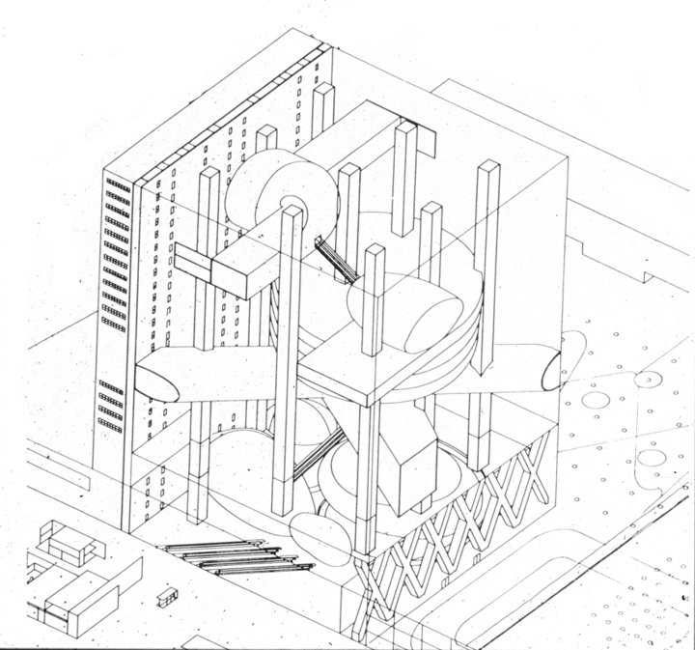
Topics for Discussion
Experience with Building Blocks for the Data Modernization Initiative
Lessons Learned

Slide 7
DMI Building Block: The Data Pipeline
Virginia’s Experience
Rebecca Early, MPH, DIIS Director
Jrebecca.Early@vdh.virginia.gov
August 22, 2023
Virginia Department of Health
Division of Informatics and Information Systems (DIIS)

Slide 8
Background
CDC’s Data Modernization Initiative: create a modern public health surveillance system
Fall 2021: Discussions with CDC on partnering on ‘Common Data Model’
Defined the current state
  Challenges, limitations, and how data feeds worked
  VDH, CDC, and the United States Digital Service (USDS)
Objective: data model's ability to serve as a foundation for “next-gen” public health systems
  VA wanted to provide opportunity to think about the data, independent of systems

Slide 9
Pilot Use Case
Fall 2021: Discovery sessions with CDC and United State Digital Service (USDS)
Breakthrough COVID-19 infections was selected as use case
  People who are vaccinated who still get COVID-19
Virginia activities – addressed challenges of sharing public health data
1/2022 – 9/2022: Pipeline of raw HL7 messages: ELR, eCR, VXU
  Data is from 18 day period

Slide 10
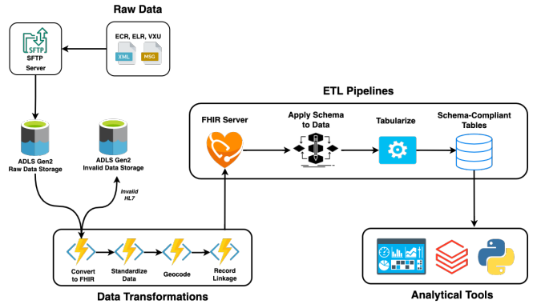
Prototype Architecture

Slide 11
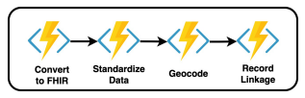
Building Blocks / Services
= Services
Convert to FHIR
Standardize Data
  Name & Phone #
    International names & non-English characters
  Timestamp normalization
  Address
Geocoding
  Utilized SmartyStreets
Record Linkage - Deterministic
  Address – Name – DOB → Hashed ID

Slide 12
Conclusions and Limitations
Benefits:
  Prototype: customizable, cloud-based pipeline, standardized, deduplicated, geocoded – designed to save time and manual effort
  Increase processing speeds and ‘source of truth’ for incoming data
Limitations:
  Relatively small sample size
  COVID-19 data focus (for eCR, and majority of ELR and Vax)
  Pipeline not integrated into Production systems with existing data or tools
  Promise of this solution rests on a myriad of services that need to be subscribed\configured, assumes complementary architecture, relies on future development in the open-source arena and standardization

Slide 13
Conclusions and Limitations continued
Great collaboration
Created awareness that incoming, standards-based public health data is not as simple (messier) to utilize as thought
Somewhat different perspectives: provide product vs. proof of concept
Incoming data by itself lacks utility without case investigation data
Need to validate assumptions in the model, e.g., use of geocoding tools, and ensure configurable steps (e.g., local tools)
COVID Breakthrough not actively researched
Notes:
Standards-based data was messier than collaborators were expecting
Standards based data, however – telephone numbers and timestamps
Somewhat different perspectives:
USDS targeted to provide a product
Proof of concept
Data by itself lacks utility without case investigation data; i.e., a new positive lab doesn’t equal a new case.
The incoming data are clinical versus public health data that ultimately creates surveillance data
Assumptions: Use of geocoding platform (SmartyStreets) – validate assumptions like use of geocoding tools
COVID Break-through
Use case was not investigated
Deaths
Duplication

Slide 14
Questions & Future
Which Building Blocks would be most valuable to transition into a product?
How can Building Blocks be accessible to STLTs while ensuring a unified and scalable approach for adoption?
What sort of metrics define success for a Building Block? (e.g., adoption rate, efficiency improvements, etc.)
What is the best way to create a collaborative, open-source community to continually develop, support, and iterate on these Building Blocks?

Slide 15
Acknowledgements & Contact Info
VDH Partners:
Co-Author: Tim Powell, J. Michael Consulting
Sara Gowda, OIM Messaging Manager
Prabhat Kumar, Tech Project Manager
Merylyn Huitz, DIIS Messaging Manager
Dheeraj Katangur, Enterprise Architect
Anup Srikumar, Acting CPHI Director
CDC and USDS:
Celeste Espinoza
Molly Murray
Bryan Britten
Jeremy Zitomer
Mike Judd
USDS and CDC Teams

Slide 16

Data Integration
Building Blocks
(DIBBS)
Pilot Project
LA County Department of Public Health
Centers for Disease Control and Prevention
United States Digital Services
Skylight Digital

Slide 17

USDS and LA County DIBBS Pilot Goals
eCR data is available in LA County DPH electronic disease surveillance system (IRIS) to aid in investigations and case management
LAC has an ingestion pipeline for HL7 data including eCR, ELR, and ADT that handles cleaning, transformation, linkage, deduplication, and that scales with other data streams
LA County DPH gains more experience and build internal capacity with cloud services, modern development tools, and agile product development approaches

Slide 18

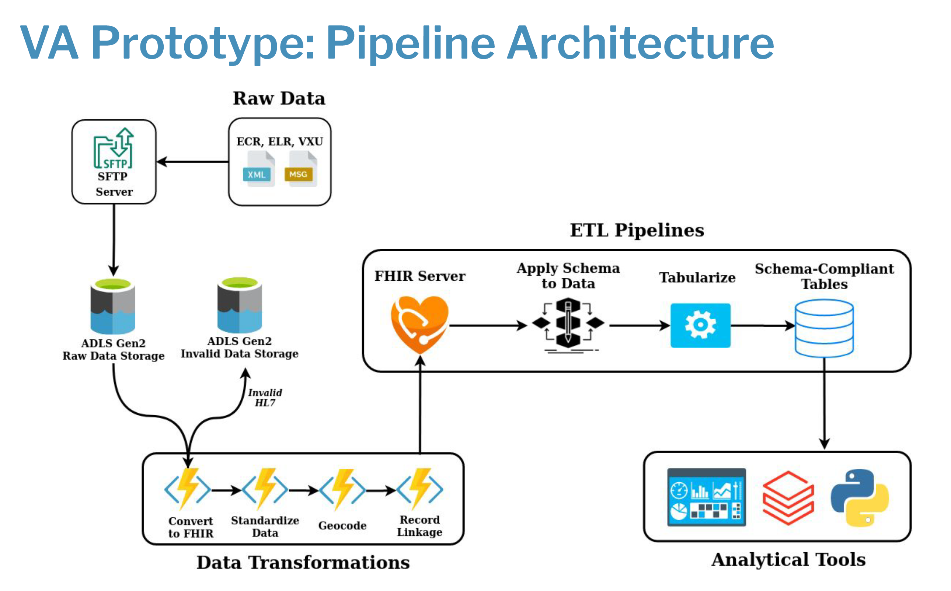
V

Slide 19
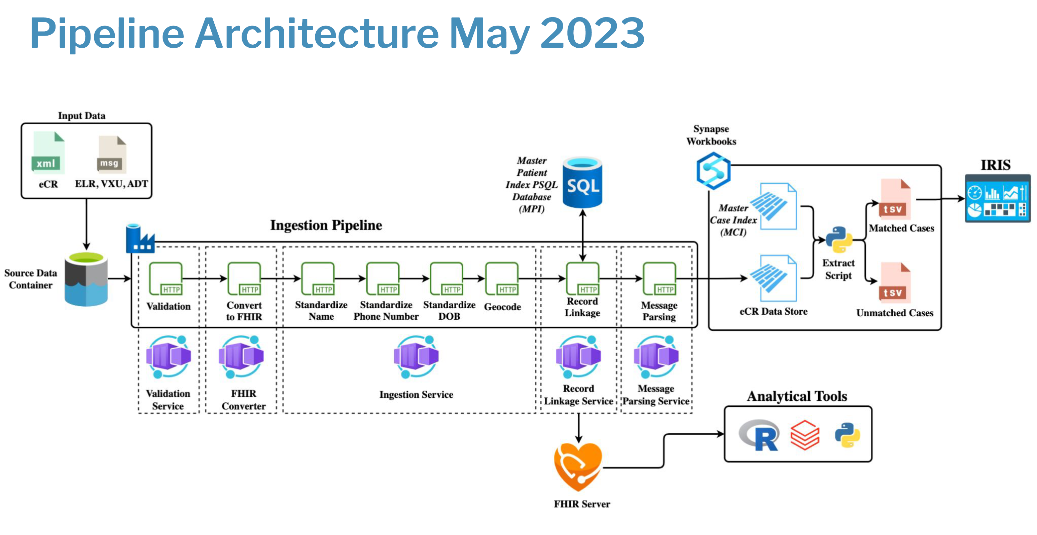
P

Slide 20
eCR Conversion to FHIR
● The Microsoft FHIR Converter’s CCDA templates weren’t extracting all the data needed from eCR messages.
● As a result, we added custom templates to ensure when the eCR (XML) messages are converted to FHIR, using the HL7 standards for eCR, providing the data
LAC needed.
Validation
● Created a new validation building
block, and developed a validation schema
for eCR messages in partnership with
LAC.
● This validation checks for the presence
and proper formatting of certain fields
before passing the message down to the
rest of the pipeline.
Ingestion
● The name standardization endpoint was
updated to provide better inputs for
record linkage.
● Date of birth standardization was also
incorporated into the starter kit pipeline.
Record Linkage
● The building block developed with VA was
rudimentary, relying on exact matches for patient
name and date of birth.
● The algorithm developed in LA is significantly more advanced, incorporating information like address and MRN.
● The algorithm implementation also advanced
significantly, using fuzzy matching as well as
optimizations like multiple data passes, blocking, and multi-value querying (e.g., we can match someone who changed their name or moved).
● The building block developed for LA also supports algorithm customization to increase use-case flexibility.

Slide 21
Record Linkage Building Block
● Bundling the MPI and record linkage algorithm into a single building block to deliver a standalone record linkage service.
○ Developed an API to act as a
user-friendly entry point to this service.
Master Person Index (MPI)
● For the new iteration of record linkage to work, needed a source of truth that contained all patient and person records for LA.
● Added a Postgres database to serve as our MPI.
● The MPI consists of two simple tables that allows storage of unmodified patient records for downstream use, while also maintaining links to deduplicated Person entities.
● This MPI is seeded routinely with person data from IRIS and seeded with real-time data moving through the pipeline.
Message Parsing Service
● Necessary for IRIS integration and used to populate the eCR data
store.
● Given a schema, will extract the desired
fields from a FHIR bundle and return them
as JSON.

Slide 22

Pilot Extension
-Ongoing QA and product research testing using production data
August 2022
December 2022
January 2023-February 2023
March 2023-April 2023
May 2023
June 2023-August 2023
Kick off
-Pilot Planning
-Initial Discovery
Extensive Discovery
-Interviews
-Guided Group Discovery
Pipeline Deployment in LA County Azure
-Infrastructure and Starter Kit
eCR Validation MVP
-validate eCR based on LAC specification for 50 priority fields
Record Linkage Algorithm MVP
-Replicate and iterate on LAC patient linkage algorithm
eCR to FHIR Conversion
-FHIR conversion for LAC specification for 50 priority fileds
eCR Parsing service MVP
-Parse and write to external data store
External data store MVP
-Create data store outside of FHIR server
Integration Engine MVP
-End-to-end processing raw CDA to EDSS ingestion format
QA testing
-Process real eCRs end-to-end
Handoff
-Code freeze May 19

Slide 23


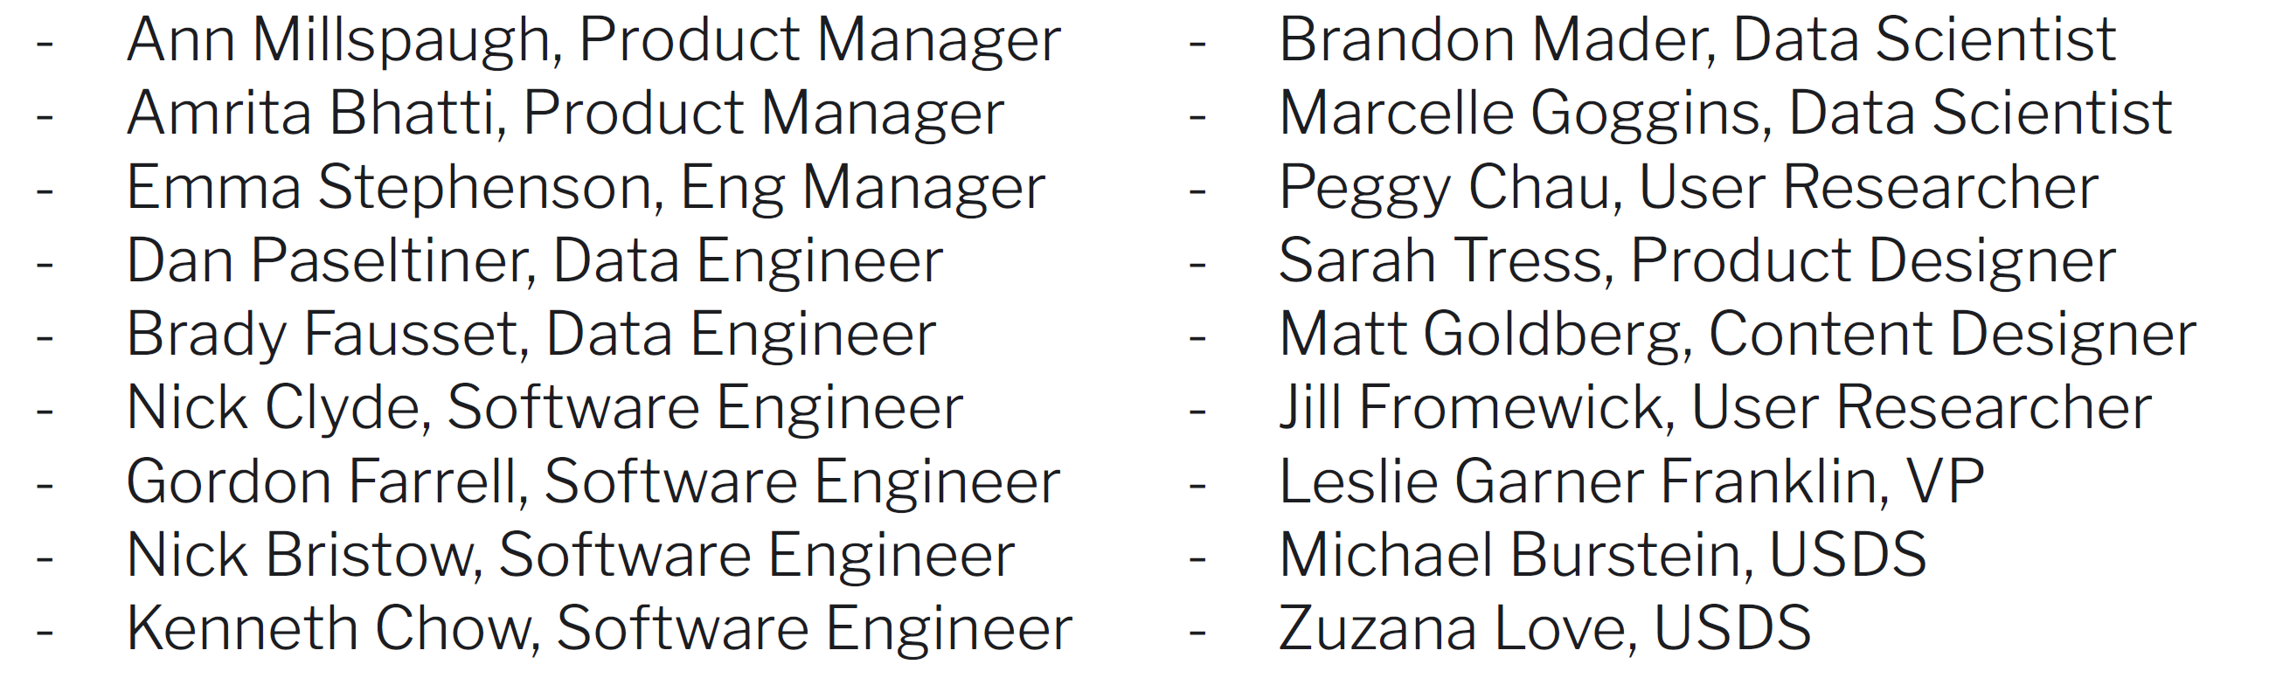
Questions?
Rebecca Fisher, MPH MA
Chief Epidemiologist, Acute Communicable Disease Control
rfisher@ph.lacounty.gov
LA County DPH Team
USDS and Skylight Digital DIBBS Team

Slide 24

Q & A

Slide 25




Next eSHARE
Thank you!
Next NNDSS eSHARE: September 19, 2023
Subscribe to
Case Surveillance News
Access NNDSS’ Technical Resource Center
Email edx@cdc.gov for technical help
Learn about case surveillance modernization

