Slide 1

NNDSS eSHARE July Webinar
July 18, 2023
Division of Health Informatics and Surveillance

Slide 2
Agenda
NNDSS Updates and Announcements
Highlights from 2023 Council of State and Territorial Epidemiologists (CSTE) Annual Conference
Questions and Answers

Slide 3
NNDSS Updates and Announcements
Michele Hoover, MS
Office of Public Health Data, Surveillance, and Technology

Slide 4
Agenda | eSHARE 7.18.23
Overview of 2023 CSTE Annual Conference – Becky Lampkins
Recap of S/I Conference Workshop – Taylor Pinsent, Megan Tompkins
Review of Approved 2023 CSTE Position Statements - Meredith Lichtenstein Cone
Highlights from the Surveillance/Informatics Track – Becky Lampkins
CSTE Workgroups and Projects –Becky Lampkins, Taylor Pinsent, Shaily Krishan, Megan Tompkins
2023-2024 Surveillance/Informatics Priorities – Annie Fine, Gillian Haney
Q&A

Slide 5
Overview of 2023 CSTE Annual Conference - Becky Lampkins

Slide 6

CSTE Annual Conference – Epidemiology Elevated

Slide 7
Attendance and Sessions
Attendance
2,690 registered attendees
STLT Health Agency: 66%
Federal Agency: 9%
Student: 2%
Other: 23%
Conference Workshops
Sunday, June 25
17 Workshops + State Epi Forum
Conference Sessions
Mon-Wed, June 26-28
3 Plenary Sessions
Jonathan M. Mann Memorial Lecture
7 Session Tracks
  125 Breakout Sessions
  87 Roundtables
  ~170 Posters
Networking Opportunities/Receptions
Position Statements

Slide 8

2023 CSTE Annual Conference Sponsors

Slide 9
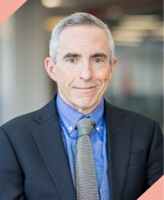
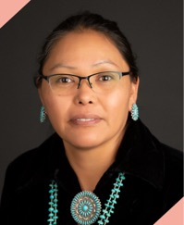
Monday’s Plenary Speakers
Andrew T. Pavia, MD is the George and Esther Gross Presidential Professor and Chief of the Division of Pediatric Infectious Diseases and adjunct Professor of Medicine at the University of Utah. He also serves as Director of Hospital Epidemiology at Primary Children's Medical Center and Associate Director of the Antimicrobial Stewardship Program. He was voted “Utahn of the year” by the Salt Lake Tribune for his efforts to advocate for children during the COVID-19 pandemic.
Jill Jim, PhD, MPH, MHA is an enrolled member of the Navajo Nation and former member of the Biden-Harris Transition COVID-19 Advisory Board. Her career has focused on prevention of chronic diseases and addressing healthcare and health disparities among Native Americans. She has served urban and tribal communities in non-profit, state, federal agencies and most recently tribal government as an Executive Director for the Navajo Department of Health.

Slide 10
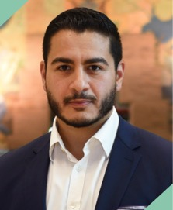

Tuesday’s Plenary Speakers
Abdul El-Sayed, MD, DPhil is a physician, epidemiologist, and public servant. He serves as director of Wayne County’s (MI) Department of Health, Human & Veterans Services and health officer for the county. He holds academic appointments at the intersection between public health, public policy, and politics at the University of Michigan Gerald R. Ford School of Public Policy, the FXB Center for Health & Human Rights at the Harvard T.H. Chan School of Public Health, Wayne State University, and American University.
Ben Abbott, PhD is a professor of environmental science and sustainability at Brigham Young University. He works on renewable energy, climate feedbacks, aquatic ecosystems, wildfire, and air quality. After finishing his Ph.D. in 2014, he worked as a Marie Curie postdoctoral fellow at the French National Science Foundation (CNRS). While in western France, he studied the effects of agriculture and urbanization on aquatic and marine ecosystems.

Slide 11
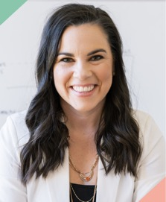
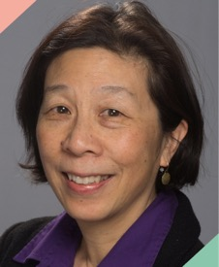
Wednesday’s Plenary Speakers
Katelyn Jetelina, MPH PhD is an epidemiologist, data scientist, and internationally renowned scientific communicator. She is the Director of Population Health Analytics, a nonprofit, non-partisan health policy think tank. She is also a Senior Scientific Advisor to several government and non-profit agencies, including the White House, CDC, Resolve to Save Lives, and Make-A-Wish Foundation. Dr. Jetelina publishes Your Local Epidemiologist, a public health newsletter that translates science for the general public.
Lena Sun, MA is is a national reporter for The Washington Post covering health, with a special focus on public health and infectious disease. A longtime reporter at The Post, she has covered a variety of beats, including the Metro transit system, immigration and education. She has also served as The Post's Beijing bureau chief. Lena has won a number of journalism awards, including the 2002 Pulitzer Prize for National Reporting and the 1994 Robert F. Kennedy journalism award for international print.

Slide 12
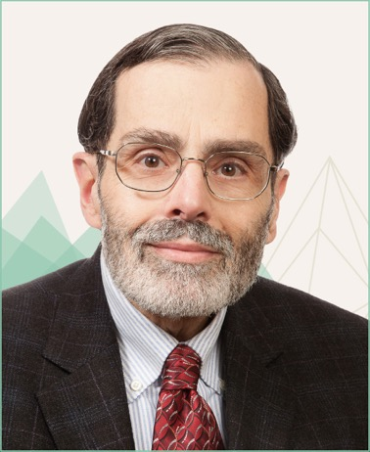
2023 Jonathan M. Mann Memorial Lecture
Alfred DeMaria, Jr., MD, is a Medical and Laboratory Consultant at the Massachusetts Department of Public Health where he previously served as Medical Director of the Bureau of Infectious Disease and Laboratory Sciences, and for many years as State Epidemiologist for Massachusetts. He currently is a member or advisor on multiple committees of the Massachusetts Medical Society, as well as serving on the boards of the Grimes King Foundation and the Boston Medical Library, and as President of the Board of Directors of The Public Health Museum. Dr. DeMaria is a past president of CSTE (2014-15), the Massachusetts Infectious Diseases Society and the Northeast Branch of the American Society for Microbiology.

Slide 13
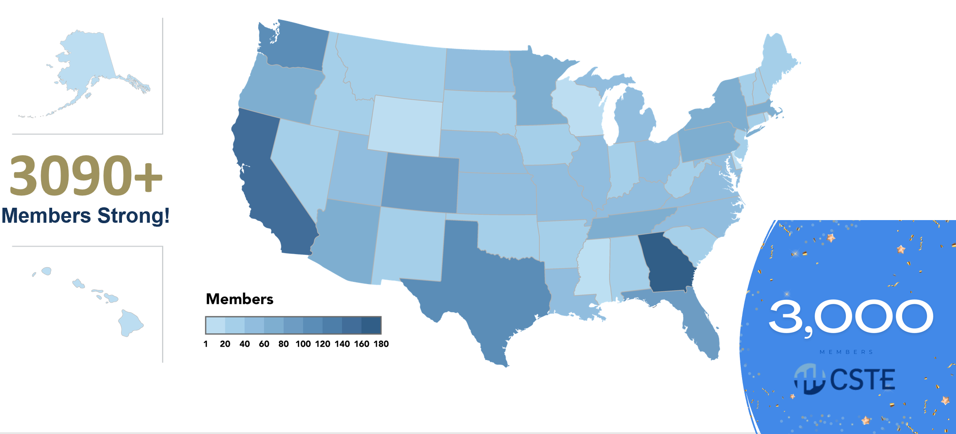
Business Meeting
State of CSTE Presentation
  Financial Overview, Programs Accomplishments
Presentation of Position Statements
Introduction of 2023-2024 Executive Board

Slide 14
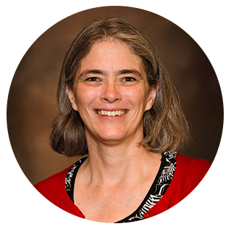
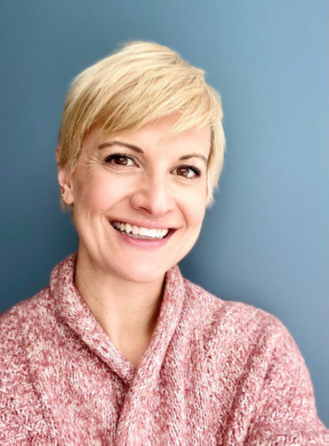
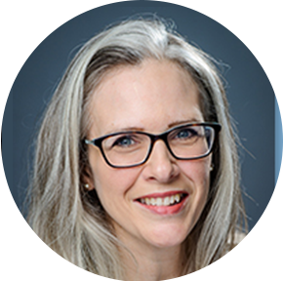

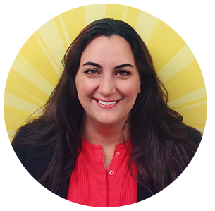
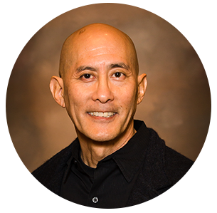
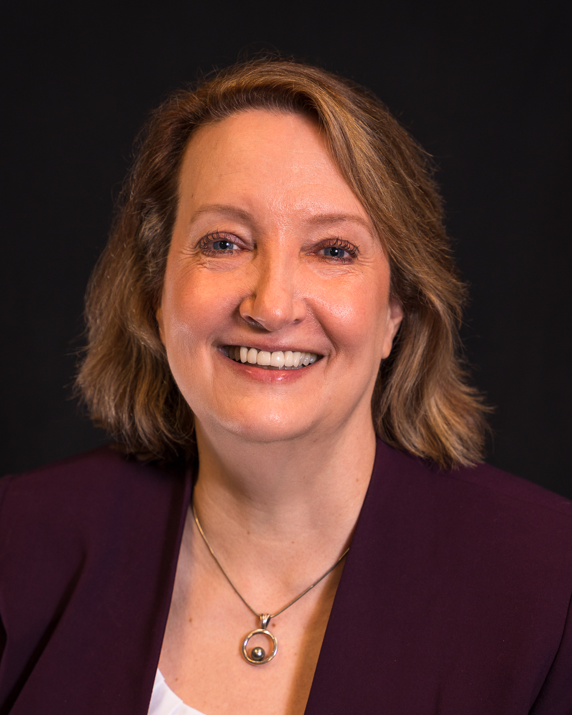

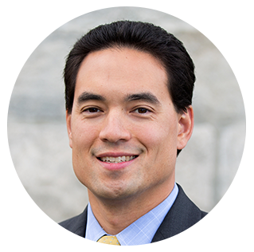
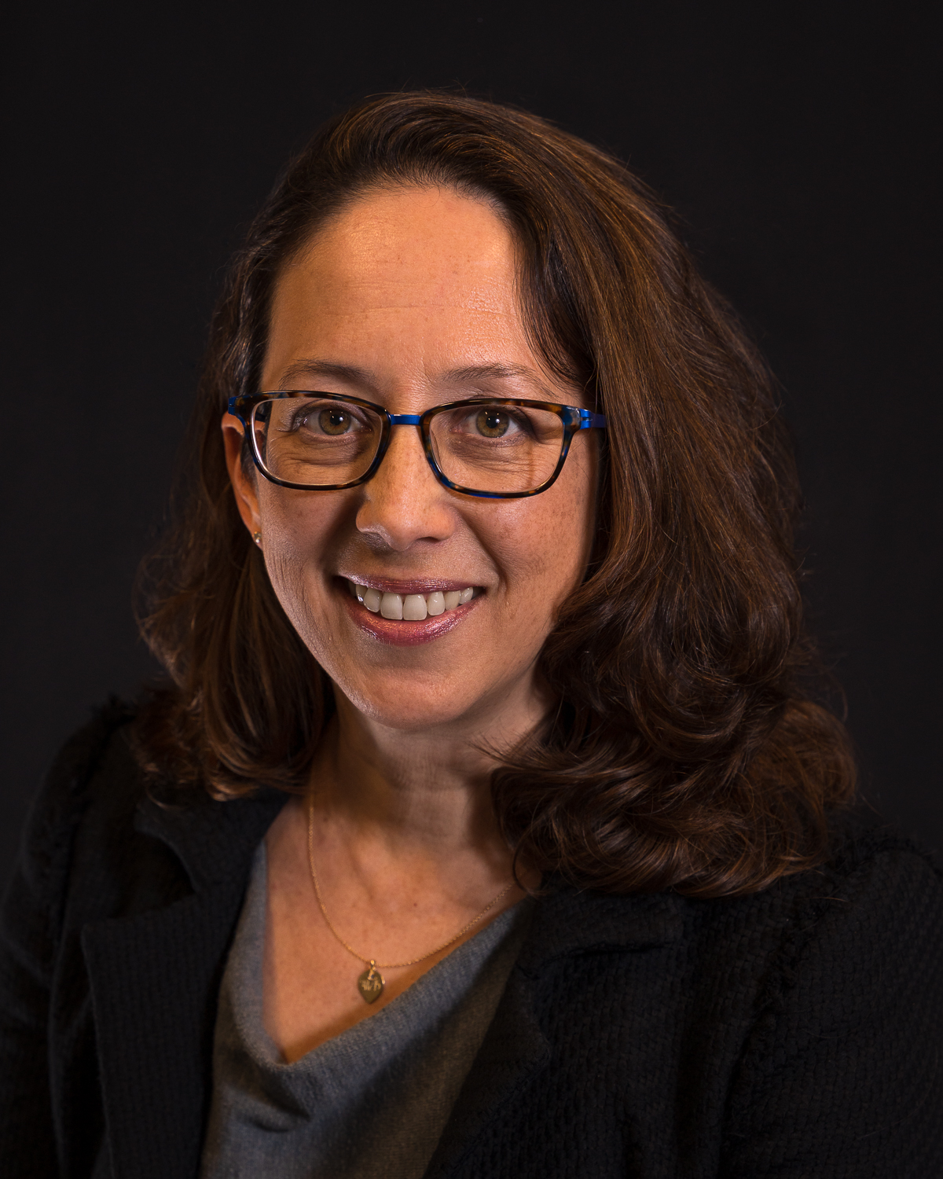
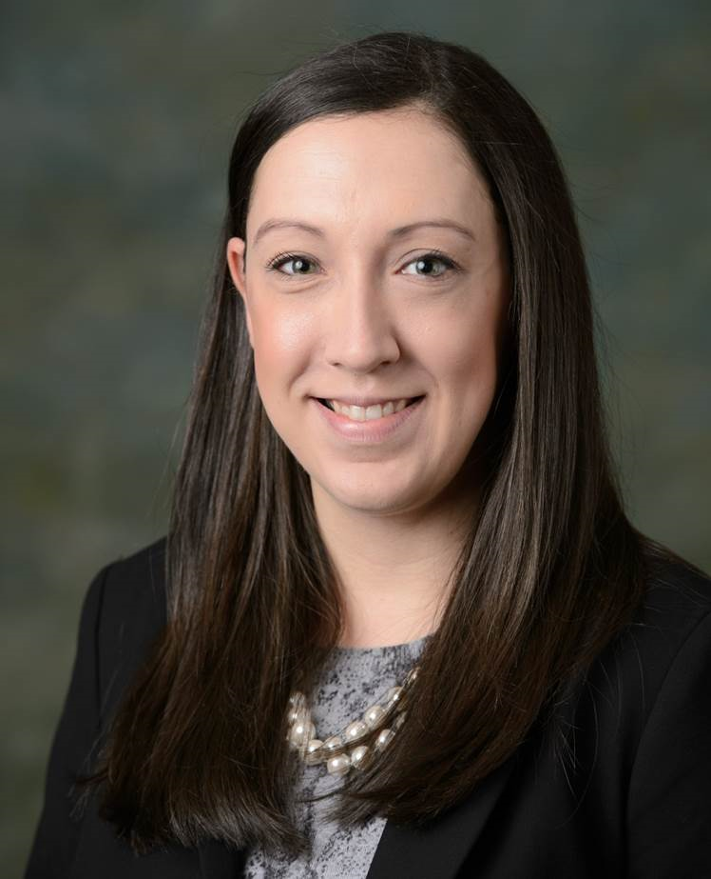
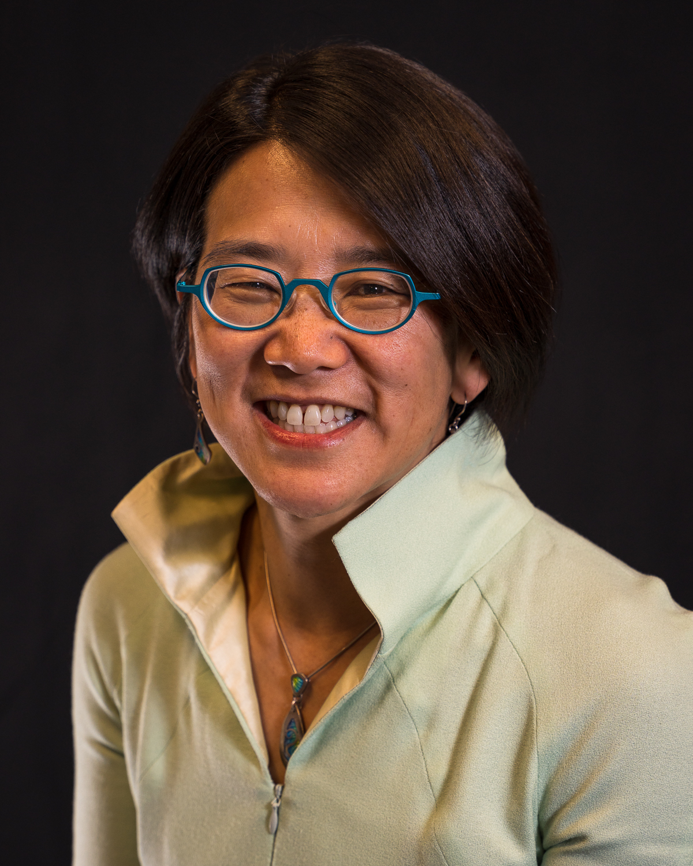
2023-2024 CSTE Executive Board
Sarah Lyon-Callo
President
Michigan
Angela Dunn
Vice President
Salt Lake County
Sherri Davidson
Alabama
Kate Goodin
Tennessee
Melissa Jordan
Florida
Ken Komatsu
Arizona
Officers
Members-at-Large
Benjamin Chan
New Hampshire
Sarah Kemble
Hawaii
Mary-Margaret Fill
Tennessee
Erica Pan
California
Catherine Brown
President-Elect
Massachusetts
Ruth Lynfield
Secretary-Treasurer
Minnesota

Slide 15
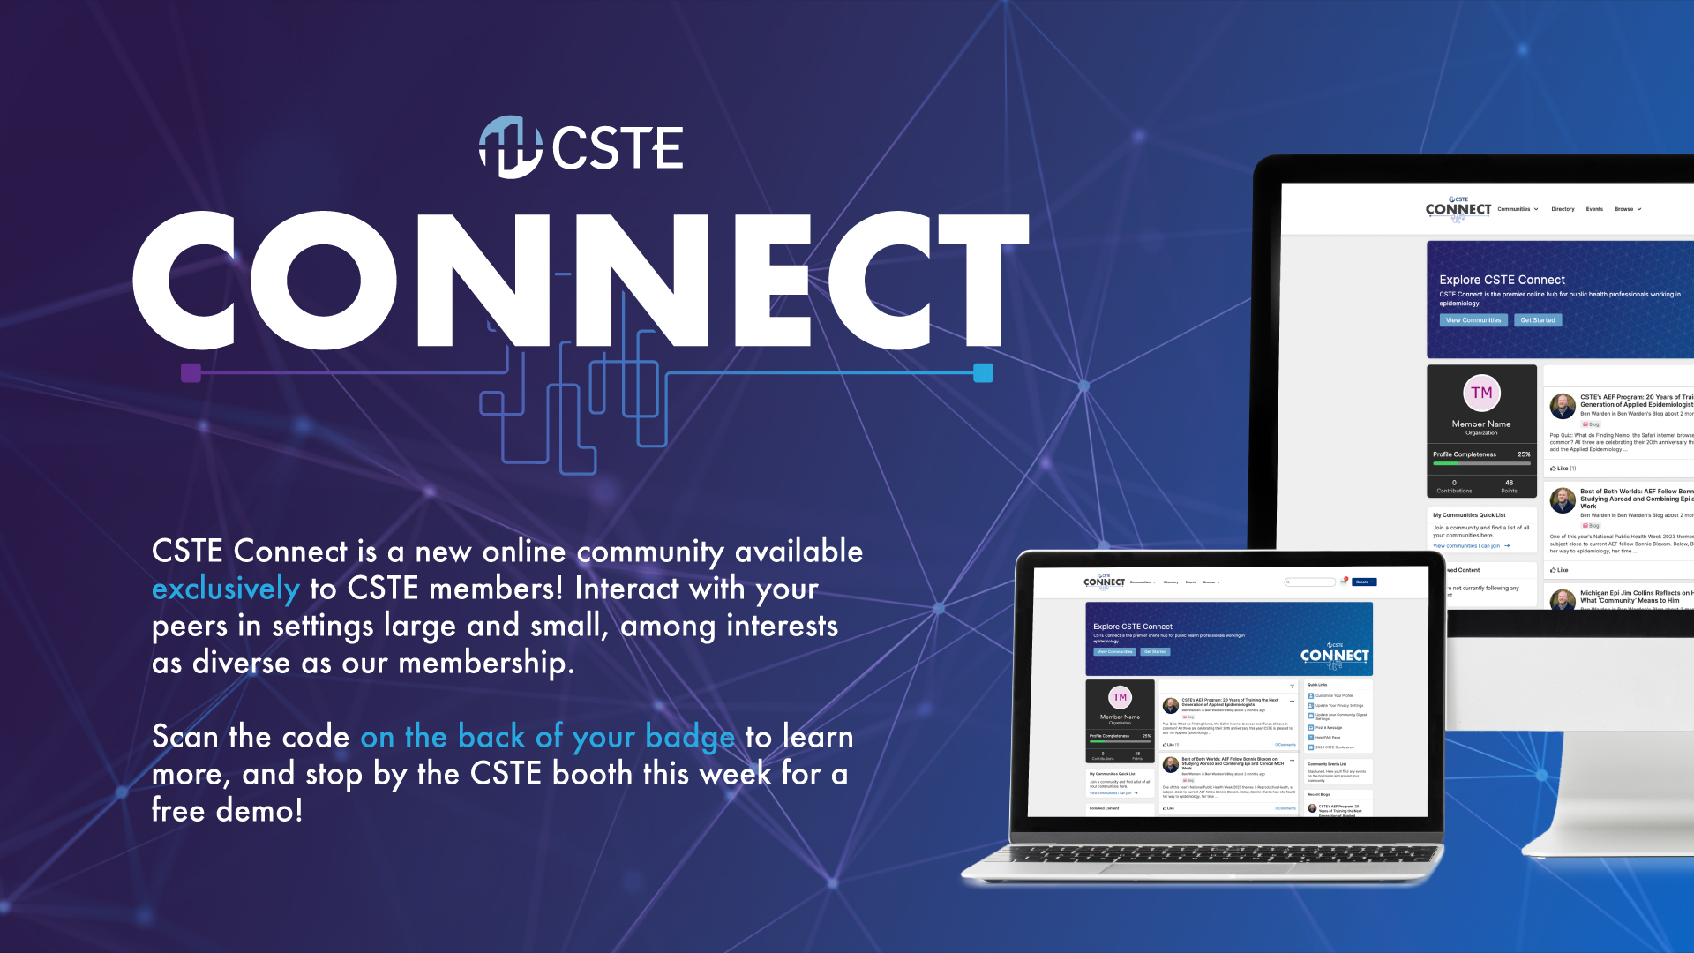
CSTE Connect

Slide 16
Continuing Education (CE)
CSTE has partnered with CDC to provide up to 20 hours of CE for doctors (CME), nurses (CNE), veterinarians (RACE), health educators (CHES), and those Certified in Public Health (CPH)
Eligible sessions include the NASPHV Business Meeting, all Sunday workshops, plenary sessions, and the Jonathan M. Mann Lecture
Claim your CE at https://tceols.cdc.gov no later than Monday, July 31, 2023
  Course Access Code: 2023CSTEAC
For questions, email WFResources@cste.org

Slide 17
Conference Evaluation, Other Resources
Complete the 2023 CSTE Conference Evaluation by Friday, July 28
  If you attended a Sunday Workshop, please complete the workshop evaluation
Session Recordings
  Plenary Session and Breakout Session Recordings are now available to registered attendees in the online agenda and conference app
  Plenary Session Recordings will also be available in CSTE Connect!
Position Statement Archive
  https://www.cste.org/page/PositionStatements

Slide 18
Recap of S/I Conference Workshop – Taylor Pinsent & Megan Tompkins

Slide 19
2023 Surveillance/ Informatics Workshop:
Ascending to New Heights in Surveillance & Informatics
High Demand In-person Workshop on Sunday, June 25
  400 people registered and on waitlist
  ~305 people attended
Pre-workshop Preparatory Virtual Session on Wednesday, June 14
  Presenter: Kate Goodin (TN)
Our aim for this workshop was to prepare the public health surveillance and informatics community to meet and help shape evolving data expectations.
The workshop characterize the changing landscape, emphasize the need for public health to directly contribute to the conversation, demonstrate opportunities to build consensus across the public health surveillance community, and elevate public health voice.
We provided participants with increased awareness of and opportunities to engage in strategies, standards, and technology needed both at STLT health departments as well as across the broader connected Public Health surveillance and informatics landscape.
We hope participants left this workshop feeling inspired, motivated, and equipped with methods to collaborate on surveillance and informatics.

Slide 20
2023 Surveillance/ Informatics Workshop:
Ascending to New Heights in Surveillance & Informatics
DMI Stories from the Field
Purpose: Recognize innovation and resiliency in public health surveillance and informatics; Inspire cross-jurisdictional collaboration; Educate on importance of DMI through documentation of successes; Document and share these stories through CDC and CSTE outlets
Create multimedia outputs like written stories and videos
Share on the webpage, during calls, on CSTE Connect
>80 stories from more than 30 jurisdictions received
Highlighted written submissions from MI, CT, UT, IL, AL, OR, FL; video from ID

Slide 21
2023 Surveillance/ Informatics Workshop:
Ascending to New Heights in Surveillance & Informatics
Opening Remarks with CDC, Dr. Jen Layden
Themes: OPHDST structure, CDC Data Strategy, progress and collaboration
Q&A with Jen Layden and Heather Strosnider, CDC
Themes: Funding sustainability, CDC alignment across programs, governance over shared tools

Slide 22
2023 Surveillance/ Informatics Workshop:
Ascending to New Heights in Surveillance & Informatics
Morning Panel:
Inform and Educate on realistic cutting-edge technologies and sharing success stories
A Seat at the Table: Open communication and shared decision making | Michelle Barber (OR)
USDS pilot on the DMI Building Block data pipeline | Rebecca Early (VA)
USDS Data Integrations Building Blocks Development Pilot | Rebecca Fisher (LA County)
Syndromic Surveillance partnership- State of Alaska & Alaska Native Tribal Epi Center | Anna Frick (AK)
What is the Medicolegal Death Investigation Data Modernization Initiative and Why Should Public Health Care? | Michele Trofatter (CDC Fdn)
Climbing The Technical Assistance Hill with APHL | Vanessa Holley (APHL)

Slide 23
2023 Surveillance/ Informatics Workshop:
Ascending to New Heights in Surveillance & Informatics
Afternoon Speaker: Erin Holt Coyne (TN): Initiatives of Consequence
Afternoon Panel:
Characterize the changing landscape and the need for public health to be engaged in the conversations that will shape public health practice in the future
United States Core Data for Interoperability (USCDI) & USCDI +, Trusted Exchange Framework and Common Agreement (TEFCA), & Helios | Rachel Abbey (ONC) & Grace Mandel (CDC)
Public Health Fast Healthcare Interoperability Resources (FHIR) Implementation Collaborative | Justin Irving (MITRE)
Health Information Technology Advisory Committee (HITAC) Public Health System Certification | Bryant Karras (WA)
Engaging with CDC on Data Modernization and the Public Health Data Strategy | Lesliann Helmus (CDC)

Slide 24
2023 Surveillance/ Informatics Workshop:
Ascending to New Heights in Surveillance & Informatics
Afternoon Interactive Activity: 3-2-1
facilitated by Rachelle Boulton (UT)
Participants reflected and shared on opportunities, ideas, or aspirations from the workshop that will elevate the public health voice in surveillance and informatics for impact across all levels.
3 opportunities, ideas or aspirations- National level
2 opportunities, ideas or aspirations- Jurisdictional level
1 opportunity, idea or aspiration- Individual level

Slide 25
Review of Approved 2023 CSTE Position Statements - Meredith Lichtenstein Cone

Slide 26
Approved 2023 Position Statements
23-ID-01: Update to Public Health Reporting and National Notification for Anaplasmosis
  Updates 09-ID-15, separates anaplasmosis from ehrlichiosis
  Removes “Ehrlichiosis/Anaplasmosis, undetermined” from notifications
  Specifies publication in NNDSS annual tables only
23-ID-04: Update to Public Health Reporting and National Notification for Ehrlichiosis
  Updates 09-ID-15, separates ehrlichiosis from anaplasmosis
  Adds “Ehrlichia muris eauclairensis” and e.g., “Unspeciated Ehrlichia” to notifications
  Removes “Ehrlichiosis/Anaplasmosis, undetermined” from notifications
  Specifies publication in NNDSS annual tables only

Slide 27
Approved 2023 Position Statements
23-ID-02: Standardized Surveillance Case Definition for Congenital Cytomegalovirus (cCMV) Infection and Disease
  Establishes standardized case definition for cCMV infection and disease
  Does not make cCMV nationally notifiable
23-ID-03: Public Health Reporting and National Notification of Invasive Cronobacter Infection Among Infants
  Establishes standardized case definition for invasive Cronobacter infection among infants <12 months of age
  Adds invasive Cronobacter infections among infants to the Nationally Notifiable Conditions List as “immediately notifiable, urgent (within 24 hours)” for confirmed and probable cases

Slide 28
Approved 2023 Position Statements
23-ID-05: Update to Public Health Reporting and National Notification for Acute and Chronic Hepatitis B Infections
  Updates 11-ID-03 and 11-ID-04, combines acute and chronic HBV infections into single position statement
  Adds probable acute HBV infection cases to notifications
23-ID-06: Update to Public Health Reporting and National Notification for Mumps
  Updates 11-ID-08
  No changes were made to national notifiability
23-ID-07: Update to Public Health Reporting and National Notification for Paralytic Poliomyelitis and Nonparalytic Poliovirus Infection
  Updates 09-ID-53
  Updates notification timeframe from “Immediately notifiable, extremely urgent (within 4 hours)” to “Immediately notifiable, urgent (within 24 hours)”

Slide 29
Approved 2023 Position Statements
23-ID-08: Standardized Surveillance Case Definition for Toxoplasma gondii Infection and Toxoplasmosis, including Congenital Toxoplasmosis
  Establishes a standardized surveillance case definition for toxoplasmosis
    Includes optional sub-classifications of cases for jurisdictions with available capacity
  Does not make toxoplasmosis nationally notifiable
23-ID-09: Update to Public Health Reporting and National Notification of Varicella
  Updates 09-ID-68
  No changes were made to national notifiability

Slide 30
Approved 2023 Position Statements
23-ID-10: Update to Public Health Reporting and National Notification for Non-congenital and Congenital Zika Virus Disease
  Updates 16-ID-01
  Removes non-congenital and congenital Zika virus infection without disease from notifications
23-MCH-01: Update to the Neonatal Abstinence Syndrome (NAS) Standardized Case Definition
  Updates 19-MCH-01
  Does not make NAS nationally notifiable

Slide 31
Highlights from the Surveillance/Informatics Track - Becky Lampkins

Slide 32
Surveillance/Informatics Track Overview
Surveillance/Informatics Track Overview
17 Roundtable Sessions
  S/I Steering Committee Meeting
  National ELR Workgroup Meet & Greet
  eCR Workgroup/RCKMS CoP Roundtable
  NSSP CoP Roundtable
  Data Modernization
  Syndromic Surveillance
  ELR
  Exposure Notification
  Data Science Capacity
  Case Surveillance – Data Standardization
36 Posters
16 Breakout Sessions
  eCR
  Surveillance Tools for Outbreak Detection and Response
  Data Modernization
  Syndromic Surveillance
  Data Linkage
  Informatics in support of Health Equity
  Data Quality
  Automation Processes
  Data Visualization
  Cluster Detection/Modeling
  Case Notification
  Novel Approaches to Informatics Challenges

Slide 33
S/I Steering Committee, eCR, and ELR Workgroup Roundtable Discussion Topics
Increase transparent coordination among partner associations and build connection across program areas
  Data modernization – who is taking lead on various activities?
Workforce Development - need to share existing or new resources broadly within community
  Training opportunities
  Ensure common understanding of terminology/technologies
  Organizational charts
Communication - more robust and coordinated online platforms
  CSTE Connect
  Share information, calendar, resources/repository, ideas

Slide 34
CSTE Workgroups and Projects
Becky Lampkins, Taylor Pinsent, Shaily Krishan, Megan Tompkins

Slide 35
CSTE S/I Steering Committee, Subcommittees, Workgroups
S/I Steering Committee
Chair: Jim Collins (MI)
Vice Chair: vacant
Electronic Laboratory and Disease Reporting (ELDRS)
Co-Chairs: Jennifer Stewart (NC) and Nancy Barrett (CT)
National ELR Workgroup
Co-chairs: Nicole Kikuchi (FL) and Cody McNeese (OR)
Surveillance Policy
Co-Chairs: Tracy Miller (ND) and Josh Clayton (SD)
Data Release, Presentation, Access, Suppression, and Sharing Workgroup
Co-chairs: MaryKate Martelon (MA) and Abigail Cheney (MI)
Steering Committee
Subcommittees
Workgroups
Surveillance Practice & Implementation (SPIS)
Chair: Rachelle Boulton (UT)
Data Standardization Workgroup
Co-chairs: Molly Crockett (MA) and Laura Erhart (AZ)
NNDSS Evaluation Workgroup
eCR Workgroup
Co-chairs: Ann Kayser (MN) and Melanie Epstein-Corbin (CA)
t

Slide 36
CSTE Subcommittees and Workgroups
Surveillance Practice & Implementation Subcommittee
  Subcommittee Chair: Rachelle Boulton (UT)
  Meets 1st Friday of each month (1:30-3:00 pm ET) – next call, August 4
  Current focus: surveillance methods, data modernization, case surveillance, data standardization, standards, reportable and nationally notifiable conditions
  Data Standardization Workgroup
    Meets last Friday of each month (1-2 pm ET) – next call, July 28
    Purpose: convene epidemiologists and informaticians across jurisdictions and program areas to develop recommendations for defining basic ‘core’ surveillance data elements present across many conditions/standardizing common definitions and interpretations
  NNDSS Evaluation Workgroup
    Meets 4th Tuesday of each month (3-4 pm ET) – next call, July 25
    Purpose: convene jurisdictional representatives and NNDSS colleagues to discuss case notification practices, MMG implementation, onboarding, technical assistance
CSTE Staff Contact: Becky Lampkins (blampkins@cste.org)

Slide 37
CSTE Subcommittees and Workgroups (continued)
Surveillance Policy Subcommittee
  Co-chairs: Dr. Tracy Miller (ND) & Dr. Josh Clayton (SD)
  Meets second Friday of each month at 2:05 pm ET (next call is August 11)
  Current focus: data governance policies
  CSTE Data Release, Presentation, Access, Suppression, and Sharing (DRPASS) Workgroup
    Co-chairs: MaryKate Martelon (MA) & Abigail Cheney (MI)
    Meets second Tuesday of each month at 3:05 pm ET (next call is August 8)
    Current focus: data release policies (for public use aggregate data), data suppression, data privacy, data release lifecycle
  CSTE staff contact: Taylor Pinsent (tpinsent@cste.org)

Slide 38
CSTE Subcommittees and Workgroups (continued)
Electronic Laboratory and Disease Reporting Subcommittee (ELDRS)​
Co-Chairs: Nancy Barrett (CT), Jennifer Stewart (NC)
CSTE eCR Workgroup
  Co-chairs: Melanie Epstein-Corbin (CA), Ann Kayser (MN)
  Workgroup charge: To convene staff from STLT public health agencies participating in eCR implementation activities, including other key stakeholders (CDC, APHL) to improve eCR reporting across all PHAs through informing policy and procedures via CSTE, as appropriate. To facilitate discussion, information sharing, and identifying best practices around processes related to eCR implementation, Healthcare Organization (HCO) production data, HCO testing practices, and PHA validation methods and procedures.
  Meets monthly, 3rd Tuesday, 4-5 pm ET
CSTE National ELR Workgroup
  Co-chairs: Nicole Kikuchi (FL), Cody McNeese (OR)
  Long-standing workgroup to discuss issues and solutions directly related to the electronic exchange of laboratory data, including orders and results reporting.
  Meets monthly, 1st Tuesday, 1-2 pm ET
CSTE staff contact: Devra Barter (dbarter@cste.org)

Slide 39
Selected CSTE Activities: RCKMS & eCR
Reportable Conditions Knowledge Management System (RCKMS)
  Development & maintenance of Reporting specifications and Reportable Condition Trigger Codes (RCTC) for eCR
    208 conditions available in RCKMS as of July 2023
  RCKMS User Support
    Authoring Support Associate team
    eCR/ RCKMS Community of Practice, RCKMS Office hours, CoP Townhall Meetings
    Help desk (Tickets, issue tracking & resolution, technical troubleshooting of case reports)
    RCKMS Training Modules on CSTE Learn & other resources on RCKMS website
Partnership with CDC, PHAs & academic evaluation center to conduct an evaluation of eCR data quality, timeliness and completeness
CSTE eCR Workgroup for STLT
  To support/share solutions on eCR implementation
  Identify PHA challenges & priorities
Collaboration with APHL & CDC eCR teams to prioritize RCKMS technical development activities, quality assurance, direct support requests from PHAs

Slide 40
Selected CSTE Activities: Data Modernization
STLT DMI Priorities Report (CSTE product in development).
  This Report includes six STLT-identified priorities:
  Develop a roadmap for DMI implementation
  Elevate DMI through collaboration, information sharing, and result articulation
  Ensure STLTs have a sustained, engaged, skilled, and diverse workforce for public health informatics
  Engage constructively across the STLT and federal public health landscape
  Sustainably strengthen public health data infrastructure
  Establish framework for data governance processes
Initially articulated during the CSTE DMI Summit in March 2023
Presented widely for input, including discussion at the CSTE Annual Conference during the DMI Roundtable

Slide 41
2023-2024 Surveillance/Informatics Priorities – Annie Fine, Gillian Haney

Slide 42
CSTE S/I and DMI Priorities – 2023-2024
DMI
  Advocacy for sustained funding
  DMI workgroup
  Articulate and support STLT DMI priorities – possible second summit
    Publish DMI STLT priorities report
  Continue CDC engagement (Consortium, OPHDST)
  Expand to non-ID programs
  Success stories
eCR
Standards work
  Data standardization and harmonization across STLTs
  Improve public health participation and input into standards
  USCDI, USCDI+, FHIR accelerator
Focus on improving national case notification processes
Data sharing policies

Slide 43

Save the Date – June 9-13, 2024 in Pittsburgh, Pennsylvania

Slide 44
CSTE Staffing Info
--- CSTE Science and Surveillance Office, Staff Contact Info ---
Annie Fine – Chief Science and Surveillance Officer, Senior Advisor to DMI – afine@cste.org
Meredith Lichtenstein Cone – Director of Scientific and Surveillance Consensus Development – mlichtenstein@cste.org
Kirtana Ramadugu – Senior Program Analyst (Scientific and Surveillance Consensus Development) – kramadugu@cste.org
Megan Tompkins – DMI Implementation Lead – mtompkins@cste.org
Bridget Teevan – Senior Program Analyst (DMI) – bteevan@cste.org
Gillian Haney – Surveillance/Informatics Director – ghaney@cste.org
Shaily Krishan – S/I Program Manager (Electronic Reporting) - skrishan@cste.org
Devra Barter – Senior Program Analyst (RCKMS/eCR) – dbarter@cste.org
Shahidah Williams – Program Analyst III (RCKMS/eCR, FHIR) - swilliams@cste.org
Becky Lampkins – S/I Program Manager (Surveillance Systems, Practice, Policy) - blampkins@cste.org
Jordyn Easterling – S/I Program Associate (NSSP CoP/RCKMS) – jeasterling@cste.org
James Muncy – Program Analyst III (Syndromic Surveillance/NSSP CoP) – jmuncy@cste.org
Taylor Pinsent – Senior Program Analyst (Surveillance Policy/Data Sharing) - tpinsent@cste.org
Becca Tugan – Program Analyst II (Syndromic Surveillance/NSSP CoP) - rtugan@cste.org

Slide 45

Q & A

Slide 46




Next eSHARE
Thank you!
Next NNDSS eSHARE: August 22, 2023
Subscribe to
Case Surveillance News
Access NNDSS’ Technical Resource Center
Email edx@cdc.gov for technical help
Learn about case surveillance modernization

