Slide 1

NNDSS eSHARE June Webinar
June 20, 2023
Division of Health Informatics and Surveillance

Slide 2
Agenda
NNDSS Updates and Announcements
CDC’s Office of Public Health Data, Surveillance, and Technology: Updates on Case Surveillance Modernization
Questions and Answers

Slide 3
eSHARE Webinar
Dr. Jennifer Adjemian
Office of Public Health Data, Surveillance, and Technology
Centers for Disease Control and Prevention
June 20, 2023

Slide 4
Agenda
Intro to New Office
Public Health Data Strategy
Case Surveillance Modernization
  MITRE Landscape Assessment
  EpiSync
  Flexible Case Data Exchange
Meeting will be recorded for notetaking purposes

Slide 5



OPHDST
The Office of Public Health Data, Surveillance, and Technology (OPHDST) is dedicated to leading, coordinating, and executing a comprehensive public health data strategy.
KEY RESPONSIBILITIES
PUBLIC HEALTH CORE
DATA SYSTEMS
TECHNOLOGY SOLUTIONS AND TOOLS
DATA POLICY
ESSENTIAL TO CORE PUBLIC HEALTH MISSIONS

Slide 6

About OPHDST
Office of the Chief Operating Officer
Immediate Office of the Director
Office of the Chief of Staff
Office of Equal Employment Opportunity and Workplace Equity
Office of Policy, Performance, and Evaluation
  The establishment of OPHDST works to address goals of the Moving Forward initiative, tackling CDC data and technology challenges to:
  Create accountability for public health data and technology strategy
  Increase interoperability and improve data standards within public health and between public health and healthcare
  Improve timeliness of data needed for situational awareness and readiness
  Remove barriers to accessing and using data across the public health ecosystem
  Consistently deliver public health information and guidance to Americans in near real-time
Office of Health Equity
Office of Communication
Office of Science
CDC Washington Office
Office of Laboratory Science and Safety
Office of Readiness and Response
Office of Public Health Data, Surveillance, and Technology
Center for Forecasting and Outbreak Analytics
National Center for Health Statistics
National Centers

Slide 7
The Public Health Data Strategy
SUMMARY
A 2-YEAR PUBLIC HEALTH STRATEGY TO DIRECT RESOURCES AND ACTIVITIES . . .
. . . THAT OUTLINES 4 GOALS TO ENABLE OUR CORE PUBLIC HEALTH MISSIONS . . .
. . . WHICH ARE MEASURED AND MONITORED BY
15 MILESTONES . . .
OPHDST is the office accountable for implementing the Public Health Data Strategy.
Successful implementation of the strategy—and achievement of the Public Health Data Goals over the next two years―will require collaboration with state, tribal, local, and territorial (STLT) jurisdictions, healthcare partners, and other federal agencies, as well as sustained resources.

Slide 8





Public Health Data Strategy Goals
Core public health missions
Strengthen the core of public health data
1
Ensure Core Data Sources¹ are more complete, timely, rapidly exchanged, and available to support the integrated ability to detect, monitor, investigate, and respond to public health threats
  Accelerate access to analytic and automated solutions to support public health investigations and advance health equity
Detect and monitor
Investigate and respond
2
Make tools available so STLTs and public health decision-makers can better use public health data to address health disparities
3
Visualize and share insights to inform public health action
Serve as a trusted source for near real-time visualizations and offer situational awareness for the public and decision-makers to understand risks, make decisions, and direct resources
Inform and disseminate
Be response-ready
4
Ensure more open and interoperable public health data
Enable exchange of interoperable data so that healthcare, STLTs, federal agency partners, and CDC programs can access and use the data they need, when they need it
1. Case (including Electronic Case Reporting eCR), Lab (including Electronic Lab Reporting ELR, Electronic Test Orders and Results ETOR), Syndromic (including National Syndromic Surveillance Program NSSP emergency department data), Vital statistics, Immunization, Healthcare capacity (including National Healthcare Safety Network NHSN data)

Slide 9
Public Health Data Strategy and Data Modernization Initiative
Addressing the imperative set by the CDC Moving Forward effort, the Public Health Data Strategy (PHDS) and two-year milestones focus on the execution of broader ongoing efforts for the Data Modernization Initiative (DMI)
 | Public Health Data Strategy | Data Modernization Initiative
Scope | Streamlines actions and efforts aimed at enabling the efficient and secure exchange of critical core data Not all critical core data sources, or exhaustive aspects, related to data modernization are included | Outlines all-encompassing aspects of data modernization needed across the healthcare, federal, and STLT public health landscape
Timing | Focuses on concrete milestones that are most critical to deliver in the next two years, building on lessons learned in the COVID-19 pandemic | Multi-year undertaking that involves consistent effort and investment
Accountability | Creates accountability in OPHDST | Is an initiative being undertaken across many different partners across all levels of public health, with OPHDST leading ongoing coordination of DMI in close collaboration with the Office of the Chief Information Officer (OCIO) and CDC programs

Slide 10
Case Surveillance
Modernization
Moving Toward Faster, Flexible, More Complete Case Data
Updates on CDC’s latest case surveillance modernization plans, June 2023
The Vision:
A common process for reporting core data.
Different data formats for faster reporting.
Standard reporting of additional data.
A pause on starting any new disease-specific data collection.
Faster decision-making for public health partners.
One “Front Door” for getting data in and out of CDC.

Slide 11
Recommendations for Modernized Case Surveillance
Enable
  Enable submission of a generic, core data feed for all national notifiable diseases, allowing a timely and sustainable flow of critical information
Expand
  Expand the range of data formats and methods so that jurisdictions can send their notifiable disease data to CDC in a way that works for their system
Develop
  Develop agile, flexible solutions with common data standards for disease-specific case data to alleviate burden and support responsiveness to changing needs
Pause
  Pause current high-burden, unsustainable approach to disease-specific supplemental case data reporting
Provide
  Provide clear value to public health action with automated, near real-time data tools with tiered access to jurisdictions, partners, and public
Eliminate
  Eliminate the need for jurisdictions to send the same data in multiple formats to multiple places at CDC by leveraging the “one front door” approach
These recommendations support the larger vision of building a flexible, efficient, and scalable data pipeline for both routine and emergency public health needs that is centered on providing value to the jurisdictions, CDC programs, and the public

Slide 12
Dimensions of Modernizing Case Data
Data Format
Continue to use HL7® v2.5
Data Standards
Continue using HL7-based MMGs
Continue to move towards standard data elements
Technology
Continue legacy formats until systems are modernized
Once modernized, legacy formats and transports retire and redirect to more flexible options
Additional option of CSV
Future flexible approaches (e.g., EpiSync) for core case data and additional data elements

Slide 13
CSV: An important option
CDC recognizes that CSV is not a permanent solution to modernize public health data.
CSV helps CDC meet individual jurisdictions where they are now, while also moving forward the entire case surveillance data ecosystem towards modern infrastructure.
CSV offers critical short-term flexibility and an opportunity to help improve response-ready data now.
CDC is exploring all long-term options, including FHIR and APIs. This process will take time.

Slide 14
Pause of NNDSS MMGs
The pause on NNDSS message mapping guides (MMGs) will end in a phased approach on a case-by-case basis, for both onboarding of current NNDSS MMGs and developing new MMGs.
Decision Drivers:
  Have data elements in an MMG been standardized and harmonized across the public health ecosystem?
  Will data elements in an MMG meet current needs of both CDC programs and jurisdictions?
  Will the data elements in an MMG place a burden on jurisdictions to collect or submit this information to CDC?
  Will available data formats allow jurisdictions to send data to CDC with minimal burden on available technology and personnel resources?
It is critical that jurisdictions, programs, and other partners reach a shared understanding and mutual agreement on the answers to these questions before unpausing.

Slide 15
Concerns and Considerations
CDC recognizes that pausing new MMG development and onboarding has led to concerns. Consequently:
  CDC acknowledges and applauds the many jurisdictions who have invested significant effort into developing HL7 expertise and onboarding HL7-based MMGs.
  CDC will continue to receive HL7 data from jurisdictions who prefer to use this format. CDC will end the pause on MMGs on a case-by-case basis.
  CDC will offer CSV as an alternative format to HL7 to meet the needs of all jurisdictions regardless of their available resources.
  CDC will work closely with jurisdictions, CDC programs, and partners such as CSTE to discuss options and establish mutually acceptable timelines.

Slide 16
Data Standardization is key to success
CDC and CSTE are partnering on case surveillance data standardization to increase system interoperability.
We are working to standardize and harmonize data elements across conditions and across the case surveillance ecosystem.
Discussions are being held in the CSTE Data Standardization Work Group (DSWG) that will lead to a standardized set of case surveillance data elements.
Please join these discussions - we want to hear from everyone! Email Becky Lampkins at blampkins@cste.org to join the DSWG.

Slide 17
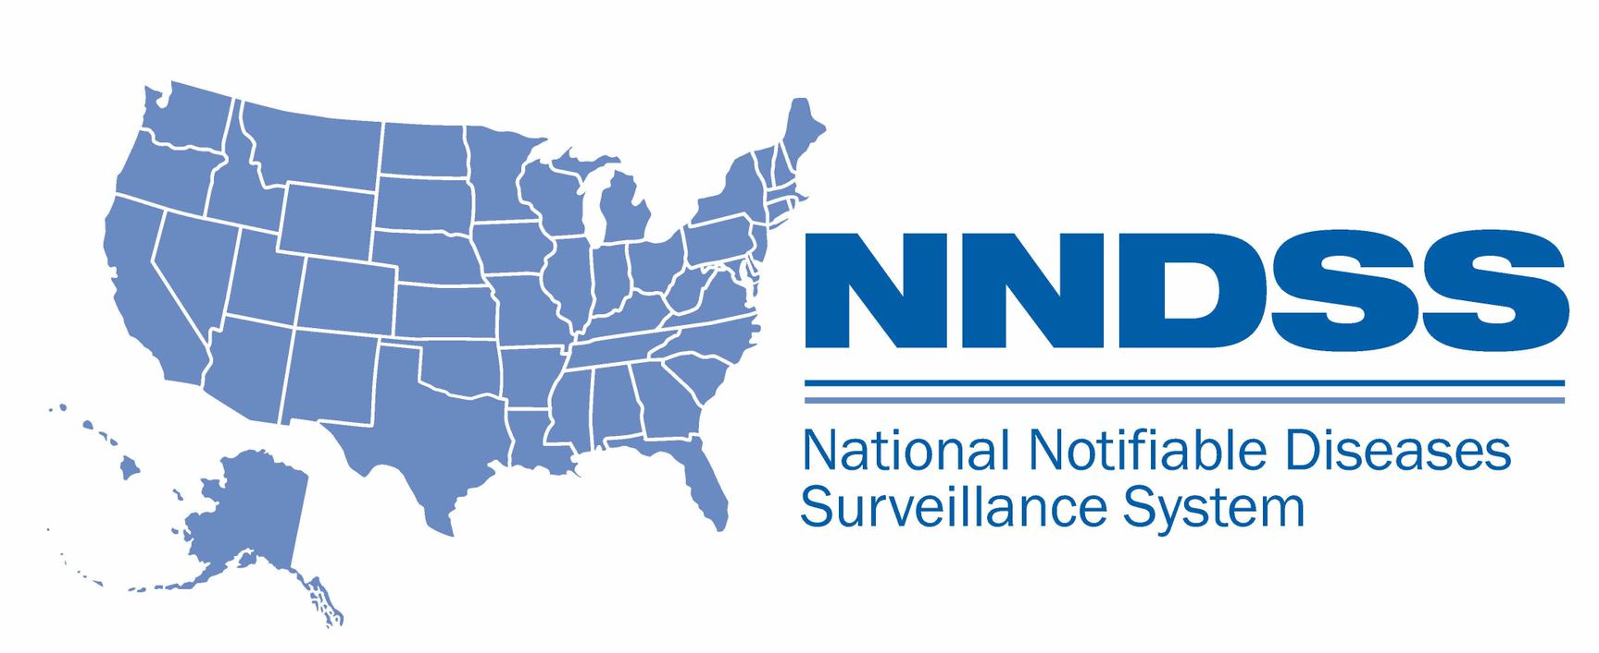
MITRE Landscape Assessment
Jurisdiction Implementation Plans for Sending Generic Version 2 Message Mapping Guide (MMG)

Slide 18
Background
HL7® Generic v2 (GenV2) Message Mapping Guide (MMG) was developed to modernize NNDSS case notifications
  Standardized core data elements for surveillance across notifiable conditions​​
  Disease-specific MMGs build upon GenV2 with additional data elements to meet program needs​​
  Many jurisdictions continue to send data in legacy formats​​ with fewer elements or values that cannot be accepted.
Current approach lacks the flexibility needed for emergency response ​​
  Challenging to add additional data elements
  Cannot easily be linked to other data sources​​
Major need to better understand the unique challenges and barriers for each jurisdiction to send core data as defined by GenV2

Slide 19
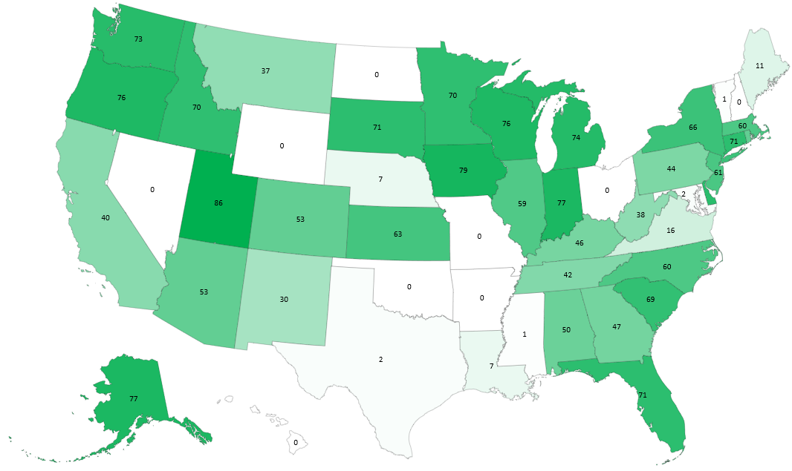

Percentage of Reportable Conditions using
GenV2-Based Content
*
53
*
72
*SD and DC are actively onboarding Generic v2 MMG and are therefore included here.

Slide 20
Barriers to MMG Implementation
Lack of staff and high-turnover in public health at local and state levels
Surveillance system technology and expertise varies by jurisdiction
Limited benefits plus competing priorities prevent transition to HL7® from legacy formats (such as National Electronic Telecommunications System for Surveillance, or NETSS)
Lack of harmonization and standardization across case data elements
Lack of resources to develop and maintain modern technologies
Resistance to changing surveillance processes at CDC and jurisdictions

Slide 21
MITRE Landscape Analysis Approach
Conduct desk review of information about each jurisdiction
Hold tailored discussions with each jurisdiction to understand specific challenges including:
  Capabilities to transform and send data in HL7® formatted messages
  Specific barriers to implementing HL7®
  Other formats that could be used to send core data in near-real time
Develop jurisdiction-specific recommendations with actionable plans

Slide 22
Landscape Assessment Anticipated Outcomes
Understand the resources and level of support needed for all jurisdictions to report core data for all notifiable conditions using a GenV2 data model
Provide improved access to more timely case notification data to inform public health decisions, especially for emergency response efforts
Identify themes across jurisdictions that could inform broader approaches (e.g., technical assistance models, data formats)

Slide 23
Alternative Approach to offer GenV2-based content as CSV
Enables jurisdictions with limited resources to provide a file
Capability being built to work with MVPS
CSV format will align with GenV2 to maximize flexibility
  Uses current NNDSS data flows and processing by MVPS
  Offers a 'transition' format
  Condition-specific content can independently be submitted in addition to GenV2 core data as either HL7®v2 or CSV
  Facilitates use of a single case data flow process during emergency responses
We are calling this approach 'EpiSync'

Slide 24
What is EpiSync?
CSV + rules
An attempt to get at the data as collected at the STLT
A cloud storage transport
A set of improvements to NNDSS
Ability to observe data and processing status
Reconciliation and Validation

Slide 25
EpiSync status and next steps
CDC will begin piloting EpiSync features with jurisdictions using the Generic v2 MMG later in 2023.
If the pilot is successful, CDC will work on adding EpiSync support for other Gen V2-based, disease-specific MMGs.
Prototypes have been written, but production coding has not started​.
MVPS modernization improvement work is ongoing​, including adding the capability to receive and process CSV data

Slide 26
Flexible Case Data Exchange
In the modern vision of CDC's Front Door concept:
  Jurisdictions will submit NNDSS case data to CDC through Enterprise Data Exchange (DEX) platform
  Message Validation, Processing, and Provisioning System (MVPS) will then process, analyze, and provide case data to CDC programs

Slide 27
Case Data Exchange Goals
STLTs submit case data through one location to reach CDC programs
Improve how NNDSS case data are sent from jurisdictions to CDC.
Ensure faster, more automated, and less burdensome process for jurisdictions while also supplying more complete data for public health action

Slide 28
Summary
Key Takeaways
CDC will, through EpiSync, offer CSV as an alternative format to HL7 to meet the needs of all jurisdictions regardless of their available resources.
CDC will continue to receive and support use of HL7 data from jurisdictions who prefer to use this format. CDC will end the pause on MMGs on a case-by-case basis.
CSV offers critical short-term flexibility and an opportunity to help improve response-ready data now. CDC is exploring all long-term options, including FHIR and APIs. This process will take time.
In the modern vision of CDC's Front Door concept, jurisdictions will submit NNDSS case data to CDC through Enterprise Data Exchange (DEX) platform.

Slide 29

Q & A

Slide 30




Next eSHARE
Thank you!
Next NNDSS eSHARE: July 18, 2023
Subscribe to
Case Surveillance News
Access NNDSS’ Technical Resource Center
Email edx@cdc.gov for technical help
Learn about case surveillance modernization

