Slide 1
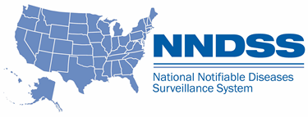
NNDSS eSHARE May Webinar
May 16, 2023
Division of Health Informatics and Surveillance

Slide 2
Agenda
NNDSS Updates and Announcements
CDC Case Surveillance Modernization Updates
Annual Reconciliation of 2022 NNDSS Data
Finalization of 2022 NNDSS COVID-19 Annual Data
Questions and Answers

Slide 3
NNDSS Updates and Announcements
Michele Hoover, MS
Data Standardization and Assistance Team (DSAT)
Office of Public Health Data, Surveillance, and Technology

Slide 4

Visit the New NBS Modernization Website!
cdc.gov/nbs/modernization
Learn more about this important work, including:
Why NBS is Modernizing: The overarching goals for NBS modernization, benefits, and CDC’s commitment to the modernization efforts
How NBS is Modernizing: CDC’s development approach and multi-year goals
Timeline: How CDC plans to evolve NBS over time to keep up with new technologies and changing user needs
Latest Project Updates
Resources for Jurisdictions
Bookmark and share!
4

Slide 5
Updated HAI MDRO MMG
  Value Set Updates
    Version 4 is the most up-to-date version of the PHIN VADS Healthcare-Associated Infections (HAI), Multidrug-Resistant Organisms (MDRO) Case Notification View. Changes include:
      Two values added to PHVS_TypeCoInfection_C.auris (now v.2)
      Two values added to PHVS_LabTestType_CP-CRE (now v.2)
      Four values added to PHVS_LabTestMethod_MDRO (now v.3)
      16 values added and five deprecated for PHVS_GeneName_CP-CRE (now v.4)
      76 values added and two deprecated for PHVS_Organism_CP-CRE (now v.3)
HAI MDRO MMG v1.0.2: https://ndc.services.cdc.gov/mmgpage/healthcare-associated-infections-multidrug-resistant-organisms-hai-mdro-message-mapping-guide/
HAI MDRO PHIN VADS Case View (version 4): https://phinvads.cdc.gov/vads/ViewView.action?id=0C960826-03DE-ED11-81C4-005056ABE2F0
PHIN VADS Type of Co-Infection (C. auris) value set (version2): https://phinvads.cdc.gov/vads/ViewValueSet.action?id=A4EEB4D1-9973-4C3B-AB92-1F9226AB5128
PHIN VADS CP-CRE Lab Test Type value set (version 2): https://phinvads.cdc.gov/vads/ViewValueSet.action?id=5A174E34-675E-4D93-BEF9-8532BAF8F0A7
PHIN VADS MDRO Lab Test Method value set (version 3): https://phinvads.cdc.gov/vads/ViewValueSet.action?id=677FC72C-7C87-4A34-AA1B-3D6378AED584
PHIN VADS Gene Name (CP-CRE) value set (version 4): https://phinvads.cdc.gov/vads/ViewValueSet.action?id=F7776687-51DC-4465-A93B-32B5AC1CAB7D
PHIN VADS Organism (CP-CRE) value set (version 3): https://phinvads.cdc.gov/vads/ViewValueSet.action?id=14A802B7-A3D8-4BC7-950E-0DC8156DFF48
5

Slide 6
OMB Approval – New Events
OMB approval to receive and process new conditions starting for 2023 data year was received on March 23, 2023
Strongyloidiasis (event code 12036)
Carbapenemase-Producing Organisms (CPO), clinical (event code 50270)
Carbapenemase-Producing Organisms (CPO), screening (event code 50271)
Transition to CPO:
CP-CRE (event code 50244) will be accepted through 2023 as jurisdictions transition to sending CPO
CP-CRE (event code 50244) will be retired and error out, starting in 2024
6

Slide 7
CDC Enhancements to Case Surveillance
Implementation Update
Danielle Tack, DVM, MPVM, DACVPM
Data Standardization and Assistance Team
Office of Public Health Data, Surveillance, and Technology

Slide 8
Progress Highlights
Recommendation | Status | Planned Actions
Prioritize onboarding of all jurisdictions and conditions onto a generic, core data feed | MITRE landscape analysis on track to launch this month Finalizing documents for desktop review | Kickoff call and initiation of MITRE desktop review
Pause disease-specific MMG new development & onboarding | Emailed jurisdictions on 5/4 with specific MMGs being supported, based on criteria for onboarding during the pause | Responding to jurisdiction replies to emails Assessing jurisdiction recommendations on MMGs that should be supported regardless of implementation status
Develop case reporting data dictionary | CSTE data standardization – launched Travel 4/28, next call 5/26 Use of DMI Priority Team 2 product (case data elements for emergency response) to inform CSTE data standardization WG priorities | Continued assessment of Symedical and other commercial products Exploration of building an in-house vocabulary tool Expanding MMG AT capabilities to support .CSV builds and machine readable specifications
Develop a strategy for a flexible data pipeline from sending jurisdictions | Working to launch an “EpiSync” pilot focused on more flexible processing, with .CSV as a format option | Continued support to pilots for advancing NSA Assessing MVPS processing and validating .CSV files (core data) as a transition mechanism
8

Slide 9

CDC Enhancements to Case Surveillance
Questions or Feedback?
Use this jurisdiction feedback form
Visit our Frequently Asked Questions page
We look forward to hearing from you!
9

Slide 10
Annual Reconciliation of 2022 NNDSS Data
Keaton Hughes, MPH
Epidemiologist
Office of Public Health Data, Surveillance, and Technology

Slide 11
What is NNDSS Reconciliation?
A process used to finalize case counts for the previous year
  Involves collaboration between reporting jurisdictions and CDC
  Ensures agreement between the reporting jurisdiction and the final numbers in CDC NNDSS database
  Ensures data published in the NNDSS Annual Tables are transparent and accurate
Reconciliation is important as it builds trust among jurisdiction partners, CDC programs, and the public
11

Slide 12
User Roles/Access & Permission Guidance

Slide 13
User Roles and Their Activities in Reconciliation
Jurisdiction User
  Lock and submit conditions reviewed and ready for STD Manager and State/Territorial Epidemiologist approval
Jurisdiction Data Manager
  Update user access and permissions
STD Manager
  Review and verify STD conditions
State/Territorial Epidemiologist
  Sign off and approve final data
  Verify reporting exceptions and conditions sent using retired event codes
13

Slide 14
New User Access for MVPS portal
Ensure necessary staff have MVPS portal access through (SAMS) by having the Jurisdiction Data Manager send an e-mail to edx@cdc.gov with subject line “New MVPS User Access”
14

Slide 15
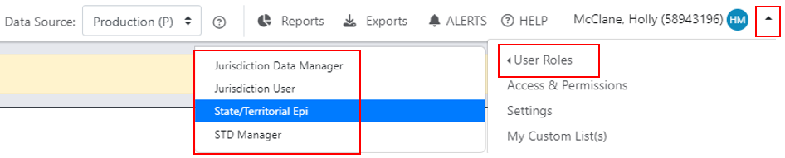
Switch User Roles as Needed
If an individual has multiple roles they can easily switch between them to perform activities.
15

Slide 16
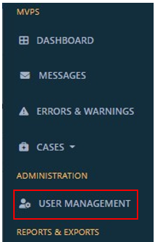
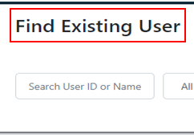

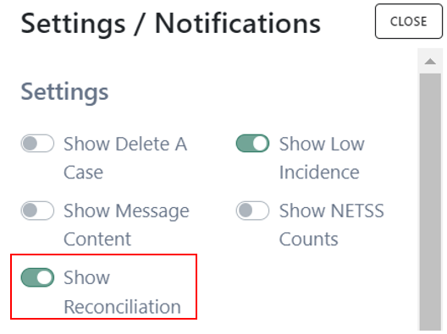
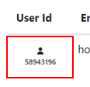
Enable Reconciliation Module Permissions
Select “User Management”
Find and select desired individual
Select “Settings” and toggle on reconciliation
Only Jurisdiction Data Managers can modify access and permissions.
16

Slide 17
2022 Reconciliation Topics
2022 reconciliation process overview
Walking through the new reconciliation process in the MVPS portal
Steps for finalizing sexually transmitted disease (STD) and congenital syphilis data
Resources and methods for successful reconciliation
2022 NNDSS aggregate COVID-19 data request
Questions/discussion

Slide 18
2022 Reconciliation Process Overview

Slide 19

New Reconciliation Process in MVPS portal!
The intention remains the same but tasks will now be completed in MVPS
    Review reporting exceptions
    Review cases being sent using retired event codes
    Verify and update low incidence cases
    View/download stratification reports and line list
    Lock records when they appear correct
    Unlock and re-lock records if case notification updates are needed
    STD Manager and State/Territorial Epidemiologists can verify and approve data (sign-off in MVPS)
19

Slide 20
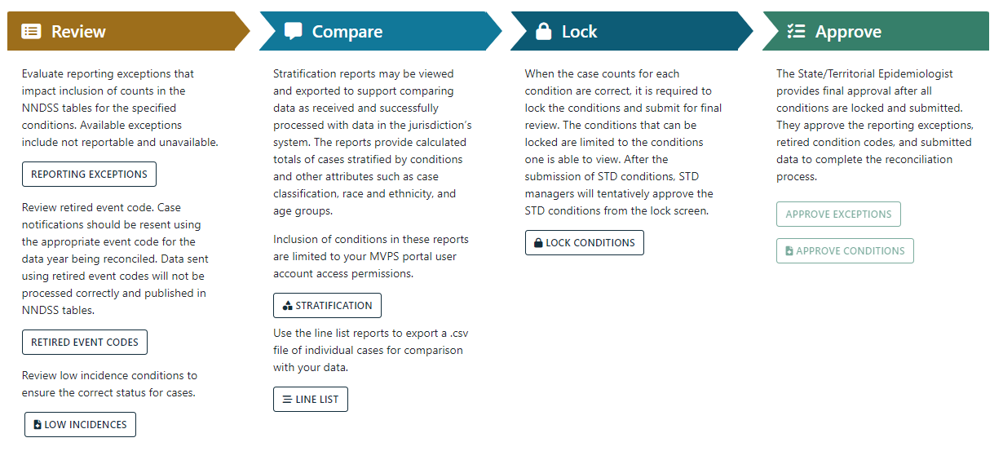
New Reconciliation Process and Flow
20

Slide 21
Comparing Major Differences - Last Year with Now
Activity | Last Year | Going Forward
Reconciliation Tables | NNDSS Surveillance Officers would prepare and share through e-mail as needed. | Jurisdictions can autonomously prepare/calculate stratification tables in the MVPS portal.
Locking/Unlocking Data | NNDSS Surveillance Officers would lock and unlock data grouped by STD- and non-STD conditions. | Jurisdictions can autonomously lock/unlock data by individual conditions in the MVPS portal.
Reporting Exceptions | Jurisdictions verified with NNDSS Surveillance Officers and they were included in the final tables signed by state epidemiologists | Jurisdictions can verify in the MVPS portal and if changes are needed they will inform their NNDSS Surveillance Officer.
State/Territorial Epi Final Table Sign Off | Back and forth communication confirming data and e-mailing copies of the final tables. | The state/territorial epidemiologist may sign off on the final tables in the MVPS portal.
21

Slide 22
2022 Reconciliation Calendar: Journey to Success
5/16/23 | eSHARE Webinar: Reconciliation Process for NNDSS Annual Tables, 2022 State/Territorial Epi reconciliation letter with production calendar sent
 | State/Territorial Epi reconciliation letter with production calendar sent
5/17/23 | NNDSS Surveillance Officer e-mails reconciliation packets Reconciliation module in MVPS portal is available
5/25/23 | Special eSHARE Webinar: Reconciliation and Finalization of 2022 NNDSS Mpox Annual Data
7/28/23 | CDC program databases closed:
 | ArboNet | Pediatric flu mortality and novel flu | Pediatric flu mortality and novel flu
 | Tuberculosis | HIV diagnosis | HIV diagnosis
 | Rabies, animal | Varicella mortality | Varicella mortality
 | Deadline to send STD and Congenital Syphilis (CS) data to CDC
22

Slide 23
2022 Reconciliation Calendar: Journey to Success (cont)
8/11/23 | Deadline to lock data in MVPS (excluding CS data) Deadline to request that DSTDP lock CS data
8/18/23 | Deadline for jurisdiction STD Managers to verify and tentatively approve STD data in the MVPS portal DSTDP emails sign off letters to jurisdictions
8/25/23 | Deadline for State/Territorial Epidemiologist to complete the following: Sign off on final tables in MVPS portal Sign off on final CS numbers with DSTDP Sign off final mpox numbers in DCIPHER Sign off final COVID-19 aggregate case counts in Epi InfoTM form NNDSS database CLOSED (FINAL) for all jurisdictions
23

Slide 24
Walking Through the New Reconciliation Process in the MVPS Portal

Slide 25
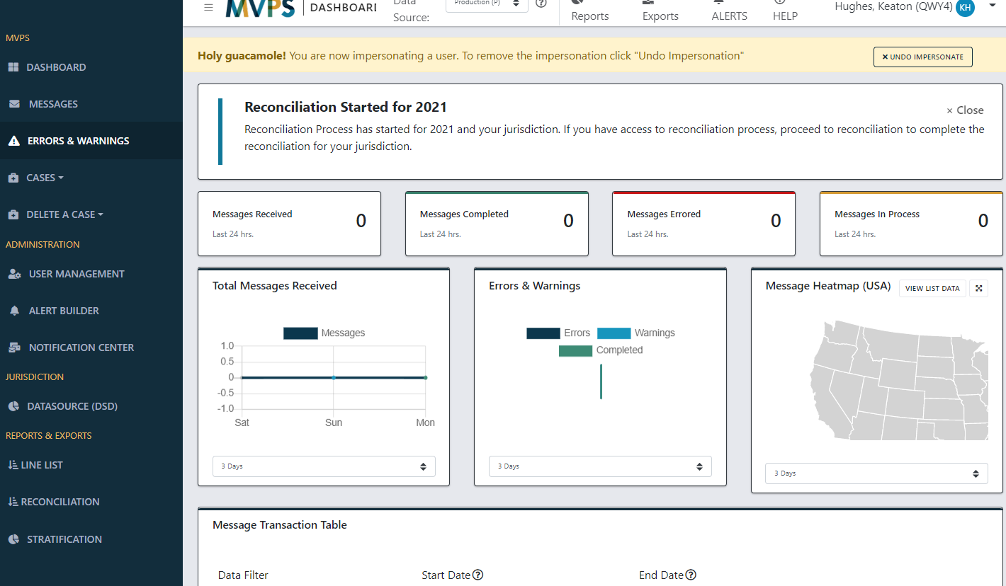
New Reconciliation Start
25

Slide 26
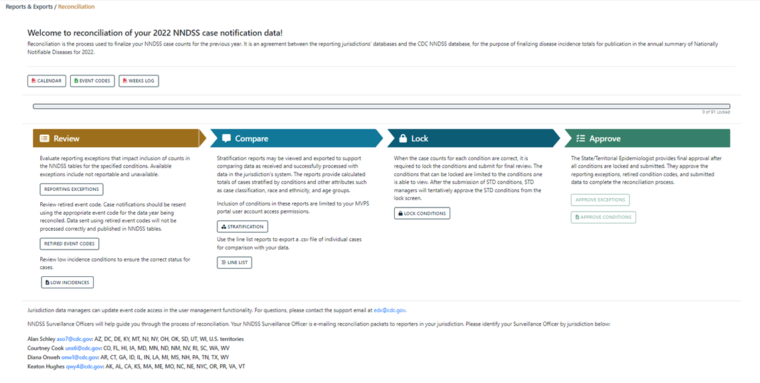
Reconciliation Landing Page
26

Slide 27
Review: Reporting Exceptions
27

Slide 28
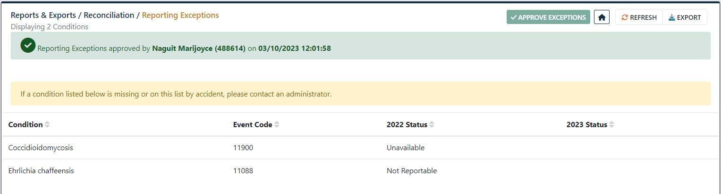
Review: Reporting Exceptions
Reporting exceptions exclude case counts from publication
If condition is not reportable in jurisdiction, the NNDSS tables display “N”
If data are unavailable in jurisdiction, the NNDSS tables display “U”
Important to inform your NNDSS Surveillance Officer of any reporting exception changes early in the reconciliation process!
28

Slide 29
Review: Retired Event Codes
29

Slide 30
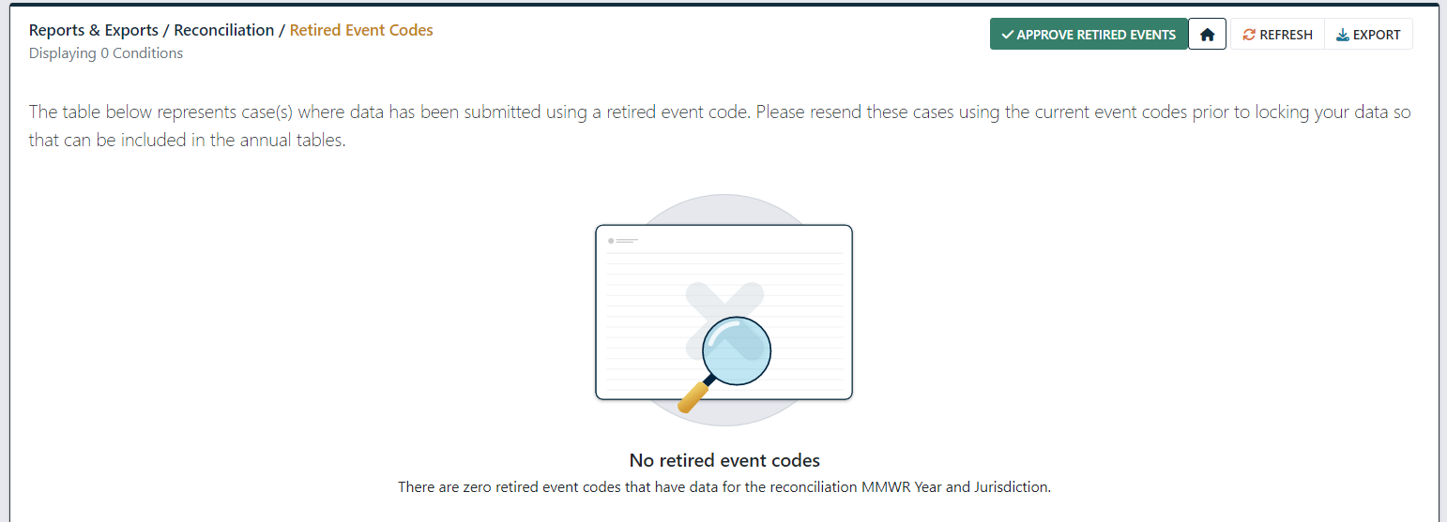
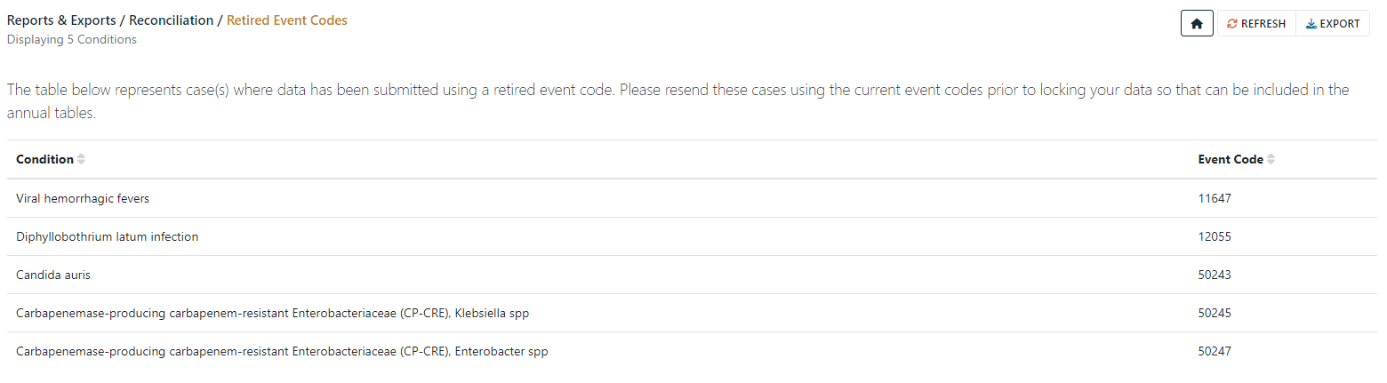
Review: Retired Event Codes
30

Slide 31
Review: Low Incidence Verification
31

Slide 32
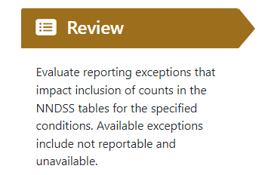
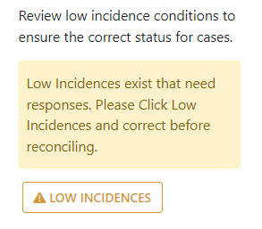
Review: Low Incidence Verification
Low incidence cases require a response by jurisdictions and/or CDC programs prior to locking and finalizing the data
  Responses are required for all cases in the Low Incidences section of MVPS
  Cases that should not be published numbers also need updates sent to CDC (e.g., change classification to 'not a case')
32

Slide 33
Compare: Stratification Reports
33

Slide 34
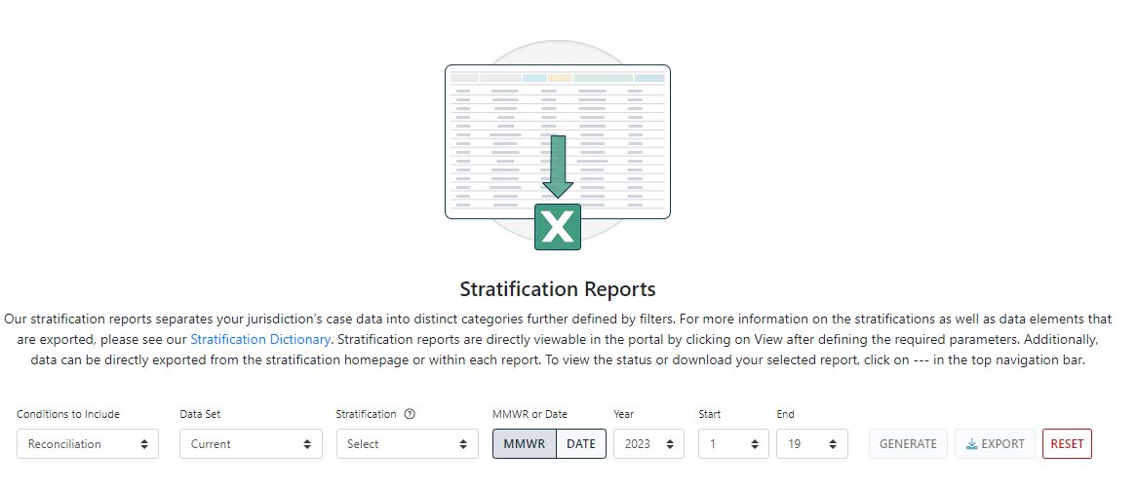
Compare: Choosing Stratification Report Criteria
34

Slide 35
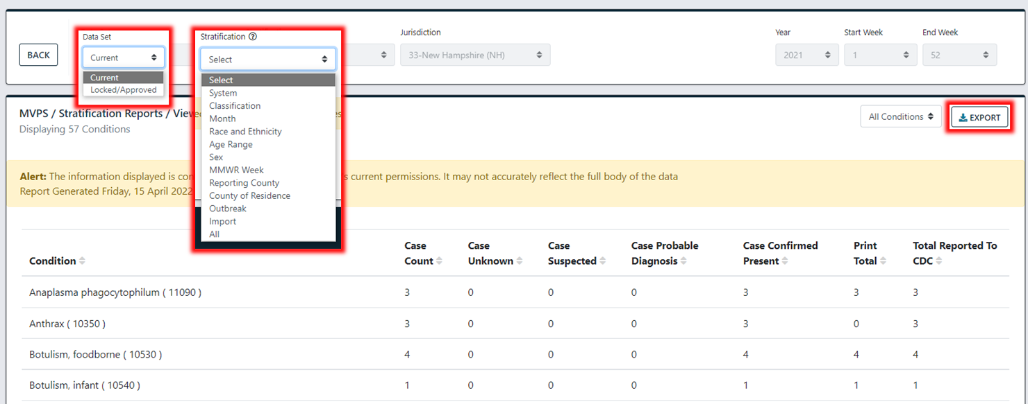
Compare: Viewing Stratification Reports
35

Slide 36
Compare: Identifying Line List
36

Slide 37
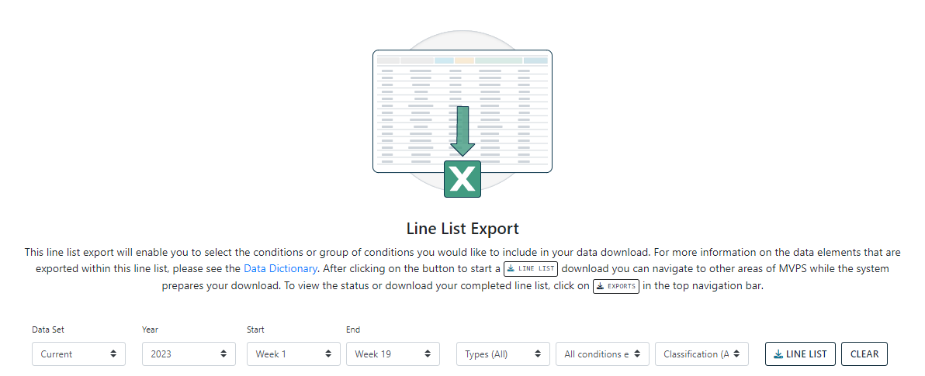
Compare: Choosing Line List Criteria
37

Slide 38
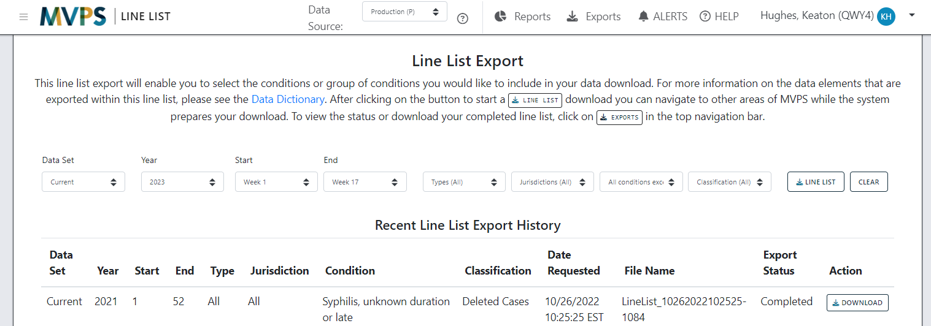
COMPARE: Downloading and Viewing Line List
38

Slide 39
Lock: Locking and Unlocking
39

Slide 40
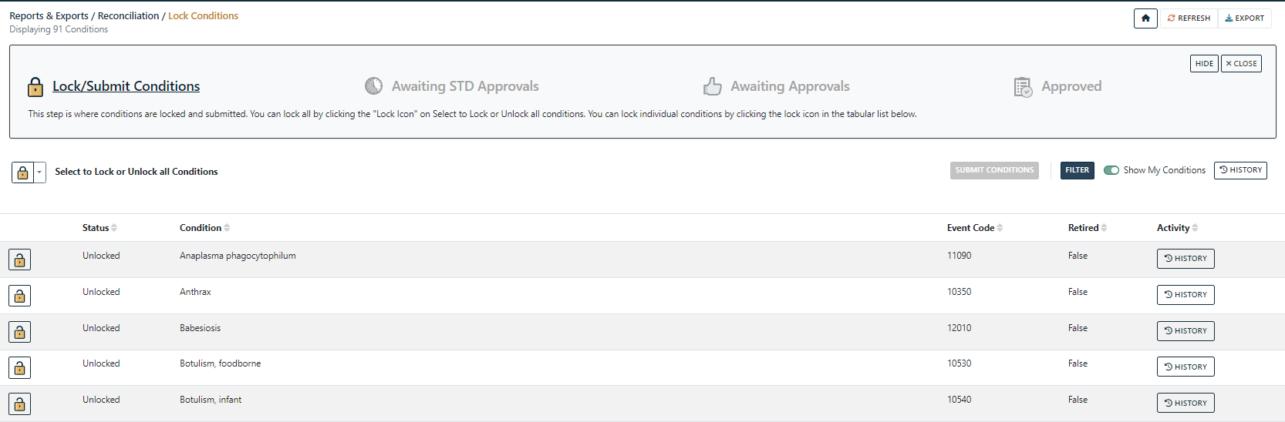
Lock: Locking and Unlocking Landing Page
40

Slide 41
Lock: Locking and Unlocking Individual Conditions
41

Slide 42
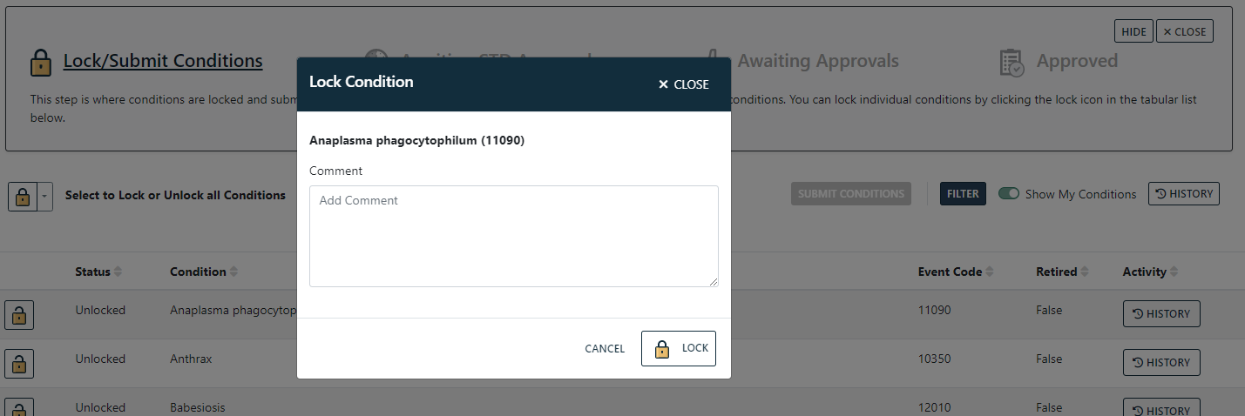
Lock: Locking and Unlocking Individual Conditions
42

Slide 43
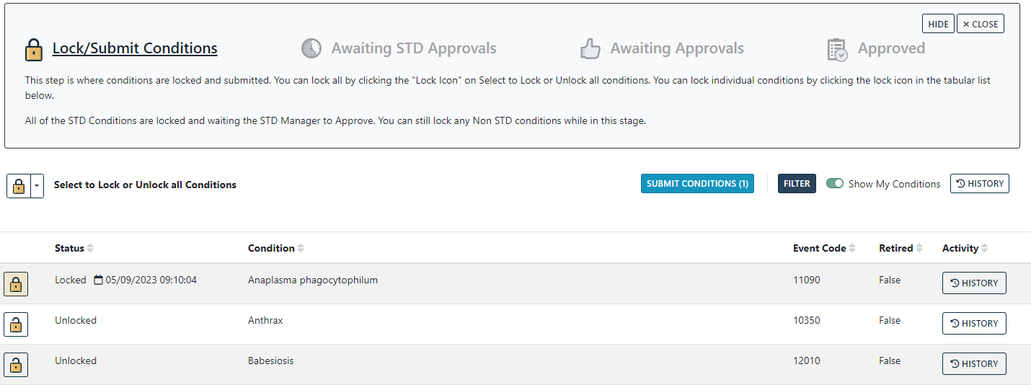
Lock: Locking and Unlocking Individual Conditions
43

Slide 44
Lock: Locking and Unlocking Groups of Conditions
44

Slide 45
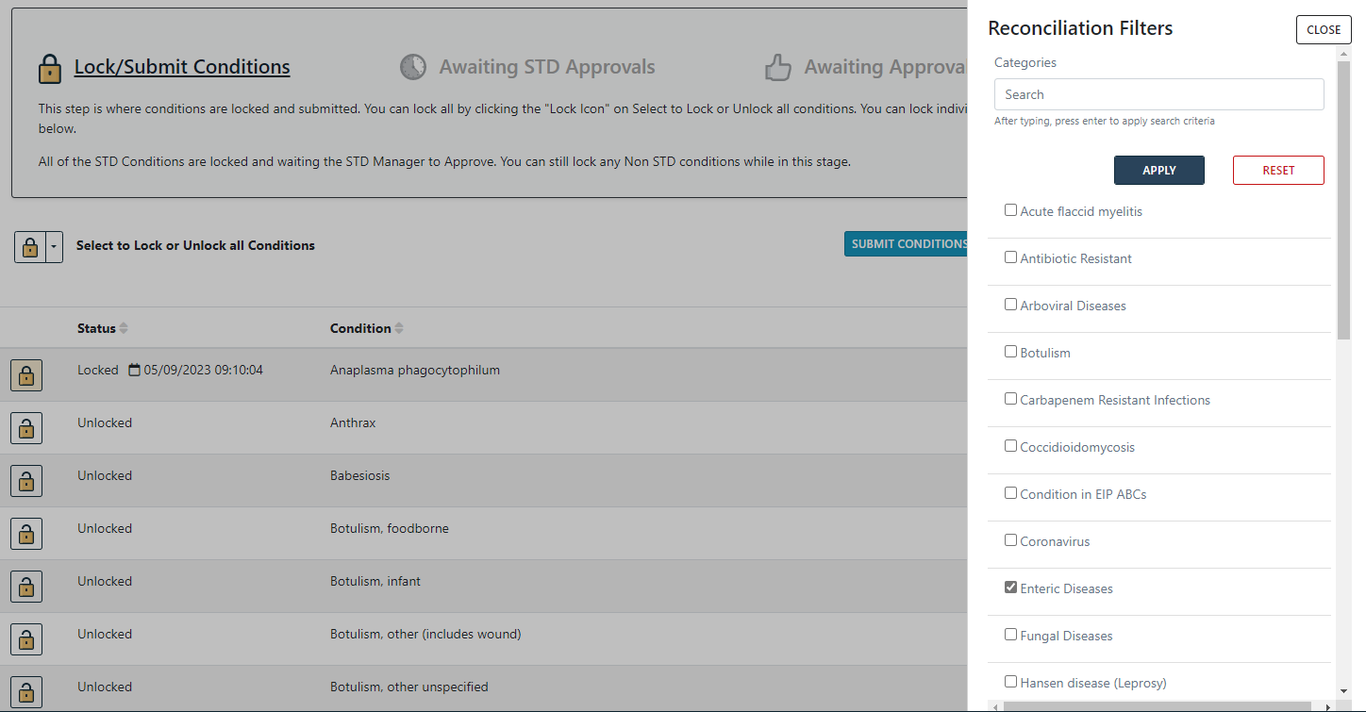
Lock: Locking and Unlocking Groups of Conditions
45

Slide 46
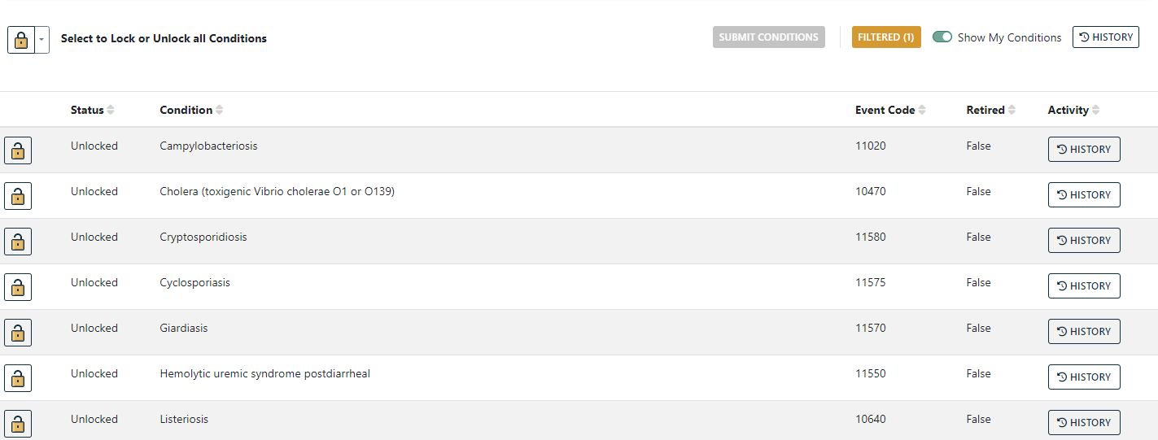
Lock: Locking and Unlocking Groups of Conditions
46

Slide 47
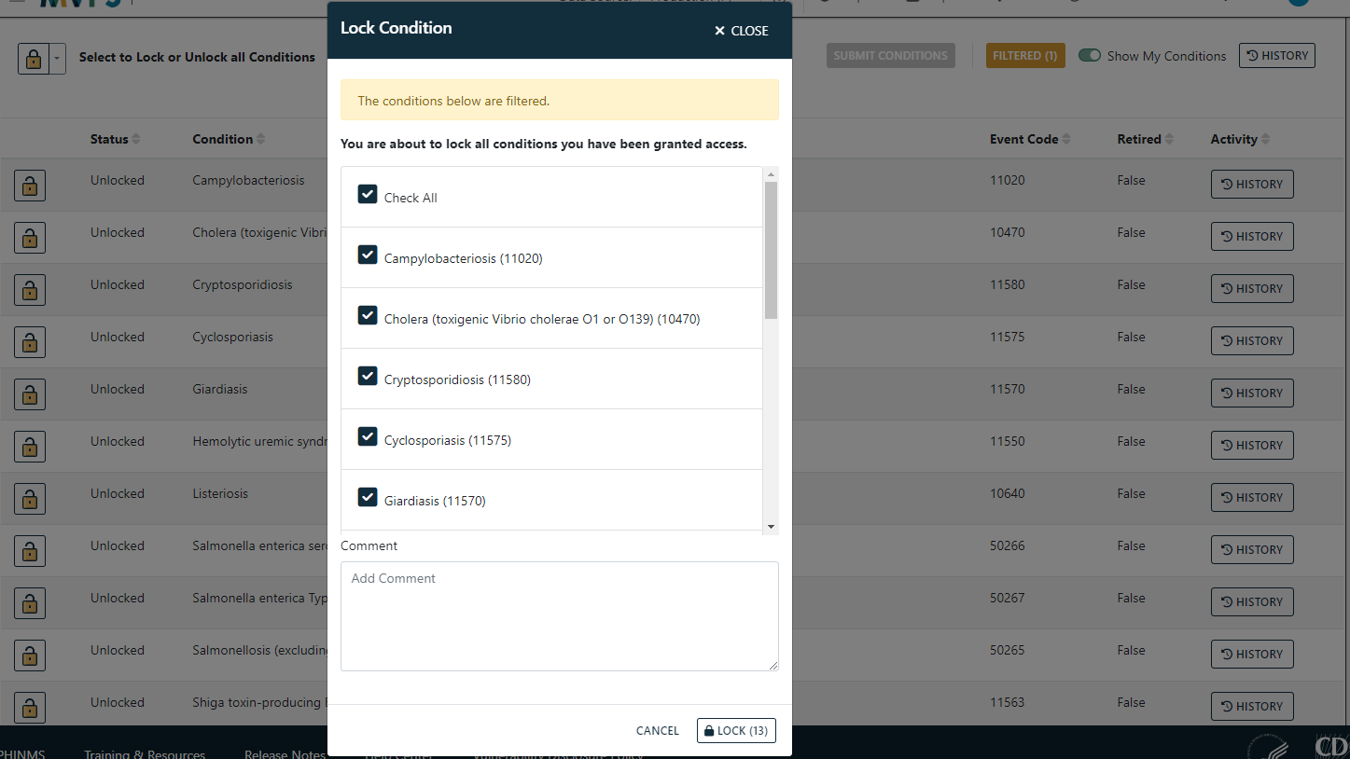
Lock: Locking and Unlocking Groups of Conditions
47

Slide 48
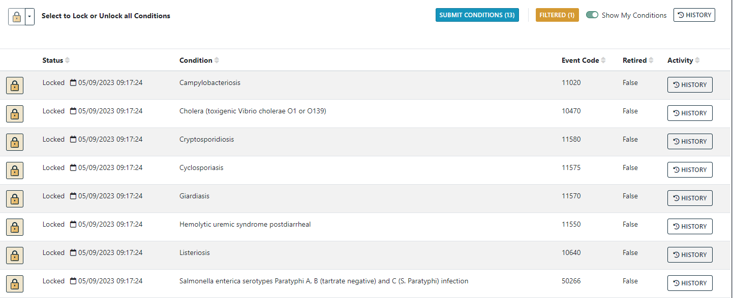
Lock: Locking and Unlocking Groups of Conditions
48

Slide 49
Lock: Submit, Withdraw, and Reject
Submit
  A condition is locked and ready to progress through reconciliation
Withdraw
  An individual realized a condition was submitted that needs to be updated further
Reject
  STD Manager or State/Territorial Epidemiologist reviews case numbers and send conditions back to lock/unlock status to allow for further updates
49

Slide 50
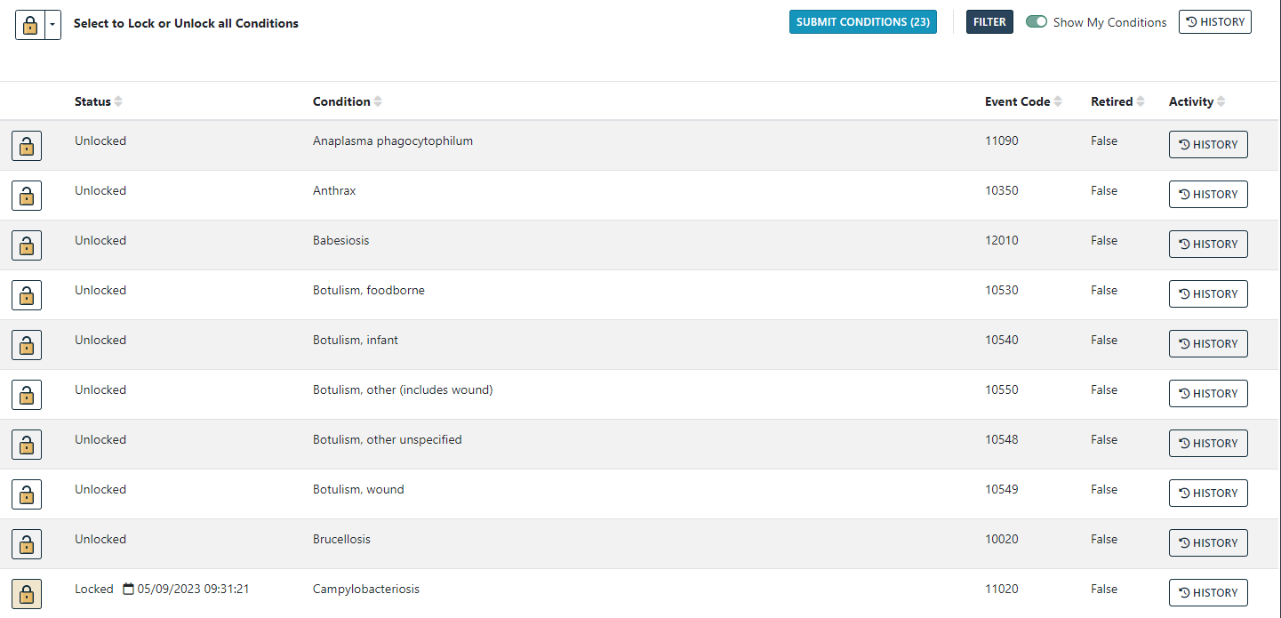
Lock: Submitting Locked Conditions
50

Slide 51
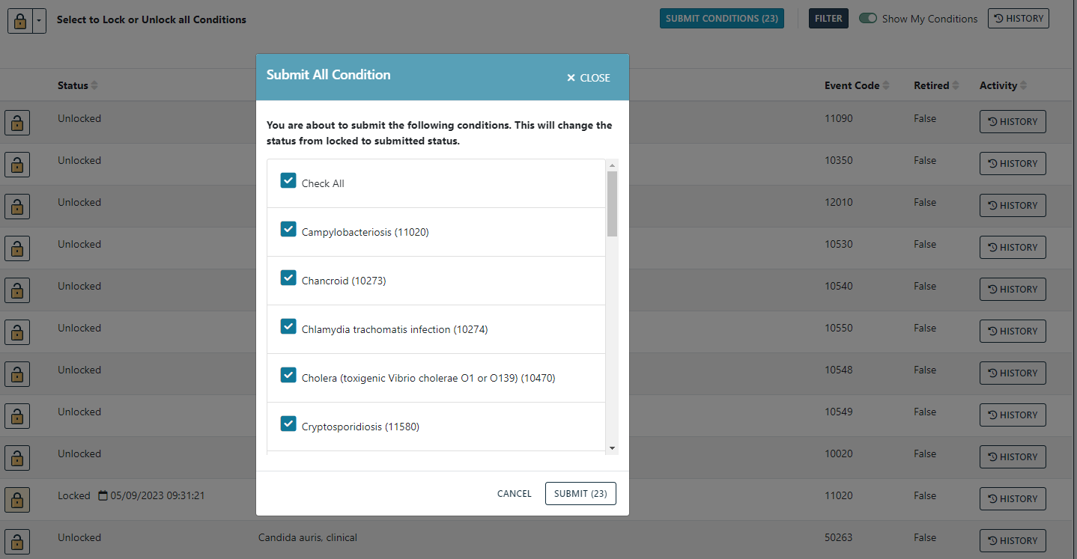
Lock: Submitting Locked Conditions
51

Slide 52
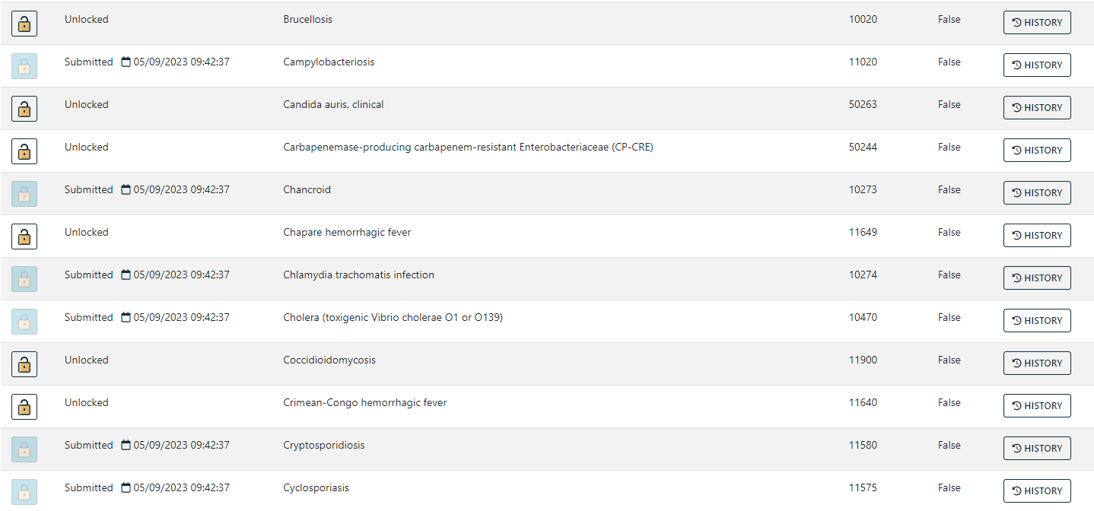
Lock: Submitting Locked Conditions
52

Slide 53
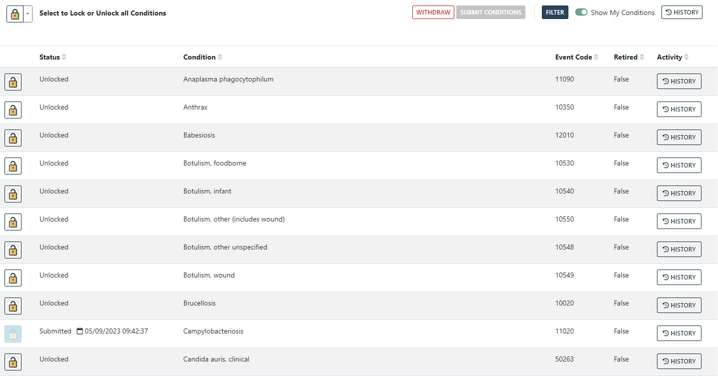
Lock: Withdrawing Submitted Conditions
53

Slide 54
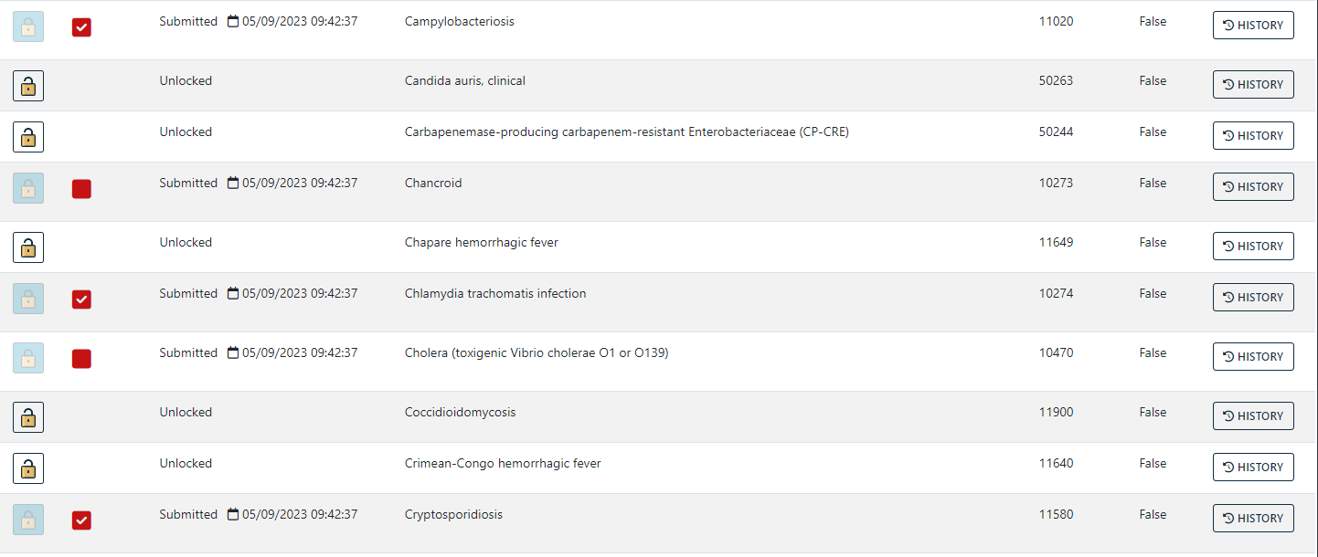
Lock: Withdrawing Submitted Conditions
54

Slide 55
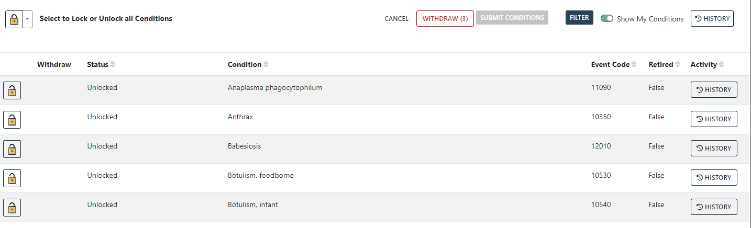
Lock: Withdrawing Submitted Conditions
55

Slide 56
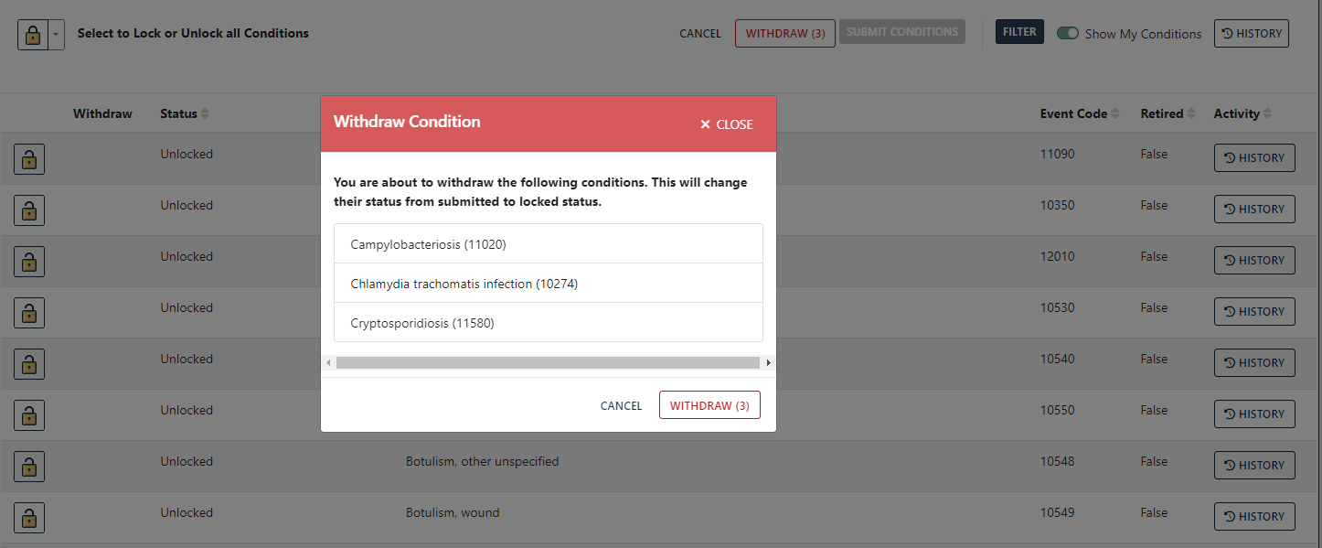
Lock: Withdrawing Submitted Conditions
56

Slide 57
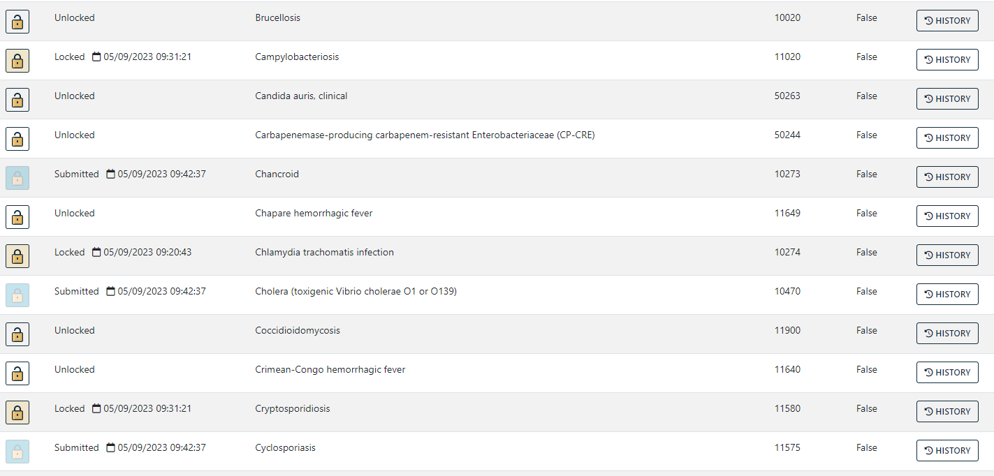
Lock: Withdrawing Submitted Conditions
57

Slide 58
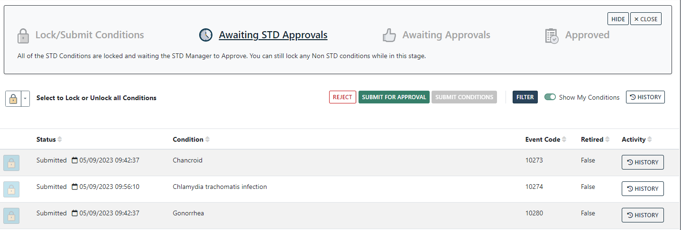
Lock: STD Manager Approval
58

Slide 59
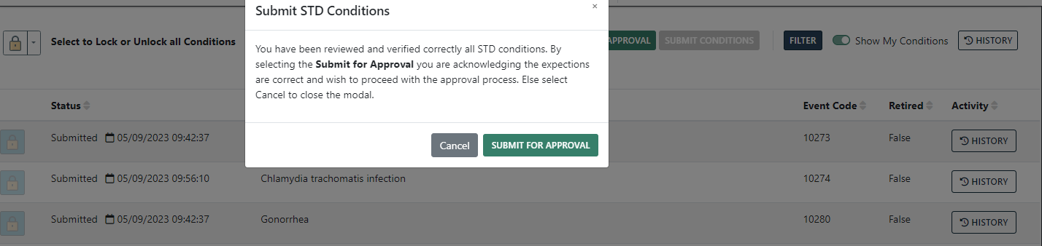
Lock: STD Manager Approval
59

Slide 60
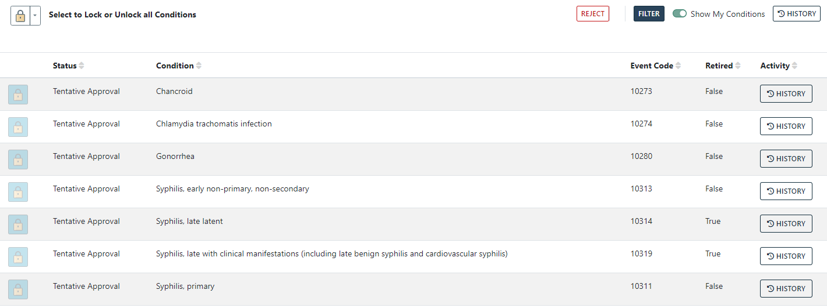
Lock: STD Manager Approval
60

Slide 61
Lock: STD Manager Rejection
61

Slide 62
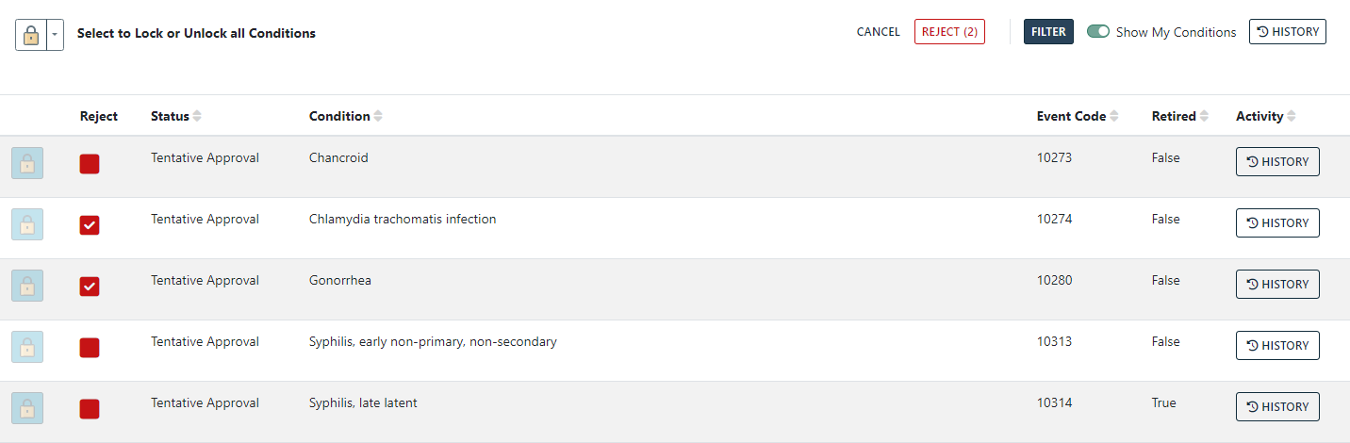
Lock: STD Manager Rejection
62

Slide 63
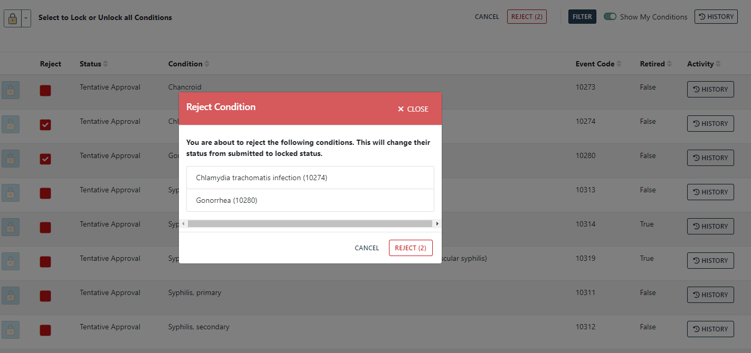
Lock: STD Manager Rejection
63

Slide 64
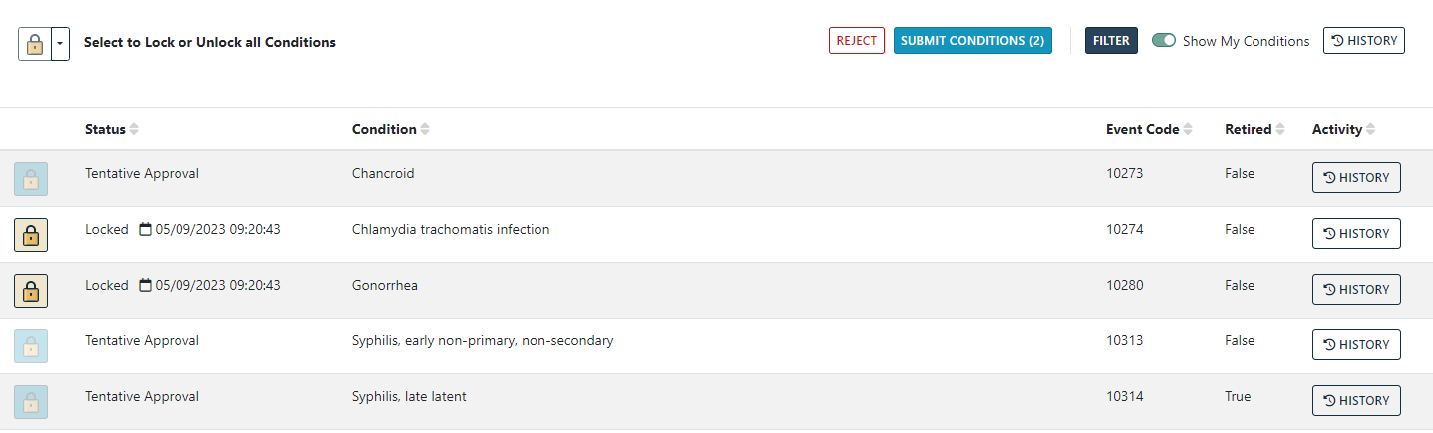
Lock: STD Manager Rejection
64

Slide 65
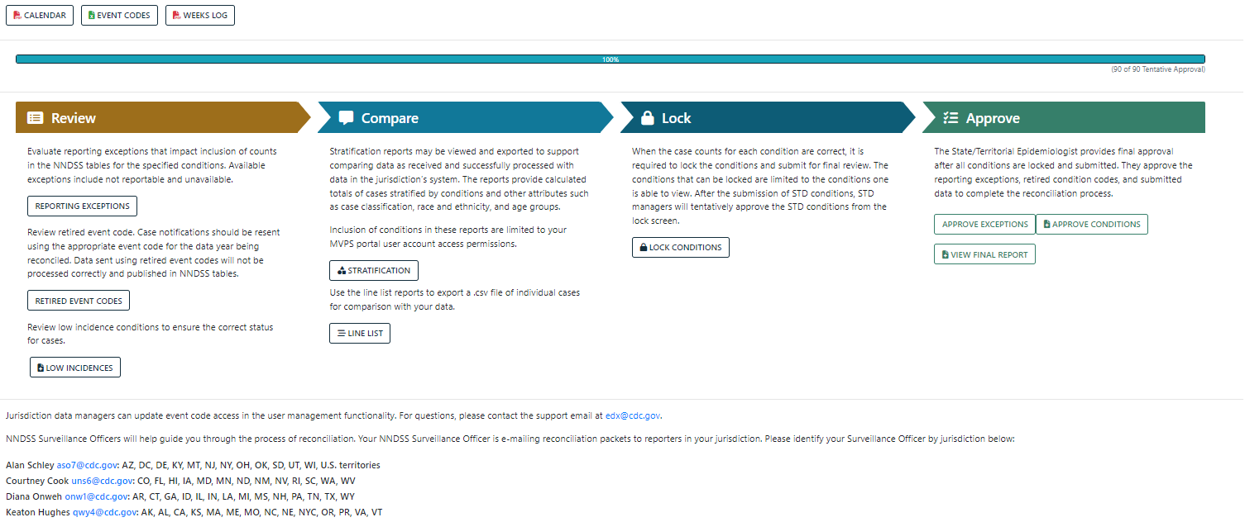
Approve: State/Territorial Epi Approval
65

Slide 66
Approve: Approve Exceptions
66

Slide 67
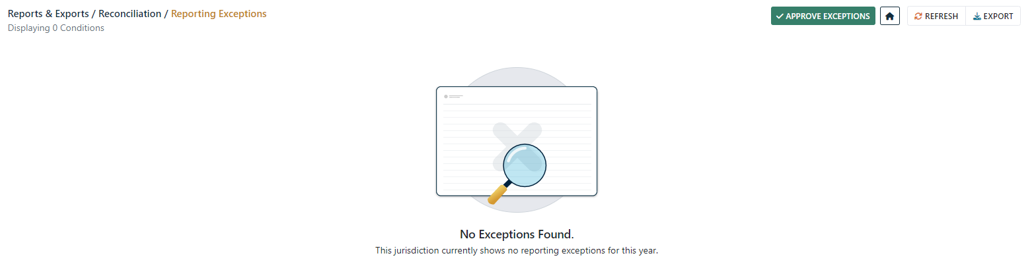
Approve: Approve Exceptions
67

Slide 68
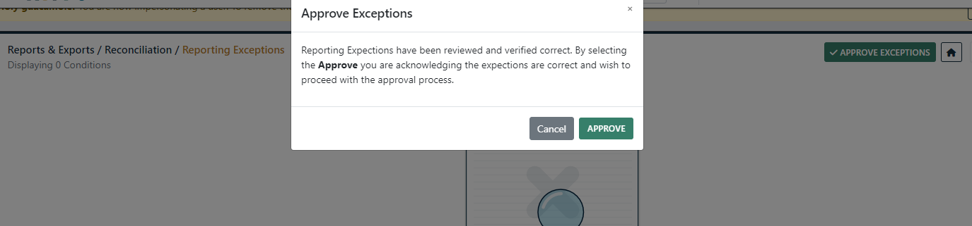
Approve: Approve Exceptions
68

Slide 69
Approve: View Final Report
69

Slide 70
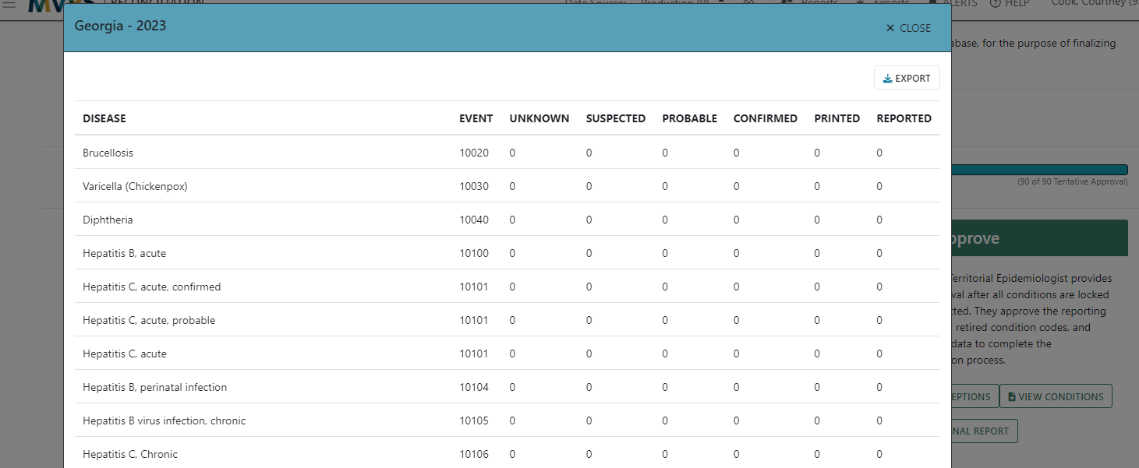
Approve: View Final Report
70

Slide 71
Approve: Approve Conditions
71

Slide 72
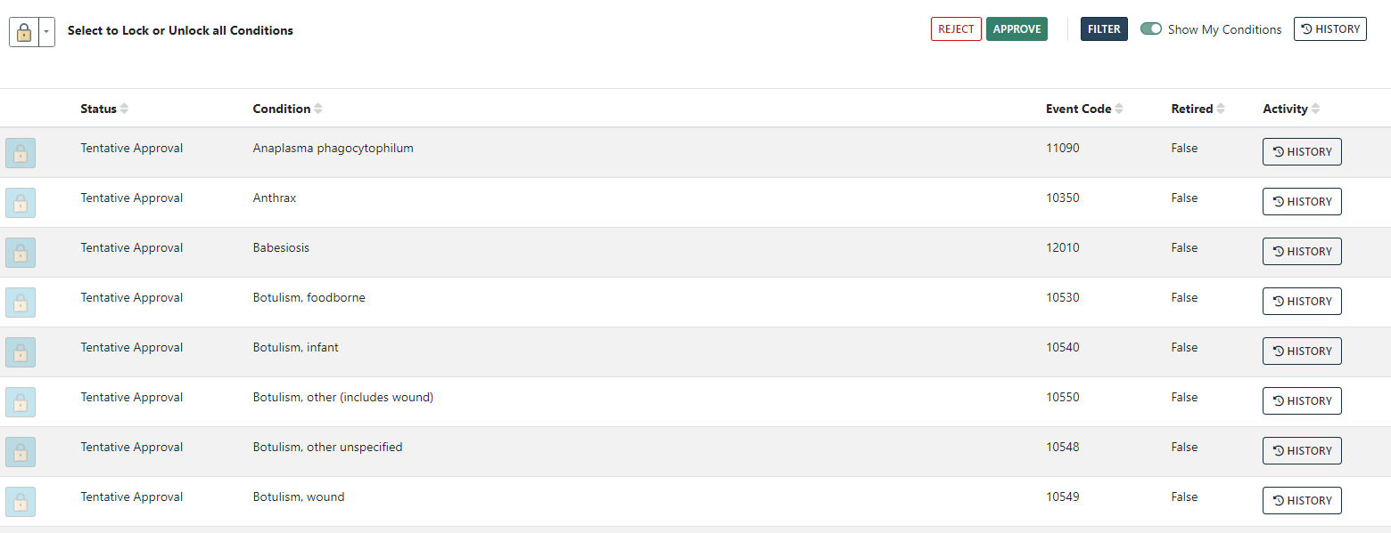
Approve: Approve Conditions
72

Slide 73
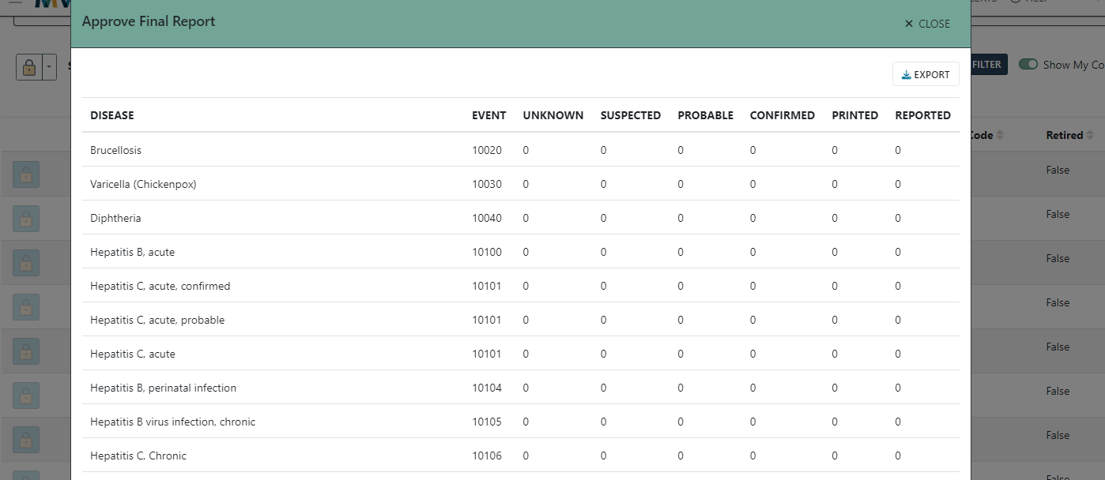
Approve: Approve Conditions
73

Slide 74
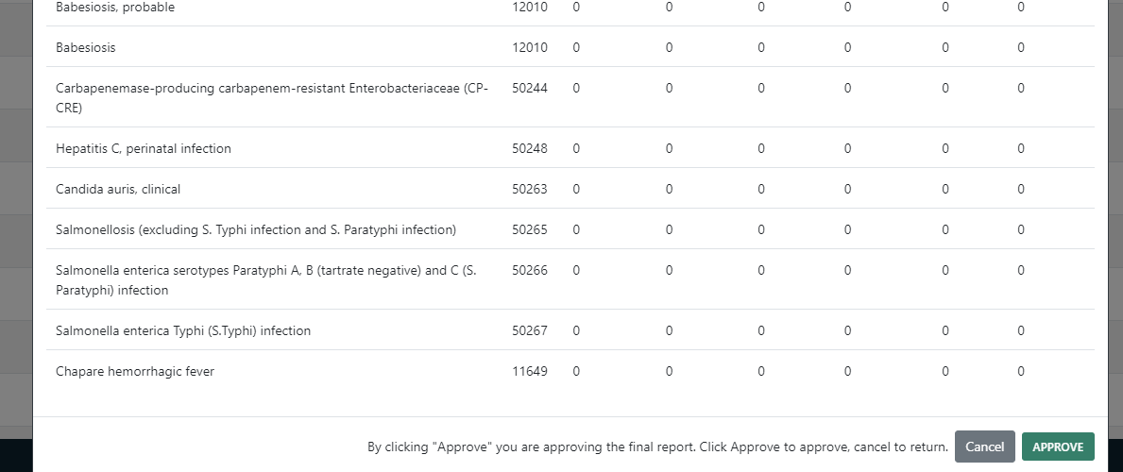
Approve: Approve Conditions
74

Slide 75
Steps For Finalizing STD and Congenital Syphilis Data
Melissa Pagaoa, MPH
Lead, Data Management Team
National Center for HIV, Viral Hepatitis, STD, and TB Prevention

Slide 76
STD data will be reconciled within the MVPS portal;
Congenital syphilis will be reconciled with DSTDP
Date | STD Data | Congenital Syphilis Data
7/28/23 | Deadline for jurisdictions to send data to CDC | Deadline for jurisdictions to send data to CDC
8/11/23 | Deadline for jurisdictions to lock data in MVPS | Deadline for jurisdictions to request DSTDP lock data
8/18/23 | Deadline for jurisdictions’ STD Managers to verify and tentatively approve data in MVPS | Deadline for DSTDP to email sign off letters to jurisdictions
8/25/23 | State/Territorial Epidemiologist sign off on final tables in MVPS | State/Territorial Epidemiologist email/fax completed sign off letters to DSTDP
76

Slide 77
Additional Information
DSTDP will email sign off letters with final STD numbers to all territories and freely associated states (except for Puerto Rico) and final congenital syphilis numbers to all jurisdictions
"Syphilis, unknown duration or late (10320)" combines event codes 10314, 10319, and 10320 in 2022 Stratification Reports
  Event codes listed separately in line list, lock page, and approval page
For STD and congenital syphilis-related data questions, please email: std_surv_inquiry@cdc.gov
77

Slide 78
Resources and Methods for Successful Reconciliation
Courtney Cook, MS
Epidemiologist
Office of Public Health Data, Surveillance, and Technology

Slide 79
Documents Available
Available in MVPS portal for easy access
  Reconciliation User Guide
  MMWR Week Ending Log
  NNDSS Event Code List
  Stratification Report Instructions
  Reconciliation Production Calendar
79

Slide 80
Reconciliation User Guide
Provides step-by-step guidance on conducting the electronic reconciliation process in MVPS, as previously described
  Defines user roles
  Describes the basic steps of reconciliation and the detailed processes within each step
    Review
    Compare
    Lock
    Approve
80

Slide 81
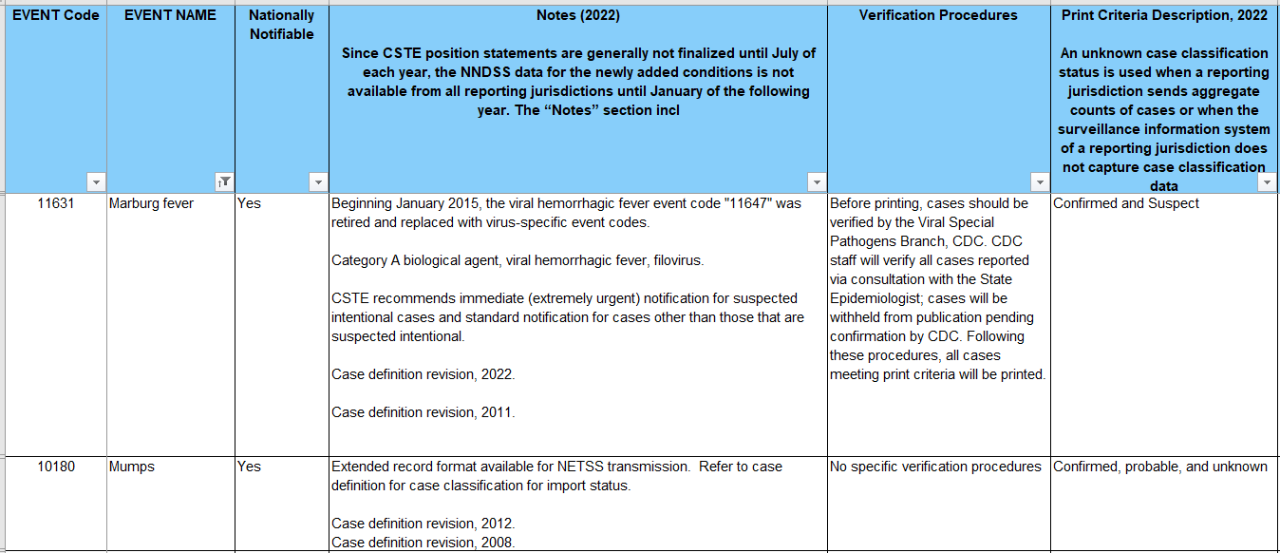
Event Code List Example
81

Slide 82
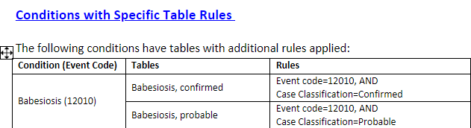
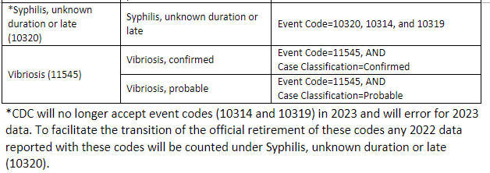
Stratification Report Instructions Example
New section!
82

Slide 83

CDC Programs
Jurisdiction’s disease-specific subject matter experts can work with associated CDC program contacts to review or verify case numbers
83

Slide 84
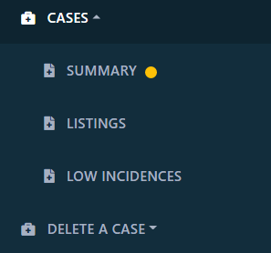
Functionalities in MVPS portal
Background querying allows reports to be prepared without waiting and applies to:
  Case Listing
  Case Summary
  Delete a Case – Case Finder
  Errors & Warnings
Line List and Stratification Reports are also downloaded in the background and previously prepared data is stored and retrievable going forward
84

Slide 85

Functionalities in MVPS portal
The Errors & Warnings function allows you to see messages that have not successfully processed due to errors.
85

Slide 86

Functionalities in MVPS portal
86

Slide 87
NNDSS Surveillance Officers
We are here and enjoy helping!
  New process? Troubleshooting data not updating as expected? Timelines? Anything!!
Alan Schley (aso7@cdc.gov): AZ, DC, DE, KY, MT, NJ, NY, OH, OK, SD, UT, WI, U.S. territories
Courtney Cook (uns6@cdc.gov): CO, FL, HI, IA, MD, MN, ND, NM, NV, RI, SC, WA, WV
Diana Onweh (onw1@cdc.gov): AR, CT, GA, ID, IL, IN, LA, MI, MS, NH, PA, TN, TX, WY
Keaton Hughes (qwy4@cdc.gov): AK, AL, CA, KS, MA, ME, MO, NC, NE, NYC, OR, PR, VA, VT
87

Slide 88

EDX Mailbox
edx@cdc.gov
  Subject line: 2022 reconciliation
88

Slide 89
Finalization of 2022 NNDSS COVID-19 Annual Data

Slide 90
Process for 2022 NNDSS COVID-19 Data
Similar to previous years, final 2022 NNDSS data for COVID-19 will not be reconciled
CDC will collect aggregate case counts for confirmed and probable cases
CDC will provide an Excel worksheet with instructions to help you prepare your data
CDC will send an email (starting May 17) to the State/Territorial Epidemiologists with the link to the Epi Info™ web form to enter the data
State/Territorial Epidemiologists will sign off on the aggregate counts in
Epi Info™
CDC will use the aggregate counts in the 2022 annual NNDSS tables
90

Slide 91
COVID-19 Data for the 2022 Annual NNDSS Tables
2022 final NNDSS COVID-19 aggregate data are needed for confirmed and probable cases among U.S. residents for:
  Total cases in jurisdiction
  Month (based upon MMWR weeks)
  Age group
  Sex
  Race and Hispanic ethnicity
States send data for all the above categories
U.S. territories send only total confirmed and probable cases
Unknown or missing demographic and month data will be collected
91

Slide 92
Combined Race and Ethnicity Categories
Race and ethnicity will be collected in a combined table but will be presented separately in the published NNDSS tables
Cross tabulations of the following race categories with each of the Hispanic/Latino ethnicity values (Hispanic/Latino, non-Hispanic/Latino, and unknown/missing Hispanic/Latino ethnicity) are as follows:
  Native American or Alaska Native
  Black or African American
  White
  Asian
  Native Hawaiian or Other Pacific Islander
  Other or multi-race
  Unknown or missing race
92

Slide 93
Race Categories
These race categories are different from race in the NETSS* record layout:
  Asian and Native Hawaiian or Other Pacific Islander are separate categories
If a person has multiple races, only count the case under the “Other or multi-race” category
In the 2022 NNDSS tables, race and ethnicity data will be presented separately, just as they appear in the 2019 NNDSS annual tables
*NETSS: National Electronic Telecommunications System for Surveillance
93

Slide 94
Epi Info™ Web Form for 2022 Final NNDSS COVID-19 Aggregate Data
To allow for secure data entry, CDC will provide a unique Epi Info™ web form link to each State/Territorial Epidemiologist
Enter requested data into the form and ensure the State or Territorial Epidemiologist reviews and approves the data
  Coordinate within your jurisdiction on who should enter aggregate 2022 COVID-19 data into the form
  Note: Different people can enter different components of the data, but only one person should enter data at a time
    If multiple people enter data at the same time, one person may overwrite the changes of another
94

Slide 95
NNDSS COVID-19 Epi Info™ Web Form
After the data entry is complete, the State or Territorial Epidemiologist can use the link to the Epi Info™ form to review, approve, and submit the final 2022 NNDSS COVID-19 data
Do not click the “Submit” button until all data have been entered, reviewed, and approved by the State/Territorial Epidemiologist
Remember: Although the link can be shared, only one person at a time should enter data in the form
Questions or prematurely submitted the data?
  Email edx@cdc.gov with the subject “2022 final NNDSS COVID-19 data”
95

Slide 96
CDC Review of Final Counts
CDC review of final counts will include:
  Comparing submitted 2022 NNDSS COVID-19 aggregate data to:
    Aggregate case counts submitted by jurisdictions to the response (or pulled from websites)
    Line-level data sent through NNDSS and/or CSV upload to DCIPHER
  Identifying potential data entry errors or transposition of data across fields
In the Epi Info™ web form, enter the name and email of the person CDC should contact for questions
96

Slide 97
Timeline: 2022 Final NNDSS COVID-19 Aggregate Data
By Friday, August 25, 2023
  Jurisdictions should enter their data into the Epi Info™ web form
  State/Territorial Epidemiologist should approve the case counts for the 2022 NNDSS COVID-19 data in the Epi Info™ web form
  The finalized information and sign-off should be submitted through the Epi Info™ web form
97

Slide 98

Q & A

Slide 99

Join Us…
Next NNDSS eSHARE
May 25, 2023, from 3:00-4:00 ET
Topic: Reconciliation and Finalization of 2022 NNDSS Mpox Annual Data

Slide 100




N
Thank you!
Subscribe to
Case Surveillance News
Access NNDSS’ Technical Resource Center
Email edx@cdc.gov for technical help
Learn about case surveillance modernization

