Slide 1
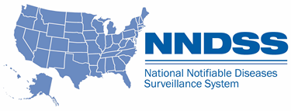
NNDSS eSHARE April Webinar
April 18, 2023
Division of Health Informatics and Surveillance

Slide 2
Agenda
NNDSS Updates and Announcements
CDC Case Surveillance Modernization Updates
Preview of the 2022 NNDSS Annual Data Reconciliation
The NIOCCS Tool: Automated Coding of Occupational Health Data
Questions and Answers

Slide 3
NNDSS Updates and Announcements
Michelle Hoover, MS
Data Standardization and Assistance Team (DSAT)
Office of Public Health Data, Surveillance, and Technology

Slide 4

Visit the New NBS Modernization Website!
cdc.gov/nbs/modernization
Learn more about this important work, including:
Why NBS is Modernizing: The overarching goals for NBS modernization, benefits, and CDC’s commitment to the modernization efforts
How NBS is Modernizing: CDC’s development approach and multi-year goals
Timeline: How CDC plans to evolve NBS over time to keep up with new technologies and changing user needs
Latest Project Updates
Resources for Jurisdictions
Bookmark and share!
4
Notes:
CDC is excited to share the newly published National Electronic Disease Surveillance System Base System (NBS) modernization website
The new pages highlight the important work being done to modernize NBS
NBS is a top priority of CDC’s Data Modernization Initiative and CDC’s North Star Architecture framework— a core component of CDC’s approach for making public health data work better.
Find information about why CDC is modernizing, how CDC is modernizing, timelines, the latest updates on our progress, and key resources to learn more.
For eSHARE:
CDC will use this website, along with other communication channels such as eSHARE and Case Surveillance News, to share information on this effort with STLTs
We encourage you to bookmark and share the new website with staff and leadership in your jurisdictions
For Biweekly:
OPHDST/DHIS will use this website, along with other communication channels such as these biweekly calls, eSHARE, and Case Surveillance News, to share information on this effort with your programs.
We encourage you to bookmark and share the new website with staff and leadership in your programs as well as STLT partners.

Slide 5
Updated Malaria MMG
  Value Set Updates
    Version 6 is the most up-to-date version of the PHIN VADS Malaria Case Notification View. Changes include:
      10 additional values and deprecating one for Travel Reason (Malaria)
Malaria MMG v1.0.2: https://ndc.services.cdc.gov/mmgpage/malaria-message-mapping-guide/
Malaria PHIN VADS Case View version 6: https://phinvads.cdc.gov/vads/ViewView.action?id=F5287F42-8AD4-ED11-81C4-005056ABE2F0
PHIN VADS Malaria Travel Reason value set (version 4): https://phinvads.cdc.gov/vads/ViewValueSet.action?id=F47D38D9-22B4-4FEF-9A4B-BDC3CC9491B5
5

Slide 6
OMB Approval – New Events
OMB approval to receive and process new event codes starting for 2023 data year was received on March 23, 2023
Carbapenemase-Producing Organisms (CPO), clinical (event code 50270)
Carbapenemase-Producing Organisms (CPO), screening (event code 50271)
Strongyloidiasis (event code 12036)
Transition to CPO:
CP-CRE (event code 50244) will be accepted through 2023 as jurisdictions transition to CPO, clinical (event code 50270) and CPO, screening (event code 50271)
CP-CRE (50244) will be retired and error out, starting in 2024
6

Slide 7
CDC Enhancements to Case Surveillance
Implementation Update
Danielle Tack, DVM, MPVM, DACVPM
Data Standardization and Assistance Team
Office of Public Health Data, Surveillance, and Technology

Slide 8
Progress Highlights
Recommendation | Status | Planned Actions
Prioritize onboarding of all jurisdictions and conditions onto a generic, core data feed | Continued documentation prep and prioritization of jurisdictions | MITRE landscape analysis for GenV2 to launch in late April or early May
Pause disease-specific MMG new development & onboarding | Updated gaps in MMG implementation status based on ELC-HIS quarterly calls held to date Updated FAQs posted for: ELC HIS on where MMG efforts could be refocused Use of MMG content during the pause | ELC-HIS calls ended in March, additional follow-up first couple of weeks of April Finalizing NBS page implementation guidance
Develop case reporting data dictionary | CSTE data standardization – starting Travel 4/28 Use of DMI priority Team 2 product (case data elements for emergency response) to inform CSTE data standardization WG priorities | Continued assessment of Symedical and other commercial products Exploration of building an in-house vocabulary tool
Develop a strategy for a flexible data pipeline from sending jurisdictions | Working to launch an “EpiSync” pilot focused on more flexible processing, with .CSV as a format option | Continued support to pilots for advancing NSA Assessing MVPS processing and validating .csv files (core data) as a transition mechanism
8

Slide 9

CDC Enhancements to Case Surveillance
Questions or Feedback?
Use this jurisdiction feedback form
Visit our Frequently Asked Questions page
We look forward to hearing from you!
9

Slide 10
Preview of the 2022 NNDSS Annual Data Reconciliation
Sara Johnston, MPH
NNDSS Program Lead
Office of Public Health Data, Surveillance, and Technology

Slide 11
New Reconciliation Process in MVPS Portal!
Complete the reconciliation process in the MVPS portal
  View/download stratification reports and line list
  Lock records when they appear correct
  STD Manager and State/Territorial Epidemiologist can verify and approve data (sign-off in MVPS)
New user permission/roles:
  State/Territorial Epidemiologist role
  STD Manager role
  Other users – add permission to reconciliation module (Coming in May!)
Reconciliation kickoff will be mid-May and Closeout expected mid-August
11

Slide 12
2022 Reconciliation Preparation
New MVPS User Roles
CDC is assigning State/Territorial Epidemiologist roles in MVPS to sign off and approve final data
  Contact us (edx@cdc.gov) if your State/Territorial Epi recently changed or a different person usually approves the annual data (e.g., Deputy State Epi)
The CDC STD program is communicating with your STD teams to confirm the list of STD Managers to review and verify STD conditions
  Follow up on inquiry from std_surv_inquiry@cdc.gov if needed
MVPS Portal User Access
Request new users (edx@cdc.gov, subject: “MVPS Access”)
12

Slide 13
COVID-19 2022 Reconciliation
2022 NNDSS COVID-19 Aggregate Data
Data will be finalized as in previous years – using the Epi Info™ web form
  Jurisdictions will enter their final 2022 aggregate data and the State/Territorial Epidemiologists will sign off electronically in the form
  These numbers will be used in the annual NNDSS publication
13

Slide 14
Mpox 2022 Reconciliation
2022 Mpox Process
Case data submitted through DCIPHER will be used for reconciliation and the data will be finalized through a tool/module in DCIPHER
  Case data may be reviewed in DCIPHER, with reports available to support comparison
  A mechanism will be made available in DCIPHER to lock and finalize 2022 mpox data
  These numbers will be used in the annual NNDSS publication
14

Slide 15

Getting to Work:
Tools for Coding Occupational Data for Public Health Surveillance
Stacey Marovich, MHI, MS, PMP
Lead Health Informatics Scientist
Centers for Disease Control and Prevention (CDC)
National Institute for Occupational Safety and Health (NIOSH)
Division of Field Studies & Engineering (DFSE)
Health Informatics Branch (HIB)
NNDSS eSHARE April Meeting
April 18, 2023

Slide 16



What is NIOSH?
The National Institute for Occupational Safety and Health (NIOSH)
  Part of the Centers for Disease Control and Prevention (CDC)
  Website: https://www.cdc.gov/niosh/
VISION
MISSION
Safer,
Healthier
Workers
To develop new knowledge in the field of occupational safety and health and to transfer that knowledge into practice.
16

Slide 17


NIOSH Surveillance Program
Performs and supports surveillance of:
  Cases of deaths, injuries, illnesses, and hazards known to be related to work
  Patterns of deaths, injuries, illnesses, and health behaviors among different groups of workers that suggest occupational risk factors
  Dissemination of worker health surveillance data
17

Slide 18
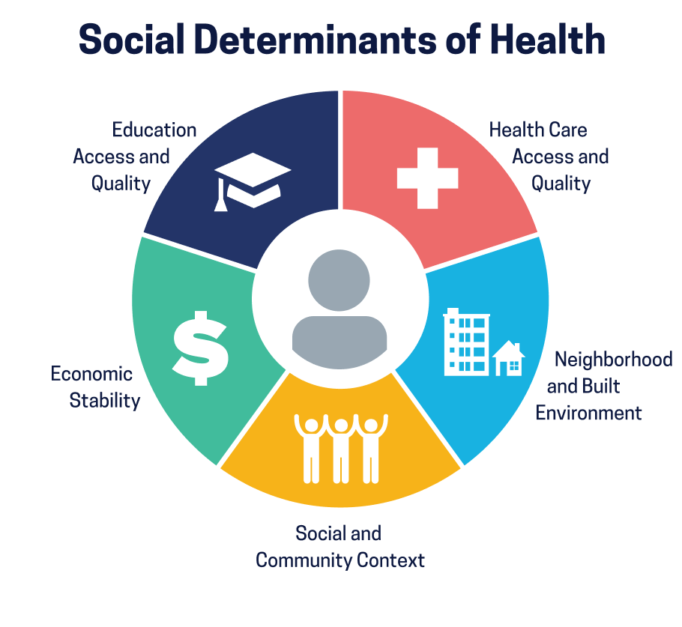
Importance of Collecting Work Information in Health Data Collections
Work is a Social Determinant of Health (SDOH)
Measure health equities/inequities among workers and populations
Measure differential impact of SDOH among worker populations
Assess the impact of work and other environmental factors, e.g., climate change, on workers’ health
18

Slide 19


Work Impacts Health. Health Impacts Work.
Health and work are interrelated but work information is often inadequately collected in public health activities
Critical need for industry and occupation (I&O) to be collected and coded into structured categories to facilitate clinical care and inform interventions
19

Slide 20








What is Industry and Occupation?
Industry – The kind of business where a person works
Examples: Grocery Store, Hospital, Bank, Auto Manufacturer
Occupation – The kind of work a person does to earn a living
Examples: Bank Teller, Nurse, Inspector, Waiter
20

Slide 21






Collecting and Coding Industry and Occupation Data
Collect
Code
Collect BOTH industry & occupation
Collect free text descriptions NOT dropdowns
How to ask for I&O:
Industry:
Occupation:
Industry & occupation codes are standardized
Different classification systems for coding I&O data
Use NIOCCS to autocode free text I&O data as it’s collected in real-time (single record) or after collection is complete (multiple records)
https://www.cdc.gov/niosh/topics/coding/
21

Slide 22
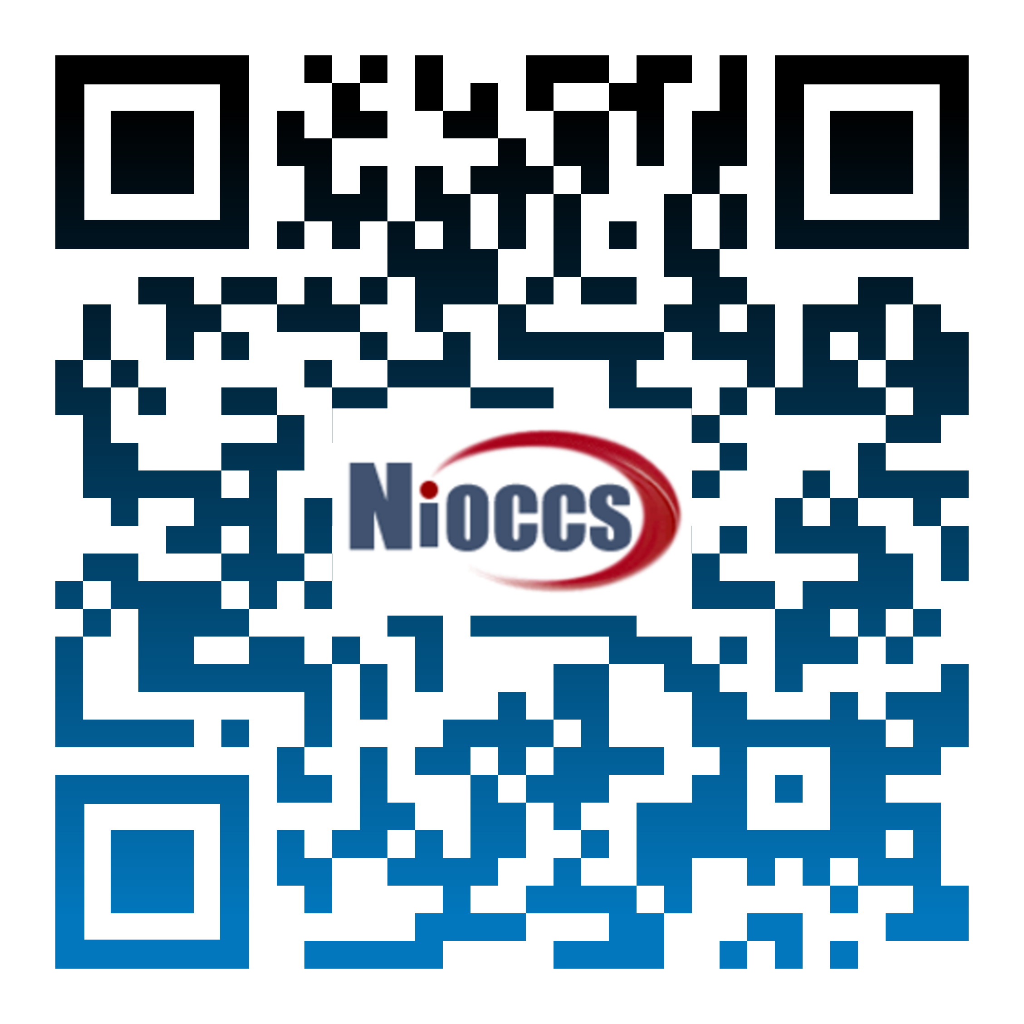


NIOCCS – What Is It?
NIOSH developed the NIOSH Industry and Occupation Computerized Coding System (NIOCCS), a web-based software platform, used to translate industry and occupation (I&O) narratives into standardized I&O codes
NIOCCS is free and makes coding I&O data easy, fast, and consistent – it has been used to code hundreds of millions of records to date
Modernizes public health surveillance systems to enable rapid assessment of how people’s jobs impact their health and safety
22

Slide 23




NIOCCS – Who Uses It?
NIOCCS has over 1200 user accounts
Global user base includes US and 25 other countries
Used by variety of organizations that collect and/or evaluate information using I&O including:
  Occupational researchers
  Federal government agencies
  State/local health departments
  Academic institutions
  Cancer registries, etc.
23

Slide 24

NIOCCS - History
2018 – NIOCCS V3
2012 – NIOCCS V1
* Autocode rate: 84%
* Autocode rate: 59%
2015 – NIOCCS V2
* Autocode rate: 66%
2021 – NIOCCS V4
* Introduced machine learning for auto-coding
Machine learning
* Autocode rate: 100%
24

Slide 25

How Does NIOCCS Work?
INPUTS
OUTPUTS
Occupation Free Text
Occupation Standardized Codes
Industry Free Text
Industry Standardized Codes
25

Slide 26
NIOCCS - Industry and Occupation Classification Systems
North American Industry Classification System (NAICS)
Used by federal agencies to classify business establishments
Standard Occupational Classification (SOC)
Used by federal agencies to classify workers into occupational categories
NAICS and SOC are unrelated
Census Industry and Occupation Classification System
Derived from NAICS and SOC and maintained by the U.S. Census Bureau
Census I&O codes can be related or paired
Codes are less detailed than NAICS and SOC to protect privacy
NAICS and SOC are unrelated
Developed by OMB
Developed by BLS
Updated every 5 years
Updated every 5 years
* Office of Management and Budget (OMB)
* Bureau of Labor Statistics (BLS)
26

Slide 27
Examples of Industry and Occupation Coding Using NIOCCS
NIOCCS does the coding for you!
What industry do you work in? | Census industry code | North American Industry Classification System (NAICS) code
Hospital | 8191 | 622110
Medical Center | 8191 | 622110
VA hospital | 8191 | 622110
Hopsital | 8191 | 622110
What kind of job do you do? | Census occupation code | Standard Occupational Classification (SOC)
Nurse | 3255 | 29-1141
Registered Nurse | 3255 | 29-1141
RN | 3255 | 29-1141
Nurce | 3255 | 29-1141
NIOCCS autocodes free text industry and occupation narratives into NAICS, SOC, and Census codes.
NIOCCS can even code some misspelled entries like “hopsital” and “nurce.”
These four different text responses provided for industry would autocode to the same industry code.
The four different text responses provided for occupation would autocode to the same occupation code.
27

Slide 28
NIOCCS Tools
NIOCCS Feature | Functionality
Single Record Coding | Codes or crosswalks one I&O record
File Coding | Codes or crosswalks multiple I&O records in batch files
Crosswalk Coding | Maps codes from one classification to another or different years within the same classification
Epi Info™ I&O Template | Template can be plugged into any survey built in Epi Info™ to collect and code I&O data in real-time
Web API | Codes I&O data in real-time
28

Slide 29
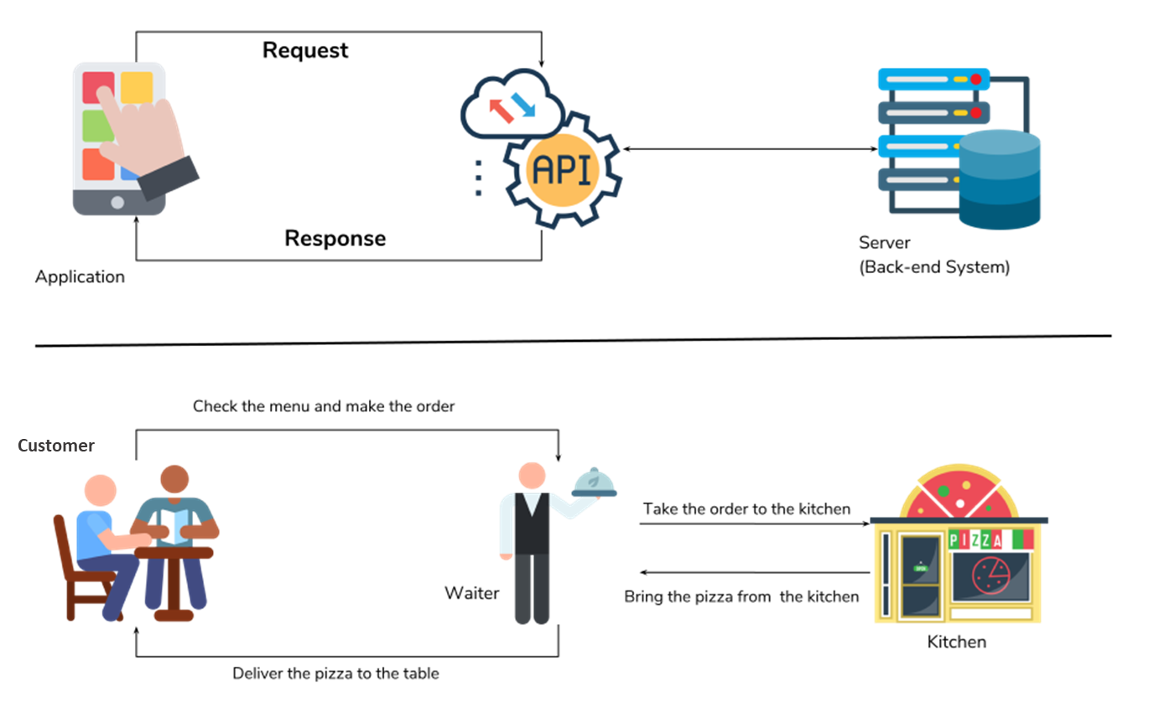
What is a Web API?
* Application Programming Interface (API)
Source: https://www.geeksforgeeks.org/
29

Slide 30



What is the NIOCCS Web API?
Enables real-time coding of industry and occupation into any data collection platform
Built on the same industry and occupation autocoder used by the NIOCCS website
Accessed for free via a simple web call
No login or account required
No data is stored/retained on the NIOSH server
Can be used to generate autocoded data and code candidates in applications other than NIOCCS
Example code and more information available at: https://csams.cdc.gov/nioccs/HelpWebService.aspx
30

Slide 31
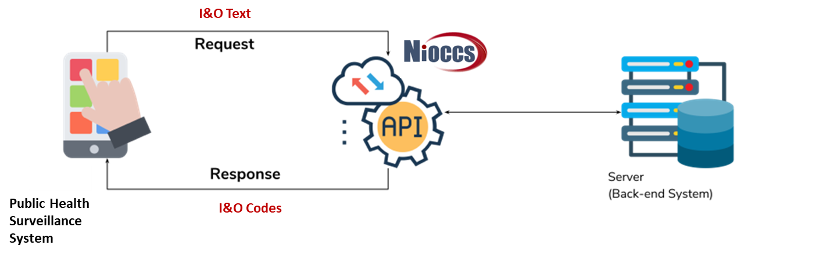

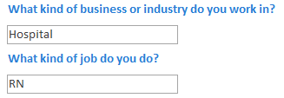
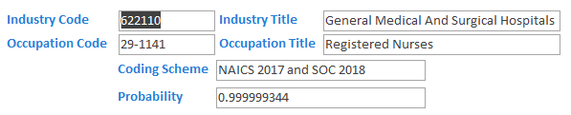
Implementation of NIOCCS Web API
IMPACT
  Real-time coded I&O
  Facilitates analysis of illnesses and injuries among specific jobs and industries
REQUEST
RESPONSE
31

Slide 32
NIOCCS in Action
Multiple state and local jurisdictions use NIOCCS to code industry and occupation data
California
Wisconsin
“The California Department of Public Health’s (CDPH) Occupational Health Branch (OHB) used NIOCCS extensively during its COVID-19 response to I/O code weekly fatalities, collected workplace outbreak and survey data. The NIOCCS web service [Web API] automated processing of large datasets weekly, with improved machine learning-based quality meant CDPH OHB manual review of only the lowest probability results. Together these improvements have enabled quick CDPH OHB COVID-19 response, reduced the team training and modernized high throughput, high quality I/O [industry and occupation], simply not possible through manual coding alone.”
“NIOCCS has transformed the field of occupational surveillance and epidemiology and its latest versions have accelerated CDPH OHB efforts to characterize the California workplace COVID-19 burden for prevention of worker exposures, illnesses and deaths.”
“We use NIOCCS to gather real-time coded industry and occupation data on various communicable disease interview forms (including COVID-19 forms). We also use the file coder to code large historical datasets.”
“Where employment data would previously have been coded manually or assigned via arbitrary dropdown menus, NIOCCS allows us to quickly assign detailed NAICS and SOC codes – enabling efficient analysis of large datasets. In turn, this makes rapid dissemination of important workplace measures to local and tribal health departments possible.”
32

Slide 33

Acknowledgements
NIOCCS System Development Team
Stacey Marovich (NIOSH), Team Lead/Project Officer
Kelly Vanoli (NIOSH), Lead Developer
Jennifer Cornell (NIOSH), Technical Information Specialist
Jeff Purdin (Contractor), Developer/Data Manager
Igor Kalennyy (Contractor), UI/UX Specialist
Industry and Occupation Data Coding Team
Matt Hirst (Contractor), Coding Team Lead
Katrina Bicknaver (Contractor), Coder
Crystal Greene (Contractor), Coder
Joetta Thornton (Contractor), Coder
Liz Smith (Contractor), QC Coding Team Lead
Rebecca Purdin (Contractor), QC Coder
Surprese Watts (Contractor), QC Coder
Additional Support
Amy Mobley (NIOSH), Health Communications Specialist
Marie Haring Sweeney (NIOSH), DFSE/HIB Branch Chief
https://csams.cdc.gov/nioccs/

Slide 34

Q & A

Slide 35
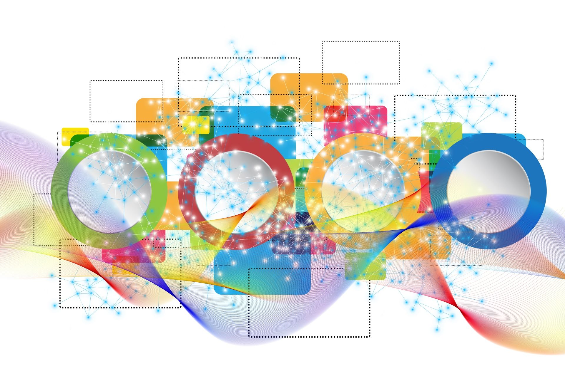
Join Us…
Next NNDSS eSHARE
May 16, 2023, from 3:00-4:30 ET
(extended to 1 ½ hours)
Topic: 2022 NNDSS Annual Data Reconciliation Kickoff

Slide 36




N
Thank you!
Subscribe to
Case Surveillance News
Access NNDSS’ Technical Resource Center
Email edx@cdc.gov for technical help
Learn about case surveillance modernization

