Slide 1
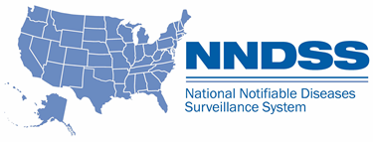
NNDSS eSHARE
January 2023 Webinar
Division of Health Informatics and Surveillance
January 17, 2023

Slide 2
Agenda
  NNDSS Updates and Announcements
  What Jurisdictions Need to Know for 2023
  CDC Case Surveillance Modernization Updates
  Questions and Answers

Slide 3
NNDSS Updates and Announcements
Michele Hoover, MS
Data Standardization and Assistance Team
Center for Surveillance, Epidemiology, and Laboratory Services

Slide 4
Updated Lyme/Tickborne Rickettsial Diseases (TBRD) Message Mapping Guide (MMG)
  Value Set Updates
    Version 4 is the most up-to-date version of the PHIN Vocabulary Access and Distribution System (VADS) Lyme/TBRD Case Notification View
    Changes include:
      15 additional values for Lab Test Type (Lyme) and
      four additional values for Lab Test Type (TBRD)
Lyme & TBRD MMG v1.0.2: https://ndc.services.cdc.gov/mmgpage/lyme-and-tickborne-rickettsial-diseases-message-mapping-guide/
Lyme & TBRD PHIN VADS Case View version 4: https://phinvads.cdc.gov/vads/ViewView.action?id=B63E2CFD-8176-ED11-81BF-005056ABE2F0
PHIN VADS Lyme Lab Test Type value set (version 3): https://phinvads.cdc.gov/vads/ViewValueSet.action?id=7814BF16-A346-4F7C-BE8B-917DD9FE8D56
PHIN VADS TBRD Lab Test Type value set (version 5): https://phinvads.cdc.gov/vads/ViewValueSet.action?id=E435AC06-2CD6-4FB5-9D79-D9357DF2CF99

Slide 5
New Interactive Tool for NNDSS Annual Data
  Makes NNDSS data more transparent and enhances the user experience
  The new tool allows users to:
    Create customized data visualizations to meet their needs
    Analyze data and understand trends and pattern by comparing NNDSS data across years, specific populations, conditions, and geographic areas
  Please Note: CDC is not adding any new data elements to NNDSS data displays or the ability to stratify existing NNDSS data elements in ways not previously available
https://wonder.cdc.gov/nndss-annual-summary.html

Slide 6

Progress

Slide 7
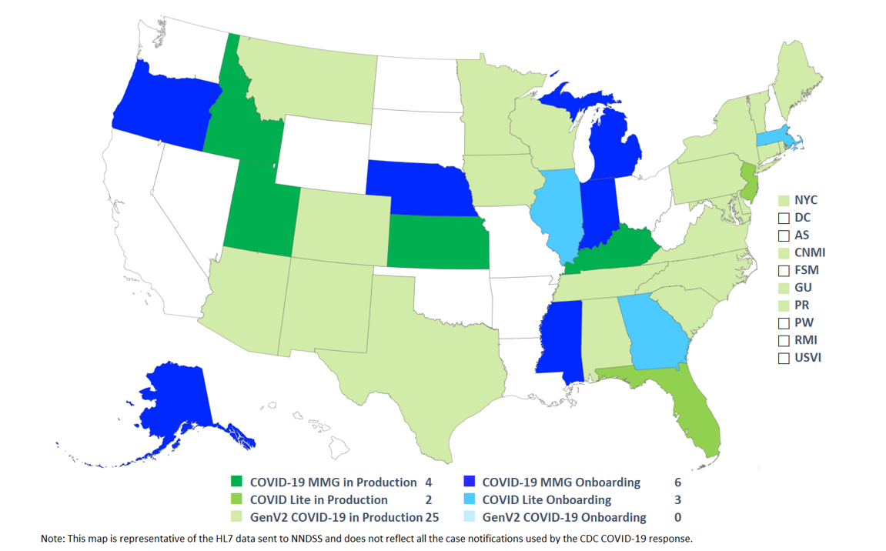
COVID-19 HL7 Data Implementation January 2022
Status as of 1/18/2022

Slide 8
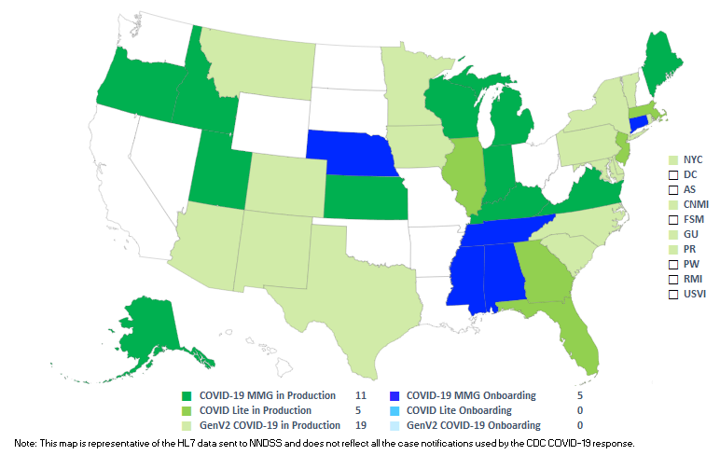
COVID-19 HL7 Data Implementation January 2023
Status as of 1/17/2023

Slide 9
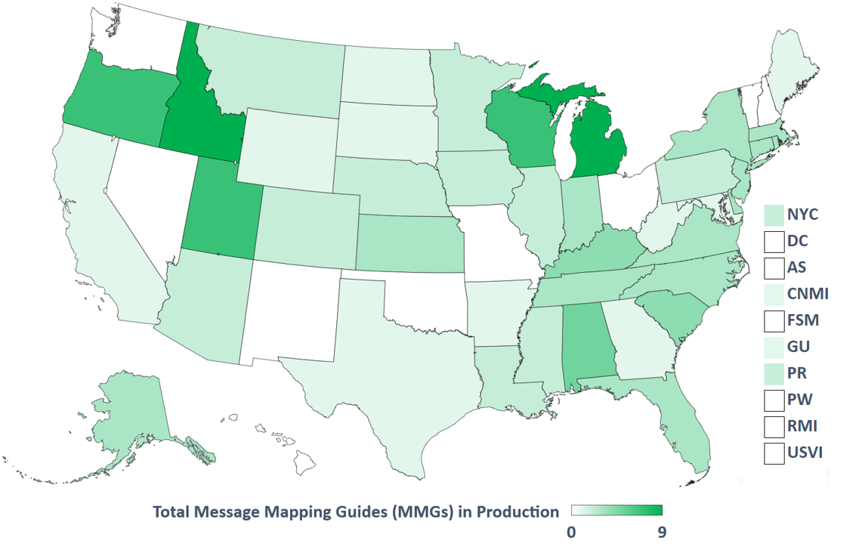
Total Message Mapping Guides (MMGs) in Production 2022
Status as of 1/18/2022

Slide 10
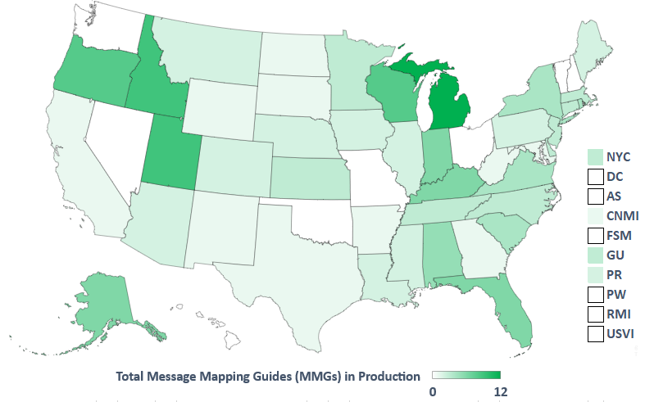
Total Message Mapping Guides (MMGs) in Production 2023
Status as of 1/17/2023
Notes:
Since the webinar on January 18, 2022, the highest number of MMGs in production for a Jurisdiction is 12.
Top 5 jurisdictions include:
MI 12
ID and UT 9
OR and WI 8

Slide 11
Kudos to Jurisdictions Onboarding in 2022!
Message Mapping Guide | Jurisdictions
Arboviral | Guam, Kentucky
Carbon Monoxide | Florida, Wisconsin
Foodborne and Diarrheal Diseases | New York State
Generic v2 | District of Columbia, Washington
Health-Associated Infections, Multi-Drug Resistant Organisms (HAI MDRO) | Oregon
Lyme/TBRD | Kentucky
Malaria | Kentucky
STD* and Congenital Syphilis | Iowa,* Rhode Island, Utah
Tuberculosis and Latent Tuberculosis Infection | New York City
*Iowa onboarding for STD MMG only
Notes:
Kudos representing jurisdictions who were actively onboarded in 2022 and continues through the onboarding process to date.
As previously noted during the COVID-19 data implementation in progress map update, we also give kudos to 5 states including, AL, CT, MS, NE, & TN

Slide 12
2023 Changes to NNDSS
What Jurisdictions Need to Know
Delicia Carey, Surveillance Operations and Communications Lead
Center for Surveillance, Epidemiology, and Laboratory Services

Slide 13
Topics
New NNDSS diseases and conditions
Conditions with revised surveillance case definitions
Syphilis event codes being retired

Slide 14
New NNDSS Conditions—Morbidity and Mortality Weekly Report (MMWR) Year 2023
Disease/Condition | Nationally Notifiable? | Event Code
Candida auris, screening (Uses the same event code as Candida auris, colonization/screening) | Yes | 50264
*Carbapenemase-producing organisms (CPO), clinical | Yes | 50270
*CPO, screening | Yes | 50271
Mpox (previously Monkeypox) implemented on August 1, 2022 | Yes | 11801
Melioidosis | Yes | 11585
*Strongyloidiasis | No | 12036
*CDC is seeking Office of Management and Budget Paperwork Reduction Act (OMB PRA) approval to receive case notifications for these conditions

Slide 15
Candida auris, screening (event code 50264)
“Candida auris, screening” replaces “Candida auris, colonization/screening”
  Nationally notifiable in MMWR year 2023
  No change in event code – still 50264
Updates to Council of State and Territorial Epidemiologists (CSTE) Position Statement (PS) 22-ID-05 reflect improved lab capability to identify C. auris and highlight importance of reporting screening cases
C. auris, clinical (50263), and C. auris, screening (50264): routinely notifiable
Submission options:
  HAI MDRO MMG
  Generic V2 MMG
  Legacy methods: National Electronic Telecommunications System for Surveillance (NETSS), NEDSS Base System (NBS) master message
Only confirmed C. auris, clinical, and C. auris, screening, cases will be published in the NNDSS tables

Slide 16
CPO clinical (50270) and CPO screening (50271)
CPO replaces Carbapenemase-producing Carbapenem-Resistant Enterobacteriaceae (CP-CRE)
  PS 22-ID-04 broadens CP-CRE case definition
  Adds additional organisms, including: Enterobacterales, Acinetobacter baumannii, Pseudomonas aeruginosa
CPO clinical and CPO screening are both routinely notifiable
  CPO clinical: specimens collected to diagnose or treat disease
  CPO screening: specimens collected for detection of colonization
Submission options after OMB PRA approval:
  HAI MDRO MMG
  Generic V2 MMG
  Legacy methods: NETSS, NBS master message

Slide 17
CPO Implementation Plans for 2023 and 2024
MMWR Year 2023: transition year
  NNDSS weekly tables will publish confirmed cases as “CPO, total” for:
    CP-CRE (event code 50244)
    CPO, clinical (event code 50270)
    CPO, screening (event code 50271)
MMWR Year 2024: CP-CRE event code (50244) retired
  CP-CRE case notifications will error out
MMWR Year 2024: full implementation year for CPO
  Confirmed cases for CPO clinical (50270), CPO screening (50271), and CPO total displayed in NNDSS weekly tables

Slide 18
Mpox* (event code 11801)
Use the case definition in PS 22-ID-10
Immediately notifiable urgent condition
  Notify CDC within 24 hours of a case meeting the confirmed or probable case classification
  Send case data as soon as possible, even before case investigation is complete
Submission options:
  Generic v2 MMG
  Legacy methods: NETSS, NBS master message
NNDSS tables will publish confirmed, probable, and total mpox cases when the mpox response stops publishing the data
* Previously Monkeypox

Slide 19
Melioidosis (event code 11585)
PS 22-ID-08 updates case definition and makes nationally notifiable
  Immediately notifiable urgent condition
  Notify CDC within 24 hours of a case meeting the confirmed or probable case classification
Low-incidence case verification by jurisdiction and National Center for Emerging and Zoonotic Infectious Diseases
  Low incidence verification job aid located in the Message Validation, Processing, and Provisioning System portal help section
Submission options:
  Generic v2 MMG
  Legacy methods: NETSS, NBS master message
NNDSS weekly and annual tables will combine counts for confirmed and probable cases

Slide 20
Strongyloidiasis (event code 12036)
PS 22-ID-09 establishes case definition
Under standardized surveillance; not Nationally Notifiable Condition (NNC)
Submission options after OMB PRA approval:
  Generic V2 MMG
  Legacy methods: NETSS, NBS master message
Strongyloidiasis data will not be published in the NNDSS tables

Slide 21
Revised Case Definitions—MMWR year 2023
Disease/Condition | Nationally Notifiable? | Event Code
Animal rabies | Yes | 10340
Coccidioidomycosis | Yes | 11900
COVID-19 | Yes | 11065
Gonorrhea | Yes | 10280
Lead in blood | Yes | No event code assigned
Multisystem inflammatory syndrome in children (MIS-C) associated with SARS-CoV-2 infection | No | 11066

Slide 22
Animal Rabies (event code 10340)
PS 22-ID-06 updates case definition
  Adds new laboratory criteria
  Updates reporting data elements
  Updates timeframes for significant animal rabies events to support international reporting
Only published in annual NNDSS tables beginning MMWR year 2023
Submission options:
  Legacy methods: Generic v1 MMG, NETSS, NBS master message
  Monthly reporting to CDC via the National Rabies Surveillance System (NRSS)
PS specifies criteria for confirmed cases to be considered immediately notifiable urgent and routinely notifiable

Slide 23
Animal Rabies: immediate, urgent notification
In compliance with international reporting regulations, confirmed animal rabies cases require notification to CDC within 24 hours of identification for:
Importation: Rabies or non-rabies lyssavirus in an animal imported from outside the continental United States within the previous 365 days, unless variant is known to circulate in the United States
New geographic area: A rabies virus variant or non-rabies virus lyssavirus in a new geographic area
Sustained transmission: Sustained transmission of any rabies virus variant or non-rabies lyssavirus among animals of a previously unrecognized reservoir species

Slide 24
Animal Rabies: routine notification
Routine (standard) notification to CDC for confirmed cases:
Send positive and negative animal rabies test results for all situations that do not meet criteria for immediate notification
Should occur at least once a month
Include negative results from direct fluorescent antibody, direct rapid immunohistochemical test, immunohistochemistry on formalin-fixed tissues, and pan-lyssavirus real-time reverse transcription-polymerase chain reaction

Slide 25
Coccidioidomycosis (event code 11900)
PS 22-ID-07 adds new clinical, laboratory, and epidemiologic criteria
Routinely notifiable: send confirmed and probable cases
Submission options:
  Generic v2 MMG
  Legacy methods: NETSS, NBS master message
Different expectations for high- and low-incidence jurisdictions
  High-incidence jurisdictions: send confirmed cases
  Low-incidence jurisdictions: send confirmed and probable cases

Slide 26
Coccidioidomycosis:
Criteria for high- and low-incidence jurisdictions
High-incidence jurisdictions:
  Average coccidioidomycosis incidence of ≥10 confirmed cases per 100,000 population for three consecutive years
  As of July 2022, Arizona and California meet this criterion
Low-incidence jurisdictions:
  Have not had an average coccidioidomycosis incidence of ≥10 confirmed cases per 100,000 population for three consecutive years
Once a jurisdiction meets high-incidence criteria, it should permanently switch to high-incidence criteria

Slide 27
COVID-19 (event code 11065)
PS 22-ID-01 updates case definition
  Removes clinical criteria and epidemiologic linkage criteria
  Updates probable and suspect case classifications and laboratory criteria
Continues to be an NNC; changed to routinely notifiable
NNDSS tables will display confirmed, probable, and total cases
  2020 and 2021 NNDSS annual tables use aggregate data sent to NNDSS through the Epi InfoTM web form
Submission options:
  COVID-19 and COVID-19 lite MMGs
  Generic v2 MMG
  Legacy methods: NETSS, NBS master message

Slide 28
Gonorrhea (event code 10280)
PS 22-ID-03 updates case definition:
  Captures disseminated gonococcal infection (DGI)
  Addresses reporting of drug resistance measures for gonorrhea
Cases that result in DGI should be classified according to the guidance in the CSTE position statement
  Use “Type of Complications” repeating group in the STD v1.2.0 MMG for reporting DGI status
NNDSS tables will include only confirmed and probable cases in counts beginning with MMWR Year 2023 data
  Because all case classification statuses were included in published counts previously, counts may be lower when compared to previous years

Slide 29
Lead in Blood (no event code assigned)
PS 22-EH-01
  Changes name of condition from “elevated blood lead level” to “lead in blood”
  Updates criteria for reporting, case definition, and case classifications
Notifications for adults should be sent to National Institute for Occupational Safety and Health
Notifications for children should be sent to National Center for Environmental Health

Slide 30
Lead in Blood
Send notifications for all blood lead test data for children and adults, regardless of blood lead level
If jurisdictions do not have the resources to collect and process all blood lead lab results, at a minimum, send:
  All confirmed and suspect cases in children (<16 years) with blood lead levels at or above the reference value (≥3.5 ug/dL)
  All confirmed cases in adults (≥16 years) at or above the reference value (≥3.5 ug/dL)

Slide 31
MIS-C (event code 11066)
PS 22-ID-02 places MIS-C for persons aged <21 years under standardized surveillance
  Use to estimate disease burden, monitor geographic trends in incidence, and characterize demographics of affected persons
  Not an NNC, but CDC requests the case data
Event code 11066 does not have an age restriction
National MIS-C surveillance staff assign final case classification for all MIS-C cases

Slide 32
MIS-C
National Center for Immunization and Respiratory Diseases expects to publish MIS-C data monthly
  NNDSS tables will not publish MIS-C
Submission options:
  Preferred methods: HHS Protect, CDC MIS-C REDCap project, secure file transfer portal, or secure email
  Alternative method: Generic V2 MMG with case report form

Slide 33
Syphilis event code retirement
Beginning in MMWR year 2023, CDC will NOT accept:
  10314 (syphilis, late latent)
  10319 (syphilis, late with clinical manifestations)
These codes:
  Will receive an error for MMWR years 2023 and later cases
  May be submitted for previous MMWR years (before 2023)
Active syphilis event codes:
  10311 (primary)
  10312 (secondary)
  10313 (early non-primary, non-secondary)
  10316 (congenital)
  10320 (unknown duration or late)

Slide 34
CDC Case Surveillance Modernization
Implementation Update
Danielle Tack, Data Standardization and Assistance Team (DSAT) Lead
Center for Surveillance, Epidemiology, and Laboratory Services

Slide 35
Progress Highlights
Recommendation | Status | Planned Actions
Prioritize onboarding of all jurisdictions and conditions onto a generic, core data feed | MITRE landscape analysis for GenV2 core data elements delayed due to contract process estimated start March, trying to expedite and start sooner | Documentation prep and prioritization of jurisdictions
Pause creation of new disease-specific MMGs | Working through action items from meetings; programs awaiting DSAT followup should begin receiving items | Finalize plans based on program meetings and feedback to further define implementation of US Digital Service recommendations
Pause disease-specific MMG onboarding | Continued assessment based on jurisdiction outreach Working on adjusting some processes for NBS pages with no NNDSS legacy data | Use of Epidemiology and Laboratory Capacity-Health Information System (ELC-HIS) calls to fill in gaps in MMG status Develop specific guidance for ELC HIS on where MMG efforts could be refocused Use of MMG content to inform surveillance efforts
Develop case reporting data dictionary | Continued working with CDC Data Modernization Initiative (DMI) priority team 2 (core data for situational awareness) & DMI priority team 1c (CDC case data landscape analysis) Assessing tools to assist with standardization Working with CSTE to convene jurisdictions and CDC programs to work through data element standardization | Continue work with DMI priority team and CSTE to identify best next steps to use developed MMGs and other inputs to move toward standard data elements If interested in joining the CSTE Data Standardization Workgroup, please email Becky Lampkins (blampkins@cste.org)

Slide 36

Questions or Feedback?
Use this Jurisdiction feedback form
We look forward to hearing from you!

Slide 37



Thank you!
Next NNDSS eSHARE:
**Date: February 21, 2023
**Topic: Data Standardization
Subscribe to
Case Surveillance News
Access NNDSS Technical Resource Center
For more information, contact CDC
1-800-CDC-INFO (232-4636)
TTY: 1-888-232-6348 www.cdc.gov
Email edx@cdc.gov for Technical Help or to Onboard HL7 Message Mapping Guides
The findings and conclusions in this report are those of the authors and do not necessarily represent the official position of the Centers for Disease Control and Prevention.

