Slide 1

NNDSS eSHARE
November Webinar
Division of Health Informatics and Surveillance
November 15, 2022

Slide 2

Agenda
  NNDSS Updates and Announcements
  New NNDSS Event Code Updates for 2023
  Emergency Response Case Data Elements
  CDC Case Surveillance Modernization Updates
  Questions and Answers

Slide 3
NNDSS Updates and Announcements
Sara Johnston, MPH
NNDSS Program Lead
Center for Surveillance, Epidemiology, and Laboratory Services

Slide 4
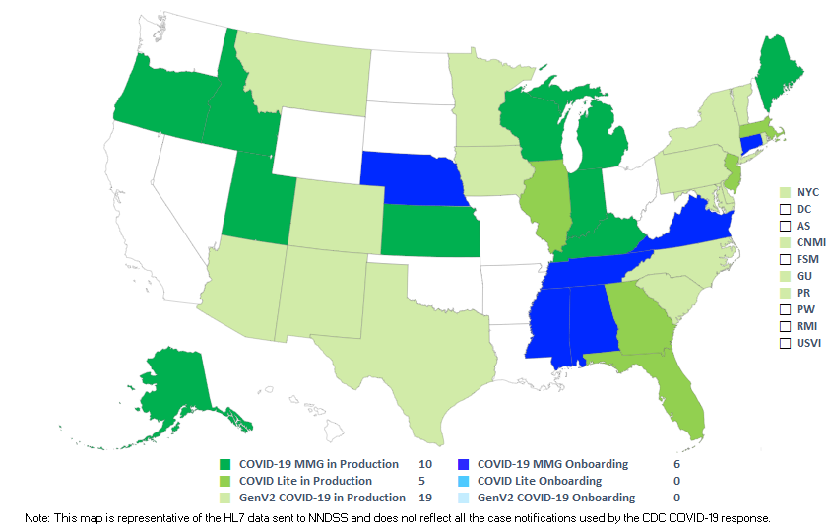
COVID-19 HL7 Data Implementation In-progress
Status as of 11/15/2022

Slide 5
Updated COVID-19 Message Mapping Guide (MMG)
  NEW: The PHIN Vocabulary Access and Distribution System (VADS) COVID-19 case notification view has been updated
    Version 14 is now the most up-to-date version
    Includes two additional values to Vaccine Type (NND) (now v.12)
COVID-19 PHIN VADS Case Notification View version 14: https://phinvads.cdc.gov/vads/ViewView.action?id=55DFBFAD-785C-ED11-81BE-005056ABE2F0
Vaccine Type (NND) version 12: https://phinvads.cdc.gov/vads/ViewValueSet.action?id=DD97237E-7BDE-4272-8E3F-0D9A61C211EF

Slide 6
2021 Reconciliation Target Dates
THANK YOU for all the hard work so far!
Submit and lock non-STD data by 11/18/2022
  This will provide an opportunity to review the reconciliation tables using locked data.
  Once the reconciliation tables are verified, inform your NNDSS Surveillance Officer and we will provide final signature tables.
We appreciate you returning signed final tables by 12/1/2022 to your NNDSS Surveillance Officer.

Slide 7
2021 NNDSS Aggregate COVID-19 Data Request
By Thursday, December 1, 2022
  Jurisdictions should enter their data into the Epi Info™ web form
  State/Territorial Epidemiologist should approve the case counts for the 2021 NNDSS COVID-19 data in the Epi Info™ web form
  The finalized information and sign-off should be submitted through the Epi Info™ web form

Slide 8
New NNDSS Event Codes Updates
Ruth Jajosky, Case-based Surveillance Operations Team Lead
Center for Surveillance, Epidemiology, and Laboratory Services

Slide 9
2023 Event Codes for New NNDSS Conditions
Disease/Condition | Nationally Notifiable? | Event Code
Carbapenemase-producing organisms (CPO), clinical | Yes | 50270
CPO, screening | Yes | 50271
Candida auris, screening (will use the same code as Candida auris, colonization/screening) | Yes | 50264
Melioidosis | Yes | 11585
Strongyloidiasis | No | 12036

Slide 10
Syphilis Event Code Changes in 2023
Beginning with cases reported for Morbidity and Mortality Weekly Report (MMWR) year 2023, jurisdictions should not use the following codes:
  10314 (syphilis, late latent)
  10319 (syphilis, late with clinical manifestations).
2023 cases sent to CDC with the above codes will receive an error in the Message Validation, Processing, and Provisioning System and will not be published in the NNDSS tables.
Jurisdictions may continue to use 10314 and 10319 to send 2022 cases or to update cases already sent to CDC for previous years (i.e., before MMWR year 2023).

Slide 11
Active Event Codes for Syphilis Case Notifications
The following are aligned with the current 2018 Council of State and Territorial Epidemiologists (CSTE) case definition and should be used:
  10311 (primary),
  10312 (secondary),
  10313 (early non-primary, non-secondary),
  10316 (congenital), and
  10320 (unknown duration or late).

Slide 12
CDC and Jurisdictions Accelerating Data to Action:
“Emergency Response Case Data Elements”
Activity timeframe: August 2022 to February 2023
November 15, 2022
Update to NNDSS eSHARE call
Katie Fullerton, MPH
Senior Advisor for Surveillance and Data Modernization, Infectious Diseases
CDC/DDID

Slide 13
13
  Define data requirements for case-level situational awareness from day one of a public health emergency
  (as defined under Team 2 in the 2022–2023 Implementation Plan)
  aka “Emergency Response Case Data Elements”
  Data Modernization Initiative (DMI) 2022–2023 Implementation Plan, Objective 2c: Scalable and adaptable enterprise tools, standard data feeds, and processes are used for outbreak or emerging threat response
  *From day one: operationalized as “for the start of an event (first ~2 weeks)”

Slide 14
Problem statement
  In an emergency response that escalates quickly and crosses jurisdictions, state, tribal, local, or territorial (STLT) health departments and CDC need to exchange case-level data rapidly to provide situational awareness at the federal level to support decision-making at all levels of public health
  To reduce the burden on STLT partners and to support the rapid transformation of data into information for decision-making, STLT and CDC programs need to use a pre-defined set of standardized data elements for case line-level situational awareness; ideally, these data elements would be defined before an emergency, and capabilities for transmission would be in place before an emergency, drawing from STLT integrated surveillance systems.
14

Slide 15
Approach and Out of Scope topics
Out of scope for this activity,
to be addressed in later activities
  How data are transmitted from STLT to CDC (e.g., PHIN specification)
  When and to where data elements are transmitted from STLT to CDC
  Timeliness of implementation in STLT and CDC
  Disease/program-specific data elements
  Changing definitions to already defined data elements
    These data elements will be defined as they currently are in NNDSS Genv2 Data Dictionary, electronic laboratory reporting, and standard situational awareness reports
  Aggregate data from hospitals or healthcare (already defined through HealthIT.gov)
Approach
Work across partners to develop a combined list of data elements for case-level notification to support situational awareness in an emergency response
Build off work previously done in this area (such as Generic V2 MMG)
15

Slide 16
INPUT
STLT Integrated Disease Surveillance (IDS) Systems
What do states routinely collect and have in their IDS systems at the start of an event?
OUTPUT
Minimum dataset for line-level case situational awareness at the start of an event
Office of Management and Budget (OMB)-approved data elements for NNDSS (Generic V2, lab, vaccine)
Situational Awareness (SA) Reports
What is already defined for routine, condition-agnostic, case notification?
What questions need to be answered at the start of an event?
16

Slide 17
Activity Roadmap
6 Months
September 2022 to February 2023
January: Define Next Steps
6
5
December: Iterate Deliverables
February: Final Deliverables
4
3
November: Draft Deliverables
August: Background Research
2
October: Gather Inputs
PRE
WORK
1
September: Introduce Activity
PRELIMINARY and PRE-DECISIONAL
17

Slide 18
Proposed Timelines
Two deliverables: Combined list of data elements (Deliverable A) and “Parking Lot” document (Deliverable B)
Deliverable A
  Receive inputs: Oct 12; first draft combined list Oct 26
  Review and iteration: Oct 26 to Dec 14 (may be adjusted)
  Final deliverable target: Jan 18 (may be adjusted)
Deliverable B
  Draft, review, iterate: Jan 18 to Feb 15 (may be adjusted)
  Final deliverable target: Feb 24 (may be adjusted)
18

Slide 19
Concentric Circles Model
Informed Group
Participating Group
Core Team
Planning Team
Program management approach using iteration through concentric circles of partners to generate buy-in as process progresses
The Concentric Circles Model | Centre For Effective Altruism
19

Slide 20
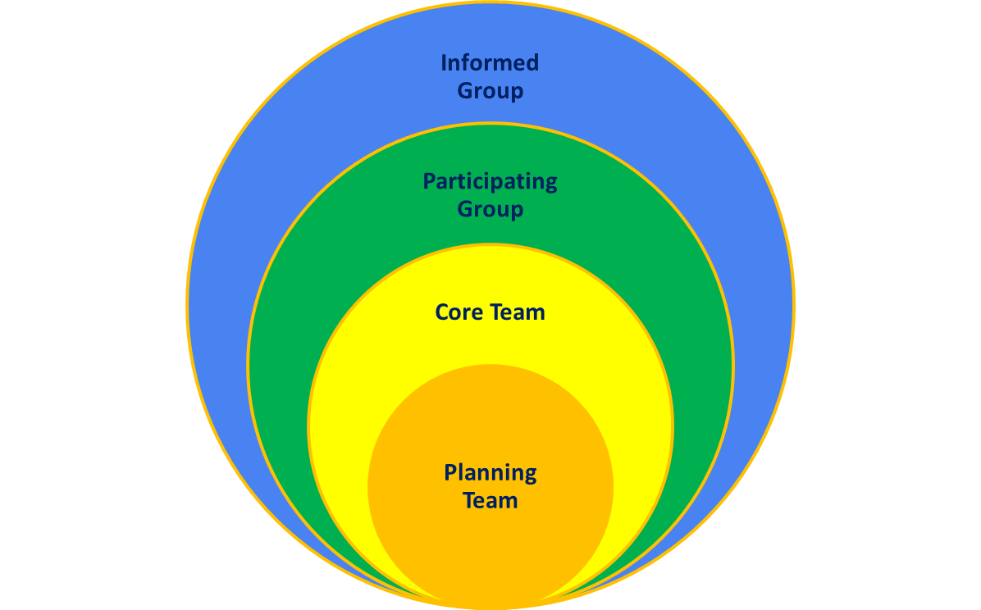
DMI Team 2 Activity: Minimum dataset for case-level situational awareness at start of an event
Circle | Members | Activity Role
Planning Team | DMI Team 2 (activity owner) | Coordinate, organize, define scope for minimum dataset Align with DMI objectives Connection point to next activity for Team 2 work
Core Team | CSTE-DMI leadership and surveillance/informatics (S/I) leadership, CSELS-Division of Health Informatics and Surveillance (DHIS) reps Center for Preparedness and Response Division of Emergency Operations (CPR-DEO), CDC Infectious Diseases Surveillance Informatics Workgroup (CDC-ID-SIWG) reps CDC DMI Priority Teams 2, 1c, 1d reps | Provide input for the proposed minimum dataset Support revisions of the proposed minimum dataset based on feedback from participating group
Participating Group | CSTE DMI Community, CSTE-S/I Community, CDC ID-SIWG Community, CDC DMI Community (Team 1c, 1d, 2, DAKS), CDC Response Community (CPR/DEO/SA) | Provide feedback on the proposed minimum dataset, through iterative process
Informed | NNDSS eSHARE, CSTE membership, STLT epi and informatics staff, CDC programs, CSELS-DHIS, Office of the Chief Information Officer, CPR-DEO, Consortium for Data Modernization (note this list not exhaustive) | Receive and share information about the minimum dataset as project progresses
20

Slide 21
Draft 1 proposed minimum dataset for line-level case situational awareness at the start of an event
Emailed to the Core Team October 26
Core Team facilitates sharing and collecting feedback from the Participating Group
Working meeting for the Core Team (internal and external) November 1 for discussion
Feedback requested November 9
Next draft to be circulated to core team November 18
21

Slide 22
Activity to define data elements for case-level situational awareness reporting at the beginning of an emergency response (beginning of response =~2 weeks).
List of data elements for situational awareness for public health event response (case level)
n=23
Primary input: Pre-defined situational awareness reports (CDC/CPR/DEO)
n=15
Informational: Minimum dataset for situational awareness for aggregate data (CDC and ONC PH EPR**)
Primary input: NNDSS generic data (Gen V2 MMG*: R and 1)
(CDC/CSELS/DHIS)
n=33/67 (Gen V2)
n=8/21 (vaccine) and 0/56 (lab) – OMB list
Primary input: STLT Surveillance System data elements
n=35
Draft 1
**PH ERP: Public Health Emergency Preparedness and Response with HealthIT.gov (CDC and ONC ISA (Interoperability Standards Advisory):
Public Health Emergency Preparedness and Response | Interoperability Standards Advisory (ISA) (healthit.gov)
*Generic Message Mapping Guide (cdc.gov)
22

Slide 23
Situational awareness goals at the start of an event
Describe what event is happening, from where are cases being reported
Count the number of people affected (cumulative totals, new per day total, epi curves)
Describe demographics of cases, combined with condition and case status and geography
Describe geography of cases, combined with condition and case status (maps, counts by state)
Describe testing in cases, combined with condition and case status and geography
Characterize cases by case status, hospitalization status, pregnancy status, death status, illness characteristics
Not an exhaustive list
23

Slide 24
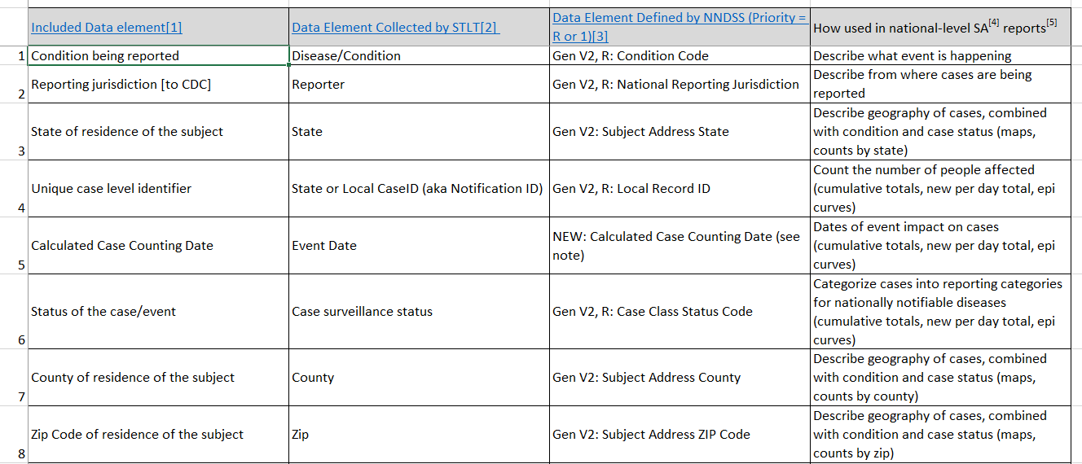
Pre-decisional
Proposed data elements to include in minimum dataset (page 1 of 3)
24

Slide 25
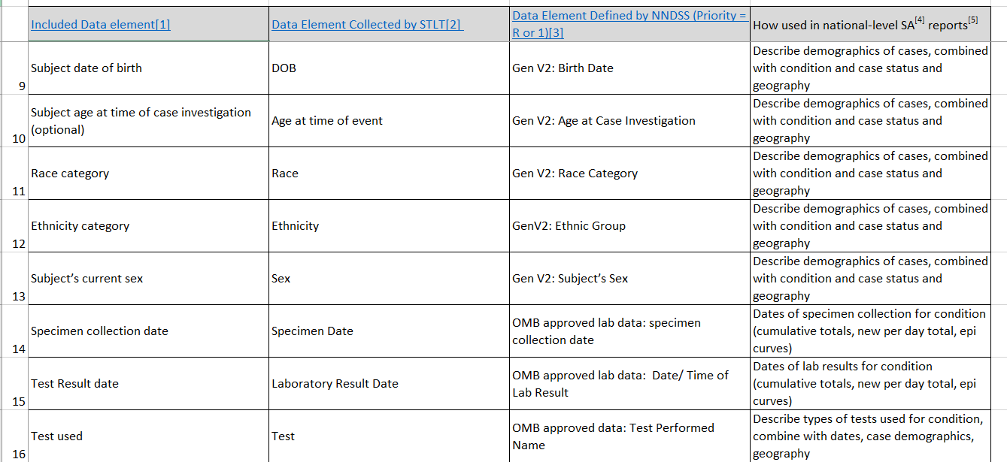
Proposed data elements to include in minimum dataset (page 2 of 3)
Pre-decisional
25

Slide 26
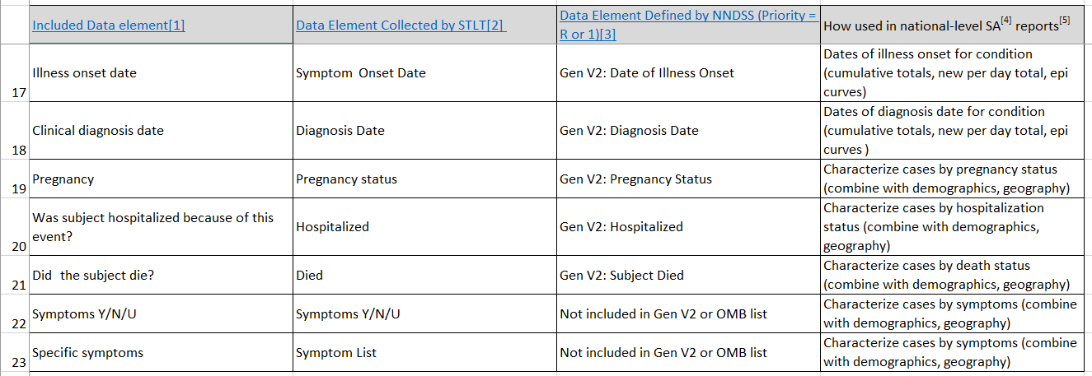
Proposed data elements to include in minimum dataset (page 3 of 3)
Pre-decisional
26

Slide 27
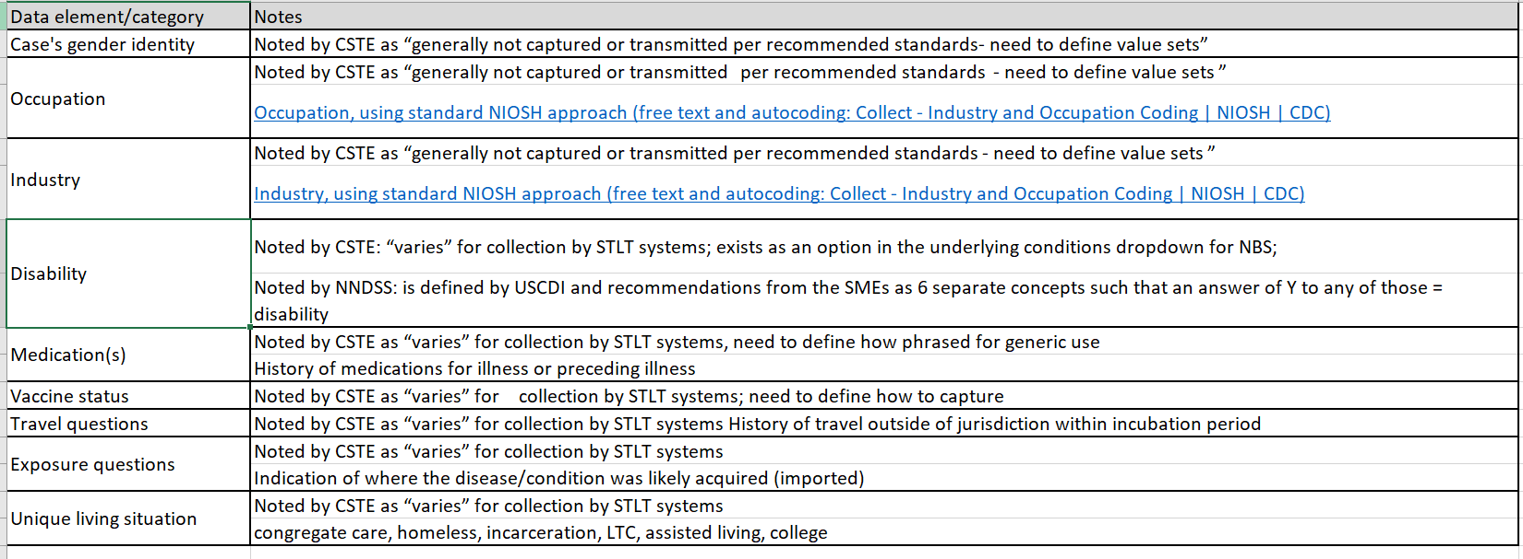
Data elements to consider including in minimum dataset (page 1 of 1)
Pre-decisional
27

Slide 28
Next Steps
Timeline for iteration
  Draft 1: Oct 26 – Nov 9
  Draft 2: Nov 18 – Nov 30
  Draft 3: Dec 9 – Dec 14 (note: may not need this iteration)
  Final: Jan 4 – Jan 18
28

Slide 29
QUESTIONS?

Slide 30
CDC Case Surveillance Modernization
Implementation Update
Danielle Tack, Data Standardization and Assistance Team Lead
Center for Surveillance, Epidemiology, and Laboratory Services

Slide 31
Progress Highlights
Recommendation | Status
Prioritize onboarding of all jurisdictions and conditions onto a generic, core data feed | 10/21: Scoped a jurisdiction landscape analysis with MITRE
Pause creation of new disease-specific MMGs | Inventoried the status of all MMG development work Met with CDC programs: COVID, Hepatitis, Lyme/TBRD, Parasitics, HAI, & Arbovirus
Pause disease-specific MMG onboarding | Inventoried the status of jurisdictions' onboarding & pre-onboarding work Pause work on early pre-onboarding (mapping/prepping) for published MMGs Decision to support onboarding efforts when they advance adoption of GenV2 MMG and TB/LTBI MMG, jurisdictions have started CDC onboarding, or jurisdictions have made system changes and are in the final stages of pre-onboarding and would like to finish Jurisdictions do not need to complete the ELC HIS MMG performance measure as originally described
Develop case reporting data dictionary | Continue working with DMI priority teams for defining core data for situational awareness and a landscape analysis of CDC case data
Develop a strategy for a flexible data pipeline from sending jurisdictions | Collaborating with Data Exchange (DEX) team to explore potential solutions

Slide 32
Next Steps
Recommendation | Status
Prioritize onboarding of all jurisdictions and conditions onto a generic, core data feed | Finalize MITRE project work plan with launch goal of January 2023
Pause creation of new disease-specific MMGs | Meet with CDC programs: STD/CS, BSP, CO, VPD, RIBD, & FDD. Develop plans based on program meetings and feedback to further define implementation of recommendations
Pause disease-specific MMG onboarding | Develop plans based on program meetings and feedback from jurisdictions based on recommendations outlined in previous slide Develop specific guidance for ELC HIS on where MMG efforts could be refocused
Develop case reporting data dictionary | Continue work with DMI priority teams Work with CSTE and jurisdictions to identify best next steps for data standardization using developed MMGs and DMI activities
Develop a strategy for a flexible data pipeline from sending jurisdictions | Continued collaboration with Data Exchange (DEX) team

Slide 33

Case Surveillance Modernization Webpage
CDC has posted a new “Case Surveillance Modernization” section of the National Notifiable Diseases Surveillance System (NNDSS) website, including:
a high-level overview of CDC’s current implementation plans for each recommendation,
frequently asked questions for program and technical audiences, and
a report with findings from the case surveillance discovery sprint.
We invite you to bookmark this webpage and check back regularly for the latest updates. CDC will continue to update this webpage as new information is ready to share.

Slide 34

Questions or Feedback?
Use this Jurisdiction feedback form
We look forward to hearing from you!

Slide 35




Thank you!
See you January 17, 2023, for the next NNDSS eSHARE
Subscribe to
Case Surveillance News
Access NNDSS Technical Resource Center
For more information, contact CDC
1-800-CDC-INFO (232-4636)
TTY: 1-888-232-6348 www.cdc.gov
Email edx@cdc.gov for Technical Help
The findings and conclusions in this report are those of the authors and do not necessarily represent the official position of the Centers for Disease Control and Prevention.

Slide 36
Case Surveillance Data
Condition-Specific Enhanced Surveillance
Condition-Specific Case Management
Related work:
CDC Case Surveillance Enhancements
CDC Data Modernization Initiative (DMI Team 1c) case surveillance landscape analysis
Advisory Committee to the Director – Data Working Group: memo to CDC Director recommending defining minimum dataset for all core data sources*
Alignment with USCDI+
Condition-specific case notification
Routine, condition-agnostic, case notification
Situational awareness
*Public health core data sources: Healthcare data, Laboratory data, Case Surveillance data, Syndromic Surveillance data, Vital Records data, and Immunization data
36

Slide 37
Note that AGGREGATE data requirements in a public health emergency are already defined
Public Health Emergency Preparedness and Response | Interoperability Standards Advisory (ISA) (healthit.gov))
  LOINC 89724-9 — Minimum Data Set (MDS) for Public Health Emergency Operations Centers (EOC) [CDC Emergency Operations Centers]
Healthcare Personnel:
  LOINC 95892-6 — Healthcare personnel status [CDC Emergency Operations Centers]
Hospital/Facility Bed Utilization
  LOINC 95893-4 — Hospital or facility beds utilization panel [CDC Emergency Operations Centers]
Laboratory Operations, population laboratory surveillance:
  LOINC 89756-1 — Laboratory operations report [CDC Emergency Operations Centers]
Mass vaccination status:
  LOINC 96987-3 — Mass vaccination status [CDC Emergency Operations Centers]
Population-level morbidity and mortality:
  LOINC 89754-6 — Event status [CDC Emergency Operations Centers]
37

