Slide 1
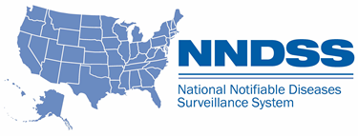
NNDSS Special Session eSHARE
October Webinar
Division of Health Informatics and Surveillance
October 25, 2022

Slide 2

Agenda
  NNDSS Updates and Announcements
  Monkeypox Response Updates
  Questions and Answers

Slide 3
NNDSS Updates and Announcements
Michele Hoover, MS
Data Standardization and Assistance Team
Center for Surveillance, Epidemiology, and Laboratory Services

Slide 4
Onboarding NNDSS Monkeypox (MPX) Data to DCIPHER
Raquel Velazquez-Kronen, PhD
Case Data Team
MPX Data Analytics and Visualization Task Force

Slide 5
Overview—MPX Case Reporting using NNDSS
PART 1
Onboard to NNDSS
PART 2
Onboard NNDSS data to DCIPHER
DCIPHER serves as the MPX Response Common Operating Platform, bringing together key data from different sources to provide situational awareness.
5

Slide 6
Expectations for NNDSS MPX Data
Verify with each jurisdiction:
    Match NNDSS case IDs to all existing MPX case IDs in DCIPHER
    Confirm continued submission of initial case reports to CDC, in accordance with the Council of State and Territorial Epidemiologists (CSTE) MPX position statement
    Determine the submission frequency for reporting supplemental short CRF (sCRF) data to DCIPHER―beyond Core NNDSS data elements
6

Slide 7
MPX Case Reporting – Validate NNDSS Data in DCIPHER
Submit all sCRF data or supplemental data, using any existing processes to DCIPHER
Augment
sCRF and NNDSS data
Jurisdiction Collects
Case Data
Submit core MPX data using NNDSS
Populate NNDSS core data in DCIPHER
Part 2:
One-time validation of NNDSS case data in DCIPHER
Push
validated NNDSS data to production in DCIPHER
12 pm daily
DCIPHER Platform Interface
7
Notes:
This is a high-level diagram showing the steps for enabling case data to flow through NNDSS to DCIPHER and be included in the national case surveillance database.
The data flow begins when the jurisdiction collects MPX case data, shown in the blue box on the far left, and then follows along either of 2 paths.
The first path shown along the top is for jurisdictions who want to continue to submit MPX case data using any of the existing processes already established. Jurisdictions can choose to continue sending complete sCRF data in this manner, or supplemental data if NNDSS is used to submit core data.
The second path along the bottom shows the newly available alternative path for core MPX data, which can now be submitted via NNDSS.
For jurisdictions choosing to use NNDSS, supplemental MPX data will still need to be submitted directly to DCIPHER. After completion of Onboarding Part 1, a jurisdiction’s NNDSS data begins flowing through an established pipeline to DCIPHER, shown as the second grey box along the bottom path.
However, a jurisdiction must complete the one-time validation step in the DCIPHER platform before this data can be pushed into production, shown by the middle blue box with the red arrow.
Before describing the final box in the data flow, I’m going to use the next two slides to quickly explain this validation step.

Slide 8
Onboarding NNDSS Data to DCIPHER
Validate and approve the NNDSS case data in DCIPHER
  Review with CDC the one-time validation process
  CDC verifies ID matching between NNDSS and DCIPHER
  Jurisdiction approves that NNDSS data can be used for case counts
8
Notes:
A jurisdiction must validate the NNDSS case data in DCIPHER and approves the use of their NNDSS for case counts.
CDC staff meet 1:1 with each jurisdiction ahead of time to review this one-time validation and approval process.
The response verifies ID matching between NNDSS and DCIPHER data and provides support where needed.
The jurisdiction can easily review and indicate approval of their NNDSS case data.

Slide 9
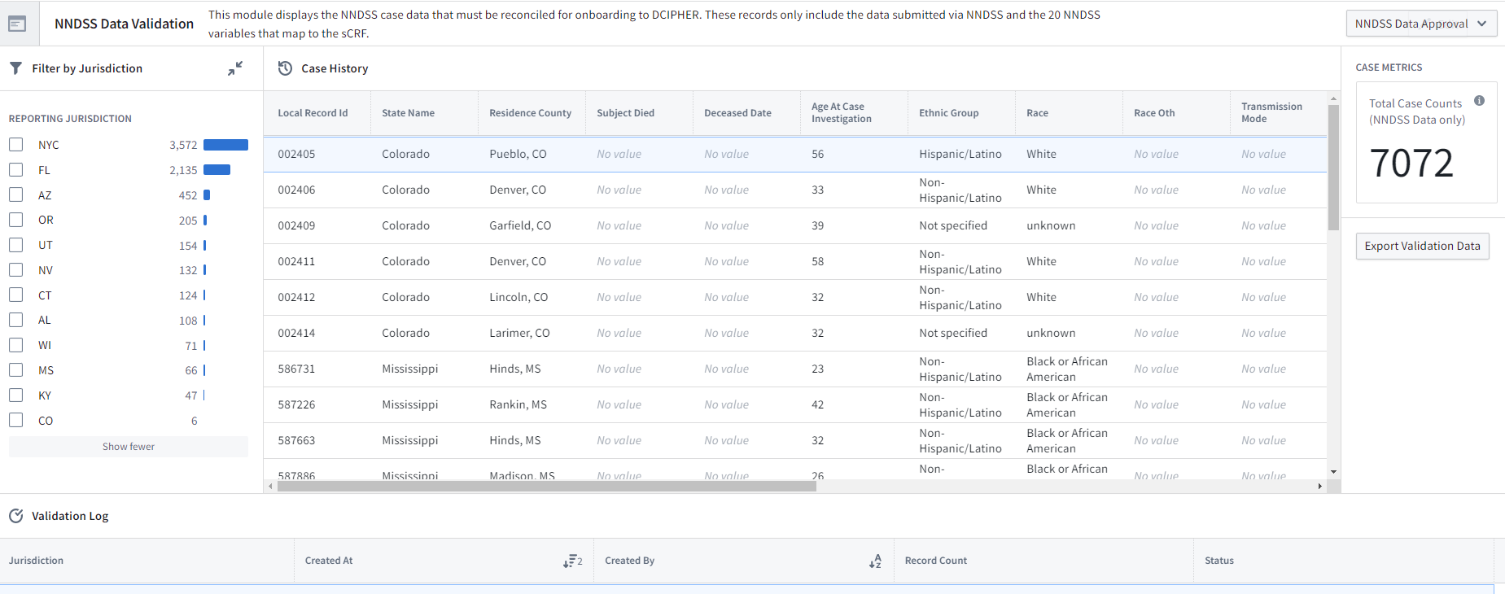
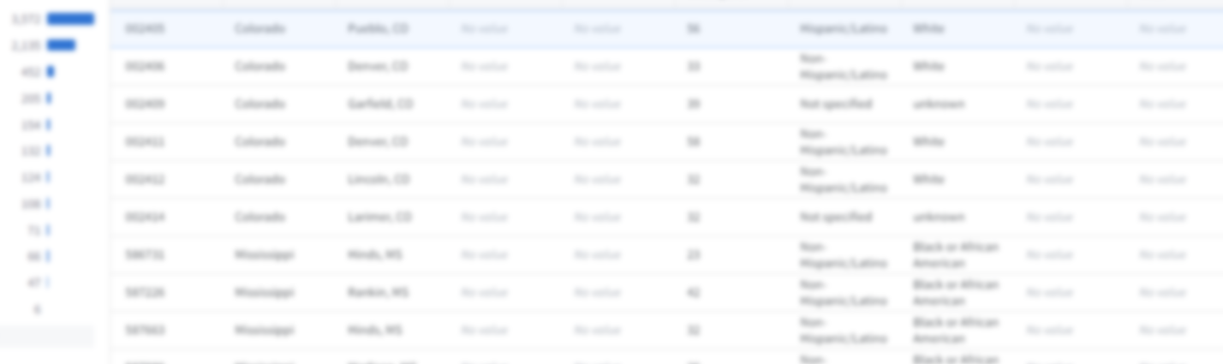
Approving NNDSS Case Data in DCIPHER
9
Notes:
Using the “NNDSS Validation Workshop”, jurisdictions who have met with us can easily review and indicate approval of their NNDSS case data, after which these data can be used by the response.
Within the Workshop you be able to see total case counts displayed. Please note this is only the NNDSS data displayed here, not the NNDSS data after being combined with the other sources in DCIPHER.
We understand these NNDSS data along with the CRF data reported to DCIPHER are provisional and will be updated over time. Updates sent via NNDSS will be received and reflected in DCIPHER.

Slide 10
MPX Case Reporting – Validating NNDSS Data in DCIPHER
Submit all sCRF data or supplemental data, using any existing processes to DCIPHER
Augment
sCRF and NNDSS data
Jurisdiction Collects
Case Data
Submit core MPX data using NNDSS
Populate NNDSS core data in DCIPHER
Part 2:
One-time validation of NNDSS case data in DCIPHER
Push
validated NNDSS data to production in DCIPHER
12 pm daily
DCIPHER Platform Interface
10
Notes:
Once a jurisdiction has completed the one-time validation of NNDSS data in DCIPHER, the data is then pushed into production. During the final augmentation step, core data elements from NNDSS are combined with the supplemental data along with any matching historic MPX data. The augmentation process can be tailored to meet jurisdictional reporting preferences.

Slide 11
New Feature: Case Data Augmentation in DCIPHER
Augmentation takes multiple case reports about a case (unique case ID) and combines them into a single sCRF record containing the best data from all available reports
DCIPHER assigns a default priority to each MPX data source (i.e., reporting method)
  DCIPHER uses the priority order to merge all the case data reported across all sources.
  Jurisdiction can adjust these default priorities:
    NNDSS
    sCRF application programming interface (API)
    sCRF bulk upload
    sCRF bulk upload REDCap
    sCRF direct entry
    Original Case Report Form (oCRF) bulk upload
    Original Case Report Form (oCRF) direct entry REDCap
    Call Center
11
Notes:
A bit more about data augmentation. In this context, augmentation means taking multiple case reports about a case, defined by a unique case ID, and combining them into a single sCRF record containing the best data from all available reports.
Since we know jurisdictions have different reporting preferences, the “best data” for augmentation is based on the augmentation priority shown in Red and ranked with the most recent data source listed at the top, and the least recent data source at the bottom.

Slide 12

MPX Case Data Augmentation - A Simple Example
Most up-to-date
Least up-to-date
sCRF Field Value | 1. NNDSS | 2. Short CRF (sCRF) direct entry | 3. Call Center
case_id | ID_abc | ID_abc | ID_abc
jurisdiction | Jurisdiction A | Jurisdiction A | Jurisdiction A
age | null | 41 | Unknown
ethnicity | null | Unknown | Hispanic or Latino
Post-Augmentation sCRF Dataset
*Assumption that the highest priority data source contains most accurate data
case_id | jurisdiction | age | ethnicity
ID_abc | Jurisdiction A | 41 | Unknown*
12
Notes:
Here’s a simple example of how case data augmentation works based on 3 different case reporting data sources captured over time. The 3 different sources are shown in the column headers in blue, with the numbers showing the chosen augmentation priority, first priority data source is NNDSS, second priority data source is short CRF direct entry, followed finally by the Call Center.
For the 4 data elements in the left-hand column, each data source happens to report slightly different data, as might be expected.
Using the augmentation processing priority for the data sources shown, DCIPHER generates a single augmented record for this case ID, shown at the bottom of the slide. After augmentation, this case report contains now contains a valid age value instead of the null value initially reported via NNDSS.
There also appears to be a data correction for the ethnicity field. The Call Center data record shows “Hispanic or Latino”, possibly a data entry error overwritten during the augmentation process by the “Unknown” data value reported in the more recent Short CRF record.
It’s important to consider the most up to date sources for your jurisdiction being listed as higher priority. No data are deleted during this process, instead a final analytical file is generated.

Slide 13
MPX Case Reporting – Special Considerations
Adding and Deleting Cases
  If case status changes from “case” to “not a case,” users will need to make that change within NNDSS and also in the supplemental data uploaded to DCIPHER
13

Slide 14
MPX Case Reporting – Augmenting Case Data in DCIPHER
Jurisdiction reviews and can adjust default data augmentation priority in DCIPHER
Populate DCIPHER sCRF
Generate Combined Case Dataset
Execute Augmentation Priority
Generate Case Counts
Push
validated NNDSS data to production in DCIPHER
DCIPHER Platform Interface
14
Notes:
This diagram is an extension of the previous one.
CDC can review case augmentation with each jurisdiction to demonstrate the process for adjusting the default priority set up in DCIPHER, as needed.

Slide 15
MPX Case Reporting- Conclusions
Incorporating NNDSS reporting should improve timeliness and completeness of MPX case surveillance
  Surveillance system constraints require continued reporting of MPX Supplemental Data Elements to DCIPHER
MPX Informatics and Case Data Teams are here to help incorporate your NNDSS data into MPX Case Reporting
Work with jurisdictions on a 1-on-1 basis to ensure accurate, timely, and complete case surveillance
15
Notes:
- The MPX Informatics Team is here to help jurisdictions onboard to reporting

Slide 16
MPX Case Reporting – Next Steps
Interested in sending NNDSS MPX data?
  Email CDC Electronic Data Exchange at edx@cdc.gov with subject “MPX validation”
Already sending NNDSS MPX data?
  Work with NNDSS to confirm your submissions
  CDC MPX response will review and contact you to set up a call when ready to incorporate into DCIPHER
Have questions or need assistance?
  Email the CDC MPX Informatics Team at eocevent570@cdc.gov
16
Notes:
What jurisdictions should expect based on current status

Slide 17

Q & A

Slide 18



Thank you!
See you November 15, 2022, for the next NNDSS eSHARE
Subscribe to
Case Surveillance News
Access NNDSS Technical Resource Center
For more information, contact CDC
1-800-CDC-INFO (232-4636)
TTY: 1-888-232-6348 www.cdc.gov
Email edx@cdc.gov for Technical Help or to Onboard HL7 Message Mapping Guides
The findings and conclusions in this report are those of the authors and do not necessarily represent the official position of the Centers for Disease Control and Prevention.

