Slide 1
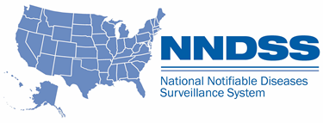
NNDSS eSHARE
October Webinar
Division of Health Informatics and Surveillance
October 18, 2022

Slide 2

Agenda
  NNDSS Updates and Announcements
  Updates on COVID-19 Surveillance Cadence
  New Features: Annual NNDSS Data Tables on CDC WONDER
  CDC Enhancements to Case Surveillance
  Questions and Answers

Slide 3
NNDSS Updates and Announcements
Michele Hoover, MS
Data Standardization and Assistance Team
Center for Surveillance, Epidemiology, and Laboratory Services

Slide 4
Updated COVID-19 MMG and “COVID Lite”
  Version 1.2 is the most current for the COVID-19 message mapping guide (MMG)
    Adds the data element Lineage (INV1405)
    Uses the same PHIN Vocabulary Access and Distribution System (VADS) COVID-19 case notification view as COVID MMG v1.0 and v1.1
  Version 1.2 is the most current for “COVID Lite”
    V1.2 Implementation Spreadsheet and Test Case Scenarios now available
    Adds the data elements Lineage (INV1405) and First Positive Specimen Date (95366-1)

Slide 5
Updated COVID-19 MMG and “COVID Lite” cont’d
  NEW: The most current PHIN VADS COVID-19 case notification is Version 13. Updates include:
    37 additional values to Risk Factor (COVID-19) (now v.3)
    13 additional values to Treatment Type (COVID-19) (now v.2) to include medication treatment options, including Paxlovid
    12 additional values (6 new U.S. vaccines and 6 non-U.S.) to Vaccine Type (NND) (now v.11)
    One non-COVID additional value for Manufacturers of vaccines (MVX) (now v.14)
COVID-19 MMG version 1.2: https://ndc.services.cdc.gov/wp-content/uploads/COVID-19_V1_2_MMG-and-TS_F_20220930.xlsx
COVID-19 PHIN VADS Case Notification View version 13: https://phinvads.cdc.gov/vads/ViewView.action?id=5856A461-F935-ED11-81BB-005056ABE2F0
“COVID Lite” version 1.2 Implementation Spreadsheet: https://ndc.services.cdc.gov/wp-content/uploads/COVID19_Lite_v1_2_nmi_implementation_spreadsheet_and_instructions_20220930.xlsx
“COVID Lite” version 1.2 Test Case Scenarios: https://ndc.services.cdc.gov/wp-content/uploads/COVID-Lite_V1_2_Test-Case-Scenarios_F_20220930.xlsx
Risk Factor (COVID-19) version 3: https://phinvads.cdc.gov/vads/ViewValueSet.action?id=3DD1E6B4-C041-40A3-988A-3C9E1308F526
Treatment Type (COVID-19) version 2: https://phinvads.cdc.gov/vads/ViewValueSet.action?id=A2DF7269-6E63-43CE-AF02-32FA89AECE49
Vaccine Type (NND) version 11: https://phinvads.cdc.gov/vads/ViewValueSet.action?id=30C421BC-181C-467E-A058-8ED01B08A3BC
Manufacturers of vaccines (MVX) version 14: https://phinvads.cdc.gov/vads/ViewValueSet.action?id=A91611E3-72D7-4B1A-BD42-2A44A2F1941E

Slide 6
Case Surveillance Transition Planning Update
text
Change in COVID-19 Surveillance Cadence
William Duck
Case Data Section Lead, Data Analytics & Visualization Task Force
2019 Novel Coronavirus (COVID-19) Response
PRE-DECISIONAL | FOR OFFICIAL USE ONLY

Slide 7
Overall Weekly Cadence Summary
Starting this fall, CDC will move from a daily to a weekly cadence* for collecting, analyzing, and reporting COVID-19 aggregate case and death data and line-level data.
Important dates to remember:
  October 19th is the data processing cutoff for line-level (10 AM) and aggregate (5 PM) jurisdictional data submissions.
  October 20th is the first publication date of line-level and aggregate cases and death data on a weekly cadence from jurisdictions.
To support this change in reporting cadence, CDC is in the process of updating data processing, analytics, and visualization products.
For questions or additional information, please contact the line-level data team at eocevent333@cdc.gov and the aggregate data team at eocevent118@cdc.gov
*Jurisdictions can maintain more frequent reporting because of established process; CDC will process and update numbers on only a weekly cadence.
PRE-DECISIONAL | FOR OFFICIAL USE ONLY
7

Slide 8
Common Questions Related to Reporting Cadence Change
Will there be follow-up correspondence in the coming weeks prior to the “go live” date?
  Definitely. You will receive official correspondence from our respective
  line-level and aggregate team representatives.
What will be the reporting deadlines for aggregate data? For line-level data?
  5 pm ET each Wednesday for aggregate county-level data (if reporting via Epi Info, report due by 9 am ET on Thursday)
  10 am ET each Wednesday for line-level data
PRE-DECISIONAL | FOR OFFICIAL USE ONLY
8

Slide 9
Common Questions Related to Reporting Cadence Change
Why are the data processing cutoffs different for line-level vs aggregate data?
  Additional processing time is required to accommodate the various line-level data input mechanisms, such as the Message Validation, Processing, and Provisioning System (MVPS); National Electronic Telecommunications System for Surveillance (NETSS); NEDSS Base System master message (NBS); and HL7.
Why Wednesday?
  Based on when we get the most data submissions from jurisdictions, a Wednesday cadence aligns best with current reporting habits; also, it aligns with the current release schedule for COVID-19 Community Levels.
If my jurisdiction already has an established reporting cadence, do we need to change?
  No. However, the closer your reporting cadence aligns with the Wednesday deadline, the timelier the data will be and without reporting lag.
PRE-DECISIONAL | FOR OFFICIAL USE ONLY
9

Slide 10
Common Questions Related to Reporting Cadence Change
Do jurisdictions still need to submit Epi Info Jurisdictional Survey updates for aggregate case and death data?
  It depends. Jurisdictions whose overall aggregate reporting total equals the sum of their county-level totals can discontinue Epi Info reporting if they choose; CDC will use the county-level aggregate to determine the jurisdictional total. When there are discrepancies in publicly available jurisdictional aggregate data (dashboards, data portals, etc.) or lack of updates altogether, CDC will continue to collect the Epi Info reports.
Do jurisdictions need to change how they make their county-level aggregate data available?
  No. However, we encourage jurisdictions to maintain their county-level aggregate data through jurisdictional dashboards (CDC will web scrape the information) or via data portals.
PRE-DECISIONAL | FOR OFFICIAL USE ONLY
10

Slide 11
Common Questions Related to Reporting Cadence Change
Can jurisdictions still provide historical corrections for aggregate case and death data?
  Yes. To ensure accurate jurisdictional representation for weekly updates, please note the data processing cutoff (every Wednesday at 5 PM EST).
Will CDC share communications materials as we get closer to the “go live” date?
  Yes. Official jurisdictional correspondence from both the line-level and aggregate data teams went out on October 7th.
  Banner updates to data.cdc.gov and COVID Data Tracker will be updated on October 13th one week prior to the “go live” publication date of October 20th.
  This deck has been shared previously through the Council of State and Territorial Epidemiologists (CSTE) and will be made available to everyone today.
PRE-DECISIONAL | FOR OFFICIAL USE ONLY
11

Slide 12
Thank you for continued support!
The findings and conclusions in this presentation are those of the author(s) and do not necessarily represent the views of the Centers for Disease Control and Prevention/Agency for Toxic Substances and Disease Registry.

Slide 13
New Features: Annual NNDSS Data on CDC WONDER
Sara Johnston, NNDSS Program Lead
Center for Surveillance, Epidemiology, and Laboratory Services

Slide 14
Background

Slide 15
NNDSS Publication
1961 to 2017—NNDSS Annual and Weekly tables were published in Morbidity and Mortality Weekly Report (MMWR)
2017—Transitioned publication of static NNDSS Annual tables from MMWR to the CDC WONDER web platform
2018—Transitioned publication of static NNDSS Weekly tables from MMWR to the CDC WONDER web platform

Slide 16
Where We Are

Slide 17
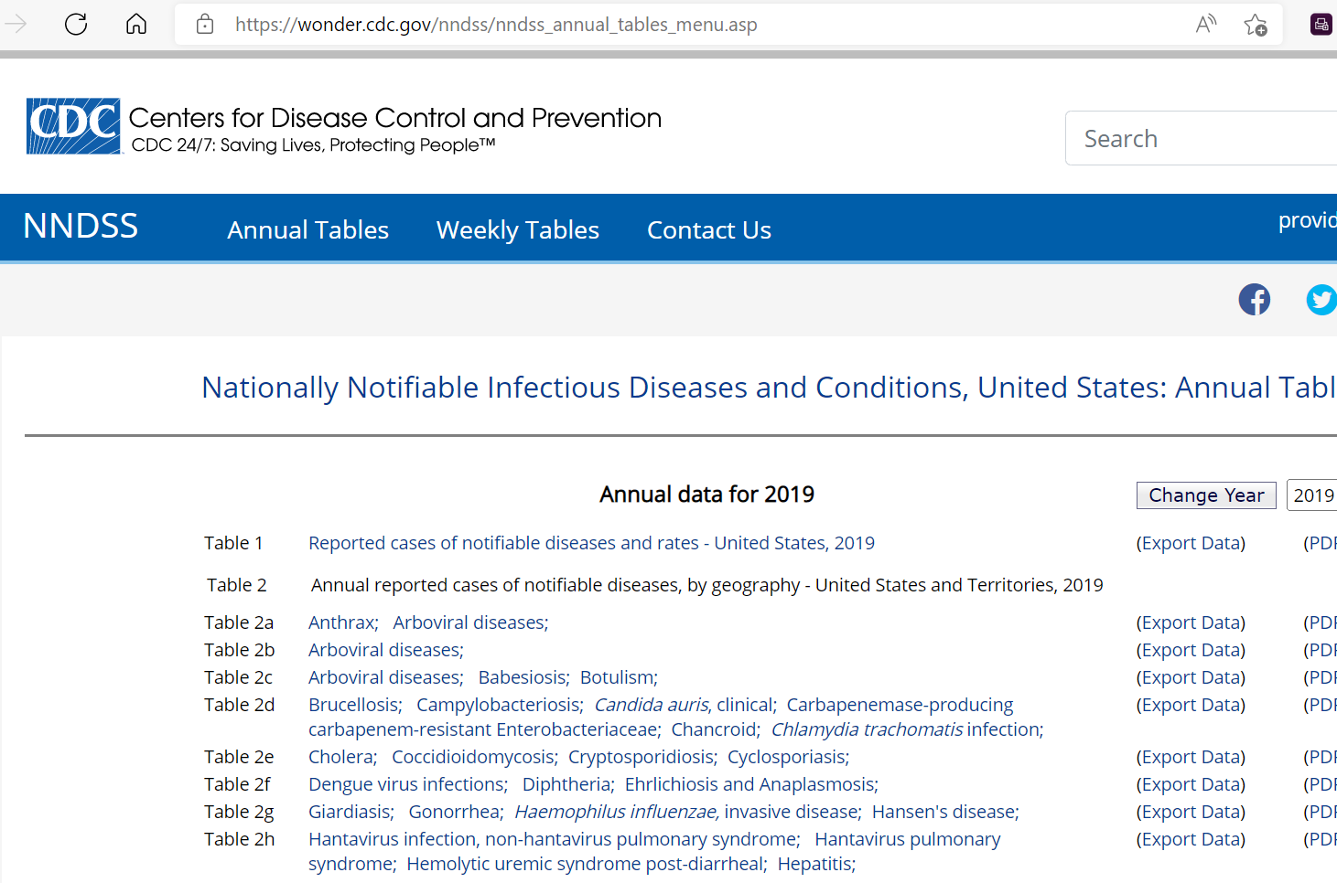
Current NNDSS Annual Table Listing View

Slide 18
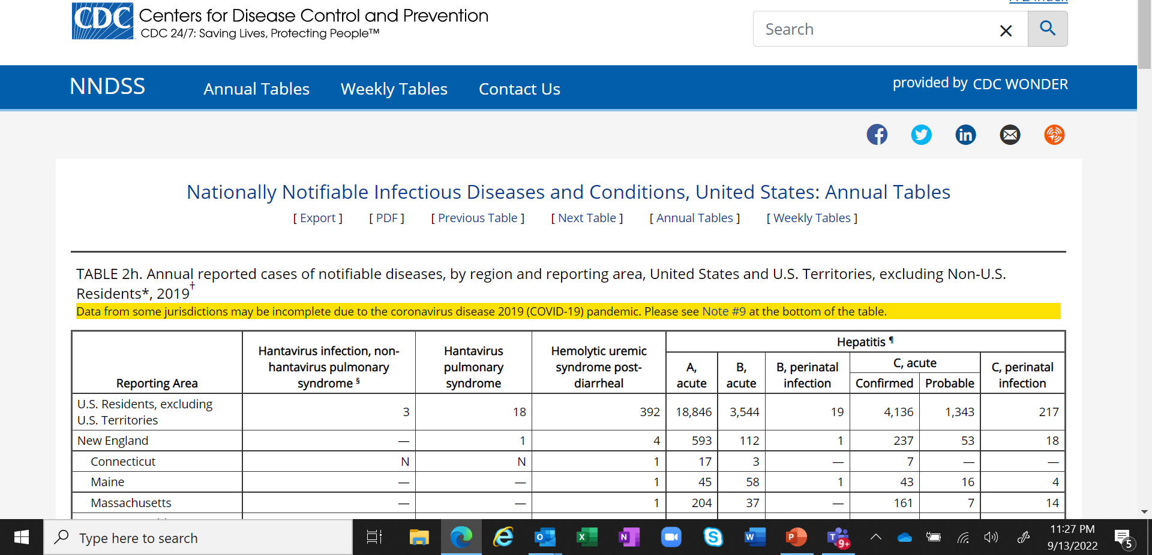
Current NNDSS Annual Table “Static” View

Slide 19
Where We Are Going

Slide 20
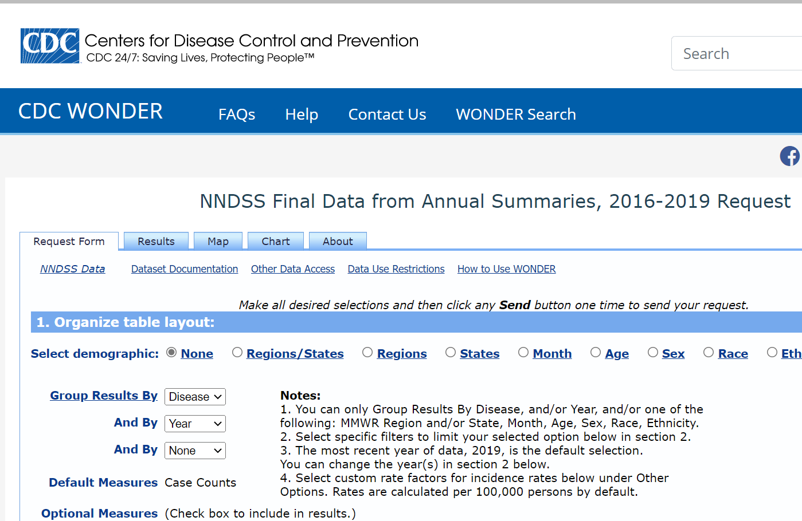
Future NNDSS Annual Table “Interactive” View

Slide 21
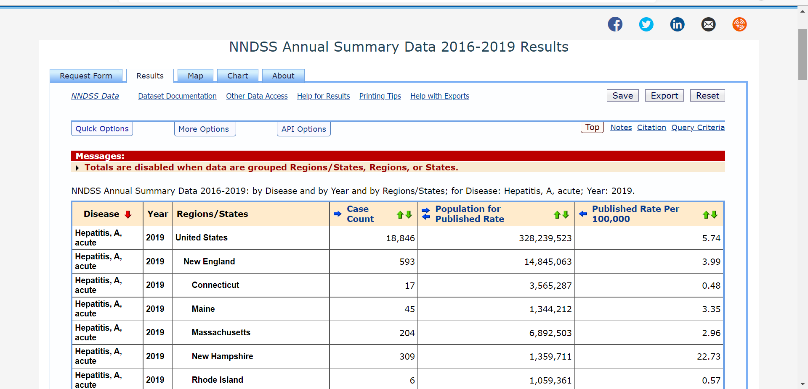
Future NNDSS Annual Table “Results” Tab

Slide 22
New Functionality Benefits
Provides an interactive means of accessing the NNDSS Annual data, without introducing additional data stratifications
Enhances the availability and use of NNDSS Annual data
Provides the ability to compare across years and focus on specific conditions, places, or populations
Improves showcasing of NNDSS Annual data

Slide 23
What is Not Changing
No new stratifications are available in the interactive WONDER views
Existing table views will still be available for users more comfortable with the current format
Weekly data will not be available in the interactive views

Slide 24
Special Consideration
Calculated rates will be provided by nation, region, and state
Currently published annual tables:
  Only national-level rates are calculated and displayed
  Denominators are provided for other geographies, but rates need to be calculated by users

Slide 25
Reporting Exceptions
Not reportable in jurisdiction
  Current annual tables publish “N” in these cells
  New WONDER view will include “Not Applicable”
Data are unavailable from the jurisdiction for a reportable condition
  Current annual tables publish ”U” in these cells
  New WONDER view will include “Not Available”
No cases reported
  Current annual tables publish “—” to indicate a numeric value of zero
  New WONDER view will include “0”

Slide 26
Reporting Exceptions – Example
Disease | Year | State | Case Count | Population | Published Rate
Babesiosis, Total | 2019 | Alaska | Not Applicable | Not Available | Not Applicable
Babesiosis, Total | 2019 | Indiana | 0 | 6,732,219 | 0.00
Babesiosis, Total | 2019 | American Samoa | Not Available | Not Available | Not Applicable

Slide 27
Demonstration by Ugo Okeke

Slide 28
Next Steps

Slide 29
NNDSS Interactive Annual Tables Timeline
Demonstrations
October 18: NNDSS eSHARE meeting
November 4: CSTE Surveillance Practice and Implementation Subcommittee
Release date target
End of November/early December

Slide 30
Feedback
Please send comments to edx@cdc.gov with a subject of “New NNDSS WONDER View.”

Slide 31
CDC Enhancements to Case Surveillance
Dr. Jennifer Layden
Associate Deputy Director, Public Health Science and Surveillance
Dr. Jennifer Adjemian
Director, Division of Health Informatics and Surveillance

Slide 32



Challenges with Case Surveillance
Current strategy is
burdensome
Current strategy is
time consuming
Current strategy is
not flexible
State, territorial, local, and tribal (STLT) health department staff shoulder a large burden of counting, cleaning, and collating case data for CDC.
Creating, onboarding, and updating data flows (message mapping guides) is time consuming for all parties involved and requires in-depth expertise across several disciplines.
Data flows are currently inflexible and can take years to update even for simple data element changes.
32

Slide 33



Sprint Discovery Method
What is a discovery sprint?
A method to quickly build a common understanding of the status of a complex system or organization and create a path toward solutions by identifying specific actionable next steps.
Who was included?
From May–July 2022, a team of 5 USDS and 2 CDC staff conducted desk research and qualitative research at CDC, CSTE, NACCHO, and 19 state and local health departments. The team conducted 65 conversations with 148 individuals.
How was it done?
The team mapped people, processes, and technologies in the lifecycle of national notifiable case data and identified pain points and opportunities where CDC can make an impact.
33

Slide 34

Recommendations for Case Surveillance
Enable
  Enable submission of a generic, core data feed for all national notifiable diseases, allowing a timely and sustainable flow of critical information
Expand
  Expand the range of data formats and methods so that jurisdictions can send their notifiable disease data to CDC in a way that works for their system
Develop
  Develop agile, flexible solutions with common data standards for disease-specific case data to alleviate burden and support responsiveness to changing needs
Pause
  Pause current high-burden, unsustainable approach to disease-specific supplemental case data notification
Provide
  Provide clear value to public health action with automated, near real-time data tools with tiered access to jurisdictions, partners, and public
Eliminate
  Eliminate the need for jurisdictions to send the same data in multiple formats to multiple places at CDC by leveraging the “one front door” approach
These recommendations support the larger vision of building a flexible, efficient, and scalable data pipeline for both routine and emergency public health needs that is centered on providing value to the jurisdictions, CDC programs, and the public.
34

Slide 35





Ongoing, Agency-wide Effort
Supported by the CDC Director and aligned with CDC Moving Forward and the Data Modernization Initiative
Led by the Deputy Director Public Health Science and Surveillance (DDPHSS) and Division of Health Informatics and Surveillance (DHIS) in the Center for Surveillance, Epidemiology, and Laboratory Services (CSELS)
Designates responsibility, authority, and leadership for DHIS to create and steward national case surveillance data standards
35

Slide 36
FY 23 Objectives:
Goal 1
Support jurisdictions in collecting and sending case data in a timely manner, at a cost commensurate with the utility of these data
Designate responsibility, authority, and leadership for DHIS to create and steward national case surveillance data standards.
The current “Generic Message Mapping Guide v2” should be turned into a format-agnostic data standard.
Onboard all jurisdictions for all notifiable diseases to report core data elements using this standard, supporting formats beyond HL7 V2 (such as CSV or FHIR).
Pause and rethink how jurisdictions send supplemental case data to CDC currently using condition-specific message mapping guides.
Leverage NBS Modernization and “Building Blocks” work and pilot innovative data ingestion and data processing tools with a few jurisdictions.
36

Slide 37
Proposed Actions: Goal 1
Conduct a landscape analysis to identify gaps in HL7 Gen v2 MMG use by jurisdictions and propose appropriate, alternative solutions for those jurisdictions.
Collaborate with CDC programs to document their data collection objectives and plan how to collect these data through the case surveillance pipeline.
Identify MMGs and jurisdictions that are in the process of onboarding, and work with programs to identify a strategy for when to pause the current process.
Work with ELC HIS to evaluate how these decisions would affect jurisdictions' evaluation criteria and develop plans to mitigate potential risks and prevent duplicative funding streams.
Support jurisdictions in collecting and sending case data in a timely manner, at a cost commensurate with the utility of these data
37

Slide 38
FY 23 Objectives:
Goal 2
Provide jurisdictions with a single entry-point to CDC for all their disease surveillance data, including disease-specific data and emergency response data
Provide jurisdictions with a way to submit all their case data to a single place at CDC.
Help jurisdictions in setting up these data flows.
Execute a proof of concept "exercise" through the NBS Modernization project with a few diverse jurisdictions. This would help prove that new conditions and new data elements could flow swiftly, using the same mechanism and CDC entry point, in case of an emergency.
Define the product strategy, software architecture, and organizational structure to implement this vision. Staff this workflow with expertise in human-centered design, product management, and software architecture.
38

Slide 39
Proposed Actions, Goal 2
Develop a product strategy and an implementation plan for a “one front door” solution with SMEs from DHIS, OCIO, and USDS.
Bolster existing customer service-oriented teams in DHIS to include a primary point of contact for each jurisdiction and CDC program to receive technical assistance and support across all case data pipeline-related needs.
Prioritize the research and development of flexible case notification functionality for NBS modernization.
Provide jurisdictions with a single-entry point to CDC for all data from their surveillance systems, including disease-specific supplemental data and emergency response data
39

Slide 40
FY 23 Objectives:
Goal 3
Provide value to national public health by leveraging the unique opportunities that national data aggregation offers
Define the product strategy and implementation plan with SMEs from DHIS, OCIO, and USDS.
Pilot a few innovative data products that can be accessed in a shared environment for use by jurisdictions and CDC programs.
Set expectations around data sharing:
  Define clear data ownership and stewardship roles.
  Develop a better understanding of the data users both inside and outside of CDC.
  Describe what it looks like for data to be shared with the public in a timely, easy to analyze and easy to find manner and commit to it.
40

Slide 41
Immediate Next Steps, Goal 3
Define the product strategy and implementation plan with SMEs from DHIS, OCIO, and USDS.
Develop a plan for how case data flowing into CDC from jurisdictions will undergo transparent and effective quality control.
Develop a plan for how CDC will make data available to CDC programs and jurisdictions and accessible using analytical tools such as ESSENCE, EDAV, SEDRIC, or DCIPHER.
Identify a surveillance team that uses these tools in a central, program-agnostic organizational unit to routinely review the data for quality control measures and for public health purposes.
Provide value to national public health by leveraging the unique opportunities that national data aggregation offers
41

Slide 42

What Jurisdictions Can Do
Communicate
Participate
Communicate the importance of this work to your staff; your support is critical to the success of this effort.
Participate in upcoming listening sessions to give input and feedback on any barriers or obstacles your organization may face with these recommendations.
42

Slide 43
Contact:
DMI Inquiries (subject line “Case Surveillance Enhancements”): dmi@cdc.gov
Dr. Jennifer Layden
Associate Deputy Director, Public Health Science and Surveillance qbg5@cdc.gov
Dr. Jennifer Adjemian
Director, Division of Health Informatics and Surveillance gdn5@cdc.gov
Questions?

Slide 44

Q & A

Slide 45



Thank you!
See you on October 25, 2022, for the
Special Session on Monkeypox Response Updates
Subscribe to
Case Surveillance News
Access NNDSS Technical Resource Center
For more information, contact CDC
1-800-CDC-INFO (232-4636)
TTY: 1-888-232-6348 www.cdc.gov
Email edx@cdc.gov for Technical Help or to Onboard HL7 Message Mapping Guides
The findings and conclusions in this report are those of the authors and do not necessarily represent the official position of the Centers for Disease Control and Prevention.

