Slide 1
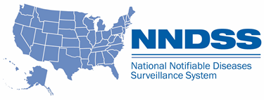
NNDSS eSHARE
August Webinar
Division of Health Informatics and Surveillance
August 16, 2022

Slide 2

Agenda
  NNDSS Updates and Announcements
  2021 Reconciliation Process Overview
  Finalization of 2021 NNDSS COVID-19 Data
  Questions and Answers

Slide 3
NNDSS Updates and Announcements
Michele Hoover, MS
Data Standardization and Assistance Team
Center for Surveillance, Epidemiology, and Laboratory Services

Slide 4
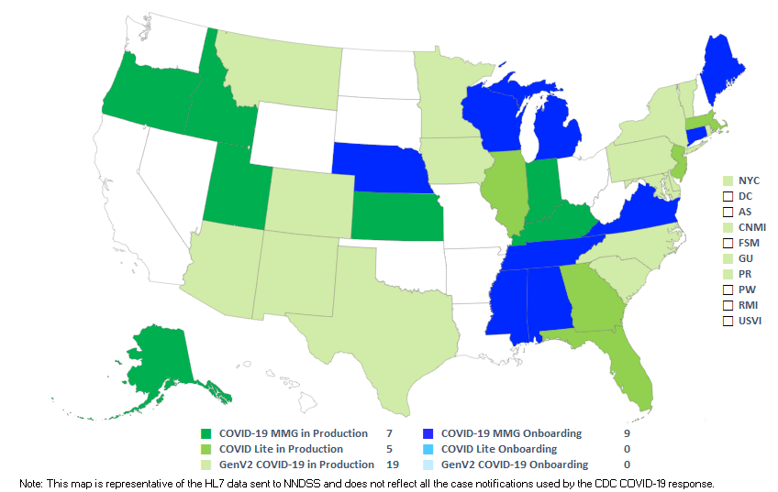
COVID-19 HL7 Data Implementation In-progress
Status as of 8/16/2022

Slide 5
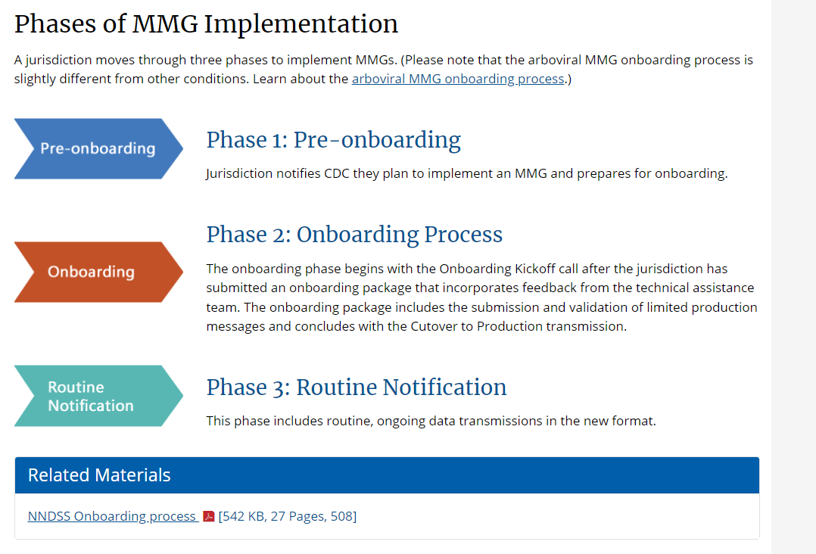
Update: NNDSS Onboarding Website
UPDATED Content: https://www.cdc.gov/nndss/trc/onboarding/overview.html
Detailed process document

Slide 6
Updated Babesiosis MMG
  Version 1.1 is the most current
    Adds Mother's Local Record ID
    Updates format description for Physician Phone (68340-9)
    Integrates Generic v2.0.1 updates into the test case scenario worksheets
  Value Set Updates
    Version 5 is the most up-to-date version of the PHIN VADS Babesiosis Case Notification View
Babesiosis MMG v1.1: https://ndc.services.cdc.gov/mmgpage/babesiosis-message-mapping-guide/
Babesiosis PHIN VADS Case View version 5: https://phinvads.cdc.gov/vads/ViewView.action?id=729FCC10-D4CF-EC11-81AD-005056ABE2F0

Slide 7
Case Surveillance Updates
Sara Johnston
NNDSS Program Lead
Center for Surveillance, Epidemiology, and Laboratory Services

Slide 8




Reconciliation:
2021 NNDSS Annual Tables
Center for Surveillance, Epidemiology, and Laboratory Services
Ruth Jajosky, DMD, MPH
Lead, Case-Based Surveillance Operations Team
Keaton Hughes, Diana Onweh, Alan Schley
Surveillance, Practice and Partnerships (SPP) Section
Case-Based Surveillance Operations Team
National Center for HIV, Viral Hepatitis, STD, and TB Prevention
Melissa Pagaoa, MPH
Lead, Data Management Team

Slide 9
2021 Reconciliation Process Topics
2021 reconciliation process overview
Steps for finalizing NNDSS data
Steps for finalizing sexually transmitted disease (STD) data
2021 reconciliation data tables
Questions

Slide 10
2021 Reconciliation Process Overview

Slide 11
What is NNDSS Reconciliation?
Process used to finalize case counts for the previous year
  Collaboration between reporting jurisdictions and CDC
  Ensures agreement between reporting jurisdiction database and CDC NNDSS database
  Data published on CDC WONDER

Slide 12
Reconciliation Guidance
State/Territorial Epidemiologist letter sent with production calendar
State reporter letter with:
    Reconciliation tables (1-13) with instructions for reviewing tables
    Unformatted reconciliation data in Excel workbook
    Week-ending calendar
    2021 NNDSS event code list
Final step: State or Territorial Epidemiologist signs off on final counts

Slide 13
2021 Reconciliation Calendar
08/16 eSHARE Webinar: Reconciliation Process for NNDSS Annual Tables, 2021
08/19 State or Territorial Epidemiologist reconciliation letter with production calendar
08/22 Surveillance, Practice and Partnerships (SPP) Team starts sending reconciliation packets to State/Territorial epidemiologists & reporters
10/19 Deadline for “final” STD 2021 data submission
11/09 STD database closed: Last day for jurisdictions to request SPP to “lock” their STD data as final
11/18 CDC program databases closed:
ArboNet
HIV diagnosis
Pediatric flu mortality and novel flu
Rabies, animal
Tuberculosis database closed by CDC program
Varicella mortality

Slide 14
Reconciliation Calendar (cont’d)
11/18 - Last day for jurisdictions to request SPP to “lock” their non-STD data as final - Last day for jurisdictions to confirm or update their 2021 reporting exceptions - SPP sends a set of updated reconciliation tables for final review by jurisdiction - After final review, SPP emails final counts to State/Territorial Epidemiologists for signatures.
12/01 - Last day for State/Territorial Epidemiologists to email final signature reports to CDC - Last day for jurisdictions to submit final 2021 NNDSS aggregate COVID-19 case counts
12/01 - NNDSS database CLOSED (final) for all jurisdictions - NNDSS team begins preparation of final 2021 tables for publication

Slide 15
Steps for finalizing nndss data

Slide 16
Step 1: Reconciliation Kick-Off
NNDSS surveillance officer sends out reconciliation packets that include:
  Overview of changes and guidelines for this year
  Production calendar
  Week-ending calendar
  Abbreviated event code list for 2021
  Instructions for reviewing reconciliation tables
  Reconciliation tables 1–13

Slide 17
Step 2: Data Reconciliation
  Ensure necessary staff have Message Validation, Processing, and Provisioning System (MVPS) portal access through Secure Access Management Services (SAMS)
    Jurisdiction Data Manager sends e-mail to edx@cdc.gov with subject line "New MVPS User Access“
  Compare your surveillance system data with those in the NNDSS database using reconciliation tables and the MVPS portal line list and case summary

Slide 18
Step 2: Data Reconciliation (cont’d)
Send case notification updates to correct differences using:
  HL7
  NEDSS Base System (NBS)
  National Electronic Telecommunications System for Surveillance (NETSS):
    Send complete Year-to-Date (YTD) files (STD, non-STD) by placing files into your SAMS “YTD” folder
    YTD files must contain complete data for each year represented in the file
Or use Delete a Case feature in MVPS
Request new set of reconciliation tables from NNDSS as needed

Slide 19
Step 3: Finalizing Data
Inform NNDSS surveillance officer when totals are accepted as final
  “Lock” STD conditions and non-STD conditions as final
  After locking 2021 data, subsequent updates will be accepted in MVPS but not included in locked totals unless jurisdiction requests to “unlock” their data
  Unlocking, and later relocking, will allow subsequent case notification updates to be included in the finalized annual dataset.

Slide 20

Step 4: State or Territorial Epi Sign-off
Confirm or update your 2021 reporting exceptions
  NNDSS surveillance officers will send out a new set of reconciliation tables based on the locked data for final review by jurisdiction.
Review and sign off on final data
  Upon final review and agreement of the tables, the surveillance officers will share final tables that should be signed by the State or Territorial Epi and returned.

Slide 21
Assistance With Reconciliation
Guidance documents are available within the MVPS portal
NNDSS surveillance officers are here to help!
  Keaton Hughes (qwy4@cdc.gov): AL, AK, CA, HI, KS, ME, MA, MN, MO, NE, NC, ND, NYC, OR, PR, SC, VT, VA
  Diana Onweh (onw1@cdc.gov): AR, CO, CT, GA, ID, IA, IL, IN, LA, MD, MI, MS, NH, NV, PA, TN, TX, WA, WY​
  Alan Schley (aso7@cdc.gov): AZ, DE, FL, KY, MT, NJ, NM, NY, OH, OK, RI, SD, UT, DC, WV, WI, territories

Slide 22
Tips For 2021 Data Reconciliation
Work with CDC programs to finalize your case counts
Use MVPS portal to review 2021 cases for low incidence conditions that require verification prior to locking and finalizing data
  Responses are required for all cases in the Low Incidences section of MVPS; or
  Cases that should not be printed also need updates sent to CDC (e.g., change classification to 'not a case')
Resolve transmission issues
  Verify PHIN Messaging System (PHINMS) certificate is authenticated
  If yes, contact the PHINMS Help Desk at PHINtech@cdc.gov

Slide 23
MVPS Portal Line List Additions
  New variable additions to line list:
    Printed
    MMWRMonth
    AgeGroup
    CurrentRecordFlag
    TransactionID
Line List Data Dictionary
Printed | Indicates whether the case was or will be printed in CDC information portals.
MMWR Month | MMWR month for which case information is counted for annual NNDSS publication.
Age Group | Age group based on age in years.
Current Record Flag | Indicates whether the referenced record is the most current. Value may be “No” if a case is in a locked/approved status for annual closeout.
Transaction ID | A unique identifier generated by MVPS for each message that may be helpful for troubleshooting issues. This ID identifies the current or locked/approved record depending on the “Data Set” selection used to generate the Line List.

Slide 24
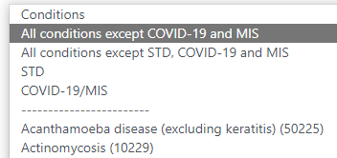
MVPS Portal Conditions Filter
  New group options for Conditions filter on multiple pages
  The default Conditions filter is being updated to “All conditions except COVID-19 and MIS” for:
    Case Listings, Delete a Case Transaction Finder, Line List

Slide 25
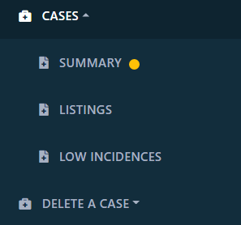
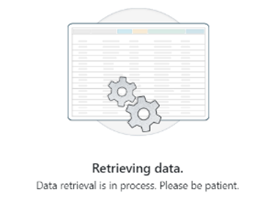
MVPS Performance Enhancement
Problem: Many MVPS portal searches time out due to the volume of data.
Solution: Allow users to start the search and navigate away from the page while it runs. When complete, an indicator will alert user to return for results.
Will apply to:
Case Listing
Case Summary
Delete a Case –
Case Finder
Errors & Warnings

Slide 26
Steps for finalizing Sexually Transmitted Diseases

Slide 27
Sexually Transmitted Diseases
  Division of STD Prevention (DSTDP) sends out data quality reports to jurisdictions the week of August 1
  Deadline for “final” STD 2021 data submission: October 19, 2022
      Jurisdictions are encouraged to send data before deadline
  After jurisdiction's STD programs inform SPP that final STD 2021 data were sent to CDC, SPP will send updated reconciliation tables to jurisdictions upon request
  Jurisdiction's STD programs will confirm numbers and request SPP to lock data
  DSTDP will perform quality assurance processes based on locked data and send final sign-off letters to jurisdictions

Slide 28
Sexually Transmitted Diseases (cont’d)
  December 1, 2022: deadline for STD Program Manager and State/Territorial Epidemiologist to return final, approved sign-off letters to DSTDP
  Contact Alesia Harvey for questions
      std_surv_inquiry@cdc.gov; 404-639-8196

Slide 29
Sexually Transmitted Diseases (cont’d)
  Table 4 – Race/Ethnicity by Disease
      The STD program collects Office of Management & Budget (OMB) race categories (select all that apply) in the program-specific variables
      The race/ethnicity presented in the reconciliation table are based on OMB Race and Ethnicity categories; whereas, in previous years the core values were used
      The OMB race/ethnicity data reported in program-specific variables will be available in reconciliation table 4 and MVPS line list reports starting August 22

Slide 30
Sexually Transmitted Diseases (cont’d)
  Table 11 – Import Status by Disease
      STD program has modified this variable and the data are captured in the program-specific variables
      The data presented in reconciliation report and line list do not reflect this; default to data reported in core variable

Slide 31
2021 Reconciliation data tables

Slide 32
2021 Reconciliation Tables
Table 1 Case count by receiving system and diseases
Table 2 Case count by case status classification and diseases
Table 3 Case count by month and disease
Table 4 Case count by race/ethnicity and disease
Table 5 Case count by age group (years) and disease
Table 6 Case count by sex and disease
Table 7 Case count by Morbidity and Mortality Weekly Report (MMWR) week and disease
Table 8 Case count by reporting county and disease
Table 9 Case count by Genv2-based HL7 county of residence and disease
Table 10 Case count by outbreak status and disease
Table 11 Case count by import status and disease
Table 12 Case count by disease and reporting exception
Table 13 Case count for retired event codes
*Excel Workbook provides tables 1-11 in a machine-readable format.

Slide 33
Reporting Exceptions
  Reporting exceptions exclude case counts from publication:
    If condition is not reportable in jurisdiction, the NNDSS tables display “N”
    If data are incomplete or unavailable in jurisdiction, the NNDSS tables display “U”
  Ensure appropriate denominators for rates are included
  For the Year 2021:
    The “N” and “U” indicators in the NNDSS tables are currently assigned based on reporting exceptions finalized during last year’s reconciliation
    It is important to update or confirm your 2021 reporting exceptions during reconciliation to ensure accuracy in the annual publication

Slide 34
Example: Table 12. Case Count by Disease and Reporting Exception
Disease | Event | Reporting Exception | Total Reported to CDC
Babesiosis, total | 12010 | Not Reportable | 1
Babesiosis, confirmed | 12010 | Not Reportable | 0
Babesiosis, probable | 12010 | Not Reportable | 1
Hantavirus infection (non-HPS) | 10610 | Not Reportable | 0
Leptospirosis | 10390 | Not Reportable | 2
Q fever, chronic | 10258 | Data Unavailable | 0
Information on notifiable conditions that are not reportable or do not have data available for the jurisdiction

Slide 35
Example: Table 2. Case Count by Case Status and Disease
Disease | Event | Unknown Status | Suspect Status | Probable Status | Confirmed Status | Print Total | Total Reported to CDC
Anthrax | 10350 | 0 | 0 | 0 | 1 | 1 | 1
Babesiosis, total | 12010 | 0 | 0 | 1 | 2 | 3 | 3
Babesiosis, confirmed | 12010 | 0 | 0 | 0 | 2 | 2 | 2
Babesiosis, probable | 12010 | 0 | 0 | 1 | 0 | 1 | 1
Botulism, foodborne | 10530 | 0 | 0 | 0 | 0 | 0 | 0
Botulism, infant | 10540 | 0 | 0 | 0 | 10 | 10 | 10
Botulism, other | 10550 | 0 | 0 | 4 | 5 | 5 | 9
Brucellosis | 10020 | 0 | 0 | 1 | 16 | 17 | 17

Slide 36
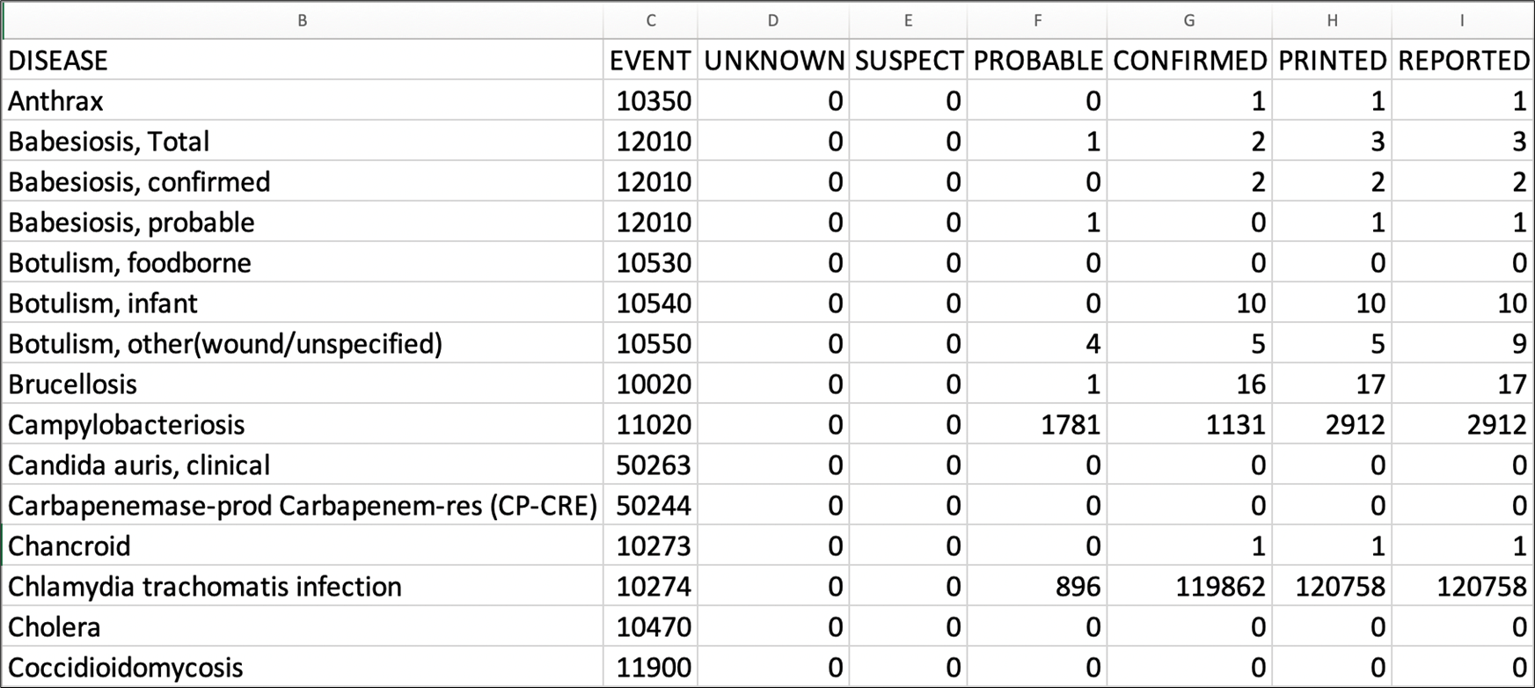
Example: Excel Workbook, Table 2

Slide 37
2021 NNDSS Aggregate COVID-19 Data Request
Center for Surveillance, Epidemiology, and Laboratory Services
Ruth Jajosky, DMD, MPH
Lead, Case-Based Surveillance Operations Team

Slide 38
Process for 2021 NNDSS COVID-19 Data
  Final 2021 NNDSS data for COVID-19 will not be reconciled
  CDC will collect aggregate case counts for confirmed and probable cases
  CDC will provide an Excel worksheet with instructions to help you prepare your data
  CDC will send an email (starting August 15) to the State/Territorial Epidemiologists with the link to the Epi Info™ web form to enter the data
  State/Territorial Epidemiologists will sign off on the aggregate counts in Epi Info™
  CDC will use the aggregate counts in the 2021 annual NNDSS tables

Slide 39
COVID-19 Data for the 2021 Annual NNDSS Tables
  2021 final NNDSS COVID-19 aggregate data are needed for confirmed and probable cases among U.S. residents for:
      Total cases in jurisdiction
      Month (based upon MMWR weeks)
      Age group
      Sex
      *Race and Hispanic ethnicity
  States send data for all the above categories
  U.S. territories send only total confirmed and probable cases
  NNDSS will collect counts for unknown or missing demographic and month data
  *Race and ethnicity will be collected in a combined table but will be presented separately in the published NNDSS tables; see next slide.

Slide 40
Combined Race and Ethnicity Categories
  Cross tabulations of the following race categories with each of the Hispanic/Latino ethnicity values (Hispanic/Latino, non-Hispanic/Latino, and unknown/missing Hispanic/Latino ethnicity) are as follows:
      Native American or Alaska Native
      Black or African American
      White
      Asian
      Native Hawaiian or Other Pacific Islander
      Other or multi-race
      Unknown or missing race

Slide 41
Race Categories
  These race categories are different from race in the NETSS* record layout:
      Asian and Native Hawaiian or Other Pacific Islander are separate categories
  If a person has multiple races, only count the case under the “Other or multi-race” category
  In the 2021 NNDSS tables, race and ethnicity data will be presented separately, just as they appear in the 2019 NNDSS annual tables
  *NETSS: National Electronic Telecommunications System for Surveillance

Slide 42
Epi Info™ Web Form for 2021 Final NNDSS COVID-19 Aggregate Data
  To allow for secure data entry, CDC will provide a unique Epi Info™ web form link to each State/Territorial Epidemiologist
  Enter requested data into the form and ensure the State or Territorial Epidemiologist reviews and approves the data
    Coordinate within your jurisdiction on who should enter aggregate 2021 COVID-19 data into the form
    Note: Different people can enter different components of the data, but only one person should enter data at a time
      If multiple people enter data at the same time, one person may overwrite the changes of another

Slide 43
Epi Info™ Web Form
  After the data entry is complete, the State or Territorial Epidemiologist can use the link to the Epi Info™ form to review, approve, and submit the final 2021 NNDSS COVID-19 data
  Do not click the “Submit” button until all data have been entered, reviewed, and approved by the State/Territorial Epidemiologist
  Remember: Although the link can be shared, only one person at a time should enter data in the form
  Questions or prematurely submitted the data?
      Email edx@cdc.gov with the subject “2021 final NNDSS COVID-19 data”

Slide 44
CDC Review of Final Counts
  CDC review of final counts will include:
    Comparing submitted 2021 NNDSS COVID-19 aggregate data to:
      Aggregate case counts submitted by jurisdictions to the response (or pulled from websites)
      Line-level data sent through NNDSS and/or CSV upload to DCIPHER
    Identifying potential data entry errors or transposition of data across fields
  In the Epi Info™ web form, enter the name and email of the person CDC should contact for questions

Slide 45
Timeline: 2021 Final NNDSS COVID-19 Aggregate Data
  By Thursday, December 1, 2022
      Jurisdictions should enter their data into the Epi Info™ web form
      State/Territorial Epidemiologist should approve the case counts for the 2021 NNDSS COVID-19 data in the Epi Info™ web form
      The finalized information and sign-off should be submitted through the Epi Info™ web form

Slide 46

Q & A

Slide 47



Thank you!
See you September 20, 2022, for the next NNDSS eSHARE
Subscribe to
Case Surveillance News
Access NNDSS Technical Resource Center
For more information, contact CDC
1-800-CDC-INFO (232-4636)
TTY: 1-888-232-6348 www.cdc.gov
Email edx@cdc.gov for Technical Help or to Onboard HL7 Message Mapping Guides
The findings and conclusions in this report are those of the authors and do not necessarily represent the official position of the Centers for Disease Control and Prevention.

