Slide 1
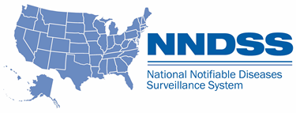
NNDSS eSHARE
July Special Session Webinar
Division of Health Informatics and Surveillance
July 26, 2022

Slide 2

Agenda
  NNDSS Updates and Announcements
  Draft Bacterial Special Pathogens Message Mapping Guides (MMGs): Overview and Jurisdiction Feedback
  Questions and Answers

Slide 3
NNDSS Updates and Announcements
Michele Hoover, MS
Data Standardization and Assistance Team
Center for Surveillance, Epidemiology, and Laboratory Services

Slide 4
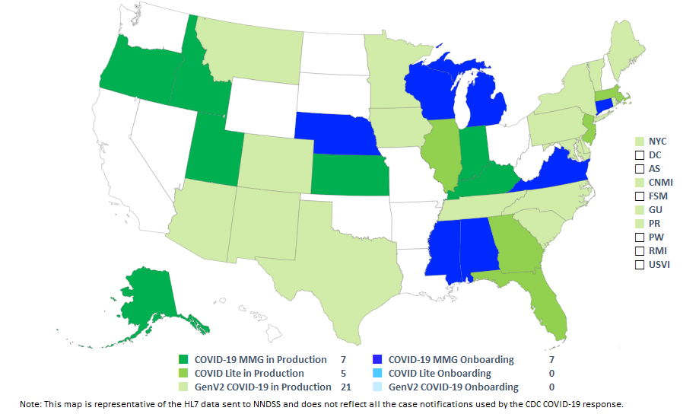
COVID-19 HL7 Data Implementation In-progress
Status as of 7/26/2022

Slide 5
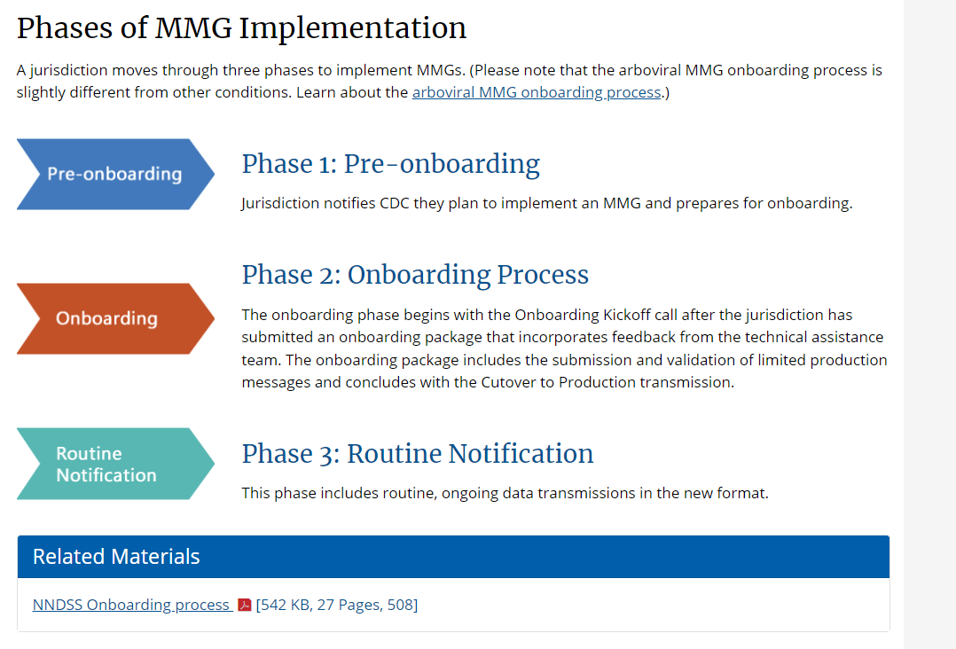
Update: NNDSS Onboarding Website
UPDATED Content: https://www.cdc.gov/nndss/trc/onboarding/overview.html
Detailed process document

Slide 6
Updated Tuberculosis and Latent TB Infection (LTBI) MMG
  Version 3.0.3 is the most current
    Updates CDC priorities to the 1, 2, 3 categories
    Includes four updated TB, one updated LTBI, and two new LTBI test scenarios for a total of seven test scenarios
    Integrates Generic v2.0.1 updates into the test case scenario worksheets
    Corrects sample segments and implementation notes in data elements tab
    Provides new URL for Census Tract of Case-Patient Residence (PID-11.10) census tract value lookup
  Value Set Updates
    Version 7 is the most up-to-date version of the PHIN VADS TB and LTBI Case Notification View
    Corrected spelling of preferred concept code “Para-Aminosalicylic acid” in value set PHVS_Medications_TB & PHVS_SusceptibilityTestType_TB
Tuberculosis and Latent TB Infection MMG v3.0.3: https://ndc.services.cdc.gov/mmgpage/tuberculosis-and-latent-tb-infection-message-mapping-guide/
PHIN VADS Tuberculosis and LTBI Case Notification View version 7: https://phinvads.cdc.gov/vads/ViewView.action?id=A1286853-27EC-EC11-81AF-005056ABE2F0
PHVS_Medications_TB value set version 3: https://phinvads.cdc.gov/vads/ViewValueSet.action?id=51D7CC55-283E-4E7B-AC1A-CBC133C4E285
PHVS_SusceptibilityTestType_TB version 3: https://phinvads.cdc.gov/vads/ViewValueSet.action?id=983BBA74-C532-424A-9A3D-35F692E147FD

Slide 7
Case Surveillance Updates
Sara Johnston
NNDSS Program Lead
Center for Surveillance, Epidemiology, and Laboratory Services

Slide 8
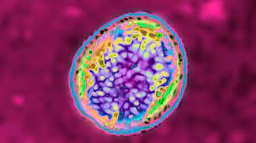
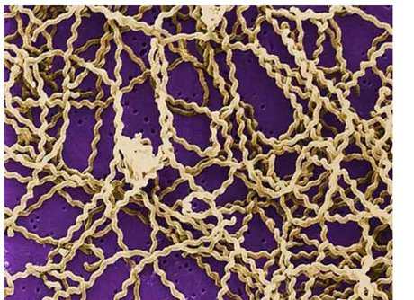
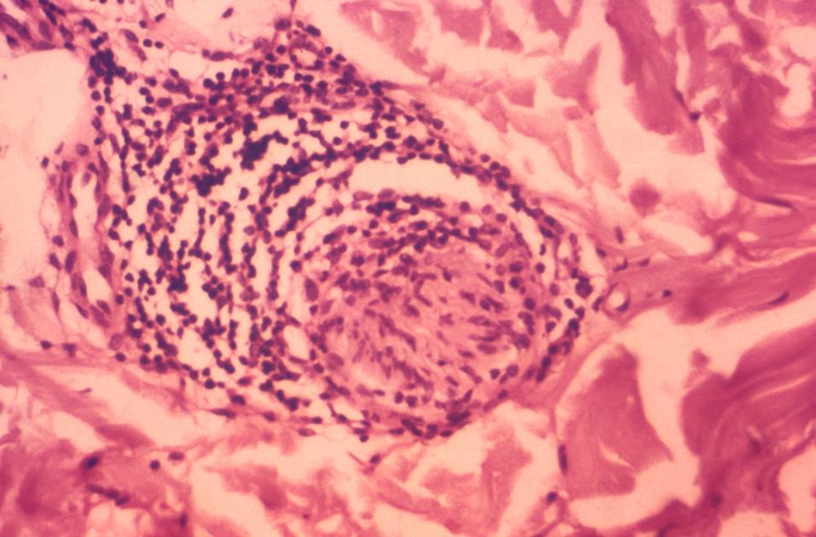
Overview of Draft Brucellosis, Leptospirosis, and Hansen’s Disease MMGs for Review and Feedback
Bacterial Special Pathogens Branch
Division of High Consequence Pathogens and Pathology

Slide 9
Background

Slide 10
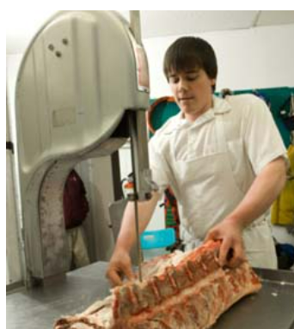

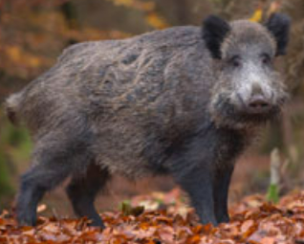
Brucellosis Background
B. suis, B. melitensis, B. abortus = select agents
120-160 cases reported annually in the US
Common exposure risks:
  Contact with infected animals
  Consumption of unpasteurized products or undercooked meat
  Occupational risk: laboratorians + persons working with animals
10

Slide 11



Leptospirosis Background
Increasing case counts in the US, particularly since the 2017 hurricanes
  150-200 cases reported annually
Common exposure risks:
  Contact with bodily fluids of infected animals
  Contact with contaminated water or soil
    Severe weather (storms, floods)
    Recreational outdoor activities
  Occupational Risk: Persons working outdoors or with animals
11

Slide 12
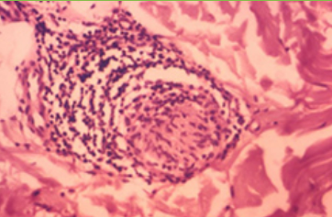
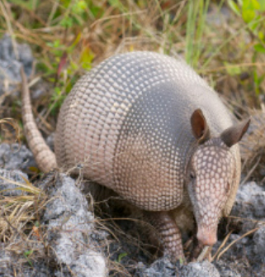
Hansen’s Disease Background
Chronic infectious disease is also known as leprosy
70-100 cases reported annually in the US
Caused by slow-growing bacteria Mycobacterium leprae
Transmission: prolonged close contact with infected person
Some armadillos in the southern US are naturally infected
Three classifications:
  Paucibacillary or tuberculoid
  Multibacillary (MB), or lepromatous
  Borderline or dimorphous
12

Slide 13
Message Mapping Guides
Brucellosis, Leptospirosis, Hansen’s Disease

Slide 14
Overview of Sections
Brucellosis
Physician Contact Information
Industry and Occupation
Disease Presentation
Clinical Manifestations
Temperature
Treatment and Post Exposure Prophylaxis
Travel History
Animal Exposure
Animal-based Product Exposure
Laboratory or Vaccine Exposure
Epi-Related Contact Exposure
Laboratory
Hansen’s Disease
Subject Information
Industry and Occupation
Treatment and Post Exposure Prophylaxis
Prior Residence
Household Contacts
Previously Diagnosed Household Contacts
Laboratory
Leptospirosis
Subject Information
Industry and Occupation
Employment Location
Clinical Manifestations
Hospitalization
Disease Outcome
Treatment
Environmental and Animal Exposure
Rodent Exposure
Severe Weather Exposure
Travel History
Laboratory
Blue color indicates repeating group
14

Slide 15
Leptospirosis-specific MMG Sections

Slide 16
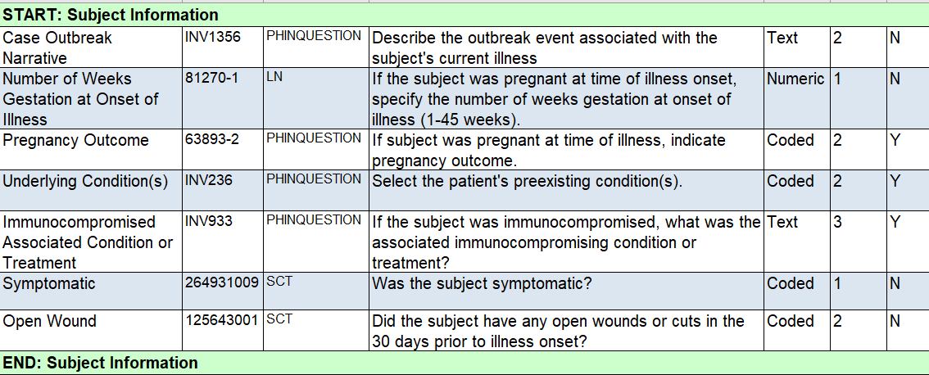
Leptospirosis: Subject Information
Live Birth
Stillbirth
Neonatal Disorder
Neonatal Death
Termination Pregnancy
Miscarriage
Immunocompromised
Renal Disease
Liver Disease
Lungs Disease
Unknown
16

Slide 17
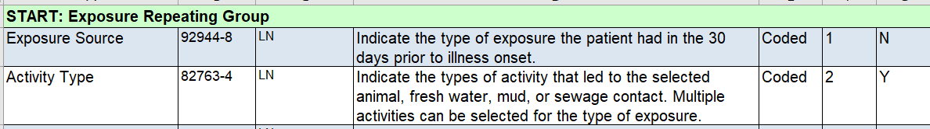
Leptospirosis: Exposure Repeating Group
Bathing
Bike riding
Boating
Camping
Drinking water
Freshwater fishing
Gardening
Hiking
House cleaning
House maintenance
Hunting
Motorbiking
Pet ownership
Livestock ownership
Occupational
Outdoor competition
Outdoor sports
Swimming
Touching animals
Washing laundry
Washing dishes
Yardwork
Unknown
Other
Animal Contact
Fresh water
Mud
Sewage
Unknown
17

Slide 18
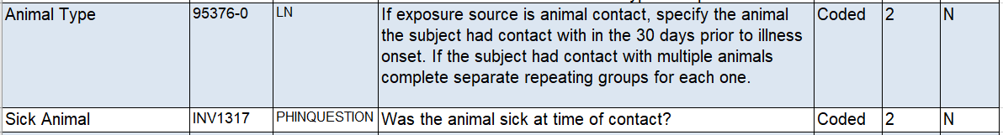
Leptospirosis: Exposure Repeating Group
Continued
Two fields in the repeating group are just for animal exposures:
Horse
Dog
Deer
Mongoose
Goat /Sheep
Skunk
Rats
Racoon
Pig
Unknown
18

Slide 19
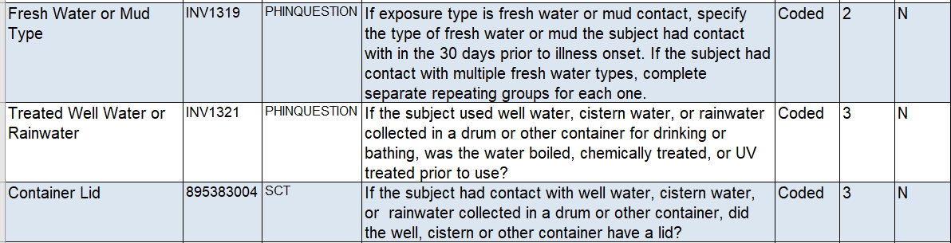
Leptospirosis: Exposure Repeating Group
Continued
Three fields in the repeating group are just for water/mud exposures:
Rainwater
Run Off Rainwater
Cistern
Standing water (lake, pond)
Mud/Puddles
Running water from river or stream
Flood water
Well water
Unknown
19

Slide 20
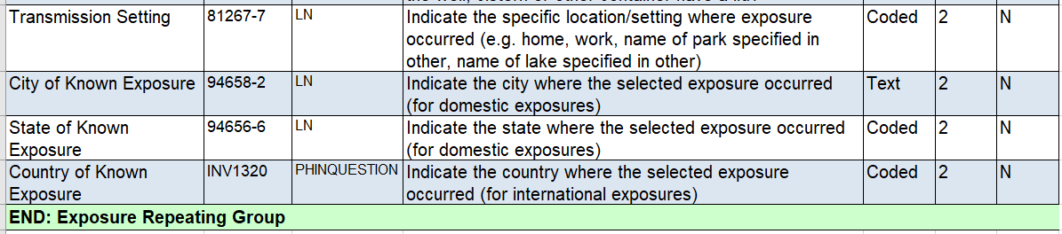
Leptospirosis: Exposure Repeating Group
Continued
Location information would be applicable for all exposures:
Home
Work
Other
Unknown
20

Slide 21
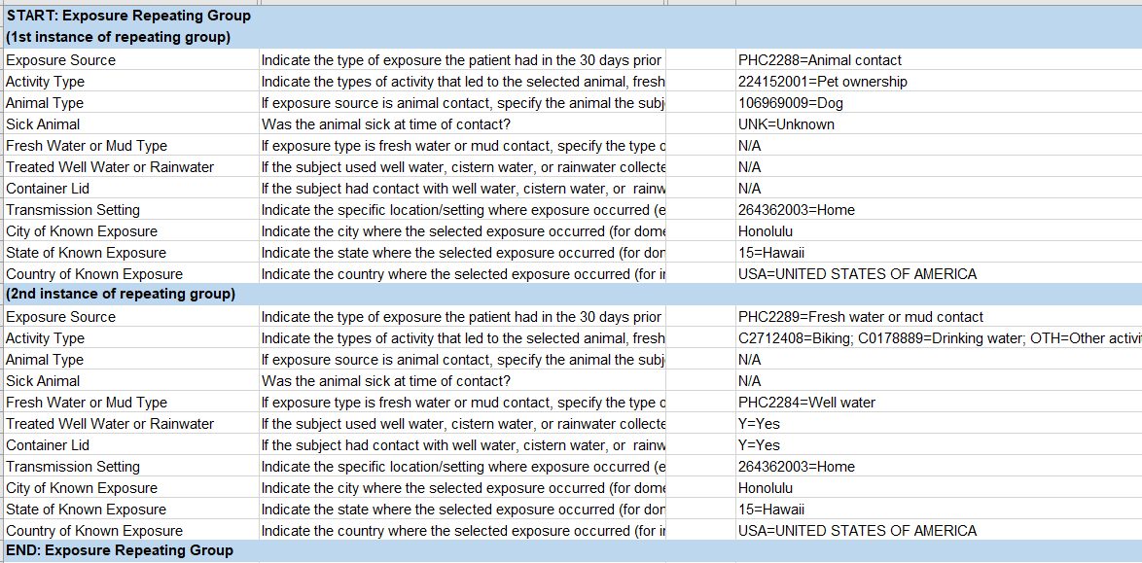
Leptospirosis: Exposure Repeating Group
Example
21

Slide 22
Leptospirosis: Exposure Repeating Group
Questions for consideration:
  Should we capture the animal and environmental exposures in the same repeating group?
  For each exposure source, multiple activity types can be selected. Can your jurisdiction support this data structure?
  Does your jurisdiction routinely collect water source, storage, and treatment information?
  How much detail does your jurisdiction capture on exposure location? Are the location variables proposed feasible to implement?
22

Slide 23
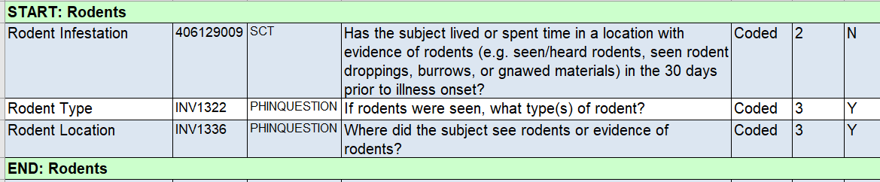
Leptospirosis: Rodent Data Elements
Rattus norvegicus (Rat)
Mouse
Home
Work
Other
Unknown
Question for consideration: Is it feasible for your jurisdiction to capture these variables?
23

Slide 24
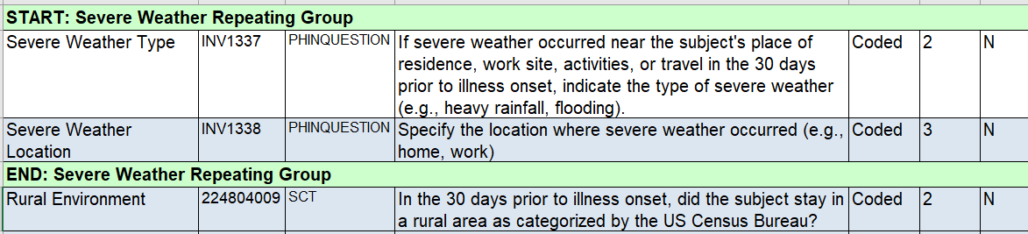
Leptospirosis: Weather Repeating Group
Flooding
Torrential Rain
Home
Work
Other
Unknown
Question for consideration: For the question on rural environment, we reference the US Census Bureau designation. Does your jurisdiction use this designation? Or is there a different designation that would be a better fit?
24

Slide 25
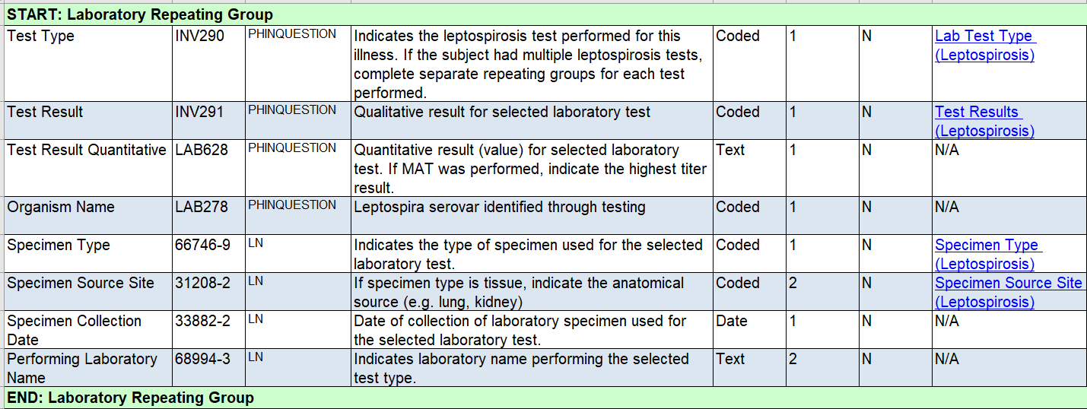
Leptospirosis: Laboratory Repeating Group
Question for Consideration: We want to make the organism's name (Leptospira serovar) a coded variable. However, there are over 300 serovars. Would listing the 20 serovars tested at CDC with an option for other (free text) be sufficient? Or are there additional serovars your jurisdiction tests that should be included in the coded list?
25

Slide 26
Brucellosis-specific MMG Sections

Slide 27
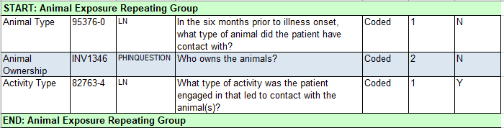
Brucellosis: Animal Exposure Repeating Group
Goat
Elk
Dog
Deer
Pig
Bison
Cattle
Sheep
Other animal (text)
Wild
Case
Commercial
Private
Unknown
Other type of ownership
Birthing
Hunting
Skinning
Slaughter
Unknown
Other
27

Slide 28
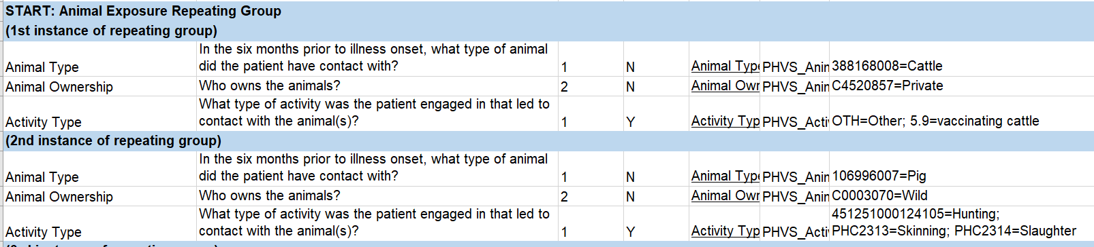
Note: You can select multiple activity types per animal
Brucellosis: Animal Exposure Repeating Group
Example
28

Slide 29
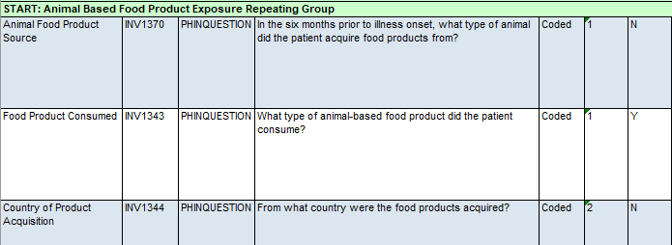
Brucellosis: Animal Product Exposure Repeating Group
Goat
Elk
Dog
Deer
Pig
Bison
Cattle
Sheep
Other animal (text)
Undercooked meat
Fresh cheese
Milk
Soft cheese
Other
Unknown
Outside the US
US
Unknown
29

Slide 30
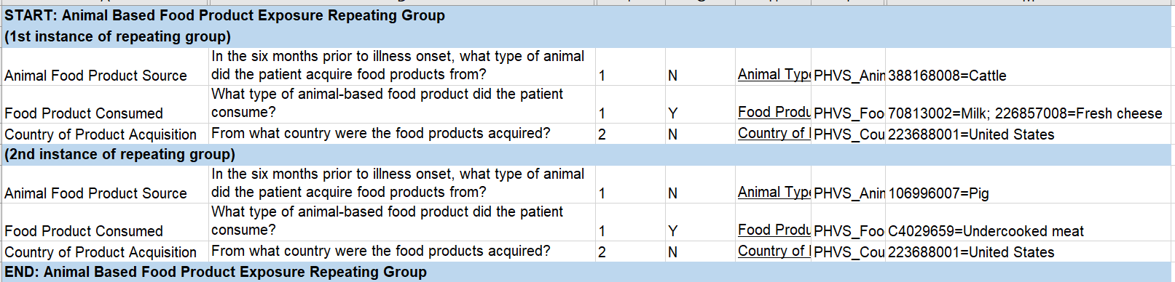
Brucellosis: Animal Product Exposure Repeating Group
Example
Brucellosis: Animal Product Exposure Repeating Group
Example
Note: You can select multiple types of food product per animal
30

Slide 31
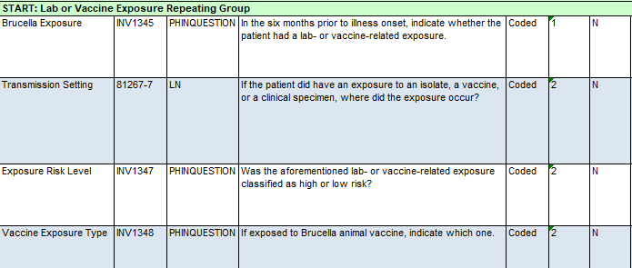
Brucellosis: Lab/Vaccine Exposure Repeating Group
Isolate
Clinical specimen
Vaccine
Unknown
Other
Clinical setting
Farm
Lab
Ranch
Surgery
Other
RB51
Rev1
S19
Other
Unknown
High
Low
Unknown
Question for consideration: Is it feasible for your jurisdiction to capture laboratory and vaccine exposure information in the same repeating group?
31

Slide 32
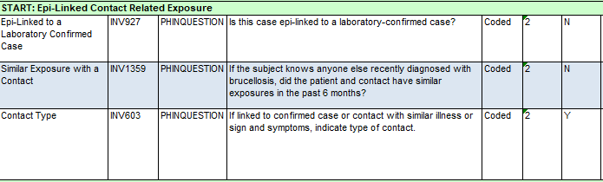
Brucellosis: Epi-linked Contact Related Exposure
Yes
No
Unknown
Coworker
Household
Neighbor
Other
Unknown
Question for consideration: Can your system support a repeated data element inside a repeating group for all brucellosis exposure blocks?
32

Slide 33
Brucellosis: Epidemiology Lab Repeating Group
Test and Result:
Test type
Qualitative test result
Organism name
Quantitative test result
If titer result, indicate type of titer
Specimen Information:
Specimen received date
Specimen type
Specimen source site
Specimen collection date
Was the specimen collected prior to antimicrobial therapy?
Specimen still available?
Specimen sent to CDC for testing?
Question for consideration: Is it feasible to answer a yes/no question assessing whether the specimen was collected before antimicrobial therapy?
Or should this be a calculated field based on specimen collection and antimicrobial start dates?
33

Slide 34
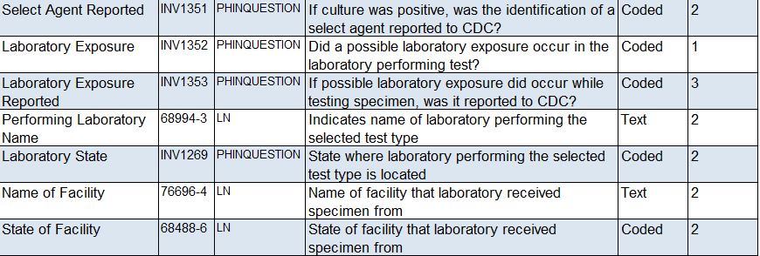
Brucellosis: Epidemiology Lab Repeating Group Continued
Additional variables in this repeating group that might be less common
Question for consideration: Is the information on laboratory exposures captured with the testing information, as we have it here, or would it be better to move it to another section?
34

Slide 35
Hansen’s Disease-specific MMG Sections

Slide 36
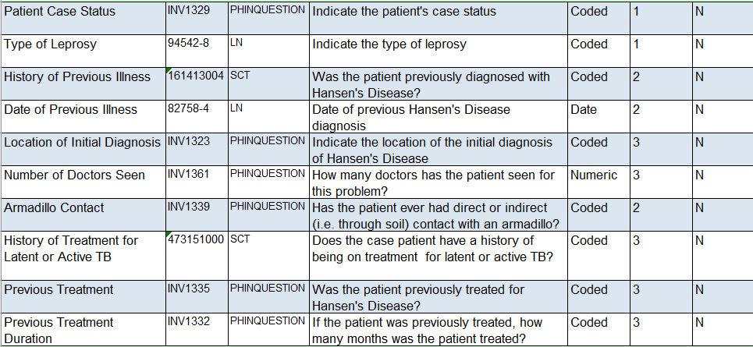
Hansen’s Disease: Subject Information
New
Reclassification
Relapsed
Return Case
Return after loss to follow up
Transfer Case
Other
Lepromatous leprosy
Tuberculoid leprosy
Borderline Lepromatous leprosy
Borderline Tuberculoid leprosy
Indeterminate leprosy
Unspecified
Other
36

Slide 37
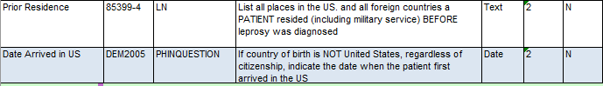
Hansen's Disease: Prior Residence
Question for consideration: What is the most manageable format to capture prior residences? It is currently a free text field. Would it be easier to implement if it was a repeating variable capturing each location separately?
37

Slide 38
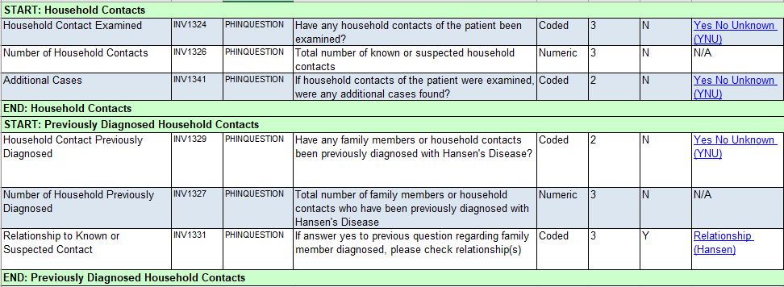
Hansen's Disease: Household Contacts Variables
Question for consideration: Does your jurisdiction capture information about household contacts within a case record? Or is this information captured elsewhere?
38

Slide 39
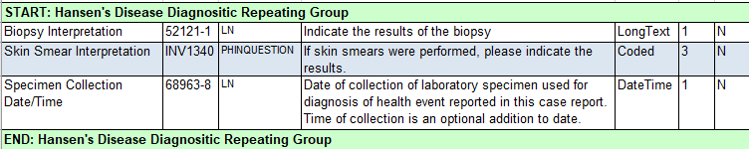
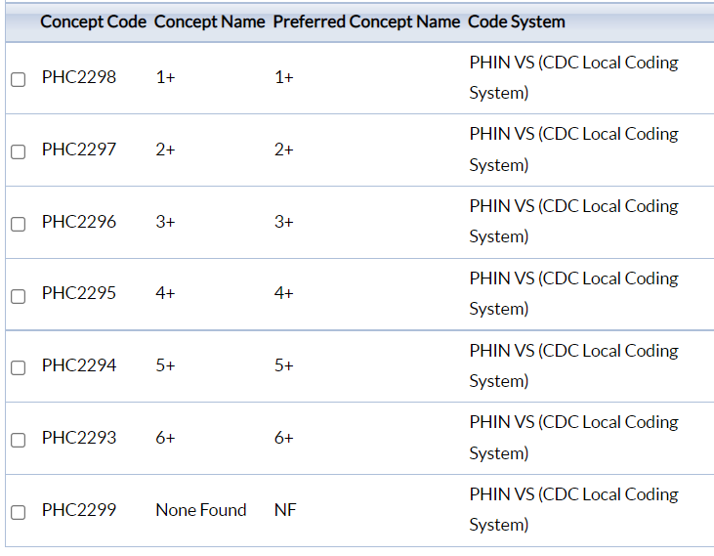
Hansen’s Disease: Biopsy and Skin Smear Repeating Group
39
Notes:
- Potential questions for jurisdictions:

Slide 40
Common Sections across MMGs

Slide 41
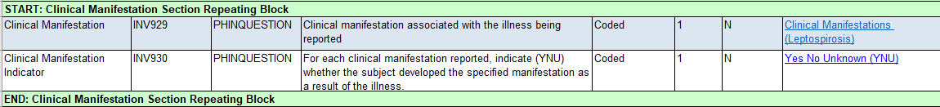
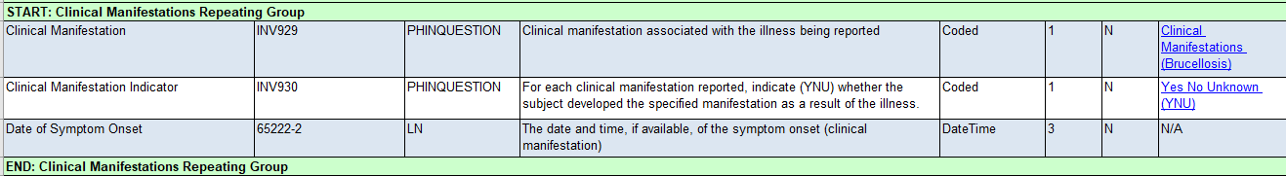
Clinical Manifestations
Leptospirosis captures the presence/absence of a variety of symptoms:
Brucellosis also includes an onset date field for each symptom:
Question for consideration: Is it feasible to capture the date of onset for each symptom? Or does your jurisdiction primarily capture a single date of illness onset?
41

Slide 42
Treatment and Post Exposure Prophylaxis (PEP)
Brucellosis
Did subject receive any antimicrobials for this illness or following exposure?
Repeating group for all antimicrobials taken:
  Treatment or Prophylaxis?
    Antimicrobial Name
    Dose Administered
    Dose Units
    Start Date
    End Date
    Duration (days)
    Completed Course?
    Reason not Completed
Hansen’s Disease
Repeating group for all antimicrobials taken by case subject OR household contact:
  Treatment or Prophylaxis?
    Recipient of medication
    Antimicrobial Name
    Frequency Administered
    Frequency Units
    Start Date
    End Date
    Duration
    Duration Units
Leptospirosis
Were antimicrobials prescribed or administered to the patient for this illness?
Repeating group for all antimicrobials taken:
  Antimicrobial Name
  Start Date
42

Slide 43
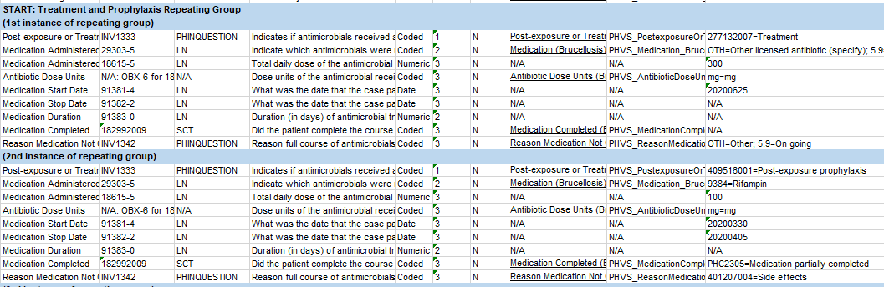
Treatment and Post Exposure Prophylaxis (PEP)
Example of Brucellosis Repeating Group
43

Slide 44
Treatment and Post Exposure Prophylaxis (PEP)
Questions for consideration:
  For Brucellosis and Hansen’s Disease:
    Is it feasible for your jurisdiction to capture treatment and PEP in the same repeating group?
    We are asking about antimicrobials received rather than antimicrobials prescribed. Does your jurisdiction primarily capture information on antimicrobials prescribed or antimicrobials obtained?
      Is it feasible for your jurisdiction to capture whether medications are being completed as prescribed?
  For Hansen’s Disease:
    Does your jurisdiction capture information on medications taken by close contacts?
    Is it feasible for your jurisdiction to capture medication information for the case and close contacts in the same repeating group?
  For Leptospirosis:
    Would it be easier to implement the leptospirosis treatment repeating group if it more closely aligned to the brucellosis and Hansen’s Disease groups, even if it means capturing more information?
44

Slide 45
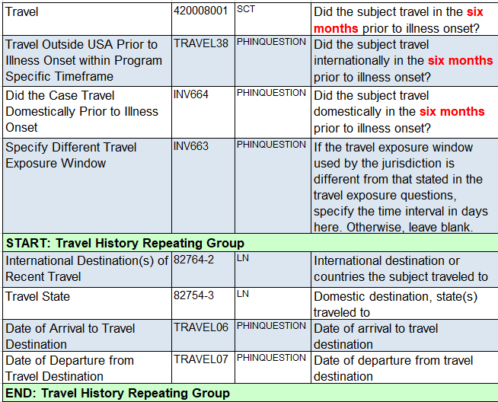
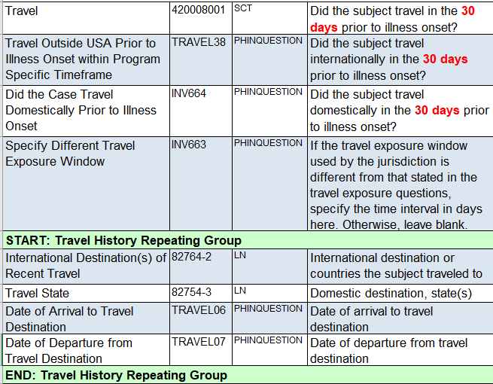
Travel History
Brucellosis
Leptospirosis
45

Slide 46
Next Steps
  Please provide feedback by August 9, 2022
  Email feedback to: edx@cdc.gov
  Subject line: “Draft BSP v1.0 MMG Feedback”
  Include
    Data Element (DE) Identifier Sent in HL7 Message or Data Element Name
    Comment/question/suggestion
    Evidence to support suggestion if possible
    Additional contact information (name, role and phone number)
46

Slide 47
What happens after feedback is received?
  Feedback will be reviewed by CDC
    Data Standardization and Assistance Team
    CDC program staff
  CDC will share the outcome of the reconciliation process with CSTE and external partners
    Issues/comments
    Outcome/how they were reconciled
  RESULT: “Pilot Test-Ready” MMG Package for delivery to the TA team and MVPS
47

Slide 48

Closing Slide
Bacterial Special Pathogens Branch
bspb@cdc.gov
404-639-1711

Slide 49



Thank you!
See you on August 16, 2022
Subscribe to
Case Surveillance News
Access NNDSS Technical Resource Center
For more information, contact CDC
1-800-CDC-INFO (232-4636)
TTY: 1-888-232-6348 www.cdc.gov
Email edx@cdc.gov for Technical Help or to Onboard HL7 Message Mapping Guides
The findings and conclusions in this report are those of the authors and do not necessarily represent the official position of the Centers for Disease Control and Prevention.

