Slide 1
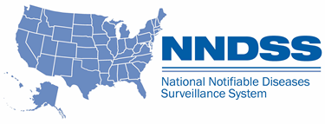
NNDSS eSHARE
July Webinar
Division of Health Informatics and Surveillance
July 19, 2022

Slide 2
NNDSS Updates & Announcements
Michele Hoover, MS
Data Standardization and Assistance Team
Center for Surveillance, Epidemiology, and Laboratory Services

Slide 3
NNDSS eSHARE Webinar
Highlights from the 2022 CSTE Conference
Tuesday, July 19, 2022
Becky Lampkins
Shaily Krishan
Meredith Lichtenstein Cone
Taylor Pinsent
Annie Fine

Slide 4
Agenda
Overview of 2022 CSTE Annual Conference – Becky Lampkins
Recap of S/I Conference Workshops – Shaily Krishan
Review of Approved 2022 CSTE Position Statements - Meredith Lichtenstein Cone
Surveillance/Informatics Steering Committee Roundtable Summary - Becky Lampkins
CSTE Workgroups and Projects – Shaily Krishan, Taylor Pinsent, Becky Lampkins
2022-2023 Surveillance/Informatics Priorities - Annie Fine
Q & A
4

Slide 5
Overview of 2022 CSTE Annual Conference - Becky Lampkins

Slide 6

CSTE 2022 Annual Conference; Louisville Kentucky; June 19-23 (Hybrid) – CSTE 2022 – Unbridled Spirit of Public Health

Slide 7

Attendance and Sessions
Attendance
2,600 registered attendees
State Health Agency: 59%
Local Health Agency: 17%
Federal Agency: 8%
Student: 2%
Tribal Agency: ~1%
Other: 13%
Conference Workshops
Sunday, June 19
15 Workshops
Conference Sessions
Mon-Wed, June 20-22
Plenary Sessions
8 tracks
  73 Breakout Sessions
  55 Roundtables
  27 On-Demand
  ~150 Posters
11 Sponsors - Roundtables
Networking Opportunities
7

Slide 8


CSTE Annual Business Meeting (Thursday, June 23)
State of CSTE Presentation
  Financial Overview and Programs Accomplishments
Presentation of Position Statements
Installation of New President and Introduction of 2022-2023 Executive Board
8

Slide 9


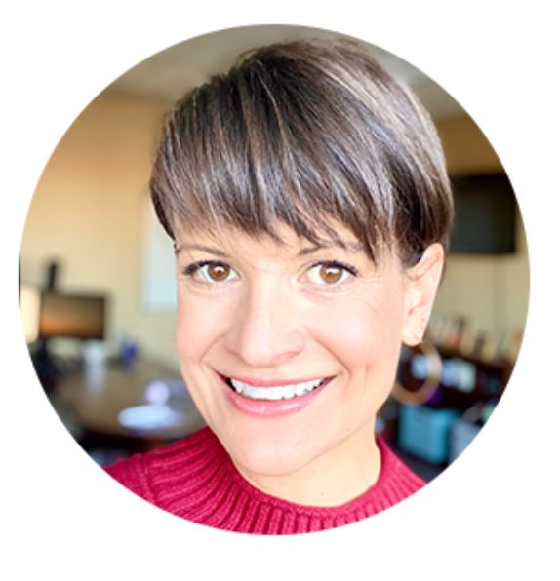



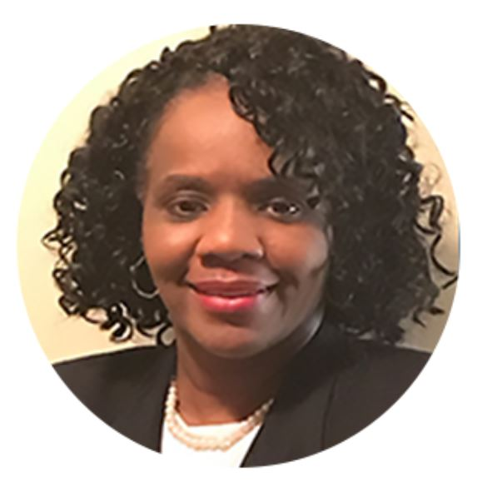

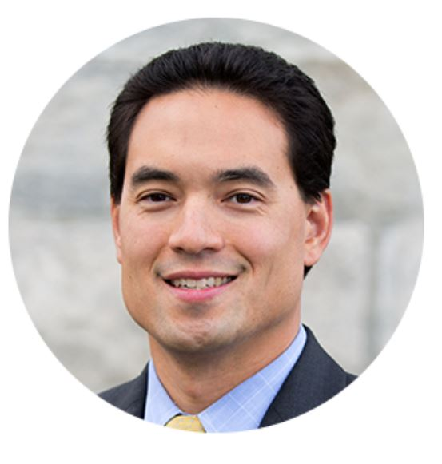


2022-2023 CSTE Executive Board
Angela Dunn
President
Salt Lake County
Ruth Lynfield
Vice President
Minnesota
Kathryn Turner
Secretary/Treasurer
Idaho
Sarah Lyon-Callo*
President-Elect
Michigan
Melissa Jordan
Florida
Catherine Brown
Massachusetts
Kate Goodin
Tennessee
Stephanie Ayers-Millsap
Jefferson County, Alabama
Ken Komatsu
Arizona
Benjamin Chan*
New Hampshire
Sherri Davidson
Alabama
Growth to 11 members!
9
* new executive board members

Slide 10
NNDSS Related Sessions
Roundtables
  Efforts to Standardize and Align Core Data Elements in Case Notification Message Mapping Guides (MMGs) with Electronic Case Reporting (eCR) and United States Core Data for Interoperability (USCDI)
  Identifying Training Needs and Improvements to the National Notifiable Diseases Surveillance System (NNDSS) Health Level 7 (HL7) Case Notification Process
Presentations
  Case-based and Syndromic Surveillance Data Visualization in R
  NNDSS Progress and Future Directions
  Applying Power Business Intelligence (BI) Techniques to National Notifiable Diseases Surveillance Data Visualizations
  Technical Assistance Tools to Facilitate Implementation of HL7 Case Notifications
  Advancing National Notifiable Diseases Surveillance System Data Visualizations
  Data Modernization
10

Slide 11
For more information…
2022 Conference Presentation Recordings (available to registered attendees only)
  On-demand recordings of certain presentations are available for up to three (3) months
  Recordings may be accessed by logging into the conference platform:
  https://event-app2.eventpower.com/event_app/user/login/22CSTE
2022 Position Statements
  Position Statement Archive
  https://www.cste.org/page/PositionStatements
11

Slide 12
Recap of S/I Conference Workshops - Shaily Krishan

Slide 13
2022 Surveillance/ Informatics Workshop: Leading the Field with Data Modernization
Virtual workshop on Sunday, June 19
  >200 attendees
Workshop sessions overview:
  Keynote address - CDC’s Data Modernization Initiative (DMI)…Connecting Beyond COVID
    Daniel Jernigan, CDC
  Panel discussion- Examples of DMI Implementation in Jurisdictions
    Panelists: Rebecca Fisher (LA county), David Lee (NYC), Quinyatta Mumford (NM), Tim Powell (VA)
  Presentation- Community Engagement Around Data
    Speaker: Sujata Joshi (Northwest Portland Area Indian Health Board)
  Panel discussion- Data Sharing and Privacy Related Issues
    Jason Barnes (UT), Raed Mansour (Chicago), Mary Beth Kurilo (American Immunization Registry Association)
  Presentations- Re-imagining surveillance
    Heather Strosnider (CDC), Jennifer White (NY), Cliff Mitchell (MD)
13

Slide 14
2022 Surveillance/ Informatics Workshop:
Breakout Room Discussion Themes
Examples of DMI Implementation in Jurisdictions
  Need for culture change at jurisdictions and CDC
  Need for quality, process, and outcome metrics
  High priority to ensure enterprise-wide approach is a shared roadmap
  Targeted workforce training
Community Engagement Around Data
  Leverage DMI/ data lakes to perform efficient linkages across data sources
  Crowdsourced data collection efforts, need incentivization to drive participation
  Lessons learned from successful Privacy Protecting Record Linkage (PPRL) implementations in clinical care
  Legal considerations for bidirectional data interfaces- leverage existing laws
  Focus on health equity
14

Slide 15
2022 Surveillance/ Informatics Workshop:
Breakout Room Discussion Themes
Data Sharing and Privacy Related Issues
  Data are “owned” by the people, public health should focus on stewardship and application of security/ privacy principles
  Explore changes in state policies/ laws to promote data sharing
  Data sharing aligned with DMI efforts and need for data governance to address a diverse data landscape (TEFCA, other policies)
  Tribal data sharing: Engage tribes, promote joint ownership of data, facilitate trust relationship
Re-imagining surveillance
  Surveillance activities necessitate fitting the right data solution to the current public health problem, that might change over time
  Need to think about right-sized approaches to public health issues as we move forward with data modernization
  Need for agile standards development
  Technology focus: Open-source solutions, RPA (Robotic Process Automation), FHIR APIs, interoperability, eCR, data dashboards
  Workforce training & development
  Shared tools & solutions for Infectious Disease (ID) & non- ID use cases
15

Slide 16
2022 REDCap Training – ½ Day Workshop
REDCap 101
  Navigating REDCap
  Project Design Considerations
  Project Development
  Form Enhancement
  Data Collection and Data Export
  REDCap Applications
  Advanced REDCap Features
16

Slide 17
Review of Approved 2022 CSTE Position Statements - Meredith Lichtenstein Cone

Slide 18
Approved 2022 Position Statements
22-EH-01: Public Health Reporting and National Notification for Lead in Blood
22-ID-01: Update to the standardized surveillance case definition and national notification for SARS-CoV-2 infection (the virus that causes COVID-19)
22-ID-02: Standardized Case Definition for Surveillance of Multisystem Inflammatory Syndrome in Children Associated with SARS-CoV-2 Infection
22-ID-03: Update to Public Health Reporting and National Notification for Infection Caused by Neisseria gonorrhoeae
18

Slide 19
Approved 2022 Position Statements
22-ID-04: Change in Case Definition from Carbapenemase-Producing Carbapenem-Resistant Enterobacteriaceae (CP-CRE) to Carbapenemase-Producing Organisms (CPO)
22-ID-05: Update to the Standardized Case Definition and National Notification for Candida auris
22-ID-06: Revision of Public Health Reporting and Timeframes for National Notification for Animal Rabies
22-ID-07: Update to the Standardized Surveillance Case Definition and National Notification for Coccidioidomycosis
19

Slide 20
Approved 2022 Position Statements
22-ID-08: Update to Public Health Reporting and National Notification of Melioidosis
22-ID-09: Standardized Surveillance Case Definition for Strongyloidiasis (Current or Past)
22-ID-10: Public Health Reporting and National Notification for Monkeypox Virus Infection
22-INJ-01: Standardized surveillance case definition for law enforcement-involved injuries and fatal encounters (LEIFE) among community members
20

Slide 21
Surveillance/Informatics Steering Committee Roundtable Summary - Becky Lampkins

Slide 22
2022 Surveillance/Informatics Steering Committee Roundtable
Key Takeaways
Increase transparent coordination among partner associations and build connection across program areas
  Data modernization – who is taking lead on various activities?
Need to share existing or new resources broadly within community
  Ensure common understanding of terminology/technologies
  Organizational charts
More robust and coordinated online platforms
  Communication forum
  Share information, resources, ideas
22

Slide 23
CSTE Workgroups and Projects - Shaily Krishan,
Taylor Pinsent,
Becky Lampkins

Slide 24
CSTE Subcommittees and Workgroups
Surveillance Practice & Implementation Subcommittee
  CSTE Subcommittee Chair: currently vacant (previously Gillian Haney, MA)
  Data Standardization Workgroup
    Workgroup Mission: Improve data quality through the development and application of consensus definitions for the core data elements for disease surveillance
    Developed first CSTE Brief “Data Standardization: Dates of Importance to Public Health Surveillance”
    Developed draft guidelines for a new, calculated date field to be used as the case counting date, that can represent the most epidemiologically relevant date to describe “when disease occurred”.
    Coming soon: Identifying best practice recommendations for the timing/timeliness of sending case notifications to CDC
  NMI Evaluation Workgroup
    Workgroup Charge: To convene epidemiologists, informaticians, and surveillance experts from state, local and territorial jurisdictions participating in NMI Message Mapping Guide (MMG) implementation activities, and other key stakeholders to evaluate and identify improvements in processes related to MMG implementation, MMG onboarding, MMG maintenance, and Technical Assistance (TA).
  CSTE Staff Contact: Shaily Krishan (skrishan@cste.org)
24

Slide 25
CSTE Subcommittees and Workgroups
Surveillance Policy Subcommittee - Chair: Tracy Miller (North Dakota)
  Data sharing landscape assessment (in development)
    Goal: identify barriers and facilitators for public health data sharing across the enterprise (interagency, interstate, and federal)
    Tool: Qualtrics survey
    Audience: State, Tribes, Local, and Territorial CSTE members
    Output: Guide discussion between all levels of government to inform the development of tools
    Timeline for data collection and analysis: August 2022-December 2022
    CSTE Staff Contact: Taylor Pinsent (tpinsent@cste.org)
  *new* Data Release, Suppression, and Presentation Workgroup
    Timeline: August 2022-July 2023
    Forum for discussion and consensus building on…
      Data sharing
      Release or re-release guidance
      Data suppression science
      Open data
      Data visualization topics
      Governance
    CSTE Staff Contact: Taylor Pinsent (tpinsent@cste.org)
25

Slide 26
Selected CSTE Activities
Electronic Laboratory and Disease Reporting Subcommittee (ELDRS)
  Subcommittee Chair: Rachelle Boulton (UT)
National ELR Workgroup
  Workgroup Chair: Nancy Barrett (CT)
State Reportable Conditions Assessment – coming soon
NSSP Community of Practice
Reportable Conditions Knowledge Management System (RCKMS)
  RCKMS Community of Practice
  eCR
26

Slide 27
2022-2023 Surveillance/Informatics Priorities - Annie Fine

Slide 28
CSTE S/I and DMI Priorities – 2022-2023
DMI
  Advocacy for sustained funding
  Articulate and support STLT DMI priorities
  Continue CDC engagement (Consortium, DSW, work with CSELS)
  Expand to non-ID programs
  Success stories
eCR
Standards work
  Data standardization and harmonization across STLTs
  Improve public health participation and input into standards
  USCDI, USCDI+, FHIR accelerator
Focus on improving national notification processes
Data sharing policies
28

Slide 29

CSTE 2023 Annual Conference –Save the Date; June 25-29, 2023; Salt Lake City, Utah

Slide 30
CSTE National Office
2635 Century Parkway NE, Suite 700
Atlanta, Georgia 30345
770.458.3811
770.458.8516
skrishan@cste.org

Slide 31



Thank you!
See you on July 26, 2022, for the
Special Session on Bacterial Special
Pathogens MMGs
Subscribe to
Case Surveillance News
Access NNDSS Technical Resource Center
For more information, contact CDC
1-800-CDC-INFO (232-4636)
TTY: 1-888-232-6348 www.cdc.gov
Email edx@cdc.gov for Technical Help or to Onboard HL7 Message Mapping Guides
The findings and conclusions in this report are those of the authors and do not necessarily represent the official position of the Centers for Disease Control and Prevention.

