Slide 1

NNDSS eSHARE May Webinar
Division of Health Informatics and Surveillance
May 17, 2022

Slide 2

Agenda
  NNDSS Updates and Announcements
  Draft Hepatitis Message Mapping Guide v2.0: Overview and Jurisdiction Comment and Feedback
  Questions and Answers

Slide 3
NNDSS Updates & Announcements
Michele Hoover, MS
Data Standardization and Assistance Team
Center for Surveillance, Epidemiology, and Laboratory Services

Slide 4
Updated Lyme and Tickborne Rickettsial Diseases MMG
  Version 1.0.2 is the most current
    Updates CDC priorities to the 1, 2, 3 categories
    Integrates Generic v2.0.1 updates into the test case scenario worksheets
  NEW: The PHIN Vocabulary Access and Distribution System
  Lyme and Tickborne Rickettsial Diseases Case Notification view has
  been updated
    Version 3 is now the most up-to-date version
    Adds 18 LOINC codes to Lab Test Type (TBRD) for Test Type (INV290)
    Incudes the most current Country value set for Travel Country (82753-5)
    Corrects spelling in Organism (Lyme) for Organism Name (LAB278)
Lyme & Tickborne Rickettsial Diseases MMG v1.0.2: https://ndc.services.cdc.gov/mmgpage/lyme-and-tickborne-rickettsial-diseases-message-mapping-guide/
Lyme & Tickborne Rickettsial Diseases PHIN VADS Case View version 3: https://phinvads.cdc.gov/vads/ViewView.action?id=729FCC10-D4CF-EC11-81AD-005056ABE2F0
Lab Test Type (TBRD) version 4: https://phinvads.cdc.gov/vads/ViewValueSet.action?id=7A56AEFB-BDB3-4FB7-B0E9-96DC1A099A98
Country ISO 3166-1 Version 6: https://phinvads.cdc.gov/vads/ViewValueSet.action?id=8628EEFE-2F6A-4BC1-BBEB-609153F92CF7
Organism (Lyme) Version 2: https://phinvads.cdc.gov/vads/ViewValueSet.action?id=9AE4EF41-7D4D-41C8-B0E0-E3532173B012

Slide 5
Case Surveillance Modernization Efforts
Sara Johnston
NNDSS Program Lead
Center for Surveillance, Epidemiology, and Laboratory Services

Slide 6
Draft Hepatitis Message Mapping Guide (MMG) v2.0 for Comment
Division of Viral Hepatitis
Nicola Thompson, PhD
Noreen Kloc, MPH
May 17, 2022

Slide 7
Agenda
  Viral hepatitis background
  Message Mapping Guide (MMG) overview and components
  Key points of interest
  Hepatitis program’s specific questions
  Objectives of the external review and timeline
7

Slide 8
Viral Hepatitis Background

Slide 9
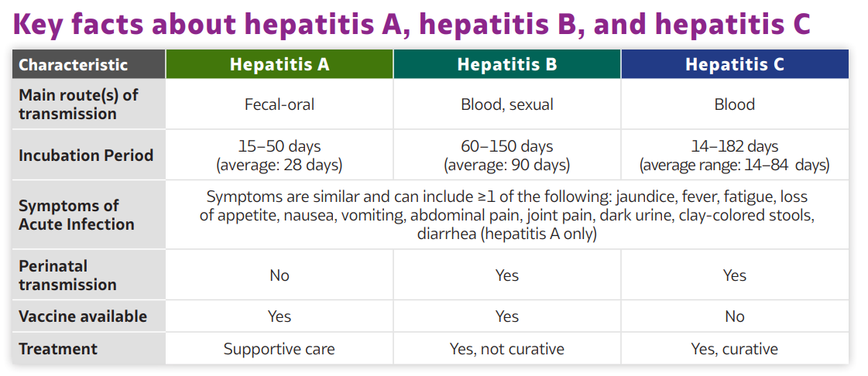
Key Facts about Hepatitis A, Hepatitis B, and Hepatitis C
9

Slide 10
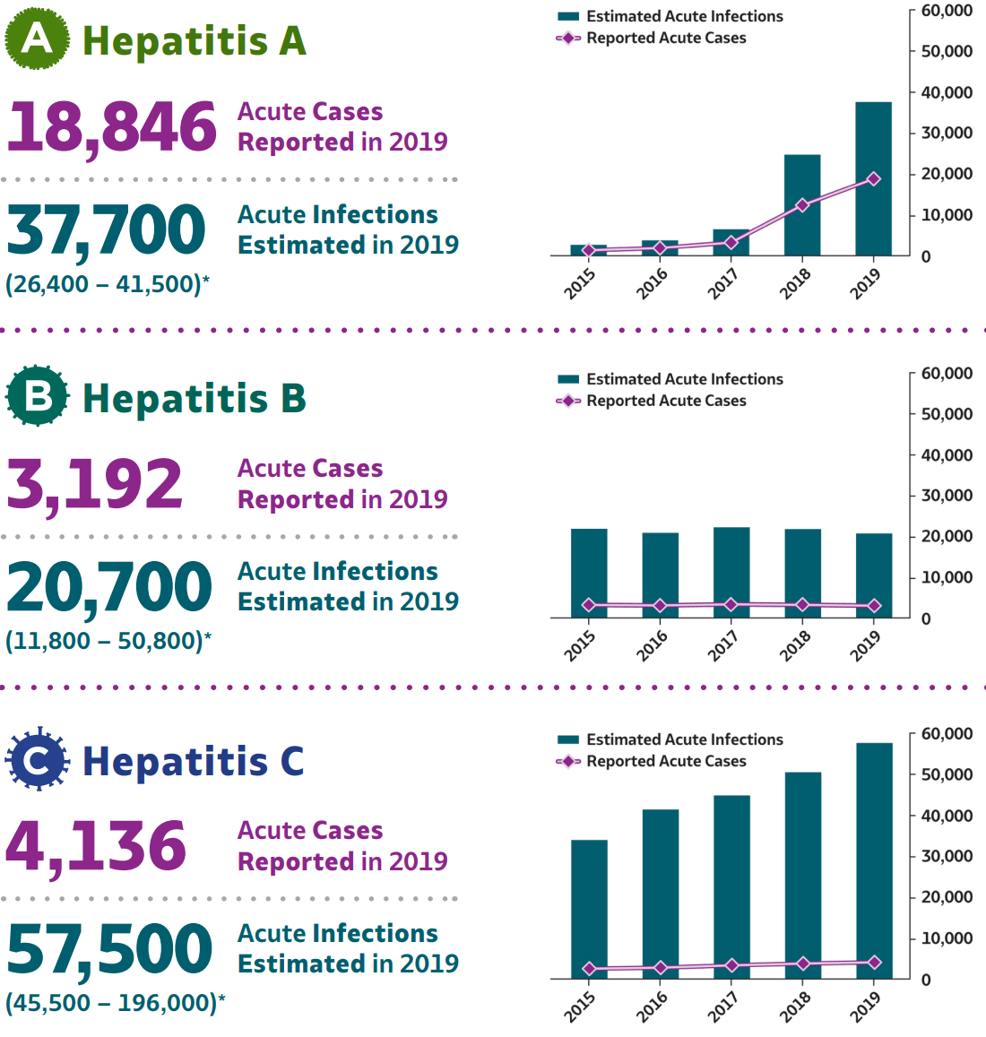
Acute Cases Reported and Infections Estimated in 2019 for Hepatitis A, B, and C
www.cdc.gov/hepatitis/statistics/2019surveillance/index.htm
10

Slide 11
Changing epidemiology of viral hepatitis
  Widespread outbreaks of hepatitis A, ongoing in some states
  Stable incidence of acute hepatitis B, vaccine preventable disease
    ~14,000 chronic hepatitis B cases reported/year
    Perinatal B rare, but important to track
  Annual increases in incidence of acute hepatitis C, primarily related to injection drug use and opioid epidemic
    ~123,000 chronic hepatitis C cases reported/year
    New perinatal hepatitis C case definition, 2018
www.cdc.gov/hepatitis/statistics/2019surveillance/index.htm
11

Slide 12
Changes in Risk factors, Case definitions, Terms
  New and updated CSTE case definitions
    New: perinatal hepatitis C, 2018
    Updates
      hepatitis A (2019)
      hepatitis C case - acute & chronic definitions (2020)
      new criteria: bilirubin level
  Update terminology
    Inclusive, person-first language
    Health equity terms & language
  Change in risk factors
  Hepatitis A
      People who use drugs (injection or non-injection)
      People experiencing unstable
      housing or homelessness
      Men who have sex with men (MSM)
      People who are currently or were recently incarcerated
  Hepatitis B & C transmission
      Elimination of blood transfusion
      and surgery
      Inclusion of organ and tissue transplant recipients
12

Slide 13
https://www.cdc.gov/hepatitis/policy/2103_CoAg.htm
Why implement the Hepatitis MMG v2.0?
  Hepatitis v1.0 was the first NNDSS condition specific MMG finalized in 2017
    Re-format the MMG to standardize with current MMG practices and other condition specific guides
  More relevant and timely data to inform viral hepatitis surveillance and prevention
  Allows for the submission and monitoring of performance measures under new Integrated Viral Hepatitis Cooperative Agreement¹
  Makes data available to CDC program sooner to help identify changes in frequency, geographic expansion, and monitor data quality
    Data for action
13

Slide 14
Hepatitis MMG Overview and Components

Slide 15
Hepatitis MMG v2.0 Overview
  Major version update (v2.0) of MMG for sending data elements via HL7 for the following conditions:
    Hepatitis A
    Hepatitis B, Acute, Chronic, and Perinatal
    Hepatitis C, Acute, Chronic, and Perinatal
15

Slide 16
How to Use The Hepatitis MMG
  One case notification will pull data elements from the Gen V2 and Hepatitis MMG
GenV2
Hepatitis core data elements
Condition-specific data elements
One HL7 message
16

Slide 17
Example Hepatitis B, Acute case notification
GenV2, examples
Case ID
Age
Race
Ethnicity
Country of birth
Pregnancy status
Date first reported to PHD
Hepatitis core, examples
SOGI
Clinical Data:
  Acute symptom onset
  Peak ALT Level
  Peak total bilirubin
Clinical Diagnostic Tests
  Test type indicator
  Test Result
  Specimen collection date
Condition specific, examples
Test Conversion
Received Hepatitis B vaccine
Risk Factors
  Contact with drug sharing partner
  MSM
  Multiple sexual partners
  Homelessness
GenV2
Hepatitis core data elements
Condition-specific data elements
One HL7 message
17

Slide 18
Key Points of Interest

Slide 19
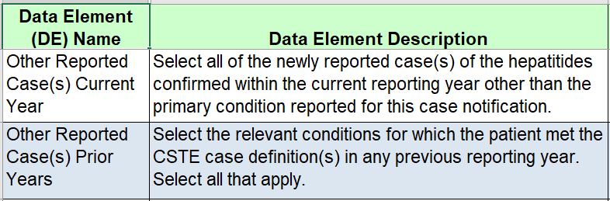
Other Reported Case(s) Current Year and Prior Years
    Hepatitis A; Hepatitis B, Acute; Hepatitis B, Chronic; Hepatitis B, Perinatal; Hepatitis C, Acute; Hepatitis C, Chronic; Hepatitis C, Perinatal
19

Slide 20
Sexual Orientation
  Sexual Orientation data elements, pending OMB approval:
  Birth Sex (What sex were you assigned at birth, on your original birth certificate?)
    Value set: Male, Female, Unknown
  Sexual Orientation (Patient identified sexual orientation)
    Value set USCDI values Sexual Orientation | Interoperability Standards Advisory (ISA) (healthit.gov)
20

Slide 21
Hepatitis A Risk Factors
  Hepatitis A in the [15 to 50 days] before symptom onset date
  New risk factors in 2.0
    Incarcerated
    Contact with drug sharing partner
    Men who have Sex with Men
    Homelessness
  Values consistent in 1.0 and 2.0
    Inject nonprescription drugs
    Noninjection drugs not prescribed
    Contact with confirmed or suspected case
    Contact with a sexual partner
    Contact with household member (nonsexual)
21

Slide 22
Hepatitis B, Acute Risk Factors
  Hepatitis B, Acute in the [60 to 150 days] before symptom onset date
  New Risk Factors 2.0
    Contact with drug sharing partner
    Homelessness
    Organ or tissue transplant
  Risk Factors Retained from 1.0
    Inject nonprescription drugs
    Noninjection drugs not prescribed
    Contact with known hepatitis B case
      sexual partner
      household member (nonsexual)
    Men who have Sex with Men *
    Multiple sexual partners *
    STI diagnosis *
    * Change in how risk factor is defined
22

Slide 23
Hepatitis C, Perinatal
  Hepatitis C, Perinatal (new 2018 CSTE case definition)
  Gestational Parent Section:
    Race and ethnicity
    HCV testing performed prior to delivery / after delivery
  Infant Section:
    Infant anti-HCV Test
      (Did the infant receive an anti-HCV test between age 18-36 months?)
    Infant Nucleic Acid Test
      (Did the infant receive nucleic acid testing for HCV RNA between age 2-36 months?)
23
https://www.cdc.gov/knowmorehepatitis/hcp/Test-For-HepC-During-Pregnancy.htm

Slide 24
Hepatitis MMG v2.0 Overview

Slide 25
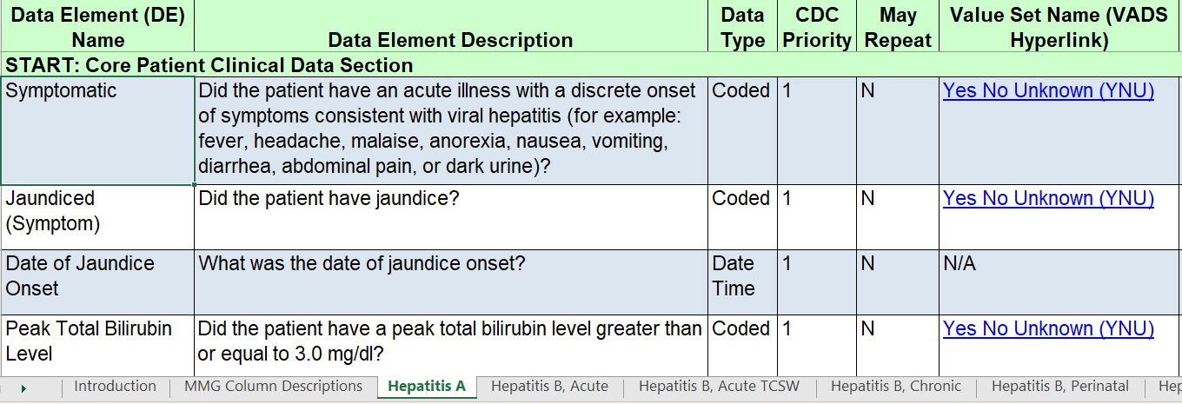
Hepatitis MMG v2.0 Overview
25

Slide 26
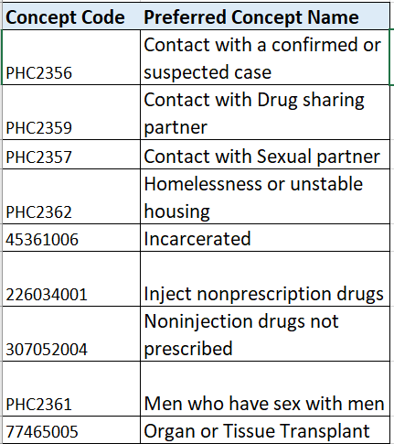
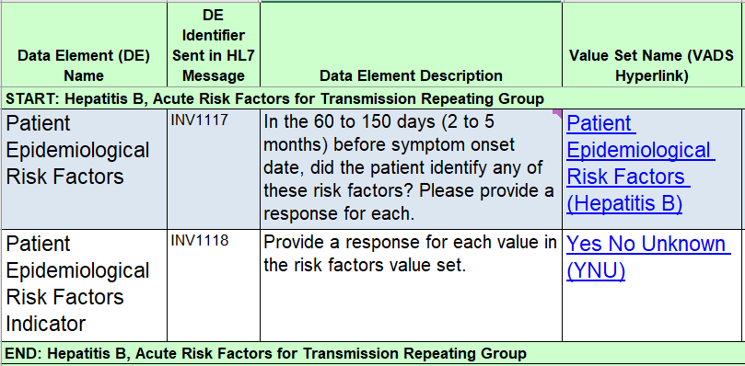
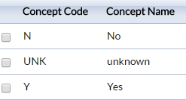
Repeating Group
Value sets
Repeating block
26

Slide 27
Hepatitis Program’s Specific Questions

Slide 28
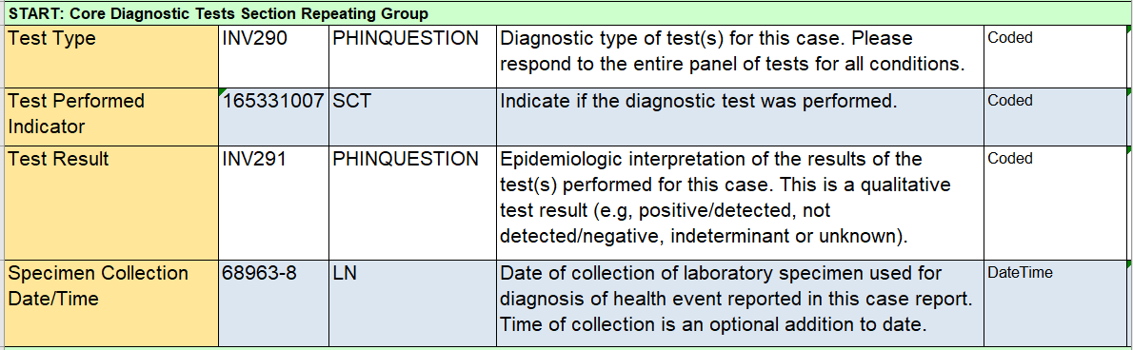
Updated Laboratory Section – Repeating Block
28

Slide 29
Core Diagnostic Tests Section – Value Set
Diagnostic Test Type | Test Performed Indicator | Test Result | Specimen Collection Date
Hepatitis A
IgM anti-HAV | □ Yes □ No □ Unknown | □ Detected/Positive □ Not detected/Negative □ Indeterminate □ Unknown
Total anti-HAV | □ Yes □ No □ Unknown | □ Detected/Positive □ Not detected/Negative □ Indeterminate □ Unknown
HAV RNA | □ Yes □ No □ Unknown | □ Detected/Positive □ Not detected/Negative □ Indeterminate □ Unknown
Hepatitis B
HBsAg | □ Yes □ No □ Unknown | □ Detected/Positive □ Not detected/Negative □ Indeterminate □ Unknown
IgM anti-HBc | □ Yes □ No □ Unknown | □ Detected/Positive □ Not detected/Negative □ Indeterminate □ Unknown
Total anti-HBc | □ Yes □ No □ Unknown | □ Detected/Positive □ Not detected/Negative □ Indeterminate □ Unknown
HBeAg | □ Yes □ No □ Unknown | □ Detected/Positive □ Not detected/Negative □ Indeterminate □ Unknown
HBV DNA | □ Yes □ No □ Unknown | □ Detected/Positive □ Not detected/Negative □ Indeterminate □ Unknown
Hepatitis C
anti-HCV | □ Yes □ No □ Unknown | □ Detected/Positive □ Not detected/Negative □ Indeterminate □ Unknown
HCV RNA | □ Yes □ No □ Unknown | □ Detected/Positive □ Not detected/Negative □ Indeterminate □ Unknown
HCV antigen | □ Yes □ No □ Unknown | □ Detected/Positive □ Not detected/Negative □ Indeterminate □ Unknown
Hepatitis D
anti-HDV | □ Yes □ No □ Unknown | □ Detected/Positive □ Not detected/Negative □ Indeterminate □ Unknown
HDV RNA | □ Yes □ No □ Unknown | □ Detected/Positive □ Not detected/Negative □ Indeterminate □ Unknown
Hepatitis E
IgM anti-HEV | □ Yes □ No □ Unknown | □ Detected/Positive □ Not detected/Negative □ Indeterminate □ Unknown
IgG anti-HEV | □ Yes □ No □ Unknown | □ Detected/Positive □ Not detected/Negative □ Indeterminate □ Unknown
HEV RNA | □ Yes □ No □ Unknown | □ Detected/Positive □ Not detected/Negative □ Indeterminate □ Unknown
29

Slide 30
Specific Questions for Hepatitis v2.0
  Diagnostic Tests Repeating Group Section
  Test Performed Indicator for each Test Type
    Can you respond (Y/N/U) for each test?
    Can you determine ‘No’ test not performed from Unknown?
    Would you set up a default Unknown response?
    Would it be easier to indicate ‘Not Tested’ in the Test Result?
  Test Result (Detected/Positive, Not detected/Negative, Indeterminate, Unknown)
    Can you submit the qualitative result?
30

Slide 31
Specific Questions for Hepatitis v2.0
  Peak Total Bilirubin Level ≥ 3.0 mg/dl (Y/N/U)
    Can you provide the coded response: Y/N/U?
    Would an option to submit a numeric value for Peak Total Bilirubin Level be easier to implement?
  Peak Alanine Aminotransferase (ALT) Level (IU/L)
    Can you provide a coded response: <100, 100-200, >200, Unknown?
    Would an option to submit a numeric value for Peak ALT Level be easier to implement?
31

Slide 32
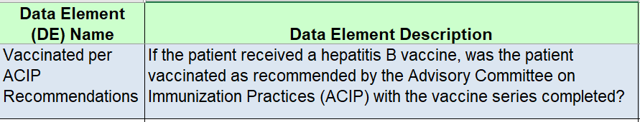
Specific Questions for Hepatitis v2.0
  Any concerns with answering this question or mapping data to this data element?
  Would a different data element that focuses on capturing if the vaccination series was completed be easier to implement?
32

Slide 33
Objectives of the External Review and Timeline

Slide 34
We Need Your Overall Feedback
Any critical and important information not included in the current draft MMG?
Any data elements or value sets that you cannot collect/capture with your current system?
Any structure/format issues (data type or repeat option)?
Any potential implementation issues related to the data elements requested?
Any elements or values that need more clarification?
34

Slide 35
Next Steps
  Please provide feedback by June 1, 2022
  Email feedback to: edx@cdc.gov
  Subject line: “Draft Hepatitis MMG v2.0 Feedback”
  Include
    Data Element (DE) Identifier Sent in HL7 Message or Data Element Name
    Comment/question/suggestion
    Include evidence to support suggestion if possible
    Additional contact information (name, role and phone number)
35

Slide 36
What happens after feedback is received?
  Feedback will be reviewed by CDC
    Data Standardization and Assistance Team
    CDC program staff
  CDC will share the outcome of the reconciliation process with CSTE and external partners
    Issues/comments
    Outcome/how they were reconciled
  RESULT: “Pilot Test-Ready” MMG Package for delivery to the TA team and MVPS
36

Slide 37
Acknowledgements
Neil Gupta
Megan Hofmeister
Kathleen Ly
Henry Roberts
Shaoman Yin
APHL
NBS
DSAT
Jurisdictions that reviewed and provided feedback on CRF

Slide 38
Questions?

Slide 39



Thank you!
See you on June 28, 2022 for the
NBS Special Session
Subscribe to
Case Surveillance News
Access NNDSS Technical Resource Center
For more information, contact CDC
1-800-CDC-INFO (232-4636)
TTY: 1-888-232-6348 www.cdc.gov
Email edx@cdc.gov for Technical Help or to Onboard HL7 Message Mapping Guides
The findings and conclusions in this report are those of the authors and do not necessarily represent the official position of the Centers for Disease Control and Prevention.

Slide 40
Appendix

Slide 41
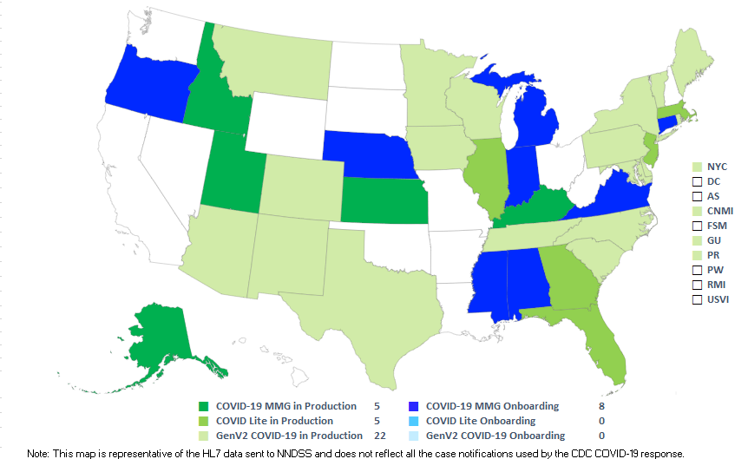
COVID-19 HL7 Data Implementation In-progress
Status as of 5/17/2022
41

