Slide 1
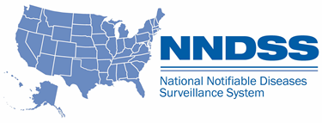
National Notifiable Diseases Surveillance System (NNDSS) eSHARE February Webinar
Center for Surveillance, Epidemiology, and Laboratory Services
Division of Health Informatics and Surveillance
February 15, 2022

Slide 2

Agenda
Agenda
  NNDSS Updates and Announcements
  State Panel Discussion: Linking to Immunization Data,
  Where Are We Now?
    California, Connecticut, Oregon, and Wisconsin
  Questions and Answers
2
2

Slide 3
NNDSS Updates and Announcements
Center for Surveillance, Epidemiology, and Laboratory Services
Michele Hoover, MS
Data Standardization and Assistance Team
Center for Surveillance, Epidemiology, and Laboratory Services

Slide 4
4
Healthcare-Associated Infections, Multidrug-Resistant Organisms (HAI MDRO) Message Mapping Guide (MMG)
Open for General Onboarding
  Includes Candida auris and Carbapenemase Producing Carbapenem-Resistant Enterobacteriaceae (CP-CRE)
  Uses updated Version 1.0.2
    Updated CDC priority levels (R, 1, 2, 3 format)
    Description updated for 5 data elements
    Eight new test scenarios provided for Candida auris
  Uses PHIN Vocabulary Access and Distribution System (VADS) HAI MDRO case notification view version 2
    Includes updated PHVS_Country_ISO_3166-1 for Destination(s) of Recent Travel (82764-2)
    Includes updated PHVS_Specimen_CDC for Specimen Type (66746-9)
HAI MDRO v1.0.2 MMG: https://ndc.services.cdc.gov/mmgpage/healthcare-associated-infections-multidrug-resistant-organisms-hai-mdro-message-mapping-guide/
PHIN VADS HAI MDRO Case View version 2: https://phinvads.cdc.gov/vads/ViewView.action?id=6B668D9B-EF7A-EC11-81AA-005056ABE2F0

Slide 5
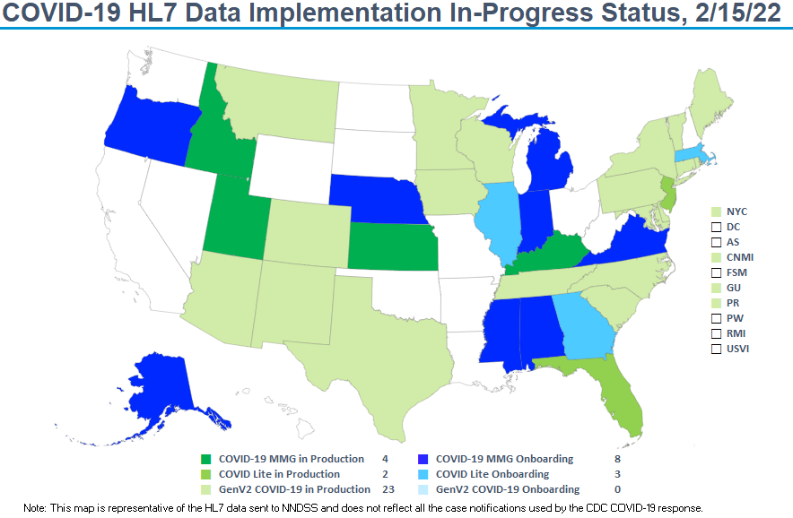

Plan
5

Slide 6
State Panel Discussion: Linking to Immunization Data,
Where Are We Now?
Center for Surveillance, Epidemiology, and Laboratory Services
Michele Hoover, MS
Data Standardization and Assistance Team
Center for Surveillance, Epidemiology, and Laboratory Services

Slide 7
COVID-19
State Panelists
  California Department of Public Health
    Lauren Nelson, Rui Zhao
  Connecticut Department of Public Health
    Gary Archambault, Nancy Barrett, Thomas Bavone, Alycia McNutt
  Oregon Health Authority—Division of Public Health
    Robert Laing
  Wisconsin Department of Health Service
    Misty Johnson, Sarah Kangas, Anna Kocharian, Sydni Warner
7

Slide 8

Slide8
Topics for Discussion
  Staff Resources and Capacity
  Tools and Resources Used
  Approach
  Challenges and Lessons Learned

Slide 9

Open Discussion

Slide 10
What’s Next?

Slide 11

Next NNDSS Webinar: September 21, 2021
Subscribe to the monthly NNDSS newsletter, Case Surveillance News
Access the NNDSS Technical Resource Center
Email edx@cdc.gov to request NNDSS technical assistance or begin onboarding HL7 message mapping guides
Next NNDSS eSHARE:
April 19, 2022 (more details coming soon)

Slide 12
Appendix: Additional Information
Vaccination History During the Response

Slide 13
Updating Surveillance Data with Vaccine History
During the Response
Alycia McNutt, Epidemiologist 3
Alycia.mcnutt@ct.gov
Tom Bavone, Information Technology Analyst 3
Thomas.Bavone@ct.gov
Connecticut Department of Public Health
Infectious Disease Informatics Program

Slide 14
Connecticut Dept of Public Health
CT using Maven for case and lab test management during the response. System is called CTEDSS, is web-based, and hosted at our state data center.
Immunization system is CTWiZ which is based on the WebIZ system and cloud hosted by the vendor.
We developed a SQL based data platform – the CT Public Health Analytics and Integration Platform - to meet the need to generate daily response reports for our Office of the Governor.
  Developed because using the internal CTEDSS reporting capability was not adequate for the volume of data.
There is an automated daily data pull done at 2 AM from the CTEDSS SQL database into the CPHAIP. Additional response data from various data systems, such as immunizations and death, are also captured.

Slide 15
Connecticut Dept of Public Health
Vaccination data is a manual pull from the CTWiZ data mart – changes to allow this to be automated are pending.
Confirmed and probable case data are matched by name and DOB to data pulled from CTWiZ. Match is 56% - adding additional data fields did not improve match percent. Match is automated.
Vaccine questions based on MMG requirements added to CTEDSS. Match process generates a csv file that is manually uploaded. We hope to automate this in the future.
First matching was done in July 2021 and generated 390,000 records. These were uploaded in 10 days and a daily match has been done ever since with that file uploaded daily (M-F). Re-match to catch new doses.

Slide 16
Connecticut Dept of Public Health
Why did we take an integration vs. a direct interoperability approach?
  Direct sharing of information between complex data systems not always feasible and is resource intensive. Systems may not be natively designed to have this functionality.
  Setting up an integration platform for data analytics has allowed us to leverage that work for this data integration and others.
  Matching data and returning desired information is more efficient and allows us to only share what is allowed between systems (confidentiality and security).
  This proof of concept was very successful and will be applied to future VPDs.
We are implementing an external MPI solution – Veratos – to improve person identification and deduplication across systems by creating a shareable unique MPI ID. This will improve match percentages.

