Slide 1
NNDSS eSHARE July 2025 Webinar
Centers for Disease Control and Prevention
Office of Public Health Data, Surveillance, and Technology
July 15, 2025

Slide 2

Agenda
Case Notification MDN content release
NNDSS updates
Case Surveillance and 1CDP
Questions and Answers

Slide 3
Case Notification Minimal Data Necessary
Erin Conners
Office of Public Health Data, Surveillance, and Technology

Slide 4
CDC's Minimal Data Necessary (MDN) Initiative
Minimal data necessary for public health emergency response (MDN)
  Focus is on the early part of the response
  Timely availability of key data for decision-making: What is the minimum we need to answer important questions?
As much as possible, need to build into routine data exchange
  "Hit the ground running" in a response
  Prepare analyses and visualizations in advance
Should be a subset of critical information available until more complete data needs can be met
4

Slide 5
Case Notification MDN for Response
Co-developed by CDC, CSTE, and partner organizations in 2024
Is the basis of response data
Multiple artifacts are now ready
  Internal CDC release was in April/May
  Today (July 15) marks release to jurisdictions
7 versions
6 jurisdictions in Engagement Group
11+ jurisdictions provided detailed feedback
26 program reps in Engagement Group
Lots of feedback from CSTE, APHL, OPHDST, ORR
5

Slide 6

CDC is publishing the following documents externally for the Case Notification MDN
Data Dictionary
CSV Implementation Guide
Implementation Spreadsheet
Sample Case Report Form
CSV Addendum for Case Reporting during a response
6

Slide 7
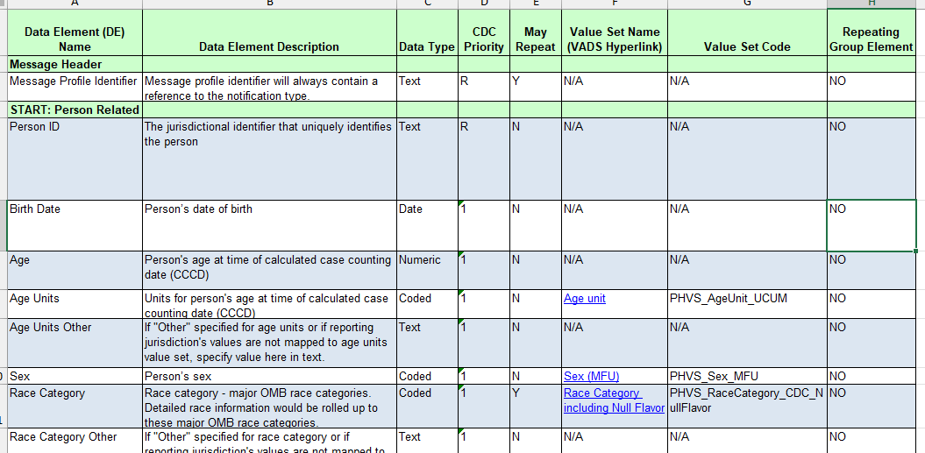
Case Notification MDN
Data Dictionary
  Data elements
  Regardless of format
CSV Implementation Guide
  Data elements
  CSV mapping specifications
7

Slide 8
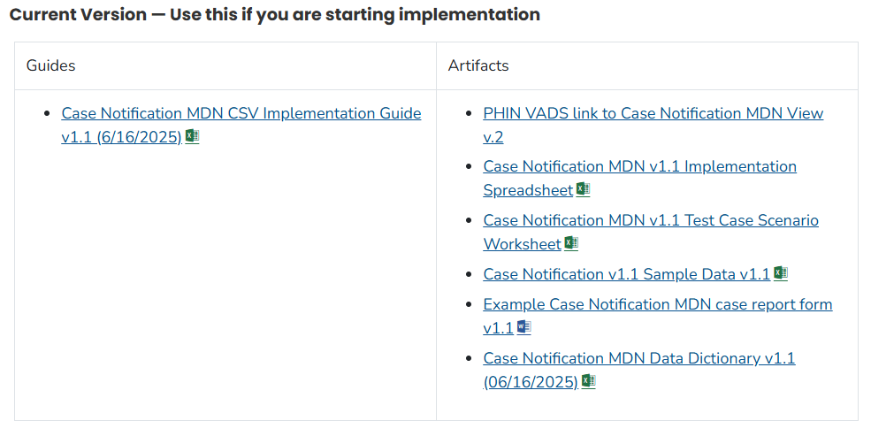
Case Notification MDN CSV artifacts
CSV Implementation Spreadsheet
Test Case Scenario Worksheet and sample data
New: Sample case report form
8

Slide 9
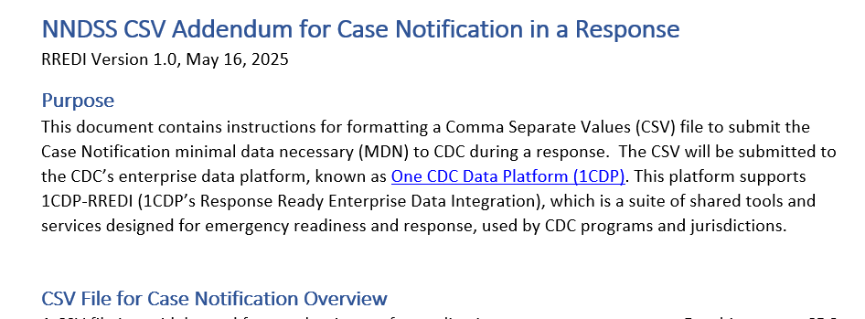
Case Notification MDN CSV Addendum
CSV Addendum for Case Notification
  Information necessary to make a properly formatted CSV for case notification during a response
  Analogous to a PHIN Spec for HL7
9

Slide 10

How should jurisdictions use the Case Notification MDN?
Begin aligning your system
  Case Notification MDN defines the content to be shared from jurisdictions to CDC for readiness and response activities
This is the base of what CDC will ask jurisdictions to send
  Will leverage CDC’s enterprise data platform (1CDP)
Additional guidance on transmission to CDC will be shared with jurisdiction partners during the start of response preparedness activities
10

Slide 11

Looking Towards the Future…
The Case Notification MDN is being shared with you as data standard for use during responses.
The MDN is the new basis for a larger set of core case data (GenV3), where the same core elements are sent to 1CDP for routine case surveillance and for response.
This core data will be coupled with program-specific and/or response specific data elements to answer specific scientific questions for surveillance and response
11

Slide 12
Have questions about using the MDN for response?
Email edx@cdc.gov with Subject Line, “MDN for Response”

Slide 13
NNDSS Updates & Announcements
Anne McIntyre
Office of Public Health Data, Surveillance, and Technology

Slide 14
Changes in 2025
As part of ongoing work to modernize case data exchange, NNDSS data processing through the Message Validation, Processing, and Provisioning System (MVPS) is migrating to CDC’s enterprise data platform, One CDC Data Platform (1CDP).
CDC is postponing NNDSS reconciliation and publication of 2024 annual data until 2026. CDC made this decision to focus our limited staffing capacity on migrating NNDSS data processing to 1CDP in 2025.
CDC is planning to reconcile and publish annual NNDSS data for 2024 and 2025 cases at the same time in 2026. CDC will reconcile and publish data using 1CDP with updated processes to maintain current data quality while saving time and resources.
14

Slide 15
What Will Stay the Same?
CDC will continue to process and publish weekly data to data.cdc.gov as we migrate NNDSS data processing to 1CDP. This change only affects reconciliation of the 2024 annual data.
NNDSS data have already been available within 1CDP to support program-driven surveillance and emergency response. The only change is that data will be processed in the platform rather than ingested into the platform after processing.
15

Slide 16
Next Steps
CDC’s Office of Public Health Data, Surveillance, and Technology will coordinate with CDC programs and jurisdictions to resume annual reconciliation and publication of NNDSS national case surveillance data in 2026.
CDC encourages jurisdictions to continue reviewing their 2024 annual data on their own as time allows.
As we shared on June 11, CDC will not provide a preliminary snapshot of 2024 NNDSS annual data, which was referenced in our original announcement on June 3. CDC is no longer asking jurisdictions to review and transmit their 2024 data to CDC by July 25, 2025.
16

Slide 17
Using MVPS to Lock 2024 Annual Data
Jurisdictions can review and lock their 2024 annual data using the reconciliation module in MVPS
The functionality is optional and is available from July 14, 2025, through Sept. 30, 2025
CDC posted a detailed job aid on July 14, 2025 in the help section of the MVPS portal
However, CDC’s NNDSS team will not be able to provide hands-on reconciliation assistance in 2025
Send questions to edx@cdc.gov with the subject line “2024 Reconciliation Questions”
17

Slide 18
Case Surveillance and 1CDP
Katie Fullerton
Office of Public Health Data, Surveillance, and Technology

Slide 19
A grounding moment
Data modernization remains a major priority
  Data modernization remains a major priority for OPHDST and the agency. We are leading several efforts in collaboration with partners to establish a robust, interconnected data infrastructure.
Building on progress
  Because of the progress we’ve made through data modernization, we can prevent, detect, and respond to health threats more rapidly.
Harnessing technological innovations and a strong foundation of public health data
  Further adaptation and innovation are essential to build on our strong foundation of core data to overcome longstanding challenges with data exchange and enhance our overall response capabilities.
Prioritizing impact and sustainability
  Through efforts like advancing our One CDC Data Platform (1CDP), optimizing eCR, and establishing Implementation Centers, we are prioritizing our resources to focus on where we can make the greatest impact while ensuring long-term sustainability.
Collaboration with partners is key
  Active dialogue with our STLT partners has been and will continue to be vital to make these efforts successful.
19

Slide 20
Bringing you more information
Detect and Monitor Division (DMD) within OPHDST has started an internal bimonthly update series related to Case Surveillance, for DMD and CDC program partners
Each month, we will share a summary of the internal conversations and information with you all in this forum
The goal is parallel information sharing about case surveillance and its modernization into 1CDP
The following slides are summary of internal CDC sessions on June 24 and July 8
20

Slide 21
Bottom Lines Up Front
Case surveillance data (including NNDSS) have been defined as a core data source in the Public Health Data Strategy since 2023
  The Public Health Data Strategy (PHDS) is the overarching strategy for data and technology for public health. This strategy was released in 2023 and is updated yearly with relevant milestones.
One CDC Data Platform (1CDP) was launched at CDC in October 2024.
  1CDP is on a three-year roadmap (FY25 to FY27) to full scalability and operation across CDC and with partners.
Case surveillance/NNDSS Message Validation, Processing, and Provisioning System [MVPS] is being migrated into 1CDP in Year 1 and Year 2.
Migrating MVPS to 1CDP will be a complex, multi-year process
21

Slide 22
Three categories of case surveillance data are transmitted from jurisdictions to CDC.
Core Data Elements
for all diseases/conditions/events,
pre-defined, routinely transmitted
Program-specific Data Elements
for a subset of diseases/ conditions/events,
pre-defined, routinely transmitted
Response-specific Data Elements
defined at the time of response, specific to the response, ad-hoc transmission
Case Notification Minimal Data Necessary (MDN)
for situational awareness in a response

Slide 23

How do current NNDSS terms align with the three content categories?
Generic version 2 (GenV2)
Case notification minimal data necessary (MDN)
Generic version 3 (GenV3) *in development*
Core case data elements
NNDSS: Condition-specific MMG data elements
Non-NNDSS: other sources of program case data (e.g., REDCap)
Program-specific data elements
Response-specific data elements
Response-specific data elements
23

Slide 24
CDC is developing two new tools to manage case data in 1CDP
1CDP Case Data Exchange (CDE) Pipeline will process, validate, and provision all case data, including what is currently being sent to NNDSS.
1CDP Case Profile Manager (CPM) will be used to define the data content to be used for cases reported to CDC, which may include core, program-specific, and response-specific data content.
Both tools are currently in development and planned for deployment in 1CDP Year 1 (by Sep 30, 2025)
  Support for CDC program and partner use will be focus of Year 2, timing to be determined
24

Slide 25
How do current NNDSS terms align with the new tools?
Message Validation, Processing, and Provisioning System (MVPS)
Case Data Exchange Pipeline
25

Slide 26
Current MVPS functionality includes processing, validation, and provisioning of NNDSS case data.
MVPS
Processing
Validation
Provisioning
Data sent by jurisdictions
To CDC Programs
26

Slide 27
MVPS functionality is being migrated to 1CDP in FY25 and FY26.
Processing
Validation
Provisioning
1CDP
27

Slide 28

Timing of MVPS migration
MVPS Migration in FY25 is focused on providing a mirror of current MVPS outputs in 1CDP
Current MVPS processing will run in parallel with 1CDP case data exchange processing through FY 2026 to allow for a transition and off-ramp period.
Transitioning CDC Programs and Jurisdictional partners to the data provisioned in 1CDP will begin in FY26, with CDC/OPHDST support.
After MVPS processing is fully transitioned to 1CDP, MVPS will be deprecated, and 1CDP case surveillance tools: 1CDP Case Data Exchange pipeline and 1CDP Case Profile Manager will be operational
28

Slide 29
Impact of MVPS migration to jurisdictions
The migration of MVPS to 1CDP will not change the way jurisdictions send data to CDC in 2025.
Case surveillance data will be sent from jurisdictional partners to CDC and processed in the 1CDP case data exchange pipeline
  Year 1 – through current transport mechanisms
  Year 2 – (estimate mid-2026) – through 1CDP Ingest, a shared capability of the platform
    This will introduce new endpoints/processes for sending data
    The term “ingest” refers to the functionality of 1CDP to receive data sent through any format from jurisdictions to 1CDP
    1CDP Ingest is being developed in 1CDP Year 1, by the Platforms Division in OPHDST
    More details to be provided in this forum
29

Slide 30
Summary
Case surveillance/NNDSS Message Validation, Processing, and Provisioning System [MVPS] is being migrated into 1CDP in 2025 and 2026.
The migration of MVPS to 1CDP has affected some routine NNDSS processes (reconciliation of 2024 data), but will not change the way jurisdictions send case data to CDC currently.
30

Slide 31

Q & A

Slide 32




Thank you!
Next NNDSS eSHARE: August 19, 2025
Subscribe to
Case Surveillance News
Access NNDSS’ Technical Resource Center
Email edx@cdc.gov for technical help
Learn about case surveillance modernization

