Slide 1
Message Evaluation and Testing Service
User Guide
edx@cdc.gov
MVPS Support Team

Slide 2
Table of Contents
Introduction to MVPS | 3
METS Orientation | 7
MVPS Support | 12

Slide 3
Introduction to MVPS

Slide 4
Overview of MVPS and METS
Message Validation, Processing, and Provisioning System (MVPS)
A system that validates and processes nationally notifiable disease (NND) case notification messages sent by jurisdictions and provisions the data to CDC programs.
Message Evaluation and Testing Service (METS)
A tool that validates and provides feedback on messages that will be submitted to MVPS based on required standards.
MVPS Drivers
Data Collaboration
Timely and Accurate Data
Streamlined Data Collection
The system will provide submitting jurisdictions the ability to view the data they have submitted and identify data quality issues.
The system will allow CDC programs to analyze health-related data, including electronic health record data, to further the agency’s public health goals.
MVPS reduces the number of systems processing data at CDC and allow for streamlined message processing from jurisdictions to CDC.

Slide 5
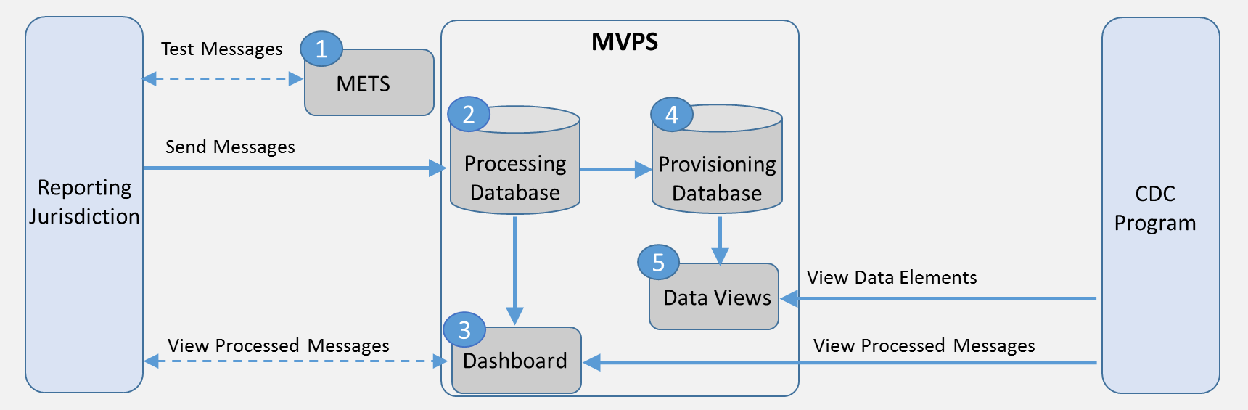
Components of MVPS
1
Message Evaluation and Testing Service (METS):
Tool that validates and provides feedback on messages that will be submitted to MVPS based on required standards
2
Processing Database:
Integration engine that parses, validates, and stores messages/files
3
MVPS Dashboard:
Dashboard that allows jurisdictions to identify notifications that have been received by MVPS and corresponding validation results
4
Provisioning Database:
Database management system that enables provisioning of HL7 data for use by CDC programs
5
Data Views:
Views that limit users to data for the conditions and jurisdictions they are authorized to access

Slide 6
MVPS Common Terminology
MVPS Term | Definition
Message Mapping Guides (MMGs) | Data dictionaries defining the required data elements a Health Level 7 (HL7) message should contain for a specific type of notifiable disease
Message Processing | Messages submitted by jurisdictions are processed, validated for errors and warnings, and stored on the MVPS dashboard Message Processing- Successful Message Processing Warnings Signals the user that something could be wrong with the values in the data will still pass in MVPS and go into the tables, but will trigger a warning in case the user wants to resend/update the message Message Processing Errors A message is missing a required data element or does not properly follow HL7 structure, and will not be processed or provisioned in MVPS
Message Provisioning | HL7 messages submitted by jurisdictions are provisioned into the appropriate format for respective programs

Slide 7
METS Orientation

Slide 8
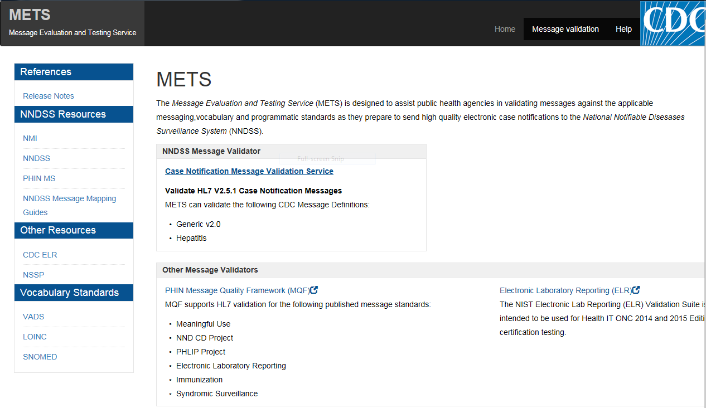
METS Landing Page
METS Landing Page
METS is publically available and may be accessed at https://mets.cdc.gov.

Slide 9
METS Message Validation
METS Message Validation
2
Users have two options to access the Message Validation Tool on the METS Landing Page
1

Slide 10
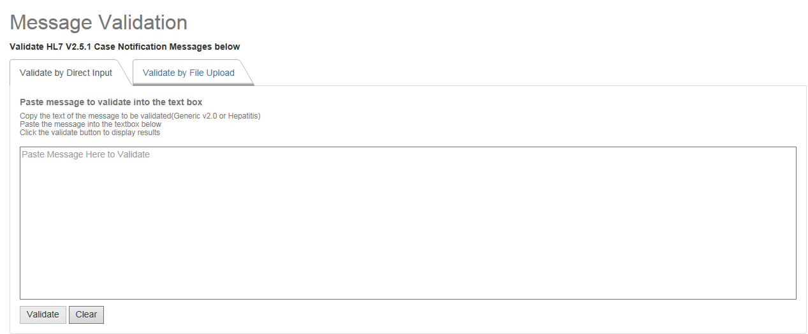
METS Validation Tool
METS Validation Tool
After accessing the Message Validation Tool, users may directly input a message or upload an accepted message file (.TXT and .HL7) for testing.
Users may input a message directly into METS by using the Validate by Direct Input feature or upload a message file by using the Validate by File Upload
Select the Validate button to complete the message validation

Slide 11
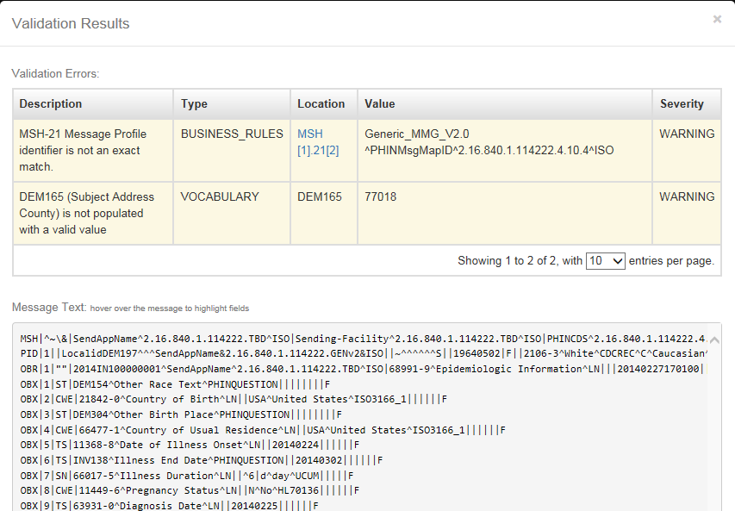
METS Validation Tools
METS Validation Tools
After selecting a “Message Validation” link, users may validate their raw messages by using the following options:
After the user inputs the message to be validated, a pop-up window with the Validation Results will appear. It will include:
  Validation Warnings and Errors
  Message Text

Slide 12
MVPS Support

Slide 13
MVPS Support
Please email edx@cdc.gov for all MVPS related questions. All questions will be directed to a member of the MVPS Support Team.

