Slide 1
Healthy People 2020 Progress Review: Cancer and Genomics
February 6, 2013

Slide 2
Howard K. Koh, MD, MPH
Assistant Secretary for Health
U.S. Department of Health and Human Services

Slide 3
Progress Review Overview
Summarize the burden of Cancer in the U.S. and the role of Genomics
Provide an update on the progress of Healthy People 2020 objectives
Examine what is being done to achieve the Healthy People 2020 objectives

Slide 4
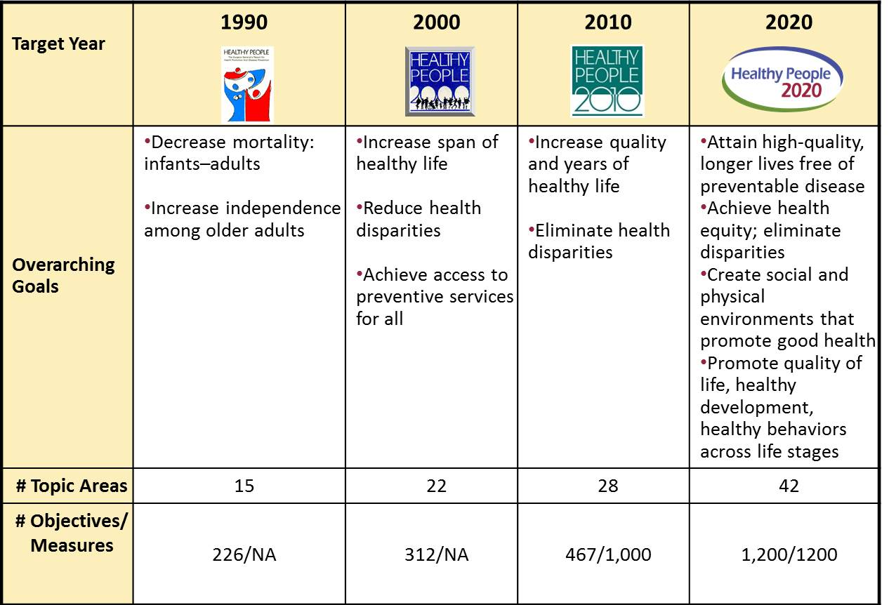

Evolution of Healthy People

Slide 5
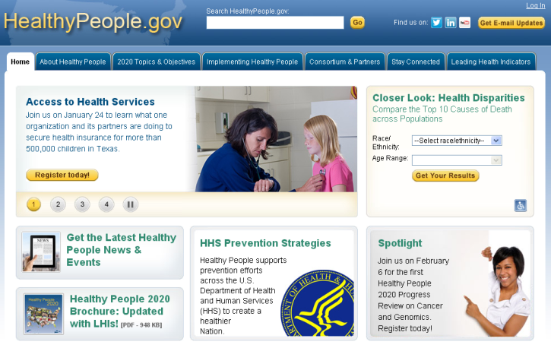
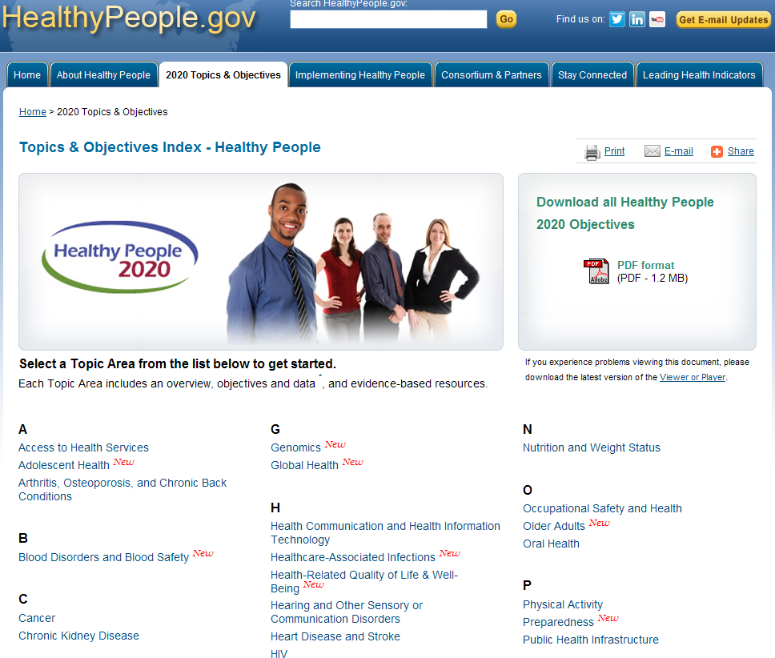
Healthy People 2020
  42 topic area and 1200 objectives
  Source for reliable, science-based, public health measures
  Can be customized to meet needs of diverse users
  Guided by collaborative stakeholder-driven process

Slide 6
The Burden of Cancer and Role of Genomics
Cancer is the second leading cause of death in the U.S.
12.5 million Americans have had a cancer diagnosis
$227 billion in costs to the Nation (2007)
USPSTF - Women whose family history is associated with an increased risk for deleterious mutations in BRCA1 or BRCA2 genes should be referred for genetic counseling

Slide 7
Presenters
Chair
Howard K Koh, MD, MPH
Assistant Secretary for Health, HHS
Data Presentation
Edward Sondik, PhD Director, National Center for Health Statistics, CDC
Cancer Topic Area
Robert Croyle, PhD Director, Division of Cancer Control and Population Sciences, NCI
Marcus Plescia, MD, MPH Director, Division of Cancer Prevention and Control, CDC
Genomics Topic Area
Muin Khoury, MD, PhD Director, Office of Public Health Genomics, CDC
Carolyn Clancy, MD Director, Agency for Healthcare Research and Quality
Community Highlight
Summer Lee Cox Coordinator, Oregon Genetics Program, Oregon Health Authority

Slide 8
Edward J. Sondik, PhD
Director, National Center for Health Statistics
Centers for Disease Control and Prevention

Slide 9
Public Health Impact: Cancer
Cancer is the second leading cause of death in the U.S. after heart disease
Although cancer death rates are steadily declining, cancer is projected to be the leading cause of death by 2013
The NIH estimated that the 2008 overall costs of cancer were about $201.5 billion
Early diagnosis and screening can reduce death rates for some cancers such as breast cancer and colorectal cancer
2 of 5 Americans are estimated to have a cancer diagnosis during their lifetime; approximately 1 in 5 will die from cancer

Slide 10
Cancer Deaths, 2010
NOTES: Data are for selected groupings of ICD-10 codes C00-C97 reported as underlying cause of death.
* Colorectal Includes cancer of the anus
SOURCE: National Vital Statistics System—Mortality (NVSS-M), CDC/NCHS.

Slide 11
Public Health Impact: Genomics
Genetics play a role in 9 of the 10 leading causes of death, including:
  Cancer
  Heart disease
  Stroke
  Diabetes
  Alzheimer’s disease
For those at increased risk for hereditary breast and ovarian cancer, or hereditary colorectal cancer, genetic tests may reduce their risk of those cancers through early detection

Slide 12
Progress Review Data Focus
Breast and Colorectal Cancer
  Deaths
  C-3 Female breast cancer deaths
  C–5 Colorectal cancer deaths
  Incidence
  C–9 Invasive colorectal cancer
  C–11 Late-stage female breast cancer
  Screening
  C–16 Colorectal cancer screening
  C–17 Breast cancer screening
Breast and Ovarian Cancer
  Genetic counseling (1 objective)
  G-1 Genetic counseling for women with a family history of breast and/or ovarian cancer
Target met Improving Little/no change
Notes:
Definitions
Target met: Target met or exceeded
Improving - Movement is in the desired direction:
Change in objective is statistically significant*, OR
Objective has achieved 10% or more of the targeted change
Little/No change:
Objective has achieved less than 10% of the targeted change (and is not statistically significant*)
Objective has a deficit of less than 10% relative to its baseline which it needs to regain before starting to move toward the target (and is not statistically significant*)
Getting worse - Movement is not in the desired direction:
Change in objective is statistically significant*, OR
Objective has a deficit of 10% or more (relative to its baseline), which it needs to regain before starting to move toward the target
Baseline only: Baseline data only; progress cannot be assessed
Developmental: Objective is developmental (does not have baseline data)
Informational: Objective is informational (does not have a target)
Notes
*Statistical significance is only assessed when estimates of variability are available
Percent of targeted change achieved = 100 × (Most recent value – Baseline value) / (HP2020 target – Baseline value)
Percent in deficit = 100 × |Most recent value – Baseline value| / (Baseline value)

Slide 13
Colorectal Cancer Deaths, 2000–2010
Decrease desired
Black, non-Hispanic
White, non-Hispanic
Total
Hispanic or Latino
2020 Target
American Indian or Alaska Native
Asian or Pacific Islander
NOTES: Data are for ICD-10 codes C18-C21 (2000–2006) and C18-C21, C26.0 (2007–2010) reported as underlying cause of death. All data are age adjusted to the 2000 standard population. Multiple-race data were reported by some states; multiple-race data were bridged to the single-race categories for comparability. Persons of Hispanic origin may be of any race.
Obj. C-5
SOURCE: National Vital Statistics System—Mortality (NVSS-M), CDC/NCHS.

Slide 14
Female Breast Cancer Deaths, 2000–2010
Decrease desired
Black, non-Hispanic
Total
White, non-Hispanic
Hispanic or Latino
2020 Target
American Indian or Alaska Native
Asian or Pacific Islander
NOTES: Data are for ICD-10 code C50 reported as underlying cause of death and are age adjusted to the 2000 standard population. Prior to 2003, only one race could be recorded; recording more than one race was not an option. Beginning in 2003 multiple-race data were reported by some states; multiple-race data were bridged to the single-race categories for comparability. Persons of Hispanic origin may be of any race.
Obj. C-3
SOURCE: National Vital Statistics System—Mortality (NVSS-M), CDC/NCHS.

Slide 15
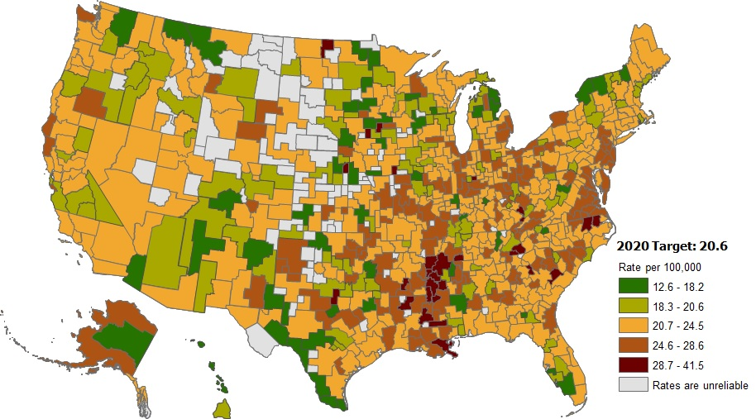
Female Breast Cancer Deaths, 2006–2010
NOTES: Data are for ICD-10 code C50 reported as underlying cause of death and are age adjusted to the 2000 standard population. Rates are displayed by a modified Jenks classification for U.S. health service areas. Two lowest categories show health service areas that met target.
Obj. C-3
SOURCE: National Vital Statistics System—Mortality (NVSS-M), CDC/NCHS.

Slide 16
New Cases of Colorectal Cancer
Decrease desired
1999
2009
2009
2020 Target
NOTES: Data are for diagnosed incident cases of invasive colorectal cancer (ICD-O-3 codes C18.0-C18.9, C19.9 and C20.9). Data are age adjusted to the 2000 standard population. Persons of Hispanic origin may be any race.
I = 95% confidence interval.
SOURCE: National Program of Cancer Registries (NPCR), CDC/NCCDPHP; Surveillance, Epidemiology, and End Results (SEER) Program, NIH/NCI.
Obj. C-9

Slide 17
New Cases of Late-Stage Female Breast Cancer
Decrease desired
2009
1999
2009
2020 Target
NOTES: Data are for diagnosed incident cases of breast cancer (ICD-O-3 codes C50.1-C50.9) in regional or distant stages. Data are age adjusted to the 2000 standard population. Persons of Hispanic origin may be any race.
I = 95% confidence interval.
SOURCE: National Program of Cancer Registries (NPCR), CDC/NCCDPHP; Surveillance, Epidemiology, and End Results (SEER) Program, NIH/NCI.
Obj. C-11

Slide 18
Persons Meeting U.S. Preventive Services Task Force (USPSTF)
Guidelines for Colorectal Cancer Screening
Increase desired
2010
2010
2020 Target
2008
NOTES: Data are for the proportion of persons aged 50–75 who stated they had a blood stool test in the past year, sigmoidoscopy in the past 5 years with blood stool test in the past 3 years, or a colonoscopy in the past 10 years. Data are age adjusted to the 2000 standard population. Respondents were asked to select one or more races. Data for the single race categories are for persons who reported only one racial group. Data for the Native Hawaiian or Other Pacific Islander population do not meet the criteria for statistical reliability, data quality, or confidentiality. Persons of Hispanic origin may be any race.
I = 95% confidence interval.
SOURCE: National Health Interview Survey (NHIS), CDC/NCHS.
Obj. C-16

Slide 19
Women Meeting U.S. Preventive Services Task Force (USPSTF)
Guidelines for Breast Cancer Screening
Increase desired
2010
2008
2010
2020 Target
NOTES: Data are for the proportion of women aged 50–74 (2008 and 2010) who stated they had a mammogram in the past 2 years. Data are age adjusted to the 2000 standard population. Respondents were asked to select one or more races. Data for the single race categories are for persons who reported only one racial group. Data for the American Indian or Alaska Native and Native Hawaiian or Other Pacific Islander populations do not meet the criteria for statistical reliability, data quality, or confidentiality. Persons of Hispanic origin may be any race.
I = 95% confidence interval.
SOURCE: National Health Interview Survey (NHIS), CDC/NCHS.
Obj. C-17

Slide 20
Women Aged 18 Years and Older with a Family
History of Breast or Ovarian Cancer, 2010
NOTES: Data are for women aged 18 years and older who met the United States Preventive Services Task Force (USPSTF) criteria, based on first-degree relatives only, for BRCA1/2 genetic counseling referral, and who do not have a personal history of breast or ovarian cancer. Data are age adjusted to the 2000 standard population.
SOURCE: National Health Interview Survey (NHIS), CDC/NCHS.

Slide 21
Women Aged 18 Years and Older with a Family History of Breast or
Ovarian Cancer Who Have Discussed Genetic Testing, 2005 and 2010
Increase desired
2020 Target
NOTES: Data are for women aged 18 years and older who have ever discussed the possibility of getting a genetic test for cancer risk with a health care provider, who met the United States Preventive Services Task Force (USPSTF) criteria, based on first-degree relatives only, for BRCA1/2 genetic counseling referral, and who do not have a personal history of breast or ovarian cancer. Data are age adjusted to the 2000 standard population.
I = 95% confidence interval.
SOURCE: National Health Interview Survey (NHIS), CDC/NCHS.
Obj. G-1

Slide 22
Current HP2020 Objective Status: Cancer
  C-1 Overall cancer deaths
  C-2 Lung cancer deaths
  C-3 Female breast cancer deaths
  C–4 Uterine cervix cancer deaths
  C–5 Colorectal cancer deaths
  C–6 Oropharyngeal cancer deaths
  C–7 Prostate cancer deaths
  C–8 Melanoma deaths
  C–9 Invasive colorectal cancer
  C–10 Invasive uterine cervical cancer
  C–11 Late-stage female breast cancer
  C–12 Statewide cancer registries
  C–13 Cancer survival
  C–14 (Developmental) Mental and physical health-related quality of life of cancer survivors
  C–15 Cervical cancer screening
  C–16 Colorectal cancer screening
  C–17 Breast cancer screening
  C–18.1 Receipt of counseling about mammograms
  C–18.2 Receipt of counseling about Pap tests
  C–18.3 (Developmental) Receipt of counseling about colorectal cancer screening
  C–19 (Developmental) Prostate-specific antigen (PSA) test
  C–20.1 (Developmental) Adolescent sunburn
  C–20.2 Adult sunburn
  C–20.3 Adolescent artificial UV light for tanning
  C–20.4 Adult artificial UV light for tanning
  C–20.5 Adolescent measures to reduce risk of skin cancer
  C–20.6 Adult measures to reduce risk of skin cancer
Target met Improving Little/No change Getting worse Baseline only Developmental
Notes:
Definitions:
Target met
Target met or exceeded
Improving - Movement is in the desired direction:
Change in objective is statistically significant*, OR
Objective has achieved 10% or more of the targeted change
Little/No change
Objective has achieved less than 10% of the targeted change (and is not statistically significant*)
Objective has a deficit of less than 10% relative to its baseline which it needs to regain before starting to move toward the target (and is not statistically significant*)
Getting worse - Movement is not in the desired direction:
Change in objective is statistically significant*, OR
Objective has a deficit of 10% or more (relative to its baseline), which it needs to regain before starting to move toward the target
Baseline only
Baseline data only; progress cannot be assessed
Developmental
Objective is developmental (does not have baseline data)
Informational
Objective is informational (does not have a target)
Notes:
*Statistical significance is only assessed when estimates of variability are available
Percent of targeted change achieved = 100 × (Most recent value – Baseline value) / (HP2020 target – Baseline value)
Percent in deficit = 100 × |Most recent value – Baseline value| / (Baseline value)

Slide 23
Current HP2020 Objective Status Summary: Cancer
Total number of objectives: 27
Target met
Improving
Little/No change
Getting worse
Baseline only
Developmental
Notes:
Definitions:
Target met
Target met or exceeded
Improving - Movement is in the desired direction:
Change in objective is statistically significant*, OR
Objective has achieved 10% or more of the targeted change
Little/No change
Objective has achieved less than 10% of the targeted change (and is not statistically significant*)
Objective has a deficit of less than 10% relative to its baseline which it needs to regain before starting to move toward the target (and is not statistically significant*)
Getting worse - Movement is not in the desired direction:
Change in objective is statistically significant*, OR
Objective has a deficit of 10% or more (relative to its baseline), which it needs to regain before starting to move toward the target
Baseline only
Baseline data only; progress cannot be assessed
Developmental
Objective is developmental (does not have baseline data)
Informational
Objective is informational (does not have a target)
Notes:
*Statistical significance is only assessed when estimates of variability are available
Percent of targeted change achieved = 100 × (Most recent value – Baseline value) / (HP2020 target – Baseline value)
Percent in deficit = 100 × |Most recent value – Baseline value| / (Baseline value)

Slide 24
Current HP2020 Objective Status: Genomics
  G-1 Genetic counseling for women with a family history of breast and/or ovarian cancer
  G-2 (Developmental) Genetic testing for persons with colorectal cancer to detect Lynch syndrome
Target met Improving Little/No change Getting worse Baseline only Developmental
Notes:
Definitions:
Target met
Target met or exceeded
Improving - Movement is in the desired direction:
Change in objective is statistically significant*, OR
Objective has achieved 10% or more of the targeted change
Little/No change
Objective has achieved less than 10% of the targeted change (and is not statistically significant*)
Objective has a deficit of less than 10% relative to its baseline which it needs to regain before starting to move toward the target (and is not statistically significant*)
Getting worse - Movement is not in the desired direction:
Change in objective is statistically significant*, OR
Objective has a deficit of 10% or more (relative to its baseline), which it needs to regain before starting to move toward the target
Baseline only
Baseline data only; progress cannot be assessed
Developmental
Objective is developmental (does not have baseline data)
Informational
Objective is informational (does not have a target)
Notes:
*Statistical significance is only assessed when estimates of variability are available
Percent of targeted change achieved = 100 × (Most recent value – Baseline value) / (HP2020 target – Baseline value)
Percent in deficit = 100 × |Most recent value – Baseline value| / (Baseline value)

Slide 25
Summary
Progress over the past decade in reducing death and incidence rates for the major cancers is encouraging
Cancer
  Disparities by race and ethnicity and by income persist in the risks of developing and dying from cancer
  Collecting data from the smaller population groups is a continuing challenge
  Screening guidelines are subject to change, which affects trends
Genomics
  Monitoring progress is challenged by the relatively small target populations

Slide 26
Robert T. Croyle, PhD
Director, Division of Cancer Control and Population Sciences
National Cancer Institute

Slide 27
National Cancer Institute
Division of Cancer Control and Population Sciences
Science and research to promote the use of effective cancer screening and to inform policy
  Understanding current screening practices and outcomes
  Identifying high risk populations
  Evaluating screening strategies and new technologies
Related research areas
  Health disparities and underserved populations
  Health care research
  Health communication and health literacy
  Decision making
  Common measures in behavior and social science research
  Implementation science

Slide 28
Screening as a Process Rather than an Isolated Event
Risk assessment
Processes of Care across the
Cancer Care Continuum
Patient
Outcomes
Primary prevention
Risk status
Biologic outcomes
Health related quality of life & well-being
End-of-life experience
Financial burden
Patient engagement
Detection
Screening or
Symptomatic
Screening
Diagnosis
Cancer or precursor RX
Post-treatment survivorship
Population
Outcomes
End-of-life care
Mortality
Morbidity
Cost-effectiveness

Slide 29
Population-based Research Optimizing Screening through Personalized Regimens (PROSPR)
Goal: Develop multi-site, coordinated, transdisciplinary research to document, evaluate and improve the entire screening process
Research to understand recruitment, screening, diagnosis, and referral for treatment of breast, colon and cervical cancer
Objectives:
  Comparative effectiveness of existing and emerging screening processes in community practice
  Balance of benefits and harms across recognized cancer risk profiles
  Preliminary studies to inform future research
Objectives C-15, C-16, C-17, C-18 Increase the proportion of adults who received screening based on most recent guidelines and increase the proportion of adults who were counseled about cancer screening consistent with guidelines

Slide 30
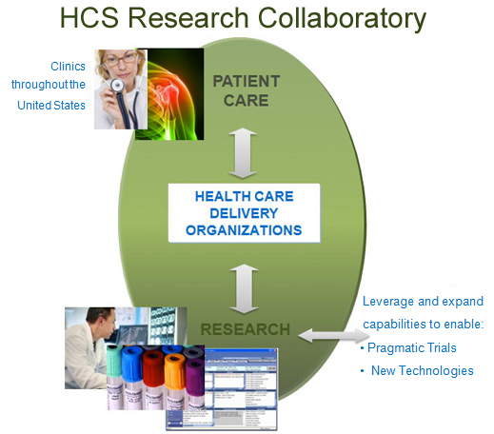
Health Care Systems Research Collaboratory (HCS)
Goal: Strengthen the national capacity to implement cost-effective large-scale research studies that engage health care delivery organizations as research partners

Slide 31
  HCS Demonstration Project - Strategies and Opportunities to Stop Colon Cancer in Priority Populations
Goal: Establish partnership between research institutions and federally qualified health centers (FQHCs) to achieve sustainable and large –scale impacts on colorectal cancer (CRC) screening rates
Assess effectiveness of:
    Automated data-driven, EHR-linked program for mailing Fecal Immunochemical Test (FIT) kits to patients due for CRC screening
    Higher-intensity program consisting of a mailed FIT kit plus additional interventions selected by clinics
Objective C-16 Increase the proportion of adults who received colorectal cancer screening based on most recent guidelines

Slide 32
Cancer Intervention and Surveillance Modeling Network (CISNET)
Goal: Model the relationship between upstream (screening rates and risk factors) and downstream (incidence and mortality) goals to evaluate public health interventions
Support modeling consortiums for breast, colorectal, esophagus, lung and prostate cancer
Objectives:
  Translating scientific evidence to the population setting
  Identifying key factors influencing outcomes
  Identifying efficient cancer control strategies
  Informing clinical practice and recommended guidelines
Objectives C-2, C-3, C-5, C-7, C-11, C-13 Reduce cancer death rate for lung, breast, colorectal and prostate cancer, reduce incidence of colorectal cancer and late stage breast cancer

Slide 33
HMO Cancer Research Network (CRN)
Goal: Use HMO delivery systems to conduct research in the community setting
  Cancer prevention
  Early detection
  Cancer communication
  Dissemination and implementation
Includes information from 14 HMOs nationwide that collectively provide care to nearly 10 million individuals
Multidisciplinary approach includes expertise in epidemiology, health services, behavioral medicine, biostatistics, and specialty care
Objectives C-15, C-16, C-17, C-18 Increase the proportion of adults who received screening based on most recent guidelines and increase the proportion of adults who were counseled about cancer screening consistent with guidelines

Slide 34
National Surveys that Measure Progress for HP2020 Objectives
Goal: Estimate screening utilization, knowledge, perceptions, patient-provider communications and provider attitudes
  National Health Interview Survey (NHIS)
  Serves as a main source of patterns and trends in individual screening behaviors
Health Information National Trends Survey (HINTS)
  Uniquely dedicated to learning how people find, use and understand health information
Behavioral Risk Factor Surveillance System (BRFSS)
  Tracks health conditions and risk behaviors at the state level
Objectives C-14, C-15, C-16, C17, C-18, C-19, C-20 Measure mental and physical health-related quality of life, screening rates, counseling on screening, sun exposure activities

Slide 35





Cancer Control P.L.A.N.E.T.
Plan, Link, Act Network with Evidence-based Tools
Research Synthesis
  Guide to community preventive services
  Evaluation of genomic applications in practice and prevention (EGAPP)
Research-tested intervention programs
Evaluation – Research effectiveness adoption implementation maintenance (Re-AIM)
Comprehensive cancer control plans and budgets
SPONSORS

Slide 36
Marcus Plescia, MD, MPH
Director, Division of Cancer Prevention and Control
Centers for Disease Control and Prevention

Slide 37
Centers for Disease Control and Prevention
Division of Cancer Prevention and Control
Mission
  Build and support public health capacity for cancer prevention and control across the nation
  Translate research into public health programs, practices, and services
National Programs
  Colorectal Cancer Control Program
  National Breast and Cervical Cancer Early Detection Program
  National Program of Cancer Registries

Slide 38








Division of Cancer Prevention and Control Programs, Initiatives, and Campaigns

Slide 39
National Breast and Cervical Cancer Early Detection Program (NBCCEDP)
Goal: Increase breast and cervical cancer screening among underinsured and uninsured women
  Clinical services: Access to timely cancer screening and diagnostic services across the nation
    Treatment services: Medicaid eligibility for cancer treatment (Breast & Cervical Cancer Prevention and Treatment Act)
Objective C-17: Increase the proportion of women who receive a breast cancer screening based on the most recent guidelines

Slide 40
Realizing HP 2020 Objectives:
Future Approaches to Cancer Screening
Goal: Build on the existing capacity and extensive clinical network of the National Breast and Cervical Cancer Early Detection Program
    Public education and outreach
    Screening services and care coordination
    Quality assurance, surveillance, and monitoring
    Organized systems to provide screening

Slide 41
Realizing HP 2020 Objectives:
Colorectal Cancer Control Program
Goal: Increase colorectal cancer (CRC) screening among underinsured and uninsured adults
  Screening promotion (population-based)
    Emphasis on policy and systems change
    Implement evidence-based strategies (Community Guide)
    Ensure adequate diagnostic and treatment follow-up
  Screening provision (clinical services)
    Screening for eligible low income, under- and uninsured men and women
Objective C-16: Increase the proportion of adults who receive a CRC screening based on the most recent guidelines

Slide 42
Realizing HP 2020 Objectives:
Innovative Public Health Approaches
Minnesota Department of Health
  Collaboration with state Medicaid program
  Direct mail reminders about cancer screening to unscreened beneficiaries
New York State Health Department
  Collaboration with Federally Qualified Health Centers
  Registry to track screening rates and quality among providers

Slide 43
Federal Partnerships:
Cancer Prevention and Control Research Network
Goal: Provide an infrastructure for applying relevant research to local cancer prevention and control needs
  Increases expertise in community-based intervention research in cancer prevention and control
  Facilitates translation of interventions into practice
  Aims to provide expertise for research that meets Community Guide standards

Slide 44
Cancer Prevention and Control Research Network Example
Washington University in St. Louis and United Way 2-1-1 Missouri
Callers to 2-1-1 have greater need for cancer control services
Three randomized study arms: verbal referral only, verbal referral plus mailed reminder and verbal referral plus a telephone coach/navigator
Callers in the verbal referral plus telephone coach/navigator group were more likely to seek referrals for mammograms and Pap tests

Slide 45
Federal Partnerships
Cancer Surveillance Data
Goal: complete local, state, regional, and national data on cancer incidence
  100% coverage for the U.S. population
  Surveillance, Epidemiology, and End Results program (NCI)
  National Program of Cancer Registries (CDC)
  Source for Healthy People cancer incidence objectives
Objectives C-9, C-10, C-11: Reduce incidence of colorectal cancer (C-9), invasive uterine cervical cancer (C-10), and late stage breast cancer (C-11)

Slide 46
Muin J. Khoury, MD, PhD
Director, Office of Public Health Genomics
Centers for Disease Control and Prevention

Slide 47
Centers for Disease Control and Prevention
Office of Public Health Genomics
Mission: To integrate advances in genomics effectively and responsibly into public health programs to improve population health
Goals:
Implement evidence-based genomic testing and family health history applications into public health programs
Evaluate genomic tests to identify new opportunities to improve health and transform healthcare
Develop and provide communications publications, training, policy and technical assistance to programs, providers, policymakers, and consumers.

Slide 48
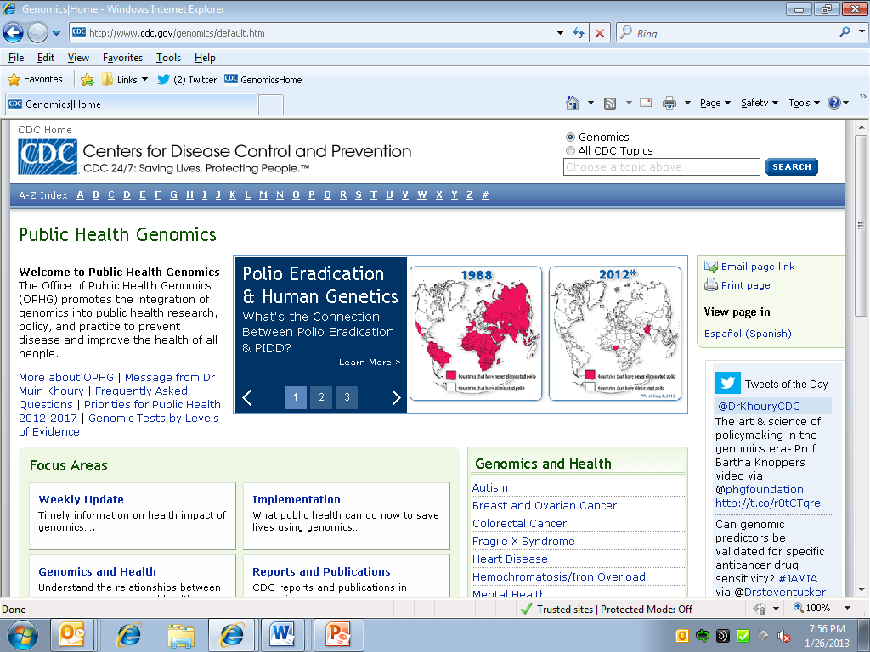
15 Years of Public Health Genomics in the United States

Slide 49
Evidence-based Classification of Genomic Tests and Family History to Inform Policy, Practice and Public Health Programs
Tier 1: Recommended for clinical use by evidence-based panels, based on systematic review of evidence of validity and utility.
Tier 2: May be useful for informed decision making, based on demonstrated validity, and promising utility.
Tier 3: Not ready for clinical use, due to validity or utility not demonstrated, or systematic assessment finding harms outweigh benefits.
http://www.cdc.gov/genomics/gtesting/tier.htm

Slide 50
HP 2020 Genomics Objectives
G-1: Increase the proportion of women with a family history of breast and/or ovarian cancer who receive genetic counseling
➔ U.S. Preventive Services Task Force Recommendation
G-2: Increase the proportion of persons with newly diagnosed colorectal cancer who receive genetic testing to identify Lynch syndrome
➔ Evaluation of Genomic Applications in Practice and Prevention (EGAPP) Working Group Recommendation

Slide 51

OPHG-Sponsored
EGAPP Working Group
Independent, multidisciplinary, non-federal panel established in 2004
Established a systematic, evidence-based process to assess validity & utility of genomic tests & family health history applications.
    New methods for evidence synthesis and modeling in 2013, including next generation sequencing and stratified screening
Six recommendation statements to date:
    Colorectal cancer, breast cancer, heart disease, clotting disorders, depression
New recommendations in 2013
  Prostate cancer, diabetes, and more

Slide 52
Realizing HP 2020 Objectives:
State Genomics Programs
Since 2008, CDC has supported state genomics programs in Michigan, Oregon, and more recently Georgia, to implement the evidence-based genomics recommendations underpinning the HP objectives.
States are:
  Identifying people targeted by the HP 2020 genomics objectives using cancer registries and educating health providers about evidence-based recommendations
  Implementing model payer policies to facilitate coverage consistent with the breast/ovarian cancer objective
  Developing and evaluating new data sources to measure progress toward these objectives

Slide 53
Cancer Registries for Case Finding and Provider Education
Cancer registry bidirectional reporting
Identify relevant breast, ovarian, colorectal and other cancer cases reported to central cancer registry
Inform reporting institutions of relevant cancer cases with informational materials about hereditary breast and ovarian cancer and Lynch syndrome
Michigan reported back over 15,000 cases of cancer relevant to HP 2020 objectives (2007-2008 data).
Connecticut reported back over 5000 cases of cancer through a Healthy People 2020 Action Award (2008-2009 data).

Slide 54
Model payer policies to promote HP 2020 genomics objectives
Michigan Department of Community Health partnered with major payers to implement payer policies consistent with the USPSTF recommendation/HP 2020 breast cancer objective.
  From 2008-2011, insurance coverage consistent with the USPSTF recommendation/HP 2020 breast cancer objective has been extended to over 6.6 million Michigan residents.
CDC’s Division of Cancer Prevention and Control examined medical policies related to genetic counseling for hereditary breast and ovarian cancer.
  Of 348 health plans across 38 states, 58% had written policies

Slide 55
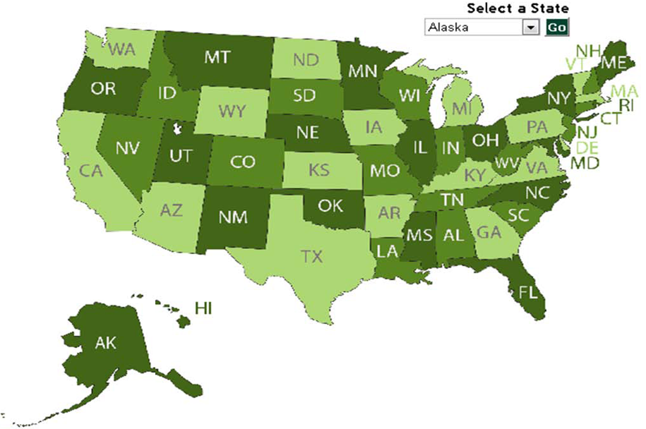
Public Health Genomics
State Programs Clickable Map

Slide 56
HP 2020 Genomics Objectives
Additional Facilitators
Affordable Care Act coverage of the USPSTF recommendation for hereditary breast and ovarian cancer as a preventive service
Meaningful Use of Electronic Health Records—inclusion of family health history
Public Health Reporting Initiative—inclusion of family health history
Current Procedural Terminology code revisions—specific codes for genetic tests, including those relevant to HP 2020 objectives, being implemented

Slide 57
Challenges in Implementing Genomic Medicine (HP2020 & Beyond)
Evidence of clinical validity and utility slow to accumulate
Provider awareness and education
Need for genetic/genomic professionals
Healthcare system limitations (e.g., family history collection and cascade testing in relatives)
Laboratory issues
Ethical, legal and social issues
Coverage and reimbursement
Potential for increasing health disparities

Slide 58
Carolyn M. Clancy, MD
Director, Agency for Healthcare Research and Quality

Slide 59
AHRQ’s role in addressing Healthy People 2020 objectives
Mission: To improve the quality, safety, efficiency, and effectiveness of health care for all Americans
AHRQ supports research that helps people make more informed decisions and improves the quality of health care services
AHRQ also works to translate new knowledge into evidence and tools that people can use to improve the safety and quality of health care.
~80 percent of AHRQ's budget is invested in grants and contracts focused on improving health care

Slide 60
U.S. Preventive Services Task Force
The U.S. Preventive Services Task Force is an independent group of national experts in prevention and evidence-based medicine.
The Task Force works to improve the health of all Americans by making evidence-based recommendations about clinical preventive services such as:
  Screenings
  Counseling services
  Preventive medications
AHRQ convenes the Task Force and provides ongoing scientific, administrative, and dissemination support for the operations of the Task Force

Slide 61
U.S. Preventive Services Task Force (continued)
Systematically reviews evidence for clinical preventive services implemented in a primary care setting
The Task Force makes recommendations to help primary care clinicians and patients decide together whether a preventive service is right for a patient’s needs
To learn more about the USPSTF and how you can engage with them, visit:
USPreventiveServicesTaskForce.org

Slide 62
Examples of recent USPSTF Cancer-related A and B recommendations
The USPSTF recommends screening for cervical cancer in women ages 21 to 65 years with cytology (Pap smear) every 3 years or, for women ages 30 to 65 years who want to lengthen the screening interval, screening with a combination of cytology and human papillomavirus (HPV) testing every 5 years. (A Recommendation)
The USPSTF recommends counseling children, adolescents, and young adults aged 10 to 24 years who have fair skin about minimizing their exposure to ultraviolet radiation to reduce risk for skin cancer. (B Recommendation)
Objectives C-4 Reduce the death rate from cancer of the uterine cervix and C-15 Increase the proportion of women who receive a cervical cancer screening based on the most recent guidelines.
Objective C-20 Increase the proportion of persons who participate in behaviors that reduce their exposure to harmful ultraviolet irradiation and avoid sunburn.

Slide 63
Genomics-related USPSTF recommendation
The USPSTF recommends that women whose family history is associated with an increased risk for deleterious mutations in BRCA1 or BRCA2 genes be referred for genetic counseling and evaluation for BRCA testing. (B Recommendation)
Recommendation is currently being updated.
Objectives G-1 Increase the proportion of women with a family history of breast and/or ovarian cancer who receive genetic counseling.

Slide 64
Implementation of the USPSTF recommendations
As a result of the Affordable Care Act, HHS utilizes A and B recommendations from the USPSTF along with recommendations of three other groups to guide Medicare, Medicaid and private insurance companies to increase access to clinical preventive services and to ensure that they are affordable for all Americans.
AHRQ’s cancer-related research areas include:
  Multiple chronic conditions
  Delivery of culturally appropriate clinical preventive services

Slide 65

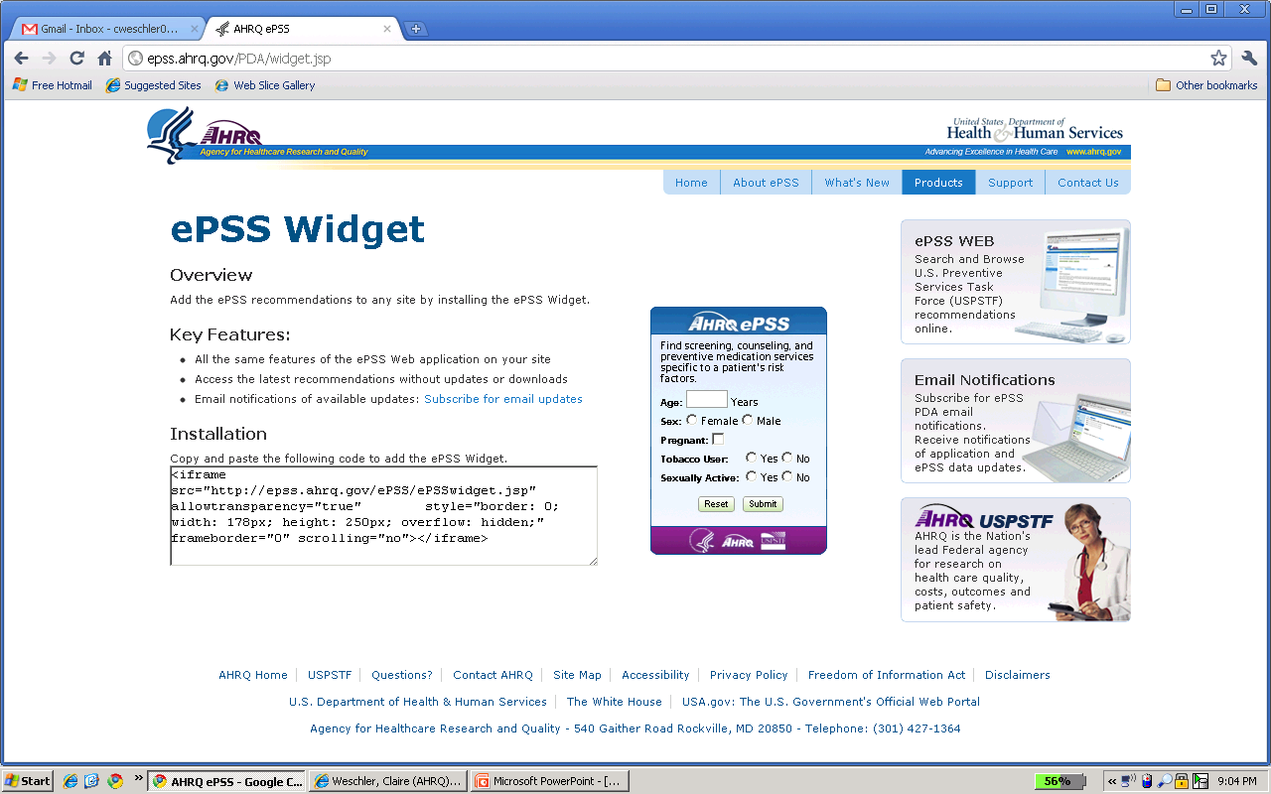
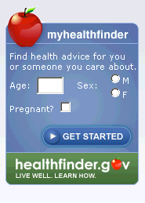
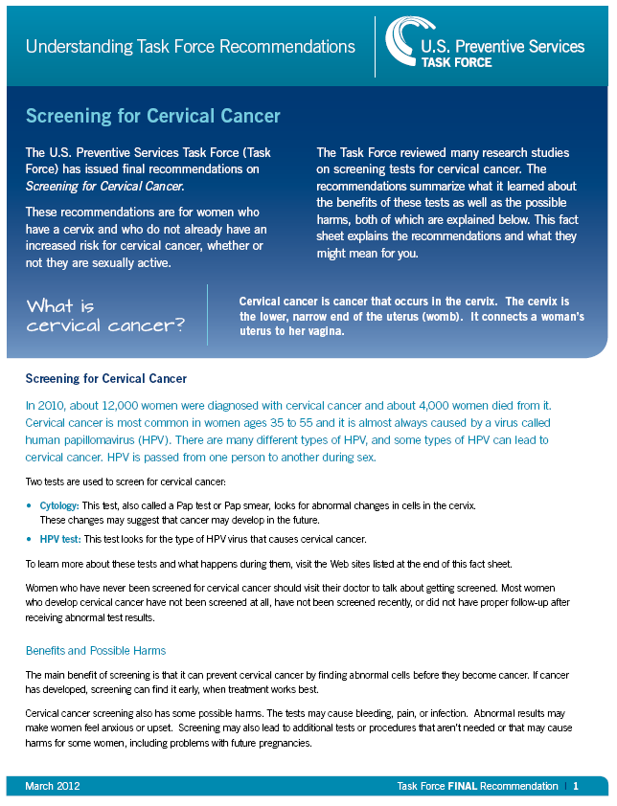
Tools for implementation
The Guide to Clinical Preventive Services, 2012
Electronic Preventive Services Selector (ePSS)
MyHealthfinder
Consumer fact sheets

Slide 66

Clinical decision support tool
AHRQ developed a clinical decision support tool to facilitate shared decision making between clinicians and women at risk of breast or ovarian cancer.
Tool was originally
developed to support
the USPSTF’s
recommendation.
It has been adapted
for use by the CDC’s
Division of Cancer
Prevention and
Control.
https://www3.orau.gov/BodyTalk

Slide 67
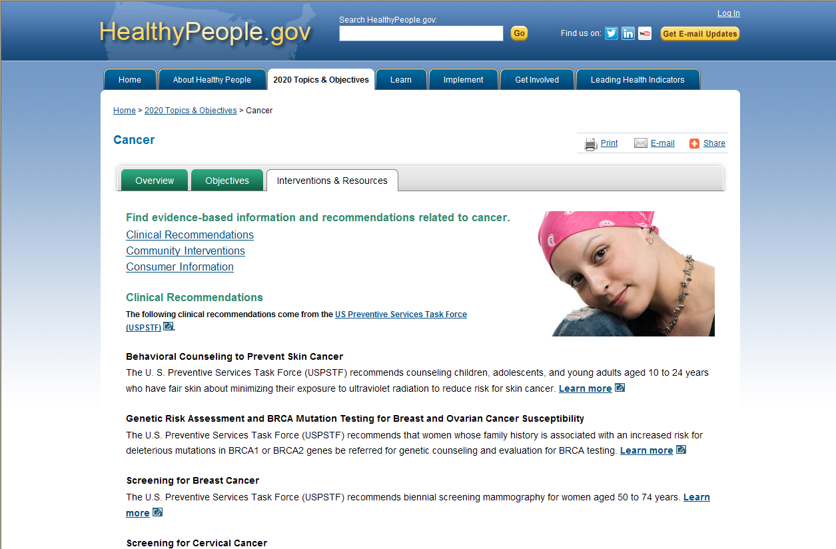
Healthy People and the U.S. Preventive Services Task Force

Slide 68


Oregon Genetics Program
Public Health Division / Oregon Health Authority
Summer Lee Cox, MPH
Feb 6, 2013

Slide 69
Oregon Genetics Program
Center for Prevention & Health Promotion
  Oregon Public Health Division/Oregon Health Authority
Mission
  Promote the health, well-being, and quality of life of Oregonians using up-to-date knowledge of genomics
Funding
  CDC Division of Cancer Prevention and Control

Slide 70
Surveillance, Education & Policy
Surveillance
  Identify use & understanding, current gaps and opportunities for change
Education
  Health care providers, health insurers and the public
Policy
  Improve access to genetic services

Slide 71
Cancer Risks: Comparing BRCA+ to the General Population (among Women)
National Cancer Institute (NCI). BRCA1 and BRCA2: Cancer Risk and Genetic Testing. 05/29/2009

Slide 72
The Adult Oregon Population
Approximately 154,000 candidates for BRCA testing
data source: Oregon Genetics Program Report: BRCA 1&2 and MMR Gene Mutations in the Oregon Population: Estimating Mutation Carriers and Referrals for Genetic Services. March, 2011. Not Published.

Slide 73
Oregon BRCA Testing in 2008
data sources: 2008 data supplied by Myriad, private communication; 2009 Oregon Genetic Services Data, unpublished; 2008-2012 OPHG Close-out Report, unpublished.

Slide 74
Policy
Healthcare Systems &
Providers
Cancer Genetic Specialists
Oregon Partnership for Cancer Control (OPCC)
Oregon Medicaid
Education/Outreach
Other Public Health Programs
Oregon State Cancer Registry (OSCaR)
Surveillance
General Public & Targeted Populations
(Ashkenazi Ancestry)

Slide 75
OGP Approach - Surveillance
Surveillance Data
  Oregon cancer genetics clinics
  Oregon State Cancer Registry (OSCaR)
  Oregon Medicaid
  Behavioral Risk Factor Surveillance Study (BRFSS)
  2010 Healthcare provider survey
  2011 Insurance Company survey

Slide 76
OGP Approach – Education
Education Goals
  Increasing the use of evidence based guidelines (USPSTF & NCCN)
  Increasing the number of appropriate referrals to genetic services (Tier 1 applications)
  Increasing the use and awareness of family history
Populations
  Ashkenazi Jewish population & general population
  Healthcare Providers
  Health Insurance Companies

Slide 77
OGP Approach - Policy
Policy
  Medicaid coverage guidelines
  Education of stakeholders on genetic counselor licensure
Future activities
  Discussion with health insurance companies
    Evidence based guidelines to decide coverage
  Discussion with healthcare providers & systems
    Evidence based guidelines to decide health care

Slide 78
What We Have Learned
What gets measured gets done
  baseline data & targets
Use multiple data sources
  OSCaR, Oregon Census data, data from literature
Bring together multiple partners
  Share resources and brainstorm
Use multiple and comprehensive approaches
  Multipronged solutions for complex conditions

Slide 79
Next Steps
Letter writing campaign
  Collaboration with the Oregon Cancer Registry
  Simultaneously educating cancer patients AND their doctors
Discussion with health insurance companies
  Evidence based recommendations
  Cost effectiveness studies
  Client support
Continue collaborating with Cancer partners

Slide 80
Oregon Genetics Program
www.healthoregon.org/genetics
Amy Zlot, Epidemiologist
  amy.zlot@state.or.us
Bridget Roemmich, Manager
  bridget.r.roemmich@state.or.us
Rani George, Analyst
  rani.m.george@state.or.us
Summer Cox, Coordinator
  summer.l.cox@state.or.us

Slide 81

Please submit your questions through the chat function.

Slide 82
Healthy People 2020 Staff
HEALTHY PEOPLE 2020 Cancer and Genomics Progress Review
Core Planning Group
  Martina Taylor (NCI)
  Kathy Cronin (NCI)
  Laurie Cynkin (NCI)
  Annie Archbold (CDC)
  Katherine Kolor (CDC)
  Cheryl Thomas (CDC)
  Lisa Richardson (CDC)
  Bob McNellis (AHRQ)
  Yen Luong (ODPHP)
  Ellis Davis (ODPHP)
  Emmeline Ochiai (ODPHP)
  Geri Tebo (ODPHP)
  Rebecca Hines (NCHS)
  David Huang (NCHS)
  Deepthi Kandi (NCHS)
  Jeff Pearcy (NCHS)

Slide 83





Stay Connected
Web healthypeople.gov
Email hp2020@hhs.gov
Twitter @gohealthypeople
LinkedIn Healthy People 2020
YouTube ODPHP(search “healthy people”)
Join the Healthy People Listserv & Consortium
Notes:
83

