Slide 1
Appendix

Slide 2
Objective Status: Food Safety
  FS-1.1 Reduce infections caused by Campylobacter species transmitted commonly through food
  FS-1.2 Reduce infections caused by Shiga toxin-producing Escherichia coli (STEC) O157 transmitted commonly through food
  FS-1.3 Reduce infections caused by Listeria monocytogenes transmitted commonly through food
  FS-1.4 Reduce infections caused by Salmonella species transmitted commonly through food
  FS-1.5 Reduce postdiarrheal hemolytic uremic syndrome (HUS) in children under 5 years of age
  FS-1.6 Reduce infections caused by Vibrio species transmitted commonly through food
  FS-1.7 Reduce infections caused by Yersinia species transmitted commonly through food
  FS-2.1 Reduce the number of outbreak-associated infections due to Shiga toxin-producing E. coli O157, or Campylobacter, Listeria, or Salmonella species with beef.
  FS-2.2 Reduce the number of outbreak-associated infections due to Shiga toxin-producing E. coli O157, or Campylobacter, Listeria, or Salmonella species with dairy.
  FS-2.3 Reduce the number of outbreak-associated infections due to Shiga toxin-producing E. coli O157, or Campylobacter, Listeria, or Salmonella species with fruits and nuts.
  FS-2.4 Reduce the number of outbreak-associated infections due to Shiga toxin-producing E. coli O157, or Campylobacter, Listeria, or Salmonella species with leafy vegetables.
Notes:
Definitions
Target met: Target met or exceeded
Improving – Change is toward the target:
Change in objective is statistically significant*, OR
Objective has achieved 10% or more of the targeted change
Little/No change:
Objective has achieved less than 10% of the targeted change (and is not statistically significant*), OR
Objective has a deficit of less than 10% relative to its baseline which it needs to regain before starting to move toward the target (and is not statistically significant*), OR
No change between baseline and most recent data point
Getting worse – Change is away from the target:
Change in objective is statistically significant*, OR
Objective has a deficit of 10% or more (relative to its baseline), which it needs to regain before starting to move toward the target
Baseline only: Baseline data only; progress cannot be assessed
Developmental: Objective is developmental (does not have baseline data)
Informational: Objective is informational (does not have a target)
Notes
*Statistical significance is only assessed when estimates of variability are available
Percent of targeted change achieved = 100 × (Most recent value – Baseline value) / (HP2020 target – Baseline value)
Percent in deficit = 100 × |Most recent value – Baseline value| / (Baseline value)

Slide 3
Objective Status: Food Safety
  FS-2.5 Reduce the number of outbreak-associated infections due to Shiga toxin-producing E. coli O157, or Campylobacter, Listeria, or Salmonella species with poultry.
  FS-3.1 Prevent an increase in the proportion of nontyphoidal Salmonella isolates from humans that are resistant to nalidixic acid (quinolone).
  FS-3.2 Prevent an increase in the proportion of nontyphoidal Salmonella isolates from humans that are resistant to ceftriaxone (third-generation cephalosporin).
  FS-3.3 Prevent an increase in the proportion of nontyphoidal Salmonella isolates from humans that are resistant to gentamicin.
  FS-3.4 Prevent an increase in the proportion of nontyphoidal Salmonella isolates from humans that are resistant to ampicillin.
  FS-3.5 Prevent an increase in the proportion of nontyphoidal Salmonella isolates from humans that are resistant to three or more classes of antimicrobial agents.
  FS-3.6 Prevent an increase in the proportion of Campylobacter jejuni isolates from humans that are resistant to erythromycin
  FS-4 Reduce severe allergic reactions to food among adults with a food allergy diagnosis.
  FS-5.1 Increase the proportion of consumers who follow the key food safety practice of “Clean: wash hands and surfaces often.”
  FS-5.2 Increase the proportion of consumers who follow the key food safety practice of “Separate: don’t cross-contaminate.”
  FS-5.3 Increase the proportion of consumers who follow the key food safety practice of “Cook: cook to proper temperatures.”
  FS-5.4 Increase the proportion of consumers who follow the key food safety practice of “Chill: refrigerate promptly.”
  FS-6 Improve food safety practices associated with foodborne illness in foodservice and retail establishments.
Notes:
Definitions
Target met: Target met or exceeded
Improving – Change is toward the target:
Change in objective is statistically significant*, OR
Objective has achieved 10% or more of the targeted change
Little/No change:
Objective has achieved less than 10% of the targeted change (and is not statistically significant*), OR
Objective has a deficit of less than 10% relative to its baseline which it needs to regain before starting to move toward the target (and is not statistically significant*), OR
No change between baseline and most recent data point
Getting worse – Change is away from the target:
Change in objective is statistically significant*, OR
Objective has a deficit of 10% or more (relative to its baseline), which it needs to regain before starting to move toward the target
Baseline only: Baseline data only; progress cannot be assessed
Developmental: Objective is developmental (does not have baseline data)
Informational: Objective is informational (does not have a target)
Notes
*Statistical significance is only assessed when estimates of variability are available
Percent of targeted change achieved = 100 × (Most recent value – Baseline value) / (HP2020 target – Baseline value)
Percent in deficit = 100 × |Most recent value – Baseline value| / (Baseline value)

Slide 4
Current HP2020 Objective Status:
Food Safety
4%
(n=1)
Total number of objectives: 24
Target met
Improving
Little/No change
Getting worse
Developmental
Notes:
Definitions
Target met: Target met or exceeded
Improving – Change is toward the target:
Change in objective is statistically significant*, OR
Objective has achieved 10% or more of the targeted change
Little/No change:
Objective has achieved less than 10% of the targeted change (and is not statistically significant*), OR
Objective has a deficit of less than 10% relative to its baseline which it needs to regain before starting to move toward the target (and is not statistically significant*), OR
No change between baseline and most recent data point
Getting worse – Change is away from the target:
Change in objective is statistically significant*, OR
Objective has a deficit of 10% or more (relative to its baseline), which it needs to regain before starting to move toward the target
Baseline only: Baseline data only; progress cannot be assessed
Developmental: Objective is developmental (does not have baseline data)
Informational: Objective is informational (does not have a target)
Notes
*Statistical significance is only assessed when estimates of variability are available
Percent of targeted change achieved = 100 × (Most recent value – Baseline value) / (HP2020 target – Baseline value)
Percent in deficit = 100 × |Most recent value – Baseline value| / (Baseline value)

Slide 5
Objective Status: Medical Product Safety
MPS-1 Healthcare organizations reporting adverse drug events
MPS-2.1 Patients suffering from untreated pain due to lack of access to pain treatment
MPS-2.2 Non-FDA approved pain medications
MPS-2.3 Serious injuries from use of pain medicines
MPS-2.4 Deaths from use of pain medicines
MPS-3 Adverse events from medical products
MPS-4 Medical products associated with predictive biomarkers
MPS-5.1 ED visits for overdoses from oral anticoagulants
MPS-5.2 ED visits for overdoses from injectable antidiabetic agents
MPS-5.3 ED visits for overdoses from narrow-therapeutic-index medications
MPS-5.4 ED visits for medication overdoses among children <5 yrs
Notes:
Definitions
Target met: Target met or exceeded
Improving – Change is toward the target:
Change in objective is statistically significant*, OR
Objective has achieved 10% or more of the targeted change
Little/No change:
Objective has achieved less than 10% of the targeted change (and is not statistically significant*), OR
Objective has a deficit of less than 10% relative to its baseline which it needs to regain before starting to move toward the target (and is not statistically significant*), OR
No change between baseline and most recent data point
Getting worse – Change is away from the target:
Change in objective is statistically significant*, OR
Objective has a deficit of 10% or more (relative to its baseline), which it needs to regain before starting to move toward the target
Baseline only: Baseline data only; progress cannot be assessed
Developmental: Objective is developmental (does not have baseline data)
Informational: Objective is informational (does not have a target)
Notes
*Statistical significance is only assessed when estimates of variability are available
Percent of targeted change achieved = 100 × (Most recent value – Baseline value) / (HP2020 target – Baseline value)
Percent in deficit = 100 × |Most recent value – Baseline value| / (Baseline value)

Slide 6
Current HP2020 Objective Status:
Medical Product Safety
Total number of objectives: 11
Target met
Little/No change
Baseline only
Developmental
Notes:
Definitions
Target met: Target met or exceeded
Improving – Change is toward the target:
Change in objective is statistically significant*, OR
Objective has achieved 10% or more of the targeted change
Little/No change:
Objective has achieved less than 10% of the targeted change (and is not statistically significant*), OR
Objective has a deficit of less than 10% relative to its baseline which it needs to regain before starting to move toward the target (and is not statistically significant*), OR
No change between baseline and most recent data point
Getting worse – Change is away from the target:
Change in objective is statistically significant*, OR
Objective has a deficit of 10% or more (relative to its baseline), which it needs to regain before starting to move toward the target
Baseline only: Baseline data only; progress cannot be assessed
Developmental: Objective is developmental (does not have baseline data)
Informational: Objective is informational (does not have a target)
Notes
*Statistical significance is only assessed when estimates of variability are available
Percent of targeted change achieved = 100 × (Most recent value – Baseline value) / (HP2020 target – Baseline value)
Percent in deficit = 100 × |Most recent value – Baseline value| / (Baseline value)

Slide 7
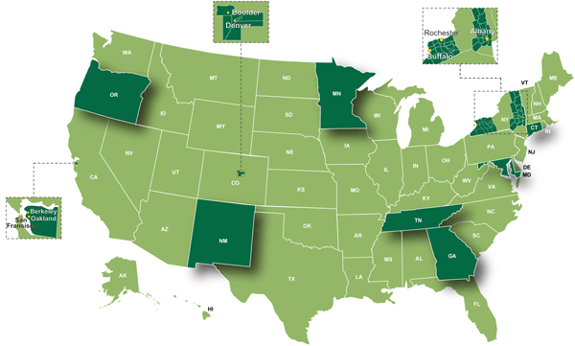
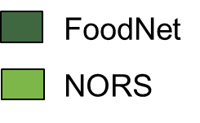
Foodborne Disease Active Surveillance Network (FoodNet)
Developed: 1995
What: Conducts surveillance among 15% of the U.S. population for
Laboratory confirmed cases of infections with nine pathogens
transmitted commonly through food.
How: Work closely with 10 state health departments and other
federal agencies
SOURCES: Foodborne Diseases Active Surveillance Network (FoodNet), CDC/NCEZID.
National Outbreak Reporting System (NORS), CDC/NCEZID.

Slide 8
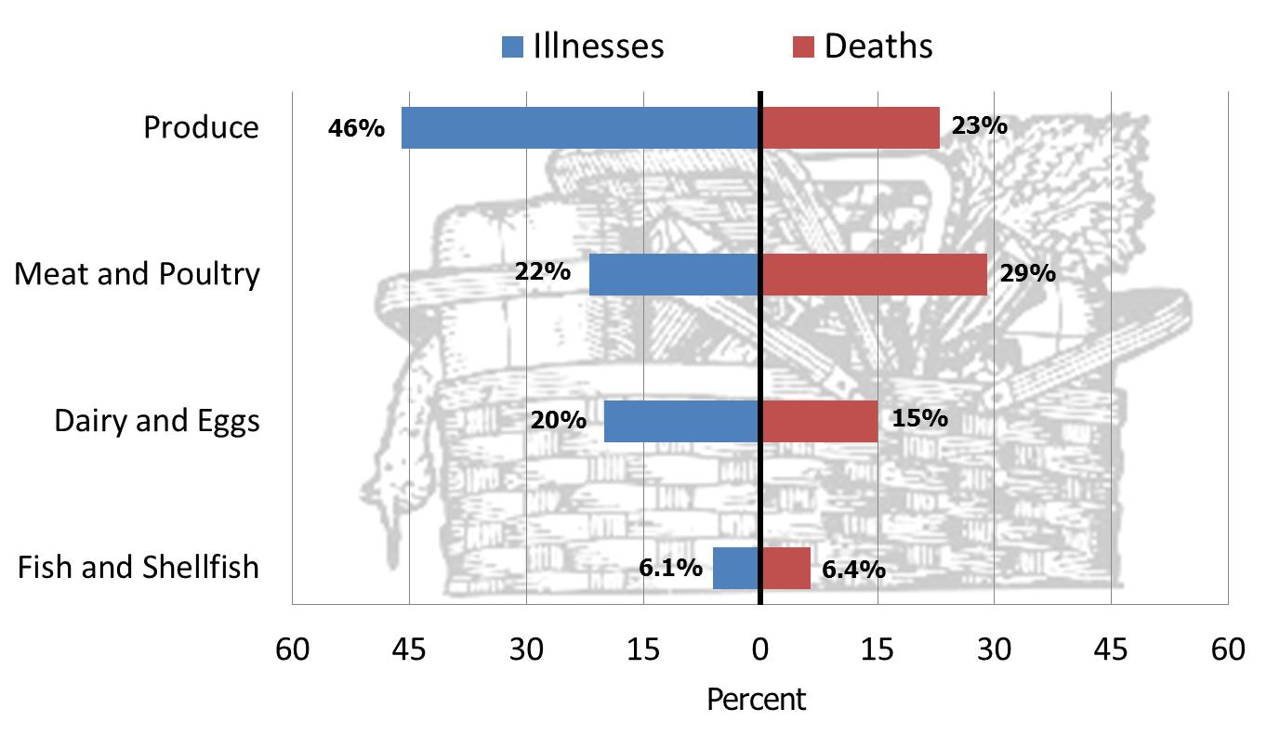
Contribution of Food Categories to Estimated Domestically Acquired Illnesses and Deaths, 1998–2008
NOTES: Chart does not show 5% of illnesses and 2% of deaths attributed to other commodities. In addition, 1% of illnesses and 25% of deaths were not attributed to commodities; these were caused by pathogens not in the outbreak database, mainly Toxoplasma and Vibrio vulnificus.
SOURCE: Painter JA, et al. Attribution of foodborne diseases, hospitalizations, and deaths to food commodities by using outbreak data, United States, 1998-2008. Emerg Infect Vol. 19, No. 3, March 2013.

Slide 9
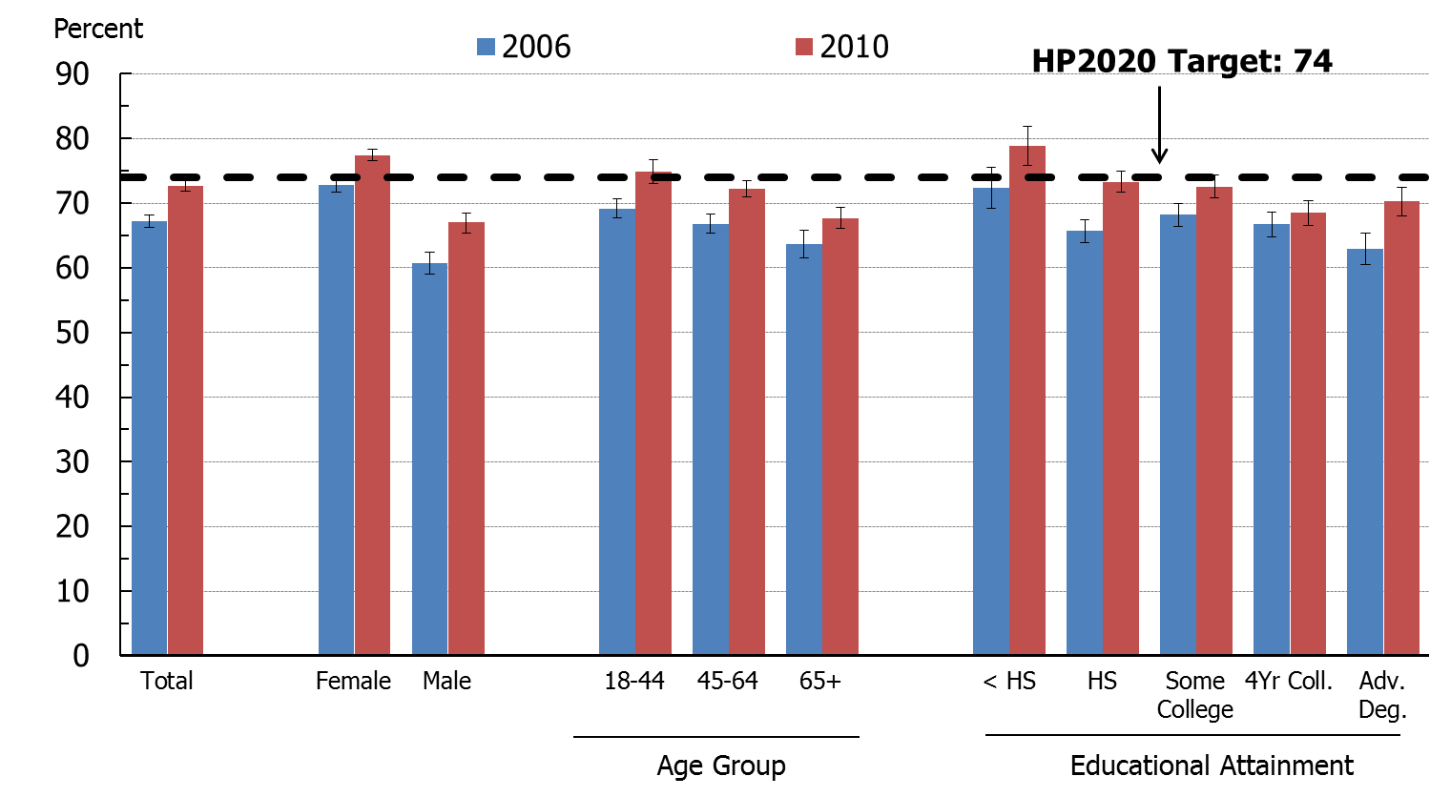
Key Food Safety Practice: Clean – wash hands and surfaces often, 2006 and 2010
SOURCE: Food Safety Survey, FDA.
NOTE: I = 95% confidence interval.
Obj. FS-5.1
Increase desired

Slide 10
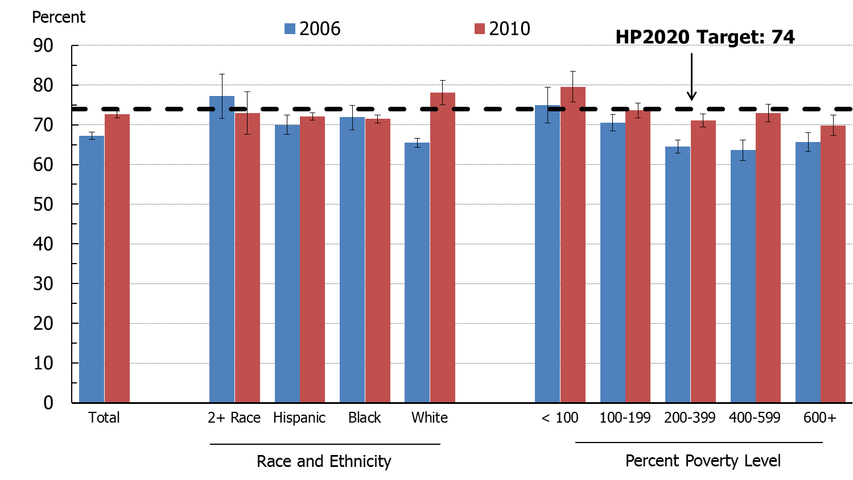
Key Food Safety Practice: Clean – wash hands and surfaces often, 2006 and 2010
SOURCE: Food Safety Survey, FDA.
NOTE: I = 95% confidence interval.
Obj. FS-5.1
Increase desired

Slide 11
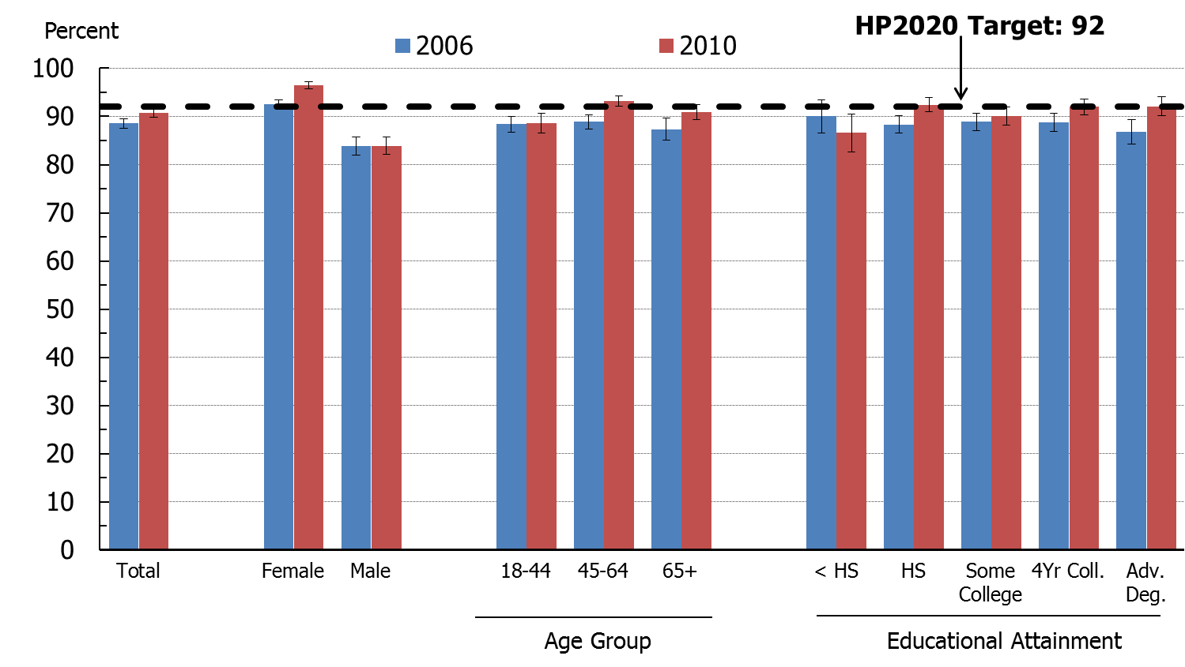
Key Food Safety Practice: Separate – don’t cross contaminate, 2006 and 2010
SOURCE: Food Safety Survey, FDA.
NOTE: I = 95% confidence interval.
Obj. FS-5.2
Increase desired

Slide 12
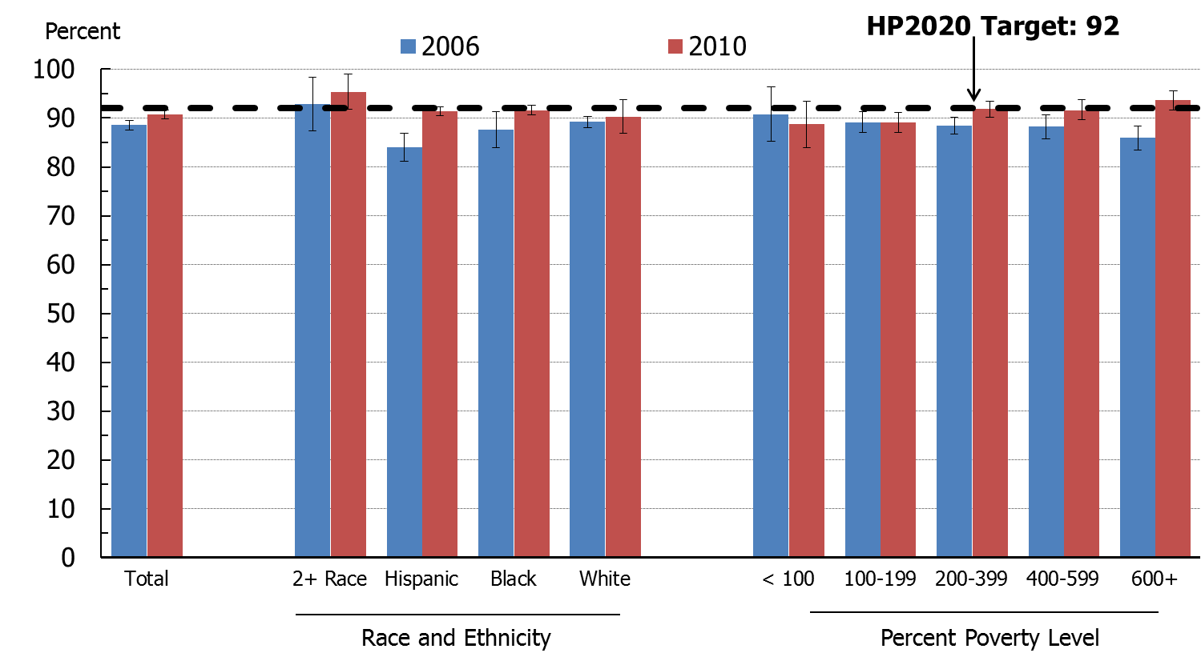
Key Food Safety Practice: Separate – don’t cross contaminate, 2006 and 2010
SOURCE: Food Safety Survey, FDA.
NOTE: I = 95% confidence interval.
Obj. FS-5.2
Increase desired

Slide 13
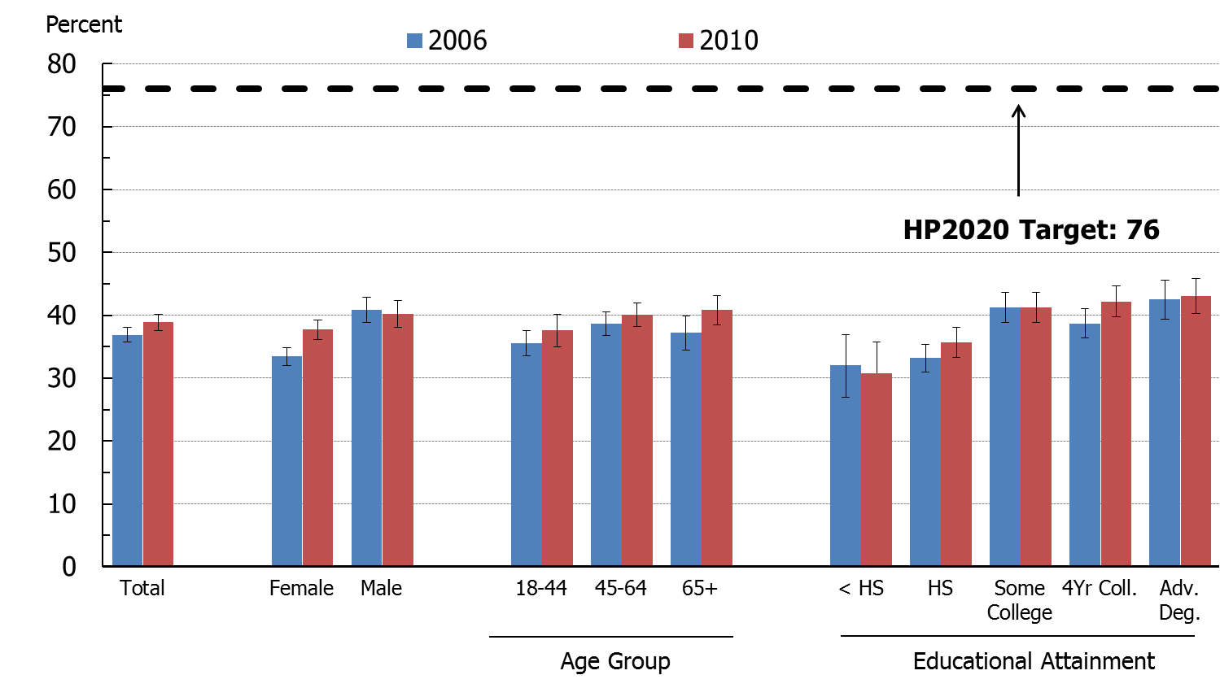
Key Food Safety Practice: Cook – cook to proper temperature, 2006 and 2010
SOURCE: Food Safety Survey, FDA.
NOTE: I = 95% confidence interval.
Obj. FS-5.3
Increase desired

Slide 14
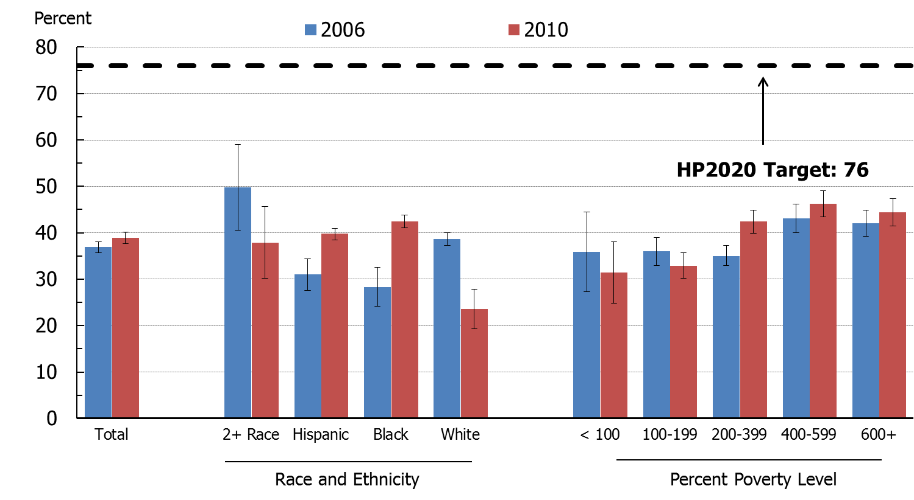
Key Food Safety Practice: Cook – cook to proper temperature, 2006 and 2010
SOURCE: Food Safety Survey, FDA.
NOTE: I = 95% confidence interval.
Obj. FS-5.3
Increase desired

Slide 15
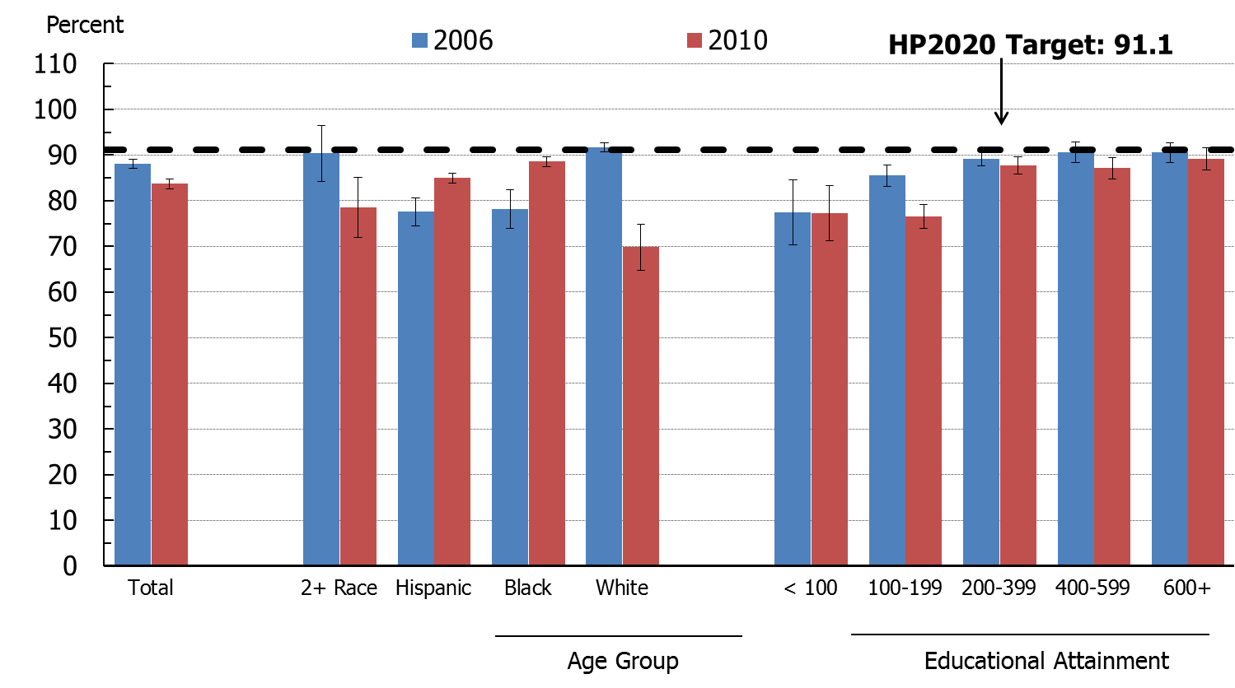
Key Food Safety Practice: Chill – refrigerate promptly, 2006 and 2010
SOURCE: Food Safety Survey, FDA.
NOTE: I = 95% confidence interval.
Obj. FS-5.4
Increase desired

Slide 16
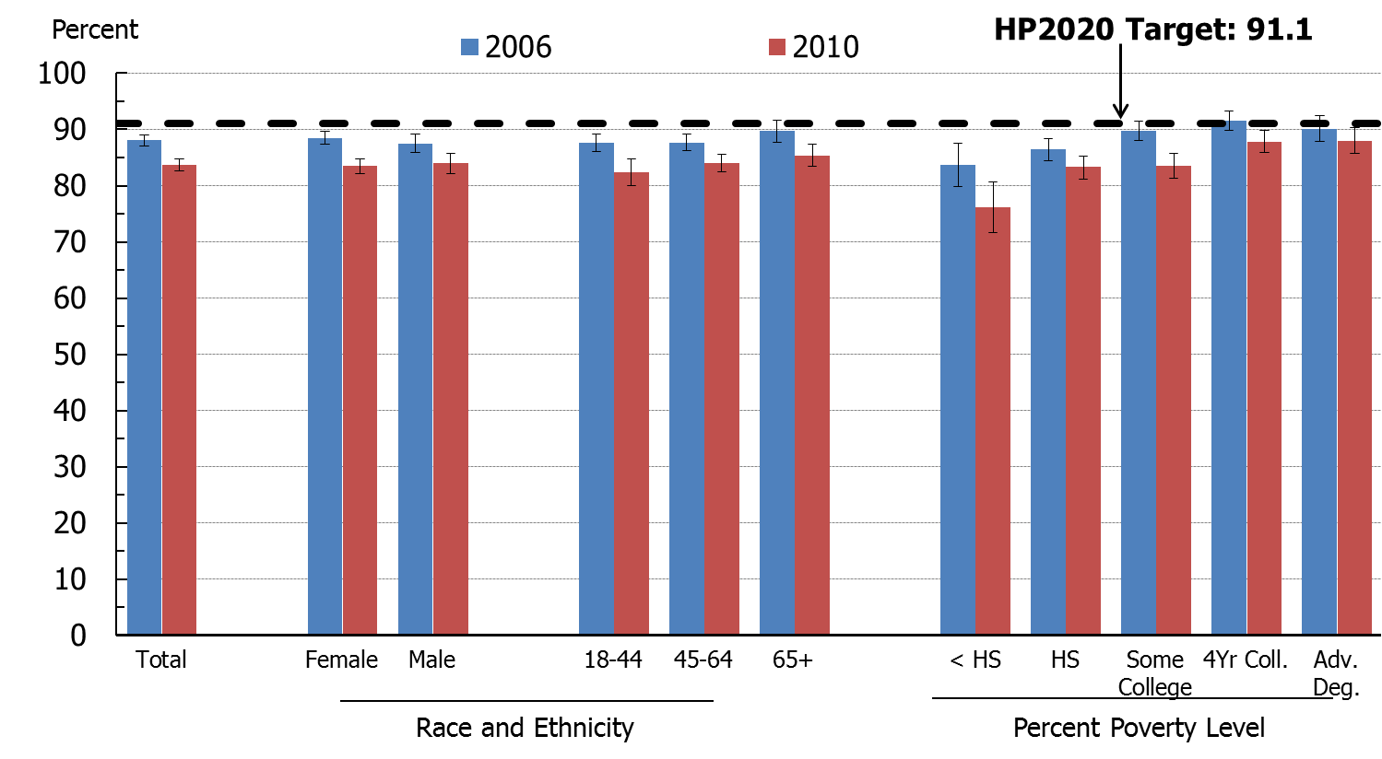
Key Food Safety Practice: Chill – refrigerate promptly, 2006 and 2010
SOURCE: Food Safety Survey, FDA.
NOTE: I = 95% confidence interval.
Obj. FS-5.4
Increase desired

