Slide 1



Progress Review Webinar:
Public Health Infrastructure and Preparedness
April 10, 2018

Slide 2
Strong Organizations and
Resilient Communities
Don Wright, MD, MPH
Deputy Assistant Secretary for Health
Director, Office of Disease Prevention and Health Promotion
U.S. Department of Health and Human Services

Slide 3
Agenda and Presenters
Chair
Don Wright, MD, MPH, Deputy Assistant Secretary for Health, U.S. Department of Health and Human Services
Presentations
Charles Rothwell, MBA, MS, Director, National Center for Health Statistics, CDC
Craig Thomas, PhD, Associate Director for Strategy, Center for State, Tribal, Local, and Territorial Support (proposed), CDC
Luis Padilla, MD, FAAFP, Associate Administrator, Bureau of Health Workforce, Director of the National Health Service Corps, HRSA
Rachel Avchen, PhD, MS, CAPT, U.S. Public Health Service, Branch Chief, Applied Science and Evaluation Office, Office of Public Health Preparedness and Response, CDC
Sally Phillips, RN, PhD, Deputy Assistant Secretary for Policy, Office of the Assistant Secretary for Preparedness and Response, U.S. Department of Health and Human Services
Dan Dodgen, PhD, Director, Division of Policy and Strategic Planning, Office of the Assistant Secretary for Preparedness and Response, U.S. Department of Health and Human Services
Community Highlight
Jeffrey Gunzenhauser, MD, MPH, Interim Health Officer, County of Los Angeles Department of Public Health, California

Slide 4
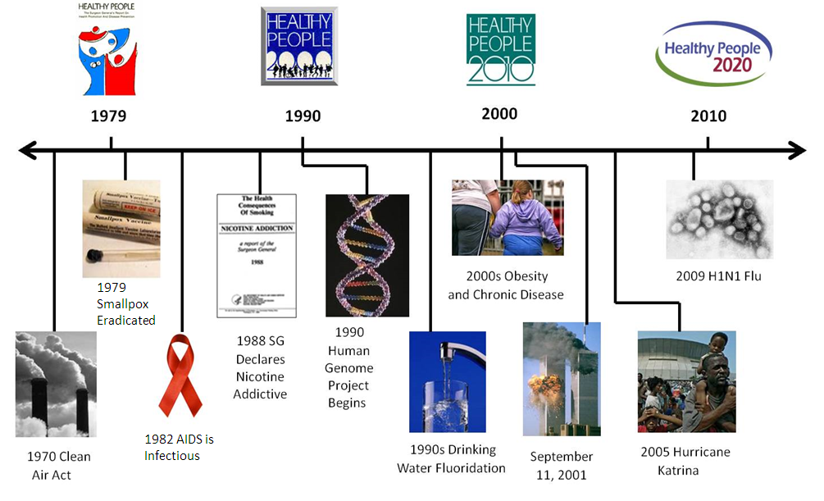
Healthy People at the Forefront of Public Health

Slide 5
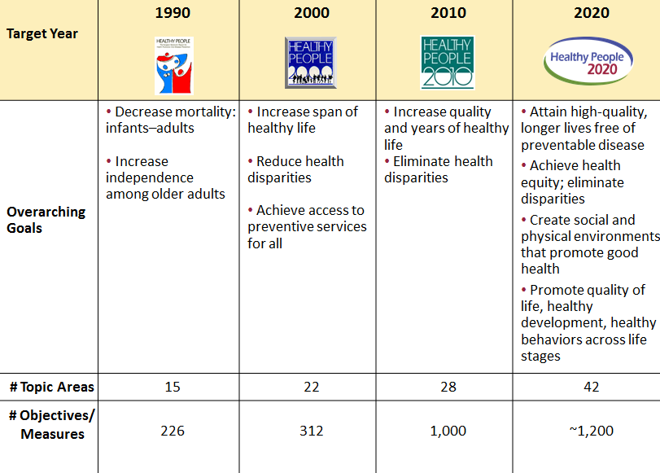
Evolution of Healthy People

Slide 6
Public Health Infrastructure
Provides communities, states, and the Nation the capacity to prevent disease, promote health, and prepare for and respond to both acute threats and chronic challenges to health.
Federal, State, Tribal, territorial, and local health agencies can effectively provide essential public health services.
Key components:
  Capable and qualified workforce
  Up-to-date data and information system
  Agencies capable of assessing and responding to public health needs

Slide 7
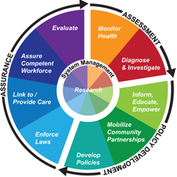
Public Health Infrastructure and the 10 Essential Health Services
Monitor health status to identify and solve community health problems.
Diagnose and investigate health problems and health hazards in the community.
Inform, educate, and empower people about health issues.
Mobilize community partnerships and action to identify and solve health problems.
Develop policies and plans that support individual and community health efforts.
Enforce laws and regulations that protect health and ensure safety.
Link people to needed personal health services and assure the provision of health care when otherwise unavailable.
Ensure competent public and personal health care workforces.
Evaluate effectiveness, accessibility, and quality of personal and population-based health services.
Research for new insights and innovative solutions to health problems.
Source: ttps://www.cdc.gov/stltpublichealth/publichealthservices/essentialhealthservices.html

Slide 8
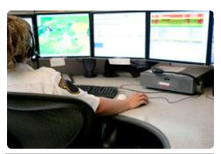
Preparedness
National health security the state in which the Nation and its people are prepared for, protected from, and resilient in the face of incidents with health consequences.
Preparedness stakeholders include:
  Individuals and families
  Communities
  Emergency management workforce
  Public health workforce
  Health care workforce
Stakeholders are supported by:
  Scientific and academic community
  Community-based organizations
  Non-profit sector
  Private sector
  Federal, state, local, tribal, and territorial governments

Slide 9



National Health Security Strategy
In Progress
Strong
Leadership
Regional Disaster Health Response System
Public Health Security Capacity
Medical Countermeasures Enterprise
Source: https://www.phe.gov/Preparedness/planning/authority/nhss/Pages/strategy.aspx

Slide 10


Charles Rothwell, MBA, MS
Director, National Center for Health Statistics
Centers for Disease Control and Prevention

Slide 11
Presentation Overview
Tracking the Nation’s Progress
Public Health Infrastructure (PHI)
Preparedness (PREP)

Slide 12
Tracking the Nation’s Progress
54 Measurable HP2020 Public Health Infrastructure Objectives:
  31 Target met
  12 Improving
  3 Little or no detectable change
  2 Getting worse
  4 Informational
  2 Baseline data only
22 Measurable HP2020 Preparedness Objectives:
  3 Target met
  6 Improving
  4 Little or no detectable change
  1 Getting worse
  1 Informational
  7 Baseline data only
NOTES: Measurable objectives are defined as having at least one data point currently available. Informational objectives are also measurable objectives, however, they do not have a target associated with their data. Developmental objectives do not have a national baseline value, as of this progress review. The PHI topic area has 6 developmental objectives and the PREP topic area has 10 developmental objectives. For a complete description of each progress status, please see National Center for Health Statistics. Chapter III: Overview of Midcourse Progress and Health Disparities. Healthy People 2020 Midcourse Review. Hyattsville, MD. 2016 https://www.cdc.gov/nchs/data/hpdata2020/HP2020MCR-B03-Overview.pdf.

Slide 13
Presentation Overview
Tracking the Nation’s Progress
Public Health Infrastructure (PHI)
  Public health workforce
    Continuing education for public health professionals
  Data and information systems
    Use of the latest vital statistics forms
  Public health organizations
    State and local health departments with health improvement plans
    State and local health departments with quality improvement plans
    Accreditation of state and local health departments
Preparedness (PREP)

Slide 14
Public Health Workforce:
Core Competencies for Public Health Professionals in Continuing Education
HP2020 Target: 57%
HP2020 Target: 18%
State public health agencies Local public health agencies
NOTES: = 95% confidence intervals. Data are for state public health agencies (including the District of Columbia) and local public health agencies that use Core Competencies for Public Health Professionals developed by the Council on Linkages in developing staff training plans.
I
SOURCES: ASTHO Profile of State Public Health, Association of State and Territorial Health Officials (ASTHO); NACCHO National Profile of Local Health Departments, National Association of County and City Health Officials (NACCHO).
Obj. PHI-2.2 and 2.3
Increase desired

Slide 15
Data and Information Systems:
Use of the Latest
U.S. Standard Birth and Death Certificates
Number of
reporting areas
HP2020 Target: 52
Birth Certificate
Increase desired
Death Certificate
NOTES: Data are for reporting areas (including the 50 states, the District of Columbia, and New York City) that used the 2003 U.S. Standard Birth and Death Certificates.
SOURCES: National Vital Statistics System-Natality (NVSS-N), CDC/NCHS; National Vital Statistics System-Mortality (NVSS-M), CDC/NCHS.
Obj. PHI-10.1 and 10.2

Slide 16
Public Health Organizations:
Development of a health improvement plan
HP2020 Target: 54%
HP2020 Target: 61%
State public health agencies Local public health agencies
NOTES: = 95% confidence intervals. Data are for state public health agencies (including the District of Columbia) and local public health agencies that have developed a health improvement plan within the last five years. Health improvement plans are long-term systematic efforts to address issues identified through a collaborative community health assessment.
I
SOURCES: ASTHO Profile of State Public Health, Association of State and Territorial Health Officials (ASTHO); NACCHO National Profile of Local Health Departments, National Association of County and City Health Officials (NACCHO).
Obj. PHI-15.2 and 15.3
Increase desired

Slide 17
Public Health Organizations:
Agencies with a Quality Improvement Process
HP2020 Target: 30%
HP2020 Target: 25%
State public health agencies Local public health agencies
NOTES: = 95% confidence intervals. Data are for state public health agencies (including the District of Columbia) and local public health agencies that have implemented a formal, agency-wide quality improvement process.
I
SOURCES: ASTHO Profile of State Public Health, Association of State and Territorial Health Officials (ASTHO); NACCHO National Profile of Local Health Departments, National Association of County and City Health Officials (NACCHO).
Obj. PHI-16.2 and 16.3
Increase desired

Slide 18
Public Health Organizations:
Accredited State Public Health Agencies
Percent
2017
WA
MT
ND
ME
OR
ID
MN
VT
NH
Increase desired
SD
WI
NY
MA
WY
MI
CT
RI
NE
IA
PA
NJ
NV
UT
IL
IN
OH
MD
DE
CA
CO
WV
DC
KS
MO
KY
VA
OK
TN
NC
AZ
NM
AR
SC
MS
AL
GA
TX
LA
AK
FL
HI
HP2020 Target: 15.8%
State public health agencies that were accredited
State public health agencies that were not accredited
NOTES: 2014* = HP2020 baseline. The line chart shows the percentage of state public health agencies (including the District of Columbia) that have been accredited by the Public Health Accreditation Board. The map shows related objective data: state public health agencies (including the District of Columbia) that were nationally accredited as of December 2017.
Obj. PHI-17.2
SOURCE: Accredited Health Department List, Public Health Accreditation Board (PHAB).

Slide 19
Public Health Organizations:
Accredited Local Public Health Agencies
Percent
2017
WA
MT
ND
ME
OR
ID
MN
VT
NH
SD
WI
NY
CT
MA
Increase desired
WY
MI
NJ
RI
NV
NE
IA
PA
UT
IL
IN
OH
MD
DE
CA
CO
WV
VA
KS
MO
KY
TN
NC
AZ
NM
OK
AR
SC
MS
AL
GA
TX
LA
AK
FL
HI
Number of accredited local
public health agencies, by state
HP2020 Target: 3.7%
0
1 - 5
6 - 8
9 - 24
25 or more
NOTES: 2014* = HP2020 baseline. The line chart shows the percentage of local public health agencies that have been accredited by the Public Health Accreditation Board. The map shows related objective data: local public health agencies, by state, that were nationally accredited as of December 2017.
Obj. PHI-17.3
SOURCE: Accredited Health Department List, Public Health Accreditation Board (PHAB).

Slide 20
Presentation Overview
Tracking the Nation’s Progress
Public Health Infrastructure
Preparedness
  Medical Reserve Corps (MRC) and preparedness training
  Hospital Preparedness Program (HPP) funded Healthcare Coalitions
  Household emergency plans
  School districts with preparedness plans
  State requirements for regulated child care providers to protect children during disasters

Slide 21
Medical Reserve Corps (MRC) Units Participating in Preparedness and Training Activities
NOTES: Data are for Medical Reserve Corps units participating in preparedness training and exercise activities in the last year.
SOURCE: National Association of County and City Health Officials MRC Network Profile (NACCHO MRC Network Profile), National Association of County and City Health Officials (NACCHO).
Obj. PREP-16.1
Increase desired

Slide 22
Healthcare Facilities that are Members of a Hospital Preparedness Program-funded Healthcare Coalition
2015 2016 2017
NOTES: Data are for healthcare facilities that are members of a Hospital Preparedness Program (HPP) funded Healthcare Coalitions.
This objective is informational and does not have a target.
Obj. PREP-18.1
Increase desired
SOURCE: The Hospital Preparedness Program (HPP), HHS Office of the Assistant Secretary for Preparedness and Response.

Slide 23
Household Emergency Plan with Specific Instructions, 2012
HP2020 Target: 51.2%
Increase desired
Education
NOTES: = 95% confidence interval. *2011 Total = HP2020 baseline. Data are for adults aged 18 years and older whose household has an emergency plan that includes instructions for household members about where to go and what to do in the event of a disaster. Black and white exclude persons of Hispanic origin. Persons of Hispanic origin may be of any race. Respondents were asked to select one or more races. Data for the single race categories are for persons who reported only one racial group.
SOURCE: Personal Preparedness in America Survey, Federal Emergency Management Agency (FEMA).
I
Obj. PREP-13

Slide 24
School Preparedness Plan:
Family Reunification Procedures
2012 2016
NOTES: I = 95% confidence interval. Data are for school districts that require schools to include family reunification procedures in their crisis preparedness, response, and recovery plans.
Obj. PREP-5.1
Increase desired
SOURCE: School Health Policies and Practices Study (SHPPS), CDC/NCHHSTP.

Slide 25
School Preparedness Plan:
Procedures for Responding to Pandemic Flu or Infectious Disease Outbreaks
2012 2016
NOTES: I = 95% confidence interval. Data are for school districts that require schools to include procedures for responding to pandemic influenza (flu) or other infectious disease outbreaks in their crisis preparedness, response,
and recovery plans.
Obj. PREP-5.2
Increase desired
SOURCE: School Health Policies and Practices Study (SHPPS), CDC/NCHHSTP.

Slide 26
School Preparedness Plan:
Provisions for Students and Staff with
Special Needs
2012 2016
NOTES: I = 95% confidence interval. Data are for school districts that require schools to include provisions for students and staff with special needs in their crisis preparedness, response, and recovery plans.
Obj. PREP-5.3
Increase desired
SOURCE: School Health Policies and Practices Study (SHPPS), CDC/NCHHSTP.

Slide 27
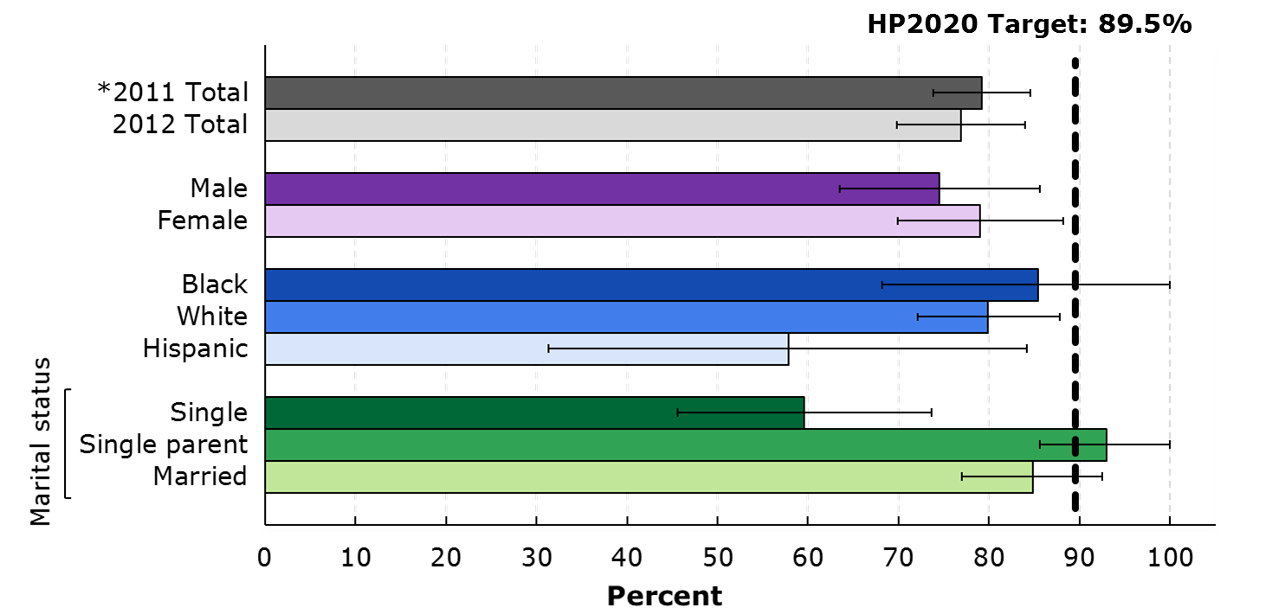
Adults with Children Who Discussed
Household Emergency Plan, 2012
Increase desired
NOTES: = 95% confidence interval. *2011 Total = HP2020 baseline. Data are for adults aged 18 years and older who reside with children attending school, day care, or part-time kindergarten, have a household emergency plan, and have had household discussions about the emergency plan. Black and white exclude persons of Hispanic origin. Persons of Hispanic origin may be of any race. Respondents were asked to select one or more races. Data for the single race categories are for persons who reported only one racial group.
SOURCE: Personal Preparedness in America Survey, Federal Emergency Management Agency (FEMA).
I
Obj. PREP-7

Slide 28
State Requirement for Regulated Child Care Providers to have Preparedness Plans
Number
HP2020 Target: 51
Increase desired
Family reunification plan
Evacuation plan
Emergency plan for children with disabilities
  NOTES: Data are for states (50 States and the District of Columbia) that require regulated child care providers to have an evacuation plan with a relocation site, plan to reunite families after a disaster, and a emergency plan for children with access and functional needs including disabilities.
SOURCE: National Report Cards on Protecting Children in Disasters, Save the Children.
Objs. PREP-20.1 through 20.3

Slide 29
Key Takeaways –
Public Health Infrastructure
The Public Health Infrastructure topic area includes objectives on the public health workforce, data and information systems, and public health organizations.
Targets have been met or exceeded for the following objectives tracking state and local public health agencies:
  Use of Core Competencies in continuing education for personnel
  Development of a health improvement plan
  Implementation of an agency-wide quality improvement process
  National accreditation
In 2017, all 52 reporting areas used the latest revision of the U.S. Standard Birth Certificate, meeting the HP2020 target.
In 2017, 51 out of 52 reporting areas used the latest revision of the U.S. Standard Death Certificate, moving toward the HP2020 target.

Slide 30
Key Takeaways – Preparedness
Medical Reserve Corps (MRC) units that participate in preparedness and training activities in the past year is getting worse, moving away from its target.
The percentage of school districts that require schools to include family reunification plans in their preparedness plans is improving.
There was little or no detectable change in the percentage of school districts that required schools to include procedures for responding to pandemic or infectious disease outbreaks and provisions for staff and students with special needs.
States that require child care providers to have an evacuation plan that include a relocation site, a family reunification plan, and an emergency plan for children with access and functional needs are all improving, moving towards their targets.
Overall, disaster preparedness and response capabilities have improved, but gaps still remain.

Slide 31

Centers for Disease Control and Prevention (CDC)
Activities Supporting Healthy People 2020 Public Health Infrastructure Objectives
Craig Thomas, PhD
Associate Director for Strategy
Center for State, Tribal, Local, and Territorial Support (proposed)

Slide 32
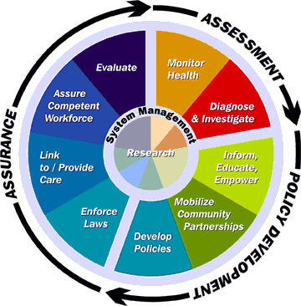

Public Health Infrastructure
Components of public health infrastructure
  Workforce
  Data and information systems
  Organizations
Essential public health services
Delivered through state, tribal, local and territorial health departments

Slide 33
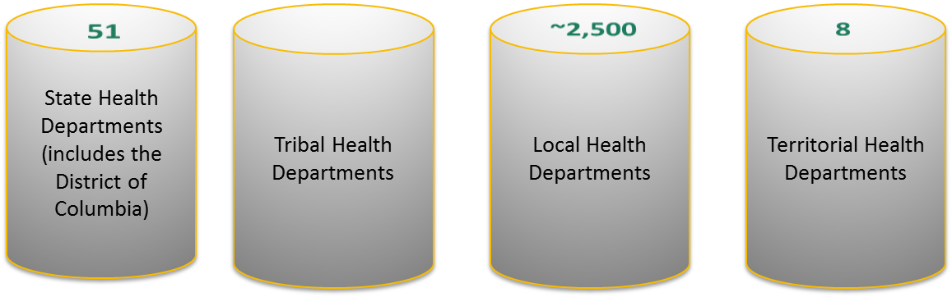
Governmental Public Health
State and Local Health Departments
Retain the primary responsibility for health under the US Constitution

Slide 34
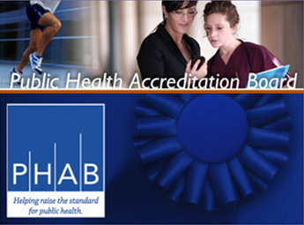
National Voluntary Accreditation for
Public Health Departments
Public Health Accreditation Board (PHAB)
    Co-funded by CDC and Robert Wood Johnson Foundation
    Considerable practitioner input through committees and testing
    Program launched in September 2011 www.phaboard.org
Key elements of PHAB Accreditation
    To advance the quality and performance of state, tribal, local and territorial health departments
    Standards and measures across 12 domains
    Accreditation assessment process with peer site visitors
CDC advances and supports accreditation readiness
PHI-16, PHI-17

Slide 35
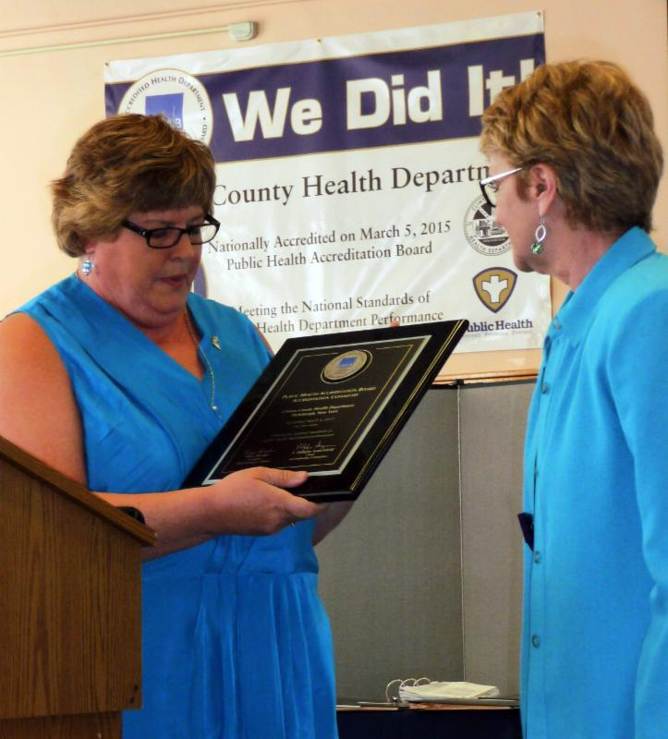
Supporting Accreditation and Quality Improvement
Supporting the national program through PHAB
Supporting accreditation readiness and quality improvement in the field
  National initiatives
  Tools, trainings, and technical assistance
  Peer learning communities
Establishing incentives – for preparing and for accreditation status
Building connections to program areas and funding streams
https://www.cdc.gov/stltpublichealth/accreditation/cdc_role.html
PHI-16, PHI-17

Slide 36
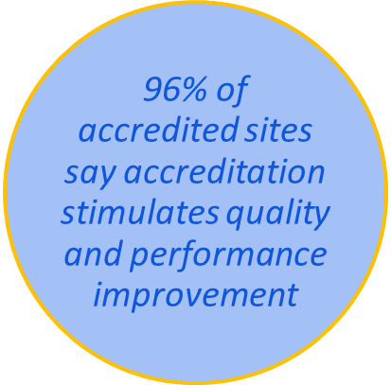
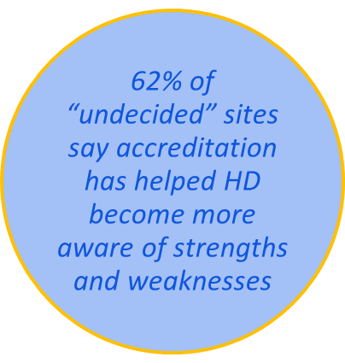
Evaluating and Continuously Improving Accreditation
Evaluation and benefits of accreditation
National standards – defining, reinforcing, and advancing practice
  Span many topics: community health improvement planning, quality improvement, workforce development, use of data, preparedness
Current and new activities
  Reaccreditation process and requirements
  Version 2.0 of PHAB standards
  Accreditation for Vital Records/Health Statistics programs
Accreditation is ‘one of the best leverage points’ to improve the public health system and success on objective health measures.
—Statement from a focus group participant in NORC evaluation conducted about PHAB, 2016
PHI-16, PHI-17
PHI-1, PHI-2, PHI-10, PHI-11, PHI-12, PHI-13, PHI-14, PHI-15, PREP-1, 2, 4

Slide 37
State/Community Health Improvement Planning
Concept and definitions
Opportunities for collaboration and leveraging
  Complementary and consistent processes expected of health departments, hospitals, and federally qualified health centers
Reinforce use of HP2020
  Accreditation standards about community health assessment mentions HP2020 as benchmarks to use in state/community plans
  Significant use of HP2020 objectives in state or community plans
Community health improvement plan - a long-term, systematic effort to address public health problems on the basis of the results of community health assessment activities and the community health improvement process. (The plan is…) used by health and other… agencies, in collaboration with community partners, to set priorities and coordinate and target resources.
PHI-15

Slide 38
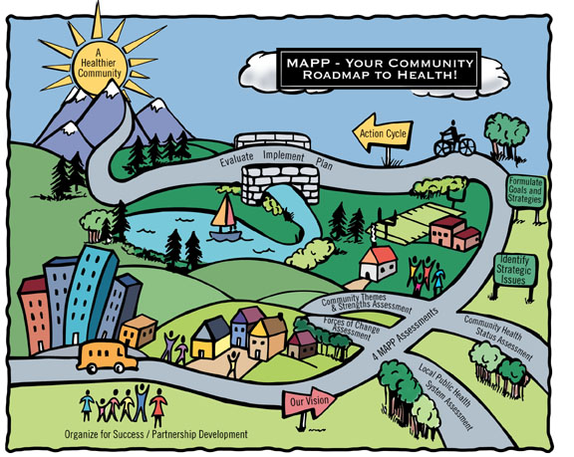

Planning Tools and Activity in the Field
CDC activities
  Support of national tools and technical assistance
  Requirements or support for CHA/CHIP through grants and cooperative agreements
Activity and trends in the field
PHI-15

Slide 39
Workforce Development
Using Competencies to define expectations in job performance or training
  Core Competencies for Public Health Professionals
  Discipline specific competencies and training
Advancing continuing education in practice settings
  Requirements in national accreditation standards
  TRAIN Learning Management System
  Leadership institutes
  Linkages between health departments and academia
Supporting fellowship and training programs for new professionals
  Examples include: Public Health Associate Program (PHAP), Public Health Informatics Fellowship, Prevention Effectiveness Fellowship (economists), Epidemic Intelligence Service (EIS)
PHI-1, PHI-2

Slide 40

Preventive Health and Health Services Block Grant
Established in 1981
  61 Grantees: 50 US States, District of Columbia, 8 Territories, and 2 American Indian Tribes
Annual Allocation
  Base awards (formula-based)
  Sex Offense Set Aside (population-based)
  Two years to expend awarded funds
Flexible funds to support state and community needs
Grantees base work plans on Healthy People objectives
  Grantees allocated approximately $38 million (29%) of $130 million in discretionary funding to Public Health Infrastructure objectives - a higher proportion than for any other topic area

Slide 41
Resources
Information and resources about the U.S. public health system and health departments https://www.cdc.gov/stltpublichealth/about/index.html
National voluntary accreditation program for health departments www.cdc.gov/stltpublichealth/accreditation
Quality improvement www.cdc.gov/stltpublichealth/pmqi
Community health assessment and health improvement planning
  www.cdc.gov/stltpublichealth/cha
  www.cdc.gov/chinav
Workforce development www.cdc.gov/fellowships/ and www.cdc.phap
Preventive Health and Health Services Block Grant www.cdc.gov/phhsblockgrant/
For more information on this presentation please contact:
  Liza Corso, MPA
  Public Health Infrastructure topic area co-lead
  Center for State, Tribal, Local, and Territorial Support (proposed)
  Centers for Disease Control and Prevention
  Lcorso@cdc.gov

Slide 42

Health Resources and Services Administration
Activities Supporting Healthy People 2020
Public Health Infrastructure Objectives
Luis Padilla, MD
Associate Administrator, Bureau of Health Workforce (BHW)
Health Resources and Services Administration (HRSA)

Slide 43

HRSA’s Vision and Mission
Vision statement:
Healthy Communities, Healthy People
Mission statement:
Improve health and achieve health equity through access to quality services, a skilled health workforce and innovative programs

Slide 44
Health Resources and Services Administration (HRSA) Overview
Supports more than 90 programs that provide health care to people who are geographically isolated, economically or medically challenged
HRSA does this through grants and cooperative agreements to more than 3,000 awardees, including community and faith-based organizations, colleges and universities, hospitals, state, local, and tribal governments, and private entities
Every year, HRSA programs serve tens of millions of people, including people living with HIV/AIDS, pregnant women, mothers and their families, and those otherwise unable to access quality health care

Slide 45
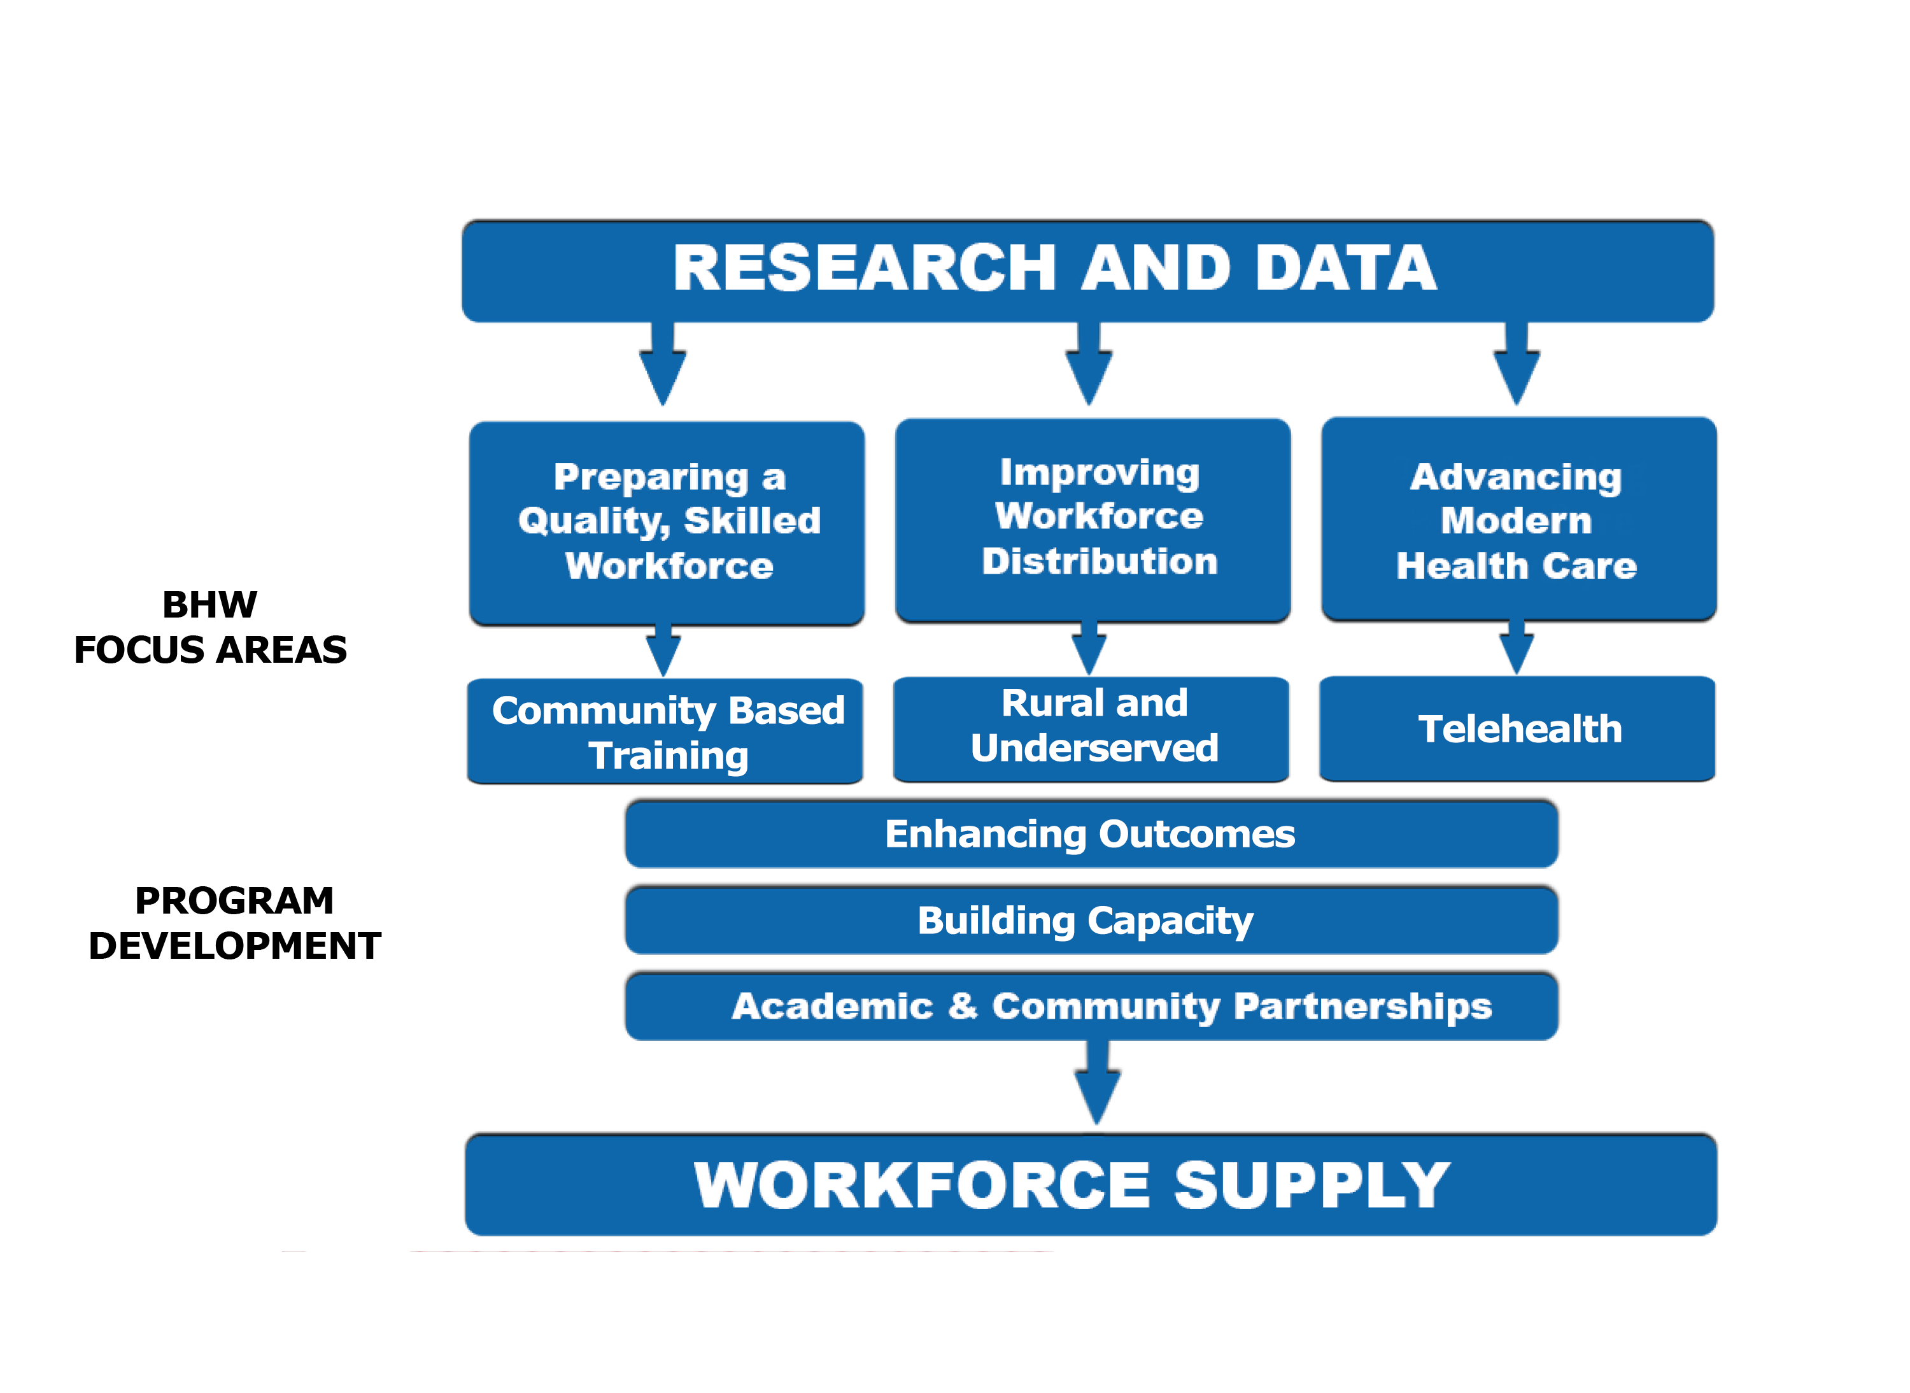
Bureau of Health Workforce Approach

Slide 46

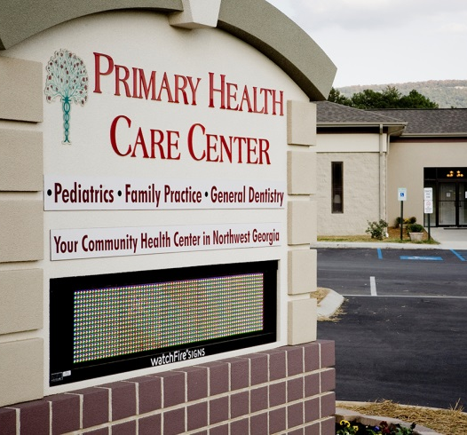
BHW Programs Snapshot
In FY 2017, we awarded over $1 billion to more than 8,000 organizations and individuals through more than 40 workforce programs.
Our programs increase the nation’s access to quality health care by developing, distributing, and retaining a competent health workforce.
PHI-2, PHI-17

Slide 47
Community-Based Training
Health Professional Training Grant Programs
Support enhanced primary care training in transformed healthcare delivery, with a focus on rural and underserved communities
Teaching Health Centers GME
  Supports primary care residency programs in community-based settings
  In AY 2017-2018, supporting over 732 residents in 57 THCs
AHS-4

Slide 48

National Health Service Corps (NHSC)
Provides scholarships and loan repayment to primary care clinicians and students in exchange for service in underserved communities.
Approximately 10,200 NHSC primary care medical, dental, nursing, and behavioral health practitioners are currently serving at sites across the nation
About 3 of every 5 NHSC members is fulfilling their service obligations at a federally qualified health center (FQHC) located in a rural, tribal or urban, high-need community
AHS-4

Slide 49

NURSE Corps
Offers scholarships and loan repayment to nurses working in health centers, rural health clinics, hospitals, and other facilities experiencing a critical shortage of nurses.
More than 1,900 nurses make up the NURSE Corps’ current field strength
About 1 in 5 NURSE Corps members is working at a rural federally qualified health center (FQHC) or health center look-alike throughout the U.S.
AHS-4

Slide 50

Public Health Workforce Programs
BHW is working to improve the health of communities by making important investments in public health students.
Public Health Training Center (PHTC) Program
  Improves the nation’s public health system by facilitating continuing education courses and supporting practice through our Public Health Learning Network (1 National Coordinating Center and 10 Regional Public Health Training Centers, and 40 Local Performance Sites) for current and future public health workforce professionals.
PHI-2, PHI-17

Slide 51
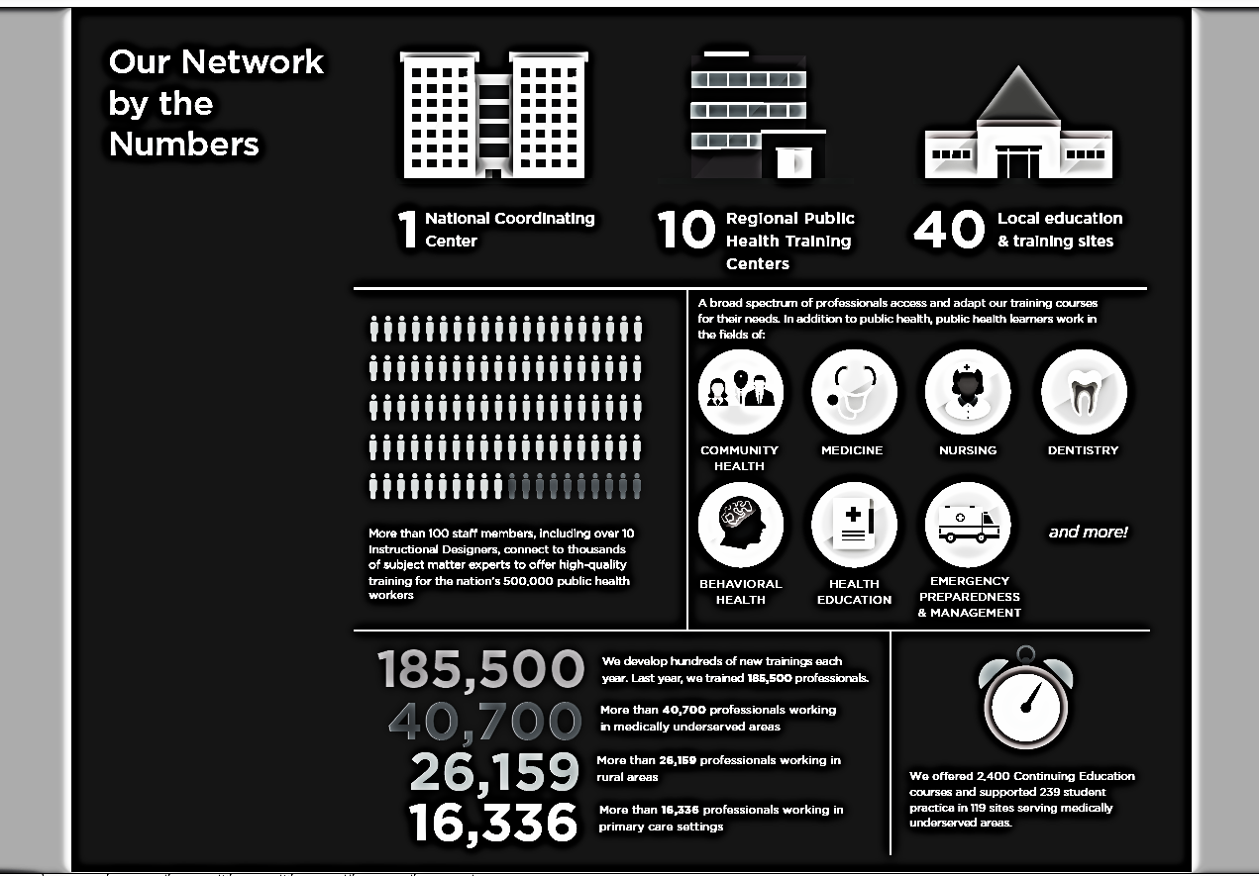
PHTC Accomplishments

Slide 52
HRSA’s Work to Combat Zika
Bureau of Primary Health Care (BPHC): Expanding primary care services through health centers in Puerto Rico, American Samoa, and the U.S. Virgin Islands, to aid in the detection and prevention of the Zika virus
Maternal and Child Health Bureau (MCHB): Strengthening support services and comprehensive health care for women, children, and families facing long-term health impacts from the Zika virus
Bureau of Health Workforce (BHW) and MCHB: Through workforce development programs, supporting a range of health professionals serving in communities most affected by Zika
PHI-2, MICH-31, AHS-4, AHS-6
52

Slide 53
Contact Us
Luis Padilla, MD
Associate Administrator, Bureau of Health Workforce (BHW)
Health Resources and Services Administration (HRSA)
Website: bhw.hrsa.gov
Phone: 1-800-221-9393

Slide 54






Connect with HRSA
To learn more about our agency, visit
www.HRSA.gov.
Sign up for the HRSA eNews
FOLLOW US:

Slide 55
CDC Office of Public Health Preparedness and Response
Activities Supporting Healthy People 2020 Preparedness Objectives
Rachel Avchen, MS, PHD
CAPT, United States Public Health Service
Branch Chief, Applied Science and Evaluation
Division of State and Local Readiness
Office of Public Health Preparedness and Response

Slide 56


Ready for Any Emergency
Preparedness requires planning
Everyone has a role in building community resilience
PREP-10, PREP- 11, PREP-12, PREP-13

Slide 57
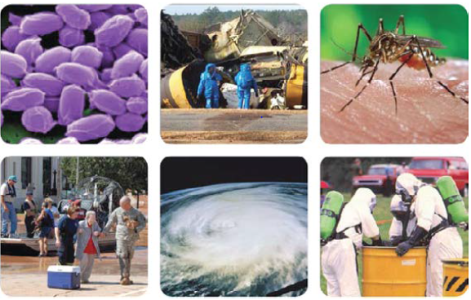
All Hazards Planning
Communities continually face unexpected emergencies
Natural disasters
Man-made threats
Biological and chemical threats
PHI-11, PHI-12, PHI-13, PHI-17
EH-3.2, EH-11, EH-16.8, EH-21, EH-22

Slide 58
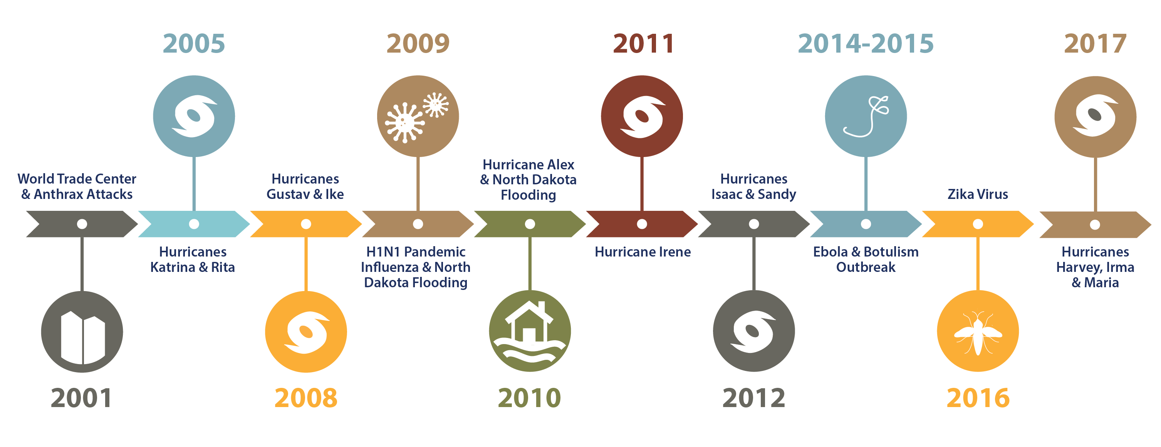
CDC Emergency Operations Center
Snapshot of CDC Public Health Responses
More than 16,000 CDC staff were deployed to help with the 2014 the Ebola outbreak.
*Does not include all responses

Slide 59
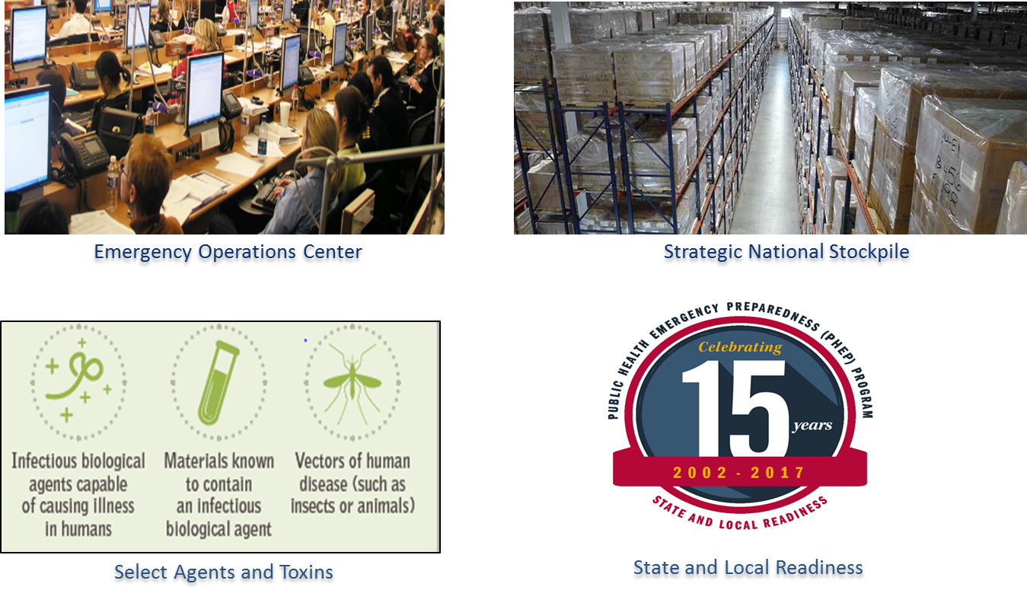
Office of Public Health Preparedness and Response

Slide 60
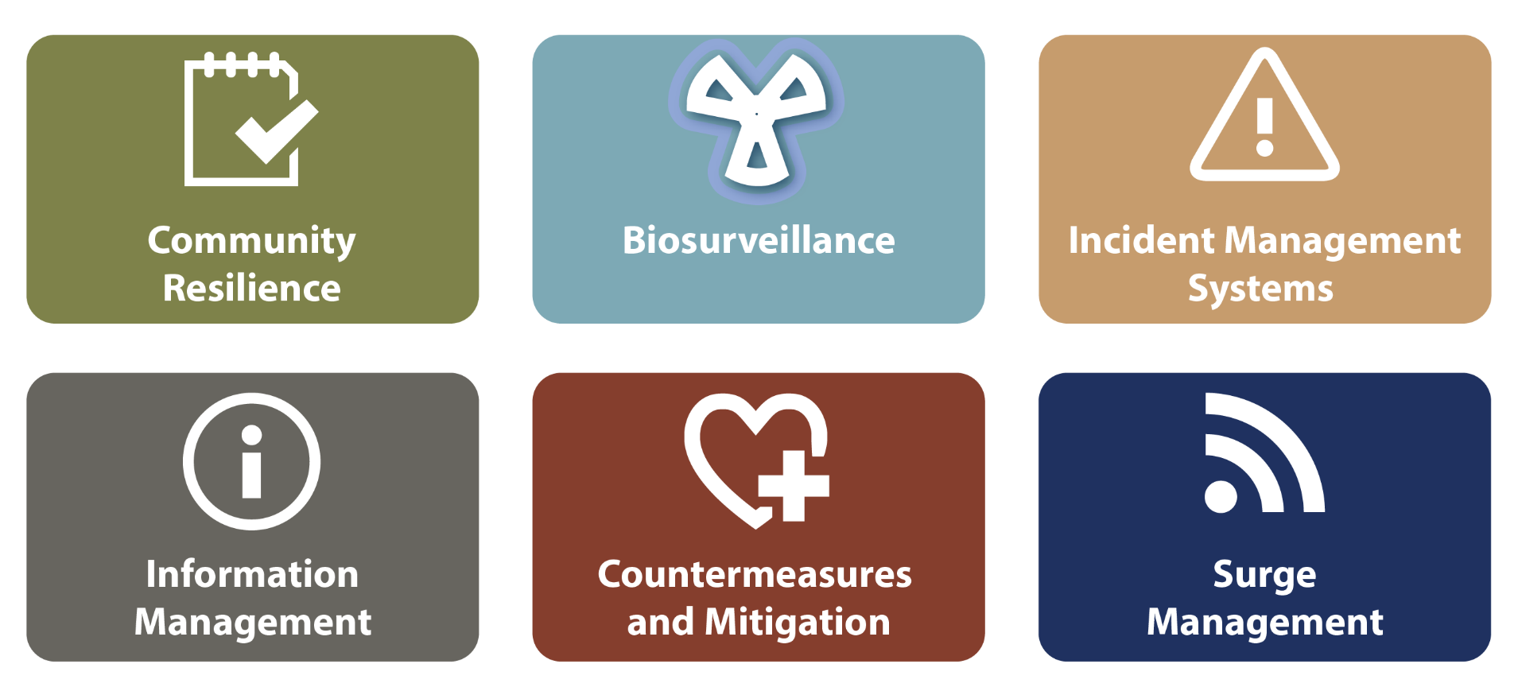
Resilient Communities are Ready to Respond
Six Public Health Preparedness Capability Domains

Slide 61
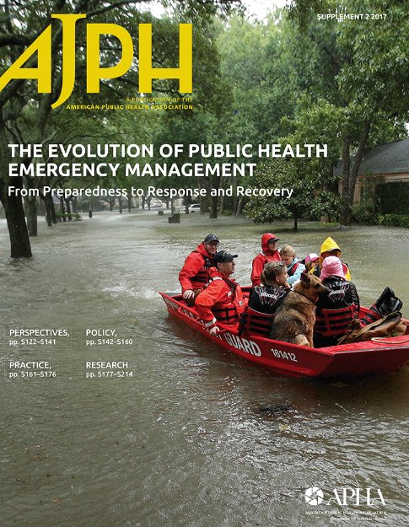


Building Public Health Preparedness
http://ajph.aphapublications.org/toc/ajph/107/S2

Slide 62

Children and Preparedness Actions
Following Hurricane Katrina,
President George W. Bush and Congress created the National Commission on Children and Disasters
https://archive.ahrq.gov/prep/nccdreport/

Slide 63
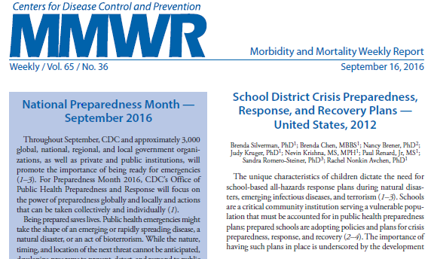
Promoting Action for School Preparedness Planning
PREP- 5: Increase the percentage of school districts that require schools to include specific topics in their crisis preparedness, response, and recovery plans.
PREP-5, 5.1, 5.2, 5.3, 5.4

Slide 64

Be Informed About What to Do
Ready Wrigley, preparedness superdog, helps young kids and families plan for disasters
Prepare ahead of an emergency
Inform children to know what to do in an emergency
PREP-13

Slide 65
Thank you
Thank you for joining this presentation. For more information on the preparedness program please visit these CDC Resources:
OPHPR Publications and Resources Website https://www.cdc.gov/phpr/reportingonreadiness.htm
Public Health Emergency Preparedness Program: Every Response is Local https://www.cdc.gov/phpr/whatwedo/phep.htm
School Health Policies and Practices Study (SHPPS) Results and Fact Sheets https://www.cdc.gov/healthyyouth/data/shpps/results.htm
State and Local Readiness Planning Resources https://www.cdc.gov/phpr/readiness/healthcare/responders.htm
For more information on this presentation please contact:
Brenda Silverman, Ph.D.
Preparedness topic co-lead
Applied Science and Evaluation Branch
Office of Public Health Preparedness and Response
bsilverman@cdc.gov

Slide 66

Office of the Assistant Secretary for Preparedness and Response (ASPR)
Activities Supporting Healthy People 2020
Preparedness Objectives
Daniel Dodgen, Ph.D.
Director, Division of Operational Policy and Strategic Planning
Office of Policy and Planning

Slide 67
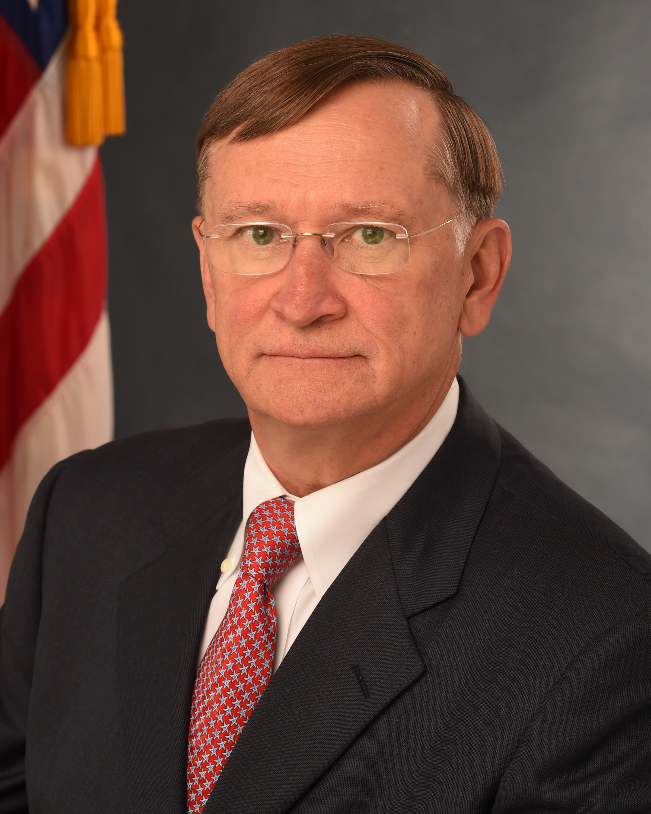
Office of the Assistant Secretary for Preparedness and Response
ASPR Saves Lives and Protects Americans from
21st Century Health Security Threats
HHS Staff Division
Created in the Pandemic and All Hazards Preparedness Act
Led by Assistant Secretary Robert Kadlec, M.D., M.S.

Slide 68
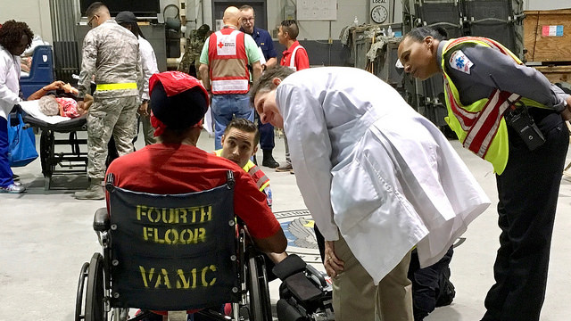
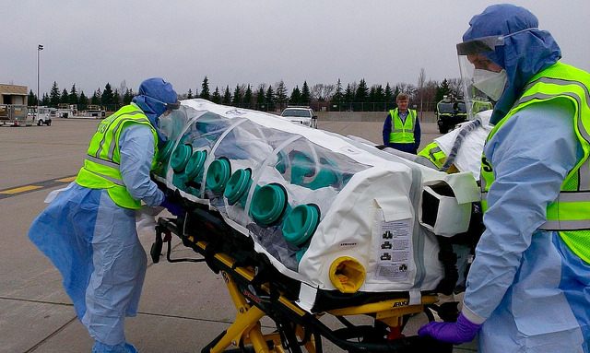
ASPR Priorities
Lead agency for Public Health and Medical Services Support Function (ESF-8)
ASPR Priorities
  Strong Leadership
  Regional Disaster Health Response System
  Public Health Security Capacity
  An Improved Medical Countermeasures Enterprise

Slide 69
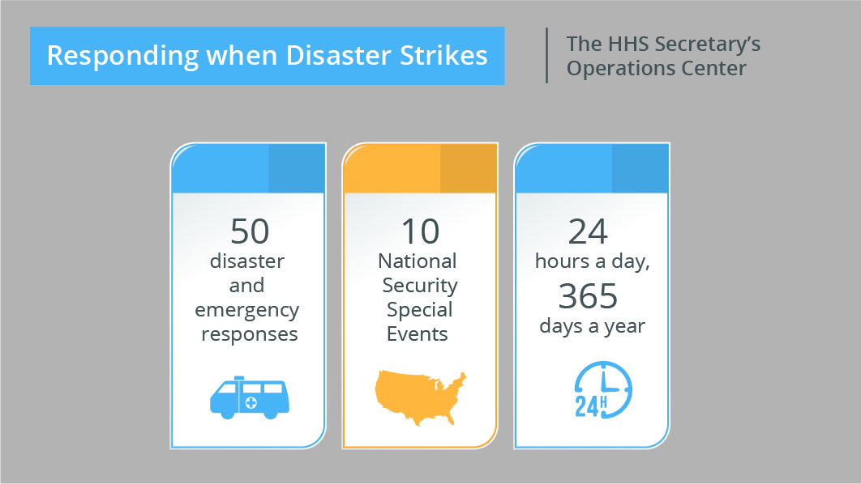
Secretary’s Operations Center

Slide 70
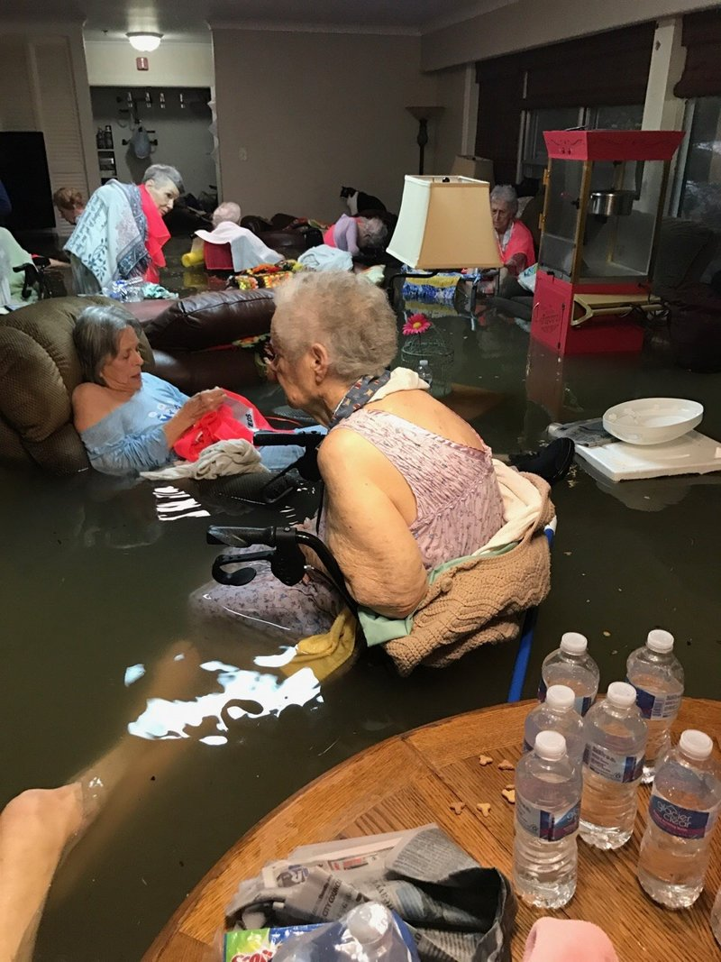
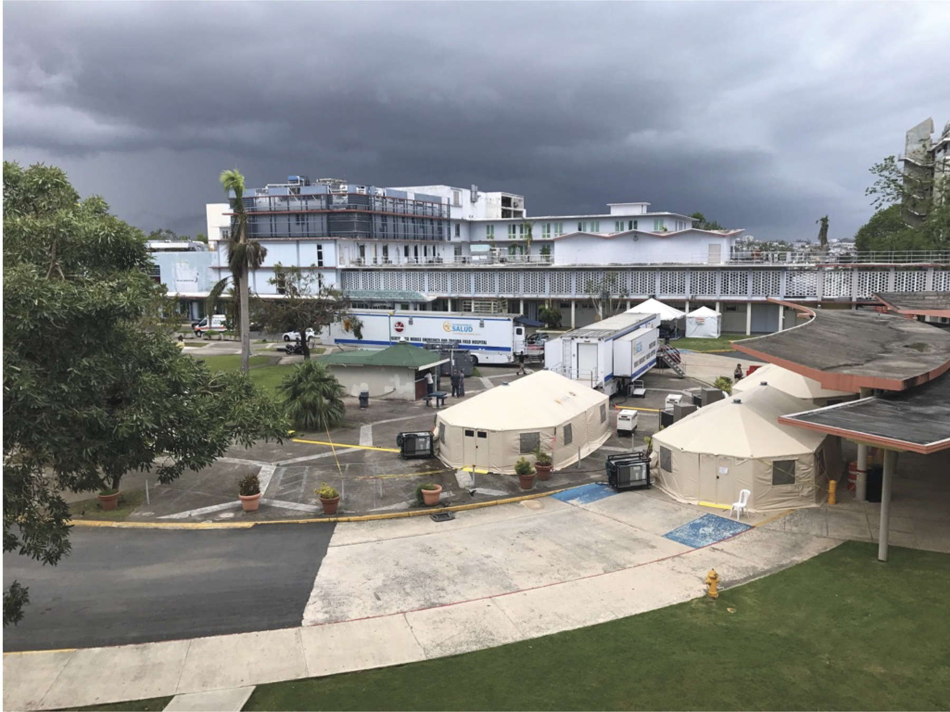
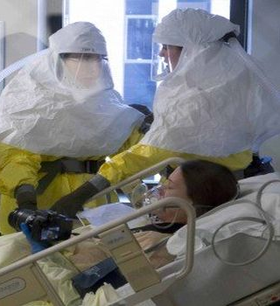
Regional Disaster Health Response System
Tiered, regional system built upon healthcare coalitions and trauma centers
Ensure robust capabilities to care for patients affected by catastrophic disaster

Slide 71
Healthcare System Preparedness:
Hospital Preparedness Program
Enables the healthcare system to save lives during emergencies
Develops and sustains regional healthcare coalitions (HCCs)
Works to advance healthcare capabilities such as:
  Hazard and risk identification
  Operational planning and response
  Information sharing
  Resource management
  Responder safety
  Healthcare evacuations and sheltering
  Medical surge
PREP-18

Slide 72
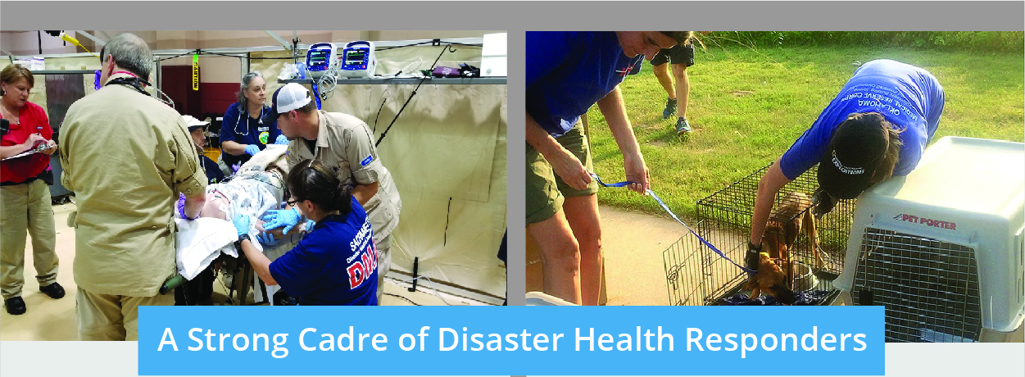
Response-Ready Personnel
Over 5,000 response personnel in the National Disaster Medical System
Approximately 190,000 Medical Reserve Corps volunteers across 900 local community MRC units
PREP-16 & PREP-17

Slide 73
ASPR Support for Healthy People
“As the last several years have shown, the threat environment is more complex than ever. We face infectious diseases with pandemic potential, severe weather events, and threats from state- and non-state actors. ASPR's number one priority is building national readiness and response capabilities for these threats. In doing so, we are in strong support of the Healthy People goal of ensuring that all people live long, healthy lives free of preventable disease, disability, injury, and premature death. We also recognize the value of strong underlying public health and medical infrastructure. As we look to HP2030, my hope is that advocates and experts across all of Healthy People will consider the unique opportunities to build resilience within your sector, and that we can work together to save lives and protect Americans from 21st century health security threats.”
Robert P. Kadlec, MD, MS
Assistant Secretary for Preparedness and Response
U.S. Department of Health & Human Services

Slide 74
Resources
HHS ASPR
  phe.gov
PAHPA
  govtrack.us/congress/bills/109/s3678
National Disaster Medical System
  phe.gov/Preparedness/responders/ndms/Pages/default.aspx
Medical Reserve Corps
  mrc.hhs.gov
Hospital Preparedness Program
  phe.gov/hpp
TRACIE
  asprtracie.hhs.gov/
For more information on this presentation please contact:
  Lauren Walsh, MPH DrPH(c)
  Preparedness topic area co-lead
  Division of Health System Policy
  Office of the Assistant Secretary for Preparedness and Response
  Lauren.walsh@hhs.gov

Slide 75
Los Angeles County
Department of Public Health
Performance Improvement and Preparedness Related Efforts
Jeffrey D. Gunzenhauser, MD, MPH
Interim Health Officer and Chief Medical Officer
April 10, 2018

Slide 76

Presentation Overview
Department of Public Health (DPH) infrastructure to support quality workforce development around preparedness
DPH preparedness activities to ensure rapid and effective response to emergencies
Two examples of DPH’s response to recent emergencies in Los Angeles County
  Aliso Canyon methane gas leak
  Hepatitis A outbreak
Overall summary
Resources

Slide 77

Los Angeles County
Los Angeles County Overview
Approximately 10 million residents
  27% of California’s population
  Largest population of any county in the nation
  3 local public health departments
4,000+ square miles (65% of area is unincorporated)
88 incorporated cities (90% of population lives in cities)
200+ languages spoken
Los Angeles County Department of Public Health
Mission: To protect health, prevent disease, and promote the health and well-being for all persons in Los Angeles County
Los Angeles County Health Agency – formed in 2015 to assure the integration of services provided by the Departments of Health Services, Mental Health, and Public Health

Slide 78
DPH Infrastructure: Overview
DPH Office of Organizational Development and Training
  Mission: to enhance public health workforce excellence through efficient and innovative educational trainings and organizational solutions
Suite of trainings that focus not only on public health-specific skills but also on building skills essential to leadership
All DPH workforce training courses are linked to public health core competencies
Department-wide mandatory training policy for workforce members
DPH University framework will provide a comprehensive workforce development platform

Slide 79
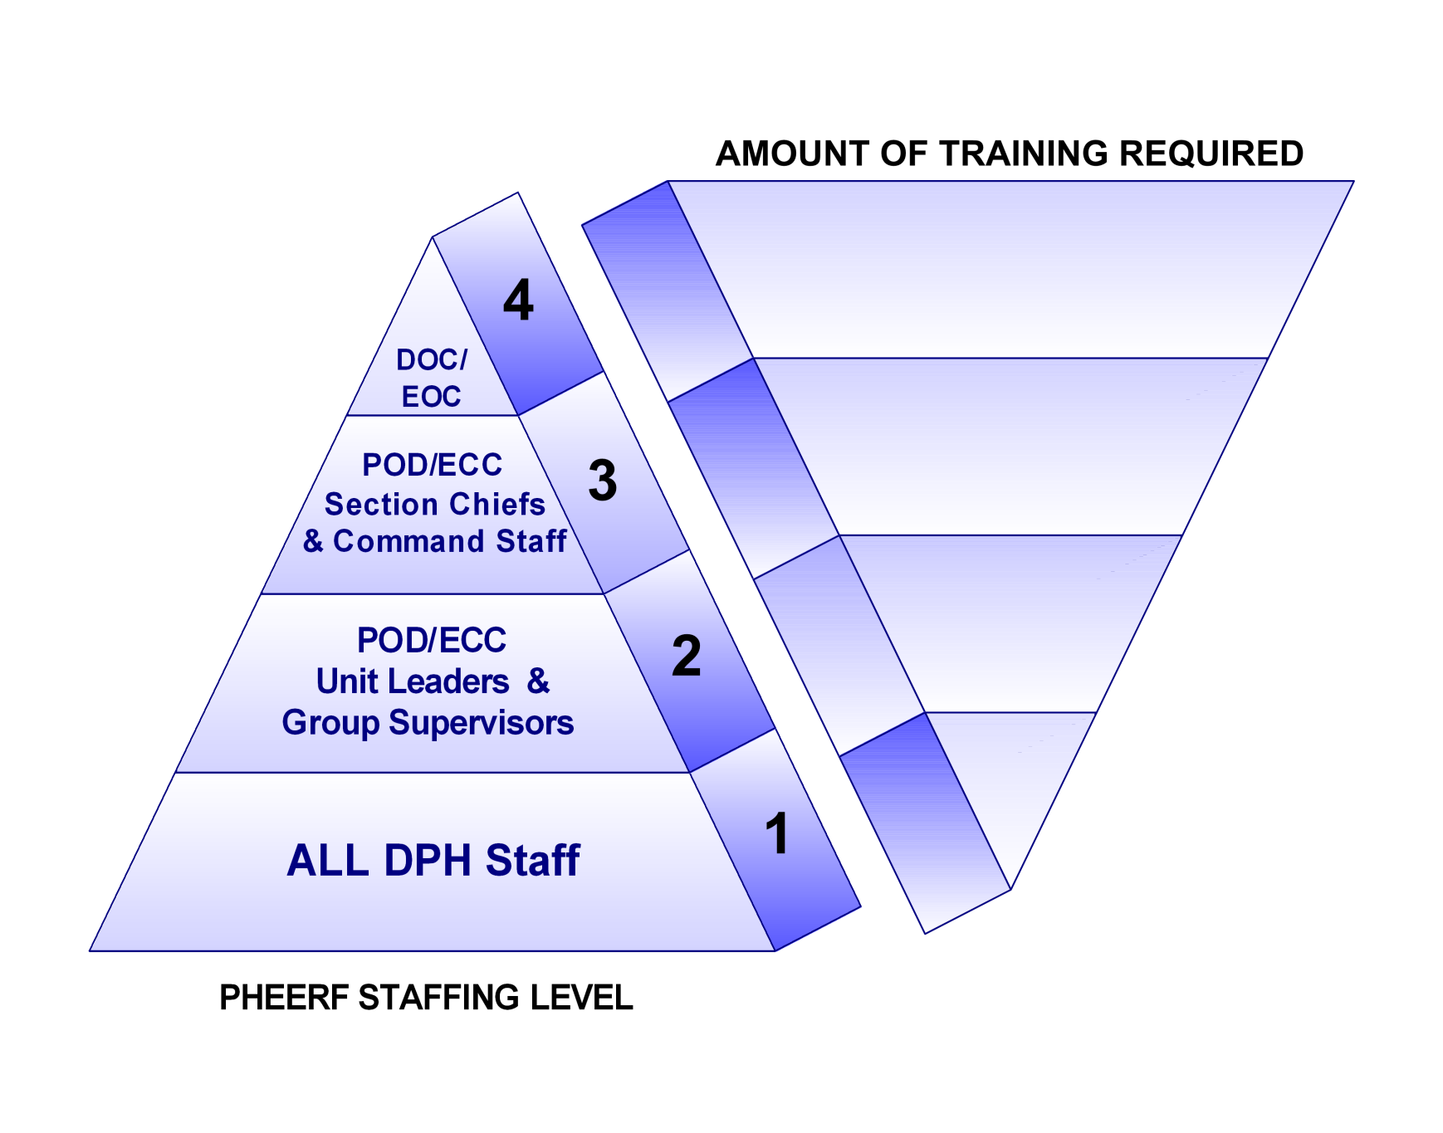
DPH Infrastructure
Public Health Employee Readiness Framework assures workforce competence around DPH ‘s operational readiness and timely response to public health emergencies.
Level 4: Department Operations Center
Level 3: M-POD Staff, Command Staff
Level 2: Specialized Teams
Level 1: ALL DPH Staff

Slide 80
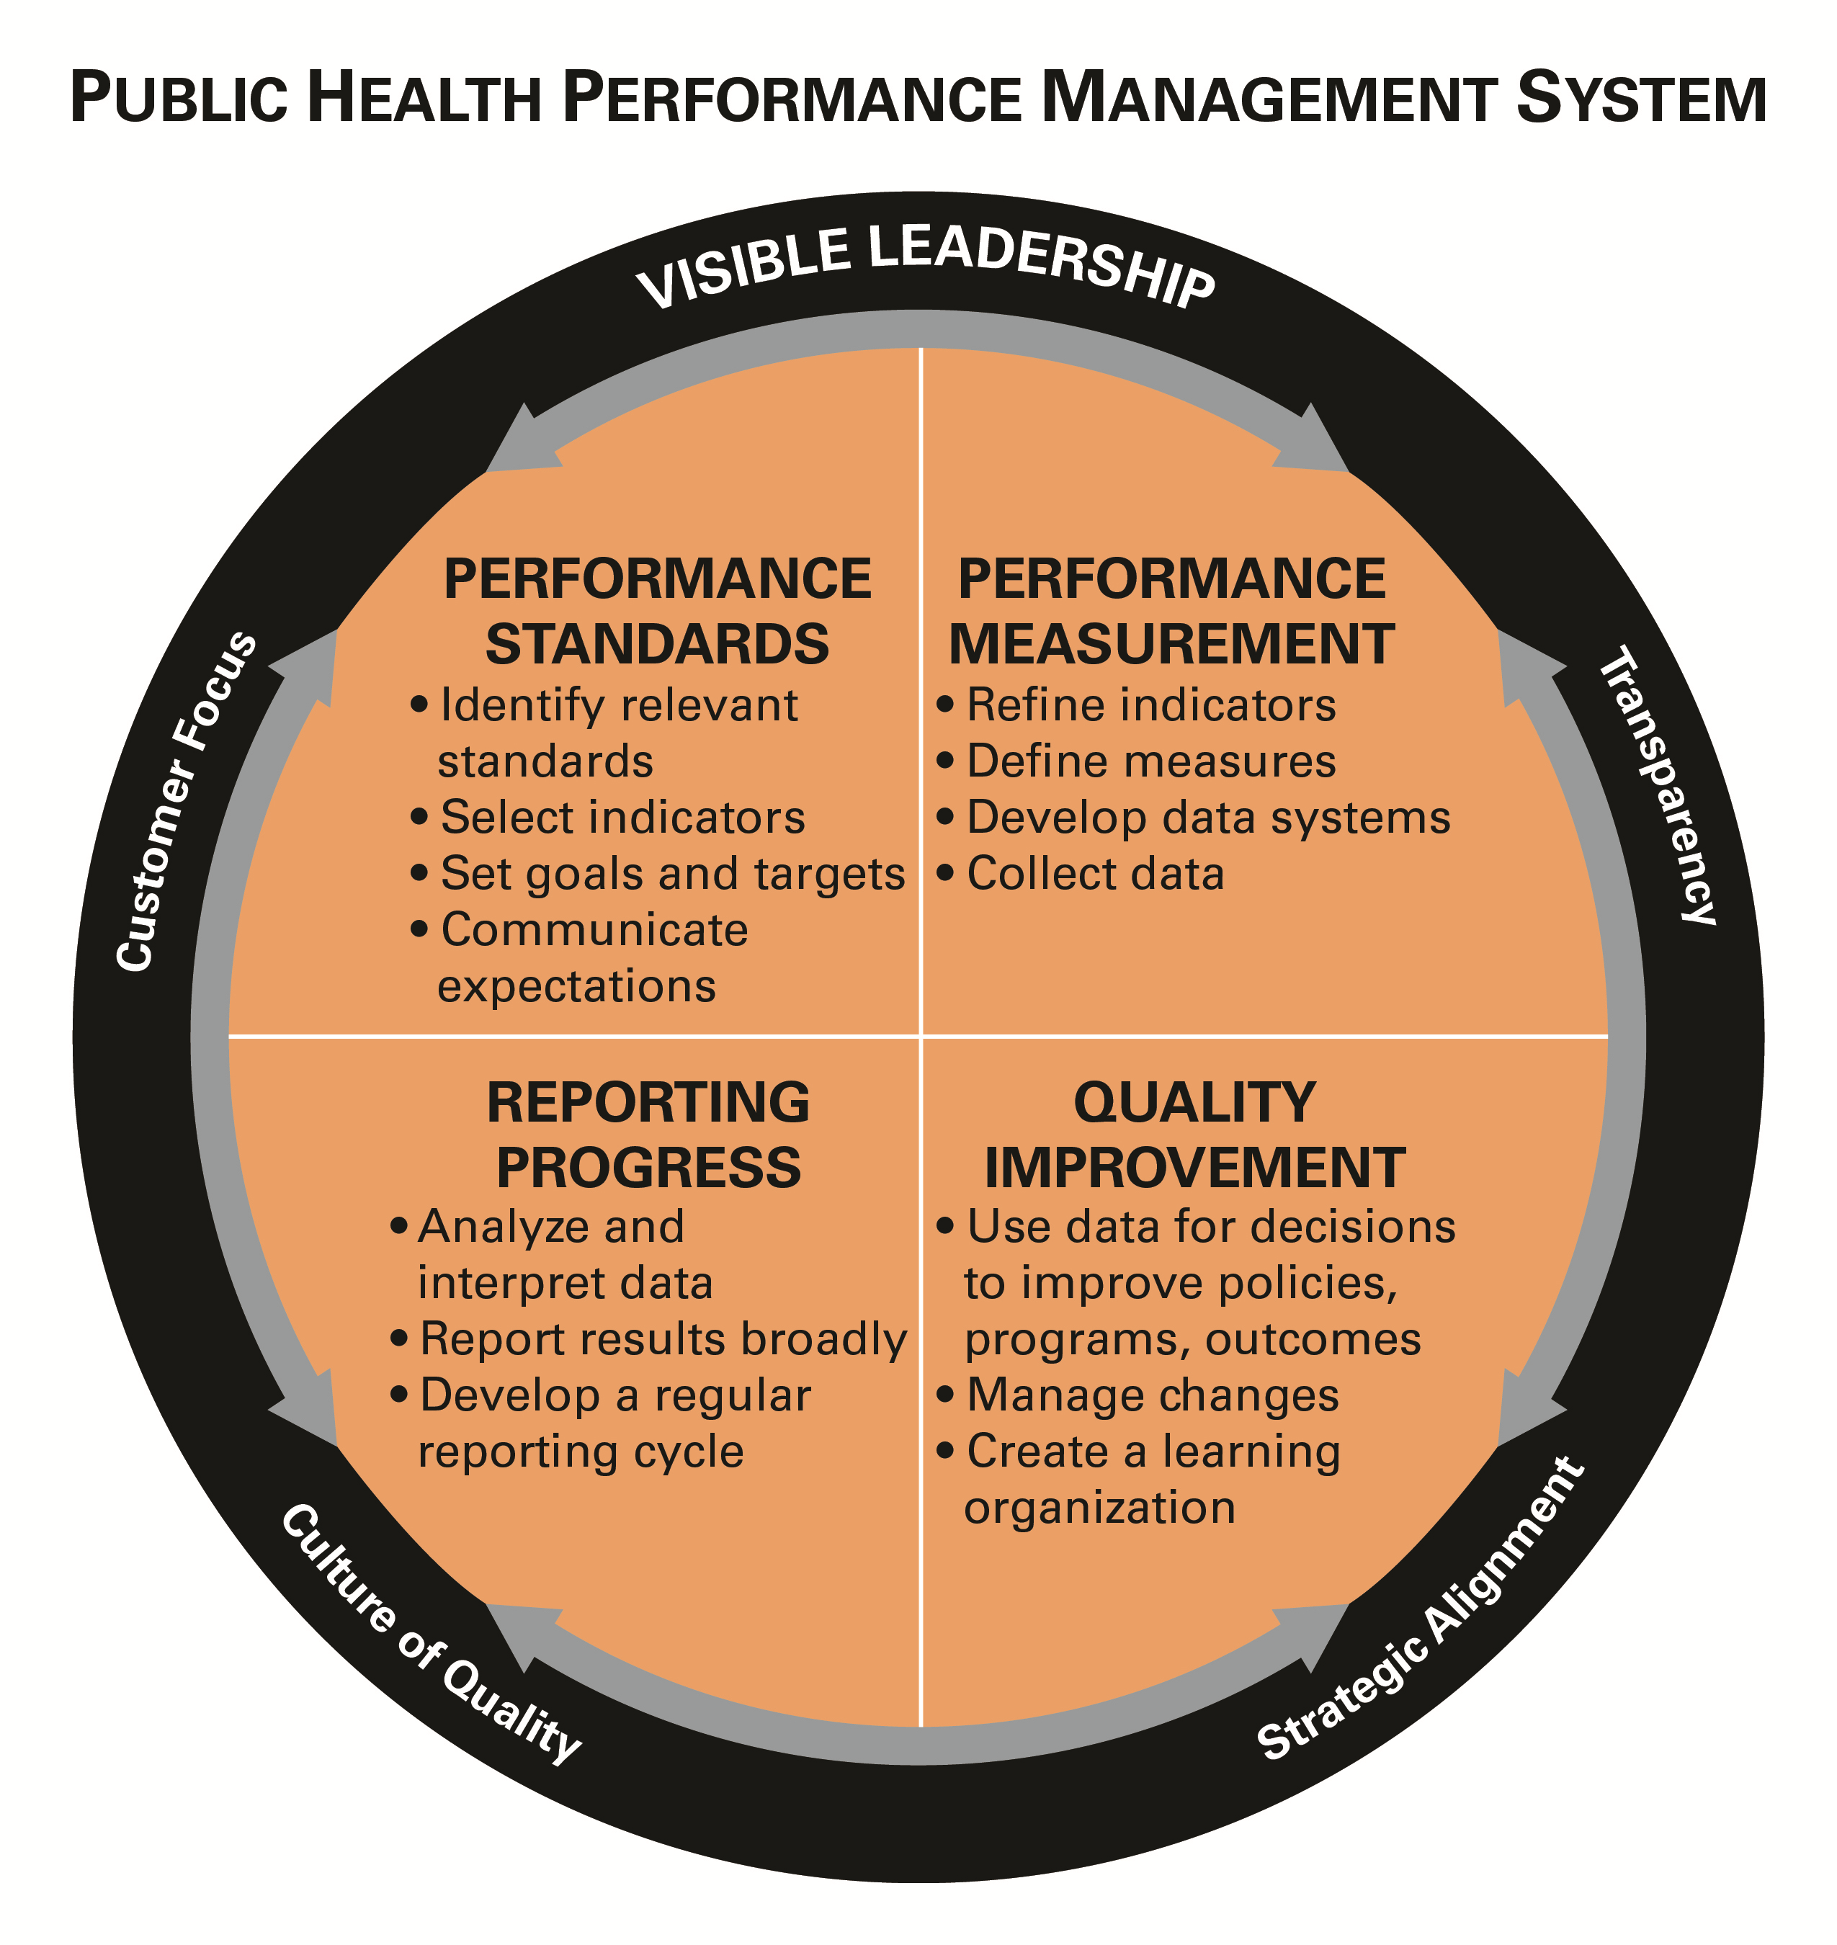
DPH Infrastructure
Leadership courses include emergency preparedness and response elements
  Communication skills enhance readiness and performance
  Training evaluations include questions on employee readiness
Well-established QI culture supports workforce development
  DPH accreditation from PHAB
  DPH Performance Management System tracks indicators and measures across the department, including ODT

Slide 81
DPH Preparedness: Readiness Activities
DPH Emergency Preparedness and Response Division (EPRD) works with partner agencies to assess and prioritize threats and hazards to public health in Los Angeles County
Develops collaborative (Whole Community) emergency and disaster plans with partner response agencies and community partners
Conducts community outreach efforts to build community resilience
Provides training to DPH staff and partners, including drills and exercises
Maintains 24/7 capability to respond to emergencies and coordinate DPH responses (Incident Command System - ICS)
Well-established QI culture in the context of emergency response
  ICS Action Reports (AARs) improvement plans
  DPH Performance Management System indicators and measures

Slide 82

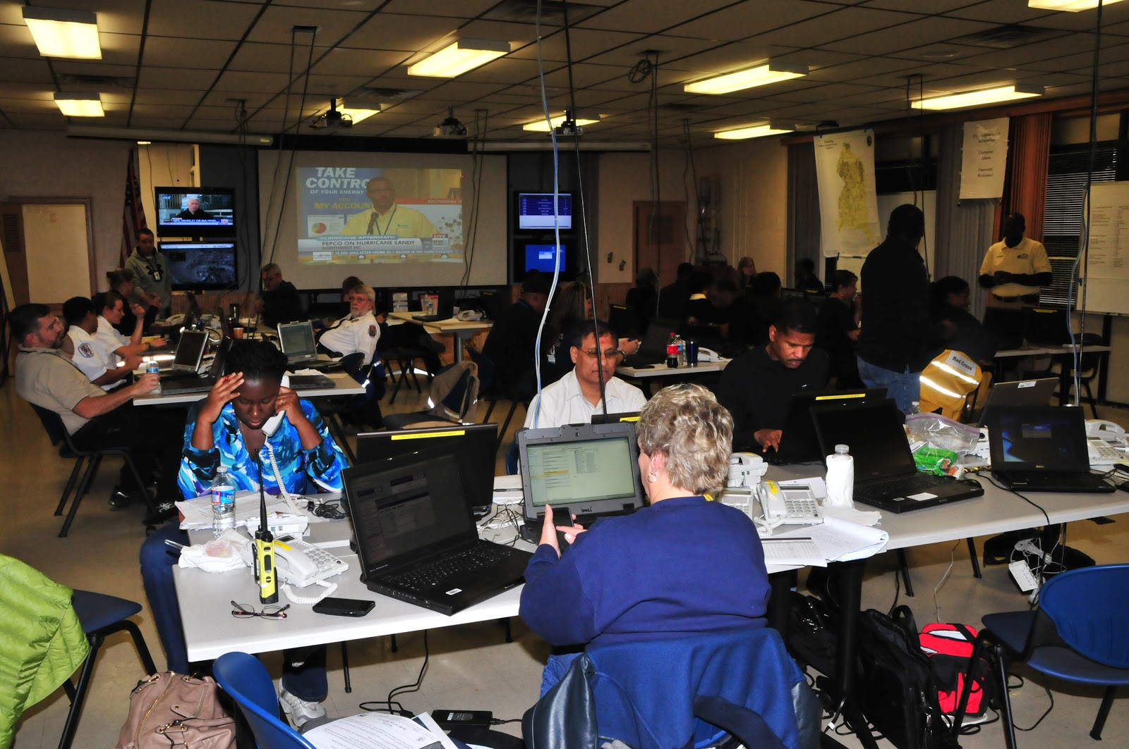
Recent Public Health Emergencies
Coordination of public health responses
  Skirball and Creek fires
  Hepatitis A
  Mosquito-borne disease
  Magnesium fire in Maywood
  Aliso Canyon gas leak

Slide 83
Aliso Canyon Gas Leak
DPH Response to Recent Emergencies

Slide 84
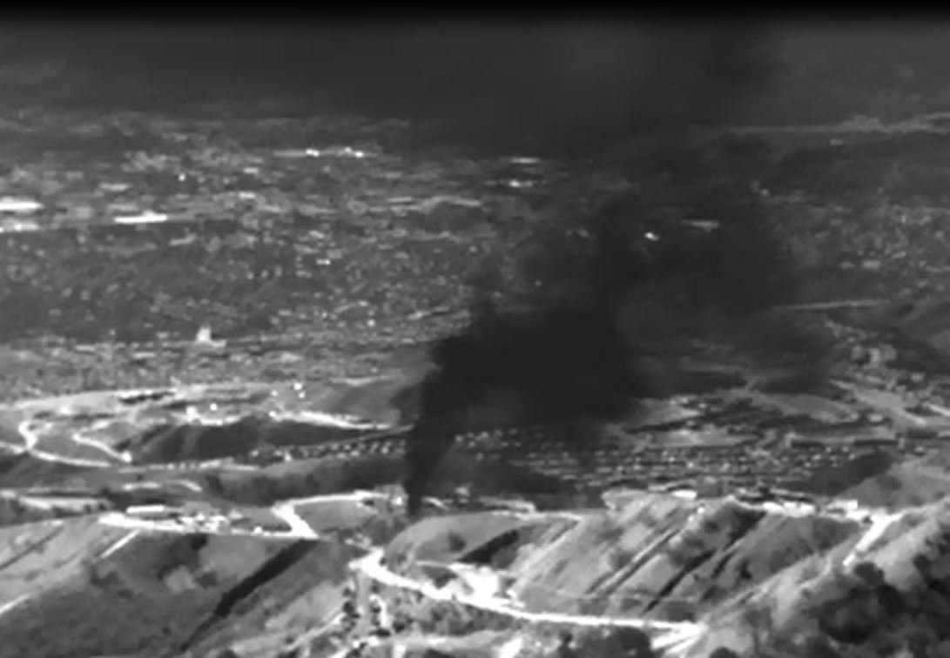

Aliso Canyon Gas Leak Disaster
Largest natural gas leak in US history
  October 2015 – February 2016
  Community of Porter Ranch
Well failure at a Southern California Gas Company (SCG) underground natural gas storage facility
DPH issued a directive to SCG
  Expedite efforts to stop the leak
  Offer free, temporary relocation to affected residents and schools
February 2016: Well permanently sealed
Recovery, assessment, and community engagement activities continue
https://www.nytimes.com/2017/01/14/business/energy-environment/aliso-canyon-gas-leak.html
84

Slide 85
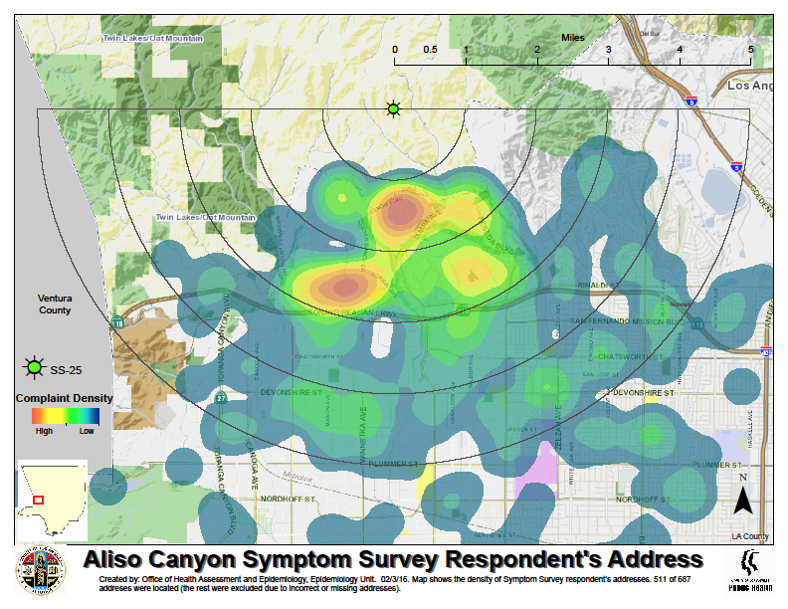
Symptoms Reported to Public Health by Distance to Well SS-25
Aliso Canyon Gas Leak Disaster

Slide 86
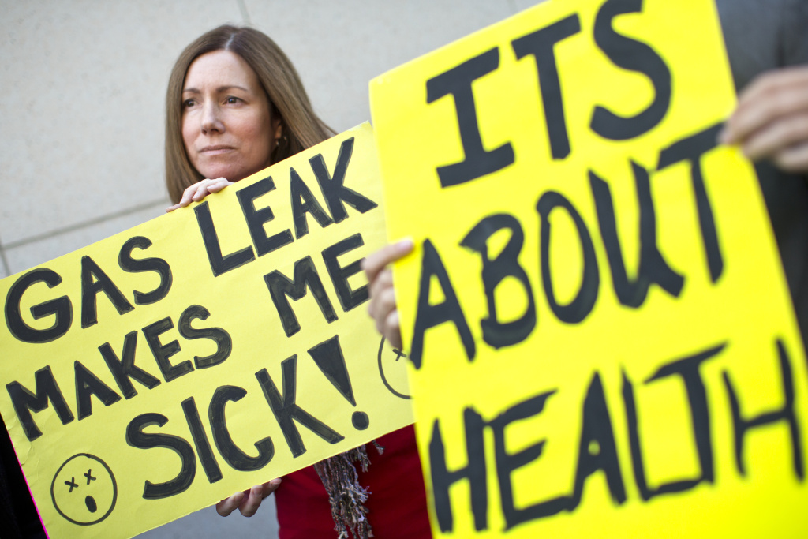
Aliso Canyon Gas Leak Disaster
Key Response Activities
During leak (October 2015 – February 2016)
  Safety of site operations, air quality measurements
  Assessment of health impact: syndromic surveillance, community complaints
Post-leak (February 2016 to present)
  CASPER survey
  Continuous community engagement
  Home cleaning directive
  Policy work
    Site itself
    Regulatory activities

Slide 87
Aliso Canyon Gas Leak Disaster
Partnerships
Fire Department
Office of Emergency Management
Southern California Gas Company
Air Quality Management Districts (Local and State)
Academic Institutions
  Environmental health subject matter experts
State Environmental Health and Protection, Emergency Management
Community-Based Organizations
Schools

Slide 88
Aliso Canyon Gas Leak Disaster
Infrastructure and Preparedness
Rapid detection and response
Inter-agency organization
Leveraging of local resources
  Safety
  Health and Environmental Assessment
  Mitigation
Policy directives

Slide 89
Hepatitis A Outbreak
DPH Response to Recent Emergencies

Slide 90

Background
Hepatitis A Outbreak
September 2017: DPH declared a local outbreak of hepatitis A (HAV) among persons who are homeless or use illicit drugs
  “Forward-leaning” due to the outbreaks in San Diego and Santa Cruz
October 2017: Governor Brown declared a statewide HAV outbreak
November 2017: DPH announced an increase in HAV cases among men who have sex with men

Slide 91
Strategies
Hepatitis A Outbreak
Educating the Public and Other Key Stakeholders
Surveillance for Cases and Rapid Vaccination of Contacts
Vaccinating Those at Risk
Improving Sanitation Conditions in Homeless Encampments and Other Locations
Developing Policies

Slide 92
Key Response Activities
Hepatitis A Outbreak
Stood up ICS, opened Department Operations Center, established dashboard
Provided stakeholder communications and telebriefings
Enhanced case surveillance, monitoring, and contact follow up/vaccination
Notified providers to increase awareness, detection, and vaccinations
Engaged with organizations that provide services to homeless people
Provided free vaccine to homeless persons, active drug users, and those who provide services and support to those individuals
  Outreach teams and clinic services
Inspected homeless shelters, encampments, and food facilities
Worked with local cities to increase access to bathrooms and handwashing stations for homeless individuals

Slide 93
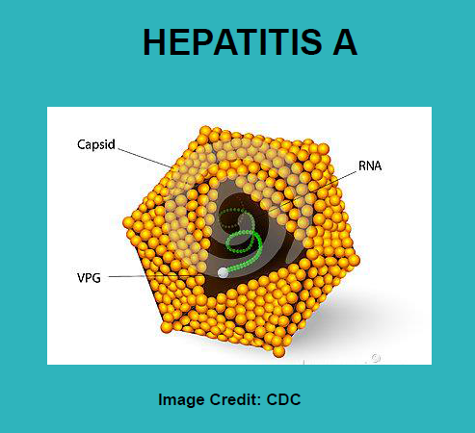
Outcomes and Outreach
Hepatitis A Outbreak
Cases: 18 (homeless / drug use)
Educational outreaches: 495
Vaccination outreaches: 586
Vaccinations: 35,843
  Hep A Case Contacts: 2,250
  Homeless: 8,122
  Rehab/SUD: 1,086
  Jail/parolee: 10,975
  LAC at-risk workers: 5,139
  Non-LAC at-risk workers: 7,708
  Other: 563

Slide 94
Innovations
Hepatitis A Outbreak
Rapid Response Teams
Recuperative Care Option
Partnership with Homeless Service Agencies
Scope of Practice Extensions for Paramedics
Environmental Assessments and Recommendations

Slide 95
Partnerships
Hepatitis A Outbreak
Healthcare providers
Homeless services organizations
Substance use treatment providers
Jails and detention centers
Law enforcement and other first responders
Cities and elected officials
Public works and sanitation districts
Unions
95

Slide 96
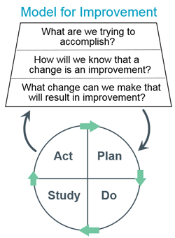
Overall Summary
Los Angeles County is a culturally and geographically diverse, highly populated, and physically large area susceptible to a wide variety of disasters
Infrastructure and preparedness/readiness activities supported by performance improvement is critical to swift and high quality response to disasters
Important to establish and maintain a QI culture based on evidence-based models of improvement that permeate all levels of the organization
Partnerships and local relationships are key
96

Slide 97
Resources
Aliso Canyon Gas Leak
  http://publichealth.lacounty.gov/media/gasleak/
LA County Hepatitis A Information
  General public: http://publichealth.lacounty.gov/media/hepa/index.htm
  Clinicians: http://publichealth.lacounty.gov/acd/Diseases/HepA.htm
LA County Public Health Emergency Preparedness
  http://publichealth.lacounty.gov/eprp/index.htm
National Association of County & City Health Officials (NACCHO) QI training, plans and projects
  http://archived.naccho.org/topics/infrastructure/accreditation/quality.cfm
National Network of Public Health Institutes’ Resource Directory
  https://nnphi.org/resource-directory/?focus_areas%5B%5D=performance-quality-improvement
97

Slide 98
Thank you!
Jeffrey D. Gunzenhauser, MD, MPH
Interim Health Officer and Chief Medical Officer
Los Angeles County Department of Public Health

Slide 99
Roundtable Discussion
Don Wright, MD, MPH
Director, Office of Disease Prevention and Health Promotion

Slide 100
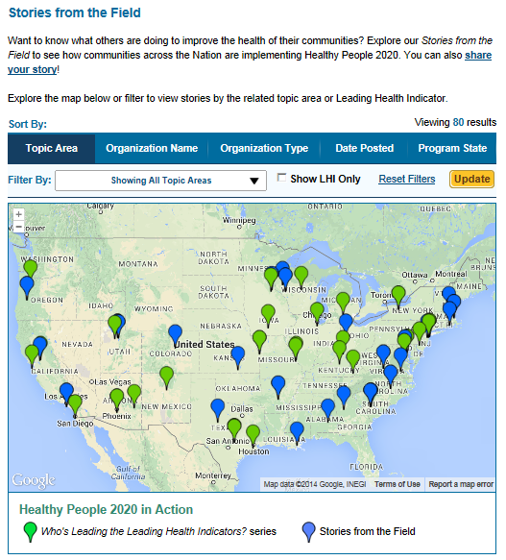
Healthy People 2020 Stories from the Field
A library of stories highlighting ways organizations across the country are implementing Healthy People 2020
Healthy People in Action
http://www.healthypeople.gov/2020/healthy-people-in-action/Stories-from-the-Field

Slide 101


Who’s Leading the Leading Health Indicators? Webinar
Please join us on
Thursday, May 24, 2018
from 12:00 to 1:00 pm ET
for a Healthy People 2020 Who’s Leading the Leading Health Indicators? webinar on Oral Health.
Registration on
HealthyPeople.gov
available soon

Slide 102





Register now at www.2018HealthyAgingSummit.org
The event will focus on keeping Americans healthy as they transition into older adulthood and maximizing the health of older adults through prevention strategies and more.
The 2018 Healthy Aging Summit goals are to:
  Explore the science on healthy aging
  Identify knowledge gaps
  Promote prevention
  Support people aging in place and in their community
Conference tracks include:
  Social and Community Context
  Maximizing Quality of Life
  Health and Health Care
  Neighborhood and Built Environment

Slide 103
Progress Review Planning Group
Stan Lehman (CDC/OD)
Emily DeCoster (HRSA)
Liza Corso (CDC/OSTLTS)
Lynette Araki (HRSA)
Diba Rab (HRSA)
Brenda Silverman (CDC/OPHPR)
Lauren Walsh (ASPR/OPP)
Franco Ciammachilli (ASPR/OPP)
David Huang (CDC/NCHS)
Leda Gurley (CDC/NCHS)
Sirin Yaemsiri (CDC/NCHS)
Robin Pendley (CDC/NCHS)
LaJeana Hawkins (CDC/NCHS)
Cheryl Rose (CDC/NCHS)
Carter Blakey (HHS/ODPHP)
Theresa Devine (HHS/ODPHP)
Yen Lin (HHS/ODPHP)

Slide 104




Stay Connected
Web healthypeople.gov
Email healthypeople@hhs.gov
Twitter @gohealthypeople
YouTube ODPHP (search “healthy people”)
Join the Healthy People Listserv & Consortium

