Slide 1



Progress Review Webinar:
Sexually Transmitted Diseases and HIV
August 1, 2017

Slide 2
Healthy People 2020 Progress Review: Diagnosis, Prevention, and Treatment of Syphilis and HIV
Don Wright, MD, MPH
Acting Assistant Secretary for Health
U.S. Department of Health and Human Services

Slide 3
Agenda and Presenters
Chair
Don Wright, MD, MPH, Acting Assistant Secretary for Health, U.S. Department of Health and Human Services
Presentations
Charles Rothwell, MBA, MS, Director, National Center for Health Statistics
Gail Bolan, MD, Director, Division of STD Prevention, CDC
Eugene McCray, MD, Director, Division of HIV/AIDS Prevention, CDC
Heather Hauck, MSW, LICSW, Deputy Associate Administrator, HRSA
Community Highlight
DeAnn Gruber, PhD, Director, Bureau of Infectious Diseases, Louisiana Department of Health, Office of Public Health, New Orleans, Louisiana

Slide 4
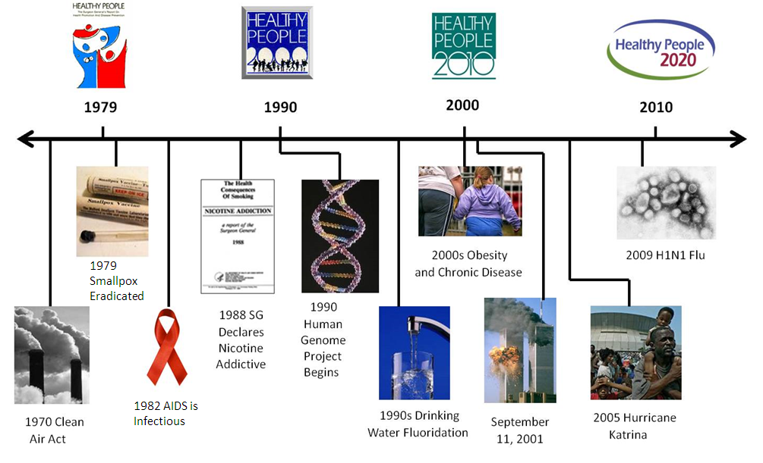
Healthy People at the Forefront of Public Health

Slide 5
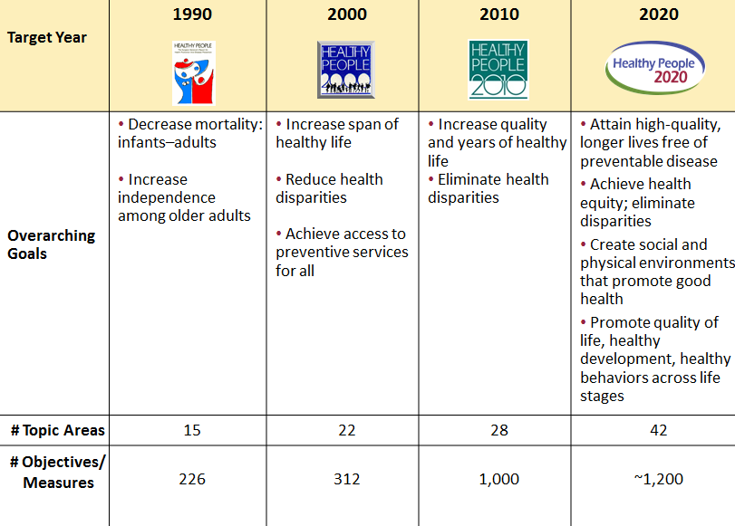
Evolution of Healthy People

Slide 6

Understanding Sexually
Transmitted Diseases
STDs refer to more than 35 infectious organisms that are transmitted primarily through sexual activity.
Despite their burdens, costs, and complications, and the fact that they are largely preventable, STDs remain a significant public health problem in the United States.
There are approximately 20 million new STD infections each year. Almost half of them among young people ages 15 to 24.
SOURCE: Healthy People 2020 Sexually Transmitted Diseases Topic Area Overview, CDC/NCHS available at: https://www.healthypeople.gov/2020/topics-objectives/topic/sexually-transmitted-diseases
2015 Surveillance Report Fact Sheet available at: https://www.cdc.gov/nchhstp/newsroom/docs/factsheets/STD-Trends-508.pdf

Slide 7

The Burden of Sexually Transmitted Diseases in the United States
The cost of STDs to the U.S. health care system is estimated to be as much as $16 billion annually.
Undiagnosed and untreated STDs are estimated to cause at least 20,000 women in the United States each year to become infertile.
SOURCE: Healthy People 2020 Sexually Transmitted Diseases Topic Area Overview, CDC/NCHS available at: https://www.healthypeople.gov/2020/topics-objectives/topic/sexually-transmitted-diseases
2015 Surveillance Report Fact Sheet available at: https://www.cdc.gov/nchhstp/newsroom/docs/factsheets/STD-Trends-508.pdf

Slide 8
Understanding HIV
Human Immunodeficiency Virus (HIV) if untreated can lead to acquired immunodeficiency syndrome (AIDS)
HIV can be spread:
  Through body fluids from sexual contact
  By sharing needles to inject drugs
  From mother to baby during pregnancy or birth
There is effective no cure for HIV
HIV can be controlled with proper medical care which includes treatment

Slide 9
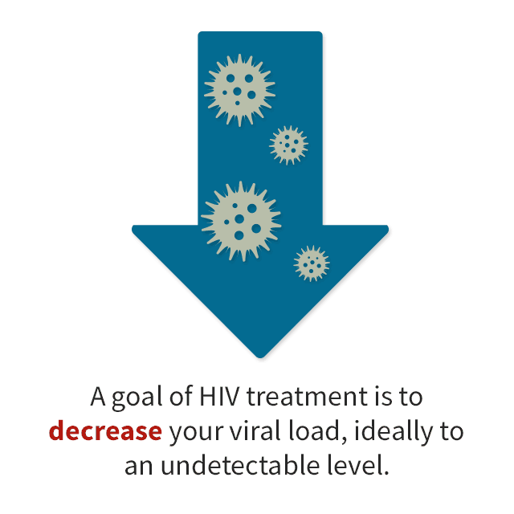
Achieving Viral Suppression
The ultimate goal of HIV treatment is to achieve viral suppression.
Viral suppression means decreasing the amount of virus in the body to an undetectable level.
Sustained viral suppression:
  Improves immune function
  Prolongs life
  Reduces illness
  Prevents HIV transmission to others

Slide 10
The Burden of HIV in the United States
In 2014, 37,600 new HIV infections occurred.
Gay, bisexual, and other men who have sexual contact with men represented 70% of new HIV infections in 2014.
About 15% of the estimated 1.1 million persons living with HIV at the end of 2014 were unaware of their infection.
In 2014, HIV infection was the 8th and 9th leading cause of death among persons aged 25-34 and 35-44, respectively.
Lifetime HIV treatment costs $449,000 (in 2015 dollars).
SOURCES: HIV/AIDS Basic Statistics, CDC/NCHHSTP available at: https://www.cdc.gov/hiv/basics/statistics.html; Centers for Disease Control and Prevention. Monitoring selected national HIV prevention and care objectives by using HIV surveillance data-United States and 6 dependent areas, 2015; HIV/AIDS HIV Cost-effectiveness, CDC/NCHHSTP available at: Farnham PG, Gopalappa C, Sansom SL, Hutchinson AB, Brooks JT, Weidle PJ, Marconi VC, Rimland D. Updates of lifetime costs of care and quality-of-life estimates for HIV-infected persons in the United States: late versus early diagnosis and entry into care. J Acquir Immune Defic Syndr 2013; 64: 183-189.

Slide 11

Charles Rothwell, MBA, MS
Director, National Center for Health Statistics
Centers for Disease Control and Prevention

Slide 12
Presentation Overview
Tracking the Nation’s Progress
Sexually Transmitted Diseases (STD)
HIV

Slide 13
Tracking the Nation’s Progress
14 Measurable HP2020 Sexually Transmitted Diseases Objectives:
    2 Target met
    4 Improving
    4 Little or no detectable change
    4 Getting worse
17 Measurable HP2020 HIV Objectives:
    3 Target met
    9 Improving
    4 Little or no detectable change
    1 Baseline data only
NOTES: Measurable objectives are defined as having at least one data point currently available, or a baseline, and anticipate additional data points throughout the decade to track progress. For a complete description of each progress status, please see National Center for Health Statistics. Chapter III: Overview of Midcourse Progress and Health Disparities. Healthy People 2020 Midcourse Review. Hyattsville, MD. 2016 https://www.cdc.gov/nchs/data/hpdata2020/HP2020MCR-B03-Overview.pdf .

Slide 14
Presentation Overview
Tracking the Nation’s Progress
Sexually Transmitted Diseases
  Gonorrhea
  Primary and Secondary Syphilis
  Congenital Syphilis
HIV

Slide 15
Gonorrhea Among Females and Males Aged 15 to 44 Years
Rate per 100,000
HP2020 Female Target: 255.6
Females
Males
HP2020 Male Target: 197.5
NOTES: *2008 = HP2020 baseline.
SOURCES: STD Surveillance System (STDSS), CDC/NCHHSTP; Population Estimates, US Census Bureau.
Objs. STD-6.1 & 6.2
Decrease desired

Slide 16
Primary and Secondary Syphilis Among Females and Males
Rate per 100,000
Males
HP2020 Male Target: 6.7
Females
HP2020 Female Target: 1.3
NOTES: *2008 = HP2020 baseline.
SOURCES: STD Surveillance System (STDSS), CDC/NCHHSTP; Population Estimates, US Census Bureau.
Objs. STD-7.1 & 7.2
Decrease desired

Slide 17
Primary and Secondary Syphilis Among Females, 2015
HP2020 Target: 1.3
Decrease desired
Age Group
(years)
†
†
The rate for females 65 years and over was 0.0 per 100,000 population.
NOTES: *2008 Total = HP2020 baseline. American Indian includes Alaska Natives. Black and White exclude persons of Hispanic origin. Persons of Hispanic origin may be of any race. Respondents were asked to select one or more races. Data for the single race categories are for persons who reported only one racial group. The HP2020 target does not apply to the age groups.
SOURCES: STD Surveillance System (STDSS), CDC/NCHHSTP; Population Estimates, US Census Bureau.
Obj. STD-7.1

Slide 18
Primary and Secondary Syphilis Among Males, 2015
HP2020 Target: 6.7
Decrease desired
Age Group
(years)
NOTES: *2008 Total = HP2020 baseline. American Indian includes Alaska Natives. Black and White exclude persons of Hispanic origin. Persons of Hispanic origin may be of any race. Respondents were asked to select one or more races. Data for the single race categories are for persons who reported only one racial group. The HP2020 target does not apply to age groups.
SOURCES: STD Surveillance System (STDSS), CDC/NCHHSTP; Population Estimates, Census.
Obj. STD-7.2

Slide 19
Primary and Secondary Syphilis Among Females, 2015
National Target = 1.3 per 100,000 population ● National Rate = 1.4 per 100,000 population
WA
MT
ND
ME
OR
ID
MN
VT
SD
WI
NY
NH
CT
MA
WY
MI
RI
NE
IA
PA
NJ
NV
UT
IL
IN
OH
MD
DE
DC
CA
CO
WV
KS
MO
KY
VA
TN
NC
AZ
NM
OK
AR
SC
Rate per 100,000
MS
AL
GA
0.0 - 0.4
0.5 - 1.0
TX
LA
1.1 - 1.3
AK
1.4 - 2.4
FL
2.5 - 8.0
States shown in green met the national target.
HI
NOTES: Data are displayed by a modified Jenks classification for U.S. states. For more information, see National Center for Health Statistics. Appendix A: Technical Notes. Healthy People 2020 Midcourse Review. Hyattsville, MD. 2016. https://www.cdc.gov/nchs/data/hpdata2020/HP2020MCR-D01-Technical-Notes.pdf
SOURCES: STD Surveillance System (STDSS), CDC/NCHHSTP; Population Estimates, Census.
Obj. STD-7.1 Decrease desired

Slide 20
Primary and Secondary Syphilis Among Males, 2015
National Target = 6.7 per 100,000 population ● National Rate = 13.7 per 100,000 population
WA
MT
ND
ME
OR
ID
MN
VT
SD
WI
NY
NH
MA
WY
MI
CT
RI
NE
IA
PA
NV
DC
OH
MD
NJ
UT
IL
IN
WV
DE
DC
CA
CO
KS
VA
MO
KY
TN
NC
AZ
NM
OK
AR
SC
Rate per 100,000
MS
AL
GA
1.3 - 5.6
5.7 - 6.7
TX
LA
6.8 - 12.9
AK
13.0 - 19.3
FL
19.4 - 26.8
States shown in green met the national target.
HI
NOTES: Data are displayed by a modified Jenks classification for U.S. states. For more information, see National Center for Health Statistics. Appendix A: Technical Notes. Healthy People 2020 Midcourse Review. Hyattsville, MD. 2016. https://www.cdc.gov/nchs/data/hpdata2020/HP2020MCR-D01-Technical-Notes.pdf
SOURCES: STD Surveillance System (STDSS), CDC/NCHHSTP; Population Estimates, Census.
Obj. STD-7.2 Decrease desired

Slide 21
Congenital Syphilis
Rate per 100,000 Live Births
Black
HP2020 Target: 9.6
*
NOTES: *2008 = HP2020 baseline. Black excludes persons of Hispanic origin.
SOURCES: STD Surveillance System (STDSS), CDC/NCHHSTP;
National Vital Statistics System-Natality (NVSS-N), CDC/NCHS.
Obj. STD-8
Decrease desired

Slide 22
Presentation Overview
Tracking the Nation’s Progress
Sexually Transmitted Diseases
HIV
  Annual Diagnoses
  HIV Testing and HIV Serostatus Awareness
  Access to Medical Care
  Viral Suppression

Slide 23
Annual HIV Diagnoses
Number
HP2020 Target: 32,855
NOTES: *2010 = HP2020 baseline. Data are the number of new HIV diagnoses in the United States by diagnosis year. The data collected on HIV diagnoses are used to monitor progression of disease after diagnosis and receipt of care and to estimate prevalence and incidence of HIV infection.
SOURCE: National HIV Surveillance System (NHSS), CDC/NCHHSTP.
Obj. HIV-1
Decrease desired

Slide 24
HIV Serostatus Awareness Among Persons Living with HIV, 2014
HP2020 Target: 90.0%
Increase desired
Transmission Category
Age Group
(years)
NOTES: *2010 Total = HP2020 baseline. Data are for persons aged 13 years and over who were aware of their HIV infection. Data are statistically adjusted to account for cases without sufficient risk factor information. Transmission categories are based on reported risk behavior that increase the risk of acquiring HIV and are mutually exclusive. Persons whose transmission category is classified as “heterosexual contact” are persons who have ever had heterosexual contact with a person known to have, or to be at high risk for, HIV infection (e.g., a person who injects drugs).
SOURCE: National HIV Surveillance System (NHSS), CDC/NCHHSTP.
Obj. HIV-13

Slide 25
HIV Testing in the Past 12 Months Among Men who Have Sex with Men
Percent
NOTES: *2008 = HP2020 baseline. Data are for men aged 18 years and over who reported having sex with a man in the past 12 months and reported having an HIV test in the same time period. The National HIV Behavioral Surveillance System collects behavioral data among persons at high risk for HIV infection including gay, bisexual and other men who have sex with men.
Source: National HIV Behavioral Surveillance System (NHBS), CDC/NCHHSTP.
Obj. HIV-14.2
Increase desired

Slide 26
Linkage to HIV Medical Care Within
1 Month of Diagnosis, 2015
HP2020 Target: 85.0%
Increase desired
Transmission Category
NOTES: *2010 Total = HP2020 baseline. Data are for persons aged 13 years and over who had a routine HIV medical visit within 1 month of HIV diagnosis. Linkage to medical care is defined as having a documented test result for a CD4 count or viral load. Transmission categories are mutually exclusive. Persons whose transmission category is classified as “heterosexual contact” are persons who have ever had heterosexual contact with a person known to have, or to be at high risk for, HIV infection (e.g., a person who injects drugs). American Indian includes Alaska Natives. Native Hawaiian includes other Pacific Islanders. Black and White exclude persons of Hispanic origin. Persons of Hispanic origin may be of any race. Respondents were asked to select one or more races. Data for the single race categories are for persons who reported only one racial group. This measure includes data from jurisdictions with complete lab reporting as follows:
14 (2010); 38 (2015). In 2015, the 38 jurisdictions accounted for 71.9% of persons living with
diagnosed HIV.
SOURCE: National HIV Surveillance System (NHSS), CDC/NCHHSTP.
Obj. HIV-19

Slide 27
Viral Suppression Among Persons Living with Diagnosed HIV, 2014
HP2020 Target: 80.0%
Increase desired
Transmission Category
NOTES: *2010 Total = HP2020 baseline. Data are for persons aged 13 years and over with diagnosed HIV infection whose most recent viral load test in the past 12 months showed that HIV viral load was suppressed. Viral suppression is defined as a viral load test of less than 200 copies/mL at the most recent viral load test. Persons whose transmission category is classified as “heterosexual contact” are persons who have ever had heterosexual contact with a person known to have, or to be at high risk for, HIV infection (e.g., a person who injects drugs). Transmission categories are mutually exclusive. This measure is obtained from jurisdictions with complete lab reporting as follows: 19 (2010); 38 (2014).
Source: National HIV Surveillance System (NHSS), CDC/NCHHSTP.
Obj. HIV-22.1

Slide 28
Viral Suppression Among Persons Living with Diagnosed HIV, 2014
HP2020 Target: 80.0%
Increase desired
Age Group
(years)
NOTES: *2010 Total = HP2020 baseline. Data are for persons aged 13 years and over with diagnosed HIV infection whose most recent viral load test in the past 12 months showed that HIV viral load was suppressed. Viral suppression is defined as a viral load test of less than 200 copies/mL at the most recent viral load test. American Indian includes Alaska Natives. Native Hawaiian includes other Pacific Islanders. Black and White exclude persons of Hispanic origin. Persons of Hispanic origin may be of any race. Respondents were asked to select one or more races. Data for the single race categories are for persons who reported only one racial group. Transmission categories are mutually exclusive. This measure is obtained from jurisdictions with complete lab reporting
as follows: 19 (2010); 38 (2014).
Source: National HIV Surveillance System (NHSS), CDC/NCHHSTP.
Obj. HIV-22.1

Slide 29
Key Takeaways –
Sexually Transmitted Diseases
The rate of new cases of gonorrhea was higher among females 15-44 years than males from 2008 to 2013; however, for 2014 and 2015, the rate among males was higher than females.
The rate of new cases of primary and secondary syphilis among males increased between 2008 and 2015. The rate remained relatively constant for females between 2008 and 2013 but increased slightly between 2014 and 2015 returning to the baseline.
For both males and females, disparities in primary and secondary syphilis exist by state and by racial/ethnic groups.
The rate of new cases of congenital syphilis continued to decrease from 2008 to 2012 and steadily increased between 2013 and 2015.
Disparities among racial/ethnic groups remain, with the highest rate of new congenital syphilis cases among Blacks annually since 1997.
29

Slide 30
Key Takeaways – HIV
Overall, the number of annual HIV diagnoses decreased between 2010 and 2015, although slight increases occurred in 2012 and 2014.
The percentage of persons aware of their HIV serostatus increased between 2010 and 2014, moving toward the HP2020 target.
HIV testing of males reporting male-to-male sexual contact has increased since the 2008 baseline, exceeding the HP2020 target in 2014.
The percentage of persons with diagnosed HIV who were linked to medical care within one month of diagnosis increased between 2010 and 2015, moving toward the HP2020 target. However, no group met the national target in 2015.
Viral suppression among persons living with diagnosed HIV increased between 2010 and 2014, moving towards the HP2020 target. But, no group met the national target in 2014.
30

Slide 31
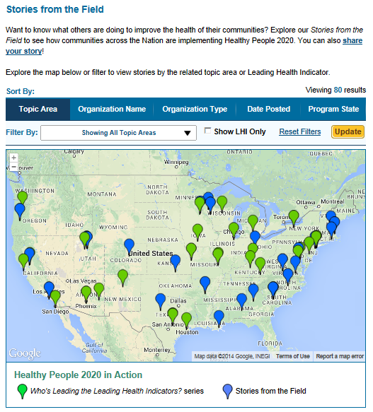
Healthy People 2020 Stories from the Field
A library of stories highlighting ways organizations across the country are implementing Healthy People 2020
Healthy People in Action
http://www.healthypeople.gov/2020/healthy-people-in-action/Stories-from-the-Field

Slide 32
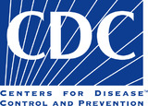
Healthy People 2020 Progress Review: Diagnosis, Prevention, and Treatment of Syphilis and HIV
Gail Bolan, MD
Director, Division of STD Prevention
Centers for Disease Control and Prevention

Slide 33

Outline
CDC’s STD Prevention Overview
STDs: a Public Sector Responsibility
Resurgence of Syphilis in the US
What CDC is doing to reverse these trends

Slide 34
CDC’s STD Prevention Strategic Plan
VISION
A society where people are empowered to protect themselves and others from STDs and achieve sexual health
MISSION
To maximize the impact of STD prevention through program, science, and policy
GOALS
Decrease morbidity, disparities and incidence of STDs
PRIORITY AREAS
Adolescents and young adults, MSM, pregnant women and health care systems
PRIORITY DISEASES
Syphilis, Gonorrhea, and Chlamydia

Slide 35
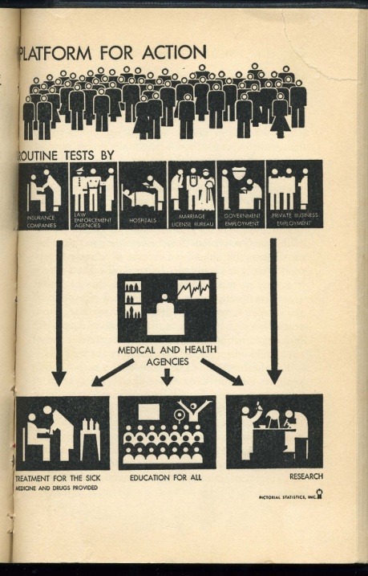
STD Control in the US:
The Approach from 1937
Public Health Service Act expanded in 1917
  Authority to do STD control
Health education and promotion
Identify and treat infected people through:
  Targeted screening of key populations
  STD clinics (funded by states and localities) - mainly for symptomatic care and contacts
  Health Department contact tracing
Individually-based interventions
Public sector responsibility

Slide 36
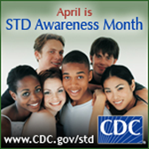
The Role of Federal, State and Local
Governments in STD Prevention
STD prevention in the U.S. is funded by federal, state, and local governments
Federal Government Supports:
Surveillance and outbreak response
Evidence-based, high impact prevention interventions through science and policies
Guidelines, tools and resources to assure recommended screening and treatment
Health care provider training and technical assistance
State and Local Health Departments Support:
Surveillance
STD preventive service delivery through:
  STD clinics or other clinical settings to provide specialized, confidential, same-day STD services
  Contact tracing and linkage to care
  Health education and promotion

Slide 37
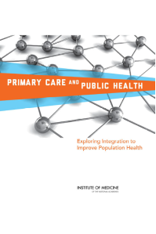

Rationale for Integration of STD Prevention in
Primary Health Care
Most sexually transmitted infections are without symptoms
Most STDs are identified and reported in primary care setting, not STD clinics
Rapid detection and timely treatment is a core STD prevention strategy

Slide 38
Resurgence of Syphilis in the U.S.

Slide 39
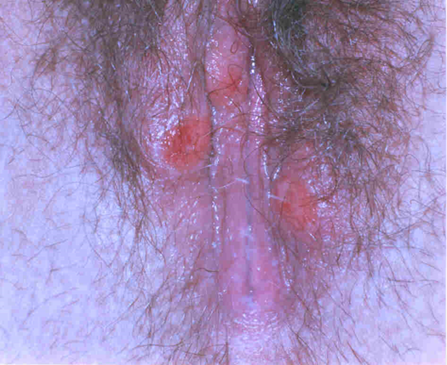
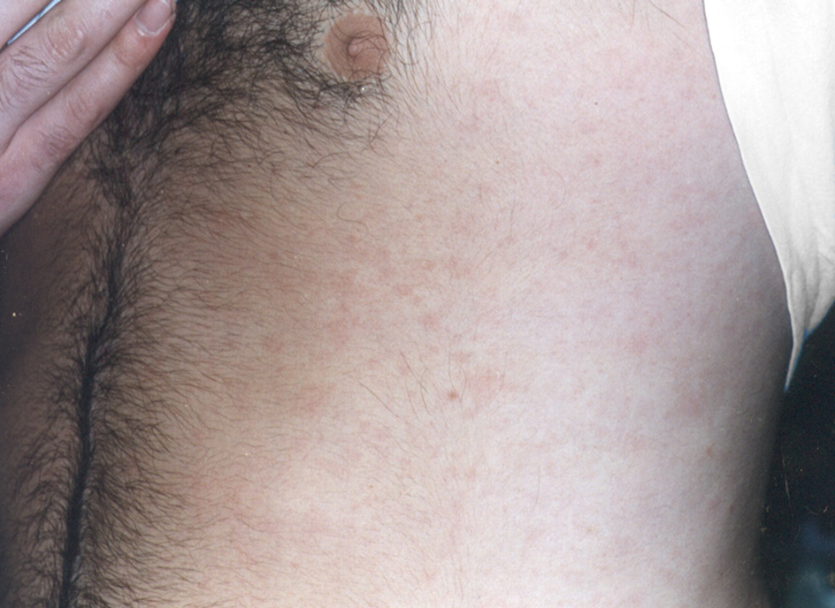
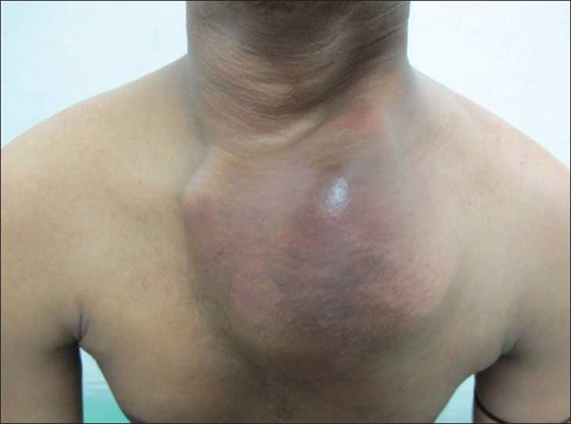
Stages of Untreated Syphilis
Early Syphilis
Late Syphilis
Primary
~ 3 weeks
after
infection
Secondary
~ 6 weeks
after
infection
Latent
Early | Late
Weeks to
years after
infection
Tertiary
Years to
Decades after
infection
Can be transmitted congenitally, most likely during early stages
Neurologic complications can occur at any stage of syphilis

Slide 40
Syphilis rates continue to increase
Primary and Secondary Syphilis — Reported Cases, United States, 1941–2016 *
Penicillin treatment
M:F Case ratio
Syphilis Elimination Effort
* Data are provisional for 2016
Obj. STD- 7.1 & 7.2

Slide 41
Primary and Secondary Syphilis Among Men — Reported Cases by Sex of Sex Partner, 30 States
United States, 2010–2016*
In 2016, 80% of male cases with known sex of sex partner had sex with men
Cases
Men who have sex with women only
Men who have sex with men and women
* Data are provisional for 2016
Obj. STD- 7.2

Slide 42
What is CDC doing to reverse these trends?

Slide 43
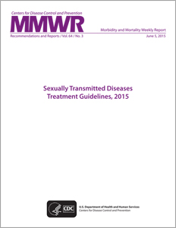
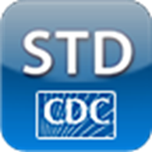

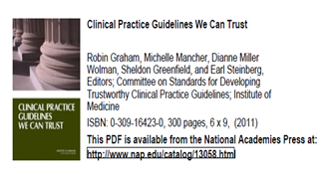
CDC STD Treatment Guidelines
Authoritative, evidence-based source for STD clinical management
Uses IOM principles for “Clinical Practice Guidelines We Can Trust”
Recommended regimens preferred over alternative regimens
Available at www.cdc.gov/std
Wall charts, pocket guides, eBook, webinars, podcasts
STD Treatment Mobile App for Apple devices (iPhone & iPads) and Droid devices (phones & tablets).

Slide 44
Proportion of Sexually Active HIV-Infected MSM in Medical Care Screened for Syphilis in the Prior 12 Months, Medical Monitoring Project 2009-2013
Syphilis screening of MSM with HIV is slowly improving, but as of 2013, still under 70%
Test for trend p<0.01
Obj. STD- 7.2
Ref: Mattson CL, et al. Increased STD testing among sexually active persons receiving medical care for HIV infection in the United States, 2009 – 2013, Clin Infect Dis. Dec. 2016

Slide 45
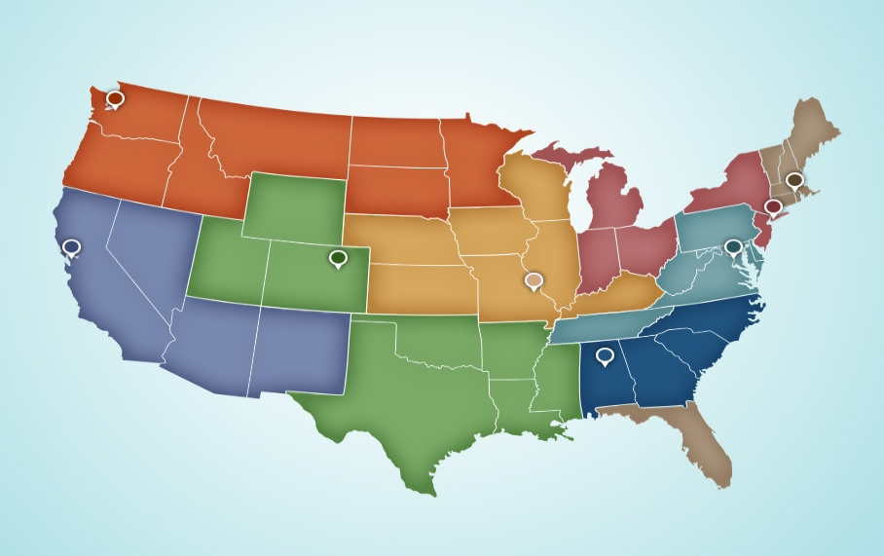
National Network of STD Clinical Prevention Training Centers
U Washington PTC
Sylvie Ratelle MA HD PTC
Columbia U PTC
Denver HD PTC
UCSF PTC
Wash U PTC
Johns Hopkins PTC
UAB PTC
STD Clinical Consultation Network (STDCCN) www.STDCCN.org

Slide 46

CDC is Taking Action to Address Increasing Syphilis in All Populations
Convened Syphilis Summit with national experts
Issued a Syphilis Call to Action that includes:
  Congenital syphilis
  Syphilis among MSM; and
  Biomedical advancements for syphilis

Slide 47

CDC is Taking Action to Address Increasing Syphilis in All Populations
Developing models and CDS to assure recommended frequency of screening and timely treatment in pregnant females and among MSM
Using molecular epidemiology techniques to study transmission dynamics and high impact interventions
Creating a specimen repository to support technological developments in diagnostics, therapeutics and vaccines

Slide 48
Summary
STDs are a collective responsibility.
There has been increasing trends of both congenital syphilis and syphilis among MSM.
CDC is working with other federal agencies, health departments, health care providers, medical and healthcare organizations, decision makers, scientists, industry and communities to take action and reverse these trends.

Slide 49
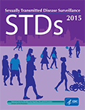
Resources
CDC’s STD Prevention Program website
  https://www.cdc.gov/std/
Syphilis Call to Action
  https://www.cdc.gov/std/syphilis/SyphilisCalltoActionApril2017.pdf
2015 Surveillance Report
  https://www.cdc.gov/std/stats15/STD-Surveillance-2015-print.pdf
Spotlight on CDC’s STD Prevention Work
  https://www.cdc.gov/std/dstdp/dstdp-stakeholder-report-design_web.pdf

Slide 50
HIV Prevention in US
Eugene McCray, MD
Director, Division of HIV/AIDS Prevention
Centers for Disease Control and Prevention

Slide 51
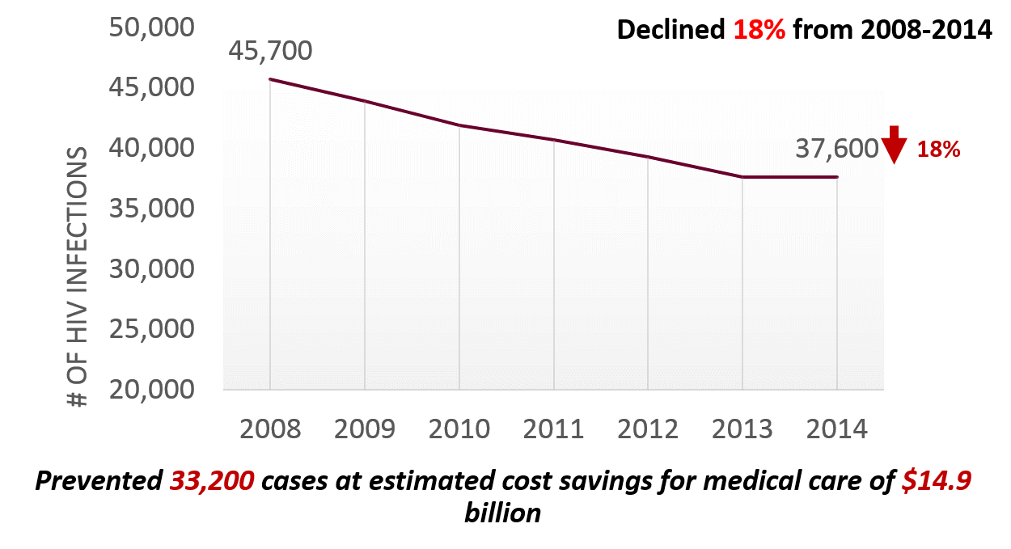
Estimated Annual HIV Infections in the U.S.

Slide 52
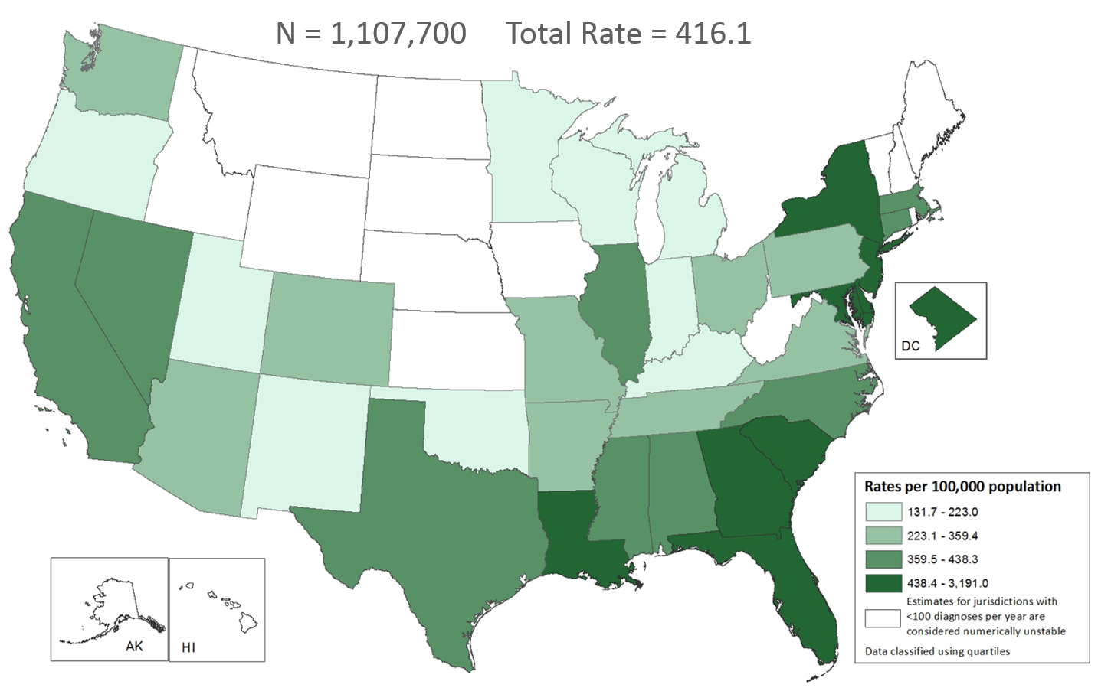
Estimated Rates of Adults and Adolescents Living with HIV Infection, By Area of Residence, Year-end 2014—United States
Note. Estimates were derived by using HIV surveillance data for persons aged ≥13 years at diagnosis in the 50 states and the District of Columbia.

Slide 53
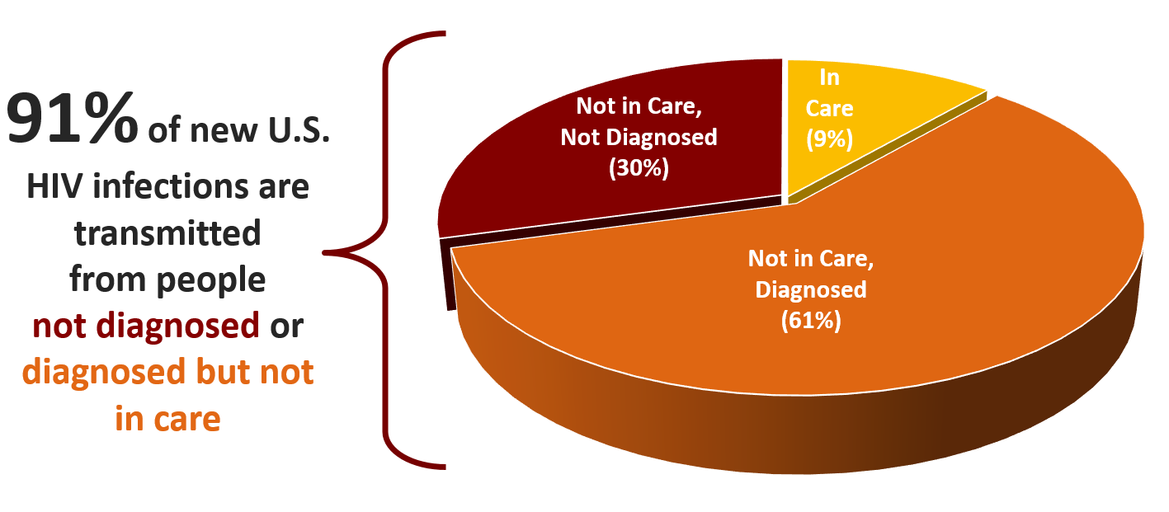
HIV Transmissions from People by Care Status, United States
Skarbinski, JAMA 2015

Slide 54
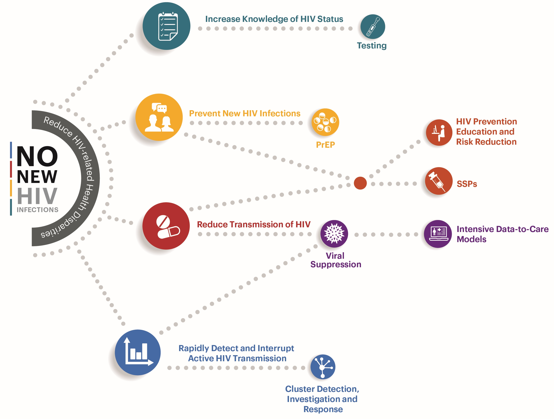
CDC’s HIV/AIDS Prevention Priorities
HIV-1
HIV-13
HIV-19
HIV-20
HIV 22.1

Slide 55
Increase Knowledge of HIV Status

Slide 56
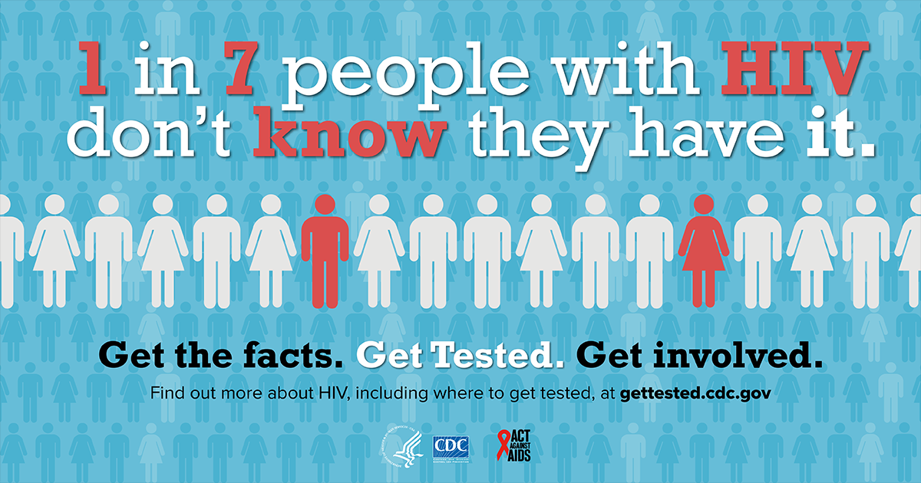
CDC’s HIV Testing Efforts
Increased, Targeted Testing and Screening:
  Approximately 3.0 million CDC-funded HIV testing events were conducted in 2015*
    12,547 (0.4%) persons -newly diagnosed HIV-positive
    13,528 (0.4%) persons – previously diagnosed
      Almost 90% out of care
Increase efforts to implement guidelines
  In clinical and non-clinical settings
Improved testing methods
Testing Campaigns (Act Against AIDS)
  Providers
  General population & most at-risk populations
*In the 61 CDC-funded jurisdictions in the United States, Puerto Rico, and the U.S. Virgin Islands. From: https://www.cdc.gov/hiv/pdf/library/reports/cdc-hiv-funded-testing-us-puerto-rico-2015.pdf
HIV-13
HIV-19

Slide 57
Prevent New HIV Infections

Slide 58
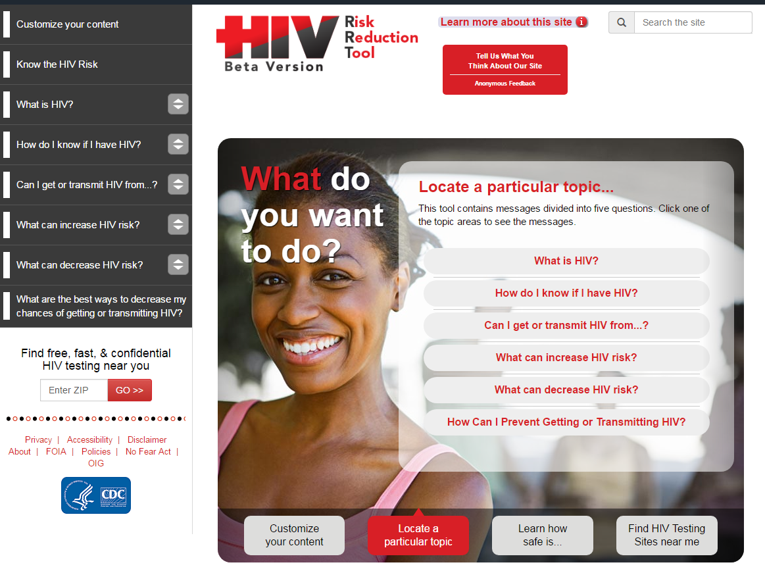

HIV Risk Reduction Tool
Launched at the 2015 National HIV Prevention Conference
The first comprehensive update of ALL HIV prevention messages for ALL audiences
Addresses two of four national HIV prevention goals:
  Goal 1- Reducing new HIV infections
  Goal 2- Increasing access to care and improving health outcomes for people living with HIV.
HIV-13
HIV-19
HIV-22.1

Slide 59
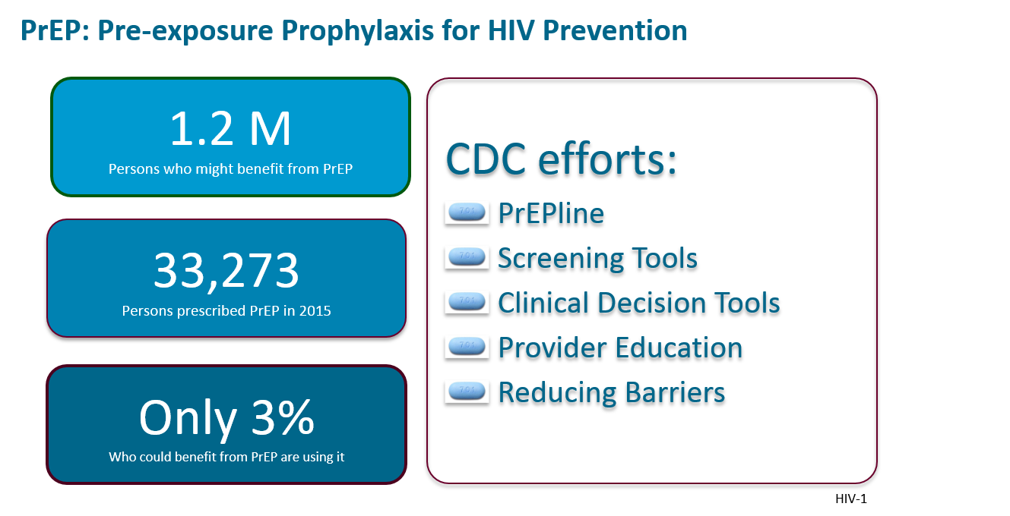
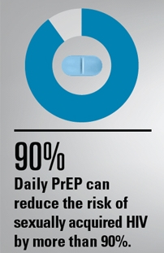
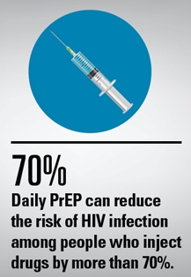
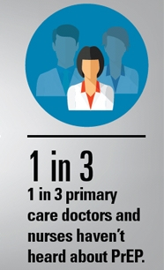
Preventing New HIV Infections: PrEP
CDC. Vital Signs November 2015
CDC. HIV Supplemental Surveillance Report 2017;22(No.2)
CDC. PrEP Clinical Practice Guidelines, 2014
HIV-1

Slide 60
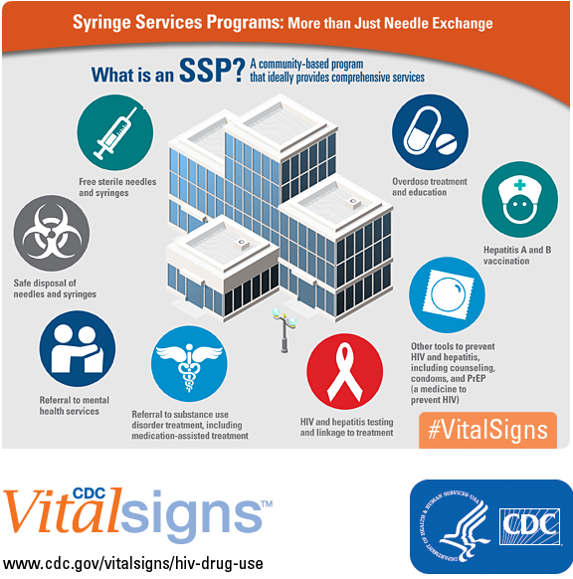
Syringe Services Programs (SSPs) for HIV Prevention
SSPs are proven effective and cost-saving
HHS released new guidance for SSPs in 2016
CDC can support some SSP costs
HIV-1
HIV-13
HIV-19
HIV-20
HIV 22.1

Slide 61
Reduce Transmission of HIV

Slide 62
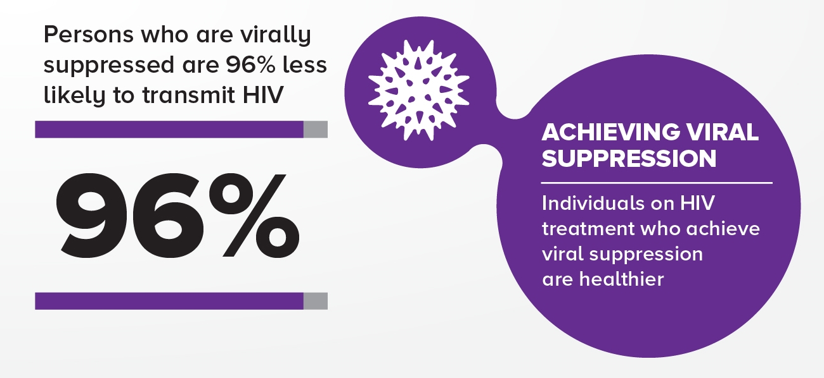
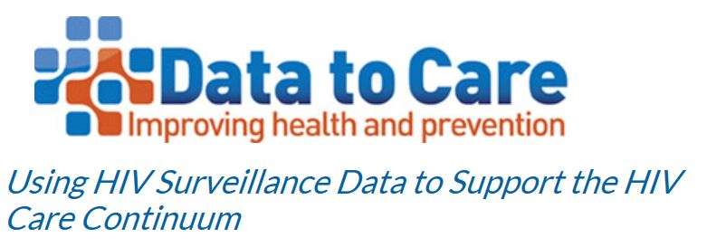
Achieving Viral Suppression
Ultimate goal of HIV treatment is to achieve viral suppression
Getting people living with HIV into medical care is essential for achieving and maintaining viral suppression
Linkage/Retention in Care:
Collection of interventions and strategies*
Demonstration projects to determine best practices to support linkage/retention in care
Capacity building support for implementation
*Compendium of Evidence-Based Interventions and Best Practices for HIV Prevention
Data to care - https://effectiveinterventions.cdc.gov/en/HighImpactPrevention/PublicHealthStrategies/DatatoCare.aspx
HIV-1
HIV-19
HIV-20
HIV-22.1

Slide 63
Rapidly Detect and Interrupt Active HIV Transmission

Slide 64
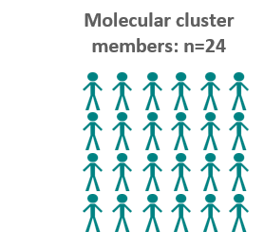
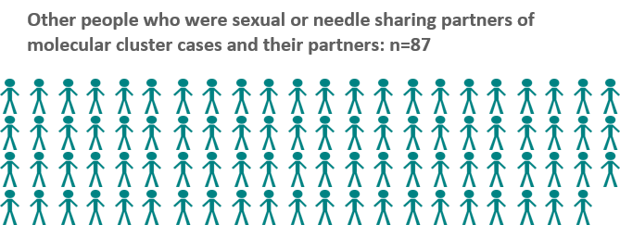
Cluster Detection, Investigation and Response
CDC analyzes HIV genetic sequences and other surveillance data to identify growing clusters that represent active transmission
Texas Cluster Investigation:
Implemented prevention efforts:
Identified persons in cluster not in care for HIV, and attempted to re-engage in care
Re-tested all HIV negative partners
Educated health care providers about recommended testing algorithm and PrEP
State increased funding to expand testing and PrEP in affected area
Monterosso A, Minnerly S, Goings S, et al. Identifying and investigating a rapidly growing HIV transmission cluster in Texas. . Conference on Retroviruses and Opportunistic Infections; 2017; Seattle, WA.
HIV-1
HIV-13
HIV-19
HIV-22.1

Slide 65
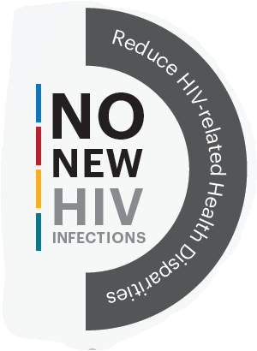
Summary
Dramatic progress in reducing new HIV infections
Testing is the gateway to care or prevention services
Linkage to care is integral to achieve viral suppression
HIV prevention toolbox is better than ever
By focusing on the four HIV priority areas, the goal of no new HIV infections seems within reach

Slide 66
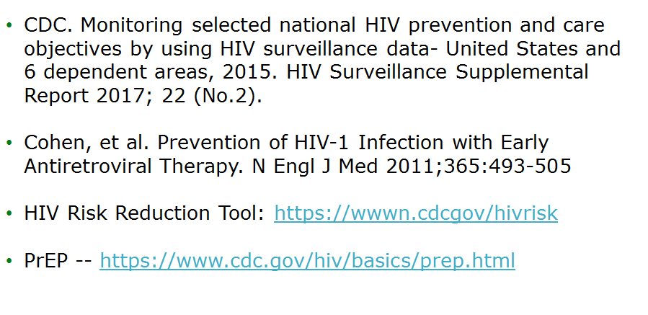
Resources

Slide 67
Thank you

Slide 68
Ryan White HIV/AIDS Program Overview
Heather Hauck, MSW, LICSW
Deputy Associate Administrator
HIV/AIDS Bureau
Health Resources and Services Administration

Slide 69
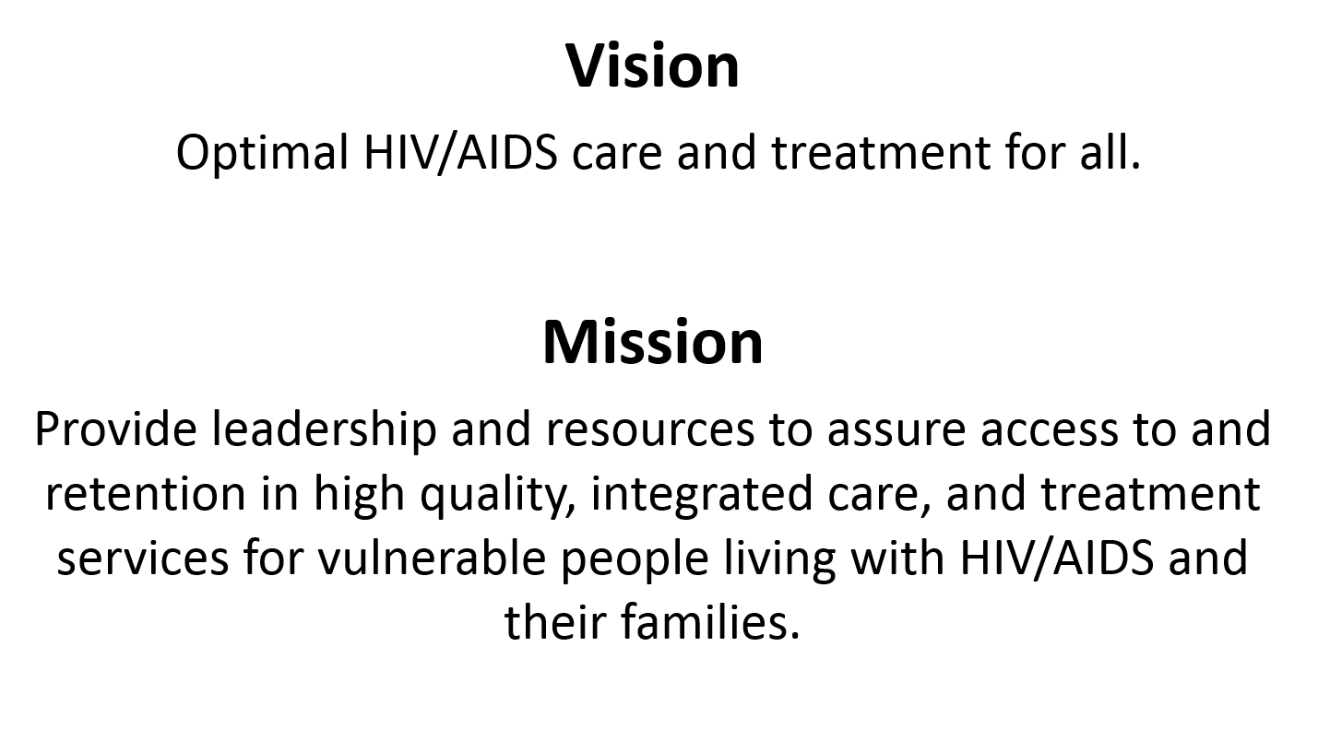
HRSA HIV/AIDS Bureau

Slide 70
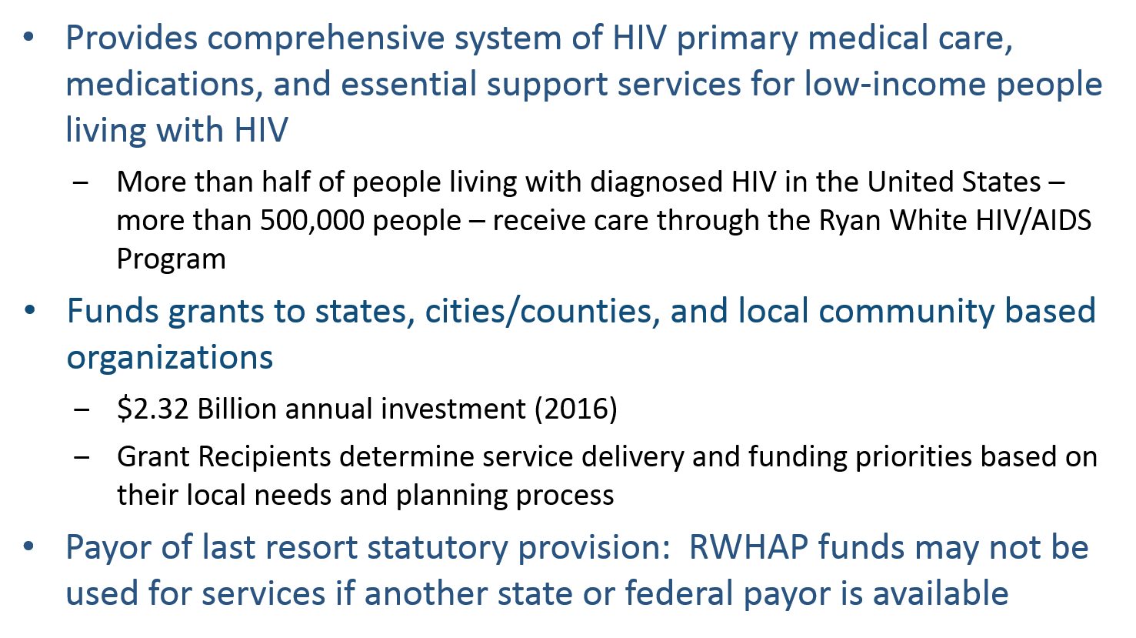
Ryan White HIV/AIDS Program

Slide 71
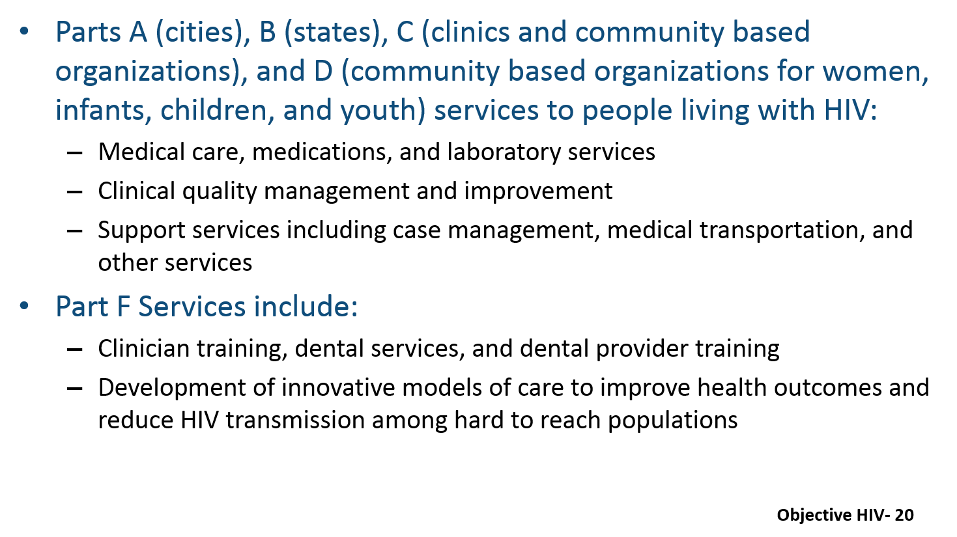
Ryan White HIV/AIDS Program

Slide 72
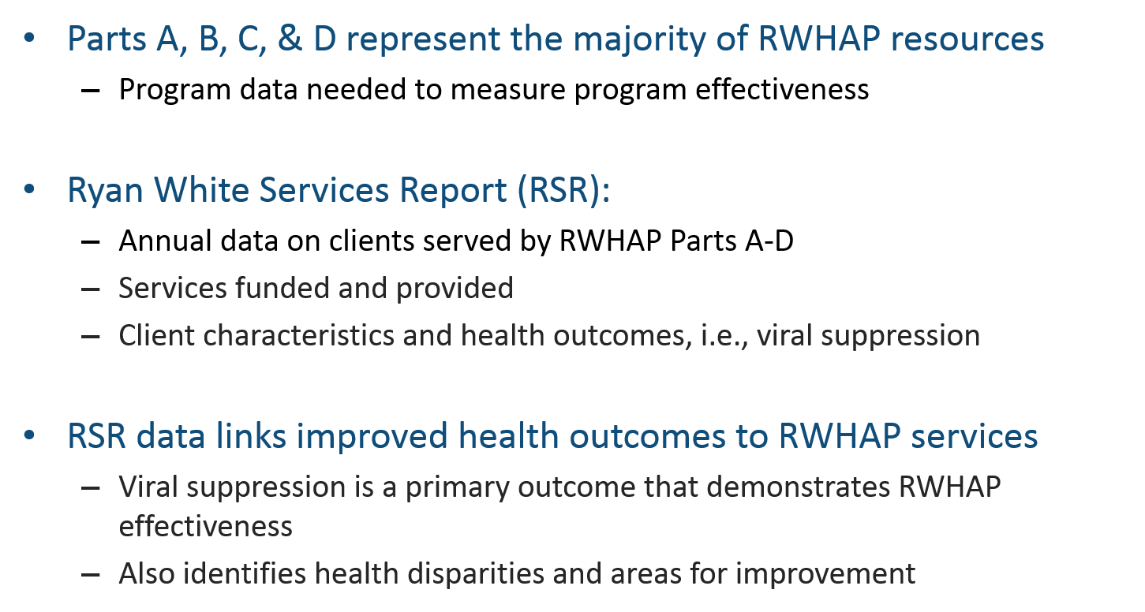
Demonstrating Effectiveness of
Program Investments
Objective HIV-22

Slide 73
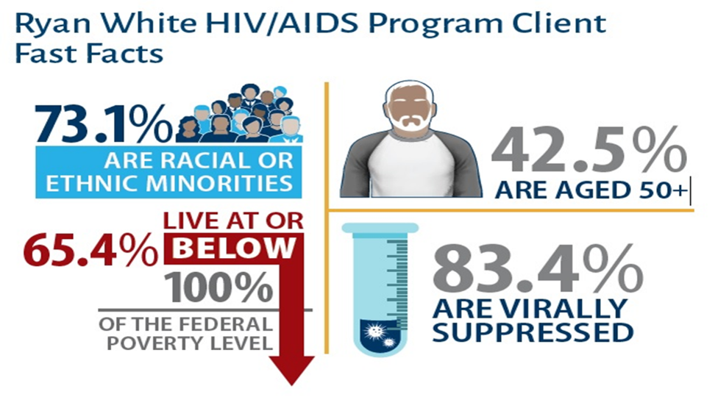
Ryan White HIV/AIDS Program Clients

Slide 74
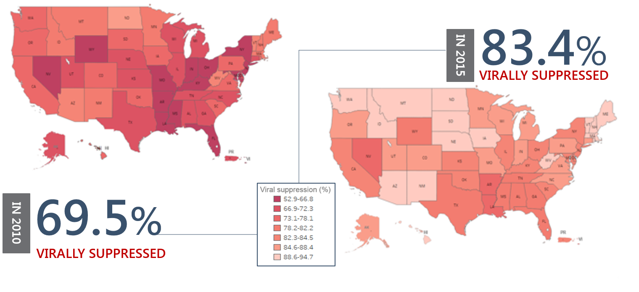
Viral Suppression among Clients Served by the Ryan White HIV/AIDS Program, by State,
2010–2015—United States and 2 Territoriesª
Viral suppression: ≥1 OAMC visit during the calendar year and ≥1 viral load reported, with the last viral load result <200 copies/mL.
ª Puerto Rico and the U.S. Virgin Islands. Due to low numbers, data for Guam are not presented.
Source: HRSA. Ryan White HIV/AIDS Program Services Report (RSR) 2015. Does not include AIDS Drug Assistance Program Data.
Objective HIV-22

Slide 75
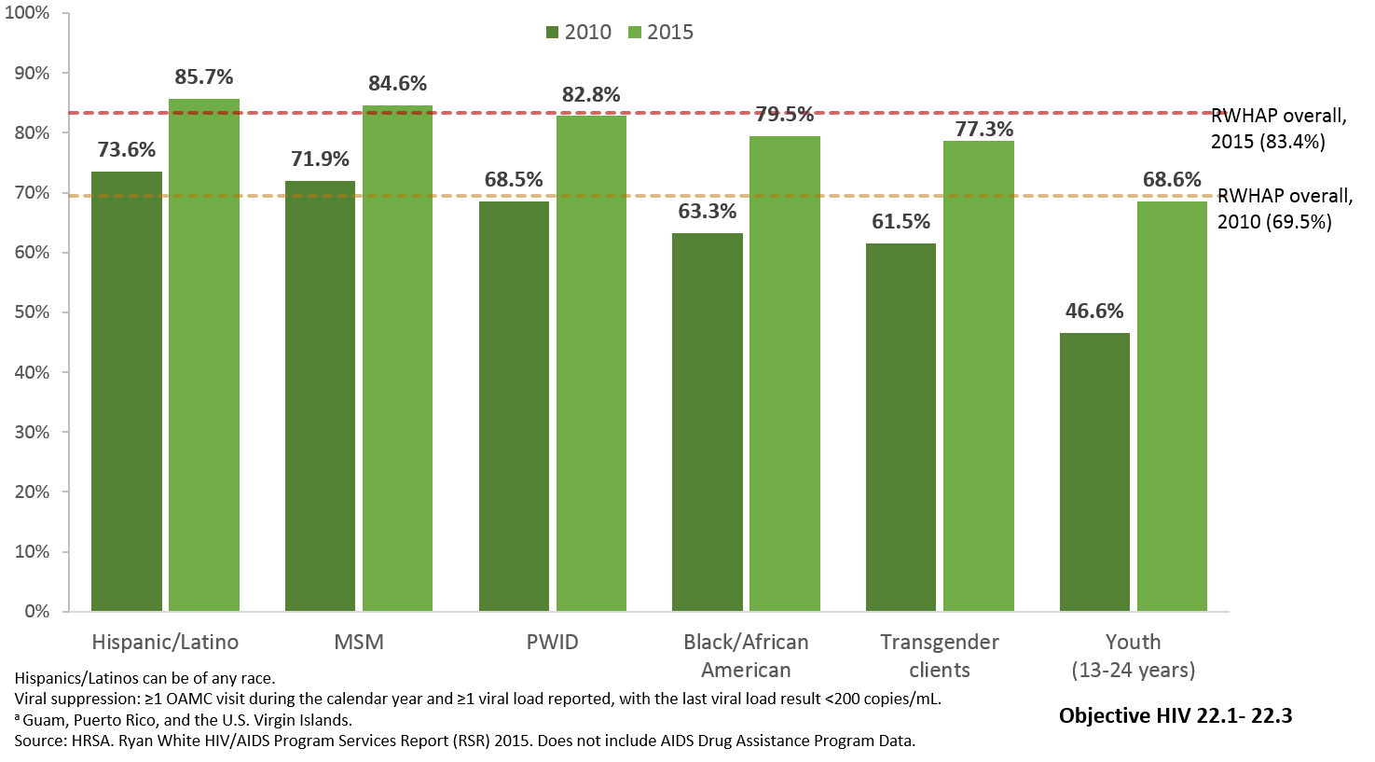
Viral Suppression among Key Populations Served by the Ryan White HIV/AIDS Program, 2010–2015—United States and 3 Territoriesª

Slide 76
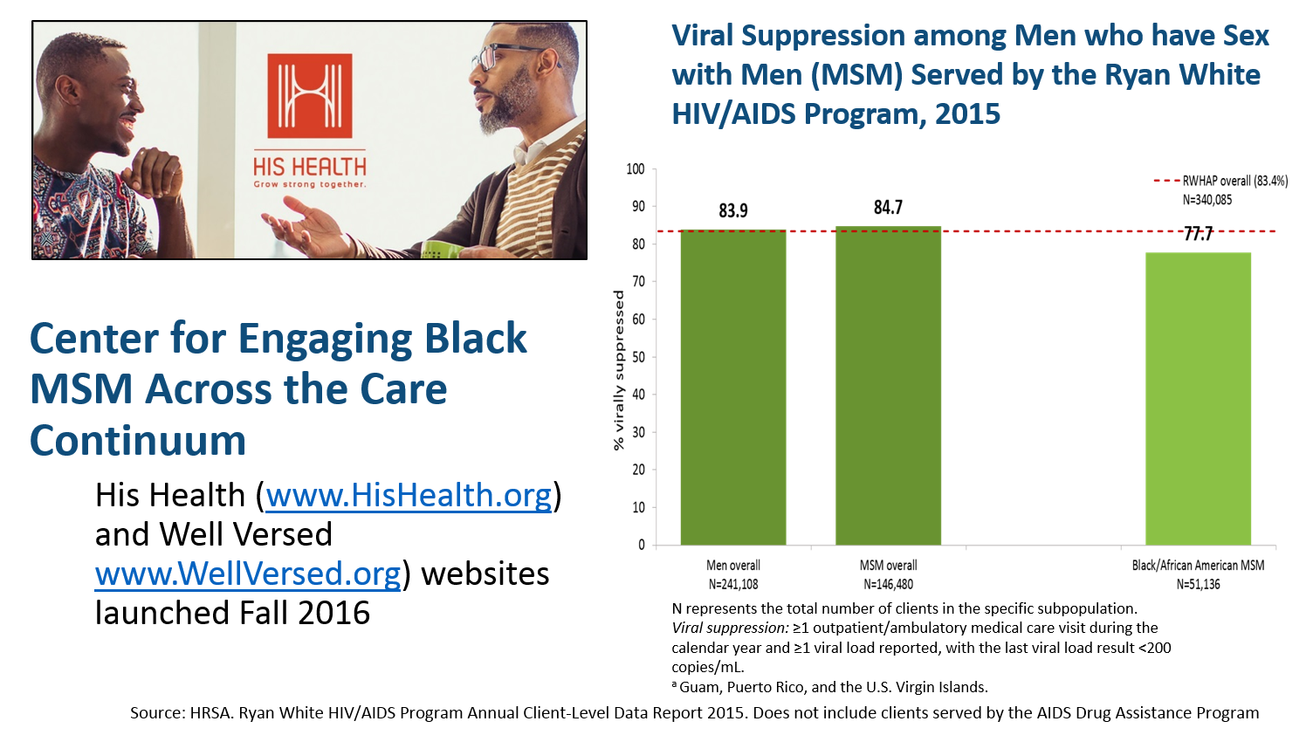
Implementing Solutions:
Improving Health Outcomes Among Black MSM

Slide 77
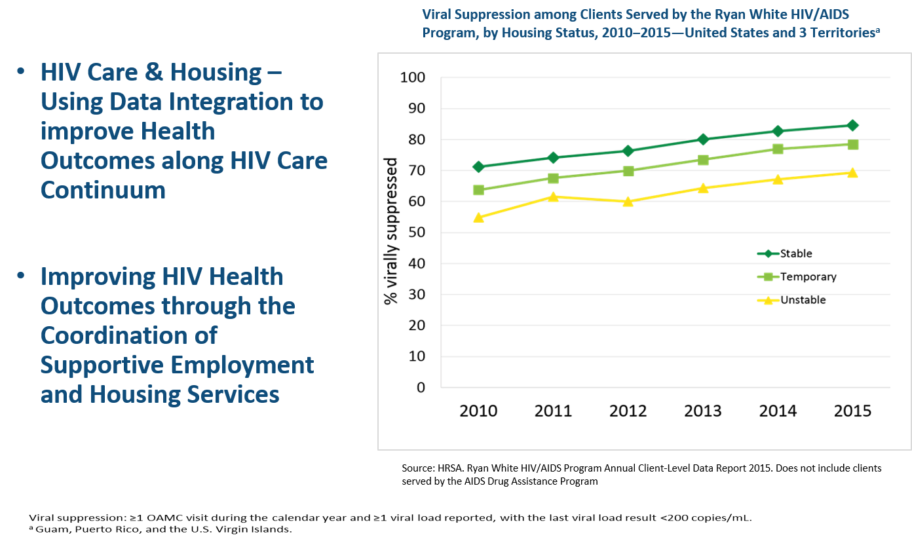
Implementing Solutions:
Focusing on Housing and Employment

Slide 78
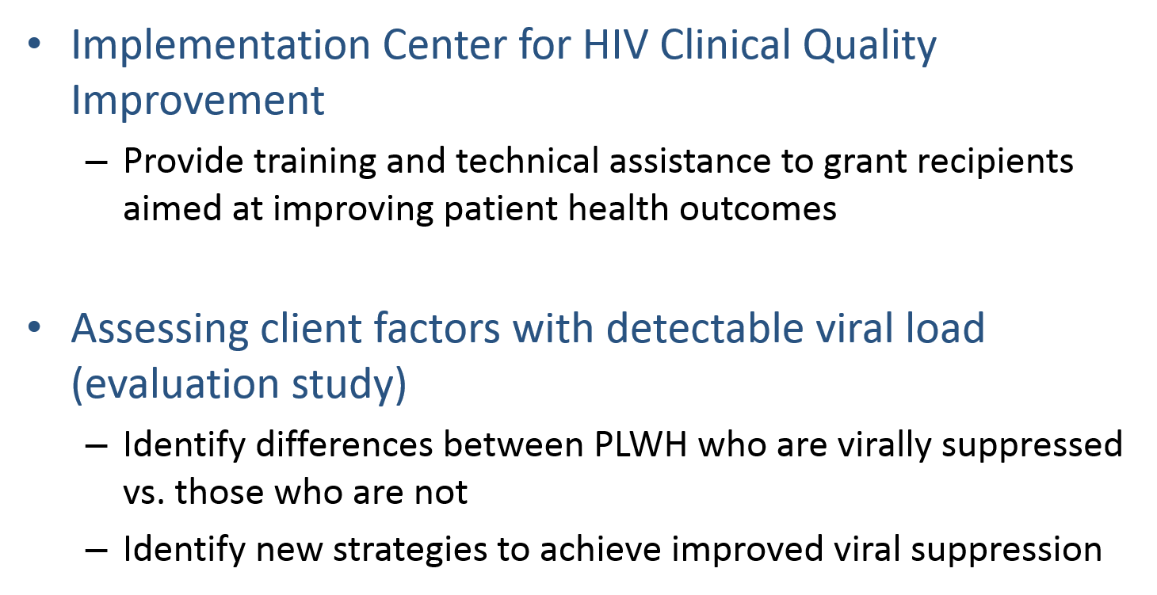
Identifying New Approaches to
Improve Health Outcomes
Objective HIV-20 and HIV-22.1

Slide 79
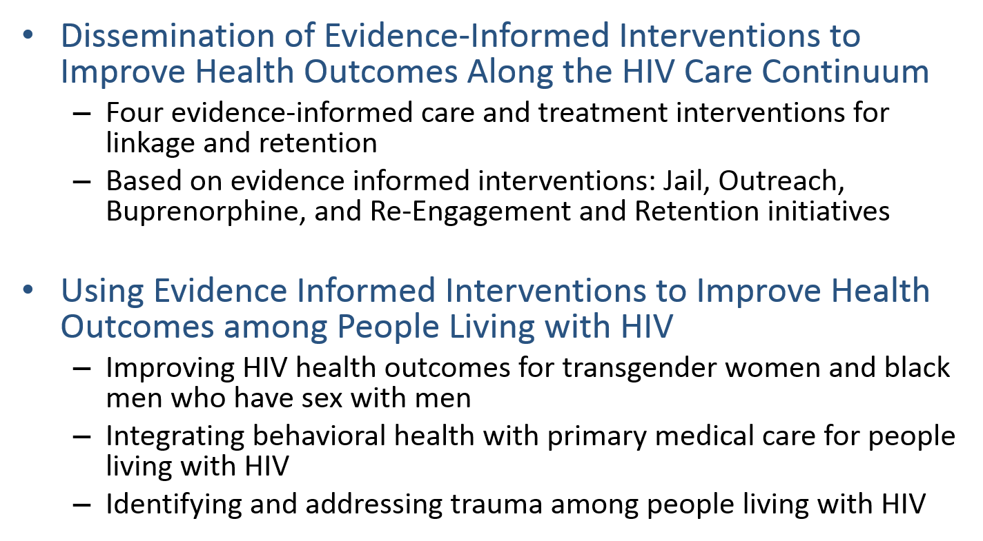
Identifying New Approaches to
Improve Health Outcomes

Slide 80
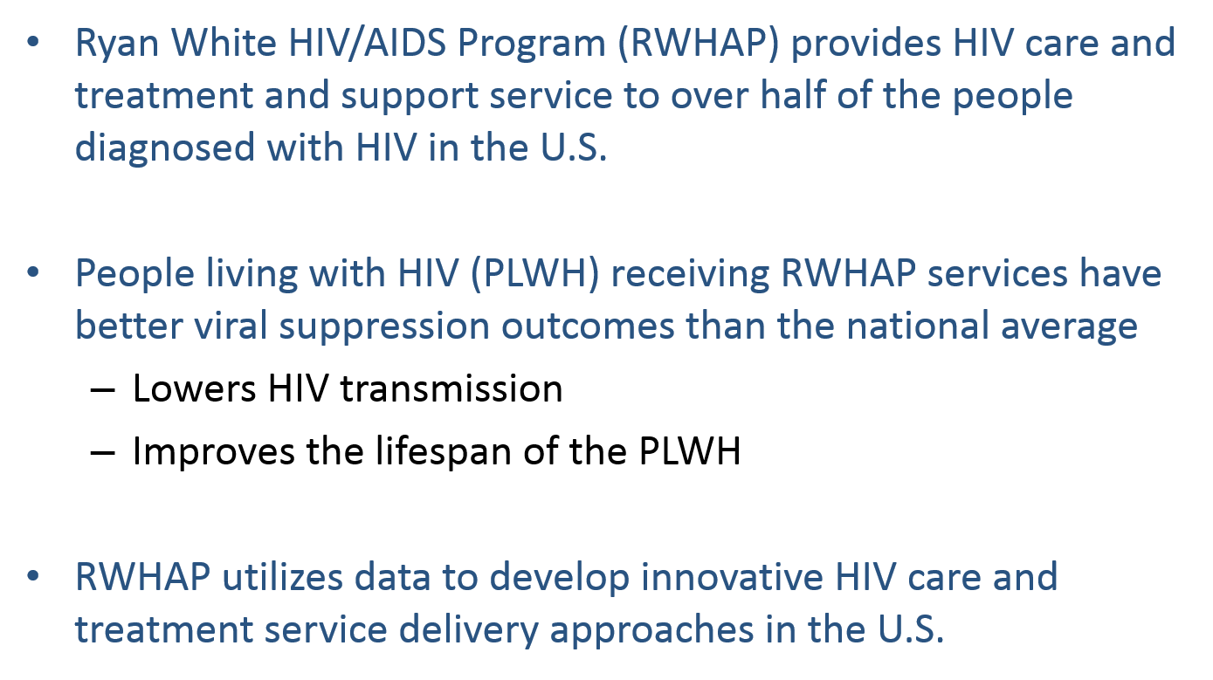
Summary

Slide 81
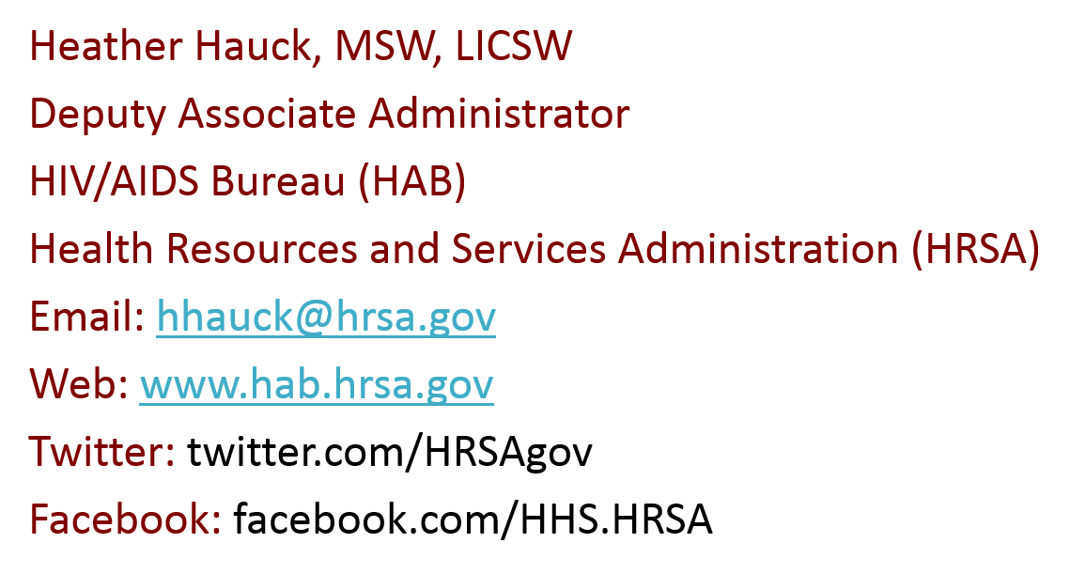
Thank you!

Slide 82
Healthy People 2020
STD/HIV Objectives:
Progress in Louisiana
DeAnn Gruber, PhD
Director, Bureau of Infectious Diseases
August 1, 2017

Slide 83
Louisiana Department of Health
Office of Public Health
STD/HIV Program
HIV/AIDS Program and STD Control Program merged in January 2011
Vision
Achieve a state of awareness that promotes personal and sexual health, ensures universal access to care, and eliminates new STD and HIV infections.
Mission
SHP’s mission is to lead the effort to build a holistic, integrated and innovative system of STD and HIV prevention, care and education that eliminates health inequities. We will do this by utilizing quality data and technology to inform and direct policy and programs around personal and sexual health.

Slide 84
Organizational Structure – Units and Core Functions
STD/HIV Program
Surveillance
Admin/Fiscal
General case ascertainment
Perinatal surveillance
HIV Incidence surveillance
Behavioral surveillance
Evaluation
Continuous Quality Improvement/ Performance Measures
Targeted Evaluation Plans
Regional Ops
Data Mgmt/Analysis
HIV/Syphilis partner services
Provider outreach/education
Outbreak response
ICCR
Data entry/cleaning/management
Data matching/analyses/reports
Services
Prevention
HIV drug assistance program
Health insurance program (Premium/co-pays)
Case management/supportive services
Housing assistance
STD/HIV testing
Linkage to care programs
Wellness centers
Condom distribution
Capacity building/community mobilization
Social media/marketing
PrEP education/support
STD Clinical
Clinician training/consultation
Collaborate with/support clinics for STD tx

Slide 85
Louisiana STD and HIV National Rankings
 | 2015
 | Ranking | # Cases | Rate
P&S Syphilis | 1st | 696 | 15.0*
Congenital Syphilis | 1st | 54 | 83.9**
Gonorrhea | 1st | 10,282 | 221.1*
Chlamydia | 2nd | 32,325 | 695.2*
HIV | 2nd | 1,131 | 24.2*
* Rate per 100,000
** Rate per 100,000 live births

Slide 86
Primary and Secondary Syphilis Diagnosis Rates
Louisiana and the United States, 2007-2016

Slide 87
Number of P&S Syphilis Diagnoses by Parish
Louisiana, 2016
75% of all P&S syphilis diagnoses in the state took place in 9 parishes.
55% of all diagnoses took place in just 4 parishes.

Slide 88
Congenital Syphilis Rates
Louisiana and the US, 2007-2016
Louisiana had 48 congenital syphilis cases in 2016, a decrease from 54 cases in 2015.
In 2015, Louisiana ranked 1st in the U.S. for CS case rate with a rate of 83.9 cases per 100,000 live births and was over six times the national rate of 12.4 cases per 100,000 live births.
In 2016, Louisiana’s case rate decreased to 75.2 cases per 100,000 live births. 2016 national data have not yet been released.
HP 2020 STD-8

Slide 89
STD/HIV Reduction Strategy
Successes
Tripled the number of syphilis tests performed at community-based organizations in 2016 (6,536) compared to 2015 (2,117)
Increased the number of primary and secondary syphilis cases that were treated within 14 days of specimen collection in public health clinics to 93.5% in 2016 compared to 78.6% in 2015
Implemented extra-genital GC/CT testing at 4 public health clinics in 2016; more than 165 cases would have been missed if dependent on urogenital testing alone
Implemented Congenital Syphilis Case Review process to identify missed opportunities and educate prenatal care providers
Supported the establishment of 13 PrEP clinics across the state in 2016, an increase from three clinics in 2015

Slide 90
HIV and Syphilis Co-infection in Louisiana, 2016
29% of all P&S syphilis diagnoses in 2016 were co-infected with HIV (211 co-infected cases/ 750 P&S syphilis cases )
  In some regions, it is much higher
    New Orleans: 47% (102/216)
    Baton Rouge: 40% (40/117)
  In other regions, much lower
    Monroe: 15% (11/73)
    Hammond/Slidell: 10% (2/20)

Slide 91
HIV Continuum of Care
Louisiana, 2016
HP 2020 HIV-20 and HP 2010 HIV-22.1
Virally Suppressed = Viral Load <200

Slide 92
Percent Virally Suppressed among All PLWDH and PLWDH in Care by Year, Louisiana
HP 2020 HIV-22.1
PLWDH = Persons Living with Diagnosed HIV

Slide 93
HIV Continuum of Care
Gay/Bisexual Men, 13-24, by Race, 2016
68% of PLWH in care were virally suppressed
88% of PLWH in care were virally suppressed
HP 2020 HIV-22.1

Slide 94
HIV Testing Highlights
Percent of persons living with HIV and diagnosed has increased from 75.4% in 2010 to 80.9% in 2014
HIV testing has increased from almost 96,000 tests in 2013 to 112,827 tests in 2016
Overall positivity ~1% each year
  In 2016, 0.4% were new positives
    0.3% at routine medical testing sites (emergency departments, clinics)
    0.9% at community-based organizations that serve priority populations
HIV linkage to care within 90 days has increased from 69% in 2013 to 83% in 2016
HP 2020 HIV-13

Slide 95
Linkage to Care Strategies
Linkage
System Navigation
Retention
Institutional Barriers
Treatment Adherence
Social
Support
Louisiana Links
Utilizes surveillance data to identify PLWH who are:
  Newly diagnosed and not linked to care
  Previously diagnosed who need reengagement
  In care, but experiencing high viral load
Linkage to Care Coordinators (LCCs) provide extensive services above and beyond the scope of traditional case management
Between September 2013 – March 2017, 1102 PLWH have been enrolled and 849 (77%) have been successfully linked to medical care

Slide 96
Louisiana HIV Continuum of Care:
Ryan White Services, 2016
Funds to support direct services to Persons Living with HIV
  Medications Assistance
  Health Insurance Support
  Oral Health Care
  Substance Use/Mental Health Services
  Case Management
  Transportation
Viral Suppression
  60% among all PLWDH in Louisiana
  80% among PLWDH who received Ryan White Services in Louisiana
HP 2020 HIV-22.1
PLWDH = Persons Living with Diagnosed HIV

Slide 97
Summary
To address high HIV and STD case rates, Louisiana has implemented specific strategies that are reflecting success:
  Increased STD and HIV testing activities to identify persons who are undiagnosed and need linkage to care/treatment
  Decreased number of congenital syphilis cases for the first time in five years
  Implemented linkage to care activities using HIV surveillance data to identify persons who are not linked to HIV-related care
  Provided direct services to persons living with HIV using Ryan White funds to increase coordinated and comprehensive care
  Continued upward trend of proportion of persons diagnosed with HIV who are virally suppressed
    60% in 2016 compared to 44% in 2012

Slide 98
Acknowledgements
Chaquetta Johnson, SHP Deputy Director
Jessica Fridge, SHP Surveillance Manager
Debbie Wendell, SHP Data Management/Analysis Manager
Sam Burgess, SHP Prevention Manager
Javone Davis Charles, SHP Regional Ops Manager
Kira Radtke Friedrich, SHP Services Manager
Catherine Desmarais, SHP Epidemiologist Supervisor
Ashley Hoover, SHP Perinatal Supervisor
Julie Fitch, SHP STD/HIV Testing Supervisor
Jacky Bickham, SHP Linkage to Care Supervisor
Joy Ewell, CDC Lead PHA
Mohammad Rahman, CDC Epidemiologist
Terri Gray, CDC PHA

Slide 99
Questions?
DeAnn Gruber, PhD
Director
Bureau of Infectious Diseases
deann.gruber@la.gov
504-568-7474

Slide 100
Roundtable Discussion
Carter Blakey
Deputy Director, Office of Disease Prevention and Health Promotion

Slide 101
Secretary’s Advisory Committee on National Health Promotion and Disease Prevention Objectives for 2030
Save the Date!
September 6 -7, 2017 (in-person)
Registration will be available soon on www.HealthyPeople.gov

Slide 102
Online Public Comment
Send Healthy People your written comments on the proposed framework for Healthy People 2030.
Visit www.HealthyPeople.gov from
June 27, 2017 – September 29, 2017

Slide 103
Progress Review Planning Group
  Norma Harris (CDC/NCHHSTP)
  Katrina Jackson (HRSA)
  Tanya Geiger (HRSA)
  Lori Elmore (CDC/NCHHSTP)
  Jennifer Ludovic (CDC/NCHHSTP)
  Stan Lehman (CDC/OD)
  Emily DeCoster (HRSA)
  Irma Arispe (CDC/NCHS)
  David Huang (CDC/NCHS)
  Leda Gurley (CDC/NCHS)
  Ritu Tuteja (CDC/NCHS)
  Sibeso Joyner (CDC/NCHS)
  Mark Montgomery (CDC/NCHS)
  Cheryl Rose (CDC/NCHS)
  Carter Blakey (HHS/ODPHP)
  Tiffani Kigenyi (HHS/ODPHP)
  Ayanna Johnson (HHS/ODPHP)
  Yen Lin (HHS/ODPHP)

Slide 104




Stay Connected
Web healthypeople.gov
Email healthypeople@hhs.gov
Twitter @gohealthypeople
YouTube ODPHP (search “healthy people”)
Join the Healthy People Listserv & Consortium

