Slide 1



Progress Review Webinar:
Early and Middle Childhood and
Adolescent Health
December 12, 2017

Slide 2
Learning and Growing: Healthy Development During Childhood and Adolescence
Don Wright, MD, MPH
Acting Assistant Secretary for Health
U.S. Department of Health and Human Services

Slide 3
Agenda and Presenters
Chair
Don Wright, MD, MPH, Acting Assistant Secretary for Health, U.S. Department of Health and Human Services
Presentations
Charles Rothwell, MBA, MS, Director, National Center for Health Statistics
Amanda Bryans, Director of Research Analysis and Communications Division, Administration for Children and Families
Evelyn Kappeler, Director, Office of Adolescent Health, U.S. Department of Health and Human Services
Georgina Peacock, MD, MPH, FAAP, Director Division of Human Development and Disability, CDC
Aaron Lopata, MD, Chief Medical Officer, Maternal and Child Health Bureau, HRSA
Community Highlight
Marilyn Crumpton, MD, MPH, Interim Health Commissioner, City of Cincinnati, Cincinnati, Ohio

Slide 4
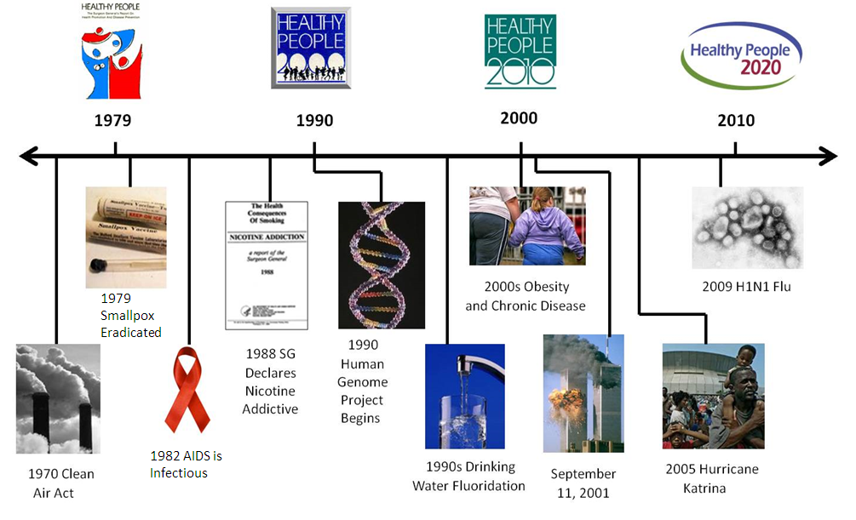
Healthy People at the Forefront of Public Health

Slide 5
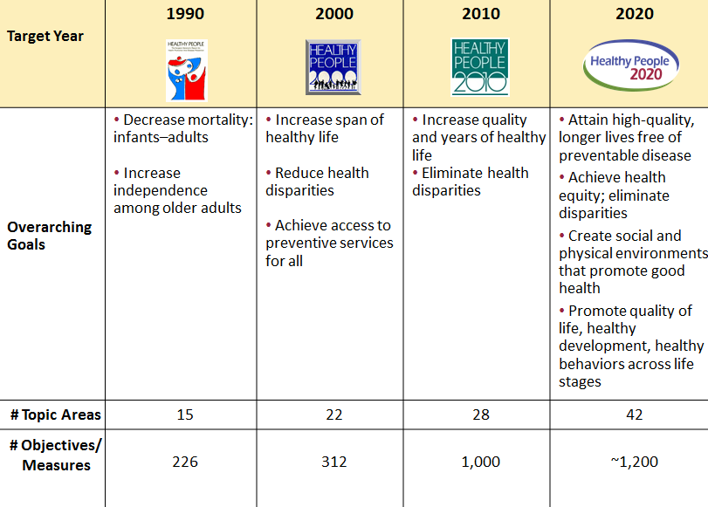
Evolution of Healthy People

Slide 6

Healthy People 2020 and Children
28 of 42 Healthy People Topic Areas impact children and adolescents such as:
  Environmental Health
  Mental Health
  Oral Health
  Sleep Health
  Maternal, Infant, and Child Health
Early and Middle Childhood and Adolescent Health topics cover a range of health objectives not addressed in other topic areas
Common themes across the topic areas include:
  Safety, security, and closeness to parents and other adults
  School readiness and academic progress
  Access to services, including developmental, wellness, and health education services
Source: https://www.healthypeople.gov/2020/topics-objectives/topic/Adolescent-Health

Slide 7

Children in the United States
In 2016, there were 73.6 million children and adolescents under the age of 18
  24.0 million ages 0-5
  24.7 million ages 6-11
  25.0 million ages 12-17
Children and adolescents make up approximately 22% of the U.S. population
Source: https://census.gov/

Slide 8

Early and Middle Childhood
Experiences in early and middle childhood are extremely important for a child’s healthy development and lifelong learning
  During early childhood, the human brain grows to 90% of its adult size by age 3
Pre-disease pathways for a number of adult health and medical conditions have their beginnings in early and middle childhood
Early and middle childhood sets the stage for:
  School success
  Health literacy
  Self-discipline
  Eating habits
  Conflict negotiations and healthy relationships
  The ability to make good decisions about risky situations
Source: https://www.healthypeople.gov/2020/topics-objectives/topic/early-and-middle-childhood

Slide 9

Understanding Adolescent Health
Adolescence is a critical transitional period that includes the biological changes of puberty and developmental tasks such as normative exploration and learning to be independent
Adolescents and young adults are particularly sensitive to influences from their social environments
Encouraging positive development of young people:
  Facilitates adoption of health behaviors
  Helps to ensure a healthy and productive adult population
Source: https://www.healthypeople.gov/2020/topics-objectives/topic/Adolescent-Health

Slide 10

Charles Rothwell, MBA, MS
Director, National Center for Health Statistics
Centers for Disease Control and Prevention

Slide 11
Presentation Overview
Tracking the Nation’s Progress
Early and Middle Childhood
Adolescent Health

Slide 12
Tracking the Nation’s Progress
13 Measurable HP2020 Early and Middle Childhood Objectives:
  1 Improving
  9 Little or no detectable change
    3 Getting worse
24 Measurable HP2020 Adolescent Health Objectives:
  8 Target met
9 Improving
5 Little or no detectable change
2 Baseline only
NOTES: Measurable objectives are defined as having at least one data point currently available, or a baseline, and anticipate additional data points throughout the decade to track progress. The Early and Middle Childhood Topic Area has 4 developmental objectives that are not discussed in this Progress Review.

Slide 13
Early and Middle Childhood:
Topic Areas with Related Objectives
Access to Health Services
Blood Disorders and Blood Safety
Cancer
Disability and Health
Educational and Community-Based Programs
Environmental Health
Food Safety
Hearing and Other Sensory or Communication Disorders
Heart Disease and Stroke
Immunization and Infectious Diseases
Injury and Violence Prevention
Maternal, Infant, and Child Health
Medical Product Safety
Mental Health and Mental Disorders
Nutrition and Weight Status
Oral Health
Physical Activity
Respiratory Diseases
Sexually Transmitted Diseases
Tobacco Use
Vision

Slide 14
Adolescent Health:
Topic Areas with Related Objectives
Access to Health Services
Immunization and Infectious Diseases
Disability and Health
Sleep Health
Injury and Violence Prevention
Substance Abuse
Mental Health and Mental Disorders
Hearing and Other Sensory or Communication Disorders
Nutrition and Weight Status
Oral Health
Physical Activity
Tobacco Use
Family Planning
HIV
Sexually Transmitted Diseases

Slide 15
Presentation Overview
Tracking the Nation’s Progress
Early and Middle Childhood
  Positive Parenting Objectives
    Positive communication between child and parent
    Young children who are read to every day
    Developmental inquiry from doctor
Adolescent Health

Slide 16
Positive Parenting: Communication between Child and Parent, 2011–2012
HP2020 Target: 76.8%
Family Income
(% Poverty Threshold)
NOTES: = 95% confidence interval. Data are for children aged 6 to 17 years whose parents reported they and child could share ideas and talk about things that mattered “very well.”
SOURCE: National Survey of Children’s Health (NSCH), HRSA/MCHB and CDC/NCHS.
I
Obj. EMC-2.2

Slide 17
Positive Parenting: Young Children Who Are Read to Every Day, 2011–2012
HP2020 Target: 52.6%
Family Income
(% Poverty Threshold)
I
NOTES: = 95% confidence interval. Data are for children aged 0 to 5 years whose parents reported that someone in their family read to the child every day in the past week.
SOURCE: National Survey of Children’s Health (NSCH), HRSA/MCHB and CDC/NCHS.
Obj. EMC-2.3

Slide 18
Positive Parenting: Developmental Inquiry from Doctor, 2011–2012
HP2020 Target: 52.8%
Family Income
(% Poverty Threshold)
NOTES: = 95% confidence interval. Data are for children aged 0 to 5 years who visited or used a health service in the past 12 months and whose parents reported that their child’s doctor or other health professional asked them about their concerns regarding the child’s learning, development, or behavior.
SOURCE: National Survey of Children’s Health (NSCH), HRSA/MCHB and CDC/NCHS.
I
Obj. EMC-2.4

Slide 19
Positive Parenting: Map of Developmental Inquiry from Doctor, 2011–2012
HP2020 Target = 52.8% ● National Rate = 51.8%
WA
MT
ND
ME
OR
ID
MN
VT
NH
SD
WI
MI
NY
MA
WY
CT
RI
NE
IA
PA
NJ
NV
UT
OH
MD
DE
IL
IN
WV
DC
CA
CO
VA
KS
MO
KY
TN
NC
OK
Percent
AZ
NM
AR
SC
39.8 - 46.0
AL
GA
46.1 - 50.9
MS
51.0 - 52.7
TX
52.8 - 59.8
LA
59.9 - 66.6
AK
States shown in green met the national target.
FL
HI
NOTES: Data are for children aged 0 to 5 years who visited or used a health service in the past 12 months and whose parents reported that their child’s doctor or other health professional asked them about their concerns regarding the child’s learning, development, or behavior. Data are displayed by a modified Jenks classification for states. For more information see National Center for Health Statistics. Appendix A: Technical Notes. Healthy People 2020 Midcourse Review. Hyattsville, MD. 2016. https://www.cdc.gov/nchs/data/hpdata2020/HP2020MCR-D01-Technical-Notes.pdf
SOURCE: National Survey of Children’s Health (NSCH), HRSA/MCHB and CDC/NCHS.
Obj. EMC-2.4
Increase desired

Slide 20
Presentation Overview
Tracking the Nation’s Progress
Early and Middle Childhood
Adolescent Health
  Wellness checkup
  Participation in extracurricular activities
  Adolescents had someone to talk to about problems
  Reading and mathematics skills
  Absenteeism due to illness
  Harassment at school
  High school graduation
  Arrests for property crimes

Slide 21
Adolescent Wellness Checkup
HP2020 Target: 75.6%
Health Insurance Status
Family Income (% Poverty Threshold)
NOTES: I = 95% confidence interval. *2008 = HP2020 baseline. Data are for adolescents aged 10 to 17 years who received a wellness checkup during the past 12 months when they were not sick or injured.
SOURCE: National Health Interview Survey (NHIS), CDC/NCHS.
Obj. AH-1
Increase desired

Slide 22
Participation in Extracurricular Activities, 2011–2012
HP2020 Target: 90.6%
Family Income
(% Poverty Threshold)
NOTES: = 95% confidence interval. Data are for adolescents aged 12 to 17 years participating in one or more organized extracurricular and/or out-of-school activities in the past 12 months including: 1. being on a sports team or taking sports lessons after school or on weekends; 2. participating in any clubs or organizations after school or on weekends; 3. participating in any other organized events or activities.
SOURCE: National Survey of Children’s Health (NSCH), HRSA/MCHB and CDC/NCHS.
I
Obj. AH-2

Slide 23
Adolescents Who Had Someone to Talk to About Problems
Percent
HP2020 Target: 83.2%
NOTES: I = 95% confidence interval. *2008 = HP2020 baseline. Data are for adolescents aged 12 to 17 years who have an adult in their lives with whom they can talk about serious problems.
SOURCE: National Survey on Drug Use and Health (NSDUH), SAMHSA.
Obj. AH-3.1
Increase desired

Slide 24
Proficient Reading and Mathematics Skills: 8th Grade Students, 2013
Percent
HP2020 Target:
35.6%
HP2020 Target: 37.3%
NOTES: I = 95% confidence interval. Data are for 8th grade students attending public or private schools scoring at the proficiency level or higher for their grade level in the reading (AH-5.3.2) and mathematics (AH-5.4.2) skills test administered by the National Assessment of Educational Progress. Proficiency is defined as demonstrating competency over challenging subject matter, including subject matter knowledge, application of such knowledge to real-world situations, analytical skills appropriate to the subject matter. American Indian or Alaska Native, Asian or Other Pacific Islander, Black and White exclude persons of Hispanic origin. Persons of Hispanic origin may be of any race.
SOURCE: National Assessment of Educational Progress (NAEP), ED/NCES.
Objs. AH-5.3.2 & AH-5.4.2
Increase desired

Slide 25
School Absenteeism Due to Illness or Injury, 2016
HP2020 Target: 3.6%
Decrease desired
Geographic Location
Family Income
(% Poverty Threshold)
NOTES: I = 95% confidence interval. *2008 = HP2020 baseline. Data are for adolescents aged 12 to 17 years who missed 11 or more whole school days during the preceding 12 months because of illness or injury.
SOURCE: National Health Interview Survey (NHIS), CDC/NCHS.
Obj. AH-5.6

Slide 26
School Policy Prohibiting Gender Identity and Sexual Orientation Harassment, 2016
National Target = 92.2% ● National Rate = 94.1%
WA
MT
ND
ME
OR
MN
VT
ID
WI
NY
NH
SD
MI
MA
WY
CT
RI
NE
IA
PA
NV
OH
MD
NJ
UT
IL
IN
DE
DC
CA
CO
WV
KS
MO
KY
VA
TN
NC
AZ
NM
OK
AR
SC
Percent
AL
78.4 - 86.9
MS
GA
87.0 - 92.1
TX
92.2 - 96.1
LA
96.2 - 99.3
AK
FL
Data not collected or statistically unreliable
States shown in green met the national target.
HI
NOTES: Data are for public and private middle and high schools that prohibit harassment based on a student’s perceived or actual sexual orientation or gender identity. Data are displayed by a modified Jenks classification for states. For more information see National Center for Health Statistics. Appendix A: Technical Notes. Healthy People 2020 Midcourse Review. Hyattsville, MD. 2016. https://www.cdc.gov/nchs/data/hpdata2020/HP2020MCR-D01-Technical-Notes.pdf
SOURCE: School Health Profiles, CDC/NCHHSTP.
Obj. AH-9
Increase desired

Slide 27
On-Time High School Graduation
Percent
HP2020 Target: 87%
Asian/Other Pacific Isl.
White
Total
Hispanic
Black
Am. Indian/Alaska Native
NOTES: *2010–2011 = HP2020 baseline. Data are for students who earned a regular high school diploma by the end of the school year, four school years after starting 9th grade for the first time and are measured using the 4-year adjusted cohort graduation rate. Black and White exclude persons of Hispanic origin. Persons of Hispanic origin may be of any race.
SOURCE: Common Core of Data (CCD), ED/NCES.
Obj. AH-5.1
Increase desired

Slide 28
High School Graduation of Students Served Under the IDEA
Percent
HP2020 Target: 65.0%
NOTES: *2007–2008 = HP2020 baseline. Data are for students aged 14 to 21 years served under the Individuals with Disabilities Education Act (IDEA), Part B, who graduated from high school with a diploma.
SOURCE: Individuals with Disabilities Education Act data (IDEA data), ED/OSERS.
Obj. AH-5.2
Increase desired

Slide 29
Arrests for Serious Property Crimes
Rate per 100,000
NOTES: *2008 = HP2020 baseline. Data are for arrests of juveniles aged 10 to 17 years and young adults aged 18 to 24 years for crimes included in the Property Crime Index including burglary, larceny-theft, motor vehicle theft, and arson.
SOURCE: Uniform Crime Reporting Program (UCR), DOJ/FBI.
Obj. AH-11.2
Decrease desired

Slide 30
Key Takeaways –
Early and Middle Childhood*
A higher percentage of young children aged 0–5 years are read to every day in families at higher family income levels.
  Children in families at or above 400% of the poverty threshold were the only group to have exceeded the target.
Disparities existed for young children aged 0–5 years whose parents reported that a doctor had asked them about concerns regarding their child’s development.
  Target exceeded: children aged 0–2 years, children living in families at or above 200% of the poverty threshold, and children covered by private health insurance.
  Target not met: children aged 3-5 years, children living below 200% of the poverty threshold, children with no health insurance, and children with public health insurance.
*Data are for 2011-2012

Slide 31
Key Takeaways – Adolescent Health
Although the percentage of adolescents who had a wellness checkup increased between 2008 and 2016, disparities existed by insurance status and family income.
In 2013, disparities for meeting the target for proficient reading and mathematics skills also existed by race and ethnicity as only Asian and White 8th graders met the targets for both objectives.
In 2016, school absenteeism due to illness or injury was highest among students from families in the two lowest income groups (i.e., <100% and 100-199%). These students did not meet the target for this objective.
Between school year 2010–2011 and 2014–2015, the high school graduation rate increased for all racial and ethnic groups. However, in 2014–2015, only Asian or other Pacific Islanders and White students met the target for graduating on time.

Slide 32
OFFICE OF HEAD START
Administration for Children and Families
Amanda Bryans
Director Research Analysis and Communication

Slide 33

PURPOSE OF HEAD START & EARLY HEAD START
To promote the school readiness of low income children by enhancing their cognitive, social and emotional development –
in a learning environment that supports children’s growth in all domains
through the provision of comprehensive services based on family needs assessments
SOURCE: HEAD START ACT Sec. 636. [42 U.S.C. 9831] as revised in 2007

Slide 34
Head Start Snapshot:
Each year nearly 1 million low income (poverty level) children from birth to age 5, including pregnant women, receive Head Start services. Approximately 200,000 in EHS and 800,000 in HS
Center based, home based, and family child care options
Over 1,600 grantees nationwide including the territories.
Approximately 13% of enrolled children are living with a disability
Source: 2017 Program Information Report (PIR)

Slide 35

Comprehensive Services-
In addition to education services, Head Start programs provide children and their families with health, nutrition, social and emotional, and family services.

Slide 36
What Comprehensive Services Look Like:
Developmental, hearing and vision screenings and follow-up evaluation and treatment as needed
Most services provided through referral
Children served nutritious meals
Family Services staff for each family

Slide 37
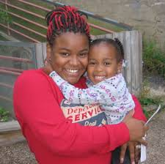
What Comprehensive Services
Look Like:
Parents included as experts on their own children and most influential people in children’s lives
Support for parents as advocates, including health literacy to promote effective interaction with medical providers

Slide 38
Medical Services
Source: PIR 2016

Slide 39
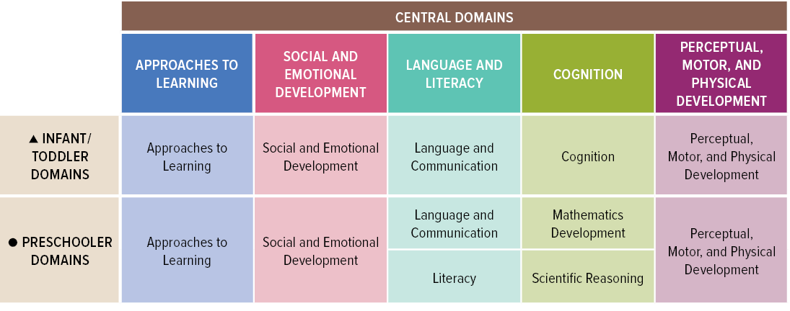
Head Start Education Services- the Early Learning Outcomes Framework
Begins with infants and toddlers and provides continuity for birth to 5 programming
Focuses on 5 key domains important for success in school and in life

Slide 40

More Information:
https://eclkc.ohs.acf.hhs.gov/

Slide 41

OAH’s Efforts to Improve Adolescent Health
Evelyn Kappeler
Director, Office of Adolescent Health (OAH)
Office of the Assistant Secretary for Health
U.S. Department of Health and Human Services

Slide 42
Office of Adolescent Health (OAH)
Mission: Leading the nation to ensure that America’s adolescents thrive and become healthy, productive adults
Key Strategies to improve adolescent health and well-being:
  Educate the public and professionals
  Support evidence-based programs and practices
  Lead through action
  Promote multi-sector partnerships
  Invest in evaluation and research

Slide 43

Adolescent Health in the U.S. Today
Adolescence is a critical period for promoting healthy behavior and reducing risk with the intent of fostering long term health
Most of the nation’s 42 million adolescents are generally physically healthy but face many social and emotional challenges
In recent years, the nation has seen declines in teen births, smoking, substance use, and higher academic achievement for younger adolescents
Adolescents can benefit from guidance to improve their health and development

Slide 44

Adolescent Health in the U.S. Today
Adolescence is a critical intervention point during the lifespan and the way adolescents spend their time can strongly influence their health later in life.
For youth to maintain a healthy future, they need plenty of sleep; good nutrition; regular exercise; and time to form relationships with family, friends, and caring adults.
Time adolescents spend in school and in after-school activities with peers and adults can advance healthy academic, emotional, social, and physical development.

Slide 45

Adolescent Health: Think, Act, Grow® (TAG)
National call to action to promote adolescent health
Comprehensive, strengths-based, positive youth development approach to improving adolescent health
Five Essentials for Healthy Adolescents
Positive connections with supportive people
Safe and secure places to live, learn, & play
Access to high-quality, teen-friendly health care
Opportunities for teens to engage as learners, leaders, team members, & workers
Coordinated adolescent- and family-centered services
AH-3 Positive Connections
AH-8 School safety
AH-11 Crimes
AH-1 Checkup
AH-5 Education Achievement
AH-2 Extracurricular
AH-9 Harassment

Slide 46



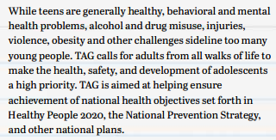
Adolescent Health: Think, Act, Grow® (TAG)

Slide 47
HHS Adolescent Health Working Group
Collaboration of adolescent health professionals across HHS
Sharing of key initiatives, tools, and resources across the department
Key presentations in the last year include:
  NIH Adolescent Brain Cognitive Development (ABCD) Study
  HRSA efforts around youth wellness checkup and transition from pediatric to adult health care
  Discussion of young male friendships
  US Surgeon General’s Report on Alcohol, Drugs, and Health
AH-1: Checkup
AH-3: Positive Connections
AH-7: Drugs

Slide 48
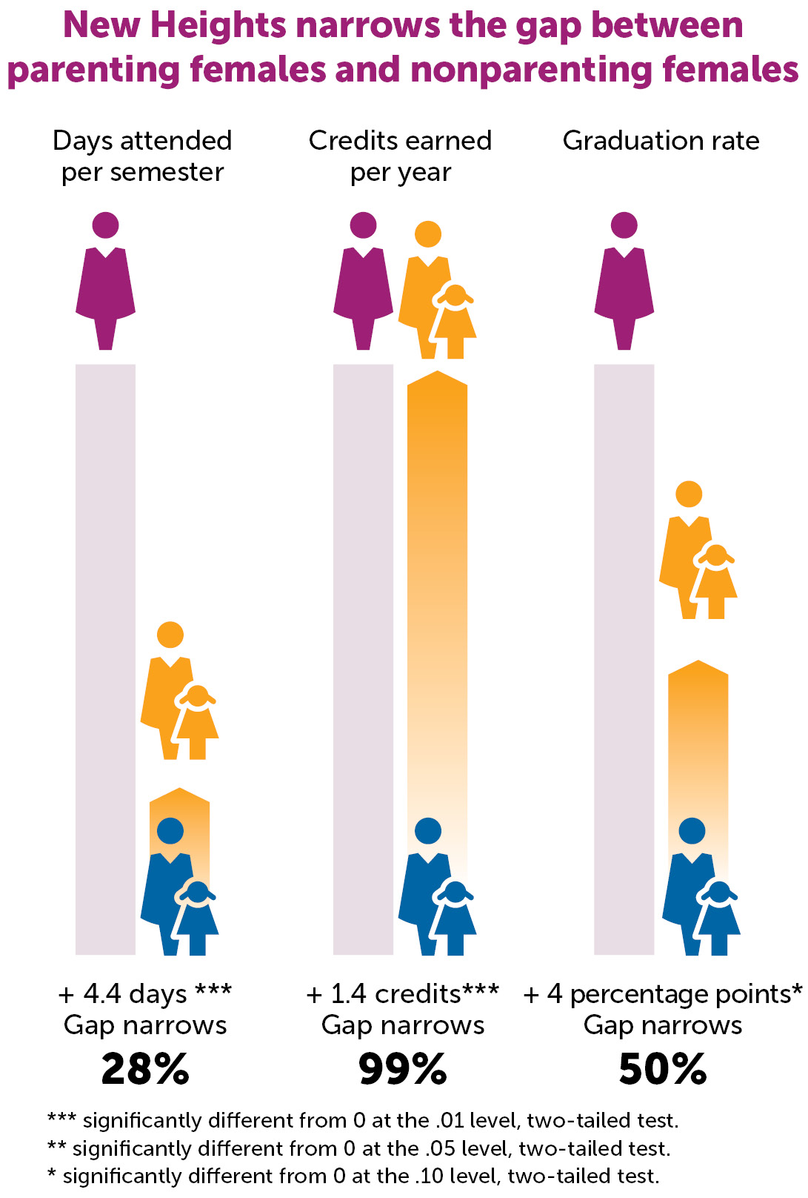
Pregnancy Assistance Fund Program
New Heights narrowed the education achievement gap between parenting females & nonparenting females
Holistic supportive services to improve health, educational, social and economic outcomes of expectant and parenting young families
Impact Results from New Heights Program in DC:
  Increase in school attendance
  Increase in credits earned
  Increase in high school graduation rate
AH-5.1: HS Graduation

Slide 49

Connect with Us!
Website: www.hhs.gov/ash/oah/
YouTube: www.youtube.com/teenhealthgov
Email for OAH: oah.gov@hhs.gov
Email for TAG: TAGteam@hhs.gov
Twitter: @teenhealthgov and #TAG42mil
E-Updates (Home Page)

Slide 50

CDC’s Programs for Childhood and Adolescence
Georgina Peacock, MD, MPH, FAAP
Director, Division of Human Development and Disability
National Center on Birth Defects and Developmental Disabilities
Centers for Disease Control and Prevention

Slide 51

Healthy Child Development: A Public Health Priority
Healthy development in childhood and adolescence is important for a healthy population
Childhood is a critical time to develop
  A healthy brain
  A healthy body
  Supportive relationships
  Healthy habits

Slide 52
CDC’s Work on Childhood and Adolescence
CDC conducts work on early and middle childhood and adolescent health objectives in multiple centers, including:
National Center on Birth Defects and Developmental Disabilities (NCBDDD)
National Center for Injury Prevention and Control (NCIPC)
National Center for Chronic Disease Prevention and Health Promotion (NCCDPHP)
National Center for HIV/AIDS, Viral Hepatitis, STD, and TB Prevention (NCHHSTP)

Slide 53






Healthy Child Development: A Public Health Priority
To protect children’s health throughout the lifespan, CDC works to
  Support parents in protecting, nurturing, and teaching children
  Train the public health workforce, including educators and healthcare providers
  Promote healthy communities and environments
  Collect needed information on health and development in childhood and adolescence to support progress
  towards the health goals

Slide 54
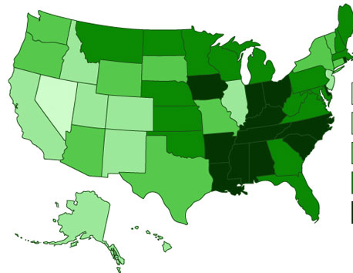


Collecting Information
CDC provides important information for Early and Middle Childhood and Adolescent Health topics:
National Health Interview Survey (NHIS)
  Monitoring the health of the nation since 1957, conducted by the Census Bureau
National Survey of Children’s Health (NSCH)
  Sponsored by the Maternal and Child Health Bureau of the Health Resources and Services Administration, conducted by the Census Bureau
Youth Risk Behavior Surveillance System (YRBSS)
  Conducted by CDC and state, territorial, and local education and health agencies and tribal governments
School Health Profiles (Profiles)
  Conducted by state, territorial, and local education and health agencies with technical assistance from CDC
School Health Policies and Practices Study (SHPPS)
  Conducted by CDC at the state, district, school, and classroom levels

Slide 55
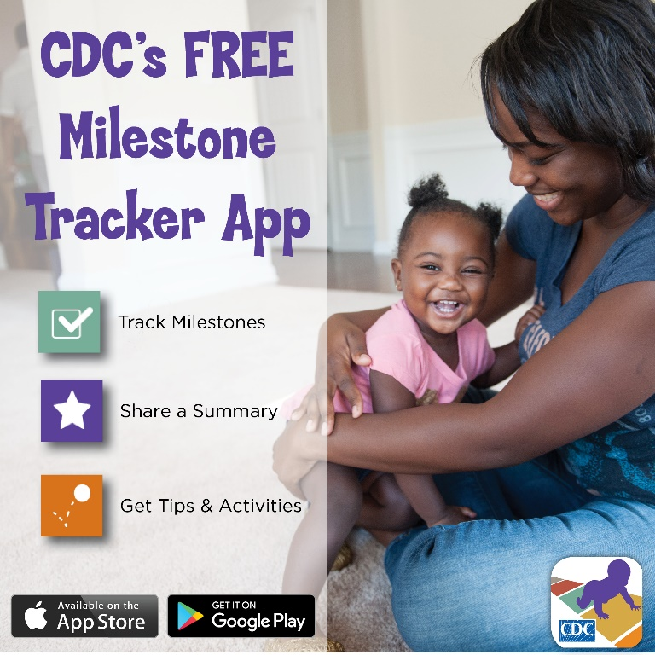
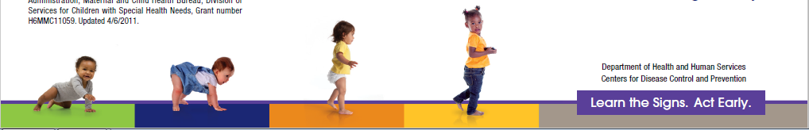
National Center on Birth Defects and Developmental Disabilities (NCBDDD)
Learn the Signs. Act Early. aims to improve early identification of developmental disabilities including autism
  Promotes parent-engaged developmental monitoring and developmental screening
  Involves parents, healthcare providers, early care and education providers, home visitors and public health providers such as WIC
  Includes Health Education Campaign and Act Early Initiative
EMC-1 School readiness
EMC-2 Positive parenting and developmental advice

Slide 56

National Center on Birth Defects and Developmental Disabilities
Legacy for Children™: Promoting positive parenting among families affected by poverty
Group-based intervention focusing on
  Role of parents and their positive influence their children
  Sense of connection among participants
Goal is to prevent developmental delays
Pilot implementation:
  Administration for Children and Families’ Early Head Start
  Health Resources and Services Administration’s Healthy Start
  Substance Abuse and Mental Health Administration’s Project LAUNCH
  Non-governmental partner sites
EMC-1 School readiness
EMC-2 Positive parenting and developmental advice

Slide 57


National Center for Injury Prevention and Control (NCIPC)
Essentials for Childhood framework to assure safe, stable, nurturing relationships and environments for all children by
  Establishing cross-sector partnerships
  Increasing reach of evidence-based programs and policies
  Providing strategies communities can consider to prevent child abuse and neglect and to promote positive parent-child relationships
EMC-1 School readiness
EMC-2 Positive parenting and developmental advice
AH-3: Positive connections
AH-8 School safety
AH-10 School violence
AH-11 Crimes

Slide 58
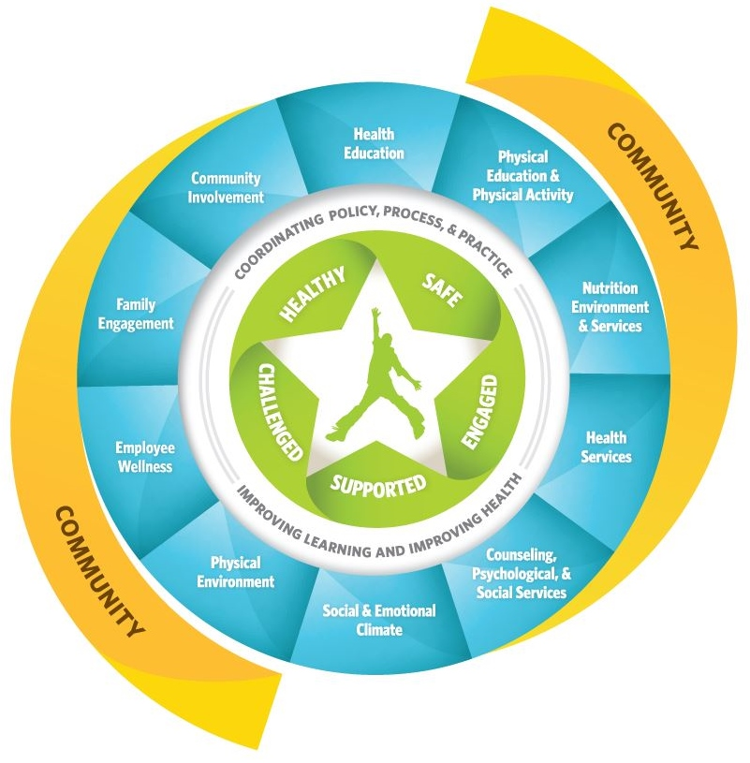
National Center for Chronic Disease Prevention and Health Promotion (NCCDPHP)
Whole School, Whole Community, Whole Child
Coordinated school health approach designed to improve learning and health in our nation’s schools.
Examples:
  School Health Index 2017: Self-assessment tool to increase health and safety at school
  Parents for Healthy Schools, Parent Engagement Strategies: Training and dissemination to state education and health leaders
EMC-1 School readiness
EMC-4 Health education
AH-3: Positive connections
AH-5 Education achievement
AH-8 School safety
AH-9 Harassment
AH-10 School violence

Slide 59
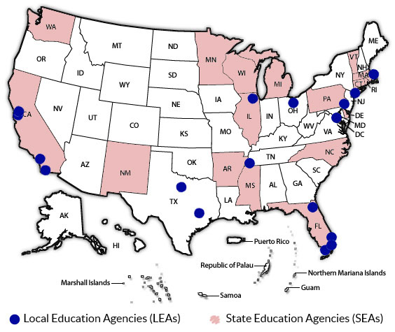
National Center for HIV/AIDS, Viral Hepatitis, STD, and TB Prevention
Division of Adolescent and School Health (NCHHSTP)
CDC provides funding and technical support for state and local education agencies to help districts and schools
Deliver sexual health education emphasizing HIV and other STD prevention
Increase access to sexual health services
Establish safe and supportive environments for students and staff
CDC works with partners to build the capacity of agencies to do this work
AH-8 School safety
AH-9 Harassment

Slide 60


Cross-Center Collaborations
Health Education Curriculum Analysis Tool (HECAT)
  Helps school districts, schools, and others conduct a clear, complete, and consistent analysis of health education curricula.
  Uses National Health Education Standards and CDC’s Characteristics of an Effective Health Education Curriculum.
Making the Connection: Teen Health and Academic Grades Report
Among U.S. high school students, health risk behaviors—specifically those related to physical inactivity, unhealthy diet, substance use, sexual risk, violence, and suicide—are linked to lower academic grades.
EMC-4 Health education
AH-10 School violence
AH-7 Drugs
AH-5 Education achievement
AH-8 School safety
AH-9 Harassment
AH-3: Positive connections

Slide 61
Contact Us!
www.cdc.gov
1-800-CDC-INFO (800-232-4636), TTY 888-232-6348
For more information on this presentation please contact:
Angelika Claussen, PhD, EMC topic area co-lead
Division of Human Development and Disability
National Center on Birth Defects and Developmental Disabilities, Centers for Disease Control and Prevention
Email: aclaussen@cdc.gov
61

Slide 62

Fostering the Health & Healthy Development of Young Children and Adolescents:
Four HRSA Programs
Aaron Lopata, M.D.
Chief Medical Officer
Maternal and Child Health Bureau (MCHB)
Health Resources and Services Administration (HRSA)

Slide 63
About the Health Resources and Services Administration (HRSA)
Is an agency of U.S. Department of Health and Human Services
Improves health care for people who are geographically isolated, economically or medically vulnerable
Serves tens of millions of people each year, including women, mothers, children, adolescents, their families, and those otherwise unable to access quality health care
Large HRSA programs serving children and adolescents:
  Health Centers provide care throughout the country
  Ryan White Program Part D provides family-centered primary care for infants, children and youth living with HIV
  Maternal and Child Health Title V Block Grant serves infants, children, and youth (ages 0-21) in every state

Slide 64
About the Maternal and Child Health Bureau
Mission – Improve the health of America’s mothers, children, and families
Vision – An America where all children and families are healthy and thriving
Approach – Evidence-based strategies to implement programs
Goals (are aligned with HRSA’s goals)
  Improve access to quality health care and services
  Strengthen the health workforce
  Build healthy communities
  Improve health equity
  Strengthen program operations

Slide 65
HRSA/MCHB Programs Fostering the Health and Healthy Development of Young Children

Slide 66
HRSA/MCHB’s
Maternal, Infant, and Early Childhood Home Visiting Program (MIECHV)

Slide 67
Overview of MIECHV Program
Gives vulnerable pregnant women and families resources and skills for raising children who are physically, socially, and emotionally healthy and ready to learn
Funds states, territories, and tribal entities to develop and implement evidence-based, voluntary programs that meet the needs of their communities
Goals for every grantee
  Improve maternal and child health
  Prevent child abuse and neglect
  Encourage positive parenting
  Promote child development and school readiness
EMC-1: School Readiness
EMC-2: Positive Parenting

Slide 68

Growth of MIECHV Program
Since 2012
  Programs have provided nearly 3.3 million home visits
In 2016
  Programs are in 50 states, including 27% of counties (893)
  States served 160,000 participants

Slide 69

Families Served by MIECHV Program
Families Served in 2016
74% of families <100% federal poverty
66% of newly enrolled adult participants had a high school diploma or less education
22% of newly enrolled households included pregnant teens
14% of newly enrolled households had a history of child abuse and neglect
13% of newly enrolled households had a history of substance abuse

Slide 70

MIECHV Program Outcomes Show a Positive Return on Investment
  Prevent child abuse and neglect, encourage positive parenting, and promote child development and school readiness
  Promote higher parental earnings, decrease use of public assistance programs, reduce maternal depression, and decrease ADHD diagnosis among young children

Slide 71
HRSA/MCHB’s Early Childhood
Comprehensive Systems (ECCS) Impact Grants and
CoIIN Coordination Center

Slide 72
ECCS Grants and CoIIN Coordination Center
Enhance building of early childhood systems and demonstrate improved outcomes in population-based children’s developmental health and family well-being
  Expectation: Within 5 years, participating communities will show a 25% increase in age-appropriate developmental skills among 3-year-old children
Include 12 agencies/organizations as grantees, each representing a state and its communities, an average of 2.5 communities per state
Use a CoIIN approach – Collaborative Improvement and Innovation Network
  Collective learning among grantees
  Coordination Center – Organizational backbone
  Quality improvement through testing to learn what works
    Common benchmarks
    Plan-do-study-act cycles using real-time data
  Dissemination of successful strategies to states and communities
EMC-1: School Readiness
EMC-2: Positive Parenting

Slide 73
HRSA/MCHB Programs Fostering the Health and Healthy Development of Children and Adolescents

Slide 74
Adolescent & Young Adult Health
National Resource Center (AYAH Center)
Strengthens the capacity of State Title V MCH Programs, and their public health and clinical partners, to improve the health and healthy development of adolescents and young adults
Five goal areas
  Access to and use of health care, especially preventive health checkups
  Quality and comprehensiveness of care
  Integration of effort between public and clinical health sectors
  Equity among population groups
  Accountability among State Title V MCH programs for increasing the proportion of adolescents who receive an annual health checkup
AH-1: Wellness Checkup
AH-2: Connection with Adult

Slide 75

Importance of the Health Checkup Visit for Adolescents
Primary focus of AYAH Center – improve receipt and quality of the health checkup visit among adolescents and young adults
Why focus on the health checkup visit?
  Increases delivery of recommended preventive services
  Increases identification of health issues and behavioral risks
  Enhances opportunities for health counseling
  Builds relationships between adolescents and caring, knowledgeable adults

Slide 76
How AYAH Center Focuses on the Health Checkup Visit
CoIIN mechanism used to improve receipt and quality of the health checkup visit for adolescents and young adults
      Drives quality improvement by testing different strategies
      Uses collaborative learning, common benchmarks, coordinated strategies, and rapid test cycles with real-time data
      Works closely with 12 states and their partners
      Has three national strategies
        To the door – increase access, engage youth and their families as well as clinical sites
        In the door – improve delivery of youth-centered, family engaged care
        Across the state – develop and improve state- and system-level policies and practices
    Technical assistance provided to the 42 states that address a national or state MCH performance measure on increasing the proportion of adolescents who receive an annual health checkup visit
      Includes lessons learned from the experiences of the CoIIN

Slide 77
CoIIN on School-Based Health Services (CoIIN-SBHS)
Program Goals
Improve the clinical quality of school-based health centers (SBHCs) and comprehensive school mental health systems (CSMHSs)
Expand the number and strengthen the sustainability of SBHCs and CSMHSs through the spread of innovative yet practical policy and finance approaches
Why Focus on School-Based Health Services?
Efficient way to reach children and adolescents
  Increased access to health care, especially among students living in rural areas or low income communities
Documented increase in delivery of recommended preventive services, such as immunizations, as well as decrease in asthma morbidity
Improved student academic achievement, attendance, and behavior
Improved school climate and enhanced perception of the school as a community
AH-1: Wellness Checkup
AH-3: Connection with Adult
AH-5: Educational Achievement
AH-7: Illegal Drugs at School
AH-8: Safety at School
AH-9: Harassment at School
AH-10: Violence at School
AH-11: Perpetration & Victimization

Slide 78
How CoIIN-SBHS Works
CoIIN mechanism provides intensity needed to achieve rapid learning of strategies that work for achieving benchmarks
  Example: Clinical quality measures for SBHCs
    Annual well child visit; Annual risk assessment; BMI screening and nutrition/physical activity counseling; Depression screening and follow-up plan documented if positive screen; Chlamydia screening
  Example: Sustainability self-assessment indicators for CSMHSs
    Diverse funding and resources; Maximal use of resources; System quality/standards for services and supports; Documentation of reporting and impact; System marketing and promotion
National engagement of at least 50% of all SBHCs and CSMHSs in quality improvement
  Clinical efforts
  Best business practices/organizational policies

Slide 79
Contact Information
Thank you from HRSA/MCHB
For additional information, please contact:
  Trina M. Anglin, M.D., Ph.D.
  Chief, Adolescent Health Branch
  Division of Child, Adolescent and Family Health
  Maternal and Child Health Bureau
  tanglin@hrsa.gov
  301/443-4291
Website
  https://mchb.hrsa.gov/

Slide 80


School Based Health Services in
Cincinnati
Marilyn Crumpton, MD, MPH
Interim Health Commissioner
December 12, 2017

Slide 81
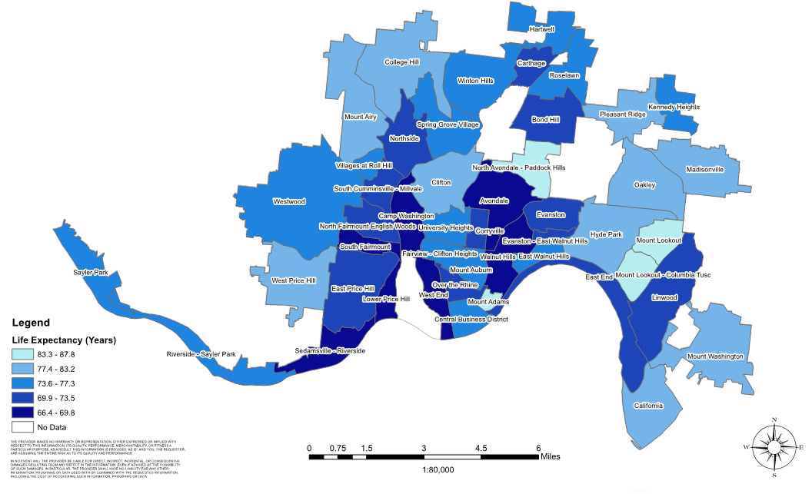

Differences in Life Expectancy (in Years) by Cincinnati Neighborhood
Based on Death Certificate Data 2001-2009
Camille Jones, MD, MPH, Assistant Health Commissioner, City of Cincinnati
Maryse Amin, PhD, MS, Supervising Epidemiologist Cincinnati Health Department

Slide 82

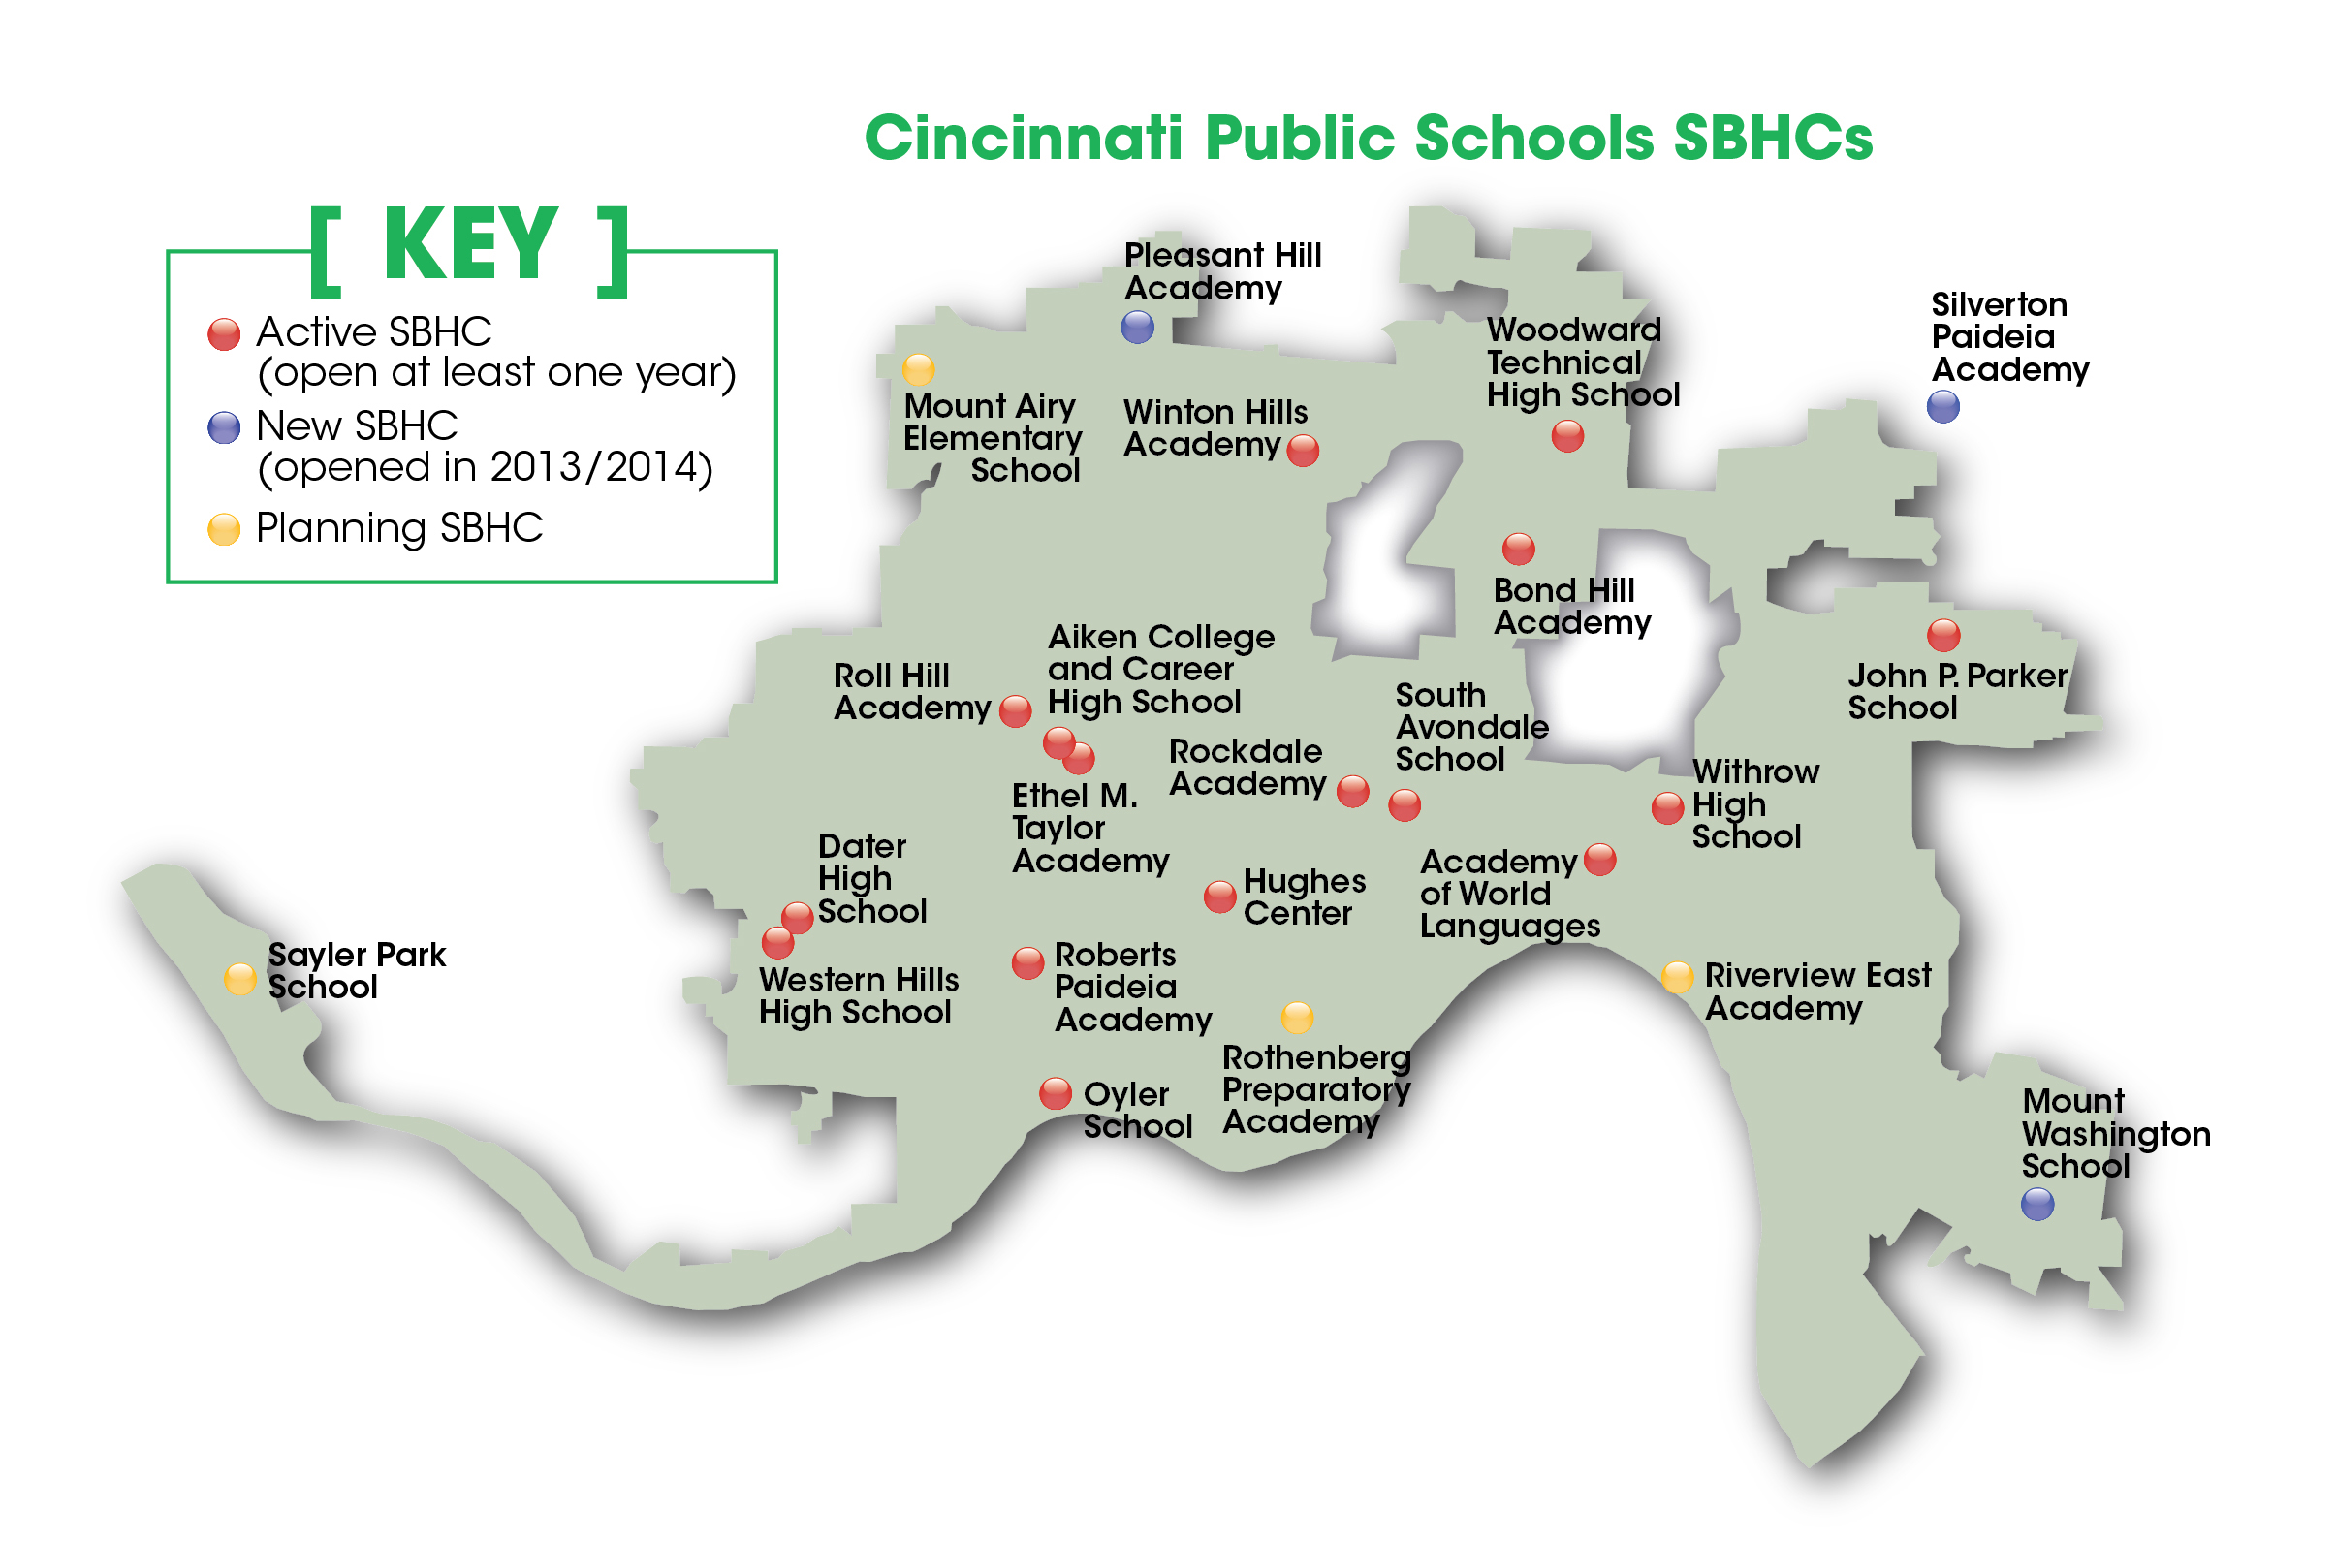

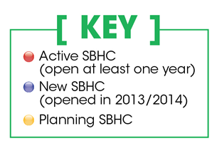
25 Cincinnati Public Schools Health Centers

Slide 83

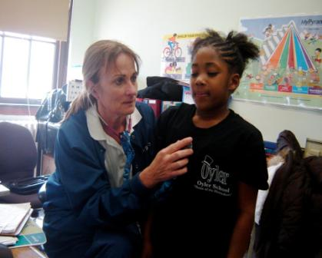
Why School Based Health Services?
  Address social determinants of health
  Locating services with children at their school
  Reduce lost seat time
  Save parent work time
  Creates regular access for completing treatment plans
  Partner with school for school-wide interventions
Notes:
83

Slide 84

Community Learning Center Model

Slide 85
School Nurses Collect & Report Student Health Data
Health Data by School Year | 2007-08 | 2008-09 | 2009-10 | 2011-12 | 2014-15 | 2016-17
Census of schools served | 20936 | 22217 | 22563 | 32095 | 34448 | 34914
Health Records | NA | NA | NA | 19238 | 22466 | 25249
Asthma | 2209 | 2659 | 2844 | 4169 | 4538 | 4776
Diabetes | 37 | 35 | 45 | 87 | 98 | 74/22
Sickle Cell | 46 | 56 | 57 | 73 | 108 | 101
Seizures | 163 | 140 | 184 | 298 | 310 | 323
Severe Allergies | 241 | 286 | 618 | 984 | 1383 | 1550
Dental Problems | 2569 | 2338 | 2117 | 2148 | 4157 | 4994
Behavioral* | NA | NA | 422 | 1047 | 1237 | 1303
ADHD* | NA | NA | 1107 | 1630 | 2247 | 2438
* Underreported

Slide 86
School Models for Resiliency Building Interventions
Health Screenings in Health Centers
Depression – PHQ
RAAPS²
SBIRT³
SDQ⁴
Other Social & Behavioral Risk Screens
Referral to Mental Health
MindPeace
Mental Health Partnerships
School Based Community Mental Health Treatment
Suicide Education, Research & Advocacy (SERA)
Trauma informed schools training
Suicide Prevention & Postvention
¹Patient Health Questionnaire
²Rapid Assessment for Adolescent Preventive Services
³Screening, Brief Intervention, & Referral to Treatment
⁴ Strengths & Difficulties Questionnaire

Slide 87
School Based Resiliency Building Interventions
  APHA: A Program to Improve Graduation
Three High Schools
RAAPS †
Health Center individual interventions
Population-wide Interventions
  Food pantry
  Shower access
  Chill Room
  Student leadership
  †Rapid Assessment for Adolescent Preventive Services
Creating a Culture of Resilience
in the Classroom
School Nurse led initiative
Foundation of teacher training
Classroom intervention strategies
  Calm down corner
  Coping skills
  Classroom management
Pilot phase

Slide 88
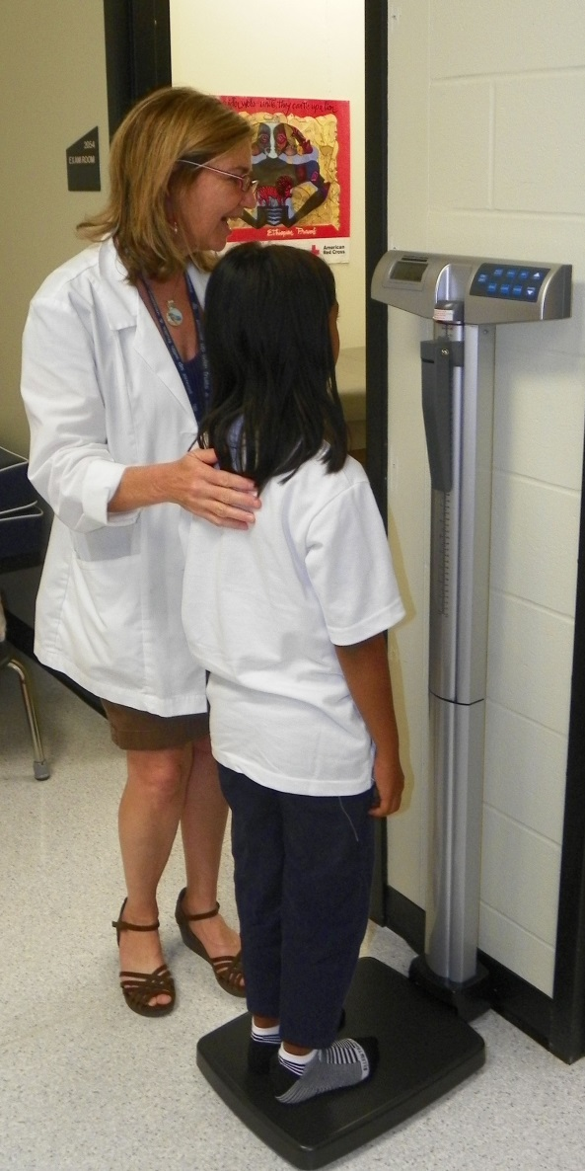
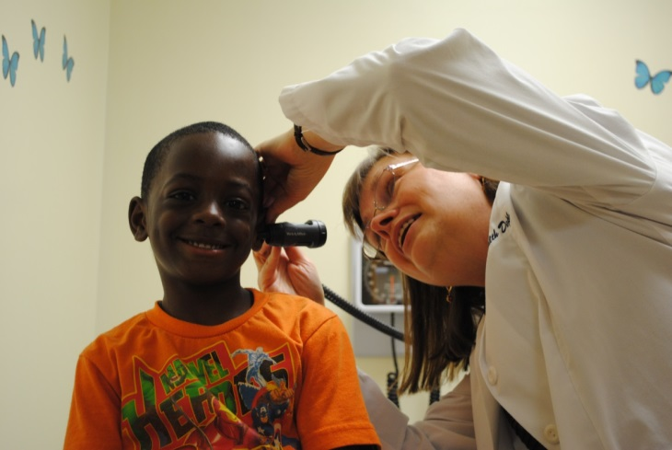

Early Childhood Access at School
Academic
Childhood screenings
  Social and behavioral risk screenings
  Developmental assessments
  Lead
Immunization
Dental
Vision
Notes:
88

Slide 89
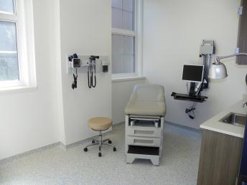
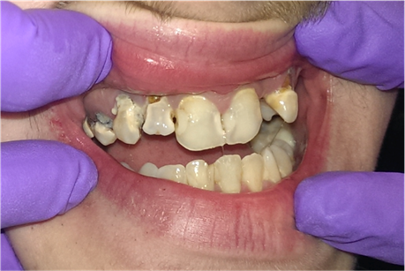
Adolescent Services
  Annual Wellness Exam
  Immunizations
  Mental Health Assessment & Referral to School Based Provider
  Chronic Disease Management
  Sexually Transmitted Disease Counseling, Screening & Treatment
  Contraception
  Referral for Prenatal Care
  Healthy Eating & Active Living
  Safety
  Dental & Vision

Slide 90
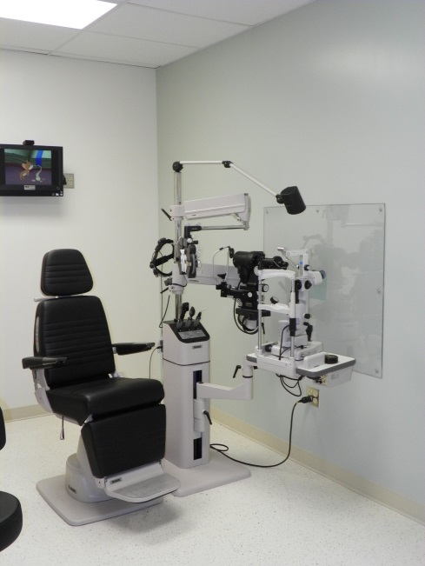

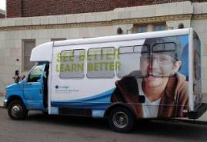

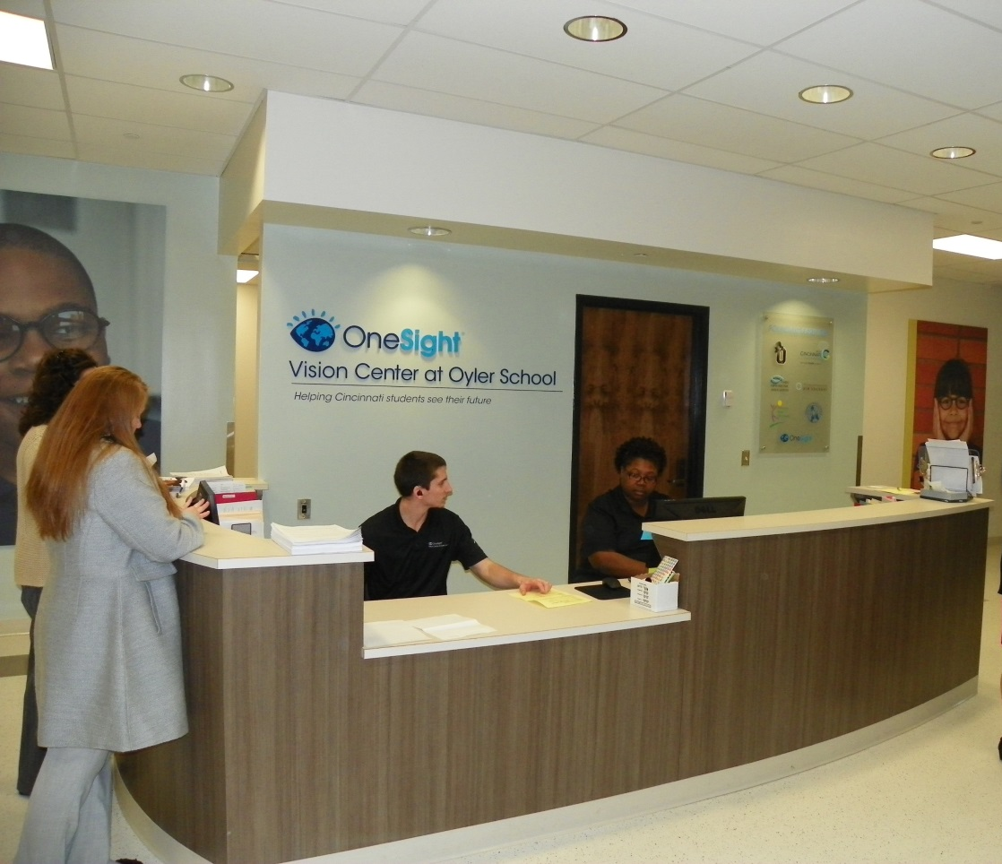
OneSight Vision Center at Oyler

Slide 91
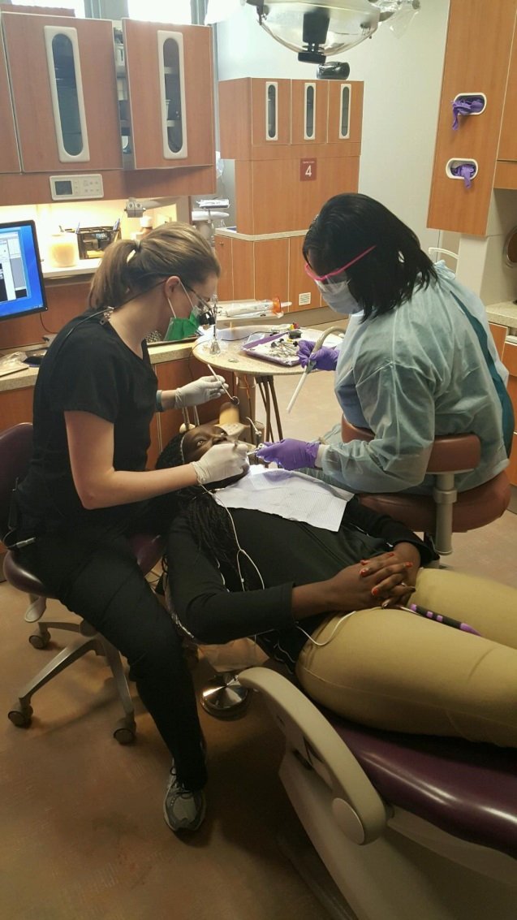
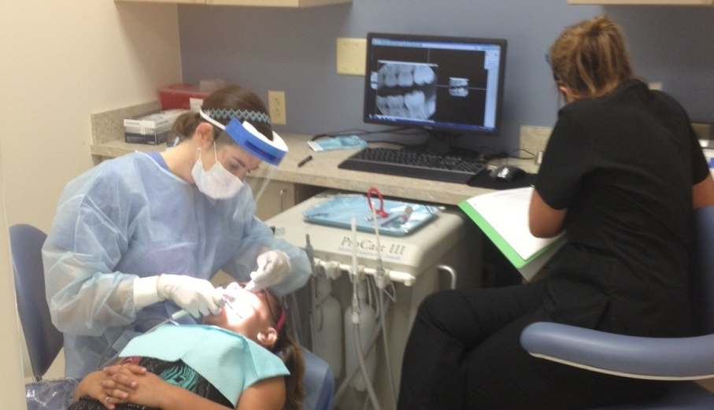
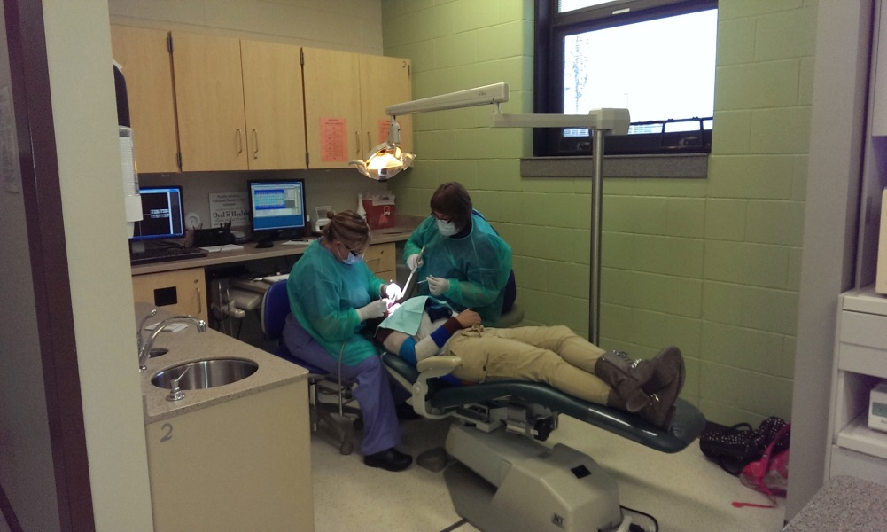

Dental Centers in Cincinnati Public Schools
May 2015
Withrow High School
Dr. Hudepohl
September 2013
Delta Dental Center at Oyler, Drs. Novais & Toole
September 2014
Deaconess at Western Hills/Dater High School
Dr. Oberlander & Toole

Slide 92
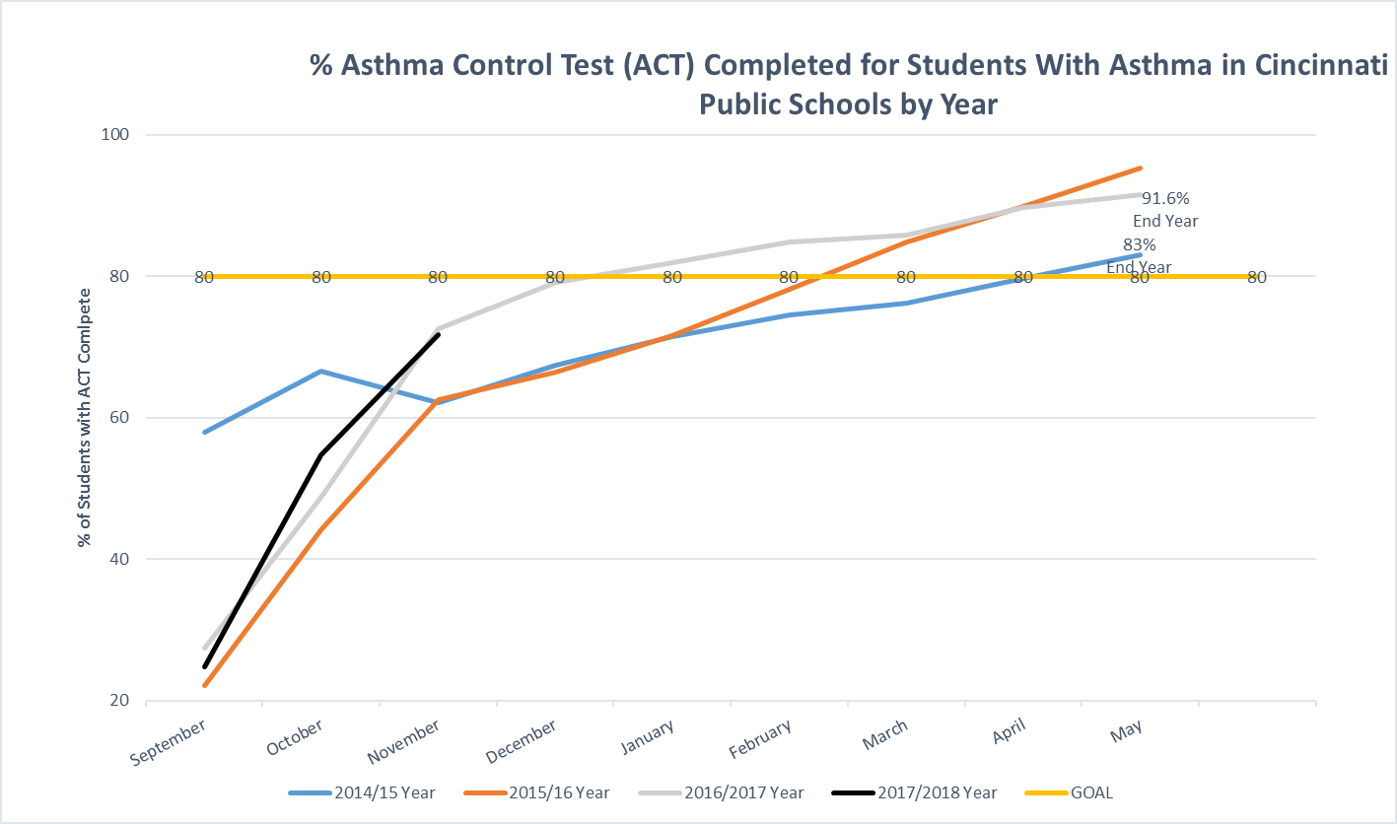


Slide 93
City of Cincinnati - Appendix
  Kercsmar, C., Beck, A., Sauers-Ford, H., Simmons, J., Wiener, B., Crosby, L., Wade-Murphy, S., Schoettker, P., Chundi, P., Samaan, Z., Mansour, M. (2017). Association of an Asthma Improvement Collaborative with Health Care Utilization in Medicaid-Insured Pediatric Patients in an Urban Community. JAMA Pediatr. 2017 Nov 1;171(11):1072-1080. doi: 10.1001/jamapediatrics.2017.2600
  CDC Division of Adolescent Health and the Link Between Academics & Health: https://www.cdc.gov/healthyyouth/health_and_academics/pdf/health-academic-achievement.pdf
  CDC Whole Community, Whole Child, Whole School: https://www.cdc.gov/healthyyouth/wscc/WSCCmodel_update_508tagged.pdf
  School Based Health Alliance: http://www.sbh4all.org/school-health-care/health-and-learning/student-success/
  School-Based Health Centers to Promote Health Equity: 2015 Community Preventive Services Task Force (CPSTF) https://www.thecommunityguide.org/sites/default/files/assets/Health-Equity-School-Based-Health-Centers_1.pdf
  One Pager School Based Health Centers: https://www.thecommunityguide.org/sites/default/files/assets/OnePager-SBHC.pdf
  Interact for Health:
    Video link: https://www.interactforhealth.org/school-based-health-centers
    SBHC Report: https://www.interactforhealth.org/upl/SBHCs_in_Greater_Cincinnati_with_Map_030813.pdf

Slide 94

City of Cincinnati - Appendix
  At the Intersection: Connecting Health and Education Data in School-Based Health Centers, pp 7-13: https://schoolhealthteams.aap.org/uploads/ckeditor/files/At-the-Intersection_Connecting-Health-and-Education-Data-in-SBHC.pdf
  Adolescent Preventive Services Guidelines: https://www.hhs.gov/ash/oah/adolescent-development/physical-health-and-nutrition/clinical-preventive-services/recommended-services/index.html
  Healthy Eating & Active Living and Academic Achievement: https://www.cdc.gov/healthyyouth/health_and_academics/pdf/health-academic-achievement.pdf
  Personal Health Linked to Academic Success: http://publichealth.yale.edu/news/archive/article.aspx?id=6785
  Health & Academics: https://www.ncbi.nlm.nih.gov/pmc/articles/PMC4606776/

Slide 95
For More Information:
  Cincinnati Health Department
  Marilyn Crumpton, MD, MPH
  3101 Burnet Ave.
  Cincinnati OH 45229
  (513) 502-4160
  Marilyn.Crumpton@Cincinnati-oh.gov
  https://www.cincinnati-oh.gov/health/index.cfm/cincinnati-health-department-divisions1/school-adolescent-health/
  Growing Well
  Francie Wolgin, Executive Director
  Program Officer, Interact for Health
  3805 Edwards Rd.
  Cincinnati OH 45209
  (513) 458-6612
  fwolgin@interactforhealth.org
  www.interactforhealth.org
  http://growingwell.org/
  MindPeace
  Susan Shelton, Executive Director
  Offices at the Cincinnati Children’s Hospital Medical Center
  College Hill Campus
  5642 Hamilton Avenue
  Cincinnati, Ohio 45224
  513.803.0844
  http://www.mindpeacecincinnati.com/

Slide 96
Roundtable Discussion
Carter Blakey
Deputy Director, Office of Disease Prevention and Health Promotion

Slide 97
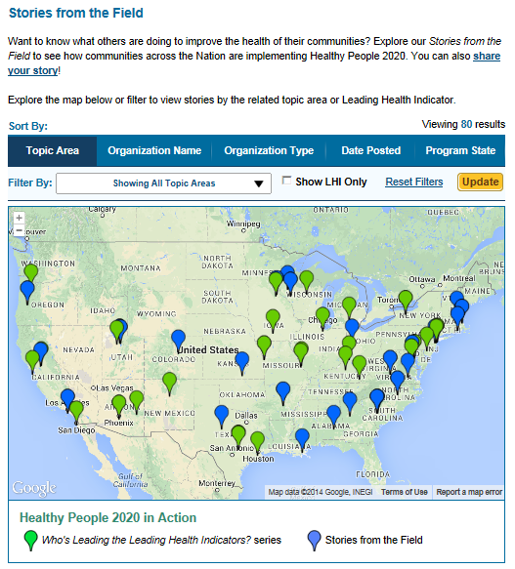
Healthy People 2020 Stories from the Field
A library of stories highlighting ways organizations across the country are implementing Healthy People 2020
Healthy People in Action
http://www.healthypeople.gov/2020/healthy-people-in-action/Stories-from-the-Field

Slide 98
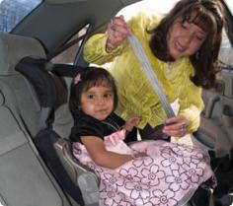

Who’s Leading the Leading Health Indicators? Webinar
Please join us on
Thursday, January 18, 2018
from 12:00 to 1:00 pm ET
for a Healthy People 2020 Who’s Leading the Leading Health Indicators? webinar on Injury and Violence Prevention.
Registration on
HealthyPeople.gov
available soon

Slide 99
Progress Review Planning Group
  Trina Anglin (HRSA/MCHB)
  Angelika Claussen (CDC/NCBDDD)
  Kyle Peplinksi (HRSA)
  D. Camille Smith (CDC/NCBDD)
  Chipper Dean (SAMHSA)
  William Potts-Datema (CDC/NCHHSTP)
  Lisa Zingman (OASH/OAH)
  Stan Lehman (CDC/OD)
  Emily DeCoster (HRSA/OA)
  Irma Arispe (CDC/NCHS)
  David Huang (CDC/NCHS)
  Leda Gurley (CDC/NCHS)
  Lesley Dobrzynski (CDC/NCHS)
  Sibeso Joyner (CDC/NCHS)
  Cheryl Rose (CDC/NCHS)
  Carter Blakey (HHS/ODPHP)
  Theresa Devine (HHS/ODPHP)
  Ayanna Johnson (HHS/ODPHP)
  Yen Lin (HHS/ODPHP)

Slide 100




Stay Connected
Web healthypeople.gov
Email healthypeople@hhs.gov
Twitter @gohealthypeople
YouTube ODPHP (search “healthy people”)
Join the Healthy People Listserv & Consortium

