Slide 1



Progress Review Webinar:
Access to Health Services and
Oral Health
June 13, 2017

Slide 2
Maximizing Access: Connecting Health Care and Oral Health Care
Don Wright, MD, MPH
Acting Assistant Secretary for Health
U.S. Department of Health and Human Services

Slide 3
Agenda and Presenters
Chair
Don Wright, MD, MPH, Acting Assistant Secretary for Health, HHS
Presentations
Charles Rothwell, MBA, MS, Director, National Center for Health Statistics, CDC
Arlene Bierman, MD, MS, Director, Center for Evidence and Practice Improvement, AHRQ
Renée Joskow, DDS, MPH, Chief Dental Officer, HRSA
Casey Hannan, MPH, Director (Acting), Division of Oral Health, CDC
Martha Somerman, DDS, PhD, Director, National Institute of Dental and Craniofacial Research, NIH
Christopher Halliday, DDS, MPH, Deputy Director, Division of Oral Health, IHS
Community Highlight
Greg Nycz, Director, Family Health Center of Marshfield, Marshfield, Wisconsin

Slide 4
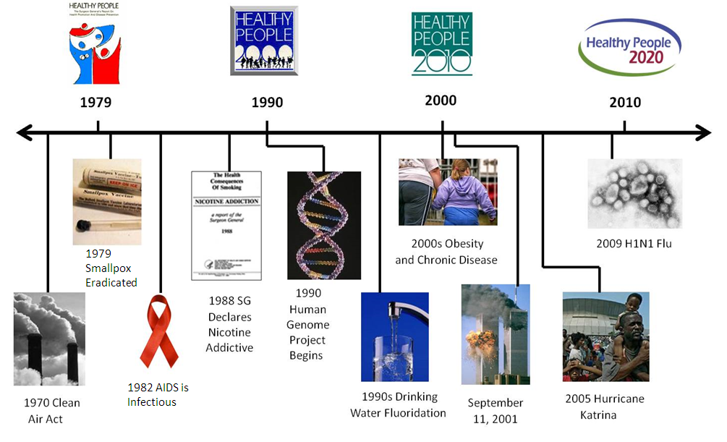
Healthy People at the Forefront of Public Health

Slide 5
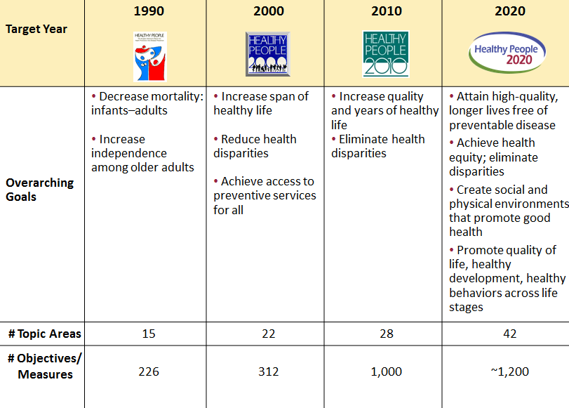
Evolution of Healthy People

Slide 6
Access to Health Services in the United States
The National Academy of Medicine (formerly IOM) defines access to health services as the timely use of personal health services to achieve the best health outcomes.
Access to health care impacts overall physical, social, oral, and mental health status and quality of life.
Access to health services requires:
  Gaining entry into the health care system
  Accessing a health care location where needed services are provided
  Finding a trusted health care provider with whom the patient can communicate
SOURCE: https://www.healthypeople.gov/2020/topics-objectives/topic/Access-to-Health-Services

Slide 7
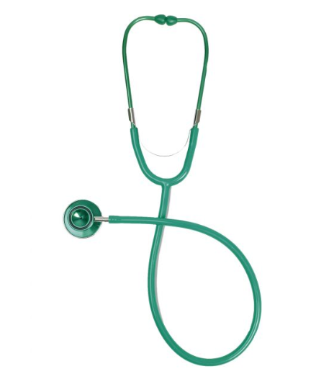
Access to Health Services in the United States
Barriers to access to health services include:
  High cost of care
  Inadequate or no insurance coverage
  Lack of availability of services
  Lack of culturally competent care
Barriers to accessing health services lead to:
  Unmet health needs
  Delays in receiving appropriate care
  Inability to get preventive services
  Preventable hospitalizations
  Financial burdens

Slide 8

Understanding Access to Health Services
Having a usual primary care provider is associated with:
  Greater patient trust in the provider
  Good patient-provider communication
  Increased likelihood that patients will receive appropriate care
People with a usual source of care have:
  Better health outcomes
  Fewer disparities
  Lower total health care costs
SOURCE:

Slide 9
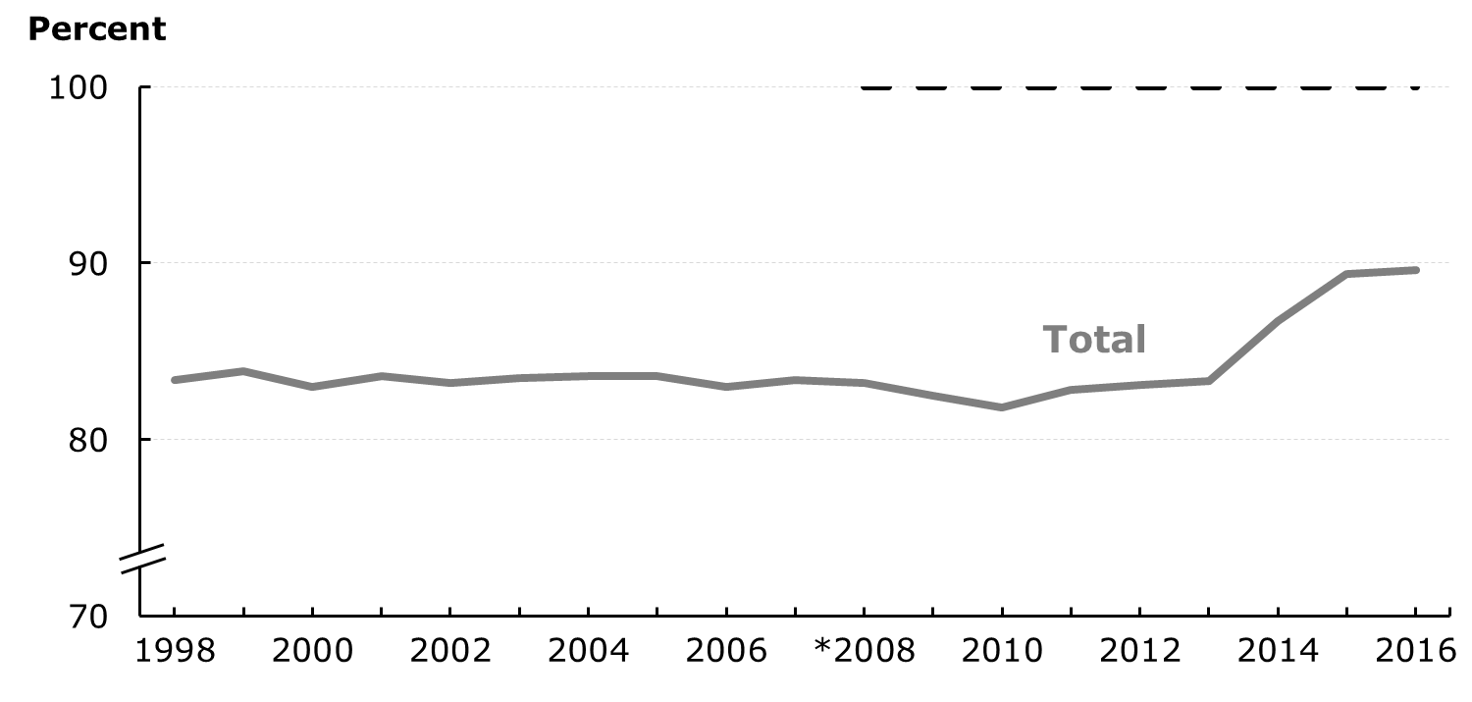
Medical Insurance Coverage, Persons <65 Years
HP2020 Target: 100%
NOTES: *2008 = HP2020 baseline. Data are for persons under age 65 years who report coverage by public and private health insurance. 2016 data are preliminary.
SOURCE: National Health Interview Survey (NHIS), CDC/NCHS.
Obj. AHS-1.1
Increase desired

Slide 10

Oral Health
Oral health is essential to overall health.
Good oral health improves a person’s ability to:
  Speak
  Smile
  Smell
  Taste
  Touch
  Chew
  Swallow
  Make facial expressions
SOURCE: https://https://www.healthypeople.gov/2020/topics-objectives/topic/oral-health

Slide 11
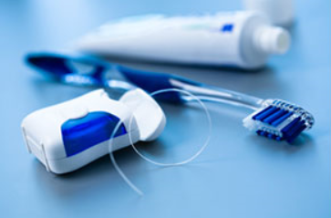
Prevention Matters
Good oral health self-care practices:
  brushing with fluoride toothpaste
  daily flossing
  professional treatment
Health behaviors that can lead to poor oral health include:
  Tobacco use
  Excessive alcohol use
  Poor diet
SOURCE: https://https://www.healthypeople.gov/2020/topics-objectives/topic/oral-health

Slide 12

Understanding Oral Health
Oral diseases cause pain and disability for millions of Americans each year.
Oral infections are associated with:
  Diabetes
  Heart disease
  Stroke
  Premature births
  Low birth weights
Dental caries (cavities) are preventable but are one of the most common chronic health problems of childhood in the United States.
More than 90% of U.S. adults experienced dental caries, and 1 in 4 currently has untreated dental decay.
SOURCES: https://www.cdc.gov/chronicdisease/pdf/aag-oral-health.pdf

Slide 13
Untreated Dental Decay, by Age
NOTES: I = 95% confidence interval. Data are for children aged 3-5 with untreated dental decay in their primary teeth, children aged 6 to 9 years with untreated dental decay in their primary or permanent teeth, and adolescents aged 13 to 15 years with untreated dental decay in their permanent teeth.
Objs. OH-2.1—3.2
Decrease desired
SOURCE: National Health and Nutrition Examination Survey (NHANES), CDC/NCHS.

Slide 14





Healthy People 2020 Progress Review
Maximizing Access: Connecting
Primary Care and Oral Health
June 13, 2017

Slide 15
Charles Rothwell, MBA, MS
Director, National Center for Health Statistics
Centers for Disease Control and Prevention

Slide 16
Presentation Overview
Tracking the Nation’s Progress
Access to Health Services
Oral Health

Slide 17
Tracking the Nation’s Progress
17 Measurable HP2020 Access to Health Services Objectives:
    4 Target met
    5 Improving
    7 Little or no detectable change
    1 Getting worse
33 Measurable HP2020 Oral Health Objectives:
    15 Target met
    3 Improving
    10 Little or no detectable change
    5 Baseline data only
NOTES: Measurable objectives are defined as having at least one data point currently available, or a baseline, and anticipate additional data points throughout the decade to track progress. The Access to Health Services Topic Area contains 2 developmental objectives.

Slide 18
Presentation Overview
Tracking the Nation’s Progress
Access to Health Services
  Medical Insurance
  Usual Source of Medical Care
  Delay in Obtaining or Inability to Obtain Needed Dental Care
Oral Health

Slide 19
Medical Insurance Coverage,
Persons <65 Years, 2015
HP2020 Target: 100%
Increase desired
Poverty
threshold
Country
of birth
NOTES: = 95% confidence interval. *2008 Total = HP2020 baseline. Data are for persons under age 65 years who report coverage by public and private health insurance.
I
SOURCE: National Health Interview Survey (NHIS), CDC/NCHS.
Obj. AHS-1.1

Slide 20
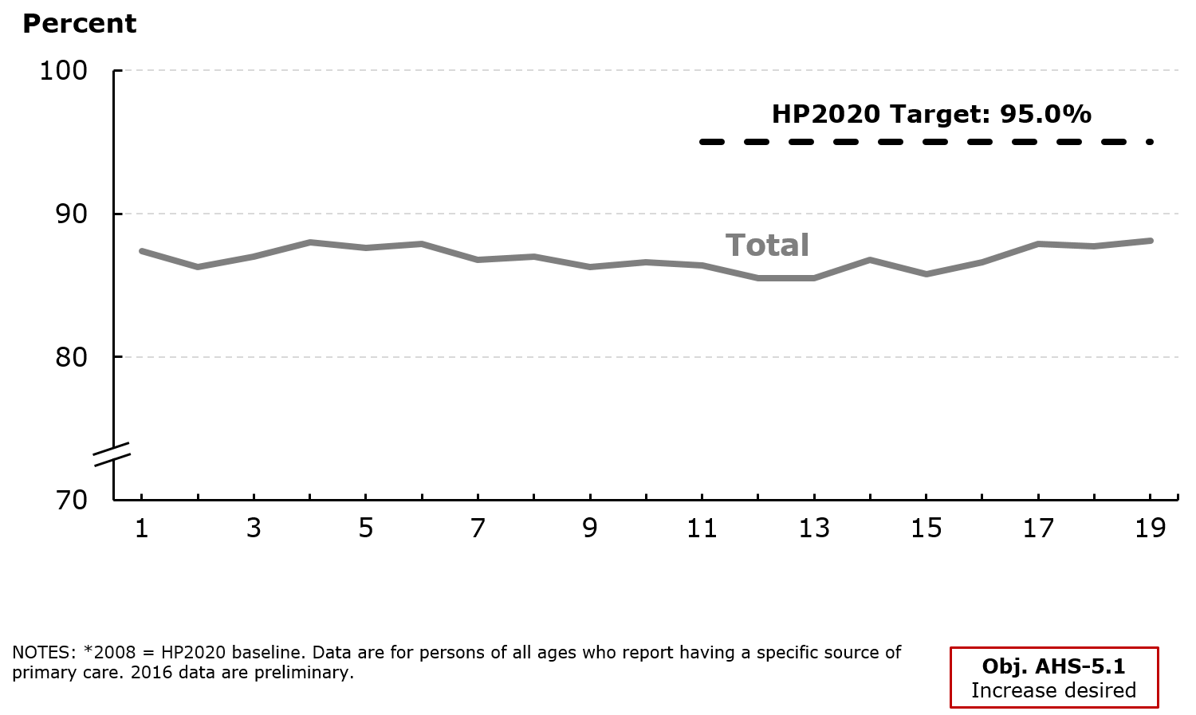
Usual Source of Medical Care
SOURCE: National Health Interview Survey (NHIS), CDC/NCHS.

Slide 21
Usual Source of Medical Care, 2015
HP2020 Target: 95.0%
Increase desired
Poverty
threshold
Health Insurance
Disability
Status
Country
of birth
NOTES: = 95% confidence interval. *2008 Total = HP2020 baseline. Data are for persons of all ages who report having a specific source of primary care. Health insurance data are for persons less than 65 years of age. Disability data are for persons 18 years of age and over.
I
SOURCE: National Health Interview Survey (NHIS), CDC/NCHS.
Obj. AHS-5.1

Slide 22
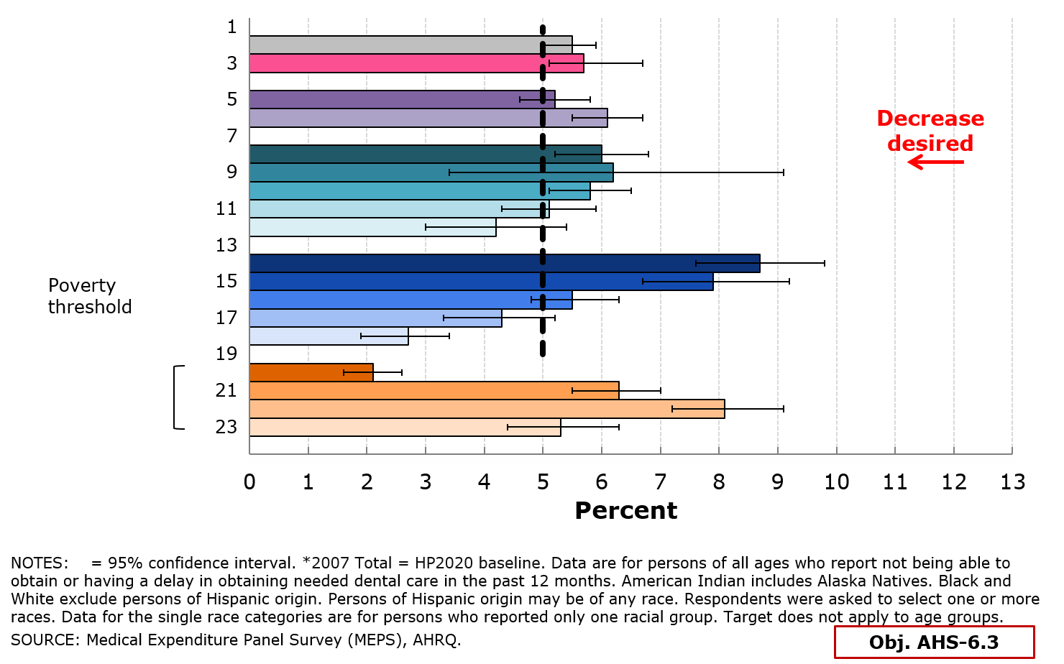
Delay in Obtaining or Inability to Obtain Needed Dental Care, 2014
HP2020 Target: 5.0%
Age (years)
I

Slide 23
Presentation Overview
Tracking the Nation’s Progress
Access to Health Services
Oral Health
  Untreated Dental Decay
  Dental Visits in the Past Year
  Low-Income Youth Receiving Preventive Dental Services
  Federally Qualified Health Centers with an Oral Health Component

Slide 24
Untreated Dental Decay
NOTES: I = 95% confidence interval. Data are for children aged 3 to 5 with untreated dental decay in their primary teeth, children aged 6 to 9 years with untreated dental decay in their primary or permanent teeth, and adolescents aged 13 to 15 years with untreated dental decay in their permanent teeth.
Objs. OH-2.1–3.2
Decrease desired
SOURCE: National Health and Nutrition Examination Survey (NHANES), CDC/NCHS.

Slide 25
Dental Visits in the Past Year,
Persons 2+ Years, 2014
HP2020 Target: 49.0%
Increase desired
Age (years)
NOTES: = 95% confidence interval. *2007 Total = HP2020 baseline. Data are for persons 2 years or older who report having had a dental visit in the past 12 months. Data (except those by age group) are age-adjusted to the 2000 standard population. Asian includes Pacific Islander. American Indian includes Alaska Natives. Black and White exclude persons of Hispanic origin. Persons of Hispanic origin may be of any race. Respondents were asked to select one or more race. Data for the single race categories are for persons who reported only one racial group. Target does not apply to age groups.
I
SOURCE: Medical Expenditure Panel Survey (MEPS), AHRQ.
Obj. OH-7

Slide 26
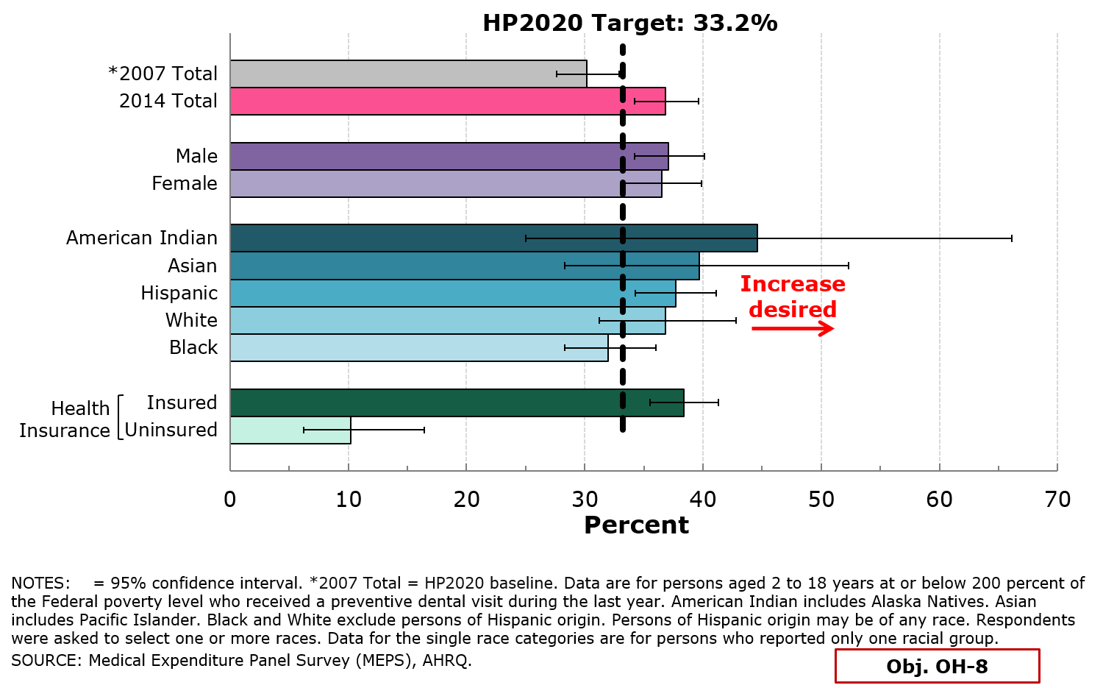
Low-income Youth Receiving Preventive
Dental Services in the Past Year, 2014
I

Slide 27
Federally Qualified Health Centers (FQHCs) with an Oral Health Component
HP2020 Target: 69.0%
NOTES: *2007 = HP2020 baseline (revised). Data are for Federally Qualified Health Centers (FQHCs) with an oral health component defined by HRSA as a Health Center that has at least 0.5 full time equivalent (FTE) Dentists and/or sees 500 patients or more per year.
Obj. OH-10.1
Increase desired
SOURCE: Uniform Data System (UDS), HRSA/BPHC.

Slide 28
Key Takeaways –
Access to Health Services
So far in the decade, 9 out of 17 Healthy People 2020 Access to Health Services objectives have reached the targets or are improving.
The proportion of persons with medical insurance coverage is increasing, moving towards its HP2020 targets.
The proportion of persons with a usual source of medical care is also improving.
The proportion of persons who report delay in obtaining or inability to obtain needed dental care in the past 12 months demonstrated little or no detectable change.

Slide 29
Key Takeaways - Oral Health
Overall, 18 out of 33 Healthy People Oral Health objectives have met their targets or are improving.
A smaller proportion of children are suffering from untreated dental decay, however adolescents and adults are still not receiving the care they need.
In general, dental visits in the past year have not changed much for the total population but disparities persist.
Preventive dental services among low-income youth improved for much of the population with a few groups showing disparities.
Federally Qualified Health Centers with an oral health component are increasing and a growing number of Americans are now receiving care there.

Slide 30
Maximizing Access: Connecting Health Care and Oral Health Care
Arlene Bierman, MD, MS
Director, Center for Evidence and Practice Improvement
Agency for Healthcare Research and Quality

Slide 31

AHRQ’s Role in Addressing Access to Health Services Objectives

Slide 32

AHRQ’s Mission
The Agency for Healthcare Research and Quality's (AHRQ) mission is to produce evidence to make health care safer, higher quality, more accessible, equitable, and affordable;
And, to work within the U.S. Department of Health and Human Services and with other partners to make sure that the evidence is understood and used.
www.ahrq.gov

Slide 33
What We Do
AHRQ invests in research and evidence to make health care safer and improve quality.
AHRQ creates materials to teach and train health care systems and professionals to help them improve care for their patients.
AHRQ generates measures and data used to track and improve performance and evaluate progress of the U.S. Health system.

Slide 34
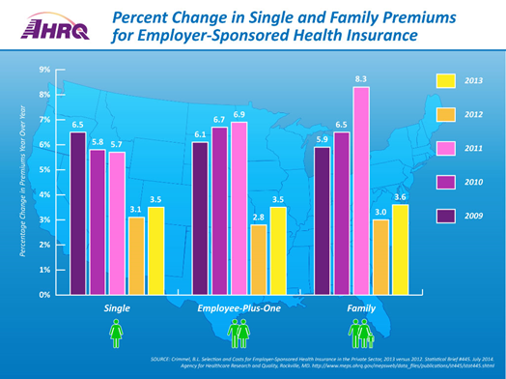
Understanding Utilization of Health Services
AHRQ provides a range of data resources on topics such as:
  Use of health care
  Costs of care
  Trends in hospital care
  Health insurance coverage
  Out-of-pocket spending
  Patient satisfaction
Medical Expenditure Panel Survey (MEPS)
    National source for comprehensive annual data on how Americans use and pay for medical care
    Provides annual estimates of health care utilization, expenditures, sources of payment and insurance coverage
AHS-1 Increase the proportion of persons with health insurance

Slide 35
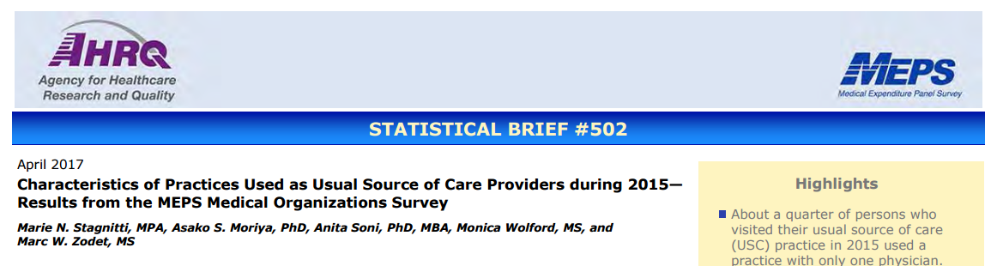
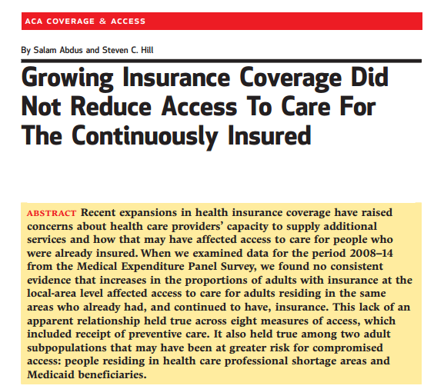
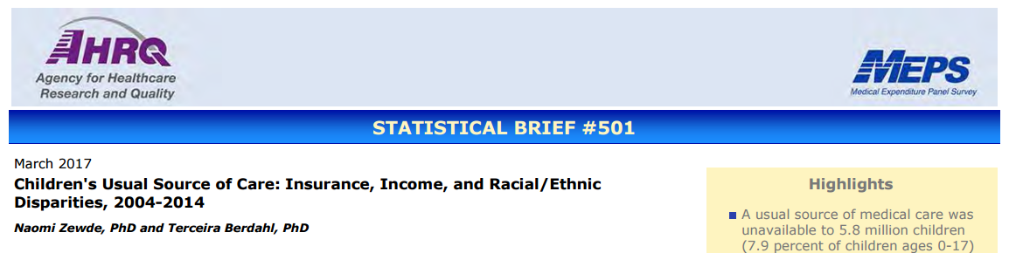
Understanding Utilization of Health Services
AHRQ has produced a number of statistical briefs on access to health services based on MEPS data
Researchers can combine MEPS data with other data sources to increase impact
AHS-5 Increase the proportion of persons who have a specific source of ongoing care

Slide 36
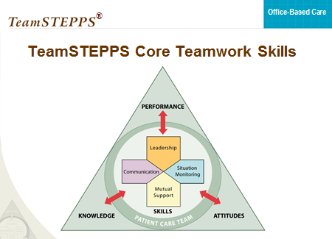
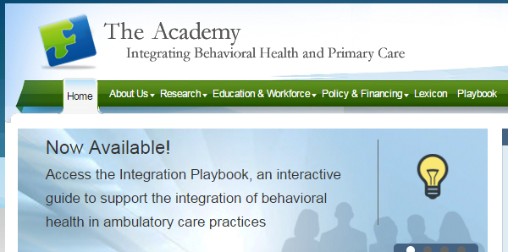
Increasing Capacity to Deliver Health Care Services
AHRQ has developed tools and resources to improve the capacity of health care settings to expand access to services
TeamSTEPPS for Office-Based Care
Academy for Integrating Behavioral Health and Primary Care
AHS-6 Reduce the proportion of persons who are unable to obtain or delay in obtaining necessary medical care, dental care, or prescription medicines

Slide 37

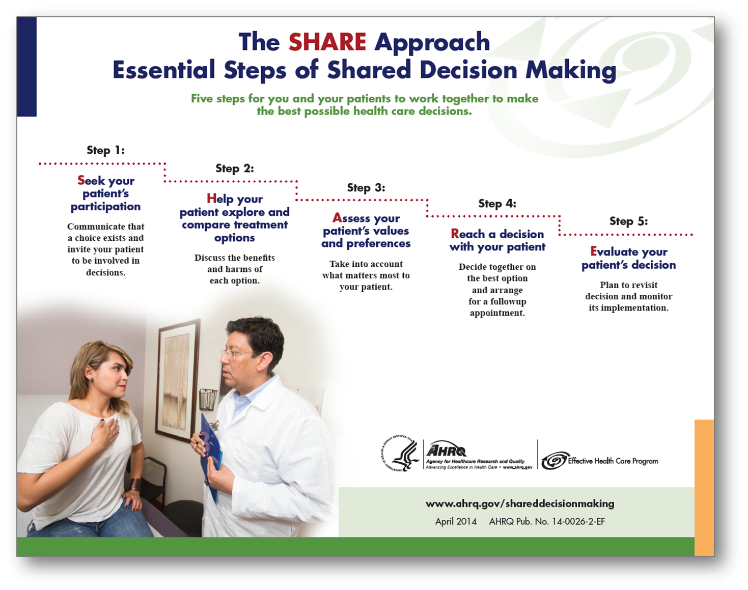
Improving Patient-centered Care and
Clinician Communication
AHRQ has developed tools and resources to increase the ability of health care professional to engage in patient-centered care and improved communication
Shared Decision Making
Health Literacy

Slide 38


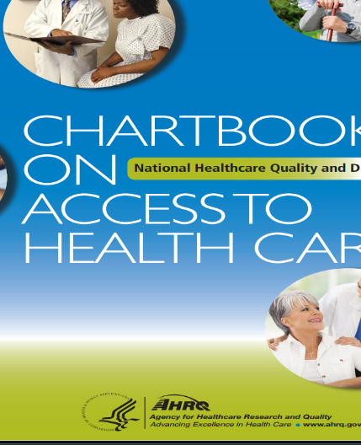
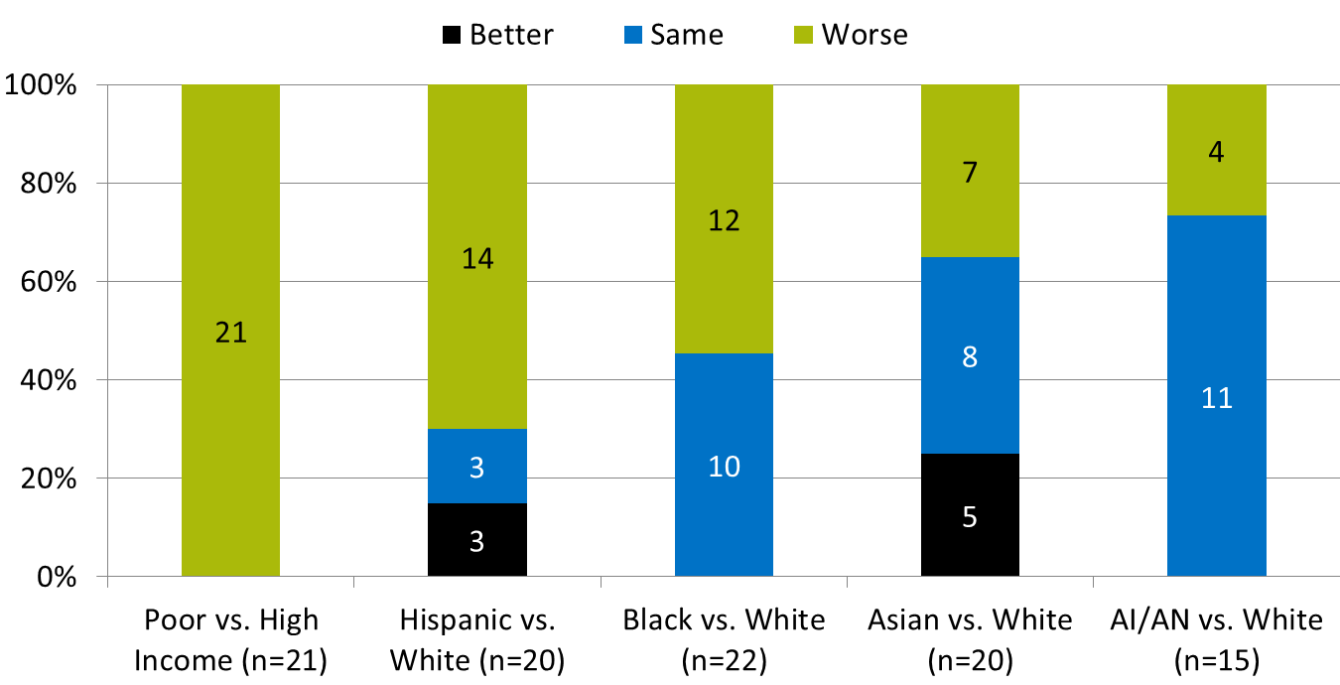
Identifying Health Disparities of Access
AHRQ annually produces the National Healthcare Quality and Disparities Report (QDR)
The most recent National Healthcare Quality and Disparities Report and National Quality Strategy Update is a joint effort addressing the progress made against the National Quality Strategy
The Chartbook on Access to Health Care is one of a family of documents and tools that support the QDR
It summarizes disparities across measures of access from the QDR
Disparities in Access to Care

Slide 39
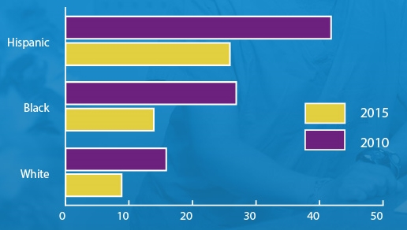
Understanding Health Disparities
Example of findings in the 2016 QDR:
The percentage of Americans under age 65 who lack health insurance dropped from 18% in 2010 to 10% in 2015.
Uninsurance rates declined among poor people, young adults and across all races.
Data from National Health Interview Survey
Percentage of People Ages 18-64 Years Without Insurance
AHS-1.1 Increase the proportion of persons with medical insurance

Slide 40
Key Takeaways and Challenges
AHRQ has a number of datasets that can be used to help identify what works, for whom, where and at what cost with regard to improving access to health services.
AHRQ has created a wide variety of evidence-based toolkits, curricula and other resources to increase the capacity of primary care and other health care setting to deliver high quality, accessible care.
Health care professionals can look to AHRQ to improve their ability to delivery patient- and family-centered care.
While health disparities persist in accessing health services, AHRQ is committed to researching and implementing solutions.

Slide 41

Discovering What Works in Health Care
Thank you!

Slide 42
Program Resources
MEPS Home – meps.ahrq.gov/mepsweb/
MEPS Statistical Briefs Topics - meps.ahrq.gov/mepsweb/data_stats/MEPS_topics.jsp
TeamSTEPPS - www.ahrq.gov/teamstepps/officebasedcare/index.html
Academy for Integrating Behavioral Health and Primary Care - integrationacademy.ahrq.gov/
SHARE Approach Toolkit - www.ahrq.gov/professionals/education/curriculum-tools/shareddecisionmaking/index.html
Health Literacy Universal Precautions Toolkit - www.ahrq.gov/professionals/quality-patient-safety/quality-resources/tools/literacy-toolkit/index.html
2015 National Healthcare Quality and Disparities Report and 5th Anniversary Update on the National Quality Strategy - www.ahrq.gov/research/findings/nhqrdr/nhqdr15/index.html
Chartbook on Access to Health Care - www.ahrq.gov/research/findings/nhqrdr/chartbooks/access/index.html
Data infographics - www.ahrq.gov/research/data/data-infographics/index.html

Slide 43
Improving Access: the Role of the Health Resources and Services Administration in Primary Care and Oral Health
Renée W. Joskow, DDS, MPH
Chief Dental Officer
Health Resources and Services Administration

Slide 44
Health Resources and Services
Administration (HRSA)
Supports more than 90 programs that provide health care to people who are geographically isolated, economically or medically vulnerable through grants and cooperative agreements to more than 3,000 awardees, including community and faith-based organizations, colleges and universities, hospitals, state, local, and tribal governments, and private entities.

Slide 45
Health Resources and Services Administration (HRSA)
Every year, HRSA programs serve tens of millions of people, including people living with HIV/AIDS, pregnant women, mothers and their families, and those otherwise unable to access quality health care.

Slide 46

HRSA’s Vision and Mission
Vision statement:
Healthy Communities, Healthy People
Mission statement:
Improve health and achieve health equity through access to quality services, a skilled health workforce and innovative programs

Slide 47
Agency Goals
Improve Access to
Quality Health Care and Services
Strengthen the Health Workforce
Improve Health Equity
Build Healthy Communities
Strengthen HRSA Program Management & Operations

Slide 48

Access and Oral Health Program Highlights
HRSA Health Center Program
Ryan White HIV/AIDS Program
Maternal and Child Health
Federal Office of Rural Health Policy

Slide 49
HRSA’s Health Center Program
Increases access to quality primary health care services, including oral health, for medically underserved populations.

Slide 50
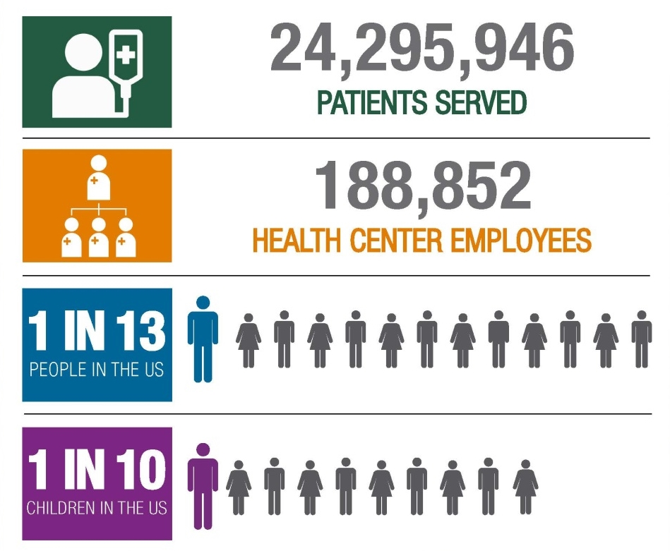
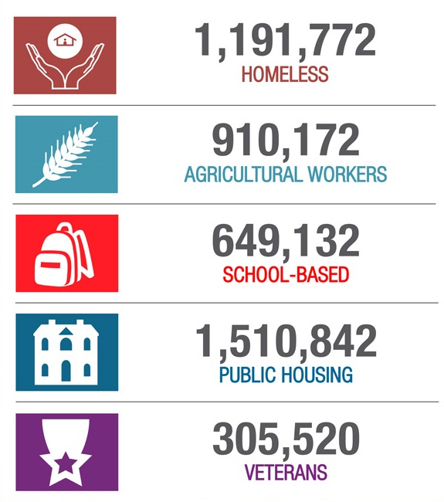
Access to High Quality, Primary Health Care
Source: Uniform Data System, 2015. National Data: U.S. Census Population Estimates Bureau, 2015

Slide 51
Health Center Program and Oral Health
Source: HRSA Uniform Data System (UDS)
HP2020 OH- 11
More than 13 million dental visits were provided in 2015, an increase of more than 1.2 million visits from the prior year.

Slide 52

Ryan White HIV/AIDS Program
Provides care and services, including dental programs, to address the unique health issues faced by people living with HIV/AIDS (PLWH).
OVER HALF of people living with diagnosed HIV in the U.S.- MORE THAN 500,000 PEOPLE – receive care through the Ryan White HIV/AIDS Program

Slide 53
Ryan White HIV/AIDS Program
83% of Ryan White HIV/AIDS Program clients are virally suppressed, up from 70% in 2010, and exceeding the national average* of 55%.
*Viral suppression among people >=13 years old diagnosed with HIV in 34 states and DC

Slide 54
Ryan White HIV/AIDS Program and Oral Health
Oral health care is especially critical for PLWH, since dental professionals can play a role in early diagnosis of HIV infection.
In FY16, HRSA programs included
  $9 million for the Dental Reimbursement Program, which defrays costs for educational institutions that provide oral health care to PLWH
  $3.2 million for the Community-Based Dental Partnership Program that provides hands-on learning opportunities for future oral health professionals to learn about PLWH

Slide 55

Maternal and Child Health
HRSA’s Maternal and Child Health (MCH) Bureau programs serve more than 50 million women, children and families each year, including half of all pregnant women and one-third of all infants and children in the United States.
  Block Grants to States - Title V Maternal and Child Health Block Grant Program is the nation’s oldest federal-state partnership. It aims to improve the health and well-being of women (particularly mothers) and children.
  Maternal, Infant, and Early
  Childhood Home Visiting
  Program - Supports at-risk
  parents and families in all
  50 States, DC, and 5 territories

Slide 56

Maternal and Child Health Programs and Oral Health
Builds and strengthens the capacity of state and community health care programs to implement systems of care that increase access and utilization of quality preventive oral health care and restorative services to MCH populations most at risk for oral disease.
MCH National Performance Measures
Bright Futures
Perinatal and Infant Oral Health Quality Improvement

Slide 57
Federal Office of Rural Health Policy
Provides policy support to the Office of Secretary and supports a number of rural health programs, including rural health networks, black lung clinics, telehealth, and veterans rural health access programs
Telehealth Network Grant Program- Since 2005, supported 3,100 new or expanded telehealth sites; nearly a 10% increase from 2015 to 2016.
Rural Community Health Gateway- The home for information about evidence-based models of rural health interventions, as well as innovative approaches- https://www.ruralhealthinfo.org/

Slide 58
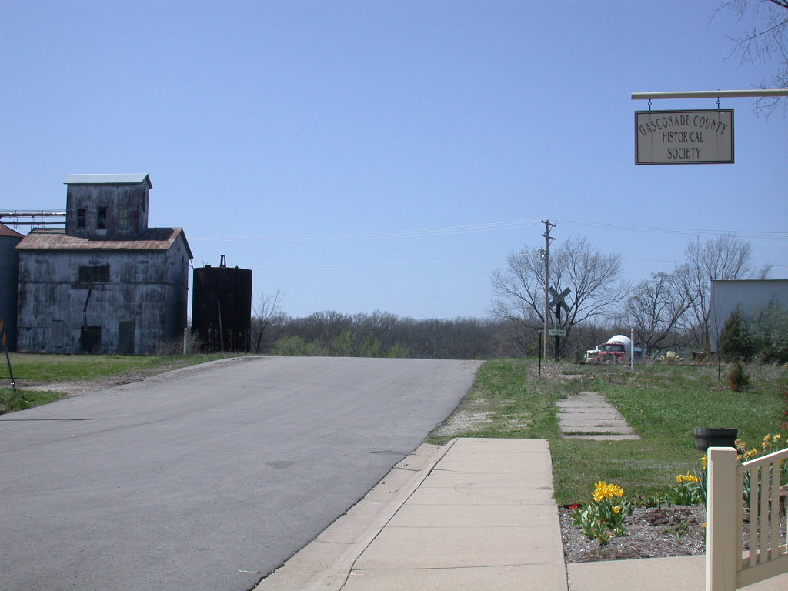
Federal Office of Rural Health Policy and Oral Health
Rural Health Care Services Outreach Program invests in rural communities to focus on outreach and education.
The Rural Health Network Development Program funds programs that utilize a network approach to provide innovative solutions to healthcare needs.
Rural Health Information Hub Oral Health toolkit
https://www.ruralhealthinfo.org/community-health/oral-health

Slide 59
Key Points/Takeaways
Disparities in access to primary medical care and oral health care persist.
HRSA continues to:
  Support an increase in health care access points to expand the availability of services to underserved, disadvantaged, geographically isolated, and medically vulnerable populations.
  Support the integration and coordination of public health with primary care, including behavioral and oral health services, to improve individual outcomes and overall population health.

Slide 60
HRSA Access Resources
HRSA Data Warehouse
  https://datawarehouse.hrsa.gov/topics/topics.aspx
Health Center Program Fact Sheet
  https://www.bphc.hrsa.gov/about/healthcenterfactsheet.pdf
Find Health Centers
  https://findahealthcenter.hrsa.gov/
Find HIV Care and Treatment
  https://findHIVcare.hrsa.gov/

Slide 61
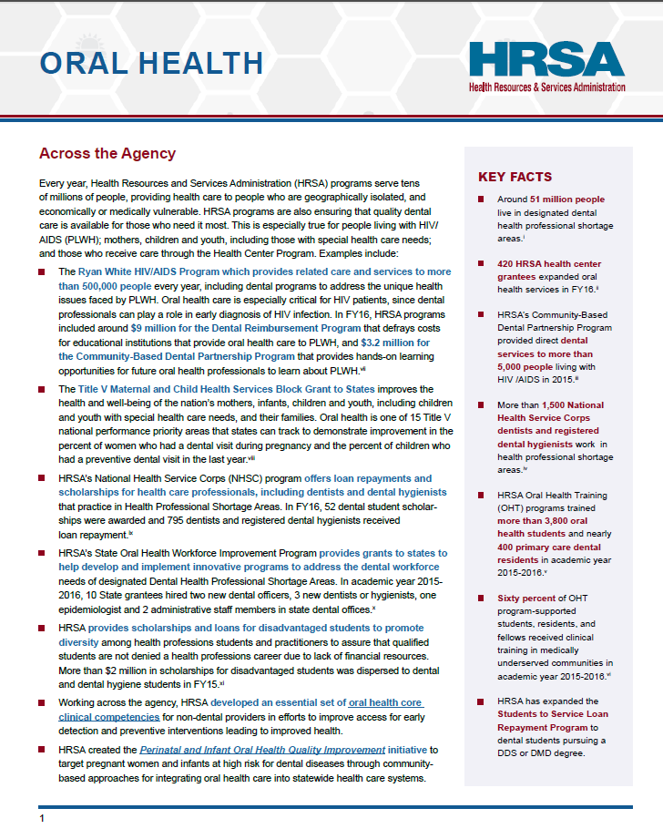
HRSA Oral Health & Fact Sheet
www.hrsa.gov/oralhealth

Slide 62
Additional Oral Health Publications & Websites
Integration of Oral Health and Primary Care Practice Report
  http://www.hrsa.gov/publichealth/clinical/oralhealth/primary care/integrationoforalhealth.pdf
Rural Health Information Hub Oral Health toolkit https://www.ruralhealthinfo.org/community-health/oral-health
Considerations for Oral Health Integration in Primary Care Practice for Children
  https://www.hrsa.gov/publichealth/clinical/oralhealth/primarycare/oralhealthprimarycare.pdf
Bright Futures in Practice: Oral Health—Pocket Guide (3rd ed.)
  http://www.mchoralhealth.org/pocket.html
Oral Health Care During Pregnancy: A National Consensus Statement
  http://www.mchoralhealth.org/PDFs/OralHealthPregnancy Consensus.pdf

Slide 63
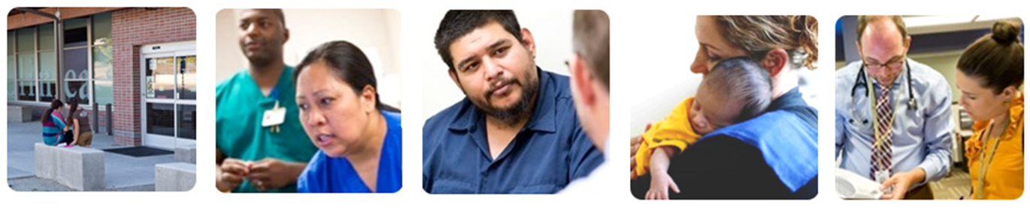
Thank you

Slide 64
Centers for Disease Control and Prevention
Casey Hannan, MPH
Director (Acting), Division of Oral Health
National Center for Chronic Disease Prevention and Health Promotion

Slide 65

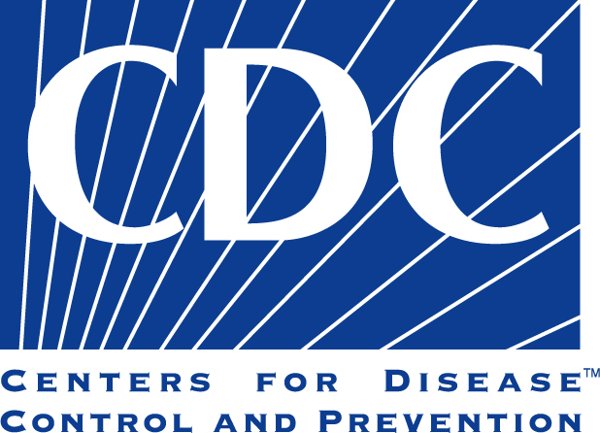
Our Mission
To prevent and control oral diseases and conditions by building the knowledge, tools, and networks that promote healthy behaviors and effective public health practices and programs.

Slide 66
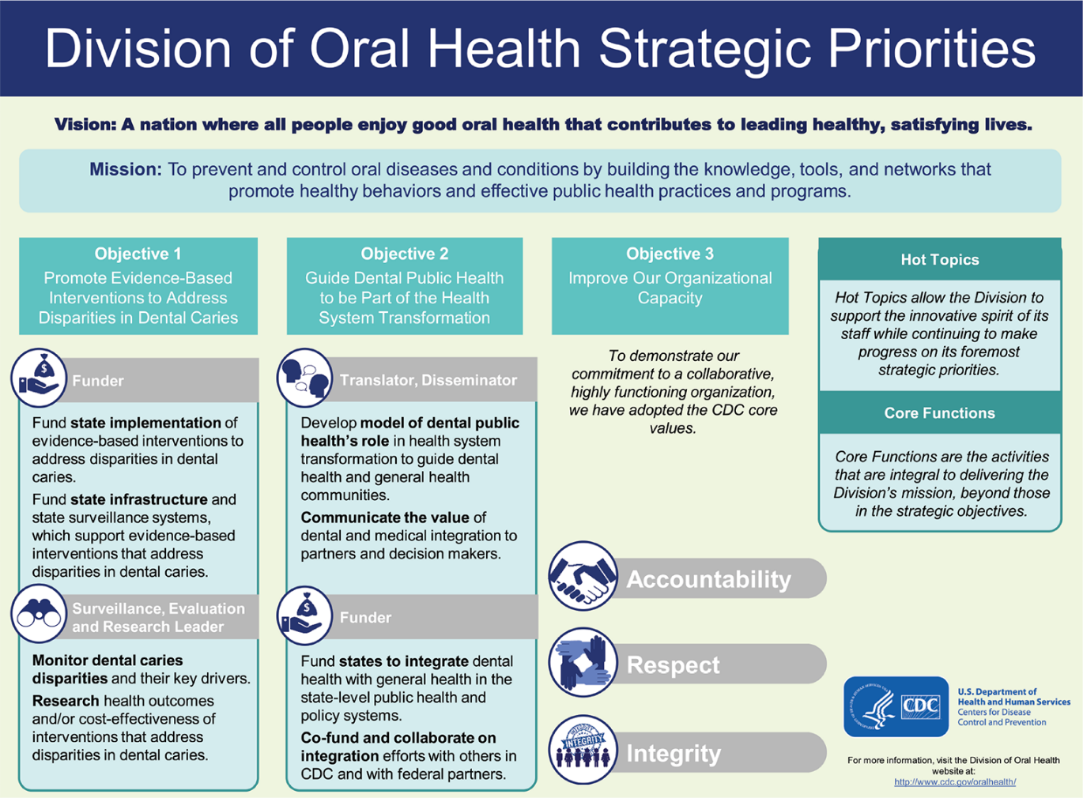
Strategic Priorities

Slide 67

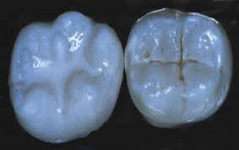
Division of Oral Health
Strategic Objective 1
Promote Evidence-Based Interventions to Address Disparities in Dental Caries

Slide 68
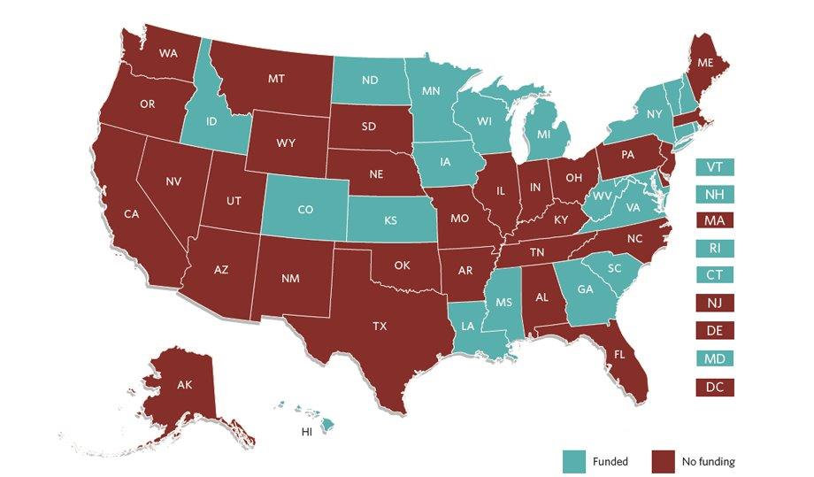
State Oral Disease Prevention
Program in 21 States
2013–2018

Slide 69
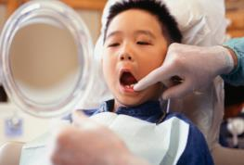
School-based Dental
Sealant Programs
State Activities: Provide sealants by dental professionals in schools with mobile equipment
  Target schools where >50% of children are eligible for free or reduced lunch programs
  Provide access to care for children without access to traditional dental offices

Slide 70
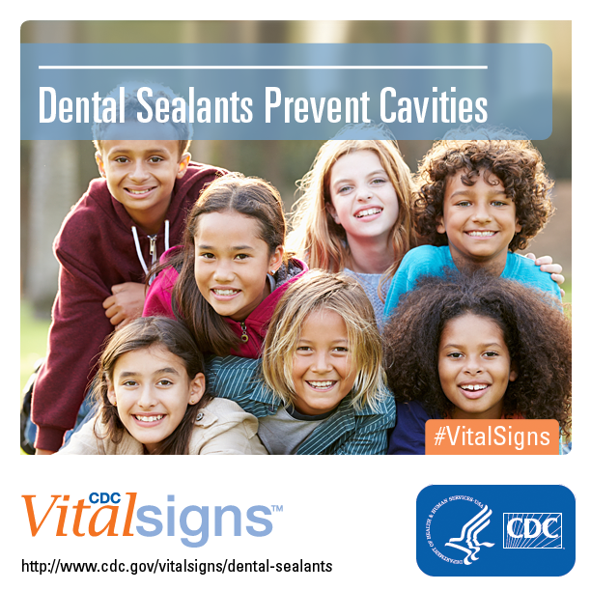
School-based Dental
Sealant Programs
Sealants are under-utilized
Placing sealants in schools target children who may not be accessing dental services
School-based sealant programs are cost-saving to states when located in schools that serve a high percentage of low-income families
Community Preventive Services Task Force. Preventing dental caries: school-based dental sealant delivery programs (abbreviated). Available at www.thecommunityguide.org/oral/schoolsealants.html

Slide 71
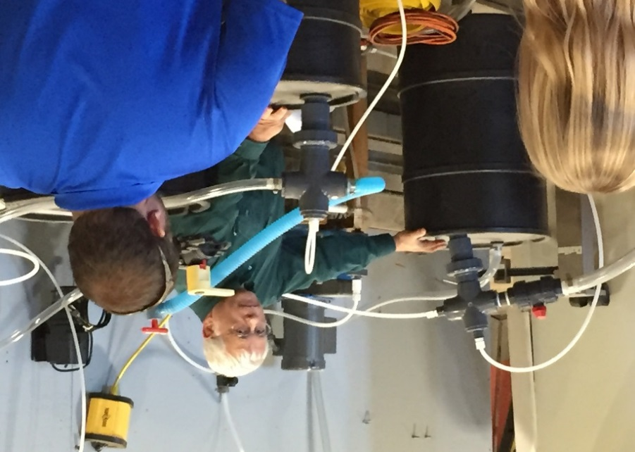
Community Water Fluoridation
State Activities:
Measure progress toward Healthy People objective (HP 2020 target-79.6%)
Establish a CWF quality control program
  Daily testing
  Training of operators
  Inspection
Participate in a proficiency
testing program
Education and promotion
of CWF

Slide 72
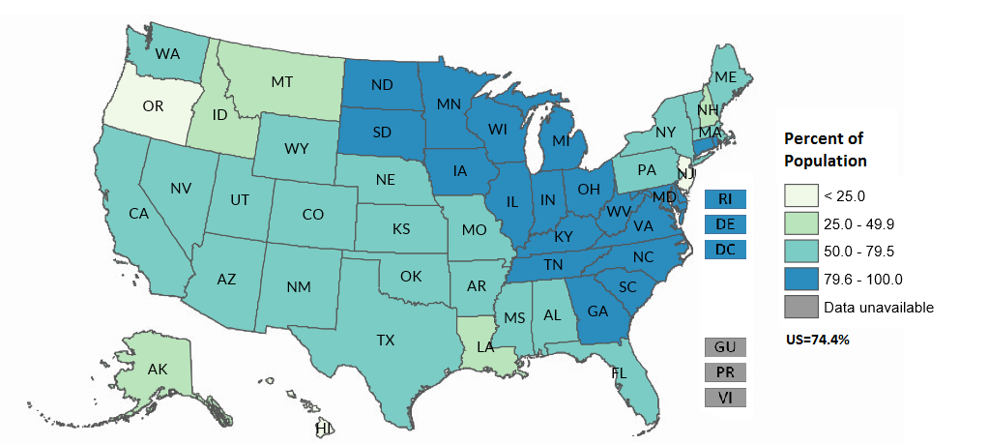
Fluoridation Status, 2014
Percent of people on community water systems receiving optimally fluoridated water (OH-13)
Healthy People 2020 Objective OH-13 Target = 79.6%

Slide 73
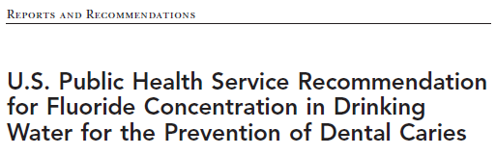
US Public Health Service Recommendation
DOH led the process to implement revised recommendations for community water systems that
add fluoride to their water
PHS recommends a fluoride concentration of 0.7 milligrams/Liter (mg/L) to maintain caries prevention benefits and reduce the risk of dental fluorosis.
Released April 27, 2015

Slide 74
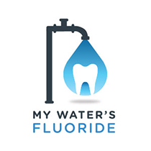


Monitor Dental Caries and their
Key Drivers
Oral health data systems monitor the prevalence of oral diseases and the factors influencing oral health.

Slide 75
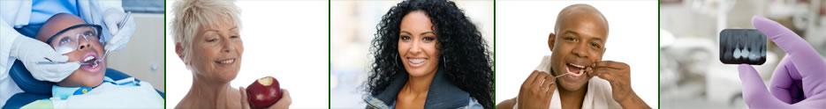
Division of Oral Health
Strategic Objective 2
Guide Dental Public Health to be Part of the Health System Transformation

Slide 76
Chronic Disease/Oral Health Integration
DOH works to integrate dental public health
into a national dialogue focused on broad
health system transformation.
Models of Collaboration for State Chronic Disease and Oral Health Programs, 2016–2017
  Funding supports state health departments to develop chronic disease prevention projects integrating activities from chronic disease and oral health programs
    Awarded to Alaska, Colorado, Georgia, Maryland,
    Minnesota, and New York
Objective 2: Guide dental public health to be part of the health system transformation

Slide 77
Partnerships
Key Federal Partners
Centers for Medicare and Medicaid Services
Environmental Protection Agency
Health Resources and Services Administration
National Institutes of Health
Indian Health Service
Key Nonfederal Partners
American Association of Public Health Dentistry
American Dental Association
Association of State and Territorial Dental Directors
Children’s Dental Health Project
Organization for Safety, Asepsis and Prevention

Slide 78
CDC Division of Oral Health
CDC Division of Oral Health
Find out more at https://www.cdc.gov/oralhealth/index.html https://www.cdc.gov/oralhealth/index.html

Slide 79





NIDCR: Guiding Advances in Oral Health Research and Innovation
Martha Somerman, DDS, PhD
Director, National Institute of Dental and Craniofacial Research, NIH
U.S. Department of Health and Human Services

Slide 80
Alignment of NIDCR Priorities with HP 2020 Objectives
Research to reduce caries (OH-1, OH-2, OH-3, OH-4)
Research to treat periodontal disease and inflammation
(OH-4, OH-5)
Research on early detection and treatment of oral and pharyngeal cancers (OH-6)
Research on disease prevention strategies (OH-7, OH-8, OH-14)
Research to reduce health disparities and to test social and behavioral interventions (OH-8, OH-12)
Research on best methods for dissemination and implementation of evidence-based practices (all objectives)
Research on genetic and environmental causes of craniofacial anomalies (OH-15, OH-16)
Training in dental public health (OH-17)

Slide 81
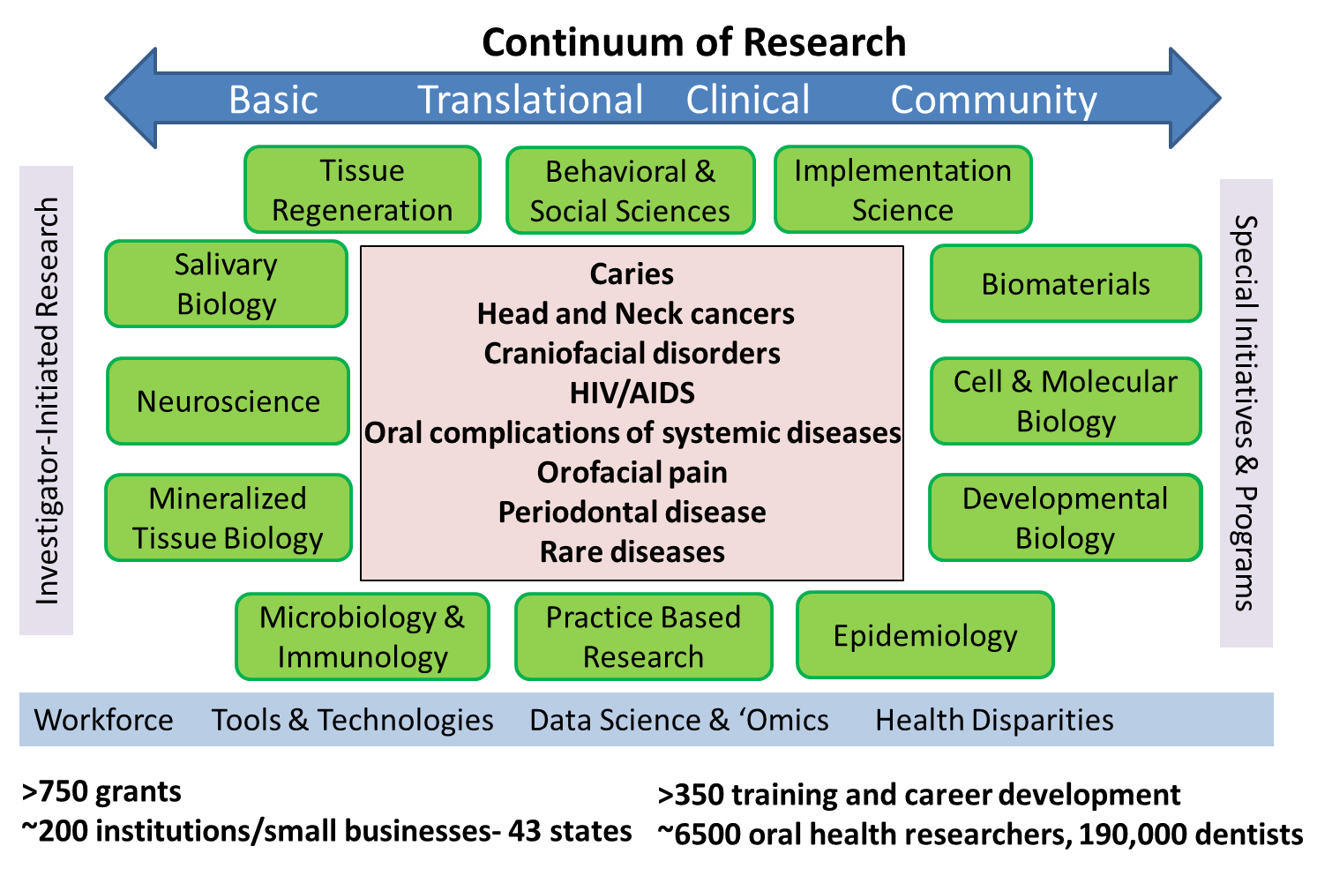
NIDCR Portfolio

Slide 82

Engaging the Community, Envisioning the Future

Slide 83
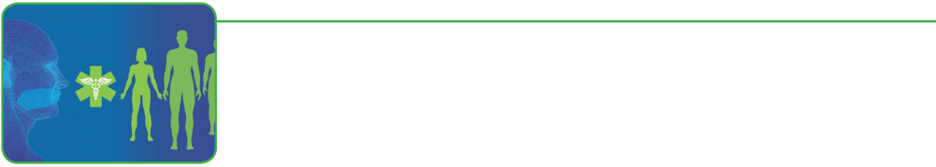
Oral Health + Overall Health
Oral health will be fully integrated into the study of overall health through a deeper understanding of the mechanisms that cause disease or support health
Integration will:
Enhance interactions and communications among practitioners, researchers, and patients
Advance our understanding of factors that cause disease or support health

Slide 84
Periodontal Disease Bacteria Linked to Rheumatoid Arthritis
Medical News & Perspectives
To Prevent Rheumatoid Arthritis, Look Past the Joints to the Gums
Jennifer Abbasi
Researchers identified a bacteria typically associated with periodontal disease in >50% of individuals with RA
Konig et al. Sci Transl Med. 8, 2016
JAMA, March 2017

Slide 85
Precision Health
Precision prevention, treatment and public health interventions will be available to all people
Including strategies to:
Promote health and prevent and treat disease based on individual’s genetics, environment, behavior, etc.
Overcome health disparities
Develop public health interventions

Slide 86
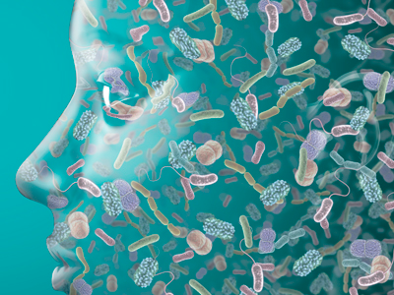
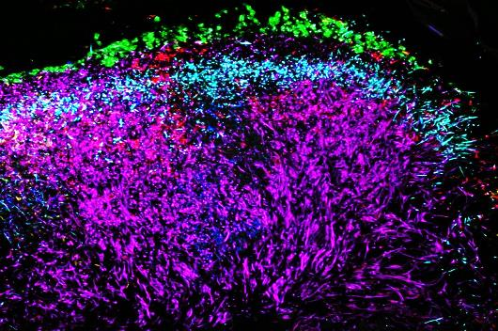
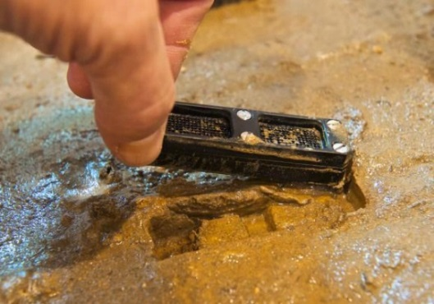
Oral Microbiome and Precision Prevention
Developing Probiotics for Caries Prevention
A newly identified strain of Streptococcus, A12, can help counteract the effects of caries-causing S. mutans
  A12 neutralizes acidic conditions and hinders S. mutans survival
  Opportunity for probiotic development - prevention
  Opportunity for precision health- caries risk assessment and identify people who could most benefit from A12

Slide 87
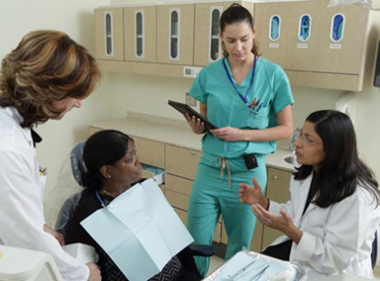


Oral Health Disparities Research
A consortium for childhood oral health disparities research
Test health promotion and disease prevention strategies
Community-based investigation and participation
Multidisciplinary team approach
Examples of Health Disparities research efforts:
Storytelling techniques in American Indian/Alaska Native communities to improve oral health knowledge and behaviors in women and their infants
  Leveraging text messaging and social networks to promote oral health behaviors in underserved populations
  Understanding the effects of aging on health (trans-NIH)

Slide 88
Improving Dental Visits for Children with Autism Spectrum Disorders
Adapting the dental environment to improve experience for children with ASD
Autism Spectrum Disorders (ASD) cause sensory processing difficulties
ASD children are at higher risk of oral diseases, including caries
Sensory Adapted Dental Environment (SADE) to improve dental office visits
Cermak S et al. (2015) J Autism Dev Disord
Lower anxiety and sensory discomfort reported with SADE

Slide 89
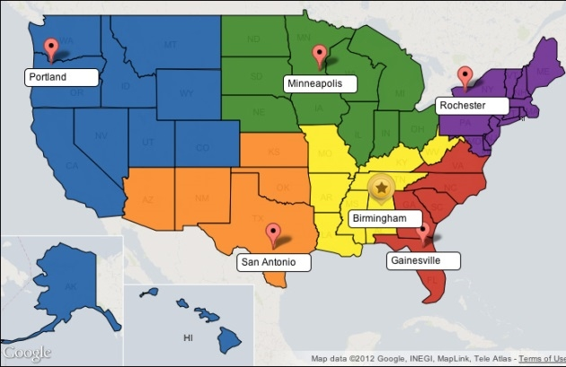
  Practice-Based Research
National Dental Practice-Based Research Network
Engaging practitioners to generate the evidence base to improve precision health care
52,500 participants enrolled and over 55 studies in National coordinating center & 6 regional centers
Over 6,800 practitioner members, all 50 states
Over progress or completed
https://www.nationaldentalpbrn.org/
Studies include: Management of painful temporomandibular disorders, HPV screening for oral cancer risk, and opioid prescribing practices of dentists

Slide 90

Recent Research Initiatives & On the Horizon
Research to better understand gene-environment
interactions in orofacial clefting
Clinical studies on craniofacial anomaly and scar
repair strategies (fibromodulin)
Initiative on dissemination and implementation research
Initiative to identify novel tumor antigens for oral cancer treatment
Research on tailoring dental treatment for individuals with systemic diseases that compromise oral health
Research to address emerging public health concerns (zika virus, opioids, HPV oral cancer, e-cigarettes, etc.)
Collaborations on effects of aging on health and disease
Development of tools & technologies to monitor health and detect and treat dental, oral and craniofacial diseases and disorders
Training program at NIDCR in Dental Public Health and Bioinformatics (with NLM)

Slide 91









Resources
Connect with Us
Twitter
Follow @NIDCR to keep up with the latest
#dental and #craniofacial research.
NIDCR Updates
Subscribe to receive our quarterly
e-newsletter and emails about events, proposed research initiatives, and more.
LinkedIn
Follow NIDCR on LinkedIn for career advice, training and job opportunities, and research developments.
Science News
Subscribe for emails about the latest NIDCR-supported science advances and the researchers who make them possible.
YouTube
Subscribe to the NIDCR playlist to view science and oral health videos.
Grants & Funding
Subscribe to receive weekly emails on funding opportunities and grant policy updates.
Go to www.nidcr.nih.gov to connect

Slide 92

Indian Health Service
Christopher G. Halliday, DDS, MPH
Deputy Director
Division of Oral Health

Slide 93

Indian Health Service
Mission
To raise the physical, mental, social and spiritual Health of American Indians and Alaska Natives to the highest level
Agency Priorities
  People
  Resources
  Partnerships
  Quality
People

Slide 94
The Indian Health Care System
Population Served
  Members of 567 Federally recognized Tribes
  More than 2.2 million American Indians and Alaska Natives
IHS Services are administered through a system of 12 Area Offices and 170 IHS and tribally managed service units
  404 total dental clinics
  76 IHS Direct
  319 Tribal
  9 Urban

Slide 95
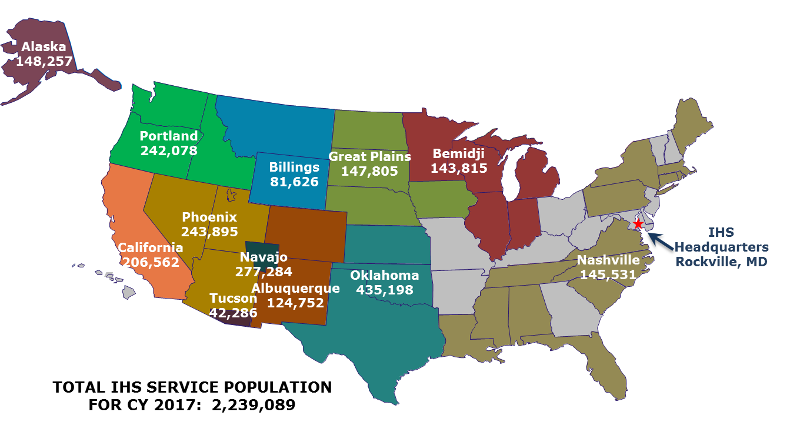
Service Population By Area
IHS Service Population Map

Slide 96
Oral Health Initiatives and Programs
Oral Health Surveillance
Early Childhood Caries Collaborative
Periodontal Treatment Initiative
Oral Health Promotion/Disease Prevention Funding Initiative
Dental Clinical and Preventive Support Centers
Alternative Dental Workforce Models
Dental Workforce Efficiency Initiative

Slide 97
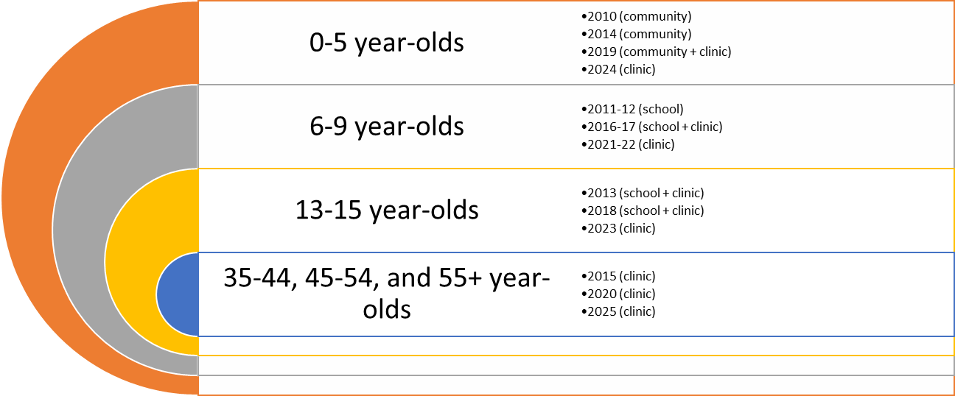
Oral Health Surveillance
Surveillance Groups

Slide 98
Early Childhood Caries Collaborative
Results:
  0-5 year old Access to Care 7.9% increase
  0-5 year old Sealants 65.0% increase
  0-5 year old Topical Fluoride 68.2% increase
  0-5 year old ITR 161.0% increase

Slide 99
Early Childhood Caries Collaborative
Results:
  1-2 year old caries experience 6.3% decrease
  1-2 year old untreated decay 4.3% decrease
  1-5 year old caries experience in
  “fully implemented sites” 16.8% decrease
  1-5 year old untreated decay in
  “fully implemented sites” 26.8% decrease

Slide 100
Periodontal Treatment Initiative
Resulted in the development and release of new National standards for screening and treatment of periodontal (gum) disease
Expanded Functions Dental Assistants (EFDAs):22 courses in the last two years, 153 dental assistants trained
Have developed a new treatment protocol for non-diabetic patients
Have developed a new Community Periodontal Index screening guide
Have evaluated the effectiveness of periodontal EFDAs

Slide 101
Oral Health Promotion/Disease Prevention Funding Initiative
The Division of Oral Health has funded prevention projects in the Indian Health Service since the year 2000
Annual Awards, averaging 15 from 2010 to 2017
16 projects funded in fiscal year 2017
Each funded program from 2014 to 2017 provided evaluation reports that were disseminated to national audience
Each of the funded initiatives demonstrated “out of the box” innovative thought that has led to national replication of their best practices

Slide 102
Dental Clinical and Preventive Support Centers
Purpose: To bolster infrastructure
Have been funded since 2004
Five year program awards and grants
8 Dental Clinical and Preventive Support Centers serving ten of twelve IHS Areas
Alaska, Albuquerque, Billings, California, Nashville, Oklahoma City, Navajo, Phoenix, Tucson and Portland areas are currently served by a Dental Clinical and Preventive Support Center

Slide 103
Alternative Dental Workforce Model Project
Collaboration with Johns Hopkins University School of Public Health
Purpose: to evaluate impact of different alternative dental workforce models on productivity (visits, RVUs), efficiency (services per patient, etc.) and GPRA (access, fluoride and sealants)
The alternative dental providers include expanded functions dental assistants, independent registered dental hygienists, primary dental health aides and dental health aide therapists
Project is ongoing

Slide 104
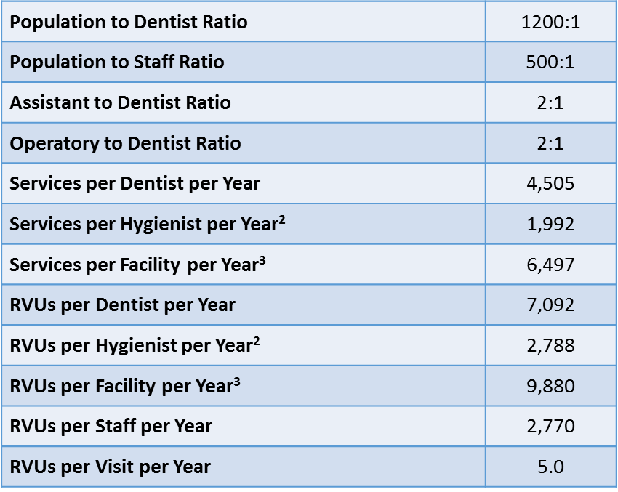
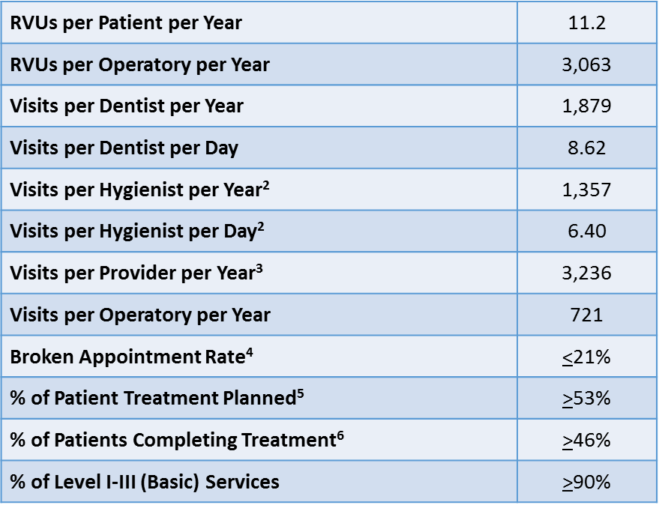
Dental Workforce Efficiency Initiative
Have developed new clinical efficiency and effectiveness indicators

Slide 105
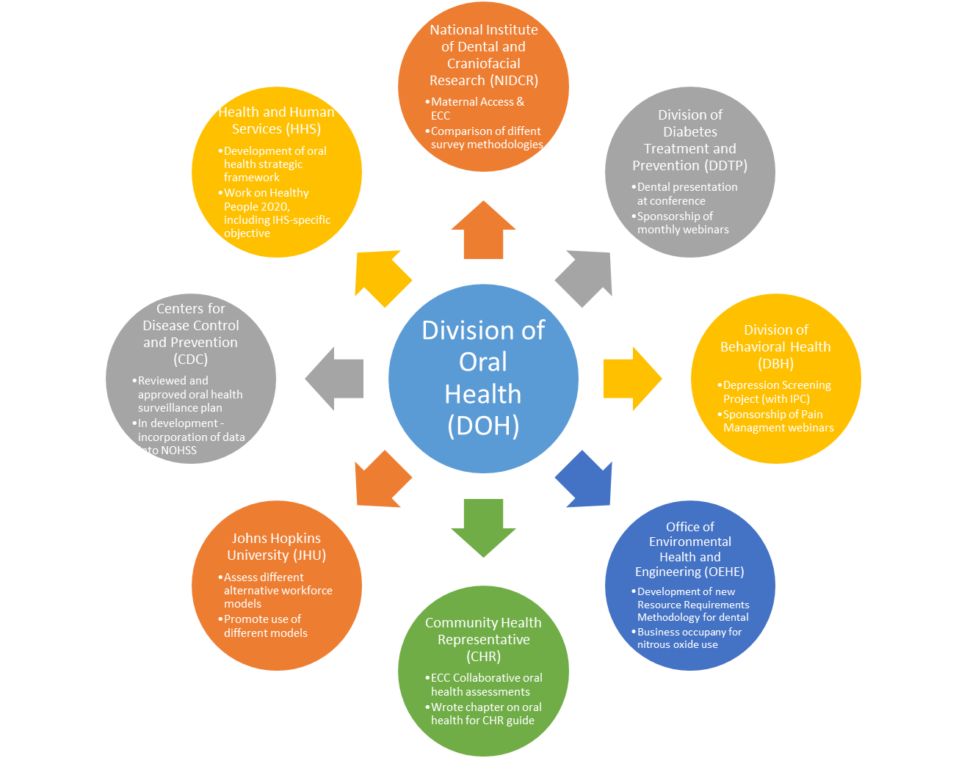
Partnerships are key in addressing oral health disparities
Division of Oral Health Partnerships

Slide 106
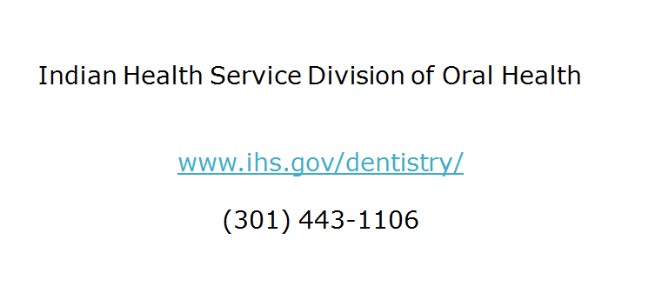
Contact information

Slide 107

Healthy People 2020 Progress Review
Maximizing Access:
Connecting Health Care and Oral Health Care
Webinar
June 13, 2017
Presented by:
Greg Nycz, Executive Director
Family Health Center of Marshfield, Inc.

Slide 108
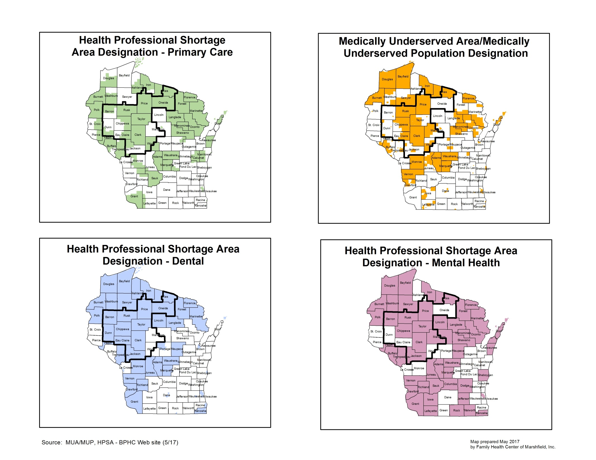
Health Professional Shortage Areas

Slide 109
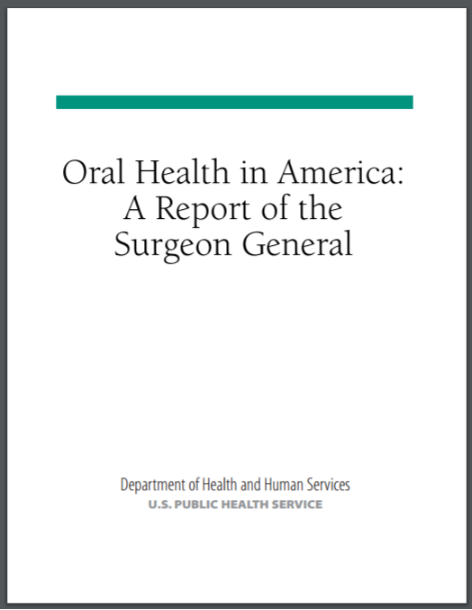

Slide 110

The Dental Access Problem
A Wisconsin Problem
30.8% of our 3rd graders have untreated decay. Four percent (8.4% in lower income schools) had urgent care needs (pain, infection, swelling, or soft tissue ulceration of more than two weeks duration) (Make Your Smile Count Survey, Wisconsin DHFS, 2001-2002)
Only 23.4% of State Medicaid recipients received a dental service in 2008. (data from Wisconsin Department of Health Services)

Slide 111
Our Plan
Our destination: 100% access to high quality services 0 health disparities
Our strategy: Develop a plan capable of
delivering us to our final
destination
Planning horizon: 10 to 20 years

Slide 112
The Need for a Comprehensive Strategy
To be successful, we must recognize the importance of dual accountabilities:
To those in need
To those who pay (the State of Wisconsin, HRSA, Medicaid) as well as those who ultimately foot the bill (taxpayer).

Slide 113
Major Components of the Plan
Rapidly expand dental capacity. If you build it they will come, but they will come when they are in pain
Foster collaboration across medicine, public health, and dentistry
Develop an integrated oral/medical electronic health record with decision support tools
113

Slide 114
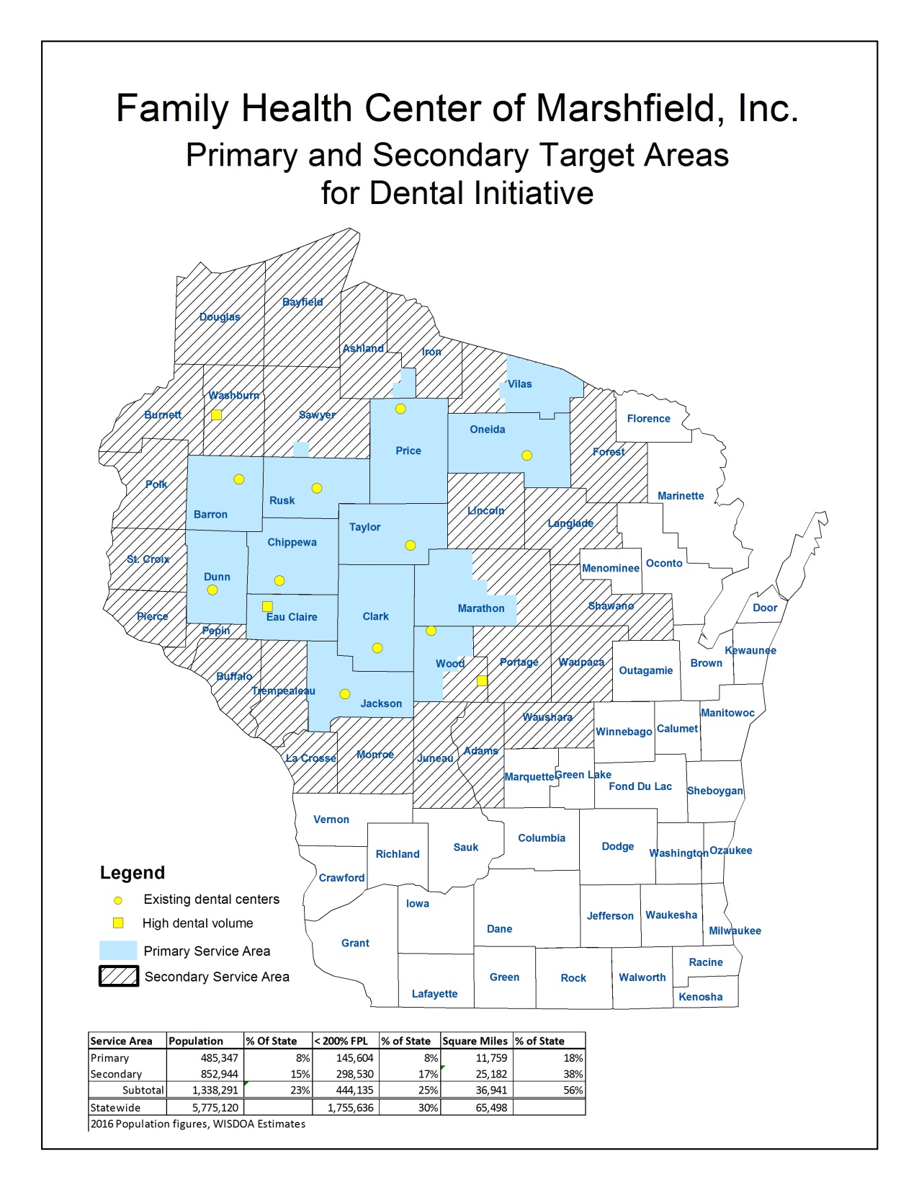
Map

Slide 115
Elements of Our Oral Health Initiative
  Access to needed services leaving no one behind
  Integration across public health/medical and dental domains
  Workforce solutions
    Not enough dentists
    Maldistribution of dentists
    Training deficits
  Quality assurance and improvement
  Expanding our knowledge base

Slide 116
Access
Leaving No One Behind
The elderly
Veterans*
Medicaid
Those with dental emergencies*
Uninsured
Disabled*
Our youngest children
Medically complex patients
Individuals whose oral condition presents a barrier to work*
*Statewide priority

Slide 117
Community Collaborations And Outreach
  Tele-dental and Head Start
  Nursing Homes/Assisted Living Facilities
  Community Hospitals
  Social Service Agencies
  Job Service Agencies
  Disability Groups
  Veteran Affairs Offices
  Local Public Health Directors and Oral Health Staff
  Schools
  Day Care Centers
  WIC Offices
  Food Pantries
  Free Clinics

Slide 118
The Dental Workforce and Rural Wisconsin
Facing a triple threat:
Aging and retirement
Dentist preferences for practice locations
Gender equality and preferences

Slide 119


OUR FIRST REGIONAL DENTAL FACILITY
THE LADYSMITH DENTAL CENTER  OPENED JULY 2003
8,840 square feet
17 operatories
5 dentists/5 hygienists
Building funded with State Rural Health Dental Clinic funds and FHC reserves
OUR TENTH REGIONAL DENTAL FACILITY
THE MENOMONIE DENTAL CENTER  OPENED DECEMBER 1, 2016
13,200 square feet
20 operatories (includes 4 training operatories)
5 dentists/4 hygienists
Special space and equipment to serve the developmentally disabled

Slide 120

2017 Current Oral Health Infrastructure

Slide 121
Why Medicine?
There are many health literacy issues that need to be addressed.
There are barriers other than financial that keep people from going to the dentist.
Opportunity (a high proportion of the population sees a physician each year).
Obligation (to care for the patient) and increasing awareness of oral-systemic relationships.

Slide 122
How Can Medicine Help?
Combined medical/dental electronic record with decision support to maximize compliance with evidence based preventive health services
Dentists and hygienists virtually teaming with primary care providers - more well-child checks, less extractions – more immunizations, less illness

Slide 123
Medical Dental Integration
Better Care?
Case example: A diabetic patient presented at our Ladysmith Dental Center. The patient was jaundiced and very ill and had a large lesion on his leg for the past four years that would not heal. He also had severe oral health disease. Following a full mouth extraction and dentures, this patient has been back for routine care. He reports his blood glucoses are under control, he has good skin color, his skin lesion is healed and he is very happy.

Slide 124
Medical Dental Integration
Better Care?
Case example: A 20-year-old female with no income presented as unemployed and depressed with very poor oral health. We provided extractions and dentures. She now has an improved self image and a job.

Slide 125
Health center patients receiving dental care
69%
83%

Slide 126

2013 Rankings of eligible children <20 who received any dental services

Slide 127

Comparison of services provided inside and outside of FHCs

Slide 128

Map of those treated by FHC

Slide 129

Penetration twice poverty by county

Slide 130

Park Falls Dental Patients (<200% of Poverty)
Seen (March 2008-June 2009) From
Target Area Communities by Distance to Care Burden

Slide 131

Zip codes with 10 or more patients treated at FQHC dental site by year

Slide 132
Excerpt from letter of support from Jackson County Department of Health & Human Services, Jackson County Public Health Nurse
“I recently took a call from a concerned sister who had a very ill 28 year old brother with a full-time job, however, no medical or dental insurance. He was experiencing high fevers, severe malaise, and significant body pain. I advised family to take him to local urgent care. Upon examination it was found that he had not had proper dental care for several years. He not only had abscessed teeth that caused him to be septic, but also had an advanced stage of jaw cancer. Hospital staff expressed concerns with him not living another 12 hours if he hadn’t come into urgent care when he did. The family and I feel strongly if he would have had access to a dental center he would have had prevention and/or earlier diagnosis of the abscessed teeth and jaw cancer.”

Slide 133




The Importance of Ground Breakings, Ribbon Cuttings, and Big Check Ceremonies
Chippewa Falls Dental Center
Groundbreaking – May 2006
Ladysmith Dental Center
Ribbon Cutting – August 2003
Senator Decker laying the cornerstone at the Ladysmith Dental Center
Park Falls Dental Center
Check Presentation – August 2007

Slide 134

For more information on Wisconsin Community Health Centers oral health initiatives contact Stephanie Harrison at WPHCA at 5202 Eastpark Blvd, Suite 109, Madison, WI 53718; 608-277-7477
For more information about Family Health Center of Marshfield, Inc.’s dental initiative contact: Greg Nycz at 1000 North Oak Avenue, Marshfield, WI 54449; 715-387-9137 or nycz.greg@marshfieldclinic.org

Slide 135
Roundtable Discussion
Carter Blakey
Deputy Director, Office of Disease Prevention and Health Promotion

Slide 136

Healthy People 2020 Stories from the Field
A library of stories highlighting ways organizations across the country are implementing Healthy People 2020
Healthy People in Action
http://www.healthypeople.gov/2020/healthy-people-in-action/Stories-from-the-Field

Slide 137
Healthy People 2030 Development: Informational Webinar
Co-Hosted by ODPHP and APHA
Save the Date!
June 22, 2017
12:00 pm to 1:00 pm ET
Register now at APHA.org

Slide 138


Who’s Leading the Leading Health Indicators? Webinar
Please join us on Thursday, July 20th for the
Social Determinants LHI Webinar
Registration on HealthyPeople.gov will be available in July.

Slide 139
Secretary’s Advisory Committee on National Health Promotion and Disease Prevention Objectives for 2030
Save the Date!
June 27, 2017
1:00 pm to 5:00 pm ET
Registration opens in June on HealthyPeople.gov

Slide 140
Progress Review Planning Group
  Anne Dievler (HRSA)
  Robert McNellis (AHRQ/CEPI)
  Shavon Artis (HHS/OASH)
  Allison Vilchinsky (HRSA)
  Gina Thornton-Evans (CDC/ONDIEH)
  Renée Joskow (HRSA)
  Tim Iafolla (NIH/NIDCR)
  Chris Halliday (IHS/HQ)
  Morgan O’Hayre (NIH/NIDCR)
  Stan Lehman (CDC/OD)
  Jennifer Villani (NIH/OD)
  Emily DeCoster (HRSA)
  Irma Arispe (CDC/NCHS)
  David Huang (CDC/NCHS)
  Leda Gurley (CDC/NCHS)
  Elizabeth Jackson (CDC/NCHS)
  Jeff Pearcy (CDC/NCHS)
  Robin Pendley (CDC/NCHS)
  Cheryl Rose (CDC/NCHS)
  Carter Blakey (HHS/ODPHP)
  Emmeline Ochiai (HHS/ODPHP)
  Angie McGowan (HHS/ODPHP)
  Ayanna Johnson (HHS/ODPHP)
  Yen Lin (HHS/ODPHP)

Slide 141




Stay Connected
Web healthypeople.gov
Email healthypeople@hhs.gov
Twitter @gohealthypeople
YouTube ODPHP (search “healthy people”)
Join the Healthy People Listserv & Consortium

