Slide 1
Healthy People 2020
Progress Review

Slide 2
Healthy People 2020 Progress Review:
Improving Health Outcomes through Inclusion and Participation
August 11, 2016

Slide 3
Karen B. DeSalvo, MD, MPH, MSc
Acting Assistant Secretary for Health
U.S. Department of Health and Human Services

Slide 4
Progress Review Agenda and Presenters
Chair
Karen B. DeSalvo, MD, MPH, MSc, Acting Assistant Secretary for Health, U.S. Department of Health and Human Services
Presentations
Charles Rothwell, MBA, MS, Director, National Center for Health Statistics
Alison Cernich, PhD, Director, National Center for Medical Rehabilitation Research, NICHD, NIH
John Tschida, MPP, Director, National Institute on Disability, Independent Living, and Rehabilitation Research, ACL
Georgina Peacock, MD, MPH, FAAP, Director, Division of Human Development and Disabilities, National Center on Birth Defects and Developmental Disabilities, CDC
Jennifer Madans, PhD, Associate Director for Science, National Center for Health Statistics
Community Highlight
Meg Traci, PhD, Project Director, Assistant Research Professor, The Montana Disability and Health Program

Slide 5
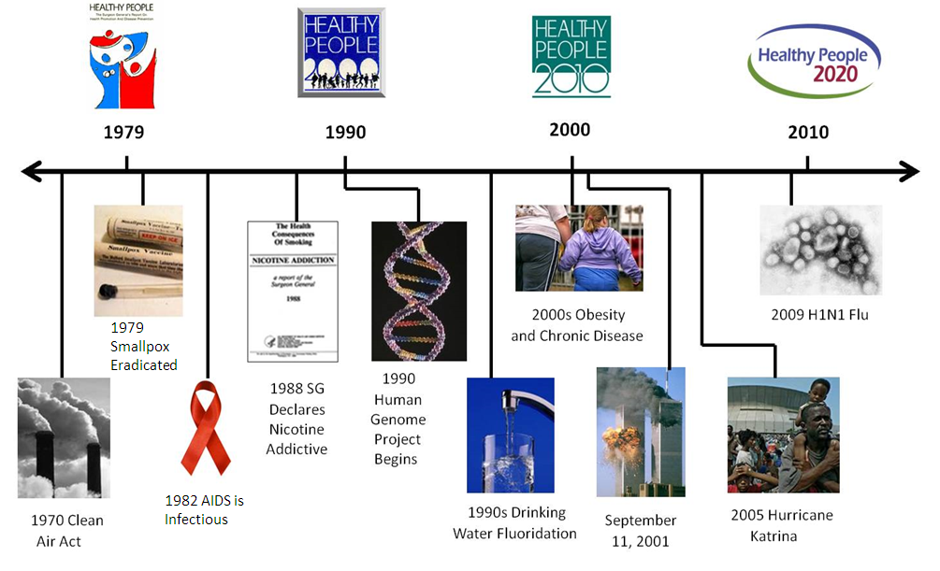
Healthy People at the Forefront of Public Health

Slide 6
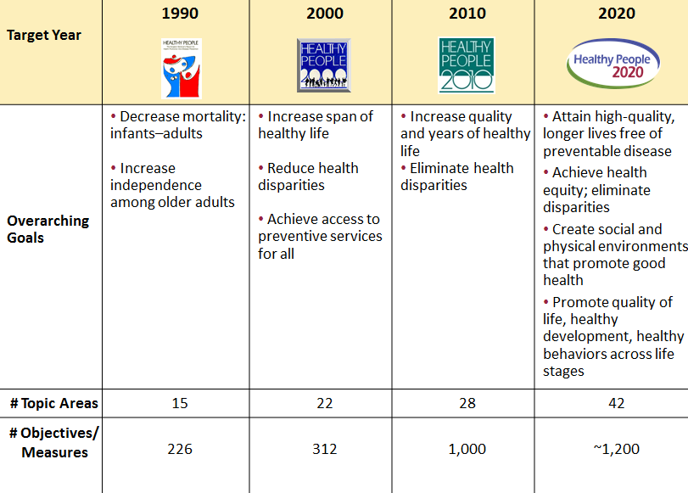
Evolution of Healthy People

Slide 7
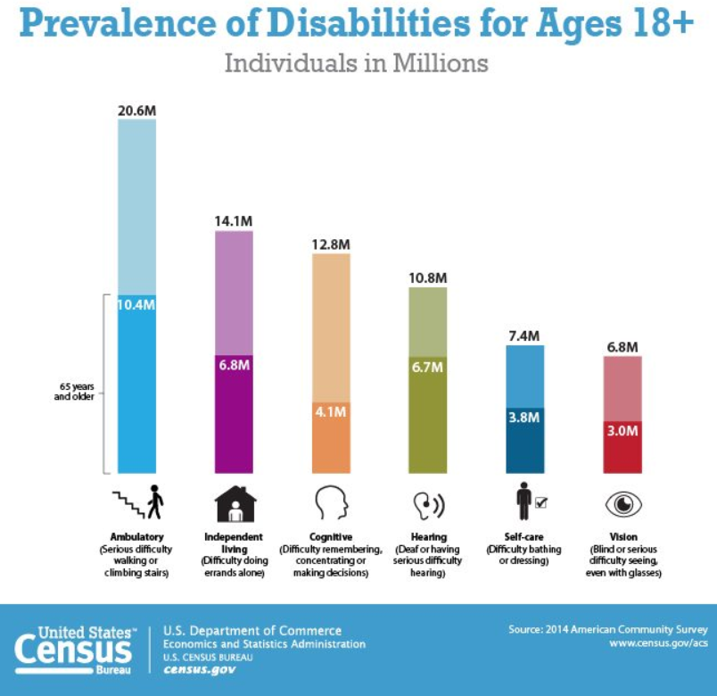
Disability and Health:
People with Disabilities
7

Slide 8
Impact: Poor health among people with disabilities
Less likely to receive recommended preventive health care services, such as routine teeth cleanings and cancer screenings
At a high risk for poor health outcomes such as obesity, hypertension, falls-related injuries, and mood disorders such as depression
More likely to engage in unhealthy behaviors that put their health at risk, such as cigarette smoking and inadequate physical activity
8

Slide 9
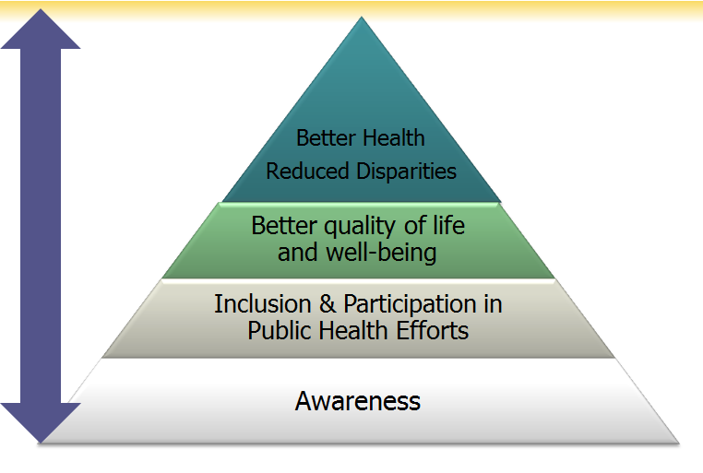
Actions Impacting
Disability and Health
9

Slide 10
Heath-Related Quality of Life and Well-Being
Multi-dimensional and includes domains that relate to physical, mental, emotional, and social functioning.
Beyond direct measures of population health such as life expectancy and causes of death, and focuses on impact of health status on quality of life.
Well-being – positive aspects of a person’s life
  Positive emotions
  Life satisfaction
SOURCES: https://www.healthypeople.gov/2020/topics-objectives/topic/health-related-quality-of-life-well-being
10

Slide 11
Charles Rothwell, MBA, MS
Director, National Center for Health Statistics
Centers for Disease Control and Prevention

Slide 12
Presentation Overview
  Tracking the Nation’s Progress
  Disability and Health
  Health-Related Quality of Life and Well-Being
12

Slide 13
Tracking the Nation’s Progress
  21 HP2020 Measurable Disability and Health Objectives:
  2 HP2020 Measurable Health-Related Quality of Life and Well-Being Objectives:
5 | Target met
2 | Improving
7 | Little or no detectable change
3 | Getting worse
4 | Baseline data only
2 | Baseline data only
NOTES: Measurable objectives are defined as having at least one data point currently available and anticipated additional data points throughout the decade to track the progress.
13

Slide 14
Presentation Overview
  Tracking the Nation’s Progress
  Disability and Health
  Data Systems and Health Promotion Programs
  Barriers to Primary Care
  Education Systems
  Unemployment
  Serious Psychological Distress
  Health-Related Quality of Life and Well-Being
14

Slide 15
Operational Definition –
Adults with Disabilities
American Community Survey Disability Questions:
Is this person deaf or does he/she have serious difficulty hearing?
Is this person blind or does he/she have serious difficulty seeing even when wearing glasses?
Because of a physical, mental, or emotional condition, does this person have serious difficulty concentrating, remembering, or making decisions?
Does this person have serious difficulty walking or climbing stairs?
Does this person have difficulty dressing or bathing?
Because of a physical, mental, or emotional condition, does this person have difficulty doing errands alone such as visiting a doctor’s office or shopping?
NOTES: The American Community Survey (ACS), Census Bureau uses this set of six questions to identify adults with disabilities. A response of “yes” to any of the questions indicates that the person has a disability.
15

Slide 16
Population-based Data Systems with
American Community Survey Disability Questions
Number of Data Systems
Target Met
NOTES: Data are for the number of Healthy People 2020 population-based data systems that include in their core the American Community Survey set of six questions that identify adults with disabilities.
SOURCE: Periodic assessment of Healthy People data sources by staff of the National Center on Birth Defects and Developmental Disabilities, CDC.
Obj. DH-1
Increase desired
16

Slide 17
Health Disparities by Disability Status
Health Care Access | Disability % (SE) | No disability % (SE)
Breast cancer screening (women 50-74 years, NHIS 2015) | 65.8% (2.483) | 72.2% (1.287)
Use of oral health care system in past year (2 years+, MEPS 2013) | 37.1% (1.959) | 44.4% (0.570)
Health Behaviors
Meeting physical activity guidelines (18 years+, NHIS 2015) | 9.6% (1.010) | 23.6% (0.534)
Healthy weight (20 years+, NHANES 2013-14) | 23.2% (1.886) | 29.5% (0.955)
Current cigarette smokers (18 years+, NHIS 2015) | 28.0% (1.547) | 13.7% (0.409)
SOURCES: National Health Interview Survey (NHIS), CDC/NCHS;
Medical Expenditure Panel Survey (MEPS), AHRQ;
National Health and Nutrition Examination Survey (NHANES), CDC/NCHS.
Objs. C-17, OH-7, PA-2.4, NWS-8 , TU-1.1
17

Slide 18
State Health Promotion Programs for Persons with Disabilities
Number of health departments
Target Met
HP2020 Target: 18
NOTES: Data are for the number of state and the District of Columbia health departments that have at least one health promotion program aimed at improving the health and well-being of persons with disabilities.
Obj. DH-2.1
Increase desired
SOURCE: Periodic assessment by staff of the National Center on Birth Defects and Developmental Disabilities, CDC.
18

Slide 19
Barriers to Primary Care, Adults with Disabilities
Percent
2009
2015
Decrease desired
HP2020 Target: 44.6%
NOTES: I = 95% confidence interval. Data are for adults aged 18 years and older with disabilities who experienced delays in receiving primary and periodic preventive care due to specific barriers. Educational attainment data are for adults 25 years and over. Respondents were asked to select one or more races. The categories black and white include persons who reported only one racial group and exclude persons of Hispanic origin. Persons of Hispanic origin may be of any race. Data are age-adjusted to the 2000 standard population.
SOURCE: National Health Interview Survey (NHIS), CDC/NCHS.
Obj. DH-4

Slide 20
Early Intervention Services, Children with Disabilities
Percent
Target Met
HP2020 Target: 95.0%
)0
NOTES: Data are for children aged 2 years and under with disabilities, who received early intervention services in home or community-based settings.
Obj. DH-20
Increase desired
SOURCE: Individuals with Disabilities Education Act data (IDEA data), ED/OSERS.

Slide 21
Regular Education Programs,
Children and Youth with Disabilities
Percent
Increase desired
HP2020 Target: 73.8%
0
NOTES: Data are for students aged 6 to 21 years with disabilities who spent at least 80% of the day in regular classrooms. Data are for school years.
Obj. DH-14
SOURCE: Individuals with Disabilities Education Act data (IDEA data), ED/OSERS.

Slide 22
Unemployment, Adults with Disabilities
Percent
The
2009
2014
Target Met
HP2020 Target: 14.0%
Education
NOTES: I = 95% confidence interval. Data are for persons aged 16 to 64 years with disabilities who want a job, are available to work, and are actively looking for work. Educational attainment data are for adults 25 to 64 years. Respondents were asked to select one or more races. The categories black and white include persons who reported only one racial group and exclude persons of Hispanic origin. Persons of Hispanic origin may be of any race. Data are age-adjusted to the 2000 standard population.
SOURCE: Current Population Survey (CPS), Census and DOL/BLS.
Obj. DH-15
Decrease desired

Slide 23
Serious Psychological Distress,
Adults with Disabilities
Percent
2010
2015
Decrease desired
HP2020 Target: 13.0%
NOTES: I = 95% confidence interval. Data are for adults aged 18 and older with disabilities who experienced serious psychological distress in the past 30 days. Respondents were asked to select one or more races. The categories black and white include persons who reported only one racial group and exclude persons of Hispanic origin. Persons of Hispanic origin may be of any race. Except for age specific estimates, data are age-adjusted to the 2000 standard population.
SOURCE: National Health Interview Survey (NHIS), CDC/NCHS.
Age (years)
Obj. DH-18

Slide 24
Presentation Overview
  Tracking the Nation’s Progress
  Disability and Health
  Health-Related Quality of Life and Well-Being
  Patient Reported Outcomes Measurement Information System (PROMIS)
  Physical Health
  Mental Health
24

Slide 25
PROMIS Measures of Physical Health
1. In general, how would you rate your physical health? Excellent Fair Very good Poor Good | 2. To what extent are you able to carry out your everyday physical activities such as walking, climbing stairs, carrying groceries, or moving a chair? Completely A little Mostly Not at all Moderately
3. In the past 7 days, how would you rate your fatigue on average? None Severe Mild Very severe Moderate | In the past 7 days, how would you rate your pain on average? Use a scale of 0-10 with 0 being no pain and 10 being the worst imaginable pain.
NOTES: PROMIS physical health measures use 4 NHIS questions on physical health, responses are combined and the data are divided in 2 categories: good or better physical health vs. fair or poor physical health.
SOURCE: Hays RD, Bjorner J, Revicki RA, Spritzer KL, Cella D. Development of physical and mental health summary scores from the Patient Reported Outcomes Measurement Information System (PROMIS) global items. Quality of Life Research 2009;18(7):873–80. http://www.ncbi.nlm.nih.gov/pubmed/19543809.
25

Slide 26
PROMIS Measures of Mental Health
1. In general, would you say your quality of life is: Excellent Fair Very good Poor Good | 2. In general, how would you rate your mental health, including your mood and your ability to think? Excellent Fair Very Good Poor Good
3. In general, how would you rate your satisfaction with your social activities and relationships? Excellent Fair Very Good Poor Good | 4. In the past 7 days, how often have you been bothered by emotional problems such as feeling anxious, depressed, or irritable? Never Often Rarely Always Sometimes
NOTES: PROMIS mental health measures use 4 NHIS questions on mental health, responses are combined and the data are divided in 2 categories: good or better mental health vs. fair or poor mental health.
SOURCE: Hays RD, Bjorner J, Revicki RA, Spritzer KL, Cella D. Development of physical and mental health summary scores from the Patient Reported Outcomes Measurement Information System (PROMIS) global items. Quality of Life Research 2009;18(7):873–80. http://www.ncbi.nlm.nih.gov/pubmed/19543809.
26

Slide 27
Self-Reported Good or Better Health by Disability Status, 2010
Percent
Without disability
With disability
HP2020 Target: 79.8%
HP2020 Target: 80.1%
Physical Health
Mental Health
NOTES: I = 95% confidence interval. Data are for adults aged 18 and over who self-reported good or
better physical or mental health in the past month (based on 8 PROMIS questions). Data are age
adjusted to the 2000 standard population.
SOURCE: National Health Interview Survey (NHIS), CDC/NCHS.
Objs. HRQOL/WB-1.1 & 1.2

Slide 28
Self-Reported Good or Better
Physical and Mental Health, 2010
Physical
health
Increase desired
Mental
health
Percent
NOTES: = 95% confidence interval. Data are for adults aged 18 and over who self-reported good or better physical or mental health in the past month (based on 8 PROMIS questions).
Objs. HRQOL/WB-1.1 & 1.2
I
SOURCE: National Health Interview Survey (NHIS), CDC/NCHS.
28

Slide 29
Self-Reported Good or Better Physical Health, 2010
HP2020 Target: 79.8%
Increase desired
Percent
NOTES: = 95% confidence interval. Except for education, data are for adults aged 18 and over who self-reported good or better physical health in the past month. Respondents were asked to select one or more races. American Indian includes Alaska Native. The categories black and white exclude persons of Hispanic origin. Persons of Hispanic origin may be of any race. Data are age-adjusted to the 2000 standard population. Educational attainment data are for adults 25 years and over.
SOURCE: National Health Interview Survey (NHIS), CDC/NCHS.
I
Obj. HRQOL/WB-1.1
29

Slide 30
Self-Reported Good or Better Mental Health, 2010
HP2020 Target: 80.1%
Increase desired
Percent
NOTES: = 95% confidence interval. Except for education, data are for adults aged 18 and over who self-reported good or better mental health in the past month. Respondents were asked to select one or more races. American Indian includes Alaska Native. The categories black and white exclude persons of Hispanic origin. Persons of Hispanic origin may be of any race. Data are age-adjusted to the 2000 standard population. Educational attainment data are for adults 25 years and over.
SOURCE: National Health Interview Survey (NHIS), CDC/NCHS.
I
Obj. HRQOL/WB-1.2
30

Slide 31
Key Takeaways: Disability and Health
Improvements in Inclusion and Participation:
The number of Healthy People 2020 population-based data systems that include ACS disability questions (n=13) has increased.
The number of states (n=19) with support for disability and health promotion programs has increased.
Use of early intervention services in community settings by children aged 2 years and under with disabilities has increased.
There has been an increase in the proportion of students aged 6 to 21 years with disabilities who spent at least 80% of their day in regular education classrooms.
31

Slide 32
Key Takeaways: Disability and Health
Opportunities for Improvement:
Disparities persist in unemployment of adults with disabilities by race/ethnicity and educational attainment.
Barriers to primary care and serious psychological distress have shown little or no change.
So far in the decade, 7 out of 21 Healthy People 2020 Disability and Health objectives have reached the targets or are improving.
32

Slide 33
Key Takeaways: Health-Related
Quality of Life and Well-Being
Overall, more than 75% of adults reported good or better physical and mental health.
The largest disparity in health-related quality of life was by disability status.
Fewer than 40% of adults with disabilities reported good or better physical health and 50% reported good or better mental health.
Disparities in health-related quality of life exist by age, sex, race/ethnicity, and education.
33

Slide 34
Disability and Health Program Highlights Related to HP2020 Objectives

Slide 35
Disability and Health Programs
State Health Departments, Universities & National Organizations
Universities & Small Business
Translational Science
Translational Science
Translational Science
University Research and Training Centers & Community Independent Living Centers
35

Slide 36
Alison Cernich, Ph.D., ABPP-Cn
Director, National Center for Medical Rehabilitation Research, NICHD, NIH

Slide 37
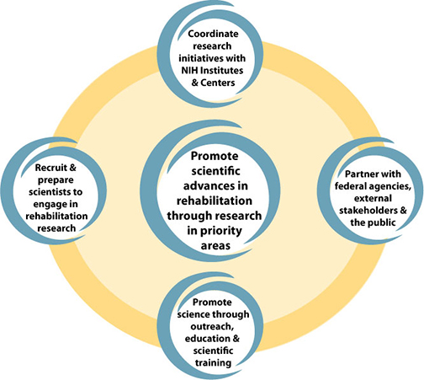
National Center for Medical Rehabilitation Research
Mission
Enhance the health, productivity, independence, and quality-of-life of
people with physical disabilities through basic, translational, and clinical research.
37

Slide 38






Building Research Capacity
National Center for Medical Rehabilitation Research
NCMRR-Supported Networks:
NCMRR-Supported Networks
38

Slide 39

Translational Research on
Social Emotional Support
Impact of Social Network Structure on Stroke (K23HD074621)
  Examine stroke recovery in relationship to the social structures in which patients are embedded, and the influence of those social elements on functional outcomes
  Implement a novel social network intervention and will assess its ability to improve stroke recovery
Network video: Stroke Recovery Network Video
DH-17 Sufficient social and emotional support
39

Slide 40
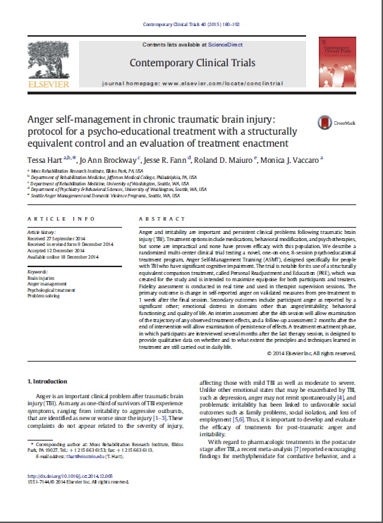
Translational Research on Psychological Distress
Anger Self-Management in Post-Acute Traumatic Brain (R01HD061400)
Improving Anxiety-Management and Rehabilitation Outcomes in Critical Care (K23HD074621)
DH-18 Psychological distress
40

Slide 41

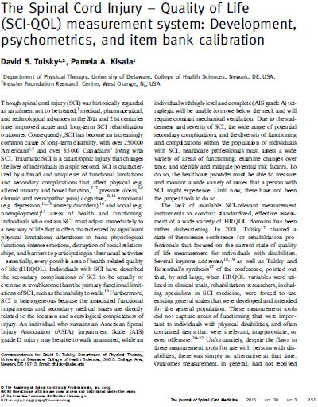
Translational Research on
Quality of Life
Quality of Life for SCI Clinical Trials: Development of the SCI-QOL (R01HD054569)
41

Slide 42
Mr. John Tschida
Director, National Institute on Disability, Independent Living, and Rehabilitation Research, Administration for Community Living

Slide 43

National Institute on Disability, Independent Living, and Rehabilitation Research
Mission
Generate new knowledge and promote its effective use to improve the abilities of people with disabilities to perform activities of their choice in the community, and
Expand society’s capacity to provide full opportunities and accommodations for its citizens with disabilities.
43

Slide 44
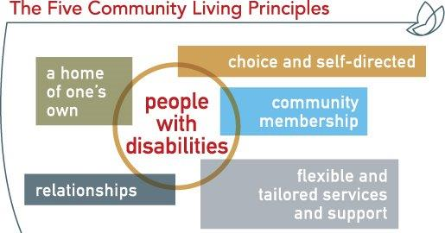
Independent Living
44

Slide 45

Applied Science – Centers for Independent Living Centers (CILs)
Core Services:
1) Information and referral.
2) Peer counseling.
3) Independent living skills training.
4) Individual and systems advocacy.
5) Assist those transitioning from institutional settings to community living; those at risk of entering institutions; and youth transitioning into adulthood.
DH-13 Participation in community activities
45

Slide 46
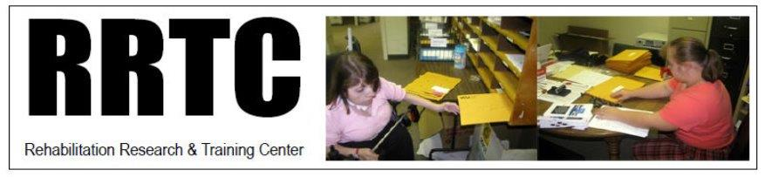
Applied Science – Rehabilitation Research and Training Centers (RRTCs)
Conduct coordinated and integrated research to:
Improve rehabilitation approaches and service delivery systems,
Alleviate or stabilize disabling conditions, or
Promote maximum social and economic independence for persons with disabilities.
http://www.acl.gov/Programs/NIDILRR/Grant-Funding/Programs/rrtc/resources.aspx
46

Slide 47

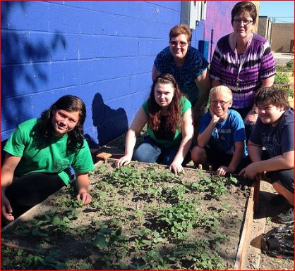
Applied Science – HealthMattersTM
HealthMattersTM
A community-based program to improve health of people with intellectual and developmental disabilities.
47

Slide 48
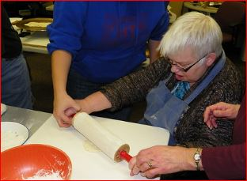
Applied Science – Scale Up & Replication of HealthMattersTM
HealthMattersTM
SCALE-UP & Replication in four states:
Alaska
Kentucky
Missouri
Illinois
48

Slide 49
Georgina Peacock, MD, MPH, FAAP
Director, Division of Human Development and Disabilities
National Center on Birth Defects and Developmental Disabilities
Centers for Disease Control and Prevention

Slide 50

National Center on Birth Defects and Developmental Disabilities
Mission
Promote the health of babies, children and adults and enhance the potential for full, productive living.
50

Slide 51
Population Science
Health Promotion in States
19 state disability and health programs, 2016
MT
MN
VT
OR
Michigan
NH
MI
NY
MA
IA
OH
UT
MD
KS
MO
KY
AR
SC
AL
FL
DH-2.1 State Disability and Health Promotion Programs
51

Slide 52
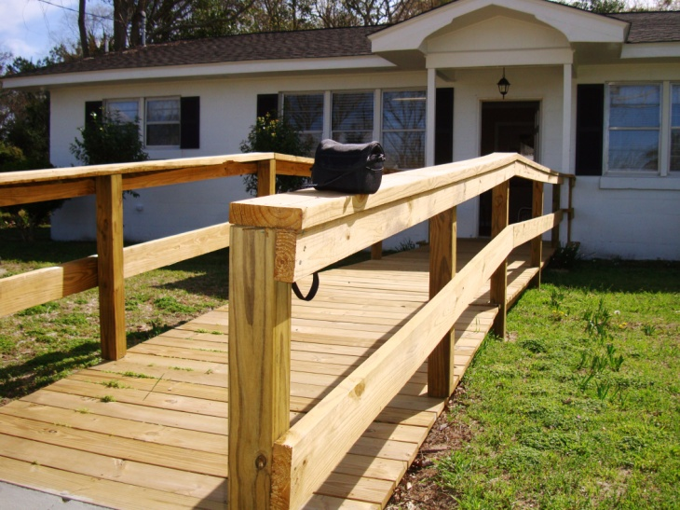
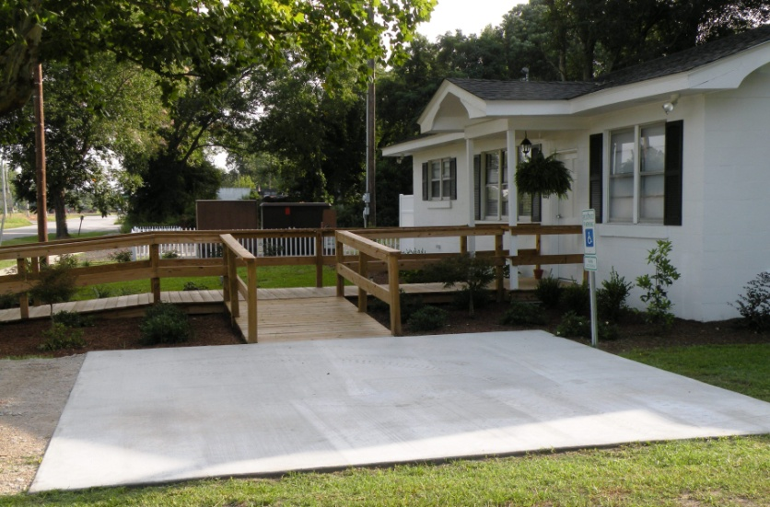
Population Science
Health Promotion in Primary Care
Removing Barriers to Primary Care
  South Carolina assessed 150 primary care sites that had a patient load of >750,000.
  Modifications were made at 1/3 of the sites: internal medicine, OB/GYN, pediatric, and dental care sites.
    AFTER: Accessible parking with signage and easy slope to the ramp
BEFORE: No accessible parking
52
DH-4 Barriers to primary care
52

Slide 53
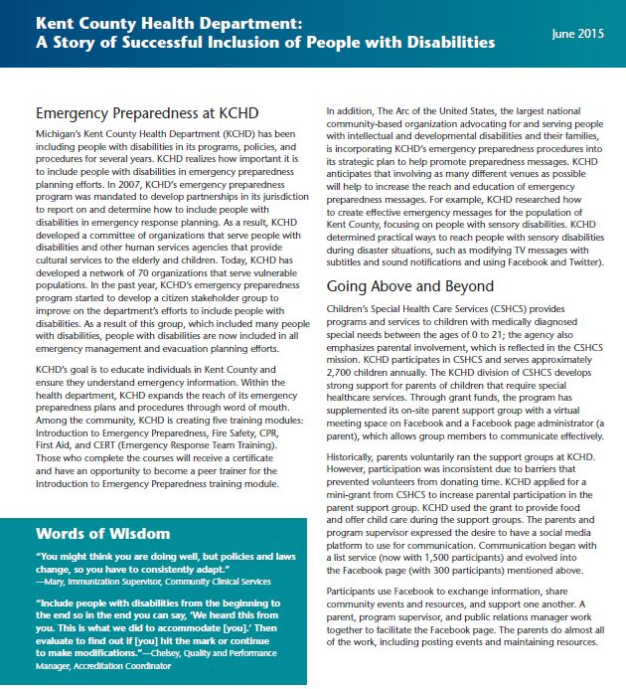

Population Science
Health Promotion in Counties (Continued)
Outcomes:
DH-13 Participation in community activities & PREP-11, 12, 13 Emergency Preparedness

Slide 54










Population Science
Health Promotion in Counties
10 communities have partnered with 5 Disability and Health State Programs
DH-8 Barriers to local health and wellness programs
DH-13 Participation in community activities
54

Slide 55

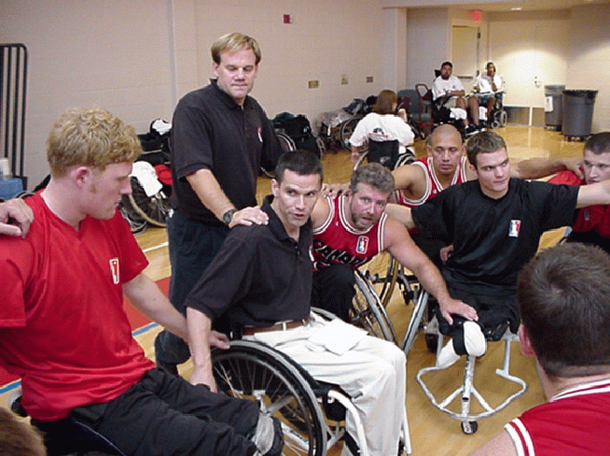
Population Science
Health Promotion in Communities
DH-4 Barriers to Primary Care;
HRQOL/WB -1.1 Physical Health; HRQOL/WB-1.2 Mental Health
55

Slide 56
Actions Impacting
Disability and Health
Better Health
Reduced Disparities
Inclusion & Participation in Public Health Efforts
Awareness
Better quality of life and well-being
56

Slide 57
Disability and Health Topic Area Contact
For more information please contact:
Lisa Sinclair MPH and Michael H. Fox, Sc.D.
Division of Human Development and Disability
National Center on Birth Defects and Developmental Disabilities, Centers for Disease Control and Prevention
Emails: lsinclair@cdc.gov or mhfox@cdc.gov
57

Slide 58
Healthy People 2020 Progress Review:
Measurement Issues in Health, Disability and Related Concepts
August 11, 2016

Slide 59
Jennifer H. Madans, PhD
Associate Director of Science,
National Center for Health Statistics
Centers for Disease Control and Prevention

Slide 60
The National Center for Health Statistics
Functions
  Monitors the nation’s health by collecting, analyzing and disseminating health data;
  Compares across time, populations, providers and geographic areas;
  Identifies health problems, risk factors, and disease patterns;
  Informs actions and policies to improve the health of the American people;
  Ensures comparability and reliability of health statistics, including consistency of statistical activities; and
  Undertakes and supports activities to improve methods in the collection of health statistics.
60

Slide 61

61

Slide 62
NCHS Data Systems
National Vital Statistics System (NVSS)
National Health Interview Survey (NHIS)
    National Immunization Survey
    State and Local Area Integrated Telephone Survey
National Health and Nutrition Examination Survey (NHANES)
National Survey of Family Growth (NSFG)
National Health Care Surveys
  Hospital Discharge Survey
  Ambulatory Care Survey
  Hospital Ambulatory Care Survey
  Nursing Home Survey
  Home and Hospice Survey
  Residential Care Survey
62

Slide 63
Monitoring ‘Health’:
A Key Component of Healthy People
  Healthy People
    Provides a framework for monitoring achievement of health goals;
    Incorporates a monitoring function;
    Informs policy and programs;
    Relies on a large number of specific objectives, with targets; and
      Traditionally includes key overarching goals.
    Challenge: How to construct overarching measures that encompass the full range of “health”
63

Slide 64
What is Health?
Multiple definitions of health
Traditionally medically-based objective definitions
    Focus on “pathologies” in body structure and/or function
Health as a social concept
    Impact of body structure and/or function on a person’s ability to participate in society
64

Slide 65
Commonly Used
“Objective” Measures
Medically defined health
    Laboratory tests
    Radiological tests
    Physical exams
    Performance measures
    Medical records
65

Slide 66
Commonly Used
“Subjective” Measures
Summary measures of health
    Self-reported health status (also used as proxy for objective measures)
    Composite measures
Functioning/disability measures
    Functioning ‘within the skin’
    Interaction with the environment
    Impact of accommodation
66

Slide 67
What is Disability?
Multiple definitions of disability
Medically-based definitions
    Similar to medically-based definition of health
    Focus on “pathologies” in body structure and/or function
Definitions based on limitations in core functional domains
    Without accommodation (e.g., walking)
Definitions based on restrictions in participation
    Similar to social concept of health
    Incorporates accommodations, including environmental barriers and facilitators
67

Slide 68
The Challenges
Multiple definitions of the same terms
  Measurement challenges
  Interpretation challenges
  Policy development challenges
68

Slide 69
Healthy People Monitoring Efforts
  Surgeon General’s Report 1979 & Healthy People 1990
    Five indicator-specific targets, with goals mapped one-to-one to these specific indicators
    Reflected the importance of enhancing life in each of the five major life stages
    Monitored by mortality by age (under 1 year, 1-14 years, 15-24 years, and 25-64 years)
    Fifth target, for the population 65 years of age and over, was a morbidity-based measure aimed at preserving independence and defined as difficulty in two or more activities of daily living.
69

Slide 70
Healthy People Monitoring Efforts
  Healthy People 2000
  Three guiding goals for the decade:
      Increase the span of healthy life,
      Reduce health disparities, and
      Achieve access to preventive services.
  Goal 1 measures
    Life Expectancy at birth
    Fair or poor self reported health status
    Healthy Life Expectancy – years of healthy life (combination of self rated health and activity limitation)
70

Slide 71
Healthy People Monitoring Efforts
  Healthy People 2010
  Two guiding goals for the decade:
      increase the quality and years of healthy life
      eliminate health disparities
  Three healthy life expectancy measures
    1. Expected years in good or better health,
2. Expected years free from activity limitations, and
3. Expected years free of selected chronic diseases.
71

Slide 72
Healthy People Monitoring Efforts
Original plans for HP2020
  Continue monitoring the 3 healthy life expectancy measures from HP2010
    Expected years free of activity limitation
    Expected years in good or better health
    Expected years free of chronic conditions
Develop additional measures
    Mental health
    Health behaviors/determinants
72

Slide 73
Healthy People 2020
Focus on functioning as the key definition of health for policy development and evaluation
Functioning is a critical aspect of health for the individual and the society
Functioning can be seen as the outcome of:
    Determinants and risk factors
    Disease states
    Use of health care
    Environmental barriers and facilitators
History of use in Healthy People
73

Slide 74
Functioning as a Key Definition of Health for Policy Development and Evaluation
Society can intervene to improve “health/functioning” in multiple places
    Prevention of pathology
    Curing the pathology
    Reduce the impact of pathology
        Rehabilitation at the person-level (e.g., assistive devices)
        Modify the environment
74

Slide 75
Functioning as a Key Definition of Health for Policy Development and Evaluation
Policy objective – Minimize participation restrictions
Monitoring function:
    Measure level of participation and monitor change in participation
    Measure level of functioning and change in functional abilities ‘within the skin’ and with accommodation
    Relate to program and policy interventions
75

Slide 76
Plan for Foundation Measures
Focus on a small set of key measures
Hierarchical framework
Tier 1 – at birth and at age 65
    Expected years free of activity limitation (participation)
    Expected years of free of severe disability*
    Expected years free of milder disability*
    Expected years in good or better health
* Functioning in core domains without accommodation
76

Slide 77
Plan for Foundation Measures
Tier 2 – all ages and 65 and over
    Life expectancy
    Percent without activity limitation (participation)
    Percent without more severe disability
    Percent without milder disability
    Percent in good or better health
77

Slide 78
Beyond 2020
Improve measures of functioning, disability and participation
International Efforts in the Measurement of Functioning and Disability
  The Washington Group on Disability Statistics
  The Budapest Initiative on the Measurement of Health Status
  Joint EU, US and Japan collaboration
Links to Sustainable Development Goals and UNCRPD which focus on full participation and inclusion
78

Slide 79

The Living Well with a Disability Program:
A Health Promotion and Wellness Program for Adults with Disabilities
Meg Traci, PhD¹; Craig Ravesloot, PhD¹; Tom Seekins, PhD¹,
Glen White, PhD², & Tracy Boehm, MPH^{1,} Naomi Kimbell, MA, MFA¹
University of Montana, Rural Institute for Inclusive Communities¹, University of Kansas²
Webinar: Improving Health Outcomes through Inclusion and Participation
Thursday, August 11, 2016 ∙ 12:30 PM ET

Slide 80
1987 – 2016 Living Well with a Disability Activity Timeline (Funding Source)
1987 Initial funding (CDC)
1990 Secondary Conditions Surveillance (CDC)
1993 First edition pilot (CDC & NIDRR)
1999 National randomized trial (CDC)
2001 Online facilitator training (CDC)
2001 Adopted by State Disability & Health Programs (CDC)
2001 Name in New Freedom Initiative
2002 Medicaid Waiver funding (CDC & CMS)
2005 Adopted by ADRC Network (CMS & AOA)
2005-6 Developed Working Well with a Disability (CDC)
2008 Spanish translation (CDC)
2010 Adopted by LA Care (CMS)
2011 Korean translation (NIDRR)
2015 Online development funding (NIDILRR)
2016 MMWR Health Disparities publication (CDC & NIDILRR)
Initial funding (CDC)
Secondary Conditions Surveillance (CDC)
First edition pilot (CDC & NIDRR)
National randomized trial (CDC)
Online facilitator training (CDC)
Adopted by State Disability & Health Programs (CDC)
Named in New Freedom Initiative
Medicaid Waiver funding (CDC & CMS)
Adopted by ADRC Network (CMS & AOA)
Developed Working Well with a Disability (CDC)
Spanish translation (CDC)
Adopted by LA Care (CMS)
Korean translation (NIDRR)
Online development funding (NIDILRR)
MMWR Health Disparities publication (CDC & NIDILRR)
1987
1990
1993
1996
1999
2001
2002
2005
2008
2011
2014
2016

Slide 81
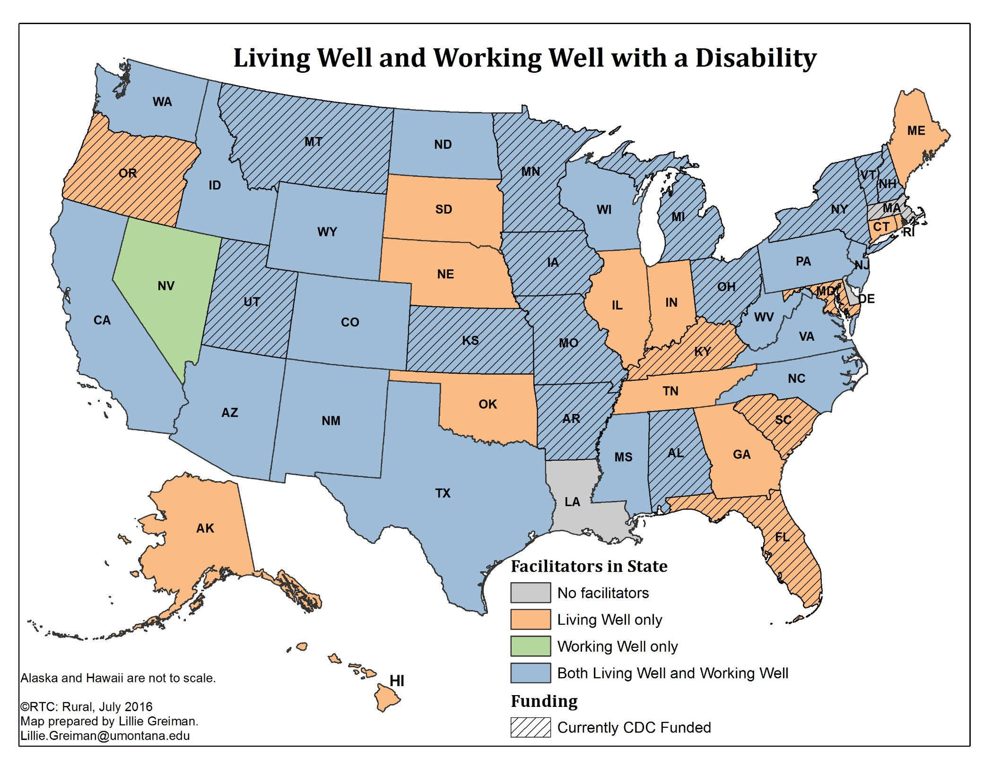
U.S. Map showing states with Living and Working Well sites
This U.S. Map shows states where RTC: Rural staff have trained Living Well and Working Well with a Disability facilitators. It also shows which states have a CDC Disability and Health State Program.
There are 46 U.S. States with Living Well with a Disability Facilitator. These states are: AL, AK, AZ, AR, CA, CO, CT, FL, GA, HI, ID, IL, IN, IA, KS, KY, ME, MD, MI, MN, MS, MO, MT, NE, NH, NJ, NM, NY, NC, ND, OH, OK, OR, RI, PA, SC, SD, TN, TX, UT, VT, VA, WA, WV, WI, WY .
Of these 46 U.S. States, 29 also have a Working Well with a Disabilty facilitator: AL, AZ, AR, CA, CO, ID, IA, KS, MI, MN, MS, MO, MT, NH, NJ, NM, NY, NC, ND, OH, PA, TX, UT, VT, VA, WA, WV, WI, WY, and 17 only have Living Well facilitator(s): AK, CT, FL, GA, HI, IL, IN, KY, ME, MD, NE, OK, OR, RI, SC, SD, and TN.
Nevada has only Working Well with a Disability facilitators (i.e., no Living Well facilitators).
The three states without Living Well or Working Well facilitators include: MA, LA, and DE.
The 19 currently funded CDC Disability and Health State Programs are in: AL, AR, FL, IA, KS, KY, MD, MA, MI, MN, MO, MT, NH, NY, OH, OR, SC, UT, and VT.
Thirteen of the CDC Disability and Health Programs are in states with a Living Well and Working Well facilitator (AL, AR, IA, KS, MI, MN, MO, MT, NH, NY, OH, UT, and VT; five of the CDC Disability and Health Programs are in states with only a Living Well facilitator (FL, KY, MD, SC and UT) ; and MA is the only state with a CDC Disability and Health Program that does not have a Living Well or Working Well facilitator.
81

Slide 82
Summary of Map
From February 1995 to May, 2016, RTC: Rural staff trained 1,181 Living Well with a Disability (LWD) facilitators in 46 states, who served more than 9,448 adults with disabilities.
  Since 2002, 753 LWD facilitators in current and previous CDC Disability and Health funded states reached over 6,024 workshop participants, whose symptom-free days are estimated at having increased by 71,685 days.
Since 2010, RTC: Rural staff trained 238 Working Well with a Disability (WWD) facilitators in 30 states, who served more than 1,904 adults with disabilities.

Slide 83
What do we mean when we say disability?
The International Classification of Functioning, Disability and Health is a framework for describing the continuum of function and disability. (WHO 2001)
In this model, disability is not considered an illness
Unlike previous models of disability, this framework considers not only bodily function but also the disabling characteristics of social, cultural and environmental contexts.
Disability is seen as a dynamic interaction between a person and these contexts.
In environments that are inclusive, such as those that include accessible built environments or social structures that support participation for all people, a person with a functional limitation may not experience that limitation as a disability.

Slide 84
Secondary Conditions: Health risks associated with disability
Poorer overall health.
Less access to adequate health care.
Pain and fatigue.
Mental health issues, such as depression.
Engaging in risky health behaviors including smoking.
"Those physical, medical, cognitive, emotional, or psychosocial consequences to which persons with disabilities are more susceptible by virtue of an underlying condition, including adverse outcomes in health, wellness, participation, and quality of life" (Hough, 1999, p. 186).

Slide 85
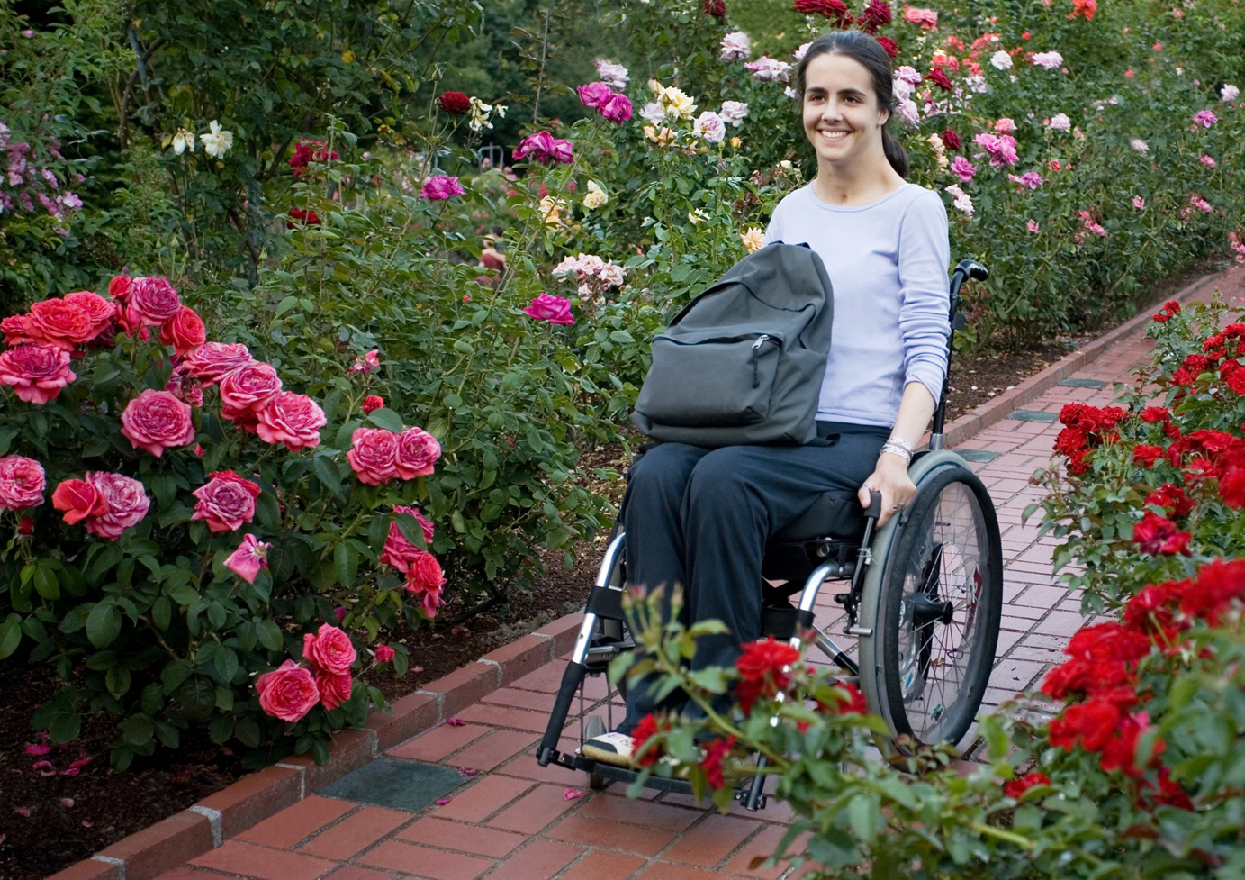
What are Living Well and Working Well?
Working toward my goals is hard, but I feel so much better when I do it.
Living and Working Well are goal-oriented health promotion programs for people with disabilities.
Living Well focuses on developing a healthy and balanced lifestyle to meet quality of life goals.
Working Well focuses on developing healthy habits that support employment goals.
Each program was developed in collaboration with consumers to ensure their relevance to actual health needs.
The Independent Living philosophy is central to the curriculum.

Slide 86

How Does Living Well Work?
Living Well With A Disability is a 10-week workshop for groups of 8-10 people.
Sessions are two hours long, meet once a week and are led by peer facilitators.
Peer facilitators have been through the program and can offer support and mentorship to participants.
Facilitators guide participants using a self-help workbook.

Slide 87
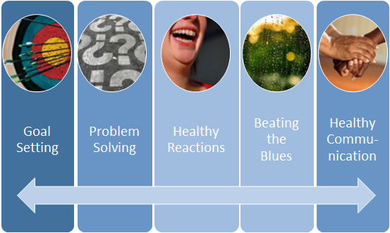
Living Well Workshop Goals and Content
The Living Well workshop begins by developing basic goal setting skills.
Each chapter in the workbook builds on the next.
As participants progress through the workshop, they get to test their skills within a supportive peer community.
The building blocks of healthy communication and healthy reactions to stressful situations are learned early to support additional skills.

Slide 88
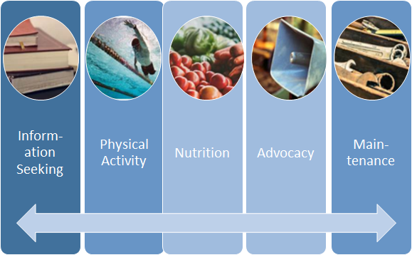
Living Well Workshop Goals and Content, Cont’d.
The Living Well workshop provides accurate information about healthy lifestyle habits including exercise and nutrition.
The program helps participants build the skills to find information for themselves and advocate for their needs.
The workshops are interactive and participants have the chance to ask questions and share ideas for maintaining lifestyle changes.

Slide 89
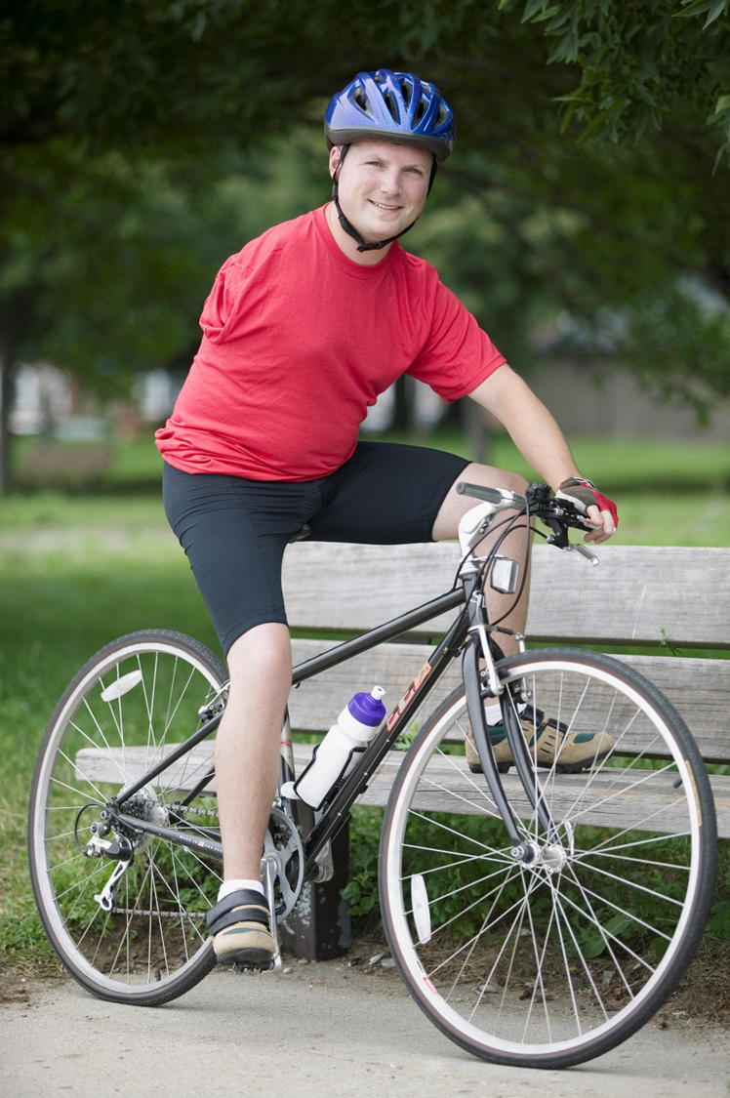
Personal Benefits of Living Well
Taking the Living Well class developed my awareness of ways to better my life.
Compared to pre-workshop measures, following the workshop participants reported:
Fewer symptom days across physical and mental health symptoms (Health Related Quality of Life – 14)
Reductions in activity limitation due to secondary conditions (Secondary Conditions Surveillance Instrument)
Improvements in health behavior (Health Promoting Lifestyle Profile II)
Improved Life Satisfaction (Behavior Risk Factor Surveillance System item)
Ravesloot, Seekins & White (2005) Living Well with a Disability Health Promotion Intervention: Improved Health Status for Consumers and Lower Costs of Healthcare Policymakers. Rehabilitation Psychology, 50(3), 239-245.

Slide 90

Third-Party Payer Benefits of Living Well
Compared 2-month retrospective recall of healthcare utilization (outpatient visits, emergency room visits, outpatient surgeries and inpatient hospital days) before and after the workshop. Converted visits to healthcare costs using 1998 Medicare reimbursement rates.
Program outcome = $3,227 savings per person
Study-wide cost savings (n=188) = $494,628 over six months
By May 2015, LWD as implemented by 279 community-based agencies in 46 states to approximately 8,900 persons with disabilities. On the basis of the 6-month cost savings observed in the field trial, these community applications are estimated to have saved as much as $28.8 million, which would have been incurred since February 1995 by health care payers without program implementation.
Ravesloot, Seekins, Traci, Boehm, White, Witten, Mayer & Monson (2016). Living Well with a Disability, a self-management program. MMWR, 65 (01), 61-67.
“ The 10-week (LWD) program allows individuals with disabilities to create a healthy lifestyle plan, unique to their desires and strengths, to overcome every day and ongoing challenges, and to reach meaningful life goals. “

Slide 91

Implementing the Program
Facilitator training
  Peer facilitators are trained in in-person or online classroom settings.
Program delivery
  Workshops are held at local service providers such as Centers for Independent Living.
Capacity building
  Community stakeholders support program implementation through consumer referrals, funding support and help in providing facilities or coordination services.

Slide 92


Information and Facts
See Public Health Differently¹ is a communication plan of the Montana Department of Public Health and Human Services; the plan leverages partners statewide to promote health and wellness programs to Montanans.
LWD and WWD are included with other programs, such as Diabetes Prevention and Self Management Education Programs, Arthritis Programs, and the Quit Line.
Traditional partners share the HP2020 DH-8 objective with CILs and other disability organizations.
  Coordination of cross-cutting strategies increases the inclusion of people with disabilities in available local health and wellness programs overall.
  Participation rates of Montanans with disabilities
    11.5% Montana Breast and Cervical Cancer Screening Program
    29.0% CVD/Diabetes Prevention Program
    41.2% Montana Tobacco Quit Line
    100% Living and Working Well with a Disability
²HP2020 DH-8. Reduce the proportion of adults with disabilities aged 18 and older who experience physical or program barriers that limit or prevent them from using available local health and wellness programs
¹Guide Available at: ChronicDiseasePrevention.mt.gov
Community Health Program Guide –
Downloadable PDF
Accessible/large print version available
Interactive Map
Accessible list – searchable by county/program name

Slide 93
Living Well with a Disability and Health Behavior Change
Stages
Pre-Contemplation
Contemplation
Preparation
Action
Maintenance
Processes
Cognitive
Behavioral
Peer Support to Increase Awareness and Motivation
Selected CDC Funded Programs
RTC: Rural, The University of Montana
Stages: Pre-Contemplation; Contemplation; Preparation; Action; Maintenance
Cognitive Processes Stages: Pre-Contemplation; Contemplation; Preparation
Behavioral Processes Stages: Preparation; Action; Maintenance
Peer support to increase awareness and motivation Stages: Pre-Contemplation; Contemplation; Preparation; Action; Maintenance
Goal Setting Stages: Contemplation; Preparation; Action; Maintenance
Training Stages: Preparation; Action; Maintenance
Advocacy Stages: Preparation; Action; Maintenance
Reinforcement: Action; Maintenance
Living Well with a Disability Stages: Pre-Contemplation; Contemplation; Preparation; Action; Maintenance
Personalized Exercise Program (PEP) Stages: Contemplation; Preparation; Action; Maintenance
Healthy Life Style Stages: Contemplation; Preparation; Action; Maintenance
Chronic Disease Self Management Stages: Preparation; Action; Maintenance
Goal Setting
Training
Advocacy
Reinforcement
Living Well with a Disability
Selected CDC Funded Programs
Personalized Exercise Program (PEP)
Healthy Life Style
Chronic Disease Self Management
RTC: Rural, The University of Montana

Slide 94
Healthy Community Living Project¹
Development project to expand the Living Well with a Disability program
Developing and evaluating two online programs that blend face-to-face and online learning using traditional (video) and social (Facebook) media.
The Community Living Skills program is using Self-Determination Theory (Deci & Ryan, 2000) to help people prepare for health self-management.
The Living Well in the Community program is adapting the Living Well with a Disability course content to an online blended learning format.
Twelve staff from eight CILs around the US are participating in an iterative participatory curriculum development process for program development.
¹ ACL NIDILRR funded Disability and Rehabilitation Research Project (DRRP) 2015-2020 (HHS 90DP0073)

Slide 95
Resources
Living and Working Well Website:
http://www.livingandworkingwell.org/
Research reports and publications:
http://rtc.ruralinstitute.umt.edu/_rtcBlog/?page_id=5350

Slide 96
Acknowledgements
Independent Living Centers and their consumers
Disability and Health Branch– NCBDDD
RTC: Rural
Montana Department of Public Health and Human Services
96

Slide 97
Roundtable Discussion
Don Wright, MD, MPH
Director, Office of Disease Prevention and
Health Promotion

Slide 98
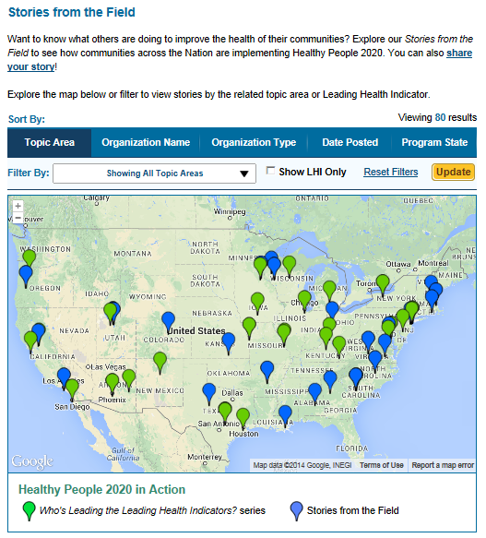
Healthy People 2020
Stories from the Field
A library of stories highlighting ways organizations across the country are implementing Healthy People 2020
Healthy People in Action
http://www.healthypeople.gov/2020/healthy-people-in-action/Stories-from-the-Field

Slide 99


Who’s Leading the Leading Health Indicators? Webinar
Please join us on Thursday, September 22nd from 12:00 to 1:00 pm ET for a Healthy People 2020 Who’s Leading the Leading Health Indicators? webinar on Reproductive and Sexual Health.
Registration on HealthyPeople.gov available soon

Slide 100
Progress Review Planning Group
  Julie Weeks (CDC/NCHS)
  Althea Grant(CDC/ONDIEH)
  Bill Riley (NIH/OD)
  Mitch Loeb (CDC/NCHS)
  Jennifer Meunier
  (CDC/NCBDDD)
  Amanda Dudley
  (CDC/NCBDDD)
  Michael Fox (CDC/NCBDDDD)
  Lisa Sinclair (CDC/NCBDDD)
  Louis Quatrano (NIH/NICHD)
  Hugh Berry (ACL/NIDILRR)
  Barbara Disckind (HHS/OWH)
  Stan Lehman (CDC/OD)
  Jennifer Villani (NIH/OD)
  Irma Arispe (CDC/NCHS)
  David Huang (CDC/NCHS)
  Leda Gurley (CDC/NCHS)
  Beth Pathak (CDC/NCHS)
  Asel Ryskulova (CDC/NCHS)
  Robin Pendley (CDC/NCHS)
  Jim Dahlhamer (CDC/NCHS)
  Carter Blakey (HHS/ODPHP)
  Angie McGowan (HHS/ODPHP)
  Tiffani Kigenyi ((HHS/ODPHP)
  Theresa Devine (HHS/ODPHP)
  Caitie Blood (HHS/ODPHP)
  Yen Lin (HHS/ODPHP)

Slide 101




Stay Connected
Web healthypeople.gov
Email healthypeople@hhs.gov
Twitter @gohealthypeople
LinkedIn Healthy People 2020
YouTube ODPHP (search “healthy people”)
Join the Healthy People Listserv & Consortium
Notes:
101

