Slide 1
Promoting Early Identification of Developmental Delay and Disability: An Overview of Developmental Surveillance, Screening, and CDC’s Developmental Milestones
An
[Insert presenters' info here]
The findings and conclusions in this presentation are those of the authors and do not necessarily reflect
the official position of the Centers for Disease Control and Prevention.

Slide 2
Disclosures
[Insert financial disclosures here]
[Include other disclosures here]

Slide 3
Presentation Objectives
Recognize that many children with developmental delays and disabilities are not identified as early as they could be.
Understand the difference between developmental surveillance and developmental screening.
Identify how surveillance and screening together improve early identification of developmental delays.
Learn to use evidence-informed CDC Learn the Signs. Act Early. (LTSAE) developmental milestones and/or other resources to support surveillance and screening in the medical home.
Understand the supporting evidence for the revised milestones released in 2022.

Slide 4
Why Monitor Development?
Developmental disabilities are common and often not identified before school age¹
1 in 6 (3–17 years of age) has a developmental disability²
1 in 31 (8-year-olds) is estimated to have autism spectrum disorder¹
Developmental disabilities are even more common among children from low-income households, with 1 in 5 children experiencing a developmental disability²
    Shaw et al. CDC, MMWR Surveillance Summary 04/2025
    Zablotsky, B, et al, Pediatrics 2019
Notes:
NOTES on References:
Shaw et al. CDC, Autism and Developmental Disabilities Monitoring Network (ADDM)

Slide 5
Developmental Surveillance, Screening,
and Early Identification

Slide 6
Developmental Surveillance vs. Screening
Surveillance
Screening
Ongoing/longitudinal at each well-child visit
No scores/risk categories
Can support screening
Six components
  Elicit concerns
  Obtain developmental history
  Assess strengths, risks
  Observe the child
  Document findings
  Obtain and share results
Recommended at:
  9, 18, 30 months for general development
  18 and 24 months for autism
  Additional screens can be done for concerns
Validated screening tools
Provides scores/risk categories
Not diagnostic, but helps determine if evaluation needed
May be used to qualify for some state early intervention programs
Notes:
NOTES:
-Summary points from the AAP January 2020 guidance linked on the previous slide (Lipkin and Macias)
-The final point of the six components of surveillance, “Obtain and share results” refers to sharing with others, such as childcare providers. This was added in the most recent revision of the guidelines to emphasize professions working together.
-Act Early milestone checklists and other program materials help with surveillance, but surveillance is more than milestones.
-It’s important to note that surveillance is not the same as screening and screening is not diagnosis, though the two are complementary and together can improve early identification.

Slide 7

Pediatrics January 2020
Detailed information on American Academy of Pediatrics (AAP) recommendations can be found in the Clinical Report
“Promoting Optimal Development: Identifying Infants and Young Children With Developmental Disorders Through Developmental Surveillance and Screening”
(Lipkin and Macias)
https://doi.org/10.1542/peds.2019-3449
Notes:
NOTE:
January 2020 American Academy of Pediatrics’ recommended clinical guidance to conduct developmental surveillance and screening is the most recent update to prior guidance since 2006.

Slide 8
Earlier Intervention is Better
Evidence shows that the earlier a child is identified to have a developmental disability or delay, the sooner interventions and family supports can start
    It is never “too late” to start services and supports
Intervention can improve skills, abilities, future school performance,
long-term self-care
Other benefits of early identification & intervention
    Families understand their child’s strengths, and areas in which they may
    need support

Slide 9
Early Identification & Intervention
Screening (universal +)
State’s Early Intervention
Supports & Services
Diagnostic Evaluations
Surveillance
Parent-Engaged
Monitoring
Notes:
NOTE:
It’s important to consider developmental surveillance and screening as well as family-engaged developmental monitoring within broad systems.
Early Intervention (state IDEA Part C programs) may be accessed after Surveillance and/or Screening steps and it may not be necessary to receive “full diagnosis” though any additional diagnosis can be used to fine-tune services received.
Entering the Early Intervention service as soon as possible may help reduce wait time to intervention services.
Each state Early Intervention service has different entry criteria, please check your state guidelines for specifics.
Family-engaged developmental monitoring that is part of surveillance, is a part of this layered and continuous approach.

Slide 10
Introduction to Learn the Signs. Act Early.

Slide 11
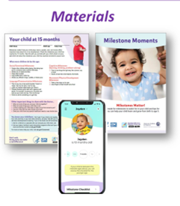

Learn the Signs. Act Early.(LTSAE)
Purpose: To improve early identification of developmental delays and disabilities, including autism, by facilitating family-engaged developmental monitoring and promoting developmental screening so children and their families can get the services and support they need at the earliest age possible.
Notes:
NOTES:
LTSAE is a broad program with partners in health care, WIC, Head Start, childcare and others working with children birth to age 5.
The Learn the Signs. Act Early. program is made up of three components:
-Health education campaign including a robust suite of FREE materials for families, healthcare providers, WIC providers, early childcare educators and more
-The Act Early Ambassador program with representation from MOST U.S. states and many territories
-Research and evaluation of program initiatives

Slide 12
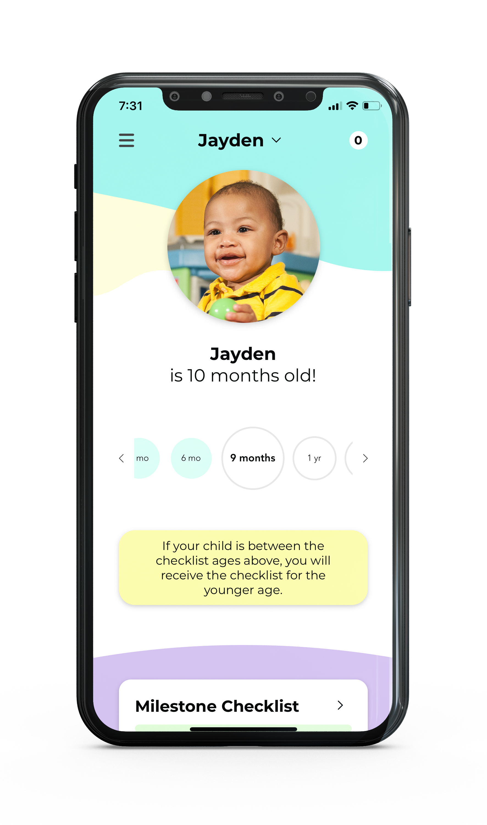
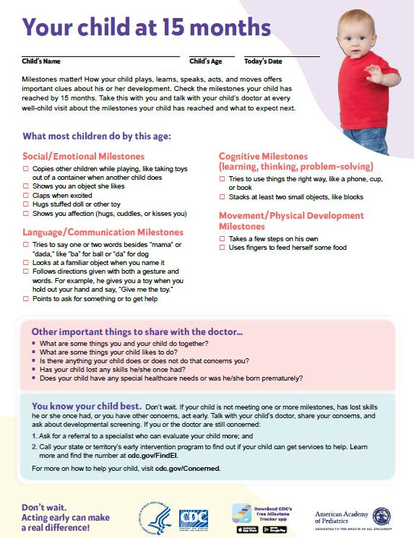
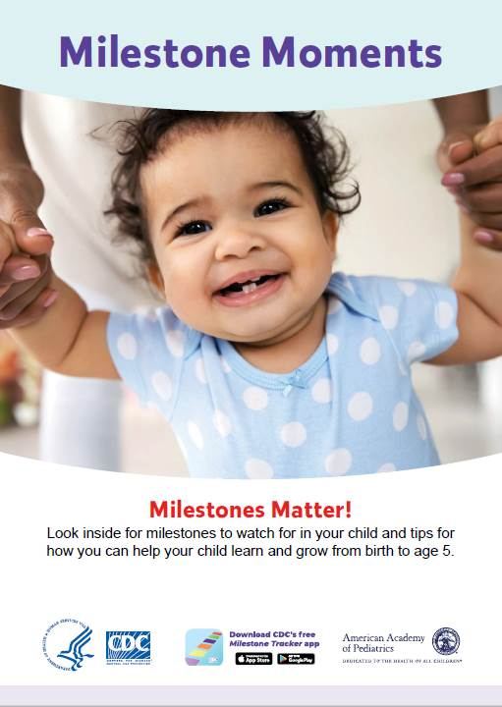
CDC’s Milestone Resources
Health Communication Tools for Developmental Surveillance
www.cdc.gov/ActEarly/Materials
Notes:
CDC’s milestone checklists and other materials like the CDC Milestone Tracker App and milestone moment booklets are great health communication tools for developmental surveillance
All materials have been updated to reflect the updated milestones released in 2022

Slide 13
Program Benefits
Is evidence-informed
Includes milestones MOST (≥75%) children are expected to achieve by given ages
  Any missed milestone is cause for discussion or action
  Approach allows for
    Discussions on milestones most children meet
    In-depth/targeted surveillance when missing milestones
    Discussion of concerns not captured by milestones (open-ended questions)
Avoids the “wait and see” approach, and encourages screening as a possible next step
Meets the needs of parents and professionals related to developmental monitoring

Slide 14

Additional Checklist Features
Open-ended questions (new)
Guidance for what to do when there is a developmental concern
Early intervention information
Tips and activities for developmental promotion and early relational health (revised/expanded)
Reminders about well visits and developmental screening ages
Anticipatory guidance on what to expect by the next age checklist
Notes:
Here are some of the additional checklist features included in the 2022 milestone checklist revisions
Checklists are family-friendly and designed to be used by parents/caregivers, but may be used by or discussed with parents/caregivers by a variety of early childhood professionals, including the primary care clinician who can discuss at the health supervision visits (with which the checklists coincide).

Slide 15
Milestone Revisions

Slide 16
Why Were the Milestones Revised?
To incorporate feedback from more than 15 years of use
Revisions will help avoid common questions like
  “How many milestones can be missing without being concerned?”
  “Are only the ‘warning signs’ important?”
Revised milestones
  Include new 15- and 30-month checklists
  Eliminated vague language (example: “may,” “begins”)
  No longer include warning signs
Revised milestones are based on what MOST children do by specific age, making missed milestones more actionable
  Avoids a “wait and see” approach
  Avoids unnecessary worry
Notes:
NOTES:
15- and 30-month checklists were added to match health supervision (or “well-child” check-ups) in pediatric primary care.
The milestones were revised to those “most” children (at or greater than 75% of children) can do by the specific ages. This is in contrast to many milestone lists which often use average (50%) skills that half of child wouldn’t be doing by the given age.

Slide 17
Revision Process
Reviewed existing CDC milestones for evidence-base and age placement
using literature review, common screening/evaluation tools, published clinical opinion
Established 11 criteria (including “most” ≥75% of children)
Searched literature for milestones with normative data
Eliminated milestones without evidence or expert agreement from CDC's surveillance checklists
Added milestones with evidence and expert agreement to CDC's surveillance checklists

Slide 18
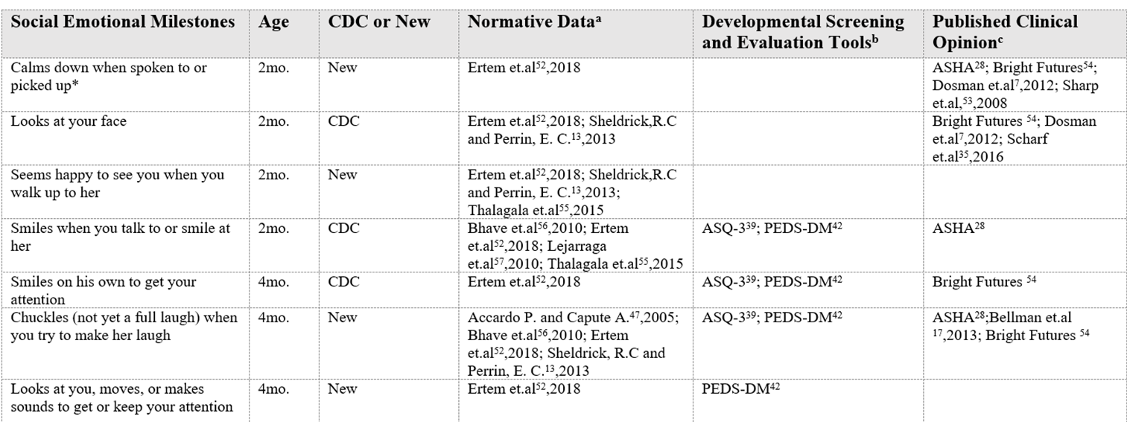
“Evidence-Informed”
TABLE 3 Social Emotional Milestones With Supporting Normative Data, Evaluation Tools, and Published Clinical Opinion References
Zubler JM, Wiggins LD, Macias MM, et al. Evidence-Informed Milestones for Developmental Surveillance Tools. Pediatrics. 2022;149(3):e2021052138. Reproduced with permission from Pediatrics, Vol. 149, Page 4, Copyright © 2022 by the AAP.
Notes:
NOTE:
This partial reproduction of one of the tables in the article in Pediatrics describing the process shows a sample of milestones, whether original or new, and the sources of normative data from the literature, screening and evaluation tools, and published clinical opinion.
There are tables in the publication for all milestones providing this information.

Slide 19
Process for Updating Parent Tips and Activities
CDC Subject Matter Experts
Reviewed parenting tips from trusted organizations
Consulted CDC communication experts, early childhood educators, pediatricians, and speech language pathologists
Looked for areas for improvement/expansion
Reworded for clarity and added more examples
Included social emotional, relational health, responsive parenting, feeding,
self-care, and screen time tips
Updated tips were reviewed by CDC nutrition, injury prevention, LTSAE, and other CDC groups
Notes:
The second page of each checklist includes parenting tips.

Slide 20
Developmental Expertise on Evidence Review Team
Developmental-behavioral pediatricians
Neurodevelopmental pediatricians
General pediatricians
Speech-language pathologists
Child and developmental psychologists
Professors of special education and early intervention
Developers of developmental screening tools
Editor of Bright Futures: Guidelines for Health Supervision of Infants, Children, and Adolescents 4th Edition
Authors of AAP’s 2020 clinical report Promoting Optimal Development: Identifying Infants and Young Children with Developmental Disorders Through Developmental Surveillance and Screening
Parent representatives/disability navigators
CDC Learn the Signs. Act Early. Ambassadors
Notes:
NOTE:
A group of experts convened by CDC and AAP worked to revise the milestones.
These were the professions represented. Some individuals had experience in more than one of these areas.

Slide 21

Biggest Challenges
Normative data was difficult to find
  References for typical developmental milestone tables are not usually cited or cite each other
Screeners/psychometric tests are often based on unpublished normative data
Even when normative data exists, milestones don’t easily “fit” into well-visit ages

Slide 22

Results of the Process
26% reduction in total milestones
    216 to 159 milestones
    25 duplicates removed
    Average milestones/checklist reduced from 23 to 13
60% of milestones were retained from original
    94 retained and 65 new
Majority of retained milestones stayed at the same age
80% of the final milestones had normative data from
at least 1 source
Evidence for social-emotional and cognitive milestones was particularly hard to find

Slide 23
Support from Leaders in the Field
Dr. Paul Dworkin, Help Me Grow National Center
Strengthening Developmental Surveillance to Enhance Developmental Promotion and Early Detection | Help Me Grow National Center
  “Simply a reflection of the intent to more clearly identify children who are lagging behind the majority of their peers and to encourage a closer look at children, through such methods as screening, when they are not meeting age expectations.”
  “For those who understand the intent and purposes of this revision, the new CDC developmental checklists should be a welcome addition to our developmental monitoring and early detection strategies.”
Dr. Barbara Howard, Johns Hopkins University, creator of CHADIS
What Can Be New About Developmental Milestones? (medscape.com)
  “As primary care providers, we not only need to detect children at risk for developmental problems but also promote and celebrate developmental progress. I hope that changing the threshold for concern to 75% will allow for a more positive review with the family ...”
  “The recommended "use of validated screening tools" when the new milestones are not met give us an objective tool to share with parents, more confidence in when referral is warranted … and baseline documentation from which we can "track" referrals, progress, and, hopefully, better outcomes.”
Zero to Three
Leading Early Childhood Development Nonprofit Applauds New Pediatric Milestones • ZERO TO THREE
  “By moving … specific milestones from 50% to 75%, we will be able to move away from ‘wait and see’ to a more direct and targeted approach. When we know what our children are facing, we can move toward earlier intervention and, ultimately, better outcomes.”

Slide 24

Pediatrics March 2022
Detailed information on CDC’s developmental milestones and the 2022 revisions can be found in
  Evidence-Informed Milestones for Developmental Surveillance Tools.
  Pediatrics.2022;149(3):e2021052138.
  https://doi.org/10.1542/peds.2021-052138
Notes:
NOTE:
The milestone revision process was completed in 2019, with additional program materials revised after the milestones themselves.
The final publication as well as new materials were released in early 2022.

Slide 25
More than Milestones

Slide 26
Open-Ended Questions
Other important things to share with the doctor
What are some things you and your child do together?
What are some things your child likes to do?
Is there anything your child does or does not do that concerns you?
Has your child lost any skills they once had?
Was your child born prematurely?
Does your child have any special healthcare needs?
Notes:
NOTE:
Open-ended questions such as these can help capture developmental concerns that may not be noted with milestones alone.
Questions aim to emphasize strengths as well as risk factors that may affect development.
These open-ended questions are the same on each Milestone Checklist.

Slide 27
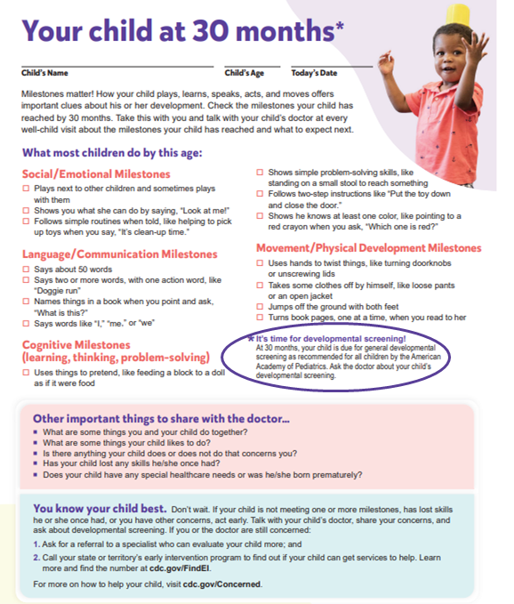
Reminders for Visits & Screenings
The checklists align with well-child check-up (health supervision visits)
Informs families
  about developmental surveillance at each visit
  when general developmental (9, 18, and 30 months) and autism screenings (18 and 24 months) are due
CDC’s Milestone Tracker app reminds families of upcoming recommended well-visits, to schedule an appointment, and to complete the checklist
Notes:
NOTE:
Open-ended questions such as these can help capture developmental concerns that may not be noted with milestones alone.
Questions aim to emphasize strengths as well as risk factors that may affect development.
These open-ended questions are the same on each Milestone Checklist.

Slide 28

Relatable and Accessible
Family-friendly language at a 5th–7th grade
reading level
Milestones observable in natural settings
Cognitive testing of the milestones done with families from different backgrounds
Available in multiple languages
Free and accessible
Notes:
Cognitive testing of the milestones done with families
From different regions
Education levels
Income levels

Slide 29
When to Act Early?
“When to act early” milestones are no longer on a separate list, though 77% are still represented in the revised checklists.
Many of the eliminated “when to act early” milestones were subjective or physical exam findings and not actual milestones.
On the new checklists, since the milestones represent those that MOST (at least 75% of children) would be expected to achieve, missing any milestone could warrant formal screening.
Open-ended questions can help identify concerns as well
  “Is there anything your child is doing or is not doing that concerns you?”
  “Has your child lost any skills they once had?”
Notes:
NOTE:
In medical practice “When to act early” are often called “Red Flags” for development, and in the past have been taught as important concerns. With milestones set at ages where MOST children would be expected to achieve a skill, missing any milestone can prompt a discussion or action, including administering a formal validated screening tool.

Slide 30
Checklist Limitations
CDC surveillance tools are not developmental screeners
Not validated (screening tools are validated)
Do not change developmental screening or evaluation tools
  Should not be used to qualify for or discontinue services
Not inclusive of all potential milestones
Remember, surveillance is more than milestones!

Slide 31

Tips from Healthcare Professionals
Discuss results of surveillance and screening tools even if not concerning
  Builds trusting relationships
Take a strength-based approach
  Then discuss any concerns
Partner with family through “shared decision-making”
Materials can support family engagement
  CDC milestone checklists
  Family-friendly referral guide
“Close the loop” after referrals have been made
  Track developmental referrals and support families while navigating referral process

Slide 32
[Add Local Information Slides]
Presenter insert [How to make an EI referral, part B and Part C] here
Presenter insert [Resources for diagnostic evaluations] here
[Click icon to the right to add an accompanying image and then DELETE this bullet point]

Slide 33

CDC’s Act Early Ambassadors
59 Ambassadors: representing 48 states; Washington, DC; and 3 territories
Champions for CDC’s Learn the Signs. Act Early.
Individuals passionate about early identification and professionally connected
Work to improve early identification of developmental delays and disabilities through integration of LTSAE into programs across their respective state/territory
Learn more and get connected here: cdc.gov/ActEarly/Ambassadors

Slide 34

Future Research Possibilities
What are the best practices for developmental surveillance?
  Use of milestones/surveillance tools
  Conversations with families regarding their child’s development
  To support developmental screening and early identification
How to work across early childhood systems for early identification?
How to support families in navigating referrals for early intervention and diagnostic evaluations?
Notes:
NOTE:
These may make good prompts for audience participation or can leave with the audience to consider on their own.

Slide 35

Practice Change
Review current processes for
  Surveillance
  Screening
  Discussion
  Referral
Consider resources to support your practice and families
Know the features, strengths, and limitations of resources to use them optimally

Slide 36
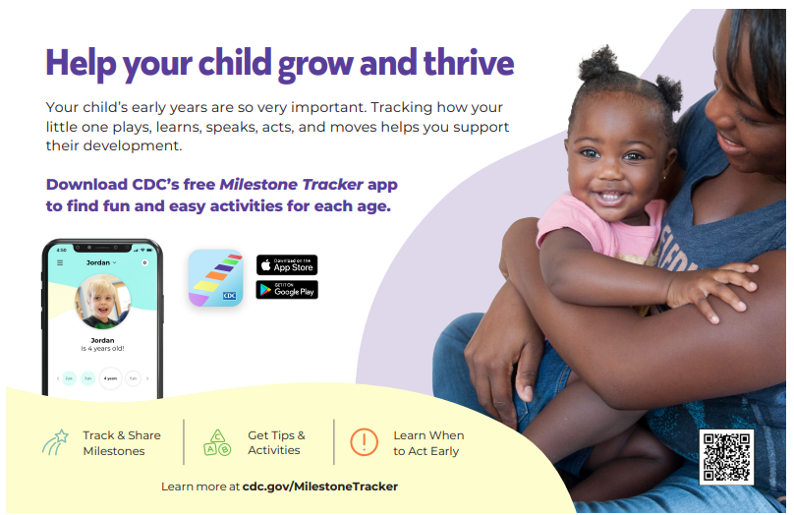
What Can I Do Today?
Download CDC’s Milestone Tracker app
Order Milestone Moment booklets and Milestone Tracker app flyers
Register/take an AAP Pedialink course
Email your Act Early Ambassador
Share a social media message
(Find under videos, social media, and web buttons)
Baby’s first smile is just as important as the first step. Learn when to expect these and other milestones www.cdc.gov/Milestones
Check out @CDCgov’s tips on how to talk to your doctor about #developmental #concerns: www.cdc.gov/Concerned

Slide 37
Resources and Trainings

Slide 38
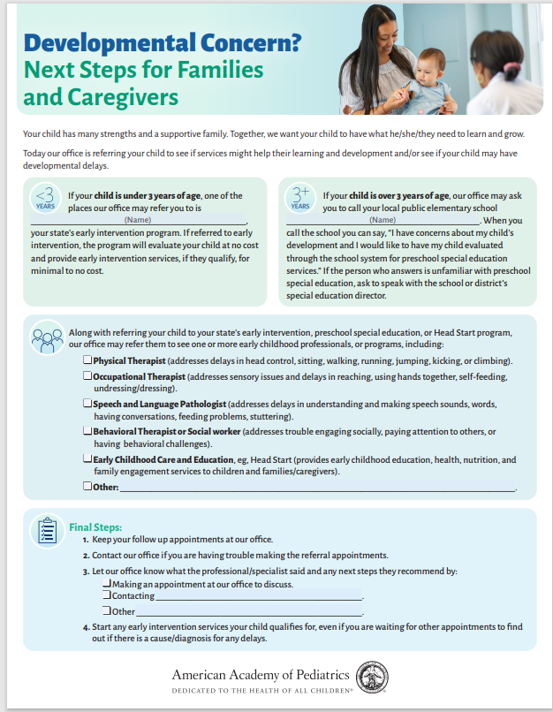
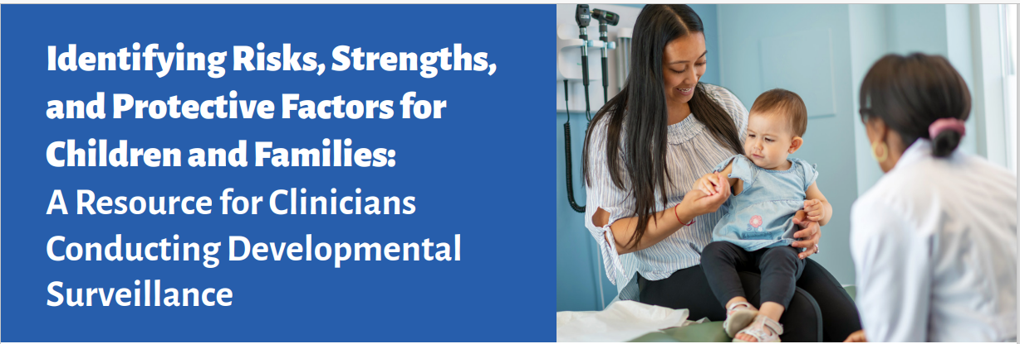
Free Resources From AAP and CDC
Family-friendly Guide to Next Steps
Clinician Tip Sheet
www.aap.org
Developmental Surveillance and Screening Patient Care (aap.org)

Slide 39



Free Pedialink Courses

Slide 40
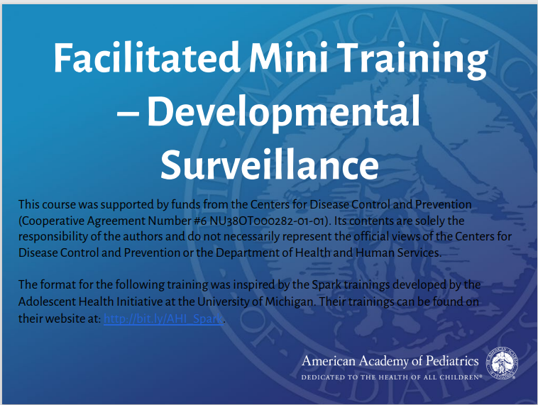
Brief Team Training
Team-based approach to surveillance and screening
Brief 15–20 minutes
Presenter slides
Speaker notes
Case-based learning

Slide 41

Questions?
[Insert speaker’ contact information here]

Slide 42
Sources

Slide 43
AAP Resource Links
“Milestones Matter: Don’t Underestimate Developmental Surveillance”
https://shop.aap.org/milestones-matter-dont-underestimate-developmental-surveillance/”
“Innovative Strategies for Improving Developmental Surveillance and Screening”
https://shop.aap.org/innovative-strategies-for-improving-developmental-surveillance-and-screening/
“Identifying and Caring for Children with Autism Spectrum Disorder: A Course for Pediatric Clinicians”
https://shop.aap.org/identifying-and-caring-for-children-with-autism-spectrum-disorder-a-course-for-pediatric-clinicians/
Family-friendly Referral Guide to Next Steps
“Developmental Concern? Next Steps for Families and Caregivers”
https://downloads.aap.org/AAP/PDF/LTSAE_FamilyFriendlyGuide_form%20updated%2010-22.pdf
Clinician Tip Sheet
“Identifying Risks, Strengths, and Protective Factors for Children and Families a Resource for Clinicians Conducting Developmental Surveillance”
https://downloads.aap.org/AAP/PDF/LTSAE_PediatriciansResourceGuide.pdf
Additional AAP resources
https://www.aap.org/dss-patient-care
Brief Team Training:
https://downloads.aap.org/AAP/PDF/Developmental_Surveillance_Spark_Training_Presentation_FINAL_10.2020.pdf

Slide 44
CDC Resource Links
Download the Milestone Tracker app:
https://www.cdc.gov/ncbddd/actearly/milestones-app.html
Order Milestone Moment Booklets, Milestone Tracker App flyers, milestone brochures, and books:
https://www.cdc.gov/ActEarly/Orders/
Download and print milestone checklists and other resources:
https://www.cdc.gov/ActEarly/Materials
Email your LTSAE Ambassador:
https://www.cdc.gov/ncbddd/actearly/ambassadors-list.html

