Slide 1
Infection Prevention and Control (IPC) for Marburg Virus Disease (MVD):
Preventing MVD from Entering Your Healthcare Facility
Healthcare Settings with Limited to Intermediate Resources
Updated: March 2023
Notes:
Intended Audience: This presentation focuses on what healthcare workers need to know to prevent Marburg virus disease from entering healthcare facilities. It focuses on the strategies of screening, isolating, and informing those who need to know.
See Training: Infection Prevention and Control for Marburg Virus Disease in Non-U.S. Healthcare Settings | Marburg virus disease | CDC for details on what members of facilities management should know to assist the process of identifying, isolating, and informing.
Please note that the IPC for MVD topics are published in sequence with the expectation that participants will progress through the series. You may, however, mix and match content to meet participant needs, and in these cases, you may need to adjust the sample script accordingly.
Estimated time with audience participation: Approximately 30 minutes
Script:
Welcome! Today we'll be focusing on key strategies to protect you, your patients, and your friends and family from Marburg virus disease. We’re going to talk about identifying people arriving to health facilities who might have Marburg and what to do if you suspect someone may be ill with Marburg.

Slide 2
Learning Objectives
After this presentation, participants will be able to
  Name the 3 key strategies to prevent introduction of MVD into healthcare facilities
  Explain why screening for MVD is important
  Describe best practices for screening for MVD
Notes:
Script:
We have three learning objectives for today’s session. By the end of our time together today, you should be able to name the 3 key strategies to prevent introduction of Marburg virus disease into health facilities, explain why screening for Marburg virus disease is important, and describe best practices for the screening process.

Slide 3
Discuss
Why is it important to identify people who might have MVD before they enter your healthcare facility?
Notes:
Activating background knowledge:
A key benefit of working with adult learners is that they likely already have some knowledge or experience related to the topic you are teaching. Activating background knowledge helps participants connect new learning to what they already know and may help them understand and remember new information better. It also helps you, the instructor, to identify gaps in knowledge where you may need to spend extra time or add emphasis while teaching. Use this slide as an opportunity to let participants share what they already know.
Script:
Let’s start with a question. Why is it important to identify people who might have Marburg virus disease before they enter your healthcare facility?
[Allow participants 2 minutes to discuss as a large group or in small groups. If it doesn’t come up in discussion, add the following.]
If a person with undiagnosed Marburg virus disease were to be allowed into a healthcare facility, they could spread Marburg virus disease to patients nearby and to the staff that cares for them. Early identification and separation of suspected Marburg virus disease patients prevents bringing unrecognized Marburg virus disease into healthcare setting, which protects you and your patients. By keeping yourself healthy, you also avoid spreading illness to your family and friends. So, keeping Marburg virus disease patients separate in a healthcare facility protects you, your patients, and your community.

Slide 4
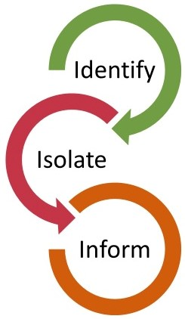
Key Strategies to Prevent Introduction of MVD in Health Facilities:
Identify
Isolate
Inform
Notes:
Script:
There are 3 key strategies to prevent the introduction of Marburg virus disease in healthcare facilities:
Identifying people who might be ill with Marburg virus disease before they enter the facility.
Isolating suspected Marburg virus disease patients from others.
And informing the necessary authorities at your facility.
These things are the most important thing we can do at our healthcare facilities to prevent the spread of Marburg virus disease.

Slide 5
Identify
Screening is the process of evaluating whether a patient meets a standardized case definition.
Screening should take place at the point of entry prior to entering a healthcare facility.
Notes:
Script:
Let’s start with the process of identifying people potentially ill with Marburg virus disease by evaluating whether a patient meets a standardized case definition. This process of identification is called screening.
Screening is like a sorting process. It operates like a sieve, separating the people who might have a condition from those who probably do not. In areas with Marburg virus disease transmission, there is increased risk that a patient will present to a facility with signs and symptoms of Marburg virus disease or risk factors. Screening allows suspected Marburg virus disease patients to be promptly isolated and referred for testing and care at a facility intended for that purpose.
Screening involves looking for Marburg virus disease symptoms and determining risk factors early in the care process – preferably before someone even enters the healthcare facility – so screening should take place at the point of entry to your facility.
Screening does not usually require close or physical contact. It can be done with a non-contact thermometer and questions. We will talk more about HOW to screen in a few minutes.

Slide 6
Isolate and Inform
When a patient is suspected of having MVD:
Isolate the patient immediately. Explain the situation and next steps to the patient.
Inform the designated physician or head nurse
  Physician or head nurse will verify and ensure isolation measures are in place
  Physician or head nurse communicates the alert to appropriate phone number
Notes:
Script:
If, through the screening process. you identify someone who may have Marburg virus disease, you should immediately do two things:
First: Isolate the patient.
Then: Quickly inform designated physicians, nurses, or administrators at your healthcare facility so that they are aware.
Isolating prevents the person from spreading Marburg virus disease to you, other healthcare workers, or patients. Your facility should have a plan for how to isolate people suspected of having Marburg virus disease and providing needed medical care to them until they can be transferred to a Marburg virus disease Treatment Unit. Being placed in isolation may be scary for your patient. To help reassure them, compassionately explain to them what is happening, what next steps are, and why this is important for their well-being. That is, if they do have Marburg virus disease, quickly starting proper care results in better outcomes (decreased mortality) for patients.
Informing the designated point of contact at your healthcare facility allows patients suspected of having Marburg virus disease to be referred for testing and care. So, it’s important to know who this designated individual is. The designated point of contact will verify and ensure isolation measures are in place, and they will communicate the potential case to the appropriate phone number identified by surveillance. If you aren’t sure who you need to inform at your facility, ask your supervisor.

Slide 7
Early identification and separation of suspected MVD patients prevents bringing unrecognized MVD into your healthcare setting.
This protects…
YOU
Your patients
Your community
Notes:
Script:
As already mentioned, early identification and separation of suspected Marburg virus disease patients prevents bringing unrecognized Marburg virus disease into the healthcare setting. This protects you and your patients. By keeping yourself healthy, you also avoid spreading illness to your family and friends.

Slide 8
Screening Basics
Notes:
Script:
We’ve talked about why using a screening process to identify people suspected to have Marburg virus disease is important. Now, let’s talk about HOW to screen.

Slide 9
Key Points for Screening for MVD
Screen everyone entering a facility
  Patients, healthcare workers, accompanying family members, etc.
Screen before any patient care activities. This can be:
  Upon entrance to a facility (e.g., a main gate)
  During patient registration (e.g., a registration desk or office)
  As additional layer, during check-in to wards (e.g., maternity)
Always assume that a patient might be infectious and use standard precautions* for ALL patients ALL the time
* Infection prevention and control practices are applied to all patients based on the principle that all blood, body fluids, secretion, excretion, nonintact skin, and mucous membrane may contain transmissible infectious agent
Notes:
Script:
Everyone who enters a facility should be screened. This includes patients, healthcare workers, and accompanying family members.
Screening should happen before any patient care activities. This can be at a facility entrance (such as the main gate) or during patient registration (such as a registration desk or office). For an additional layer of protection, screening may also happen during check-in to wards (such as the maternity ward).
The screening process should be tailored to the facility design, the human resources available, and the supplies available.
When you are screening people, always assume that they might be infectious and use standard precautions for ALL patients ALL the time. Future sessions will dive more deeply into standard precautions in the context of Marburg virus disease.

Slide 10
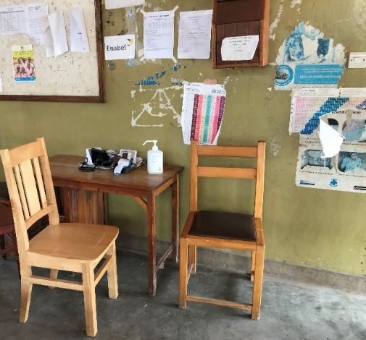
Screening Safety
Maintain distance of at least 1 meter (about arm’s length) per WHO recommendation
  If unable to maintain at least 1 meter, wear PPE (medical mask, eye protection, gown, one pair of gloves)
Avoid direct face-to-face interaction
  angle chairs away from each other
  place plexiglass between screener and person being screened
Perform hand hygiene often
Avoid face-to-face interaction and keep at least 1 meter distance except during temperature check.
Notes:
Script:
Remember that screening does not require close or physical contact. For your safety, the World Health Organization recommends that during screening activities, you maintain a distance of at least 1 meter (about an arm’s length). If you cannot maintain this distance, you should wear personal protective equipment, also called PPE, including a medical mask, eye protection, gown, and one pair of gloves.
For your protection, you also need to avoid direct face-to-face interaction to protect mucous membranes – eyes, nose, and mouth. Your facility may place plexiglass at the screening station between the screener and the person being screened. If that is not an option at your facility, angling chairs away from each other, as seen in this image, is a simple and effective way to achieve this.
As you screen patients, you should perform hand hygiene often. We will talk in more detail about hand hygiene in a future session.

Slide 11
Screening Involves Two Parts:
Temperature check
Questionnaire: signs and symptoms + risk factors in past 21 days
Notes:
Script:
Generally, screening involves 2 parts:
A temperature check.
And a questionnaire about signs, symptoms, and risk factors in the past 21 days.

Slide 12
Screening Process
  Example: “To keep everyone safe, we are screening for Marburg virus disease. We will take your temperature and ask a few questions.”
Explain
Take temperature
Non-contact (infrared) thermometer
Use screening tool
Follow questions on screening tool (symptoms, exposures)
Does the person meet case definition for suspect Marburg virus disease case?
  If YES, escort to isolation area
  If NO, they may enter the facility
Take action
Notes:
Script:
The screening process should look something like this.
Before beginning screening, you should explain what is happening to the person being screened. You can say something like: “To keep everyone safe, we are screening for Marburg virus disease. We will take your temperature and ask you a few questions.”
Then, you can proceed with the temperature check and questionnaire about symptoms and risk factors.
Based on the information gathered from the temperature check and questionnaire, you’ll need to take action. You may be able to let the person enter the facility or you may need to escort the person to an isolation area and inform someone specific in your facility about the potential Marburg virus disease case.
Now, let’s talk about the temperature check and the screening questionnaire in more detail.

Slide 13
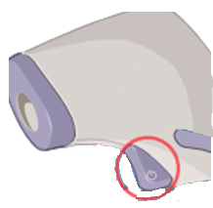
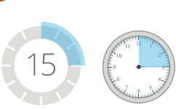
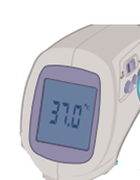
Non-contact Temperature Check
Instructions vary for different types/brands of infrared thermometers.
Always check the package insert or instructions on the manufacturer’s website.
1
Turn on the thermometer
2
Allow 15 minutes for device to warm up
(this allows for thermometer to acclimate to the temperature of the environment around it)
3
Confirm thermometer has correct settings (e.g., Celsius, ‘body’ reading instead of ‘object’)
Notes:
Script:
For the temperature check, you should use a non-contact, infrared thermometer if possible. We will talk generally about how to use this type of thermometer for screening, but instructions for infrared thermometers may vary based on the type or brand you’re using. Always check the package insert or the instructions on the manufacturer’s website to know how to correctly use the device that your facility has.
Before taking someone’s temperature for screening, you should turn on the thermometer and let it warm-up for at least 15 minutes so that it acclimates to the temperature of the surrounding environment. You should confirm that the thermometer has the correct settings. For example, ensure that you have the measurement set to Celsius and that the device is set to “body” instead of “object.”

Slide 14
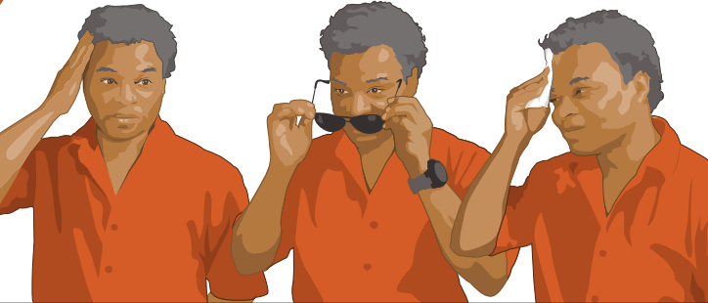
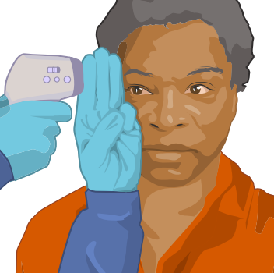
Non-contact Temperature Check (continued)
Stand to side of person whose temperature is being taken
4
Ask person to push back hair or head scarf, remove hat or glasses, and wipe off perspiration (perspiration in pores can lead to a lower temperature reading)
5
6
Aim for the temple, above the end of the eyebrow (NOT the forehead)
Hold thermometer 3-5cm from person’s temple (about width of 3 fingers) and press button
7
Notes:
Script:
Once the thermometer is ready for use, you should stand beside the person whose temperature you’re going to take. You may need to ask them to push back their hair or head scarf, remove their hat or glasses, or wipe off perspiration because perspiration in pores can lead to a lower temperature reading.
When taking the temperature, aim for the temple, above the end of the eyebrow, not the forehead. You should hold the thermometer 3-5 centimeters from the person’s temple and press the button. Notice that 3-5 centimeters is equivalent to about 3 fingers width as shown in the bottom image here. You don’t need to put three fingers up to measure. Instead, visualize this in your head. Remember that screening should not involve physical contact with the person being screened.

Slide 15
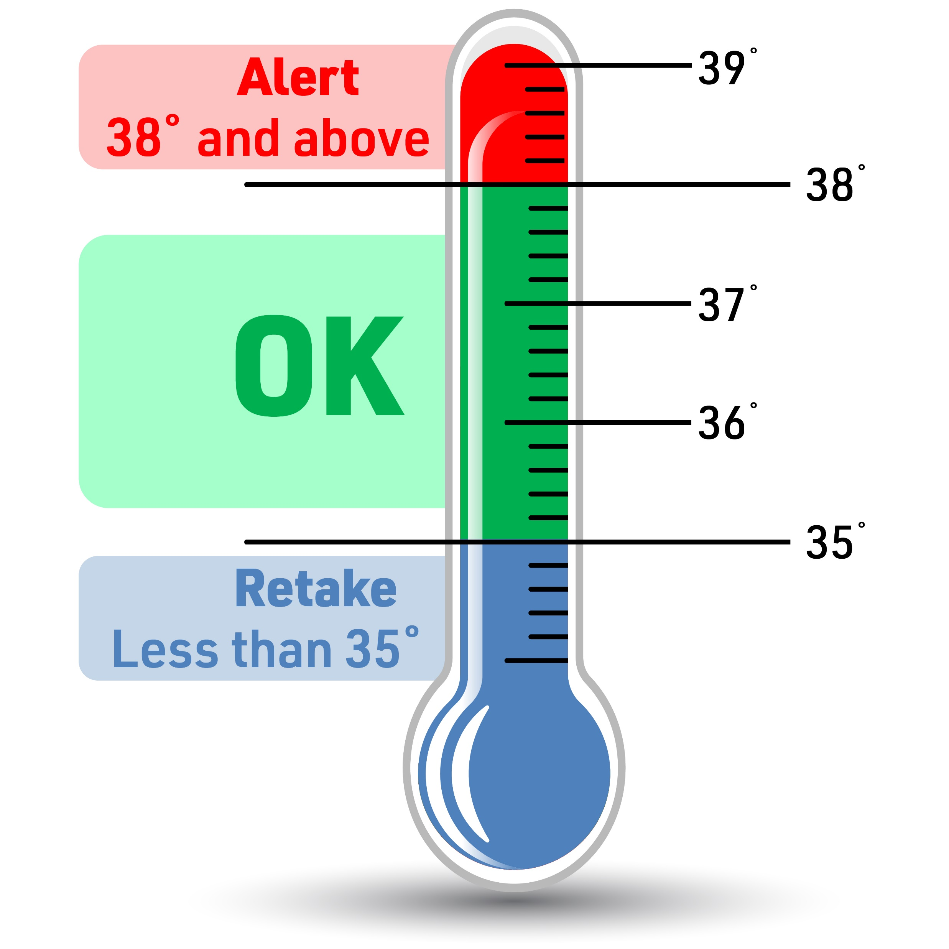
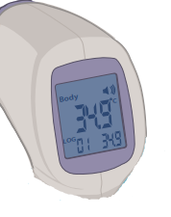
Non-contact Temperature Check (continued)
8
Read thermometer screen
If less than 35°C, take again
If 38°C or higher, fever indicated
Notes:
Script:
As you screen patients, you also want to make sure that you’re using temperature ranges as outlined in your country’s case definition for Marburg virus disease. Given the range on this slide, if a person has a temperature of 38 degrees Celsius or above, they are considered to have a fever. If the temperature is less than 35 degrees Celsius, you need to check that your thermometer has the correct settings and take the temperature again.
If you’re working at the screening station, as you take each person’s temperature, you should record the temperature on a screening register. You should then continue the evaluation of exposures and symptoms as indicated on the screening algorithm, which we’ll see on the next slide.

Slide 16
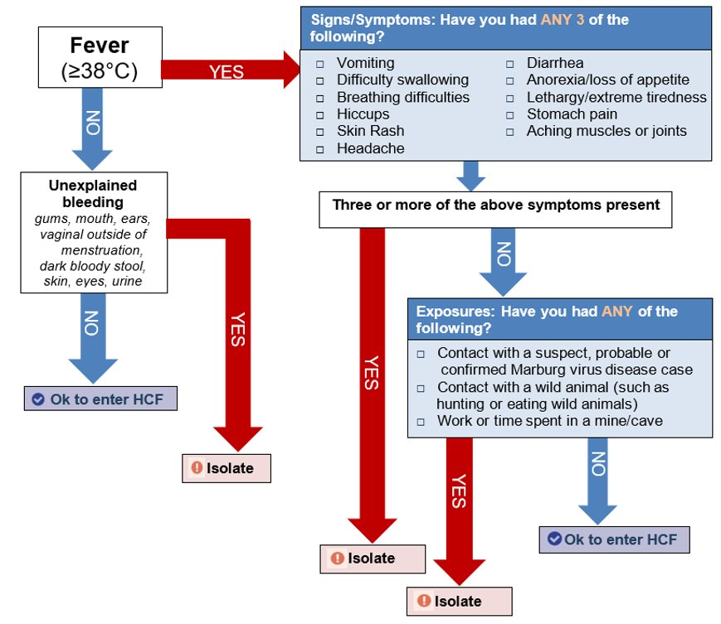
Screening Algorithm for MVD Equatorial Guinea 2023
Notes:
Script:
To help you screen patients and appropriately place them within the facility, a job aid or algorithm such as this can be kept at the screening area for reference. This is an example [from April 2023] of a Marburg virus disease screening algorithm from Equatorial Guinea. The algorithm you work with may look slightly different, but generally, this is what you can expect to see.
The algorithm starts in the top, left box that says Fever. You can see here that after checking the person’s temperature, if a person has no fever, you would ask if they have experienced any unexplained bleeding. If they answer no, they are free to enter the healthcare facility. If they answer yes, they would be considered a suspect case and would need to enter an isolation area.
If a person has a fever, the next step is to ask about symptoms and risk factors. The listed options in the signs and symptoms box are typical signs and symptoms that may be experienced by someone with Marburg virus disease. If the person answers that, yes, they have had at least 3 of those symptoms, they would be considered a suspect case and would need to enter an isolation area.
If the person answers “no” to having had signs or symptoms, the next question would be to ask if the person has traveled to an area where there are confirmed Marburg virus disease cases or if they have had contact with someone suspected of having Marburg virus disease. If they answer yes, they should enter the isolation area. If they answer no, they should be allowed to enter the healthcare facility.
Notice that screening is a complex process and is more than just taking someone’s temperature. Patients can have Marburg virus disease but not have a fever. It’s important to ask about other symptoms and about risk during screening. If you will be screening patients, you’ll need to understand the screening algorithm well and know who to contact if you come across people meeting these risks.

Slide 17
Screening Equipment and Supplies
Screening stations should have:
  Print-out of screening algorithm for reference
  Patient register
  Infrared (non-contact) thermometer
  Thermometer batteries/back-up thermometer
  PPE if distance cannot be maintained
Notes:
Script:
To accomplish all that we’ve talked about at screening stations, these stations should have several pieces of equipment or supplies including:
A job aid or screening algorithm showing what the case definition is, so you know you’re identifying cases appropriately
A patient register to log anyone entering the healthcare facility
An infrared, non-contact thermometer
And either batteries or a back-up thermometer in case one of the thermometers stops working.
When distance cannot be maintained, the screener will need to wear PPE as mentioned on the Screening Safety slide, so PPE should also be available where necessary.
Before beginning a shift in which you’ll be screening, check that these supplies are at your screening station.

Slide 18
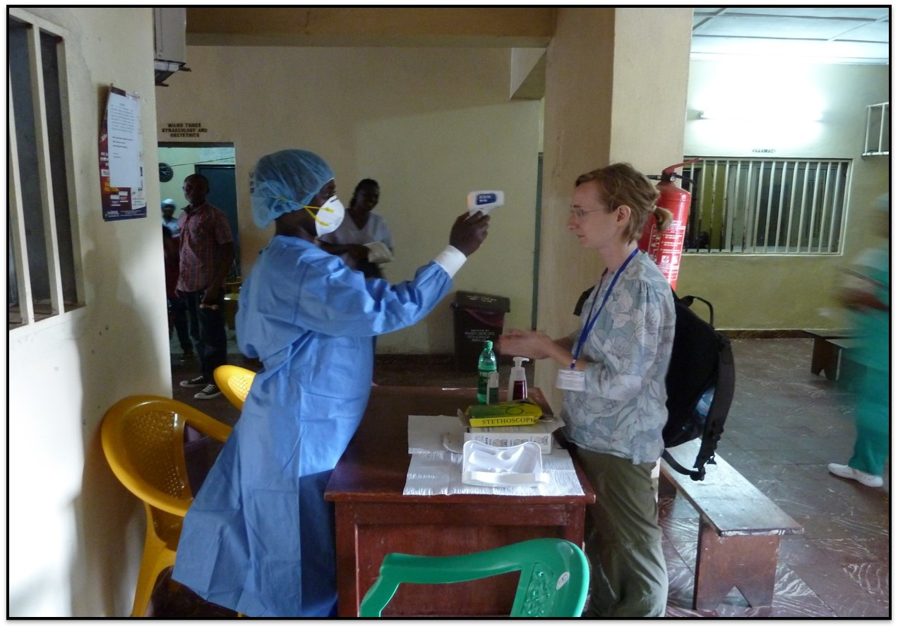
Knowledge Check
Imagine you see your co-worker screening someone entering your facility like this. What suggestions would you give them to help them screen more safely?
Notes:
Apply. Ask learners to apply the information they’ve just heard to check their understanding.
Script:
Imagine you see your co-worker screening someone entering your facility like this. What suggestions would you give them to help them screen more safely? [Give participants 2-3 minutes to write down their ideas, discuss in small groups, or discuss as a whole group.]

Slide 19



Feedback: Screening
Maintain a distance of at least 1 meter (about an arm’s length) or place barrier such as plexiglass
Wear PPE if distance of at least one meter is not possible.
Avoid being face-to-face
Point thermometer closer to person’s forehead or temple (depending on thermometer instructions)
Set chairs at angles to avoid being face-to-face. Keeping a table between chairs helps maintain proper distance.
Notes:
[Based on the discussion on the previous slide, add any of the below information that has not yet been discussed.]
Script:
Let’s talk first about what this screener is doing well:
First, there is a physical barrier – the desk - between the screener and the patient. This physical barrier helps to remind healthcare workers to maintain distance and avoid direct contact.
The use of plastic chairs is a good thing since they are nonporous and can be easily cleaned and disinfected.
Several things could be improved here, though, to help protect the screener during the process:
The screener should have at least one meter of distance (or one arm’s length) between themselves and the person being screened, and they should not be standing face to face with the person being screened. If there is no plexiglass divider to protect them, they should sit or stand at an angle as seen in the images here.
Looking at the PPE, the screener is wearing a cap, gown, and fitted mask. Since distance of at least 1 meter (about arm's length) is possible along with a no-touch approach, PPE is not required in this example. If distance cannot be maintained, the screener needs to wear a medical mask, eye protection, gown, and one pair of gloves. In this example picture, if the mask and gown are needed, gloves and eye protection would be needed, too. The cap or other head covering is not needed for screening.
The infrared-thermometer is also not being used properly. It depends on manufacturer’s instructions, but generally, the thermometer should be 3-5cm from the person’s forehead or temple. This person has the thermometer too far away from the forehead or temple of the person being screened.

Slide 20
Reflection
How is the process of screening for MVD similar to or different from screening processes you have followed in the past?
What challenges have you encountered in the past with screening? If you have never had to participate in screening, what challenges do you imagine you might have?
Notes:
Reflection:
Encourages participants to apply, analyze, and/or evaluate what they have learned, which helps them to deepen their understanding of the topic
Allows participants to think about how they’re new learning applies to their previous knowledge or experiences, which helps them better understand and remember the ideas taught
Allows you to check participants’ comprehension of what has been discussed to see if any topics need to be reviewed
Script:
Now that you’re familiar with why we need to identify suspected patients, isolate them, and inform the proper contacts and you know the basics of how to do this, let’s think about how this might work in your facility.
If you’ve ever needed to screen people entering your facility, how is the process of screening for Marburg virus disease similar to or different from screening processes you have followed in the past?
[Give participants 2-3 minutes to discuss in small groups or as a large group.]
What challenges have you encountered in the past with screening? If you haven’t participated in screening before, what challenges do you imagine you might encounter?
[If feasible, list challenges as participants mention them on a large piece of paper, a white board, etc. Then, ask the group to offer suggestions for ways they might overcome those challenges. Answers will vary. You may also offer suggestions as you see fit. Recommended time for this discussion is 7-10 minutes. You may choose to keep this conversation shorter due to time constraints or to extend it if time allows.]

Slide 21
Key Takeaways
To protect yourself, your patients, and your loved ones…
Identify
Isolate
Inform
Notes:
Script:
As we close, I want to remind you that this process of identifying, isolating, and informing is the most important thing we can do at our healthcare facilities to protect ourselves, our patients, and our families and communities. During an Marburg virus disease outbreak, screening patients to identify those who might be ill, isolating patients with suspected Marburg virus disease, and informing the proper authorities is crucial to keep Marburg virus disease out of your healthcare facility and to keep you and others safe.

Slide 22
Thank you!

