Slide 1
IPC for Marburg Virus Disease (MVD):
Facilitating Hand Hygiene
Healthcare Settings with Limited to Intermediate Resources
Updated: March 2023
Notes:
Intended Audience: This presentation focuses on what facilities management staff should know about setting up hand hygiene stations in their facilities in the context of Marburg virus disease. For information on how to perform hand hygiene, see HCW Slide Deck 5 – Hand Hygiene.
Please note that the IPC for Marburg Virus Disease topics are presented in sequence, with the expectation that participants will progress through the series. You may, however, mix and match content to meet participant needs, and you may need to adjust the sample script below accordingly.
Script:
Welcome! Today we'll be focusing on facilitating hand hygiene in the healthcare facilities where you work in the context of Marburg virus disease through setting up hand hygiene stations.

Slide 2
Learning Objectives
After this presentation, participants will be able to
  Explain why facilitating hand hygiene in healthcare facilities is important in the context of Marburg virus disease.
  Give at least three considerations for facilitating proper hand hygiene with soap and water.
Notes:
Script:
We have two learning objectives for today. By the end of our time together, you should be able to explain why facilitating hand hygiene in healthcare facilities is important in the context of Marburg virus disease and give at least three considerations for facilitating proper hand hygiene with soap and water.

Slide 3
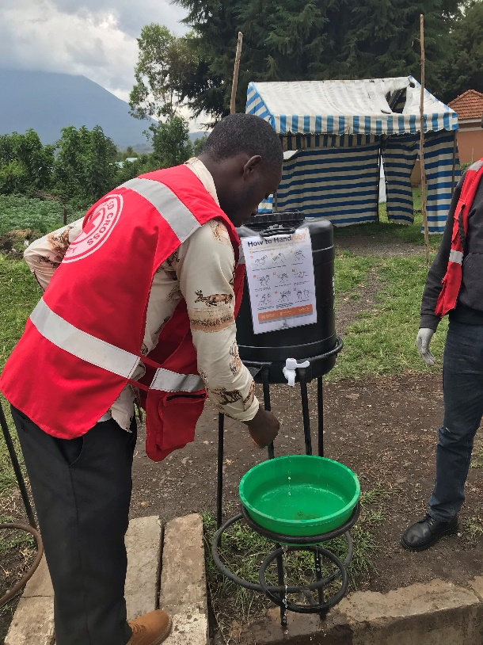
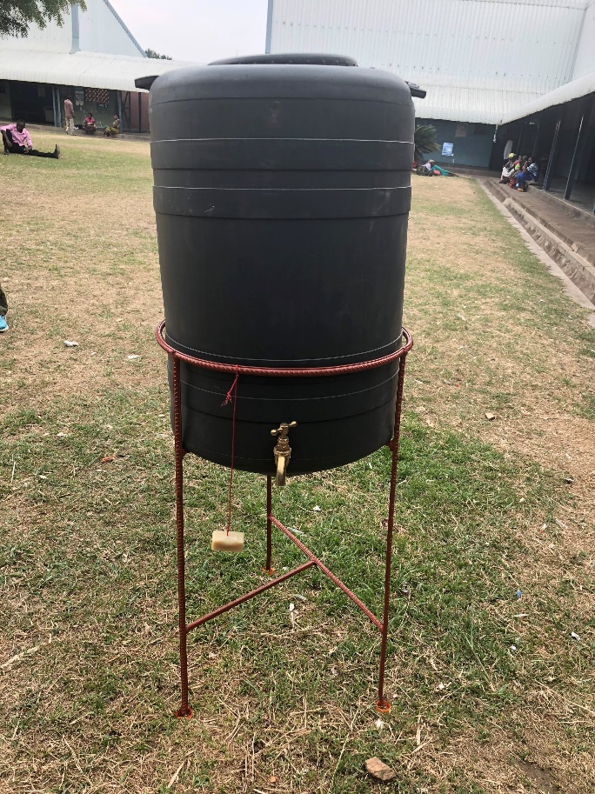
Definition: Hand Hygiene
Hand hygiene is the general term used for cleaning hands, whether using soap and water, alcohol-based hand rub, or surgical hand scrub
Handwash = soap + water
Handrub = alcohol-based hand rub
Notes:
Script:
To get started, let’s discuss some definitions of phrases I’ll be using in todays presentation. First, hand hygiene is the general term used for cleaning hands, whether using soap and water, alcohol-based hand rub, or surgical hand scrub. In technical documents, you may see references to handwashing, which involves the use of soap and water, and to hand rubbing, which involves the use of alcohol-based hand rub.

Slide 4
Definition: Hand Hygiene Station
Hand hygiene stations are areas designed for people to access products such as alcohol-based rub or soap and water to clean their hands.
Notes:
Script:
Another phrase to know is hand hygiene station. Hand hygiene stations are areas designed for people to access products such as alcohol-based rub or soap and water to clean their hands.
These photos show some examples of hand hygiene stations you might be used to seeing at your facility. Usually, these stations include a bucket sometimes with a waste basin. It’s common to see buckets of water with soap hanging by them, or it may be chlorinated water in the buckets, which we’ll talk about more shortly. Hand hygiene stations may also include dispensers of alcohol-based hand rub or a sink with soap available for use.

Slide 5
Hand Hygiene at Your Facility
Alcohol-based hand rub, soap and water, and/or chlorine?
Approximately how many hand hygiene stations available?
Location of hand hygiene stations?
Notes:
Activating background knowledge.
A key benefit of working with adult learners is that they likely already have some knowledge or experience related to the topic you are teaching. Activating background knowledge helps students connect new learning to what they already know and may help them understand new information better. It also helps you, the instructor, to identify gaps in knowledge where you may need to spend extra time or add emphasis while teaching. Use this slide as an opportunity to let students share what they already know.
Script:
Before we begin, I’d like you to take a moment to think about hand hygiene stations at your facility right now. Does your facility offer alcohol-based hand rub, soap and water, and/or chlorine at hand hygiene stations? Approximately how many hand hygiene stations are available in your facility or in the part or parts of the facility that you work in and are familiar with? Where are hand hygiene stations located?
[Give participants a minute or two to think about or write their answers.]
Now that you’ve had some time to think about this, we’re going to move into talking about why hand hygiene is important in the context of Marburg virus disease and some best practices for hand hygiene. At the end of the presentation, we’ll return to thinking about hand hygiene in the context of your specific facility or facilities.

Slide 6
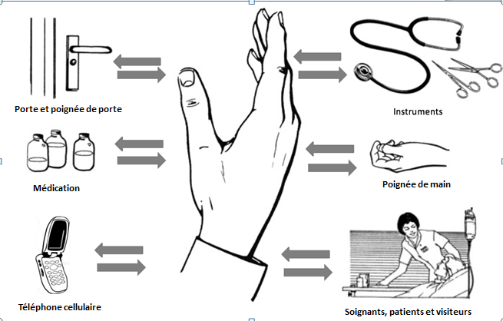
Why Hand Hygiene?
Equipment and instruments
Door handles
Medication vials
Hands
Phones
Health workers, patients, and visitors
Notes:
Script:
This image shows just some examples of the many things you and others in your facility may touch during a typical workday. As indicated by the arrows in this image, touching people, objects, and surfaces allows the transfer of pathogens from you to them and from them to you.
Touching unclean surfaces, such as a door handle, medical equipment, or your phone and then touching your eyes, nose, or mouth, can transfer pathogens, including Marburg virus disease, to you. Pathogens can also be transferred from hands to other people, including patients, if you touch an unclean surface and then touch another person or touch a medical device.
A recent systematic review by Selvaraj et al. revealed that inadequate hand hygiene was a frequent factor leading to Marburg virus disease exposure while receiving healthcare.
Hand hygiene is a simple step that can make a big difference in keeping you, your co-workers, and your patients safe from Marburg virus disease. By protecting yourself from getting sick, you help protect your family, friends, and others in your community.
By setting up and maintaining hand hygiene stations properly, you help ensure that both you and others can clean hands regularly.
Reference:
J Infect Dis. 2018 Nov 22;218(suppl_5):S679-S689. ​
Infection Rates and Risk Factors for Infection Among Health Workers During Ebola and Marburg Virus Outbreaks: A Systematic Review.​
Selvaraj SA, et al. [PMID: 30202878]

Slide 7
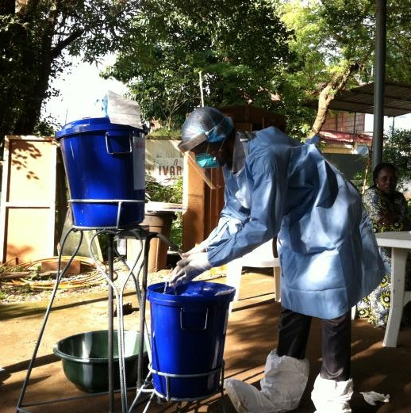
Hand Hygiene Options
Alcohol-based hand rub
Soap and water
Chlorine (not recommended)
Notes:
Script:
There are several different hand hygiene options that your facility may offer including alcohol-based hand rub, soap and water, and chlorine. We’ll talk about considerations specific to each of these options today including why chlorine is not recommended.
Image from Details - Public Health Image Library(PHIL) (cdc.gov)

Slide 8
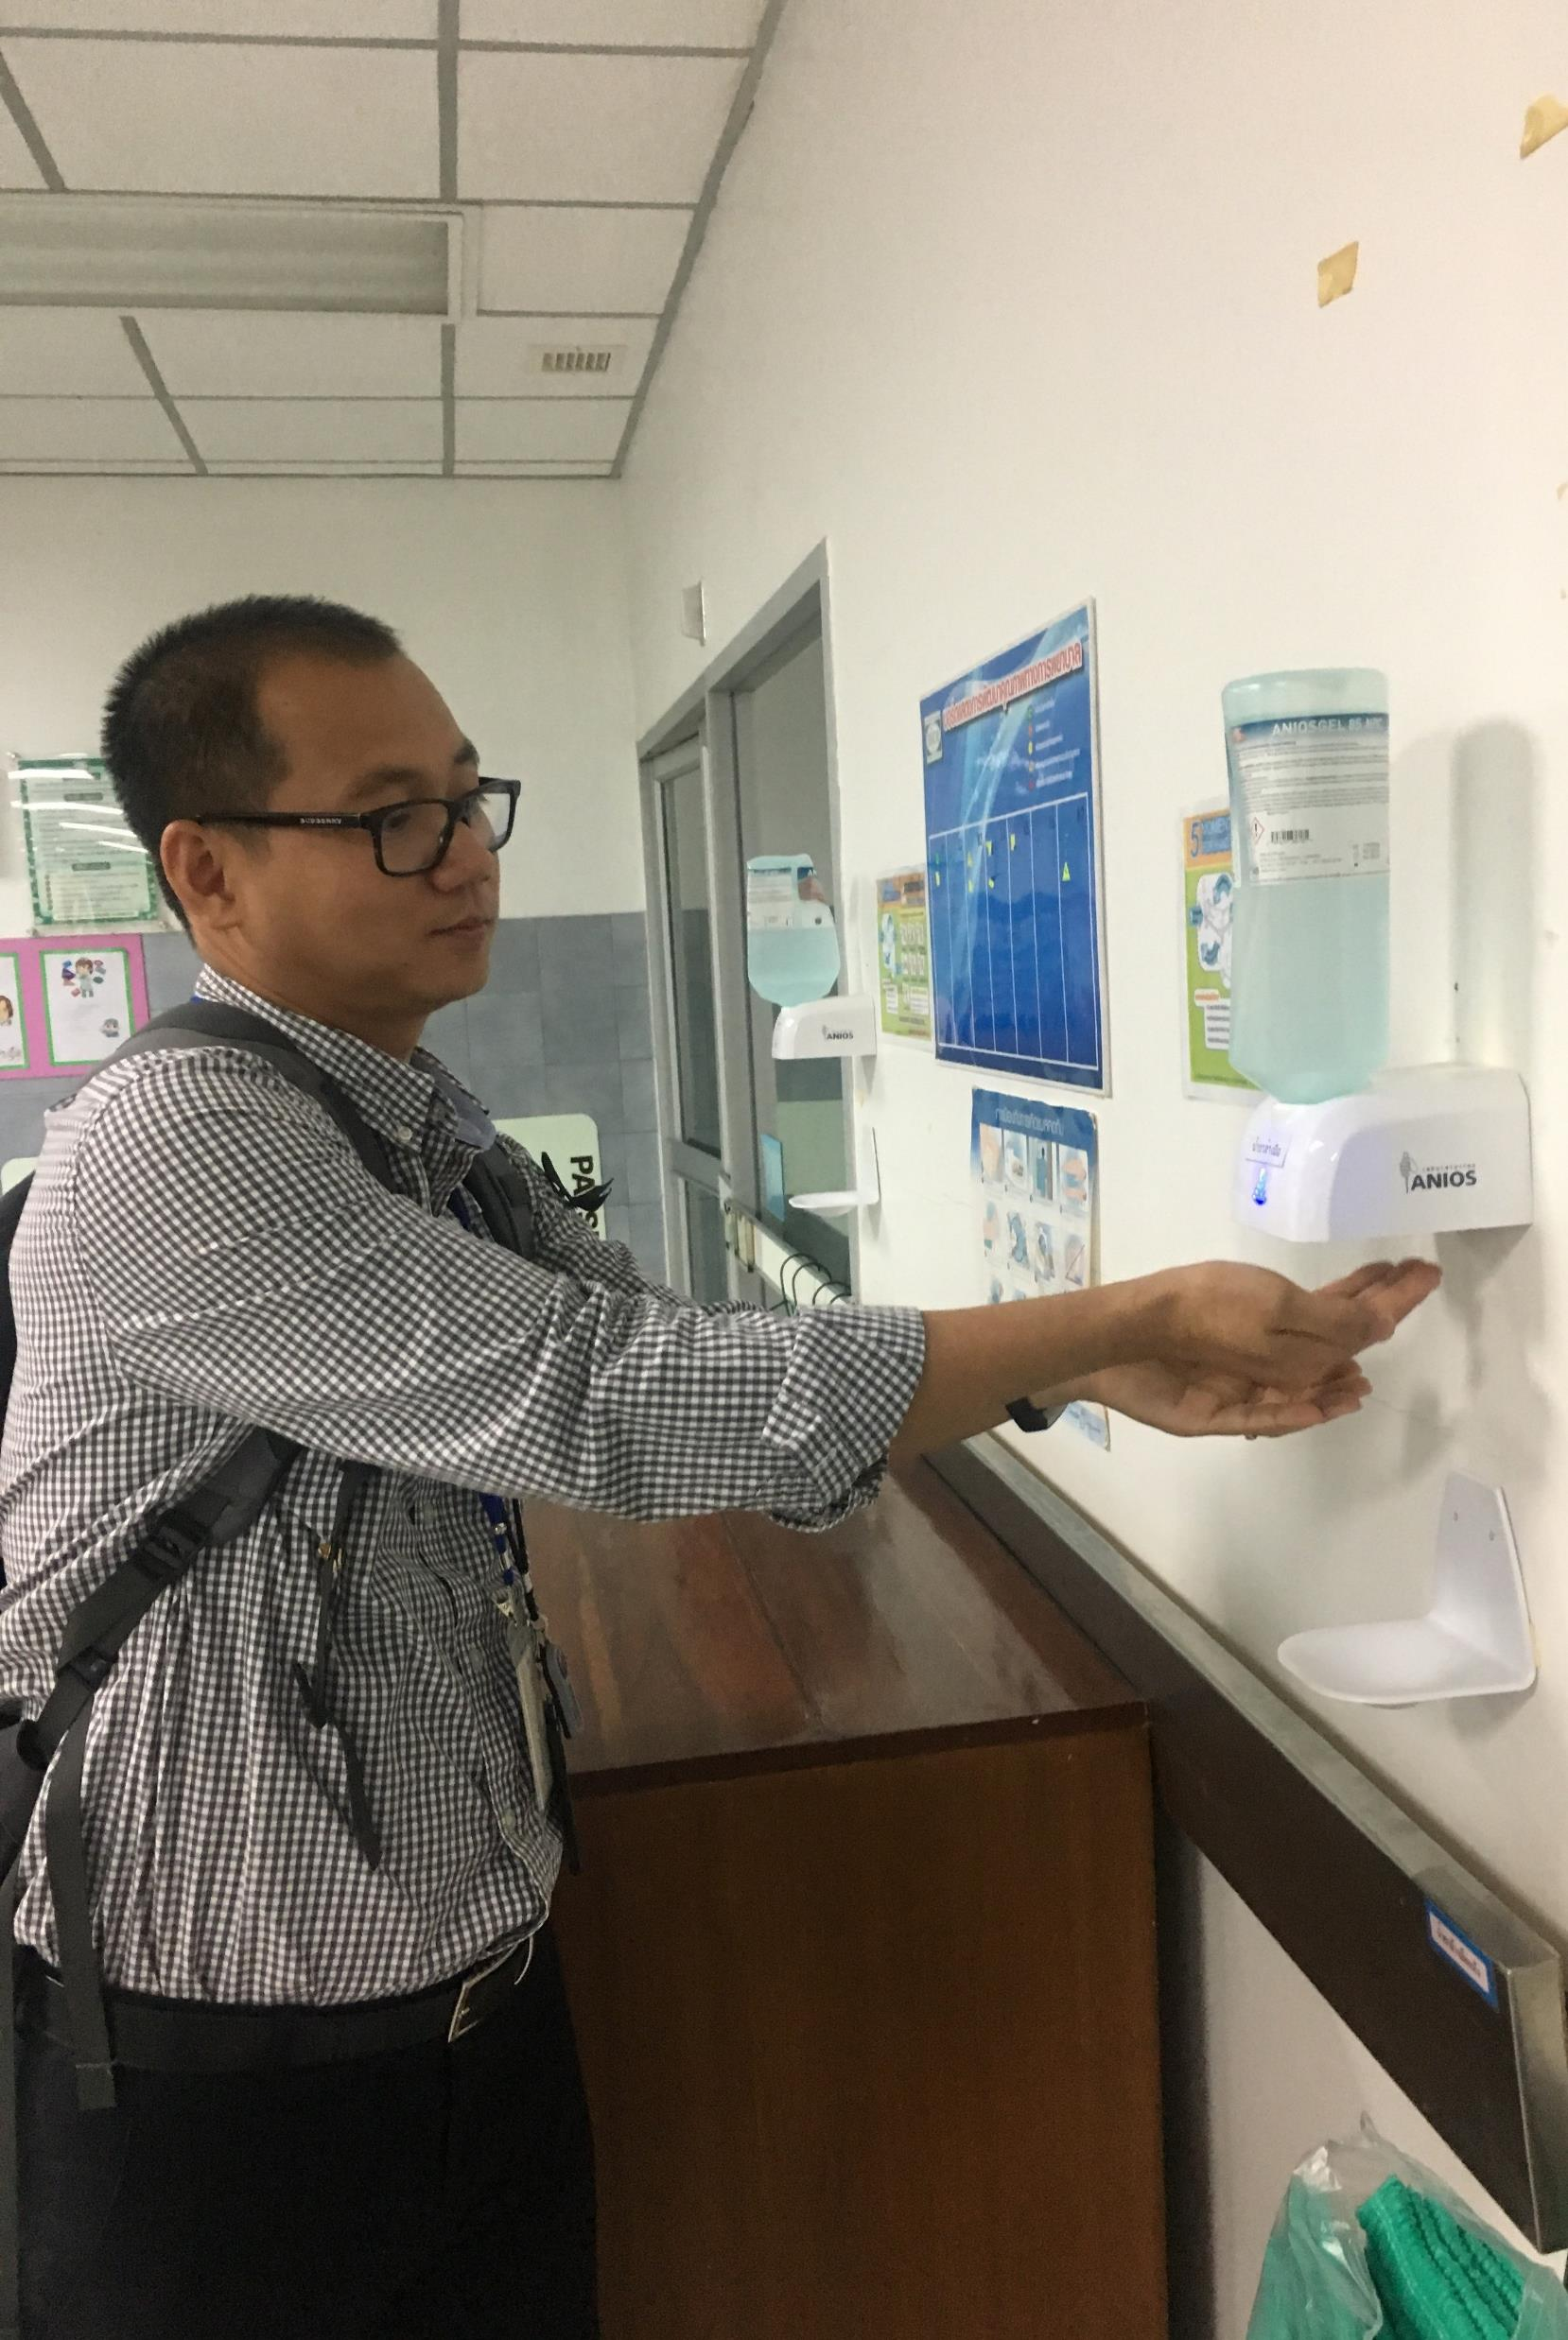
Use of Alcohol-Based Hand Rub
World Health Organization’s preferred method for hand hygiene
Keeping dispensers filled correctly should be a formal task supported by the facility
Notes:
Script:
Let start with alcohol-based hand rub. Alcohol-based hand rub is preferred for hand hygiene by the World Health Organization given the variable access to clean water globally.
Keeping dispensers filled correctly should be a formal task supported by the facility.

Slide 9
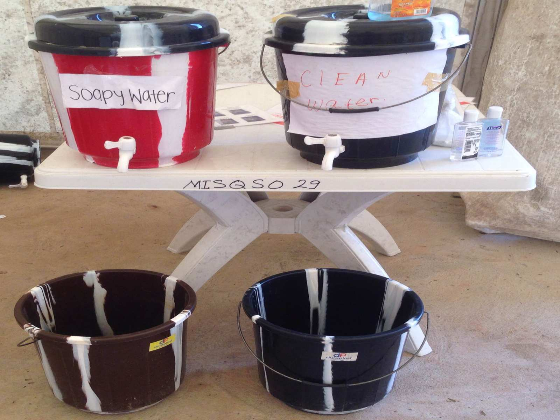
Use of
Soap and Water for Hand Hygiene
If using a bucket with soapy water, another bucket of non-soapy water is needed to rinse hands
If using bars of soap, store bars so water can’t pool underneath them
Notes:
Script:
If your facility offers soap and water for hand hygiene, you’ll need to keep a couple of things in mind.
First, if a bucket with soapy water is provided to wash hands, another bucket should also be provided with non-soapy, clean water so that people can rinse hands after washing. This is what you see in the picture on the left.
Some facilities may use bar soap. In these cases, you’ll want to think about how to store the soap. For example, you don’t want water to pool under bars because that can create a biofilm. You can see in the picture on the right that the facility chose to hang the soap from the water bucket.

Slide 10
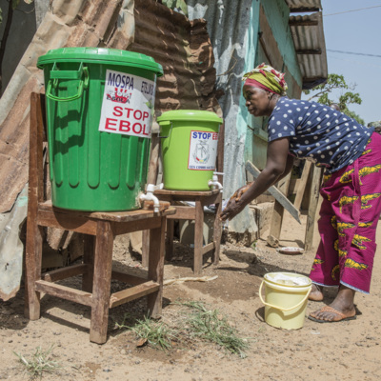
Use of Chlorine for Hand Hygiene
NOT recommended routinely¹
Interim option for when no other hand hygiene products are available
  500 ppm sodium hypochlorite (0.05%)
Considerations:
  Starting product/concentration
  Dilution (correct math)
  Daily preparation
  Storage (shield from light)
http://cdcmuseum.org/exhibits/show/ebola/public-health/ipc/handwashing
1WHO Guideline on hand hygiene in health care in the context of filovirus disease outbreak response : rapid advice guideline, November 2014
Notes:
Script:
Now, let’s talk about using chlorine for hand hygiene. Chlorine is not recommended for hand hygiene. However, if no other hand hygiene products are available, it can be used as an interim option. If used, the chlorine should be 500 ppm of sodium hypochlorite, that is, it should have a 0.05% concentration because this is what is required to kill certain types of viruses, such as Marburg virus disease, on hands.
Not all chlorine is the same. There are different concentrations and different formulations, and how it is diluted matters. Those doing the diluting need to make sure the dilution is done correctly so that it’s not too strong, which can potentially injure hands or so that it’s not too weak, which would potentially not be useful.
Chlorine is also not ideal because it must be prepared daily since it loses strength over time, and it must be shielded from light, which is why you often see it in covered buckets.
Again, chlorine is only an interim option until facilities can work with supply chains to get soap and water or alcohol-based hand rub if possible.

Slide 11
Soap/Water and Chlorine Considerations
Turning tap off without contaminating hands
Single-use towels preferred for drying; shared towels can become contaminated
Keeping buckets filled correctly should be a formal task supported by the facility
Notes:
Script:
When using soap and water or chlorine for hand hygiene, you’ll want to consider a few things:
First, dispensers provided should allow people to turn the tap off without contaminating their hands.
If possible, single-use towels should be provided for hand drying because shared towels can become contaminated.
Finally, buckets need to stay filled correctly. This should be a formal task supported by your facility.

Slide 12
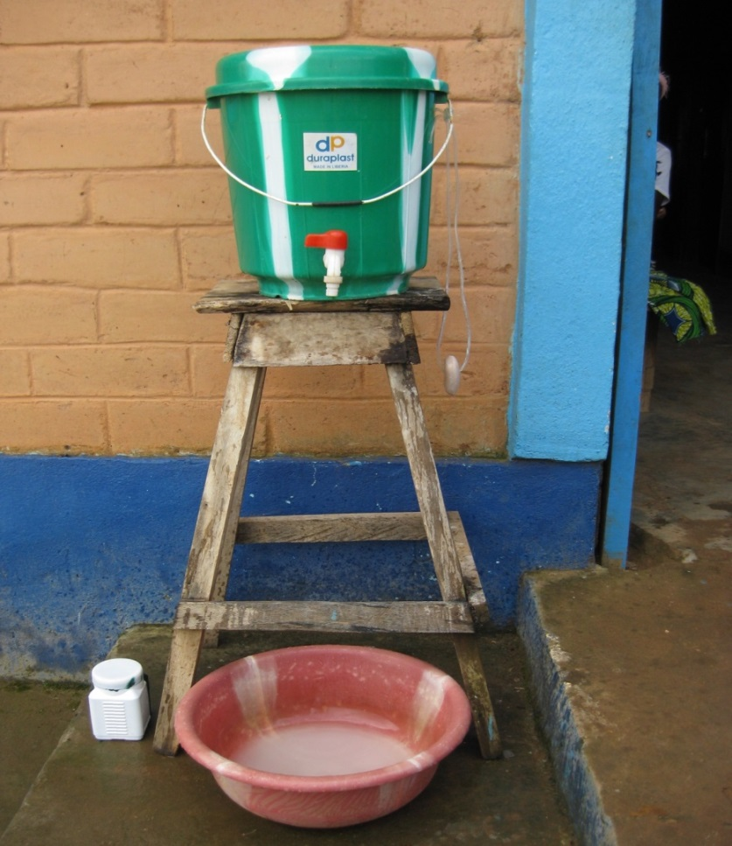
Location of Hand Hygiene Stations
Entrances
Screening areas
Areas to put on PPE
Areas to remove PPE
Isolation areas
Other patient care areas
Stations should be placed at entrances and patient care areas to encourage frequent use
Notes:
Script:
No matter the type of hand hygiene station provided, stations will be needed for people to use at facility entrances, screening areas, areas to put on and remove PPE, isolation areas, and other patient care areas. Having hygiene stations available in many areas can encourage frequent use.

Slide 13
Reflection
Based on what we discussed today…
What are some things that your facility does well to facilitate hand hygiene?
What are two things your facility could do differently to better facilitate hand hygiene?
Notes:
Reflection: Encourages participants to apply, analyze, and/or evaluate what they’ve learned, helps them to deepen their understanding of the topic and also allows you to check their comprehension of what they learned..
Personalization: Helps participants think about how what they have learned applies to their specific situations. Connecting learning to personal experiences helps learners to better understand and remember the ideas taught.
Script:
Now that we’ve talked about facilitating hand hygiene during a Marburg virus disease outbreak, I want you to think again about the facility or facilities where you work. Based on what you learned today, what are some things that your facility does well to facilitate hand hygiene? What are two things your facility could do differently to better facilitate hand hygiene? I’ll give you a few minutes to discuss/write your answers.
[Give participants several minutes to either discuss in small groups or to write individually. If time allows, you may want to ask volunteers to share their ideas after they have had time to discuss in small groups or think individually.]

Slide 14
Key Takeaways
Keeping hands clean is important to help keep you, your co-workers & patients, and your community safe during an Marburg virus disease outbreak.
Alcohol-based hand rub is preferred for hand hygiene. Chlorine is not recommended.
Hand hygiene stations should be available in many areas to encourage frequent use.
Notes:
Script:
To wrap up, there a few key things I hope you’ll take away from today’s session.
First, keeping hands clean is important to help keep you, your co-workers & patients, and others in your community, including friends and family, safe during a Marburg virus disease outbreak.
Alcohol-based hand rub is preferred for hand hygiene. Chlorine is not recommended.
Finally, hygiene stations should be available in many areas to encourage frequent use.

Slide 15
Thank you!

