Slide 1
IPC for Marburg Virus Disease (MVD):
Waste Management Part 1:
The Waste Management Process
Healthcare Settings with Limited to Intermediate Resources
Updated: March 2023
Notes:
Intended Audience: This presentation focuses on what facilities management staff should know about the waste management (WM) process in the context of Marburg virus disease. This presentation is an overview of the waste management process. Another presentation is available that details the last step of the waste management process – waste disposal <Facilities Mgmt Slide Deck 5: Wate Management Part 2 – Waste Disposal> [link].
Please note that the IPC for Marburg Virus Disease topics are presented in sequence, with the expectation that participants will progress through the series. You may, however, mix and match content to meet participant needs, and you may need to adjust the sample script accordingly.
Script:
Welcome! Today we'll be focusing on the waste management process at healthcare facilities during a Marburg virus disease outbreak. This is the first of a two-part series focused on waste management. We’ll have an overview of the entire process in this session. Then, the next session will be an in-depth look waste disposal.

Slide 2
Learning Objectives
After this presentation, participants will be able to
  Explain why waste management is important for healthcare facilities during a Marburg virus disease outbreak.
  Name at least 3 steps of the waste management process.
  Identify things to add or change in the waste management process at their own facilities.
Notes:
Script:
We have three learning objectives for today. By the end of our time together, you should be able to explain why waste management is important for healthcare facilities during a Marburg virus disease outbreak, name at least 3 steps of the waste management process, and identify things to add or change in the waste management process at your own facilities.

Slide 3
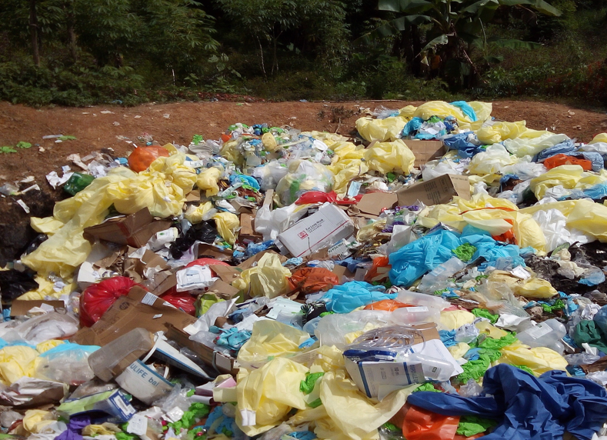
Discuss
Imagine you visited a healthcare facility and saw this.
What feedback would you give the facility to help make waste management there safer?
Notes:
Activating background knowledge.
A key benefit of working with adult learners is that they likely already have some knowledge or experience related to the topic you are teaching. Activating background knowledge helps students connect new learning to what they already know and may help them understand new information better. It also helps you, the instructor, to identify gaps in knowledge where you may need to spend extra time or add emphasis while teaching. Use this slide as an opportunity to let students share what they already know.
Script:
Let’s start with a question. Imagine you visited a medical facility and saw this. What feedback would you give the facility to help make waste management there safer? [Allow participants 2 minutes to discuss as a large group or in small groups. Write down their answers in a place they can see them (chalkboard, whiteboard, large writing tablet) to return to at the end of the session.]
As indicated by your ideas, this facility has a lot to do to improve their waste management process. So let’s talk about that process.

Slide 4
What is waste management?

Slide 5
Waste Management Includes:
storing waste
treating waste
disposing of waste
sorting/segregating waste
collecting waste
transporting waste
Safe management of waste generated during patient care is the responsibility of all staff.
Notes:
Script:
The waste management process at healthcare facilities includes several steps:
Sorting or segregating waste
Collecting waste
Transporting waste after it’s collected
Potentially storing waste
Any needed treatment of waste
And final disposal of waste.
Safe management of waste generated during patient care is the responsibility of all staff.

Slide 6
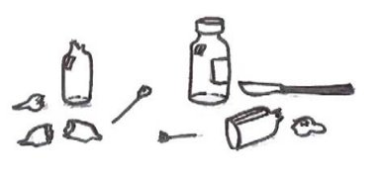
Why Waste Management?
Healthcare facilities are responsible for managing waste.
Inappropriate waste management poses potential health risks to you, your patients, and other staff in your facility, as well as to your community.
Notes:
Script:
Healthcare facilities are responsible for managing waste, whether it’s handled on site or whether there’s a contracted company. Inappropriate waste management poses potential health risks to you, your patients, and other staff in your facility, as well as to your community.
Potential risks might include exposure to items contaminated with Marburg virus, such as contaminated gloves, or exposure to sharp items such as used needles that pose a risk of physical injury as well as exposure to Marburg virus.

Slide 7
How to Manage Waste at Your Facility
Notes:
Script:
Now let’s talk about the specifics of the process of waste management.

Slide 8
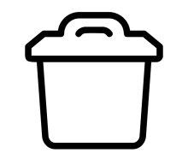
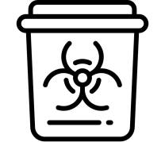

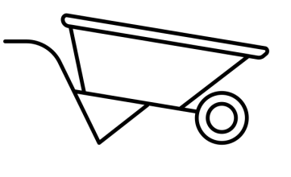



Waste Management Process
1. Sort
2. Collect
3. Transport
4. Store
5. Treat
6. Final disposal
Notes:
Script:
As previously mentioned, these are the steps in the waste management process.: sorting, collecting, transporting, storing, treating, and final disposal. We are going to talk about a few of these steps in a bit more detail.

Slide 9
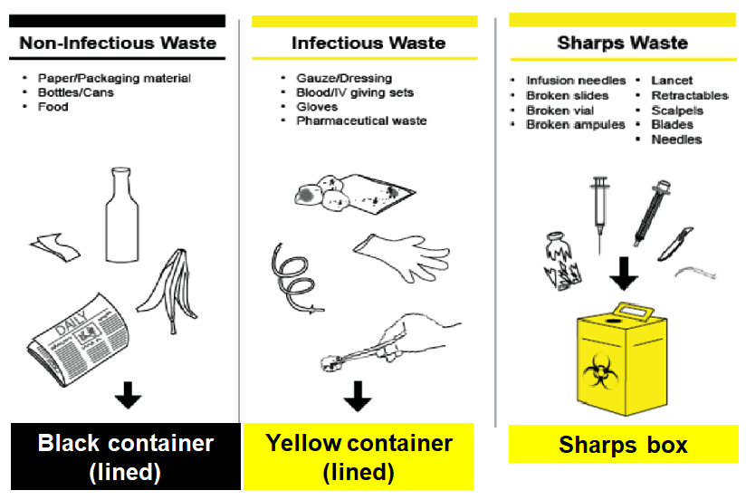
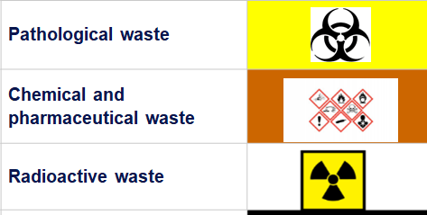
Waste Segregation (1)
3-bin system
(most common)
Other waste streams
(less common)
https://www.washinhcf.org/resource/wash-fit-training-package/
Notes:
Script:
We’ll start with the first step: waste segregation, also called waste sorting. Waste segregation is the responsibility of all staff. There is frequently a 3-bin system at healthcare facilities that includes non-infectious waste, infectious waste, and sharps waste, so we’ll talk about these three waste streams first. As facility staff do their jobs, they should dispose of waste in the appropriate waste bins.

Slide 10
Waste Segregation (2)
3-bin system
(most common)
Other waste streams
(less common)
https://www.washinhcf.org/resource/wash-fit-training-package/
Notes:
Script:
One bin should be provided for household and general waste. This type of waste is non-infectious and includes packaging, food scraps, newspapers, plastic containers, and bottles. These bins should be black and lined with a trash bag - preferably a black trash bag.

Slide 11
Waste Segregation (3)
3-bin system
(most common)
Other waste streams
(less common)
https://www.washinhcf.org/resource/wash-fit-training-package/
Notes:
Script:
Another bin should be provided for infectious waste that does NOT include sharps such as needles and blades. Infectious waste is known or suspected to contain pathogens and presents a risk of disease transmission. Examples include
gloves
laboratory cultures and microbiological stocks,
waste and wastewater contaminated with blood and other body fluids or excreta
And other materials that have been in contact with patients infected with highly infectious diseases in isolated rooms
These bins should be yellow. They should be covered and lined with a leak-proof bag – preferably a yellow bag. A bucket should also be provided for infected liquids and fluids.

Slide 12
Waste Segregation (4)
3-bin system
(most common)
Other waste streams
(less common)
https://www.washinhcf.org/resource/wash-fit-training-package/
Notes:
Script:
Finally, a sturdy container to dispose of sharps should be provided. Sharps waste includes used or unused sharp objects, such as:
Needles and syringes
Infusion sets
Scalpels
Pipettes
Knives
Blades
And broken glass.

Slide 13
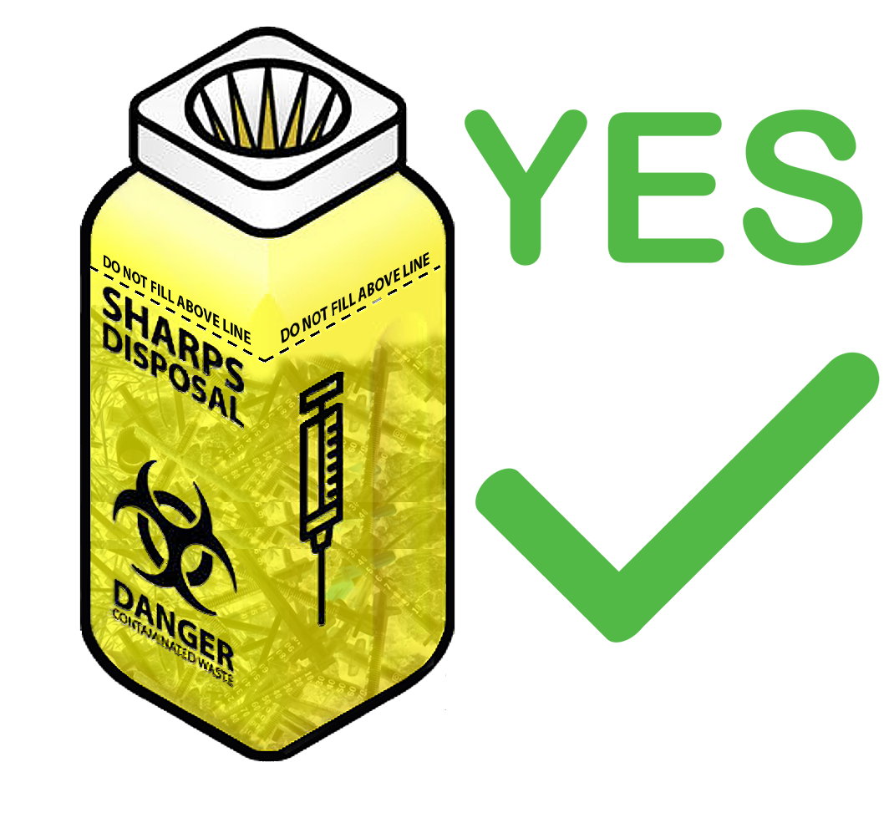

Sharps Waste
Sharps containers
  Resistant to leaks and punctures
  Closes without risk of injury
  When closed, cannot be reopened
  Clearly labeled
  Should NOT be overfilled
Location
  In each patient care area
  Within arm’s reach when giving an injection
  On a medicine cart, on a wall, or on a nearby table/surface
  NOT on floor (dangerous for children; cardboard boxes can break with repeated moisture/water on floor)
Notes:
Script:
Sharps containers may look different at different facilities. But all sharps containers should be resistant to leaks and punctures. They should close without risk of injury, and once they are closed, they should not be able to be reopened. Whatever container is used for sharps should be clearly labeled as such, and it’s important that these containers aren’t allowed to become overfilled, which increases risk of accidental injury. They should not be filled past the 'Fill Line' indicated on the side of the container.
Sharps containers should be located in each patient care area within arm’s reach of where medical staff would give injections. Importantly, sharps containers should not be placed on the floor where children could potentially reach them or where repeated exposure to moisture on the floor could cause certain types of containers to break down. Instead, sharps containers could be located on a medicine cart, on a wall, or on a nearby surface such as a table.

Slide 14
Waste Segregation
3-bin system
(most common)
Other waste streams
(less common)
https://www.washinhcf.org/resource/wash-fit-training-package/
Notes:
Script:
Some facilities may need other kinds of waste collection containers such as containers for pathological waste (organic or anatomical), chemical and pharmaceutical waste, and radioactive waste. These types of waste are disposed of in a garbage can or bucket that is most commonly either red or yellow but may also be brown.
They should be clearly labeled with the type of waste they contain. Typically, pathological waste can be disposed of on-site in a dedicated pit (e.g., placenta pit). Less common chemical and radioactive waste, if produced, should be managed in close coordination with Ministry of Health to determine appropriate disposal procedures; these may involve centralized collection.

Slide 15
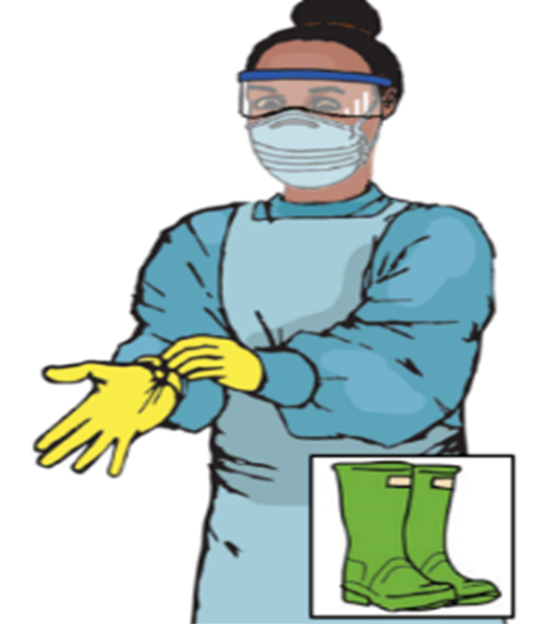
Personal Protective Equipment for Waste Handlers
Sufficient PPE should be available for collecting, handling, or disposing of potentially infectious waste
This includes:
  heavy duty gloves
  gown or coveralls
  face mask
  eye protection
  thick-soled shoes or boots
  heat proof gloves (if incineration or burning is done for treating waste)
Notes:
In the context of Marburg virus disease, any staff who collect, transport, treat, or dispose of waste, must wear appropriate PPE during the process to keep themselves safe. Appropriate PPE includes heavy duty gloves, gown or coveralls, face mask, eye protection, and thick-soled shoes or boots.
If incineration or burning is done for treating waste, heat proof gloves will also be needed.

Slide 16
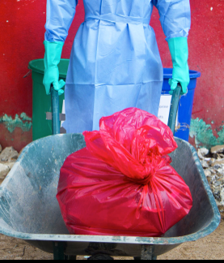
Collecting and Transporting Waste
Waste bags should be collected on a regular schedule or when bin is 2/3 full
  Wear appropriate PPE (heavy duty gloves, gown or coveralls, face mask, eye protection, foot covers or boots) when handling contaminated waste
  Transport the waste in a cart or wheelbarrow from place of segregation to place of storage or disposal
  Follow a designated transportation route
Notes:
Script:
Each separate waste bag will need to be collected. Waste bags should be collected on a regular schedule or when a bin is 2/3 full, whichever comes first, so that waste isn’t over-flowing out of bins. The waste will then need to be transported to areas of waste storage and disposal.
In the context of Marburg virus disease, any staff who collect, transport or treat/dispose of waste must wear appropriate PPE during the process to keep themselves safe. (If you’d like more information on what PPE is needed and how to put it on, check out the presentation on putting on and taking off PPE <HCW Slide Deck 7: PPE Part 2 – Putting On and Taking Off PPE> [link] .
Waste should be transported in a cart or wheelbarrow from the place of segregation, that is, the waste bins, buckets, and boxes, to the place of storage or disposal. By transporting in a cart or wheelbarrow if sharps are in some of the bags, those bags aren’t up against the body which could lead to sharps injuries. Notice that in this picture, the person isn’t carrying the bag of waste but is transporting it in a wheelbarrow.
It is also recommended to have a planned transportation route that is followed when collecting waste to avoid any exposure to staff, patients, and the public.

Slide 17
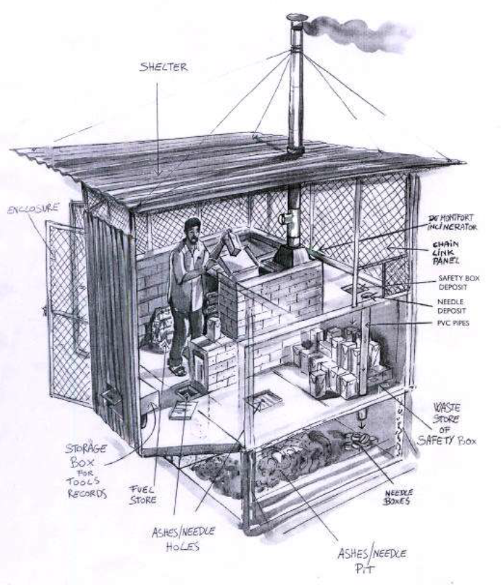
Waste Storage
Infectious waste storage
  must be separate from general waste
  should have a cleanable floor and be covered to protect from rain
  should have controlled access to prevent entrance by animals, children, and unauthorized people
The waste should not be stored for more than 24 hours before final disposal
Notes:
When it comes to storing waste, infectious waste storage must be separate from general waste. The infectious waste storage area should have a cleanable floor and be covered to protect it from rain. It should also have controlled access to prevent animals, children, or unauthorized people from entering.
Infectious waste should not be stored for more than 24 hours before final disposal.

Slide 18
Waste Disposal
Healthcare facilities must have a functional system for the final disposal of waste
Infectious and potentially infectious waste must be:
  Incinerated
  OR
  Treated with non-burn treatment (autoclaving/grinding or other alternative treatment) before being placed in regular waste stream
  OR
  Buried
Notes:
Script:
The final step in the waste management process is final disposal. Every facility must have a functional device for the final disposal of waste including an incinerator with ash pit or a non-burn system such as an autoclaving and grinding process for infectious waste. If infectious waste is autoclaved and grinded, it can be then added to the regular waste stream for landfill disposal.
In some very low-resource settings, a temporary burning pit may also be an option for treating and then burying infectious waste on-site while longer term improvements are being made. It is also common to have a placenta / organic waste pit on site, as other methods of treatment for these may not be culturally acceptable.

Slide 19
Knowledge Check: Waste Management
While visiting a healthcare facility, you see this example of waste disposal.
What feedback could you give to help make waste disposal safer at this facility?
Notes:
Script:
Now that we’ve talked about proper waste management, let’s look at this image again. Considering what you’ve just learned, is there other feedback you would give to this facility beyond what you gave at the beginning of this session? If so, what?
[Allow a few minutes for discussion. Participants may have a lot or only a little to add based on how thorough/correct their answers were at the beginning of the session. Possible answers are on the next slide.]

Slide 20
Knowledge Check Feedback
To prevent waste from accumulating in open areas, a facility should have:
  Process in place to segregate waste with resources available
  Access to standard operating procedures and documents to explain waste management
  Access to training on risks of open waste and proper waste management
  Temporary waste storage area that can be secured
  Equipment to treat and dispose of waste
Notes:
[Script may need to be adapted depending on participant answers on the last slide.]
Script:
This facility needs to consider ways to prevent waste from accumulating in an open area. They may need to implement a process to segregate waste where it is produced (e.g., in patient areas) given their available resources, or if a process already exists, they may need to ensure access to standard operating procedures (SOPs) and documents to explain waste management and provide access to training on the risks of open waste and proper waste management.
They should find a secure way to temporarily store waste, and it appears they will need to invest in equipment to treat and dispose of waste.
It seems they have a lot of work to do!

Slide 21
Reflection
How is the current waste process at your facility similar to or different from the process we discussed today?
Considering your facility’s current waste management process, what could be added or changed to improve the process to help ensure your safety and the safety of others at your facility and in your community during a Marburg virus disease outbreak?
Notes:
Reflection: Encourages participants to apply, analyze, and/or evaluate what they’ve learned, helps them to deepen their understanding of the topic and also allows you to check their comprehension of what they learned.
Personalization: Helps participants think about how what they have learned applies to their specific situations. Connecting learning to personal experiences helps learners to better understand and remember the ideas taught.
Script:
Now that you’re familiar with the waste management process for healthcare facilities during a Marburg virus disease outbreak, let’s take some time to connect what you’ve learned to what goes on in the facility where you work.
First, how is the current waste process at your facility similar to or different from the process we discussed today?
[Allow participants a few of minutes to make a list by themselves; then take a couple of minutes to share in small groups or as a large group.}
Remember that appropriate waste management during a Marburg virus disease outbreak is crucial for keeping you and your community safe. So, let’s talk about what could be added or changed in your facility’s current waste management process to help make waste management during Marburg virus disease safer for you, others in your facility, and your community. What ideas do you have?
[Give participants several minutes to discuss in small groups and then share ideas with the large group; or have a large group discussion.]

Slide 22
Key Takeaways
Performing the waste management process correctly is crucial to help keep you, others at your facility, and your community safe.
Waste handlers should always wear proper PPE during the waste management process to help keep them safe during this vital process.
Notes:
Script:
As we conclude our session today, I hope you’ll remember these important points:
First, performing the waste management process correctly is crucial for keeping you and your community safe. That includes correctly segregating waste, transporting it, and disposing of it.
And waste handlers should always wear appropriate PPE while executing this process to help protect them while they do this vital work to protect others.

Slide 23
Thank you!

